Slide 1

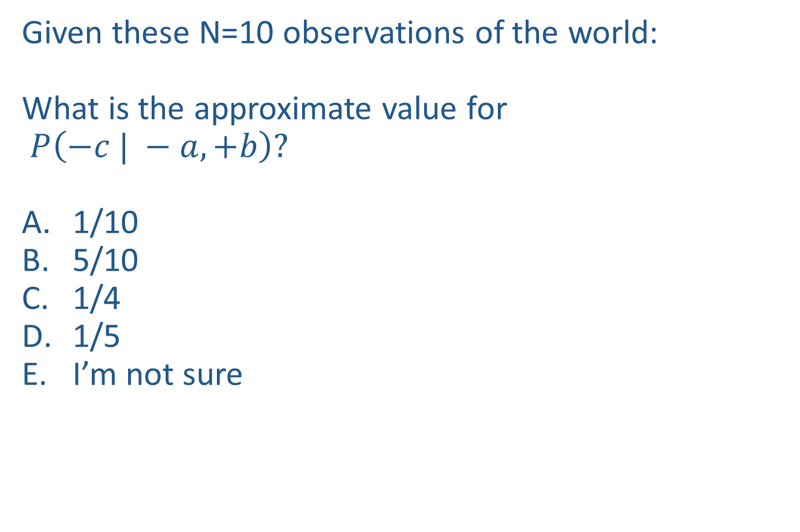
Warm-up as you walk in
Given these N=10 observations of the world:
What is the approximate value for
$P\left(−c | −a, +b\right)?$
1/10
5/10
1/4
1/5
I’m not sure
Counts
$$−a, −b, +c$$
$$+a,−b, +c$$
$$−a, −b,+c$$
$$−a, +b, +c$$
$$+a, −b, +c$$
$$−a, +b, −c$$
$$−a, +b, +c$$
$$−a, +b, +c$$
$$+a, −b, +c$$
$$−a, +b, +c$$
+a | +b | +c | 0
+a | +b | -c | 0
+a | -b | +c | 3
+a | -b | -c | 0
-a | +b | +c | 4
-a | +b | -c | 1
-a | -b | +c | 2
-a | -b | -c | 0

Slide 2
Announcements
Midterm 2
Regrade requests due by tomorrow
Assignments
P4
    Due Tonight! (or up until Saturday) 10pm
HW9
    Due Tues 4/11 10pm
P5
    Out 4/11, Due 4/27
HW10
    Out 4/18, Due Tues 4/25 10pm

Slide 3
Announcements
Final Exam
Cumulative
  Roughly half of final exam on final 1/3 of the course
  The other half of the exam covering other topics
3 cheat sheets and calculator allowed
TA next semester!
CSD application https://www.ugrad.cs.cmu.edu/ta/F23

Slide 4
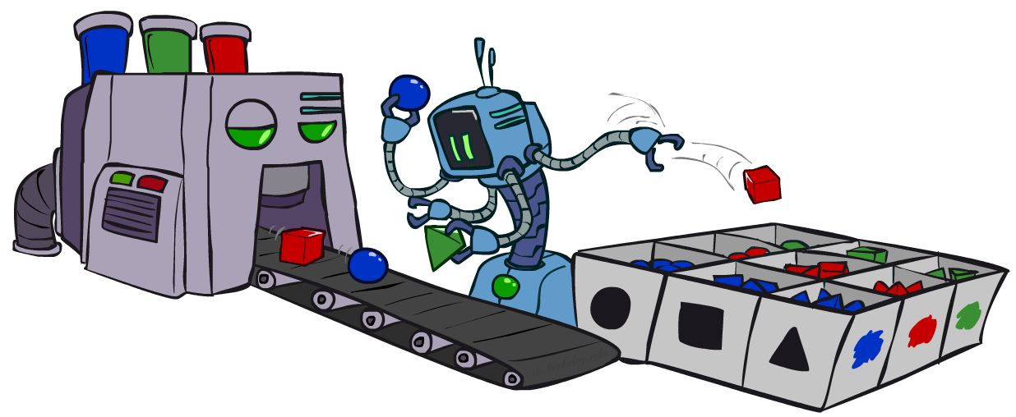
AI: Representation and Problem Solving
Bayes Nets Sampling
Instructor: Stephanie Rosenthal
Slide credits: CMU AI and http://ai.berkeley.edu

Slide 5

Bayes Nets
Part I: Representation
Part II: Exact inference
  Enumeration (always exponential complexity)
  Variable elimination (worst-case exponential complexity, often better)
  Inference is NP-hard in general
Part III: Approximate Inference

Slide 6
Inference vs Sampling

Slide 7
Motivation for Approximate Inference

Slide 8

Approximate Inference: Sampling

Slide 9

Sampling
Sampling is a lot like repeated simulation
  Predicting the weather, basketball games, …
Basic idea
  Draw N samples from a sampling distribution S
  Compute an approximate posterior probability
  Show this converges to the true probability P
Why sample?
Learning: get samples from a distribution you don’t know
Inference: getting a sample is faster than computing the right answer (e.g. with variable elimination)

Slide 10
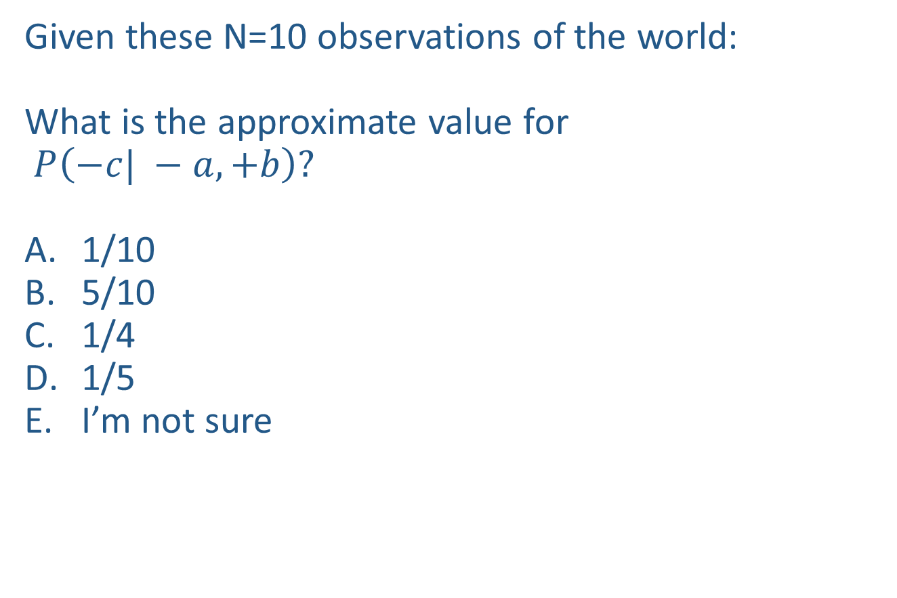
Warm-up as you walk in
Given these N=10 observations of the world:
What is the approximate value for
$P\left(−c| −a, +b\right)?$
1/10
5/10
1/4
1/5
I’m not sure
Counts
$$−a, −b, +c$$
$$+a,−b, +c$$
$$−a, −b,+c$$
$$−a, +b, +c$$
$$+a, −b, +c$$
$$−a, +b, −c$$
$$−a, +b, +c$$
$$−a, +b, +c$$
$$+a, −b, +c$$
$$−a, +b, +c$$
+a | +b | +c | 0
+a | +b | -c | 0
+a | -b | +c | 3
+a | -b | -c | 0
-a | +b | +c | 4
-a | +b | -c | 1
-a | -b | +c | 2
-a | -b | -c | 0

Slide 11




Sampling
How would you sample from a conditional distribution?
+a | 1/2
-a | 1/2
$$P(A)$$
$$A$$
+a | +b | 1/10
 | -b | 9/10
-a | +b | 1/2
 | -b | 1/2
$$P(B|A)$$
$$B$$

Slide 12
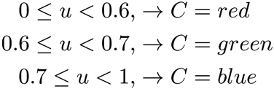

Sampling
Sampling from given distribution
  Step 1: Get sample u from uniform distribution over [0, 1)
    e.g. random() in python
  Step 2: Convert this sample u into an outcome for the given distribution by having each outcome associated with a sub-interval of [0,1) with sub-interval size equal to probability of the outcome
Example
  If random() returns u = 0.83, then our sample is C = blue
  E.g, after sampling 8 times:
C | P(C)
red | 0.6
green | 0.1
blue | 0.3

Slide 13
Sampling in Bayes’ Nets
Prior Sampling
Rejection Sampling
Likelihood Weighting
Gibbs Sampling

Slide 14
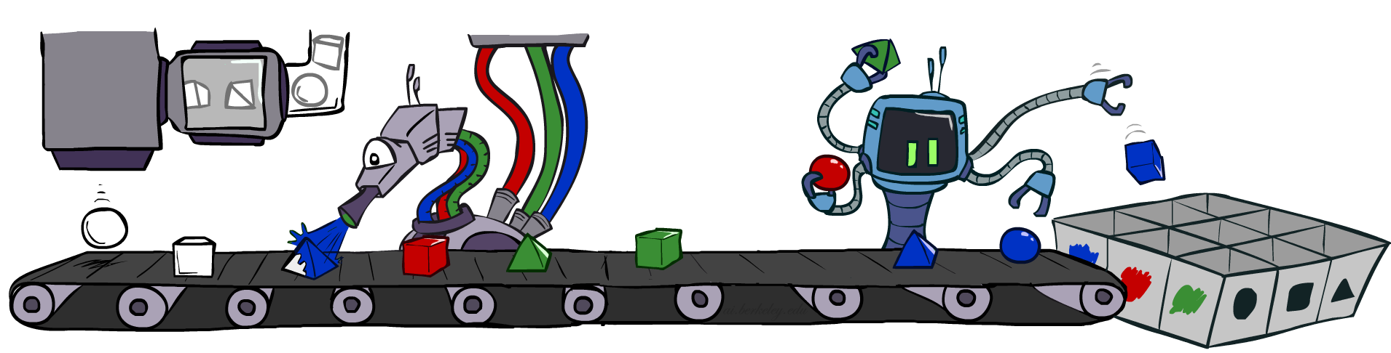
Prior Sampling

Slide 15




Prior Sampling
+c | 0.5
-c | 0.5
Cloudy
Cloudy
+c | +s | 0.1
 | -s | 0.9
-c | +s | 0.5
 | -s | 0.5
+c | +r | 0.8
 | -r | 0.2
-c | +r | 0.2
 | -r | 0.8
Sprinkler
Sprinkler
Rain
Rain
WetGrass
WetGrass
Samples:
+s | +r | +w | 0.99
 |  | -w | 0.01
 | -r | +w | 0.90
 |  | -w | 0.10
-s | +r | +w | 0.90
 |  | -w | 0.10
 | -r | +w | 0.01
 |  | -w | 0.99
+c, -s, +r, +w
-c, +s, -r, +w
…

Slide 16
Prior Sampling
For i=1, 2, …, n
  Sample x_{i} from P(X_{i} | Parents(X_{i}))
Return (x₁, x₂, …, x_{n})

Slide 17
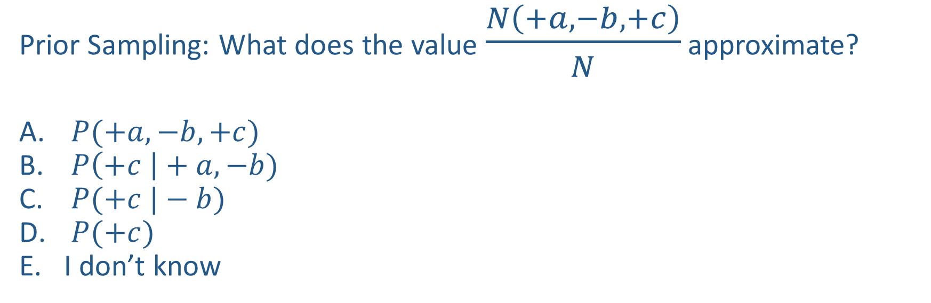

Poll 1
$$A$$
Prior Sampling: What does the value $\frac{N\left(+a, −b, +c\right)}{N}$ approximate?
$P(+a, −b, +c)$
$P\left(+c \right|+a, −b)$
$P(+c |−b)$
$P(+c)$
I don’t know
$$B$$
$$C$$

Slide 18
Poll 1
$$A$$
Prior Sampling: What does the value $\frac{N\left(+a, −b, +c\right)}{N}$ approximate?
$P(+a, −b, +c)$
$P\left(+c \right|+a, −b)$
$P(+c |−b)$
$P(+c)$
I don’t know
$$B$$
$$C$$

Slide 19

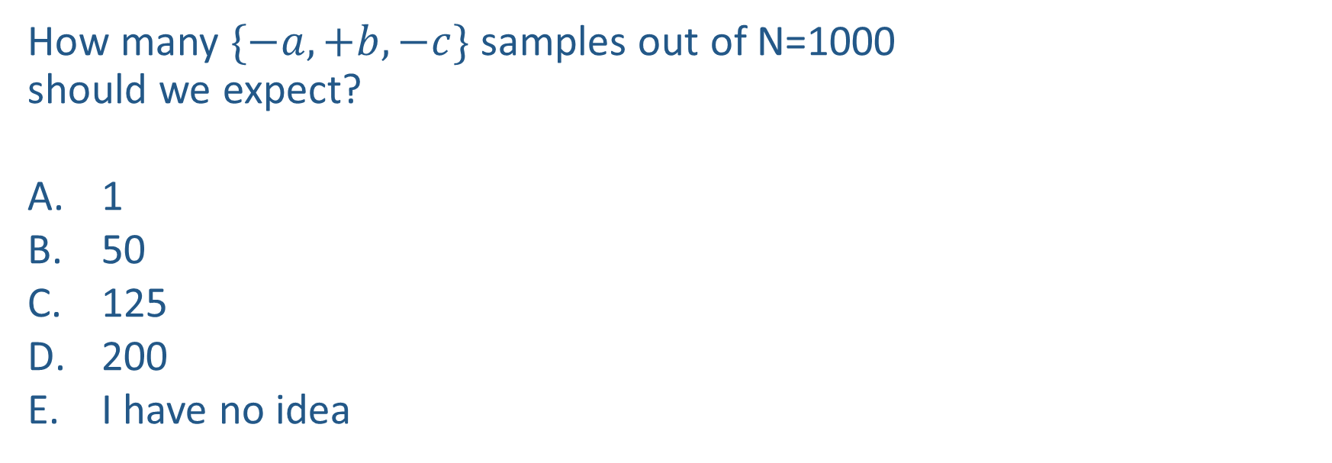
Poll 2
How many $\{−a,+b,−c\}$ samples out of N=1000
should we expect?
1
50
125
200
I have no idea
+a | 1/2
-a | 1/2
$$P(A)$$
$$A$$
+a | +b | 1/10
 | -b | 9/10
-a | +b | 1/2
 | -b | 1/2
$$P(B|A)$$
$$B$$
+b | +c | 4/5
 | -c | 1/5
-b | +c | 1
 | -c | 0
$$C$$
$$P(C|B)$$

Slide 20
Poll 2
How many $\{−a,+b,−c\}$ samples out of N=1000
should we expect?
1
50
125
200
I have no idea
+a | 1/2
-a | 1/2
$$P(A)$$
$$A$$
+a | +b | 1/10
 | -b | 9/10
-a | +b | 1/2
 | -b | 1/2
$$P(B|A)$$
$$B$$
+b | +c | 4/5
 | -c | 1/5
-b | +c | 1
 | -c | 0
$$C$$
$$P(C|B)$$

Slide 21
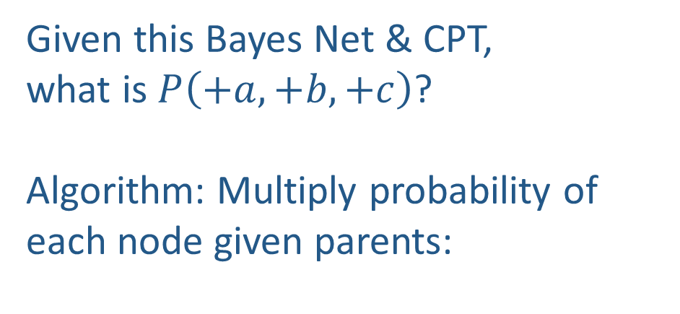
Probability of a sample
Given this Bayes Net & CPT,
what is $P\left(+a,+b,+c\right)$?
Algorithm: Multiply probability of each node given parents:
+a | 1/2
-a | 1/2
$$P(A)$$
$$A$$
+a | +b | 1/10
 | -b | 9/10
-a | +b | 1/2
 | -b | 1/2
$$P(B|A)$$
w = 1.0
for i=1, 2, …, n
  Set w = w * P(x_{i} | Parents(X_{i}))
return w
$$B$$
+b | +c | 4/5
 | -c | 1/5
-b | +c | 1
 | -c | 0
$$C$$
$$P(C|B)$$

Slide 22
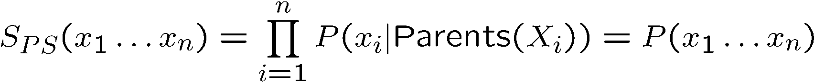

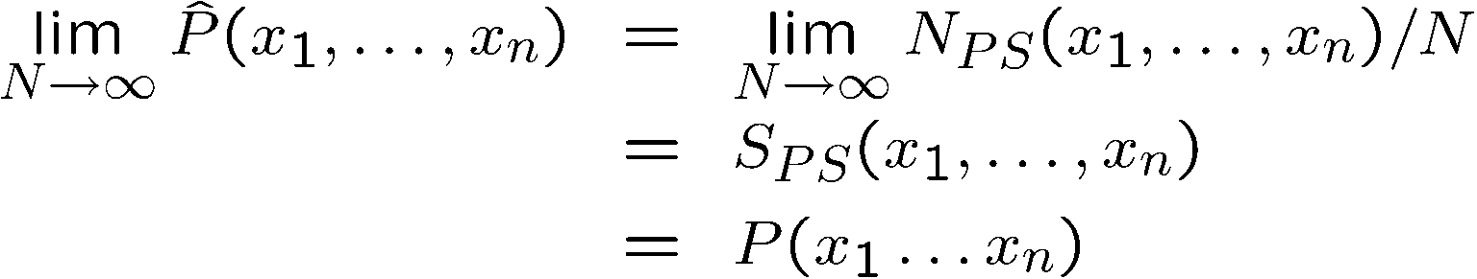
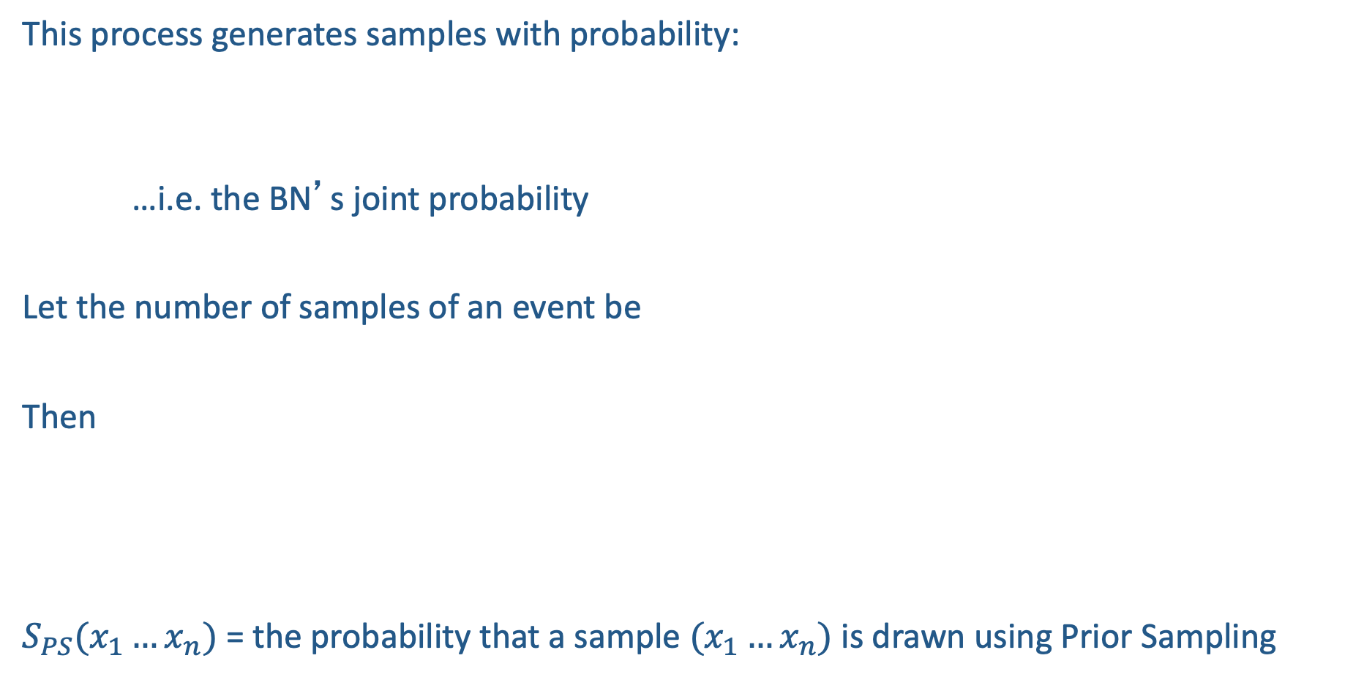
Prior Sampling
This process generates samples with probability:
…i.e. the BN’s joint probability
Let the number of samples of an event be
Then
$S_{PS}(x_{1}…x_{n})$ = the probability that a sample $(x_{1}…x_{n})$ is drawn using Prior Sampling

Slide 23
Example
We’ll get a bunch of samples from the BN:
  +c, -s, +r, +w
  +c, +s, +r, +w
  -c, +s, +r, -w
  +c, -s, +r, +w
  -c, -s, -r, +w
If we want to know P(W)
  We have counts <+w:4, -w:1>
  Normalize to get P(W) = <+w:0.8, -w:0.2>
  This will get closer to the true distribution with more samples
  Can estimate anything else, too
  What about P(C| +w)? P(C| +r, +w)? P(C| -r, -w)?
  Fast: can use fewer samples if less time (what’s the drawback?)
C
S
R
W

Slide 24
Practice Prior Sampling
Use a random number generator to pick a number between 0 and 100, divide random number by 100 to get a probability
Check the relevant probability distribution to determine what value is selected.
Continue selecting values for each variable until you have a single sample
Record the sample, repeat the process for 9 more samples

Slide 25
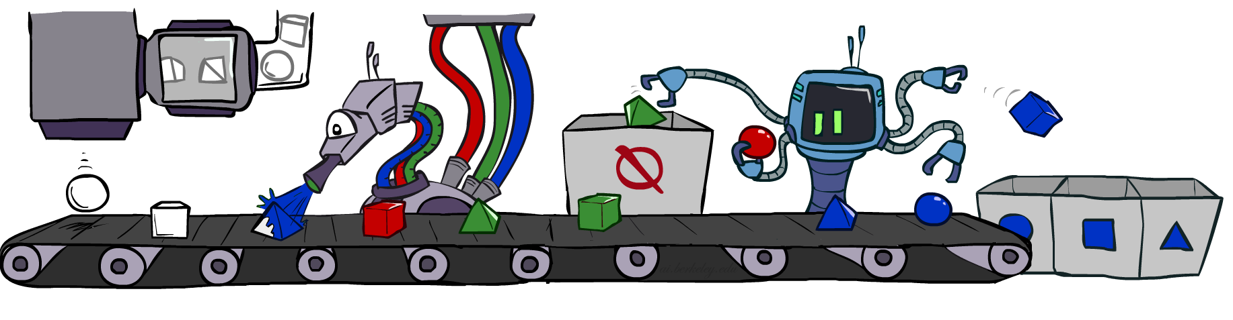
Rejection Sampling

Slide 26
Rejection Sampling
Let’s say we want P(C)
  No point keeping all samples around
  Just tally counts of C as we go
Let’s say we want P(C| +s)
  Same thing: tally C outcomes, but ignore (reject) samples which don’t have S=+s
  This is called rejection sampling
  It is also consistent for conditional probabilities (i.e., correct in the limit)
C
S
R
W
  +c, -s, +r, +w
  +c, +s, +r, +w
  -c, +s, +r, -w
  +c, -s, +r, +w
  -c, -s, -r, +w

Slide 27
Rejection Sampling
IN: evidence instantiation
For i=1, 2, …, n
  Sample x_{i} from P(X_{i} | Parents(X_{i}))
  If x_{i} not consistent with evidence
    Reject: Return, and no sample is generated in this cycle
Return (x₁, x₂, …, x_{n})

Slide 28

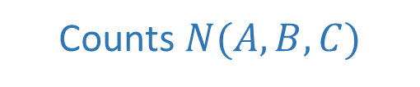
Poll 3
$$A$$
What queries can we (approximately) answer
with rejection sampling samples (evidence: $+c$)?
$P(+a, −b, +c)$
$P(+a, −b |+c)$
Both
Neither
I have no idea
$$B$$
Counts $N(A,B,C)$
+a | +b | +c | 4
+a | +b | -c
+a | -b | +c | 3
+a | -b | -c
-a | +b | +c | 2
-a | +b | -c
-a | -b | +c | 1
-a | -b | -c
$$C$$

Slide 29
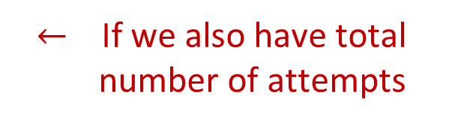
Poll 3
$$A$$
What queries can we (approximately) answer
with rejection sampling samples (evidence: $+c$)?
$P(+a, −b, +c)$
$P(+a, −b |+c)$
Both
Neither
I have no idea
$$B$$
Counts $N(A,B,C)$
+a | +b | +c | 4
+a | +b | -c
+a | -b | +c | 3
+a | -b | -c
-a | +b | +c | 2
-a | +b | -c
-a | -b | +c | 1
-a | -b | -c
$$C$$
$←$ If we also have total number of attempts

Slide 30
Practice Rejection Sampling
Use a random number generator to pick a number between 0 and 100, divide random number by 100 to get a probability
Check the relevant probability distribution to determine what value is selected.
REJECT ENTIRE SAMPLE IF VALUE IS INCONSISTENT WITH EVIDENCE
Continue selecting values for each variable until you have a single sample
Record the sample, repeat the process for 9 more samples

Slide 31
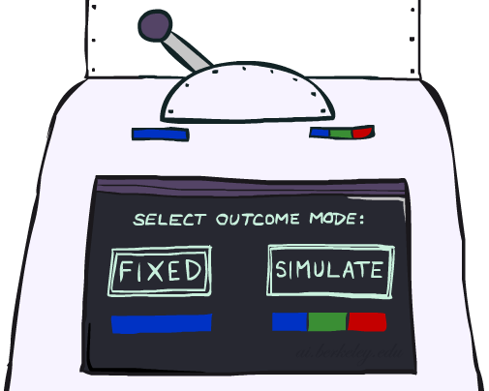
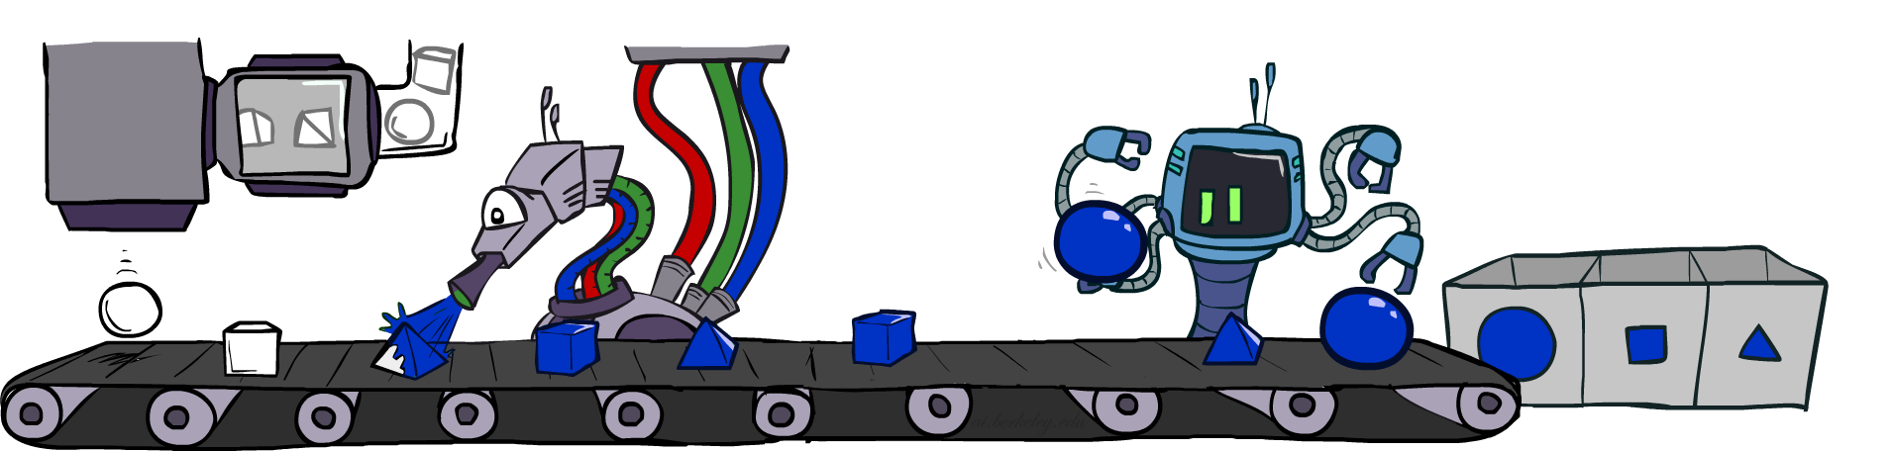
Likelihood Weighting

Slide 32
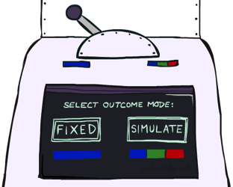


Likelihood Weighting
Problem with rejection sampling:
  If evidence is unlikely, rejects lots of samples
  Evidence not exploited as you sample
  Consider P(Shape|blue)
Idea: fix evidence variables and sample the rest
  Problem: sample distribution not consistent!
  Solution: weight by probability of evidence given parents
  pyramid, green
  pyramid, red
  sphere, blue
  cube, red
  sphere, green
  pyramid, blue
  pyramid, blue
  sphere, blue
  cube, blue
  sphere, blue
Shape
Color
Shape
Color

Slide 33



Likelihood Weighting
+c | 0.5
-c | 0.5
Cloudy
Cloudy
+c | +s | 0.1
 | -s | 0.9
-c | +s | 0.5
 | -s | 0.5
+c | +r | 0.8
 | -r | 0.2
-c | +r | 0.2
 | -r | 0.8
Sprinkler
Sprinkler
Rain
Rain
WetGrass
Samples:
WetGrass
+s | +r | +w | 0.99
 |  | -w | 0.01
 | -r | +w | 0.90
 |  | -w | 0.10
-s | +r | +w | 0.90
 |  | -w | 0.10
 | -r | +w | 0.01
 |  | -w | 0.99
+c, +s, +r, +w
…

Slide 34
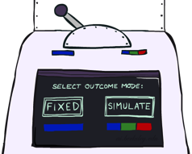
Likelihood Weighting
IN: evidence instantiation
w = 1.0
for i=1, 2, …, n
  if X_{i} is an evidence variable
    X_{i} = observation x_{i} for X_{i}
    Set w = w * P(x_{i} | Parents(X_{i}))
  else
    Sample x_{i} from P(X_{i} | Parents(X_{i}))
return (x₁, x₂, …, x_{n}), w

Slide 35
Likelihood Weighting
No evidence:
Prior Sampling
Some evidence:
Likelihood Weighted Sampling
All evidence:
Likelihood Weighted
Input: no evidence
for i=1, 2, …, n
    Sample x_{i} from P(X_{i} | Parents(X_{i}))
return (x₁, x₂, …, x_{n})
Input: evidence instantiation
w = 1.0
for i=1, 2, …, n
if X_{i} is an evidence variable
    X_{i} = observation x_{i} for X_{i}
    Set w = w * P(x_{i} | Parents(X_{i}))
else
    Sample x_{i} from P(X_{i} | Parents(X_{i}))
return (x₁, x₂, …, x_{n}), w
Input: evidence instantiation
w = 1.0
for i=1, 2, …, n
    Set w = w * P(x_{i} | Parents(X_{i}))
return w

Slide 36
Remember Poll 2
How many $\{−a,+b,−c\}$ samples out of N=1000
should we expect?
1
50
125
200
I have no idea
+a | 1/2
-a | 1/2
$$P(A)$$
$$A$$
+a | +b | 1/10
 | -b | 9/10
-a | +b | 1/2
 | -b | 1/2
$$P(B|A)$$
$$B$$
+b | +c | 4/5
 | -c | 1/5
-b | +c | 1
 | -c | 0
$$C$$
$$P(C|B)$$

Slide 37




Likelihood Weighting
How many $\{−a,+b,−c\}$ samples out of N=1000 should we expect?
+a | 1/2
-a | 1/2
$$P(A)$$
$$A$$
+a | +b | 1/10
 | -b | 9/10
-a | +b | 1/2
 | -b | 1/2
$$P(B|A)$$
$$B$$
+b | +c | 4/5
 | -c | 1/5
-b | +c | 1
 | -c | 0
$$C$$
$$P(C|B)$$

Slide 38


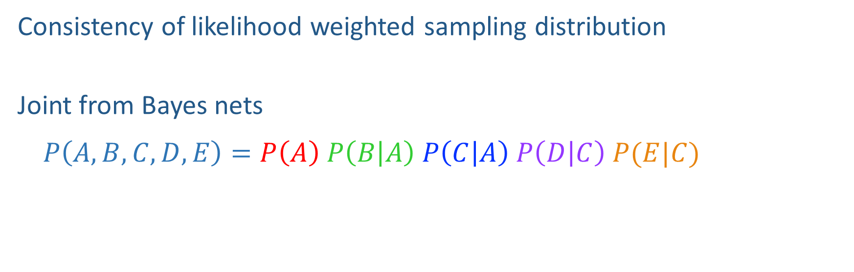



Likelihood Weighting Distribution
$$A$$
Consistency of likelihood weighted sampling distribution
Joint from Bayes nets
$$P\left(A,B,C,D,E\right)=P\left(A\right) P\left(B | A\right) P\left(C | A\right) P\left(D | C\right) P(E|C)$$
$$B$$
$$C$$
$$D$$
$$E$$

Slide 39
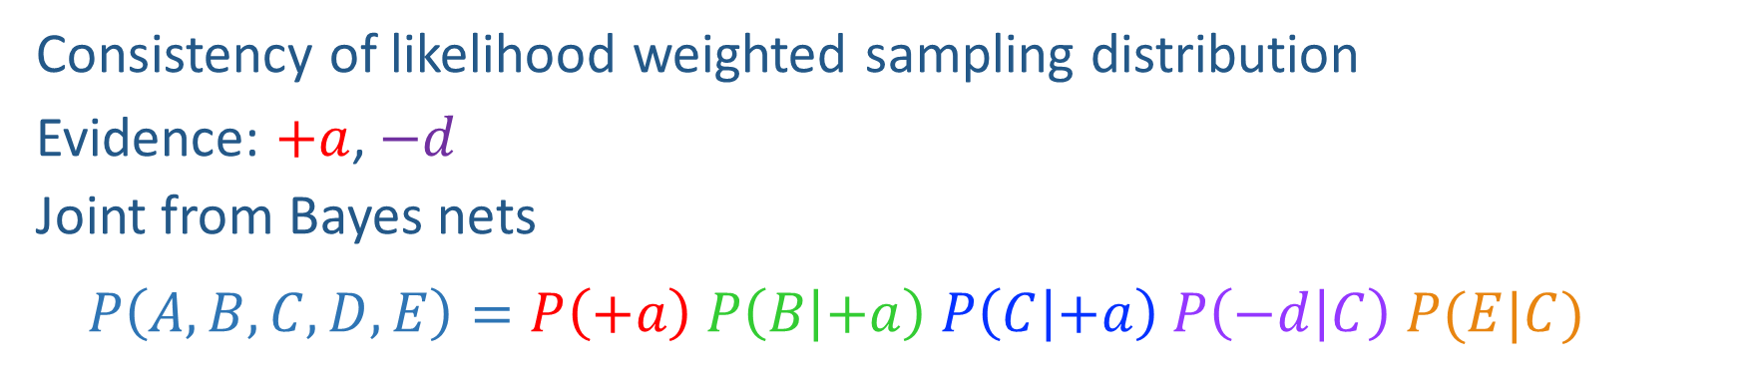

Likelihood Weighting Distribution
$$A$$
Consistency of likelihood weighted sampling distribution
Evidence: $+a$, $−d$
Joint from Bayes nets
$$P\left(A,B,C,D,E\right)=P\left(+a\right) P\left(B | +a\right) P\left(C | +a\right) P\left(−d | C\right) P(E|C)$$
$$B$$
$$C$$
$$D$$
$$E$$

Slide 40
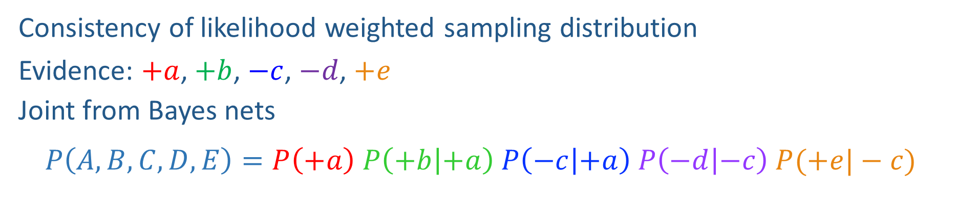
Likelihood Weighting Distribution
$$A$$
Consistency of likelihood weighted sampling distribution
Evidence: $+a$, $+b$, $−c$, $−d$, $+e$
Joint from Bayes nets
$$P\left(A,B,C,D,E\right)=P\left(+a\right) P\left(+b | +a\right) P\left(−c | +a\right) P\left(−d | −c\right) P(+e|−c)$$
$$B$$
$$C$$
$$D$$
$$E$$

Slide 41

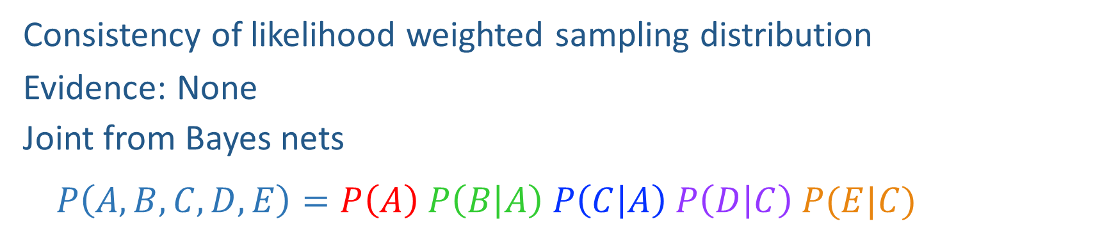
Likelihood Weighting Distribution
$$A$$
Consistency of likelihood weighted sampling distribution
Evidence: None
Joint from Bayes nets
$$P\left(A,B,C,D,E\right)=P\left(A\right) P\left(B | A\right) P\left(C | A\right) P\left(D | C\right) P(E|C)$$
$$B$$
$$C$$
$$D$$
$$E$$

Slide 42
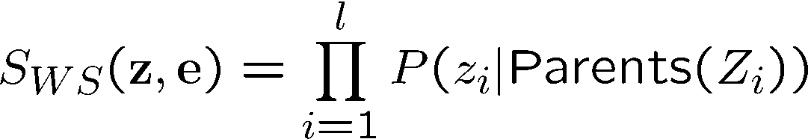
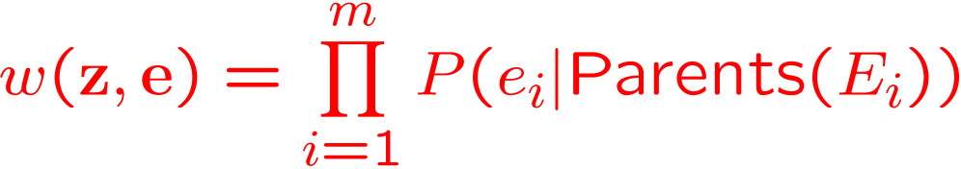
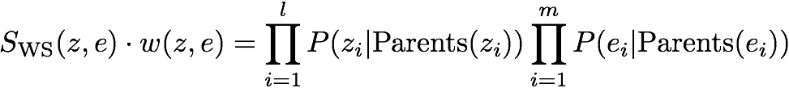

Likelihood Weighting
Sampling distribution if z sampled and e fixed evidence
Now, samples have weights
Together, weighted sampling distribution is consistent
Cloudy
C
S
R
W

Slide 43
Poll 4
Given a fixed query, two identical samples from likelihood weighted sampling will have the same exact weights.
True
False
It depends
I don’t know

Slide 44
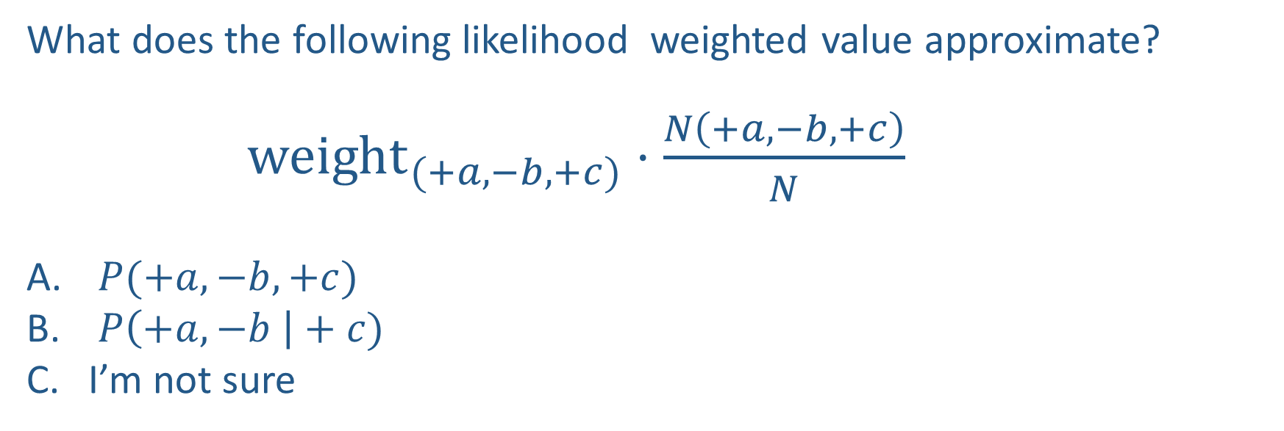
Poll 5
What does the following likelihood weighted value approximate?
${weight}_{(+a,−b,+c)}⋅\frac{N\left(+a, −b, +c\right)}{N}$
$P(+a, −b, +c)$
$P\left(+a, −b \right|+c)$
I’m not sure

Slide 45
Practice Likelihood Weighted Sampling
For each variable:
If evidence variable: you know the value, and multiply the weight of the sample by P(evidence|parents)
Else: Use a random number generator to pick a number between 0 and 100, divide random number by 100 to get a probability. Check the relevant probability distribution to determine what value is selected.
Continue selecting values for each variable until you have a single sample
Record the sample, repeat the process for 9 more samples
The probability for a given set of variables equals
(COUNT OF SAMPLES * WEIGHT)/(TOTAL COUNT OF SAMPLES)

Slide 46
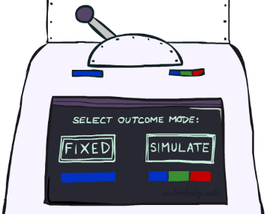
Likelihood Weighting
Likelihood weighting is good
  We have taken evidence into account as we generate the sample
  E.g. here, W’s value will get picked based on the evidence values of S, R
  More of our samples will reflect the state of the world suggested by the evidence
Likelihood weighting doesn’t solve all our problems
  Evidence influences the choice of downstream variables, but not upstream ones (C isn’t more likely to get a value matching the evidence)
We would like to consider evidence when we sample every variable

Slide 47
Likelihood Weighting
Likelihood weighting is good
  We have taken evidence into account as we generate the sample
  E.g. here, W’s value will get picked based on the evidence values of S, R
  More of our samples will reflect the state of the world suggested by the evidence
Likelihood weighting doesn’t solve all our problems
  Evidence influences the choice of downstream variables, but not upstream ones (C isn’t more likely to get a value matching the evidence)
We would like to consider evidence when we sample every variable
→ Gibbs sampling

Slide 48
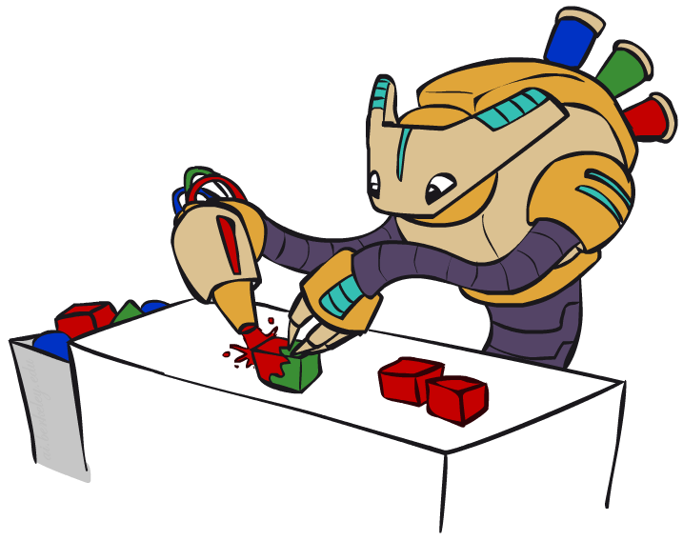
Gibbs Sampling

Slide 49
Gibbs Sampling
Iteration Procedure: keep track of a full instantiation x₁, x₂, …, x_{n}.
Start with an arbitrary instantiation consistent with the evidence.
Sample one variable at a time, conditioned on all the rest, but keep evidence fixed.
Keep repeating this for a long time.
When done, keep last values of variables as 1 sample.
Repeat iteration for each sample.

Slide 50
Gibbs Sampling Example: P( S | +r)
Step 1: Fix evidence
  R = +r
Steps 3: Repeat
  Choose a non-evidence variable X
  Resample X from P( X | all other variables)
Step 2: Initialize other variables
  Randomly
C
C
S
+r
S
+r
W
W
C
C
C
C
C
C
S
+r
S
+r
S
+r
S
+r
S
+r
S
+r
W
W
W
W
W
W

Slide 51
Gibbs Sampling Example: P( S | +r)
Each iteration here is repeated 5 times.
Keep only the last sample from each iteration:
C
C
C
C
C
S
+r
S
+r
S
+r
S
+r
S
+r
W
W
W
W
W
C
C
C
C
C
S
+r
S
+r
S
+r
S
+r
S
+r
W
W
W
W
W
C
C
C
C
C
S
+r
S
+r
S
+r
S
+r
S
+r
W
W
W
W
W

Slide 52
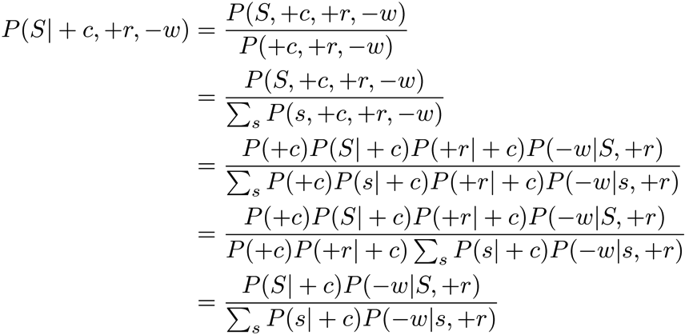
Efficient Resampling of One Variable
Sample from P(S | +c, +r, -w)
Many things cancel out – only CPTs with S remain!
More generally: only CPTs that have resampled variable need to be considered, and joined together
C
S
+r
W

Slide 53
Practice Gibbs Sampling
Procedure: keep track of a full instantiation x₁, x₂, …, x_{n}.
Start with an arbitrary instantiation consistent with the evidence.
Sample one variable at a time, conditioned on all the rest, but keep evidence fixed.
Iterate to repeat this for a long time.
Keep only the last set of variables as ONE sample
Repeat with new sample
Property: in the limit of repeating this infinitely many times the resulting sample is coming from the correct distribution

Slide 54
Gibbs Sampling
Property: in the limit of repeating this infinitely many times the resulting sample is coming from the correct distribution
Rationale: both upstream and downstream variables condition on evidence.
In contrast: likelihood weighting only conditions on upstream evidence, and hence weights obtained in likelihood weighting can sometimes be very small. Sum of weights over all samples is indicative of how many “effective” samples were obtained, so want high weight.

Slide 55
Further Reading on Gibbs Sampling
Gibbs sampling produces sample from the query distribution P( Q | e ) in limit of re-sampling infinitely often
Gibbs sampling is a special case of more general methods called Markov chain Monte Carlo (MCMC) methods
  Metropolis-Hastings is one of the more famous MCMC methods (in fact, Gibbs sampling is a special case of Metropolis-Hastings)
You may read about Monte Carlo methods – they’re just sampling

Slide 56
Markov Chain Monte Carlo*
Idea: instead of sampling from scratch, create samples that are each like the last one.
Procedure: resample one variable at a time, conditioned on all the rest, but keep evidence fixed. E.g., for P(b|c):
Properties: Now samples are not independent (in fact they’re nearly identical), but sample averages are still consistent estimators!
What’s the point: both upstream and downstream variables condition on evidence.
+b
+a
+c
-b
+a
+c
-b
-a
+c

Slide 57



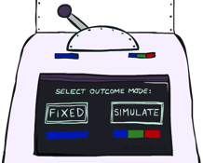

Bayes’ Net Sampling Summary
Prior Sampling P(Q, E)
Likelihood Weighting P( Q , e)
Rejection Sampling P( Q | e )
Gibbs Sampling P( Q | e )

