Slide 1
Warm-up as you come in
What is the notation behind these generic queries?
What is the probability of this given what I know?
What are the probabilities of all the possible outcomes (given what I know)?
Which outcome is the most likely outcome (given what I know)?

Slide 2
Announcements
Home Stretch
P4 - Due Thursday 4/6
HW9 - Due Tues 4/11 (day before Carnival)
HW10 - Due Tues 4/25 (last week of school)
P5 – Out 4/11, Due Thursday 4/27 (last week of school)
Final exam – Thursday 5/4, 5:30-8:30pm
TA Applications! https://www.ugrad.cs.cmu.edu/ta/F23/instructor/
Carnival
There will be lecture on 4/11 on HMMs
No Recitation Friday 4/14, videos posted

Slide 3

Bayes Nets
Part I: Representation and Independence
Part II: Exact inference
  Enumeration (always exponential complexity)
  Variable elimination (worst-case exponential complexity, often better)
  Inference is NP-hard in general
Part III: Approximate Inference

Slide 4
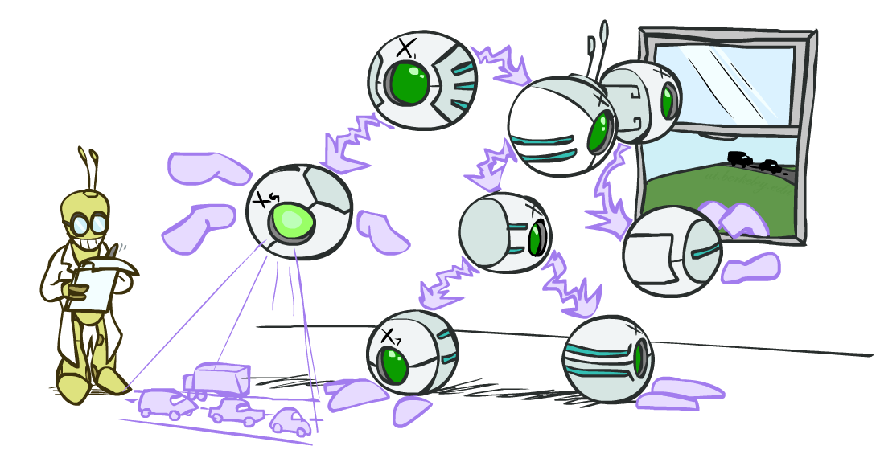
AI: Representation and Problem Solving
Bayes Nets Inference
Instructor: Stephanie Rosenthal
Slide credits: CMU AI and http://ai.berkeley.edu

Slide 5
Warm-up as you come in
What is the notation behind these generic queries?
What is the probability of this given what I know?
What are the probabilities of all the possible outcomes (given what I know)?
Which outcome is the most likely outcome (given what I know)?

Slide 6

Queries
What is the probability of this given what I know?
$P\left(q ∣ e\right)$
What are the probabilities of all the possible outcomes (given what I know)?
$P\left(Q ∣ e\right)$
Which outcome is the most likely outcome (given what I know)?
${argmax}_{q∈Q} P\left(q ∣ e\right)$

Slide 7

Queries
What is the probability of this given what I know?
$P\left(q ∣ e\right)=\frac{P(q, e)}{P(e)}$
What are the probabilities of all the possible outcomes (given what I know)?
$P\left(Q ∣ e\right)=\frac{P\left(Q, e\right)}{P\left(e\right)}$
Which outcome is the most likely outcome (given what I know)?
${argmax}_{q∈Q} P\left(q ∣ e\right)={argmax}_{q∈Q}\frac{P\left(q, e\right)}{P\left(e\right)}$

Slide 8

Queries
What is the probability of this given what I know?
$P\left(q ∣ e\right)=\frac{P(q, e)}{P(e)}=\frac{\sum_{h_{1}}{\sum_{h_{2}}{P\left(q, h_{1}, h_{2}, e\right)}}}{P(e)}$
What are the probabilities of all the possible outcomes (given what I know)?
$P\left(Q ∣ e\right)=\frac{P\left(Q, e\right)}{P\left(e\right)}=\frac{\sum_{h_{1}}{\sum_{h_{2}}{P\left(Q, h_{1}, h_{2}, e\right)}}}{P(e)}$
Which outcome is the most likely outcome (given what I know)?
${argmax}_{q∈Q} P\left(q ∣ e\right)={argmax}_{q∈Q}\frac{P\left(q, e\right)}{P\left(e\right)}={argmax}_{q∈Q}\frac{\sum_{h_{1}}{\sum_{h_{2}}{P\left(q, h_{1}, h_{2}, e\right)}}}{P(e)}$

Slide 9
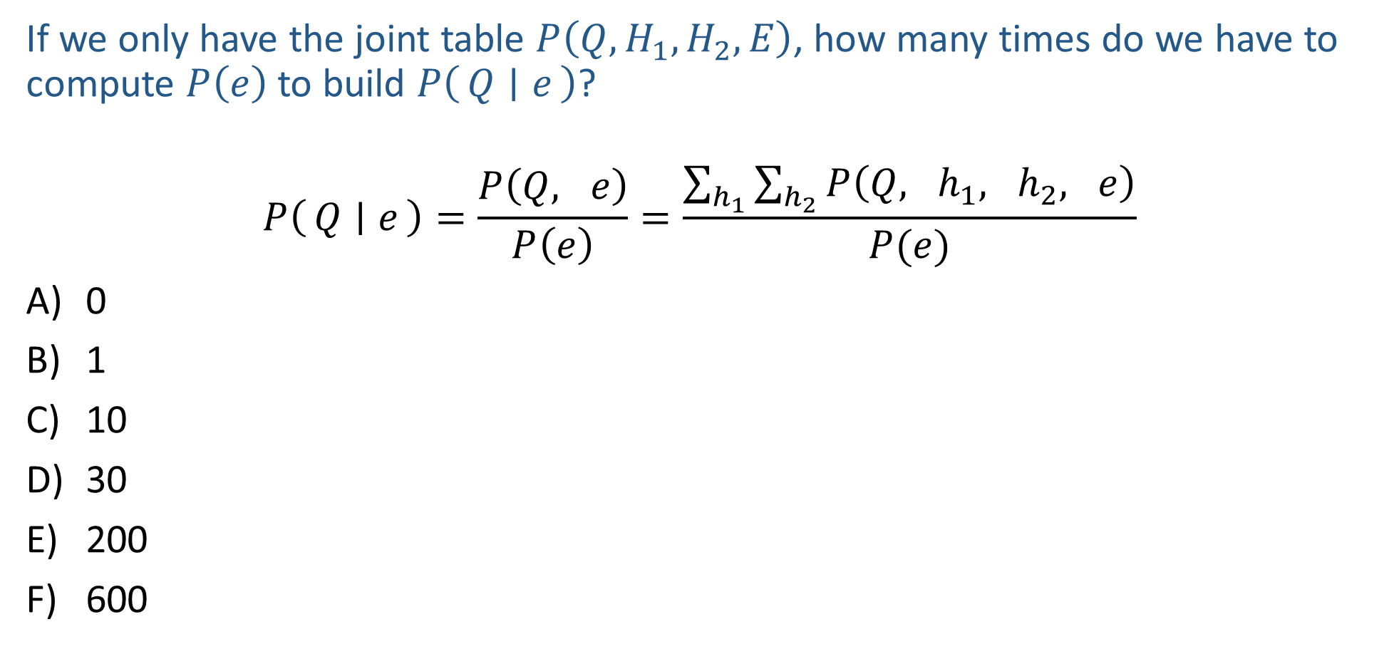
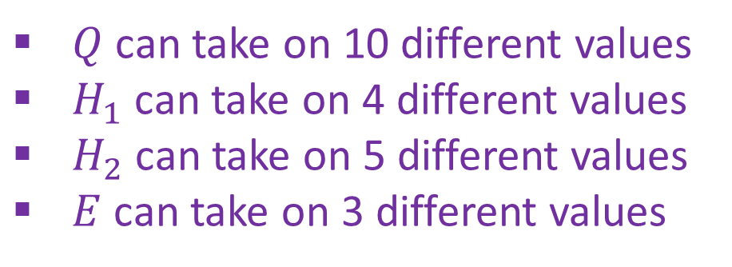
Poll 1
If we only have the joint table $P\left(Q,H_{1}, H_{2}, E\right)$, how many times do we have to compute $P\left(e\right)$ to build $P\left(Q ∣ e\right)$?
$$P\left(Q ∣ e\right)=\frac{P\left(Q, e\right)}{P\left(e\right)}=\frac{\sum_{h_{1}}{\sum_{h_{2}}{P\left(Q, h_{1}, h_{2}, e\right)}}}{P(e)}$$
0
1
10
30
200
600
$Q$ can take on 10 different values
$H_{1}$ can take on 4 different values
$H_{2}$ can take on 5 different values
$E$ can take on 3 different values

Slide 10
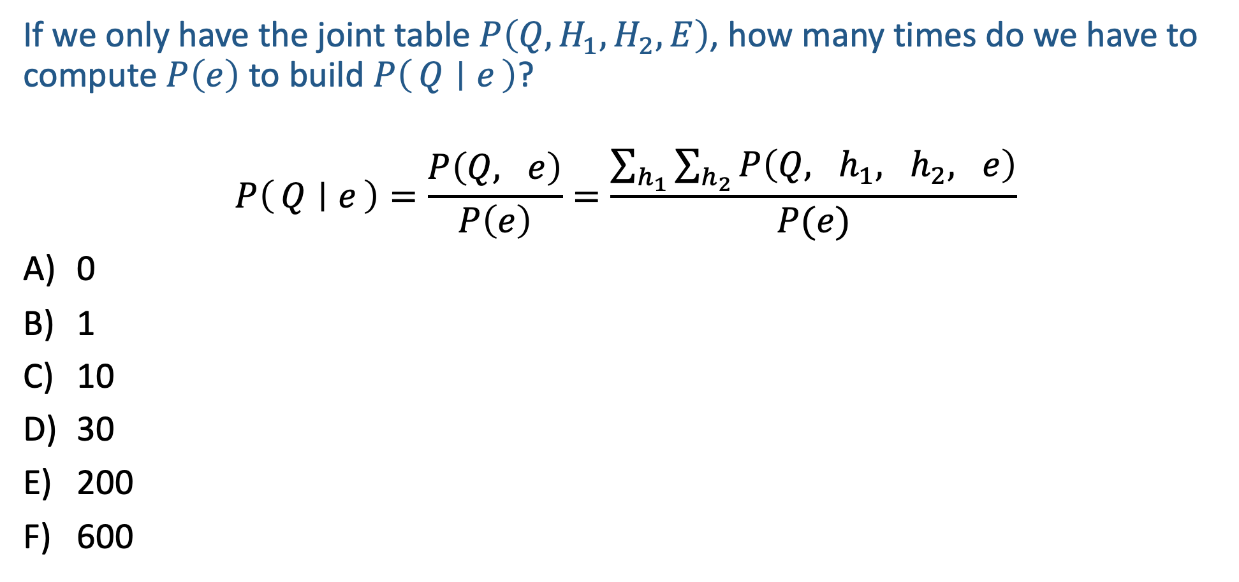
Poll 1
If we only have the joint table $P\left(Q,H_{1}, H_{2}, E\right)$, how many times do we have to compute $P\left(e\right)$ to build $P\left(Q ∣ e\right)$?
$$P\left(Q ∣ e\right)=\frac{P\left(Q, e\right)}{P\left(e\right)}=\frac{\sum_{h_{1}}{\sum_{h_{2}}{P\left(Q, h_{1}, h_{2}, e\right)}}}{P(e)}$$
0
1
10
30
200
600
$Q$ can take on 10 different values
$H_{1}$ can take on 4 different values
$H_{2}$ can take on 5 different values
$E$ can take on 3 different values

Slide 11
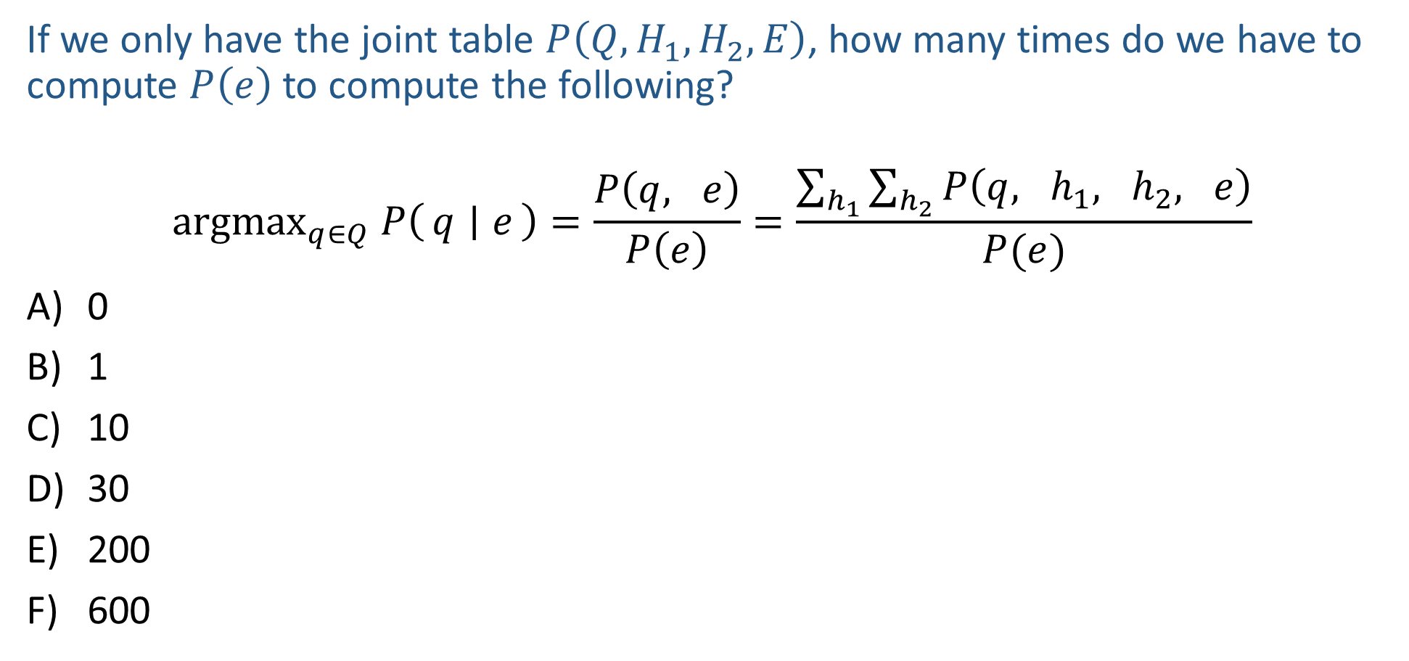
Poll 2
If we only have the joint table $P\left(Q,H_{1}, H_{2}, E\right)$, how many times do we have to compute $P\left(e\right)$ to compute the following?
$${argmax}_{q∈Q} P\left(q ∣ e\right)=\frac{P\left(q, e\right)}{P\left(e\right)}=\frac{\sum_{h_{1}}{\sum_{h_{2}}{P\left(q, h_{1}, h_{2}, e\right)}}}{P(e)}$$
0
1
10
30
200
600
$Q$ can take on 10 different values
$H_{1}$ can take on 4 different values
$H_{2}$ can take on 5 different values
$E$ can take on 3 different values

Slide 12
Poll 2
If we only have the joint table $P\left(Q,H_{1}, H_{2}, E\right)$, how many times do we have to compute $P\left(e\right)$ to compute the following?
$${argmax}_{q∈Q} P\left(q ∣ e\right)=\frac{P\left(q, e\right)}{P\left(e\right)}=\frac{\sum_{h_{1}}{\sum_{h_{2}}{P\left(q, h_{1}, h_{2}, e\right)}}}{P(e)}$$
0
1
10
30
200
600
$Q$ can take on 10 different values
$H_{1}$ can take on 4 different values
$H_{2}$ can take on 5 different values
$E$ can take on 3 different values

Slide 13
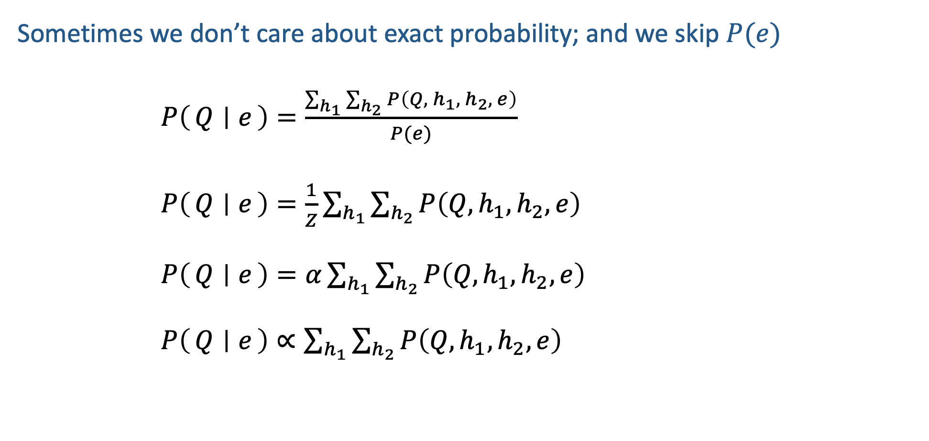
Normalization
Sometimes we don’t care about exact probability; and we skip $P(e)$
$P\left(Q ∣ e\right)=\frac{\sum_{h_{1}}{\sum_{h_{2}}{P\left(Q, h_{1}, h_{2}, e\right)}}}{P(e)}$
$P\left(Q ∣ e\right)=\frac{1}{Z}\sum_{h_{1}}{\sum_{h_{2}}{P\left(Q, h_{1}, h_{2}, e\right)}}$
$P\left(Q ∣ e\right)=α\sum_{h_{1}}{\sum_{h_{2}}{P\left(Q, h_{1}, h_{2}, e\right)}}$
$P\left(Q ∣ e\right)∝\sum_{h_{1}}{\sum_{h_{2}}{P\left(Q, h_{1}, h_{2}, e\right)}}$

Slide 14

Bayes Nets in the Wild
Example: Speech Recognition
“artificial $⋅⋅⋅⋅⋅⋅⋅⋅⋅⋅⋅$”
Find most probable next word given “artificial” and the audio for second word.

Slide 15
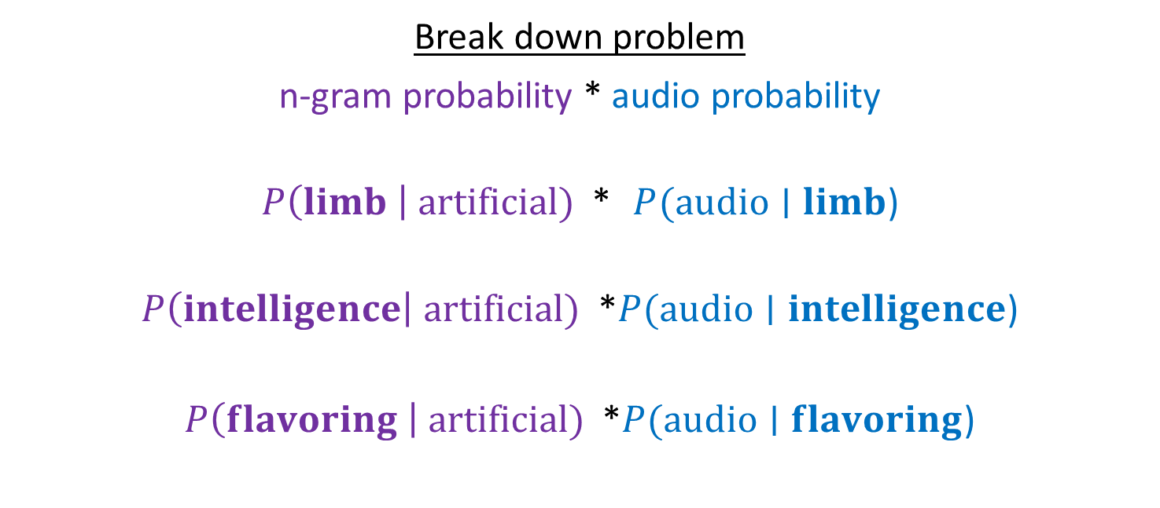
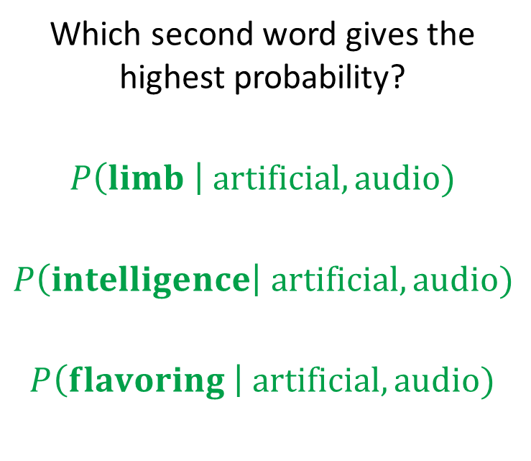
Bayes Nets in the Wild
Example: Speech Recognition
“artificial $⋅⋅⋅⋅⋅⋅⋅⋅⋅⋅⋅$”
Find most probable next word given “artificial” and the audio for second word.
Which second word gives the highest probability?
$$P\left(limb \right| artificial, audio)$$
$$P\left(intelligence\right| artificial, audio)$$
$$P\left(flavoring \right| artificial, audio)$$
Break down problem
n-gram probability * audio probability
$P\left(limb \right| artificial)$ * $P(audio∣limb$)
$P\left(intelligence\right| artificial)$ *$P(audio∣intelligence$)
$P\left(flavoring \right| artificial)$ *$P(audio∣flavoring$)

Slide 16
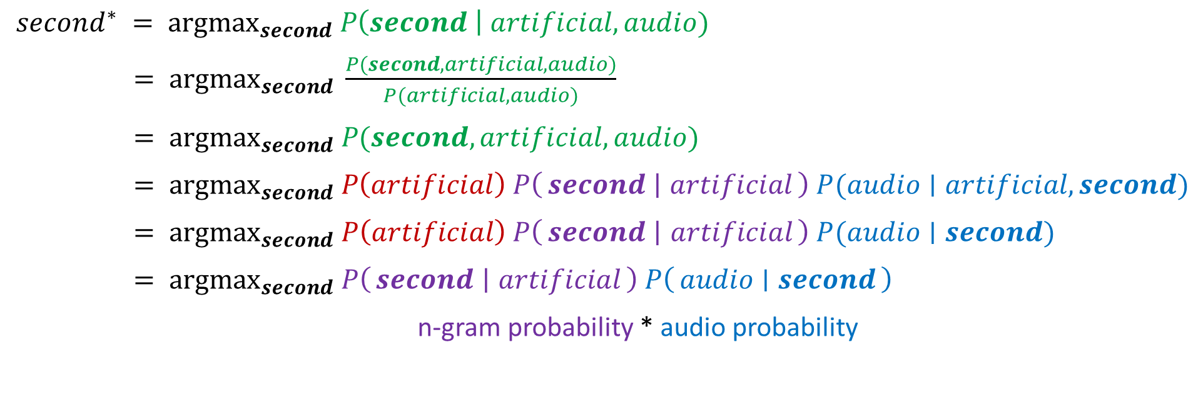
Bayes Nets in the Wild
$second^{∗} = {argmax}_{second} P\left(second \right| artificial, audio)$
$= {argmax}_{second} \frac{P(second, artificial, audio)}{P(artificial, audio)}$
$= {argmax}_{second} P(second, artificial, audio)$
$= {argmax}_{second} P\left(artificial\right) P\left(second ∣ artificial\right) P(audio∣artificial, second)$
$= {argmax}_{second} P\left(artificial\right) P\left(second ∣ artificial\right) P(audio∣second)$
$= {argmax}_{second} P\left(second ∣ artificial\right) P\left(audio ∣ second\right)$
n-gram probability * audio probability

Slide 17

Inference
Inference: calculating some useful quantity from a probability model (joint probability distribution)
Examples:
  Posterior marginal probability
    P(Q|e₁,..,e_{k})
    e.g., what disease might I have?
  Most likely explanation:
    argmax_{q,r,s} P(Q=q,R=r,S=s|e₁,..,e_{k})
    e.g., what was just said?

Slide 18
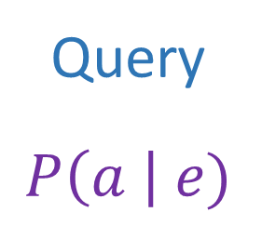
Answer Any Query from Bayes Net
Bayes Net
Joint
Query
$$P\left(a \right| e)$$
$$P\left(A\right) P\left(B | A\right) P\left(C | A\right) P\left(D | C\right) P(E|C)$$

Slide 19
Next: Answer Any Query from Bayes Net
Bayes Net
Query
$$P\left(a \right| e)$$
$$P\left(A\right) P\left(B | A\right) P\left(C | A\right) P\left(D | C\right) P(E|C)$$

Slide 20
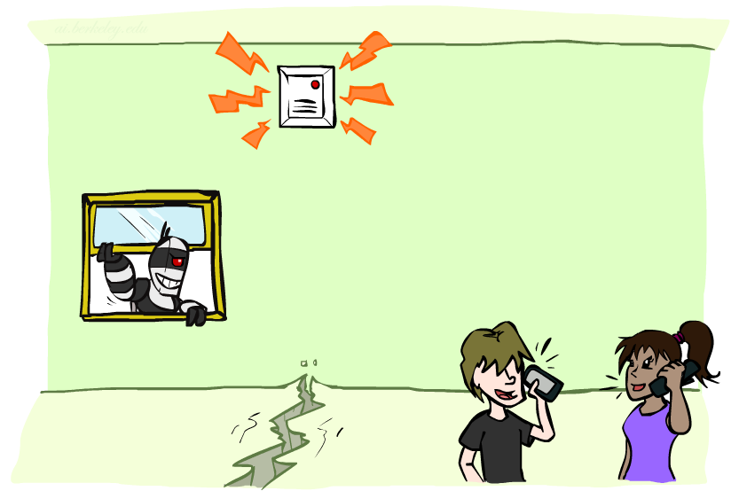
Example: Alarm Network
Variables
  B: Burglary
  A: Alarm goes off
  M: Mary calls
  J: John calls
  E: Earthquake!

Slide 21

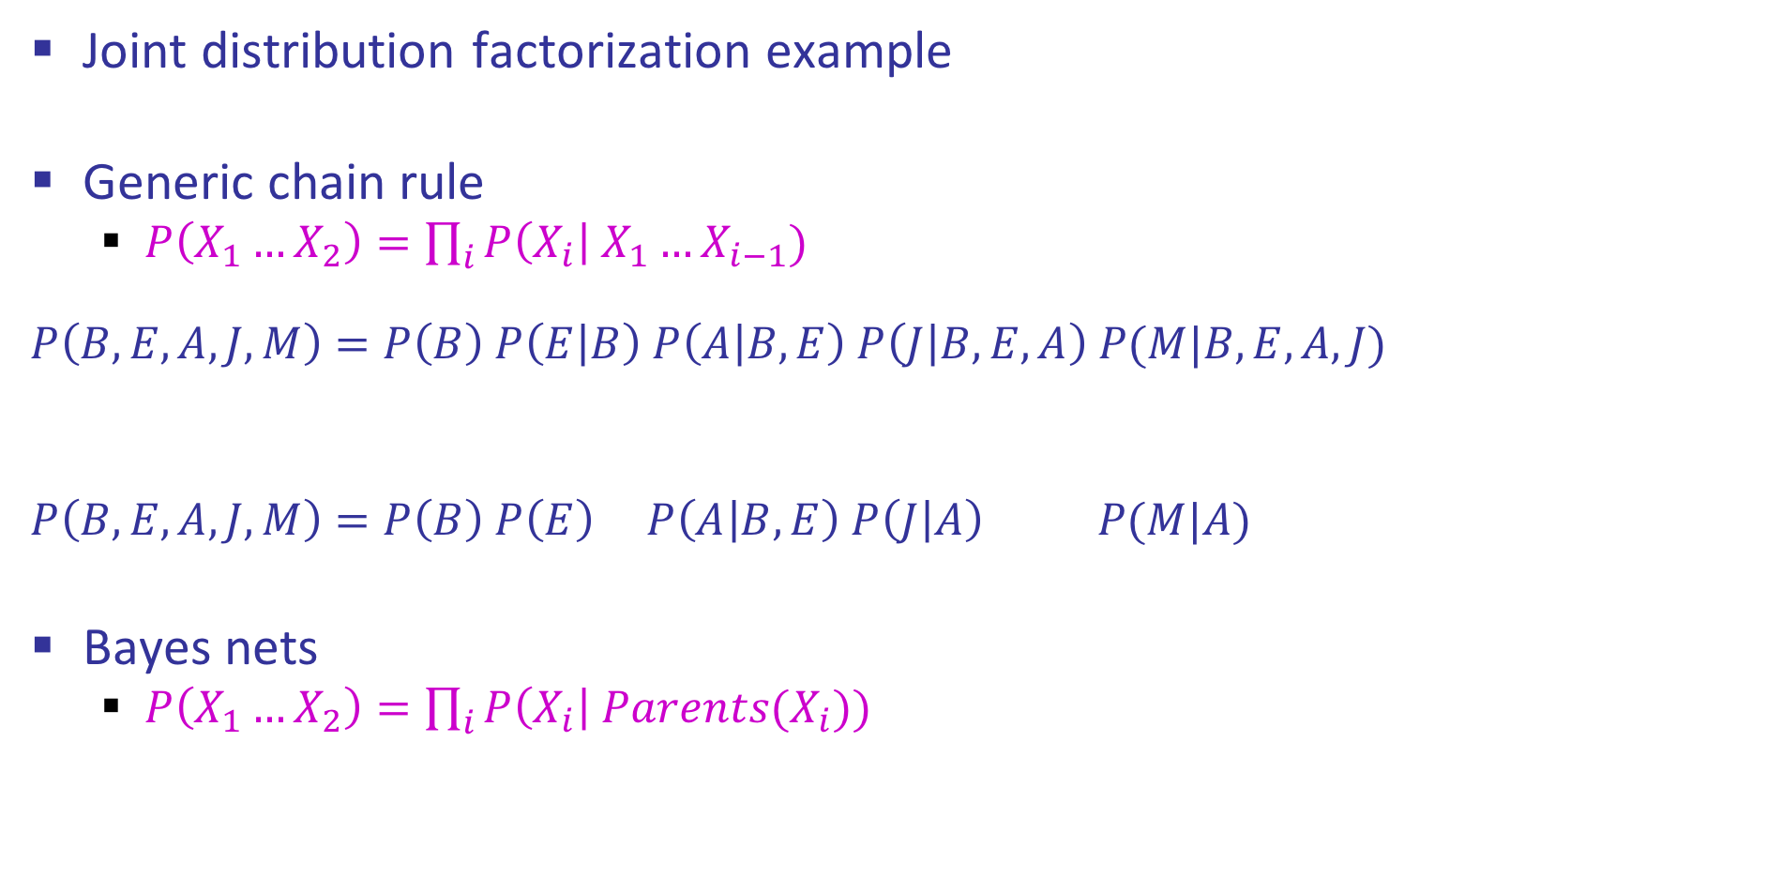
Example: Alarm Network
Joint distribution factorization example
Generic chain rule
  $P\left(X_{1}…X_{2}\right)=\prod_{i}{P\left(X_{i}\right| X_{1}…X_{i−1}) }$
  $$P\left(B,E,A,J,M\right)=P\left(B\right) P\left(E | B\right) P\left(A | B,E\right) P\left(J | B,E,A\right) P(M|B,E,A,J)$$
  $$P\left(B,E,A,J,M\right)=P\left(B\right) P\left(E\right) P\left(A | B,E\right) P\left(J | A\right) P(M|A)$$
Bayes nets
  $P\left(X_{1}…X_{2}\right)=\prod_{i}{P\left(X_{i}\right| Parents(X_{i})) }$
Burglary
Earthquake
Alarm
John calls
Mary calls

Slide 22
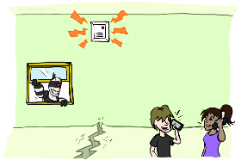

Example: Alarm Network
$P\left(+b, −e, −a, −j,−m\right)=$
B | P(B)
+b | 0.001
-b | 0.999
E | P(E)
+e | 0.002
-e | 0.998
Burglary
Earthqk
Alarm
B | E | A | P(A|B,E)
+b | +e | +a | 0.95
+b | +e | -a | 0.05
+b | -e | +a | 0.94
+b | -e | -a | 0.06
-b | +e | +a | 0.29
-b | +e | -a | 0.71
-b | -e | +a | 0.001
-b | -e | -a | 0.999
John calls
Mary calls
A | J | P(J|A)
+a | +j | 0.9
+a | -j | 0.1
-a | +j | 0.05
-a | -j | 0.95
A | M | P(M|A)
+a | +m | 0.7
+a | -m | 0.3
-a | +m | 0.01
-a | -m | 0.99
Notes:
demo

Slide 23
Inference by Enumeration in Bayes Net
Inference by enumeration:
  Any probability of interest can be computed by summing entries from the joint distribution
  Entries from the joint distribution can be obtained from a BN by multiplying the corresponding conditional probabilities
  P(B | j, m) = α P(B, j, m)
  = α ∑_{e,a} P(B, e, a, j, m)
  = α ∑_{e,a} P(B) P(e) P(a|B,e) P(j|a) P(m|a)
So inference in Bayes nets means computing sums of products of numbers: sounds easy!!
Problem: sums of exponentially many products!
B
E
A
J
M

Slide 24
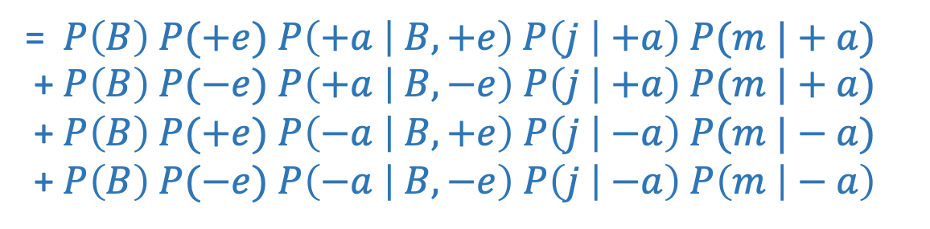
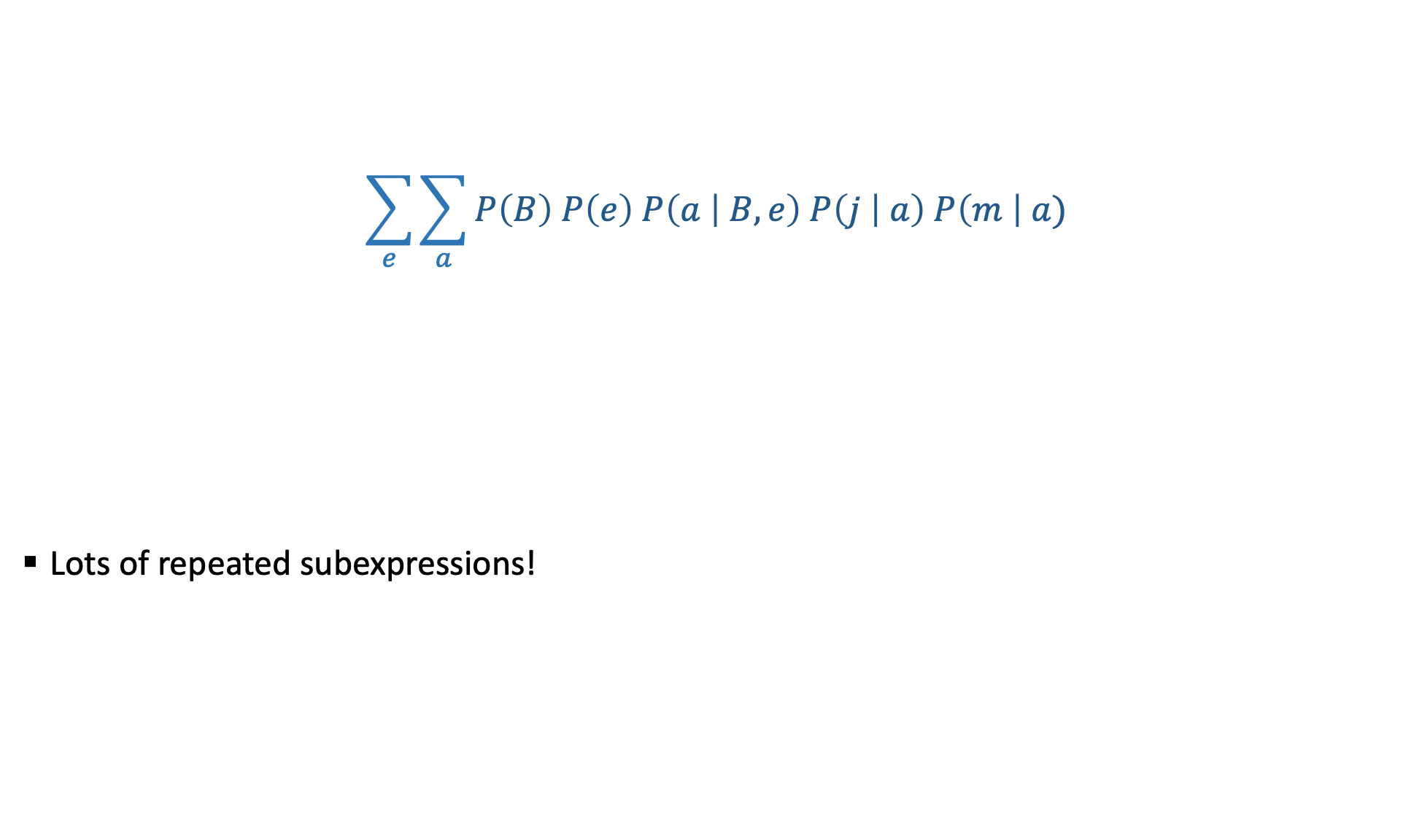
Can we do better?
$$\sum_{e}{\sum_{a}{P\left(B\right) P\left(e\right) P\left(a | B,e\right) P\left(j | a\right) P\left(m \right| a)}}$$
  Lots of repeated subexpressions!
= $P\left(B\right) P(+e)$ $P\left(+a | B,+e\right) P\left(j | +a\right) P(m |+a)$
+ $P\left(B\right) P(−e)$ $P\left(+a | B,−e\right) P\left(j | +a\right) P(m |+a)$
+ $P\left(B\right) P(+e)$ $P\left(−a | B,+e\right) P\left(j | −a\right) P(m |−a)$
+ $P\left(B\right) P(−e)$ $P\left(−a | B,−e\right) P\left(j | −a\right) P\left(m | − a\right)$

Slide 25

Can we do better?
Consider
  $x_{1}y_{1}z_{1}+x_{1}y_{1}z_{2}+x_{1}y_{2}z_{1}+x_{1}y_{2}z_{2}+x_{2}y_{1}z_{1}+x_{2}y_{1}z_{2}+x_{2}y_{2}z_{1}+x_{2}y_{2}z_{2}$
  16 multiplies, 7 adds
  Lots of repeated subexpressions!
Rewrite as
  $(x_{1}+x_{2})(y_{1}+y_{2})(z_{1}+z_{2})$

Slide 26

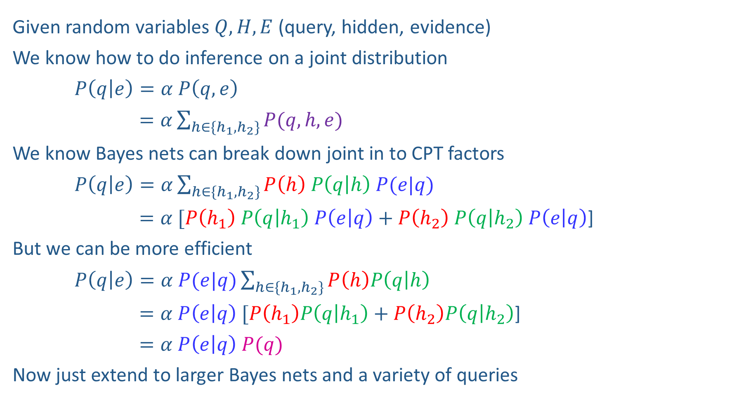


Inference Overview
Given random variables$Q, H, E$ (query, hidden, evidence)
We know how to do inference on a joint distribution
$P\left(q | e\right)=α P\left(q,e\right)$
$=α\sum_{h∈\{h_{1},h_{2}\}}{P(q,h,e)}$
We know Bayes nets can break down joint in to CPT factors
$P\left(q | e\right)=α\sum_{h∈\{h_{1},h_{2}\}}{P\left(h\right) P\left(q | h\right) P(e|q)}$
$=α [P\left(h_{1}\right) P\left(q | h_{1}\right) P\left(e | q\right)+P\left(h_{2}\right) P\left(q | h_{2}\right) P\left(e | q\right)$]
But we can be more efficient
$P\left(q | e\right)=α P(e|q)\sum_{h∈\{h_{1},h_{2}\}}{P\left(h\right)P\left(q | h\right) }$
$=α P\left(e | q\right) [P\left(h_{1}\right)P\left(q | h_{1}\right)+P\left(h_{2}\right)P\left(q | h_{2}\right)$]
$=α P\left(e | q\right) P(q)$
Now just extend to larger Bayes nets and a variety of queries
Enumeration
$$H$$
$$Q$$
$$E$$
Variable
Elimination

Slide 27
Factor Tables
$$P\left(+b, −e, −a, −j,−m\right)=P\left(+b\right) ∗ P\left(−e\right) ∗ P\left(−a | +b, −e\right) ∗ P\left(−j | −a\right) ∗ P\left(−m | −a\right)$$
$=0.001 ∗ 0.998 ∗ 0.06 ∗ 0.95 ∗ 0.99$
$$P\left(+b, −e, −a, −j,−m\right)=P\left(−e\right) ∗ P\left(−a | +b, −e\right) ∗P\left(+b\right) P\left(−j | −a\right) ∗ P\left(−m | −a\right)$$
$=0.998 ∗ 0.06 ∗ 0.0095 ∗ 0.99$
Notes:
demo

Slide 28
Example: Alarm Network
$$P\left(+b, −e, −a, −j,−m\right)=P\left(+b\right) ∗ P\left(−e\right) ∗ P\left(−a | +b, −e\right) ∗ P\left(−j | −a\right) ∗ P\left(−m | −a\right)$$
$=0.001 ∗ 0.998 ∗ 0.06 ∗ 0.95 ∗ 0.99$
$$P\left(+b, −e, −a, −j,−m\right)=P\left(−e\right) ∗ P\left(−a | +b, −e\right) ∗P\left(+b\right) ∗P\left(−j | −a\right) ∗ P\left(−m | −a\right)$$
$=0.998 ∗ 0.06 ∗ 0.001 ∗ 0.95 ∗ 0.99$
$$P\left(+b, −e, −a, −j,−m\right)=P\left(−e\right) ∗ P\left(−a | +b, −e\right) ∗P\left(+b\right) P\left(−j | −a\right) ∗ P\left(−m | −a\right)$$
$=0.998 ∗ 0.06 ∗ 0.0095 ∗ 0.99$
Multiplication order can change (commutativity)
Multiplication pairs don’t have to make sense (associativity)
Notes:
demo

Slide 29
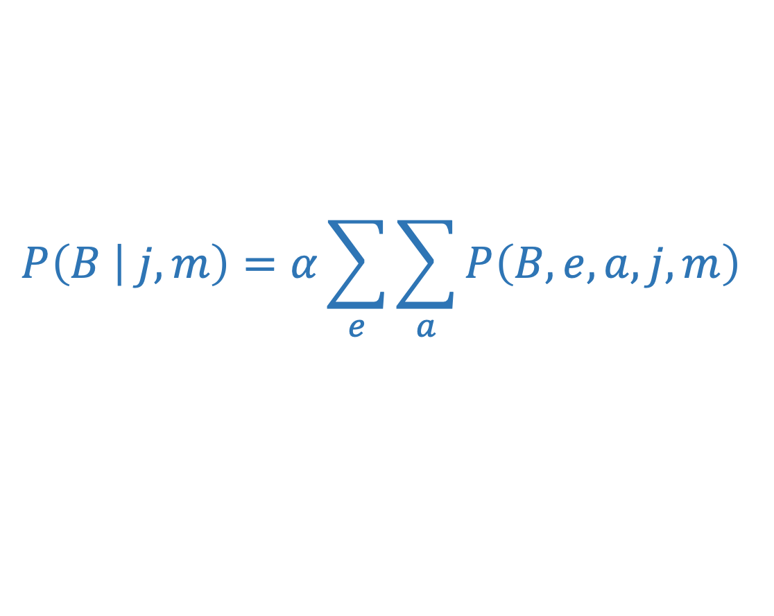
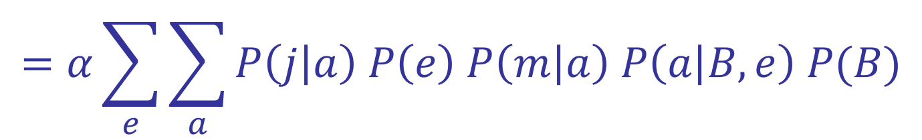
Variable elimination: The basic ideas
Move summations inwards as far as possible
$$P\left(B | j,m\right)=α\sum_{e}{\sum_{a}{P\left(B,e,a,j,m\right) }}$$
$$=α\sum_{e}{\sum_{a}{P\left(j | a\right) P\left(e\right) P\left(m | a\right) P\left(a | B,e\right) P(B)}}$$

Slide 30








Variable elimination: The basic ideas
Move summations inwards as far as possible, inner sum is easier to compute
$$P\left(B | j,m\right)=α\sum_{e}{\sum_{a}{P\left(B,e,a,j,m\right) }}$$
$$=α\sum_{e}{\sum_{a}{P\left(j | a\right) P\left(e\right) P\left(m | a\right) P\left(a | B,e\right) P(B)}}$$
$$\sum_{e}{ }$$
$$\sum_{a}{ }$$
$$=α$$
$$P\left(B\right)$$
$$P\left(e\right)$$
$$P\left(j | a\right)$$
$$P(m|a)$$
$$P\left(a | B,e\right)$$

Slide 31
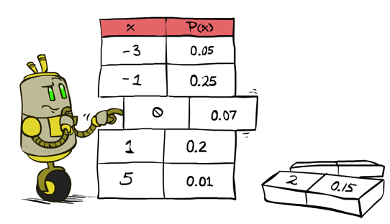
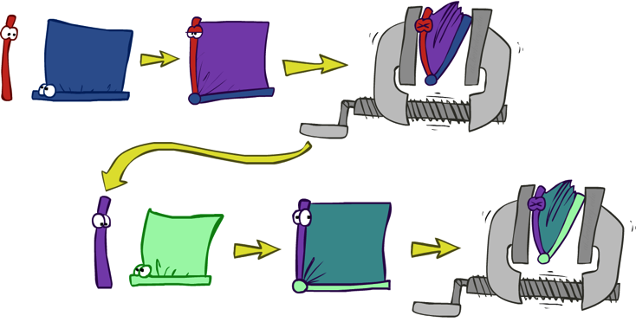


Variable Elimination
    Query: P(Q₁ ,.., Q_{m} |E₁=e₁,.., E_{k}=e_{k})
Start with initial factors:
  Local CPTs (but instantiated by evidence)
While there are still hidden variables (not Q_{i} or evidence):
  Pick a hidden variable H
  Join all factors mentioning H
  Eliminate (sum out) H
Join all remaining factors and normalize

Slide 32
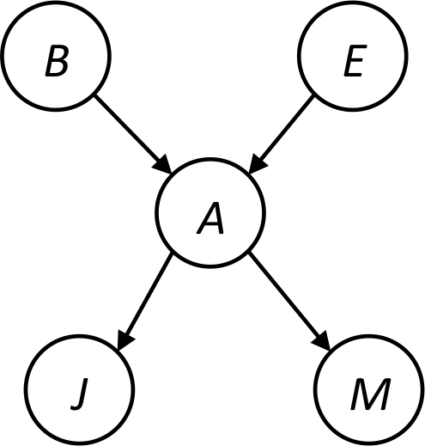
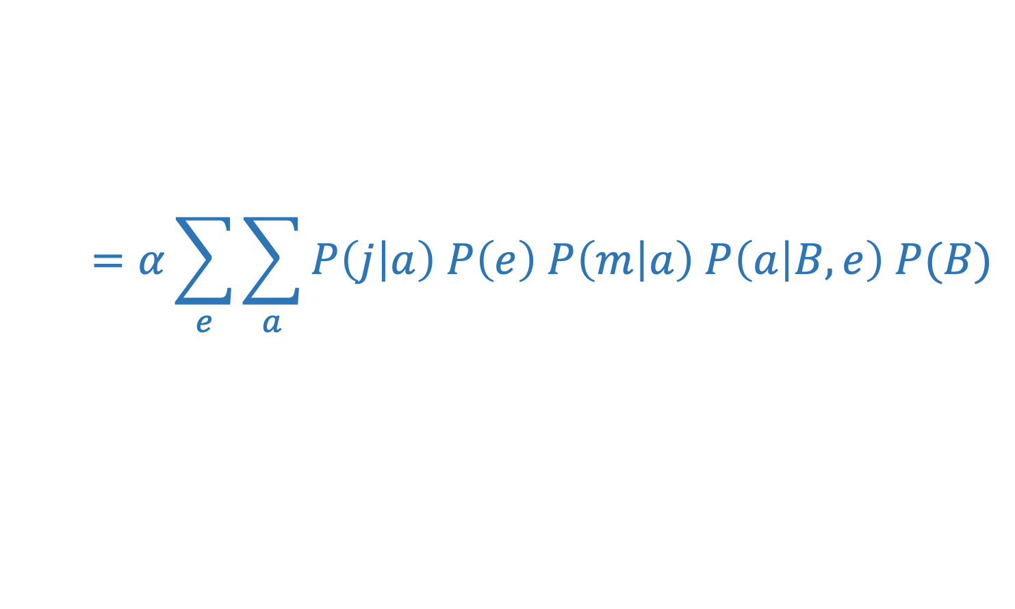
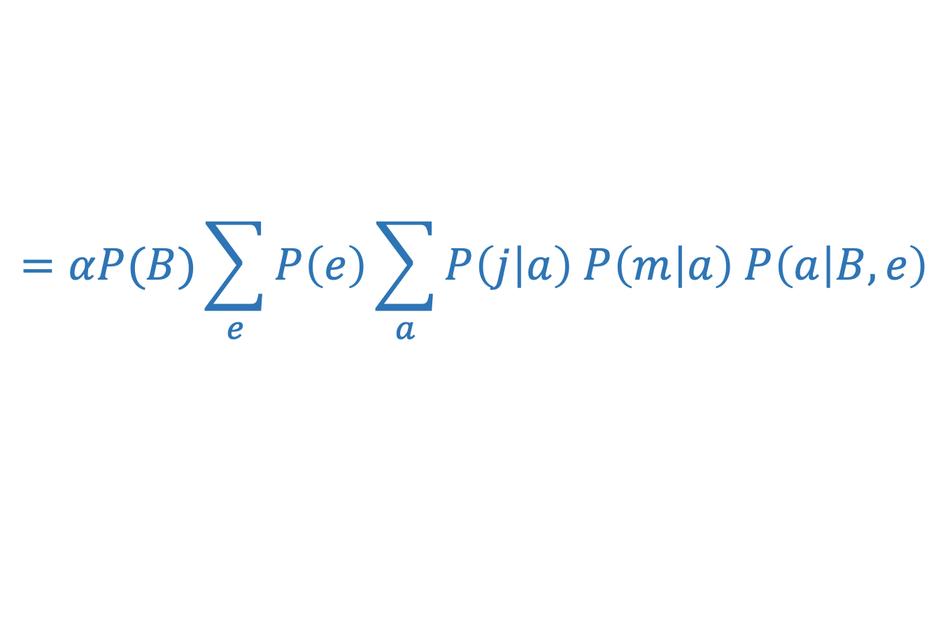
Example
Query P(B | j,m)
$$=α\sum_{e}{\sum_{a}{P\left(j | a\right) P\left(e\right) P\left(m | a\right) P\left(a | B,e\right) P(B)}}$$
Push summations inwards such that products that do not depend on the variable are pulled out of the sum.
$$=αP(B)\sum_{e}{P\left(e\right)\sum_{a}{P\left(j | a\right) P\left(m | a\right) P\left(a | B,e\right)}}$$

Slide 33
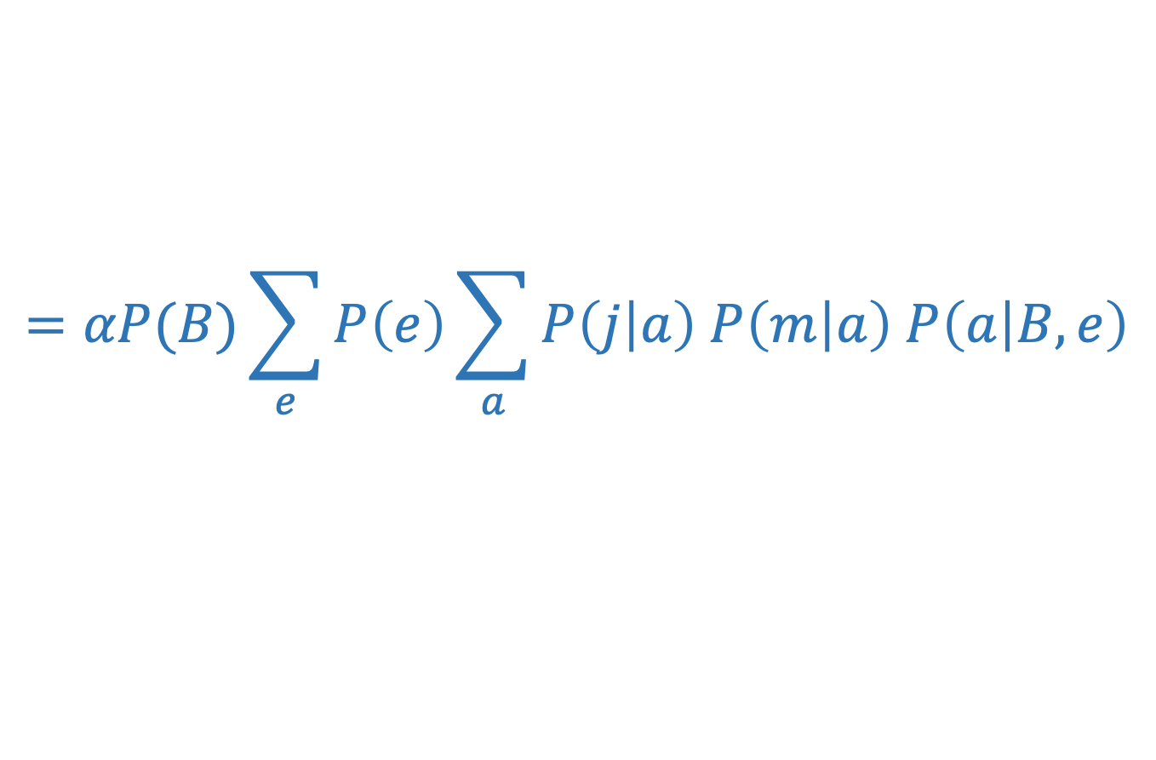
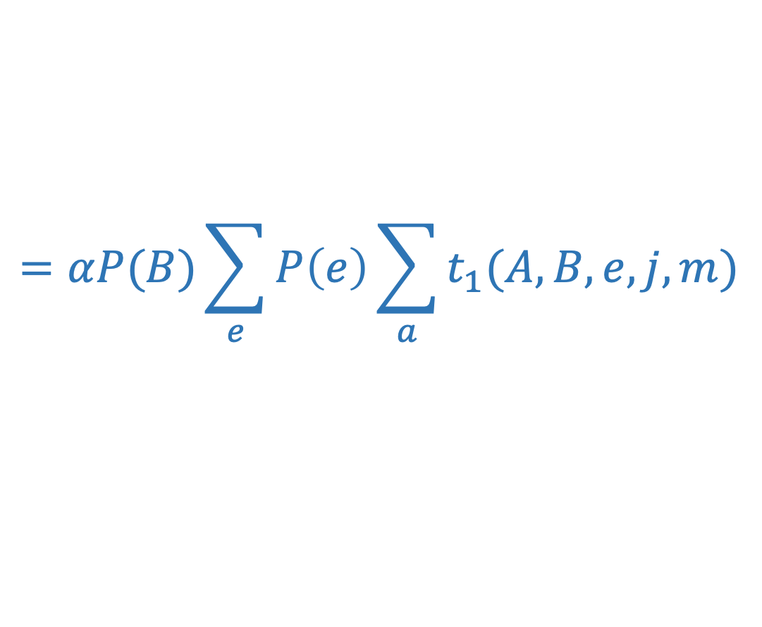
Example
Query P(B | j,m)
$$=αP(B)\sum_{e}{P\left(e\right)\sum_{a}{P\left(j | a\right) P\left(m | a\right) P\left(a | B,e\right)}}$$
Choose A (inner most sum)
  Create a table t₁ = P(A|B,e)P(j|A)P(m|A)
  How many entries does each table for each value of A have?
$$=αP(B)\sum_{e}{P\left(e\right)\sum_{a}{t_{1}(A,B,e,j,m)}}$$

Slide 34
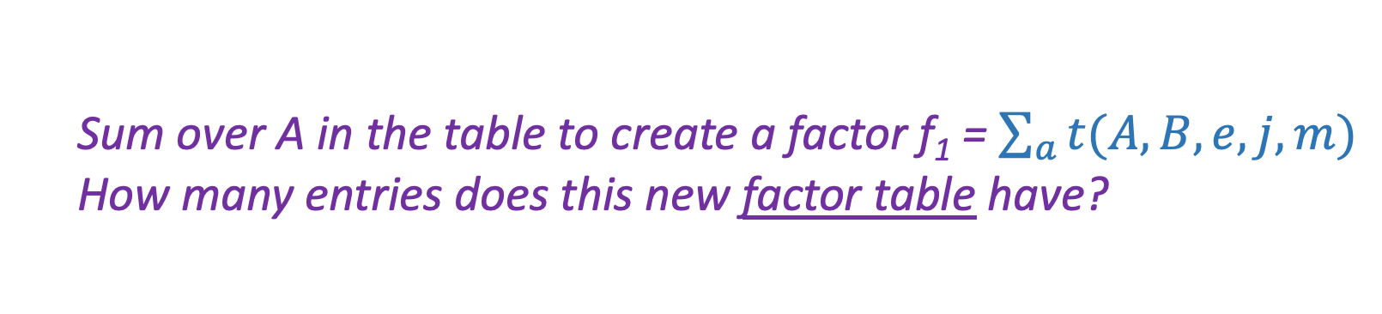
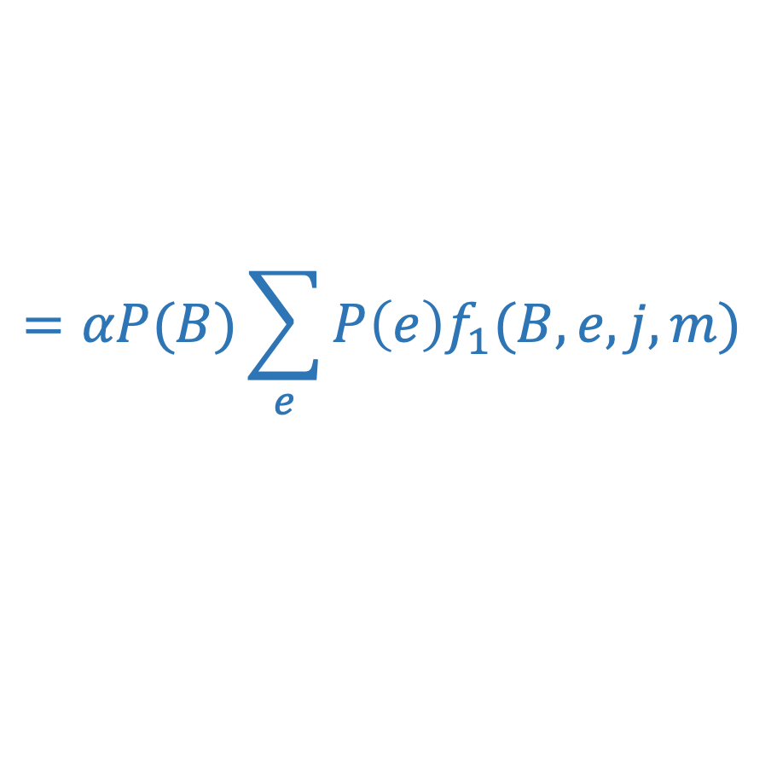
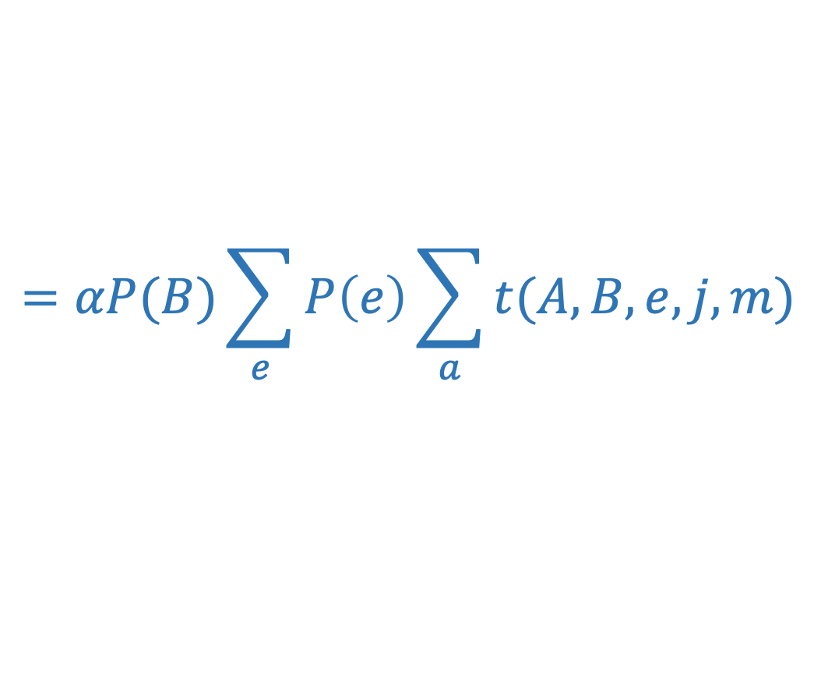
Example
Query P(B | j,m)
$$=αP(B)\sum_{e}{P\left(e\right)\sum_{a}{t(A,B,e,j,m)}}$$
Choose A (inner most sum)
  Sum over A in the table to create a factor f₁ = $\sum_{a}{t(A,B,e,j,m)}$
  How many entries does this new factor table have?
$$=αP(B)\sum_{e}{P\left(e\right)f_{1}(B,e,j,m)}$$

Slide 35
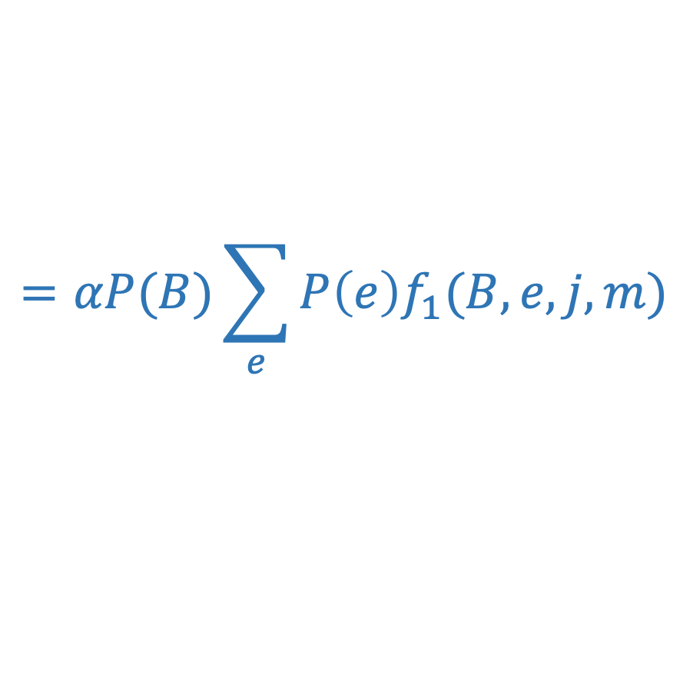
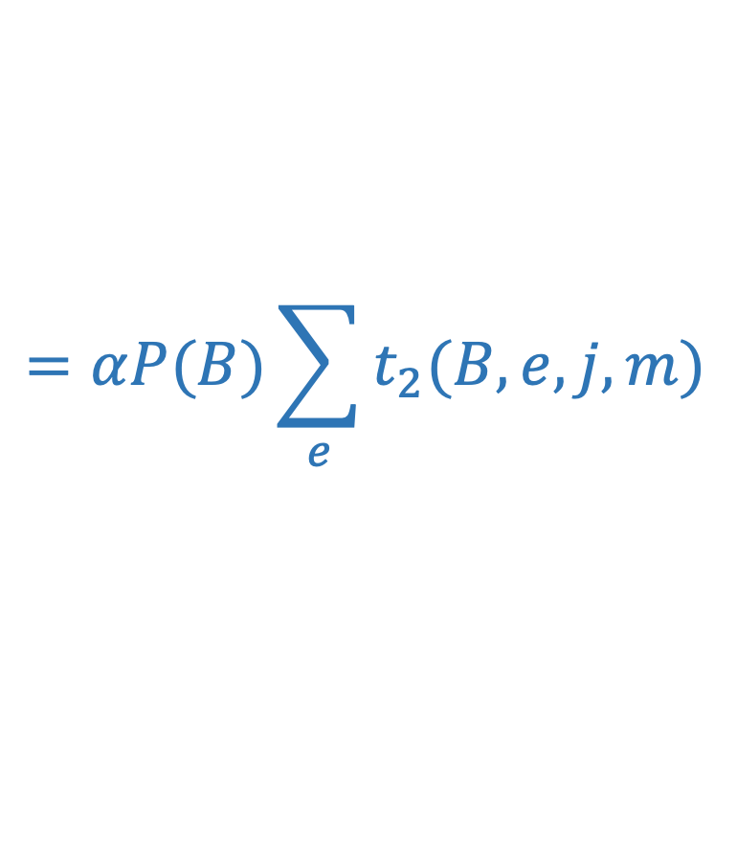
Example
$$=αP(B)\sum_{e}{P\left(e\right)f_{1}(B,e,j,m)}$$
Choose E (inner most sum)
  Create a table t₂ = P(e) f₁(B,e,j,m)
  How many entries does each table for each value of E have?
$$=αP(B)\sum_{e}{t_{2}(B,e,j,m)}$$

Slide 36
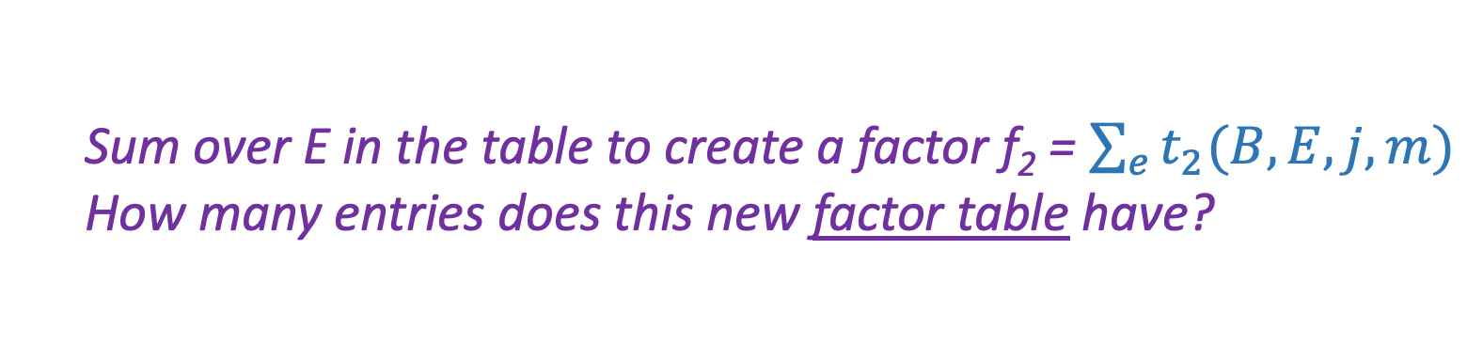
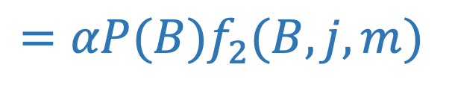
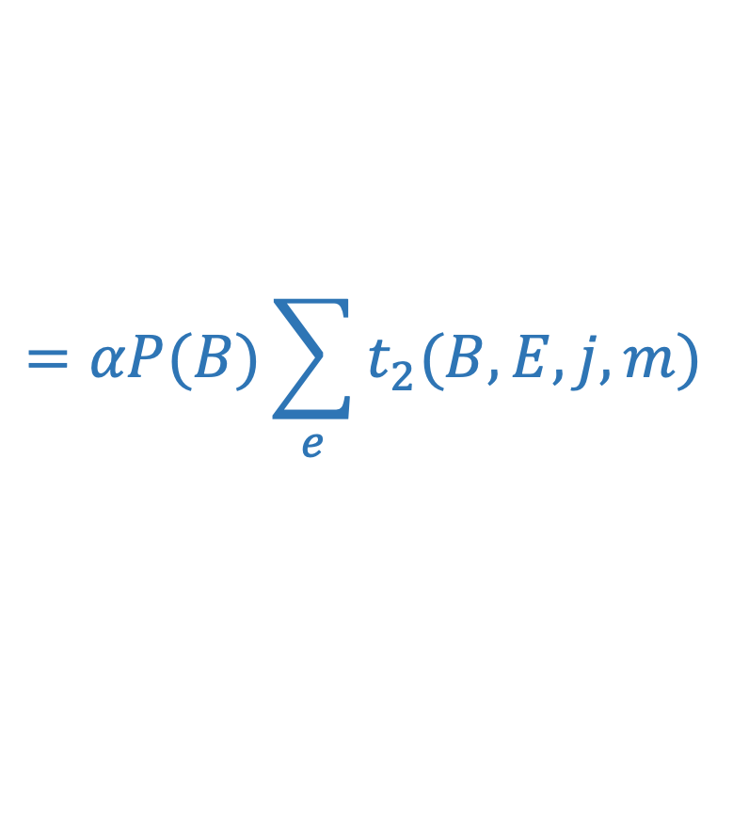
Example
$$=αP(B)\sum_{e}{t_{2}(B,E,j,m)}$$
Choose E (inner most sum)
  Sum over E in the table to create a factor f₂ = $\sum_{e}{t_{2}(B,E,j,m)}$
  How many entries does this new factor table have?
$$=αP(B)f_{2}(B,j,m)$$

Slide 37
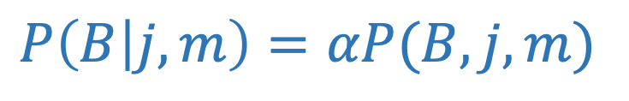
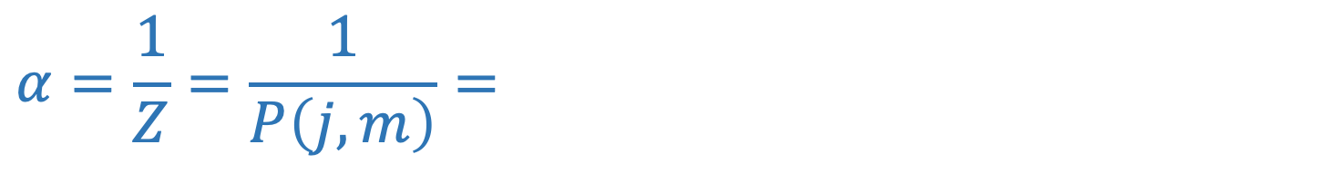
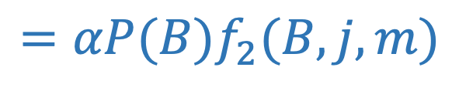
Example
$$=αP(B)f_{2}(B,j,m)$$
Multiply remaining probability to create joint probability P(B,j,m)
  How many entries does this probability table have?
Don’t forget the normalization to compute the conditional probability!
$$α=\frac{1}{Z}=\frac{1}{P\left(j,m\right)}=$$
$P\left(B | j,m\right)=αP(B,j,m)$

Slide 38
Order matters
  Elimination Order: C, B, A, Z
    P(D) = α ∑_{z,a,b,c} P(D|z) P(z) P(a|z) P(b|z) P(c|z)
    = α ∑_{z} P(D|z) P(z) ∑_{a} P(a|z) ∑_{b} P(b|z) ∑_{c} P(c|z)
    Largest factor has 2 variables (D,Z)
  Elimination Order: Z, C, B, A
    P(D) = α ∑_{a,b,c,z} P(a|z) P(b|z) P(c|z) P(D|z) P(z)
    = α ∑_{a} ∑_{b} ∑_{c} ∑_{z} P(a|z) P(b|z) P(c|z) P(D|z) P(z)
    Largest factor has 4 variables (A,B,C,D) (or 5 if you count pre-summation over Z)
  In general, with n leaves, factor of size 2^{n}
Z
A
B
C
D

Slide 39
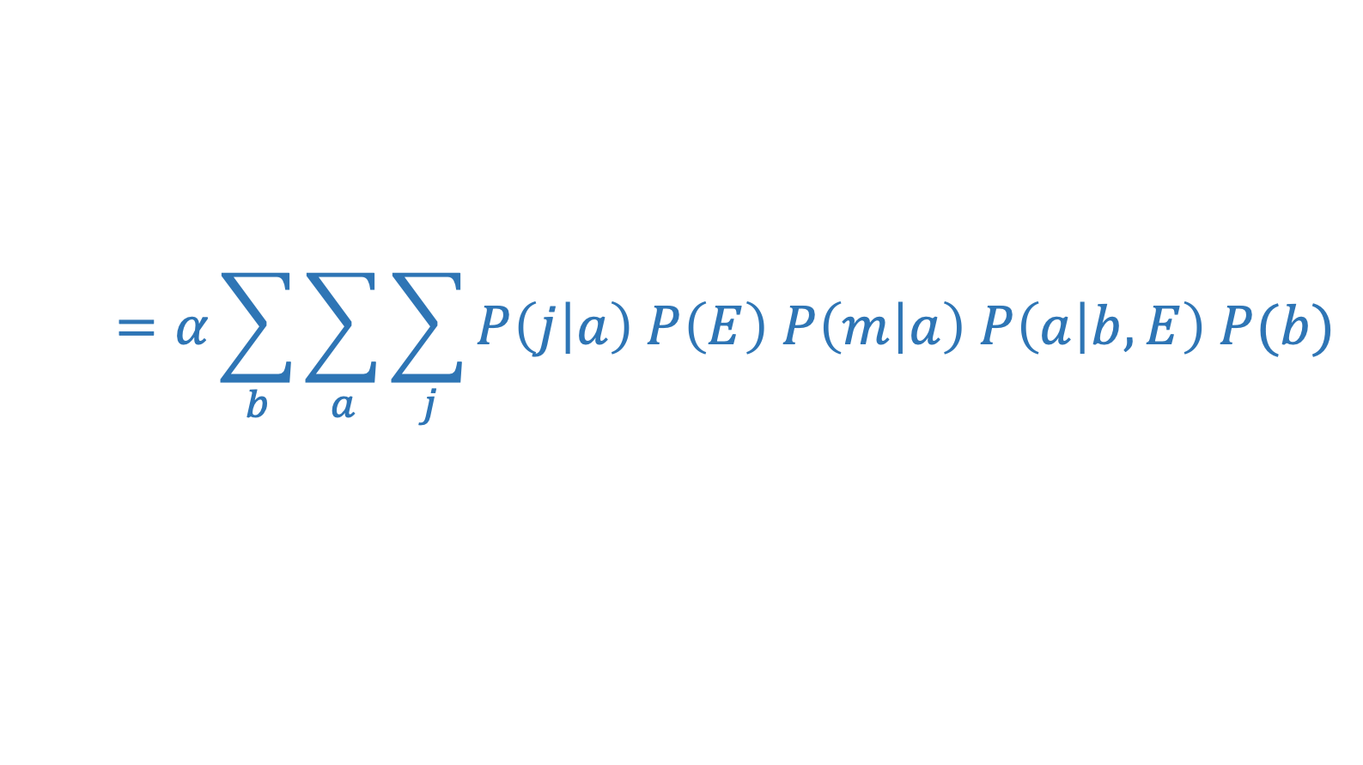
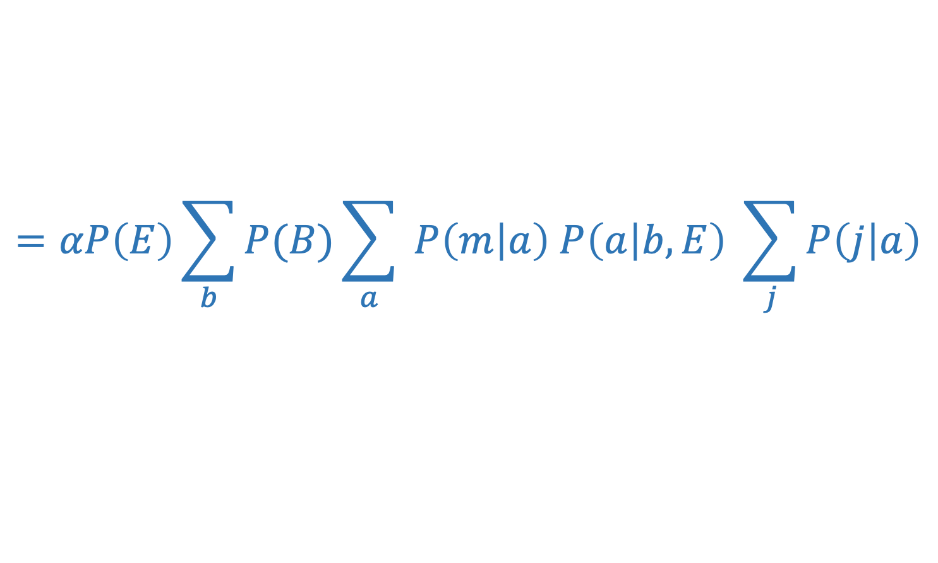
New Example
Query P(E | m)
$$=α\sum_{b}{\sum_{a}{\sum_{j}{P\left(j | a\right) P\left(E\right) P\left(m | a\right) P\left(a | b,E\right) P(b)}}}$$
Push summations inwards such that products that do not depend on the variable are pulled out of the sum.
$$=αP\left(E\right)\sum_{b}{P(B)\sum_{a}{ P\left(m | a\right) P\left(a | b,E\right) \sum_{j}{P\left(j | a\right)}}}$$

Slide 40
VE: Computational and Space Complexity
The computational and space complexity of variable elimination is determined by the largest factor (and it’s space that kills you)
The elimination ordering can greatly affect the size of the largest factor.
  E.g., previous slide’s example 2^{n} vs. 2
Does there always exist an ordering that only results in small factors?
  No!

Slide 41





















VE: Computational and Space Complexity
Inference in Bayes’ nets is NP-hard.
No known efficient probabilistic inference in general.

Slide 42
Bayes Nets
Part I: Representation and Independence
Part II: Exact inference
  Enumeration (always exponential complexity)
  Variable elimination (worst-case exponential complexity, often better)
  Inference is NP-hard in general
Part III: Approximate Inference

Slide 43
Additional Variable Elimination Slides

Slide 44
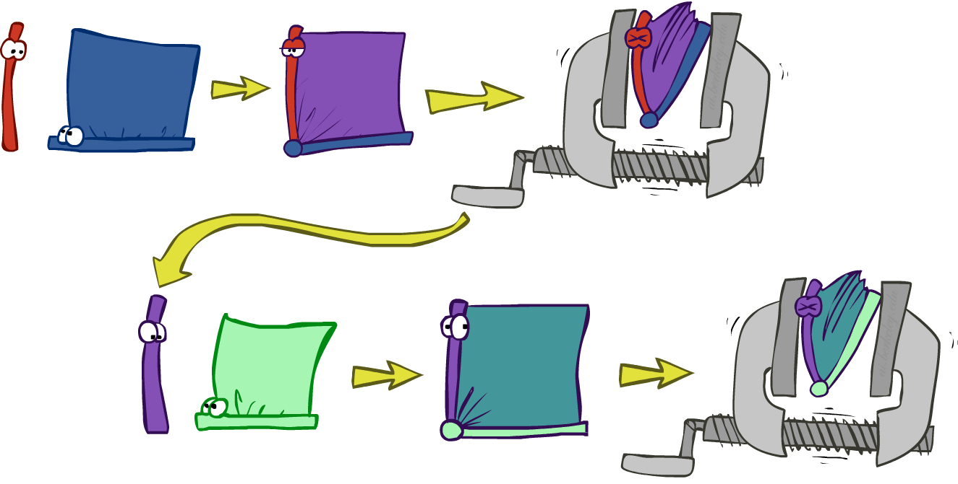
Variable elimination: The basic ideas
Move summations inwards as far as possible
  P(B | j, m) = α ∑_{e}∑_{a}P(B) P(e) P(a|B,e) P(j|a) P(m|a)
  = α P(B) ∑_{e} P(e) ∑_{a} P(a|B,e) P(j|a) P(m|a)
Do the calculation from the inside out
  I.e., sum over a first, then sum over e
  Problem: P(a|B,e) isn’t a single number, it’s a bunch of different numbers depending on the values of B and e
  Solution: use arrays of numbers (of various dimensions) with appropriate operations on them; these are called factors

Slide 45

Operation 1: Pointwise product
First basic operation: pointwise product of factors (similar to a database join, not matrix multiply!)
  New factor has union of variables of the two original factors
  Each entry is the product of the corresponding entries from the original factors
Example: P(A) x P(J|A) = P(A,J)
P(J|A)
P(A,J)
P(A)
A \ J | true | false
true | 0.9 | 0.1
false | 0.05 | 0.95
A \ J | true | false
true
false
 | 0.09 | 0.01
 | 0.045 | 0.855
true | 0.1
false | 0.9
x
=

Slide 46
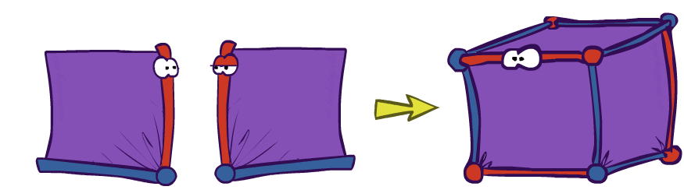
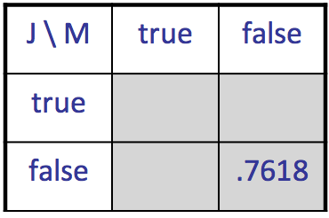
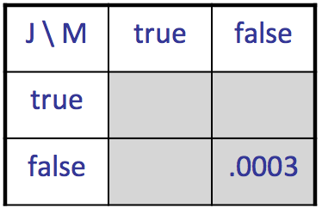
Example: Making larger factors
Example: P(J|A) x P(M|A) = P(J,M|A)
P(J,M|A)
P(J|A)
P(M|A)
A \ J | true | false
true | 0.99 | 0.01
false | 0.145 | 0.855
A \ M | true | false
true | 0.97 | 0.03
false | 0.019 | 0.891
x
=
A=false
A=true

Slide 47
Example: Making larger factors
Example: f₁(U,V) x f₂(V,W) x f₃(W,X) = f₄(U,V,W,X)
Sizes: [10,10] x [10,10] x [10,10] = [10,10,10,10]
I.e., 300 numbers blows up to 10,000 numbers!
Factor blowup can make VE very expensive

Slide 48
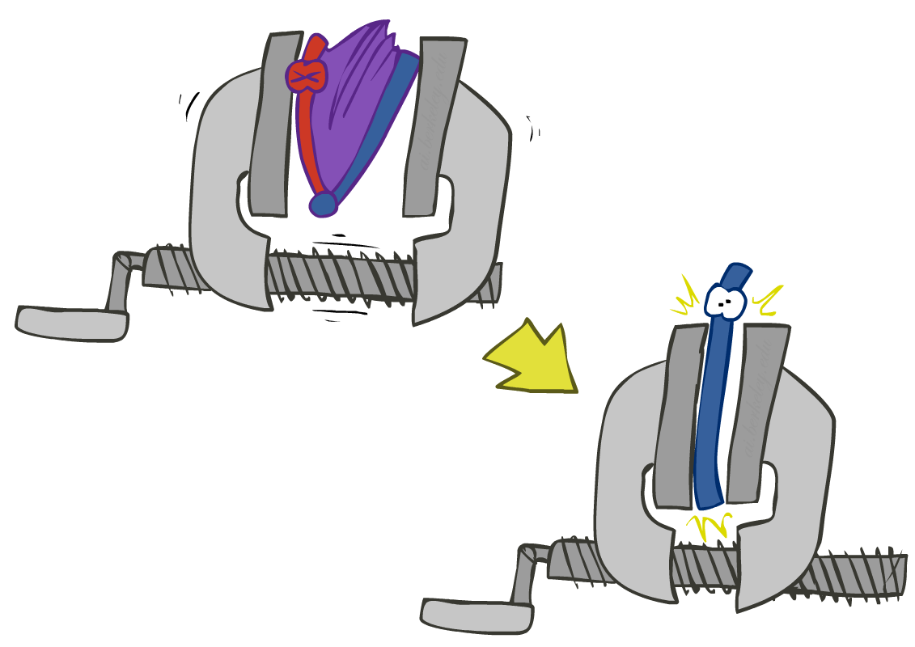
Operation 2: Summing out a variable
Second basic operation: summing out (or eliminating) a variable from a factor
  Shrinks a factor to a smaller one
Example: ∑_{j} P(A,J) = P(A,j) + P(A,¬j) = P(A)
P(A,J)
P(A)
A \ J | true | false
true | 0.09 | 0.01
false | 0.045 | 0.855
Sum out J
true | 0.1
false | 0.9

Slide 49

Summing out from a product of factors
Project the factors each way first, then sum the products
  Example: ∑_{a} P(a|B,e) P(j|a) P(m|a)
  = P(a|B,e) P(j|a) P(m|a) + P(¬a|B,e) P(j|¬a) P(m|¬a)
  = P(a,j,m|B,e) + P(¬a,j,m|B,e)
  = P(j,m|B,e)

