Slide 1
Announcements
Assignments
HW8 - Due 3/28, 10 pm
P4: MDP/RL - Due Thurs 4/6, 10 pm
Midterm 2
One week!!! in lecture
See Piazza for details
Review session 6-8pm Tuesday in Rashid Auditorium
In scope: Bayes nets representation and independence (today)

Slide 2
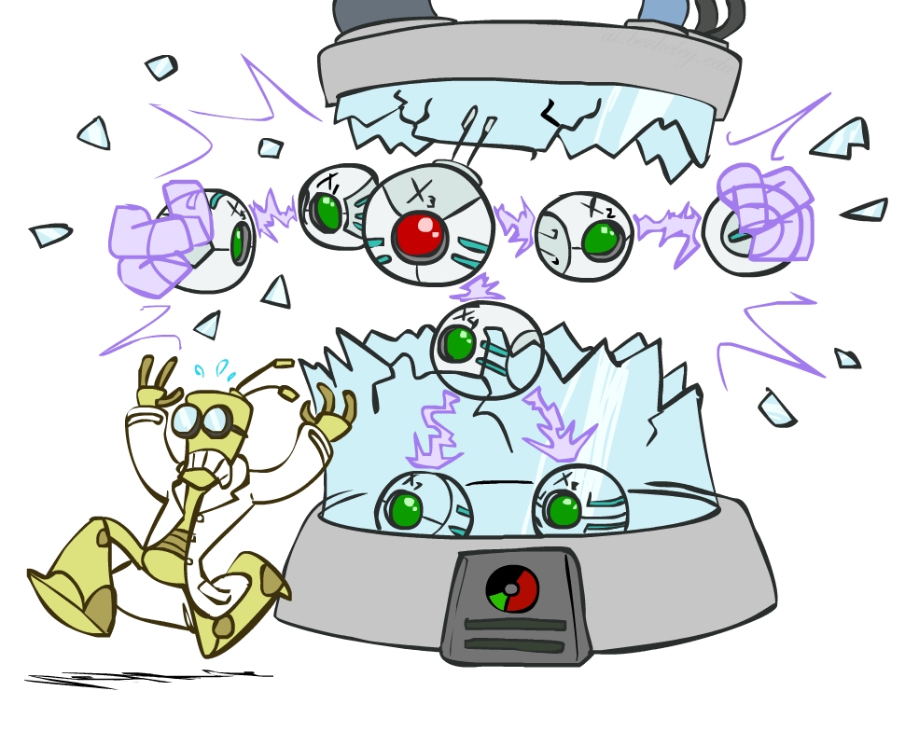
AI: Representation and Problem Solving
Bayes Nets: Independence
Instructor: Stephanie Rosenthal
Slide credits: CMU AI and http://ai.berkeley.edu

Slide 3
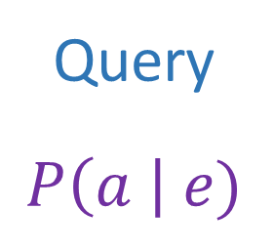
Answer Any Query from Condition Probability Tables
Conditional Probability Tables and Chain Rule
Joint
Query
$$P\left(a \right| e)$$
$P\left(A\right) P\left(B | A\right) P\left(C | A,B\right) P\left(D | A,B,C\right)$ $P(E|A, B,C,D)$

Slide 4
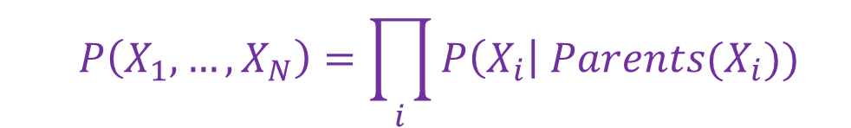
Answer Any Query from Condition Probability Tables
Bayes Net
Joint
Query
$$P\left(a \right| e)$$
$$P\left(A\right) P\left(B | A\right) P\left(C | A\right) P\left(D | C\right) P(E|C)$$
  $$P\left(X_{1},…,X_{N}\right)=\prod_{i}{P\left(X_{i}\right| Parents(X_{i})) }$$

Slide 5

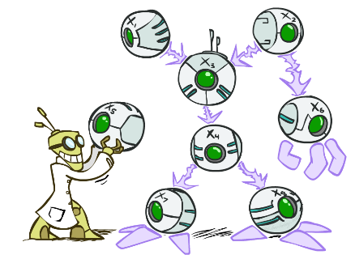
Bayes’ Nets: Big Picture
Two problems with using full joint distribution tables as our probabilistic models:
  Unless there are only a few variables, the joint is WAY too big to represent explicitly
  Hard to learn (estimate) anything empirically about more than a few variables at a time
Bayes nets: a technique for describing complex joint distributions (models) using simple, local distributions (conditional probabilities)
  A type of probabilistic graphical models
  We describe how variables locally interact
  Local interactions chain together to give global, indirect interactions

Slide 6


Bayes Nets for Medical Diagnosis
https://www.microsoft.com/en-us/research/people/dabelgra/
Developmental Profiles of Eczema, Wheeze, and Rhinitis:
Two Population-Based Birth Cohort Studies
Danielle Belgrave, et al. PLOS Medicine, 2014
https://journals.plos.org/plosmedicine/article?id=10.1371/journal.pmed.1001748

Slide 7
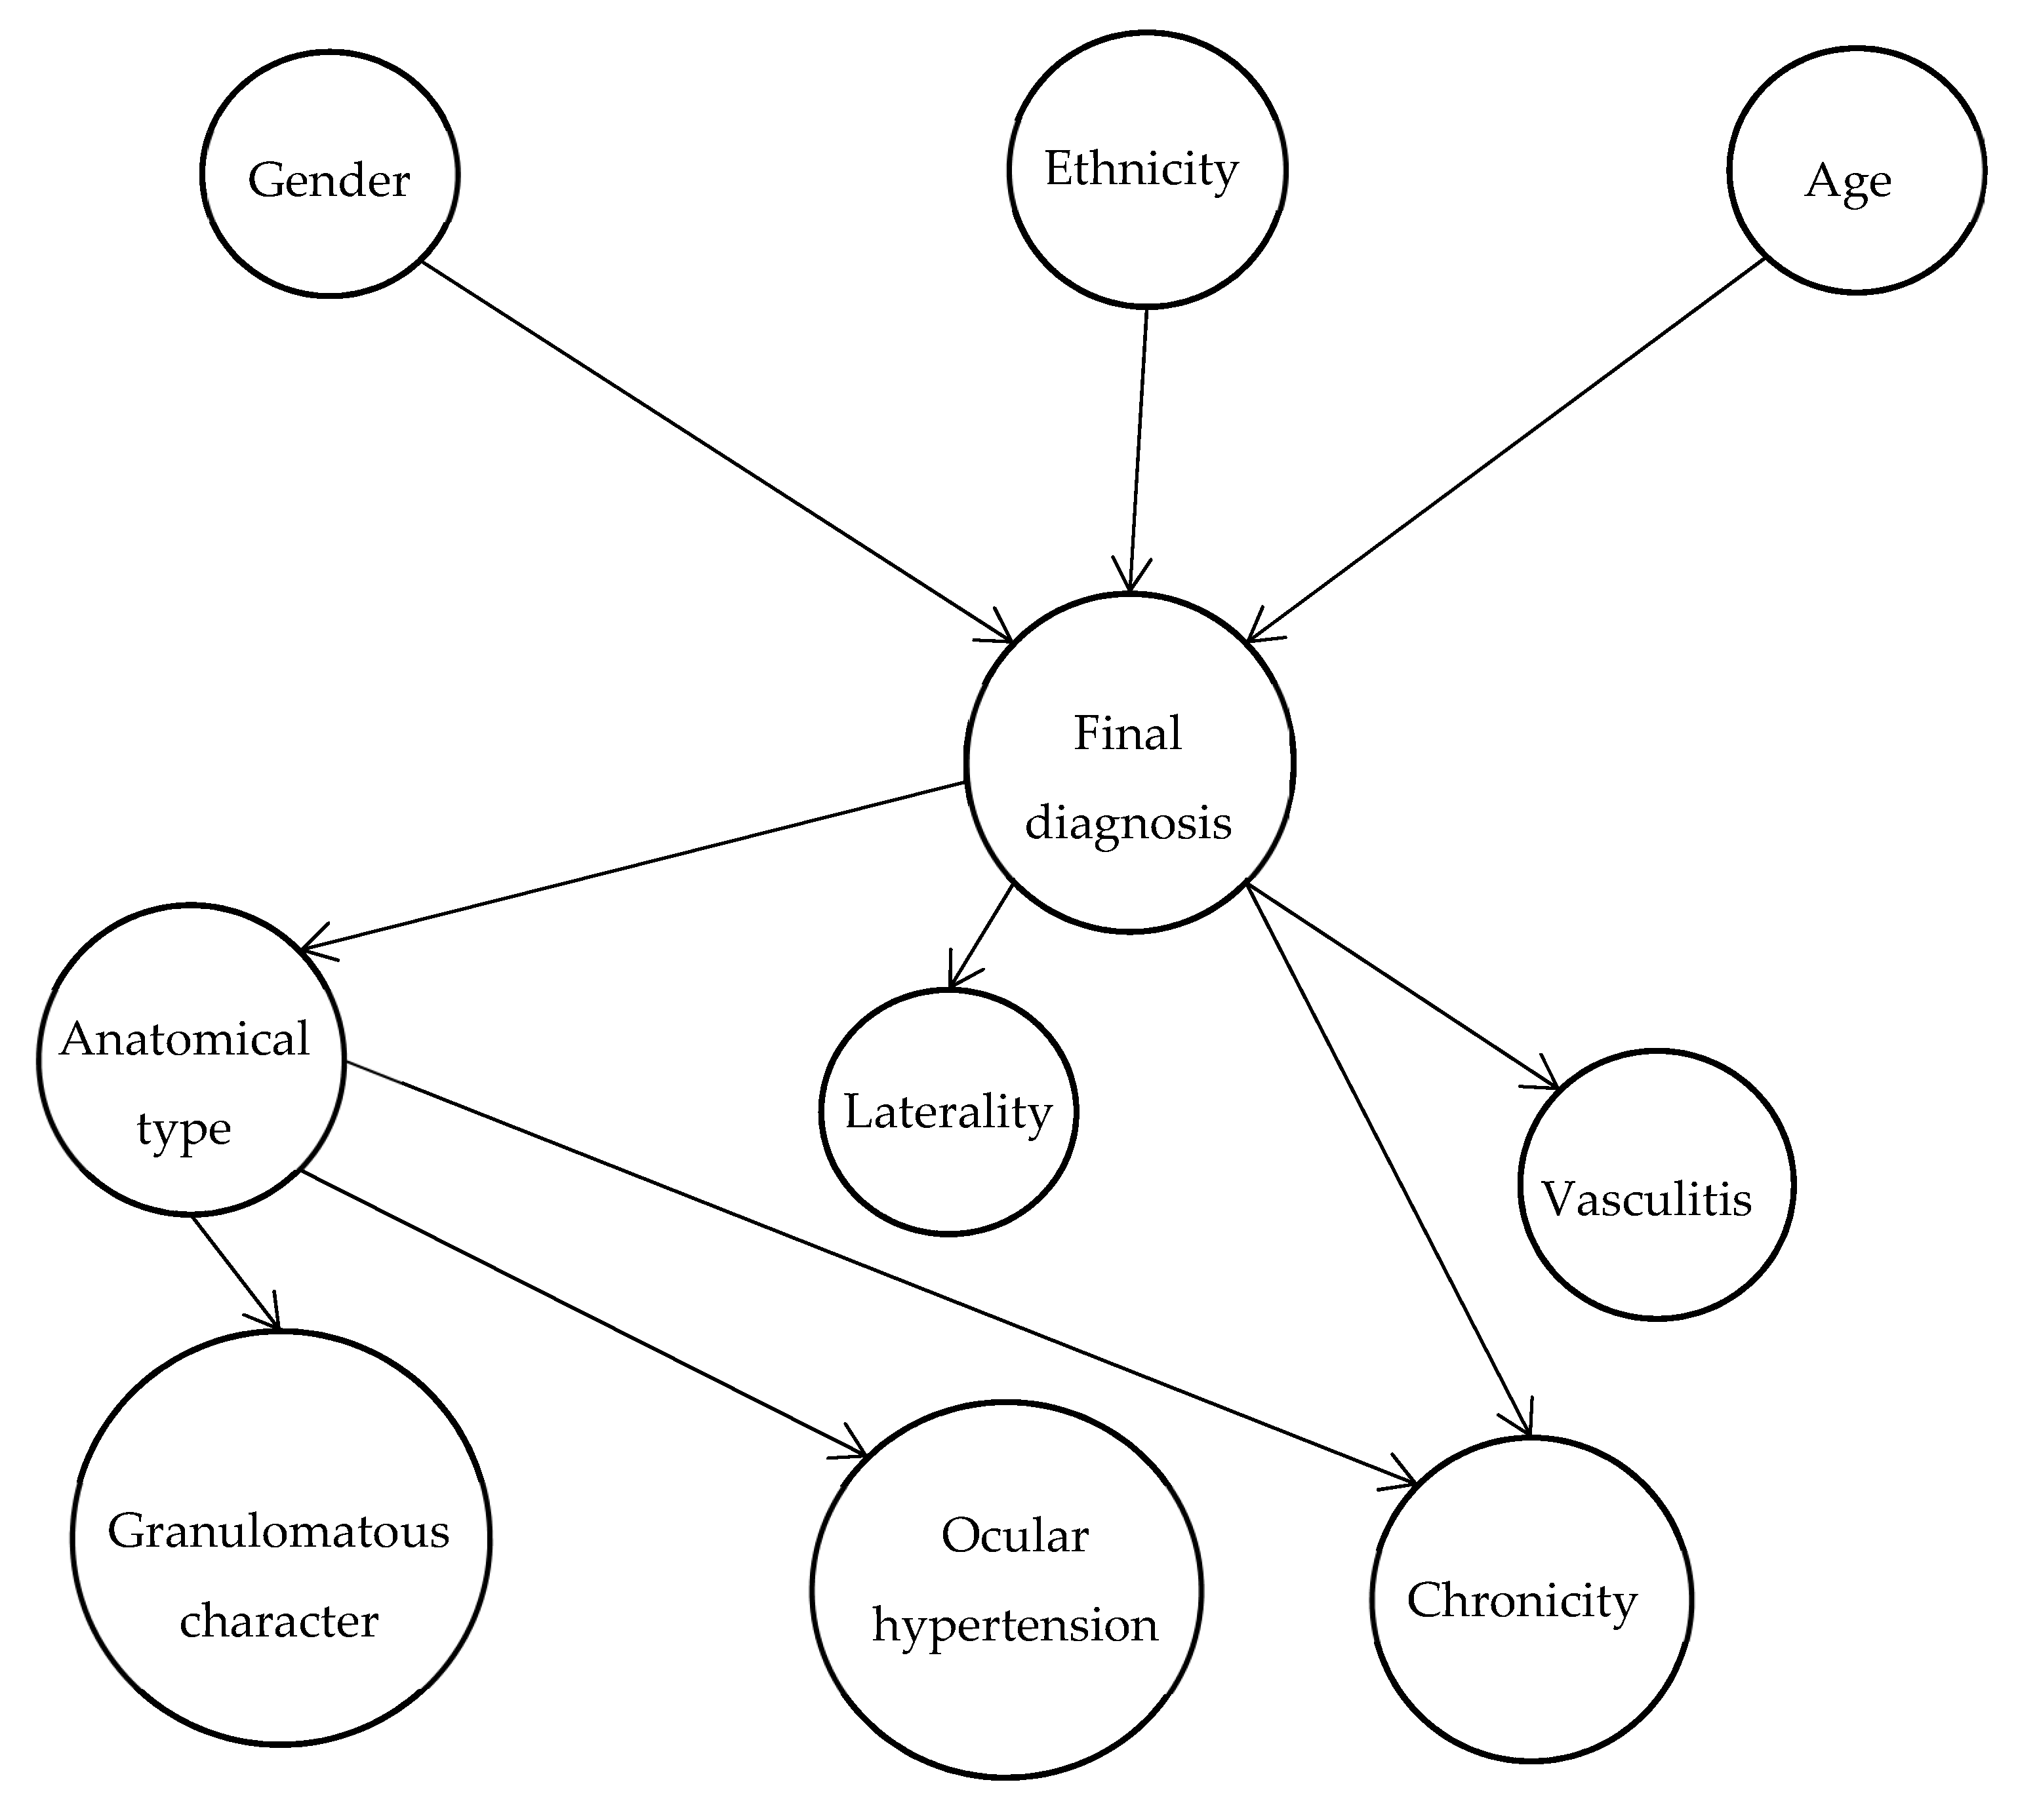
Bayes Nets for Medical Diagnosis
Jamilloux, Yvan, Nicolas Romain-Scelle, Muriel Rabilloud, Coralie Morel, Laurent Kodjikian, Delphine Maucort-Boulch, Philip Bielefeld, and Pascal Sève. 2021. "Development and Validation of a Bayesian Network for Supporting the Etiological Diagnosis of Uveitis" Journal of Clinical Medicine 10, no. 15: 3398.

Slide 8

Bayes Nets for Medical Diagnosis

Slide 9
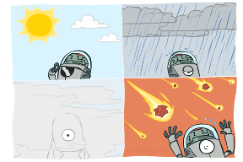
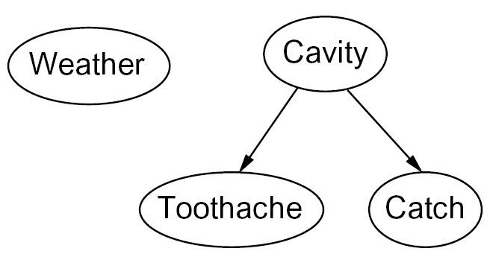
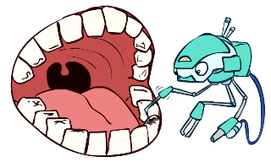
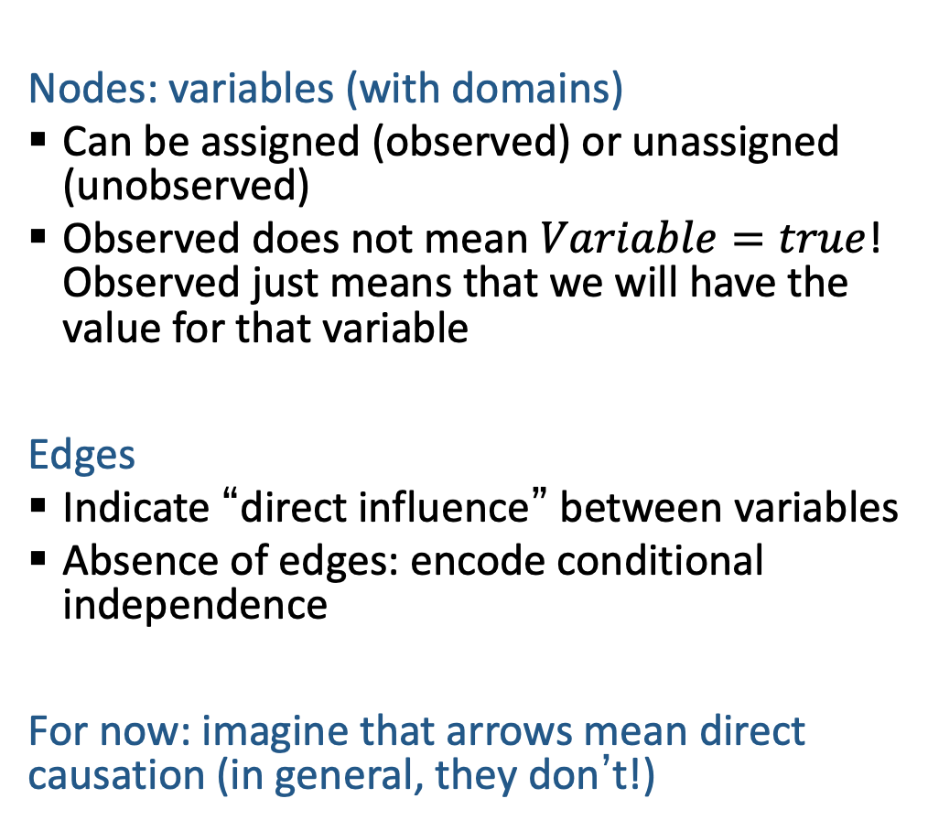
Graphical Model Notation
Nodes: variables (with domains)
  Can be assigned (observed) or unassigned (unobserved)
  Observed does not mean $Variable=true$! Observed just means that we will have the value for that variable
Edges
  Indicate “direct influence” between variables
  Absence of edges: encode conditional independence
For now: imagine that arrows mean direct causation (in general, they don’t!)

Slide 10

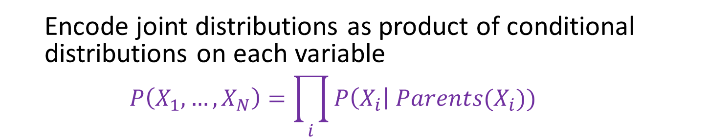



Bayesian Networks
Bayes net
One node per random variable
Directed-Acyclic-Graph
One CPT per node: P(node | Parents(node) )
$$A$$
$$B$$
$$C$$
Joint Probability
$$D$$
$P\left(A, B, C, D\right)=P\left(A\right) P(B) P\left(C | A,B\right) P\left(D | C\right)$
  Encode joint distributions as product of conditional distributions on each variable
  $$P\left(X_{1},…,X_{N}\right)=\prod_{i}{P\left(X_{i}\right| Parents(X_{i})) }$$

Slide 11
Bayesian Networks
Bayes net
One node per random variable
Directed-Acyclic-Graph
One CPT per node: P(node | Parents(node) )
$$A$$
$$B$$
$$C$$
Joint Probability
$$D$$
$$P\left(A, B, C, D\right)=P\left(A\right) P\left(B | A\right) P\left(C | A,B\right) P\left(D | A,B,C\right)$$
  Encode joint distributions as product of conditional distributions on each variable
  $$P\left(X_{1},…,X_{N}\right)=\prod_{i}{P\left(X_{i}\right| Parents(X_{i})) }$$

Slide 12
Bayesian Networks
Bayes net
One node per random variable
Directed-Acyclic-Graph
One CPT per node: P(node | Parents(node) )
$$A$$
$$B$$
$$C$$
Joint Probability
$$D$$
$P\left(A, B, C, D\right)=P\left(A\right) P\left(B | A\right) P\left(C | A,B\right) P\left(D | C\right)$
  Encode joint distributions as product of conditional distributions on each variable
  $$P\left(X_{1},…,X_{N}\right)=\prod_{i}{P\left(X_{i}\right| Parents(X_{i})) }$$

Slide 13
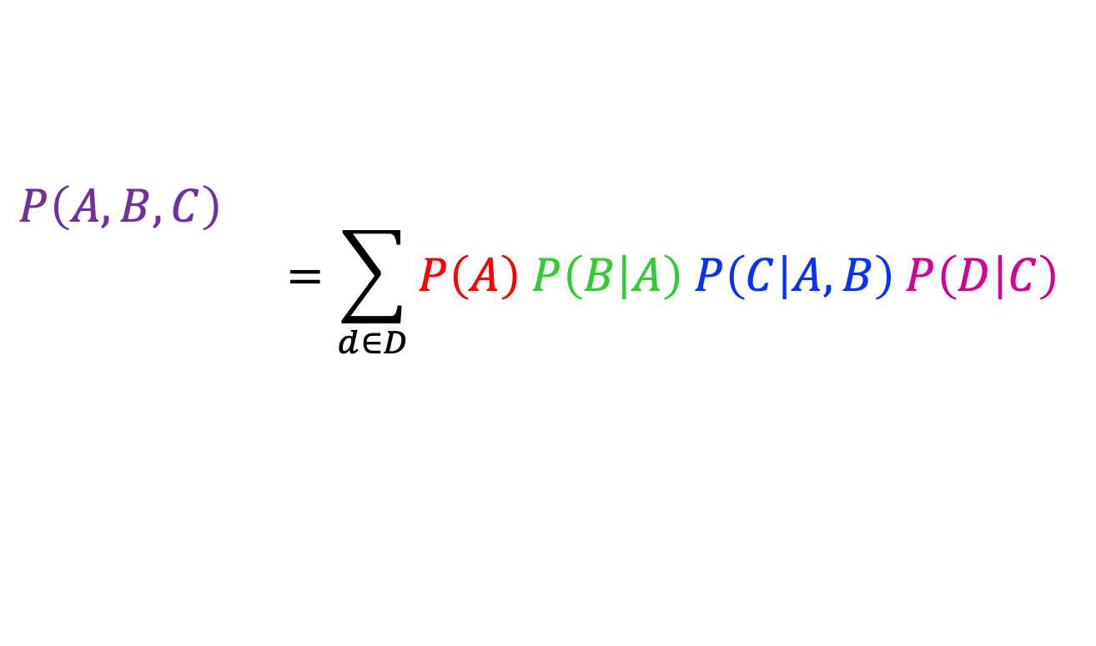
Bayesian Networks
Bayes net
$P\left(A, B, C, D\right)=P\left(A\right) P\left(B | A\right) P\left(C | A,B\right) P\left(D | C\right)$
$$A$$
$$B$$
$$P\left(A,B, C\right)$$
$$=\sum_{d∈D}{P\left(A\right) P\left(B | A\right) P\left(C | A,B\right) P\left(D | C\right)}$$
$$C$$
$$D$$

Slide 14
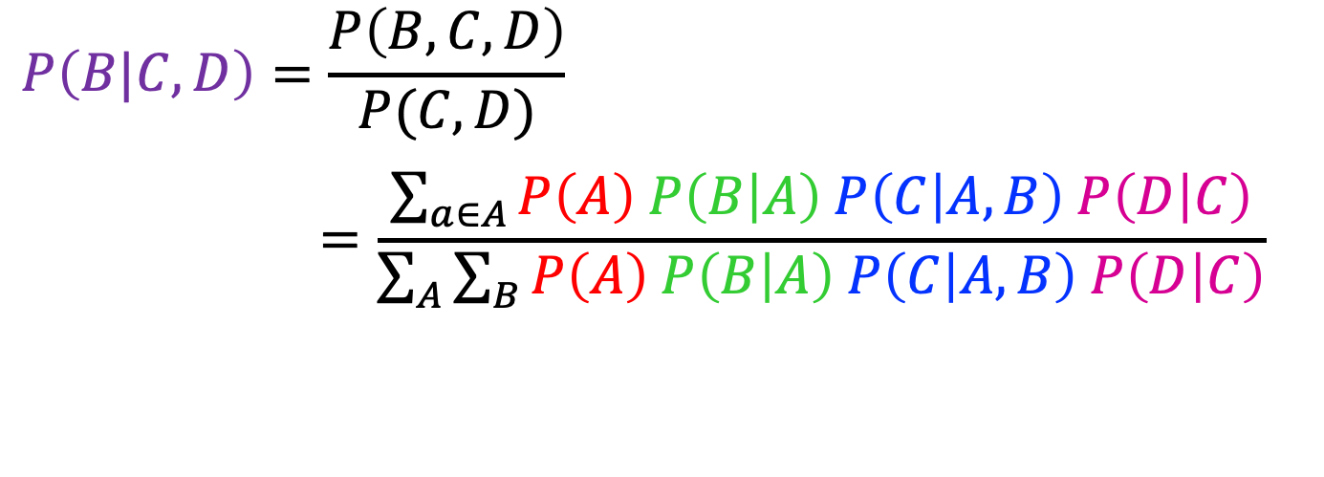
Bayesian Networks
Bayes net
$P\left(A, B, C, D\right)=P\left(A\right) P\left(B | A\right) P\left(C | A,B\right) P\left(D | C\right)$
$$A$$
$$B$$
$$P\left(B|C, D\right)=\frac{P\left(B,C,D\right)}{P(C,D)}$$
$$=\frac{\sum_{a∈A}{P\left(A\right) P\left(B | A\right) P\left(C | A,B\right) P\left(D | C\right)}}{\sum_{A}{\sum_{B}{P\left(A\right) P\left(B | A\right) P\left(C | A,B\right) P\left(D | C\right)}}}$$
$$C$$
$$D$$

Slide 15

Independence

Slide 16

Independence
Two variables X and Y are independent if
∀x,y P(x, y) = P(x) P(y)
  This says that their joint distribution factors into a product of two simpler distributions
  Combine with product rule P(x,y) = P(x|y)P(y) we obtain another form:
  ∀x,y P(x | y) = P(x) or ∀x,y P(y | x) = P(y)
Example: two dice rolls Roll₁ and Roll₂
  P(Roll₁=5, Roll₂=5) = P(Roll₁=5) P(Roll₂=5) = 1/6 x 1/6 = 1/36
  P(Roll₂=5 | Roll₁=5) = P(Roll₂=5)

Slide 17

Example: Independence
n fair, independent coin flips:
P(X₁)
P(X₂)
P(X_{n})
H | 0.5
T | 0.5
H | 0.5
T | 0.5
H | 0.5
T | 0.5
P(X₁,X₂,...,X_{n})
2^{n}

Slide 18



Poll 1
Are T and W independent?
$$P(T)$$
T | P
hot | 0.5
cold | 0.5
$$P\left(T,W\right)$$
T | W | P
hot | sun | 0.4
hot | rain | 0.1
cold | sun | 0.2
cold | rain | 0.3
$$P(W)$$
W | P
sun | 0.6
rain | 0.4

Slide 19


Poll 1
Are T and W independent?
No
$$P(T)$$
T | P
hot | 0.5
cold | 0.5
$$P\left(T,W\right)$$
$P\left(T\right)P(W)$
T | W | P
hot | sun | 0.4
hot | rain | 0.1
cold | sun | 0.2
cold | rain | 0.3
T | W | P
hot | sun | 0.3
hot | rain | 0.2
cold | sun | 0.3
cold | rain | 0.2
$$P(W)$$
W | P
sun | 0.6
rain | 0.4

Slide 20

Conditional Independence
P(Toothache, Cavity, Catch)
If I have a cavity, the probability that the probe catches in it doesn't depend on whether I have a toothache:
  P(+catch | +toothache, +cavity) = P(+catch | +cavity)
The same independence holds if I don’t have a cavity:
  P(+catch | +toothache, -cavity) = P(+catch| -cavity)
Catch is conditionally independent of Toothache given Cavity:
  P(Catch | Toothache, Cavity) = P(Catch | Cavity)
Equivalent statements:
P(Toothache | Catch , Cavity) = P(Toothache | Cavity)
P(Toothache, Catch | Cavity) = P(Toothache | Cavity) P(Catch | Cavity)
One can be derived from the other easily

Slide 21
Conditional Independence
Absolute (unconditional) independence very rare (why?)
Conditional independence is our most basic and robust form of knowledge about uncertain environments.
X is conditionally independent of Y given Z
if and only if:
∀x,y,z P(x | y, z) = P(x | z)
or, equivalently, if and only if
∀x,y,z P(x, y | z) = P(x | z) P(y | z)

Slide 22
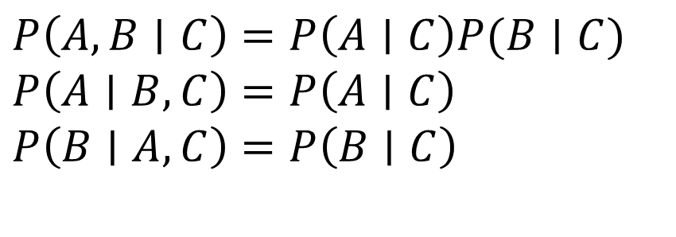
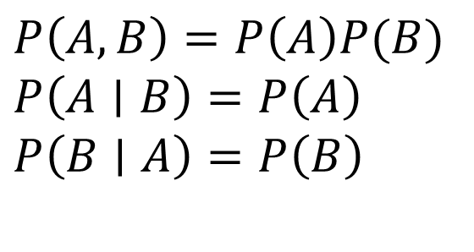
Independence Rules
Independence
If A and B are independent, then:
Conditional independence
If A and B are conditionally
independent given C, then:
$P\left(A, B\right)=P\left(A\right)P(B)$
$P\left(A∣B\right)=P\left(A\right)$
$P\left(B∣A\right)=P\left(B\right)$
$P\left(A, B∣C\right)=P\left(A∣C\right)P(B∣C)$
$P\left(A∣B, C\right)=P\left(A∣C\right)$
$P\left(B∣A, C\right)=P\left(B∣C\right)$

Slide 23
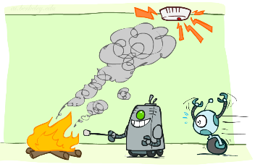
Conditional Independence and Bayes Nets
Fire, Smoke, Alarm
Causal story to create Bayes net
Assumptions
Joint distribution

Slide 24
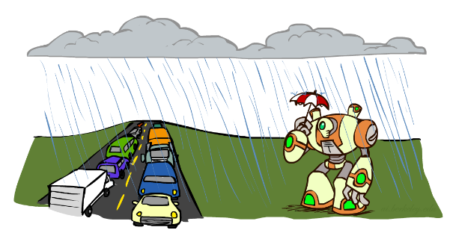
Conditional Independence and Bayes Nets
What about this domain:
  Traffic
  Umbrella
  Raining

Slide 25

Conditional Independence and the Chain Rule
Chain rule:
P(x₁, x₂,…, x_{n}) = ∏_{i} P(x_{i} | x₁,…, x_{i-1})
Trivial decomposition:
P(Rain, Traffic, Umbrella) =
With assumption of conditional independence:
P(Rain, Traffic, Umbrella) =
Bayes nets / graphical models help us express conditional independence assumptions
Notes:
Will be obvious from ghostbusters example

Slide 26
Conditional Independence and the Chain Rule
Chain rule:
P(x₁, x₂,…, x_{n}) = ∏_{i} P(x_{i} | x₁,…, x_{i-1})
Trivial decomposition:
P(Rain, Traffic, Umbrella) = P(Rain) P(Traffic | Rain) P(Umbrella | Rain, Traffic)
With assumption of conditional independence:
P(Rain, Traffic, Umbrella) = P(Rain) P(Traffic | Rain) P(Umbrella | Rain)
Bayes nets / graphical models help us express conditional independence assumptions
Notes:
Will be obvious from ghostbusters example

Slide 27

Example: Coin Flips
N independent coin flips
No interactions between variables: absolute independence
X₁
X₂
X_{n}

Slide 28
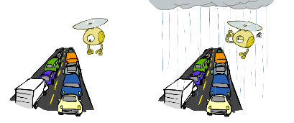
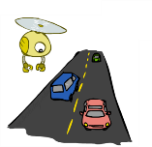
Example: Traffic
Variables:
  R: It rains
  T: There is traffic
Model 1: independence
Why is an agent using model 2 better?
Model 2: rain causes traffic
R
R
T
T

Slide 29
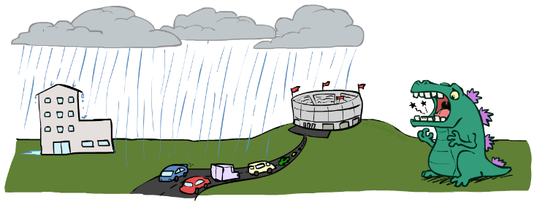

Example: Traffic II
Let’s build a causal Bayes net!
Variables
  T: Traffic
  R: It rains
  L: Low pressure
  D: Roof drips
  B: Ballgame
  C: Cavity

Slide 30
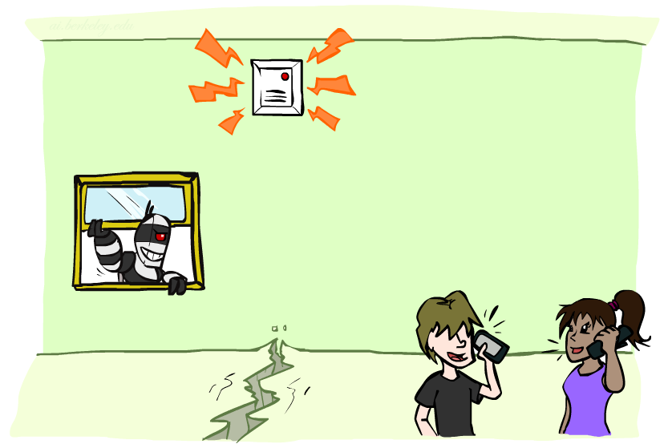
Example: Alarm Network
Variables
  B: Burglary
  A: Alarm goes off
  M: Mary calls
  J: John calls
  E: Earthquake!

Slide 31
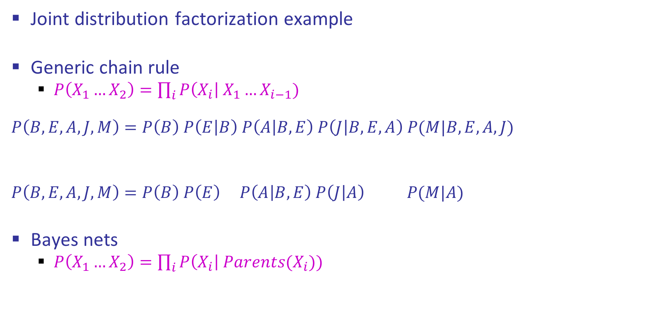
Semantics Example
Joint distribution factorization example
Generic chain rule
  $P\left(X_{1}…X_{2}\right)=\prod_{i}{P\left(X_{i}\right| X_{1}…X_{i−1}) }$
  $$P\left(B,E,A,J,M\right)=P\left(B\right) P\left(E | B\right) P\left(A | B,E\right) P\left(J | B,E,A\right) P(M|B,E,A,J)$$
  $$P\left(B,E,A,J,M\right)=P\left(B\right) P\left(E\right) P\left(A | B,E\right) P\left(J | A\right) P(M|A)$$
Bayes nets
  $P\left(X_{1}…X_{2}\right)=\prod_{i}{P\left(X_{i}\right| Parents(X_{i})) }$
Burglary
Earthquake
Alarm
John calls
Mary calls

Slide 32
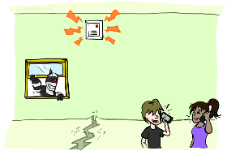
Example: Alarm Network
B | P(B)
+b | 0.001
-b | 0.999
E | P(E)
+e | 0.002
-e | 0.998
Burglary
Earthqk
Alarm
B | E | A | P(A|B,E)
+b | +e | +a | 0.95
+b | +e | -a | 0.05
+b | -e | +a | 0.94
+b | -e | -a | 0.06
-b | +e | +a | 0.29
-b | +e | -a | 0.71
-b | -e | +a | 0.001
-b | -e | -a | 0.999
John calls
Mary calls
A | J | P(J|A)
+a | +j | 0.9
+a | -j | 0.1
-a | +j | 0.05
-a | -j | 0.95
A | M | P(M|A)
+a | +m | 0.7
+a | -m | 0.3
-a | +m | 0.01
-a | -m | 0.99
Notes:
demo

Slide 33

















Poll 2
Match the product of CPTs to the Bayes net.
I.
II.
III.
$$A$$
$$A$$
$$B$$
$$A$$
$$B$$
$$C$$
$$B$$
$$C$$
$$C$$
  $$P\left(A\right) P\left(B | A\right) P\left(C | B\right)$$
  $$P\left(A\right) P\left(B | A\right) P\left(C | A\right)$$
  $$P\left(A\right) P\left(B\right) P\left(C | A, B\right)$$
  $$P\left(A\right) P\left(B\right) P\left(C | A, B\right)$$
  $$P\left(A\right) P\left(B | A\right) P\left(C | B\right)$$
  $$P\left(A\right) P\left(B | A\right) P\left(C | A\right)$$
  $$P\left(A\right) P\left(B | A\right) P\left(C | B\right)$$
  $$P\left(A|B,C\right) P\left(B\right) P(C)$$
  $$P\left(A\right) P\left(B | A\right) P\left(C | B\right)$$
Notes:
1

Slide 34
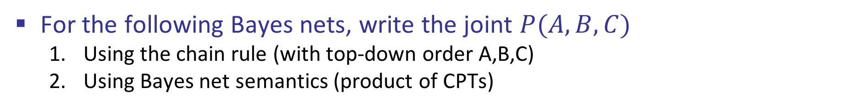
Conditional Independence Semantics
For the following Bayes nets, write the joint $P(A,B,C)$
  Using the chain rule (with top-down order A,B,C)
  Using Bayes net semantics (product of CPTs)
$$A$$
$$A$$
$$B$$
$$A$$
$$B$$
$$C$$
$$B$$
$$C$$
$$C$$

Slide 35
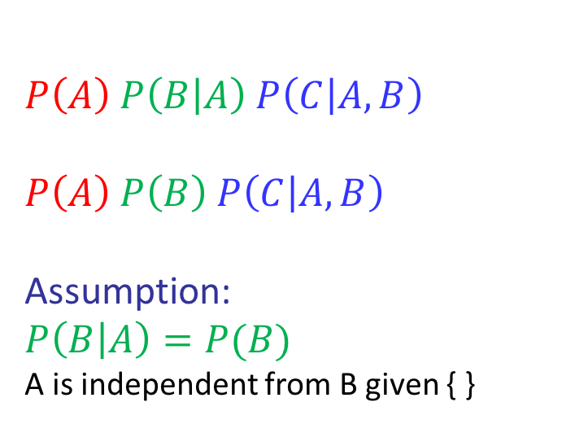
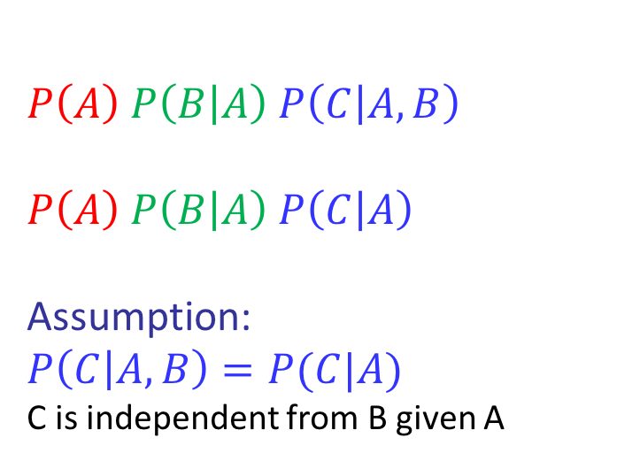
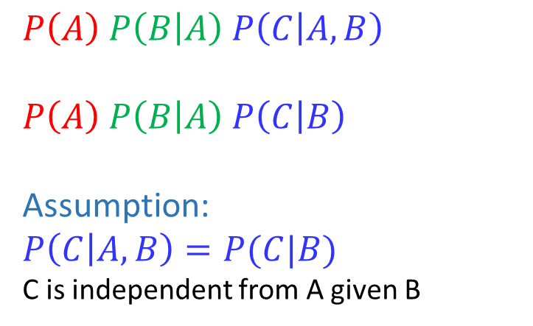
Conditional Independence Semantics
For the following Bayes nets, write the joint $P(A,B,C)$
  Using the chain rule (with top-down order A,B,C)
  Using Bayes net semantics (product of CPTs)
$$A$$
$$A$$
$$B$$
$$A$$
$$B$$
$$C$$
$$B$$
$$C$$
$$C$$
  $$P\left(A\right) P\left(B | A\right) P\left(C | A,B\right)$$
  $$P\left(A\right) P\left(B | A\right) P\left(C | B\right)$$
  Assumption:
  $$P\left(C | A,B\right)=P(C|B)$$
  C is independent from A given B
  $$P\left(A\right) P\left(B | A\right) P\left(C | A,B\right)$$
  $$P\left(A\right) P\left(B | A\right) P\left(C | A\right)$$
  Assumption:
  $$P\left(C | A,B\right)=P(C|A)$$
  C is independent from B given A
  $$P\left(A\right) P\left(B | A\right) P\left(C | A,B\right)$$
  $$P\left(A\right) P\left(B\right) P\left(C | A, B\right)$$
  Assumption:
  $$P\left(B | A\right)=P(B)$$
  A is independent from B given { }

Slide 36
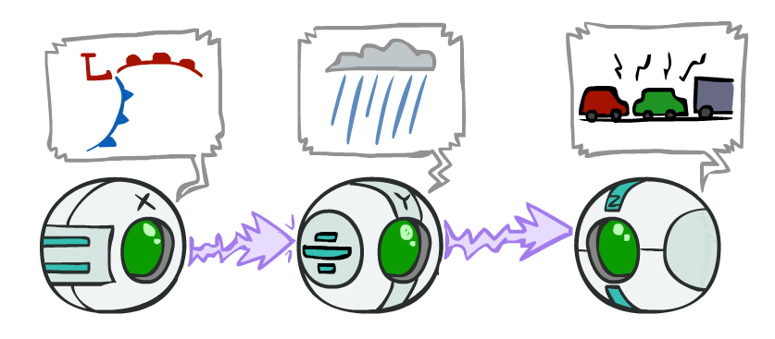
Causal Chains
Guaranteed X independent of Z ?
No!
One example set of CPTs for which X is not independent of Z is sufficient to show this independence is not guaranteed.
Example:
  Low pressure always causes rain
  Rain always causes traffic
  High pressure always causes no rain
  No rain always causes no traffic
  In numbers:
  P( +y | +x ) = 1 P( +z | +y ) = 1
  P( -y | -x ) = 1 P( -z | -y ) = 1
This configuration is a “causal chain”
X: Low pressure Y: Rain Z: Traffic

Slide 37
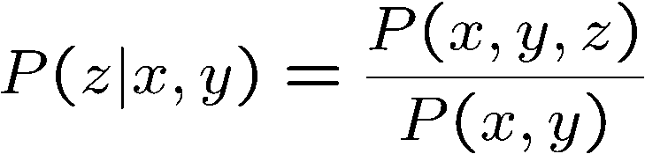
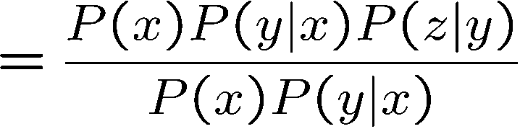

Causal Chains
This configuration is a “causal chain”
Guaranteed X independent of Z given Y?
  Evidence along the chain “blocks” the influence
X: Low pressure Y: Rain Z: Traffic
Yes!

Slide 38
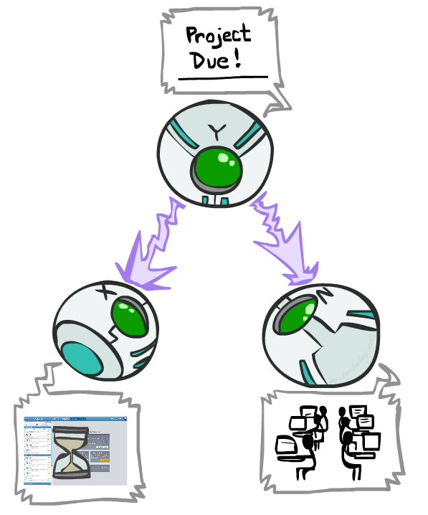
Common Cause
This configuration is a “common cause”
Guaranteed X independent of Z ? No!
  One example set of CPTs for which X is not independent of Z is sufficient to show this independence is not guaranteed.
  Example:
    Project due always causes both forums busy
    and lab full
    In numbers:
    P( +x | +y ) = 1 P( -x | -y ) = 1,
    P( +z | +y ) = 1 P( -z | -y ) = 1
Y: Project due
X: Forums busy
Z: Lab full

Slide 39
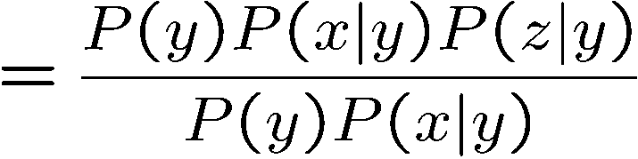
Common Cause
This configuration is a “common cause”
Guaranteed X and Z independent given Y?
  Observing the cause blocks influence between effects.
Y: Project due
X: Forums busy
Z: Lab full
Yes!

Slide 40
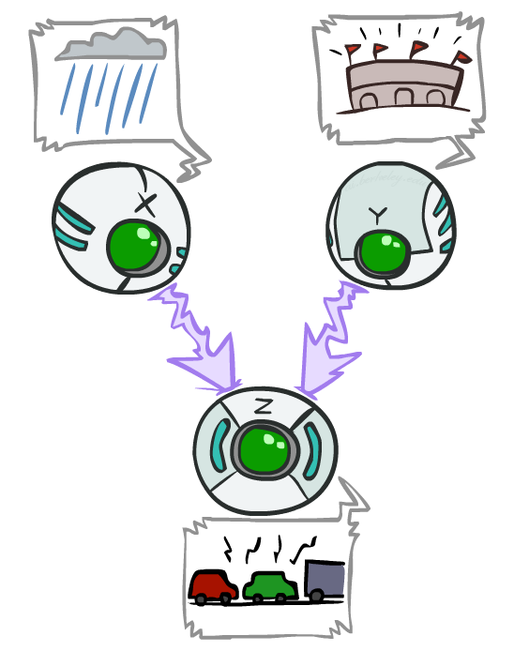
Common Effect
Last configuration: two causes of one effect (v-structures)
Are X and Y independent?
  Yes: the ballgame and the rain cause traffic, but they are not correlated
  Still need to prove they must be (try it!)
Are X and Y independent given Z?
  No: seeing traffic puts the rain and the ballgame in competition as explanation.
This is backwards from the other cases
  Observing an effect activates influence between possible causes.
X: Raining
Y: Ballgame
Z: Traffic

Slide 41
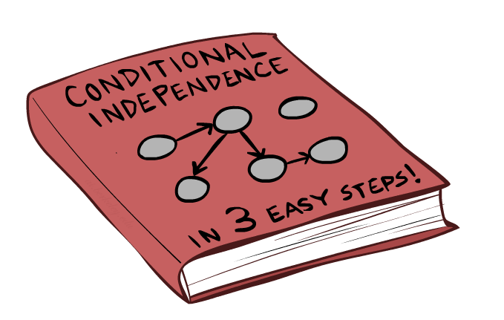
Bayes Net Independence

Slide 42















Answering Independence Questions
Is A independent from E?
Is A independent from E given C?
Is A independent from C given E?
$$A$$
$$B$$
$$C$$
$$D$$
$$E$$
$$A$$
$$B$$
$$C$$
$$D$$
$$E$$
$$A$$
$$B$$
$$C$$
$$D$$
$$E$$

Slide 43

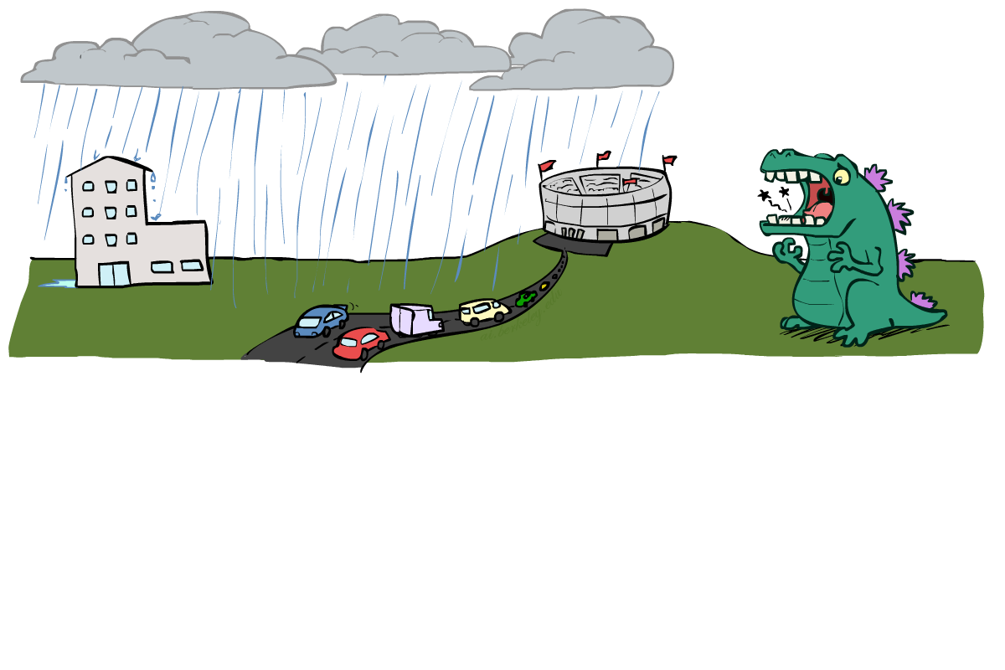
Reachability
L
Recipe: shade evidence nodes, look for paths in the resulting graph
Attempt 1: if two nodes are connected by an undirected path not blocked by a shaded node, they are conditionally independent
Almost works, but not quite
  Where does it break?
  Answer: the v-structure at T doesn’t count as a link in a path unless “active”
R
B
D
T

Slide 44
Active / Inactive Paths
Question: Are X and Y conditionally independent given evidence variables {Z}?
  Yes, if X and Y “d-separated” by Z
  Consider all (undirected) paths from X to Y
  No active paths = independence!
A path is active if each triple is active:
  Causal chain A → B → C where B is unobserved (either direction)
  Common cause A ← B → C where B is unobserved
  Common effect (aka v-structure)
  A → B ← C where B or one of its descendents is observed
All it takes to block a path is a single inactive segment
Active Paths
Inactive Paths

Slide 45

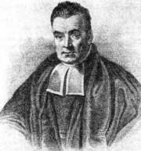
Bayes Ball
Question: Are X and Y conditionally independent given evidence variables {Z}?
Active Paths
Inactive Paths
Shachter, Ross D. "Bayes-Ball: Rational Pastime (for Determining Irrelevance and Requisite Information in Belief Networks and Influence Diagrams)." Proceedings of the Fourteenth conference on Uncertainty in Artificial Intelligence. 1998.

Slide 46
Bayes Ball
Question: Are X and Y conditionally independent given evidence variables {Z}?
  Shade in Z
  Drop a ball at X
  The ball can pass through any active path and is blocked by any inactive path (ball can move either direction on an edge)
  If the ball reaches Y, then X and Y are NOT conditionally independent given Z
Active Paths
Inactive Paths

Slide 47
Bayes Ball
Active Paths
Inactive Paths

Slide 48
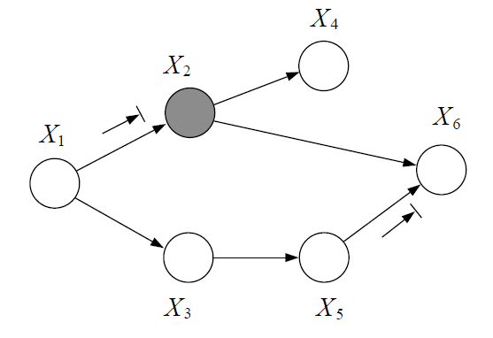
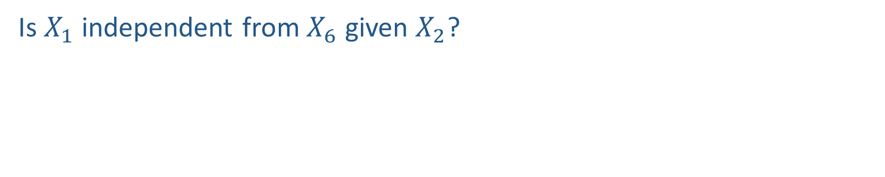
Poll 3
Is $X_{1}$ independent from $X_{6}$ given $X_{2}$?

Slide 49
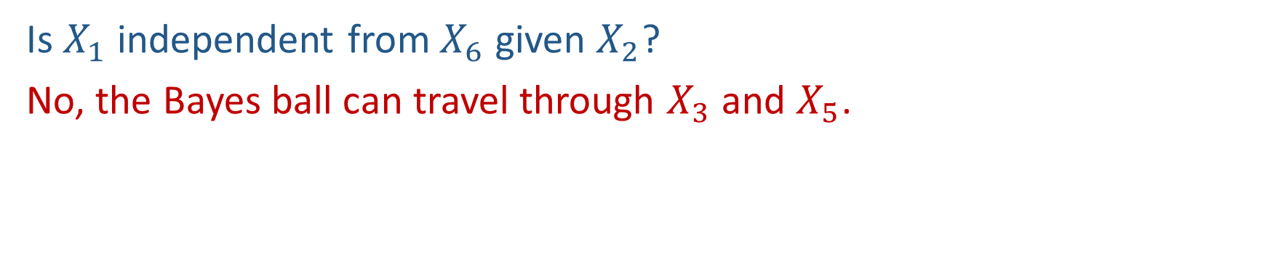
Poll 3
Is $X_{1}$ independent from $X_{6}$ given $X_{2}$?
No, the Bayes ball can travel through $X_{3}$ and $X_{5}$.

Slide 50
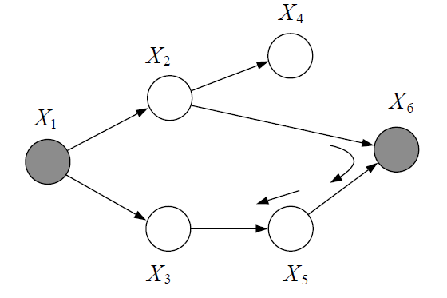
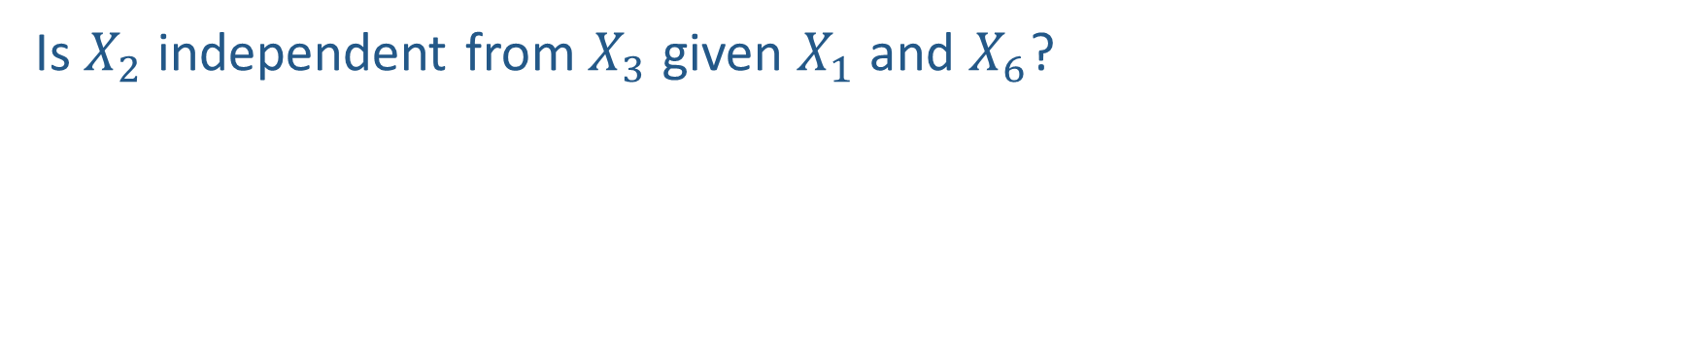
Poll 4
Is $X_{2}$ independent from $X_{3}$ given $X_{1}$ and $X_{6}$?

Slide 51
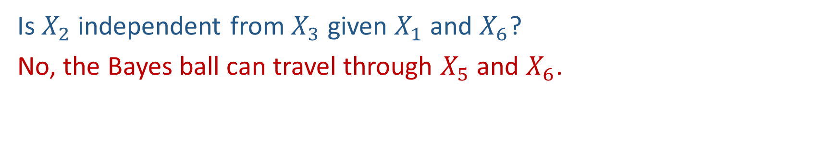
Poll 4
Is $X_{2}$ independent from $X_{3}$ given $X_{1}$ and $X_{6}$?
No, the Bayes ball can travel through $X_{5}$ and $X_{6}$.

Slide 52
Conditional Independence Semantics
Every variable is conditionally independent of its non-descendants given its parents
GP3
P2
P1
P3
X
W
Z
A
C1
C2
GC2

Slide 53
Markov blanket
A variable’s Markov blanket consists of parents, children, children’s other parents
Every variable is conditionally independent of all other variables given its Markov blanket
GP3
P2
P1
P3
C
B
X
W
Z
A
C1
C2
GC2

Slide 54
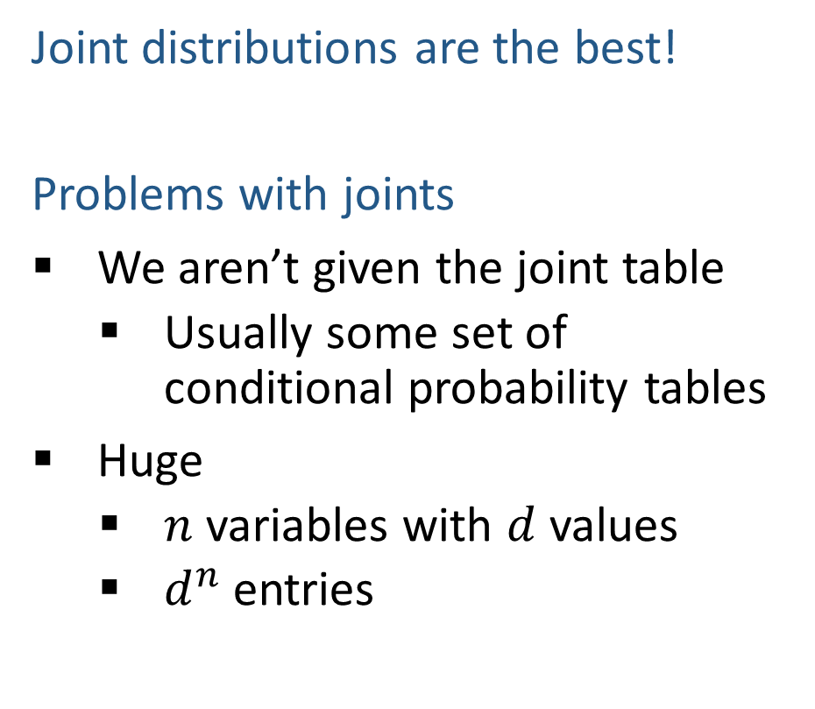
Answer Any Query from Joint Distribution
Joint distributions are the best!
Problems with joints
We aren’t given the joint table
    Usually some set of conditional probability tables
Huge
    $n$ variables with $d$ values
    $d^{n}$ entries
Joint
Query
$$P\left(a \right| e)$$

Slide 55
Answer Any Query from Bayes Net
Bayes Net
Joint
Query
$$P\left(a \right| e)$$
$$P\left(A\right) P\left(B | A\right) P\left(C | A\right) P\left(D | C\right) P(E|C)$$

Slide 56
Next: Answer Any Query from Bayes Net
Bayes Net
Query
$$P\left(a \right| e)$$
$$P\left(A\right) P\left(B | A\right) P\left(C | A\right) P\left(D | C\right) P(E|C)$$

