Slide 1

Announcements
Assignments
HW7 Due tonight!
HW8 Due Tues 3/28, 10 pm
P4: MDPs/RL Due Thursday 4/6, 10 pm
Check the Final Exam Schedule for conflicts by next week 3/31
Coming up
Midterm 2 Review – Tues. 3/28 6-8pm in GHC Rashid
Midterm 2 – 3/30 (covers Logic, Classical Planning MDPs, RL, Bayes)
80 minutes in class, same general rules as before
Single function calculators or graphing calculators (no phones, iPads, etc)
1 8.5”x11” handwritten pen/pencil/paper cheatsheet, not written digitally and printed

Slide 2
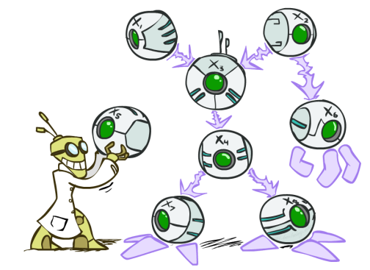
AI: Representation and Problem Solving
Bayes Nets
Instructor: Stephanie Rosenthal
Slide credits: CMU AI and http://ai.berkeley.edu

Slide 3




Omega Pizzeria!
What is the probability of getting a slice with:
No mushrooms
Spinach and no mushrooms
Spinach, when asking for slice with no mushrooms
Mushrooms
Spinach
No spinach
No spinach and mushrooms
No spinach when asking for no mushrooms
No spinach when asking for mushrooms
Spinach when asking for mushrooms
No mushrooms and no spinach
Icons: CC, https://openclipart.org/detail/296791/pizza-slice

Slide 4
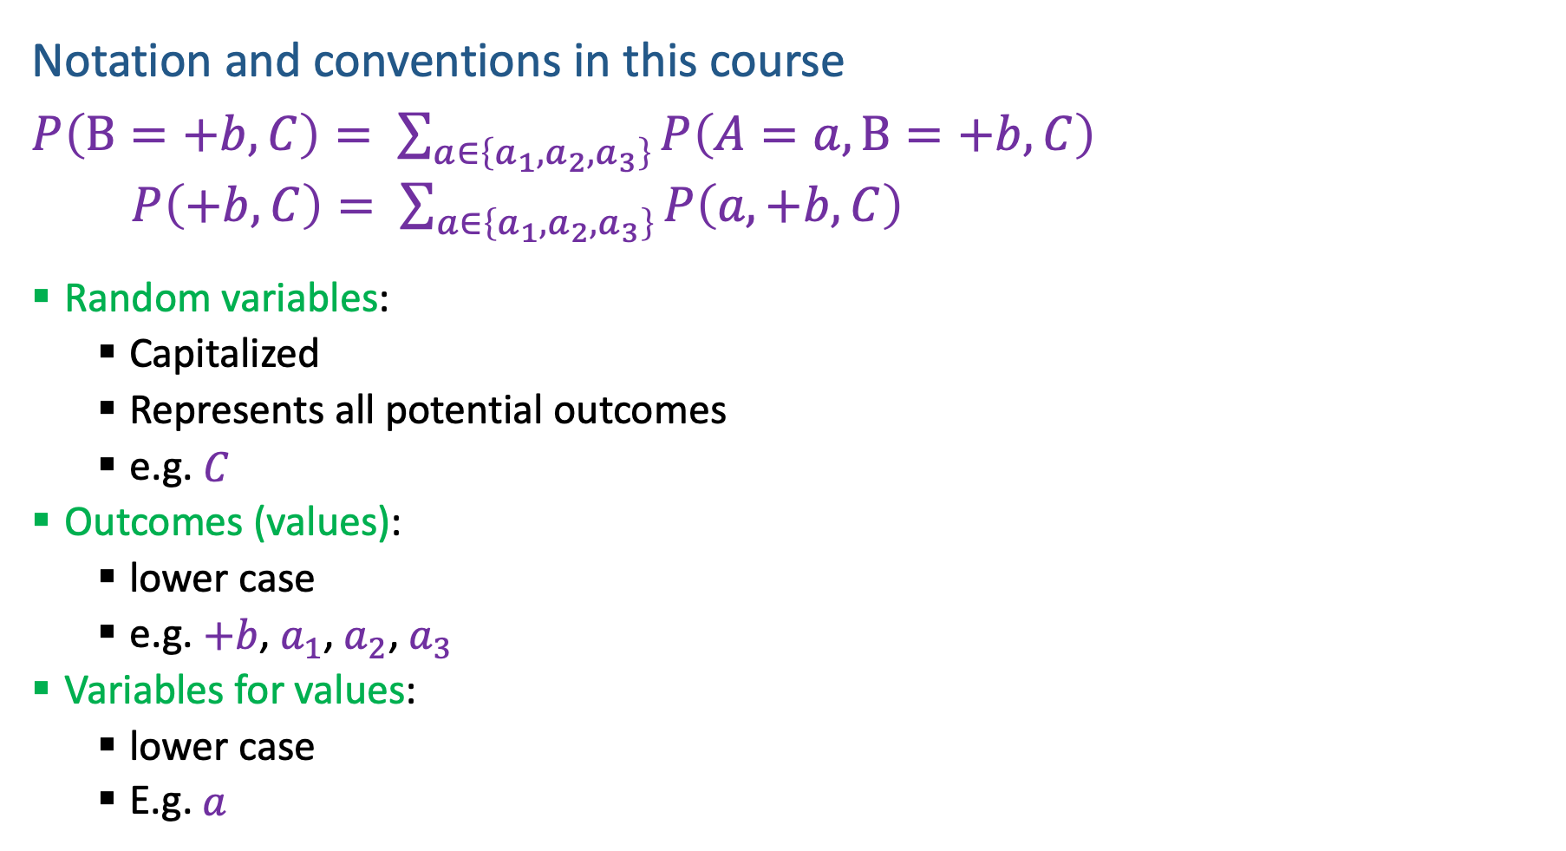
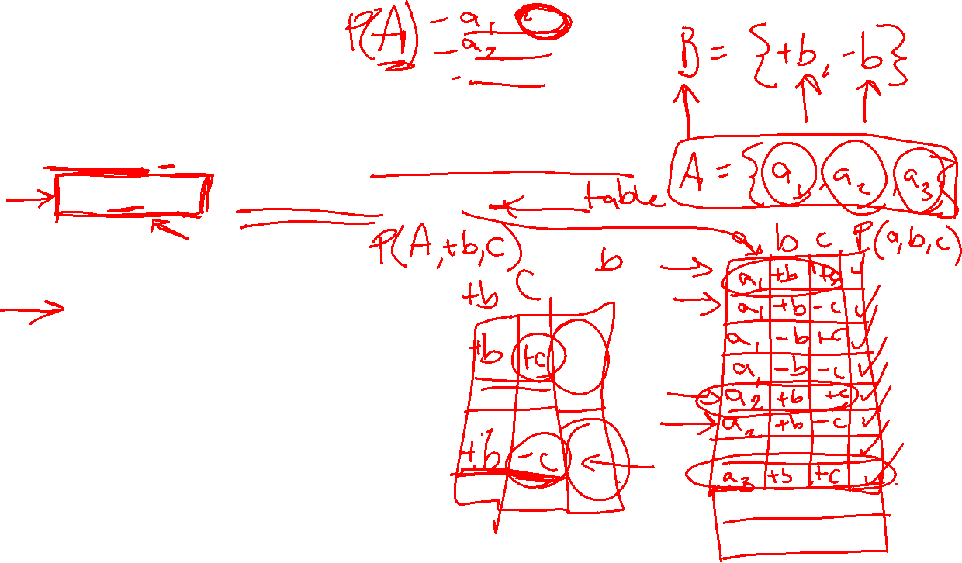
Probability Notation
Notation and conventions in this course
$P\left(B=+b, C\right)= \sum_{a∈\left\{a_{1}, a_{2},a_{3}\right\}}{P\left(A=a, B=+b, C\right)}$
$P\left(+b, C\right)= \sum_{a∈\left\{a_{1}, a_{2},a_{3}\right\}}{P\left(a, +b, C\right)}$
Random variables:
Capitalized
Represents all potential outcomes
e.g. $C$
Outcomes (values):
lower case
e.g. $+b$, $a_{1}$, $a_{2}$, $a_{3}$
Variables for values:
lower case
E.g. $a$

Slide 5

Probability Notation
Notation and conventions in this course
$P\left(B=+b, C\right)= \sum_{a∈\left\{a_{1}, a_{2},a_{3}\right\}}{P\left(A=a, B=+b, C\right)}$
$P\left(+b, C\right)= \sum_{a∈\left\{a_{1}, a_{2},a_{3}\right\}}{P\left(a, +b, C\right)}$

Slide 6

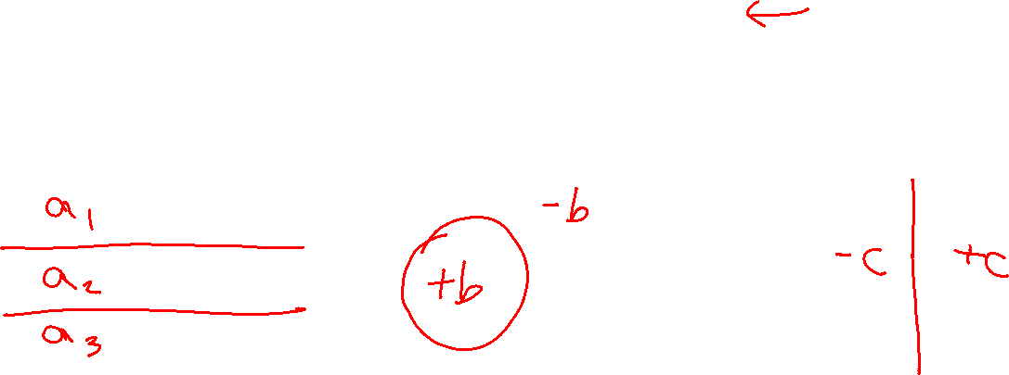
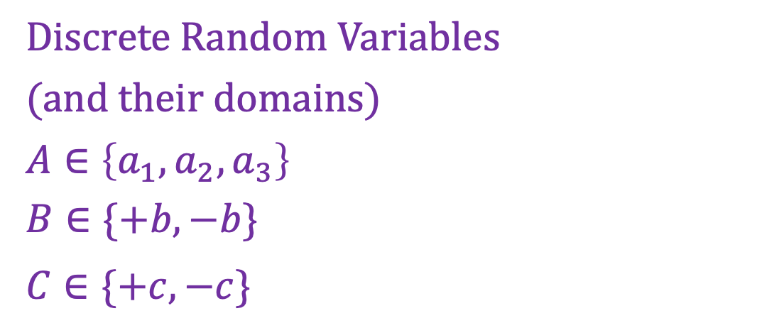


Discrete Probability Distributions
Partitions
For each random variable
Discrete outcomes
Disjoint outcomes
Accounts for entire event space
Not always binary
Event space
Discrete Random Variables
(and their domains)
$A∈\left\{a_{1},a_{2}, a_{3}\right\}$
$B∈\{+b, −b\}$
$C∈\{+c, −c\}$
$$A$$
$$B$$
$$C$$

Slide 7
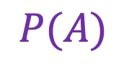
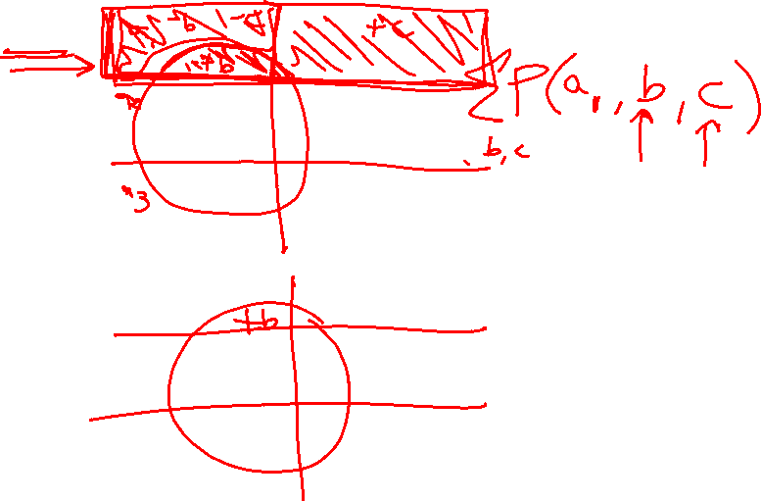
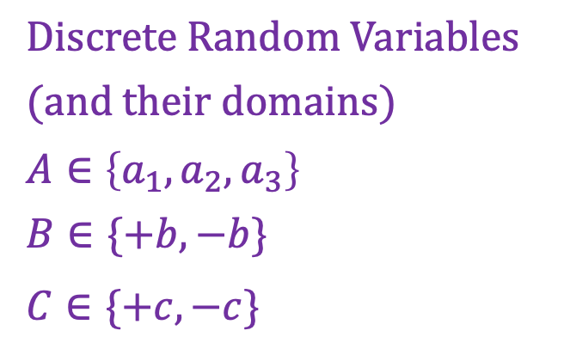
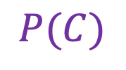
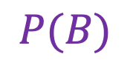
Discrete Probability Distributions
Discrete Random Variables
(and their domains)
$A∈\left\{a_{1},a_{2}, a_{3}\right\}$
$B∈\{+b, −b\}$
$C∈\{+c, −c\}$
Marginal distribution
$$P(A)$$
$$P(B)$$
$$P(C)$$

Slide 8
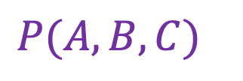
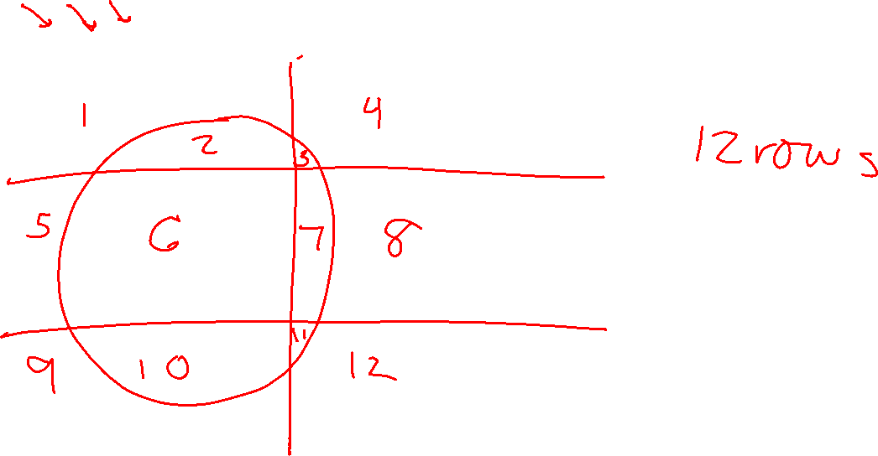
Discrete Probability Distributions
Discrete Random Variables
(and their domains)
$A∈\left\{a_{1},a_{2}, a_{3}\right\}$
$B∈\{+b, −b\}$
$C∈\{+c, −c\}$
Joint distribution
$P(A, B, C)$

Slide 9
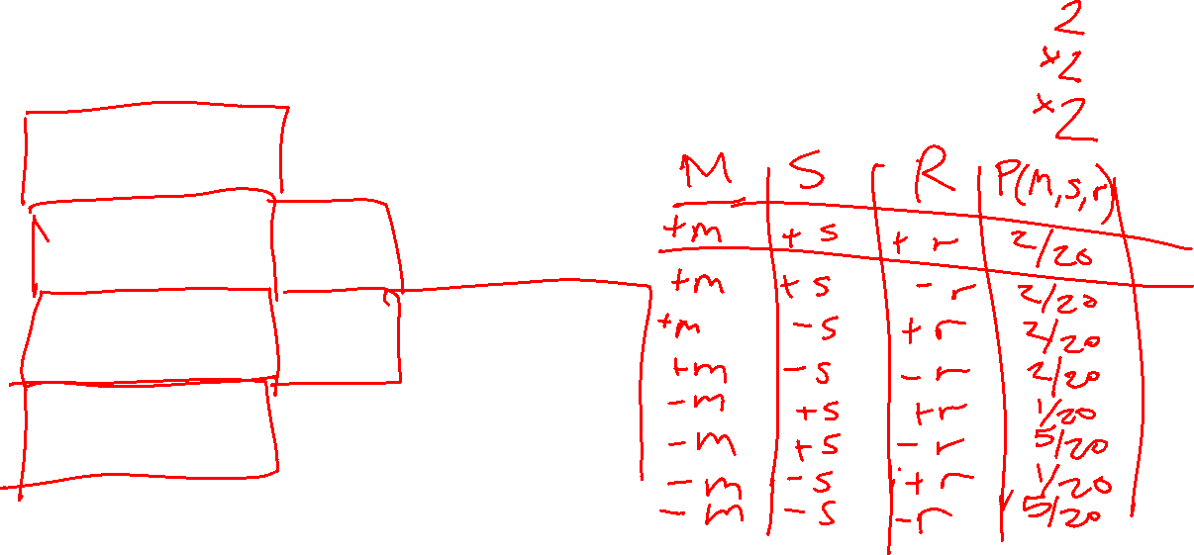
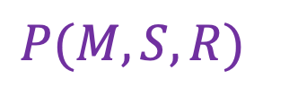
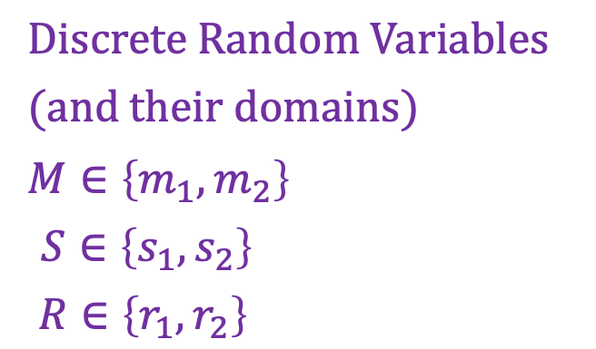
Discrete Probability Distributions
Discrete Random Variables
(and their domains)
$M∈\left\{m_{1},m_{2}\right\}$
$S∈\left\{s_{1},s_{2}\right\}$
$R∈\left\{r_{1},r_{2}\right\}$
Joint distribution
$P(M, S, R)$
Icons: CC, https://openclipart.org/detail/296791/pizza-slice

Slide 10
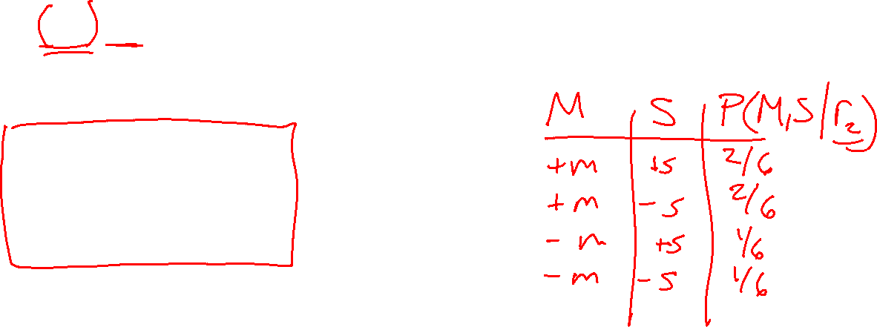
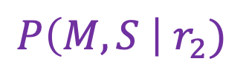
Discrete Probability Distributions
Discrete Random Variables
(and their domains)
$M∈\left\{m_{1},m_{2}\right\}$
$S∈\left\{s_{1},s_{2}\right\}$
$R∈\left\{r_{1},r_{2}\right\}$
Conditional distribution
$P\left(M, S \right| r_{2})$
Icons: CC, https://openclipart.org/detail/296791/pizza-slice

Slide 11
Discrete Probability Distributions
Discrete Random Variables
(and their domains)
$M∈\left\{m_{1},m_{2}\right\}$
$S∈\left\{s_{1},s_{2}\right\}$
$R∈\left\{r_{1},r_{2}\right\}$
Conditional distribution
$P\left(M, S \right| r_{2})$
Icons: CC, https://openclipart.org/detail/296791/pizza-slice

Slide 12
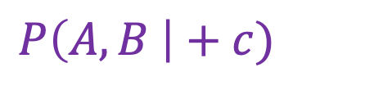
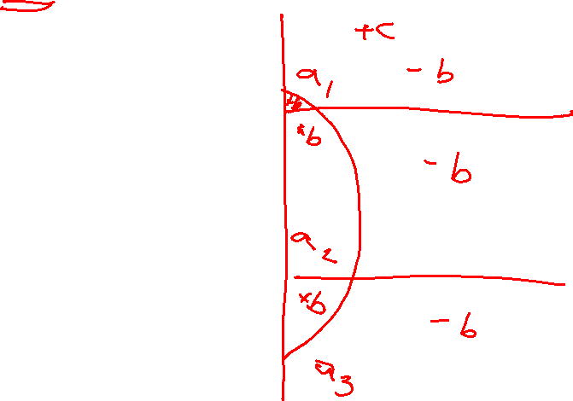
Discrete Probability Distributions
Discrete Random Variables
(and their domains)
$A∈\left\{a_{1},a_{2}, a_{3}\right\}$
$B∈\{+b, −b\}$
$C∈\{+c, −c\}$
Conditional distribution
$P\left(A, B \right|+c)$

Slide 13
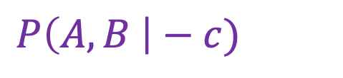
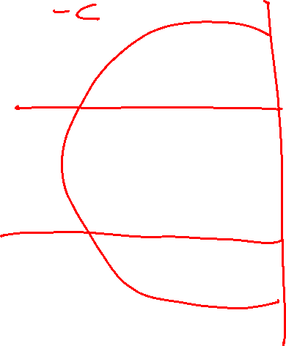
Discrete Probability Distributions
Discrete Random Variables
(and their domains)
$A∈\left\{a_{1},a_{2}, a_{3}\right\}$
$B∈\{+b, −b\}$
$C∈\{+c, −c\}$
Conditional distribution
$P\left(A, B \right|−c)$

Slide 14
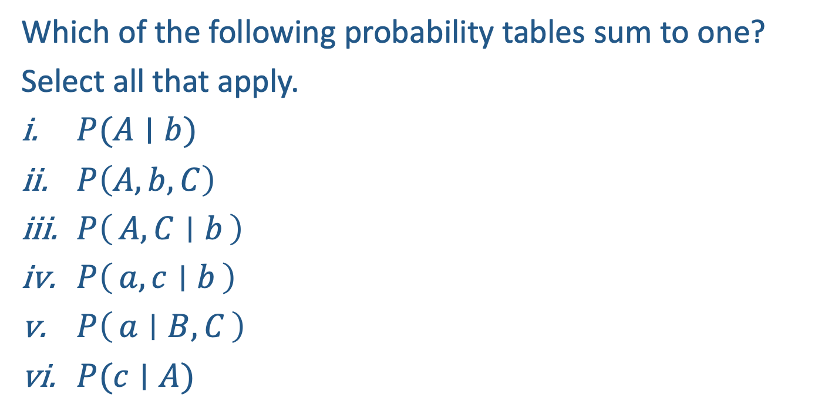
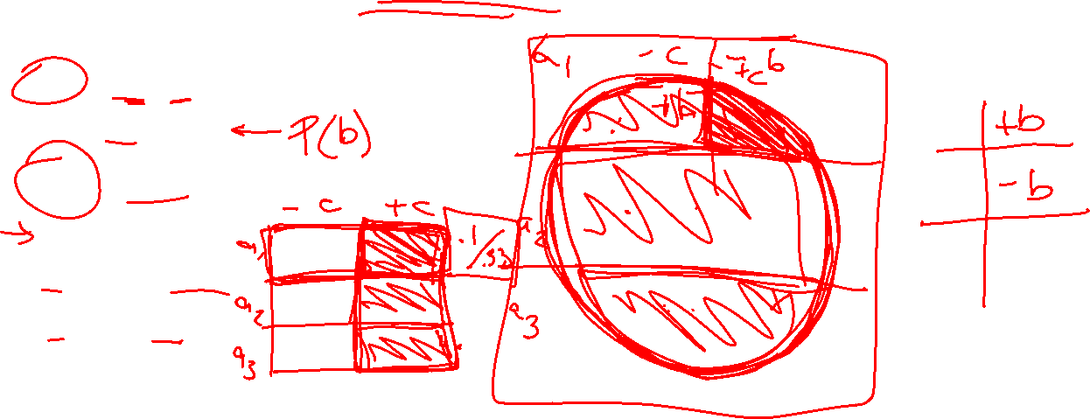
Poll 1
Which of the following probability tables sum to one?
Select all that apply.
$P(A∣b)$
$P\left(A, b, C\right)$
$P\left(A, C ∣ b\right)$
$P\left(a, c ∣ b\right)$
$P\left(a ∣ B, C\right)$
$P(c∣A)$

Slide 15

Poll 1
Which of the following probability tables sum to one?
Select all that apply.
$P(A∣b)$
$P\left(A, b, C\right)$
$P\left(A, C ∣ b\right)$
$P\left(a, b ∣ c\right)$
$P\left(a ∣ B, C\right)$
$P(c∣A)$

Slide 16

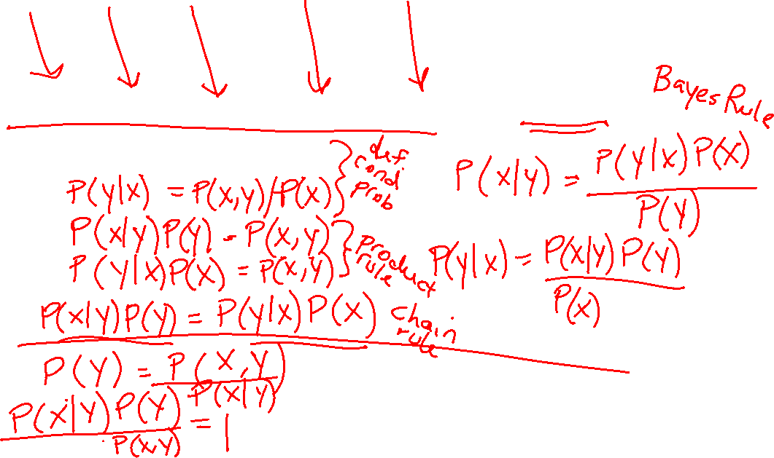
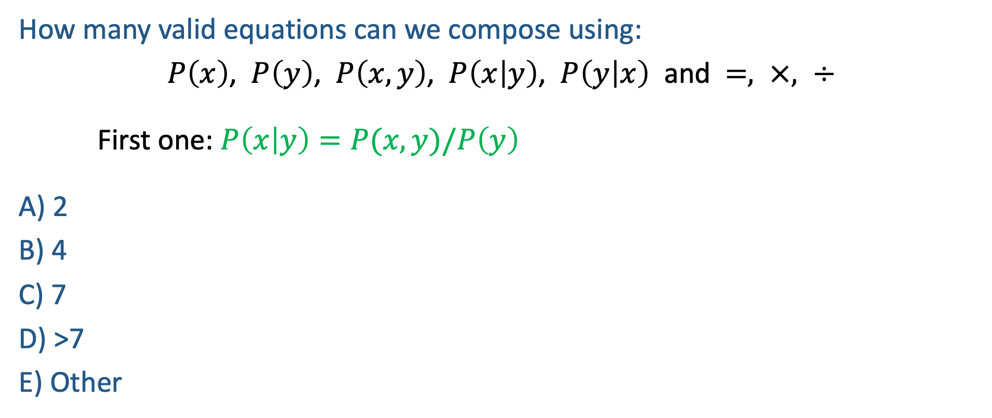

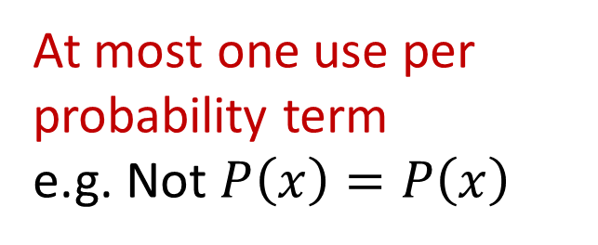
Poll 2
How many valid equations can we compose using:
$P\left(x\right)$, $P\left(y\right)$, $P\left(x,y\right)$, $P\left(x | y\right)$, $P\left(y | x\right)$ and $=, ×, ÷$
First one: $P\left(x | y\right)=P(x,y)/P\left(y\right)$
A) 2
B) 4
C) 7
D) >7
E) Other
At most one use per probability term
e.g. Not $P\left(x\right)=P\left(x\right)$
Must be different
e.g. Cannot also use
$$P(x,y)/P(y) =P(x|y)$$

Slide 17
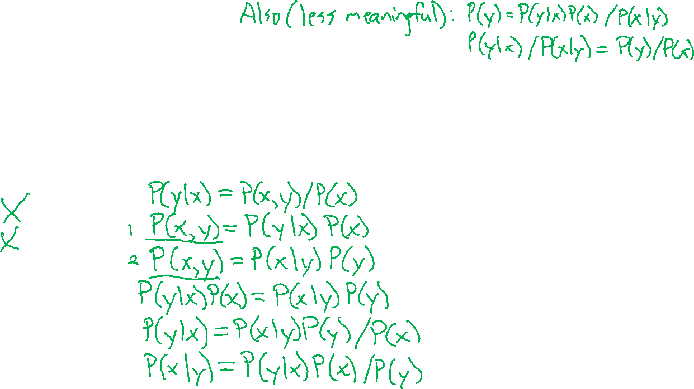
Poll 2
How many valid equations can we compose using:
$P\left(x\right)$, $P\left(y\right)$, $P\left(x,y\right)$, $P\left(x | y\right)$, $P\left(y | x\right)$ and $=, ×, ÷$
First one: $P\left(x | y\right)=P(x,y)/P\left(y\right)$
A) 2
B) 4
C) 7
D) >7
E) Other
At most one use per probability term
e.g. Not $P\left(x\right)=P\left(x\right)$
Must be different
e.g. Cannot also use
$$P(x,y)/P(y) =P(x|y)$$

Slide 18

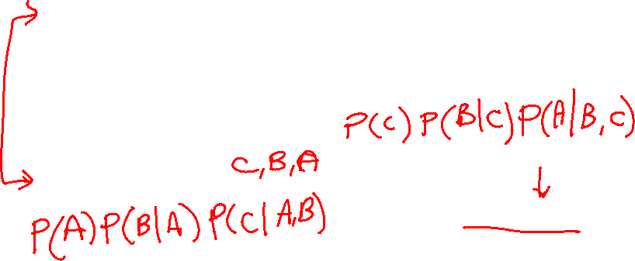
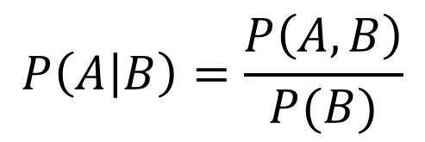
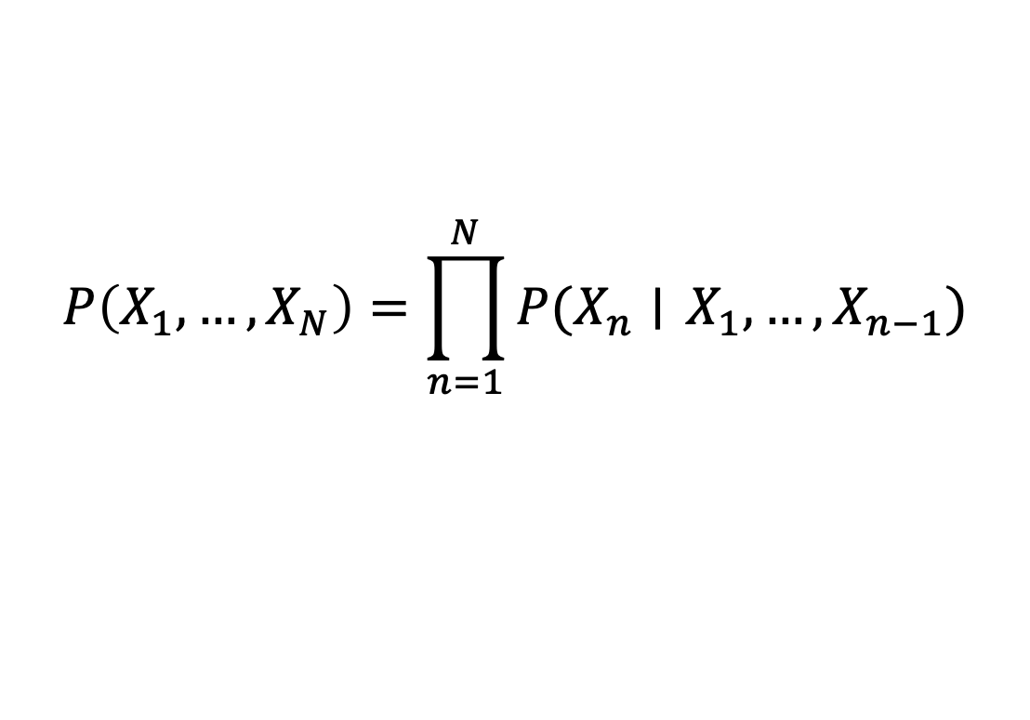
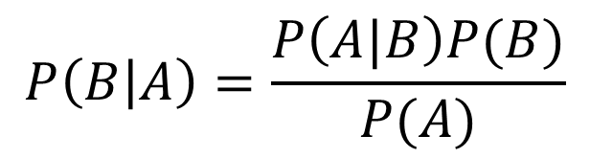
Probability Tools Summary
Our toolbox
Definition of conditional probability
Product Rule
Bayes’ theorem
Chain Rule
$$P\left(A | B\right)=\frac{P\left(A, B\right)}{P(B)}$$
$$P(A,B)=P\left(A | B\right)P(B)$$
$$P\left(B | A\right)=\frac{P\left(A|B\right)P(B)}{P(A)}$$
$$P\left(X_{1}, …, X_{N}\right)=\prod_{n=1}^{N}{P(X_{n}∣} X_{1},…, X_{n−1})$$

Slide 19
Answer Any Query from Joint Distribution
What is the probability of getting a slice with:
No mushrooms
Spinach and no mushrooms
Spinach, when asking for slice with no mushrooms
Mushrooms
Spinach
No spinach
No spinach and mushrooms
No spinach when asking for no mushrooms
No spinach when asking for mushrooms
Spinach when asking for mushrooms
No mushrooms and no spinach
Icons: CC, https://openclipart.org/detail/296791/pizza-slice

Slide 20


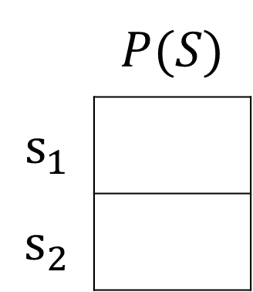
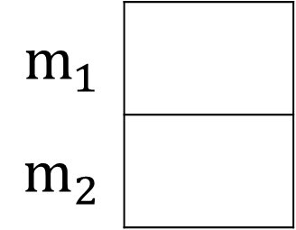

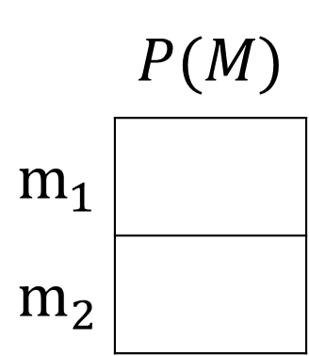


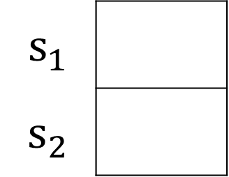
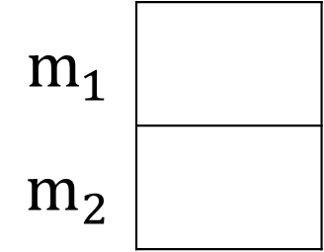


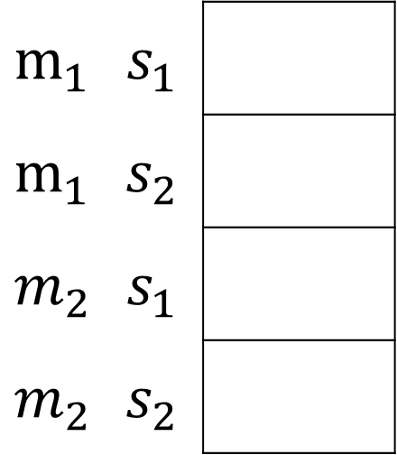
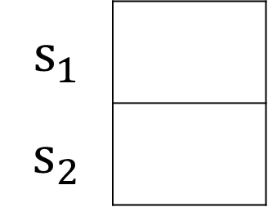

Answer Any Query from Joint Distribution
You can answer all of these questions:
$P(M|s_{1})$
$P(M|s_{2})$
 | $$P(M)$$
$$m_{1}$$
$$m_{2}$$
$P(M,S)$
$$m_{1}$$
$$m_{2}$$
$$m_{1}$$
$$m_{2}$$
$$12/20$$
$$m_{1}$$ | $$s_{1}$$
$$m_{1}$$ | $$s_{2}$$
$$m_{2}$$ | $$s_{1}$$
$$m_{2}$$ | $$s_{2}$$
$$6/20$$
$P(S|m_{1})$
$P(S|m_{2})$
 | $$P(S)$$
$$s_{1}$$
$$s_{2}$$
$$s_{1}$$
$$s_{2}$$
$$s_{1}$$
$$s_{2}$$
$$6/12$$

Slide 21
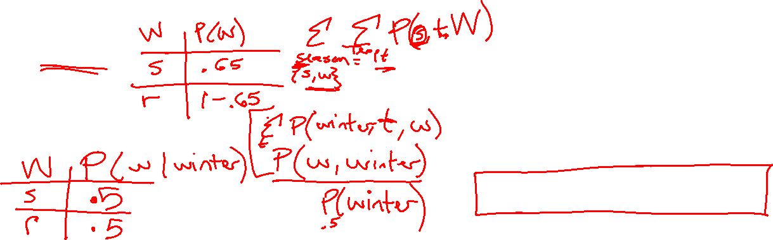
Answer Any Query from Joint Distribution
P(Weather)?
P(Weather | winter)?
P(Weather | winter, hot)?
Season | Temp | Weather | P(S, T, W)
summer | hot | sun | 0.30
summer | hot | rain | 0.05
summer | cold | sun | 0.10
summer | cold | rain | 0.05
winter | hot | sun | 0.10
winter | hot | rain | 0.05
winter | cold | sun | 0.15
winter | cold | rain | 0.20

Slide 22
Answer Any Query from Joint Distribution
P(Weather)?
Season | Temp | Weather | P(S, T, W)
summer | hot | sun | 0.30
summer | hot | rain | 0.05
summer | cold | sun | 0.10
summer | cold | rain | 0.05
winter | hot | sun | 0.10
winter | hot | rain | 0.05
winter | cold | sun | 0.15
winter | cold | rain | 0.20

Slide 23
Answer Any Query from Joint Distribution
P(Weather | winter)?
Season | Temp | Weather | P(S, T, W)
summer | hot | sun | 0.30
summer | hot | rain | 0.05
summer | cold | sun | 0.10
summer | cold | rain | 0.05
winter | hot | sun | 0.10
winter | hot | rain | 0.05
winter | cold | sun | 0.15
winter | cold | rain | 0.20

Slide 24
Answer Any Query from Joint Distribution
P(Weather | winter, hot)?
Season | Temp | Weather | P(S, T, W)
summer | hot | sun | 0.30
summer | hot | rain | 0.05
summer | cold | sun | 0.10
summer | cold | rain | 0.05
winter | hot | sun | 0.10
winter | hot | rain | 0.05
winter | cold | sun | 0.15
winter | cold | rain | 0.20

Slide 25

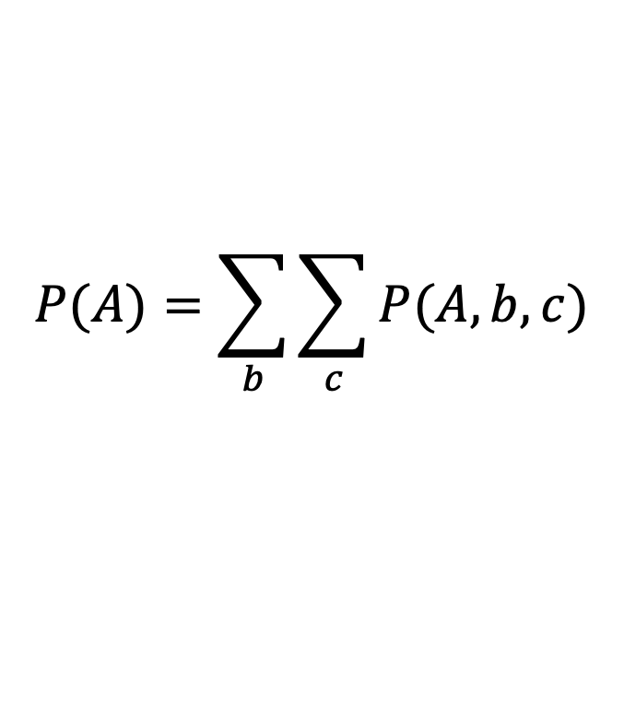
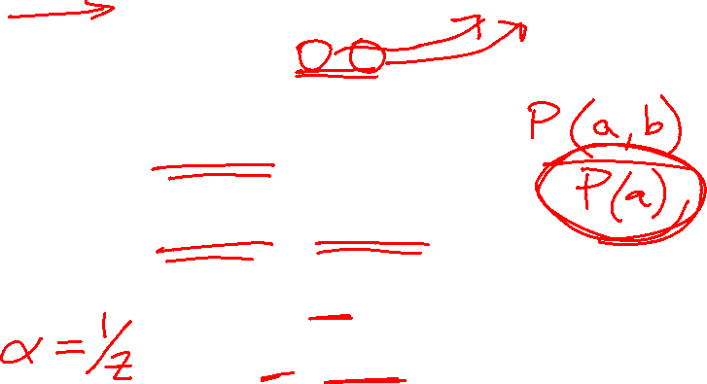
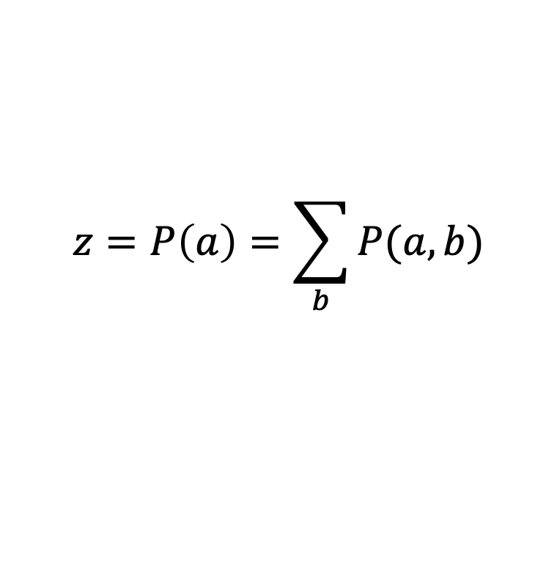
Additional Probability Tools
Marginalization (law of total probability) (summing out)
Normalization
$$P(A)=\sum_{b}{\sum_{c}{P(A, b, c)}}$$
$$P\left(B | a\right)=\frac{P(a,B)}{P(a)}$$
$P\left(B | a\right)∝P(a,B)$
$P\left(B | a\right)=\frac{1}{z}P(a,B)$
$$z=P\left(a\right)=\sum_{b}{P(a,b)}$$

Slide 26
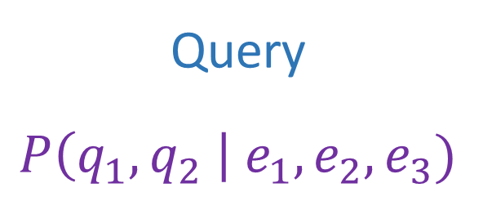
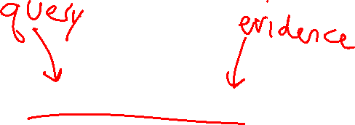
Answer Any Query from Joint Distribution
Joint distributions are the best!
Joint
Query
$$P\left(q_{1},q_{2} \right| e_{1}, e_{2},e_{3})$$

Slide 27
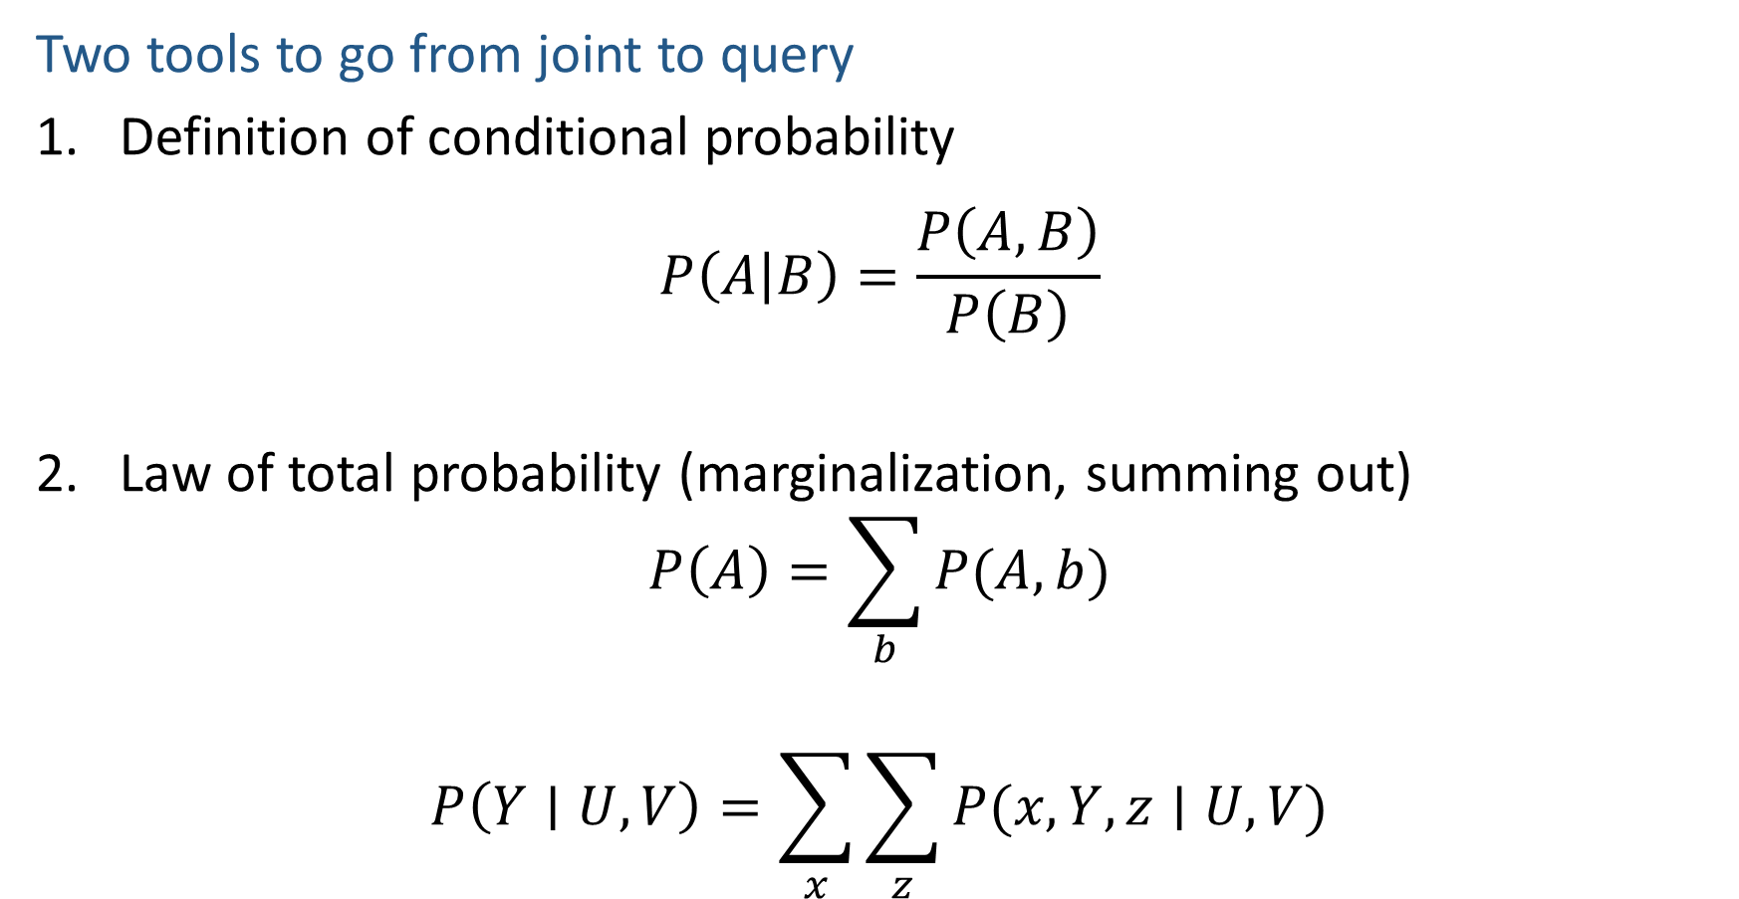
Answer Any Query from Joint Distribution
Two tools to go from joint to query
Definition of conditional probability
$$P\left(A | B\right)=\frac{P\left(A,B\right)}{P\left(B\right)}$$
Law of total probability (marginalization, summing out)
$$P\left(A\right)=\sum_{b}{P(A,b)}$$
$$P\left(Y∣U, V\right)=\sum_{x}{\sum_{z}{P(x, Y, z∣U, V)}}$$

Slide 28
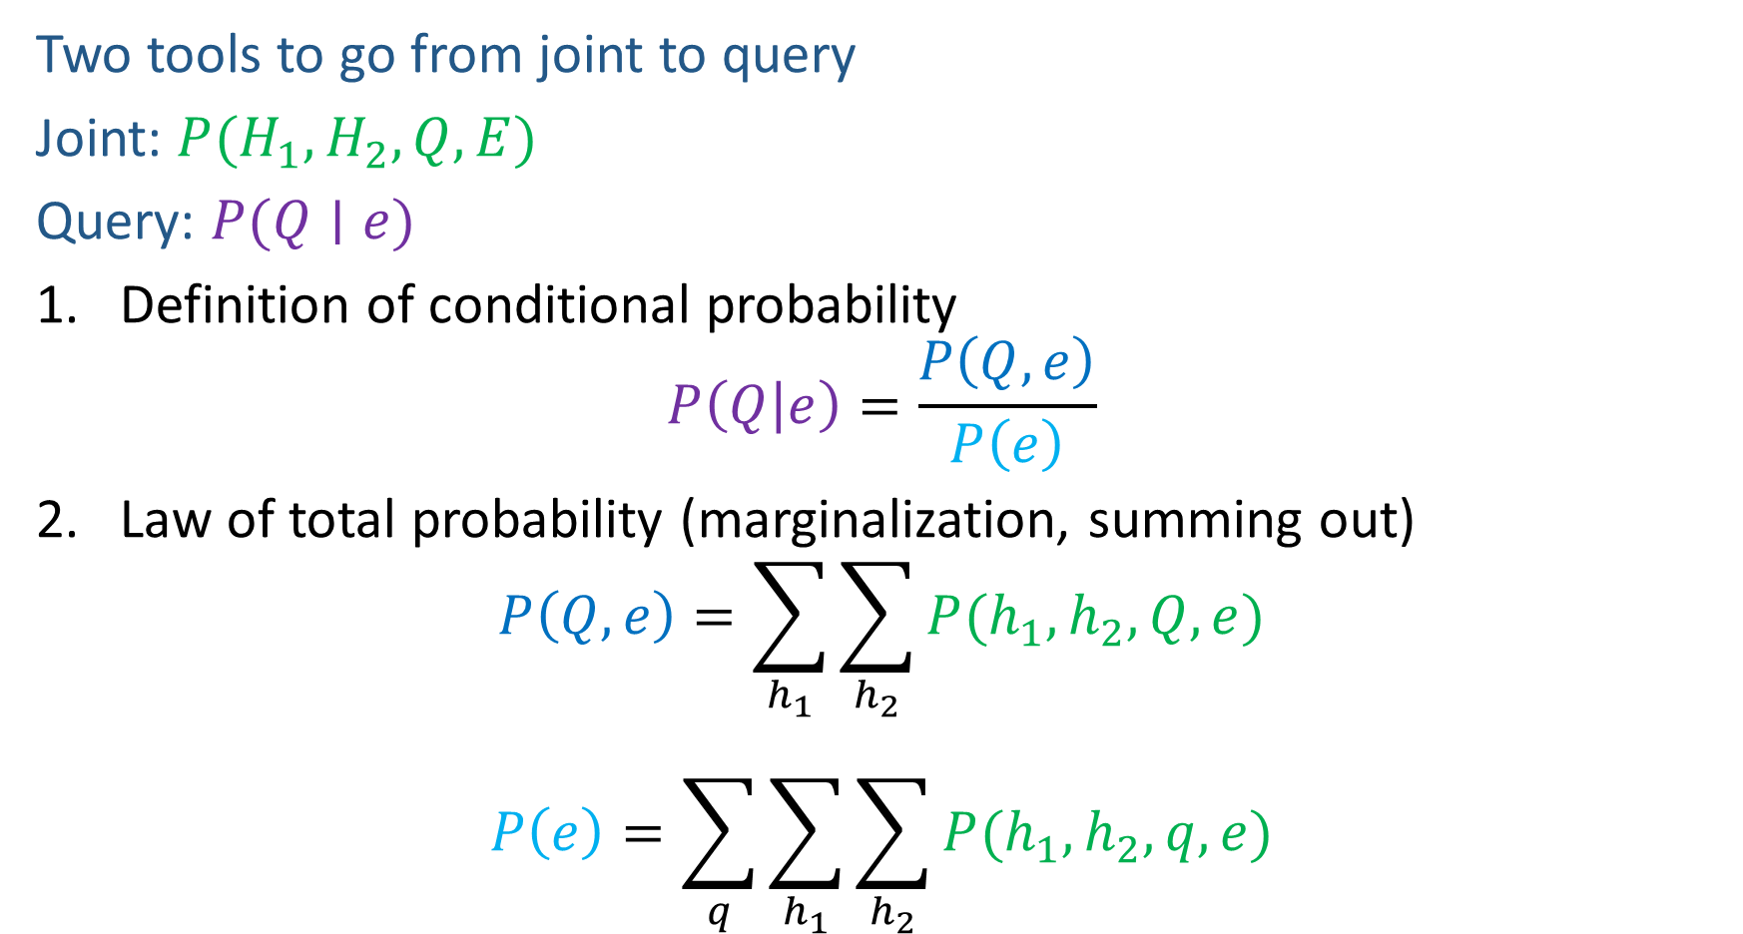

Answer Any Query from Joint Distribution
Two tools to go from joint to query
Joint: $P(H_{1}, H_{2}, Q, E)$
Query: $P(Q∣e)$
Definition of conditional probability
$$P\left(Q | e\right)=\frac{P\left(Q,e\right)}{P\left(e\right)}$$
Law of total probability (marginalization, summing out)
$$P\left(Q,e\right)=\sum_{h_{1}}{\sum_{h_{2}}{P(h_{1},h_{2},Q, e)}}$$
$$P\left(e\right)=\sum_{q}{\sum_{h_{1}}{\sum_{h_{2}}{P(h_{1},h_{2}, q,e)}}}$$

Slide 29
Answer Any Query from Joint Distribution
P(Weather)?
P(Weather | winter)?
P(Weather | winter, hot)?
Season | Temp | Weather | P(S, T, W)
summer | hot | sun | 0.30
summer | hot | rain | 0.05
summer | cold | sun | 0.10
summer | cold | rain | 0.05
winter | hot | sun | 0.10
winter | hot | rain | 0.05
winter | cold | sun | 0.15
winter | cold | rain | 0.20

Slide 30
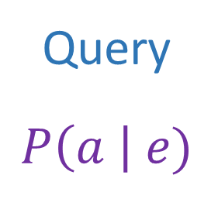
Answer Any Query from Joint Distribution
Joint distributions are the best!
Problems with joints
We aren’t given the joint table
Usually some set of conditional probability tables
Joint
Query
$$P\left(a \right| e)$$

Slide 31

Build Joint Distribution Using Chain Rule
Conditional Probability Tables and Chain Rule
Joint
Query
$$P\left(a \right| e)$$
$P\left(A\right) P\left(B | A\right) P\left(C | A,B\right) P\left(D | A,B,C\right)$ $P(E|A, B,C,D)$

Slide 32

Build Joint Distribution Using Chain Rule
Two tools to construct joint distribution
Product rule
$$P\left(A,B\right)=P\left(A ∣ B\right)P\left(B\right)$$
$$P\left(A,B\right)=P\left(B ∣ A\right)P(A)$$
Chain rule
$$P\left(X_{1},X_{2},…,X_{n} \right)=\prod_{i}{P\left(X_{i} ∣ X_{1},…,X_{i−1}\right)}$$
$P\left(A,B,C\right)=P\left(A\right)P\left(B ∣ A\right)P\left(C ∣ A, B\right)$ for ordering A, B, C
$P\left(A,B,C\right)=P\left(A\right)P\left(C ∣ A\right)P\left(B ∣ A,C\right)$ for ordering A, C, B
$P\left(A,B,C\right)=P\left(C\right)P\left(B ∣ C\right)P\left(A ∣ C,B\right)$ for ordering C, B, A
$$…$$

Slide 33


Build Joint Distribution Using Chain Rule
Binary random variables
Fire
Smoke
Alarm

Slide 34



Poll 3
Variables
B: Burglary
A: Alarm goes off
M: Mary calls
J: John calls
E: Earthquake!
How many different ways can we write the chain rule?
$1$
$5$
$5 choose 5$
$5!$
$5^{5}$

Slide 35
Build Joint Distribution Using Chain Rule
Conditional Probability Tables and Chain Rule
Joint
Query
$$P\left(a \right| e)$$
$P\left(A\right) P\left(B | A\right) P\left(C | A,B\right) P\left(D | A,B,C\right)$ $P(E|A, B,C,D)$

Slide 36
Answer Any Query from Condition Probability Tables
Process to go from (specific) conditional probability tables to query
Construct the joint distribution
Product Rule or Chain Rule
Answer query from joint
Definition of conditional probability
Law of total probability (marginalization, summing out)

Slide 37

Answer Any Query from Condition Probability Tables
Bayes’ rule as an example
Given: $P\left(E | Q\right), P\left(Q\right)$ Query: $P(Q∣e)$
Construct the joint distribution
Product Rule or Chain Rule
$$P\left(E,Q\right)=P\left(E | Q\right)P(Q)$$
Answer query from joint
Definition of conditional probability
$$P\left(Q ∣ e\right)=\frac{P\left(e, Q\right)}{P\left(e\right)}$$
Law of total probability (marginalization, summing out)
$$P\left(Q ∣ e\right)=\frac{P\left(e, Q\right)}{\sum_{q}{P(e,q)}}$$

Slide 38






Bayesian Networks
Bayes net
One node per random variable
DAG
One CPT per node: P(node | Parents(node) )
$$A$$
$$B$$
$$C$$
$$D$$
$$P\left(A, B, C, D\right)=P\left(A\right) P\left(B | A\right) P\left(C | A,B\right) P\left(D | A,B,C\right)$$
Encode joint distributions as product of conditional distributions on each variable
$$P\left(X_{1},…,X_{N}\right)=\prod_{i}{P\left(X_{i}\right| Parents(X_{i})) }$$

Slide 39

Build Bayes Net Using Chain Rule
Binary random variables
Fire
Smoke
Alarm

Slide 40






Question
$$B$$
$$A$$
Variables
B: Burglary
A: Alarm goes off
M: Mary calls
J: John calls
E: Earthquake!
Given the Bayes net, write the joint distribution?
$$M$$
$$E$$
$$J$$

Slide 41

Answer Any Query from Bayes Net
Joint
Bayes Net and
Conditional Probability Tables
$$A$$
Query
$$P\left(a \right| e)$$
$$B$$
$$C$$
$$D$$

Slide 42
Answer Any Query from Condition Probability Tables
Conditional Probability Tables and Chain Rule
Joint
Query
$$P\left(a \right| e)$$
$P\left(A\right) P\left(B | A\right) P\left(C | A,B\right) P\left(D | A,B,C\right)$ $P(E|A, B,C,D)$

Slide 43

Answer Any Query from Condition Probability Tables
Conditional Probability Tables and Chain Rule
Problems
Huge
$n$ variables with $d$ values
$d^{n}$ entries
We aren’t given the right tables
$P\left(A\right) P\left(B | A\right) P\left(C | A,B\right) P\left(D | A,B,C\right)$ $P(E|A, B,C,D)$

Slide 44
Do We Need the Full Chain Rule?
Binary random variables
Fire
Smoke
Alarm

Slide 45
Answer Any Query from Condition Probability Tables
Conditional Probability Tables and Chain Rule
Joint
Query
$$P\left(a \right| e)$$
$P\left(A\right) P\left(B | A\right) P\left(C | A,B\right) P\left(D | A,B,C\right)$ $P(E|A, B,C,D)$

Slide 46

Answer Any Query from Condition Probability Tables
Bayes Net
Joint
Query
$$P\left(a \right| e)$$
$$P\left(A\right) P\left(B | A\right) P\left(C | A\right) P\left(D | C\right) P(E|C)$$
$$P\left(X_{1},…,X_{N}\right)=\prod_{i}{P\left(X_{i}\right| Parents(X_{i})) }$$

