Slide 1
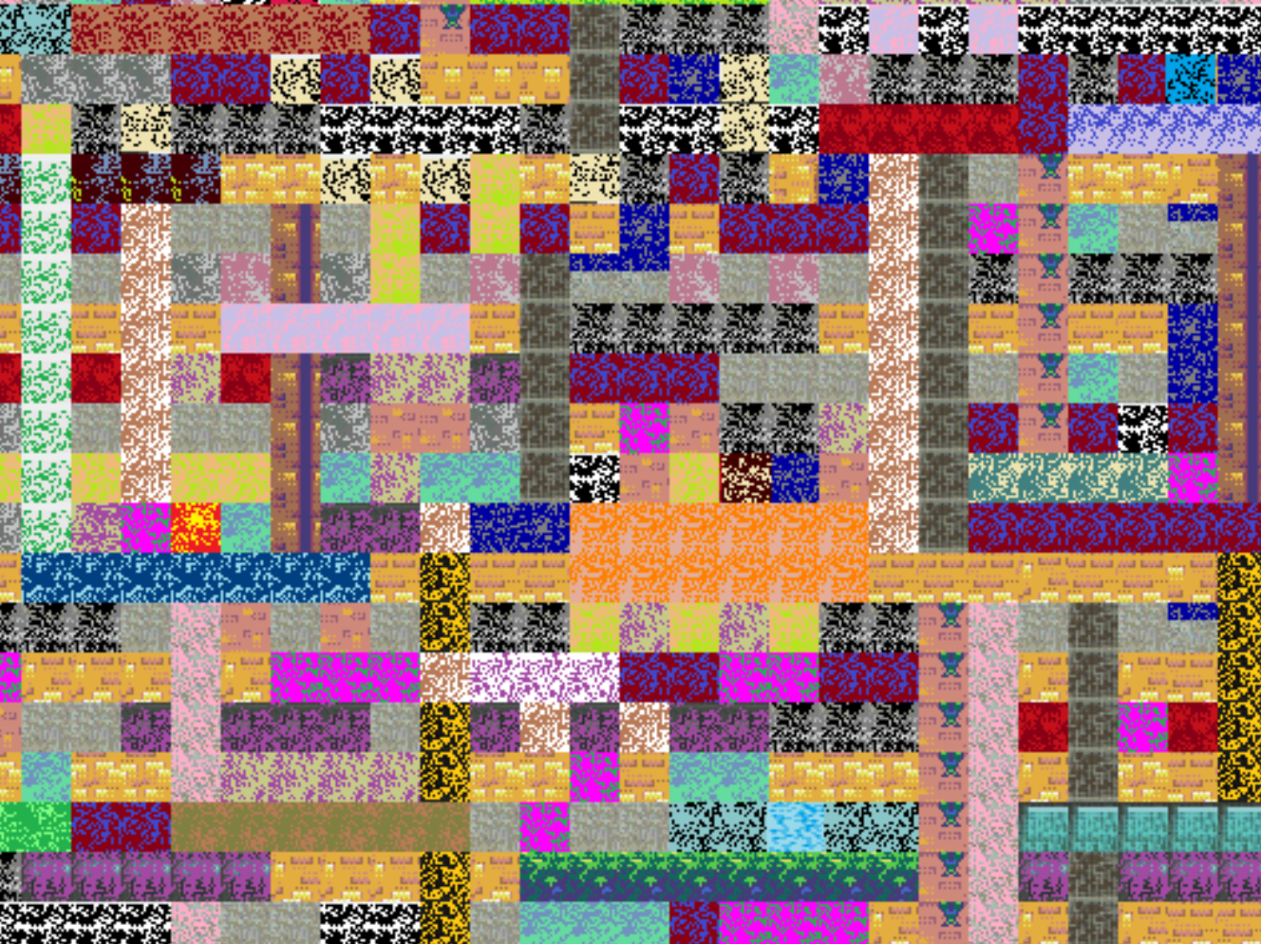
Try if you’d like…
https://high-level-4.herokuapp.com/experiment
https://rach0012.github.io/humanRL_website/

Slide 2
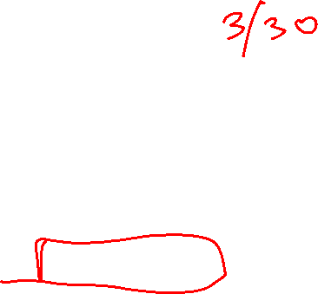
Announcements
Assignments
P3: Logic Plan and Classical Planning due Tomorrow 3/17 10pm
HW7 (written) due Tuesday 3/21 10pm
HW8 (online) due Tuesday 3/28 10pm
Coming up
Midterm 2
Review Session – TBA
Topics: Logic, Classical Planning, MDPs, RL, Probability, Bayes Nets up to 3/28
More info next week
Midsemester and TA Feedback form! See Piazza – 1 participation point

Slide 3
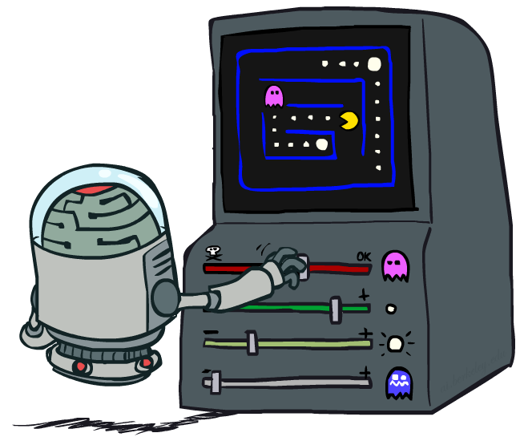
AI: Representation and Problem Solving
Reinforcement Learning II
Instructor: Stephanie Rosenthal
Slide credits: CMU AI and http://ai.berkeley.edu

Slide 4

Reinforcement Learning
We still assume an MDP:
  A set of states s ∈ S
  A set of actions (per state) A
  A model T(s,a,s’)
  A reward function R(s,a,s’)
Still looking for a policy π(s)
New twist: don’t know T or R, so must try out actions
Big idea: Compute all averages over transition probabilities using sample outcomes

Slide 5
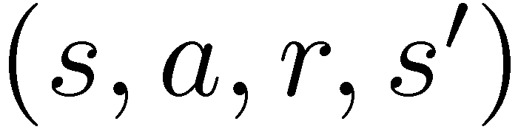
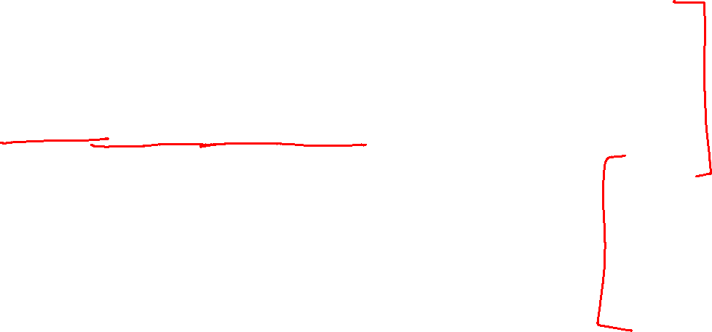
Model-Free Learning
s
Model-free (temporal difference) learning
  Experience world through episodes
  Update estimates each transition
  Over time, updates will mimic Bellman updates
a
s, a
r
s’
a’
s’, a’
s’’

Slide 6
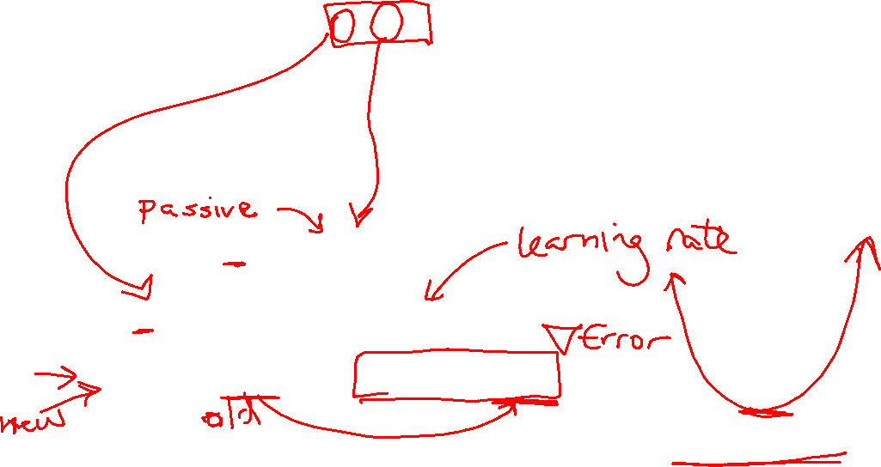

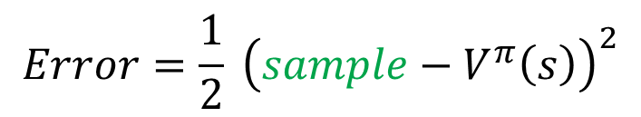


Temporal Difference Learning
Big idea: learn from every experience!
  Update V(s) each time we experience a transition (s, a, s’, r)
  Likely outcomes s’ will contribute updates more often
Temporal difference learning of values
  Policy still fixed, still doing evaluation!
  Move values toward value of whatever successor occurs: running average
s
π(s)
s, π(s)
s’
Sample of V(s):
$$sample= r+γ V^{π}\left(s^{′}\right)$$
Update to V(s):
$$V^{π}\left(s\right) ← {\left(1−α\right) V}^{π}\left(s\right)+(α) sample$$
Same update:
$$V^{π}\left(s\right) ← V^{π}(s) +α \left[sample− V^{π}\left(s\right)\right]$$
$$Error=\frac{1}{2} {\left(sample−V^{π}\left(s\right)\right)}^{2}$$
Same update:
$$V^{π}\left(s\right) ← V^{π}\left(s\right)−α∇Error$$

Slide 7
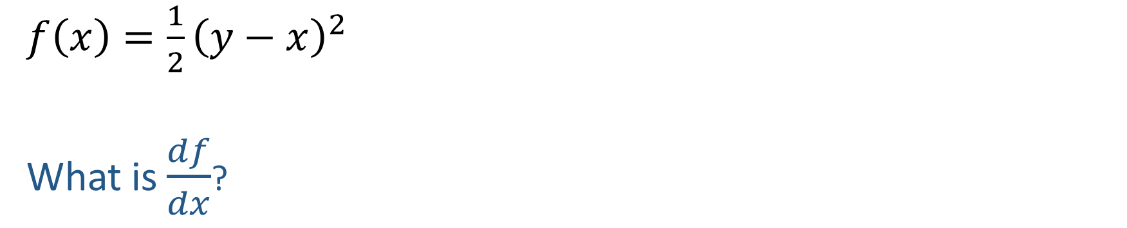
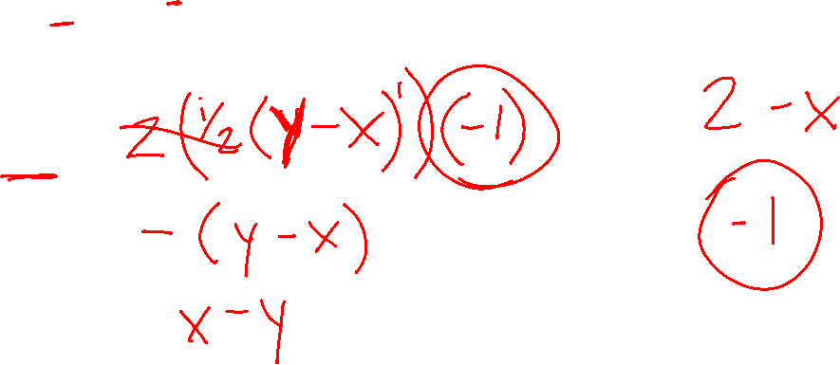
Quick Calculus Quiz
$f\left(x\right)=\frac{1}{2}{\left(y−x\right)}^{2}$
What is $\frac{df}{dx}$?

Slide 8

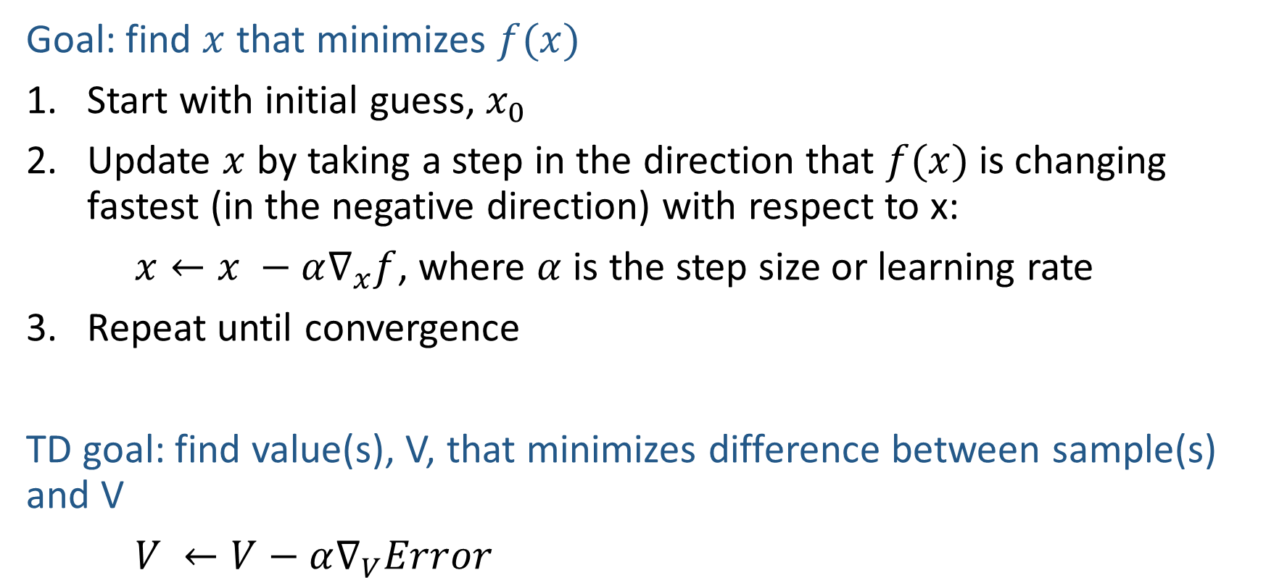
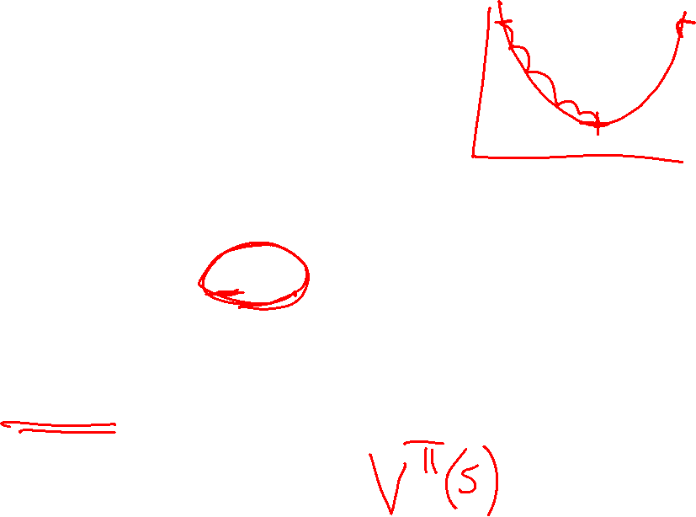
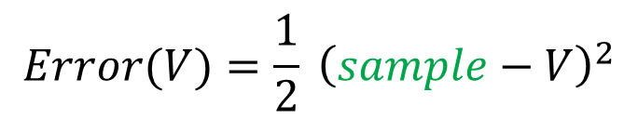
Gradient Descent
$$f\left(x\right)=\frac{1}{2}{\left(y−x\right)}^{2}$$
$$\frac{df}{dx}=−(y−x)$$
Goal: find $x$ that minimizes $f(x)$
Start with initial guess, $x_{0}$
Update $x$ by taking a step in the direction that $f(x)$ is changing fastest (in the negative direction) with respect to x:
$x←x −α∇_{x}f$, where $α$ is the step size or learning rate
Repeat until convergence
TD goal: find value(s), V, that minimizes difference between sample(s) and V
$V ←V−α∇_{V}Error$
$$Error(V)=\frac{1}{2} {\left(sample−V\right)}^{2}$$

Slide 9
Temporal Difference Learning
Big idea: learn from every experience!
  Update V(s) each time we experience a transition (s, a, s’, r)
  Likely outcomes s’ will contribute updates more often
Temporal difference learning of values
  Policy still fixed, still doing evaluation!
  Move values toward value of whatever successor occurs: running average
s
π(s)
s, π(s)
s’
Sample of V(s):
$$sample= r+γ V^{π}\left(s^{′}\right)$$
Update to V(s):
$$V^{π}\left(s\right) ← {\left(1−α\right) V}^{π}\left(s\right)+(α) sample$$
Same update:
$$V^{π}\left(s\right) ← V^{π}(s) +α \left[sample− V^{π}\left(s\right)\right]$$
$$Error=\frac{1}{2} {\left(sample−V^{π}\left(s\right)\right)}^{2}$$
Same update:
$$V^{π}\left(s\right) ← V^{π}\left(s\right)−α∇Error$$

Slide 10

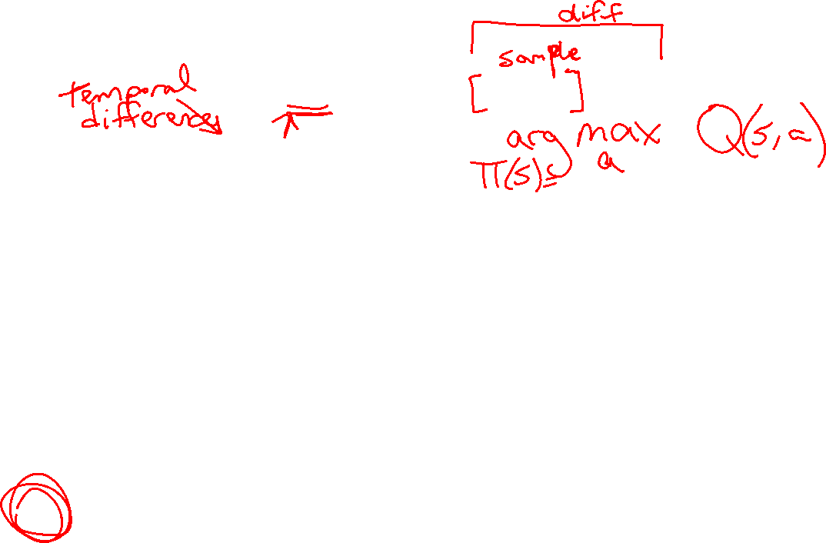
Poll 1
TD update:
$$V^{π}\left(s\right) = V^{π}(s) +α \left[r+γ V^{π}\left(s^{′}\right)− V^{π}\left(s\right)\right]$$
Which converts TD values into a policy?
$$V_{k+1}\left(s\right)=\max_{a}{\sum_{s′}{P\left(s^{′} | s,a\right)\left[R\left(s,a,s^{′}\right)+γV_{k}\left(s^{′}\right)\right]}}, ∀ s$$
$$Q_{k+1}\left(s,a\right)=\sum_{s′}{P\left(s^{′} | s,a\right)[R\left(s,a,s^{′}\right)+γ\max_{a^{′}}{Q_{k}(s^{′},a^{′})]}, } ∀ s,a$$
$$π_{V}\left(s\right)=\underset{a}{argmax}{\sum_{s′}{P\left(s^{′} | s,a\right)[R\left(s,a,s^{′}\right)+γV\left(s^{′}\right)]}}, ∀ s$$
$$V_{k+1}^{π}\left(s\right)=\sum_{s′}{P\left(s^{′} | s,π\left(s\right)\right)[R\left(s,π\left(s\right),s^{′}\right)+γV_{k}^{π}\left(s^{′}\right)]}, ∀ s$$
$$π_{new}\left(s\right)=\underset{a}{argmax}{\sum_{s′}{P\left(s^{′} | s,a\right)\left[R\left(s,a,s^{′}\right)+γV^{π_{old}}\left(s^{′}\right)\right]}}, ∀ s$$
A) Value iteration:
B) Q-iteration:
C) Policy extraction:
D) Policy evaluation:
E) Policy improvement:
F) None of the above

Slide 11
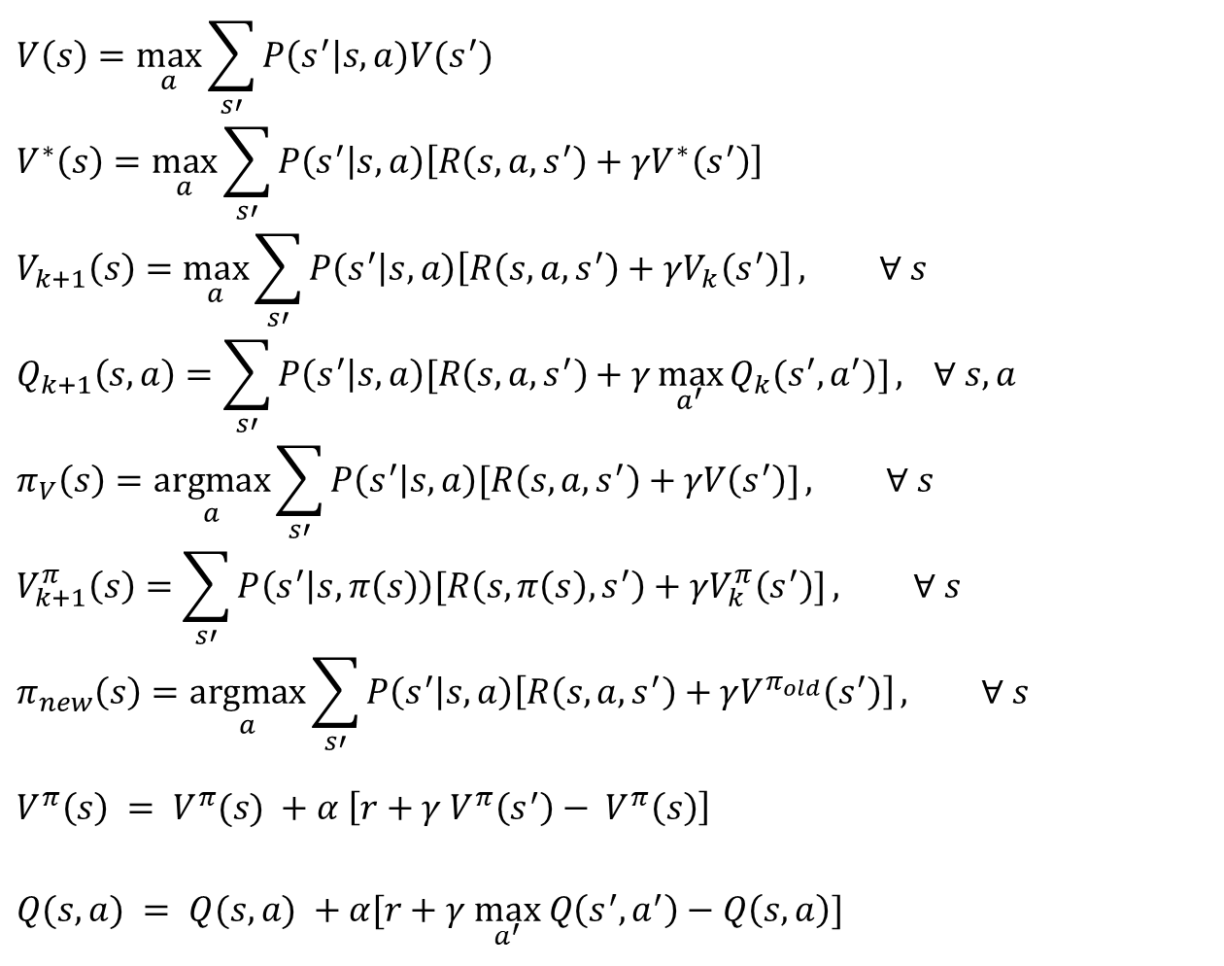
MDP/RL Notation
Standard expectimax:
$$V\left(s\right)=\max_{a}{\sum_{s′}{P\left(s^{′}\right|s,a)V(s^{′})}}$$
$$V^{∗}\left(s\right)=\max_{a}{\sum_{s′}{P\left(s^{′} | s,a\right)\left[R\left(s,a,s^{′}\right)+γV^{∗}\left(s^{′}\right)\right]}}$$
$$V_{k+1}\left(s\right)=\max_{a}{\sum_{s′}{P\left(s^{′} | s,a\right)\left[R\left(s,a,s^{′}\right)+γV_{k}\left(s^{′}\right)\right]}}, ∀ s$$
$$Q_{k+1}\left(s,a\right)=\sum_{s′}{P\left(s^{′} | s,a\right)[R\left(s,a,s^{′}\right)+γ\max_{a^{′}}{Q_{k}(s^{′},a^{′})]}, } ∀ s,a$$
$$π_{V}\left(s\right)=\underset{a}{argmax}{\sum_{s′}{P\left(s^{′} | s,a\right)[R\left(s,a,s^{′}\right)+γV\left(s^{′}\right)]}}, ∀ s$$
$$V_{k+1}^{π}\left(s\right)=\sum_{s′}{P\left(s^{′} | s,π\left(s\right)\right)[R\left(s,π\left(s\right),s^{′}\right)+γV_{k}^{π}\left(s^{′}\right)]}, ∀ s$$
$$π_{new}\left(s\right)=\underset{a}{argmax}{\sum_{s′}{P\left(s^{′} | s,a\right)\left[R\left(s,a,s^{′}\right)+γV^{π_{old}}\left(s^{′}\right)\right]}}, ∀ s$$
$$V^{π}\left(s\right) = V^{π}(s) +α \left[r+γ V^{π}\left(s^{′}\right)− V^{π}\left(s\right)\right]$$
$Q(s,a) = Q(s,a) +α[r+γ \max_{a^{′}} Q\left(s^{′},a^{′}\right)−Q\left(s, a\right)]$
Bellman equations:
Value iteration:
Q-iteration:
Policy extraction:
Policy evaluation:
Policy improvement:
Value (TD) learning:
Q-learning:

Slide 12
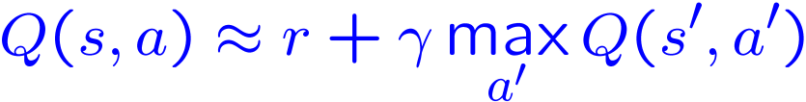
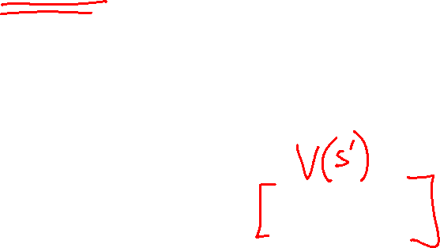
Q-Learning
We’d like to do Q-value updates to each Q-state:
  But can’t compute this update without knowing T, R
Instead, compute average as we go
  Receive a sample transition (s,a,r,s’)
  This sample suggests
  But we want to average over results from (s,a) (Why?)
  So keep a running average

Slide 13
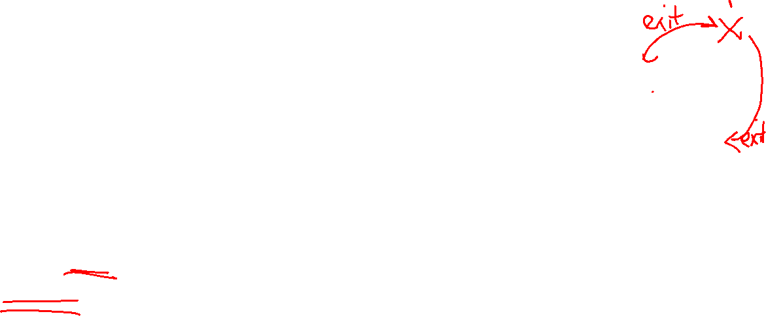
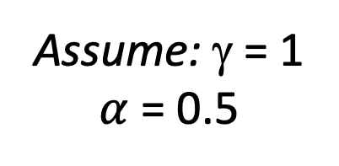
Q-Learning + Lecture 14 Poll 2
Input S,A
Observed Episodes (Training)
Output Q-Values
Episode 1
Episode 2
 | A
B | C | D
 | E
B, east, C, -1
C, east, D, -1
D, exit, x, +10
B, east, C, -1
C, east, D, -1
D, exit, x, +10
 | A
B | C | D
 | E
Episode 3
Episode 4
E, north, C, -1
C, east, D, -1
D, exit, x, +10
E, north, C, -1
C, east, A, -1
A, exit, x, -10
Assume: γ = 1
$α$ = 0.5
Notes:
For episode 1:
Initialize all Qs to 0
Q(B,East) = -.5
Q(C,East) = -.5
Q(D,exit) = 5
Episode 2:
Q(B,East) = -.75 = (.5*-.5)+(.5*(-1+0))
Q(C,East) = 1.75 = (.5*-.5)+(.5*(-1+5))
Q(D,exit) = 7.5
Episode 3:
Q(E,North) = 0.375
Q(C,East) = 4.125
Q(D,exit) = 8.75
Episode 4:
Q(E,North) = 1.75
Q(C,East) = 1.5625
Q(A,exit) = -5

Slide 14

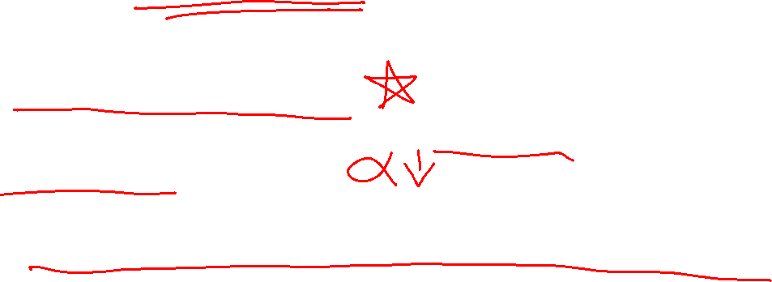
Q-Learning Properties
Amazing result: Q-learning converges to optimal policy -- even if you’re acting suboptimally!
This is called off-policy learning
Caveats:
  You have to explore enough
  You have to eventually make the learning rate
  small enough
  … but not decrease it too quickly
  Basically, in the limit, it doesn’t matter how you select actions (!)

Slide 15
The Story So Far: MDPs and RL
Known MDP: Offline Solution
Goal Technique
Compute V*, Q*, π* Value / policy iteration
Evaluate a fixed policy π Policy evaluation
Unknown MDP: Model-Based
Unknown MDP: Model-Free
Goal Technique
Compute V*, Q*, π* VI/PI on approx. MDP
Evaluate a fixed policy π PE on approx. MDP
Goal Technique
Compute V*, Q*, π* Q-learning
Evaluate a fixed policy π TD/Value Learning

Slide 16
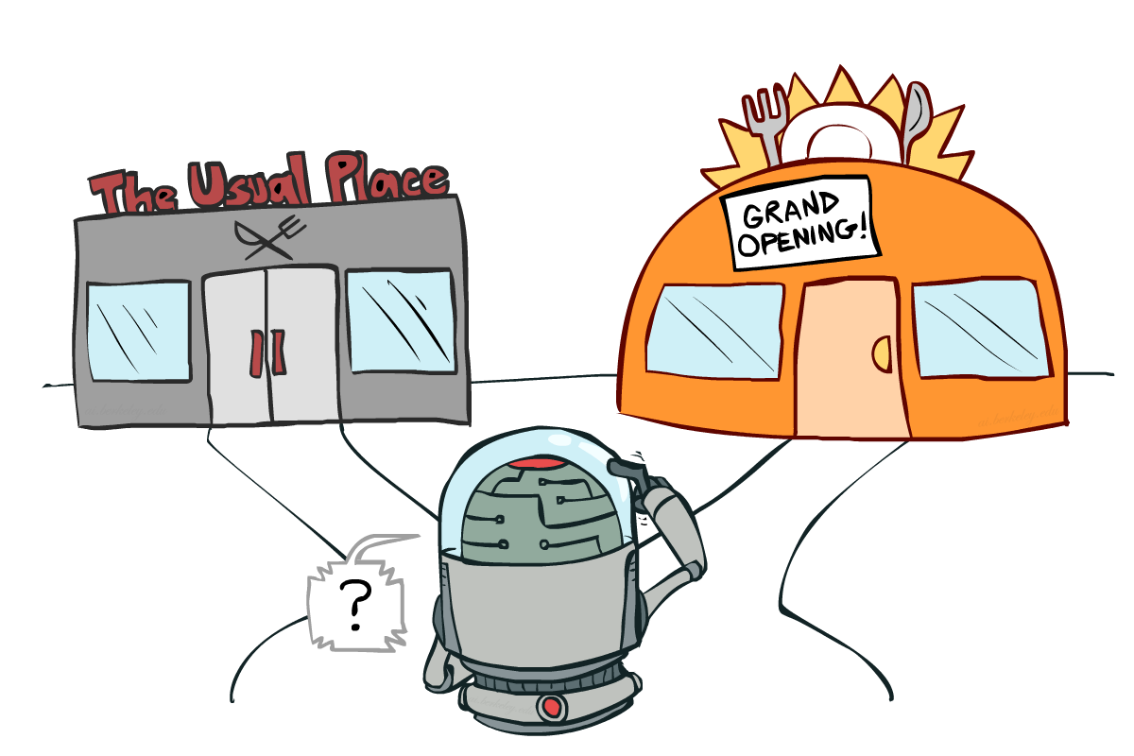

Exploration vs. Exploitation

Slide 17

How to Explore?
Several schemes for forcing exploration
  Simplest: random actions (ε-greedy)
    Every time step, flip a coin
    With (small) probability ε, act randomly
    With (large) probability 1-ε, act on current policy
  Problems with random actions?

Slide 18
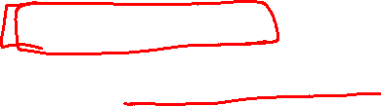
How to Explore?
Several schemes for forcing exploration
  Simplest: random actions (ε-greedy)
    Every time step, flip a coin
    With (small) probability ε, act randomly
    With (large) probability 1-ε, act on current policy
  Problems with random actions?
    You do eventually explore the space, but keep thrashing around once learning is done
    One solution: lower ε over time
    Another solution: exploration functions

Slide 19
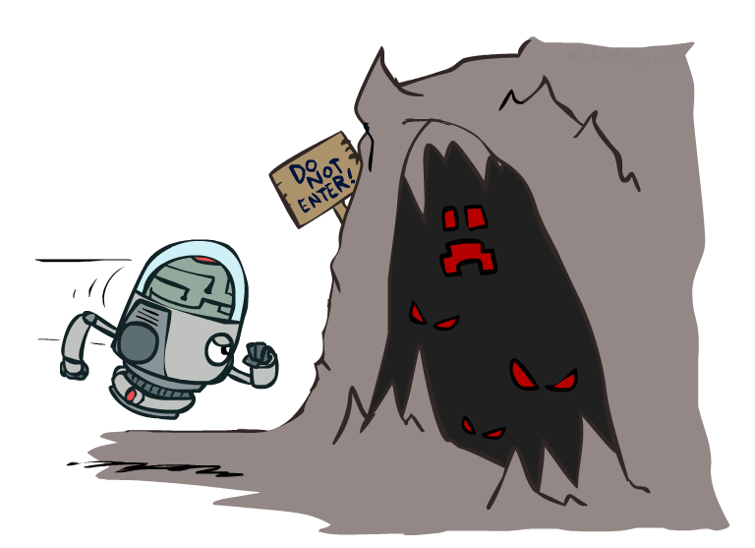
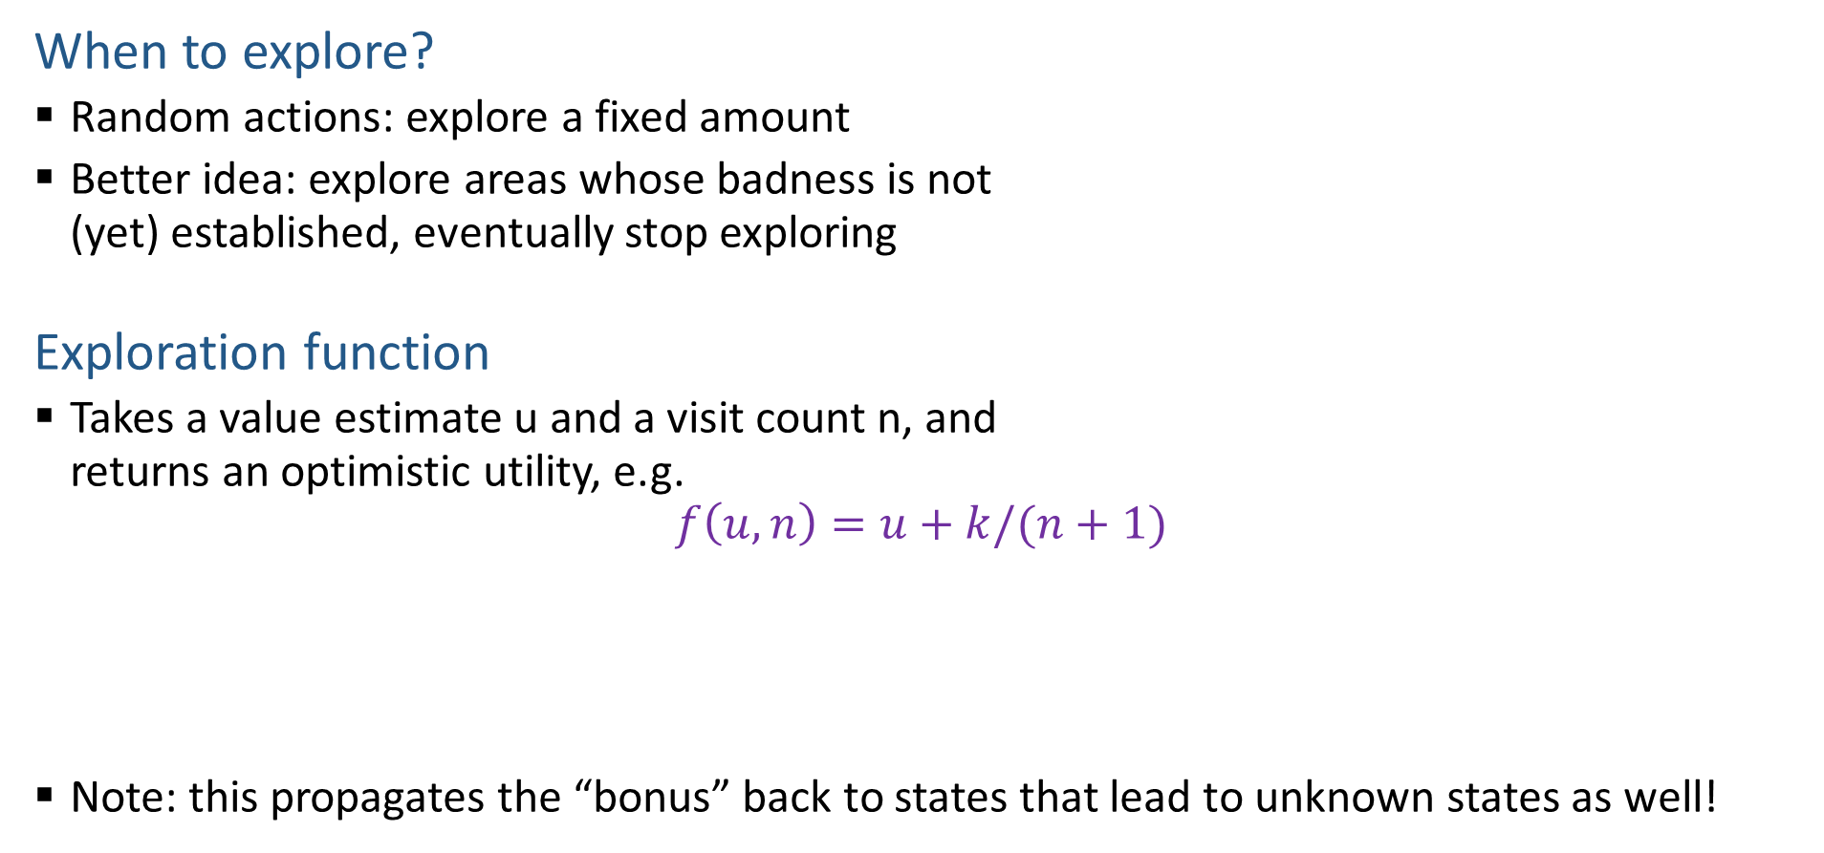
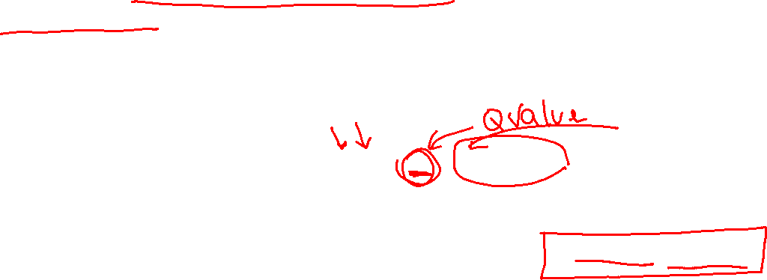
Exploration Functions
When to explore?
  Random actions: explore a fixed amount
  Better idea: explore areas whose badness is not
  (yet) established, eventually stop exploring
Exploration function
  Takes a value estimate u and a visit count n, and
  returns an optimistic utility, e.g.
  $$f\left(u, n\right)=u+k/(n+1)$$
  Note: this propagates the “bonus” back to states that lead to unknown states as well!
Regular Q-Update: $Q\left(s, a\right)=Q\left(s,a\right)+α [r+γ\max_{a^{′}} Q\left(s^{′}, a^{′}\right) −Q\left(s, a\right)]$
Modified Q-Update: $Q\left(s, a\right)=Q\left(s,a\right)+α [r+γ\max_{a^{′}} f(Q\left(s^{′}, a^{′}\right), N\left(s^{′}, a^{′}\right)) −Q\left(s, a\right)]$

Slide 20
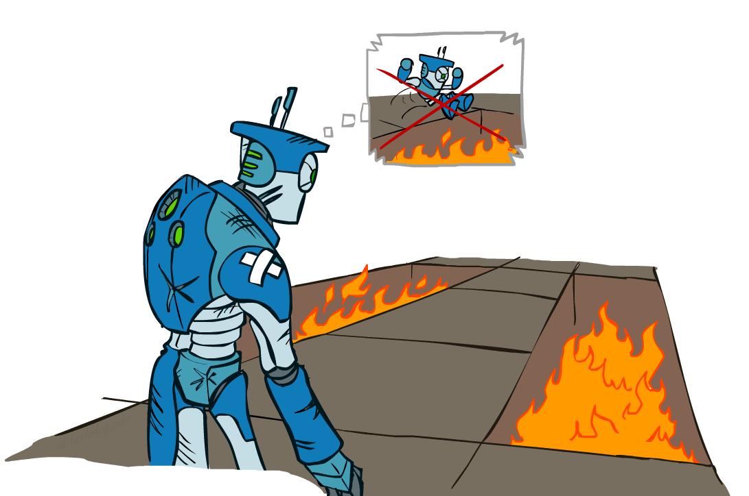
Regret
Even if you learn the optimal policy, you still make mistakes along the way!
Regret is a measure of your total mistake cost: the difference between your (expected) rewards, including youthful suboptimality, and optimal (expected) rewards
Minimizing regret goes beyond learning to be optimal – it requires optimally learning to be optimal
Example: random exploration and exploration functions both end up optimal, but random exploration has higher regret

Slide 21
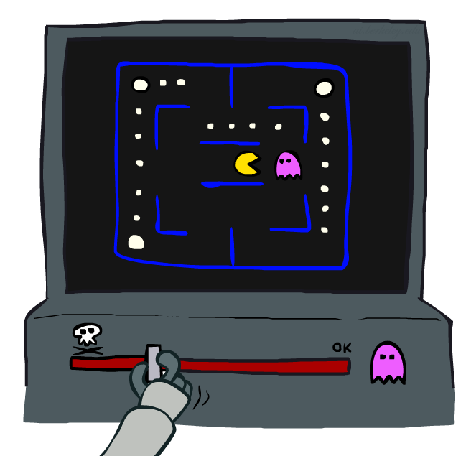
Approximate Q-Learning
Notes:
:34 in, :40 to go

Slide 22
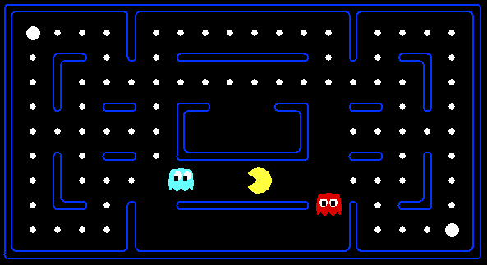



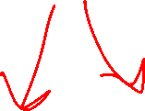
Example: Pacman
Let’s say we discover through experience that this state is bad:
In naïve q-learning, we know nothing about this state:
Or even this one!

Slide 23

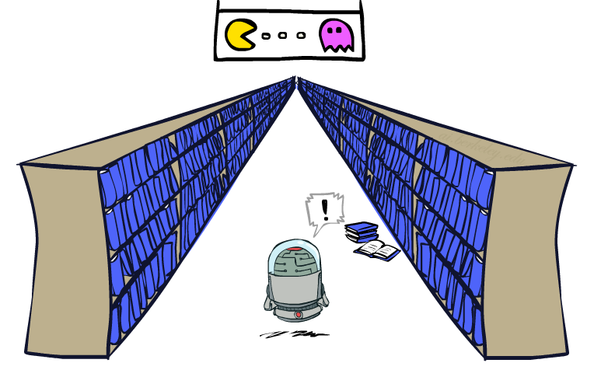
Generalizing Across States
Basic Q-Learning keeps a table of all q-values
In realistic situations, we cannot possibly learn about every single state!
  Too many states to visit them all in training
  Too many states to hold the q-tables in memory
Instead, we want to generalize:
  Learn about some small number of training states from experience
  Generalize that experience to new, similar situations
  This is a fundamental idea in machine learning, and we’ll see it over and over again
[demo – RL pacman]

Slide 24
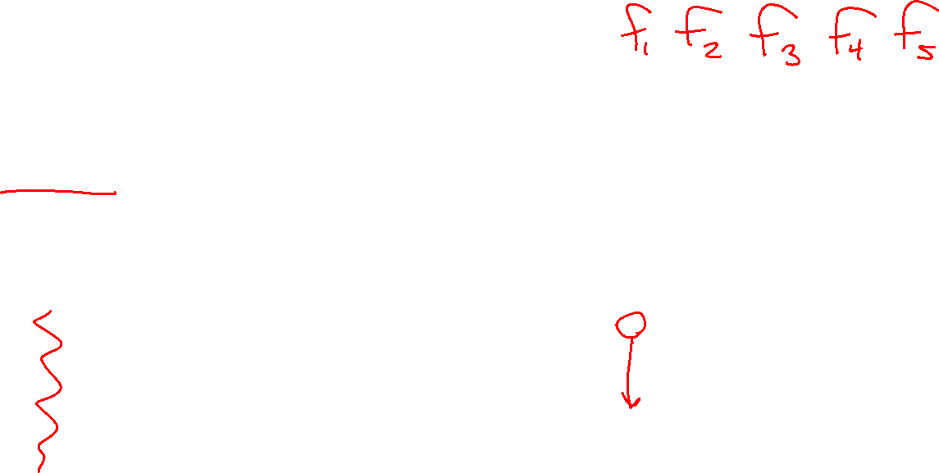
Feature-Based Representations
Solution: describe a state using a vector of features (properties)
  Features are functions from states to real numbers (often 0/1) that capture important properties of the state
  Can also describe a q-state (s, a) with features (e.g. action moves closer to food)
  Example features:
Notes:
Distance to closest ghost
Distance to closest dot
Number of ghosts
1 / (dist to dot)²
Is Pacman in a tunnel? (0/1)
…… etc.
Is it the exact state on this slide?

Slide 25
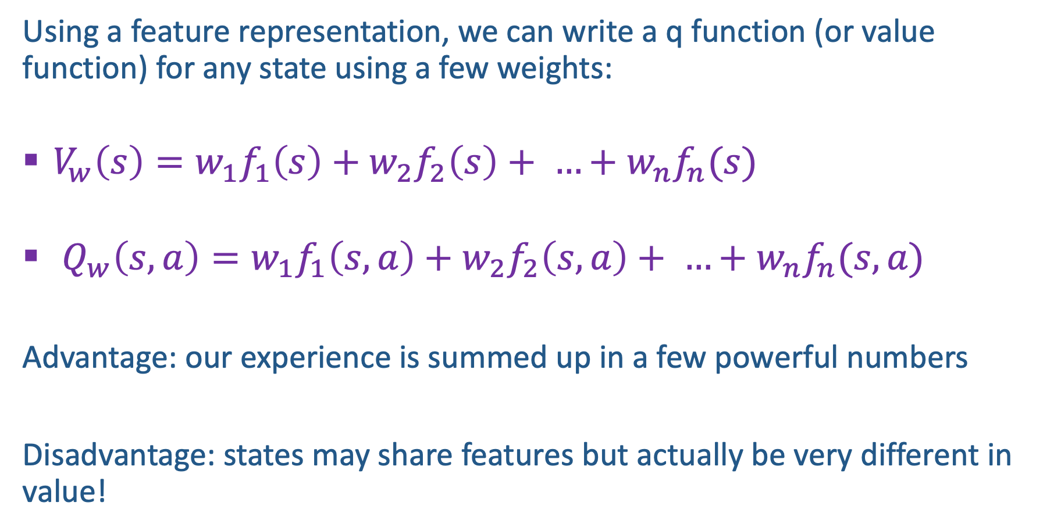
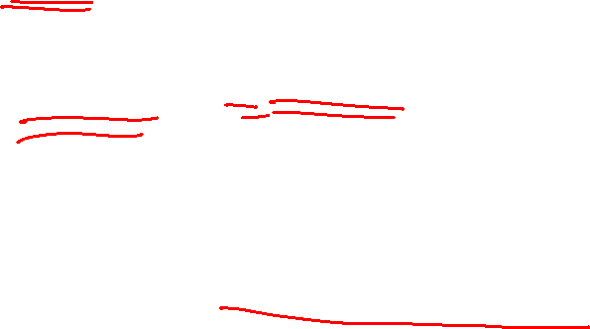
Linear Value Functions
Using a feature representation, we can write a q function (or value function) for any state using a few weights:
  $V_{w}\left(s\right)=w_{1}f_{1}\left(s\right)+w_{2}f_{2}\left(s\right)+ …+w_{n}f_{n}(s)$
  $Q_{w}\left(s,a\right)=w_{1}f_{1}\left(s,a\right)+w_{2}f_{2}\left(s,a\right)+ …+w_{n}f_{n}(s,a)$
Advantage: our experience is summed up in a few powerful numbers
Disadvantage: states may share features but actually be very different in value!

Slide 26

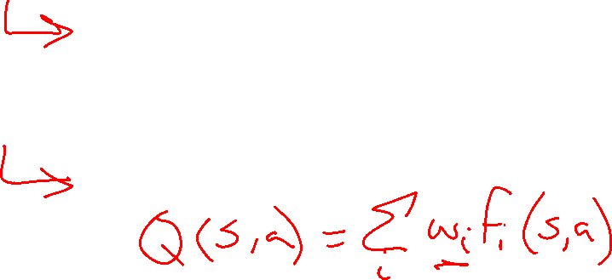
Updating a linear value function
Original Q learning rule tries to reduce prediction error at s, a:
    $Q\left(s,a\right)←Q\left(s,a\right)+α[R\left(s,a,s^{′}\right)+γ \max_{a^{′}} Q\left(s^{′},a^{′}\right)−Q\left(s,a\right)]$
Instead, we update the weights to try to reduce the error at s, a:
      $w_{i}← ?$

Slide 27
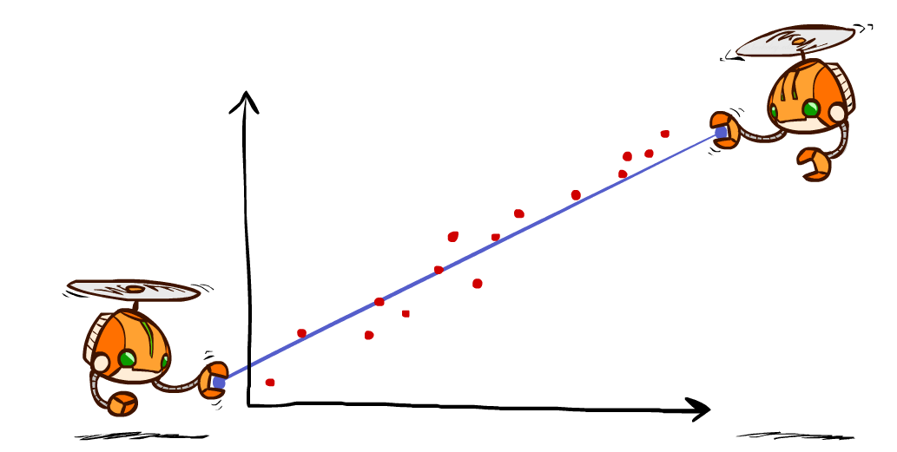
Detour: Minimizing Error and Least Squares
Notes:
DK :57 in, :17 to go

Slide 28
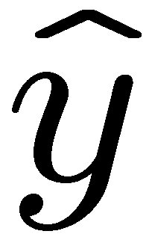
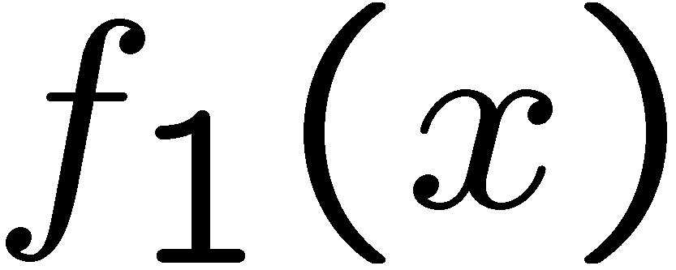
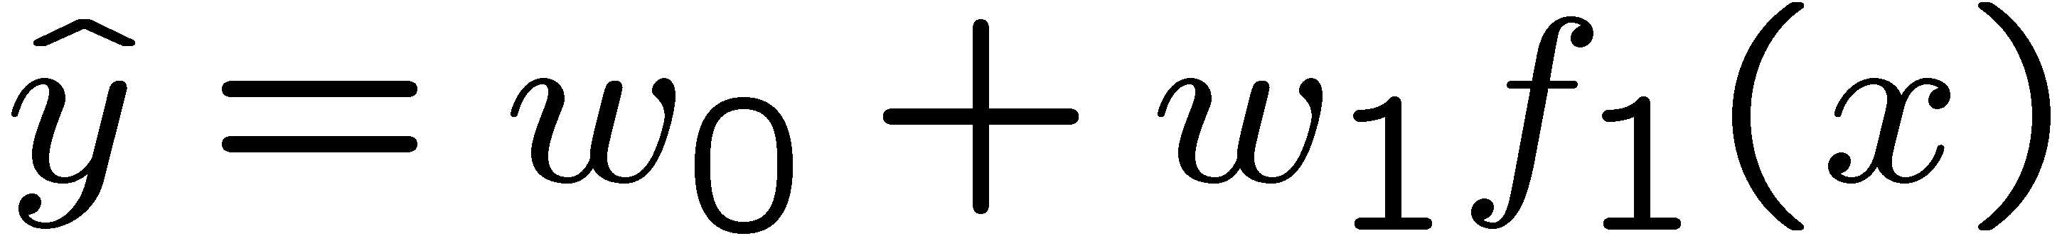
Linear Approximation: Regression
40
26
24
20
22
20
30
20
40
0
0
20
30
10
20
0
10
0
Prediction:
Prediction:
Notes:
Figure 1: scatter(1:20,10+(1:20)+2*randn(1,20),'k','filled'); a=axis; a(3)=0; axis(a);

Slide 29
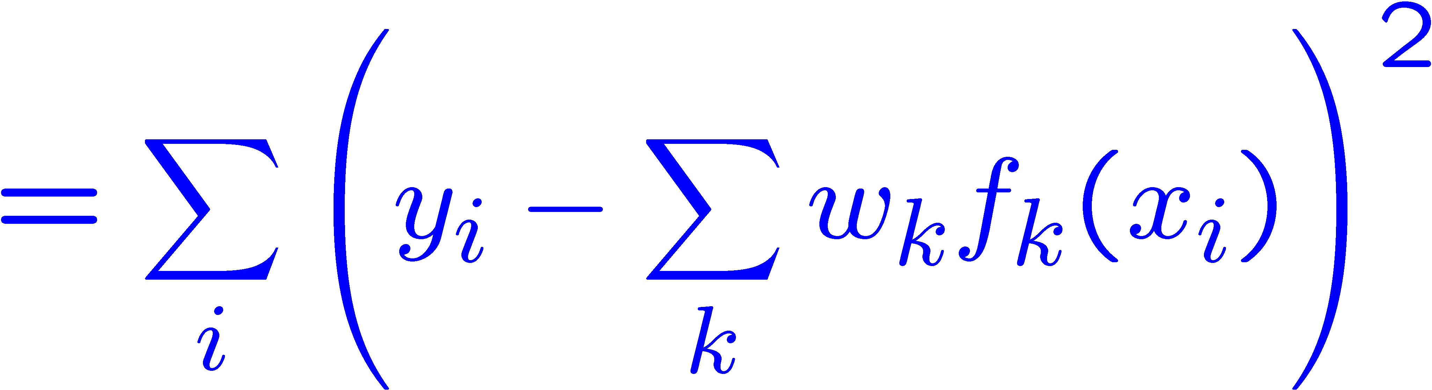
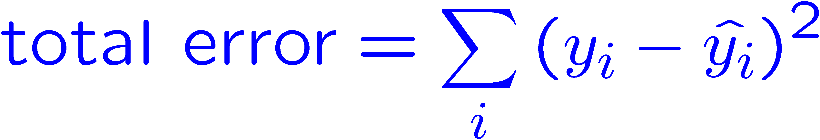
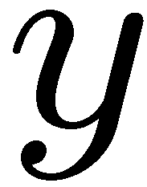
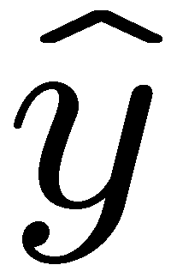

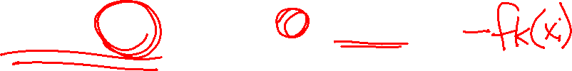
Optimization: Least Squares
Error or “residual”
Observation
Prediction
0
0
20
Notes:
Figure 1: scatter(1:20,10+(1:20)+2*randn(1,20),'k','filled'); a=axis; a(3)=0; axis(a);

Slide 30

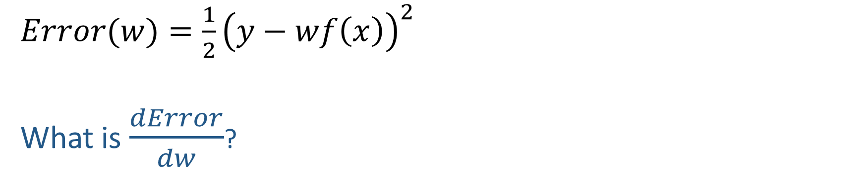
Quick Calculus Quiz
Last time
$$Error\left(x\right)=\frac{1}{2}{\left(y−x\right)}^{2}$$
$$\frac{dError}{dx}=−(y−x)$$
$Error(w)=\frac{1}{2}{\left(y−wf\left(x\right)\right)}^{2}$
What is $\frac{dError}{dw}$?

Slide 31
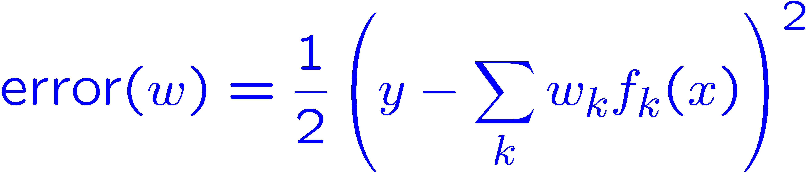
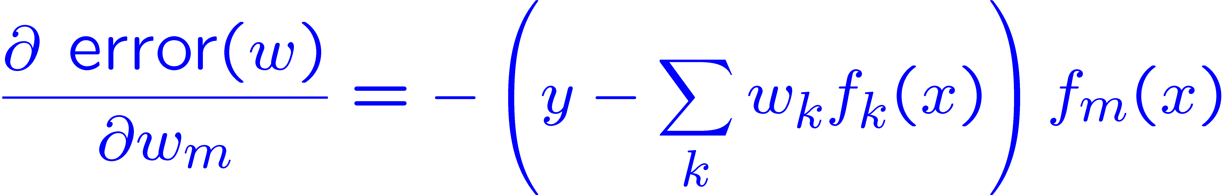
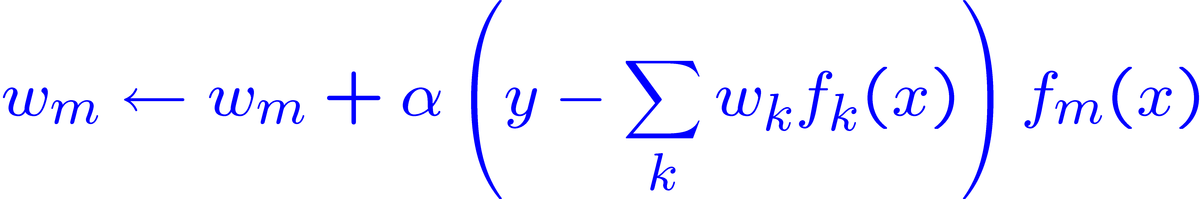

Minimizing Error
Imagine we had only one point x, with features f(x), target value y, and weights w:
Approximate q update explained:
“target”
“prediction”

Slide 32

Minimizing Error
Imagine we had only one point x, with features f(x), target value y, and weights w:
Example: $Q\left(s,a\right)=2f_{1}\left(s,a\right)+3f_{2}(s,a)$
$f_{1}\left(s,a\right)=4, f_{2}\left(s,a\right)=1, r_{sampled}=3$
$$w_{2}←$$

Slide 33

Updating a linear value function
Original Q learning rule tries to reduce prediction error at s, a:
    $Q\left(s,a\right)←Q\left(s,a\right)+α[(R\left(s,a,s^{′}\right)+γ \max_{a^{′}} Q\left(s^{′},a^{′}\right))−Q\left(s,a\right)]$
Instead, we update the weights to try to reduce the error at s, a:
      $w_{i}←w_{i}+α∗f_{i}\left(s,a\right)∗[(R\left(s,a,s^{′}\right)+γ \max_{a^{′}} Q\left(s^{′},a^{′}\right))−Q\left(s,a\right)]$

Slide 34



Approximate Q-Learning
Q-learning with linear Q-functions:
Intuitive interpretation:
  Adjust weights of active features
  E.g., if something unexpectedly bad happens, blame the features that were on: disprefer all states with that state’s features
Formal justification: online least squares
Exact Q’s
Approximate Q’s

Slide 35








Example: Q-Pacman
$$α=0.004$$

Slide 36
Example: Q-Pacman

Slide 37
Recent Reinforcement Learning Milestones

Slide 38
TDGammon
1992 by Gerald Tesauro, IBM
4-ply lookahead using V(s) trained from 1,500,000 games of self-play
3 hidden layers, ~100 units each
Input: contents of each location plus several handcrafted features
Experimental results:
  Plays approximately at parity with world champion
  Led to radical changes in the way humans play backgammon

Slide 39

Deep Q-Networks
sample = r + γ max_{a’} Q_{w} (s’,a’)
Q_{w}(s,a): Neural network
Deep Mind, 2015
Used a deep learning network to represent Q:
  Input is last 4 images (84x84 pixel values) plus score
49 Atari games, incl. Breakout, Space Invaders, Seaquest, Enduro
Image: Deep Mind

Slide 40




Images: Open AI, Atari

Slide 41




OpenAI Gym
2016+
Benchmark problems for learning agents
https://gym.openai.com/envs
Images: Open AI

Slide 42

AlphaGo, AlphaZero
Deep Mind, 2016+

Slide 43
Autonomous Vehicles?

