Slide 1
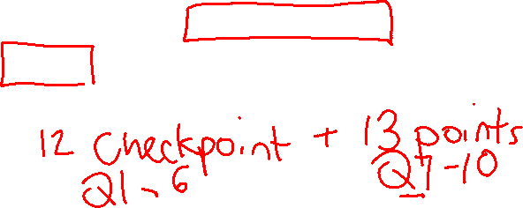
Announcements
Assignments:
P2: Optimization
    Due TONIGHT, 10 pm
HW5 (written)
    Due Tues 2/28, 10 pm
P3: Logic and Classical Planning
    Out Tonight
    FIRST HALF!! Due Friday 3/3, 10 pm before spring break
    ALL!! Due Friday 3/17, 10 pm Friday after spring break
    Grading

Slide 2

AI: Representation and Problem Solving
Classical Planning
or Symbolic Planning
Instructor: Stephanie Rosenthal
Slide credits: CMU AI
Image: Shutterstock

Slide 3
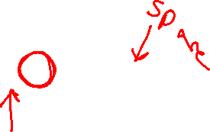
Changing a Tire
You start with a flat tire on the axle of your car and a spare in the trunk
You can perform the following actions:
Remove(tire,axle)
Put(tire,axle)
Remove(tire,trunk)
Put(tire,trunk)
Your goal is to replace the flat tire on the axle with the spare in the trunk.
How would solve this problem with search, e.g., BFS?

Slide 4
Changing a Tire
You start with a flat tire on the axle of your car and a spare in the trunk
You can perform the following actions:
Remove(tire,axle)
Put(tire,axle)
Remove(tire,trunk)
Put(tire,trunk)
Your goal is to replace the flat tire with the spare.
How would solve this problem with logic?

Slide 5
Search, Logic, and Classical Planning
Search Planning
State representation that changes as you act
Propositional Logic Planning
Represent world with Boolean propositions and successor state axioms
Different symbols for different time points
Classical Planning
Represent the world with objects and Boolean predicates
State changes as you act

Slide 6

Idea of Classical Planning
Represent objects/values separately from the state (instances)
Define predicates as true/false functions over the objects
States are conjunctions of predicates
Goals are conjunctions of predicates

Slide 7
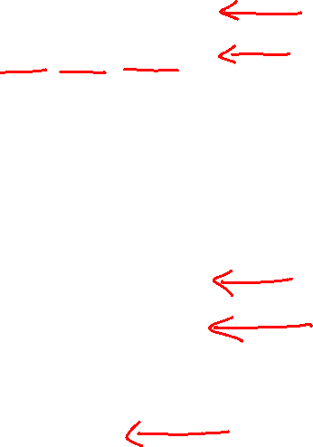
Poll 1
Which predicates apply to this state? (Select all that apply)
Instances:
TIRES: flat_tire, spare_tire
LOCS: axle, trunk, ground
Predicates:
1) On(flat_tire, axle)
2) On(spare_tire, axle)
3) On(flat_tire, trunk)
4) On(spare_tire, trunk)
5) On(flat_tire, ground)
6) On(spare_tire, ground)
7) Empty(Trunk)
8) Empty(Axle)
spare_tire
flat_tire
Notes:
Spare tire is on the trunk, flat tire is on the ground

Slide 8

Full State Description
Instances:
TIRES: flat_tire, spare_tire
LOCS: axle, trunk, ground
Predicates:
On(spare_tire, trunk)
On(flat_tire, ground)
Optional: ~On(flat_tire, axle), ~On(spare_tire, axle),
~On(flat_tire, trunk), ~On(spare_tire, ground),
~Empty(trunk), ~Empty(axle)
Why Optional?
spare_tire
flat_tire

Slide 9
Operators
Operators change the state by adding/deleting predicates
Preconditions:
Actions can be applied only if all precondition predicates are true in the current state
Effects:
New state is a copy of the current predicates with the addition or deletion of specified predicates
Unlike the successor-state axioms, we do not explicitly represent time and we can use our objects and predicates to more easily scale to new more complex problems (e.g., new objects, predicates, and operators).

Slide 10
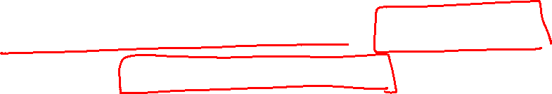
Rules of Tire Fixing
A tire can be removed from an axle if it is on the axle (precondition)
Effect: the tire is on the ground
A tire can be put on an axle if it is on the ground (precondition)
Effect: the tire is on the axle
A tire can be removed from the trunk if it is in the trunk (precondition)
Effect: the tire is on the ground
A tire can be put in the trunk if it is on the ground (precondition)
Effect: the tire is in the trunk

Slide 11
Rules of Tire Fixing
A tire can be removed from an axle/trunk if it is on there (precondition)
Effect: the tire is on the ground
A tire can be put on an axle/trunk if it is on the ground (precondition)
Effect: the tire is on the axle/trunk
The trunk/axle can be empty if nothing is on it
At most one thing can be on the trunk/axle
NOTE: A successor state axiom in logic would have to be defined for EACH tire and EACH loc, but in classical planning, these rules are defined for an object type

Slide 12

Remove Tire from Trunk (State Transition)
Instances:
Tires: flat, spare
Locs: axle, trunk, ground
Possible Predicates:
On(tire, loc)
Old State:
On(flat,ground)
On(spare,trunk)
New State:
On(flat,ground)
On(spare,ground)
Empty(trunk)
spare_tire
flat_tire
Notes:
The only thing that changes is that the tire that was in the trunk is now on the ground

Slide 13
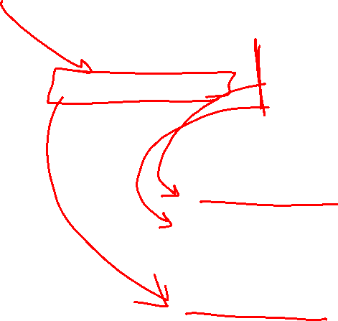
Remove Tire from Trunk (State Transition)
Instances:
Tires: flat, spare
Locs: axle, trunk, ground
Possible Predicates:
On(tire, loc)
Old State:
On(flat,ground)
On(spare,trunk)
New State:
On(flat,ground)
On(spare,ground)
Empty(trunk)
Add Effect:
On(spare,ground)
Empty(trunk)
Delete Effect:
On(spare,trunk)
spare_tire
flat_tire
Notes:
The only thing that changes is that the tire that was in the trunk is now on the ground

Slide 14
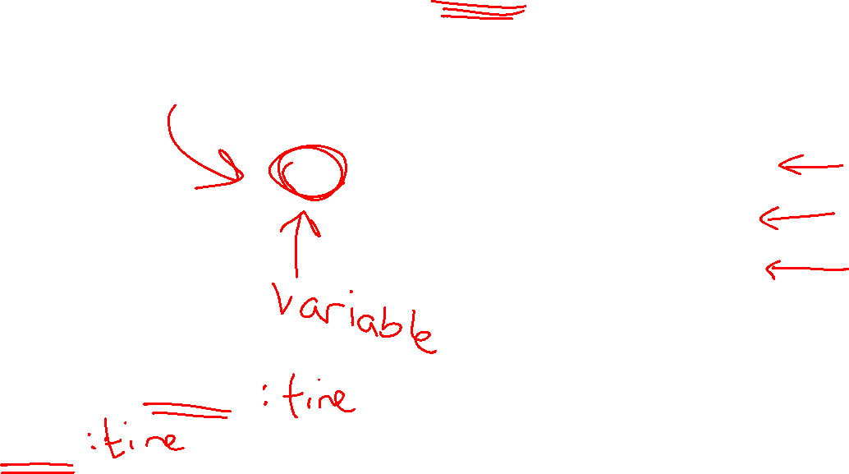
Operator: Remove(tire, trunk)
Preconditions Effects
On(tire,trunk) Add On(tire,ground)
Empty(trunk)
Delete On(tire,trunk)
spare_tire
flat_tire

Slide 15
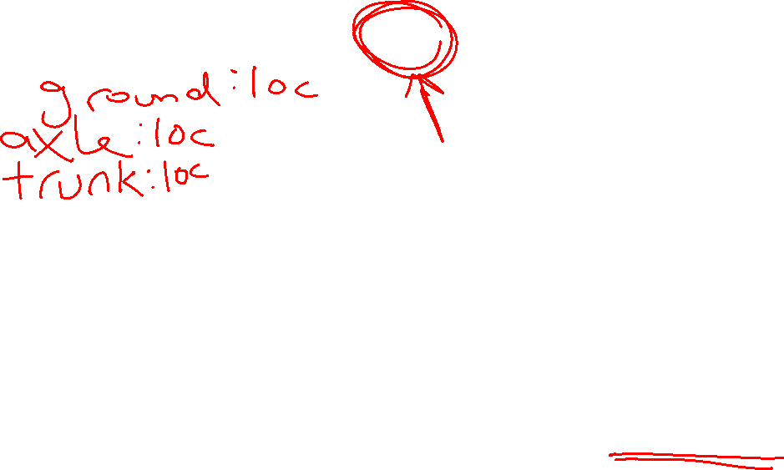
Operator: Remove(tire, loc)
Preconditions Effects
On(tire,loc) Add On(tire,ground)
Empty(loc)
Delete On(tire,loc)
WAIT: THIS DOESN’T WORK! WHAT IF LOC=GROUND???
spare_tire
flat_tire

Slide 16
Operator: Remove(tire, loc)
Preconditions Effects
On(tire,loc) Add On(tire,ground)
loc != ground Empty(loc)
Delete On(tire,loc)
spare_tire
flat_tire

Slide 17
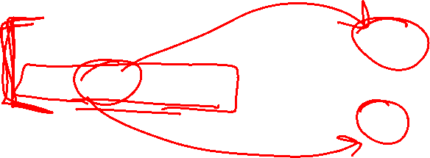
Operator: Remove(tire, loc)
Preconditions Effects
On(tire,loc) Add On(tire,ground)
~On(tire,ground) Empty(loc)
Delete On(tire,loc)
~On(tire, ground)
spare_tire
flat_tire

Slide 18

Operator: Put(tire, loc)
Preconditions Effects
On(tire,ground) Add On(tire,loc)
loc != ground Delete On(tire,ground)
Empty(loc) Empty(loc)
spare_tire
flat_tire

Slide 19
Operators for Fixing a Tire
Put(tire,loc):
Pre: On(tire,ground), loc != ground
Empty(loc)
Add: On(tire,loc)
Delete: On(tire,ground), Empty(loc)
Remove(tire,loc):
Pre: On(tire,loc), loc != ground
Add: On(tire,ground), Empty(loc)
Delete: On(tire,loc)
Why does ground get referenced directly instead of as a location like axle and trunk?
Why do we add Empty but not add ~Empty when it’s full?

Slide 20
Example Matching Operators
On(flat, axle) AND On(spare, trunk)

Slide 21
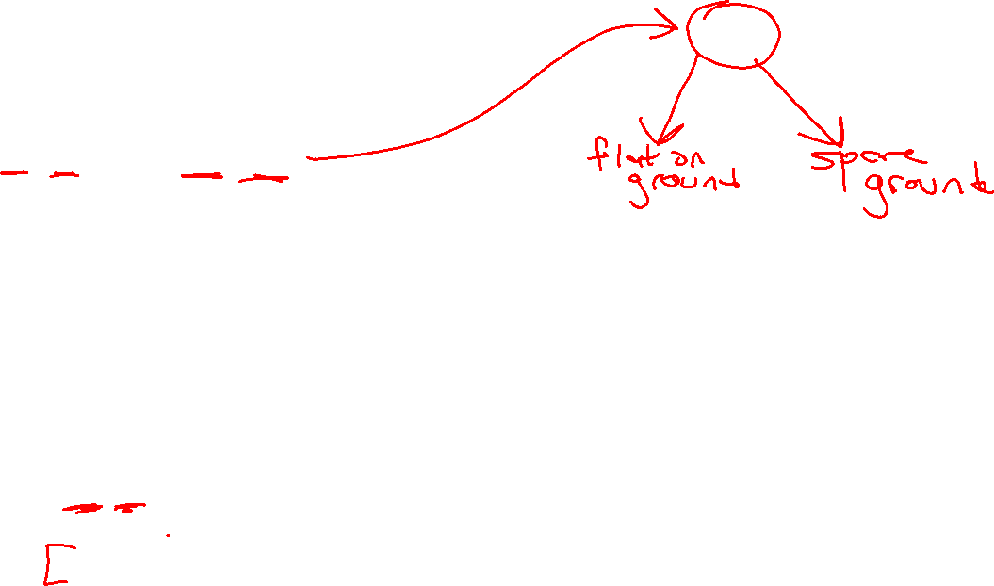
Example Matching Operators
On(flat, axle) AND On(spare, trunk)
Remove(tire,loc):
Pre: On(tire,loc), loc != ground
Add: On(tire,ground), Empty(loc)
Delete: On(tire,loc)

Slide 22
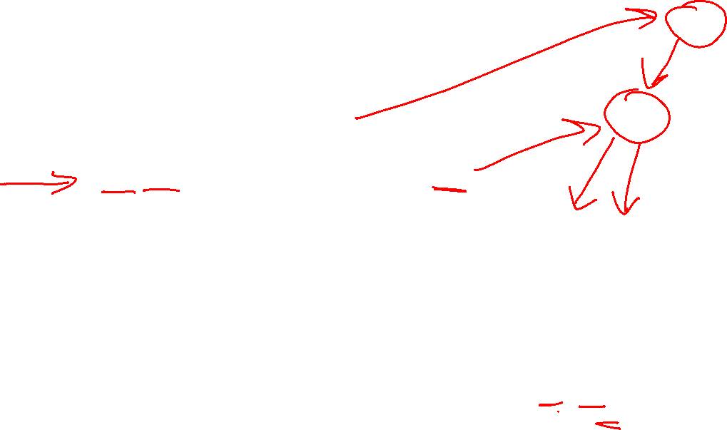
Example Matching Operators
On(flat, axle) AND On(spare, trunk)
Remove(flat, axle)
On(flat, ground) AND On(spare, trunk) AND Empty(axle)
Remove(tire,loc):
Pre: On(tire,loc), loc != ground
Add: On(tire,ground), Empty(loc)
Delete: On(tire,loc)
Put(tire,loc):
Pre: On(tire,ground), loc != ground
Empty(loc)
Add: On(tire,loc)
Delete: On(tire,ground), Empty(loc)

Slide 23
Example Matching Operators
On(flat, axle) AND On(spare, trunk)
Remove(flat, axle)
On(flat, ground) AND On(spare, trunk) AND Empty(axle)
Remove(spare, trunk)
Remove(tire,loc):
Pre: On(tire,loc), loc != ground
Add: On(tire,ground), Empty(loc)
Delete: On(tire,loc)
Put(tire,loc):
Pre: On(tire,ground), loc != ground
Empty(loc)
Add: On(tire,loc)
Delete: On(tire,ground), Empty(loc)

Slide 24
Example Matching Operators
On(flat, axle) AND On(spare, trunk)
Remove(flat, axle)
On(flat, ground) AND On(spare, trunk) AND Empty(axle)
Remove(spare, trunk)
On(flat, ground) AND On(spare, ground) AND Empty(axle) AND Empty(trunk)
Remove(tire,loc):
Pre: On(tire,loc), loc != ground
Add: On(tire,ground), Empty(loc)
Delete: On(tire,loc)
Put(tire,loc):
Pre: On(tire,ground), loc != ground
Empty(loc)
Add: On(tire,loc)
Delete: On(tire,ground), Empty(loc)

Slide 25
Example Matching Operators
On(flat, axle) AND On(spare, trunk)
Remove(flat, axle)
On(flat, ground) AND On(spare, trunk) AND Empty(axle)
Remove(spare, trunk)
On(flat, ground) AND On(spare, ground) AND Empty(axle) AND Empty(trunk)
Put(spare, axle)
On(flat, ground) AND On(spare, axle) AND Empty(trunk)
Put(flat, trunk)
On(flat, trunk) AND On(spare, axle)
Remove(tire,loc):
Pre: On(tire,loc), loc != ground
Add: On(tire,ground), Empty(loc)
Delete: On(tire,loc)
Put(tire,loc):
Pre: On(tire,ground), loc != ground
Empty(loc)
Add: On(tire,loc)
Delete: On(tire,ground), Empty(loc)

Slide 26
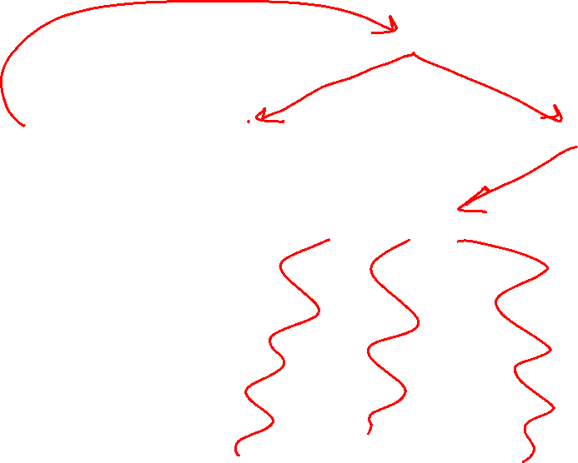
Matching Operators as Search
Put(spare, trunk)
Put(flat, axle)
On(flat, axle) AND On(spare, trunk)
Remove(flat, axle)
Remove(spare, trunk)
On(flat, ground) AND On(spare, trunk)
On(spare, ground) AND On(flat, axle)
Remove(spare, trunk)
Remove(flat, axle)
On(spare, ground) AND On(flat, ground)
On(spare, axle) AND On(flat, trunk)

Slide 27

Finding Plans with Symbolic Representations
Breadth-First Search
Sound?
Complete?
Optimal?
Yes
Yes
Yes, if equal costs of actions
Soundness - all solutions found are legal plans
Completeness - a solution can be found whenever one actually exists
Optimality - the order in which solutions are found is consistent with some measure of plan quality

Slide 28

Linear Planning
Since we have a conjunction of goal predicates, let’s try to solve one at a time
  Maintain a stack of achievable goals
  Use BFS (or anything else) to find a plan to achieve that single goal
  Add a goal back on the stack if a later change makes it violated

Slide 29
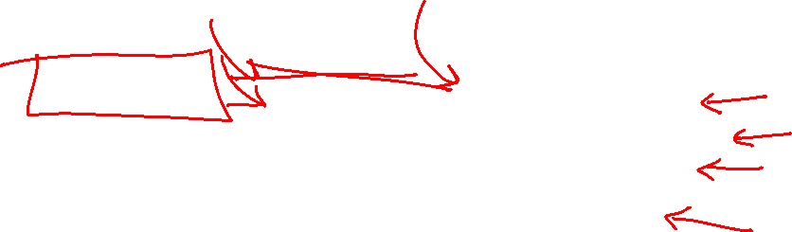
Linear Planning Spare Tire Example
Start State
On(flat,axle)
On(spare,trunk)
Goal Stack
On(flat,trunk)
On(spare,axle)
Action Plan:
On(flat,trunk)
Remove(flat,axle)
Remove(spare,trunk)
Put(flat,trunk)
On(spare,axle)
Put(spare,axle)

Slide 30

Spare Tire Example with Tools
Suppose that you needed a tool like a wrench to remove and put the tire on the axle
Suppose that the wrench needed to be stored in a tool box as a goal
Start State
On(flat,axle)
On(spare,trunk)
In(wrench,box)
Goal Stack
On(flat,trunk)
In(wrench,box)
On(spare,axle)
Action Plan:
On(flat,trunk)
Remove(wrench,box)
Remove(flat,axle)
Remove(spare,trunk)
Put(flat,trunk)
In(wrench,box)
Put(wrench,box)
On(spare,axle)
Remove(wrench,box)
Put(spare,axle)
In(wrench,box)
Put(wrench,box)
What happened?
Is linear planning sound?
Is linear planning complete?
Is linear planning optimal?
Notes:
Sound? Yes, a plan that is found does work
Complete? No, doesn’t always find a plan (sometimes you do something that can’t be undone)
Optimal? No, example given

Slide 31
Sussman’s Anomaly
A weakness of linear planning is that sometimes you get long plans
One goal can be achieved
The second goal immediately undoes it
In fact, there are some problems for which solving goals one at a time will never result in a feasible plan.
Note: This isn’t just a choice of goals. The anomaly can happen no matter which goal is first

Slide 32

Non-Linear Planning
Interleave goals to achieve plans
  Maintain a set of unachieved goals
  Search all interleavings of goals (in practice, this is very hard!)
  Add a goal back to the set if a later change makes it violated

Slide 33
Heuristics – Search Graph Representation
A planning graph’s size is potentially exponential in the number of predicates
It is possible that each action changes exactly one predicate
Can we reduce the size of the planning graph?

Slide 34
GraphPlan
GraphPlan is a relaxation of other classical planning search techniques
The GraphPlan search graph space is linear in the number of predicates

Slide 35

GraphPlan and GraphPlan Graph Representation
Graphplan graphs contain two types of layers
  Proposition layers – all reachable predicates
  Action layers – actions that could be taken
  Both layers represent one time step
  GraphPlan algorithm includes two subtasks
  Extend: One time step (two layers) in the graphplan graph
  Search: Find a valid plan in the graphplan graph
GraphPlan finds a plan or proves that no plan has fewer time steps
  Each time step can contain multiple actions

Slide 36

Building a GraphPlan Graph
Start the planning graph with all starting predicates
On(flat, axle)
On(spare,trunk)

Slide 37
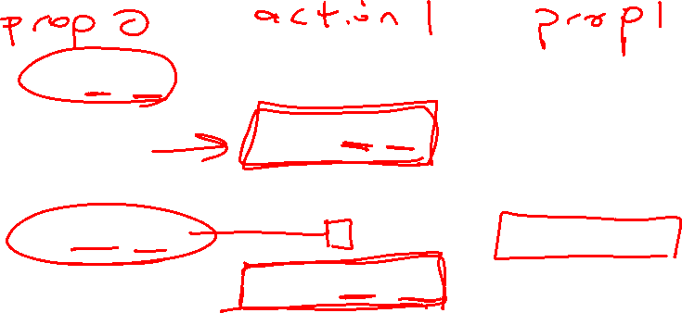
Building a GraphPlan Graph
Extend the graph with all applicable actions. Designate all effects (add/delete)
No-op
On(flat, axle)
On(spare,trunk)
On(flat, axle)
On(flat, ground)
Empty(axle)
On(spare,trunk)
On(spare,ground)
Empty(trunk)
Remove(flat,axle)
No-op
Remove(spare,trunk)

Slide 38

Building a GraphPlan Graph
Search the graph to find feasible solutions. Determine mutually exclusive actions.
No-op
Actions A and B are exclusive (mutex) at action-level i, if:
  Interference: one action effect deletes or negates a precondition of the other
  Inconsistency: one action effect deletes or negates the effect of the other
  Competing Needs: the actions have preconditions that are mutex in prev. proposition-level
On(flat, axle)
On(spare,trunk)
On(flat, axle)
On(flat, ground)
Empty(axle)
On(spare,trunk)
On(spare,ground)
Empty(trunk)
Remove(flat,axle)
No-op
Remove(spare,trunk)
Notes:
No-op and remove each interfere and are inconsistent with each other because ’remove’ deletes the precondition/effect of ‘no-op’

Slide 39
Building a GraphPlan Graph
Search the graph to find feasible solutions. Determine mutually exclusive predicates.
No-op
Propositions P and Q are exclusive (mutex) at proposition-level i, if:
  Negation: They are the negation of each other or can’t appear at the same time in a plan
  Inconsistent Support: if there is no set of non-mutex actions in action layer i-1 that produce both P and Q
On(flat, axle)
On(spare,trunk)
On(flat, axle)
On(flat, ground)
Empty(axle)
On(spare,trunk)
On(spare,ground)
Empty(trunk)
Remove(flat,axle)
No-op
Remove(spare,trunk)

Slide 40
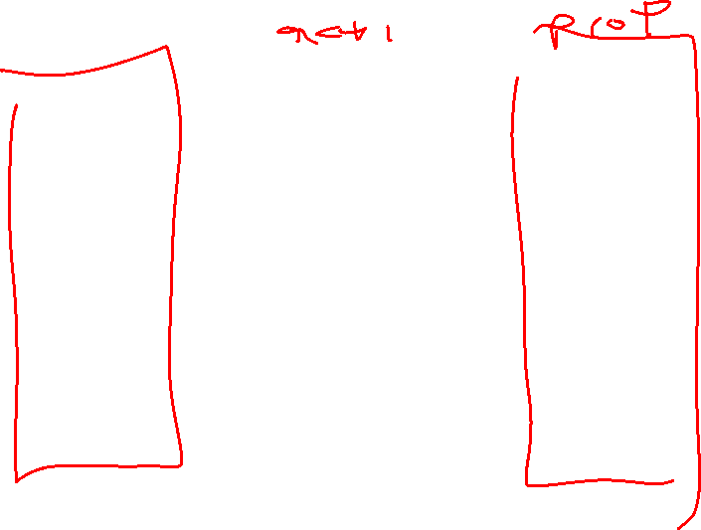
Building a GraphPlan Graph
Extend the graph with all applicable actions. Designate all effects (add/delete)
Put(flat,trunk)
On(flat,trunk)
No-op
On(flat, axle)
On(spare,trunk)
On(flat, axle)
On(flat, ground)
Empty(axle)
On(spare,trunk)
On(spare,ground)
Empty(trunk)
On(flat, axle)
On(flat, ground)
Empty(axle)
On(spare,trunk)
On(spare,ground)
Empty(trunk)
Remove(flat,axle)
Remove(flat,axle)
Put(flat,axle)
No-op
Remove(spare,trunk)
Remove(spare,trunk)
Put(spare,trunk)
Put(spare,axle)
On(spare,axle)

Slide 41
Building a GraphPlan Graph
Search the graph to find feasible solutions. Determine mutually exclusive actions/predicates.
Put(flat,trunk)
On(flat,trunk)
No-op
On(flat, axle)
On(spare,trunk)
On(flat, axle)
On(flat, ground)
Empty(axle)
On(spare,trunk)
On(spare,ground)
Empty(trunk)
On(flat, axle)
On(flat, ground)
Empty(axle)
On(spare,trunk)
On(spare,ground)
Empty(trunk)
Remove(flat,axle)
Remove(flat,axle)
Put(flat,axle)
No-op
Remove(spare,trunk)
Remove(spare,trunk)
Put(spare,trunk)
Put(spare,axle)
On(spare,axle)
The goal predicates are both present but are they mutex?
Can we perform this plan in 2 steps?
Notes:
No, they are not mutex! You can do remove(flat,axle) and remove(spare,trunk) at the same time at t=1. And you can do put(flat,trunk) and put(spare,axle) at the same time at t=2. The predicates that interfere, etc are not required at the same time.

Slide 42
GraphPlan Big Picture
Construct a Graphplan graph as an approximation of the planning graph in polynomial space
  The approximation: we do not delete any predicates that were EVER true since the start of the search. The GraphPlan graph computes the possibly reachable states although they aren’t necessarily feasible
  -> We can match multiple actions in one timestep if preconditions all match
  Finds shorter than optimal plans if actions are sequential
  How do we fix this?
  -> We have to handle the case that plans that couldn’t be actually executed because one action negates another

Slide 43
GraphPlan High Level Algorithm
Initialize first proposition layer with proposition from initial state
Loop
Extend the GraphPlan graph by adding an action level and
then a proposition level
If graph has leveled off (no new propositions added from previous level):
Return NO SOLUTION
If all propositions in the goal are present in the added proposition level: Search for a possible plan in the planning graph
(see solution algorithm)
If plan found, return with that plan

Slide 44
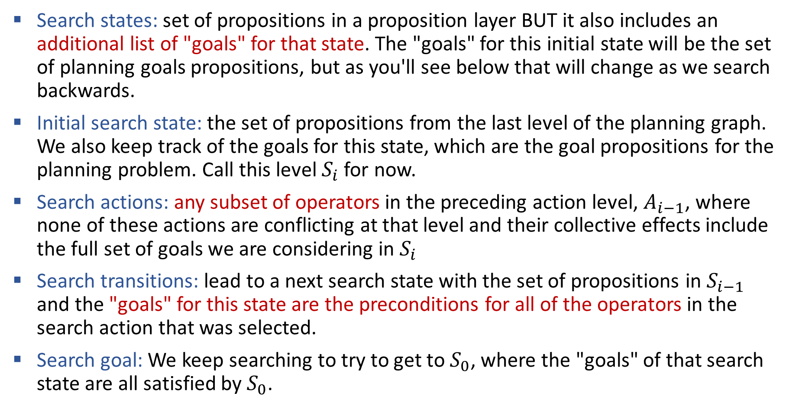
Searching the GraphPlan Graph
Search states: set of propositions in a proposition layer BUT it also includes an additional list of "goals" for that state. The "goals" for this initial state will be the set of planning goals propositions, but as you'll see below that will change as we search backwards.
Initial search state: the set of propositions from the last level of the planning graph. We also keep track of the goals for this state, which are the goal propositions for the planning problem. Call this level $S_{i}$ for now.
Search actions: any subset of operators in the preceding action level, $A_{i−1}$, where none of these actions are conflicting at that level and their collective effects include the full set of goals we are considering in $S_{i}$
Search transitions: lead to a next search state with the set of propositions in $S_{i−1}$ and the "goals" for this state are the preconditions for all of the operators in the search action that was selected.
Search goal: We keep searching to try to get to $S_{0}$, where the "goals" of that search state are all satisfied by $S_{0}$.

Slide 45
GraphPlan Takeaways
GraphPlan is a relaxation of other classical planning search techniques like BFS
It creates a different kind of graph that allows you to decide that no plan is reachable at a given depth.
If it finds a reachable solution, it may not be a feasible solution because it allows you to perform multiple actions at the same time.
The search graph is linear space in the number of predicates
Know the differences between the mutex conditions!!

Slide 46
We provide the GraphPlan implementation
In the programming assignment, you will create the representation, which will be passed into our GraphPlan implementation
In written assignments, you’ll be asked to assess the graph plan graph for mutexes and goals.

Slide 47
Implementing Symbolic Representations
Literals: Each thing/object in our model
i = Instance(“name”,TYPE)
Variables: Can take on any TYPE thing
v = Variable(“v_name”,TYPE)
Spare Tire Example:
Instances: “flat”, “spare” of type TIRE
Variable: “tire” of type TIRE
In an operator, tire can take on the value of any TIRE instance
Instances: “axle”, “trunk”, “ground” of type LOC
Variable: “loc” of type LOC
In an operator, loc can take on the value of any LOC instance

Slide 48
Implementing Symbolic Representations
Literals: Each thing/object in our model
i_spare = Instance(“spare”,TIRE), i_flat = Instance(“flat”,TIRE)
Variables: Can take on any TYPE thing
v_tire = Variable(“tire”,TIRE)
ALERT: no two literals nor variables can have the same string name!!

Slide 49
Implementing Symbolic Representations
Literals: Each thing/object in our model
i_spare = Instance(“spare”,TIRE), i_flat = Instance(“flat”,TIRE)
Variables: Can take on any TYPE thing
v_tire = Variable(“tire”,TIRE)
Propositions
Proposition(“on”, v_tire, v_loc) matches any tire and any loc
Proposition(“on”, v_tire, i_ground) matches any tire + the ground instance
Proposition(“on”, i_spare, i_axle) matches the spare tire and axle
ALERT: no two literals nor variables can have the same string name!!

Slide 50
Initial State and Goal State
Create lists of Propositions as the initial state and goal state (conjunctions)
initial = [Proposition(“on”, i_spare, i_trunk), Proposition(“on”, i_flat, i_axle)]
goal = [Proposition(“on”, i_spare, i_axle), Proposition(“on”, i_flat, i_trunk)]

Slide 51
Implementing Symbolic Representations
Operators: the actions we take change state
put = Operator(“put”, #name
[Proposition(“on”, v_tire, i_ground), #preconditions
v_loc != i_ground,
Proposition(“empty”, v_loc)],
[Proposition(“on”, v_tire, v_loc)], #add effects
[Proposition(“empty”, v_loc), #delete effects
Proposition(“on”, v_tire, i_ground)]
)
Lists are conjunctions!
All propositions with a variable must take on the same instance!
Variables that don’t match name don’t have to be the same but can be unless otherwise specified!

Slide 52
Another Example - Rocket Ship
Suppose we have a rocket ship that has enough fuel for 1 trip from A to B.
It needs to transport 2 payloads G1 and G2.
The rocket can Move, and we can Load and Unload it.
G1
G2

Slide 53
Another Example - Rocket Ship
Suppose we have a rocket ship that has enough fuel for 1 trip from A to B.
It needs to transport 2 payloads G1 and G2.
Literals?
G1
G2

Slide 54
Another Example - Rocket Ship
Suppose we have a rocket ship that has enough fuel for 1 trip from A to B.
It needs to transport 2 payloads G1 and G2.
Literals: Rocket, G1, G2, LocA, LocB
G1
G2

Slide 55
Another Example - Rocket Ship
Suppose we have a rocket ship that has enough fuel for 1 trip from A to B.
It needs to transport 2 payloads G1 and G2.
Literals: Rocket, G1, G2, LocA, LocB
Start state:
At(Rocket, LocA), Has-Fuel(),
Unloaded(G1,LocA), Unloaded(G2,LocA)
Goal state:
At(Rocket, LocB), Unloaded(G1,LocB), Unloaded(G2,LocB)
I create literals and variables as I go through the problem. In order to create the start state and the goal state, I need the literals defined.
G1
G2

Slide 56
Another Example - Rocket Ship
Literals: Rocket, G1, G2, LocA, LocB
Start state:
At(Rocket, LocA), Has-Fuel(),
Unloaded(G1,LocA), Unloaded(G2,LocA)
Goal state:
At(Rocket, LocB), Unloaded(G1,LocB), Unloaded(G2,LocB)
Move: Load: Unload:
As I create my operators Move, Load, and Unload, I will add variables.

Slide 57
Another Example - Rocket Ship
Literals: Rocket, G1, G2, LocA, LocB
Start state:
At(Rocket, LocA), Has-Fuel(),
Unloaded(G1,LocA), Unloaded(G2,LocA)
Goal state:
At(Rocket, LocB), Unloaded(G1,LocB), Unloaded(G2,LocB)
Move:
P:
A:
D:

Slide 58
Another Example - Rocket Ship
Literals: Rocket, G, O, LocA, LocB
Start state:
At(Rocket, LocA), Has-Fuel(),
Unloaded(G,LocA), Unloaded(O,LocA)
Goal state:
At(Rocket, LocB), Unloaded(G,LocB), Unloaded(O,LocB)
Variables: Start
Move:
P: At(Rocket,Start)
A:
D:
The rocket starts at a location, and it could be either location. I need to add a location variable. There is only 1 rocket, so I don’t need a variable for it.

Slide 59
Another Example - Rocket Ship
Literals: Rocket, G, O, LocA, LocB
Start state:
At(Rocket, LocA), Has-Fuel(),
Unloaded(G,LocA), Unloaded(O,LocA)
Goal state:
At(Rocket, LocB), Unloaded(G,LocB), Unloaded(O,LocB)
Variables: Start
Move:
P: At(Rocket,Start), Has-Fuel()
A:
D:
The rocket needs fuel.

Slide 60
Another Example - Rocket Ship
Literals: Rocket, G, O, LocA, LocB
Start state:
At(Rocket, LocA), Has-Fuel(),
Unloaded(G,LocA), Unloaded(O,LocA)
Goal state:
At(Rocket, LocB), Unloaded(G,LocB), Unloaded(O,LocB)
Variables: Start, Dest
Move:
P: At(Rocket,Start), Has-Fuel(), Start !=Dest
A: At(Rocket,Dest)
D:
The rocket needs to go to a destination, which needs to be different from the start location. We need to define a dest variable, which we will add after moving the rocket.

Slide 61
Another Example - Rocket Ship
Literals: Rocket, G, O, LocA, LocB
Start state:
At(Rocket, LocA), Has-Fuel(),
Unloaded(G,LocA), Unloaded(O,LocA)
Goal state:
At(Rocket, LocB), Unloaded(G,LocB), Unloaded(O,LocB)
Variables: Start, Dest
Move:
P: At(Rocket,Start), Has-Fuel(), Start !=Dest
A: At(Rocket,Dest)
D: Has-Fuel(),At(Rocket,Start)
Once the rocket has moved, it has no more fuel and it is no longer at Start.

Slide 62
Another Example - Rocket Ship
Literals: Rocket, G, O, LocA, LocB
Start state:
At(Rocket, LocA), Has-Fuel(),
Unloaded(G,LocA), Unloaded(O,LocA)
Goal state:
At(Rocket, LocB), Unloaded(G,LocB), Unloaded(O,LocB)
Variables: L, Dest
Load:
P:
A:
D:

Slide 63
Another Example - Rocket Ship
The rocket needs to load a specific package G1 or G2. The load action doesn’t care which package it is because both are loaded the same way. We need a variable pkg to use, and we need to say it starts at the starting location unloaded from the rocket.
Literals: Rocket, G, O, LocA, LocB
Start state:
At(Rocket, LocA), Has-Fuel(),
Unloaded(G,LocA), Unloaded(O,LocA)
Goal state:
At(Rocket, LocB), Unloaded(G,LocB), Unloaded(O,LocB)
Variables: Start, Dest, Pkg
Load:
P: At(Rocket,Start), Unloaded(Pkg,Start)
A:
D:

Slide 64
Another Example - Rocket Ship
Literals: Rocket, G, O, LocA, LocB
Start state:
At(Rocket, LocA), Has-Fuel(),
Unloaded(G,LocA), Unloaded(O,LocA)
Goal state:
At(Rocket, LocB), Unloaded(G,LocB), Unloaded(O,LocB)
Variables: Start, Dest, Pkg
Load:
P: At(Rocket,Start), Unloaded(Pkg,Start)
A: Loaded(Pkg,Rocket)
D: Unloaded(Pkg,Start)

Slide 65
Another Example - Rocket Ship
Literals: Rocket, G, O, LocA, LocB
Start state:
At(Rocket, LocA), Has-Fuel(),
Unloaded(G,LocA), Unloaded(O,LocA)
Goal state:
At(Rocket, LocB), Unloaded(G,LocB), Unloaded(O,LocB)
Variables: Start, Dest, Pkg
Unload:
P: At(Rocket,Dest), Loaded(Pkg,Rocket)
A: Unloaded(Pkg,Dest)
D: Loaded(Pkg,Rocket)
No new variables needed for unload, which works like Load but in reverse.

Slide 66
Rocket Ship GraphPlan Graph
Start state
Action Layer 1
Predicate Layer 1
At(Rocket,LocA)
Has-Fuel()
Unloaded(G1,LocA)
Unloaded(G2,LocA)
At(Rocket,LocB)
At(Rocket,LocA)
Has-Fuel()
Unloaded(G1,LocA)
Unloaded(G2,LocA)
Loaded(G1,Rocket)
Loaded(G2,Rocket)
Move
Load(G1)
Load(G2)

Slide 67
Rocket Ship GraphPlan Graph
At(Rocket,LocA)
Has-Fuel()
Unloaded(G,LocA)
Unloaded(O,LocA)
At(Rocket,LocB)
At(Rocket,LocA)
Has-Fuel()
Unloaded(G1,LocA)
Unloaded(G2,LocA)
Loaded(G1,Rocket)
Loaded(G2,Rocket)
Move
Load(G)
Load(O)
Mutex Actions
Interference:
Move deletes At which is a precondition of Load
Inconsistent:
Move deletes At but noop adds it
Move deletes Has-Fuel but noop adds it
Mutex Propositions:
- At(Rocket,LocB) and
At(Rocket,LocA) because
Move and noop are mutex actions
- What else?
Notes:
Both Loaded conflict with At(B)
Both Loaded conflict with Unloaded

Slide 68
Rocket Ship GraphPlan Graph
Start state
Action Layer 1
Predicate Layer 1
Action Layer 2
Predicate Layer 2
At(Rocket,LocA)
Has-Fuel()
Unloaded(G1,LocA)
Unloaded(G2,LocA)
At(Rocket,LocB)
At(Rocket,LocA)
Has-Fuel()
Unloaded(G1,LocA)
Unloaded(G2,LocA)
Loaded(G1,Rocket)
Loaded(G2,Rocket)
At(Rocket,LocB)
At(Rocket,LocA)
Has-Fuel()
Unloaded(G1,LocA)
Unloaded(G2,LocA)
Loaded(G1,Rocket)
Loaded(G2,Rocket)
Move
Move
Load(G1)
Load(G1)
Load(G2)
Load(G2)
At time 1: Move can be performed OR both Load actions
At time 2: Possible found is:
Load(G1), Load(G2), Move(LocB) ← reachable goal in two steps but feasible in three

