Slide 1

Candy Grab Game
As you walk in:
Grab a pack of game pieces (candy)
Form groups of 2 (or 3 with an observer)
Play the game!
  11 pieces on the table
  Take turns taking either 1 or 2 pieces
  Person that takes the last piece wins!
Think about how you might implement an Agent to play this in code:
class Agent
function getAction(state)
return action

Slide 2

AI: Representation and Problem Solving
Introduction
Instructors: Stephanie Rosenthal & Pat Virtue
Slide credits: CMU AI & http://ai.berkeley.edu

Slide 3











Course Staff
Instructors
Teaching Assistants
Stephanie Rosenthal
Claire (Head TA)
Aarthi
Ahana
Amy
Harlene
Maia
Sean
Simran
Tina
Pat Virtue

Slide 4



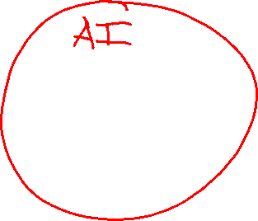
Course Information
Website: https://www.cs.cmu.edu/~15281
Canvas: canvas.cmu.edu
Gradescope: gradescope.com
Communication: piazza.com
E-mail: rosenthal@cmu.edu
pvirtue@cmu.edu
Prerequisites/Corequisites
Course Scope

Slide 5
Announcements
Recitation starting this Friday
  Recommended. Materials are fair game for exams
  Choosing sections
Assignments:
HW1 (online)
    Released tomorrow
    Due Tue 1/21, 10 pm
P0: Python & Autograder Tutorial
    Required, but worth zero points
    Already released
    Due Thu 1/23, 10 pm

Slide 6
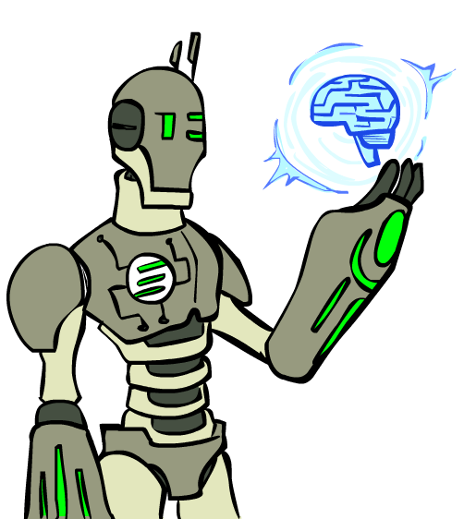
Today
What is artificial intelligence?
A brief history of AI
AI applications and techniques

Slide 7
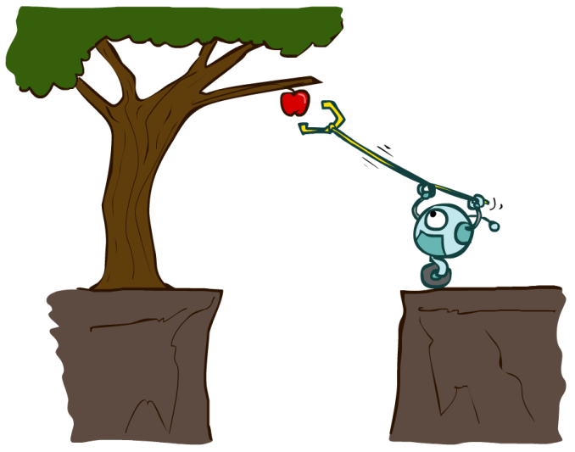
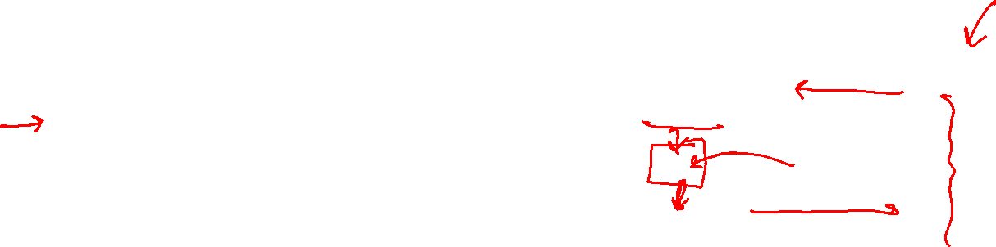
Designing Agents
An agent is an entity that perceives and acts.
Characteristics of the percepts, environment, and action space dictate techniques for selecting actions
This course is about:
  General AI techniques for a variety of problem types
  Learning to recognize when and how a new problem can be solved with an existing technique
Sensors
Agent
Percepts
Environment
?
Actuators
Actions

Slide 8
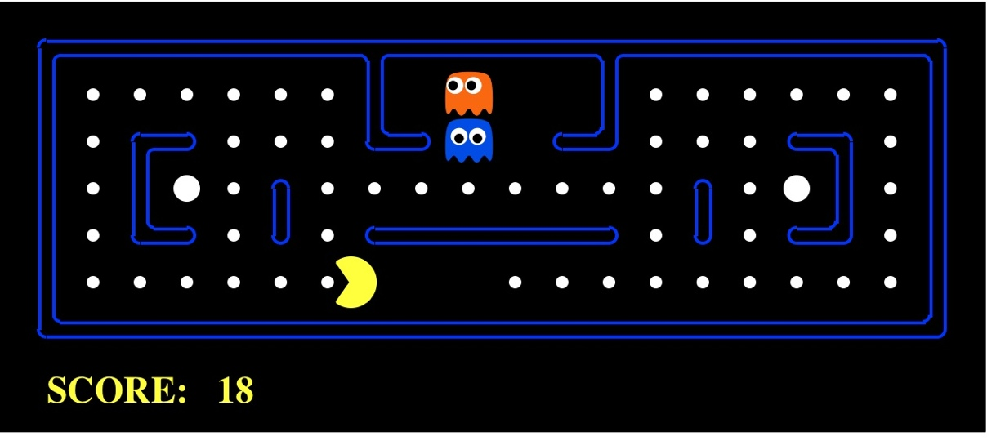
Pac-Man as an Agent
Agent
Environment
Sensors
Percepts
?
Actuators
Actions
Pac-Man is a registered trademark of Namco-Bandai Games, used here for educational purposes

Slide 9
Candy Grab Agent
class Agent
function getAction(state)
return action

Slide 10
Candy Grab Agent
Agent 001 – Always choose 1
function getAction( numPiecesAvailable )
return 1

Slide 11
Candy Grab Agent
Agent 002 – Always choose 2
function getAction( numPiecesAvailable )
return 2

Slide 12
Candy Grab Agent
Agent 004 – Choose the opposite of opponent
function getAction( numPiecesAvailable )
return ?

Slide 13
Candy Grab Agent
Agent 007 – Whatever you think is best
function getAction( numPiecesAvailable )
return ?

Slide 14
Candy Grab Agent
Agent 007 – Whatever you think is best
function getAction( numPiecesAvailable )
if numPiecesAvailable % 3 == 2
return 2
else
return 1

Slide 15
Games – Three “Intelligent” Agents
Piazza Poll question
Which agent code is the most “intelligent”?

Slide 16

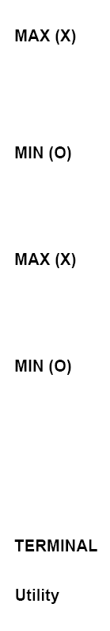

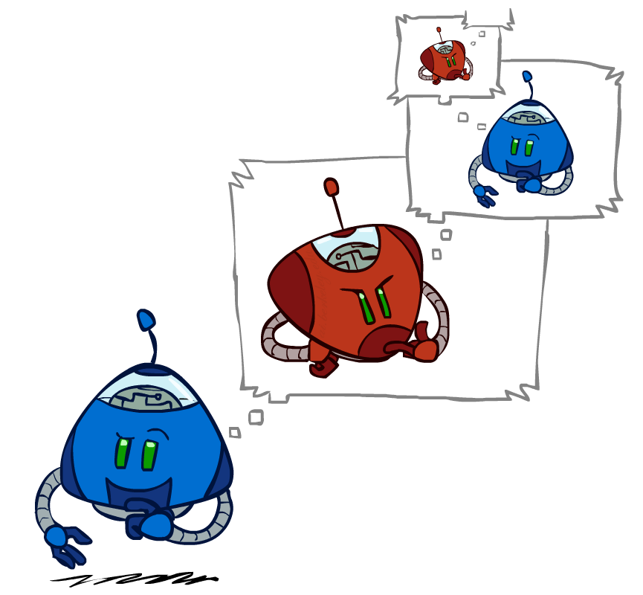
Games – Three “Intelligent” Agents
A: Search / Recursion
11
10
9
9
8
8
7
8
7
…
…
2
1
0
+1
+1
-1

Slide 17
Games – Three “Intelligent” Agents
B: Encode the pattern
10’s value:Win
9’s value:Lose
8’s value:Win
7’s value:Win
6’s value:Lose
5’s value:Win
4’s value:Win
3’s value:Lose
2’s value:Win
1’s value:Win
0’s value:Lose
function getAction( numPiecesAvailable )
if numPiecesAvailable % 3 == 2
return 2
else
return 1

Slide 18
Games – Three “Intelligent” Agents
C: Record statistics of winning positions
Pieces Available | Take 1 | Take 2
2
3
4
5
6
7
Pieces Available | Take 1 | Take 2
2 |  | 100%
3
4 | 100%
5
6
7 |  | 100%
Pieces Available | Take 1 | Take 2
2 |  | 100%
3 | 0%
4 | 100%
5
6
7 |  | 50%
Pieces Available | Take 1 | Take 2
2 | 0% | 100%
3 | 2% | 0%
4 | 75% | 2%
5 | 4% | 68%
6 | 5% | 6%
7 | 60% | 5%

Slide 19
Piazza Poll question
Games – Three “Intelligent” Agents
Which agent code is the most “intelligent”?
Search / Recursion
Encode multiple of 3 pattern
Keep stats on winning positions
Which agent code is the most “intelligent”?

Slide 20
Games – Three “Intelligent” Agents
C: Record statistics of winning positions
Pieces Available | Take 1 | Take 2
2
3
4
5
6
7
Pieces Available | Take 1 | Take 2
2 |  | 100%
3
4 | 100%
5
6
7 |  | 100%
Pieces Available | Take 1 | Take 2
2 |  | 100%
3 | 0%
4 | 100%
5
6
7 |  | 50%
Pieces Available | Take 1 | Take 2
2 | 0% | 100%
3 | 2% | 0%
4 | 75% | 2%
5 | 4% | 68%
6 | 5% | 6%
7 | 60% | 5%

Slide 21
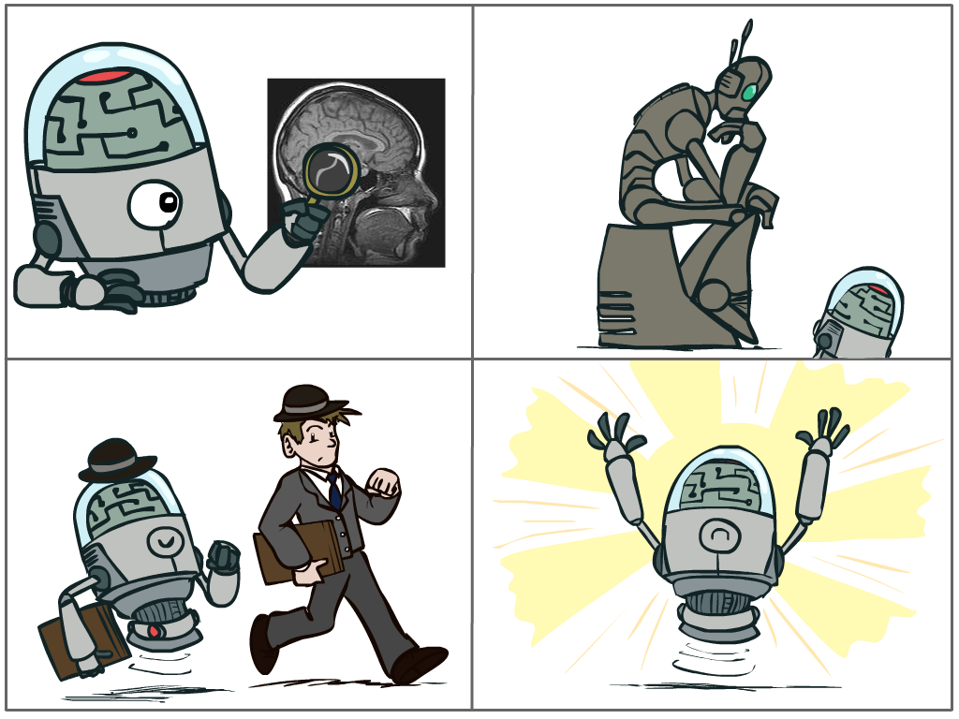
Piazza Poll: What is AI?
The science of making machines that:
A: Think like people
C: Think rationally
B: Act like people
D: Act rationally

Slide 22

Turing Test
In 1950, Turing defined a test of whether a machine could “think”
Practically though, it is a test of whether a machine can *act* like a person
“A human judge engages in a natural language conversation with one human and one machine, each of which tries to appear human. If judge can’t tell, machine passes the Turing test”
en.wikipedia.org/wiki/Turing_test

Slide 23
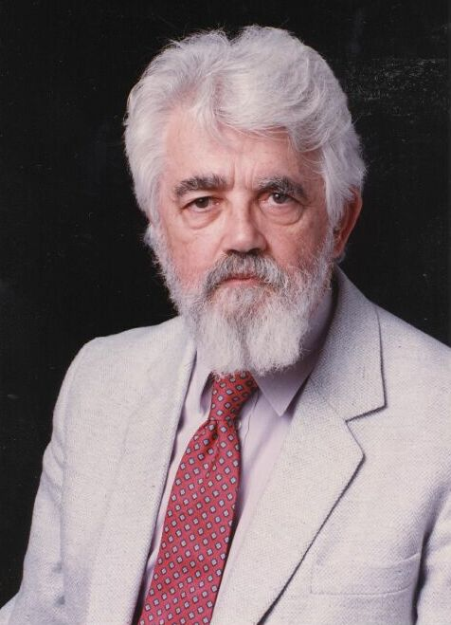

AI Definition by John McCarthy
What is artificial intelligence
  It is the science and engineering of making intelligent machines, especially intelligent computer programs
What is intelligence
  Intelligence is the computational part of the ability to achieve goals in the world
http://www-formal.stanford.edu/jmc/whatisai/whatisai.html

Slide 24
What is AI?
The science of making machines that:
A: Think like people
C: Think rationally
B: Act like people
D: Act rationally
Notes:
Top left: Think like people --- cognitive science, neuroscience
Bottom left: act like people --- actually very early definition, dating back to Alan Turing --- Turing test; problem to do really well you start focusing on things like don’t answer too quickly what the square root of 1412 is, don’t spell too well, and make sure you have a favorite movie etc. So it wasn’t really leading us to build intelligence
Think rationally – long tradition dating back to Aristotle --- but not a winner, because difficult to encode how to think, and in the end it’s not about how you think, it’s about how you end up acting

Slide 25
Rational Decisions
We’ll use the term rational in a very specific, technical way:
  Rational: maximally achieving pre-defined goals
  Rationality only concerns what decisions are made
  (not the thought process behind them)
  Goals are expressed in terms of the utility of outcomes
  Being rational means maximizing your expected utility
A better title for this course would be:
Computational Rationality
Notes:
Example of utilities. 10 for A, 1 for each Friday with friends

Slide 26
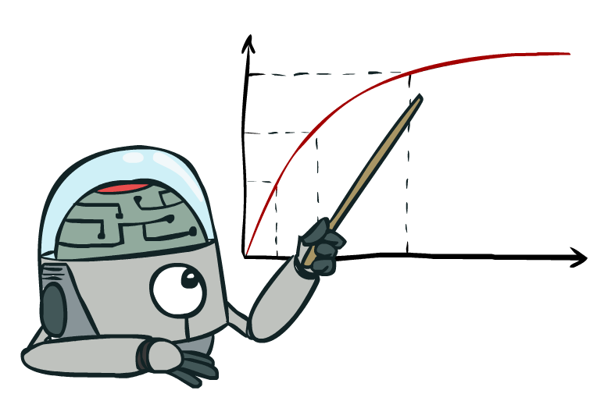
Maximize Your
Expected Utility

Slide 27
A Brief AI History

Slide 28
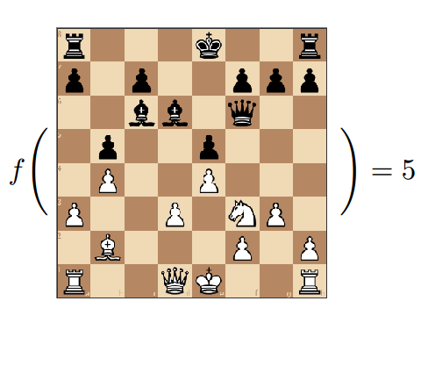
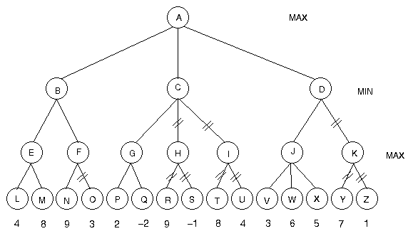
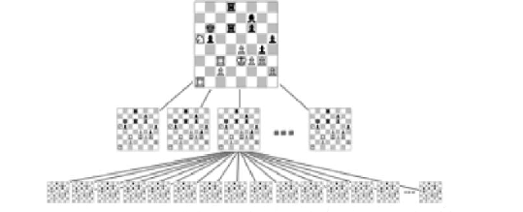
Chess as the First Killer App for AI
Claude Shannon proposed the first chess playing program in 1950
It included adversarial search and minimax (week 2 of lecture)
It also included many heuristics for faster searching

Slide 29
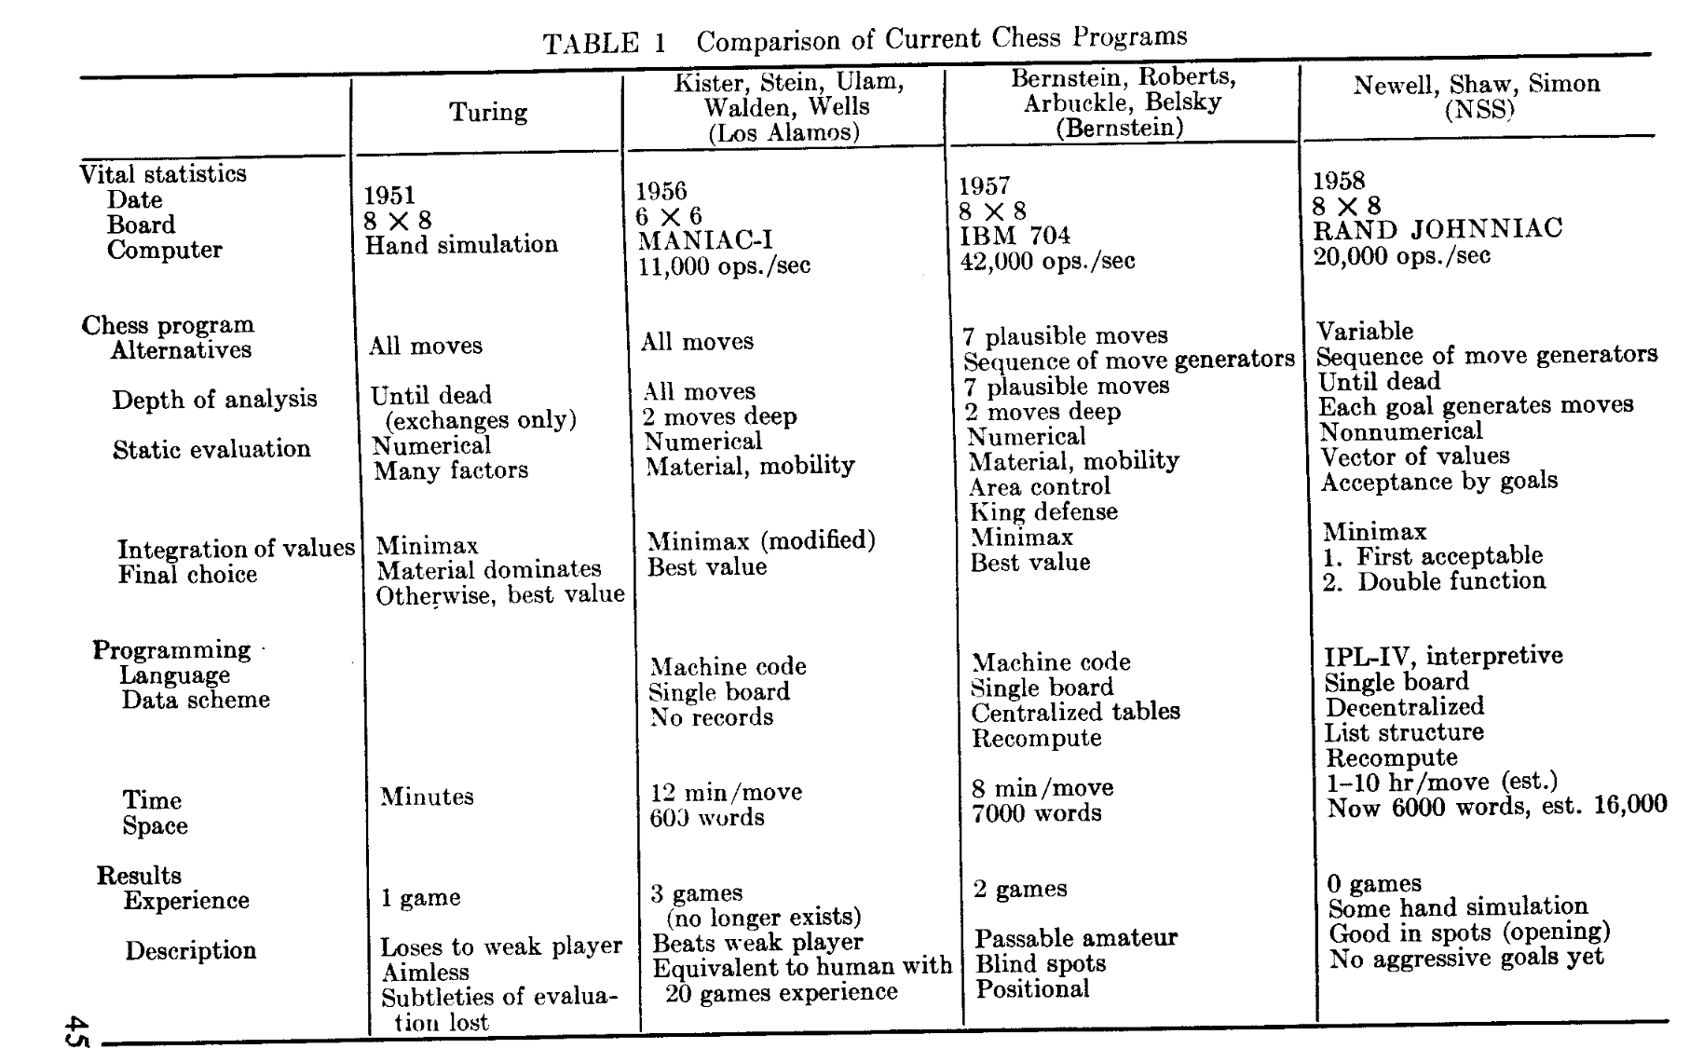
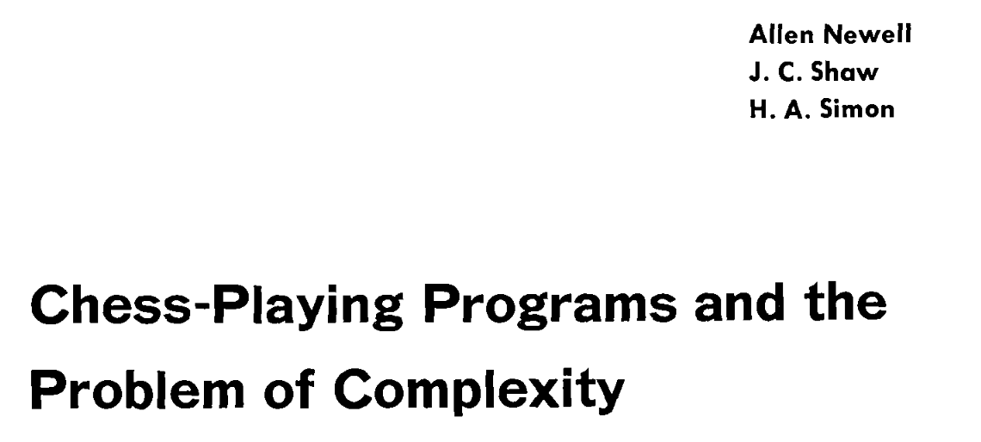

Chess by 1958

Slide 30
The Promise of AI
In 1965, Herbert Simon predicted that “machines will be capable, within 20 years, of doing any work a man can do.”
In 1967, AI pioneer Marvin Minsky predicted “in from three to eight years we will have a machine with the general intelligence of an average human being.”
In 1967, John McCarthy told the U.S. government that it would be possible to build “a fully intelligent machine” in the space of a decade.

Slide 31

Evolution of AI Research: 1970s and 1980s
Like our first two agents, focus on:
Searching for a solution using general search algorithms
Encoding knowledge that humans have and using logic to solve

Slide 32
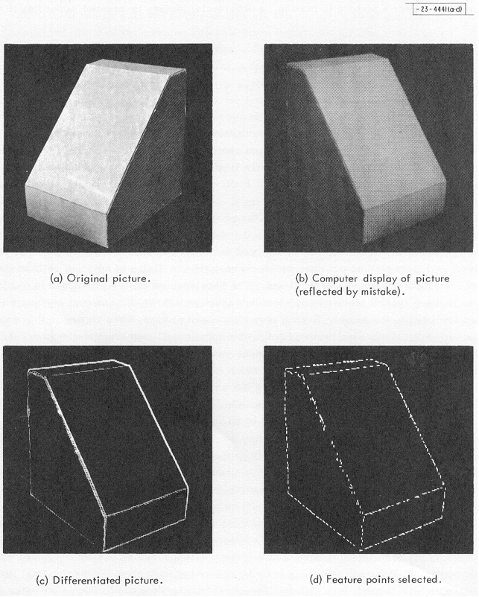
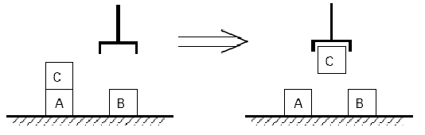
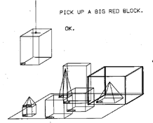
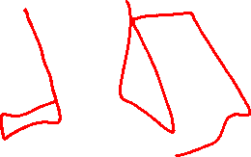
Computer Vision, Blocks World, Natural Language
Larry Roberts 1963 Thesis
Terry Winograd’s 1971 Thesis on SHRDLU
for natural language understanding

Slide 33
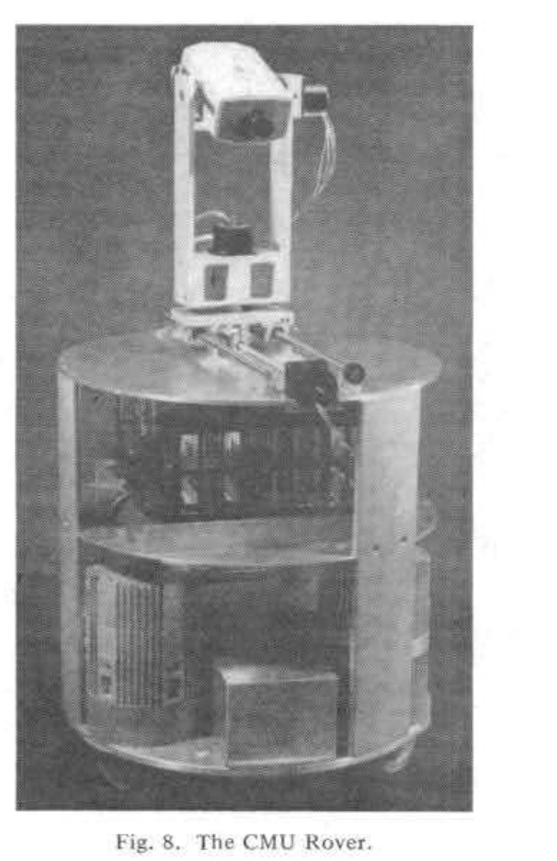
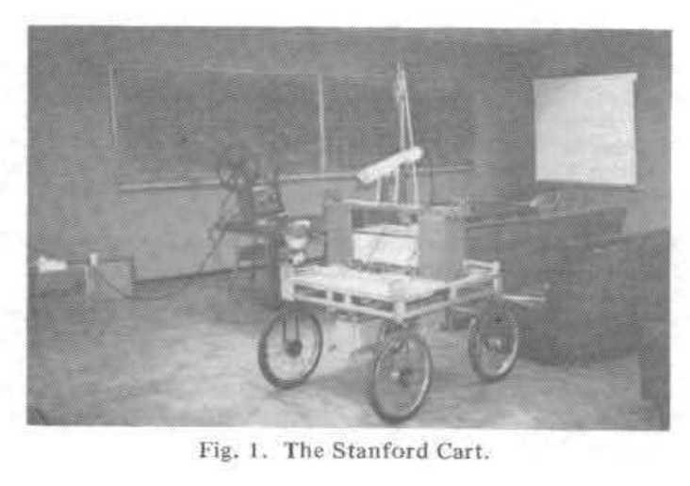
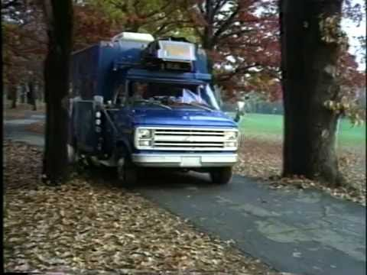
Early Robots
1983 – mobile robots by Hans Moravec
Dean Pomerleau (CMU) 1986
NAVLAB controlled by NNs
https://www.nytimes.com/video/science/1247468063802/stanford-cart.html
https://www.youtube.com/watch?v=ntIczNQKfjQ

Slide 34
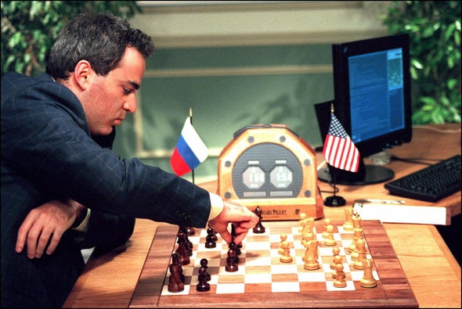
Deep Blue
Started in the mid-1980s at CMU, didn’t win until 1997
Project moved to IBM
“Good Old-Fashioned” Brute Force Search using custom hardware
https://www.youtube.com/watch?v=KF6sLCeBj0s

Slide 35
Rise of Statistical Approaches: 1990s – 2000s
Knowledge-based:
Search for a solution using general search algorithms
Encode knowledge that humans have and use logic to solve
Statistical:
Learning patterns and choosing solutions based on observed likelihood

Slide 36
Evolution of AI Research
1990s

Slide 37
Evolution of AI Research
2000s

Slide 38
Evolution of AI Research
2010s

Slide 39
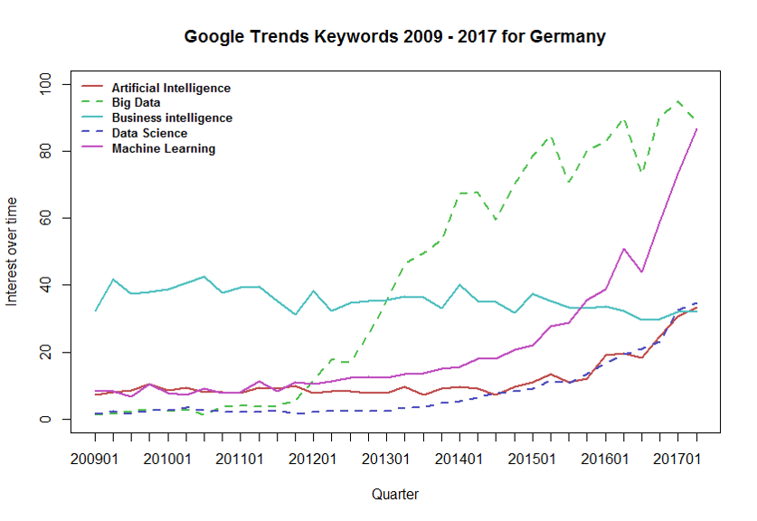
AI and Machine Learning Recent Popularity

Slide 40
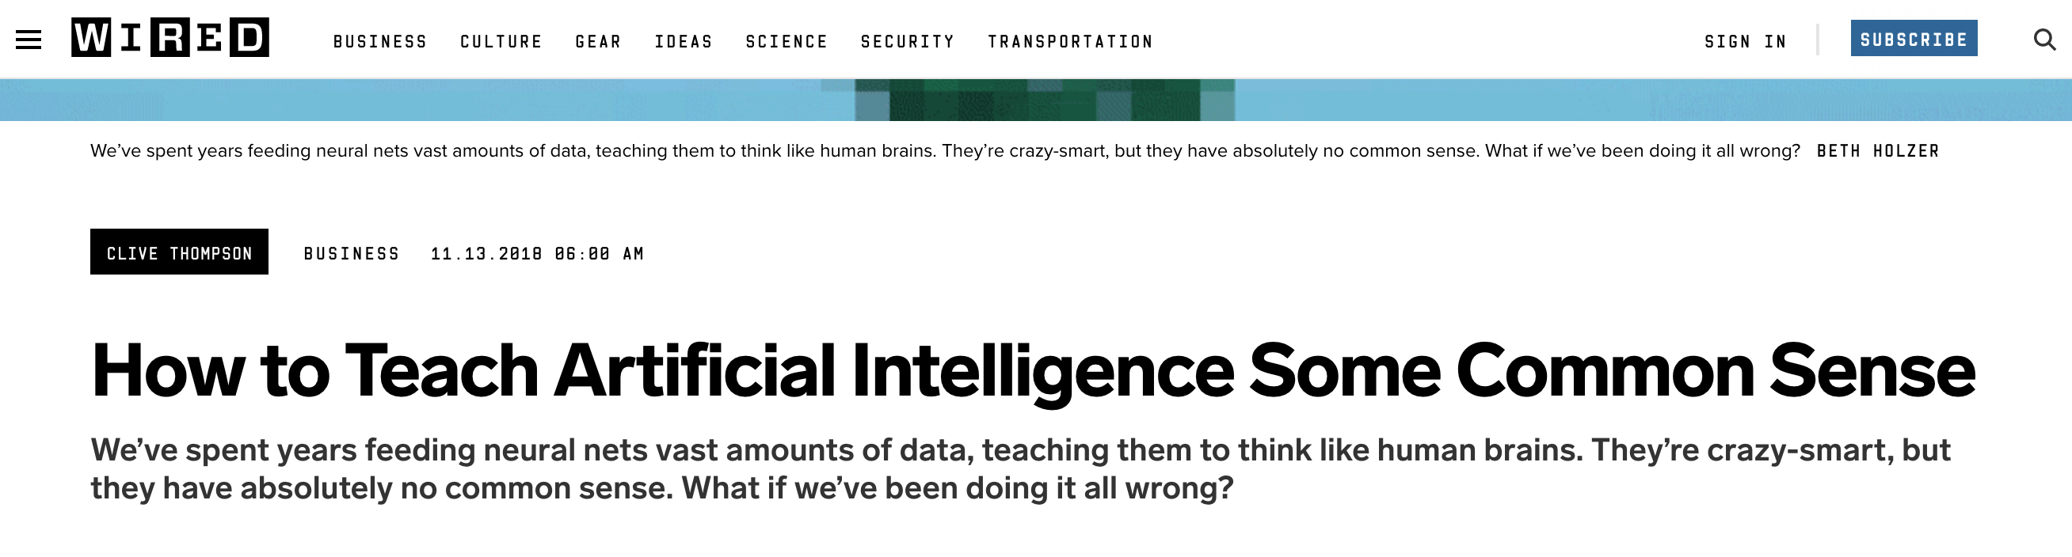
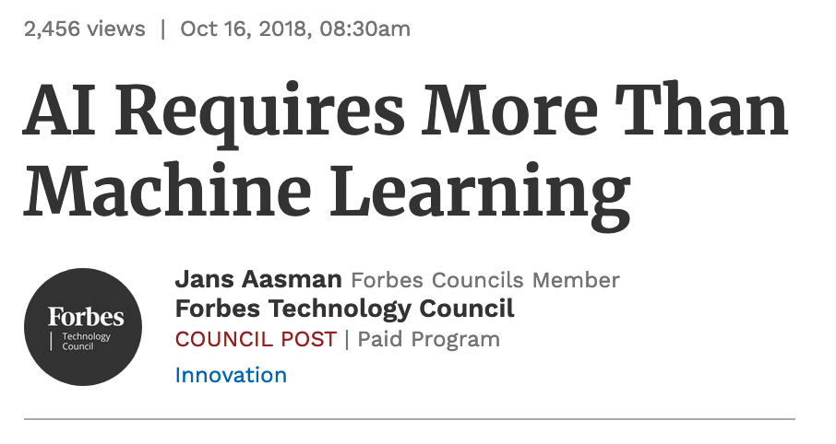
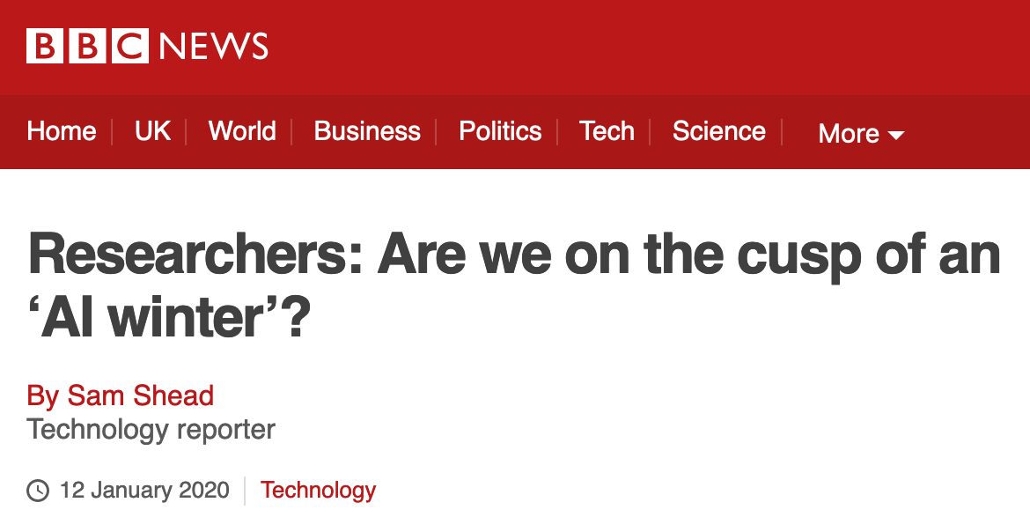
AI and Machine Learning Together: 2010s and 2020s

Slide 41
What Can AI Do?

Slide 42
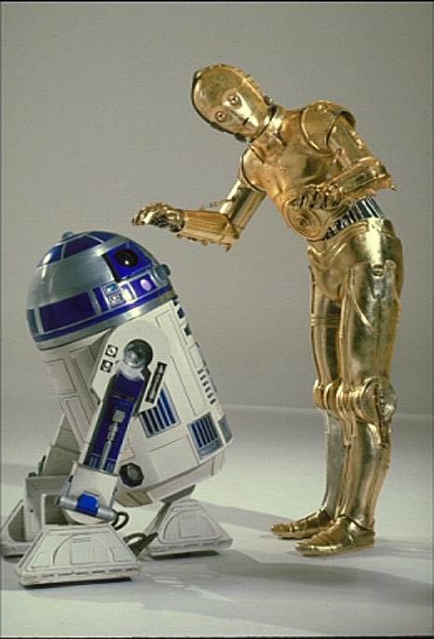
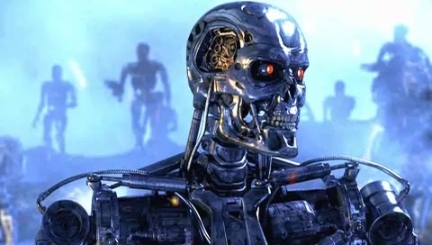
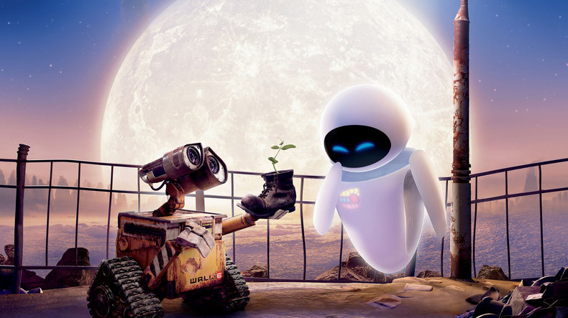
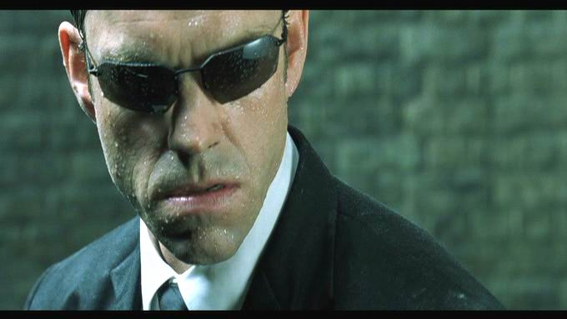
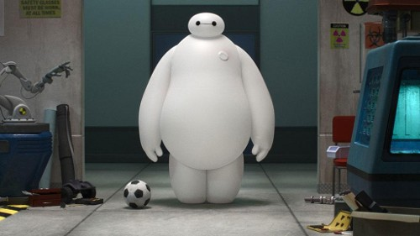
Sci-Fi AI
Notes:
Who are these? C3PO, what does he do? Essentially google translate, (but with anxiety!)
Little guy? R2D2 – what does he do, yeah, not so sure
Things got darker: machines come back from the future – to kill us!
90’s : software is scary
Basic fear about what technology might do ?
What if we can’t even tell technology apart from ourselves?
OR maybe it’ll look really different and snarky
Some exceptions like wall-E, positive view of technology (but maybe not of us humans!)
But mostly a worry
[not very worried myself, at least at present]

Slide 43
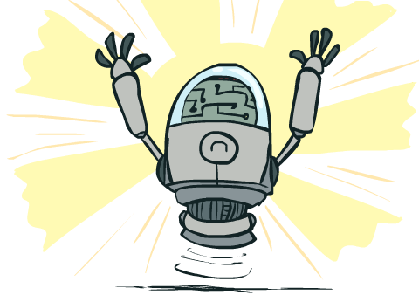
What Can AI Do?
Quiz: Which of the following can be done at present?
Play a decent game of table tennis?
Play a decent game of Jeopardy?
Drive safely along a curving mountain road?
Drive safely across Pittsburgh?
Buy a week's worth of groceries on the web?
Buy a week's worth of groceries at Giant Eagle?
Discover and prove a new mathematical theorem?
Converse successfully with another person for an hour?
Perform a surgical operation?
Put away the dishes and fold the laundry?
Translate spoken Chinese into spoken English in real time?
Write an intentionally funny story?

Slide 44
Announcements
Recitation starting this Friday
  Recommended. Materials are fair game for exams
  Choosing sections
Assignments:
HW1 (online)
    Released tomorrow
    Due Tue 1/21, 10 pm
P0: Python & Autograder Tutorial
    Required, but worth zero points
    Already released
    Due Thu 1/23, 10 pm

