Slide 1
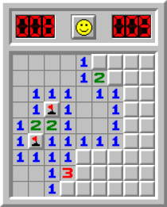
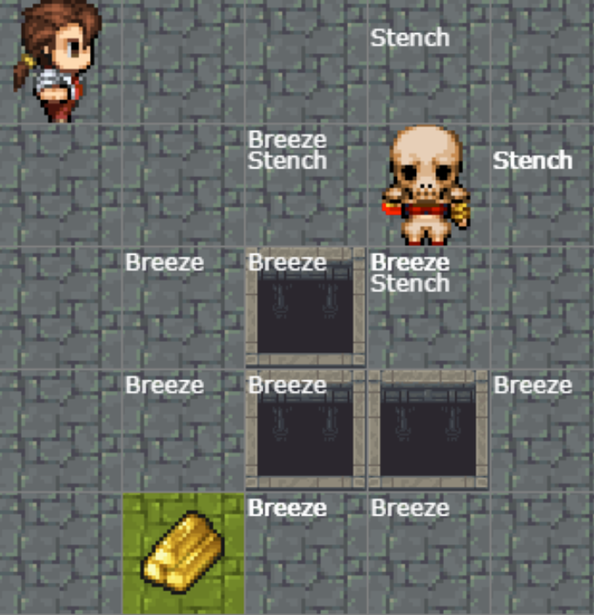
Warm-up:
Play Minesweeper or Wumpus World!
Notes:
0=7, R=4, W=6, U=2, T=8, F=1; 867 + 867 = 1734

Slide 2
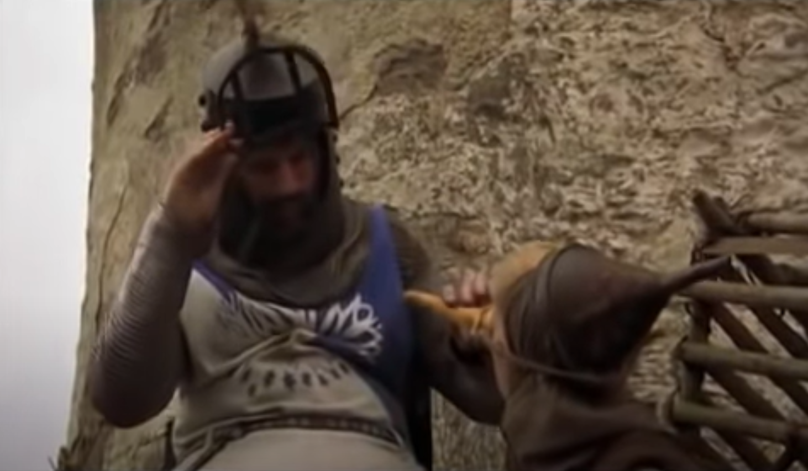
Monty Python Inference
There are ways of telling whether she is a witch
https://www.youtube.com/watch?v=rf71YotfykQ&t=52

Slide 3
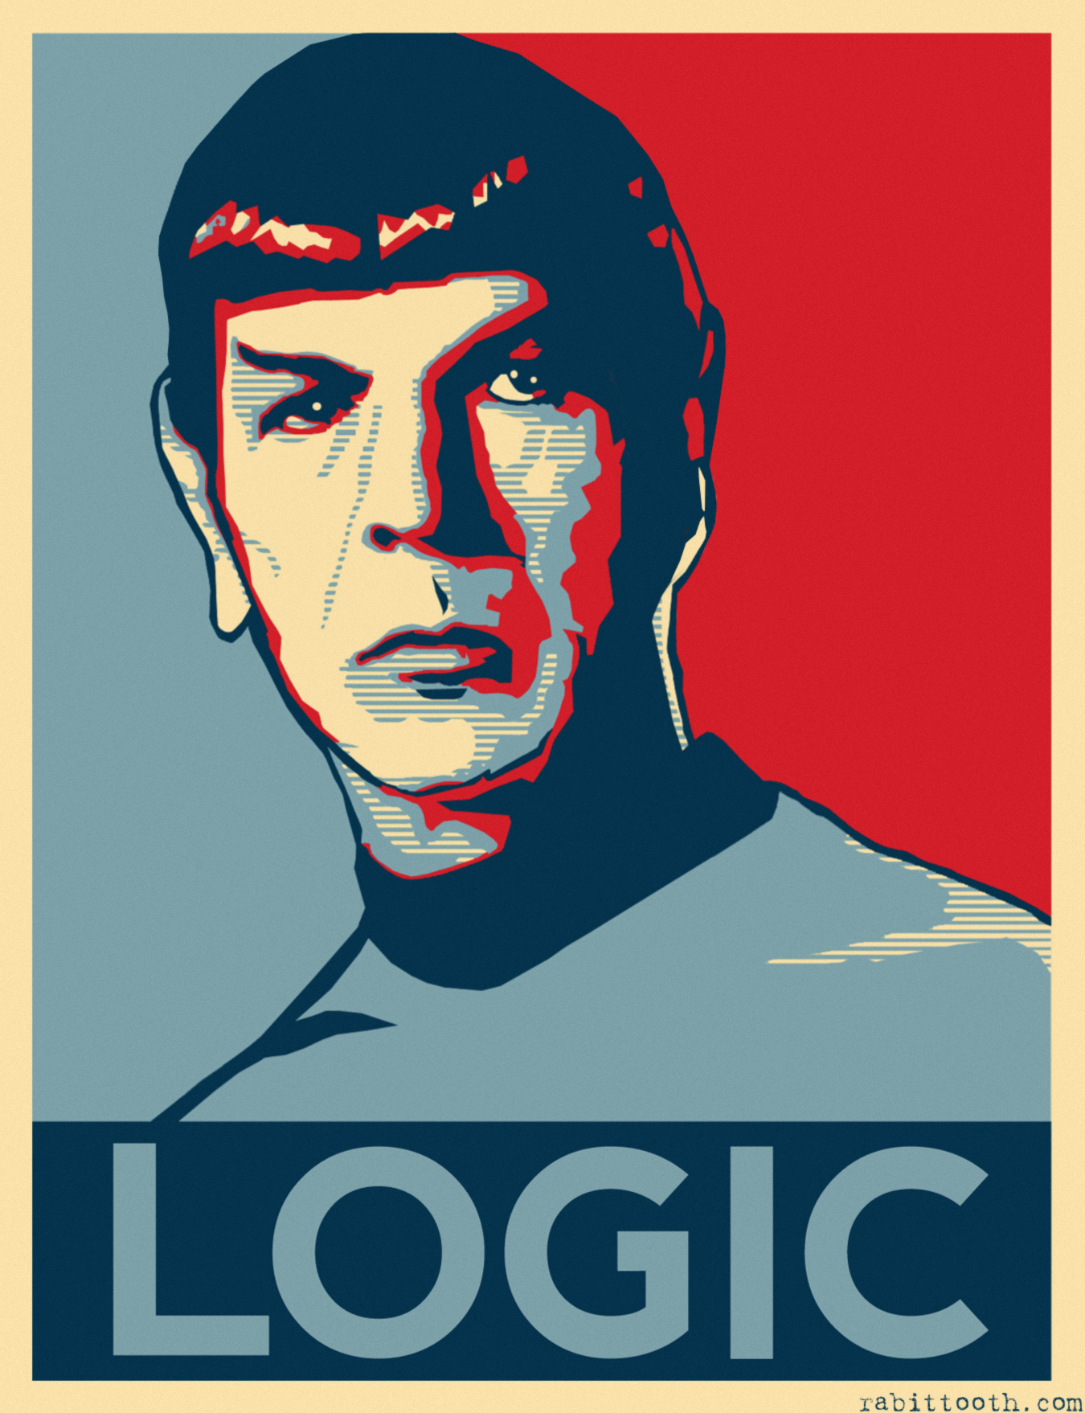
AI: Representation and Problem Solving
Logical Agent Concepts
Instructor: Pat Virtue
Slide credits: CMU AI, http://ai.berkeley.edu

Slide 4
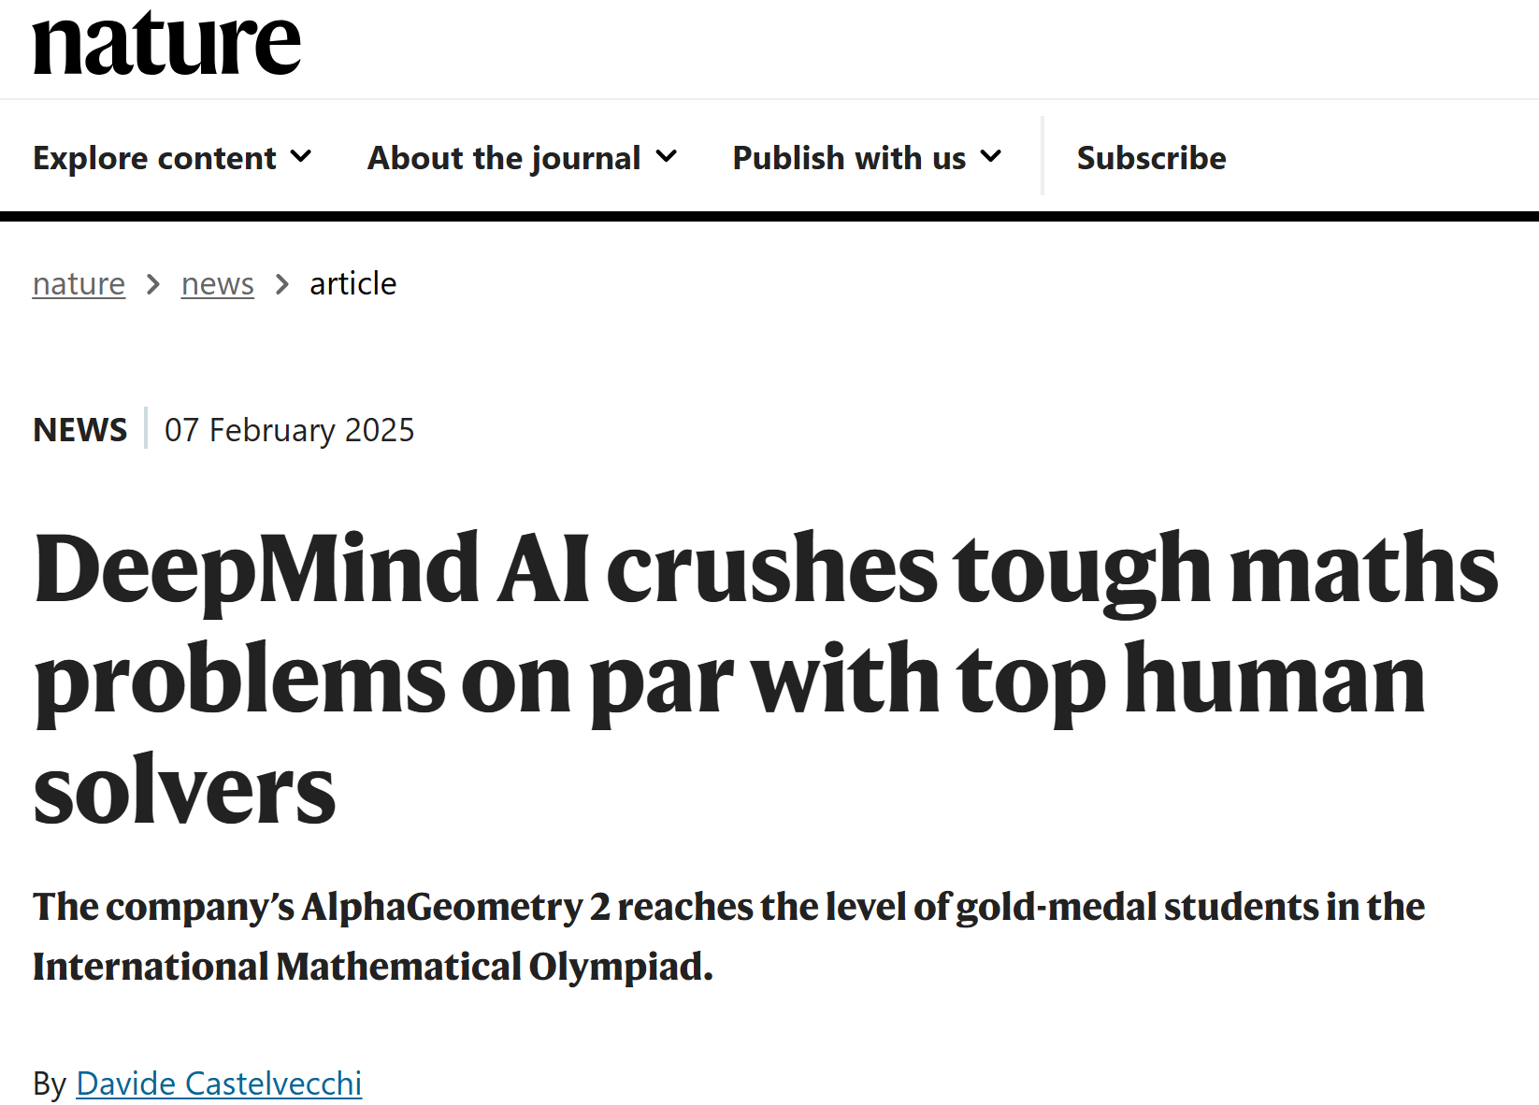
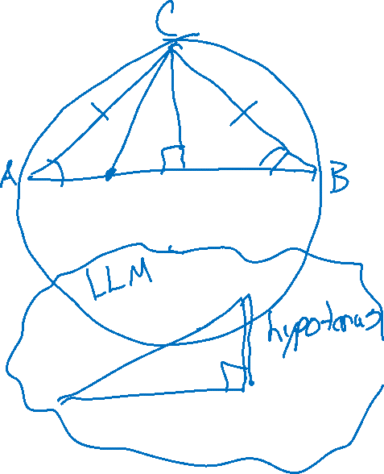
AlphaGeometry
https://www.nature.com/articles/d41586-025-00406-7

Slide 5
How do we solve Sudoku?
1
2
1
3
4

Slide 6
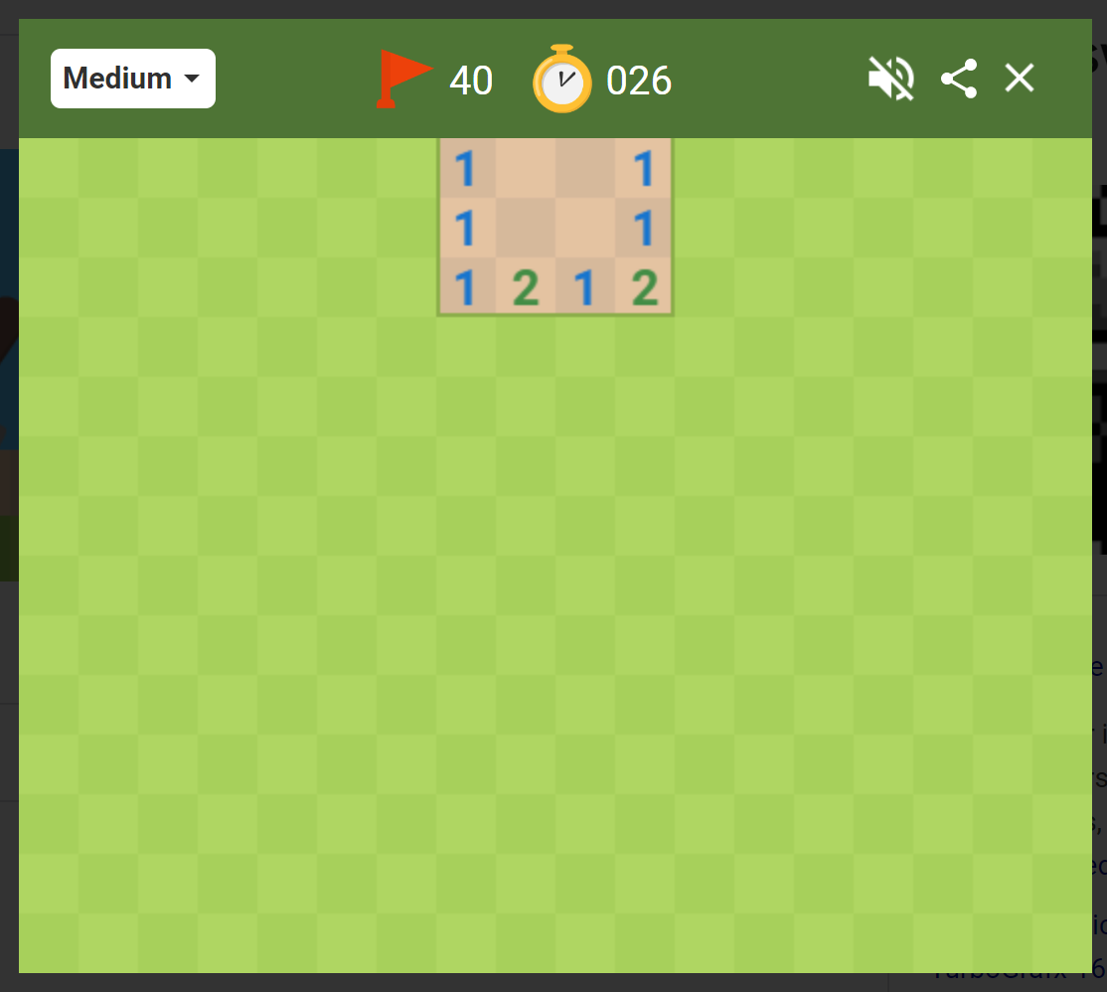
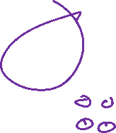
How do we play Minesweeper?
Numbers indicate how many mines are in the 8 adjacent cells
What are we trying to figure out?
A path (a sequence of actions)?
A complete solution?
 | 1
 | 2
Image: Google Minesweeper game

Slide 7
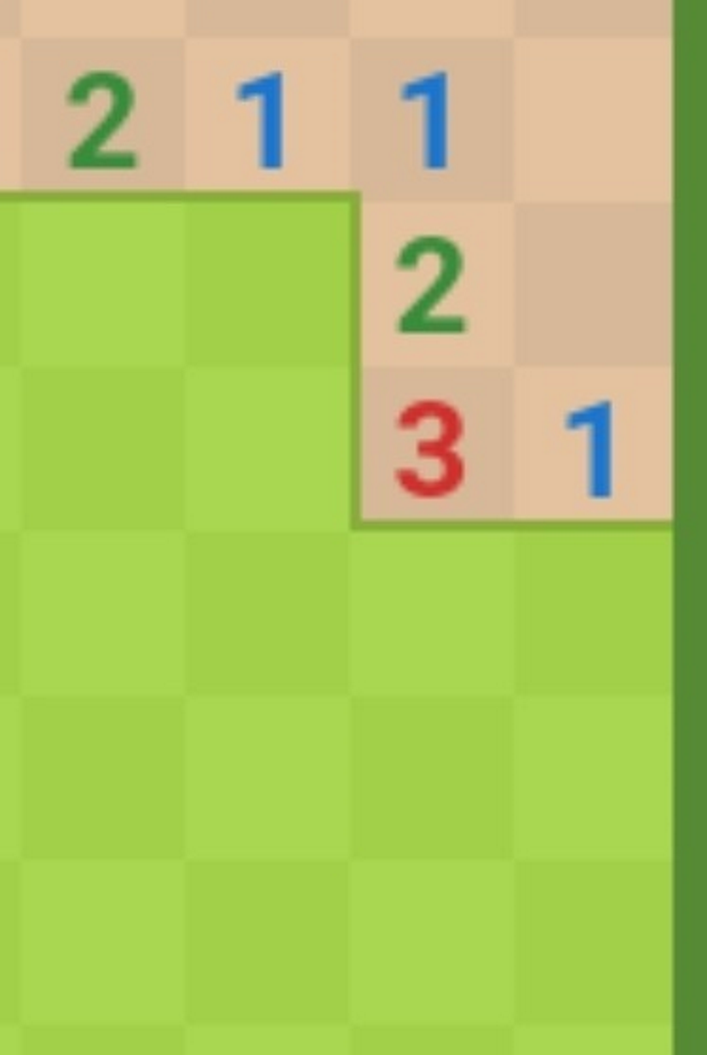
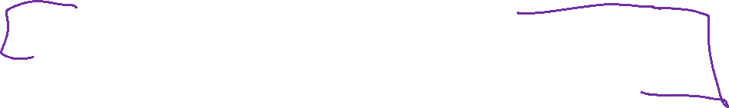
Minesweeper
Numbers indicate how many mines are in the 8 adjacent cells
 | 1
 | 2
We're trying to figure out what to do next
Which unvisited spaces that are definitely safe?
Which unvisited spaces that are definitely dangerous?
(What about the other spaces?)

Slide 8
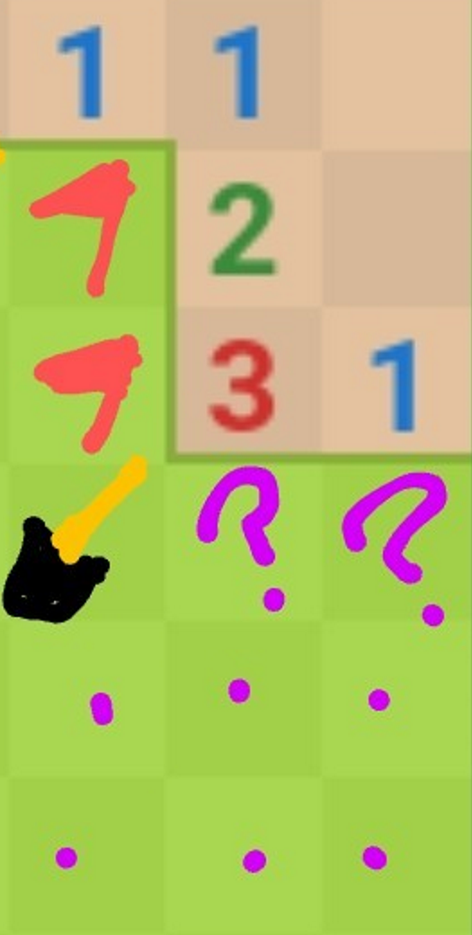

Minesweeper
Numbers indicate how many mines are in the 8 adjacent cells
 | 1
 | 2
We're trying to figure out what to do next
Which unvisited spaces that are definitely safe?
Which unvisited spaces that are definitely dangerous?
(What about the other spaces?)

Slide 9
Minesweeper
It may take a few logical steps to reason about:
What is possible
What is impossible
What is still unknown
Example human inference steps:
?

Slide 10
Minesweeper
It may take a few logical steps to reason about:
What is possible
What is impossible
What is still unknown
Example human inference steps:
?

Slide 11
High-level View: Logical Agents

Slide 12

Logical Agents
Logical agents and environments
Agent
Environment
Sensors
Percepts
Knowledge Base
Inference
?
Actuators
Actions

Slide 13

Logical Agents
So what do we TELL our knowledge base (KB)?
  Facts (sentences)
      The grass is green
      The sky is blue
  Rules (sentences)
      Eating too much candy makes you sick
      When you’re sick you don’t go to school
  Percepts and Actions (sentences)
      Pat ate too much candy today
What happens when we ASK the agent?
  Inference – new sentences created from old
      Pat is not going to school today

Slide 14

A Knowledge-based Agent
function KB-AGENT(percept) returns an action
persistent: KB, a knowledge base
persistent: t, an integer, initially 0
TELL(KB, PROCESS-PERCEPT(percept, t))
action ← ASK(KB, PROCESS-QUERY(t))
TELL(KB, PROCESS-RESULT(action, t))
t←t+1
return action

Slide 15

Models and Knowledge Bases
Entailment and Satisifiability

Slide 16
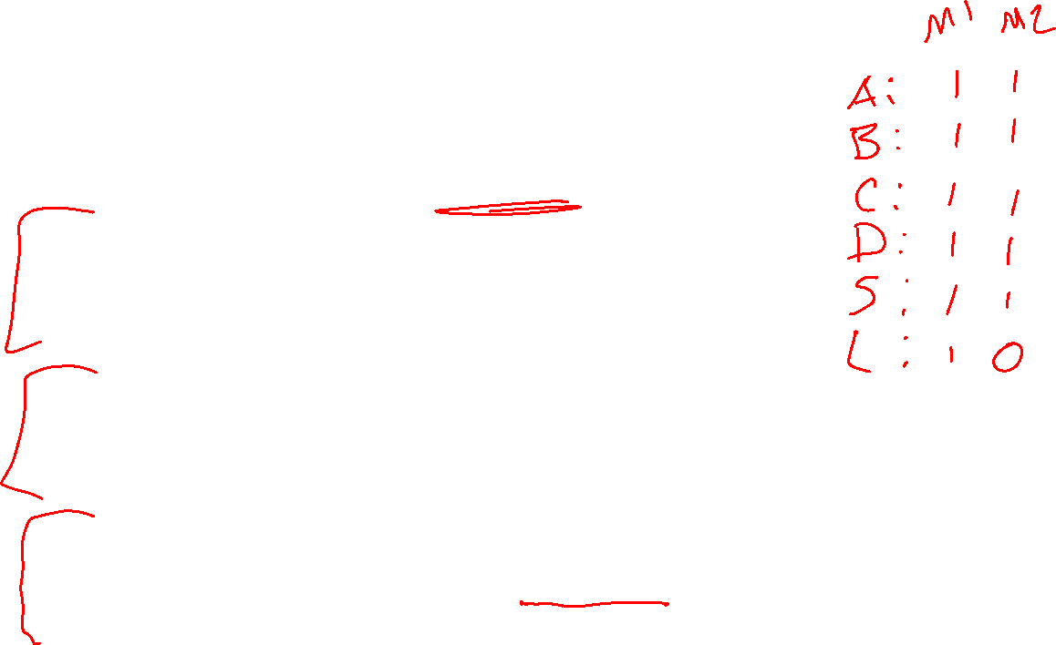
Logical Agent Vocab
Model
  An specific assignment of all symbols to True/False
Sentence
  Logical statement
  Composition of logic symbols and operators
KB
  Collection of sentences representing facts and rules we know about the world
Query
  Sentence we want to know if it is provably True, provably False, or unsure.

Slide 17

Models and Knowledge Bases
Example: Sudoku
Model
Assignment of values to all variables
Knowledge Base
Collection of things we know to be true
Rules of the world
Observations
Things we have figured out
1
2
1
3
4

Slide 18
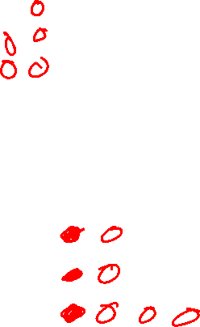
Models and Knowledge Bases
Example: Minesweeper
Model
Assignment of values to all variables
Knowledge Base
Collection of things we know to be true
Rules of the world
Observations
Things we have figured out
Numbers indicate how many mines
 | 1
 | 2

Slide 19
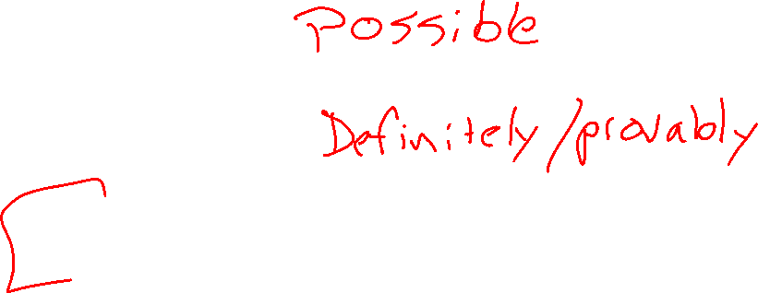
Entailment and Satisfiability
More formally
Symbol (variable)
Models (all symbols assigned a value)
Satisfiable: there exists (at least one) model that meets the constraints
Entailment: statement is true for all models that meet the constraints
How do we get a computer to do this?

Slide 20
Entailment and Satisfiability
What reasoning are we doing?
Can I click here? / Is this definitely safe?
    Yes: For all possible configurations (models), none of them have a mine in that location
    No: There exists (at least) one possible configuration with a mine in that location
Is it possibly safe?
    Yes: There exists (at least) one possible configuration with a mine in that location
    No: For all possible configurations (models), all of them have a mine in that location → It's definitely dangerous
Entailment: definitely safe
Satisfiability: possibly not safe
Satisfiability: possibly safe
Entailment: definitely not safe

Slide 21
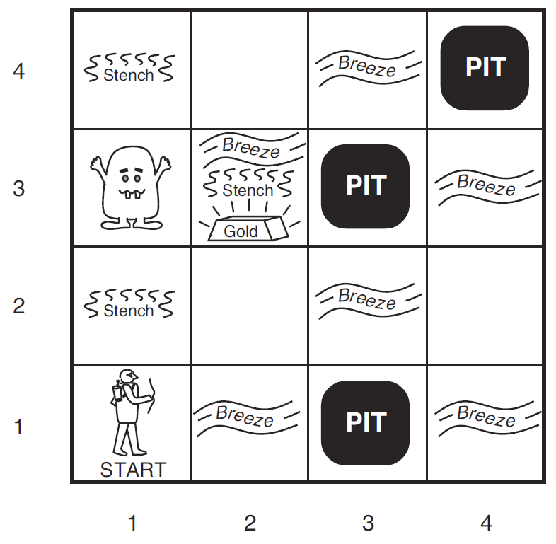
Wumpus World
We collect information as we move to a new grid in the world
Breeze: if next to a Pit
Stench: if next to a Wumpus
Both
Nothing
Oh, and there's gold
We're trying to figure out what to do next
Which unvisited spaces that are definitely safe?
Which unvisited spaces that are definitely dangerous?
(What about the other spaces?)

Slide 22
Wumpus World
Symbols for Wumpus World
B_{ij} = breeze felt
S_{ij} = stench smelt
P_{ij} = pit here
W_{ij} = wumpus here
G = gold
http://thiagodnf.github.io/wumpus-world-simulator/

Slide 23
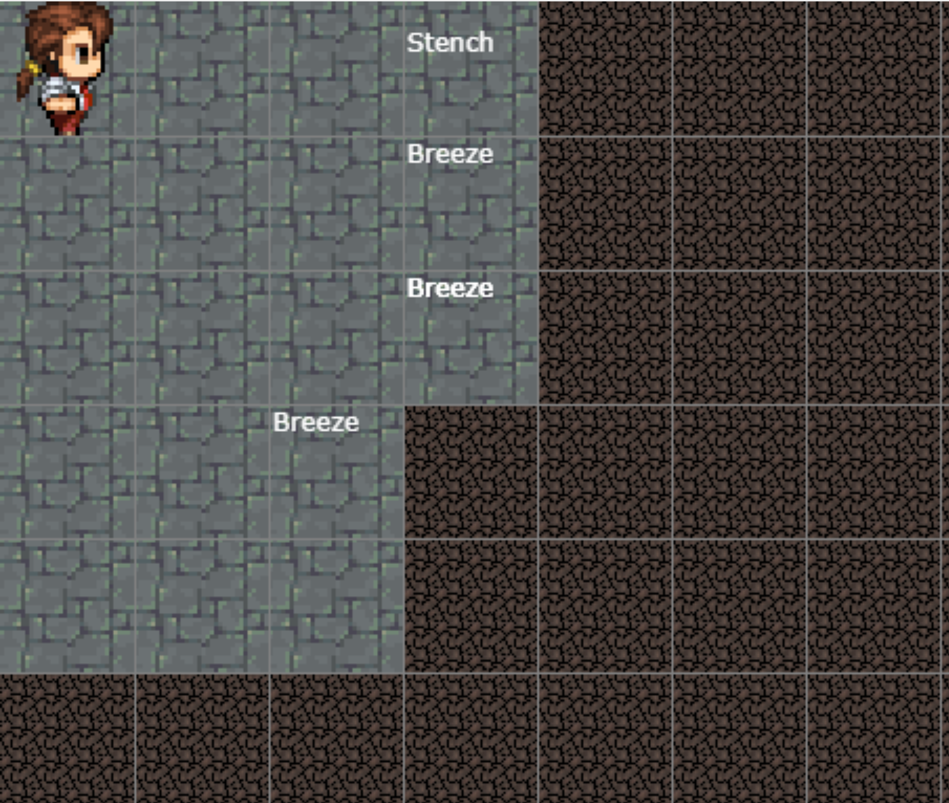
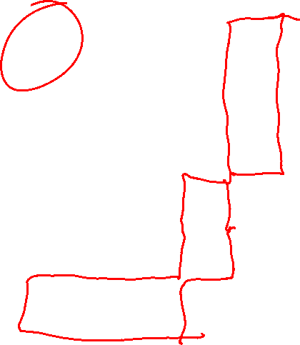
Wumpus World
Reasoning about how to get safely get more information!
http://thiagodnf.github.io/wumpus-world-simulator/

Slide 24
Propositional Logic

Slide 25
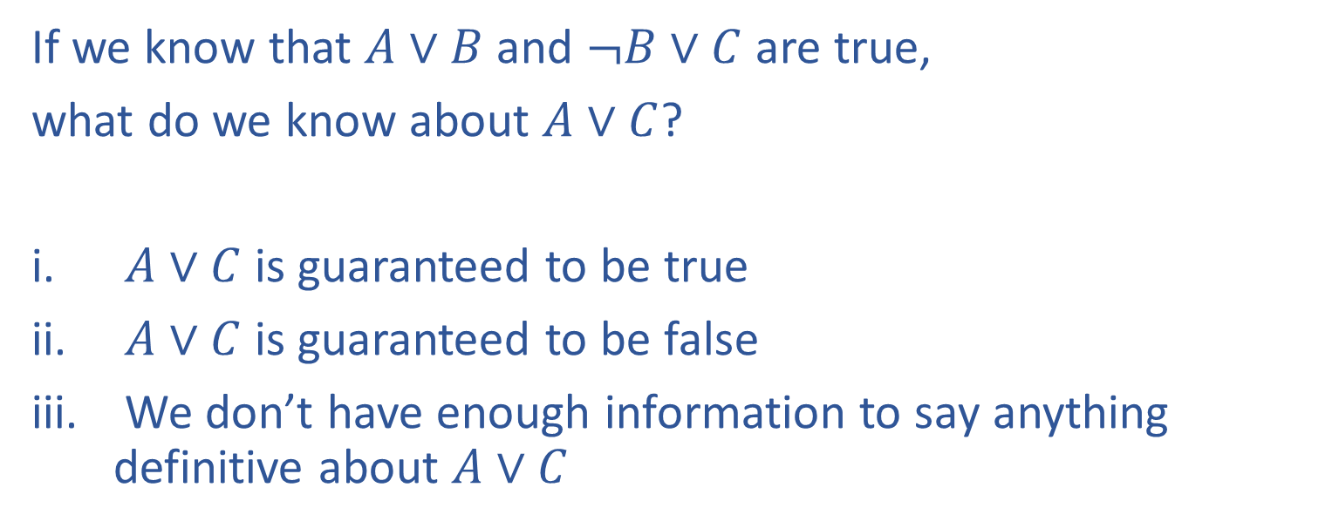
Poll 1
If we know that $A∨B$ and $¬B∨C$ are true,
what do we know about $A∨C$?
$A∨C$ is guaranteed to be true
$A∨C$ is guaranteed to be false
We don’t have enough information to say anything definitive about $A∨C$

Slide 26

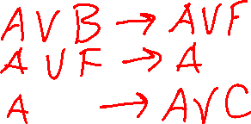

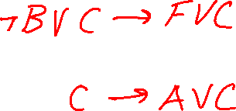
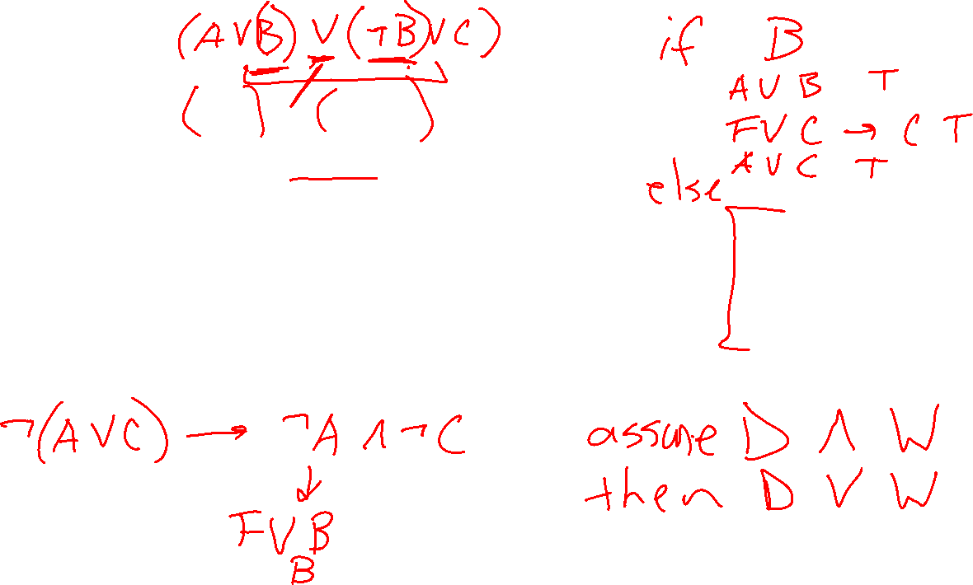
Poll 1
If we know that $A∨B$ and $¬B∨C$ are true,
what do we know about $A∨C$?
$A∨C$ is guaranteed to be true
$A∨C$ is guaranteed to be false
We don’t have enough information to say anything definitive about $A∨C$

Slide 27
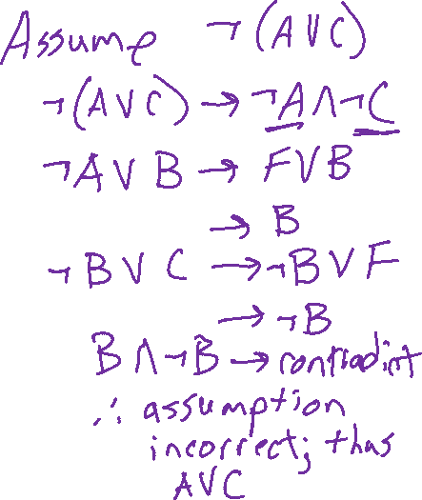
Poll 1
If we know that $A∨B$ and $¬B∨C$ are true,
what do we know about $A∨C$?
$A∨C$ is guaranteed to be true
$A∨C$ is guaranteed to be false
We don’t have enough information to say anything definitive about $A∨C$

Slide 28
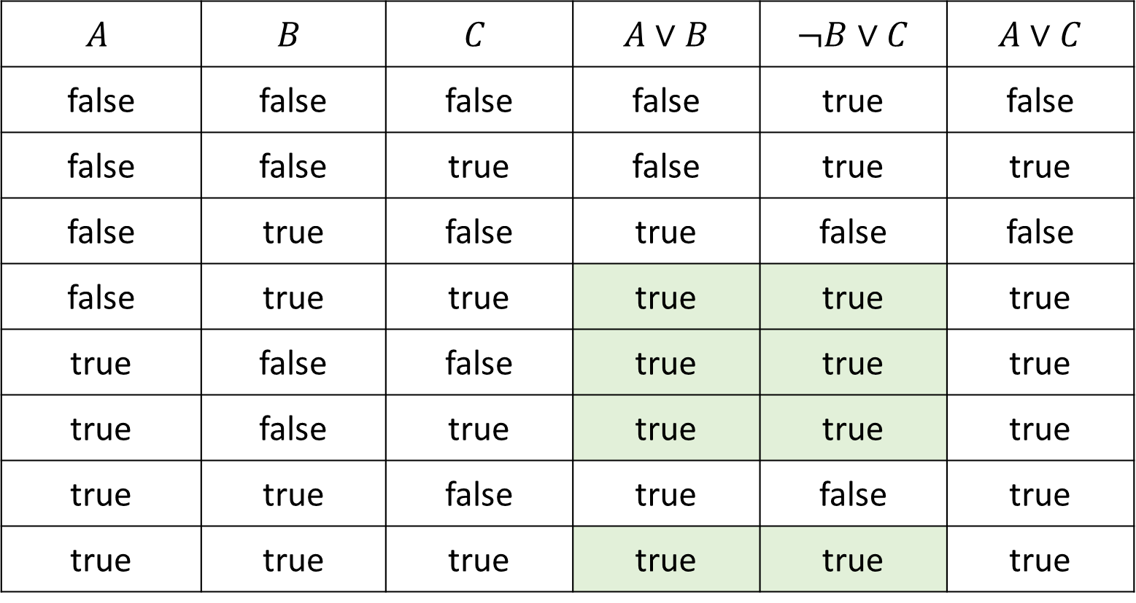
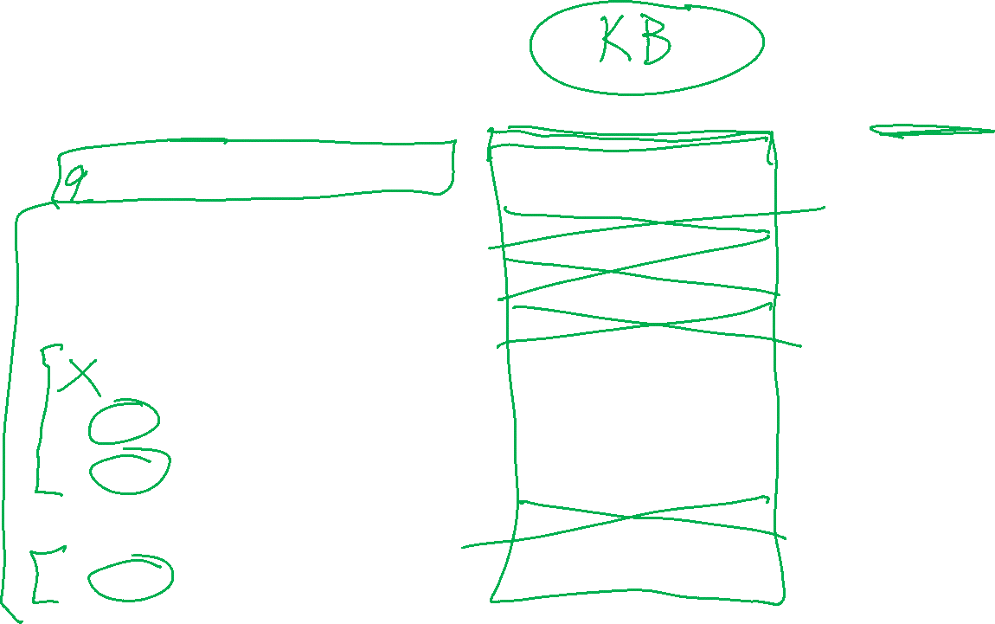
Poll 1
If we know that $A∨B$ and $¬B∨C$ are true, what do we know about $A∨C$?
$$A$$ | $$B$$ | $$C$$ | $A∨B$ | $¬B∨C$ | $A∨C$
false | false | false | false | true | false
false | false | true | false | true | true
false | true | false | true | false | false
false | true | true | true | true | true
true | false | false | true | true | true
true | false | true | true | true | true
true | true | false | true | false | true
true | true | true | true | true | true

Slide 29
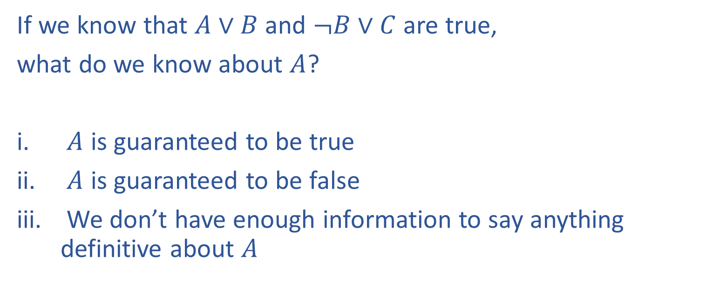
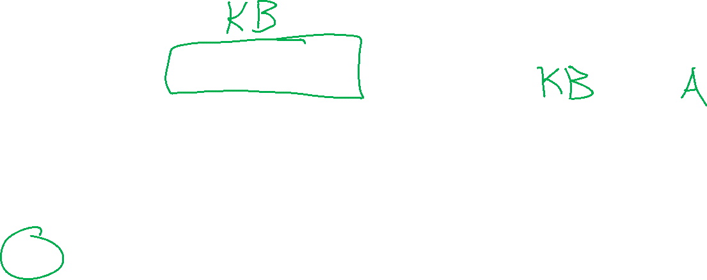
Poll 2
If we know that $A∨B$ and $¬B∨C$ are true,
what do we know about $A$?
$A$ is guaranteed to be true
$A$ is guaranteed to be false
We don’t have enough information to say anything definitive about $A$

Slide 30
Poll 2
If we know that $A∨B$ and $¬B∨C$ are true, what do we know about $A$?
$$A$$ | $$B$$ | $$C$$ | $A∨B$ | $¬B∨C$ | $A∨C$
false | false | false | false | true | false
false | false | true | false | true | true
false | true | false | true | false | false
false | true | true | true | true | true
true | false | false | true | true | true
true | false | true | true | true | true
true | true | false | true | false | true
true | true | true | true | true | true

Slide 31
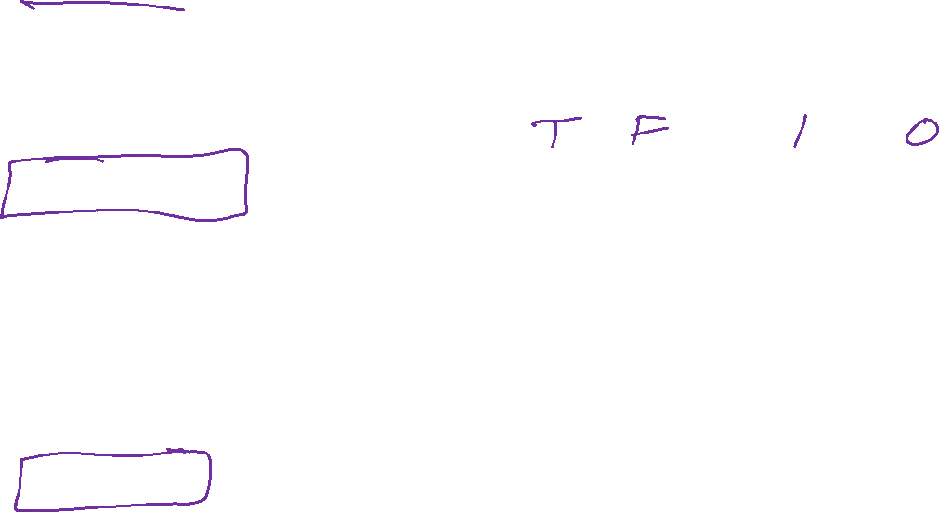
Propositional Logic
Symbol:
Variable that can be true or false
We’ll try to use capital letters, e.g. A, B, P_{1,2}
Often include True and False
Operators:
¬ A: not A
A ∧ B: A and B (conjunction)
A ∨ B: A or B (disjunction) Note: this is not an “exclusive or”
A ⇒ B: A implies B (implication). If A then B
A ⇔ B: A if and only if B (biconditional)
Sentences

Slide 32
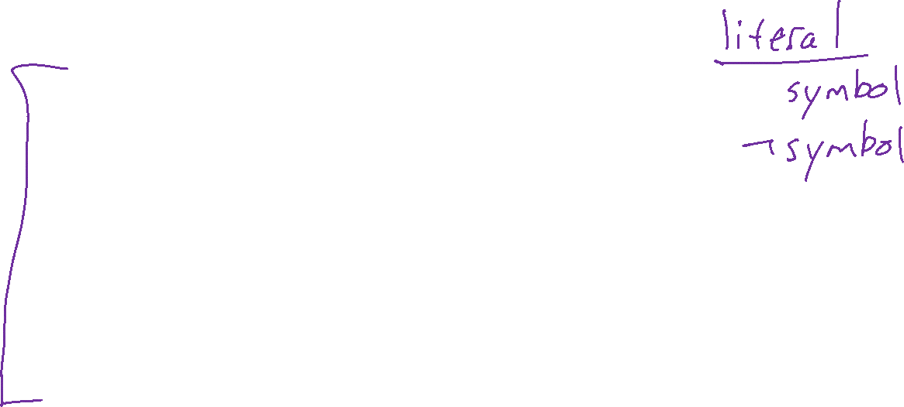
Propositional Logic Syntax
Given: a set of proposition symbols {X₁, X₂, …, X_{n}}
    (we often add True and False for convenience)
X_{i} is a sentence
If α is a sentence then ¬α is a sentence
If α and β are sentences then α ∧ β is a sentence
If α and β are sentences then α ∨ β is a sentence
If α and β are sentences then α ⇒ β is a sentence
If α and β are sentences then α ⇔ β is a sentence
And p.s. there are no other sentences!

Slide 33
Notes on Operators
𝛂 ∨ 𝛃 is inclusive or, not exclusive

Slide 34
Truth Tables
𝛂 ∨ 𝛃 is inclusive or, not exclusive
𝛂 | 𝛃 | 𝛂 ∧ 𝛃
F | F | F
F | T | F
T | F | F
T | T | T
𝛂 | 𝛃 | 𝛂 ∨ 𝛃
F | F | F
F | T | T
T | F | T
T | T | T

Slide 35
Notes on Operators
𝛂 ∨ 𝛃 is inclusive or, not exclusive
𝛂 ⇒ 𝛃 is equivalent to ¬𝛂 ∨ 𝛃
Says who?

Slide 36
Truth Tables
𝛂 ⇒ 𝛃 is equivalent to ¬𝛂 ∨ 𝛃
𝛂 | 𝛃 | 𝛂 ⇒ 𝛃 | ¬𝛂 | ¬𝛂 ∨ 𝛃
F | F | T | T | T
F | T | T | T | T
T | F | F | F | F
T | T | T | F | T

Slide 37
Notes on Operators
𝛂 ∨ 𝛃 is inclusive or, not exclusive
𝛂 ⇒ 𝛃 is equivalent to ¬𝛂 ∨ 𝛃
Says who?
𝛂 ⇔ 𝛃 is equivalent to (𝛂 ⇒ 𝛃) ∧ (𝛃 ⇒ 𝛂)
Prove it!

Slide 38
Truth Tables
𝛂 ⇔ 𝛃 is equivalent to (𝛂 ⇒ 𝛃) ∧ (𝛃 ⇒ 𝛂)
𝛂 | 𝛃 | 𝛂 ⇔ 𝛃 | 𝛂 ⇒ 𝛃 | 𝛃 ⇒ 𝛂 | (𝛂⇒𝛃) ∧ (𝛃⇒𝛂)
F | F | T | T | T | T
F | T | F | T | F | F
T | F | F | F | T | F
T | T | T | T | T | T
Equivalence: it’s true in all models. Expressed as a logical sentence:
(𝛂 ⇔ 𝛃) ⇔ [(𝛂 ⇒ 𝛃) ∧ (𝛃 ⇒ 𝛂)]

