Slide 1
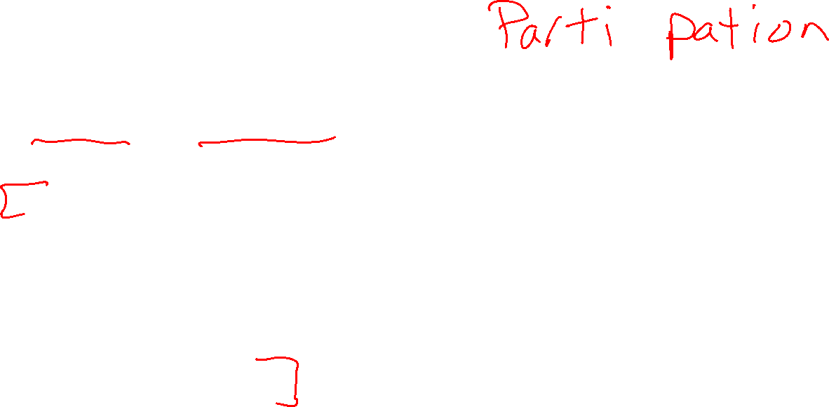

Plan
Last time
Tree search vs graph search
Today
Uniform cost search
Heuristics
Greedy search
A* search
    Optimality
[More on heuristics]

Slide 2
Uniform Cost Search
Back to Lecture 2 slides

Slide 3
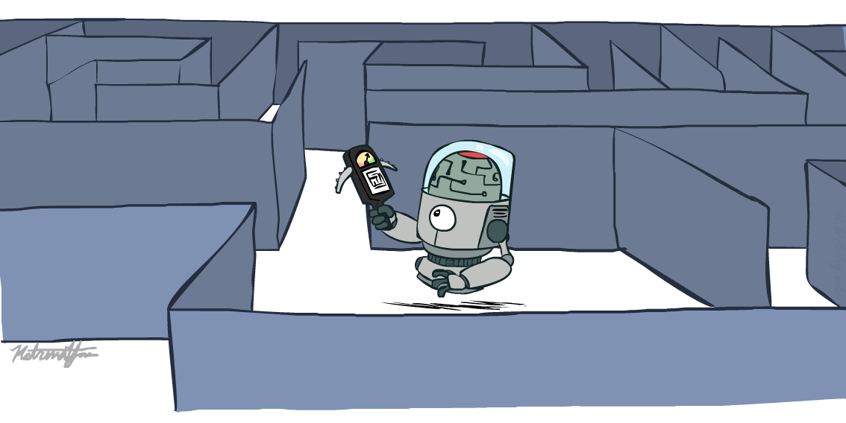

AI: Representation and Problem Solving
Informed Search
Instructor: Pat Virtue
Slide credits: CMU AI, http://ai.berkeley.edu

Slide 4
function TREE_SEARCH(problem) returns a solution, or failure
initialize the frontier as a specific work list (stack, queue, priority queue)
add initial state of problem to frontier
loop do
if the frontier is empty then
return failure
choose a node and remove it from the frontier
if the node contains a goal state then
return the corresponding solution
for each resulting child from node
add child to the frontier

Slide 5
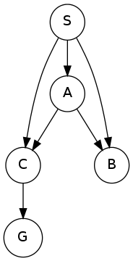
function GRAPH_SEARCH(problem) returns a solution, or failure
initialize the explored set to be empty
initialize the frontier as a specific work list (stack, queue, priority queue)
add initial state of problem to frontier
loop do
if the frontier is empty then
return failure
choose a node and remove it from the frontier
if the node contains a goal state then
return the corresponding solution
add the node state to the explored set
for each resulting child from node
if the child state is not already in the frontier or explored set then
add child to the frontier

Slide 6
function UNIFORM-COST-SEARCH(problem) returns a solution, or failure
initialize the explored set to be empty
initialize the frontier as a priority queue using node path_cost as the priority
add initial state of problem to frontier with path_cost = 0
loop do
if the frontier is empty then
return failure
choose a node and remove it from the frontier
if the node contains a goal state then
return the corresponding solution
add the node state to the explored set
for each resulting child from node
if the child state is not already in the frontier or explored set then
add child to the frontier
else if the child is already in the frontier with higher path_cost then
replace that frontier node with child
2
C
A
4
G
1
3
S
B
D
4
1

Slide 7
Recall: Breadth-First Search (BFS) Properties
What nodes does BFS expand?
  Processes all nodes above shallowest solution
  Let depth of shallowest solution be s
  Search takes time O(b^{s})
How much space does the frontier take?
  Has roughly the last tier, so O(b^{s})
Is it complete?
  s must be finite if a solution exists, so yes!
Is it optimal?
  Only if costs are all the same (more on costs later)
1 node
b
…
b nodes
s tiers
b² nodes
b^{s} nodes
b^{m} nodes

Slide 8
Recall: Breadth-First Search (BFS) Properties
What nodes does BFS expand?
  Processes all nodes above shallowest solution
  Let depth of shallowest solution be s
  Search takes time O(b^{s})
How much space does the frontier take?
  Has roughly the last tier, so O(b^{s})
b
…
s tiers

Slide 9
Uniform Cost Search (UCS) Properties
What nodes does UCS expand?
  Processes all nodes with cost less than cheapest solution
  If that solution costs C* and step costs are at least ε , then the “effective depth” is roughly C*/ε
  Takes time O(b^{C*/ε}) (exponential in effective depth)
How much space does the frontier take?
  Has roughly the last tier, so O(b^{C*/ε})
Is it complete?
  Assuming best solution has a finite cost and minimum step cost is positive, yes!
Is it optimal?
  Yes! (Proof via A*)
b
c ≤ 1
…
C*/ε “tiers”
c ≤ 2
c ≤ 3

Slide 10
Uniform Cost Issues
Strategy:
Explore (expand) the lowest path cost on frontier
The good:
UCS is complete and optimal!
The bad:
  Explores options in every “direction”
  No information about goal location
We’ll fix that today!
…
c ≤ 1
c ≤ 2
c ≤ 3
Start
Goal
[Demo: contours UCS empty (L3D1)]
[Demo: contours UCS pacman small maze (L3D3)]

Slide 11
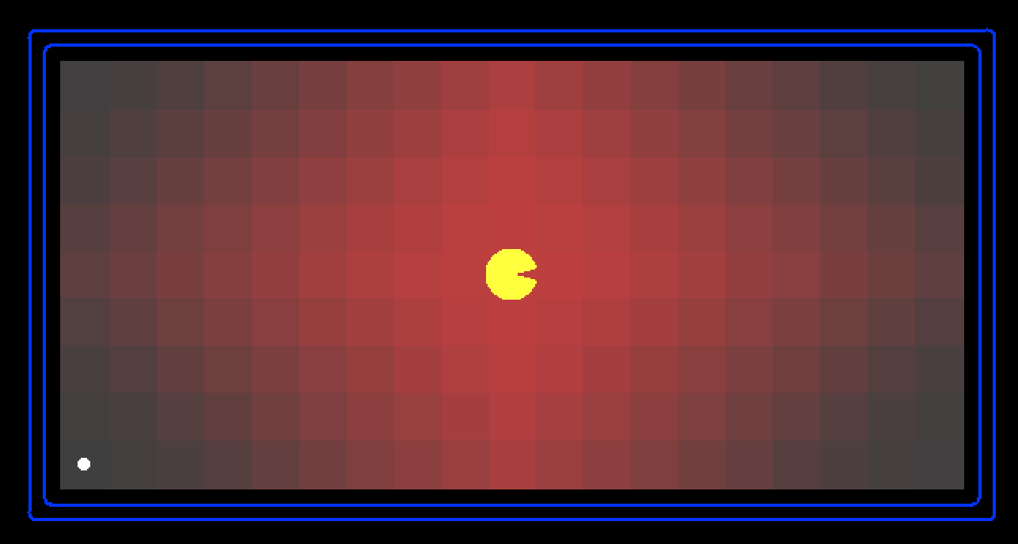
Demo Contours UCS Empty

Slide 12
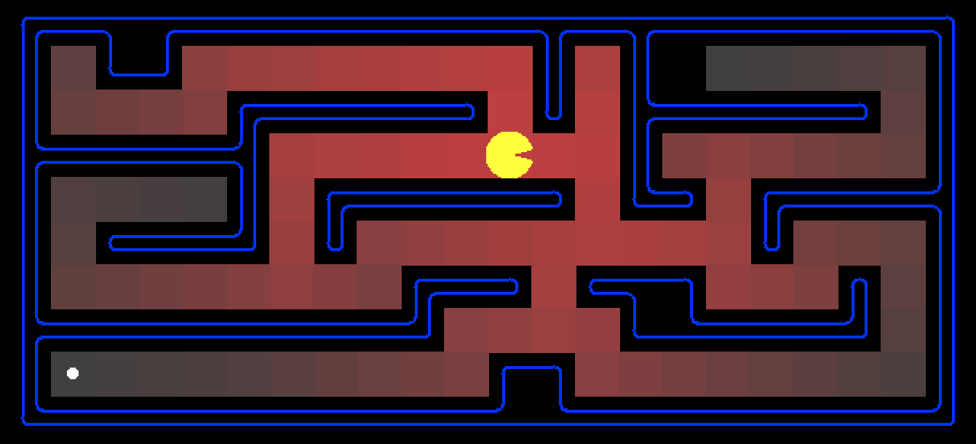
Demo Contours UCS Pacman Small Maze

Slide 13
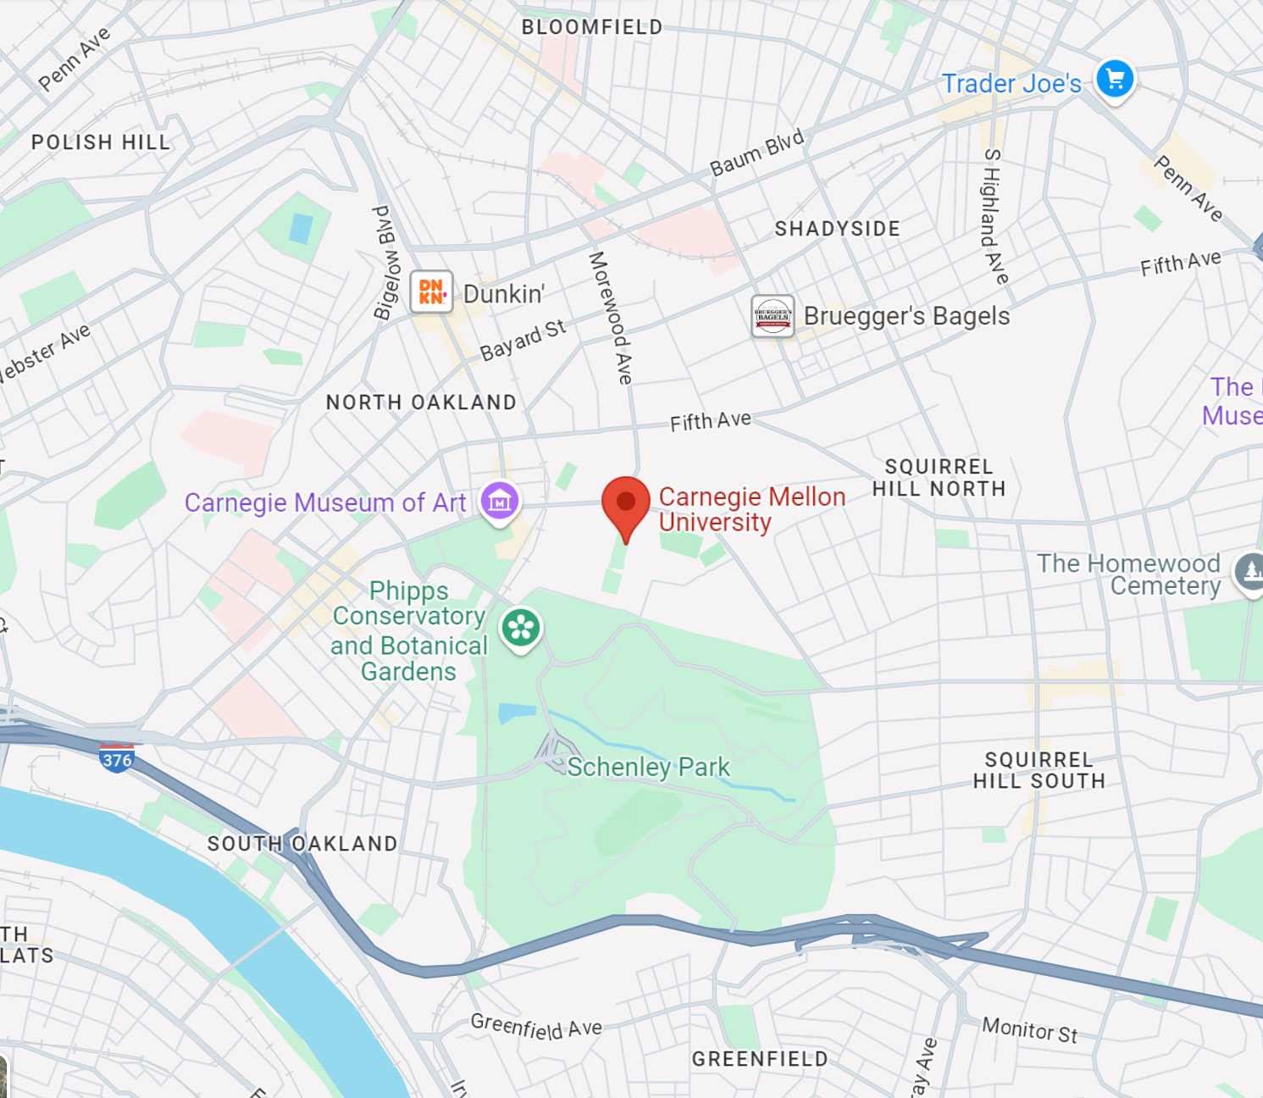
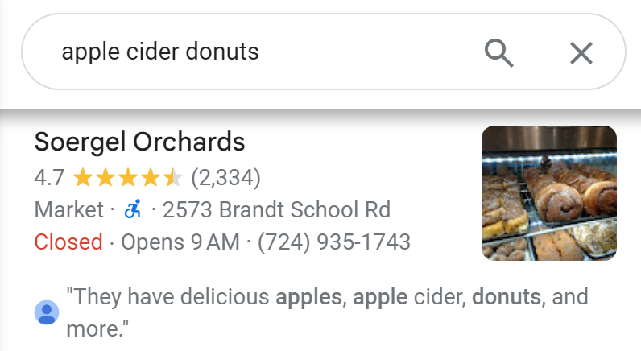
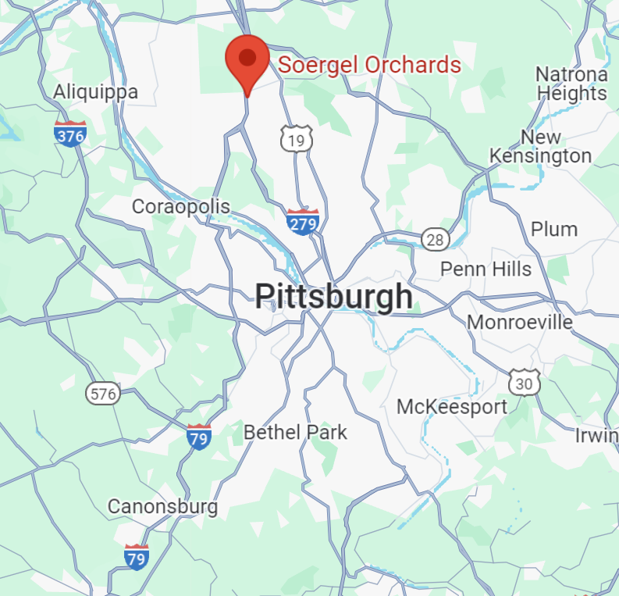
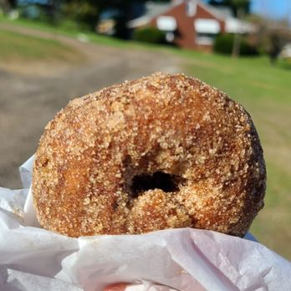
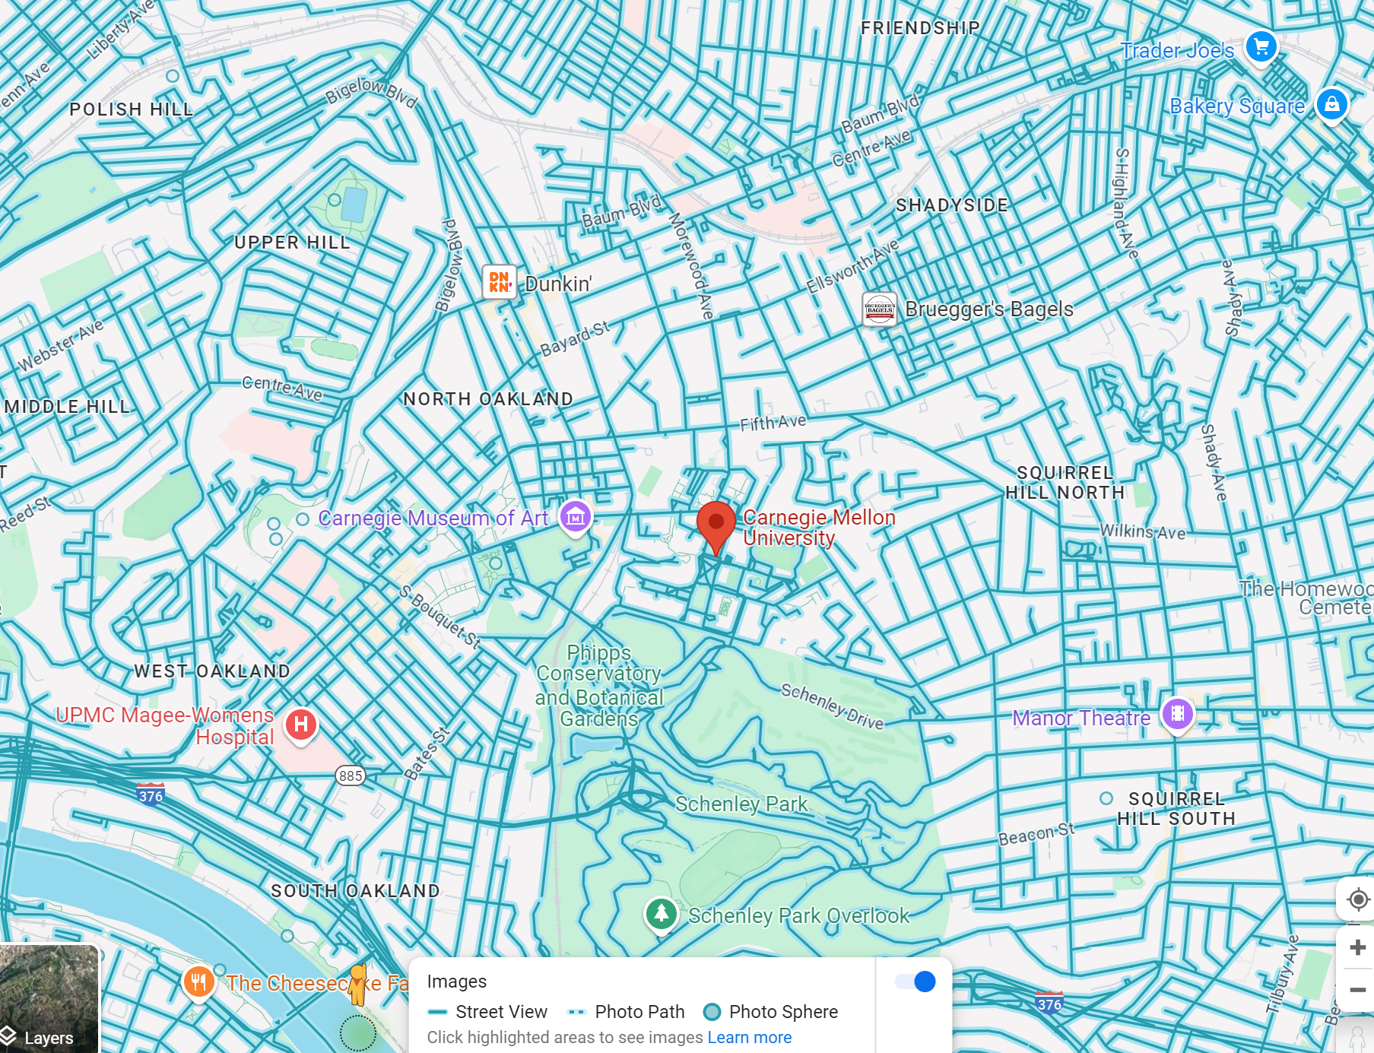
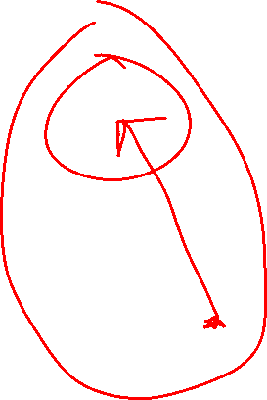
Donuts ASAP!
Images: Yelp "Soergel's", Google Maps

Slide 14
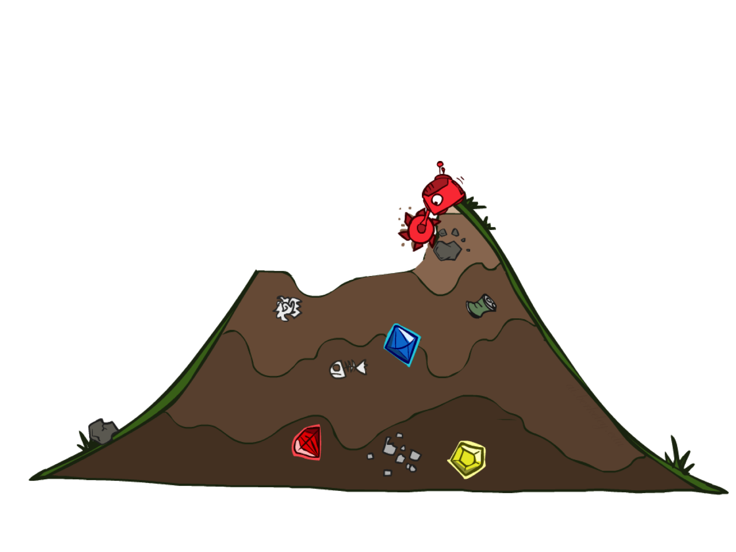
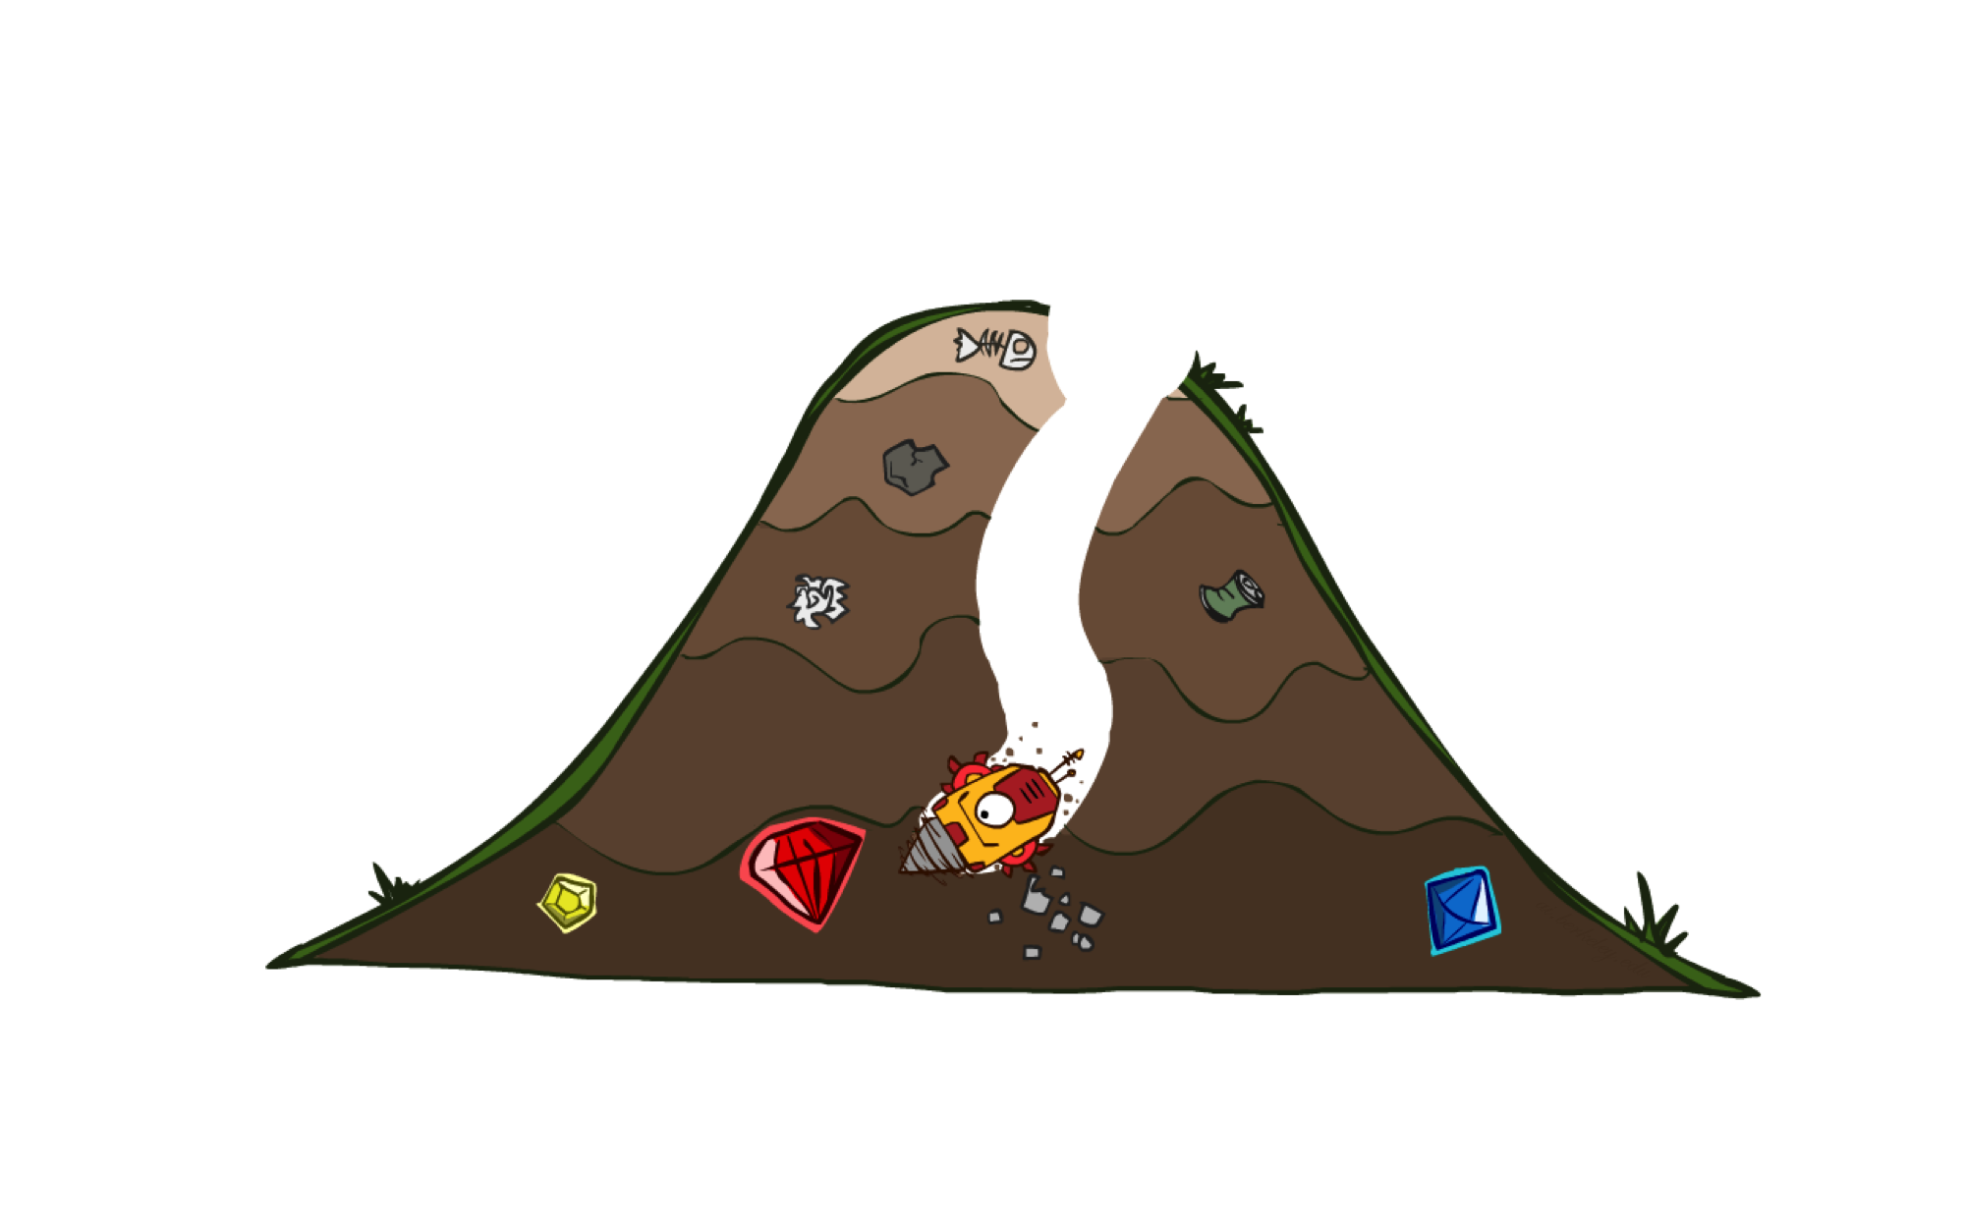

Uninformed vs Informed Search

Slide 15


Today
Informed Search
  Heuristics
  Greedy Search
  A* Search

Slide 16

Informed Search

Slide 17
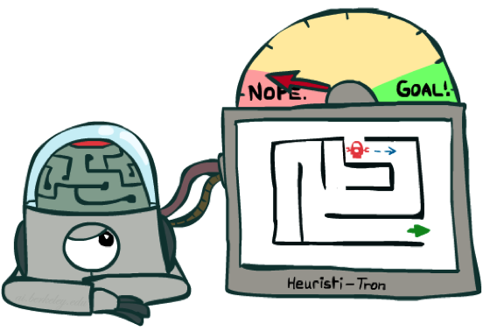
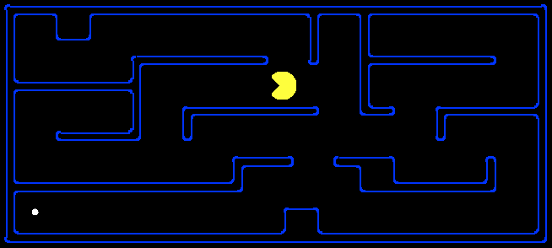
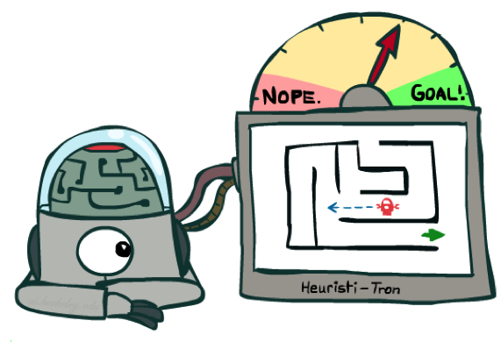

Search Heuristics
A heuristic is:
A function that estimates how close a state is to a goal
Designed for a particular search problem
Examples: Manhattan distance, Euclidean distance for pathing
10
5
11.2

Slide 18
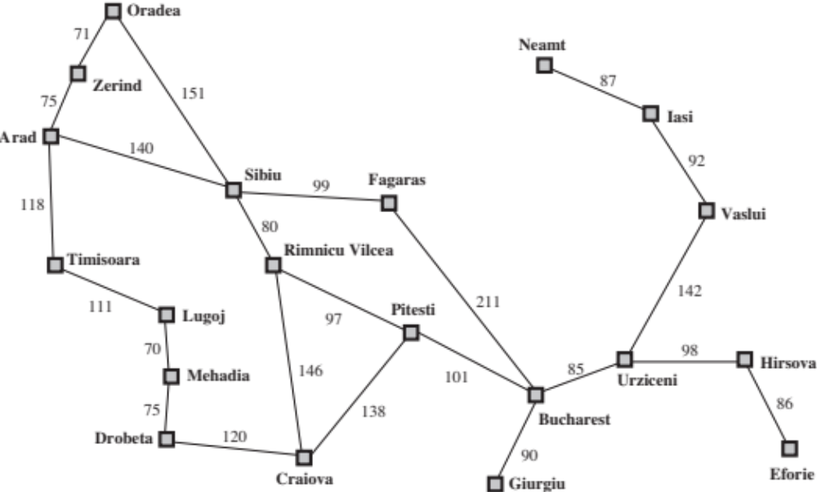
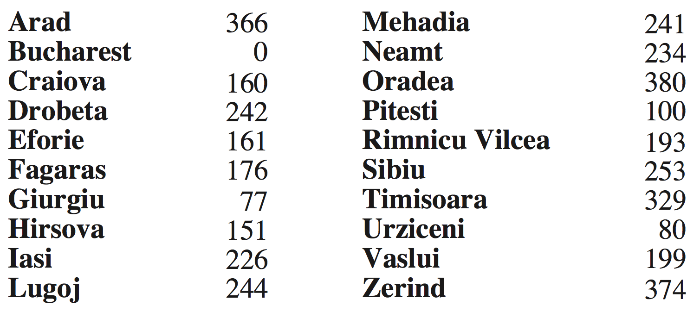
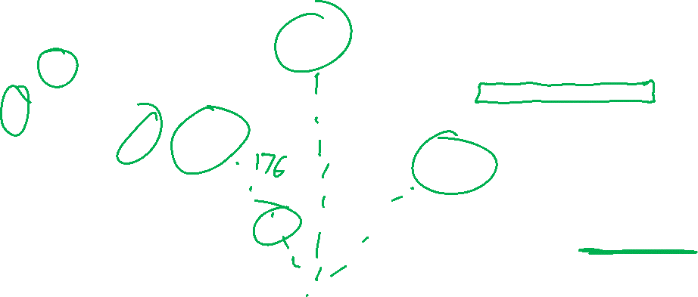
Example: Euclidean distance to Bucharest
h(state) → value

Slide 19
Effect of heuristics
Guide search towards the goal instead of all over the place
Start
Goal
Start
Goal
Informed
Uninformed

Slide 20
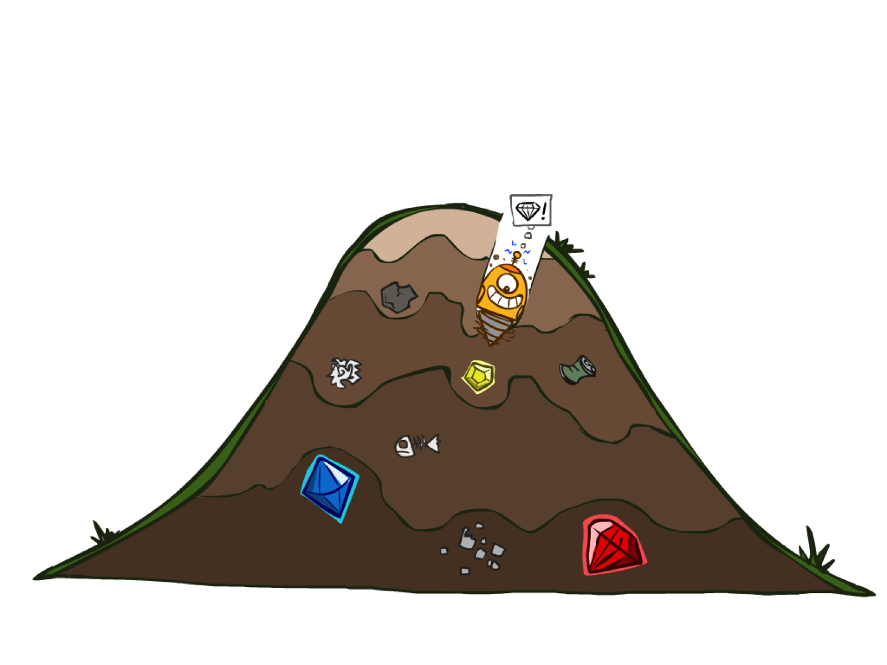
Greedy Search

Slide 21

Donuts ASAP!

Slide 22
Greedy Search
b
Strategy: expand a node that seems closest to a goal state, according to h
Problem 1: it chooses a node even if it’s at the end of a very long and winding road
Problem 2: it takes h literally even if it’s completely wrong
…
Notes:
For any search problem, you know the goal. Now, you have an idea of how far away you are from the goal.

Slide 23
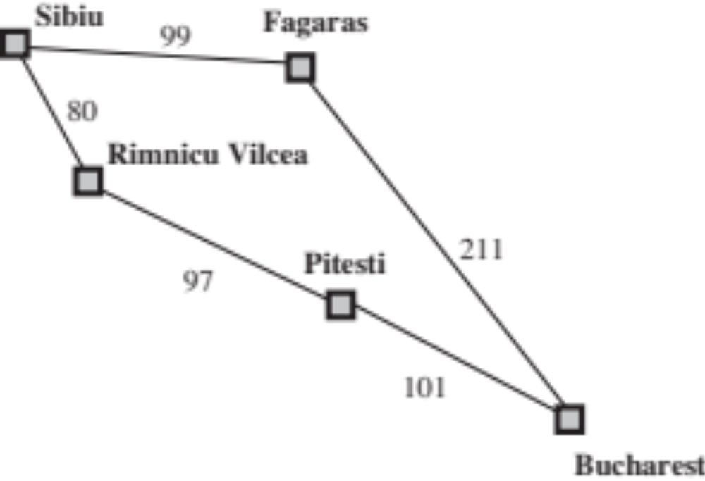

Greedy Search
Expand the node that seems closest…(order frontier by h)
What can possibly go wrong?
Sibiu-Fagaras-Bucharest =
99+211 = 310
Sibiu-Rimnicu Vilcea-Pitesti-Bucharest =
80+97+101 = 278
h= 253
h=176
h=193
1000000
h=100
h=0

Slide 24
Demo Contours Greedy (Empty)

Slide 25
Demo Contours Greedy (Pacman Small Maze)

Slide 26
A* Search

Slide 27

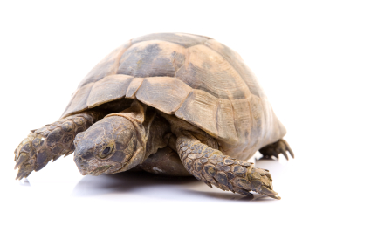

A* Search
UCS
Greedy
A*
Notes:
Notes: these images licensed from iStockphoto for UC Berkeley use.

Slide 28
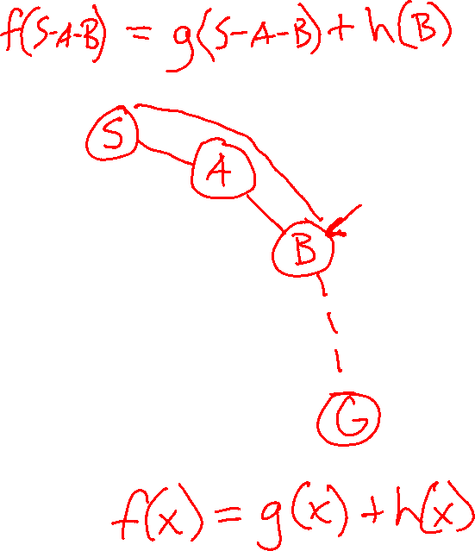
A* Search
UCS
Greedy
A*
Notes:
Notes: these images licensed from iStockphoto for UC Berkeley use.

Slide 29

Combining UCS and Greedy
Uniform-cost orders by path cost, or backward cost g(n)
8
g = 0 h=6
S
e
h=1
g = 1 h=5
a
1
1
3
2
g = 2 h=6
g = 9 h=1
S
a
d
G
b
d
g = 4 h=2
e
h=6
1
h=5
h=2
h=0
1
g = 3 h=7
g = 6 h=0
g = 10 h=2
c
b
c
G
d
h=7
h=6
g = 12 h=0
G
Example: Teg Grenager

Slide 30

Combining UCS and Greedy
Uniform-cost orders by path cost, or backward cost g(n)
Greedy orders by goal proximity, or forward cost h(n)
8
g = 0 h=6
S
e
h=1
g = 1 h=5
a
1
1
3
2
g = 2 h=6
g = 9 h=1
S
a
d
G
b
d
g = 4 h=2
e
h=6
1
h=5
h=2
h=0
1
g = 3 h=7
g = 6 h=0
g = 10 h=2
c
b
c
G
d
h=7
h=6
g = 12 h=0
G
Example: Teg Grenager

Slide 31
Combining UCS and Greedy
Uniform-cost orders by path cost, or backward cost g(n)
Greedy orders by goal proximity, or forward cost h(n)
A* Search orders by the sum: f(n) = g(n) + h(n)
8
g = 0 h=6
S
e
h=1
g = 1 h=5
a
1
1
3
2
g = 2 h=6
g = 9 h=1
S
a
d
G
b
d
g = 4 h=2
e
h=6
1
h=5
h=2
h=0
1
g = 3 h=7
g = 6 h=0
g = 10 h=2
c
b
c
G
d
h=7
h=6
g = 12 h=0
G
Example: Teg Grenager

Slide 32
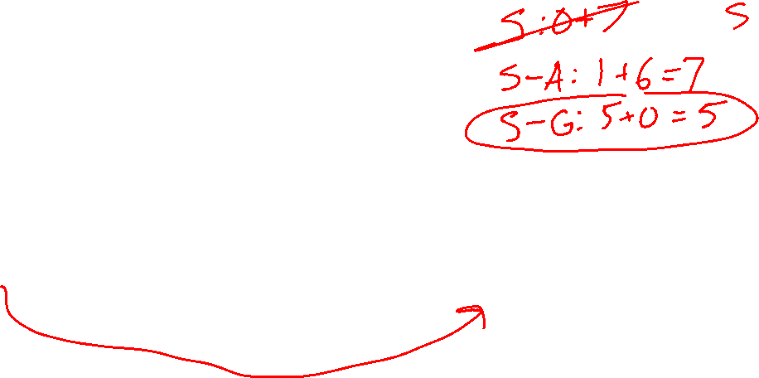
Is A* Optimal?
h = 6
1
A
3
S
h = 7
G
h = 0
5
What went wrong?
Estimated good goal cost > Actual future cost!
We need estimates to be less than actual costs!

Slide 33

The Price is Wrong…
Closest bid without going over…
https://www.youtube.com/watch?v=9B0ZKRurC5Y

Slide 34
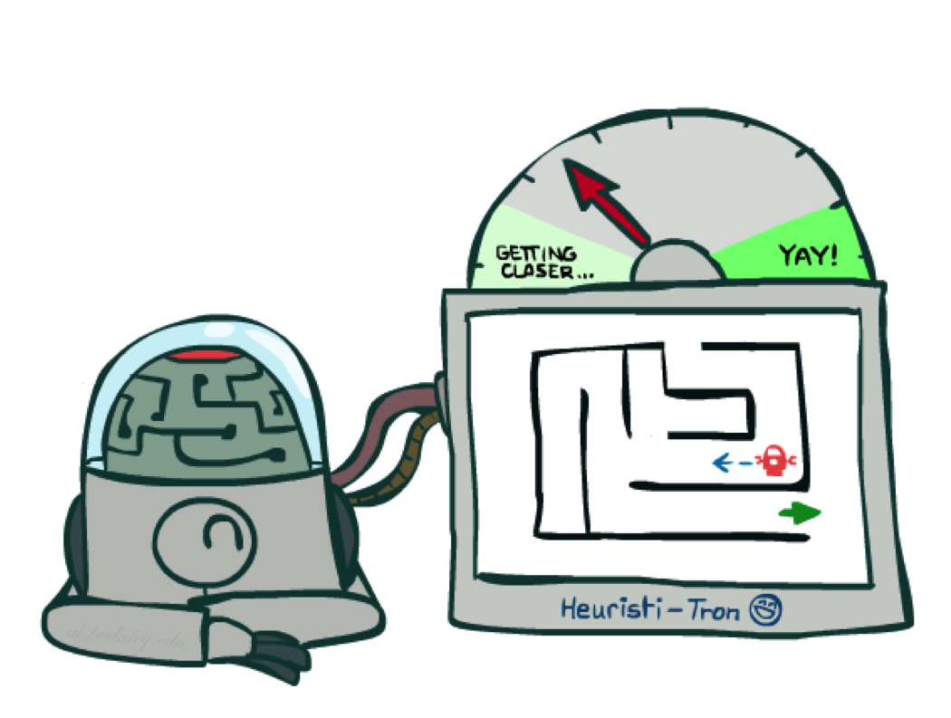
Admissible Heuristics

Slide 35
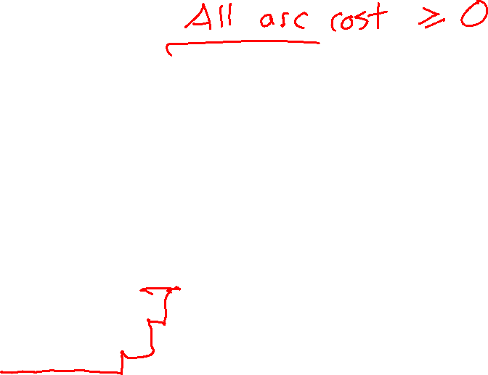
Admissible Heuristics
A heuristic h is admissible (optimistic) if:
  0 ≤ h(n) ≤ h*(n)
where h*(n) is the true cost to a nearest goal
Example:
Coming up with admissible heuristics is most of what’s involved in using A* in practice.
15

Slide 36

Optimality of A* Tree Search

Slide 37
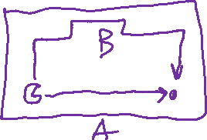

Optimality of A* Tree Search
Assume:
A is an optimal goal node
B is a suboptimal goal node
h is admissible
Claim:
A will be chosen for exploration (popped off the frontier) before B
…
A
B

Slide 38
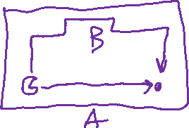
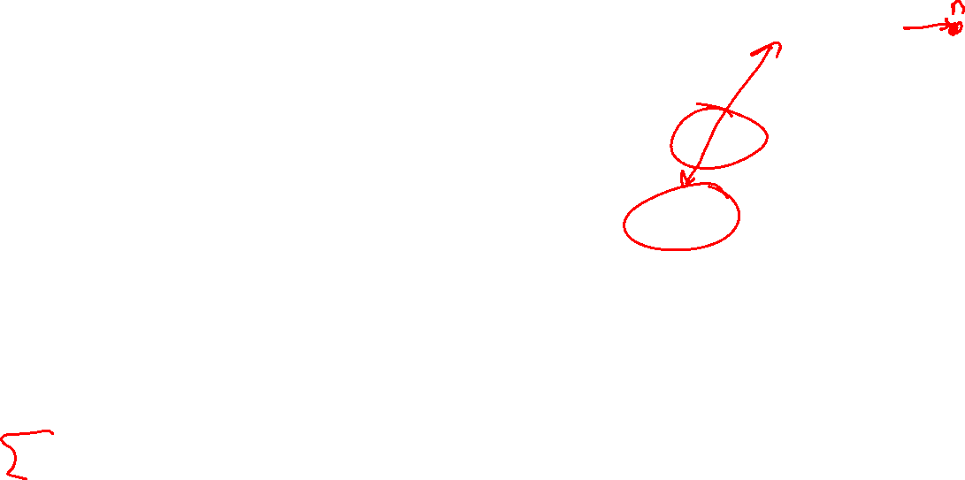
Optimality of A* Tree Search: Blocking
Proof:
Imagine B is on the frontier
Some ancestor n of A is on the frontier, too (Maybe the start state; maybe A itself!)
Claim: n will be explored before B
All ancestors of A are explored before B
A is explored before B
A* search is optimal
…
n
A
B

Slide 39

Optimality of A* Tree Search: Blocking
Proof:
Imagine B is on the frontier
Some ancestor n of A is on the frontier, too (Maybe the start state; maybe A itself!)
Claim: n will be explored before B
  f(n) ≤ f(A) ← TODO
  f(A) < f(B) ← TODO
  f(n) < f(B) then n is explored before B
All ancestors of A are explored before B
A is explored before B
A* search is optimal
…
n
A
B

Slide 40
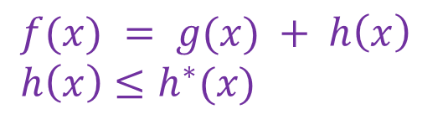

Optimality of A* Tree Search: Blocking
$f(x) = g(x) + h\left(x\right)$
$h\left(x\right)≤h^{∗}(x)$
Proof:
Imagine B is on the frontier
Some ancestor n of A is on the frontier, too (Maybe the start state; maybe A itself!)
Claim: n will be explored before B
  f(n) ≤ f(A)
  f(A) < f(B)
  f(n) < f(B) then n is explored before B
All ancestors of A are explored before B
A is explored before B
A* search is optimal
…
n
A
B
f(n) = g(n) + h(n) Definition of f-cost
f(n) ≤ g(n) + h*(n) Admissibility of h
f(n) ≤ g(A) n on optimal path to A
f(n) ≤ f(A) h = 0 at a goal

Slide 41
Optimality of A* Tree Search: Blocking
$f(x) = g(x) + h\left(x\right)$
$h\left(x\right)≤h^{∗}(x)$
Proof:
Imagine B is on the frontier
Some ancestor n of A is on the frontier, too (Maybe the start state; maybe A itself!)
Claim: n will be explored before B
  f(n) ≤ f(A)
  f(A) < f(B)
  f(n) < f(B) then n is explored before B
All ancestors of A are explored before B
A is explored before B
A* search is optimal
…
n
A
B
f(A) = g(A) + h(A) Def. of f(x)
= g(A) h = 0 at a goal
f(B) = g(B) Similarly for B
g(A) < g(B) Suboptimality of B
f(A) < f(B)

Slide 42
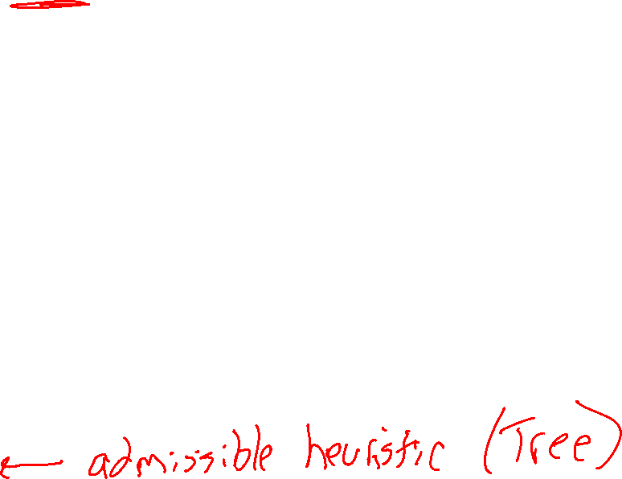
Optimality of A* Tree Search: Blocking
$f(x) = g(x) + h\left(x\right)$
$h\left(x\right)≤h^{∗}(x)$
Proof:
Imagine B is on the frontier
Some ancestor n of A is on the frontier, too (Maybe the start state; maybe A itself!)
Claim: n will be explored before B
  f(n) is less than or equal to f(A)
  f(A) is less than f(B)
  f(n) < f(B) then n is explored before B
All ancestors of A are explored before B
A is explored before B
A* search is optimal
…
n
A
B

Slide 43
UCS vs A* Contours
Uniform-Cost
A*
b
b
…
…

Slide 44
UCS vs A* Contours
Uniform-cost expands equally in all “directions”
A* expands mainly toward the goal, but does hedge its bets to ensure optimality
Start
Goal
Start
Goal

Slide 45

Demo Contours UCS Empty

Slide 46

Demo Contours UCS Pacman Small Maze

Slide 47
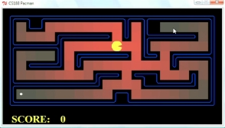
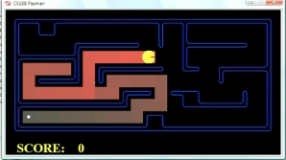
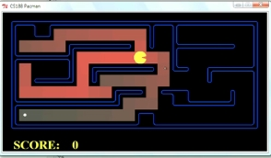
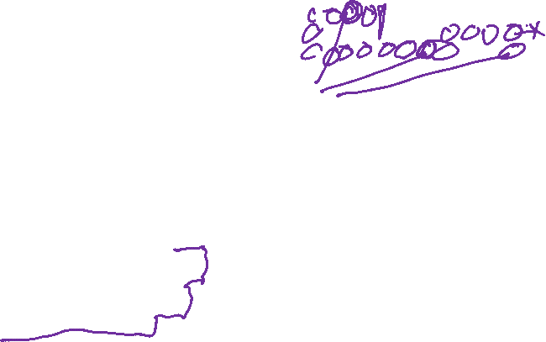
Comparison
A*
UCS
Greedy

Slide 48
Demo Empty Water Shallow/Deep – Guess Algorithm

Slide 49

A* Search Algorithms
A* Tree Search
Same tree search algorithm as before but with a frontier that is a priority queue using priority f(n) = g(n) + h(n)
A* Graph Search
Same UCS graph search algorithm but with a frontier that is a priority queue using priority f(n) = g(n) + h(n)

Slide 50
function UNIFORM-COST-SEARCH(problem) returns a solution, or failure
initialize the explored set to be empty
initialize the frontier as a priority queue using g(n) as the priority
add initial state of problem to frontier with priority g(S) = 0
loop do
if the frontier is empty then
return failure
choose a node and remove it from the frontier
if the node contains a goal state then
return the corresponding solution
add the node state to the explored set
for each resulting child from node
if the child state is not already in the frontier or explored set then
add child to the frontier
else if the child is already in the frontier with higher g(n) then
replace that frontier node with child

Slide 51
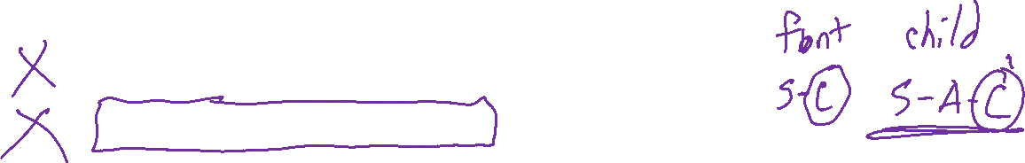
function A-STAR-SEARCH(problem) returns a solution, or failure
initialize the explored set to be empty
initialize the frontier as a priority queue using f(n) = g(n) + h(n) as the priority
add initial state of problem to frontier with priority f(S) = 0 + h(S)
loop do
if the frontier is empty then
return failure
choose a node and remove it from the frontier
if the node contains a goal state then
return the corresponding solution
add the node state to the explored set
for each resulting child from node
if the child state is not already in the frontier or explored set then
add child to the frontier
else if the child is already in the frontier with higher f(n) then
replace that frontier node with child

Slide 52
Optimality of A* Graph Search

Slide 53
A* Tree Search
State space graph
Search tree
Frontier
S (0+2)
h=4
S (0+2)
A
S-A (1+4)
1
1
h=1
S-C (3+1)
S
C
A (1+4)
C (3+1)
S-C-G (6+0)
h=2
3
S-A-C (2+1)
3
C (2+1)
G (6+0)
S-A-C-G (5+0)
G (5+0)
G
Result: S-A-C-G cost 5
Correct!
h=0

Slide 54
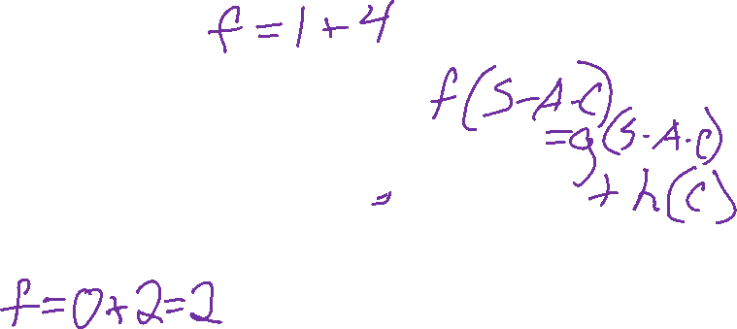
A* Graph Search
What paths does A* graph search consider during its search?
h=4
Frontier
Explored
1
A
1
h=1
S
C
h=2
3
3
G
h=0

Slide 55
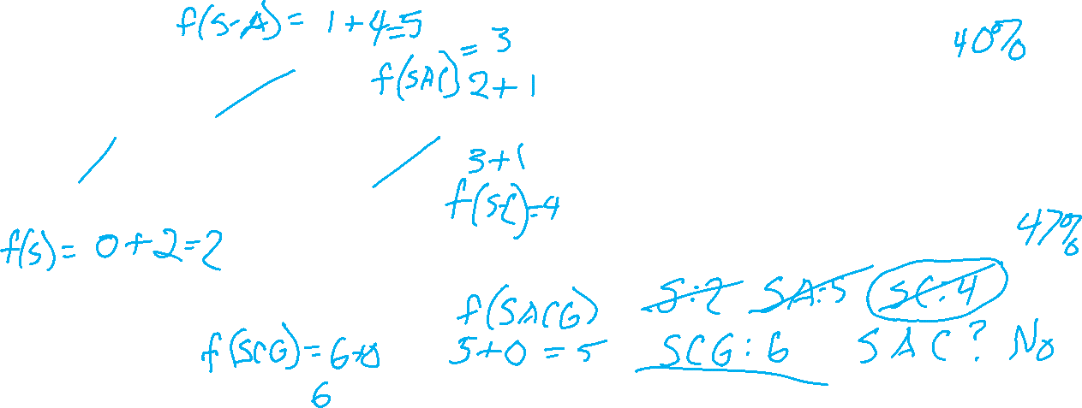
Poll 1: A* Graph Search
What paths does A* graph search consider during its search?
(What does your work for the frontier look like?)
h=4
A) S, S-A, S-C, S-C-G
1
A
1
h=1
B) S, S-A, S-C, S-A-C, S-C-G
S
C
C) S, S-A, S-A-C, S-A-C-G
h=2
3
D) S, S-A, S-C, S-A-C, S-A-C-G
3
G
h=0

Slide 56
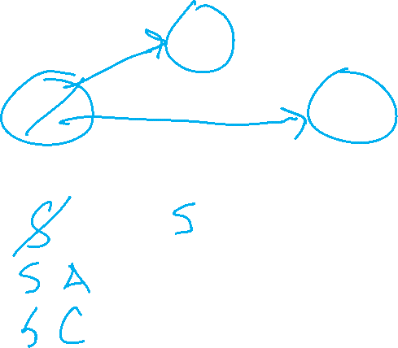
Poll 1: A* Graph Search
What paths does A* graph search consider during its search?
(What does your work for the frontier look like?)
h=4
A) S, S-A, S-C, S-C-G
1
A
1
h=1
B) S, S-A, S-C, S-A-C, S-C-G
S
C
C) S, S-A, S-A-C, S-A-C-G
h=2
3
D) S, S-A, S-C, S-A-C, S-A-C-G
3
G
h=0

Slide 57
A* Graph Search
A)
A
S
C
What does the resulting graph tree look like?
G
h=4
A
A
B)
1
1
S
C
h=1
S
C
h=2
3
G
3
C & D)
A
S
C
G
h=0
G

Slide 58
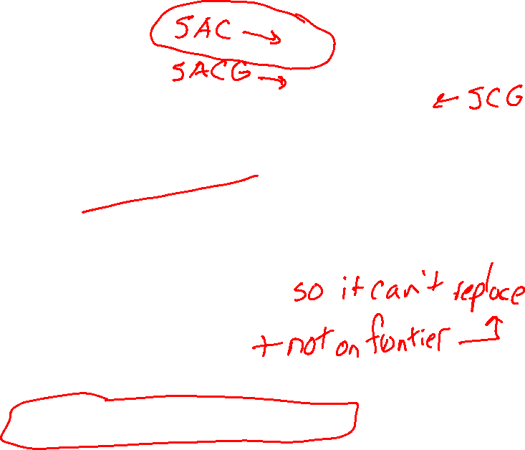
A* Graph Search Gone Wrong?
…
n
State space graph
h=4
A
S: 0+2 = 2
S-A: 1+4 = 5
S-C: 2+1 = 3
S-C-G: 6+0 = 6
1
1
h=1
S
C
h=2
3
3
C (specifically S-C) is no longer on the frontier, so it can't be replaced with the better S-A-C option
G
h=0

Slide 59

Admissibility of Heuristics
Main idea: Estimated heuristic values ≤ actual costs
  Admissibility:
  heuristic value ≤ actual cost to goal
  h(A) ≤ actual cost from A to G
A
1
C
h=4
3
G

Slide 60

Consistency of Heuristics
Main idea: Estimated heuristic costs ≤ actual costs
  Admissibility:
  heuristic cost ≤ actual cost to goal
  h(A) ≤ actual cost from A to G
  Consistency:
  “heuristic step cost” ≤ actual cost for each step
  h(A) – h(C) ≤ cost(A to C)
  triangle inequality
  h(A) ≤ cost(A to C) + h(C)
Consequences of consistency:
  The f value along a path never decreases
  A* graph search is optimal
A
1
C
h=4
h=2
h=1
G

Slide 61
Optimality of A* Graph Search
Sketch: consider what A* does with a consistent heuristic:
  Fact 1: In tree search, A* expands nodes in increasing total f value (f-contours)
  Fact 2: For every state s, nodes that reach s optimally are explored before nodes that reach s suboptimally
  Result: A* graph search is optimal
…
f ≤ 1
f ≤ 2
f ≤ 3

Slide 62
Optimality
Tree search:
  A* is optimal if heuristic is admissible
  UCS is a special case (h = 0)
Graph search:
  A* optimal if heuristic is consistent
  UCS optimal (h = 0 is consistent)
Consistency implies admissibility
In general, most natural admissible heuristics tend to be consistent, especially if from relaxed problems

Slide 63

Creating Heuristics

Slide 64
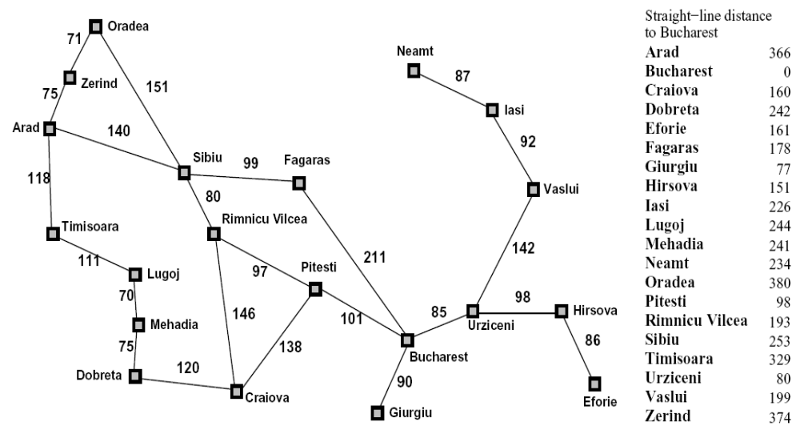

Creating Admissible Heuristics
Most of the work in solving hard search problems optimally is in coming up with admissible heuristics
Often, admissible heuristics are solutions to relaxed problems, where new actions are available
366
15

Slide 65
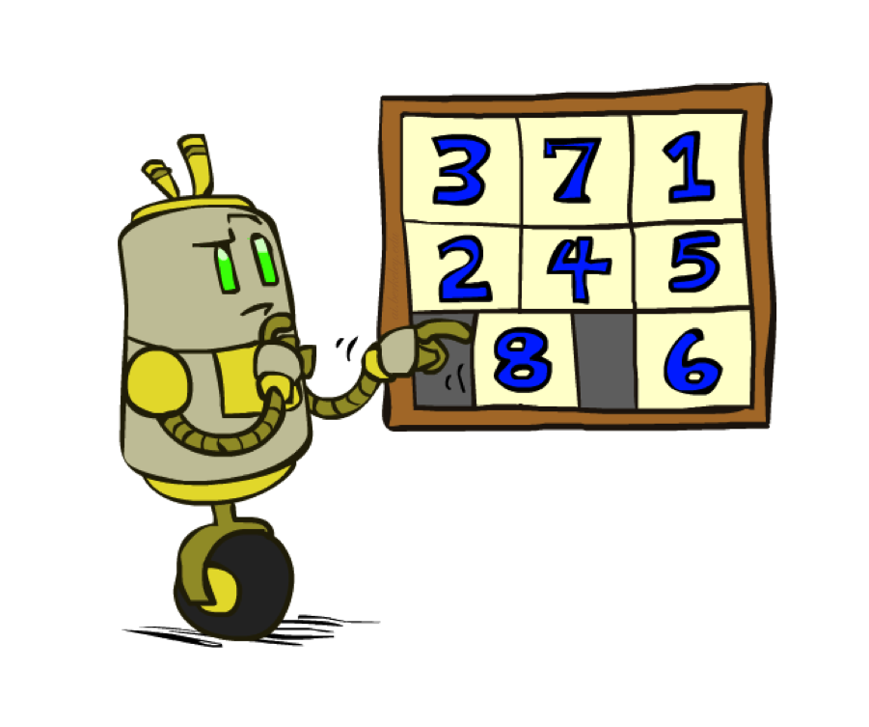
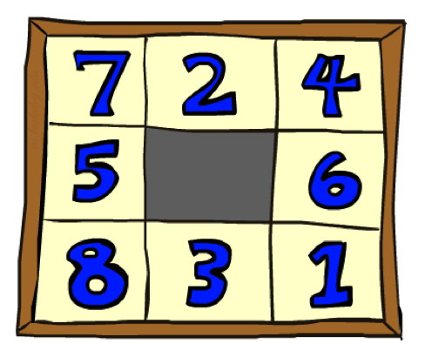
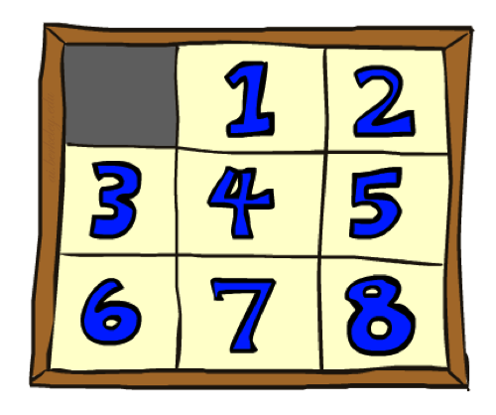
Example: 8 Puzzle
Start State
Actions
Goal State
What are the states?
How many states?
What are the actions?
How many actions from the start state?
What should the step costs be?

Slide 66
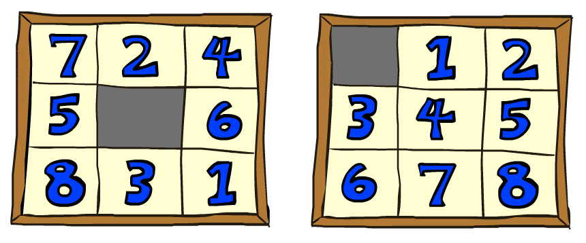


8 Puzzle I
Heuristic: Number of tiles misplaced
Why is it admissible?
h(start) =
This is a relaxed-problem heuristic
8
Start State
Goal State
 | Average nodes expanded when the optimal path has…
 | …4 steps | …8 steps | …12 steps
UCS | 112 | 6,300 | 3.6 x 10⁶
A*TILES | 13 | 39 | 227
Statistics from Andrew Moore

Slide 67

8 Puzzle II
What if we had an easier 8-puzzle where any tile could slide any direction at any time, ignoring other tiles?
Total Manhattan distance
Why is it admissible?
h(start) =
Start State
Goal State
 | Average nodes expanded when the optimal path has…
 | …4 steps | …8 steps | …12 steps
UCS | 112 | 6,300 | 3.6 x 10⁶
A*TILES | 13 | 39 | 227
 | Average nodes expanded when the optimal path has…
 | …4 steps | …8 steps | …12 steps
A*TILES | 13 | 39 | 227
A*MANHATTAN | 12 | 25 | 73
3 + 1 + 2 + … = 18

Slide 68
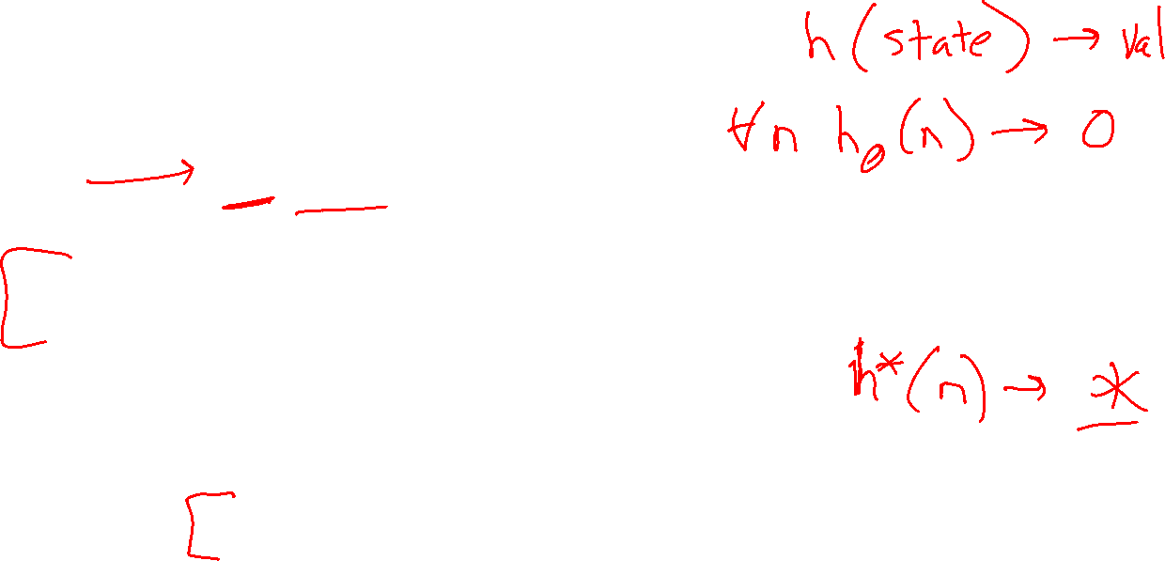
Combining heuristics
Dominance: h_{a} ≥ h_{c} if
∀n h_{a}(n) ≥ h_{c}(n)
  Roughly speaking, larger is better as long as both are admissible
  The zero heuristic is pretty bad (what does A* do with h=0?)
  The exact heuristic is pretty good, but usually too expensive!
What if we have two heuristics, neither dominates the other?
  Form a new heuristic by taking the max of both:
  h(n) = max( h_{a}(n), h_{b}(n) )
  Max of admissible heuristics is admissible and dominates both!
Notes:
Semi-lattice: x <= y <-> x = x ^ y

Slide 69

A*: Summary

Slide 70

A*: Summary
A* uses both backward costs and (estimates of) forward costs
A* is optimal with admissible / consistent heuristics
Heuristic design is key: often use relaxed problems

