Slide 1
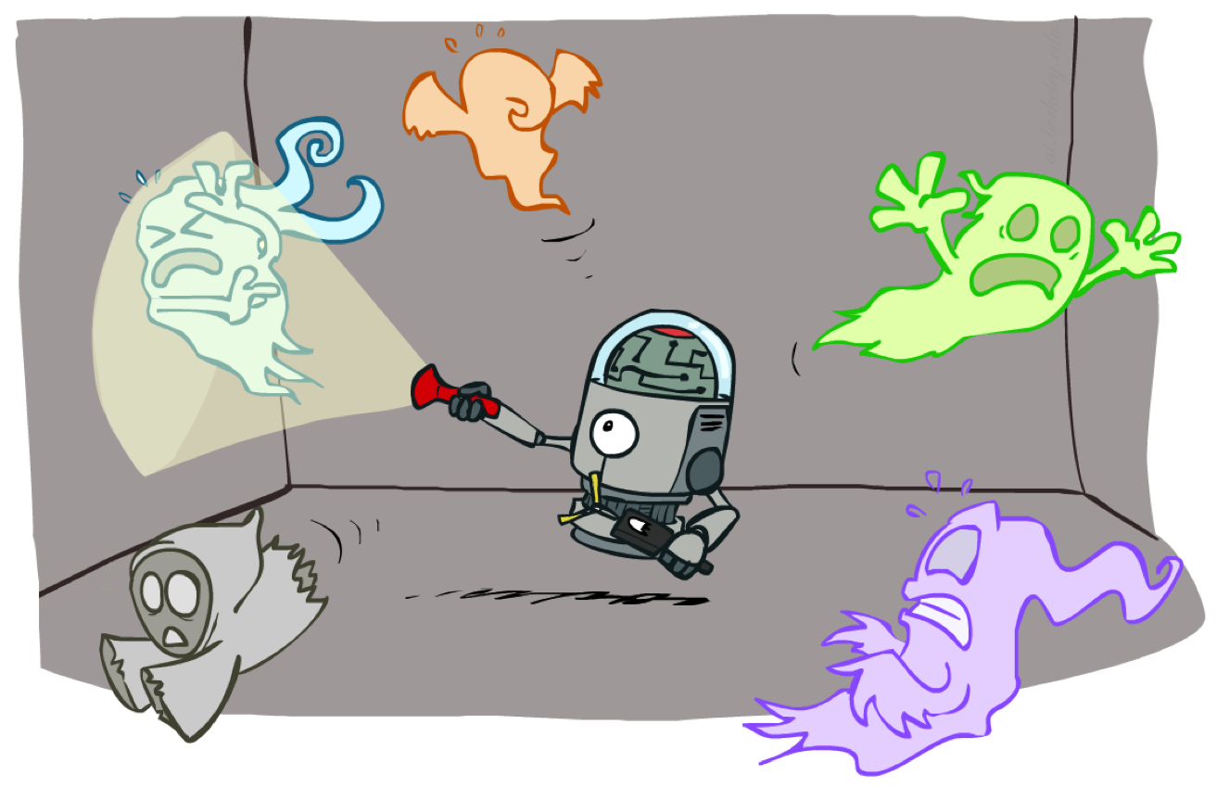
AI: Representation and Problem Solving
Particle Filtering
Instructor: Pat Virtue
Slide credits: CMU AI and http://ai.berkeley.edu

Slide 2
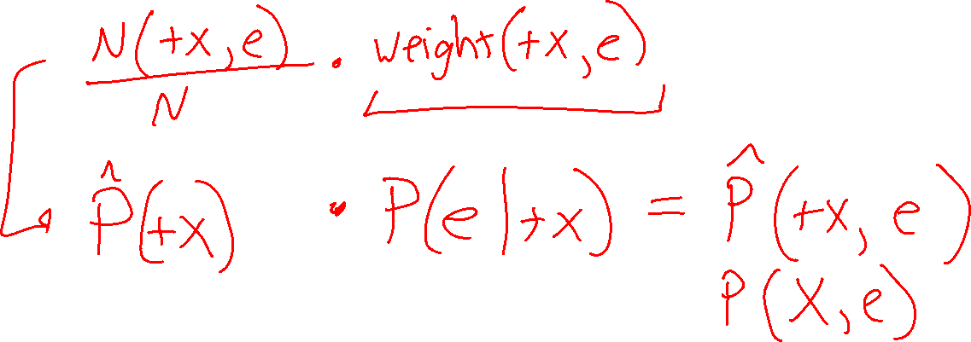
Poll 1
When sampling this Bays net using likelihood weighted sampling, what distribution do we have when we multiply fraction of counts times of the weight of the samples?
Write your distribution in terms of X and e starting with “P(”
X
e

Slide 3
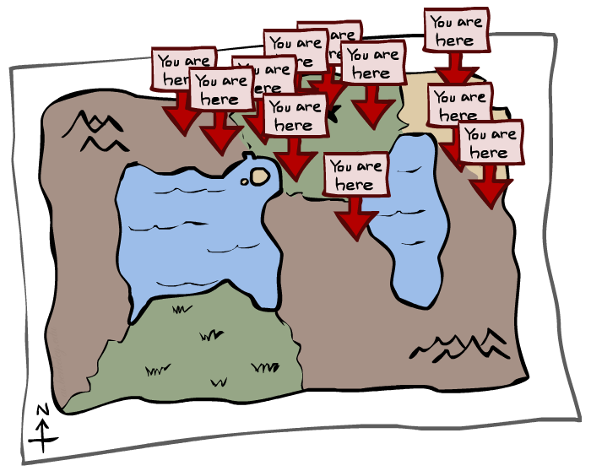
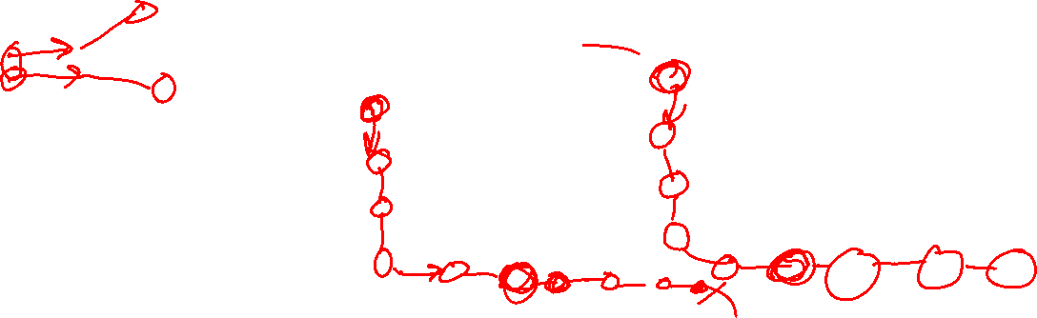
Particle Filtering

Slide 4
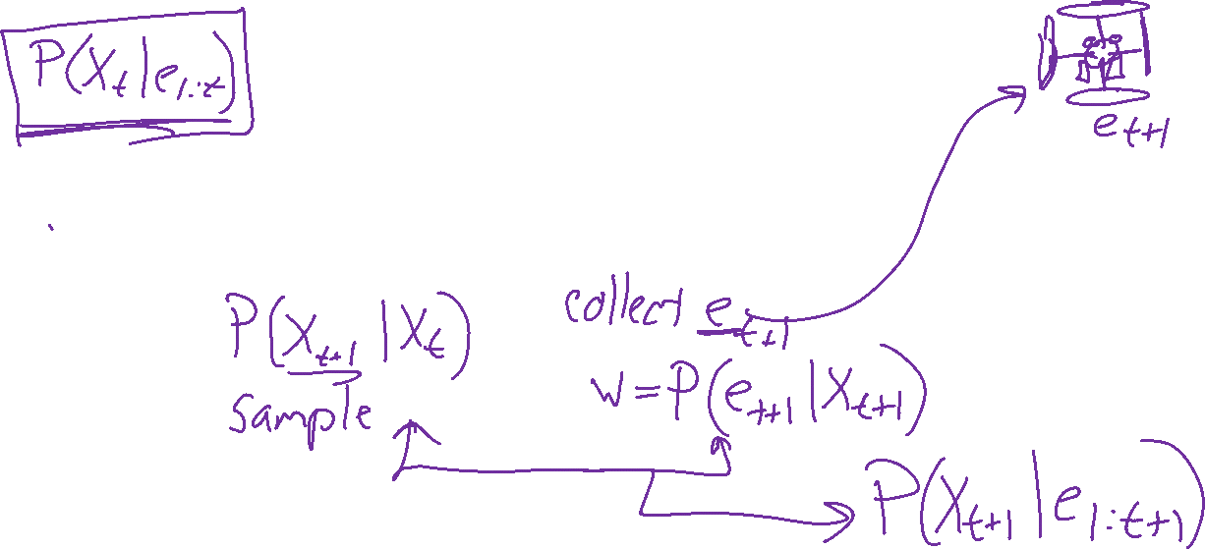
Summary: Likelihood-weighted sampling for HMMs
Particles: track samples of states rather than an explicit distribution
Propagate forward
Weight

Slide 5

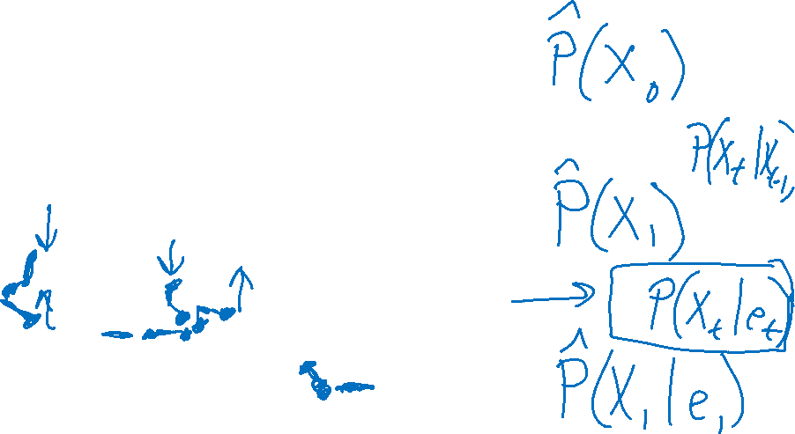
Particle Filtering

Slide 6
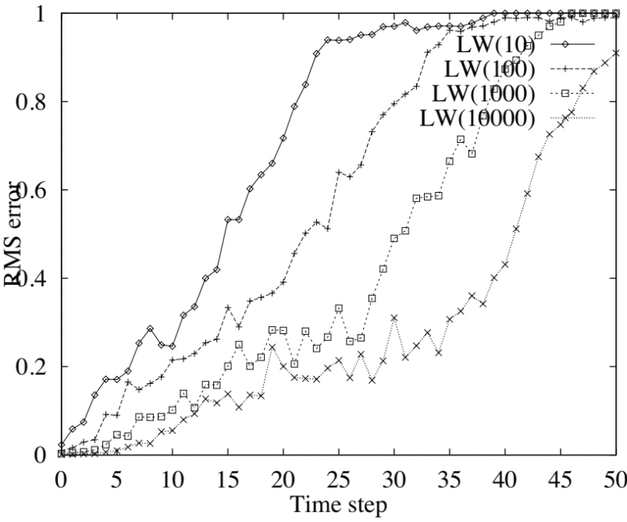
We need a new algorithm!
When |X| is more than 10⁶ or so (e.g., 3 ghosts in a 10x20 world), exact inference becomes infeasible
Likelihood weighting fails completely – number of samples needed grows exponentially with T
X₀
X₁
X₂
X₃
E₁
E₂
E₃

Slide 7
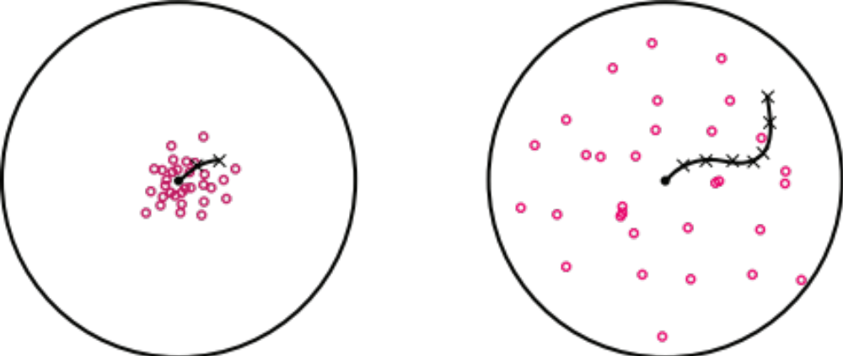
We need a new idea!
t=2
t=7
The problem: sample state trajectories go off into low-probability regions, ignoring the evidence; too few “reasonable” samples
Solution: kill the bad ones, make more of the good ones
This way the population of samples stays in the high-probability region
This is called resampling or survival of the fittest

Slide 8
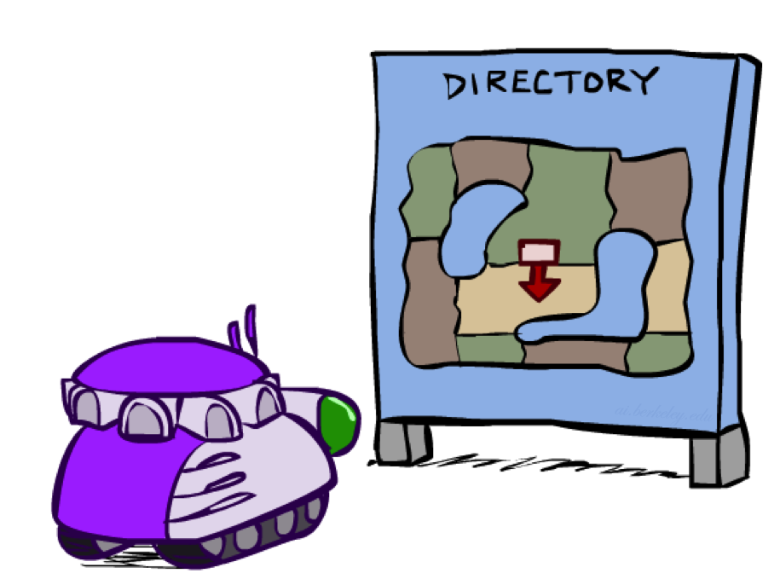
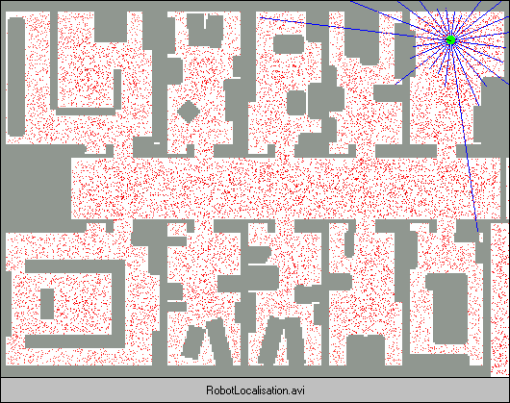
Robot Localization
In robot localization:
  We know the map, but not the robot’s position
  Observations may be vectors of range finder readings
  State space and readings are typically continuous (works basically like a very fine grid) and so we cannot store B(X)
  Particle filtering is a main technique

Slide 9
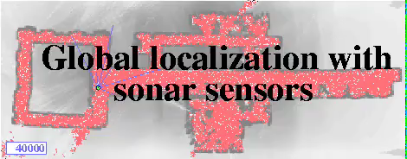
Particle Filter Localization (Sonar)
[Dieter Fox, et al.]
[Video: global-sonar-uw-annotated.avi]

Slide 10
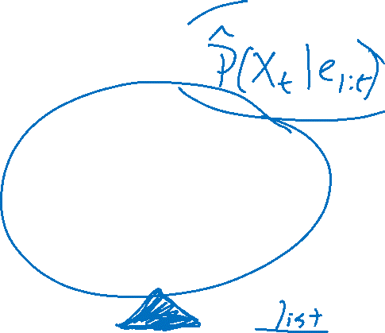
Particle Filtering
Represent belief state by a set of samples
  Samples are called particles
  Time per step is linear in the number of samples
  But: number needed may be large
This is how robot localization works in practice
0.0
0.1
0.0
0.0
0.0
0.2
0.0
0.2
0.5

Slide 11
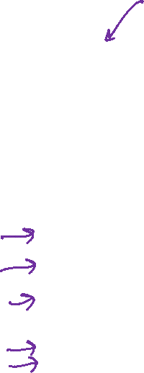
Representation: Particles
Our representation of P(X) is now a list of N particles (samples)
  Generally, N << |X|
  Storing map from X to counts would defeat the point
P(x) approximated by number of particles with value x
  So, many x may have P(x) = 0!
  More particles, more accuracy
  Usually we want a low-dimensional marginal
    E.g., “Where is ghost 1?” rather than “Are ghosts 1,2,3 in {2,6], [5,6], and [8,11]?”
For now, all particles have a weight of 1
Particles:
(3,3)
(2,3)
(3,3)
(3,2)
(3,3)
(3,2)
(1,2)
(3,3)
(3,3)
(2,3)

Slide 12
Particle Filtering: Propagate forward
A particle in state x_{t} is moved by sampling its next position directly from the transition model:
  x_{t+1} ~ P(X_{t+1} | x_{t})
  Here, most samples move clockwise, but some move in another direction or stay in place
This captures the passage of time
  If enough samples, close to exact values before and after (consistent)
Particles:
(3,3)
(2,3)
(3,3)
(3,2)
(3,3)
(3,2)
(1,2)
(3,3)
(3,3)
(2,3)
Particles:
(3,2)
(2,3)
(3,2)
(3,1)
(3,3)
(3,2)
(1,3)
(2,3)
(3,3)
(2,2)

Slide 13
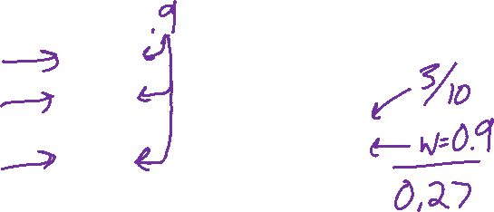
Particle Filtering: Observe
Particles:
(3,2)
(2,3)
(3,2)
(3,1)
(3,3)
(3,2)
(1,3)
(2,3)
(3,2)
(2,2)
Slightly trickier:
  Don’t sample observation, fix it
  Similar to likelihood weighting, weight samples based on the evidence
    W = P(e_{t}| x_{t})
  Normalize the weights: particles that fit the data better get higher weights, others get lower weights
Particles:
(3,2) w=.9
(2,3) w=.2
(3,2) w=.9
(3,1) w=.4
(3,3) w=.4
(3,2) w=.9
(1,3) w=.1
(2,3) w=.2
(3,3) w=.4
(2,2) w=.4

Slide 14
Particle Filtering: Resample
Rather than tracking weighted samples, we resample
We have an updated belief distribution based on the weighted particles
We sample N new particles from the weighted belief distributions
Now the update is complete for this time step, continue with the next one
Particles:
(3,2) w=.9
(2,3) w=.2
(3,2) w=.9
(3,1) w=.4
(3,3) w=.4
(3,2) w=.9
(1,3) w=.1
(2,3) w=.2
(3,3) w=.4
(2,2) w=.4
(New) Particles:
(3,2)
(2,2)
(3,2)
(2,3)
(3,3)
(3,2)
(1,3)
(2,3)
(3,2)
(3,2)

Slide 15
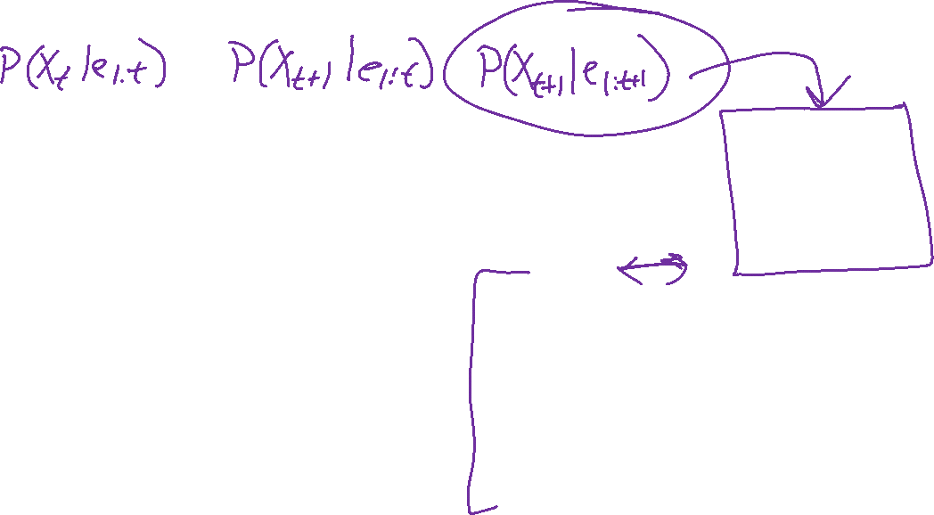
Summary: Particle Filtering
Particles: track samples of states rather than an explicit distribution
Propagate forward
Weight
Resample
Particles:
(3,3)
(2,3)
(3,3)
(3,2)
(3,3)
(3,2)
(1,2)
(3,3)
(3,3)
(2,3)
Particles:
(3,2)
(2,3)
(3,2)
(3,1)
(3,3)
(3,2)
(1,3)
(2,3)
(3,2)
(2,2)
Particles:
(3,2) w=.9
(2,3) w=.2
(3,2) w=.9
(3,1) w=.4
(3,3) w=.4
(3,2) w=.9
(1,3) w=.1
(2,3) w=.2
(3,3) w=.4
(2,2) w=.4
(New) Particles:
(3,2)
(2,2)
(3,2)
(2,3)
(3,3)
(3,2)
(1,3)
(2,3)
(3,2)
(3,2)
Consistency: see proof in AIMA Ch. 14
[Demos: ghostbusters particle filtering (L15D3,4,5)]

Slide 16
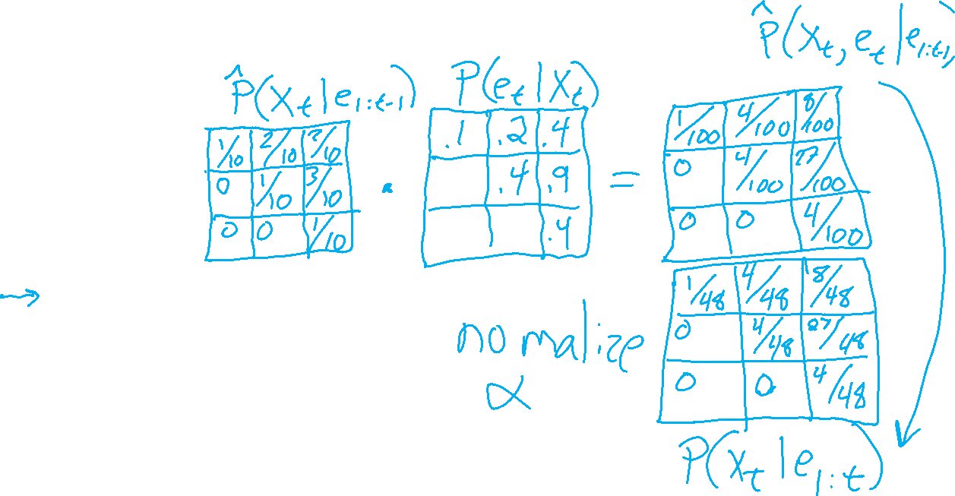
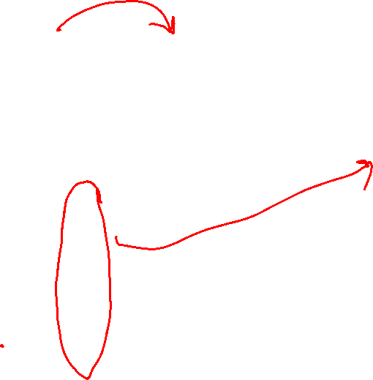
Weighting and Resampling
How to compute a belief distribution given weighted particles
Weight
Particles:
(3,2) w=.9
(2,3) w=.2
(3,2) w=.9
(3,1) w=.4
(3,3) w=.4
(3,2) w=.9
(1,3) w=.1
(2,3) w=.2
(3,3) w=.4
(2,2) w=.4

Slide 17
Poll 2
If we only have one particle which of these steps are unnecessary?
  Select all that are unnecessary.
  Propagate forward
  Weight
  Resample
  None of the above
[Demos: ghostbusters particle filtering (L15D3,4,5)]

Slide 18
Poll 2
If we only have one particle which of these steps are unnecessary?
  Select all that are unnecessary.
  Propagate forward
  Weight
  Resample
  None of the above
Propagate forward
Weight
Resample
Unless the weight is zero, in which case, you’ll want to resample from the beginning ☹
[Demos: ghostbusters particle filtering (L15D3,4,5)]

Slide 19
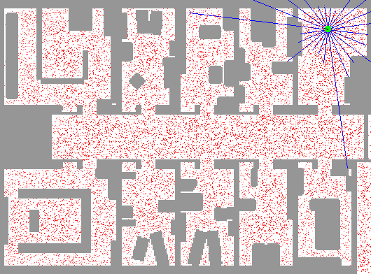
Particle Filter Localization (Laser)
[Dieter Fox, et al.]
[Video: global-floor.gif]

Slide 20
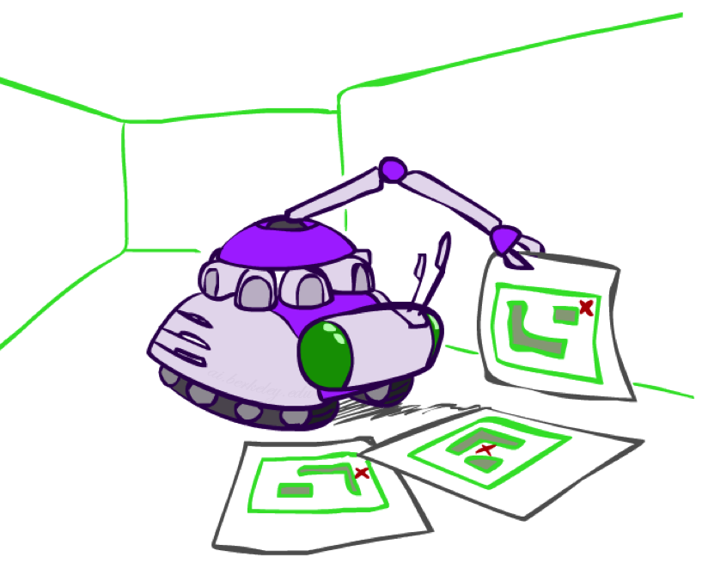
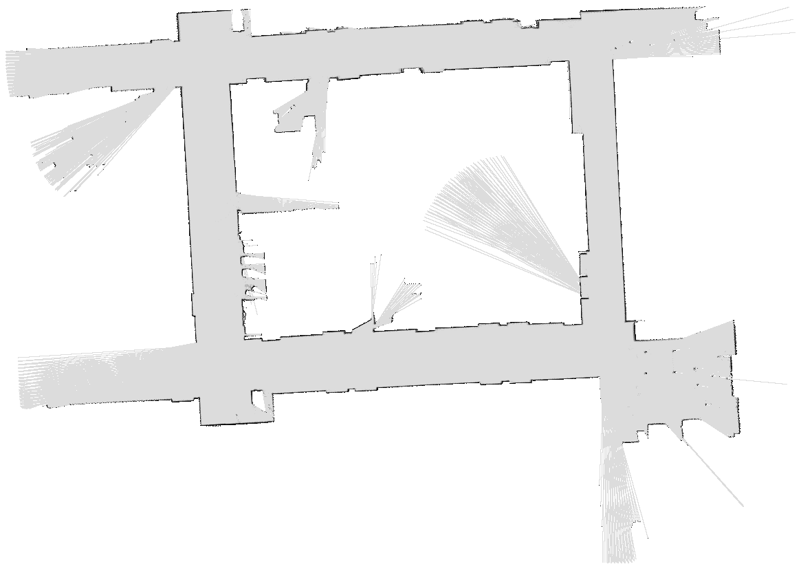
Robot Mapping
SLAM: Simultaneous Localization And Mapping
  We do not know the map or our location
  State consists of position AND map!
  Main techniques: Kalman filtering (Gaussian HMMs) and particle methods
DP-SLAM, Ron Parr
[Demo: PARTICLES-SLAM-mapping1-new.avi]

Slide 21
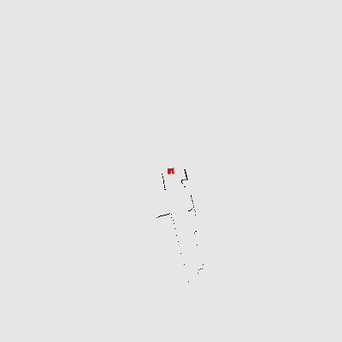
Particle Filter SLAM – Video 1
[Sebastian Thrun, et al.]
[Demo: PARTICLES-SLAM-mapping1-new.avi]

Slide 22
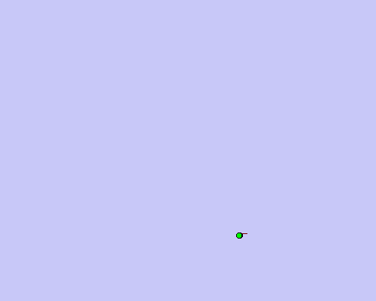
Particle Filter SLAM – Video 2
[Dirk Haehnel, et al.]
[Demo: PARTICLES-SLAM-fastslam.avi]

Slide 23

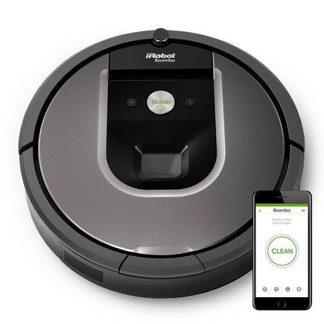
SLAM
https://www.irobot.com/

