Slide 1
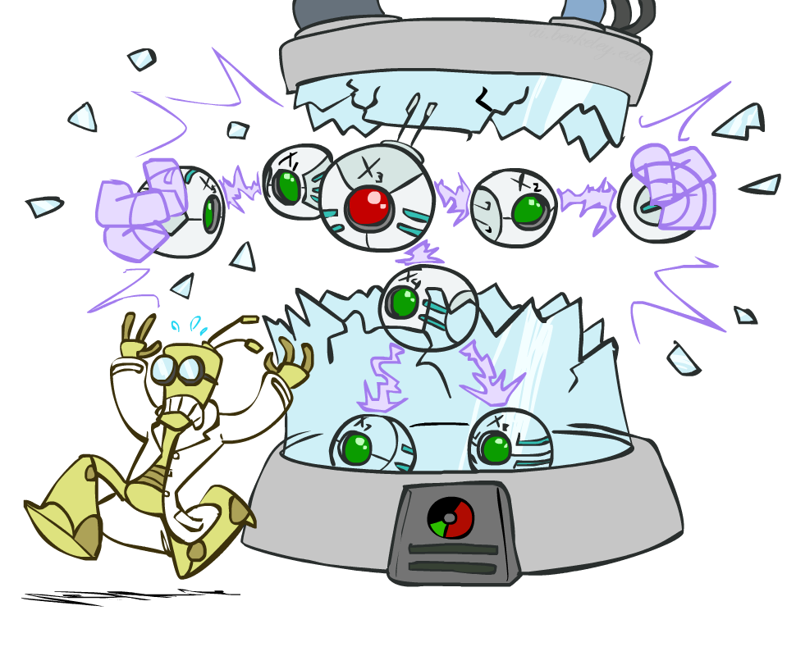
AI: Representation and Problem Solving
Bayes Nets: Independence
Instructor: Pat Virtue
Slide credits: CMU AI and http://ai.berkeley.edu

Slide 2
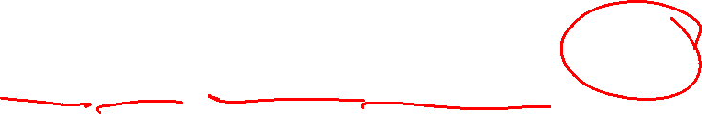
Bayesian Networks
Bayes net
One node per random variable
DAG
One CPT per node: P(node | Parents(node) )
$$A$$
$$B$$
$$C$$
$$D$$
$$P\left(A, B, C, D\right)=P\left(A\right) P\left(B | A\right) P\left(C | A,B\right) P\left(D | A,B,C\right)$$
  Encode joint distributions as product of conditional distributions on each variable
  $$P\left(X_{1},…,X_{N}\right)=\prod_{i}{P\left(X_{i}\right| Parents(X_{i})) }$$

Slide 3
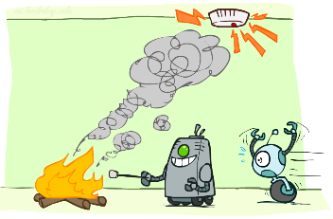
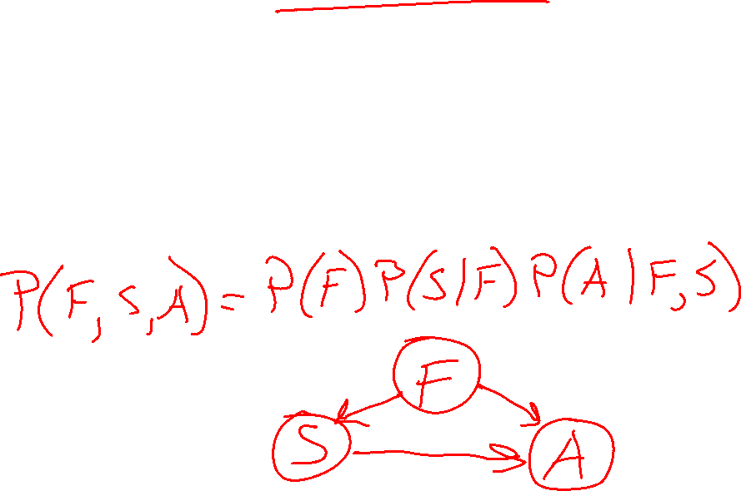
Build Bayes Net Using Chain Rule
Binary random variables
  Fire
  Smoke
  Alarm

Slide 4
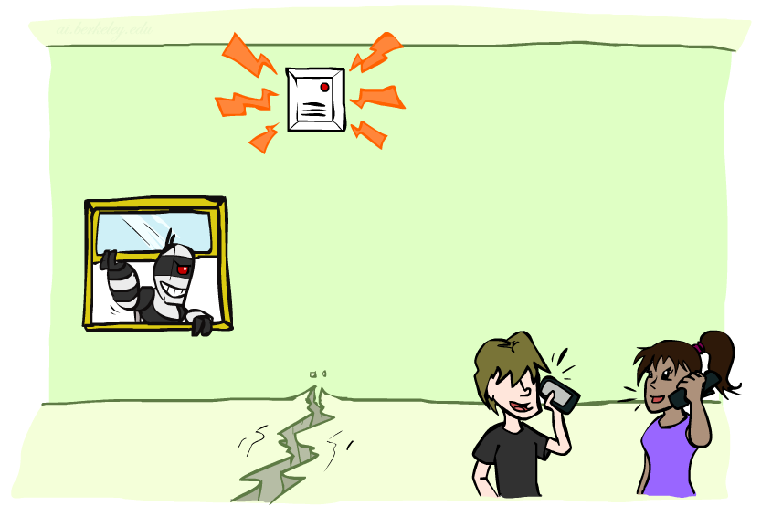
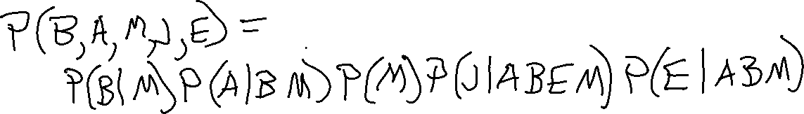
Question
$$B$$
$$A$$
Variables
  B: Burglary
  A: Alarm goes off
  M: Mary calls
  J: John calls
  E: Earthquake!
  Given the Bayes net, write the joint distribution?
$$M$$
$$E$$
$$J$$

Slide 5
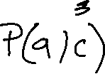
Answer Any Query from Bayes Net
Joint
Bayes Net and
Conditional Probability Tables
$$A$$
Query
$$P\left(a \right| e)$$
$$B$$
$$C$$
$$D$$

Slide 6
Answer Any Query from Condition Probability Tables
Conditional Probability Tables and Chain Rule
Joint
Query
$$P\left(a \right| e)$$
$P\left(A\right) P\left(B | A\right) P\left(C | A,B\right) P\left(D | A,B,C\right)$ $P(E|A, B,C,D)$

Slide 7
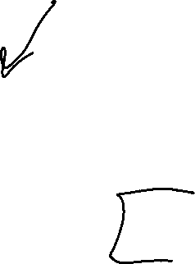
Answer Any Query from Condition Probability Tables
Conditional Probability Tables and Chain Rule
Problems
Huge
    $n$ variables with $d$ values
    $d^{n}$ entries
We aren’t given the right tables
$P\left(A\right) P\left(B | A\right) P\left(C | A,B\right) P\left(D | A,B,C\right)$ $P(E|A, B,C,D)$

Slide 8
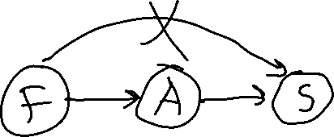
Do We Need the Full Chain Rule?
Binary random variables
  Fire
  Smoke
  Alarm

Slide 9
Answer Any Query from Condition Probability Tables
Conditional Probability Tables and Chain Rule
Joint
Query
$$P\left(a \right| e)$$
$P\left(A\right) P\left(B | A\right) P\left(C | A,B\right) P\left(D | A,B,C\right)$ $P(E|A, B,C,D)$

Slide 10
Answer Any Query from Condition Probability Tables
Bayes Net
Joint
Query
$$P\left(a \right| e)$$
$$P\left(A\right) P\left(B | A\right) P\left(C | A\right) P\left(D | C\right) P(E|C)$$
  $$P\left(X_{1},…,X_{N}\right)=\prod_{i}{P\left(X_{i}\right| Parents(X_{i})) }$$

Slide 11

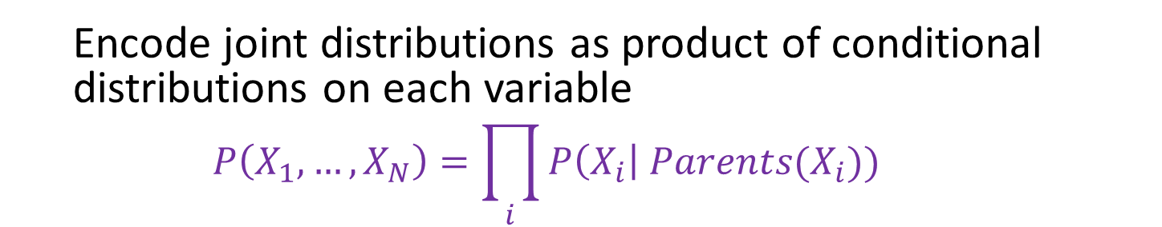



Bayesian Networks
Bayes net
One node per random variable
Directed-Acyclic-Graph
One CPT per node: P(node | Parents(node) )
$$A$$
$$B$$
$$C$$
$$D$$
$P\left(A, B, C, D\right)=P\left(A\right) P(B) P\left(C | A,B\right) P\left(D | C\right)$
  Encode joint distributions as product of conditional distributions on each variable
  $$P\left(X_{1},…,X_{N}\right)=\prod_{i}{P\left(X_{i}\right| Parents(X_{i})) }$$

Slide 12
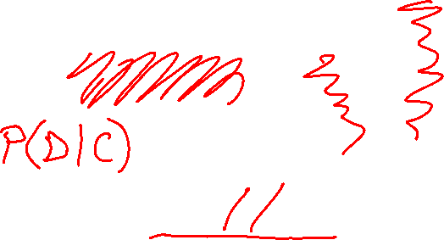
Bayesian Networks
Bayes net
Example of full chain rule Bayes net
$$A$$
$$B$$
$$C$$
$$D$$
$$P\left(A, B, C, D\right)=P\left(A\right) P\left(B | A\right) P\left(C | A,B\right) P\left(D | A,B,C\right)$$
  Encode joint distributions as product of conditional distributions on each variable
  $$P\left(X_{1},…,X_{N}\right)=\prod_{i}{P\left(X_{i}\right| Parents(X_{i})) }$$

Slide 13
Bayesian Networks
Bayes net
Missing edges (compared to full chain rule)
encode our independence assumptions
$$A$$
$$B$$
$$C$$
$$D$$
$P\left(A, B, C, D\right)=P\left(A\right) P\left(B | A\right) P\left(C | A,B\right) P\left(D | C\right)$
  Encode joint distributions as product of conditional distributions on each variable
  $$P\left(X_{1},…,X_{N}\right)=\prod_{i}{P\left(X_{i}\right| Parents(X_{i})) }$$

Slide 14

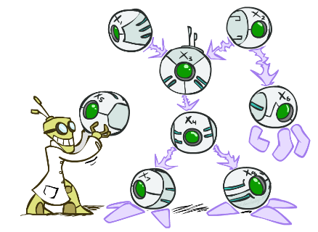

Bayes’ Nets: Big Picture
Two problems with using full joint distribution tables as our probabilistic models:
  Usually, the joint is WAY too big to represent explicitly
  Hard to learn (estimate) anything empirically about more than a few variables at a time
Bayes nets: a technique for describing complex joint distributions (models) using simple, local distributions (conditional probabilities)
  A type of probabilistic graphical models
  We describe how variables locally interact
  Local interactions chain together to give global, indirect interactions

Slide 15
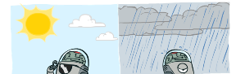
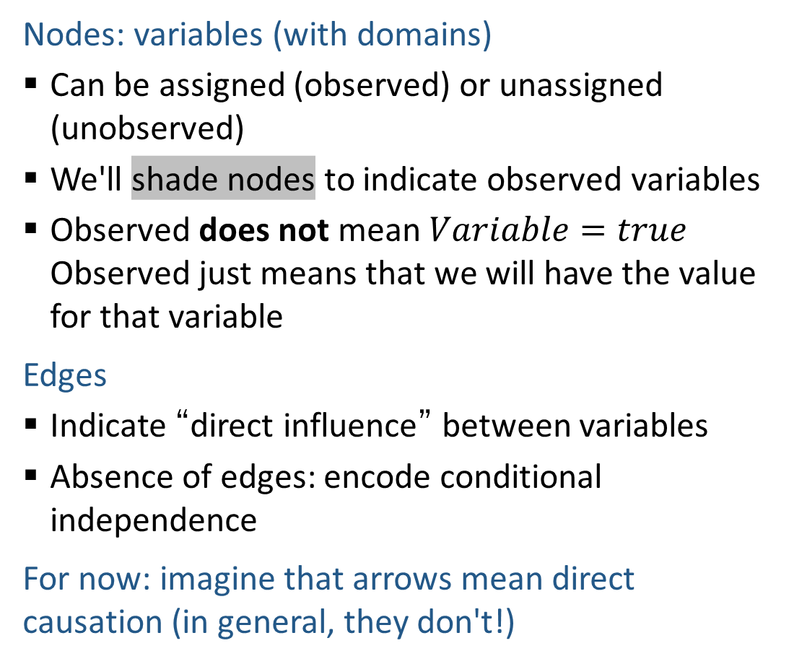
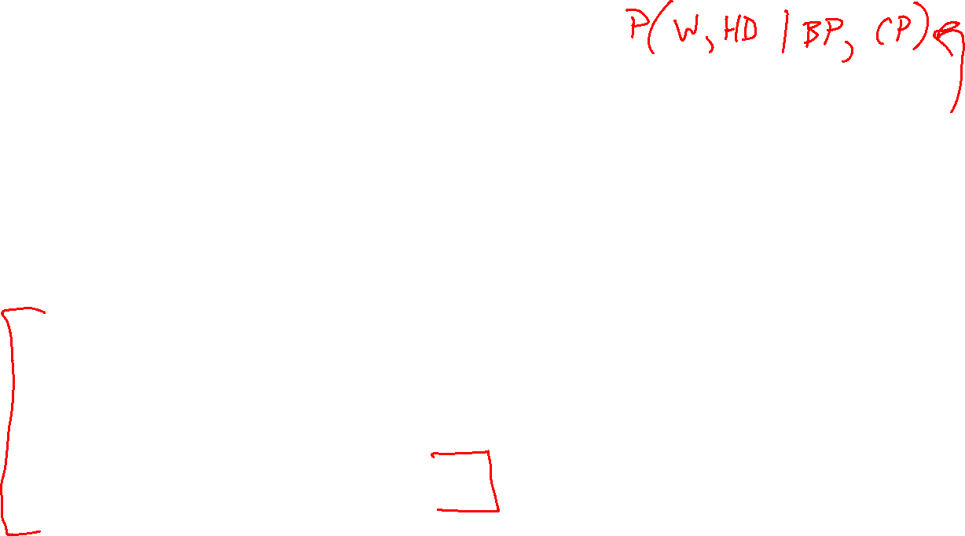
Graphical Model Notation
Nodes: variables (with domains)
  Can be assigned (observed) or unassigned (unobserved)
  We'll shade nodes to indicate observed variables
  Observed does not mean $Variable=true$ Observed just means that we will have the value for that variable
Edges
  Indicate “direct influence” between variables
  Absence of edges: encode conditional independence
For now: imagine that arrows mean direct causation (in general, they don't!)
Weather
HeartDisease
BloodPressure
ChestPain

Slide 16


Maggie Makar, University of Michigan
Assistant Professor
Computer Science and Engineering
University of Michigan
https://mymakar.github.io/
Causally-motivated shortcut removal using auxiliary labels
M. Makar, B. Packer, D. Moldovan, D. Blalock, Y. Halpern, A. D'Amour
AIStats 2022 [paper]

Slide 17
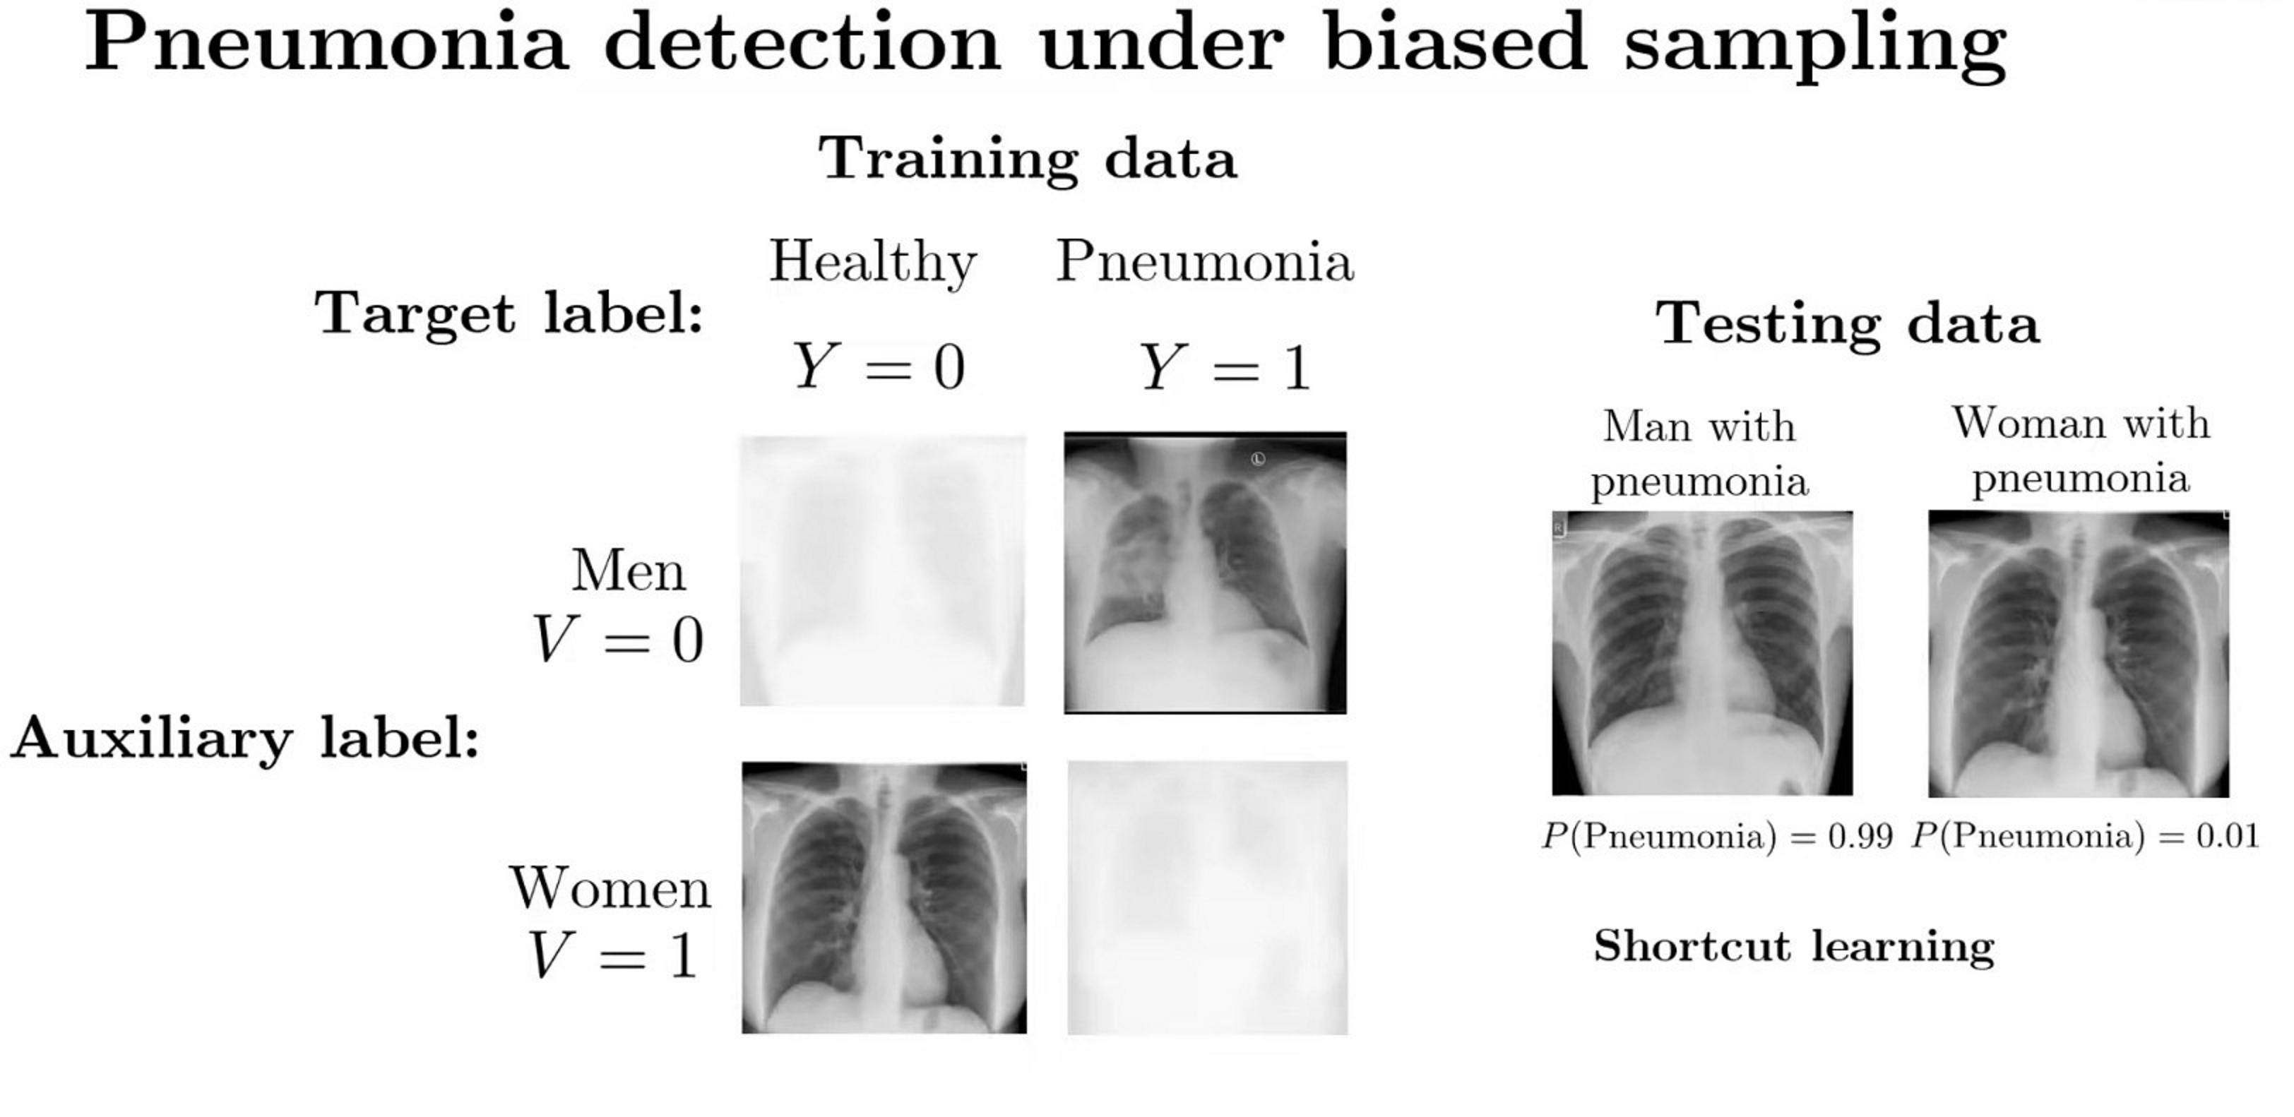
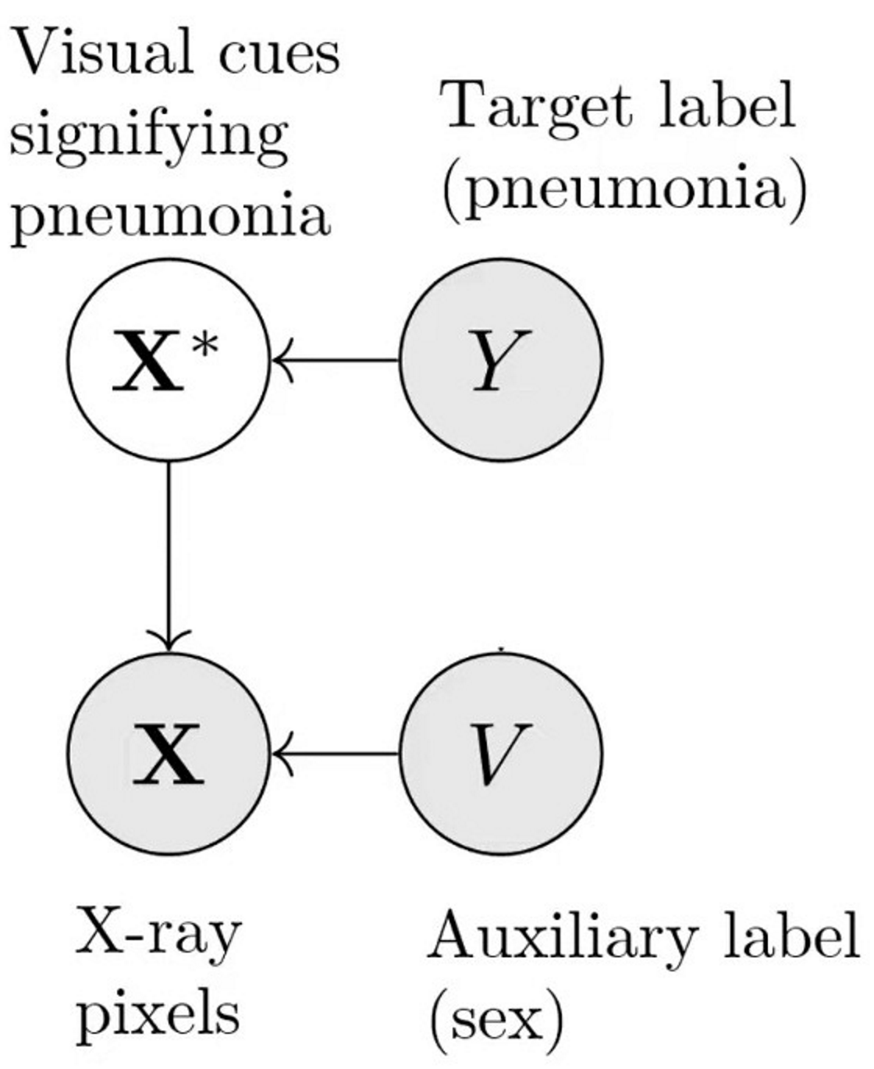
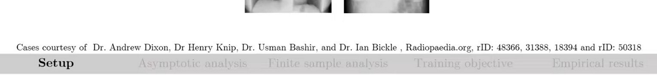
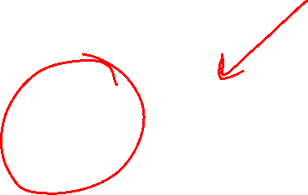
Causally-motivated shortcut removal using auxiliary labels
M. Makar, B. Packer, D. Moldovan, D. Blalock, Y. Halpern, A. D'Amour
AIStats 2022 [paper]

Slide 18



Danielle Belgrave, Microsoft Research
Vice President
AI/ML
GSK
https://www.daniellebelgrave.com
Developmental Profiles of Eczema, Wheeze, and Rhinitis:
Two Population-Based Birth Cohort Studies
Danielle Belgrave, et al. PLOS Medicine, 2014
https://journals.plos.org/plosmedicine/article?id=10.1371/journal.pmed.1001748

Slide 19
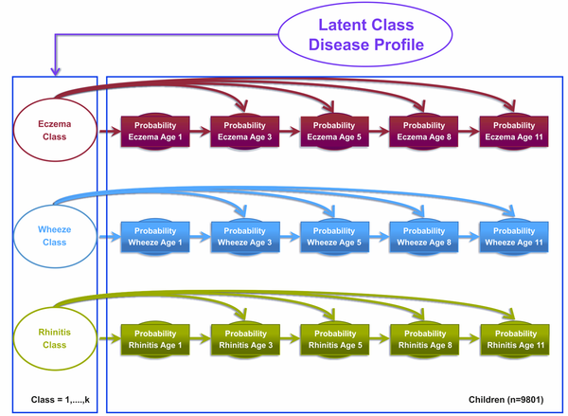

Danielle Belgrave, et al. PLOS Medicine, 2014
https://journals.plos.org/plosmedicine/article?id=10.1371/journal.pmed.1001748

Slide 20
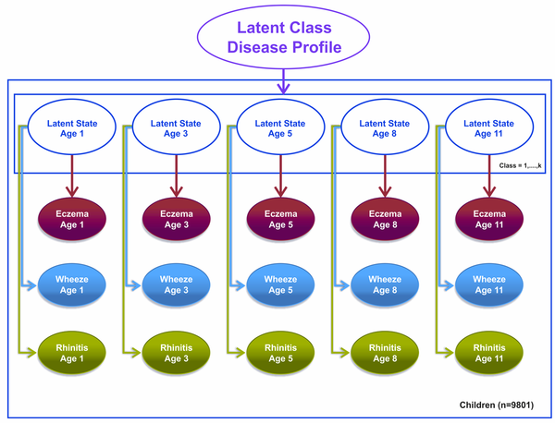
Danielle Belgrave, et al. PLOS Medicine, 2014
https://journals.plos.org/plosmedicine/article?id=10.1371/journal.pmed.1001748

Slide 21
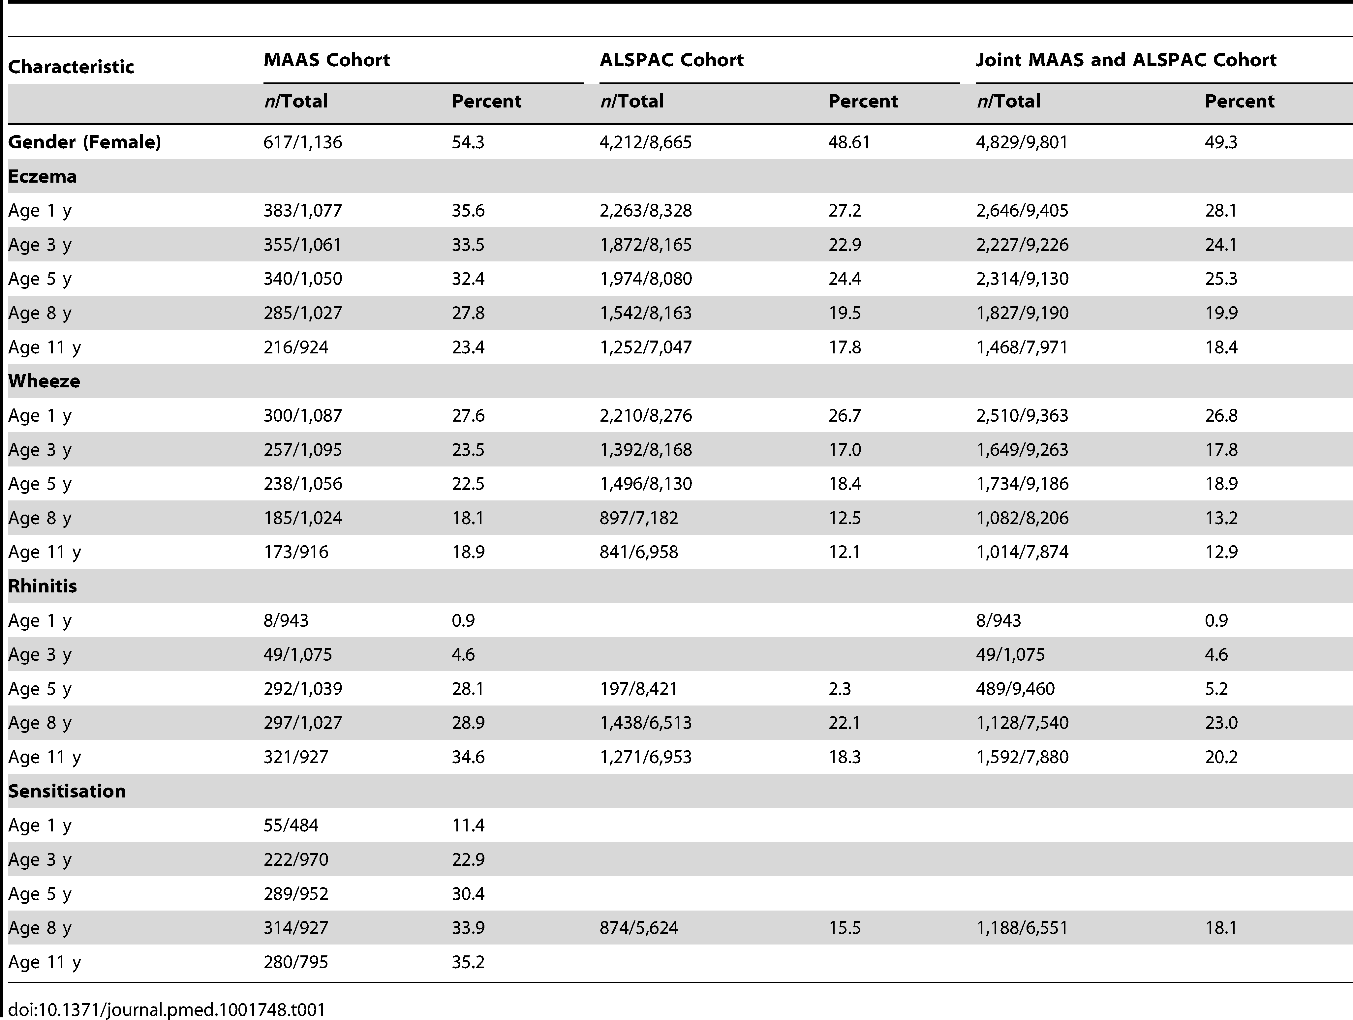
Danielle Belgrave, et al. PLOS Medicine, 2014
https://journals.plos.org/plosmedicine/article?id=10.1371/journal.pmed.1001748

Slide 22
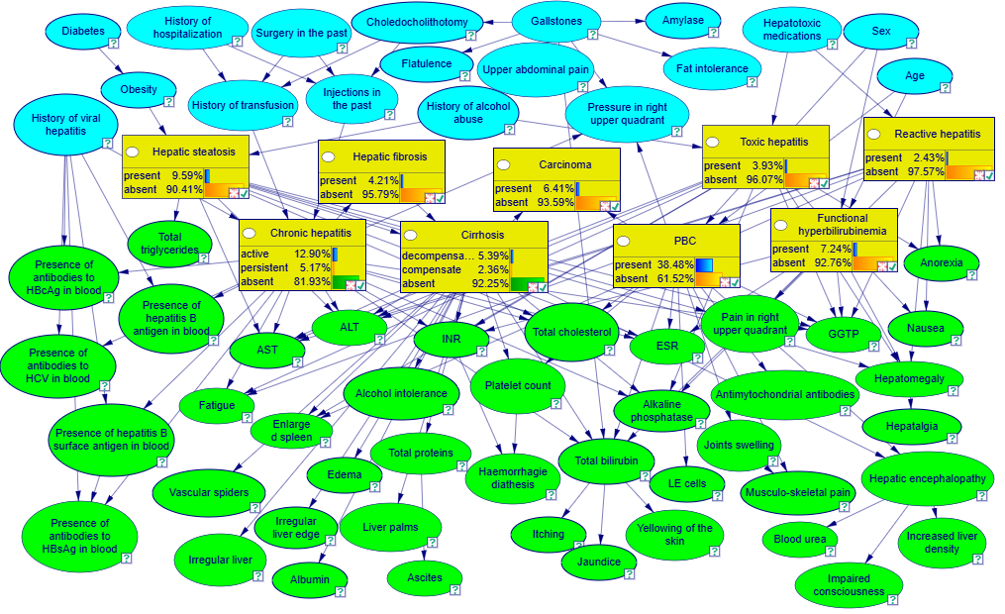
Example: Liver Disorders
https://demo.bayesfusion.com/bayesbox.html

Slide 23

Independence

Slide 24

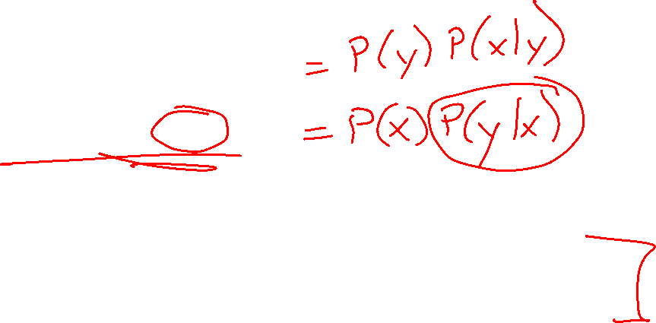
Independence
Two variables X and Y are independent if
∀x,y P(x, y) = P(x) P(y)
  This says that their joint distribution factors into a product of two simpler distributions
  Combine with product rule P(x,y) = P(x|y)P(y) we obtain another form:
  ∀x,y P(x | y) = P(x) or ∀x,y P(y | x) = P(y)
Example: two dice rolls R₁ and R₂
  P(R₁=5, R₂=5) = P(R₁=5) P(R₂=5) = 1/6 x 1/6 = 1/36
  P(R₂=5 | R₁=5) = P(R₂=5)

Slide 25


Example: Independence
n fair, independent coin flips:
P(X₁)
P(X₂)
P(X_{n})
H | 0.5
T | 0.5
H | 0.5
T | 0.5
H | 0.5
T | 0.5
P(X₁,X₂,...,X_{n})
2^{n}

Slide 26



Poll 1
Are T and W independent?
$$P(T)$$
T | P
hot | 0.5
cold | 0.5
$$P_{1}\left(T,W\right)$$
T | W | P
hot | sun | 0.4
hot | rain | 0.1
cold | sun | 0.2
cold | rain | 0.3
$$P(W)$$
W | P
sun | 0.6
rain | 0.4

Slide 27

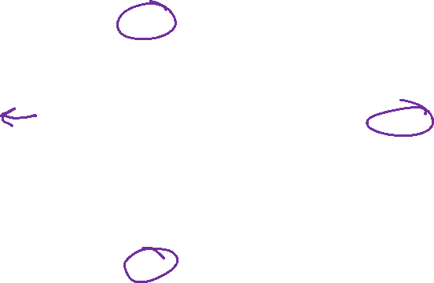

Poll 1
Are T and W independent?
No
$$P(T)$$
T | P
hot | 0.5
cold | 0.5
$$P\left(T,W\right)$$
$P\left(T\right)P(W)$
T | W | P
hot | sun | 0.4
hot | rain | 0.1
cold | sun | 0.2
cold | rain | 0.3
T | W | P
hot | sun | 0.3
hot | rain | 0.2
cold | sun | 0.3
cold | rain | 0.2
$$P(W)$$
W | P
sun | 0.6
rain | 0.4

Slide 28
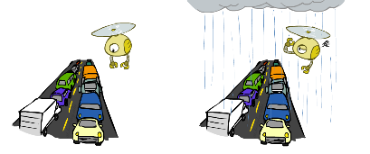
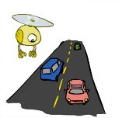

Example: Traffic
Variables:
  R: rain or not
  T: traffic or not
Model 1: independence
Why is an agent using model 2 better?
Model 2: rain affects traffic
R
R
T
T

Slide 29
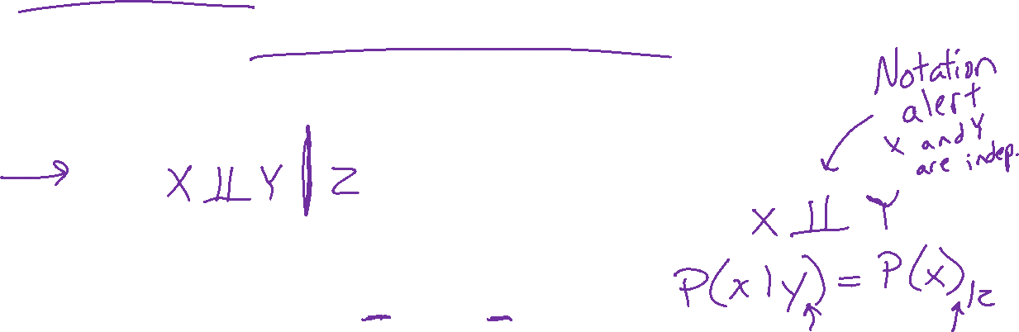
Conditional Independence
Absolute (unconditional) independence very rare (why?)
Conditional independence is our most basic and robust form of knowledge about uncertain environments.
X is conditionally independent of Y given Z
if and only if:
∀x,y,z P(x | y, z) = P(x | z)
or, equivalently, if and only if
∀x,y,z P(x, y | z) = P(x | z) P(y | z)

Slide 30
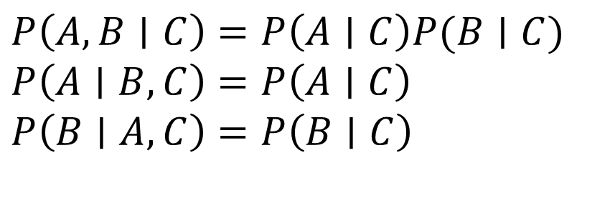
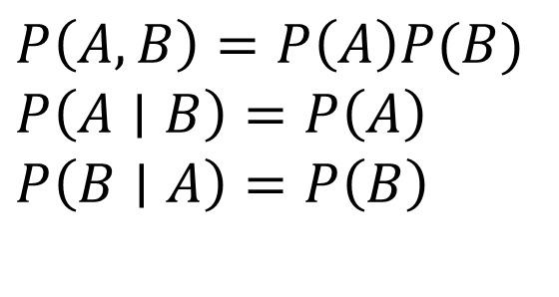
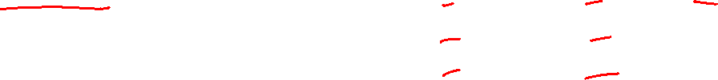
Independence Rules
Independence
If A and B are independent, then:
Conditional independence
If A and B are conditionally
independent given C, then:
$P\left(A, B\right)=P\left(A\right)P(B)$
$P\left(A∣B\right)=P\left(A\right)$
$P\left(B∣A\right)=P\left(B\right)$
$P\left(A, B∣C\right)=P\left(A∣C\right)P(B∣C)$
$P\left(A∣B, C\right)=P\left(A∣C\right)$
$P\left(B∣A, C\right)=P\left(B∣C\right)$

Slide 31
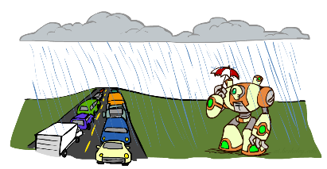

Conditional Independence
P(Traffic, Rain, Umbrella)
If it's rainining, the probability that there is traffic doesn't depend on whether see an umbrella:
  P(+traffic | +umbrella, +rain) = P(+traffic | +rain)
The same independence holds if it's not raining:
  P(+traffic | +umbrella, -rain) = P(+traffic| -rain)
Traffic is conditionally independent of Umbrella given Rain:
  P(Traffic | Umbrella, Rain) = P(Traffic | Rain)
Equivalent statements:
P(Umbrella | Traffic , Rain) = P(Umbrella | Rain)
P(Umbrella, Traffic | Rain) = P(Umbrella | Rain) P(Traffic | Rain)
One can be derived from the other easily

Slide 32


















Poll 2
Match the product of CPTs to the Bayes net.
I.
II.
III.
$$A$$
$$A$$
$$B$$
$$A$$
$$B$$
$$C$$
$$B$$
$$C$$
$$C$$
  $$P\left(A\right) P\left(B | A\right) P\left(C | B\right)$$
  $$P\left(A\right) P\left(B | A\right) P\left(C | A\right)$$
  $$P\left(A\right) P\left(B\right) P\left(C | A, B\right)$$
  $$P\left(A\right) P\left(B\right) P\left(C | A, B\right)$$
  $$P\left(A\right) P\left(B | A\right) P\left(C | B\right)$$
  $$P\left(A\right) P\left(B | A\right) P\left(C | A\right)$$
  $$P\left(A\right) P\left(B | A\right) P\left(C | A\right)$$
  $$P\left(A\right) P\left(B\right) P\left(C | A, B\right)$$
  $$P\left(A\right) P\left(B | A\right) P\left(C | B\right)$$

Slide 33

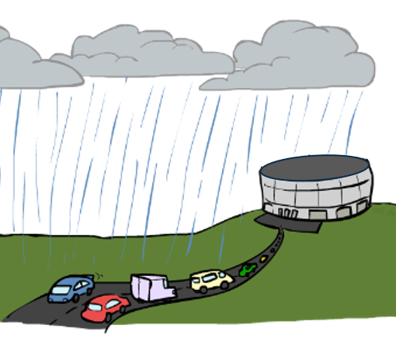








Conditional Independence Semantics
Common local releationships within a Bayes net
Causal Chain
Common Cause
Common Effect
$$R$$
$$R$$
$$H$$
$$S$$
$$F$$
$$A$$
$$T$$
$$U$$
$$T$$

Slide 34
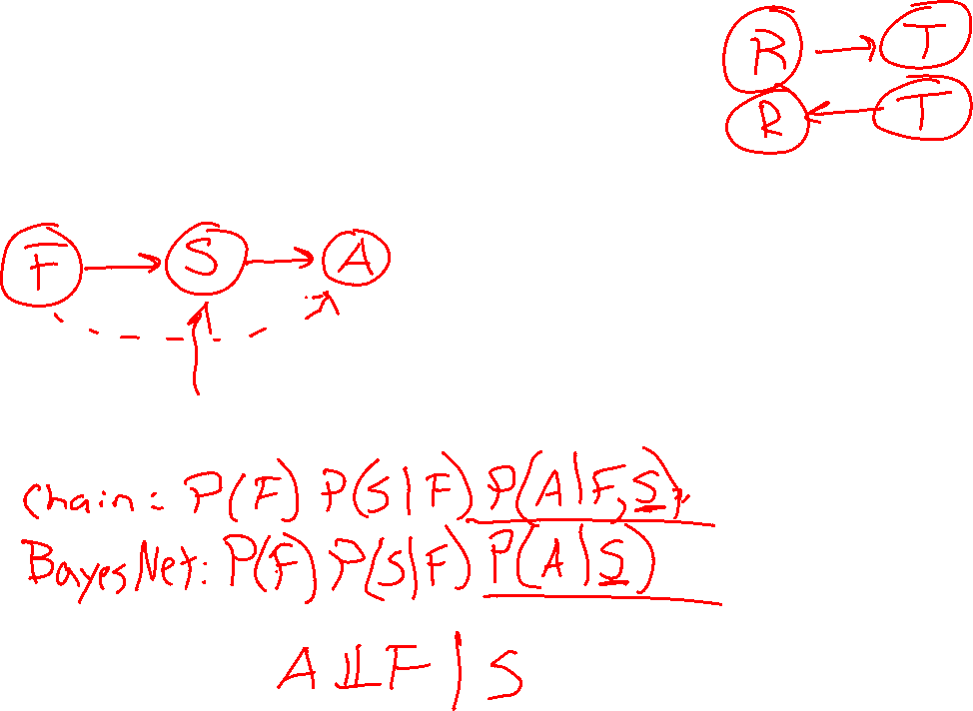
Causal Chain
Fire, Smoke, Alarm
Causal story to create Bayes net
Joint distribution
Assumptions?

Slide 35



Common Cause
$$R$$
Chain rule:
P(x₁, x₂,…, x_{n}) = ∏_{i} P(x_{i} | x₁,…, x_{i-1})
Trivial decomposition:
P(Rain, Traffic, Umbrella) =
With assumption of conditional independence:
P(Raint, Traffic, Umbrella) =
Bayes nets / graphical models help us express conditional independence assumptions
$$T$$
$$U$$
Notes:
Will be obvious from ghostbusters example

Slide 36
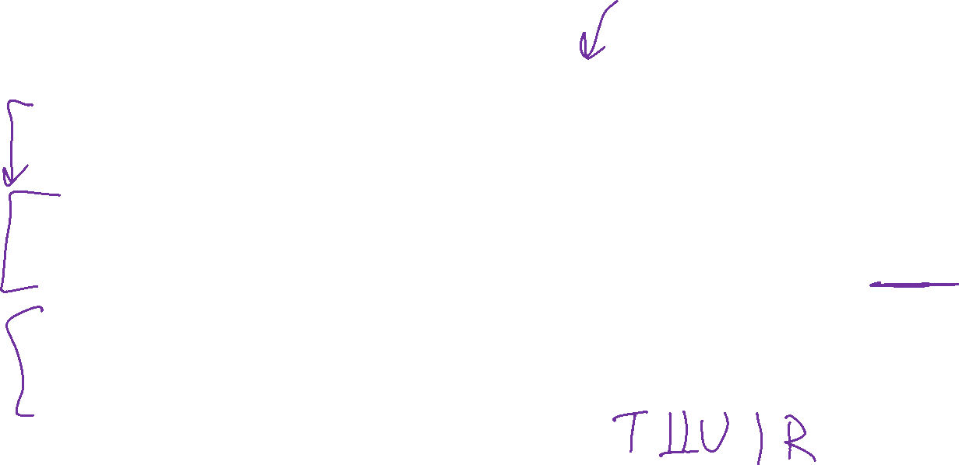
Common Cause
$$R$$
Chain rule:
P(x₁, x₂,…, x_{n}) = ∏_{i} P(x_{i} | x₁,…, x_{i-1})
Trivial decomposition:
P(Rain, Traffic, Umbrella) = P(Rain) P(Traffic | Rain) P(Umbrella | Rain, Traffic)
With assumption of conditional independence:
P(Rain, Traffic, Umbrella) = P(Rain) P(Traffic | Rain) P(Umbrella | Rain)
Bayes nets / graphical models help us express conditional independence assumptions
$$T$$
$$U$$
Notes:
Will be obvious from ghostbusters example

Slide 37

Common Effect
Chain rule:
P(x₁, x₂,…, x_{n}) = ∏_{i} P(x_{i} | x₁,…, x_{i-1})
Trivial decomposition:
P(Rain, Hockey, Traffic) = P(Rain) P(Hockey | Rain) P(Traffic | Rain, Hockey)
With assumption of conditional independence:
P(Rain, Hockey, Traffic) =
Bayes nets / graphical models help us express conditional independence assumptions
Notes:
Will be obvious from ghostbusters example

Slide 38
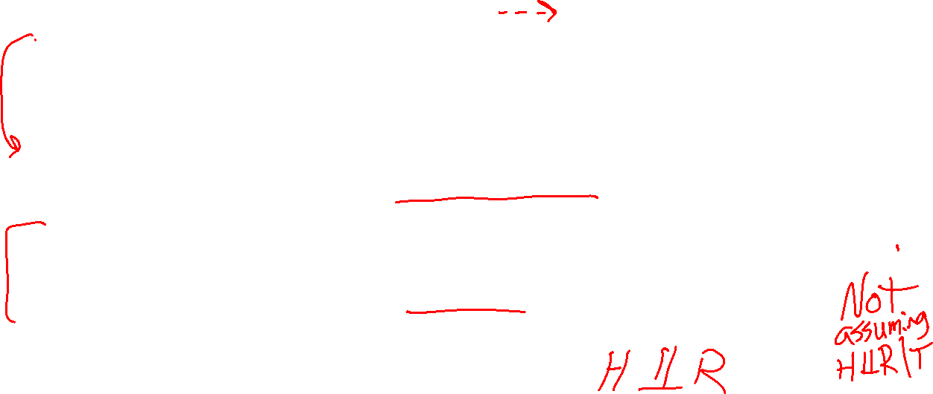



Common Effect
$$R$$
$$H$$
Chain rule:
P(x₁, x₂,…, x_{n}) = ∏_{i} P(x_{i} | x₁,…, x_{i-1})
Trivial decomposition:
P(Rain, Hockey, Traffic) = P(Rain) P(Hockey | Rain) P(Traffic | Rain, Hockey)
With assumption of conditional independence:
P(Rain, Hockey, Traffic) = P(Rain) P(Hockey) P(Traffic | Rain, Hockey)
Bayes nets / graphical models help us express conditional independence assumptions
$$T$$
Notes:
Will be obvious from ghostbusters example

Slide 39
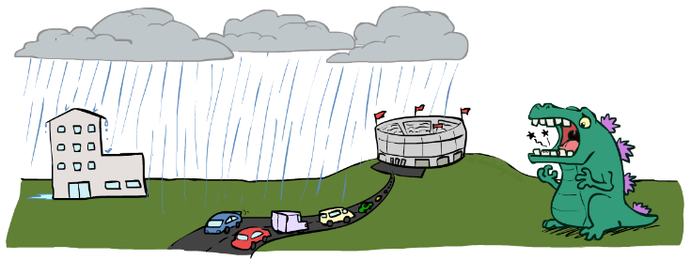
Example: Traffic II
Let’s build a causal Bayes net!
Variables
  T: Traffic
  R: It rains
  L: Low pressure
  D: Roof drips
  B: Ballgame
  C: Rain

Slide 40
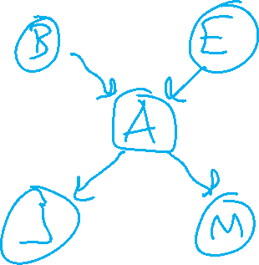
Example: Alarm Network
Variables
  B: Burglary
  A: Alarm goes off
  M: Mary calls
  J: John calls
  E: Earthquake!

Slide 41
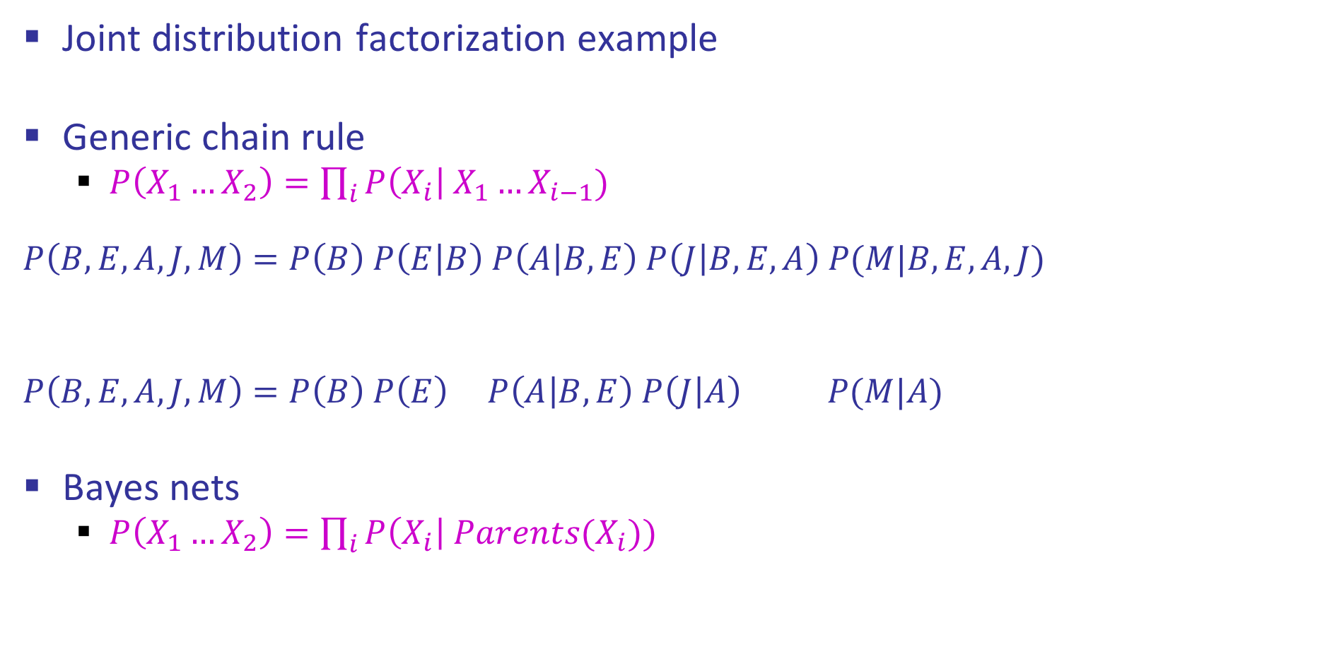

Example: Alarm Network
Joint distribution factorization example
Generic chain rule
  $P\left(X_{1}…X_{2}\right)=\prod_{i}{P\left(X_{i}\right| X_{1}…X_{i−1}) }$
  $$P\left(B,E,A,J,M\right)=P\left(B\right) P\left(E | B\right) P\left(A | B,E\right) P\left(J | B,E,A\right) P(M|B,E,A,J)$$
  $$P\left(B,E,A,J,M\right)=P\left(B\right) P\left(E\right) P\left(A | B,E\right) P\left(J | A\right) P(M|A)$$
Bayes nets
  $P\left(X_{1}…X_{2}\right)=\prod_{i}{P\left(X_{i}\right| Parents(X_{i})) }$
Burglary
Earthquake
Alarm
John calls
Mary calls

Slide 42
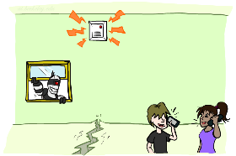

Example: Alarm Network
B | P(B)
+b | 0.001
-b | 0.999
E | P(E)
+e | 0.002
-e | 0.998
Burglary
Earthqk
Alarm
B | E | A | P(A|B,E)
+b | +e | +a | 0.95
+b | +e | -a | 0.05
+b | -e | +a | 0.94
+b | -e | -a | 0.06
-b | +e | +a | 0.29
-b | +e | -a | 0.71
-b | -e | +a | 0.001
-b | -e | -a | 0.999
John calls
Mary calls
A | J | P(J|A)
+a | +j | 0.9
+a | -j | 0.1
-a | +j | 0.05
-a | -j | 0.95
A | M | P(M|A)
+a | +m | 0.7
+a | -m | 0.3
-a | +m | 0.01
-a | -m | 0.99
Notes:
demo

Slide 43
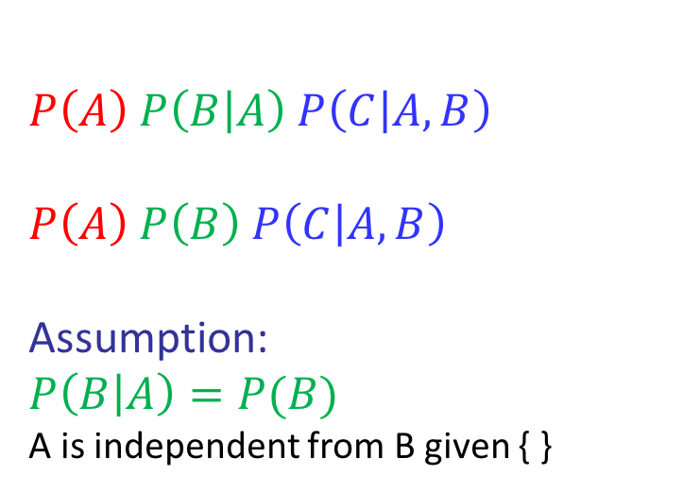
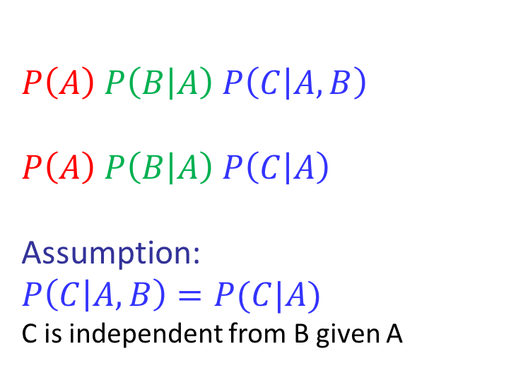
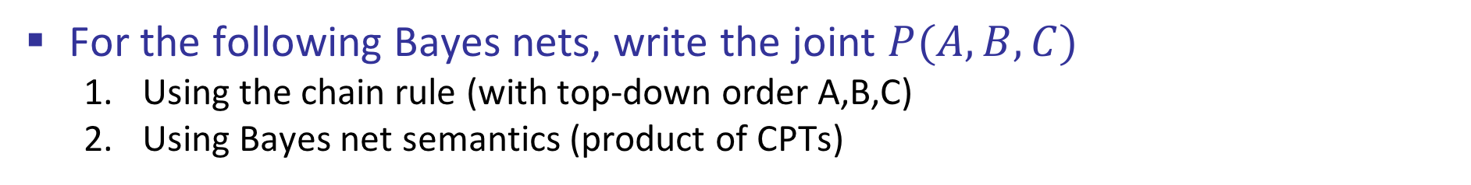
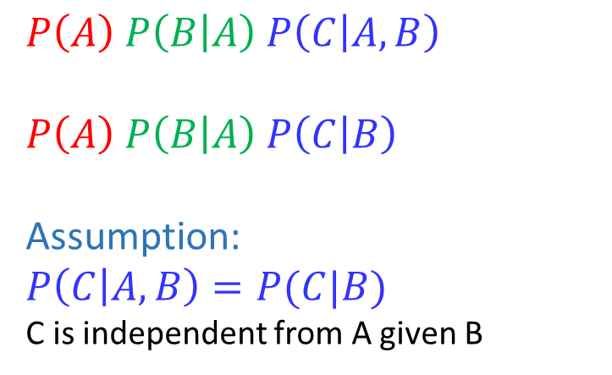
Conditional Independence Semantics
For the following Bayes nets, write the joint $P(A,B,C)$
  Using the chain rule (with top-down order A,B,C)
  Using Bayes net semantics (product of CPTs)
$$A$$
$$A$$
$$B$$
$$A$$
$$B$$
$$C$$
$$B$$
$$C$$
$$C$$
  $$P\left(A\right) P\left(B | A\right) P\left(C | A,B\right)$$
  $$P\left(A\right) P\left(B | A\right) P\left(C | B\right)$$
  Assumption:
  $$P\left(C | A,B\right)=P(C|B)$$
  C is independent from A given B
  $$P\left(A\right) P\left(B | A\right) P\left(C | A,B\right)$$
  $$P\left(A\right) P\left(B | A\right) P\left(C | A\right)$$
  Assumption:
  $$P\left(C | A,B\right)=P(C|A)$$
  C is independent from B given A
  $$P\left(A\right) P\left(B | A\right) P\left(C | A,B\right)$$
  $$P\left(A\right) P\left(B\right) P\left(C | A, B\right)$$
  Assumption:
  $$P\left(B | A\right)=P(B)$$
  A is independent from B given { }

Slide 44
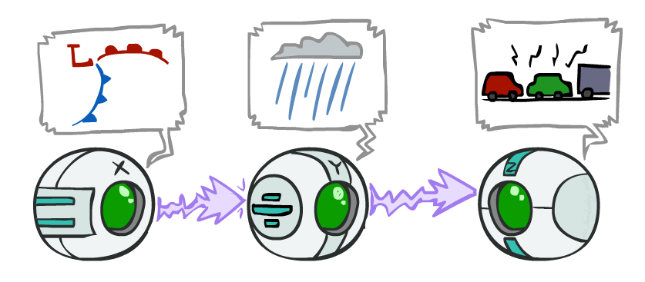
Causal Chains
Guaranteed X independent of Z ?
No!
One example set of CPTs for which X is not independent of Z is sufficient to show this independence is not guaranteed.
Example:
  Low pressure always causes rain
  Rain always causes traffic
  High pressure always causes
  No rain always causes no traffic
  In numbers:
  P( +y | +x ) = 1 P( +z | +y ) = 1
  P( -y | -x ) = 1 P( -z | -y ) = 1
This configuration is a “causal chain”
X: Low pressure Y: Rain Z: Traffic

Slide 45
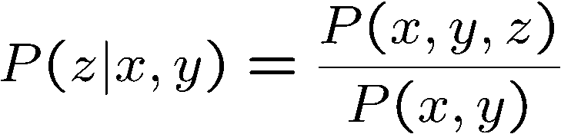
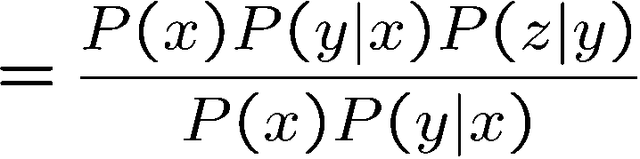

Causal Chains
This configuration is a “causal chain”
Guaranteed X independent of Z given Y?
  Evidence along the chain “blocks” the influence
X: Low pressure Y: Rain Z: Traffic
Yes!

Slide 46
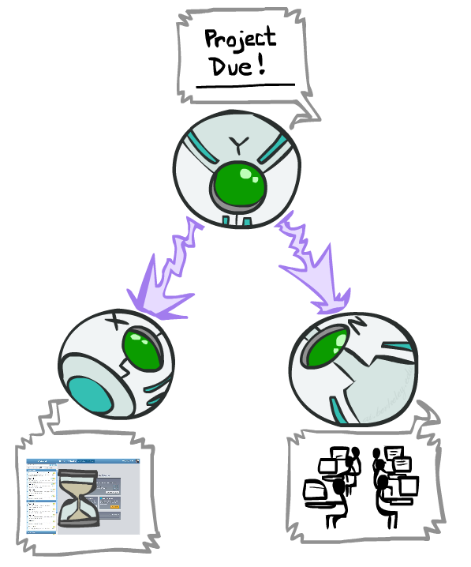
Common Cause
This configuration is a “common cause”
Guaranteed X independent of Z ? No!
  One example set of CPTs for which X is not independent of Z is sufficient to show this independence is not guaranteed.
  Example:
    Project due always causes both forums busy
    and OH full
    In numbers:
    P( +x | +y ) = 1 P( -x | -y ) = 1,
    P( +z | +y ) = 1 P( -z | -y ) = 1
Y: Project due
X: Forums busy
Z: OH full

Slide 47
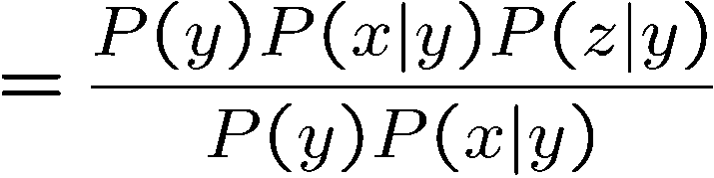
Common Cause
This configuration is a “common cause”
Guaranteed X and Z independent given Y?
  Observing the cause blocks influence between effects.
Y: Project due
X: Forums busy
Z: Lab full
Yes!

Slide 48
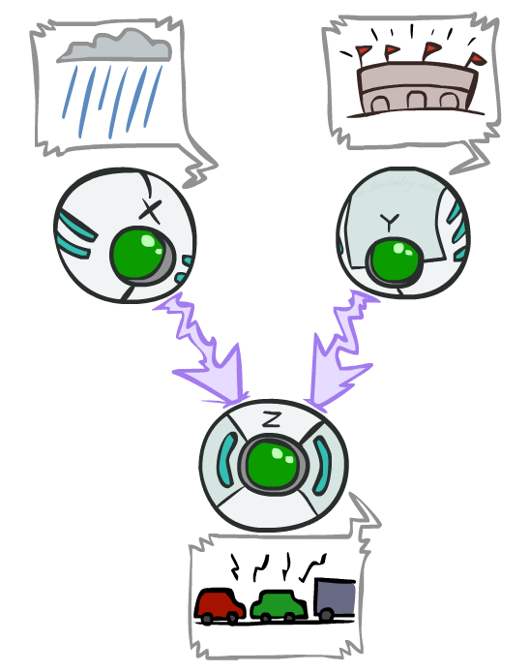
Common Effect
Last configuration: two causes of one effect (v-structures)
Are X and Y independent?
  Yes: the ballgame and the rain cause traffic, but they are not correlated
  Still need to prove they must be (try it!)
Are X and Y independent given Z?
  No: seeing traffic puts the rain and the ballgame in competition as explanation.
This is backwards from the other cases
  Observing an effect activates influence between possible causes.
X: Raining
Y: Ballgame
Z: Traffic

Slide 49


Bayes Net Independence

Slide 50
















Answering Independence Questions
Is A independent from E?
Is A independent from E given C?
Is A independent from C given E?
$$A$$
$$B$$
$$C$$
$$D$$
$$E$$
$$A$$
$$B$$
$$C$$
$$D$$
$$E$$
$$A$$
$$B$$
$$C$$
$$D$$
$$E$$

Slide 51


Reachability
L
Recipe: shade evidence nodes, look for paths in the resulting graph
Attempt 1: if two nodes are connected by an undirected path not blocked by a shaded node, they are conditionally independent
Almost works, but not quite
  Where does it break?
  Answer: the v-structure at T doesn’t count as a link in a path unless “active”
R
B
D
T

Slide 52

Active / Inactive Paths
Question: Are X and Y conditionally independent given evidence variables {Z}?
  Yes, if X and Y “d-separated” by Z
  Consider all (undirected) paths from X to Y
  No active paths = independence!
A path is active if each triple is active:
  Causal chain A → B → C where B is unobserved (either direction)
  Common cause A ← B → C where B is unobserved
  Common effect (aka v-structure)
  A → B ← C where B or one of its descendents is observed
All it takes to block a path is a single inactive segment
Active Paths
Inactive Paths

Slide 53


Bayes Ball
Question: Are X and Y conditionally independent given evidence variables {Z}?
Active Paths
Inactive Paths
Shachter, Ross D. "Bayes-Ball: Rational Pastime (for Determining Irrelevance and Requisite Information in Belief Networks and Influence Diagrams)." Proceedings of the Fourteenth conference on Uncertainty in Artificial Intelligence. 1998.

Slide 54

Bayes Ball
Question: Are X and Y conditionally independent given evidence variables {Z}?
  Shade in Z
  Drop a ball at X
  The ball can pass through any active path and is blocked by any inactive path (ball can move either direction on an edge)
  If the ball reaches Y, then X and Y are NOT conditionally independent given Z
Active Paths
Inactive Paths

Slide 55
Bayes Ball
Active Paths
Inactive Paths

Slide 56



Poll 3
Is $X_{1}$ independent from $X_{6}$ given $X_{2}$?

Slide 57

Poll 3
Is $X_{1}$ independent from $X_{6}$ given $X_{2}$?
No, the Bayes ball can travel through $X_{3}$ and $X_{5}$.

Slide 58



Poll 4
Is $X_{2}$ independent from $X_{3}$ given $X_{1}$ and $X_{6}$?

Slide 59

Poll 4
Is $X_{2}$ independent from $X_{3}$ given $X_{1}$ and $X_{6}$?
No, the Bayes ball can travel through $X_{5}$ and $X_{6}$.

Slide 60





Conditional Independence Semantics
Every variable is conditionally independent of its non-descendants given its parents
$$U_{1}$$
$$U_{m}$$
$$X$$

Slide 61








Markov blanket
A variable’s Markov blanket consists of parents, children, children’s other parents
Every variable is conditionally independent of all other variables given its Markov blanket
$$U_{1}$$
$$U_{m}$$
$$X$$
$$Z_{1j}$$
$$Z_{nj}$$
$$Y_{1}$$
$$Y_{n}$$

Slide 62



Answer Any Query from Joint Distribution
Joint distributions are the best!
Problems with joints
We aren’t given the joint table
    Usually some set of conditional probability tables
Huge
    $n$ variables with $d$ values
    $d^{n}$ entries
Joint
Query
$$P\left(a \right| e)$$

Slide 63

Answer Any Query from Bayes Net
Bayes Net
Joint
Query
$$P\left(a \right| e)$$
$$P\left(A\right) P\left(B | A\right) P\left(C | A\right) P\left(D | C\right) P(E|C)$$

Slide 64

Next: Answer Any Query from Bayes Net
Bayes Net
Query
$$P\left(a \right| e)$$
$$P\left(A\right) P\left(B | A\right) P\left(C | A\right) P\left(D | C\right) P(E|C)$$

