Slide 1
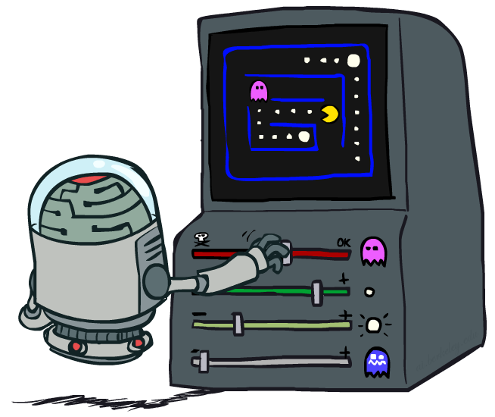
AI: Representation and Problem Solving
Reinforcement Learning II
Instructor: Pat Virtue
Slide credits: CMU AI and http://ai.berkeley.edu

Slide 2
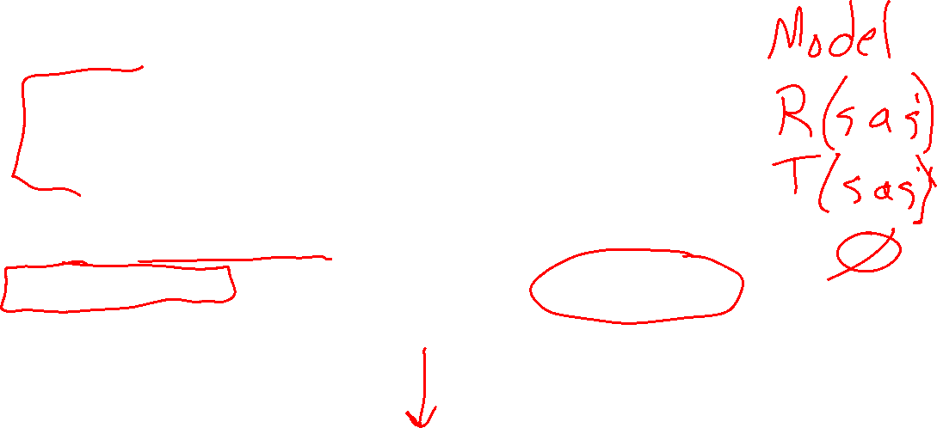
Overview: MDPs and Reinforcement Learning
Known MDP: Offline Solution
Value Iteration / Policy Iteration
Unknown MDP: Online Learning
Model-Based
Model-Free
Estimate MDP T(s,a,s') and R(s,a,s')
from samples of environment
Passive Reinforcement Learning
Direct Evaluation (simple)
TD Learning
Active Reinforcement Learning
Q-Learning

Slide 3
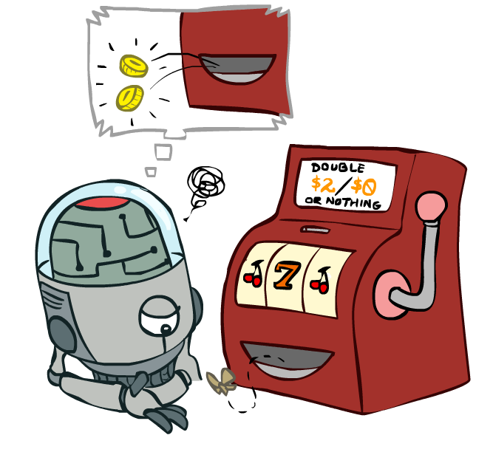
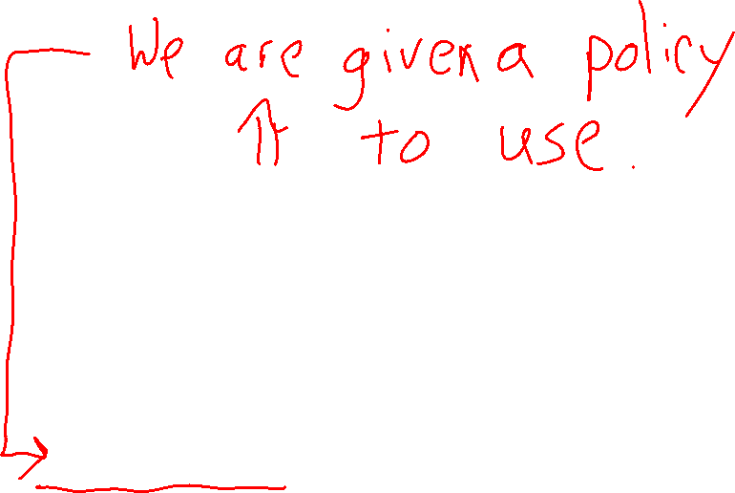

Online Learning
Model-free Learning
Passive Reinforcement Learning
Temporal Difference Learning

Slide 4
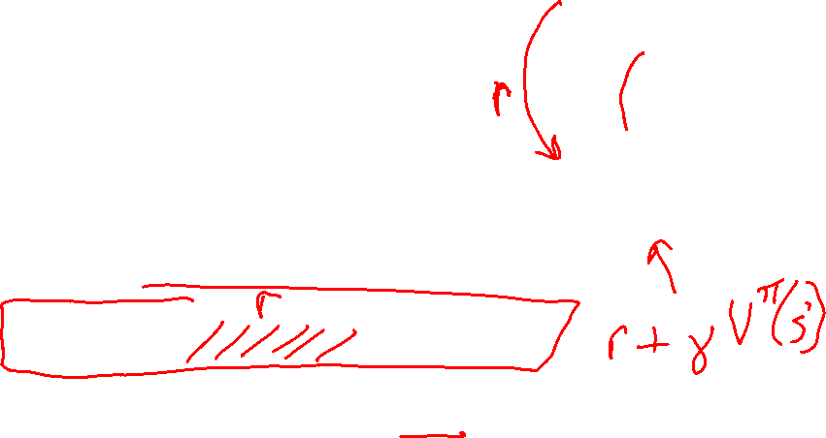


Temporal Difference Learning
s
Big idea: learn from every experience!
  Update V(s) each time we experience a transition (s, a, s’, r)
  Likely outcomes s’ will contribute updates more often
Temporal difference learning of values
  Policy still fixed, still doing evaluation!
  Move values toward value of whatever successor occurs: running average
π(s)
s, π(s)
s’
Sample of V(s):
$$sample = r + γ V_{k}^{π}\left(s′\right)$$
Update to V(s):
Same update:

Slide 5
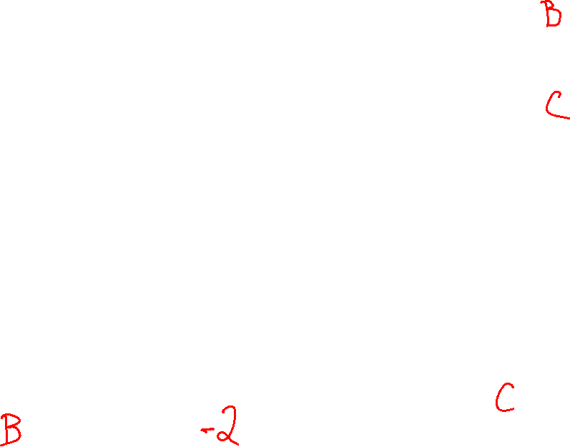
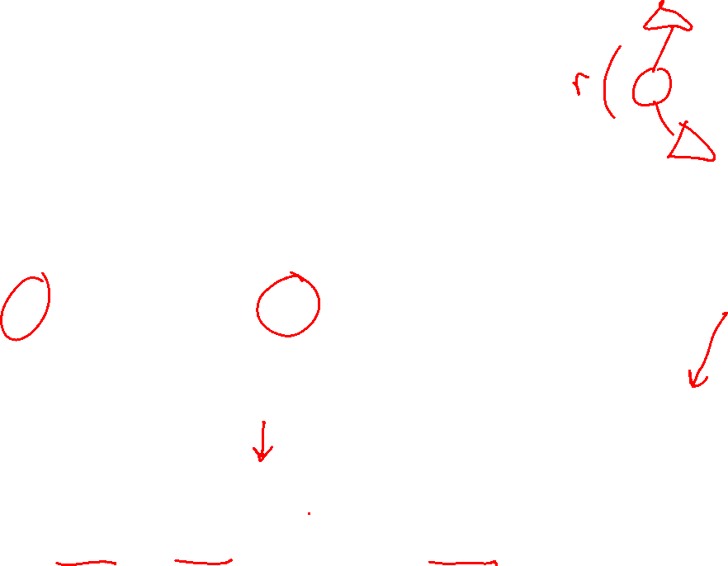
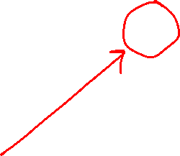
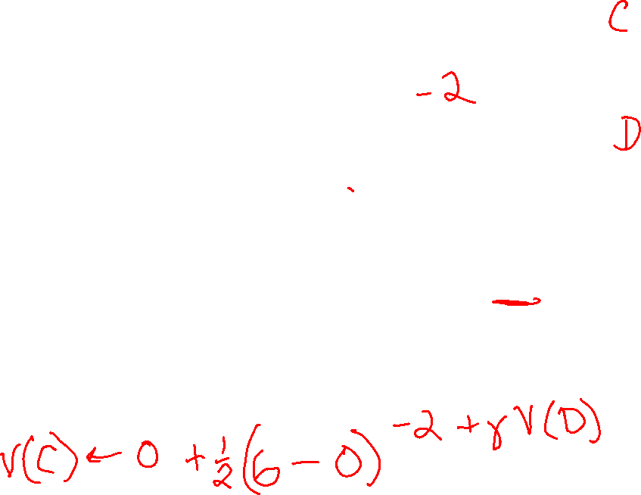
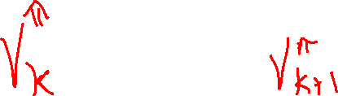
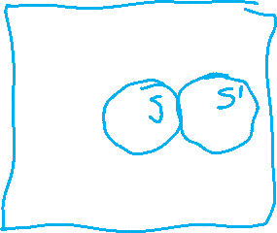
Example: Temporal Difference Learning
States
Observed Transitions
B, east, C, -2
 | A
B | C | D
 | E
 | 0
0 | 0 | 8
 | 0
 | 0
-1 | 0 | 8
 | 0
Assume: γ = 1, α = 1/2

Slide 6

Example: Temporal Difference Learning
States
Observed Transitions
B, east, C, -2
C, east, D, -2
 | A
B | C | D
 | E
 | 0
0 | 0 | 8
 | 0
 | 0
-1 | 0 | 8
 | 0
 | 0
-1 | 3 | 8
 | 0
Assume: γ = 1, α = 1/2

Slide 7
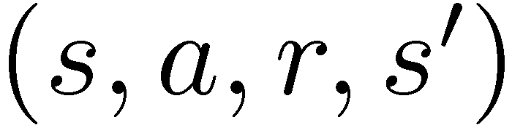
Model-Free Learning
s
Model-free (temporal difference) learning
  Experience world through episodes
  Update estimates each transition
  Over time, updates will mimic Bellman updates
a
s, a
r
s’
a’
s’, a’
s’’

Slide 8
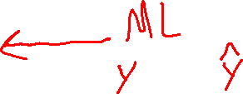

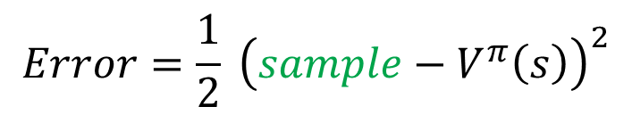


Temporal Difference Learning
Big idea: learn from every experience!
  Update V(s) each time we experience a transition (s, a, s’, r)
  Likely outcomes s’ will contribute updates more often
Temporal difference learning of values
  Policy still fixed, still doing evaluation!
  Move values toward value of whatever successor occurs: running average
s
π(s)
s, π(s)
s’
Sample of V(s):
$$sample= r+γ V^{π}\left(s^{′}\right)$$
Update to V(s):
$$V^{π}\left(s\right) ← {\left(1−α\right) V}^{π}\left(s\right)+(α) sample$$
Same update:
$$V^{π}\left(s\right) ← V^{π}(s) +α \left[sample− V^{π}\left(s\right)\right]$$
$$Error=\frac{1}{2} {\left(sample−V^{π}\left(s\right)\right)}^{2}$$
Same update:
$$V^{π}\left(s\right) ← V^{π}\left(s\right)−α∇Error$$

Slide 9
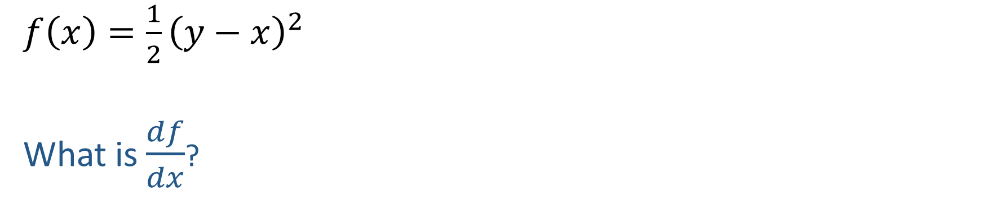
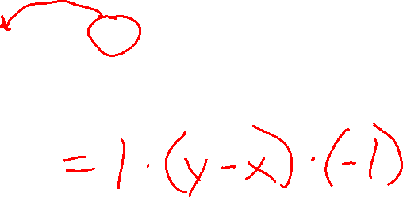
ML detour: Quick Calculus Quiz
$f\left(x\right)=\frac{1}{2}{\left(y−x\right)}^{2}$
What is $\frac{df}{dx}$?

Slide 10
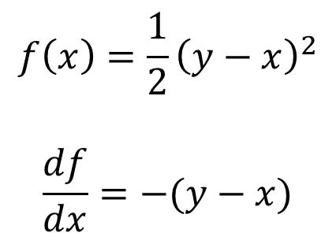
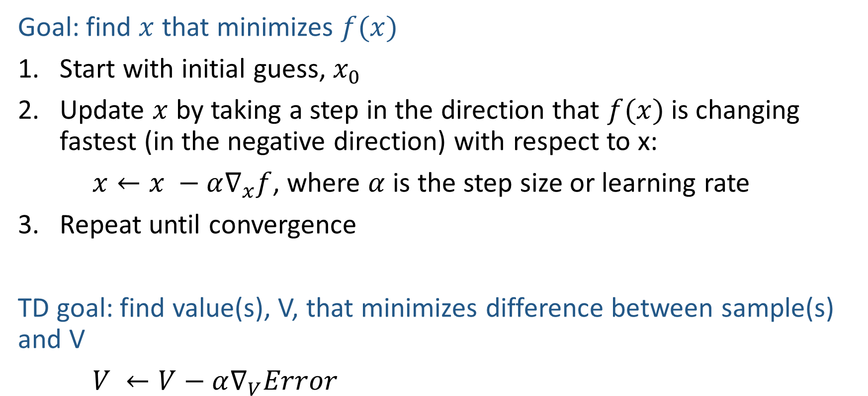
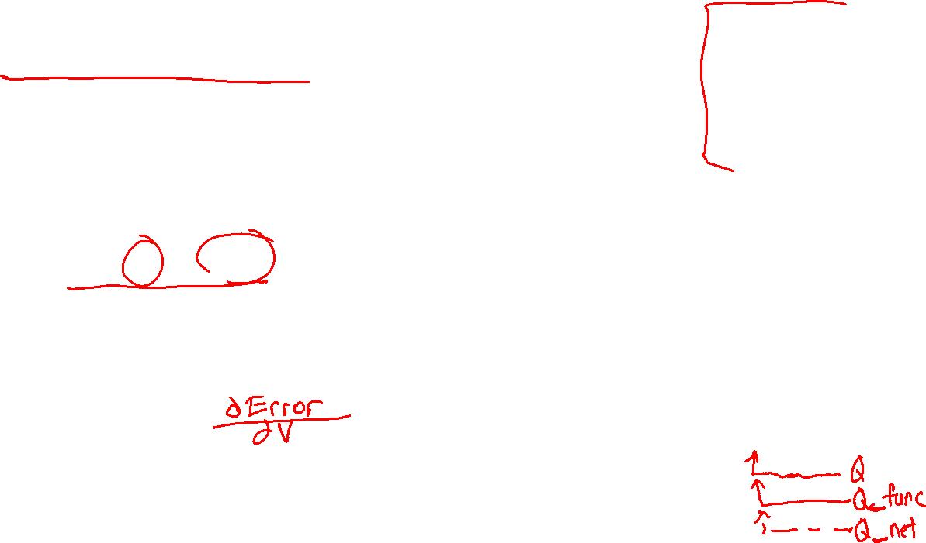
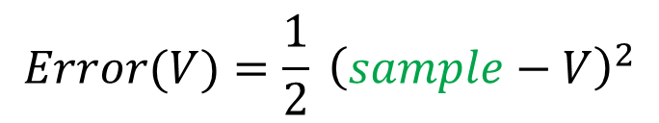
ML detour: Gradient Descent
$$f\left(x\right)=\frac{1}{2}{\left(y−x\right)}^{2}$$
$$\frac{df}{dx}=−(y−x)$$
Goal: find $x$ that minimizes $f(x)$
Start with initial guess, $x_{0}$
Update $x$ by taking a step in the direction that $f(x)$ is changing fastest (in the negative direction) with respect to x:
$x←x −α∇_{x}f$, where $α$ is the step size or learning rate
Repeat until convergence
TD goal: find value(s), V, that minimizes difference between sample(s) and V
$V ←V−α∇_{V}Error$
$$Error(V)=\frac{1}{2} {\left(sample−V\right)}^{2}$$

Slide 11
Temporal Difference Learning
Big idea: learn from every experience!
  Update V(s) each time we experience a transition (s, a, s’, r)
  Likely outcomes s’ will contribute updates more often
Temporal difference learning of values
  Policy still fixed, still doing evaluation!
  Move values toward value of whatever successor occurs: running average
s
π(s)
s, π(s)
s’
Sample of V(s):
$$sample= r+γ V^{π}\left(s^{′}\right)$$
Update to V(s):
$$V^{π}\left(s\right) ← {\left(1−α\right) V}^{π}\left(s\right)+(α) sample$$
Same update:
$$V^{π}\left(s\right) ← V^{π}(s) +α \left[sample− V^{π}\left(s\right)\right]$$
$$Error=\frac{1}{2} {\left(sample−V^{π}\left(s\right)\right)}^{2}$$
Same update:
$$V^{π}\left(s\right) ← V^{π}\left(s\right)−α∇Error$$

Slide 12
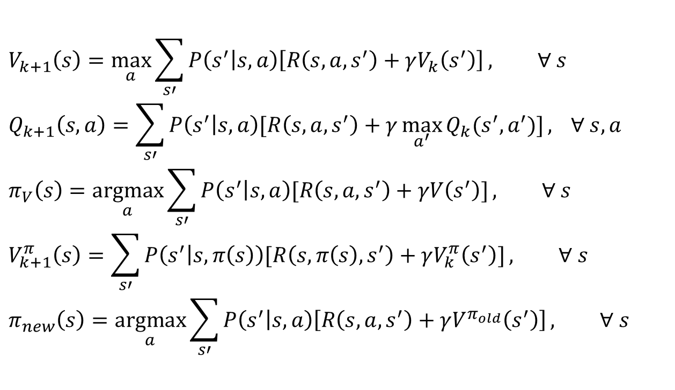
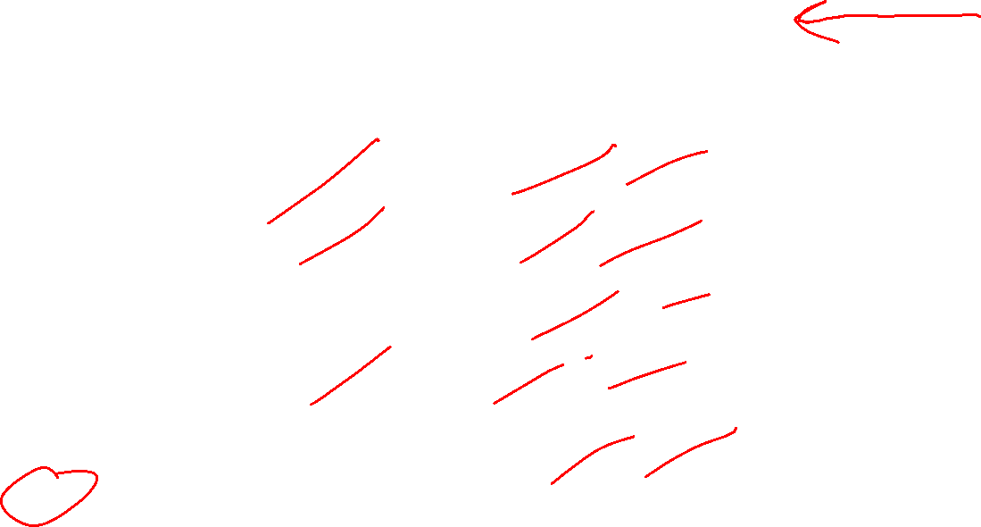
Poll 1
TD update:
$$V^{π}\left(s\right) = V^{π}(s) +α \left[r+γ V^{π}\left(s^{′}\right)− V^{π}\left(s\right)\right]$$
Which converts TD values into a policy?
$$V_{k+1}\left(s\right)=\max_{a}{\sum_{s′}{P\left(s^{′} | s,a\right)\left[R\left(s,a,s^{′}\right)+γV_{k}\left(s^{′}\right)\right]}}, ∀ s$$
$$Q_{k+1}\left(s,a\right)=\sum_{s′}{P\left(s^{′} | s,a\right)[R\left(s,a,s^{′}\right)+γ\max_{a^{′}}{Q_{k}(s^{′},a^{′})]}, } ∀ s,a$$
$$π_{V}\left(s\right)=\underset{a}{argmax}{\sum_{s′}{P\left(s^{′} | s,a\right)[R\left(s,a,s^{′}\right)+γV\left(s^{′}\right)]}}, ∀ s$$
$$V_{k+1}^{π}\left(s\right)=\sum_{s′}{P\left(s^{′} | s,π\left(s\right)\right)[R\left(s,π\left(s\right),s^{′}\right)+γV_{k}^{π}\left(s^{′}\right)]}, ∀ s$$
$$π_{new}\left(s\right)=\underset{a}{argmax}{\sum_{s′}{P\left(s^{′} | s,a\right)\left[R\left(s,a,s^{′}\right)+γV^{π_{old}}\left(s^{′}\right)\right]}}, ∀ s$$
A) Value iteration:
B) Q-iteration:
C) Policy extraction:
D) Policy evaluation:
E) Policy improvement:
F) None of the above

Slide 13
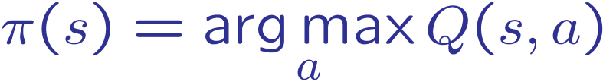
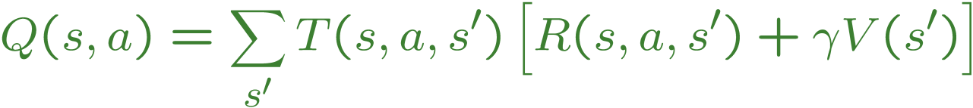
Problems with TD Value Learning
TD value leaning is a model-free way to do policy evaluation, mimicking Bellman updates with running sample averages
However, if we want to turn values into a (new) policy, we’re sunk:
Idea: learn Q-values, not values
Makes action selection model-free too!
s
a
s, a
s,a,s’
s’

Slide 14
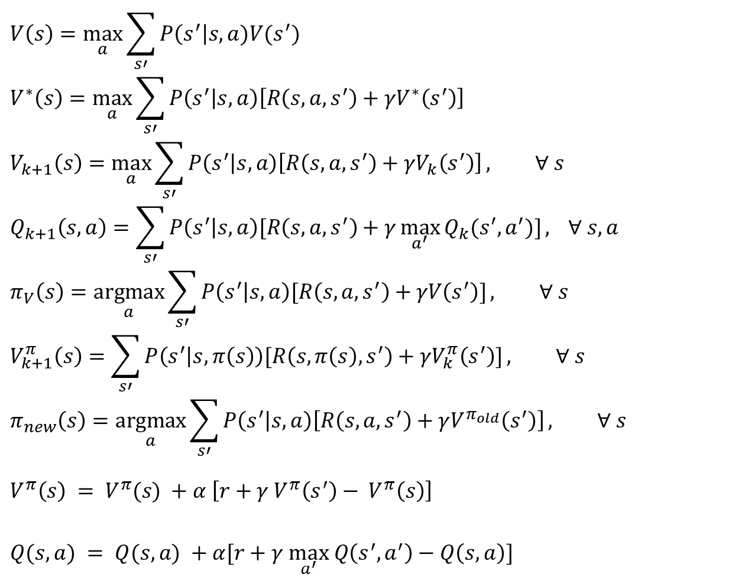
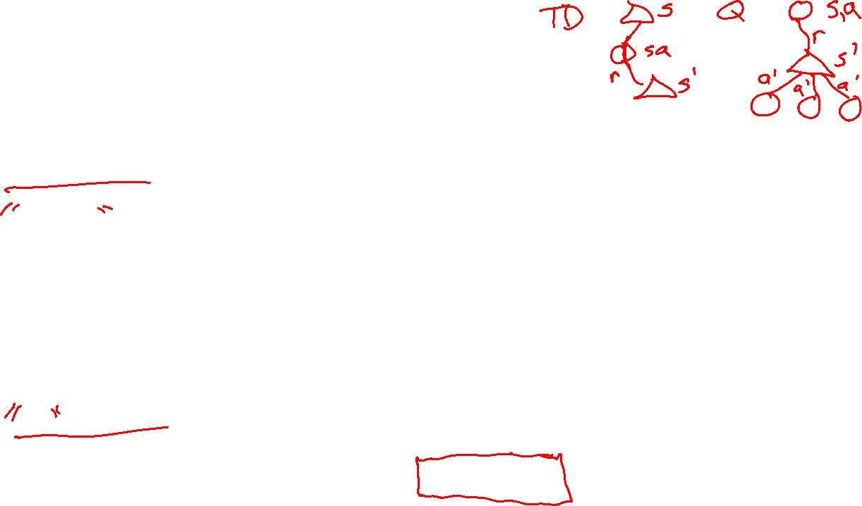
MDP/RL Notation
Standard expectimax:
$$V\left(s\right)=\max_{a}{\sum_{s′}{P\left(s^{′}\right|s,a)V(s^{′})}}$$
$$V^{∗}\left(s\right)=\max_{a}{\sum_{s′}{P\left(s^{′} | s,a\right)\left[R\left(s,a,s^{′}\right)+γV^{∗}\left(s^{′}\right)\right]}}$$
$$V_{k+1}\left(s\right)=\max_{a}{\sum_{s′}{P\left(s^{′} | s,a\right)\left[R\left(s,a,s^{′}\right)+γV_{k}\left(s^{′}\right)\right]}}, ∀ s$$
$$Q_{k+1}\left(s,a\right)=\sum_{s′}{P\left(s^{′} | s,a\right)[R\left(s,a,s^{′}\right)+γ\max_{a^{′}}{Q_{k}(s^{′},a^{′})]}, } ∀ s,a$$
$$π_{V}\left(s\right)=\underset{a}{argmax}{\sum_{s′}{P\left(s^{′} | s,a\right)[R\left(s,a,s^{′}\right)+γV\left(s^{′}\right)]}}, ∀ s$$
$$V_{k+1}^{π}\left(s\right)=\sum_{s′}{P\left(s^{′} | s,π\left(s\right)\right)[R\left(s,π\left(s\right),s^{′}\right)+γV_{k}^{π}\left(s^{′}\right)]}, ∀ s$$
$$π_{new}\left(s\right)=\underset{a}{argmax}{\sum_{s′}{P\left(s^{′} | s,a\right)\left[R\left(s,a,s^{′}\right)+γV^{π_{old}}\left(s^{′}\right)\right]}}, ∀ s$$
$$V^{π}\left(s\right) = V^{π}(s) +α \left[r+γ V^{π}\left(s^{′}\right)− V^{π}\left(s\right)\right]$$
$Q(s,a) = Q(s,a) +α[r+γ \max_{a^{′}} Q\left(s^{′},a^{′}\right)−Q\left(s, a\right)]$
Bellman equations:
Value iteration:
Q-iteration:
Policy extraction:
Policy evaluation:
Policy improvement:
Value (TD) learning:
Q-learning:

Slide 15
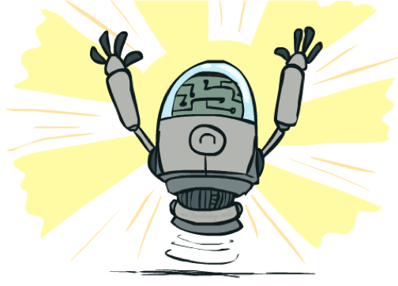
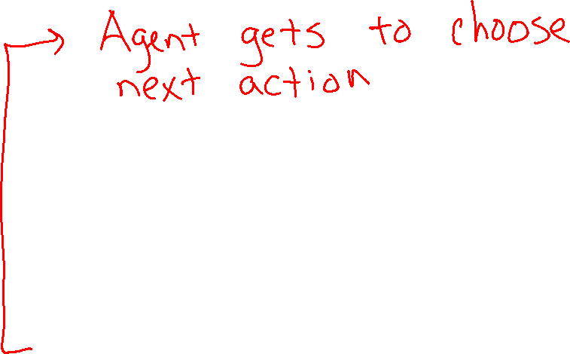
Online Learning
Model-free Learning
Active Reinforcement Learning
Q-Learning

Slide 16
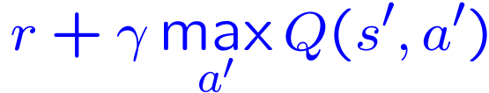

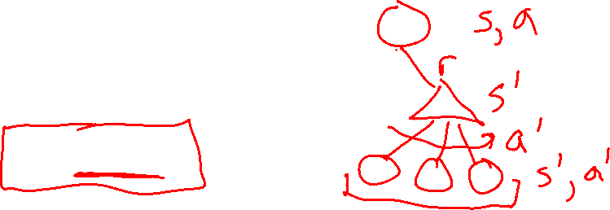
Q-Learning
We’d like to do Q-value updates to each Q-state:
  But can’t compute this update without knowing T, R
Instead, compute average as we go
  Receive a sample transition (s,a,r,s’)
  The sample value is then:
  But we want to average over results from (s,a) (Why?)
  So keep a running average
$$sample=$$

Slide 17

Q-Learning Properties
Amazing result: Q-learning converges to optimal policy -- even if you’re acting suboptimally!
This is called off-policy learning
Caveats:
  You have to explore enough
  You have to eventually make the learning rate
  small enough
  … but not decrease it too quickly
  Basically, in the limit, it doesn’t matter how you select actions (!)

Slide 18
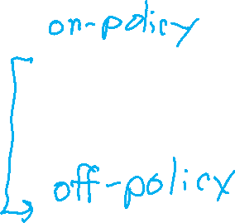
Overview: MDPs and Reinforcement Learning
Known MDP: Offline Solution
Value Iteration / Policy Iteration
Unknown MDP: Online Learning
Model-Based
Model-Free
Estimate MDP T(s,a,s') and R(s,a,s')
from samples of environment
Passive Reinforcement Learning
Direct Evaluation (simple)
TD Learning
Active Reinforcement Learning
Q-Learning

Slide 19
Demo Q-Learning Auto Cliff Grid
[Demo: Q-learning – auto – cliff grid (L11D1)]

Slide 20
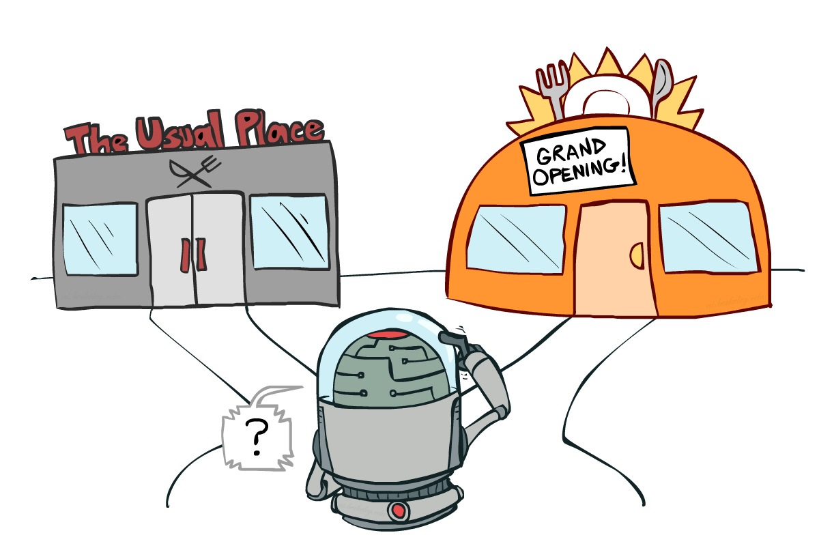
Exploration vs. Exploitation

Slide 21

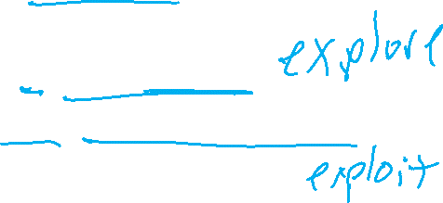
How to Explore?
Several schemes for forcing exploration
  Simplest: random actions (ε-greedy)
    Every time step, flip a coin
    With (small) probability ε, act randomly
    With (large) probability 1-ε, act on current policy
  Problems with random actions?
    You do eventually explore the space, but keep thrashing around once learning is done
    One solution: lower ε over time
    Another solution: exploration functions
[Demo: Q-learning – manual exploration – bridge grid (L11D2)] [Demo: Q-learning – epsilon-greedy -- crawler (L11D3)]

Slide 22
Demo Q-learning – Manual Exploration – Bridge Grid

Slide 23
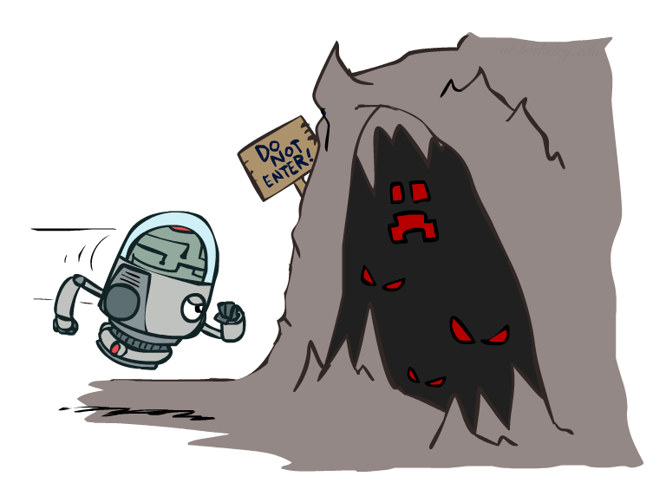

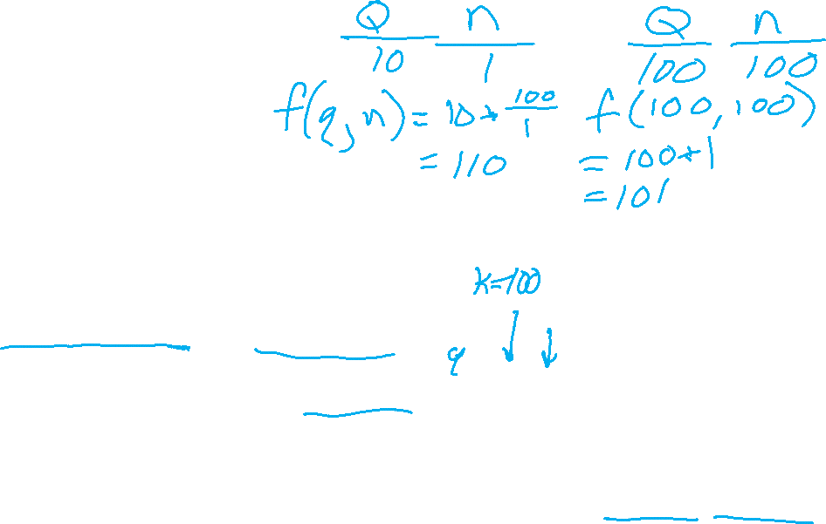
Exploration Functions
When to explore?
  Random actions: explore a fixed amount
  Better idea: explore areas whose badness is not
  (yet) established, eventually stop exploring
Exploration function
  Takes a value estimate u and a visit count n, and
  returns an optimistic utility, e.g.
  Note: this propagates the “bonus” back to states that lead to unknown states as well!
Regular Q-Update:
Modified Q-Update:
[Demo: exploration – Q-learning – crawler – exploration function (L11D4)]

Slide 24
Demo Q-learning – Epsilon-Greedy – Crawler

Slide 25
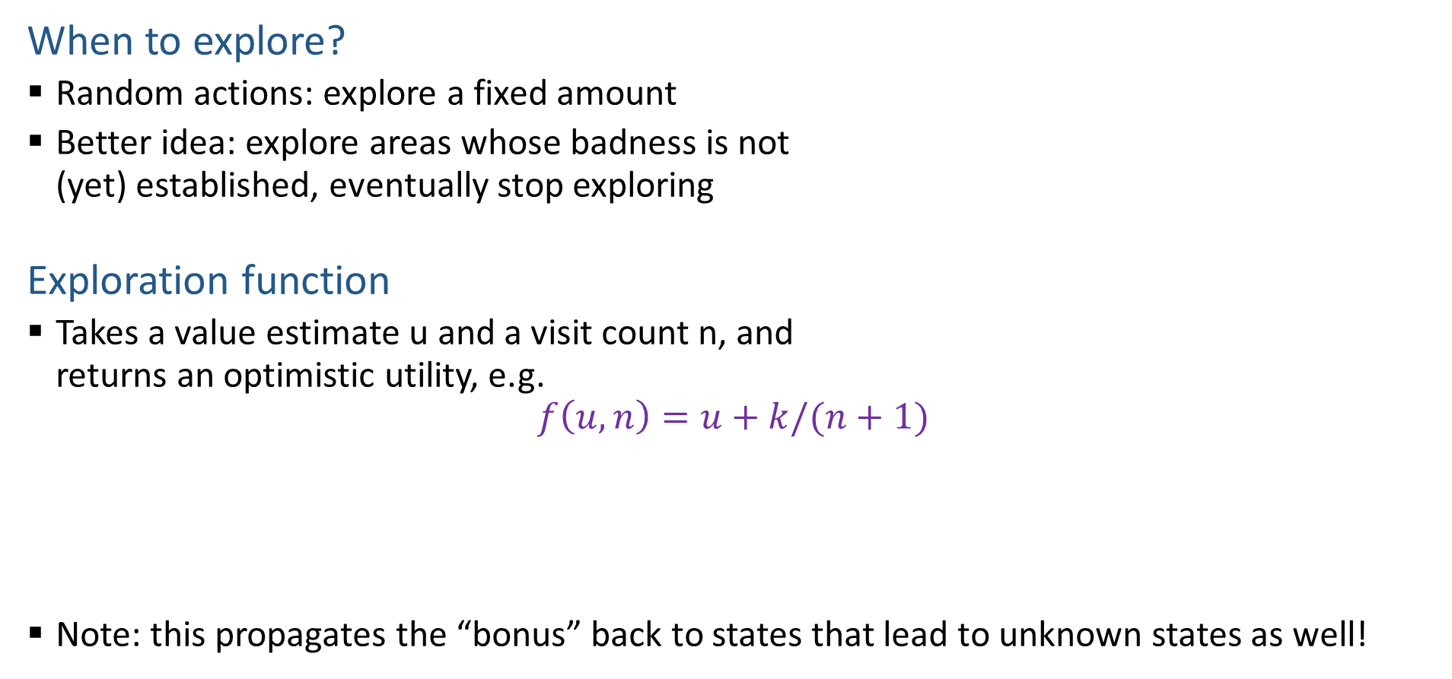
Exploration Functions
When to explore?
  Random actions: explore a fixed amount
  Better idea: explore areas whose badness is not
  (yet) established, eventually stop exploring
Exploration function
  Takes a value estimate u and a visit count n, and
  returns an optimistic utility, e.g.
  $$f\left(u, n\right)=u+k/(n+1)$$
  Note: this propagates the “bonus” back to states that lead to unknown states as well!
Regular Q-Update: $Q\left(s, a\right)=Q\left(s,a\right)+α [r+γ\max_{a^{′}} Q\left(s^{′}, a^{′}\right) −Q\left(s, a\right)]$
Modified Q-Update: $Q\left(s, a\right)=Q\left(s,a\right)+α [r+γ\max_{a^{′}} f(Q\left(s^{′}, a^{′}\right), N\left(s^{′}, a^{′}\right)) −Q\left(s, a\right)]$
[Demo: exploration – Q-learning – crawler – exploration function (L11D4)]

Slide 26
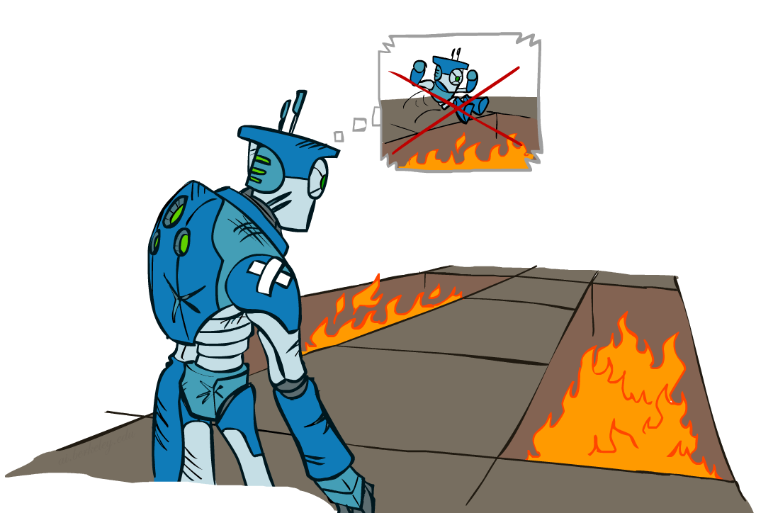
Regret
Even if you learn the optimal policy, you still make mistakes along the way!
Regret is a measure of your total mistake cost: the difference between your (expected) rewards, including youthful suboptimality, and optimal (expected) rewards
Minimizing regret goes beyond learning to be optimal – it requires optimally learning to be optimal
Example: random exploration and exploration functions both end up optimal, but random exploration has higher regret

Slide 27
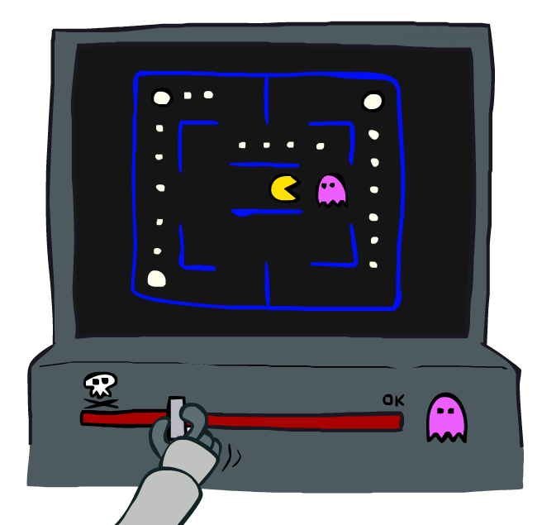
Approximate Q-Learning
Notes:
:34 in, :40 to go

Slide 28
Approximate Q-Learning
What happens when we change Candy Grab to start with 1000 pieces?
Pieces Available | Take 1 | Take 2
2 | 0% | 100%
3 | 2% | 0%
4 | 75% | 2%
5 | 4% | 68%
6 | 5% | 6%
7 | 60% | 5%

Slide 29

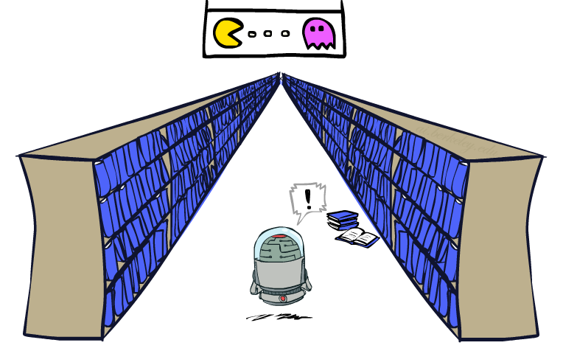
Generalizing Across States
Basic Q-Learning keeps a table of all q-values
In realistic situations, we cannot possibly learn about every single state!
  Too many states to visit them all in training
  Too many states to hold the q-tables in memory
Instead, we want to generalize:
  Learn about some small number of training states from experience
  Generalize that experience to new, similar situations
  This is a fundamental idea in machine learning, and we’ll see it over and over again
[demo – RL pacman]

Slide 30
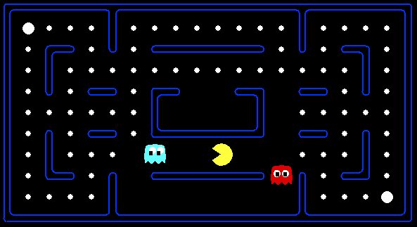



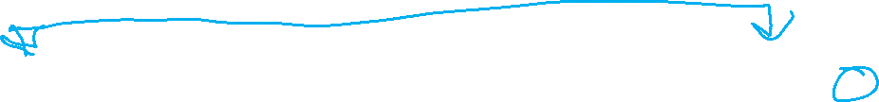
Example: Pacman
Let’s say we discover through experience that this state is bad:
In naïve q-learning, we know nothing about this state:
Or even this one!
[Demo: Q-learning – pacman – tiny – watch all (L11D5)]
[Demo: Q-learning – pacman – tiny – silent train (L11D6)]
[Demo: Q-learning – pacman – tricky – watch all (L11D7)]

Slide 31
Demo Q-Learning Pacman – Tiny – Watch All

Slide 32
Demo Q-Learning Pacman – Tiny – Silent Train

Slide 33
Demo Q-Learning Pacman – Tricky – Watch All

Slide 34
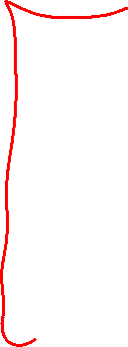
Feature-Based Representations
Solution: describe a state using a vector of features (properties)
  Features are functions from states to real numbers (often 0/1) that capture important properties of the state
  Example features:
    Distance to closest ghost
    Distance to closest dot
    Number of ghosts
    1 / (dist to dot)²
    Is Pacman in a tunnel? (0/1)
    …… etc.
    Is it the exact state on this slide?
  Can also describe a q-state (s, a) with features (e.g. action moves closer to food)

Slide 35
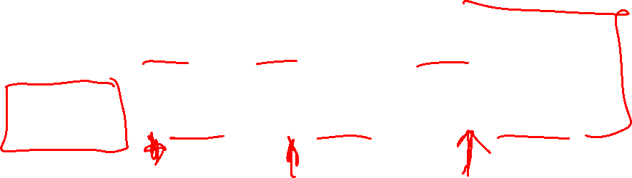

Linear Value Functions
Using a feature representation, we can write a q function (or value function) for any state using a few weights:
  V_{w}(s) = w₁f₁(s) + w₂f₂(s) + … + w_{n}f_{n}(s)
  Q_{w}(s,a) = w₁f₁(s,a) + w₂f₂(s,a) + … + w_{n}f_{n}(s,a)
Advantage: our experience is summed up in a few powerful numbers
Disadvantage: states may share features but actually be very different in value!

Slide 36
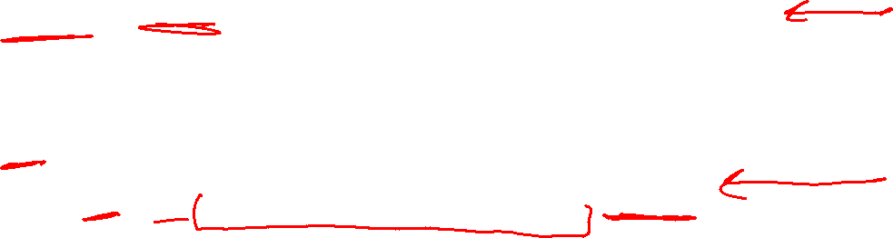
Updating a linear value function
Original Q learning rule tries to reduce prediction error at s, a:
    Q(s,a) ← Q(s,a) + α ⋅ [r + γ max_{a’} Q (s’,a’) - Q(s,a) ]
Instead, we update the weights to try to reduce the error at s, a:
      w_{i} ← w_{i} + α ⋅ [r + γ max_{a’} Q (s’,a’) - Q(s,a) ] ∂Q_{w}(s,a)/∂w_{i}
  = w_{i} + α ⋅ [r + γ max_{a’} Q (s’,a’) - Q(s,a) ] f_{i}(s,a)

Slide 37
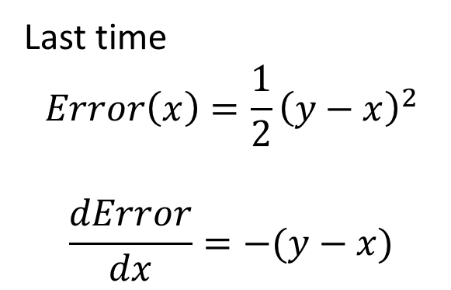
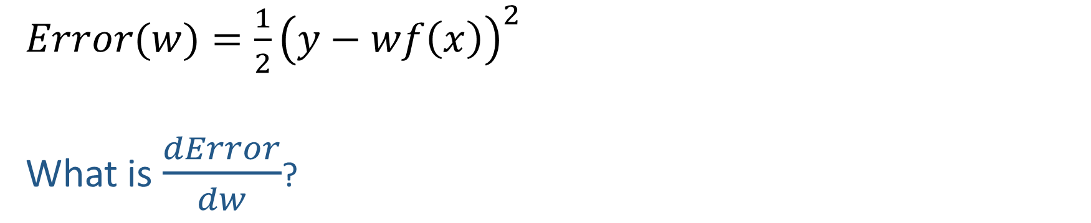
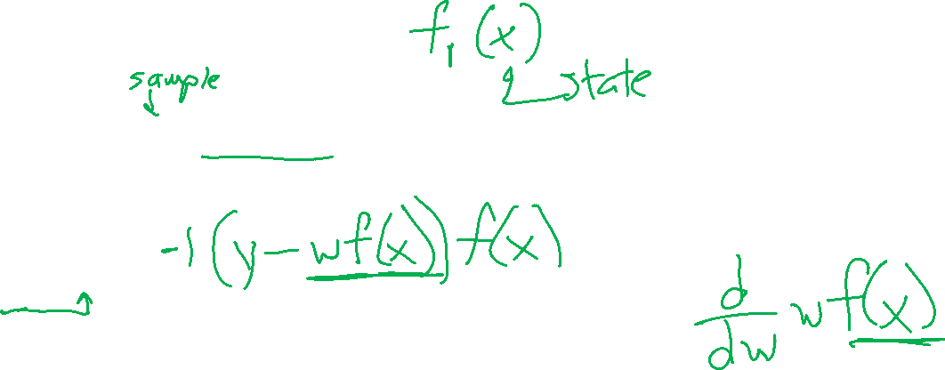
Quick Calculus Quiz
Last time
$$Error\left(x\right)=\frac{1}{2}{\left(y−x\right)}^{2}$$
$$\frac{dError}{dx}=−(y−x)$$
$Error(w)=\frac{1}{2}{\left(y−wf\left(x\right)\right)}^{2}$
What is $\frac{dError}{dw}$?

Slide 38
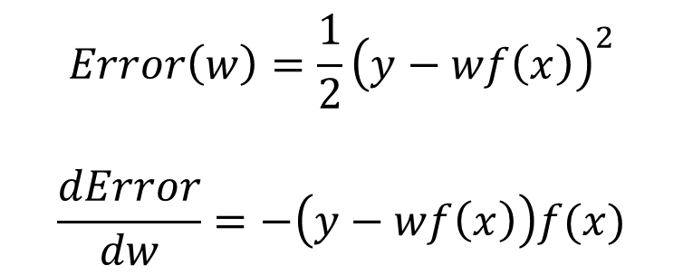
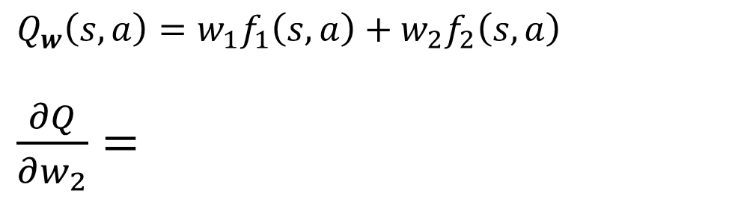
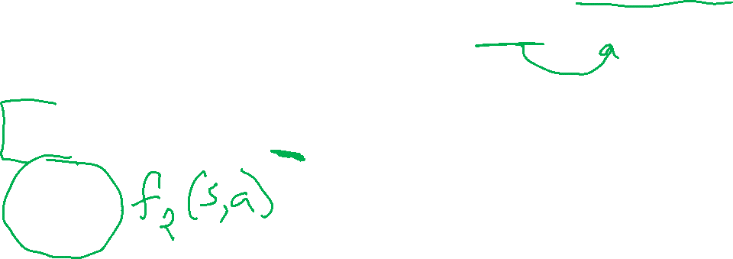
Updating a linear value function
Original Q learning rule tries to reduce prediction error at s, a:
    Q(s,a) ← Q(s,a) + α ⋅ [r + γ max_{a’} Q (s’,a’) - Q(s,a) ]
Instead, we update the weights to try to reduce the error at s, a:
      w_{i} ← w_{i} + α ⋅ [r + γ max_{a’} Q (s’,a’) - Q(s,a) ] ∂Q_{w}(s,a)/∂w_{i}
  = w_{i} + α ⋅ [r + γ max_{a’} Q (s’,a’) - Q(s,a) ] f_{i}(s,a)
$Q_{w}\left(s, a\right)=w_{1}f_{1}\left(s, a\right)+w_{2}f_{2}\left(s, a\right)$
$\frac{∂Q}{∂w_{2}}=$
$$Error\left(w\right)=\frac{1}{2}{\left(y−wf\left(x\right)\right)}^{2}$$
$$\frac{dError}{dw}=−\left(y−wf\left(x\right)\right)f(x)$$

Slide 39
Updating a linear value function
Original Q learning rule tries to reduce prediction error at s, a:
    Q(s,a) ← Q(s,a) + α ⋅ [r + γ max_{a’} Q (s’,a’) - Q(s,a) ]
Instead, we update the weights to try to reduce the error at s, a:
      w_{i} ← w_{i} + α ⋅ [r + γ max_{a’} Q (s’,a’) - Q(s,a) ] ∂Q_{w}(s,a)/∂w_{i}
  = w_{i} + α ⋅ [r + γ max_{a’} Q (s’,a’) - Q(s,a) ] f_{i}(s,a)
Qualitative justification:
  Pleasant surprise: increase weights on +ve features, decrease on –ve ones
  Unpleasant surprise: decrease weights on +ve features, increase on –ve ones

Slide 40



Approximate Q-Learning
Q-learning with linear Q-functions:
Intuitive interpretation:
  Adjust weights of active features
  E.g., if something unexpectedly bad happens, blame the features that were on: disprefer all states with that state’s features
Formal justification: online least squares
Exact Q’s
Approximate Q’s

Slide 41








Example: Q-Pacman
[Demo: approximate Q-learning pacman (L11D10)]

Slide 42
Demo Approximate Q-Learning -- Pacman

Slide 43

Q-Learning and Least Squares
Notes:
DK :57 in, :17 to go

Slide 44



Linear Approximation: Regression
40
26
24
20
22
20
30
20
40
0
0
20
30
10
20
0
10
0
Prediction:
Prediction:
Notes:
Figure 1: scatter(1:20,10+(1:20)+2*randn(1,20),'k','filled'); a=axis; a(3)=0; axis(a);

Slide 45





Optimization: Least Squares
Error or “residual”
Observation
Prediction
0
0
20
Notes:
Figure 1: scatter(1:20,10+(1:20)+2*randn(1,20),'k','filled'); a=axis; a(3)=0; axis(a);

Slide 46



Minimizing Error
Imagine we had only one point x, with features f(x), target value y, and weights w:
Approximate q update explained:
“target”
“prediction”

Slide 47
Reinforcement Learning Milestones

Slide 48

TDGammon
1992 by Gerald Tesauro, IBM
4-ply lookahead using V(s) trained from 1,500,000 games of self-play
3 hidden layers, ~100 units each
Input: contents of each location plus several handcrafted features
Experimental results:
  Plays approximately at parity with world champion
  Led to radical changes in the way humans play backgammon

Slide 49

Deep Q-Networks
sample = r + γ max_{a’} Q_{w} (s’,a’)
Q_{w}(s,a): Neural network
Deep Mind, 2015
Used a deep learning network to represent Q:
  Input is last 4 images (84x84 pixel values) plus score
49 Atari games, incl. Breakout, Space Invaders, Seaquest, Enduro
Image: Deep Mind

Slide 50




Images: Open AI, Atari

Slide 51




OpenAI Gym (now Gymnasium)
2016+
Benchmark problems for learning agents
https://gymnasium.farama.org/
Images: Open AI/Gymnasium

Slide 52

AlphaGo, AlphaZero
Deep Mind, 2016+

Slide 53
Autonomous Vehicles?

