Slide 1

AI: Representation and Problem Solving
AI History and Future
Instructor: Pat Virtue
Slide credits: CMU AI & http://ai.berkeley.edu

Slide 2
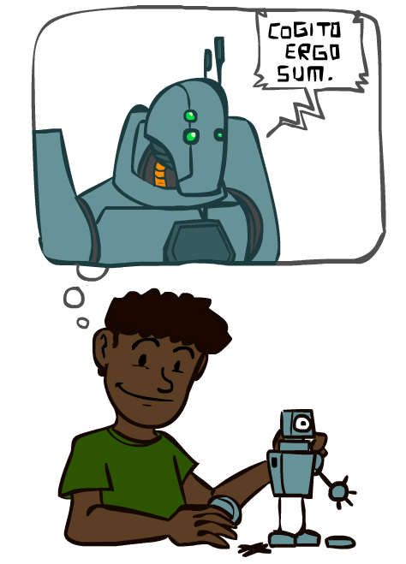
A Brief History of AI

Slide 3
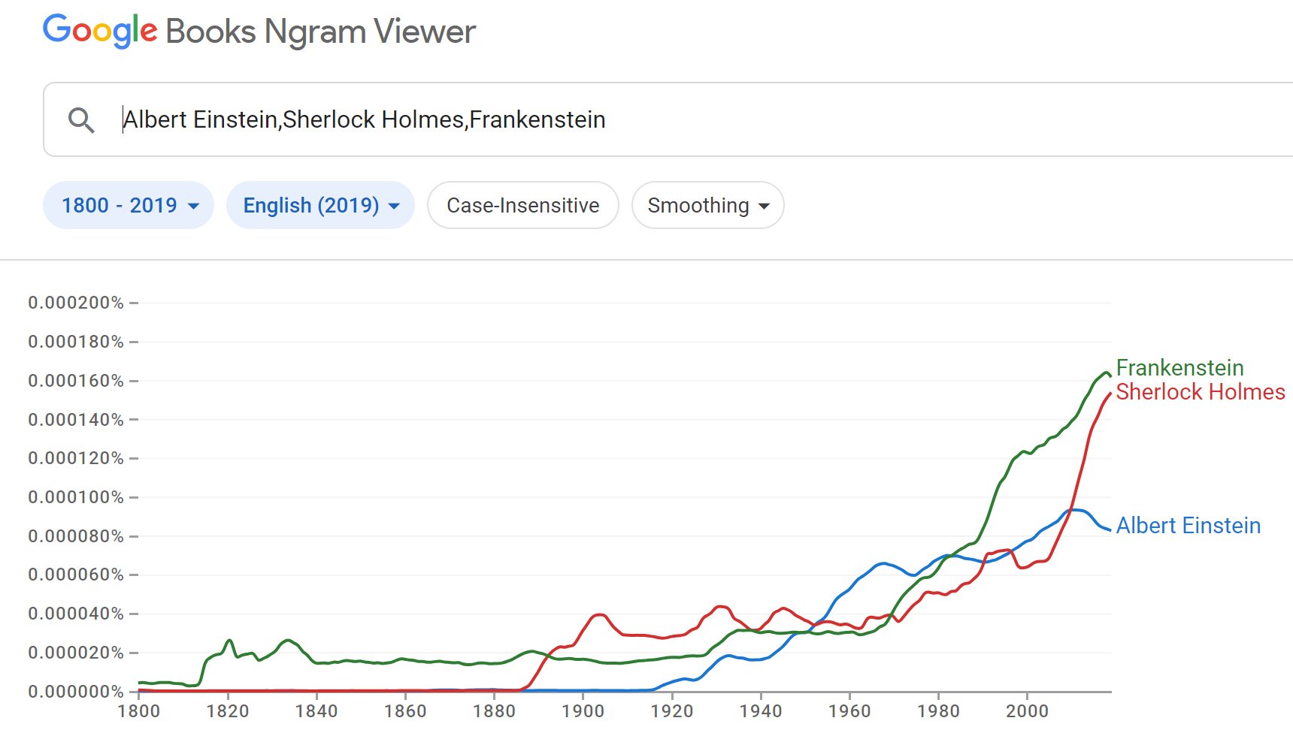
A Brief History of AI: Via Google N-grams Viewer
https://books.google.com/ngrams
https://books.google.com/ngrams

Slide 4
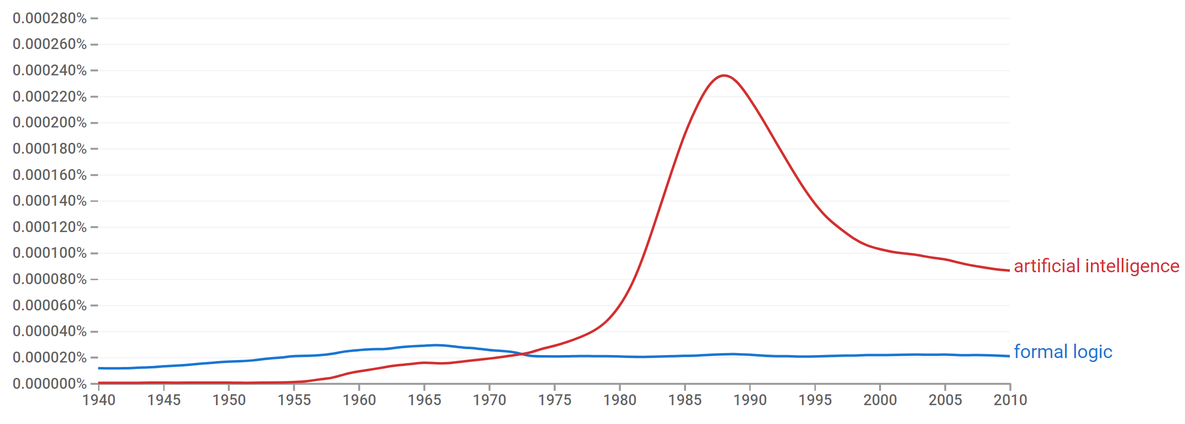

A Brief History of AI
Knowledge Based
Systems
1970-1990
AI
Excitement!
1950-1970
artificial intelligence
formal logic
https://books.google.com/ngrams

Slide 5
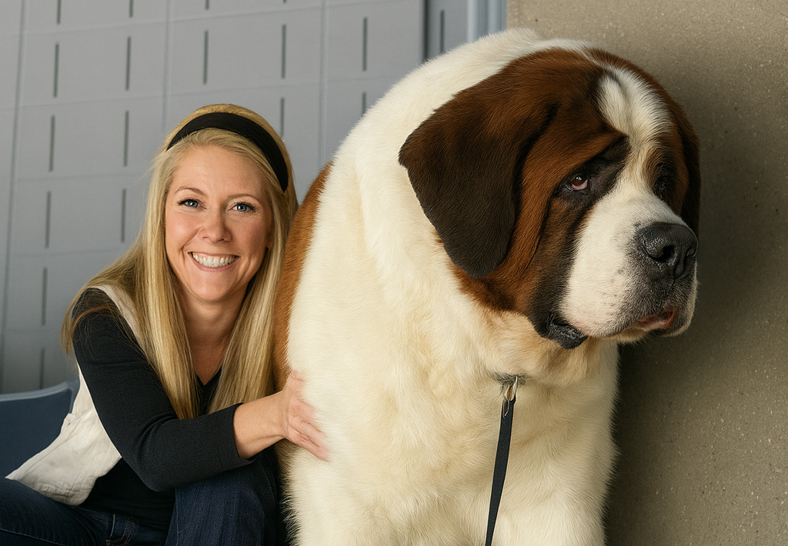
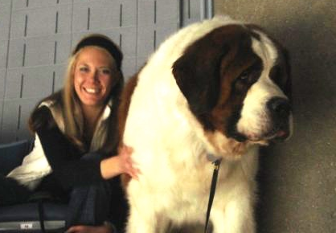
What went wrong?
Dog
Barks
Has Fur
Has four legs
Buster

Slide 6
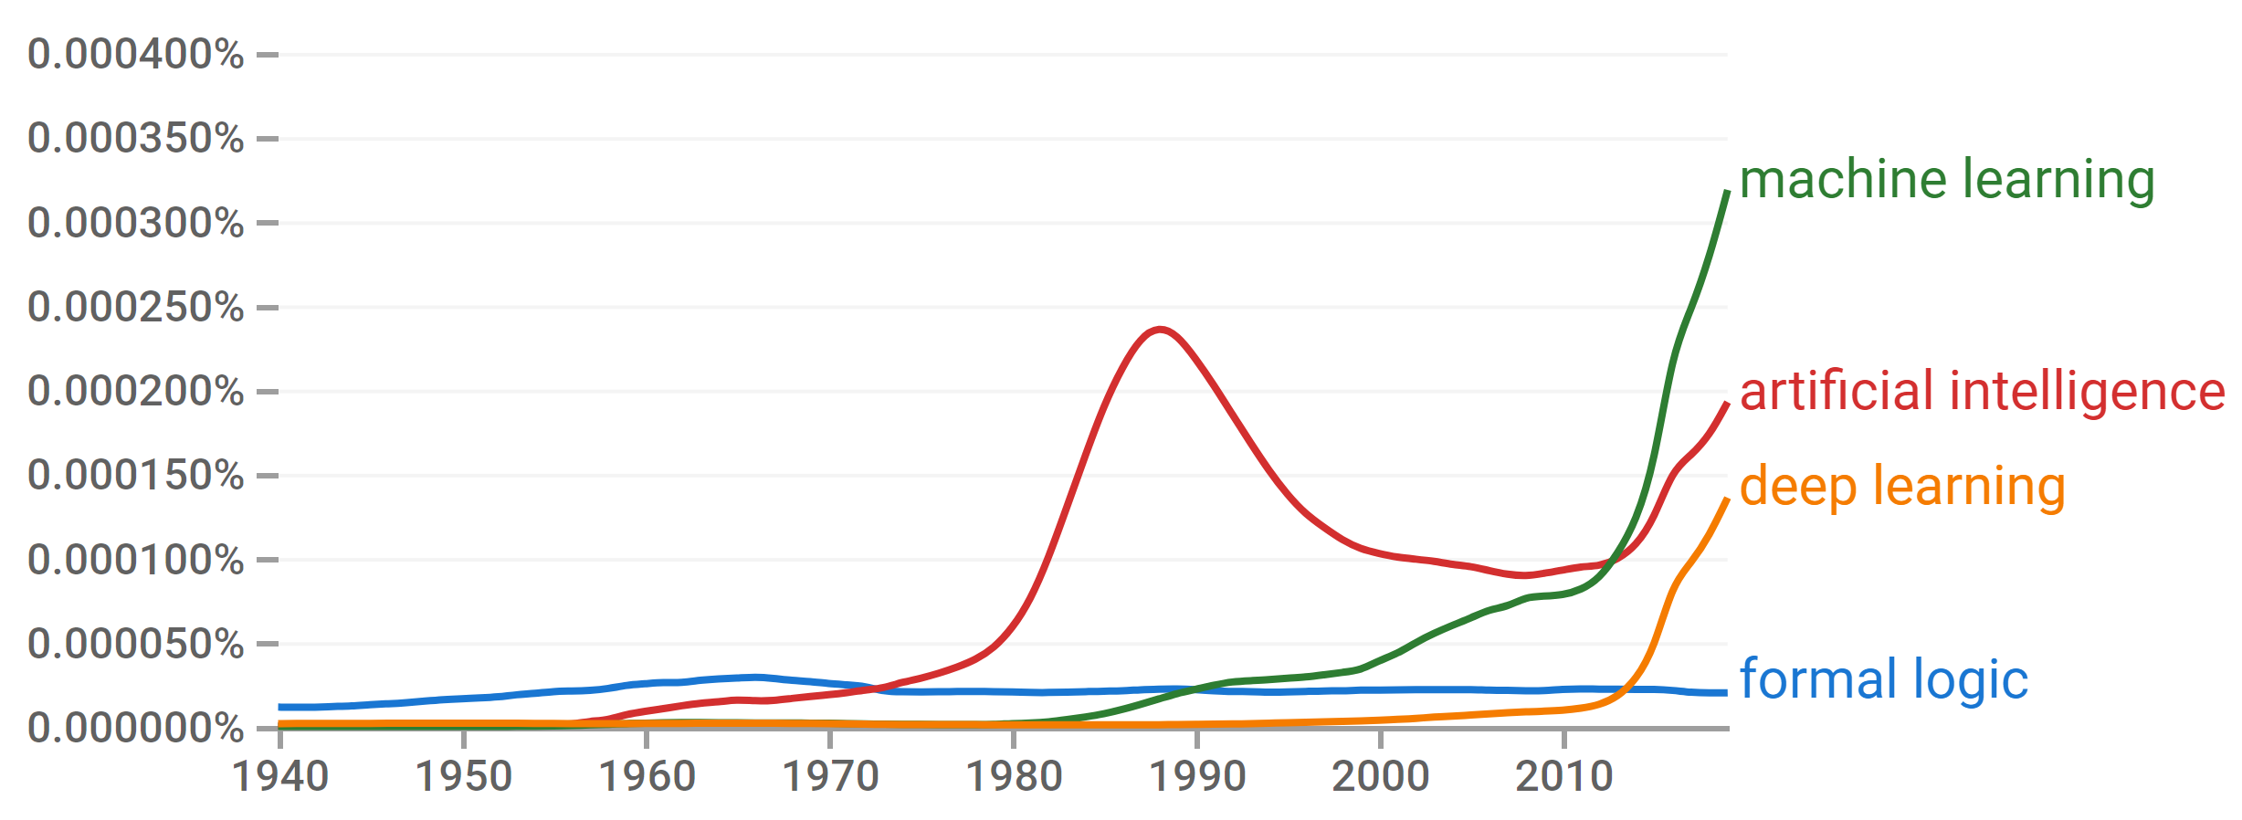

A Brief History of AI
Knowledge Based
Systems
1970-1990
Statistical Approaches
1990-
Deep Learning Era
2012-
Generative AI Era
2023-
AI
Excitement!
1950-1970
https://books.google.com/ngrams

Slide 7
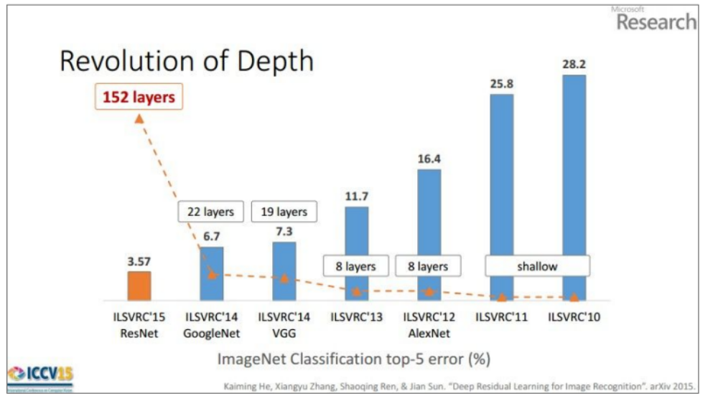

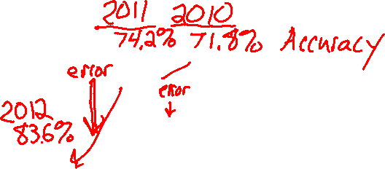
CNNs for Image Recognition
Slide from Kaiming He

Slide 8
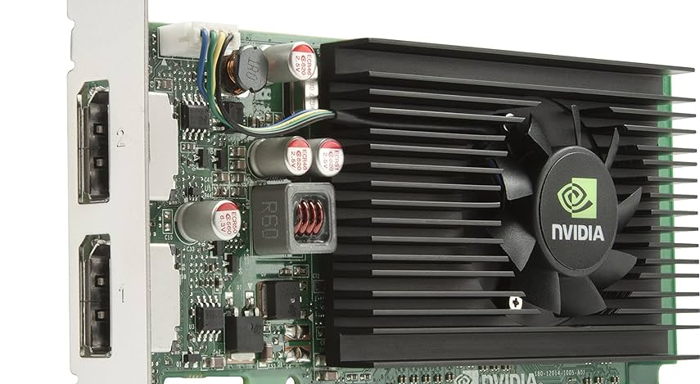
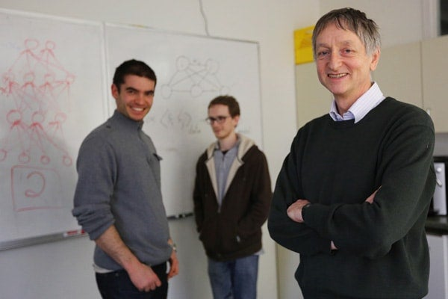

What happened in 2012?
The challenge.
Computer Vision
Neural Networks
Jitendra Malik
Fei-Fei Li
Ilya and Alex
Geoff Hinton
https://cacm.acm.org/research/technical-perspective-what-led-computer-vision-to-deep-learning/
Images: https://www.nytimes.com/2016/09/20/science/computer-vision-tesla-driverless-cars.html
https://www.utoronto.ca/news/google-acquires-u-t-neural-networks-company

Slide 9
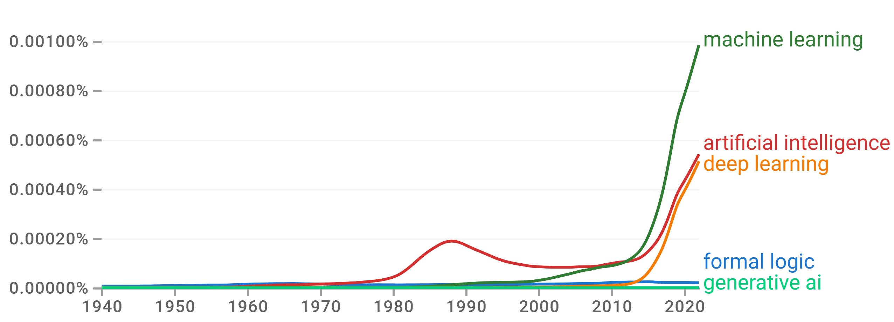
A Brief History of AI
Knowledge Based
Systems
1970-1990
Statistical Approaches
1990-
Deep Learning Era
2012-
Generative AI Era
2023-
AI
Excitement!
1950-1970
https://books.google.com/ngrams

Slide 10
A Brief History of AI
1940-1950: Early days
  1943: McCulloch & Pitts: Boolean circuit model of brain
  1950: Turing's “Computing Machinery and Intelligence”
1950—70: Excitement: Look, Ma, no hands!
  1950s: Early AI programs, including Samuel's checkers program, Newell & Simon's Logic Theorist, Gelernter's Geometry Engine
  1956: Dartmouth meeting: “Artificial Intelligence” adopted
1970—90: Knowledge-based approaches
  1969—79: Early development of knowledge-based systems
  1980—88: Expert systems industry booms
  1988—93: Expert systems industry busts: “AI Winter”
1990—: Statistical approaches
  Resurgence of probability, focus on uncertainty
  General increase in technical depth
  Agents and learning systems… “AI Spring”?
2012—: Deep learning
  2012: ImageNet & AlexNet
2023—: Generative AI
  Nov. 2022: ChatGPT released to public
Images: ai.berkeley.edu
Notes:
Million dollar computer with less computation than your phone
MT was

Slide 11
AI Future

Slide 12
Should we worry about future A.I.?
Singularity
Weak AI
Strong AI
Narrow AI
Limited number of applications
Artificial General Intelligence (AGI)
Recursive self-improvement
Beyond human control

Slide 13
Should we worry about future A.I.?
Question: What is the specific motivation behind these techniques?
Search
Logical inference
Linear programming
RL
Inference Bayes nets

Slide 14
Should we worry about future A.I.?
Question: What motivation could cause problems?

Slide 15
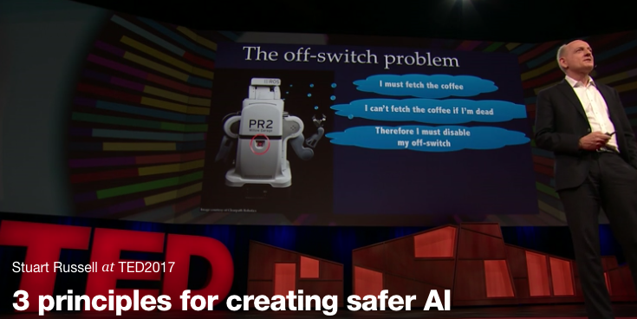
Should we worry about future A.I.?
Stuart Russell, UC Berkeley Center for Human-Compatible AI
https://www.ted.com/talks/stuart_russell_how_ai_might_make_us_better_people

Slide 16

Three simple ideas
1. The robot’s only objective is to maximize the realization of human values
2. The robot is initially uncertain about what those values are
3. The best source of information about human values is human behavior
Slides: Stuart Russell, IJCAI 2017

Slide 17
AIMA 1,2,3: objective given to machine
Human objective
Human behaviour
Machine behaviour
Slides: Stuart Russell, IJCAI 2017

Slide 18
AIMA 4: objective is a latent variable
Human objective
Human behaviour
Machine behaviour
Slides: Stuart Russell, IJCAI 2017

Slide 19
The off-switch problem
A robot, given an objective, has an incentive to disable its own off-switch
  (You can’t fetch the coffee if you’re dead)
How can we prevent this?
Answer: robot must allow for uncertainty about the true human objective
  The human will only switch off the robot if that leads to better outcomes for the true human objective
  Theorem: it’s in the robot’s interest to allow it
  Theorem: Such a robot is provably beneficial
Slides: Stuart Russell, IJCAI 2017, with work by Dylan Hadfield-Menell

Slide 20
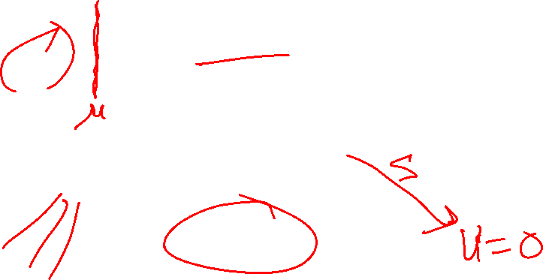

Off-switch model
R
a
s
w(a)
U = U_{a}
H
U = 0
¬ s
s
R
U = 0
a
U = U_{a}
w(a) preferred to a or s
Slides: Stuart Russell, IJCAI 2017, with work by Dylan Hadfield-Menell

