Slide 1

AI: Representation and Problem Solving
AI and Ethics
Instructor: Pat Virtue
Slide credits: CMU AI and http://ai.berkeley.edu

Slide 2
Poll 1: What questions do you have?

Slide 3
Group Discussions
Breakout rooms will have AI Ethics themes today. Start thinking about which discussion category you would like to participate in today:
Bias/Fairness
Weapons/Safety
Privacy
Liability
Jobs

Slide 4
Intelligent Agents
From first lecture
  Nim Grab
  11 pieces on the table
  Take turns taking either 1 or 2 pieces
  Person that takes the last piece wins!
class Agent
function getAction(state)
return action

Slide 5
Three “Intelligent” Agents
Poll 1
Which agent code is the most “intelligent”?

Slide 6

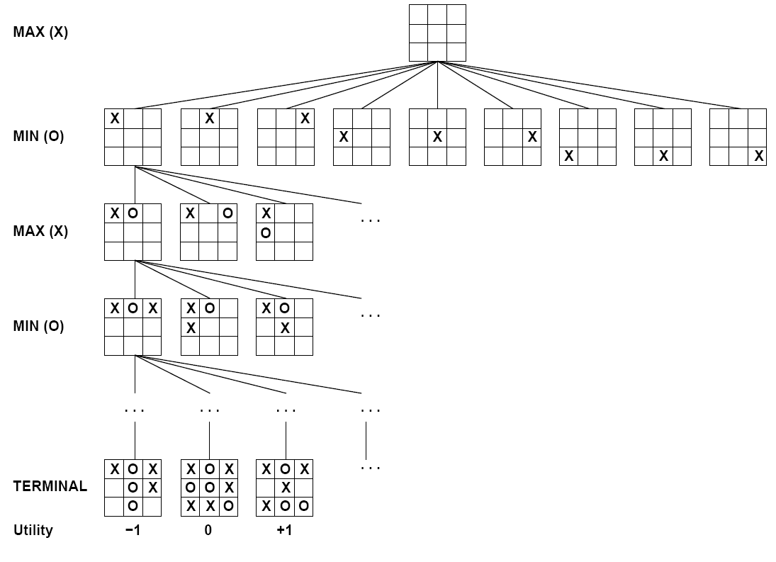

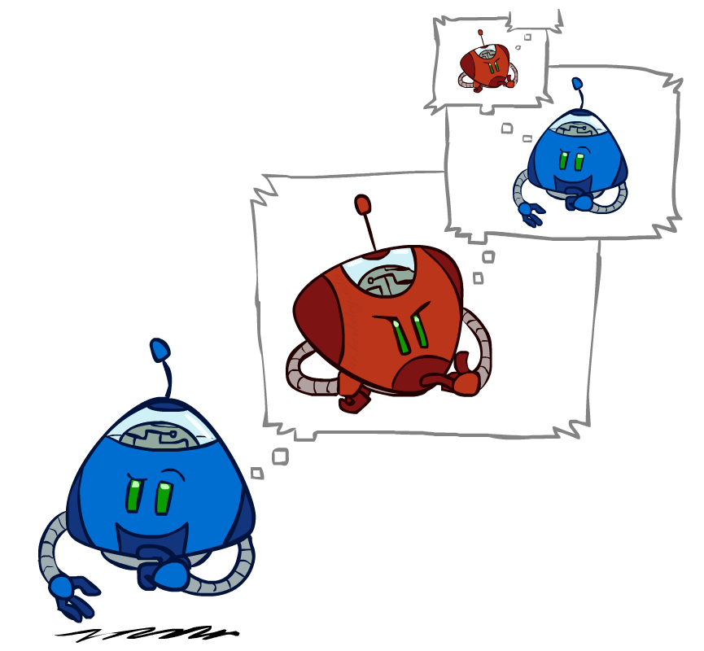
Games – Three “Intelligent” Agents
A: Search

Slide 7
Games – Three “Intelligent” Agents
B: Encode the pattern
10's value:Win
9's value:Lose
8's value:Win
7's value:Win
6's value:Lose
5's value:Win
4's value:Win
3's value:Lose
2's value:Win
1's value:Win
0's value:Lose
function getAction( numPiecesAvailable )
if numPiecesAvailable % 3 == 2
return 2
else
return 1

Slide 8
Games – Three “Intelligent” Agents
C: Record statistics of winning positions
Pieces Available | Take 1 | Take 2
2
3
4
5
6
7
Pieces Available | Take 1 | Take 2
2 |  | 100%
3
4 | 100%
5
6
7 |  | 100%
Pieces Available | Take 1 | Take 2
2 |  | 100%
3 | 0%
4 | 100%
5
6
7 |  | 50%
Pieces Available | Take 1 | Take 2
2 | 0% | 100%
3 | 2% | 0%
4 | 75% | 2%
5 | 4% | 68%
6 | 5% | 6%
7 | 60% | 5%

Slide 9
Poll 1
Three “Intelligent” Agents
Which agent code is the most “intelligent”?
Search
Encode multiple of 3 pattern
Keep stats on winning positions

Slide 10
Poll 2
Which 281 technique is the most intelligent?
Search
Logical inference
Numeric optimization
Q-learning
Approximate Q-learning
Exact inference Bayes nets
Approximate inference Bayes nets

Slide 11
Poll 3
AI Explainability
Which of the following techniques have explainable results?
(SELECT ALL THAT APPLY)
Search
Logical inference
Numeric optimization
Q-learning
Approximate Q-learning
Exact inference Bayes nets
Approximate inference Bayes nets
Deep learning

Slide 12
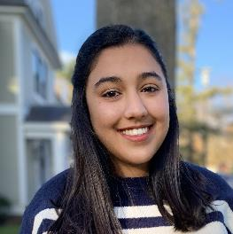
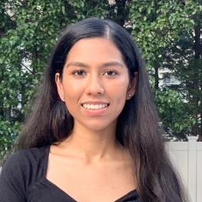
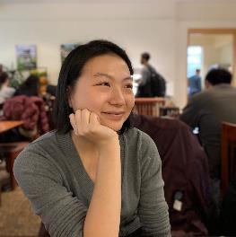
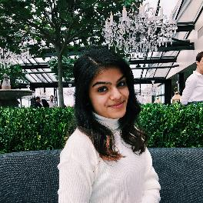



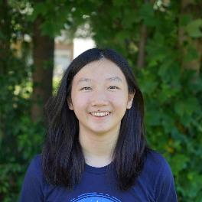
FCE: https://cmu.smartevals.com/
TA survey: https://www.ugrad.cs.cmu.edu/ta/S20/feedback/
Harlene (Head TA)
Simran (Head TA)
Adabelle
Ria
Jimin
Ihita
Adrian
Elizabeth

Slide 13
AI in the News

Slide 14
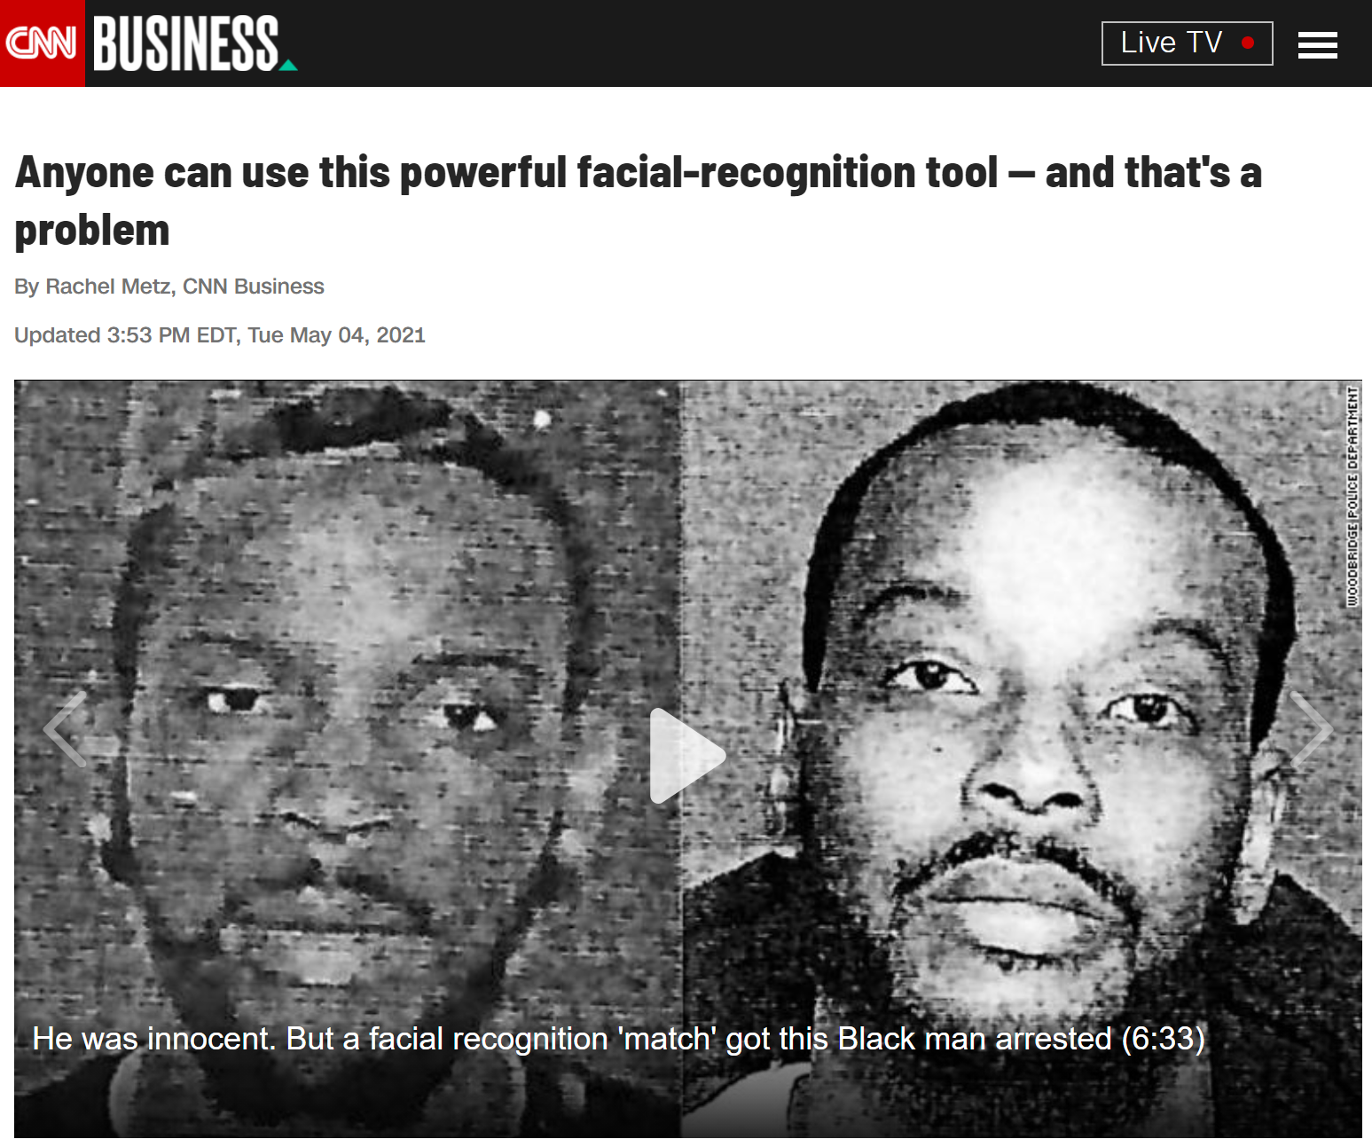
AI in the News
https://amp.cnn.com/cnn/2021/05/04/tech/pimeyes-facial-recognition/index.html

Slide 15

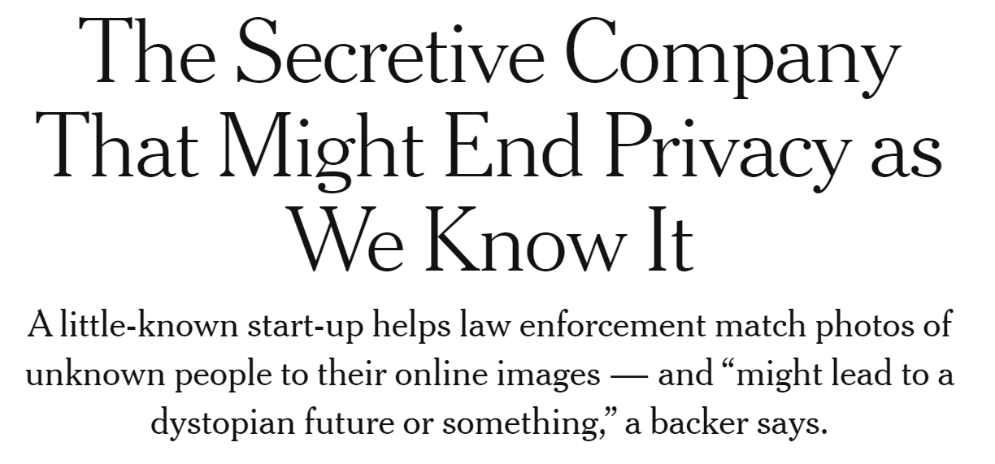

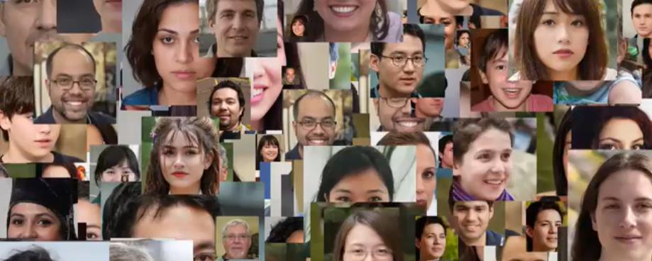
AI in the News
https://www.nytimes.com/2020/01/18/technology/clearview-privacy-facial-recognition.html

Slide 16
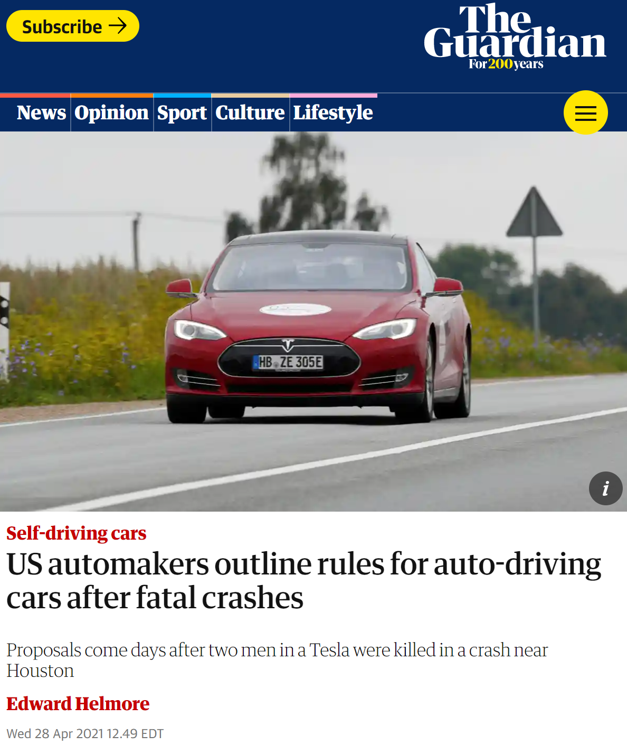
AI in the News
https://amp.theguardian.com/business/2021/apr/28/us-automakers-rules-auto-driving-cars-fatal-crashes

Slide 17
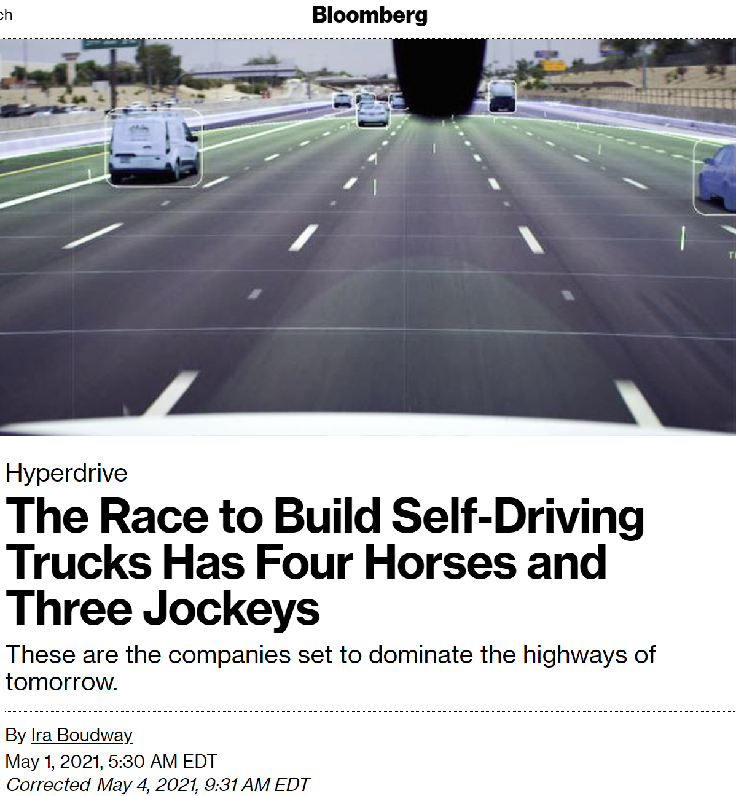
AI in the News
https://www.bloomberg.com/news/articles/2021-05-01/waymo-tusimple-aurora-inside-the-race-to-build-self-driving-trucks

Slide 18
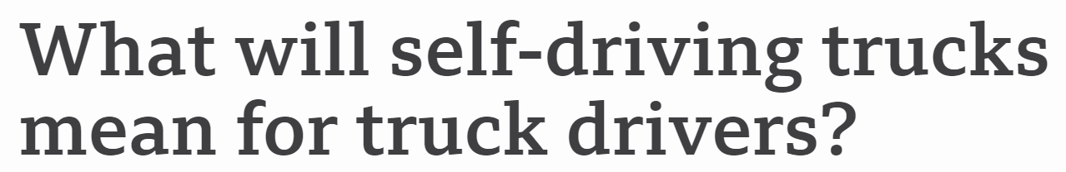



AI in the News
https://www.bbc.com/news/business-56332388.amp

Slide 19
Poll 4
Is it ok if autonomous vehicles completely replace human drivers?

Slide 20
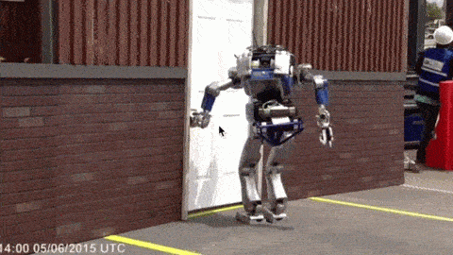
Should We Worry about Today’s A.I.?

Slide 21
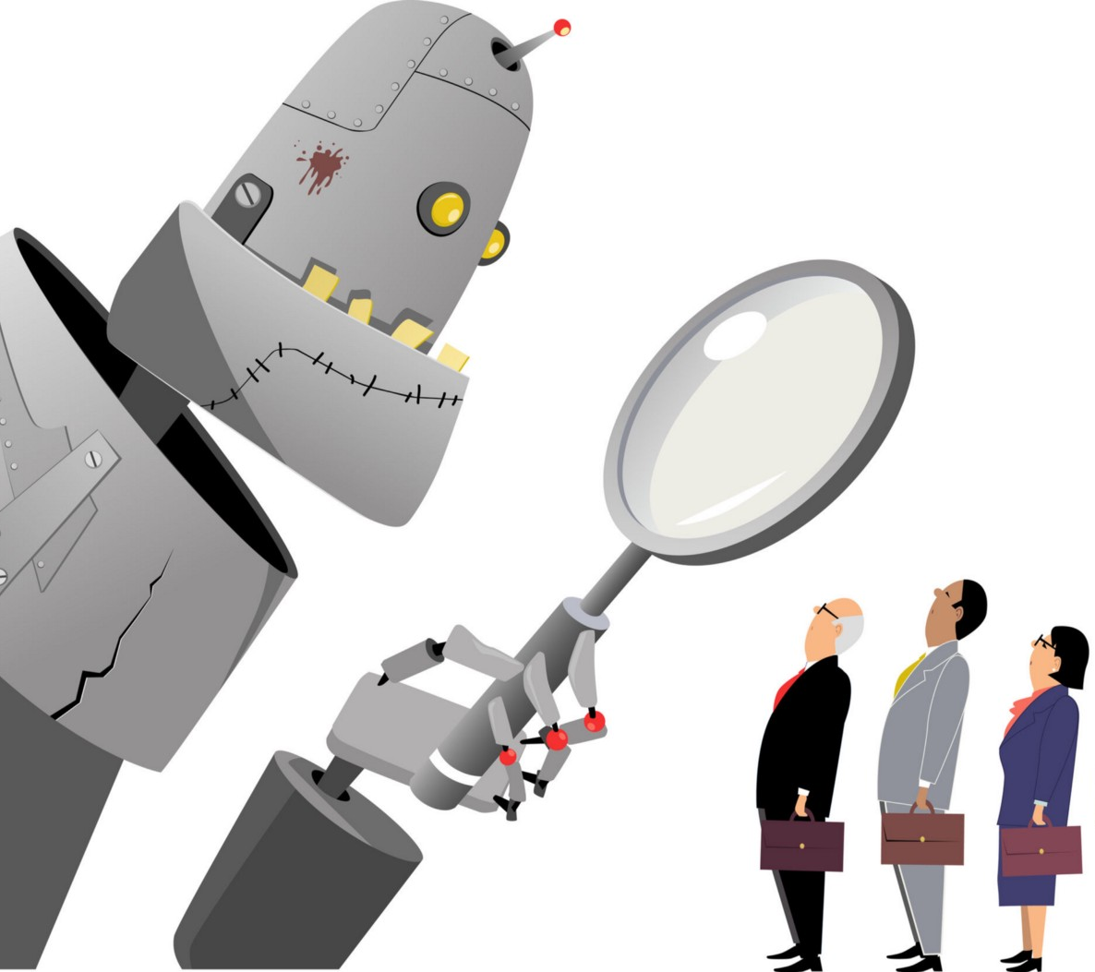

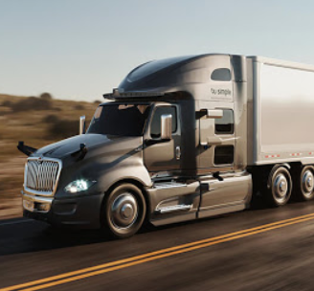
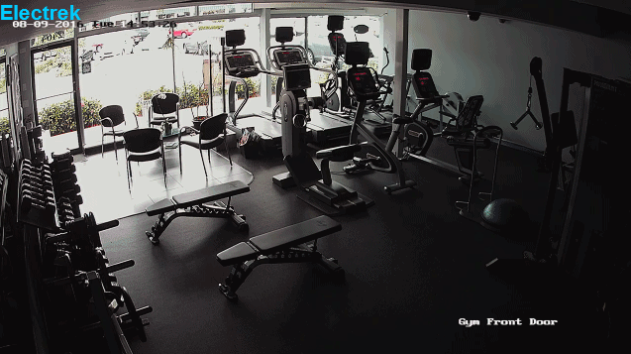
Should We Worry about Today’s A.I.?
Bias/Fairness
Privacy
Jobs
Weapons/Safety
Liability
Notes:
Images:
https://medium.com/@turalt/ai-isnt-biased-we-are-b74ec94d1698
http://futureoflife.org/2016/09/20/podcast-what-is-nuclear-risk/
https://electrek.co/2016/09/25/tesla-model-s-crashes-into-gym-driver-claims-autonomous-acceleration-tesla-says-drivers-fault/
http://ot.to/

Slide 22
Bias/Fairness
How are AI systems motivated? How does this motivation cause bias?
How could we measure bias (including cultural bias) in an AI system?
How do we as programmers introduce bias into the AI techniques we’ve learned about in 15-281?
What are some ways that bias in AI programming can impact the world?
Domains to think about:
Self-driving cars
Hiring and judicial decision making
Traffic control
Face recognition

Slide 23
Weapons/Safety
Should AI be used as a weapon or in warfare?
Where would you draw the line for how it could be used and how not?
Would you let a fully autonomous robot perform surgery on a family member?
Can you think of some rules or laws that may help prevent unsafe AI?
Domains to think about:
Social media bots and information warfare
Drones and autonomous weapons machines
Healthcare

Slide 24
Privacy
What are some tradeoffs we make when giving AI our private information?
Do you have a limit for the type or amount of data you are willing to provide?
How can we make the data usage of AI systems more explicit?
Are there ways that we can still enjoy the benefits of AI systems without giving up our private information?
Domains to think about:
Social media
Search (Google, Amazon, Yelp, …)
Healthcare
Insurance

Slide 25
Liability
How do we determine what went wrong (or right) in deployed AI systems?
Which techniques that we learned about have explainable results?
Who is responsible for “mistakes” that AI systems make?
What if someone or another AI misuses AI technology? Who is responsible?
Once autonomous vehicles are readily available, should it be illegal for humans to drive?
Domains to think about:
Self-driving cars
Healthcare decision-making
Land and Air traffic control

Slide 26
Jobs
What types of jobs should AI do instead of people?
Is it ok if autonomous vehicles completely replace human drivers?
What will people do if their jobs are taken?
How can AI systems improve or change people’s jobs even if it doesn’t take the jobs?
Domains to think about:
Driving and Logistics
Healthcare decision-making
Entertainment

Slide 27
Should We Worry about Today’s A.I.?
Bias/Fairness
Privacy
Jobs
Weapons/Safety
Liability
Notes:
Images:
https://medium.com/@turalt/ai-isnt-biased-we-are-b74ec94d1698
http://futureoflife.org/2016/09/20/podcast-what-is-nuclear-risk/
https://electrek.co/2016/09/25/tesla-model-s-crashes-into-gym-driver-claims-autonomous-acceleration-tesla-says-drivers-fault/
http://ot.to/

Slide 28
Additional Resources and Ideas

Slide 29

AI Bias/Fairness
Alexandra Chouldechova
CMU, Statistics and Public Policy
http://www.contrib.andrew.cmu.edu/~achoulde/
https://facctconference.org/

Slide 30
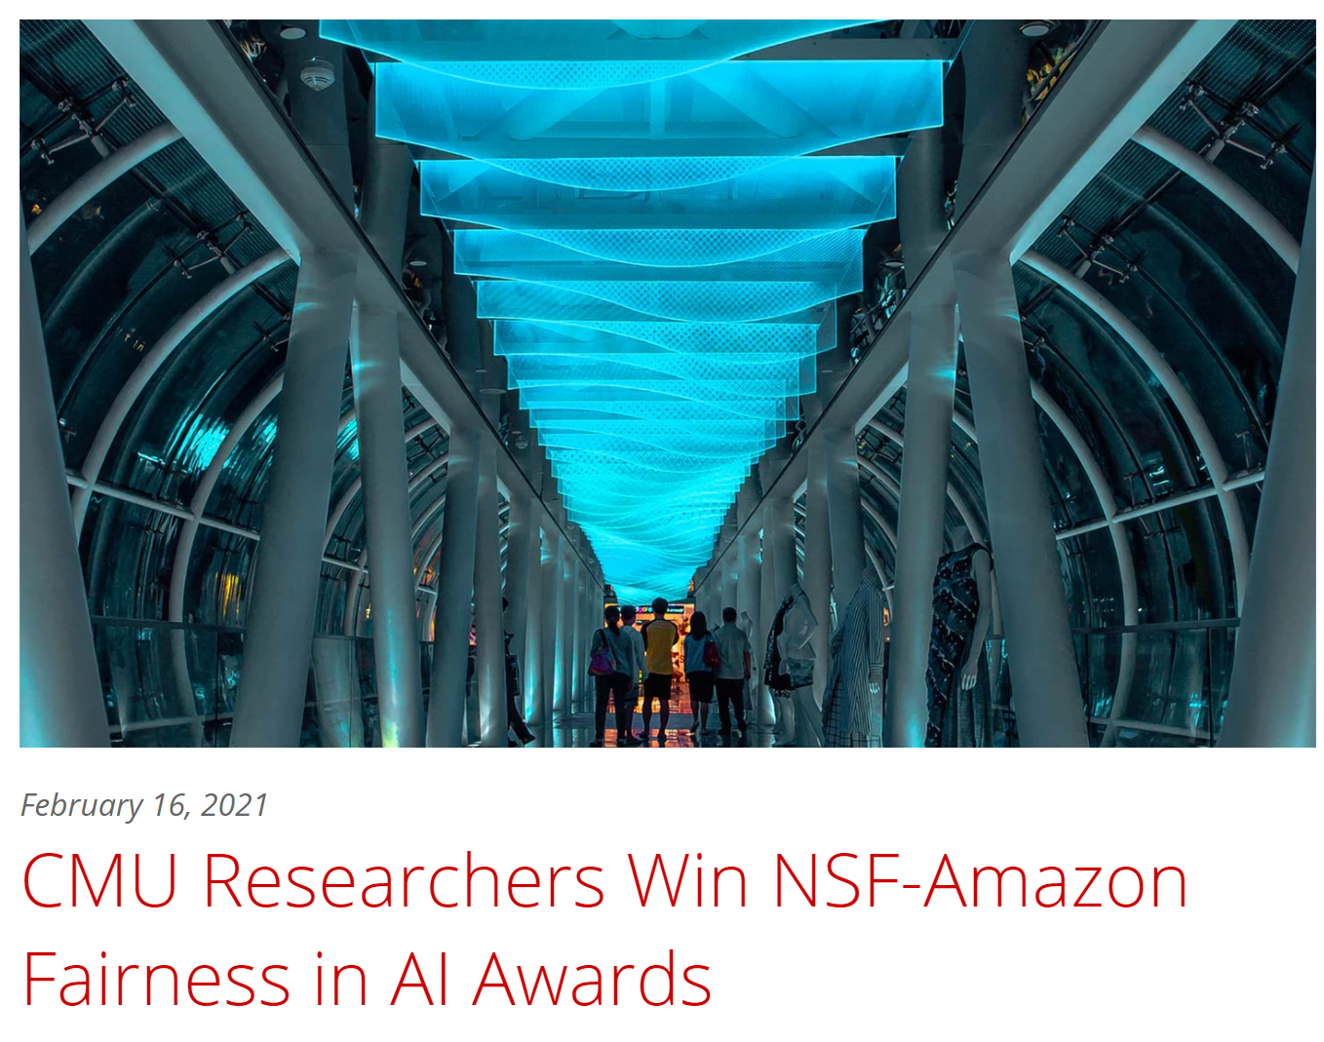
AI Bias/Fairness
Hoda Heidari
MLD
Jason Hong
HCII
Graham Neubig
LTI
https://www.ml.cmu.edu/news/news-archive/2021-2025/2021/february/carnegie-mellon-researchers-win-nsf-amazon-fairness-in-ai-awards.html

Slide 31
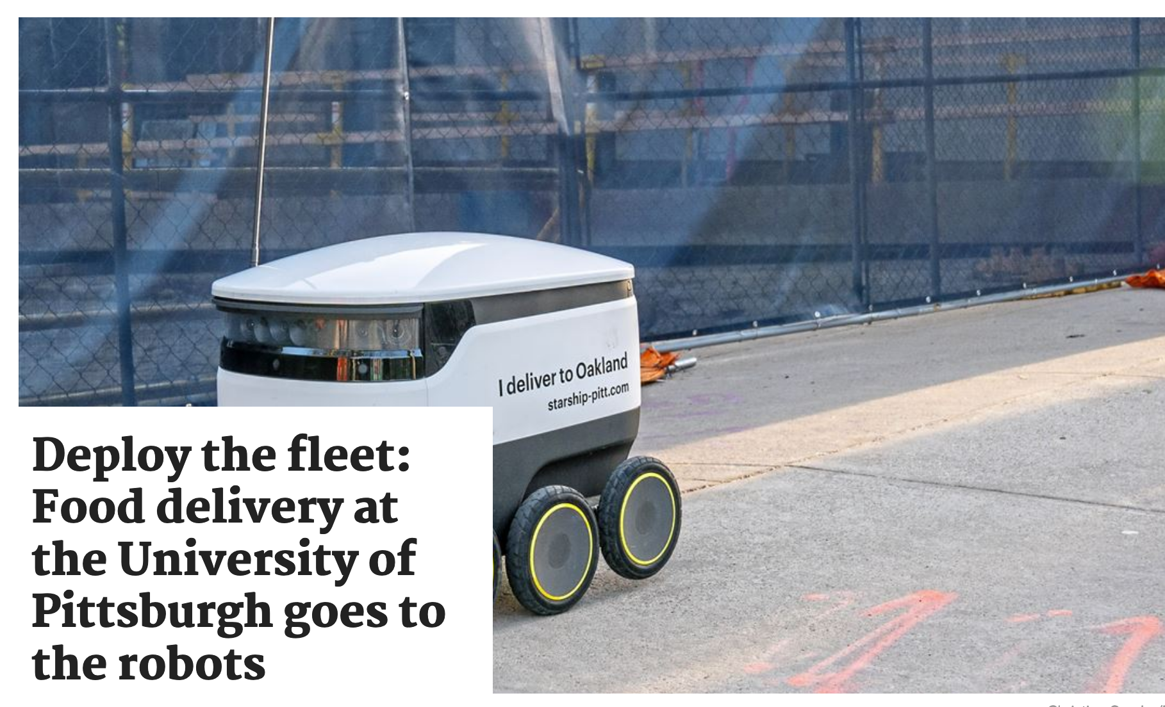
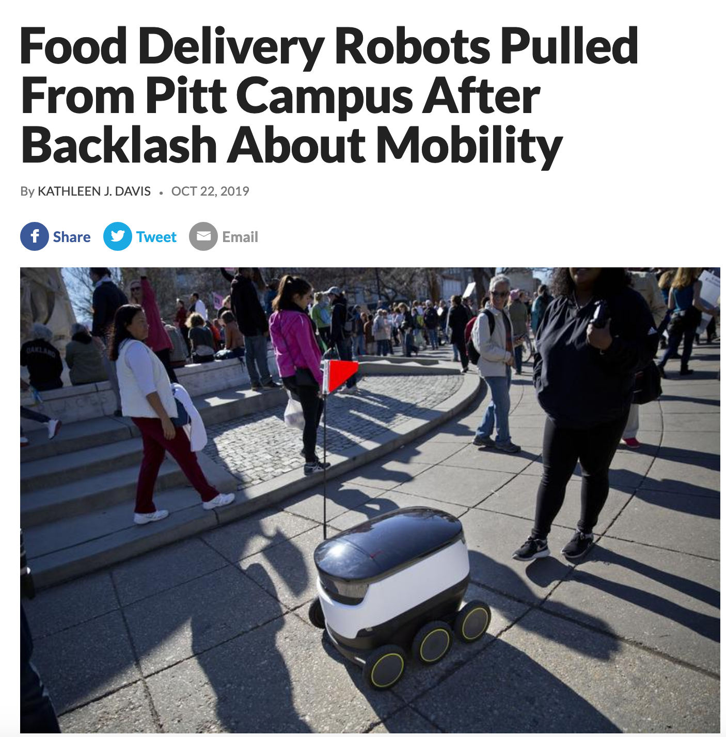
AI Bias/Fairness
Question: What technique could have been used to learn from the mistake?

Slide 32
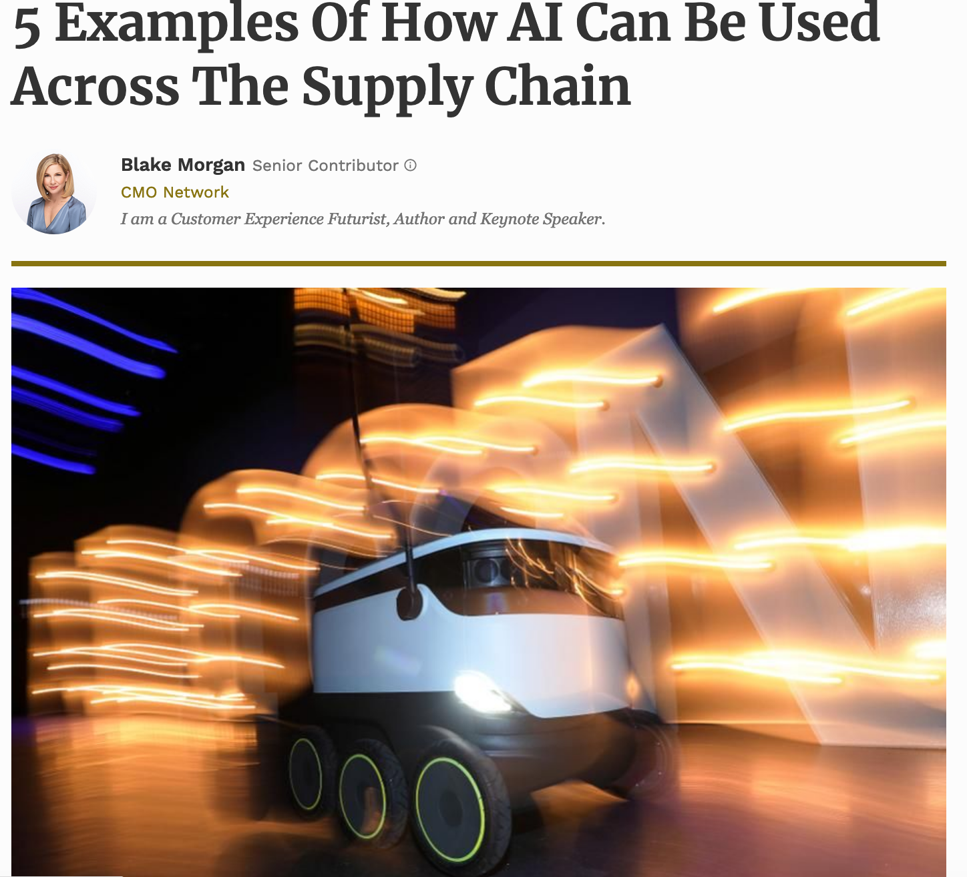
AI Bias/Fairness
Search/Navigation:
Create efficient routes for the fleet of trucks
Use of robots to deliver medicine, groceries etc
CSPs:
Deciding which stores get preference for deliveries
Deciding what products go to what stores
Forbes

Slide 33
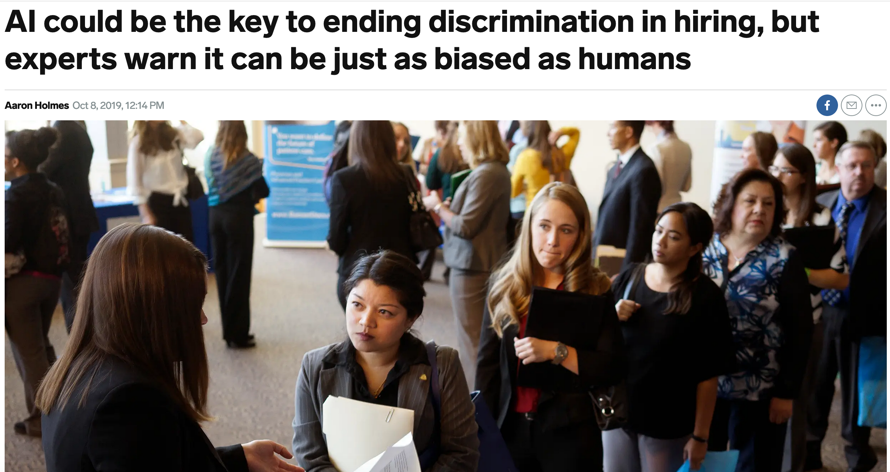
AI Bias/Fairness

Slide 34
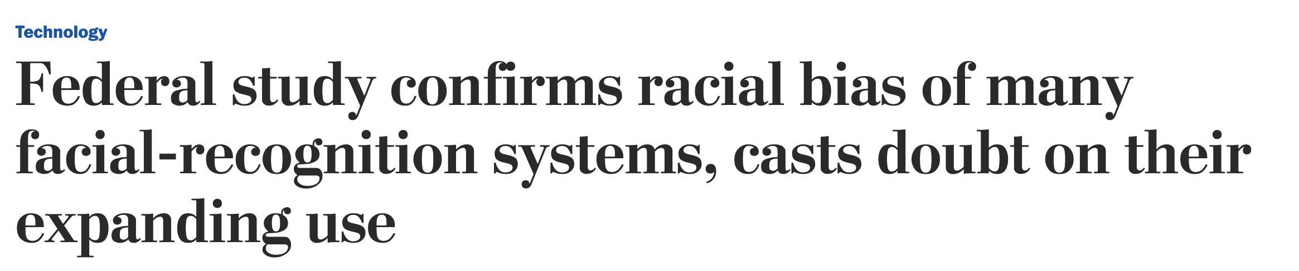
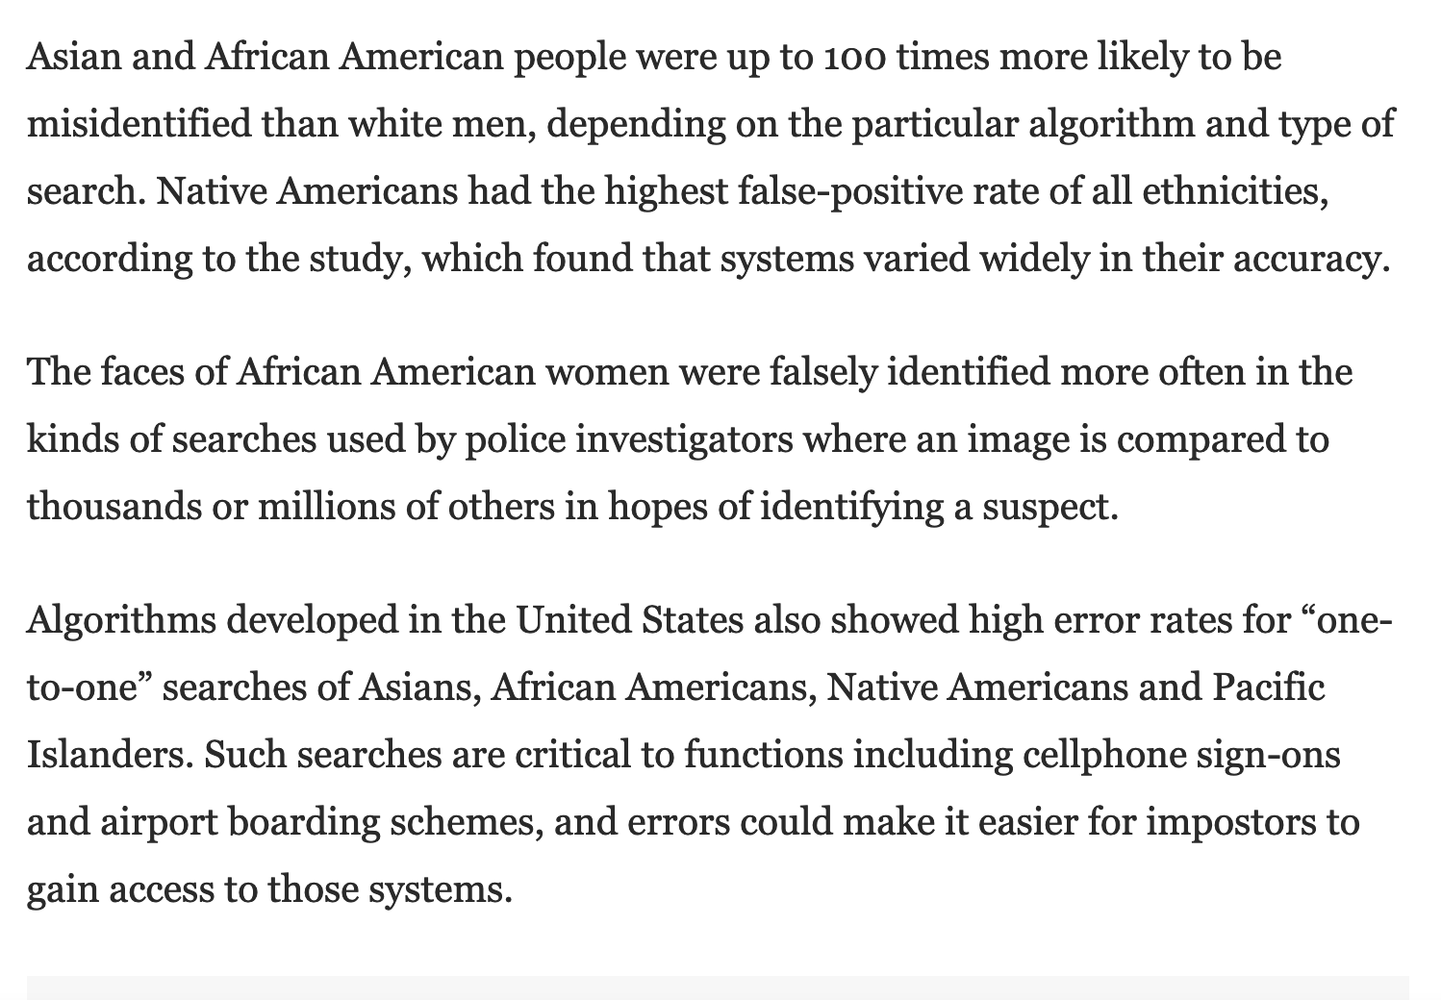
https://www.washingtonpost.com/technology/2019/12/19/federal-study-confirms-racial-bias-many-facial-recognition-systems-casts-doubt-their-expanding-use/

Slide 35
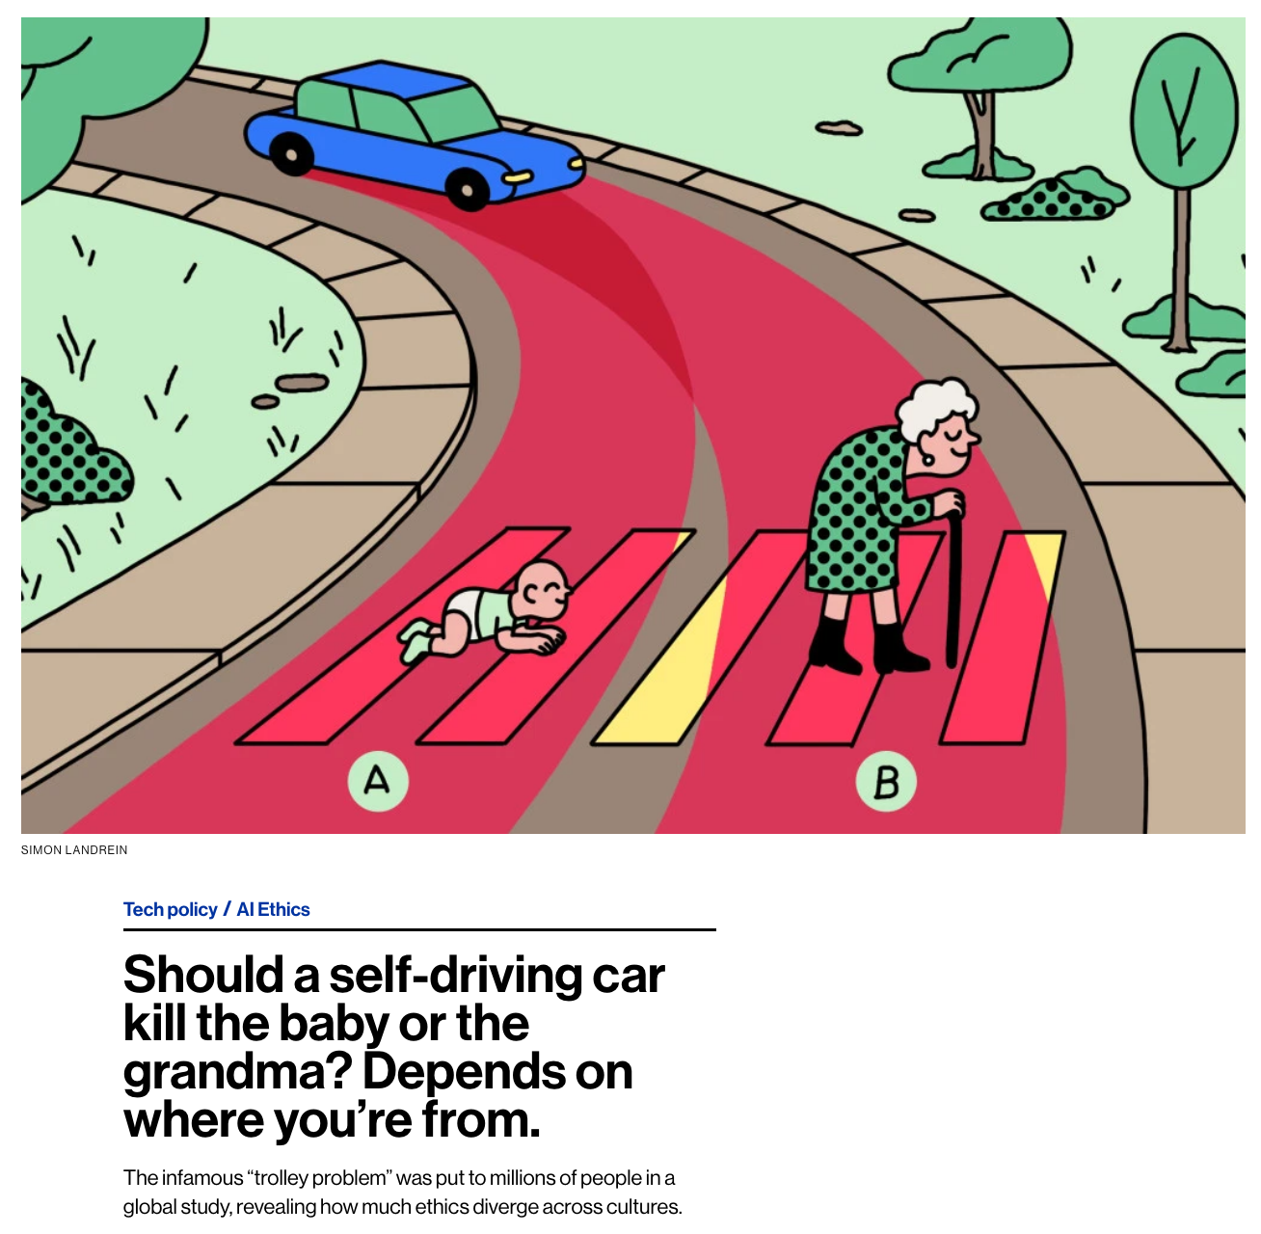
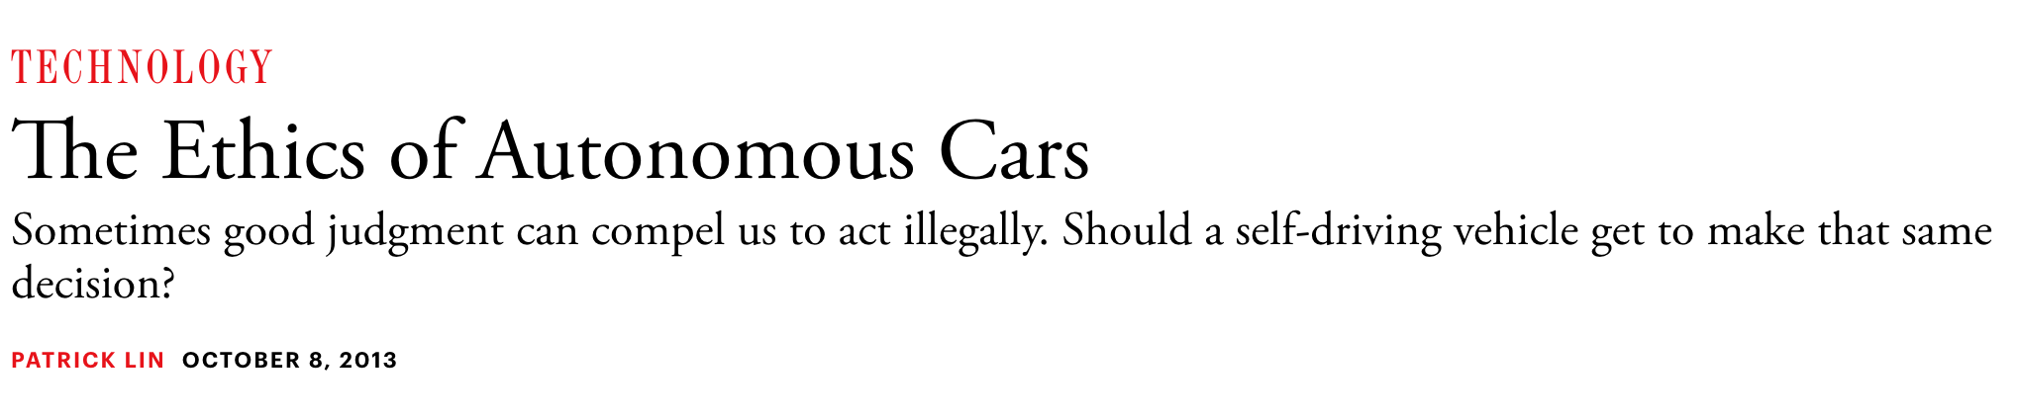
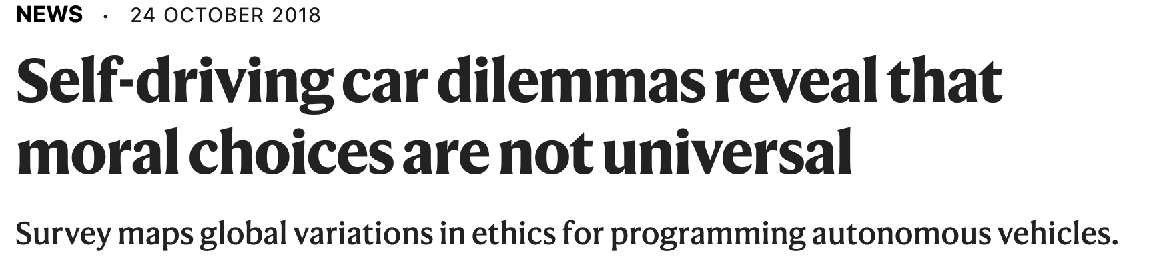
https://www.moralmachine.net/
https://www.technologyreview.com/2018/10/24/139313/a-global-ethics-study-aims-to-help-ai-solve-the-self-driving-trolley-problem/
https://www.theatlantic.com/technology/archive/2013/10/the-ethics-of-autonomous-cars/280360/

Slide 36
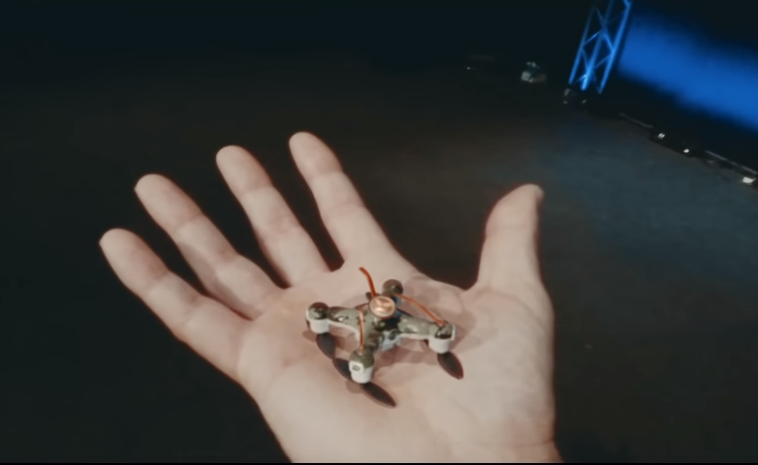
AI Weapons/Safety
https://www.youtube.com/watch?v=9CO6M2HsoIA

Slide 37
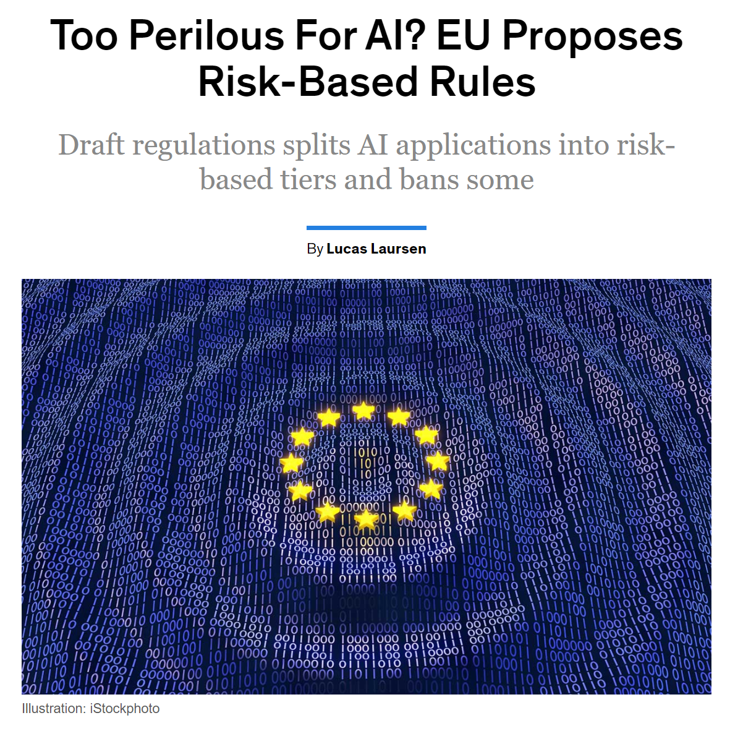
AI Weapons/Safety
https://spectrum.ieee.org/tech-talk/artificial-intelligence/embedded-ai/euairules

Slide 38
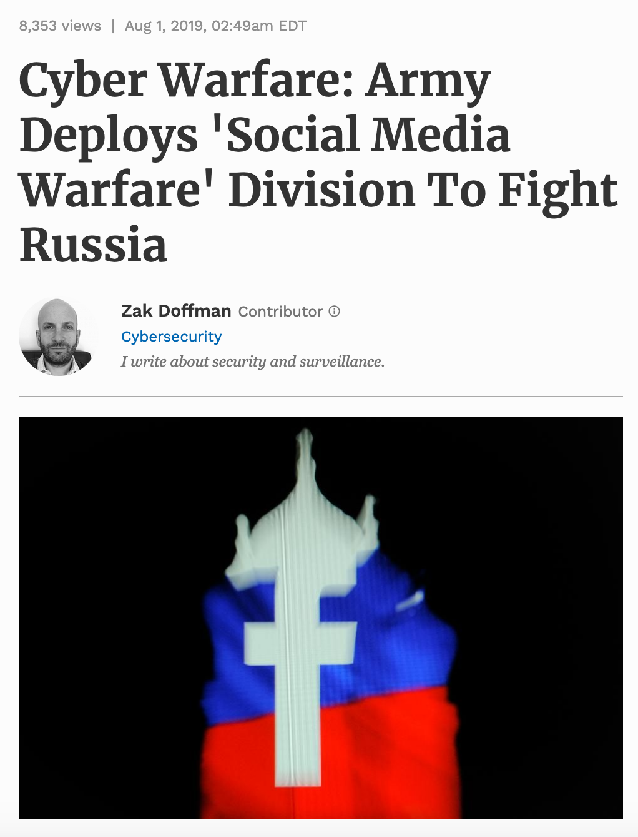
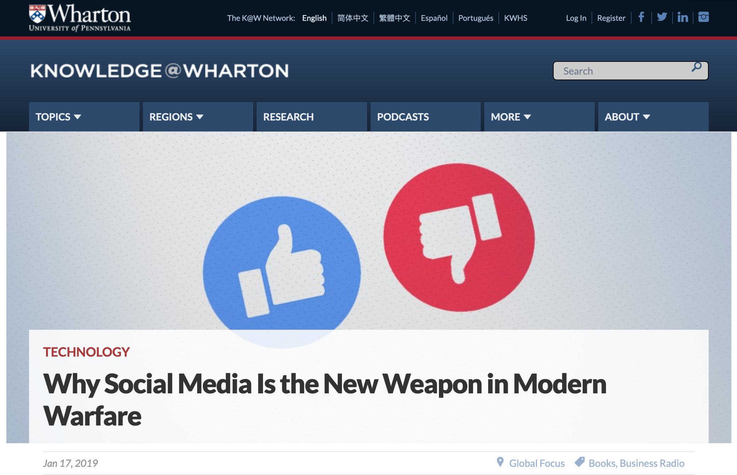
AI Weapons/Safety

Slide 39
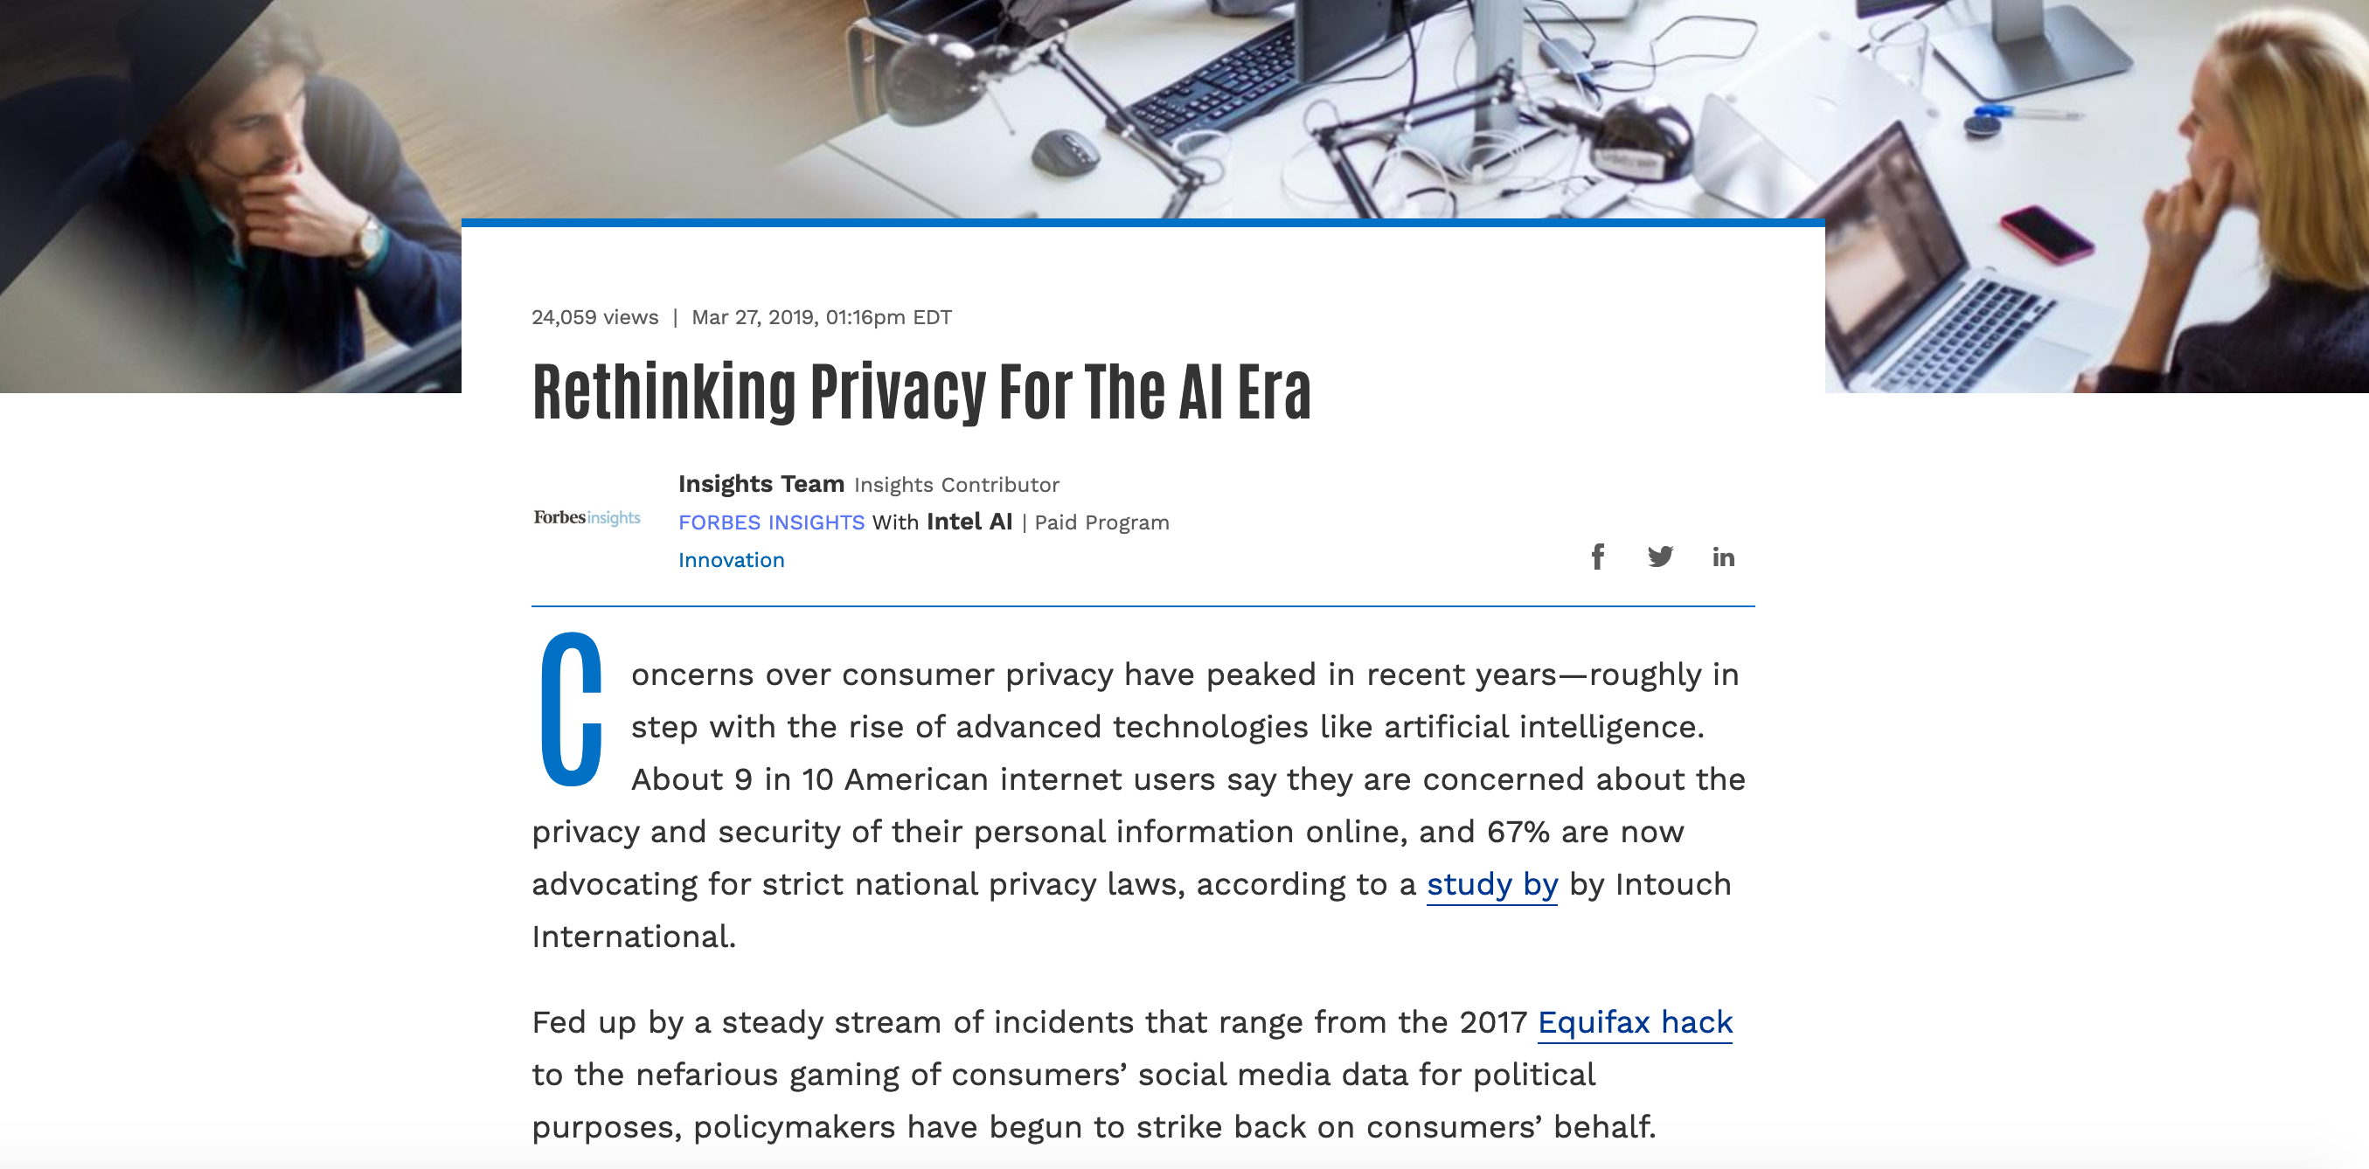
AI Privacy
https://www.forbes.com/sites/insights-intelai/2019/03/27/rethinking-privacy-for-the-ai-era

Slide 40
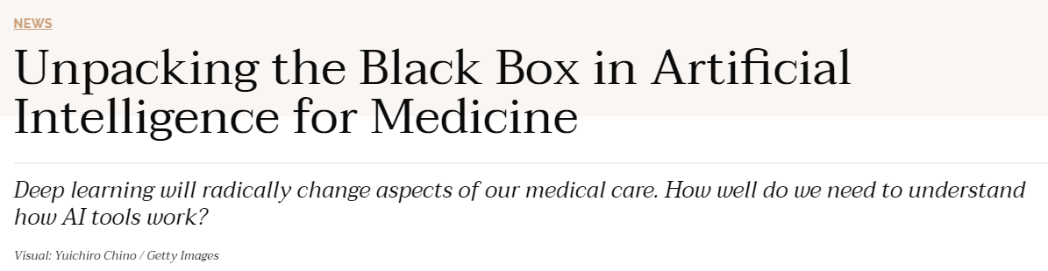
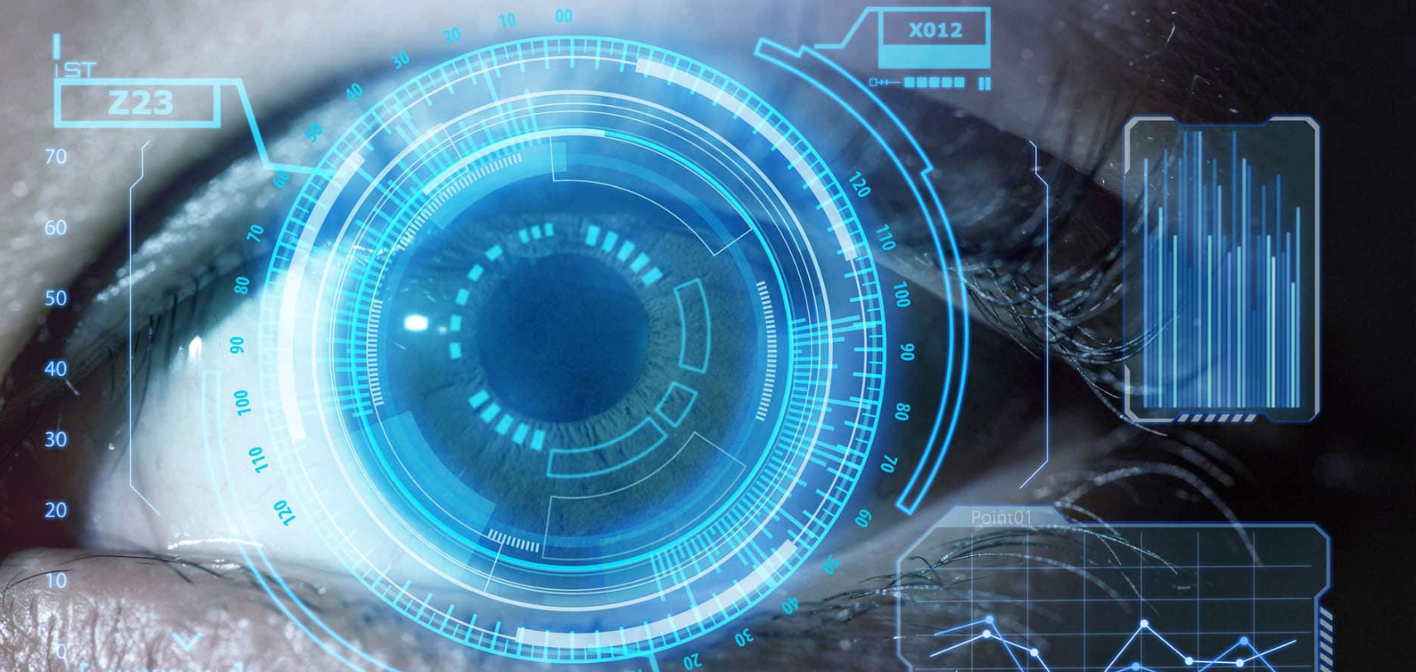
AI Liability
https://undark.org/2019/12/04/black-box-artificial-intelligence/

Slide 41
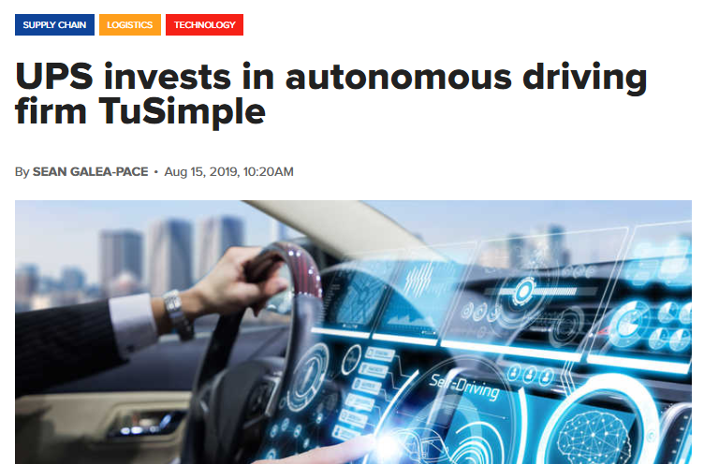
AI Jobs
https://www.supplychaindigital.com/technology/ups-invests-autonomous-driving-firm-tusimple

Slide 42
AI Jobs
Is it ok if autonomous vehicles completely replace human drivers?
https://www.brookings.edu/research/what-jobs-are-affected-by-ai-better-paid-better-educated-workers-face-the-most-exposure/
https://www.vox.com/platform/amp/policy-and-politics/2019/12/3/20965464/2020-presidential-candidates-jobs-automation-ai
https://www.irishtimes.com/business/technology/short-window-to-stop-ai-taking-control-of-society-warns-ex-google-employee-1.4104535

Slide 43
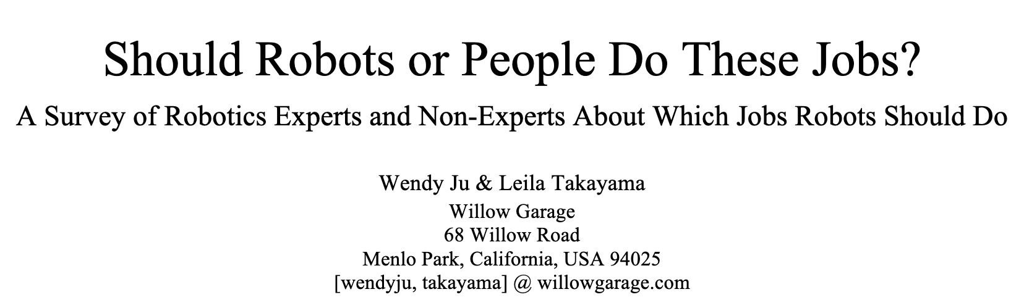
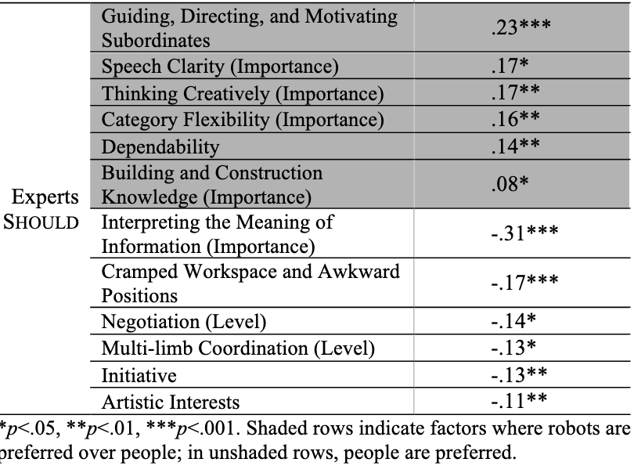
AI Jobs
http://www.wendyju.com/publications/ju_iros11.pdf

Slide 44
What about the Future?

Slide 45
Should we worry about future A.I.?
Singularity
Weak AI
Strong AI
Narrow AI
Limited number of applications
Artificial General Intelligence (AGI)
Recursive self-improvement
Beyond human control

Slide 46
Should we worry about future A.I.?
Question: What is the specific motivation behind these techniques?
Search
Logical inference
Linear programming
RL
Inference Bayes nets

Slide 47
Should we worry about future A.I.?
Question: What motivation could cause problems?

Slide 48
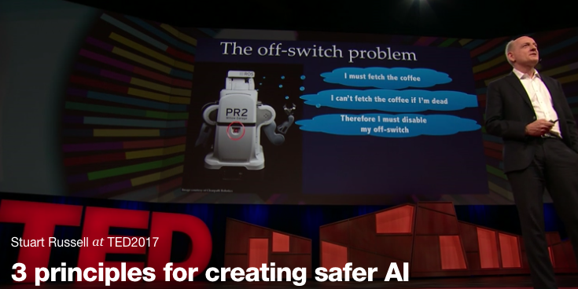
Should we worry about future A.I.?
Stuart Russell, UC Berkeley Center for Human-Compatible AI
https://www.ted.com/talks/stuart_russell_how_ai_might_make_us_better_people

Slide 49
Three simple ideas
1. The robot’s only objective is to maximize the realization of human values
2. The robot is initially uncertain about what those values are
3. The best source of information about human values is human behavior
Slides: Stuart Russell, IJCAI 2017

Slide 50
AIMA 1,2,3: objective given to machine
Human objective
Human behaviour
Machine behaviour
Slides: Stuart Russell, IJCAI 2017

Slide 51
AIMA 4: objective is a latent variable
Human objective
Human behaviour
Machine behaviour
Slides: Stuart Russell, IJCAI 2017

Slide 52
The off-switch problem
A robot, given an objective, has an incentive to disable its own off-switch
  (You can’t fetch the coffee if you’re dead)
How can we prevent this?
Answer: robot must allow for uncertainty about the true human objective
  The human will only switch off the robot if that leads to better outcomes for the true human objective
  Theorem: it’s in the robot’s interest to allow it
  Theorem: Such a robot is provably beneficial
Slides: Stuart Russell, IJCAI 2017, with work by Dylan Hadfield-Menell

Slide 53
Off-switch model
R
a
s
w(a)
U = U_{a}
H
U = 0
¬ s
s
R
U = 0
a
U = U_{a}
w(a) preferred to a or s
Slides: Stuart Russell, IJCAI 2017, with work by Dylan Hadfield-Menell

Slide 54
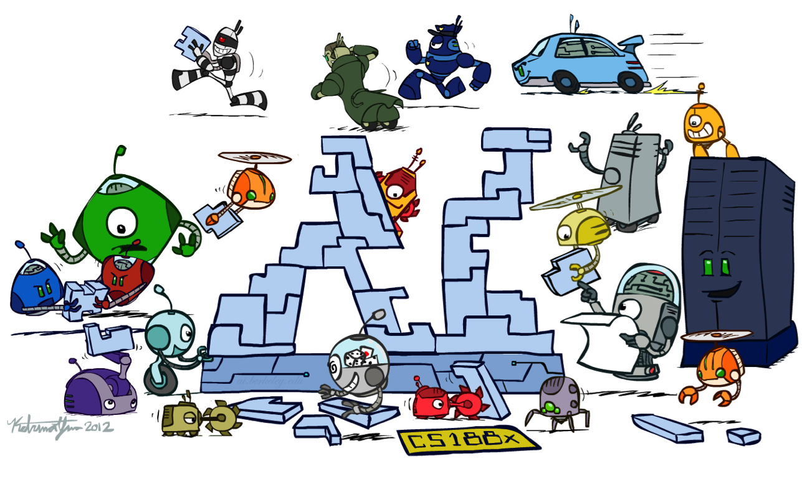
And thanks to Katrina Yim for her amazing artwork!

