Slide 1

A Battle of Wits
The Princess Bride
https://www.youtube.com/watch?v=EZSx3zNZOaU
https://www.amazon.com/Princess-Bride-Battle-Wits-3rd

Slide 2

Rock, Paper, Scissors, Lizard, Spock
CBS, Big Bang Theory
https://www.youtube.com/watch?v=iSHPVCBsnLw
Image credit: https://www.snorgtees.com/rock-paper-scissors-lizard-spock

Slide 3
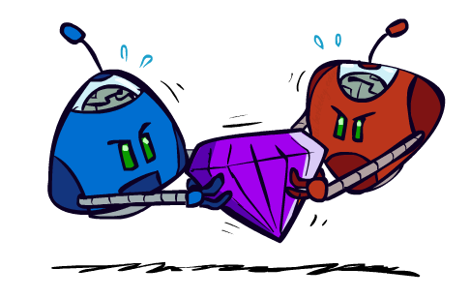
AI: Representation and Problem Solving
Game Theory: Equilibrium
Instructor: Pat Virtue
Slide credits: CMU AI, Fei Fang
Image credit: ai.berkeley.edu

Slide 4

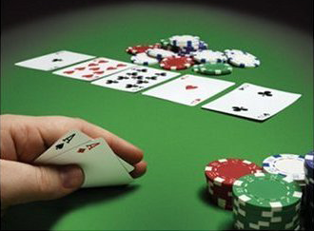



From Games to Game Theory
The study of mathematical models of conflict and cooperation between intelligent decision makers
Used in economics, political science, etc
John Nash
Winner of Nobel Memorial Prize in Economic Sciences
Notes:
We all play games, from … to … to party boardgames such as werewolf.
In most of the games, we have to play in a very strategic way to win.
Game theory is the study of strategic decision making.
More specifically, game theory is the study of mathematical models of conflict and cooperation between intelligent decision-makers. The games studied in game theory must have elements including the players, information, actions and payoffs.
Although the first known discussion of game theory is for a two-player card game, game theory is not only designed for entertaining games. Modern game theory has been used in economics and political science. Nobel Prize winner John Nash

Slide 5
Recall: Adversarial Search
Zero-sum, perfect information, two player games with turn-taking moves
3
12
8
2
4
6
14
5
2

Slide 6
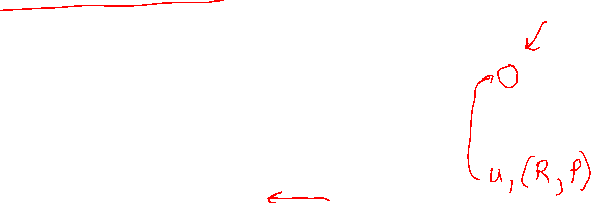
Simultaneous Play and Payoff Matrices
Rock-Paper-Scissors (RPS)
  Rock beats Scissors
  Scissors beats Paper
  Paper beats Rock
  2-player normal-form game with finite set of actions taken simultaneously
  represented in a (bi)matrix
  Player 1 is row player (typically first number)
  Player 2 is column player (typically second number)
Player 2
 | Rock | Paper | Scissors
Rock | 0, 0 | -1, 1 | 1, -1
Paper | 1, -1 | 0, 0 | -1, 1
Scissors | -1, 1 | 1, -1 | 0, 0
Player 1
Notes:
A two-player normal-form game with finite actions can be represented by a (bi)matrix
Player 1: Row player, Player 2: Column player
Often first number is for row player, second for column player

Slide 7
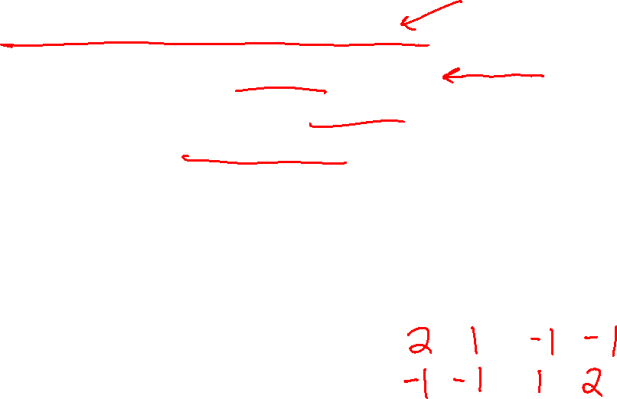
Classical Games and Payoff Matrices
Football vs Concert (FvsC)
  Historically known as Battle of Sexes
  If football together: Alex ☺☺, Berry ☺
  If concert together: Alex ☺, Berry ☺☺
  If not together: Alex ☹, Berry ☹
Fill in the payoff matrix
Berry
 | Football | Concert
Football
Concert
Alex

Slide 8
Classical Games and Payoff Matrices
Football vs Concert (FvsC)
  Historically known as Battle of Sexes
  If football together: Alex ☺☺, Berry ☺
  If concert together: Alex ☺, Berry ☺☺
  If not together: Alex ☹, Berry ☹
Fill in the payoff matrix
Berry
 | Football | Concert
Football | 2,1 | 0,0
Concert | 0,0 | 1,2
Alex

Slide 9

Classical Games and Payoff Matrices
Prisoner’s Dilemma (PD)
  If both Cooperate: 1 year in jail each
  If one Defect, one Cooperate: 0 year for (D), 3 years for (C)
  If both Defect: 2 years in jail each
  Let’s play!
Player 2
 | Cooperate | Defect
Cooperate | -1,-1 | -3,0
Defect | 0,-3 | -2,-2
Player 1
Notes:
Two members of a criminal gang are arrested and imprisoned. Each prisoner is in solitary confinement with no means of communicating with the other. The prosecutors lack sufficient evidence to convict the pair on the principal charge, but they have enough to convict both on a lesser charge. Simultaneously, the prosecutors offer each prisoner a bargain. Each prisoner is given the opportunity either to betray the other by testifying that the other committed the crime, or to cooperate with the other by remaining silent. The possible outcomes are:
If A and B each betray the other, each of them serves two years in prison
If A betrays B but B remains silent, A will be set free and B will serve three years in prison (and vice versa)
If A and B both remain silent, both of them will serve only one year in prison (on the lesser charge).

Slide 10
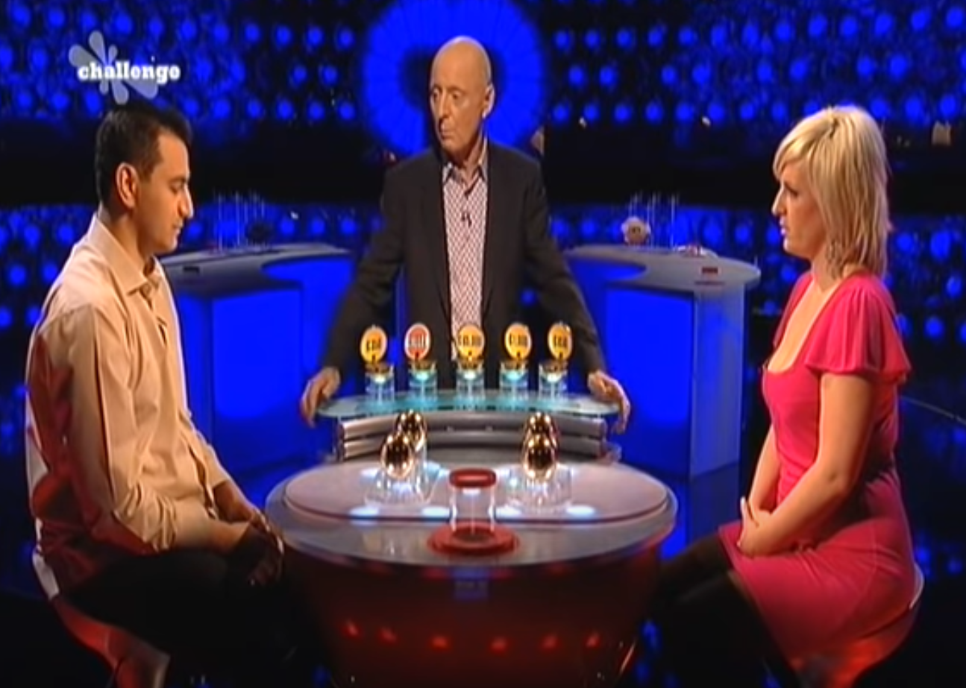
Variation: Split or Steal
https://www.youtube.com/watch?v=yM38mRHY150

Slide 11

Normal-Form Games
A game in normal form consists of the following elements
  Set of players
  Set of actions for each player
  Payoffs / Utility functions
    Determines the utility for each player given the actions chosen by all players (referred to as action profile)
  Bimatrix game is special case: two players, finite action sets
Players move simultaneously and the game ends immediately afterwards
What are the players, set of actions and utility functions of Football vs Concert (FvsC) game?
Notes:
A normal-form game is a representation of a game in game theory. It directly specifies the set of players' strategies where a strategy is a complete plan of action for every stage of the game, regardless of whether that stage actually arises in play.

Slide 12
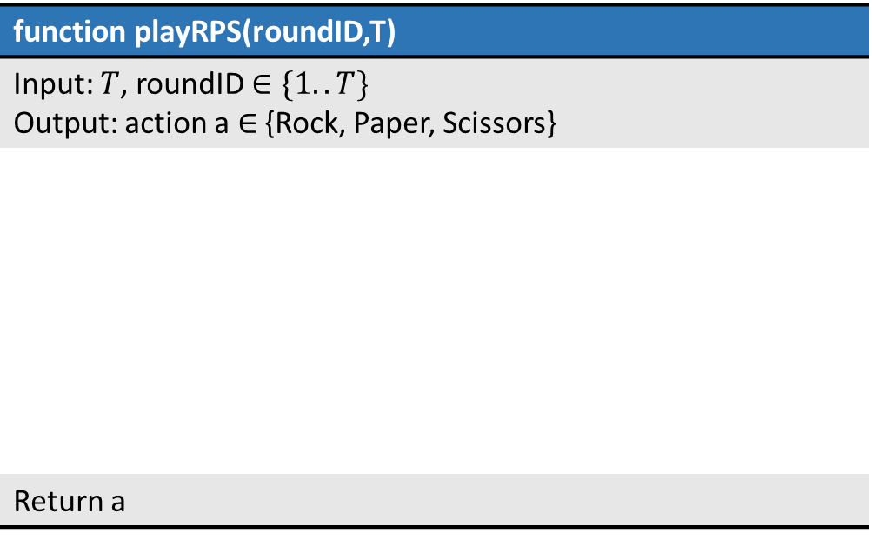
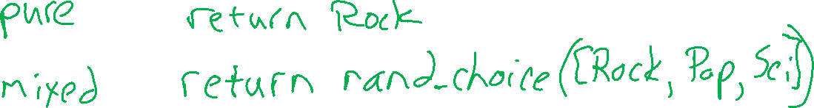
Strategy: Rock, Paper, Scissors
Design an AI to play Rock-Paper-Scissors for T rounds
If T=1, roundID=1, what action does your AI choose?
function playRPS(roundID,T)
Input: $T$, roundID $∈\{1..T\}$ Output: action a $∈$ {Rock, Paper, Scissors}
Return a

Slide 13
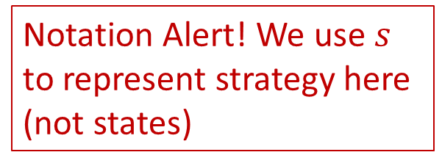
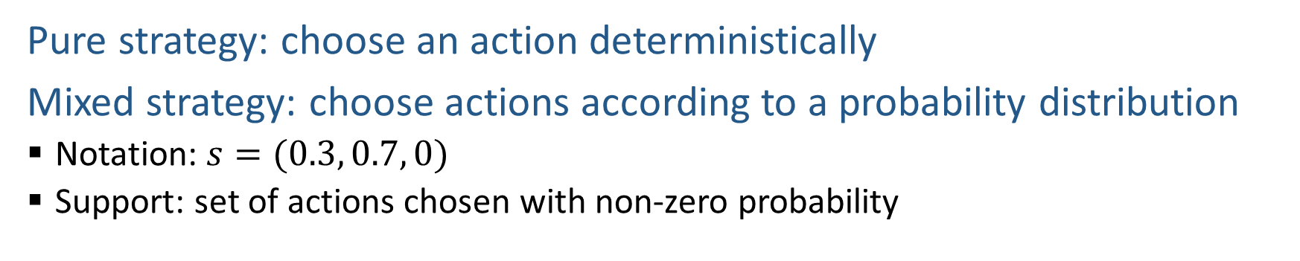
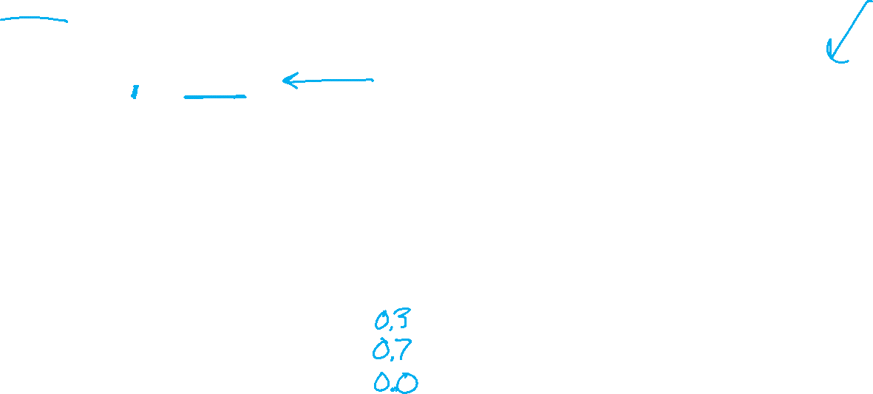
Strategy
Pure strategy: choose an action deterministically
Mixed strategy: choose actions according to a probability distribution
  Notation: $s=(0.3, 0.7, 0)$
  Support: set of actions chosen with non-zero probability
Notation Alert! We use $s$ to represent strategy here (not states)
Does your AI play a deterministic strategy or a mixed strategy?
What is the support size of your AI’s strategy?
Player 2
 | Rock | Paper | Scissors
Rock | 0, 0 | -1, 1 | 1, -1
Paper | 1, -1 | 0, 0 | -1, 1
Scissors | -1, 1 | 1, -1 | 0, 0
Player 1

Slide 14

Zero-sum vs General-sum
Zero-sum Game
  No matter what actions are chosen by the players, the utilities for all the players sum up to zero or a constant
General-sum Game
  The sum of utilities of all the players is not a constant
  Which ones are general-sum games?
Player 2
 | Cooperate | Defect
Cooperate | -1,-1 | -3,0
Defect | 0,-3 | -2,-2
Player 1
Player 2
 | Rock | Paper | Scissors
Rock | 0,0 | -1,1 | 1,-1
Paper | 1,-1 | 0,0 | -1,1
Scissor | -1,1 | 1,-1 | 0,0
Berry
Alex
 | Football | Concert
Football | 2,1 | 0,0
Concert | 0,0 | 1,2
Player 1

Slide 15
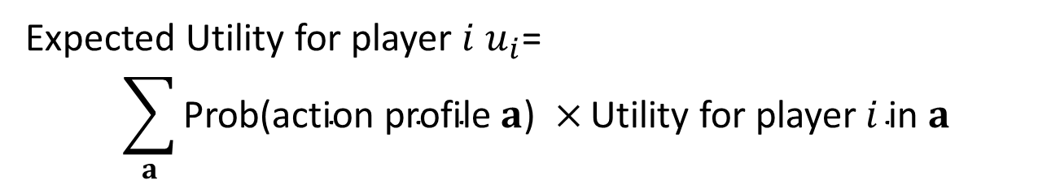
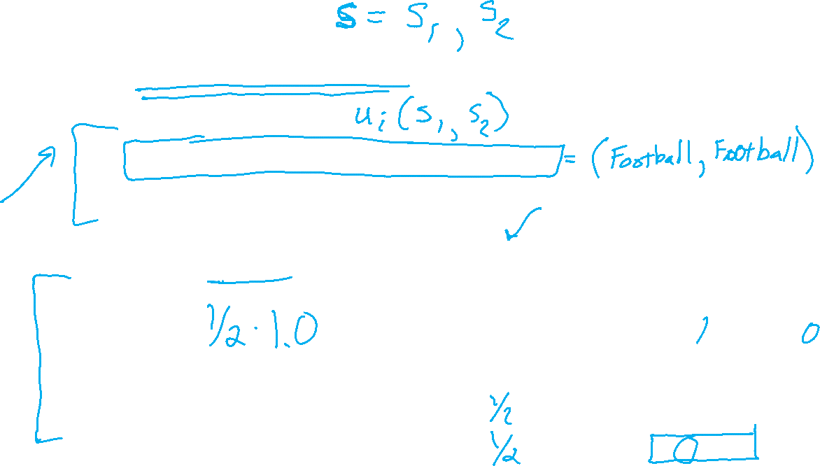
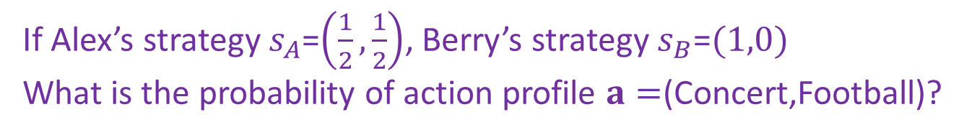
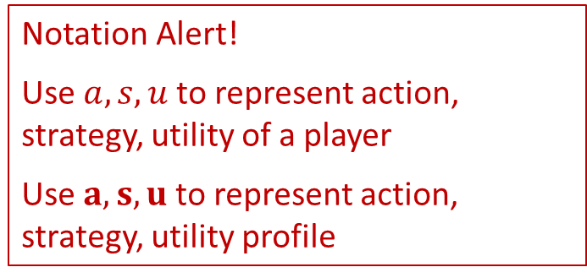
Expected Utility
Notation Alert!
Use $a, s,u$ to represent action, strategy, utility of a player
Use $a,s,u$ to represent action, strategy, utility profile
Given the strategies of all players,
Expected Utility for player $i$ $u_{i}$=
$$\sum_{a}{\text{Prob}\text{(}\text{action} \text{profile} a\text{) }×}\text{Utility} \text{for} \text{player} i \text{in} a$$
Can skip action profiles with probability $0$ or utility $0$
If Alex’s strategy $s_{A}$=$\left(\frac{1}{2},\frac{1}{2}\right)$, Berry’s strategy $s_{B}$=$(1,0)$
What is the probability of action profile $a=$(Concert,Football)?
Berry
What is Alex’s utility in this action profile?
 | Football | Concert
Football | 2,1 | 0,0
Concert | 0,0 | 1,2
Alex

Slide 16

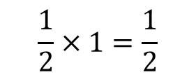
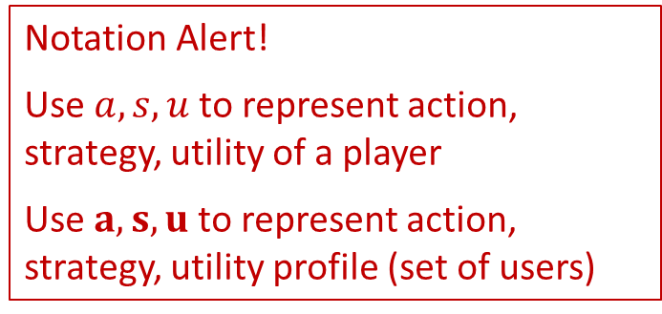
Expected Utility
Notation Alert!
Use $a, s,u$ to represent action, strategy, utility of a player
Use $a,s,u$ to represent action, strategy, utility profile (set of users)
Given the strategies of all players,
Expected Utility for player $i$ $u_{i}$=
$$\sum_{a}{\text{Prob}\text{(}\text{action} \text{profile} a\text{) }×}\text{Utility} \text{for} \text{player} i \text{in} a$$
Can skip action profiles with probability $0$ or utility $0$
If Alex’s strategy $s_{A}$=$\left(\frac{1}{2},\frac{1}{2}\right)$, Berry’s strategy $s_{B}$=$(1,0)$
What is the probability of action profile $a=$(Concert,Football)?
$$\frac{1}{2}×1=\frac{1}{2}$$
Berry
What is Alex’s utility in this action profile?
 | Football | Concert
Football | 2,1 | 0,0
Concert | 0,0 | 1,2
$$0$$
Alex

Slide 17
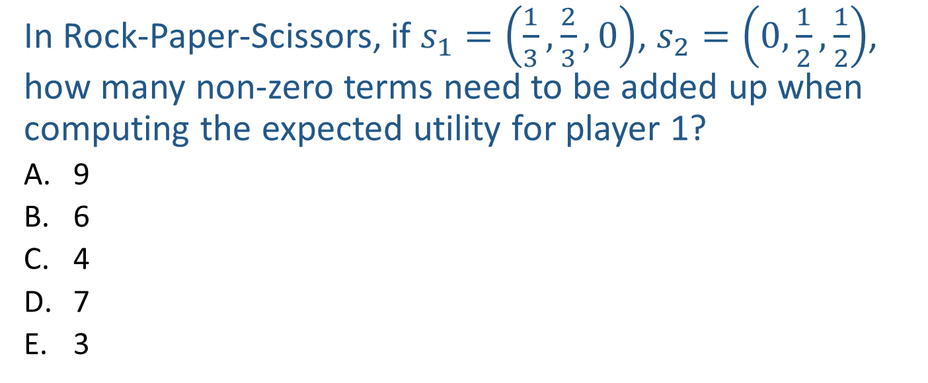
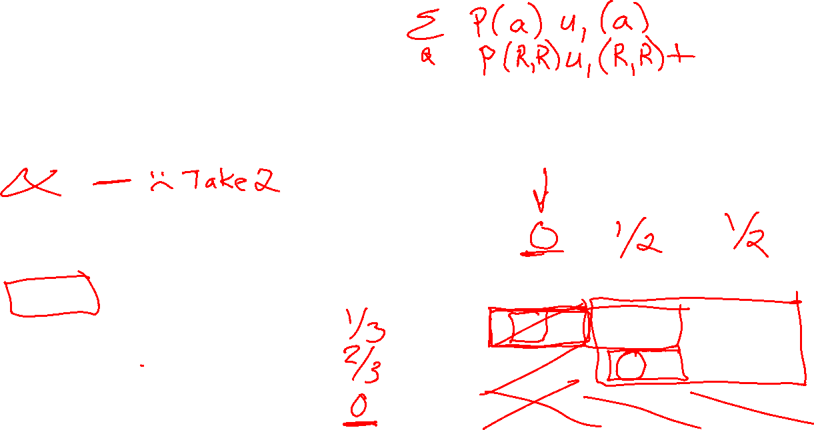
Poll 1
In Rock-Paper-Scissors, if $s_{1}=\left(\frac{1}{3},\frac{2}{3},0\right)$, $s_{2}=\left(0,\frac{1}{2},\frac{1}{2}\right)$, how many non-zero terms need to be added up when computing the expected utility for player 1?
  9
  6
  4
  7
  3
Player 2
 | Rock | Paper | Scissors
Rock | 0, 0 | -1, 1 | 1, -1
Paper | 1, -1 | 0, 0 | -1, 1
Scissors | -1, 1 | 1, -1 | 0, 0
Player 1

Slide 18
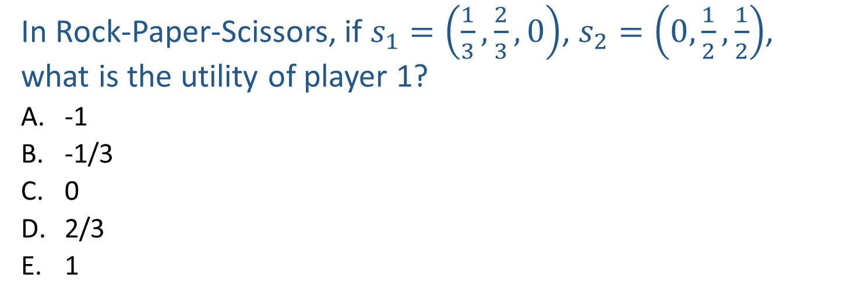

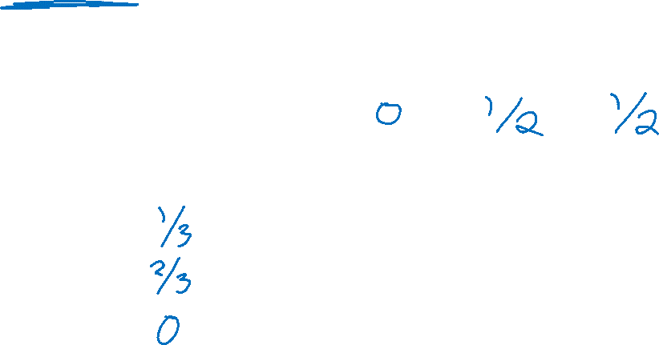
Poll 2
In Rock-Paper-Scissors, if $s_{1}=\left(\frac{1}{3},\frac{2}{3},0\right)$, $s_{2}=\left(0,\frac{1}{2},\frac{1}{2}\right)$, what is the utility of player 1?
  -1
  -1/3
  0
  2/3
  1
Player 2
 | Rock | Paper | Scissors
Rock | 0, 0 | -1, 1 | 1, -1
Paper | 1, -1 | 0, 0 | -1, 1
Scissors | -1, 1 | 1, -1 | 0, 0
Player 1

Slide 19
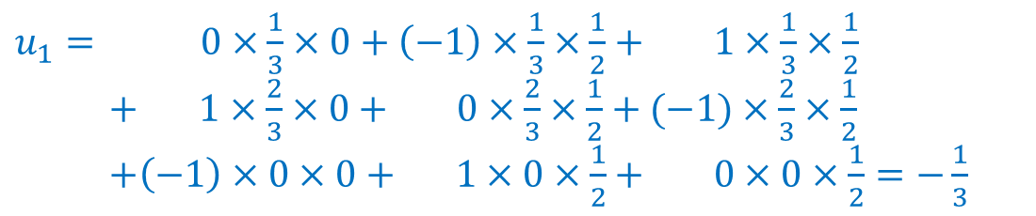
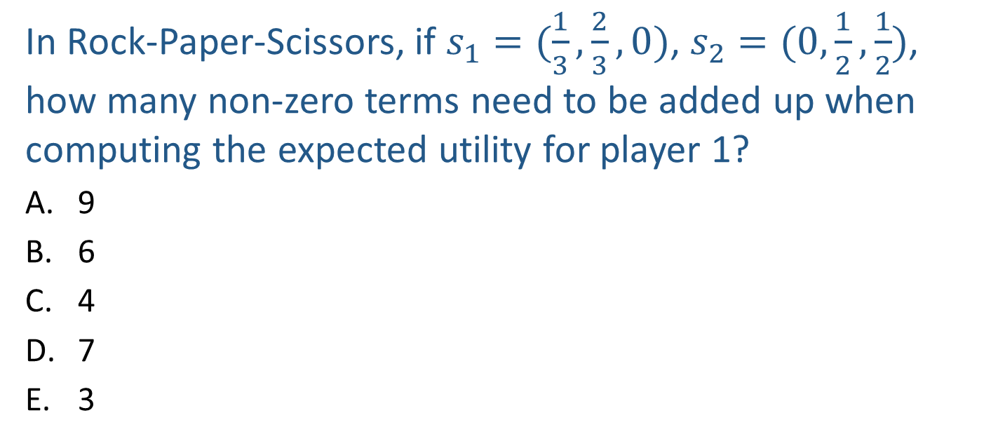
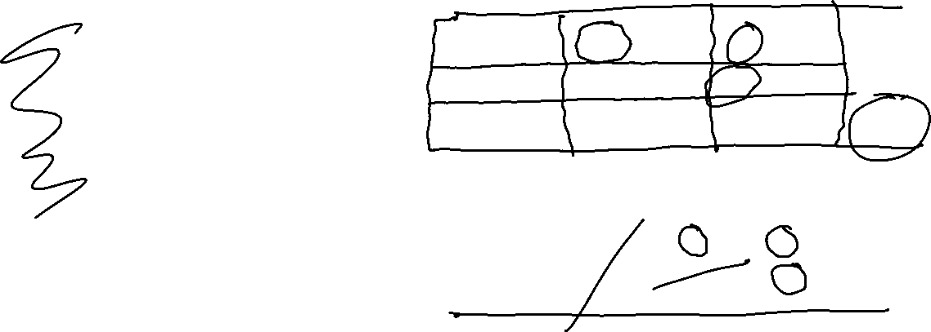
Poll 2
In Rock-Paper-Scissors, if $s_{1}=(\frac{1}{3},\frac{2}{3},0)$, $s_{2}=(0,\frac{1}{2},\frac{1}{2})$, how many non-zero terms need to be added up when computing the expected utility for player 1?
  9
  6
  4
  7
  3
$u_{1}= 0×\frac{1}{3}×0+\left(−1\right)×\frac{1}{3}×\frac{1}{2}+ 1×\frac{1}{3}×\frac{1}{2}$
$+ 1×\frac{2}{3}×0+ 0×\frac{2}{3}×\frac{1}{2}+(−1)×\frac{2}{3}×\frac{1}{2}$
$+\left(−1\right)×0×0+ 1×0×\frac{1}{2}+ 0×0×\frac{1}{2}=−\frac{1}{3}$
Player 2
 | Rock | Paper | Scissors
Rock | 0, 0 | -1, 1 | 1, -1
Paper | 1, -1 | 0, 0 | -1, 1
Scissors | -1, 1 | 1, -1 | 0, 0
Player 1

Slide 20
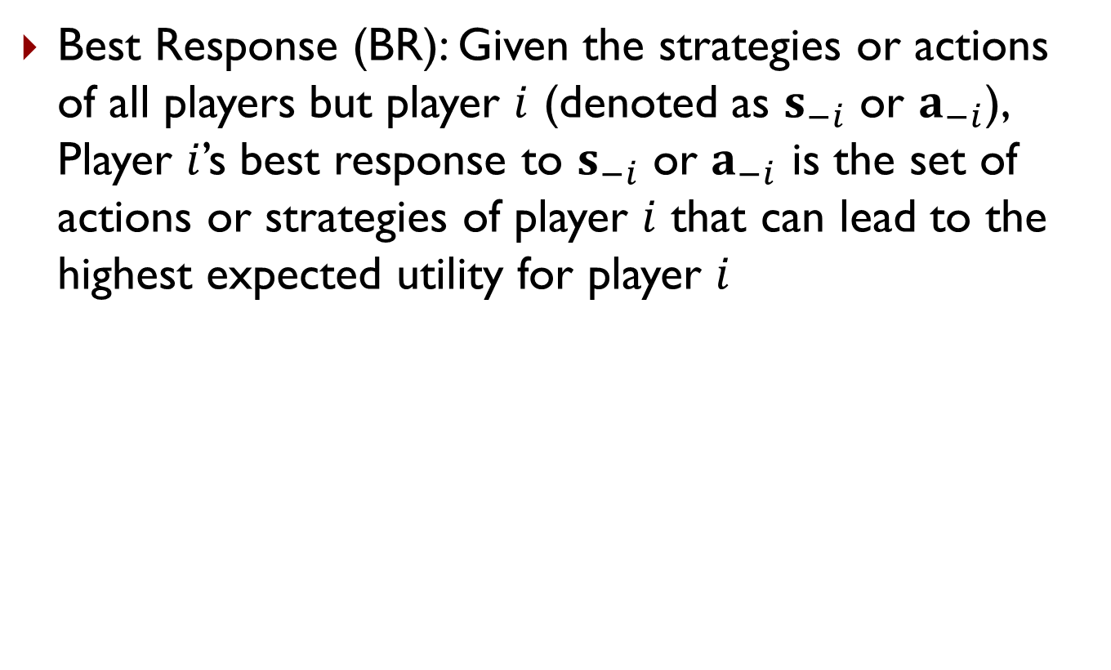
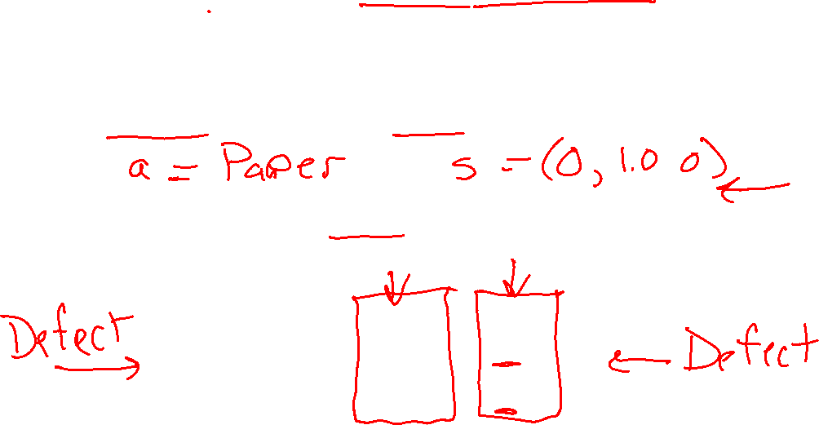
Best Response
Best Response (BR): Given the strategies or actions of all players but player $i$ (denoted as $s_{−i}$ or $a_{−i}$), Player $i$’s best response to $s_{−i}$ or $a_{−i}$ is the set of actions or strategies of player $i$ that can lead to the highest expected utility for player $i$
In RPS, what is Player 1’s best response to Rock (i.e., assuming Player 2 plays Rock)?
In Prisoner’s Dilemma, what is Player 1’s best response to Cooperate? What is Player 1’s best response to Defect?
Player 2
 | Cooperate | Defect
Cooperate | -1,-1 | -3,0
Defect | 0,-3 | -2,-2
Player 1

Slide 21
Best Response
Best Response (BR): Given the strategies or actions of all players but player $i$ (denoted as $s_{−i}$ or $a_{−i}$), Player $i$’s best response to $s_{−i}$ or $a_{−i}$ is the set of actions or strategies of player $i$ that can lead to the highest expected utility for player $i$
In RPS, what is Player 1’s best response to Rock (i.e., assuming Player 2 plays Rock)?
Paper
In Prisoner’s Dilemma, what is Player 1’s best response to Cooperate? What is Player 1’s best response to Defect?
Defect
Defect
Player 2
 | Cooperate | Defect
Cooperate | -1,-1 | -3,0
Defect | 0,-3 | -2,-2
Player 1

Slide 22
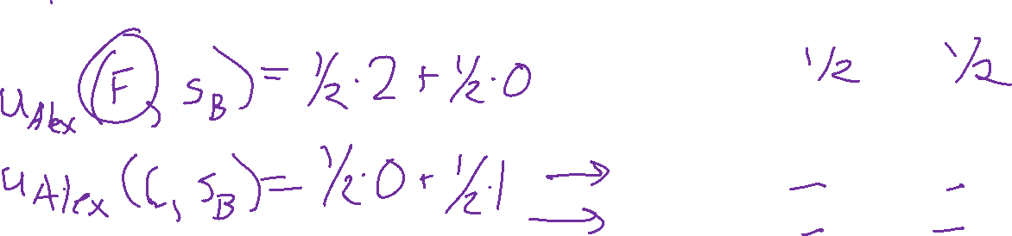
Best Response
Best Response (BR): Given the strategies or actions of all players but player $i$ (denoted as $s_{−i}$ or $a_{−i}$), Player $i$’s best response to $s_{−i}$ or $a_{−i}$ is the set of actions or strategies of player $i$ that can lead to the highest expected utility for player $i$
What is Alex’s best response to Berry’s mixed strategy $s_{B}=\left(\frac{1}{2},\frac{1}{2}\right)$?
Berry
 | Football | Concert
Football | 2,1 | 0,0
Concert | 0,0 | 1,2
Alex

Slide 23
Best Response
Best Response (BR): Given the strategies or actions of all players but player $i$ (denoted as $s_{−i}$ or $a_{−i}$), Player $i$’s best response to $s_{−i}$ or $a_{−i}$ is the set of actions or strategies of player $i$ that can lead to the highest expected utility for player $i$
What is Alex’s best response to Berry’s mixed strategy $s_{B}=\left(\frac{1}{2},\frac{1}{2}\right)$?
Football
Berry
 | Football | Concert
Football | 2,1 | 0,0
Concert | 0,0 | 1,2
Alex

Slide 24
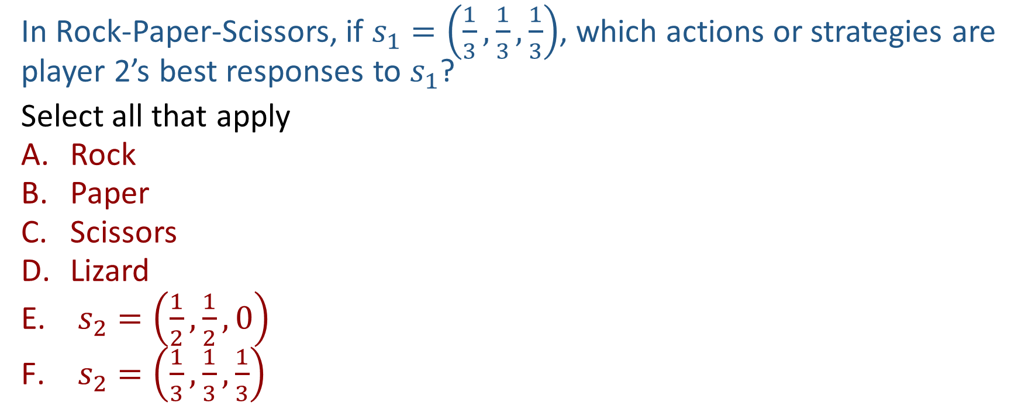
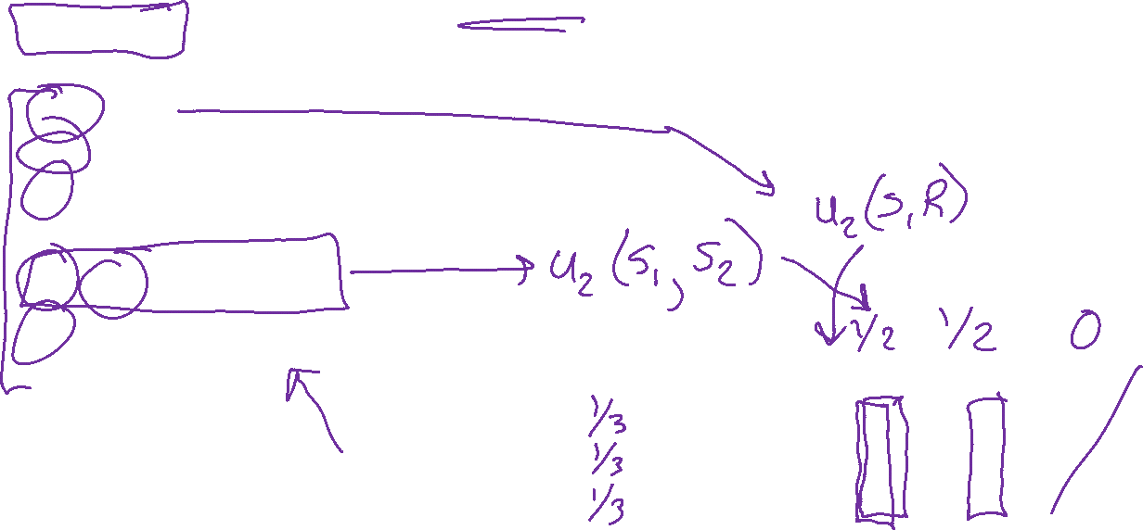
Poll 3
In Rock-Paper-Scissors, if $s_{1}=\left(\frac{1}{3},\frac{1}{3},\frac{1}{3}\right)$, which actions or strategies are player 2’s best responses to $s_{1}$?
Select all that apply
  Rock
  Paper
  Scissors
  Lizard
  $s_{2}=\left(\frac{1}{2},\frac{1}{2},0\right)$
  $s_{2}=\left(\frac{1}{3},\frac{1}{3},\frac{1}{3}\right)$
Player 2
 | Rock | Paper | Scissors
Rock | 0, 0 | -1, 1 | 1, -1
Paper | 1, -1 | 0, 0 | -1, 1
Scissors | -1, 1 | 1, -1 | 0, 0
Player 1

Slide 25
Best Response
Theorem 1 (Nash 1951): A mixed strategy is a BR iff all actions in the support are a BR
Player 2
 | Rock | Paper | Scissors
Rock | 0, 0 | -1, 1 | 1, -1
Paper | 1, -1 | 0, 0 | -1, 1
Scissors | -1, 1 | 1, -1 | 0, 0
Player 1

Slide 26
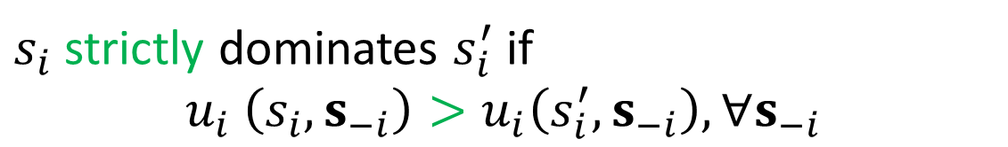

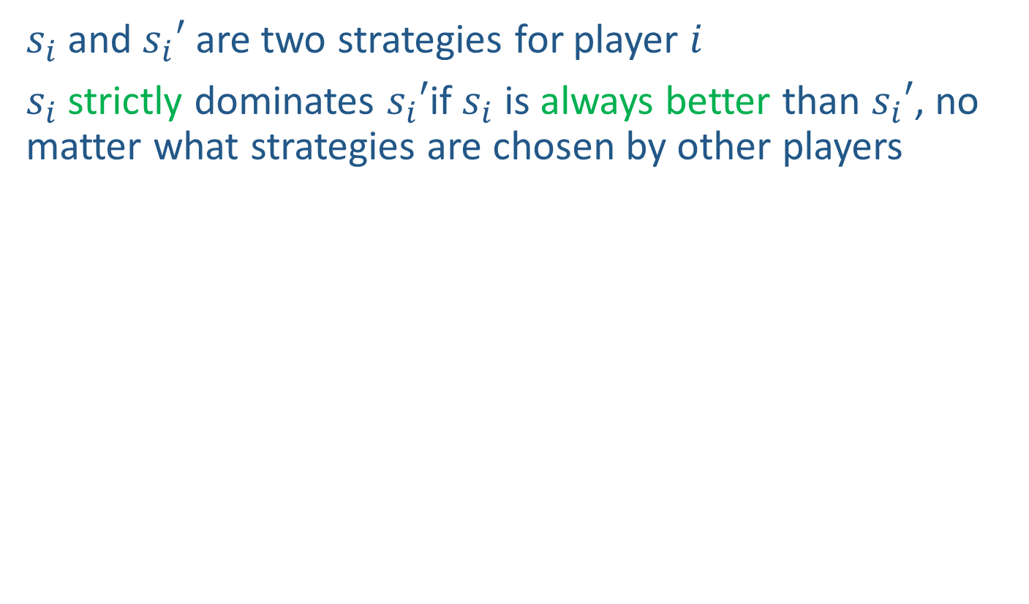
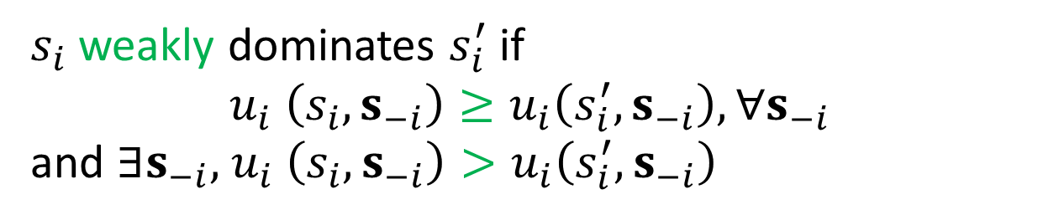
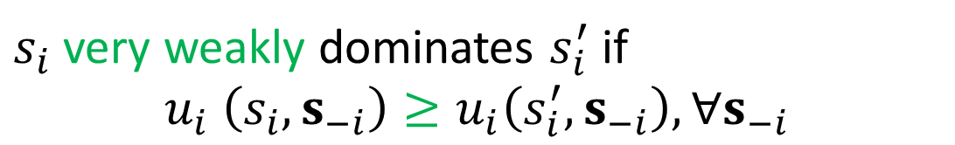
Dominance
$s_{i}$ and $s_{i}′$ are two strategies for player $i$
$s_{i}$ strictly dominates $s_{i}′$if $s_{i}$ is always better than $s_{i}′$, no matter what strategies are chosen by other players
$s_{i}$ strictly dominates $s_{i}^{′}$ if
$$u_{i} \left(s_{i},s_{−i}\right)>u_{i}\left(s_{i}^{′},s_{−i}\right),∀s_{−i}$$
always better
$s_{i}$ very weakly dominates $s_{i}^{′}$ if
$$u_{i} \left(s_{i},s_{−i}\right)≥u_{i}\left(s_{i}^{′},s_{−i}\right),∀s_{−i}$$
never worse
$s_{i}$ weakly dominates $s_{i}^{′}$ if
$$u_{i} \left(s_{i},s_{−i}\right)≥u_{i}\left(s_{i}^{′},s_{−i}\right),∀s_{−i}$$
and $∃s_{−i}\text{, }u_{i} \left(s_{i},s_{−i}\right)>u_{i}\left(s_{i}^{′},s_{−i}\right)$
never worse and sometimes better

Slide 27
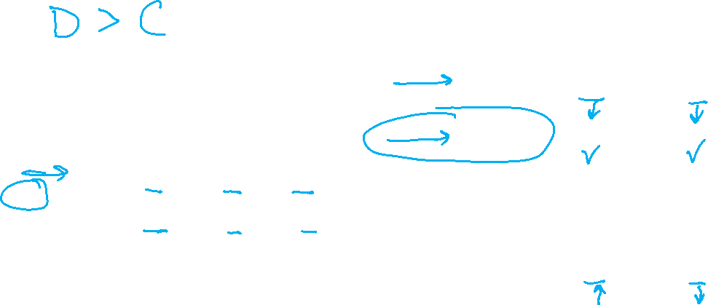
Dominance
Can you find any dominance relationships between the pure strategies in these games?
Player 2
 | Cooperate | Defect
Cooperate | -1,-1 | -3,0
Defect | 0,-3 | -2,-2
Player 2
Player 1
 | Rock | Paper | Scissors
Rock | 0,0 | -1,1 | 1,-1
Paper | 1,-1 | 0,0 | -1,1
Scissor | -1,1 | 1,-1 | 0,0
Berry
Player 1
 | Football | Concert
Football | 2,1 | 0,0
Concert | 0,0 | 1,2
Alex

Slide 28
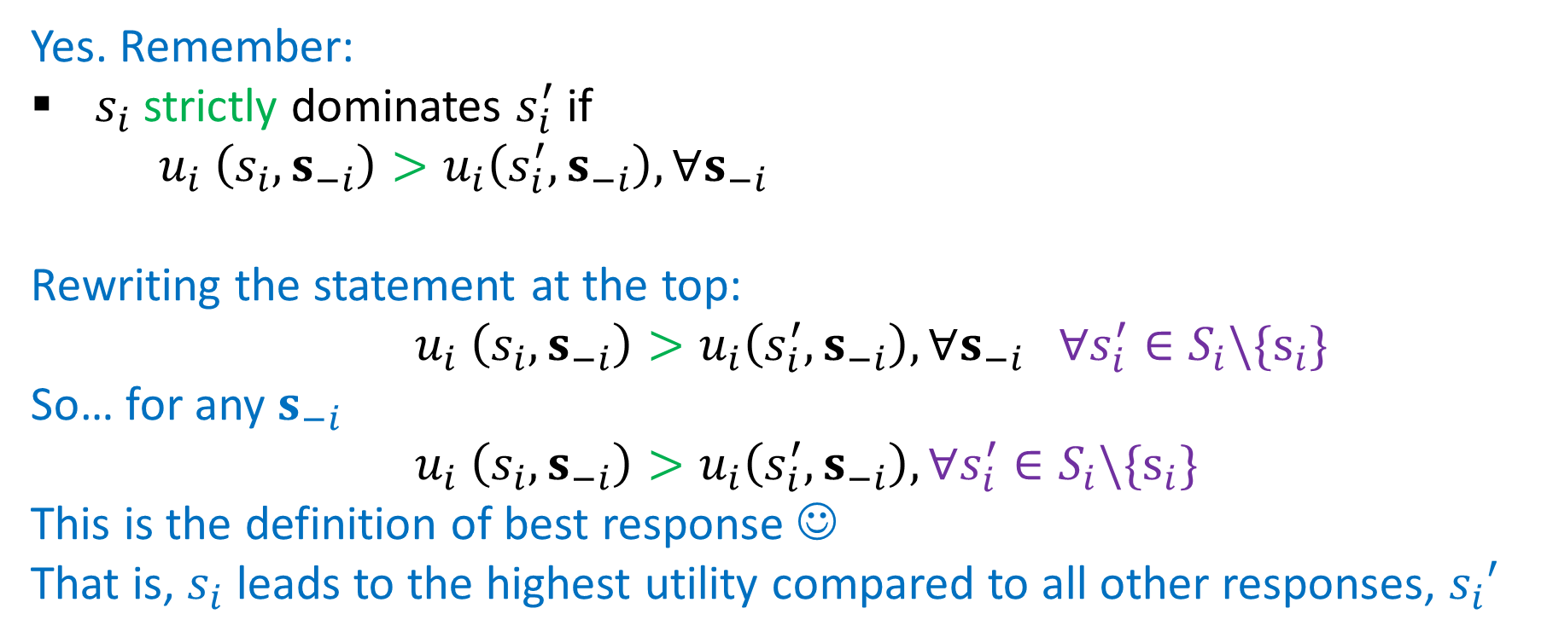
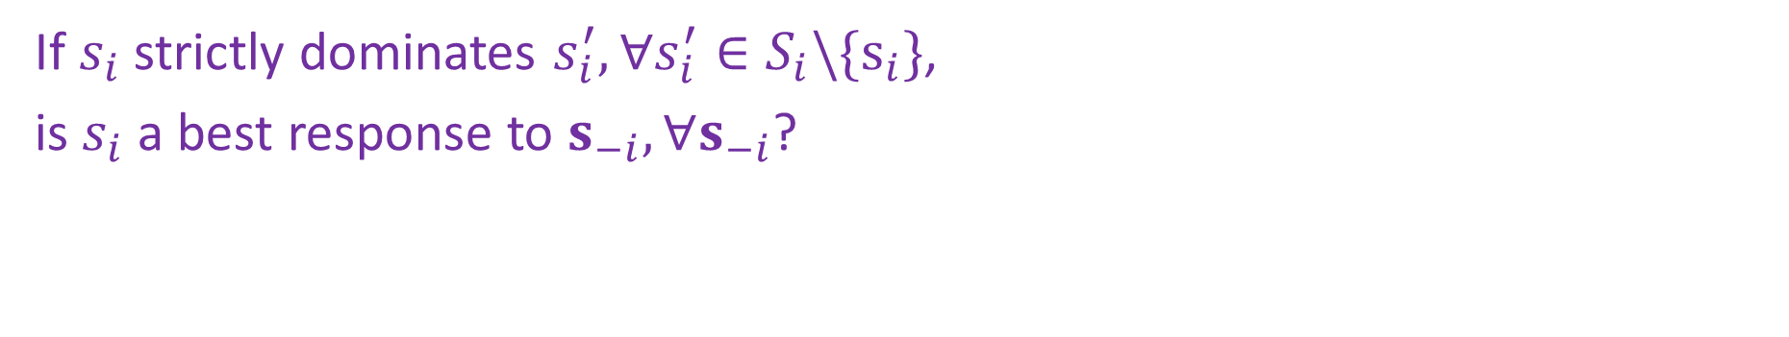
Dominance
If $s_{i}$ strictly dominates $s_{i}^{′},∀s_{i}^{′}∈S_{i}\backslash \{s_{i}\}$,
is $s_{i}$ a best response to $s_{−i},∀s_{−i}$?
Yes. Remember:
$s_{i}$ strictly dominates $s_{i}^{′}$ if
$u_{i} \left(s_{i},s_{−i}\right)>u_{i}\left(s_{i}^{′},s_{−i}\right),∀s_{−i}$
Rewriting the statement at the top:
$u_{i} \left(s_{i},s_{−i}\right)>u_{i}\left(s_{i}^{′},s_{−i}\right),∀s_{−i} ∀s_{i}^{′}∈S_{i}\backslash \{s_{i}\}$
So… for any $s_{−i}$
$u_{i} \left(s_{i},s_{−i}\right)>u_{i}\left(s_{i}^{′},s_{−i}\right),∀s_{i}^{′}∈S_{i}\backslash \{s_{i}\}$
This is the definition of best response ☺
That is, $s_{i}$ leads to the highest utility compared to all other responses, $s_{i}′$

Slide 29
Solution Concepts in Games
How should one player play and what should we expect all the players to play?
  Dominant strategy and dominant strategy equilibrium
  Nash Equilibrium
  (Minimax strategy)
  (Maximin strategy)
  (Stackelberg Equilibrium)

Slide 30
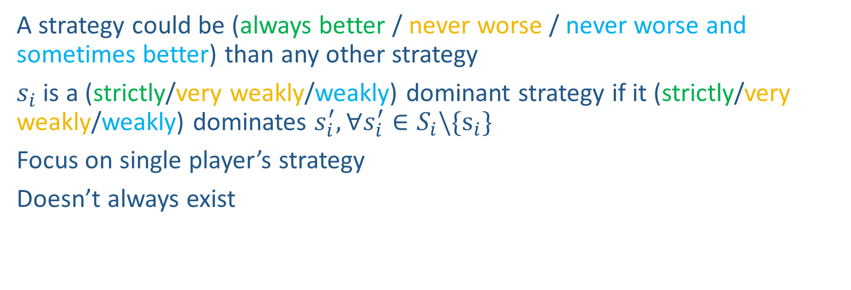

Dominant Strategy
A strategy could be (always better / never worse / never worse and sometimes better) than any other strategy
$s_{i}$ is a (strictly/very weakly/weakly) dominant strategy if it (strictly/very weakly/weakly) dominates $s_{i}^{′}, ∀s_{i}^{′}∈S_{i}\backslash \{s_{i}\}$
Focus on single player’s strategy
Doesn’t always exist
Is there a strictly dominant strategy for player 1 in PD?
Player 2
 | Cooperate | Defect
Cooperate | -1,-1 | -3,0
Defect | 0,-3 | -2,-2
Player 1

Slide 31
Dominant Strategy Equilibrium
Sometimes called dominant strategy solution
Every player plays a dominant strategy
Focus on strategy profile for all players
Doesn’t always exist
What is the dominant strategy equilibrium for PD?
Player 2
 | Cooperate | Defect
Cooperate | -1,-1 | -3,0
Defect | 0,-3 | -2,-2
Player 1

Slide 32
Solution Concepts in Games
How should one player play and what should we expect all the players to play?
  Dominant strategy and dominant strategy equilibrium
  Nash Equilibrium
  (Minimax strategy)
  (Maximin strategy)
  (Stackelberg Equilibrium)

Slide 33
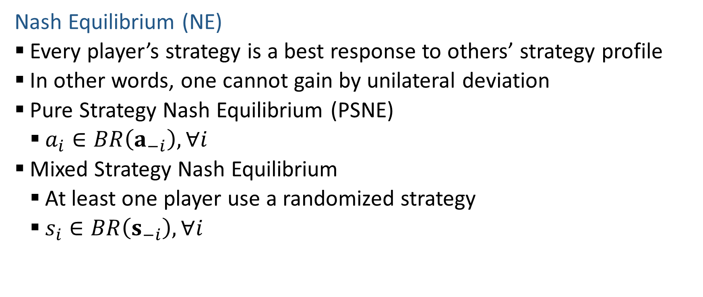
Nash Equilibrium
Nash Equilibrium (NE)
  Every player’s strategy is a best response to others’ strategy profile
  In other words, one cannot gain by unilateral deviation
  Pure Strategy Nash Equilibrium (PSNE)
    $a_{i}∈BR\left(a_{−i}\right),∀i$
  Mixed Strategy Nash Equilibrium
    At least one player use a randomized strategy
    $s_{i}∈BR\left(s_{−i}\right),∀i$

Slide 34
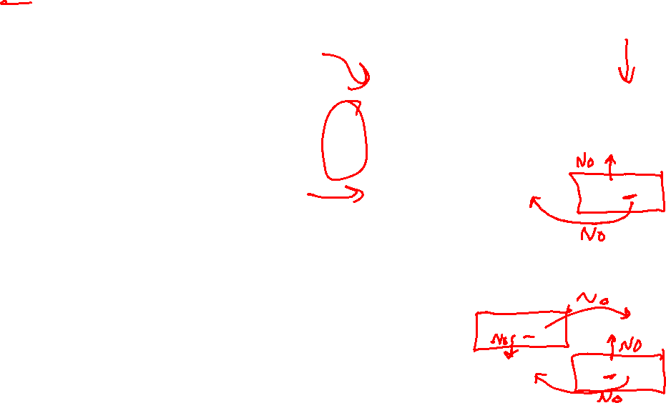
Nash Equilibrium
What are the PSNEs in these games?
What is the mixed strategy NE in RPS?
Player 2
 | Cooperate | Defect
Cooperate | -1,-1 | -3,0
Defect | 0,-3 | -2,-2
Player 1
Player 2
 | Rock | Paper | Scissors
Rock | 0,0 | -1,1 | 1,-1
Paper | 1,-1 | 0,0 | -1,1
Scissor | -1,1 | 1,-1 | 0,0
Berry
Player 1
Alex
 | Football | Concert
Football | 2,1 | 0,0
Concert | 0,0 | 1,2

Slide 35
Nash Equilibrium
What are the PSNEs in these games?
RPS: None. Prisoner’s Dilemma: (D,D). Football vs Concert: (F,F),(C,C)
What is the mixed strategy NE in RPS?
Player 2
 | Cooperate | Defect
Cooperate | -1,-1 | -3,0
Defect | 0,-3 | -2,-2
(1/3,1/3,1/3) for both players
Player 1
Player 2
 | Rock | Paper | Scissors
Rock | 0,0 | -1,1 | 1,-1
Paper | 1,-1 | 0,0 | -1,1
Scissor | -1,1 | 1,-1 | 0,0
Berry
Player 1
Alex
 | Football | Concert
Football | 2,1 | 0,0
Concert | 0,0 | 1,2

Slide 36
Nash Equilibrium
Theorem 2 (Nash 1951): NE always exists in finite games
  Finite number of players, finite number of actions
  NE: can be pure or mixed
  Proof: Through Brouwer's fixed point theorem

Slide 37
Find PSNE
Find pure strategy Nash Equilibrium (PSNE)
  Enumerate all action profile
  For each action profile, check if it is NE
    For each player, check other available actions to see if he should deviate
  Other approaches?
Player 2
 | L | C | R
U | 10, 3 | 1, 5 | 5, 4
M | 3, 1 | 2, 4 | 5, 2
D | 0, 10 | 1, 8 | 7, 0
Player 1
Notes:
for each player to see if there is no incentive for this player to deviate, i.e., there exists another action of this player that lead to higher payoff, given the actions of other players

Slide 38

Find PSNE
A strictly dominated strategy is one that is always worse than some other strategy
Strictly dominated strategies cannot be part of an NE
Why?
Which are the strictly dominated strategies for player 1?
How about player 2?
Player 2
 | L | C | R
U | 10, 3 | 1, 5 | 5, 4
M | 3, 1 | 2, 4 | 5, 2
D | 0, 10 | 1, 8 | 7, 0
Player 1

Slide 39

Find PSNE
A strictly dominated strategy is one that is always worse than some other strategy
Strictly dominated strategies cannot be part of an NE
Why?
Which are the strictly dominated strategies for player 1?
How about player 2?
Player 2
 | L | C | R
U | 10, 3 | 1, 5 | 5, 4
M | 3, 1 | 2, 4 | 5, 2
D | 0, 10 | 1, 8 | 7, 0
Player 1
$$≥$$

Slide 40
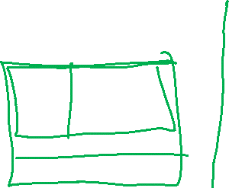
Find PSNE through Iterative Removal
Remove strictly dominated actions (pure strategies) and then find PSNE in the remaining game
Can have new strictly dominated actions in the remaining game!
Repeat the process until no actions can be removed
This is the Iterative Removal algorithm (also known as Iterative Elimination of Strictly Dominated Strategies)
Find PSNE in this game using iterative removal
Player 2
 | L | C | R
U | 10, 3 | 1, 5 | 5, 4
M | 3, 1 | 2, 4 | 5, 2
D | 0, 10 | 1, 8 | 7, 0
Player 1

Slide 41
Find PSNE through Iterative Removal
Remove strictly dominated actions (pure strategies) and then find PSNE in the remaining game
Can have new strictly dominated actions in the remaining game!
Repeat the process until no actions can be removed
This is the Iterative Removal algorithm (also known as Iterative Elimination of Strictly Dominated Strategies)
Find PSNE in this game using iterative removal
 | L | C | R
U | 10,3 | 1,5 | 5,4
M | 3,1 | 2,4 | 5,2
D | 0,10 | 1,8 | 7,0
 | L | C
U | 10,3 | 1,5
M | 3,1 | 2,4
D | 0,10 | 1,8
 | L | C
U | 10,3 | 1,5
M | 3,1 | 2,4
 | C
U | 1,5
M | 2,4
 | C
M | 2,4

Slide 42
Find PSNE through Iterative Removal
When the algorithm terminates, if the remaining game has only one action for each player, then that is the unique NE of the game and the game is called dominance solvable
  It may not be a dominant strategy equilibrium
When the remaining game has more than one action for some players, find PSNE in the remaining game
Order of removal does not matter
Player 2
 | L | C | R
U | 10,3 | 1,5 | 5,4
M | 3,1 | 2,4 | 5,2
D | 0,10 | 1,8 | 7,0
Player 1

Slide 43
Find Mixed Strategy Nash Equilibrium
Can we still apply iterative removal?
  Yes! The removed strategies cannot be part of any NE
  You can always apply iterative removal first
Notes:
, i.e., no strictly dominated strategies in the remaining game
Now assume you are given a 2 by 2 bimatrix game after iterative removal. Further, you are told that in a NE, all the actions are chosen with non-zero probability. What are the necessary conditions for a mixed strategy NE?
Check the FvsC game, in addition to PSNEs (F,F) and (C,C), there is a mixed strategy NE shown below.

Slide 44
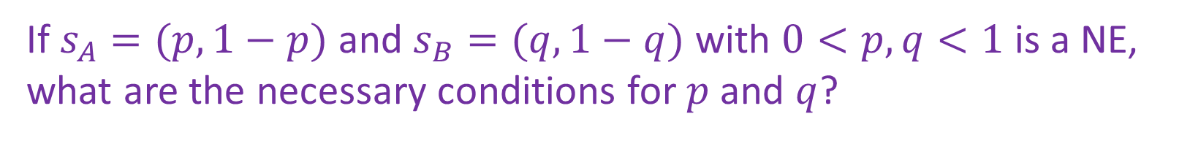
Find Mixed Strategy Nash Equilibrium
How to find mixed strategy NE (after iterative removal)?
Berry
 | Football | Concert
Football | 2,1 | 0,0
Concert | 0,0 | 1,2
Alex
If $s_{A}=(p,1−p)$ and $s_{B}=(q,1−q)$ with $0<p,q<1$ is a NE, what are the necessary conditions for $p$ and $q$?
Notes:
, i.e., no strictly dominated strategies in the remaining game
Now assume you are given a 2 by 2 bimatrix game after iterative removal. Further, you are told that in a NE, all the actions are chosen with non-zero probability. What are the necessary conditions for a mixed strategy NE?
Check the FvsC game, in addition to PSNEs (F,F) and (C,C), there is a mixed strategy NE shown below.

Slide 45
Visualizing Equilibrium
Alex wants to choose p such that Berry doesn’t want to deviate from their strategy
Berry wants the most reward they can get, so they will deviate if one strategy has more utility than another
The only way these two conditions is met is if we choose the p such that any strategy Berry picks will yield equal utility for Berry
Utility of Berry
2
Berry chooses Concert
Berry chooses Football
1
Berry
 | Football | Concert
Football | 2,1 | 0,0
Concert | 0,0 | 3,2
p
Alex
p
1-p
0
1

Slide 46
Visualizing Equilibrium
Berry wants to choose q such that Alex doesn’t want to deviate from their strategy
Alex wants the most reward they can get, so they will deviate if one strategy has more utility than another
The only way these two conditions is met is if we choose the q such that any strategy Alex picks will yield equal utility for Alex
Utility of Alex
3
Alex: Concert
2
Alex Football
Berry
1
q
1-q
 | Football | Concert
Football | 2,1 | 0,0
Concert | 0,0 | 3,2
Alex
q
0
1

Slide 47

Find Mixed Strategy Nash Equilibrium
How to find mixed strategy NE (after iterative removal)?
Berry
 | Football | Concert
Football | 2,1 | 0,0
Concert | 0,0 | 1,2
Alex
Is $s_{A}=\left(\frac{2}{3},\frac{1}{3}\right)$ and $s_{B}=\left(\frac{1}{3},\frac{2}{3}\right)$ an NE?
Notes:
, i.e., no strictly dominated strategies in the remaining game
Now assume you are given a 2 by 2 bimatrix game after iterative removal. Further, you are told that in a NE, all the actions are chosen with non-zero probability. What are the necessary conditions for a mixed strategy NE?
Check the FvsC game, in addition to PSNEs (F,F) and (C,C), there is a mixed strategy NE shown below.

Slide 48
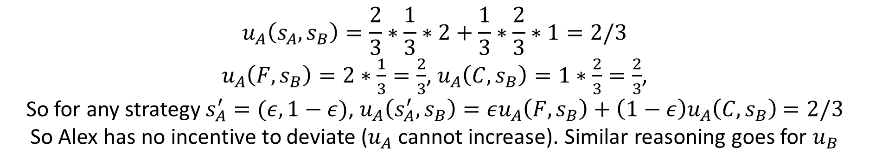
Find Mixed Strategy Nash Equilibrium
How to find mixed strategy NE (after iterative removal)?
Berry
 | Football | Concert
Football | 2,1 | 0,0
Concert | 0,0 | 1,2
Alex
Is $s_{A}=\left(\frac{2}{3},\frac{1}{3}\right)$ and $s_{B}=\left(\frac{1}{3},\frac{2}{3}\right)$ an NE?
$$u_{A}\left(s_{A},s_{B}\right)=\frac{2}{3}∗\frac{1}{3}∗2+\frac{1}{3}∗\frac{2}{3}∗1=2/3$$
$u_{A}\left(F,s_{B}\right)=2∗\frac{1}{3}=\frac{2}{3}$, $u_{A}\left(C,s_{B}\right)=1∗\frac{2}{3}=\frac{2}{3}$,
So for any strategy $s_{A}^{′}=(ε,1−ε)$, $u_{A}\left(s_{A}^{′},s_{B}\right)=εu_{A}\left(F,s_{B}\right)+\left(1−ε\right)u_{A}\left(C,s_{B}\right)$ $=2/3$
So Alex has no incentive to deviate ($u_{A}$ cannot increase). Similar reasoning goes for $u_{B}$
Notes:
, i.e., no strictly dominated strategies in the remaining game
Now assume you are given a 2 by 2 bimatrix game after iterative removal. Further, you are told that in a NE, all the actions are chosen with non-zero probability. What are the necessary conditions for a mixed strategy NE?
Check the FvsC game, in addition to PSNEs (F,F) and (C,C), there is a mixed strategy NE shown below.

Slide 49
Find Mixed Strategy Nash Equilibrium
How to find mixed strategy NE (after iterative removal)?
Berry
 | Football | Concert
Football | 2,1 | 0,0
Concert | 0,0 | 1,2
Alex
If $s_{A}=(p,1−p)$ and $s_{B}=(q,1−q)$ with $0<p,q<1$ is a NE, what are the necessary conditions for $p$ and $q$?
Notes:
, i.e., no strictly dominated strategies in the remaining game
Now assume you are given a 2 by 2 bimatrix game after iterative removal. Further, you are told that in a NE, all the actions are chosen with non-zero probability. What are the necessary conditions for a mixed strategy NE?
Check the FvsC game, in addition to PSNEs (F,F) and (C,C), there is a mixed strategy NE shown below.

Slide 50

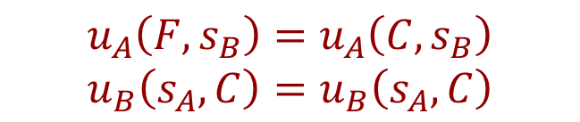
Find Mixed Strategy Nash Equilibrium
How to find mixed strategy NE (after iterative removal)?
Berry
 | Football | Concert
Football | 2,1 | 0,0
Concert | 0,0 | 1,2
Alex
If $s_{A}=(p,1−p)$ and $s_{B}=(q,1−q)$ with $0<p,q<1$ is a NE, what are the necessary conditions for $p$ and $q$?
$$u_{A}\left(F,s_{B}\right)=u_{A}\left(C,s_{B}\right)$$
$$u_{B}\left(s_{A},C\right)=u_{B}\left(s_{A},C\right)$$
Why?
For Alex: $s_{A}∈BR(s_{B})$, so according to Theorem 1,
F$∈BR\left(s_{B}\right)$, C$∈BR(s_{B})$, so $u_{A}\left(F,s_{B}\right)=u_{A}\left(C,s_{B}\right)$
Notes:
, i.e., no strictly dominated strategies in the remaining game
Now assume you are given a 2 by 2 bimatrix game after iterative removal. Further, you are told that in a NE, all the actions are chosen with non-zero probability. What are the necessary conditions for a mixed strategy NE?
Check the FvsC game, in addition to PSNEs (F,F) and (C,C), there is a mixed strategy NE shown below.

Slide 51
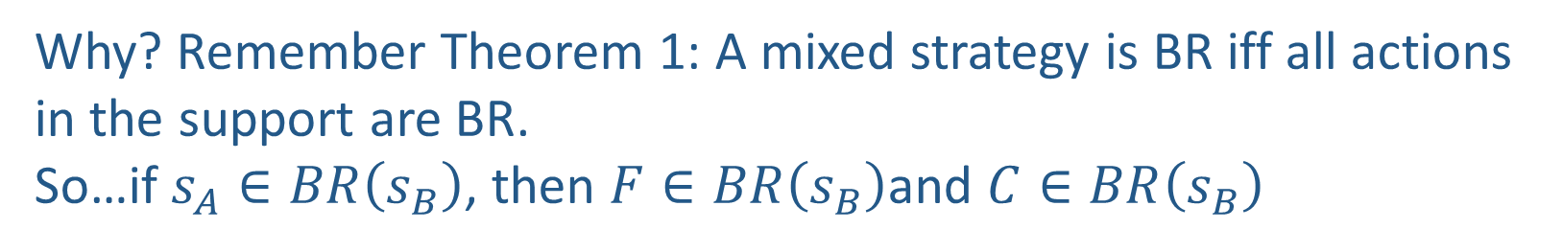


Find Mixed Strategy Nash Equilibrium
How to find mixed strategy NE (after iterative removal)?
Berry
 | Football | Concert
Football | 2,1 | 0,0
Concert | 0,0 | 1,2
Alex
If $s_{A}=(p,1−p)$ and $s_{B}=(q,1−q)$ with $0<p,q<1$ is a NE, what are the necessary conditions for $p$ and $q$?
$$u_{A}\left(F,s_{B}\right)=u_{A}\left(C,s_{B}\right)$$
$$u_{B}\left(s_{A},F\right)=u_{B}\left(s_{A},C\right)$$
Why? Remember Theorem 1: A mixed strategy is BR iff all actions in the support are BR.
So…if $s_{A}∈BR\left(s_{B}\right)$, then $F∈BR\left(s_{B}\right)$and $C∈BR\left(s_{B}\right)$
Notes:
, i.e., no strictly dominated strategies in the remaining game
Now assume you are given a 2 by 2 bimatrix game after iterative removal. Further, you are told that in a NE, all the actions are chosen with non-zero probability. What are the necessary conditions for a mixed strategy NE?
Check the FvsC game, in addition to PSNEs (F,F) and (C,C), there is a mixed strategy NE shown below.

Slide 52


Find Mixed Strategy Nash Equilibrium
How to find mixed strategy NE (after iterative removal)?
Berry
 | Football | Concert
Football | 2,1 | 0,0
Concert | 0,0 | 1,2
Alex
If $s_{A}=(p,1−p)$ and $s_{B}=(q,1−q)$ with $0<p,q<1$ is a NE, what are the necessary conditions for $p$ and $q$?
$$u_{A}\left(F,s_{B}\right)=u_{A}\left(C,s_{B}\right)$$
$$u_{B}\left(s_{A},F\right)=u_{B}\left(s_{A},C\right)$$
Notes:
, i.e., no strictly dominated strategies in the remaining game
Now assume you are given a 2 by 2 bimatrix game after iterative removal. Further, you are told that in a NE, all the actions are chosen with non-zero probability. What are the necessary conditions for a mixed strategy NE?
Check the FvsC game, in addition to PSNEs (F,F) and (C,C), there is a mixed strategy NE shown below.

Slide 53
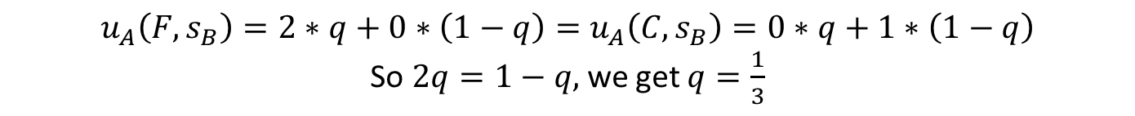

Find Mixed Strategy Nash Equilibrium
How to find mixed strategy NE (after iterative removal)?
Berry
 | Football | Concert
Football | 2,1 | 0,0
Concert | 0,0 | 1,2
Alex
If $s_{A}=(p,1−p)$ and $s_{B}=(q,1−q)$ with $0<p,q<1$ is a NE, what are the necessary conditions for $p$ and $q$?
$$u_{A}\left(F,s_{B}\right)=u_{A}\left(C,s_{B}\right)$$
$$u_{B}\left(s_{A},C\right)=u_{B}\left(s_{A},C\right)$$
$$u_{A}\left(F,s_{B}\right)=2∗q+0∗\left(1−q\right)=u_{A}\left(C,s_{B}\right)=0∗q+1∗\left(1−q\right)$$
So $2q=1−q,$ we get $q=\frac{1}{3}$
Similarly, $u_{B}\left(s_{A},F\right)=1∗p+0∗\left(1−p\right)=u_{B}\left(s_{A},C\right)=0∗p+2∗\left(1−p\right)$
So $p=2\left(1−p\right),$ we get $p=\frac{2}{3}$
Notes:
, i.e., no strictly dominated strategies in the remaining game
Now assume you are given a 2 by 2 bimatrix game after iterative removal. Further, you are told that in a NE, all the actions are chosen with non-zero probability. What are the necessary conditions for a mixed strategy NE?
Check the FvsC game, in addition to PSNEs (F,F) and (C,C), there is a mixed strategy NE shown below.

Slide 54
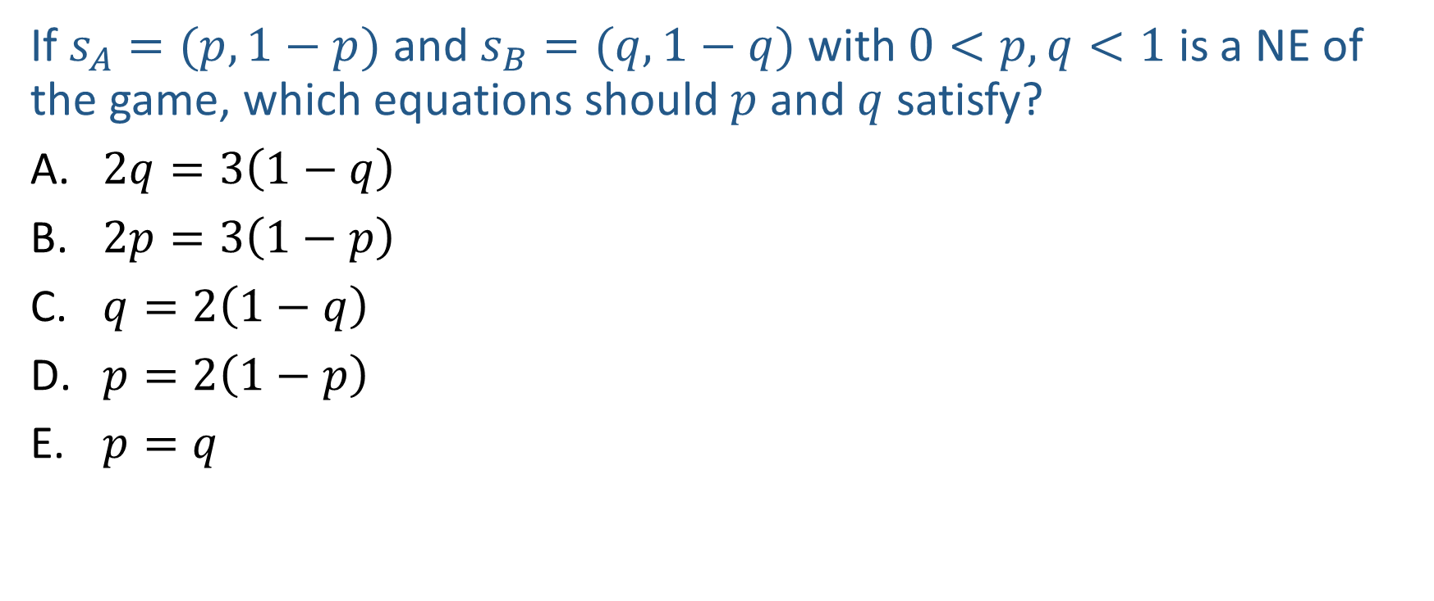
Poll 4
If $s_{A}=(p,1−p)$ and $s_{B}=(q,1−q)$ with $0<p,q<1$ is a NE of the game, which equations should $p$ and $q$ satisfy?
$2q=3\left(1−q\right)$
$2p=3\left(1−p\right)$
$q=2\left(1−q\right)$
$p=2\left(1−p\right)$
$p=q$
Berry
 | Football | Concert
Football | 2,1 | 0,0
Concert | 0,0 | 3,2
Alex
Notes:
2/3

Slide 55
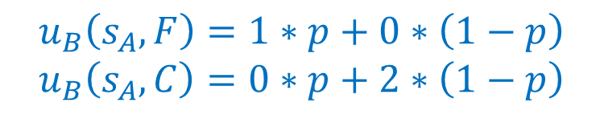
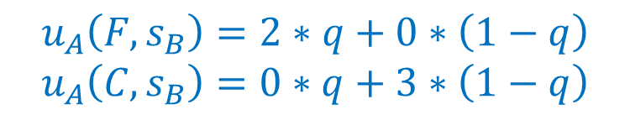


Poll 4
If $s_{A}=(p,1−p)$ and $s_{B}=(q,1−q)$ with $0<p,q<1$ is a NE of the game, which equations should $p$ and $q$ satisfy?
$2q=3\left(1−q\right)$
$2p=3\left(1−p\right)$
$q=2\left(1−q\right)$
$p=2\left(1−p\right)$
$p=q$
$$u_{A}\left(F,s_{B}\right)=u_{A}\left(C,s_{B}\right)$$
$$u_{B}\left(s_{A},C\right)=u_{B}\left(s_{A},C\right)$$
Berry
 | Football | Concert
Football | 2,1 | 0,0
Concert | 0,0 | 3,2
$$u_{A}\left(F,s_{B}\right)=2∗q+0∗\left(1−q\right)$$
$$u_{A}\left(C,s_{B}\right)=0∗q+3∗\left(1−q\right)$$
Alex
$$u_{B}\left(s_{A},F\right)=1∗p+0∗\left(1−p\right)$$
$$u_{B}\left(s_{A},C\right)=0∗p+2∗\left(1−p\right)$$
Notes:
2/3

Slide 56
Solution Concepts in Games
How should one player play and what should we expect all the players to play?
  Dominant strategy and dominant strategy equilibrium
  Nash Equilibrium
  Minimax strategy
  Maximin strategy
  Stackelberg Equilibrium

Slide 57
Solution Concepts in Games
How should one player play and what should we expect all the players to play?
  Dominant strategy and dominant strategy equilibrium
  Nash Equilibrium
  Minimax strategy
  Maximin strategy
  Stackelberg Equilibrium

Slide 58
Maximin and Minimax Strategy
Both focus on single player’s strategy
Maximin Strategy
  Maximize worst case expected utility
  Maximin value (also called safety level)
Minimax Strategy
  Minimize best case expected utility for the other player (just want to harm your opponent)
  Minimax value

Slide 59
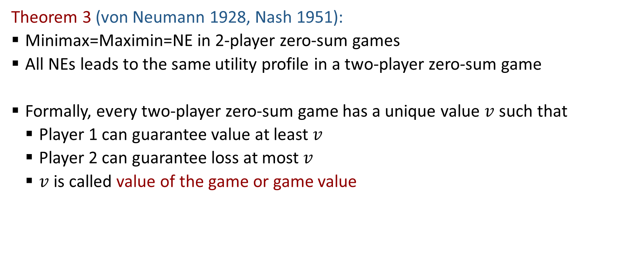
Minimax Theorem
Theorem 3 (von Neumann 1928, Nash 1951):
  Minimax=Maximin=NE in 2-player zero-sum games
  All NEs leads to the same utility profile in a two-player zero-sum game
  Formally, every two-player zero-sum game has a unique value $v$ such that
    Player 1 can guarantee value at least $v$
    Player 2 can guarantee loss at most $v$
    $v$ is called value of the game or game value

Slide 60
Solution Concepts in Games
How should one player play and what should we expect all the players to play?
  Dominant strategy and dominant strategy equilibrium
  Nash Equilibrium
  (Minimax strategy)
  (Maximin strategy)
  Stackelberg Equilibrium

Slide 61
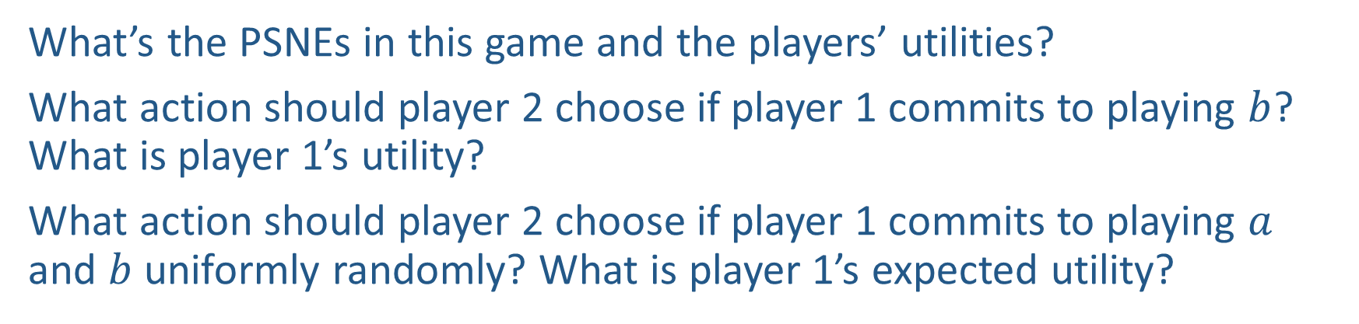
Power of Commitment
What’s the PSNEs in this game and the players’ utilities?
What action should player 2 choose if player 1 commits to playing $b$? What is player 1’s utility?
What action should player 2 choose if player 1 commits to playing $a$ and $b$ uniformly randomly? What is player 1’s expected utility?
Player 2
 | c | d
a | 2,1 | 4,0
b | 1,0 | 3,2
Player 1

Slide 62
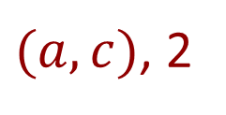

Power of Commitment
$(a,c)$, 2
What’s the PSNEs in this game and the players’ utilities?
What action should player 2 choose if player 1 commits to playing $b$? What is player 1’s utility?
What action should player 2 choose if player 1 commits to playing $a$ and $b$ uniformly randomly? What is player 1’s utility?
d, 3
d, 3.5
Player 2
 | c | d
a | 2,1 | 4,0
b | 1,0 | 3,2
Player 1

Slide 63
Stackelberg Equilibrium
Stackelberg Game
  Leader commits to a strategy first
  Follower responds after observing the leader’s strategy
Stackelberg Equilibrium
  Follower best responds to leader’s strategy
  Leader commits to a strategy that maximize her utility assuming follower best responds
Player 2
 | c | d
a | 2,1 | 4,0
b | 1,0 | 3,2
Player 1

Slide 64

Stackelberg Equilibrium
If the leader can only commit to a pure strategy, or you know that the leader’s strategy in equilibrium is a pure strategy, the equilibrium can be found by enumerating leader’s pure strategy
If ties for the follower are broken by the follower such that the leader benefits, the leader can exploit this. This is the strong Stackelberg equilibrium (SSE)
In general, the leader can commit to a mixed strategy and
$u^{SSE}≥u^{NE}$ (first-mover advantage)!
[Conitzer & Sandholm 2006, von Stengel and Zamir 2010; see also Prof. Fei Fang’s work]
Berry
Player 2
 | Football | Concert
Football | 2,1 | 0,0
Concert | 0,0 | 1,2
 | c | d
a | 2,1 | 4,0
b | 1,0 | 3,2
Alex
Player 1

