Slide 1
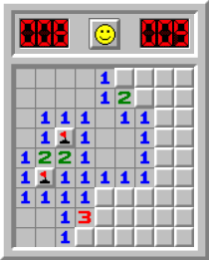
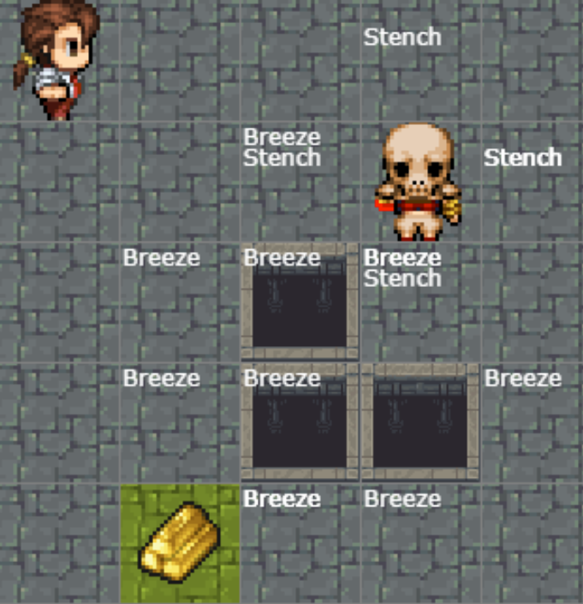
Warm-up:
Play Minesweeper or Wumpus World!
Notes:
0=7, R=4, W=6, U=2, T=8, F=1; 867 + 867 = 1734

Slide 2
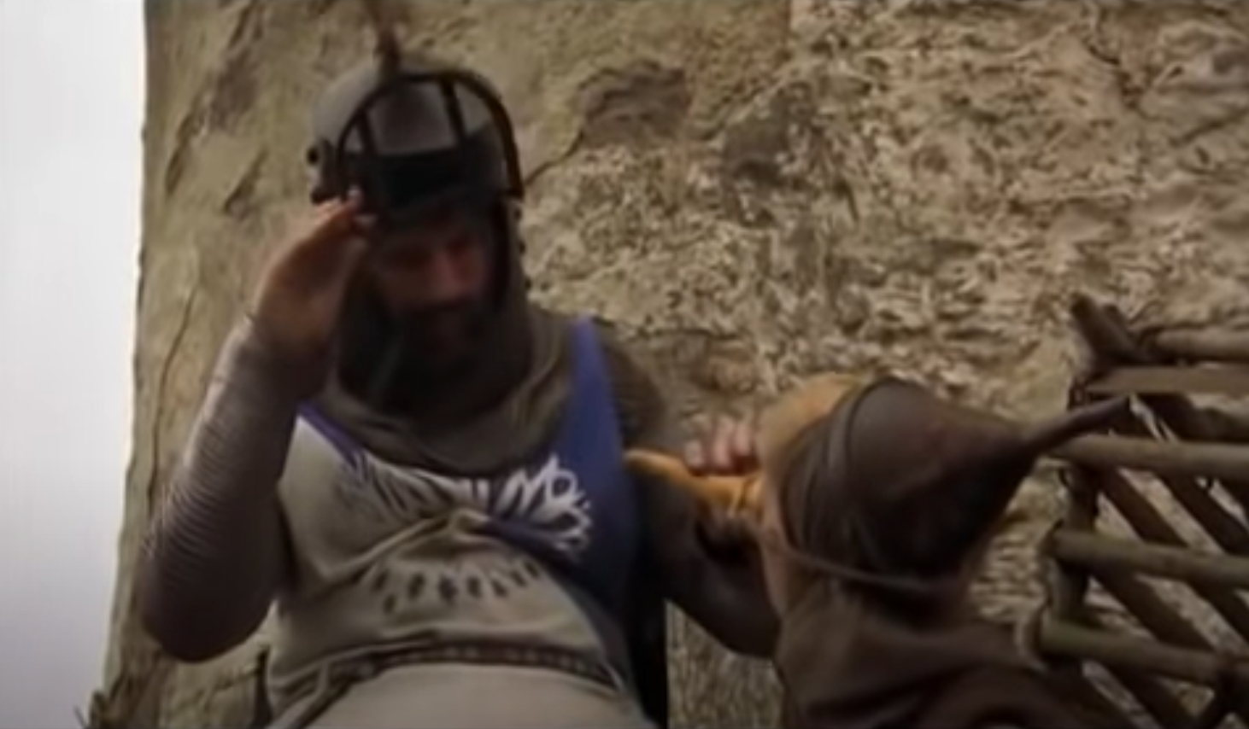
Monty Python Inference
There are ways of telling whether she is a witch
https://www.youtube.com/watch?v=rf71YotfykQ&t=52

Slide 3
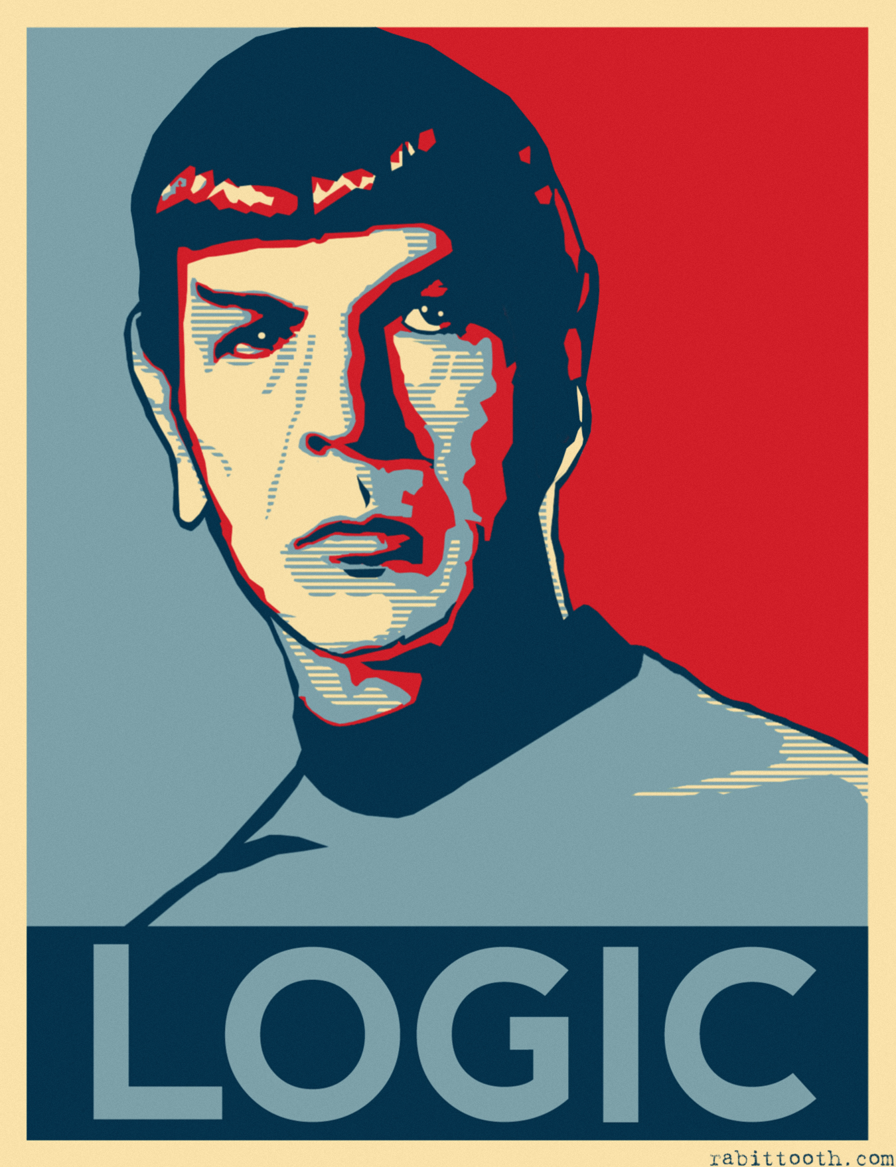
AI: Representation and Problem Solving
Propositional Logic
Instructor: Pat Virtue
Slide credits: CMU AI, http://ai.berkeley.edu

Slide 4
Models and Knowledge Bases Entailment and Satisifiability

Slide 5
Models and Knowledge Bases
Example: Sudoku
Model
Assignment of values to all variables
Knowledge Base
Collection of things we know to be true
Rules of the world
Observations
Things we have figured out
1
2
1
3
4

Slide 6
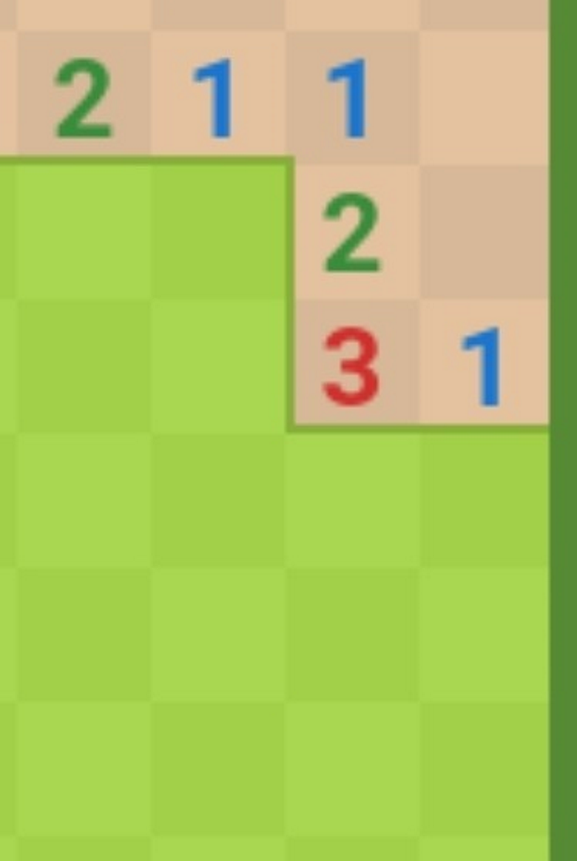
Models and Knowledge Bases
Example: Minesweeper
Model
Assignment of values to all variables
Knowledge Base
Collection of things we know to be true
Rules of the world
Observations
Things we have figured out
Numbers indicate how many mines
 | 1
 | 2

Slide 7
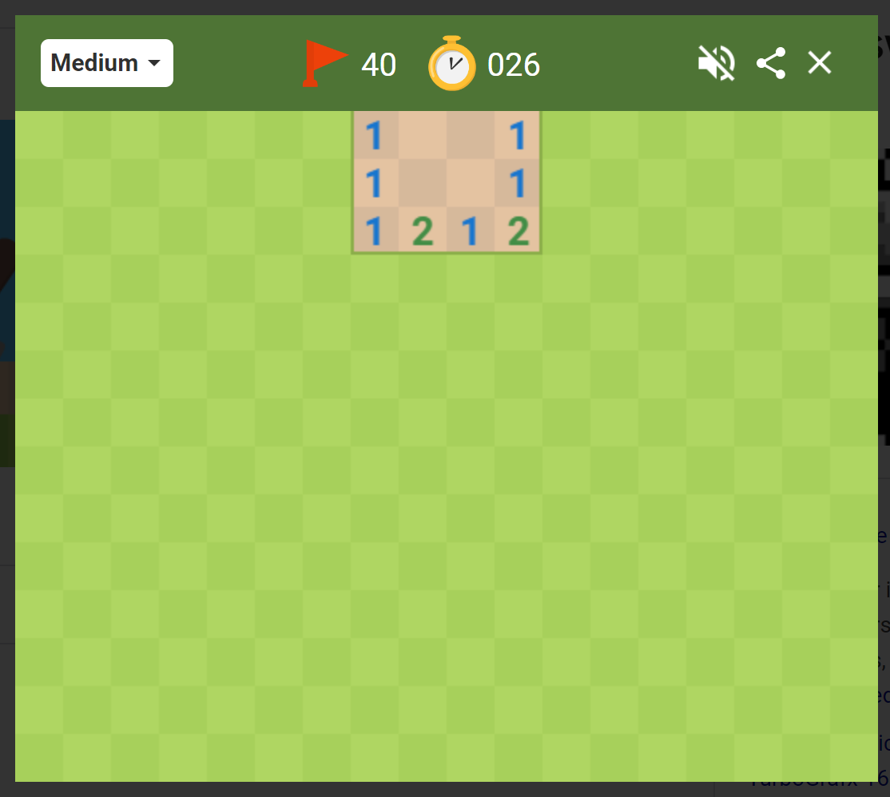
Minesweeper
Numbers indicate how many mines are in the 8 adjacent cells
What are we trying to figure out?
A path (a sequence of actions)?
A complete solution?
 | 1
 | 2
Image: Google Minesweeper game

Slide 8
Minesweeper
Numbers indicate how many mines are in the 8 adjacent cells
 | 1
 | 2
We're trying to figure out what to do next
Which unvisited spaces that are definitely safe?
Which unvisited spaces that are definitely dangerous?
(What about the other spaces?)

Slide 9
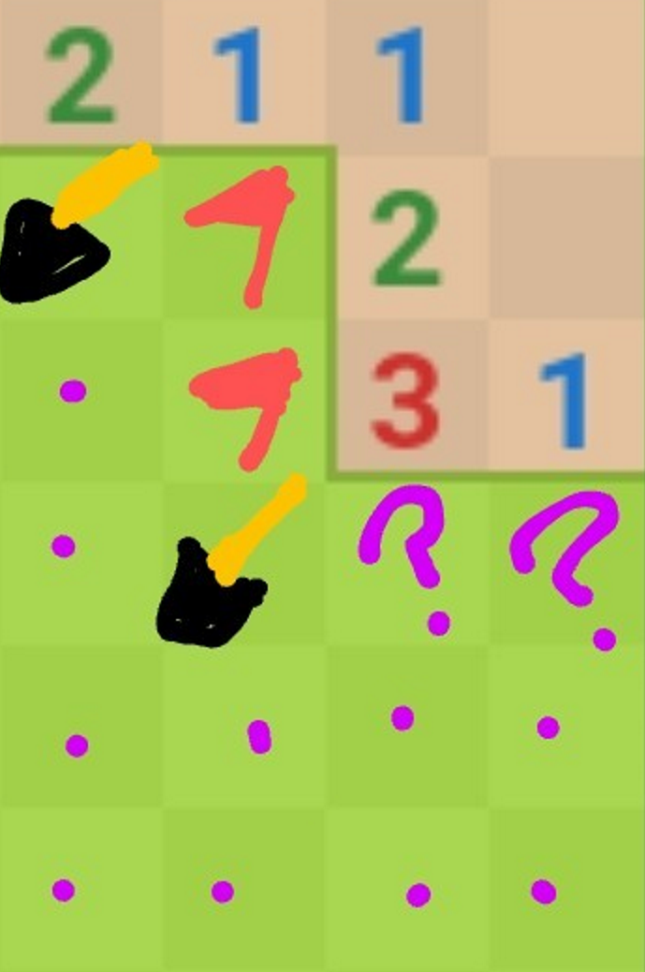
Minesweeper
Numbers indicate how many mines are in the 8 adjacent cells
 | 1
 | 2
We're trying to figure out what to do next
Which unvisited spaces that are definitely safe?
Which unvisited spaces that are definitely dangerous?
(What about the other spaces?)

Slide 10
Minesweeper
It may take a few logical steps to reason about:
What is possible
What is impossible
What is still unknown
Example human inference steps:
?

Slide 11
Minesweeper
It may take a few logical steps to reason about:
What is possible
What is impossible
What is still unknown
Example human inference steps:
?

Slide 12
Entailment and Satisfiability
What reasoning are we doing?
Can I click here? / Is this definitely safe?
Yes: For all possible configurations (models), none of them have a mine in that location
No: There exists (at least) one possible configuration with a mine in that location
Is it possibly safe?
Yes: There exists (at least) one possible configuration with a mine in that location
No: For all possible configurations (models), all of them have a mine in that location → It's definitely dangerous
Entailment: definitely safe
Satisfiability: possibly not safe
Satisfiability: possibly safe
Entailment: definitely not safe

Slide 13
Entailment and Satisfiability
More formally
Symbol (variable)
Models (all symbols assigned a value)
Satisfiable: there exists (at least one) model that meets the constraints
Entailment: statement is true for all models that meet the constraints
How do we get a computer to do this?

Slide 14
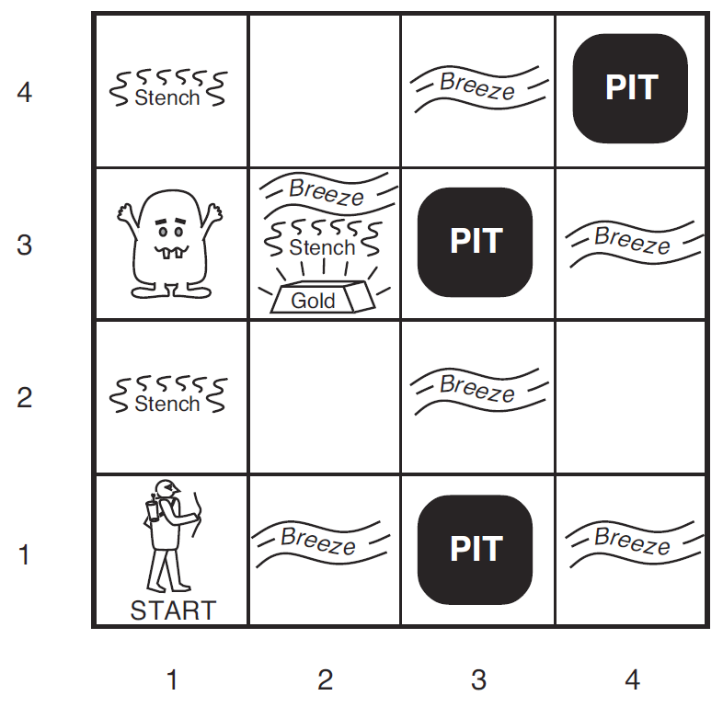
Wumpus World
We collect information as we move to a new grid in the world
Breeze: if next to a Pit
Stench: if next to a Wumpus
Both
Nothing
Oh, and there's gold
We're trying to figure out what to do next
Which unvisited spaces that are definitely safe?
Which unvisited spaces that are definitely dangerous?
(What about the other spaces?)

Slide 15
Wumpus World
Symbols for Wumpus World
B_{ij} = breeze felt
S_{ij} = stench smelt
P_{ij} = pit here
W_{ij} = wumpus here
G = gold
http://thiagodnf.github.io/wumpus-world-simulator/

Slide 16
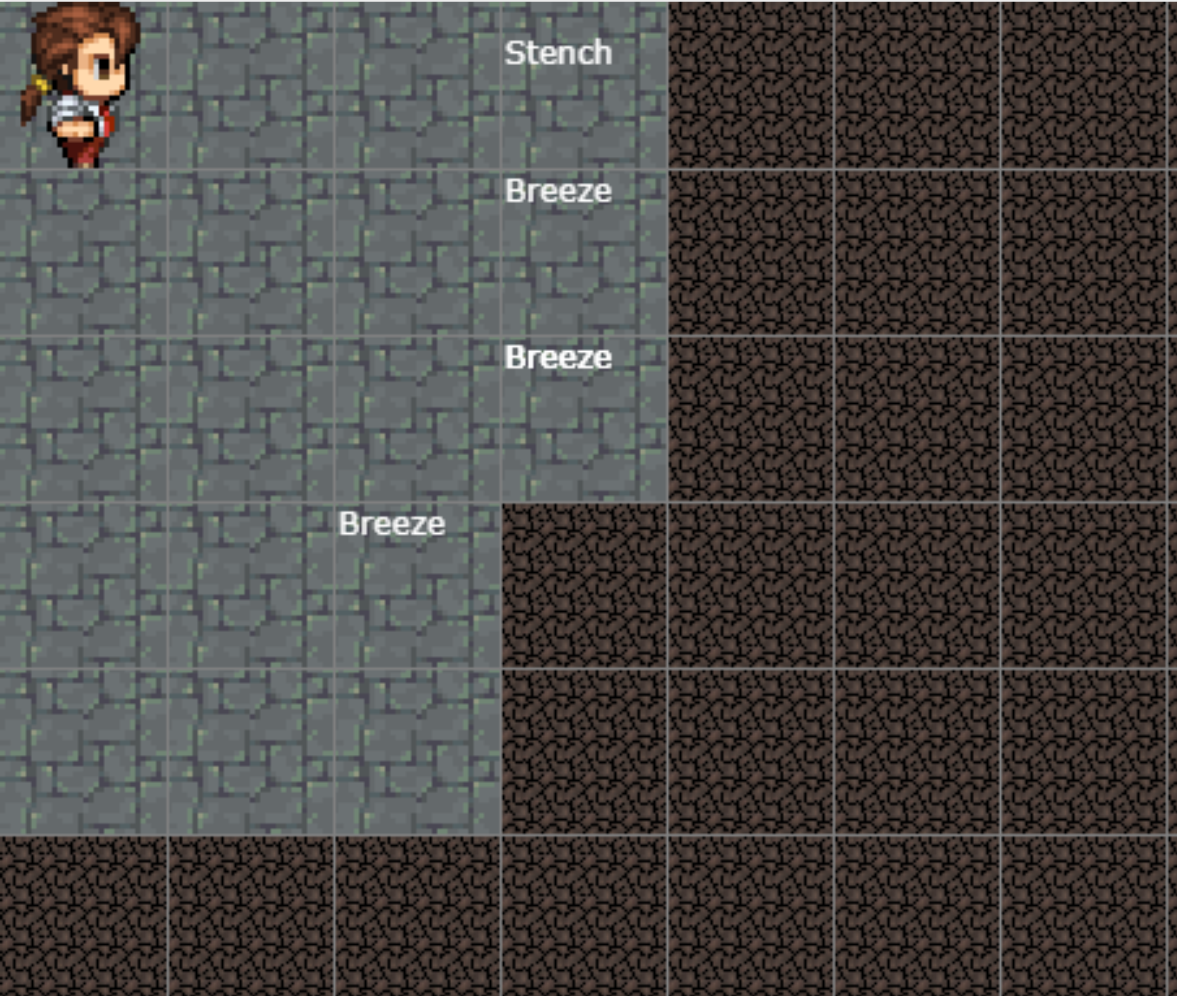
Wumpus World
Reasoning about how to get safely get more information!
http://thiagodnf.github.io/wumpus-world-simulator/

Slide 17
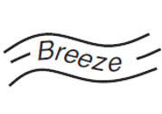
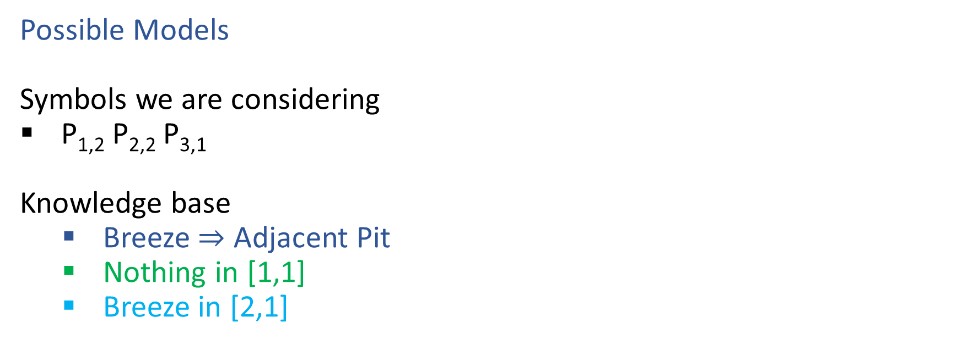

Models and Knowledge Bases: Wumpus World
Possible Models
Symbols we are considering
P_{1,2} P_{2,2} P_{3,1}
Knowledge base
Breeze $⇒$ Adjacent Pit
Nothing in [1,1]
Breeze in [2,1]
2
1
 | 1 | 2 | 3

Slide 18
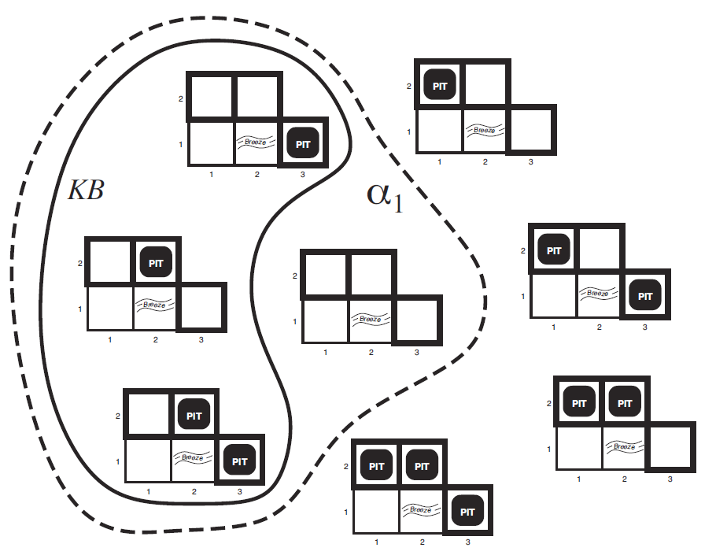
Models and Knowledge Bases: Wumpus World
Possible Models
Symbols we are considering
P_{1,2} P_{2,2} P_{3,1}
Knowledge base
Breeze $⇒$ Adjacent Pit
Nothing in [1,1]
Breeze in [2,1]

Slide 19

Entailment: Wumpus World
Possible Models
Symbols we are considering
P_{1,2} P_{2,2} P_{3,1}
Knowledge base
Breeze $⇒$ Adjacent Pit
Nothing in [1,1]
Breeze in [2,1]

Slide 20
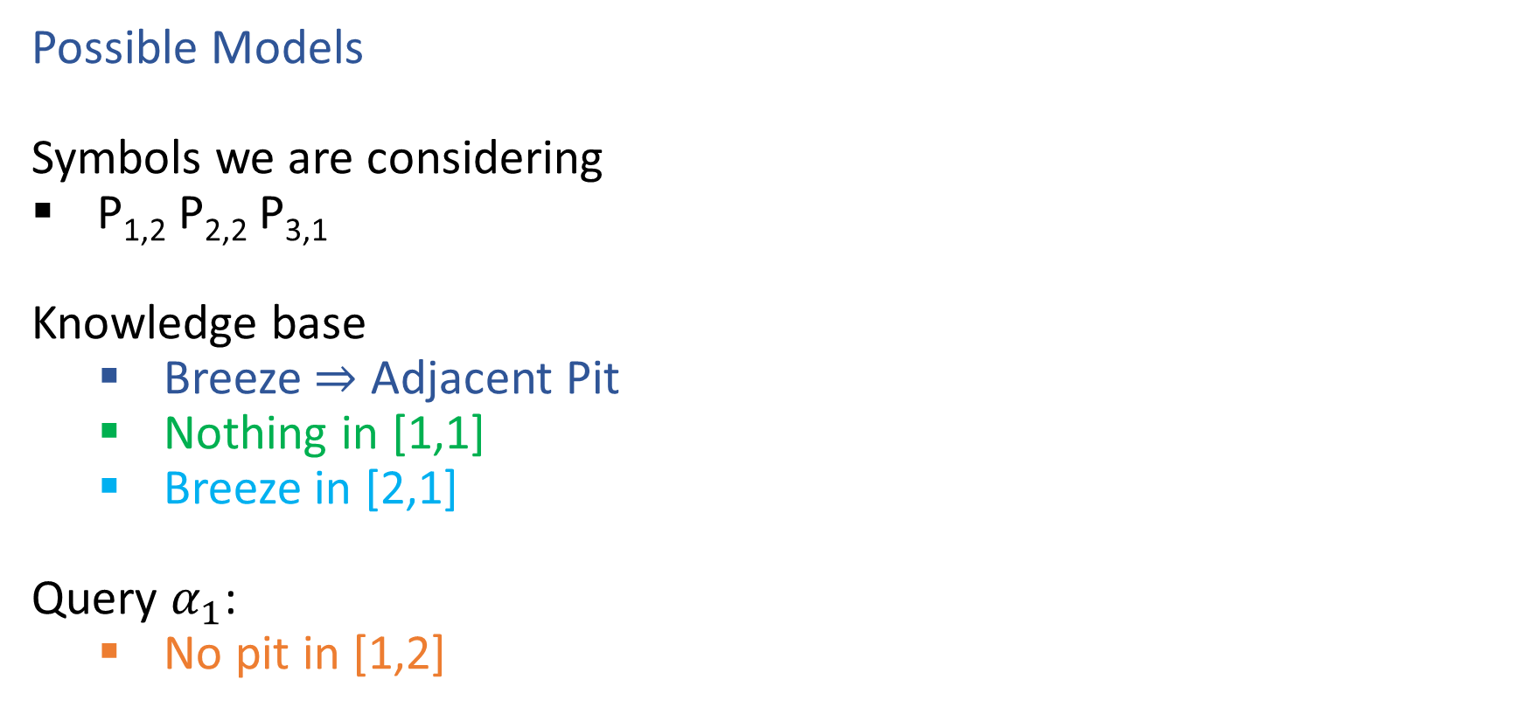
Entailment: Wumpus World
Possible Models
Symbols we are considering
P_{1,2} P_{2,2} P_{3,1}
Knowledge base
Breeze $⇒$ Adjacent Pit
Nothing in [1,1]
Breeze in [2,1]
Query $α_{1}$:
No pit in [1,2]

Slide 21
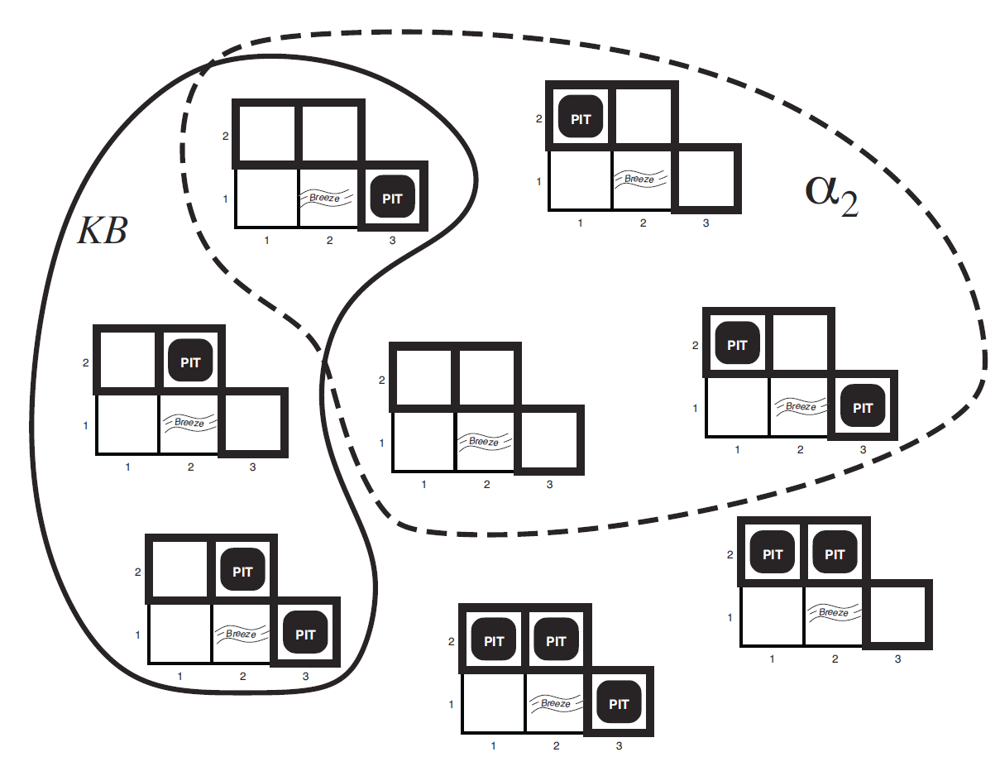
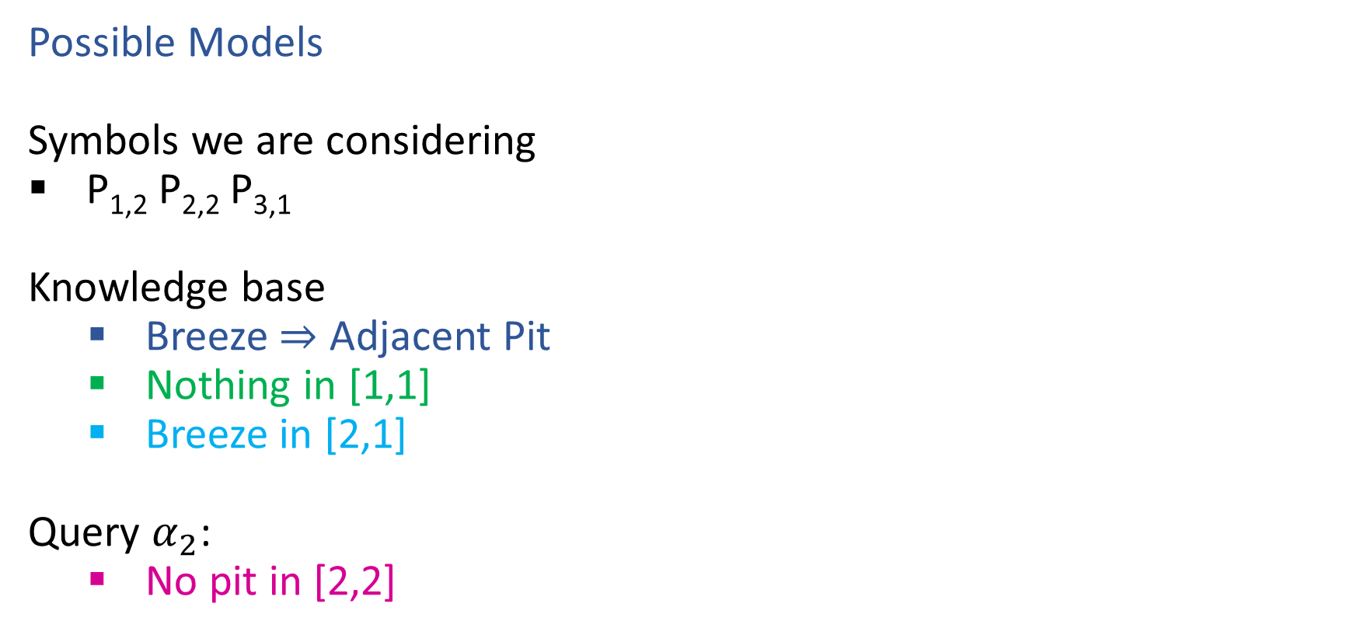
Entailment: Wumpus World
Possible Models
Symbols we are considering
P_{1,2} P_{2,2} P_{3,1}
Knowledge base
Breeze $⇒$ Adjacent Pit
Nothing in [1,1]
Breeze in [2,1]
Query $α_{2}$:
No pit in [2,2]

Slide 22
Entailment
Entailment: α |= β (“α entails β” or “β follows from α”) iff in every world where α is true, β is also true
I.e., the α-worlds are a subset of the β-worlds [models(α) ⊆ models(β)]
Usually, we want to know if KB |= query
models(KB) ⊆ models(query)
In other words
KB removes all impossible models (any model where KB is false)
If query is true in all of these remaining models, we conclude that query must be true
Entailment and implication are very much related
However, entailment relates two sentences, while an implication is itself a sentence (usually derived via inference to show entailment)

Slide 23
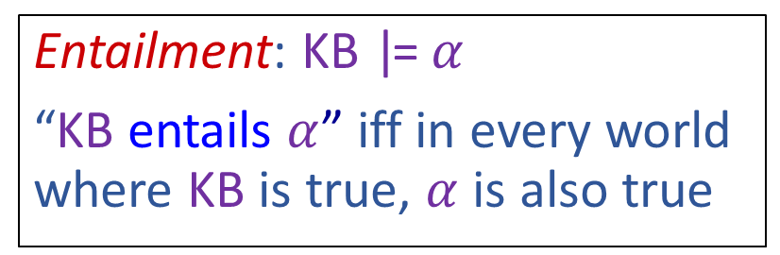
Entailment: Wumpus World
Possible Models
Symbols we are considering
P_{1,2} P_{2,2} P_{3,1}
Knowledge base
Breeze $⇒$ Adjacent Pit
Nothing in [1,1]
Breeze in [2,1]
Query $α_{1}$:
No pit in [1,2]
Entailment: KB |= $α$
“KB entails $α$” iff in every world where KB is true, $α$ is also true

Slide 24
Entailment: Wumpus World
Possible Models
Symbols we are considering
P_{1,2} P_{2,2} P_{3,1}
Knowledge base
Breeze $⇒$ Adjacent Pit
Nothing in [1,1]
Breeze in [2,1]
Query $α_{2}$:
No pit in [2,2]
Entailment: KB |= $α$
“KB entails $α$” iff in every world where KB is true, $α$ is also true

Slide 25
High-level View: Logical Agents

Slide 26
Logical Agents
Logical agents and environments
Agent
Environment
Sensors
Percepts
Knowledge Base
Inference
?
Actuators
Actions

Slide 27
Logical Agents
So what do we TELL our knowledge base (KB)?
Facts (sentences)
The grass is green
The sky is blue
Rules (sentences)
Eating too much candy makes you sick
When you’re sick you don’t go to school
Percepts and Actions (sentences)
Pat ate too much candy today
What happens when we ASK the agent?
Inference – new sentences created from old
Pat is not going to school today

Slide 28
A Knowledge-based Agent
function KB-AGENT(percept) returns an action
persistent: KB, a knowledge base
persistent: t, an integer, initially 0
TELL(KB, PROCESS-PERCEPT(percept, t))
action ← ASK(KB, PROCESS-QUERY(t))
TELL(KB, PROCESS-RESULT(action, t))
t←t+1
return action

Slide 29
Outline
Models and Knowledge Bases
Entailment and Satisfiability
How to get a computer to do this?
Need:
Representation: Language
PL
FoL
Problem Solving: Algorithm
Model checking: try them all
Theorem proving: logical steps

Slide 30
Logic Language
Natural language?
Propositional logic
Syntax: P ∨ (¬Q ∧ R); X₁ ⇔ (Raining ⇒ Sunny)
Possible model: {P=true, Q=true, R=false, S=true} or 1101
Semantics: α ∧ β is true for a model iff is α true and β is true (etc.)
First-order logic
Syntax: ∀x ∃y P(x,y) ∧ ¬Q(Joe,f(x)) ⇒ f(x)=f(y)
Possible model: Objects o₁, o₂, o₃; P holds for <o₁,o₂>; Q holds for <o₃>; f(o₁)=o₁; Joe=o₃; etc.
Semantics: φ(σ) is true for a model if σ=o_{j} and φ holds for o_{j}; etc.

Slide 31
Propositional Logic

Slide 32
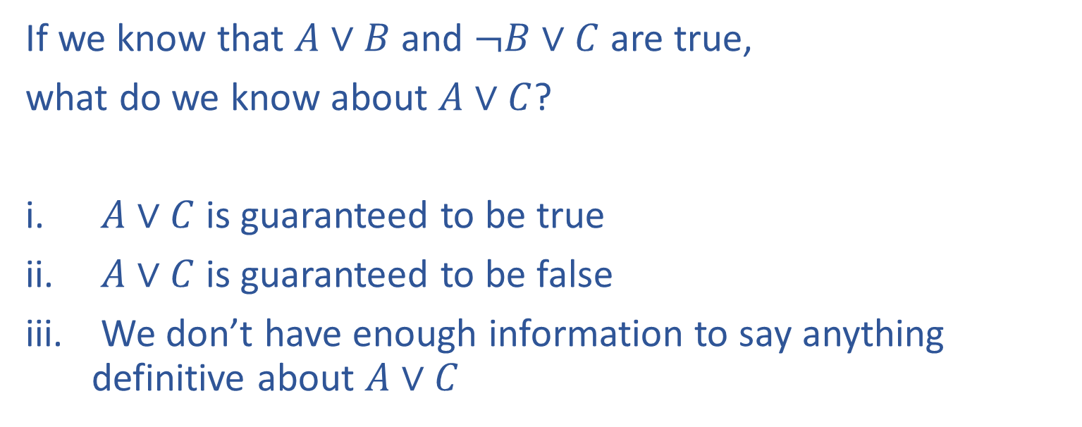
Poll 1
If we know that $A∨B$ and $¬B∨C$ are true,
what do we know about $A∨C$?
$A∨C$ is guaranteed to be true
$A∨C$ is guaranteed to be false
We don’t have enough information to say anything definitive about $A∨C$

Slide 33
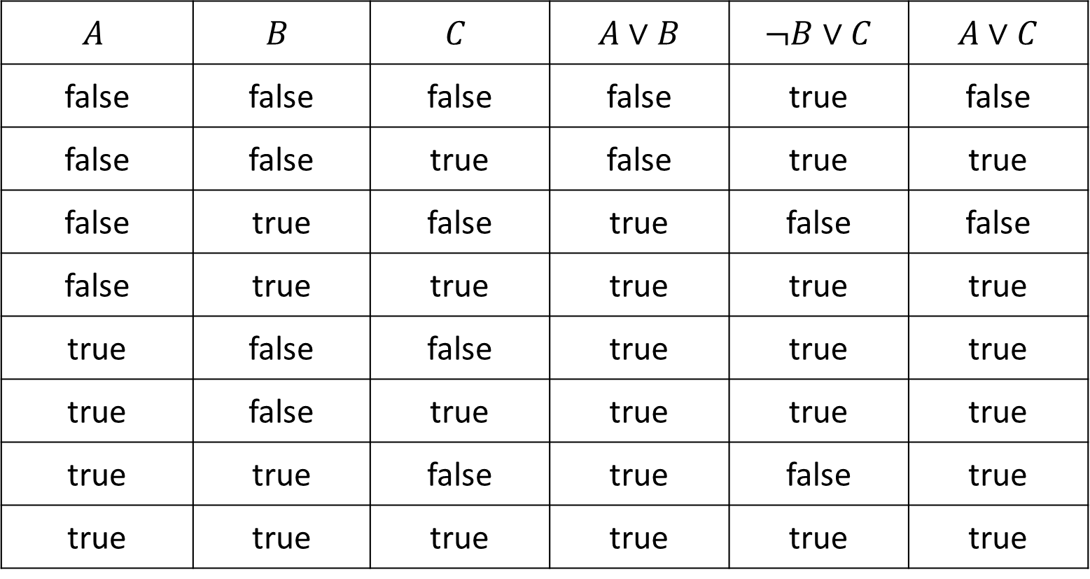
Poll 1
If we know that $A∨B$ and $¬B∨C$ are true, what do we know about $A∨C$?
$$A$$ | $$B$$ | $$C$$ | $A∨B$ | $¬B∨C$ | $A∨C$
false | false | false | false | true | false
false | false | true | false | true | true
false | true | false | true | false | false
false | true | true | true | true | true
true | false | false | true | true | true
true | false | true | true | true | true
true | true | false | true | false | true
true | true | true | true | true | true

Slide 34
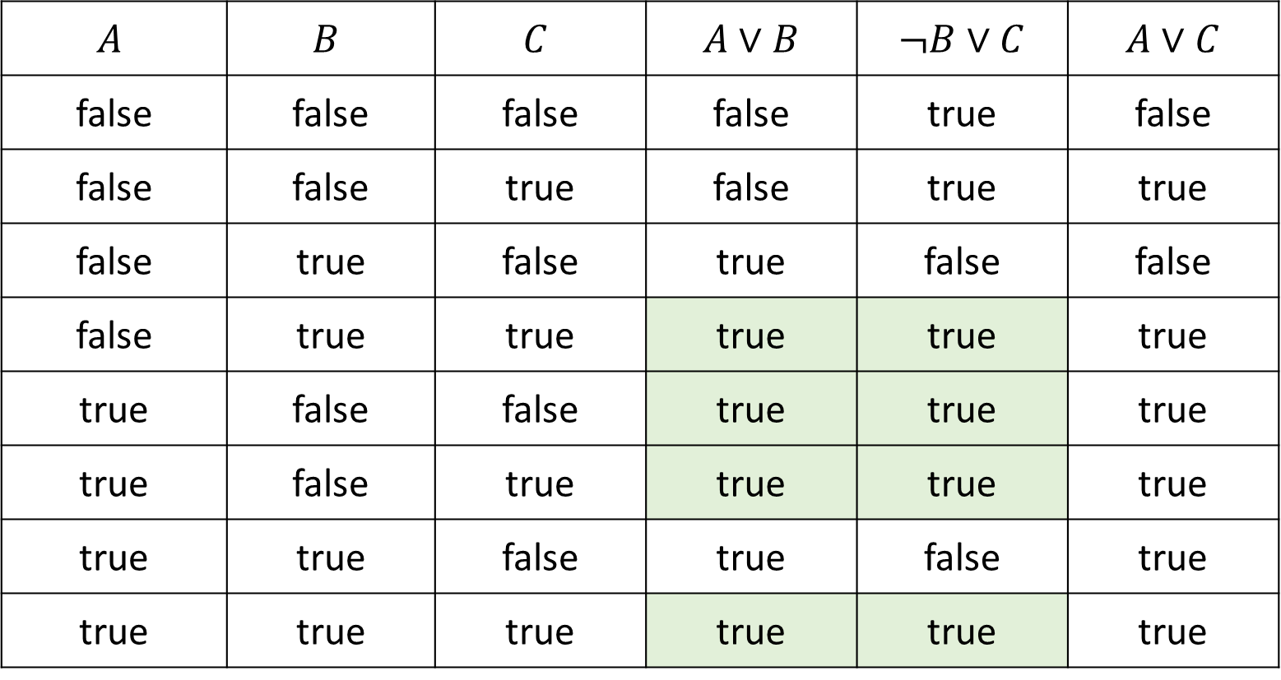
Poll 1
If we know that $A∨B$ and $¬B∨C$ are true, what do we know about $A∨C$?
$$A$$ | $$B$$ | $$C$$ | $A∨B$ | $¬B∨C$ | $A∨C$
false | false | false | false | true | false
false | false | true | false | true | true
false | true | false | true | false | false
false | true | true | true | true | true
true | false | false | true | true | true
true | false | true | true | true | true
true | true | false | true | false | true
true | true | true | true | true | true

Slide 35
Poll 1
If we know that $A∨B$ and $¬B∨C$ are true,
what do we know about $A∨C$?
$A∨C$ is guaranteed to be true
$A∨C$ is guaranteed to be false
We don’t have enough information to say anything definitive about $A∨C$

Slide 36
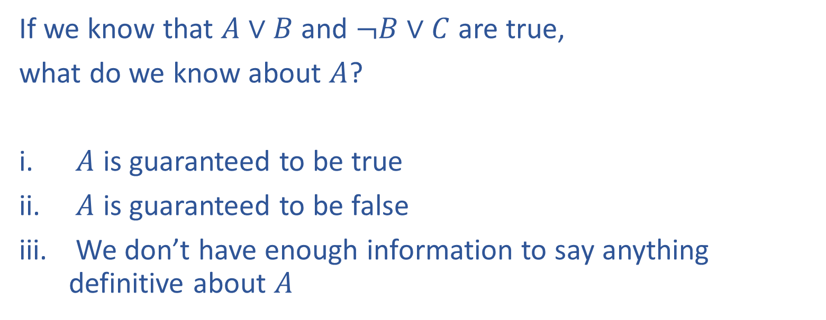
Poll 2
If we know that $A∨B$ and $¬B∨C$ are true,
what do we know about $A$?
$A$ is guaranteed to be true
$A$ is guaranteed to be false
We don’t have enough information to say anything definitive about $A$

Slide 37
Poll 2
If we know that $A∨B$ and $¬B∨C$ are true, what do we know about $A$?
$$A$$ | $$B$$ | $$C$$ | $A∨B$ | $¬B∨C$ | $A∨C$
false | false | false | false | true | false
false | false | true | false | true | true
false | true | false | true | false | false
false | true | true | true | true | true
true | false | false | true | true | true
true | false | true | true | true | true
true | true | false | true | false | true
true | true | true | true | true | true

Slide 38
Poll 2
If we know that $A∨B$ and $¬B∨C$ are true,
what do we know about $A$?
$A$ is guaranteed to be true
$A$ is guaranteed to be false
We don’t have enough information to say anything definitive about $A$

Slide 39
Propositional Logic
Symbol:
Variable that can be true or false
We’ll try to use capital letters, e.g. A, B, P_{1,2}
Often include True and False
Operators:
¬ A: not A
A ∧ B: A and B (conjunction)
A ∨ B: A or B (disjunction) Note: this is not an “exclusive or”
A ⇒ B: A implies B (implication). If A then B
A ⇔ B: A if and only if B (biconditional)
Sentences

Slide 40
Propositional Logic Syntax
Given: a set of proposition symbols {X₁, X₂, …, X_{n}}
(we often add True and False for convenience)
X_{i} is a sentence
If α is a sentence then ¬α is a sentence
If α and β are sentences then α ∧ β is a sentence
If α and β are sentences then α ∨ β is a sentence
If α and β are sentences then α ⇒ β is a sentence
If α and β are sentences then α ⇔ β is a sentence
And p.s. there are no other sentences!

Slide 41
Notes on Operators
𝛂 ∨ 𝛃 is inclusive or, not exclusive

Slide 42
Truth Tables
𝛂 ∨ 𝛃 is inclusive or, not exclusive
𝛂 | 𝛃 | 𝛂 ∧ 𝛃
F | F | F
F | T | F
T | F | F
T | T | T
𝛂 | 𝛃 | 𝛂 ∨ 𝛃
F | F | F
F | T | T
T | F | T
T | T | T

Slide 43
Notes on Operators
𝛂 ∨ 𝛃 is inclusive or, not exclusive
𝛂 ⇒ 𝛃 is equivalent to ¬𝛂 ∨ 𝛃
Says who?

Slide 44
Truth Tables
𝛂 ⇒ 𝛃 is equivalent to ¬𝛂 ∨ 𝛃
𝛂 | 𝛃 | 𝛂 ⇒ 𝛃 | ¬𝛂 | ¬𝛂 ∨ 𝛃
F | F | T | T | T
F | T | T | T | T
T | F | F | F | F
T | T | T | F | T

Slide 45
Notes on Operators
𝛂 ∨ 𝛃 is inclusive or, not exclusive
𝛂 ⇒ 𝛃 is equivalent to ¬𝛂 ∨ 𝛃
Says who?
𝛂 ⇔ 𝛃 is equivalent to (𝛂 ⇒ 𝛃) ∧ (𝛃 ⇒ 𝛂)
Prove it!

Slide 46
Truth Tables
𝛂 ⇔ 𝛃 is equivalent to (𝛂 ⇒ 𝛃) ∧ (𝛃 ⇒ 𝛂)
𝛂 | 𝛃 | 𝛂 ⇔ 𝛃 | 𝛂 ⇒ 𝛃 | 𝛃 ⇒ 𝛂 | (𝛂⇒𝛃) ∧ (𝛃⇒𝛂)
F | F | T | T | T | T
F | T | F | T | F | F
T | F | F | F | T | F
T | T | T | T | T | T
Equivalence: it’s true in all models. Expressed as a logical sentence:
(𝛂 ⇔ 𝛃) ⇔ [(𝛂 ⇒ 𝛃) ∧ (𝛃 ⇒ 𝛂)]

Slide 47
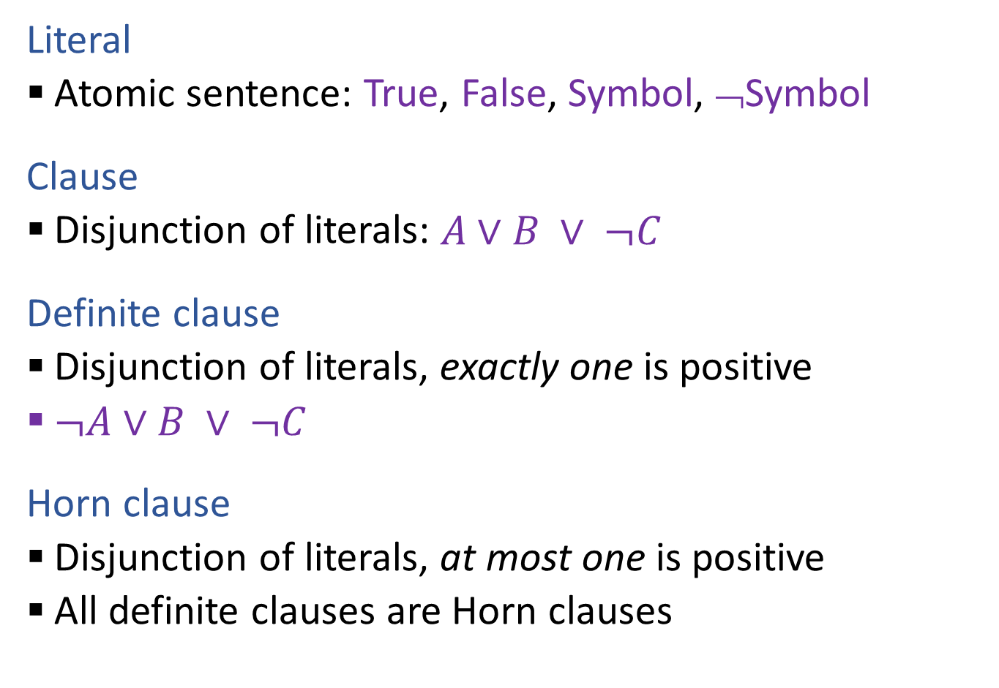
Propositional Logical Vocab
Literal
Atomic sentence: True, False, Symbol, ¬Symbol
Clause
Disjunction of literals: $A∨B ∨ ¬C$
Definite clause
Disjunction of literals, exactly one is positive
$¬A∨B ∨ ¬C$
Horn clause
Disjunction of literals, at most one is positive
All definite clauses are Horn clauses
Vocab Alert!

Slide 48
Propositional Logic
Check if sentence is true in given model
In other words, does the model satisfy the sentence?
function PL-TRUE?(α,model) returns true or false
if α is a symbol then return Lookup(α, model)
if Op(α) = ¬ then return not(PL-TRUE?(Arg1(α),model))
if Op(α) = ∧ then return and(PL-TRUE?(Arg1(α),model),
PL-TRUE?(Arg2(α),model))
etc.
(Sometimes called “recursion over syntax”)

Slide 49
Outline
Models and Knowledge Bases
Entailment and Satisfiability
How to get a computer to do this?
Need:
Representation: Language
PL
FoL
Problem Solving: Algorithm
Model checking: try them all
Theorem proving: logical steps

