Slide 1
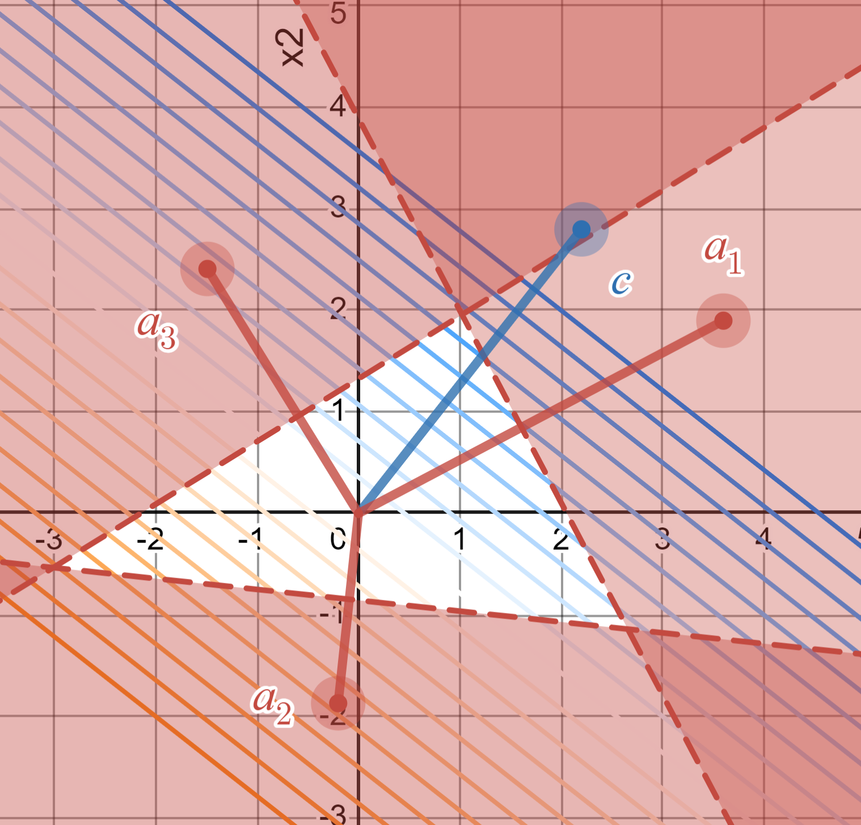
Warm-up as you walk in
What is the solution to this LP?
https://www.desmos.com/calculator/tnlo7p5plp

Slide 2
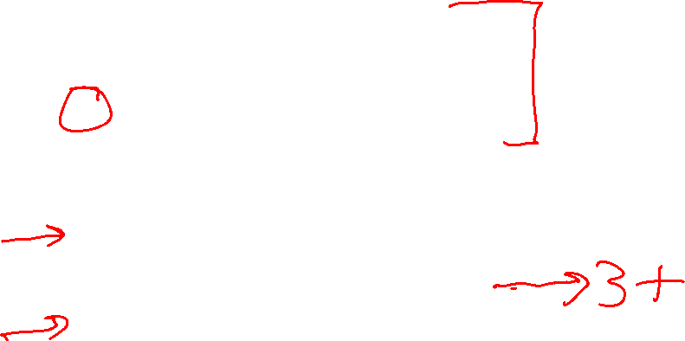
Plan
Last Time
Linear programming formulation
    Problem description
    Graphical representation
    Optimization representation
Today
Solving linear programs
Higher dimensions than just 2
Integer programs

Slide 3
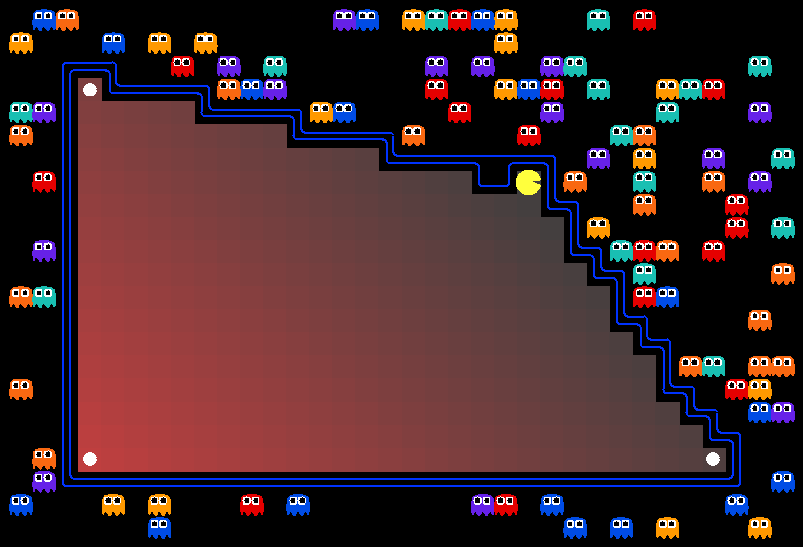
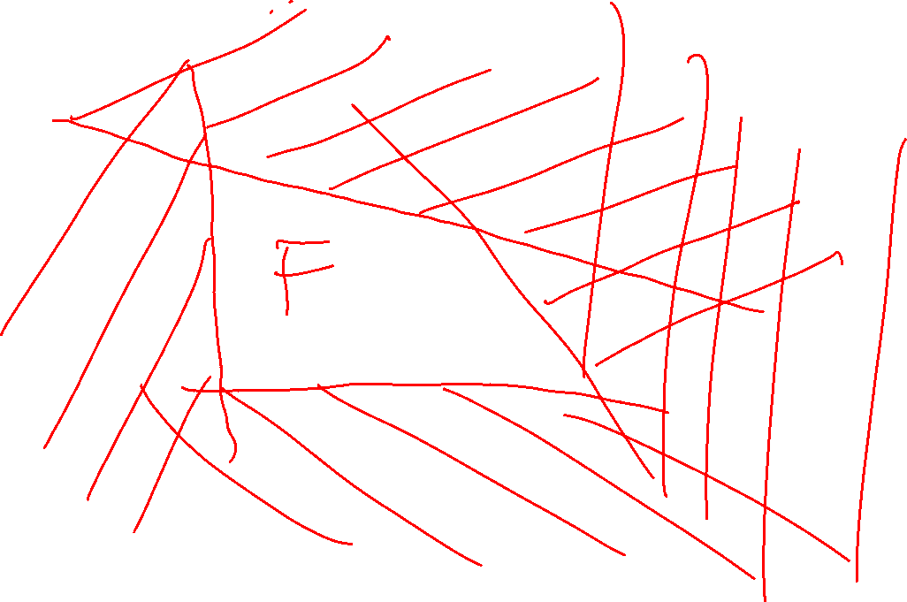
AI: Representation and Problem Solving
Integer Programming
Instructor: Pat Virtue
Slide credits: CMU AI with drawings from http://ai.berkeley.edu

Slide 4
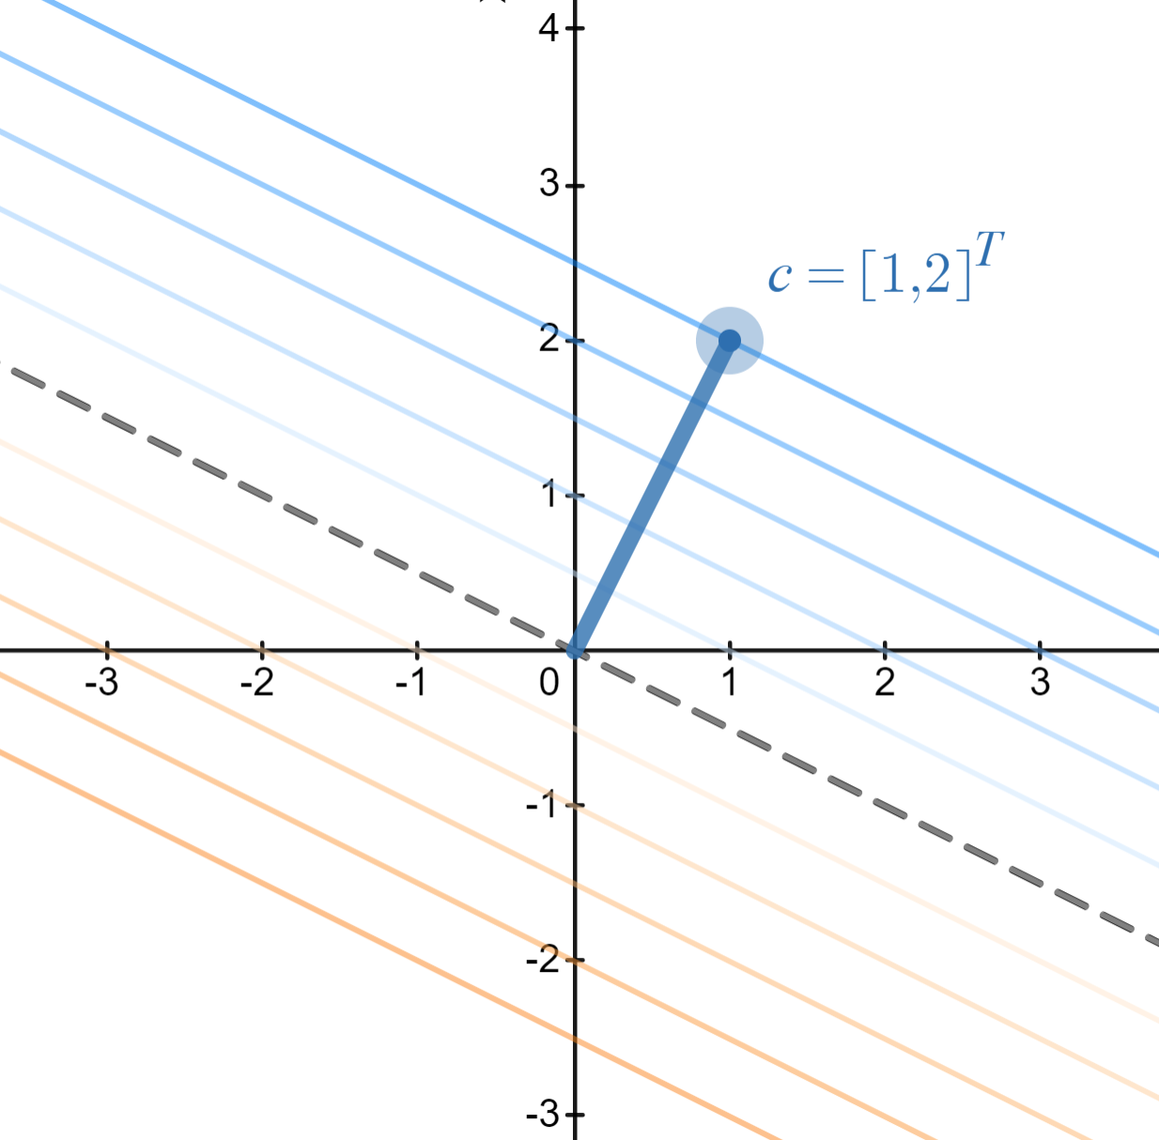
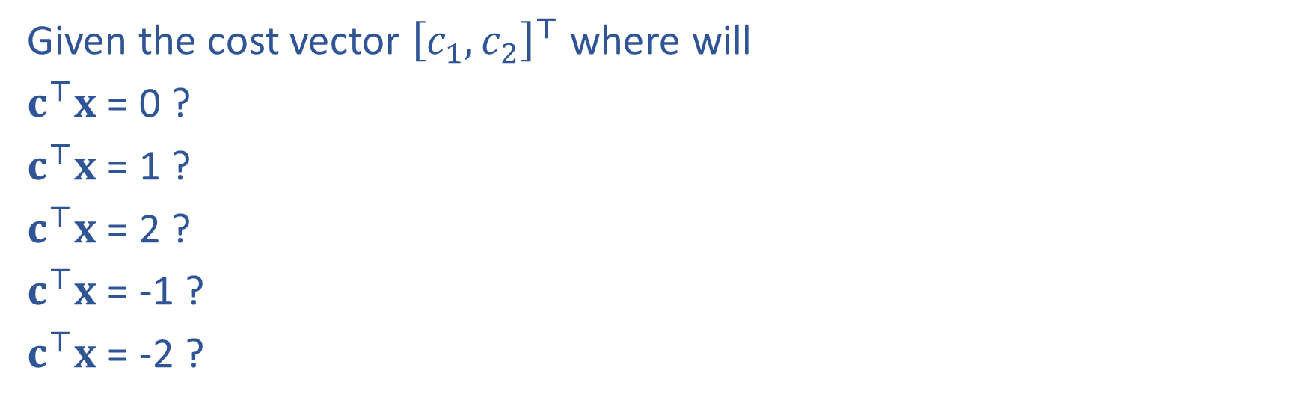
Reminder: Cost Contours
Given the cost vector ${\left[c_{1}, c_{2}\right]}^{⊤}$ where will
$c^{⊤}x$ = 0 ?
$c^{⊤}x$ = 1 ?
$c^{⊤}x$ = 2 ?
$c^{⊤}x$ = -1 ?
$c^{⊤}x$ = -2 ?
https://www.desmos.com/calculator/8d9kxbdq9u

Slide 5
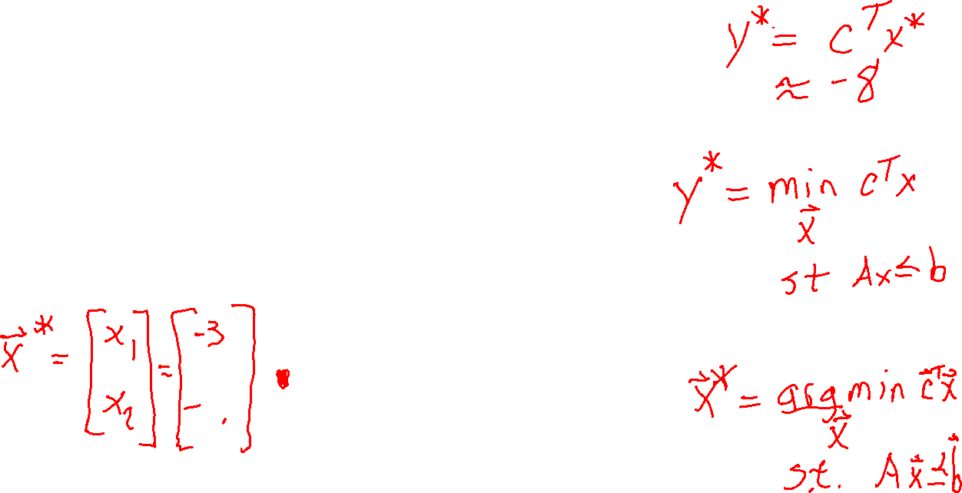
Solving a Linear Program
What is the solution to this LP?
https://www.desmos.com/calculator/tnlo7p5plp

Slide 6
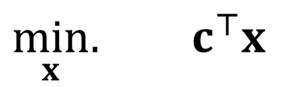
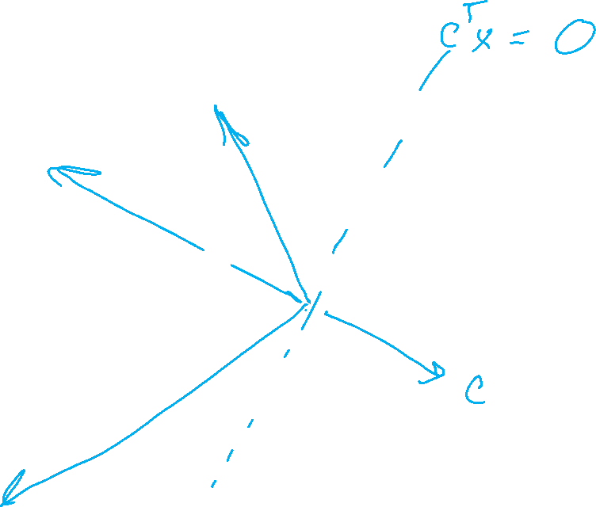
Solving a Linear Program
Inequality form, with no constraints
$\min_{x}.{ c^{⊤}x}$

Slide 7
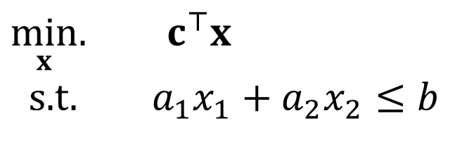
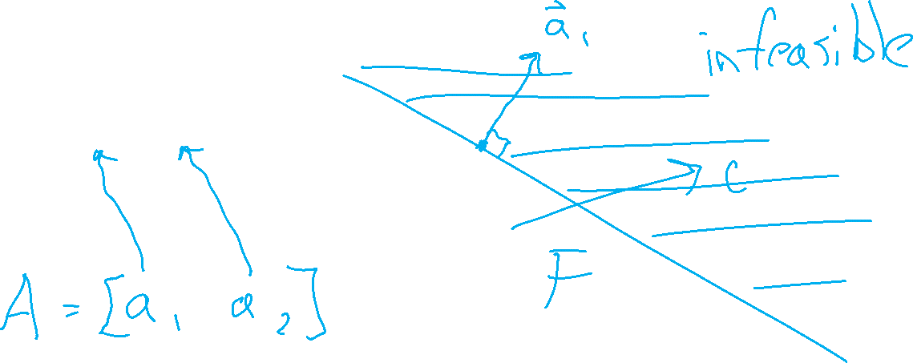
Solving a Linear Program
Inequality form, with one constraint
$\min_{x}.{ c^{⊤}x}$
s.t. $a_{1}x_{1}+a_{2}x_{2}≤b$

Slide 8

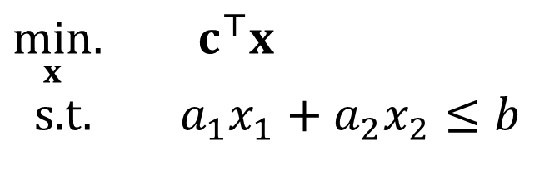
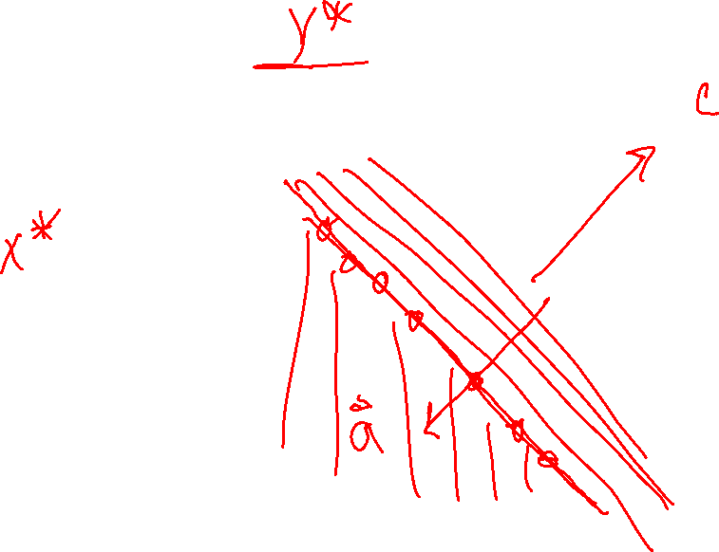
Poll 1
True or False: A minimizing LP with exactly on constraint, will always have a minimum objective at $−∞$.
$\min_{x}.{ c^{⊤}x}$
s.t. $a_{1}x_{1}+a_{2}x_{2}≤b$

Slide 9
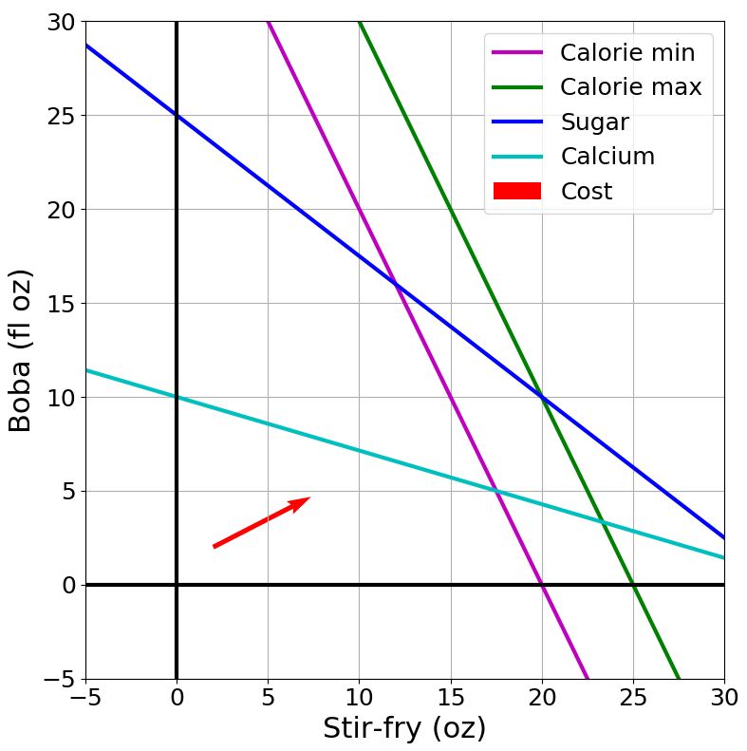

Solving an LP
Solutions are at feasible intersections
of constraint boundaries!!
Algorithms
Check objective at all feasible intersections
In more detail:
Enumerate all intersections
Keep only those that are feasible (satisfy all inequalities)
Return feasible intersection with the lowest objective value

Slide 10
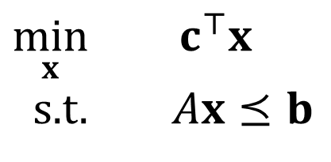
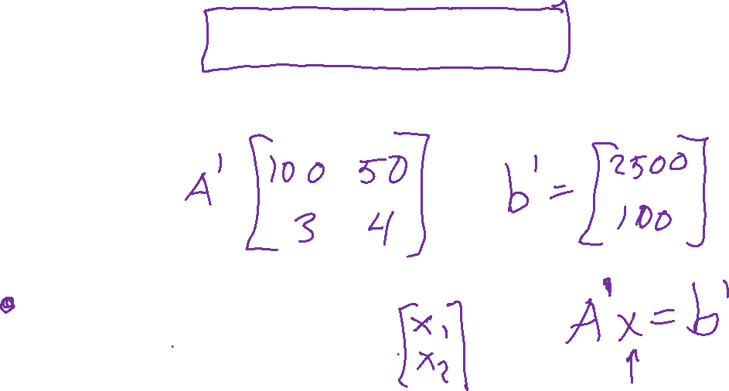
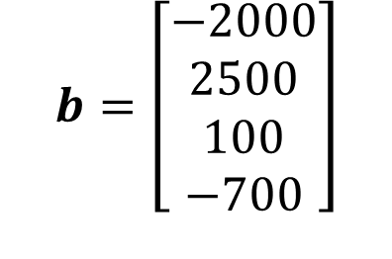
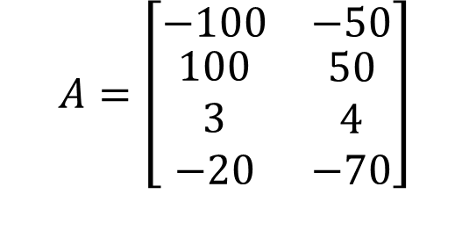
Solving an LP
But, how do we find the intersection between boundaries?
$$A=\left[\begin{matrix}−100 & −50 \\ \begin{aligned}100 \\ 3 \\ −20\end{aligned} & \begin{aligned}50 \\ 4 \\ −70\end{aligned}\end{matrix}\right]$$
$$b=\left[\begin{aligned}−2000 \\ 2500 \\ 100 \\ −700\end{aligned}\right]$$
Calorie min
$\min_{x}{ c^{⊤}x}$
s.t. $Ax⪯b$
Calorie max
Sugar
Calcium

Slide 11
Solving an LP
Solutions are at feasible intersections
of constraint boundaries!!
Algorithms
Check objective at all feasible intersections
Simplex

Slide 12
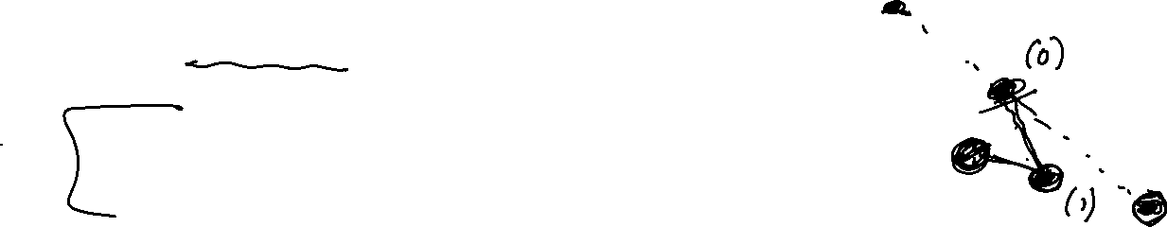
Solving an LP
Simplex algorithm
Start at a feasible intersection (if not trivial, can solve another LP to find one)
Define successors as “neighbors” of current intersection
  i.e., remove one row from our square subset of A, and add another row not in the subset; then check feasibility
Move to any successor with lower objective than current intersection
  If no such successors, we are done
Greedy local hill-climbing search! … but always finds optimal solution

Slide 13
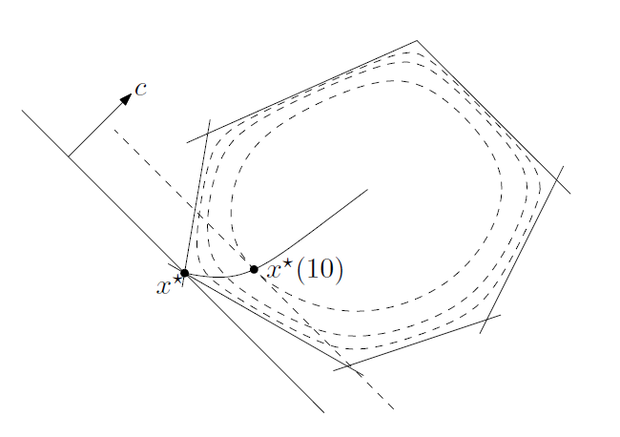

Solving an LP
Solutions are at feasible intersections
of constraint boundaries!!
Algorithms
Check objective at all feasible intersections
Simplex
Interior Point
Figure 11.2 from Boyd and Vandenberghe, Convex Optimization

Slide 14
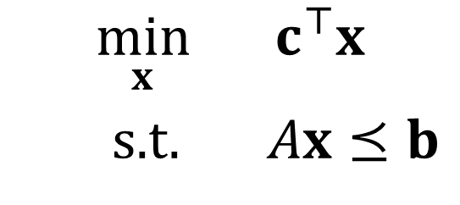
What about higher dimensions?
Problem Description
Graphical Representation
Optimization Representation
$$\min_{x}{ c^{⊤}x}$$
s.t. $Ax⪯b$

Slide 15

“Marty, you’re not thinking fourth-dimensionally”
https://www.youtube.com/watch?v=CUcNM7OsdsY

Slide 16
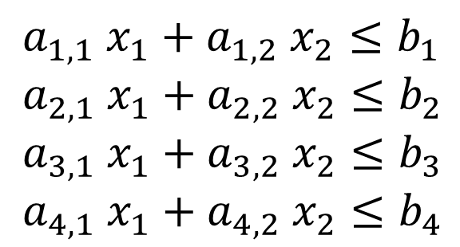

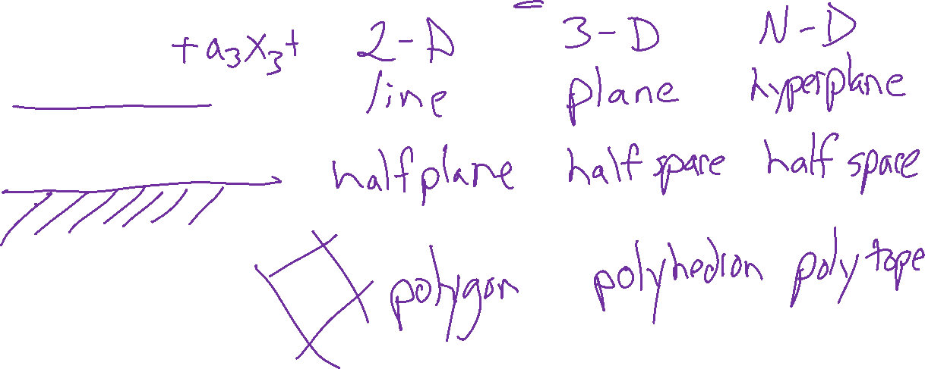

Shapes in higher dimensions
How do these linear shapes extend to 3-D, N-D?
$$a_{1} x_{1}+a_{2} x_{2}=b_{1}$$
$$a_{1} x_{1}+a_{2} x_{2}≤b_{1}$$
$a_{1,1} x_{1}+a_{1,2} x_{2}≤b_{1}$
$a_{2,1} x_{1}+a_{2,2} x_{2}≤b_{2}$
$a_{3,1} x_{1}+a_{3,2} x_{2}≤b_{3}$
$a_{4,1} x_{1}+a_{4,2} x_{2}≤b_{4}$

Slide 17
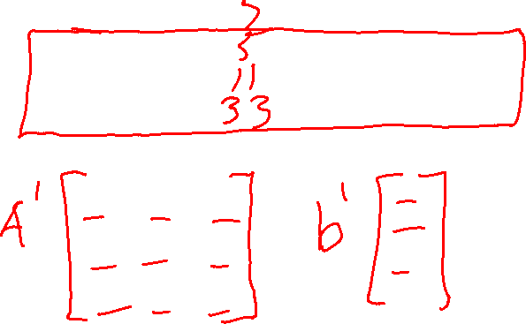


What are intersections in higher dimensions?
How do these linear shapes extend to 3-D, N-D?
$$A=\left[\begin{matrix}−100 & −50 \\ \begin{aligned}100 \\ 3 \\ −20\end{aligned} & \begin{aligned}50 \\ 4 \\ −70\end{aligned} \end{matrix}\right]$$
$$b=\left[\begin{aligned}−2000 \\ 2500 \\ 100 \\ −700\end{aligned}\right]$$
Calorie min
$\min_{x}{ c^{⊤}x}$
s.t. $Ax⪯b$
Calorie max
Sugar
Calcium

Slide 18

How do we find intersections in higher dimensions?
Still looking at subsets of $A$ matrix
$$A=\left[\begin{matrix}−100 & −50 \\ \begin{aligned}100 \\ 3 \\ −20\end{aligned} & \begin{aligned}50 \\ 4 \\ −70\end{aligned} \end{matrix}\right]$$
$$b=\left[\begin{aligned}−2000 \\ 2500 \\ 100 \\ −700\end{aligned}\right]$$
Calorie min
$\min_{x}{ c^{⊤}x}$
s.t. $Ax⪯b$
Calorie max
Sugar
Calcium

Slide 19
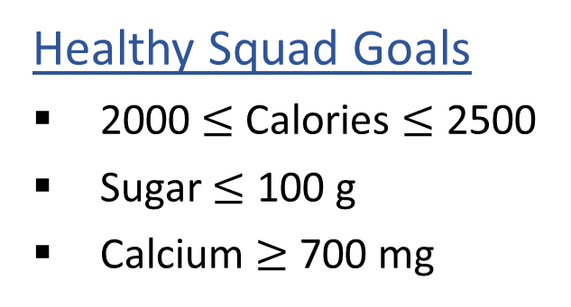

Linear Programming
We are trying healthy by finding the optimal amount of food to purchase.
We can choose the amount of stir-fry (ounce) and boba (fluid ounces).
Healthy Squad Goals
2000 $≤$ Calories $≤$ 2500
Sugar $≤$ 100 g
Calcium $≥$ 700 mg
Food | Cost | Calories | Sugar | Calcium
Stir-fry (per oz) | 1 | 100 | 3 | 20
Boba (per fl oz) | 0.5 | 50 | 4 | 70
What is the cheapest way to stay “healthy” with this menu?
How much stir-fry (ounce) and boba (fluid ounces) should we buy?

Slide 20

Linear Programming → Integer Programming
We are trying healthy by finding the optimal amount of food to purchase.
We can choose the amount of stir-fry (bowls) and boba (glasses).
Healthy Squad Goals
2000 $≤$ Calories $≤$ 2500
Sugar $≤$ 100 g
Calcium $≥$ 700 mg
Food | Cost | Calories | Sugar | Calcium
Stir-fry (per bowl) | 1 | 100 | 3 | 20
Boba (per glass) | 0.5 | 50 | 4 | 70
What is the cheapest way to stay “healthy” with this menu?
How much stir-fry (ounce) and boba (fluid ounces) should we buy?

Slide 21
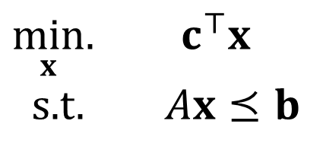
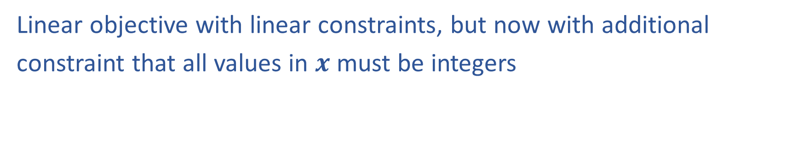
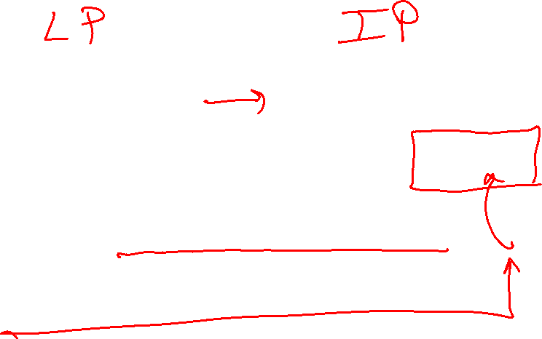
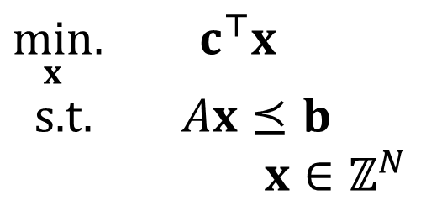
Linear Programming vs Integer Programming
Linear objective with linear constraints, but now with additional
constraint that all values in $x$ must be integers
$\min_{x}.{ c^{⊤}x}$
s.t. $Ax⪯b$
$\min_{x}.{ c^{⊤}x}$
s.t. $Ax⪯b$
$x∈ℤ^{N}$
We could also do:
Even more constrained: Binary Integer Programming
A hybrid: Mixed Integer Linear Programming
Notation Alert!

Slide 22

Integer Programming: Graphical Representation
Just add a grid of integer points onto our LP representation
$\min_{x}.{ c^{T}x}$
s.t. $Ax⪯b$
$x∈ℤ^{N}$

Slide 23
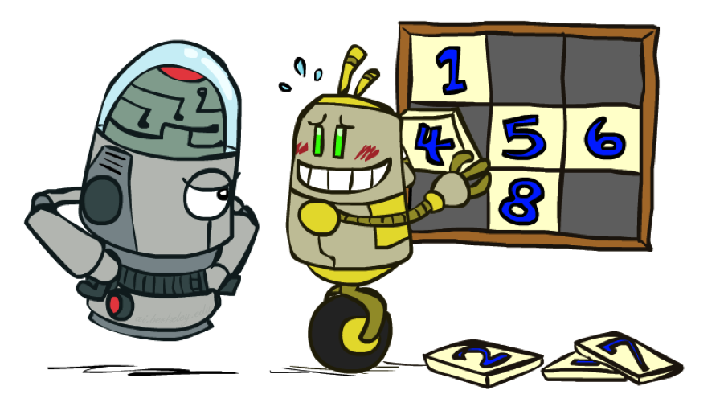

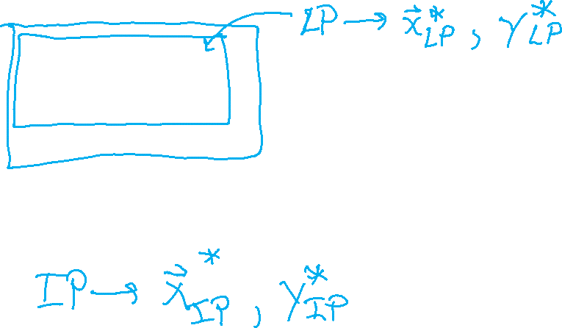
Relaxation
Relax IP to LP by dropping integer constraints
$\min_{x}.{ c^{T}x}$
s.t. $Ax⪯b$
$x∈ℤ^{N}$
Remember heuristics?

Slide 24
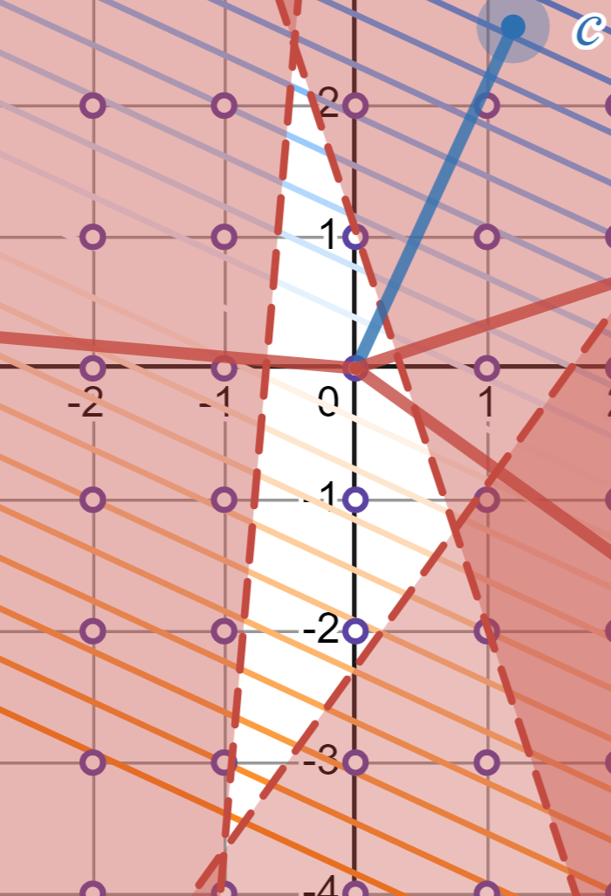
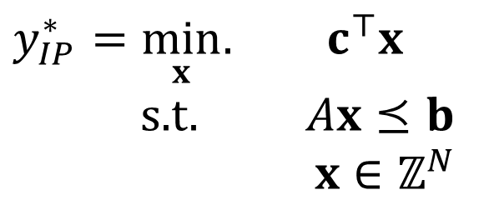
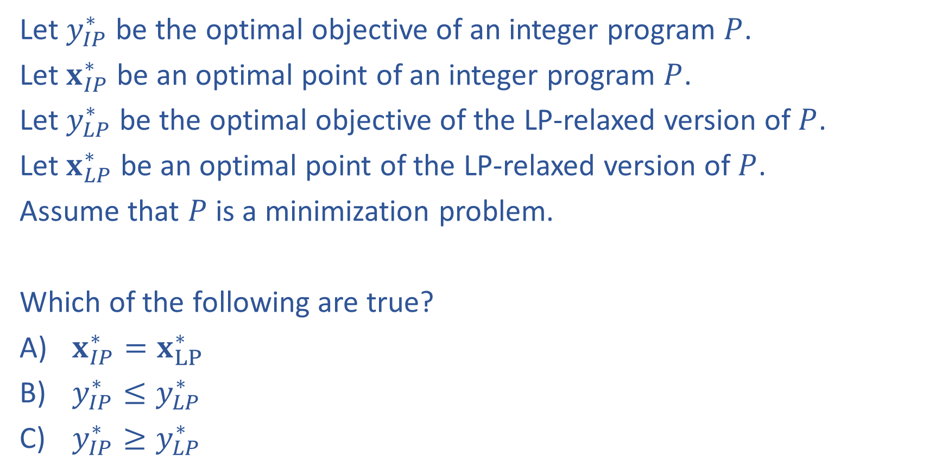

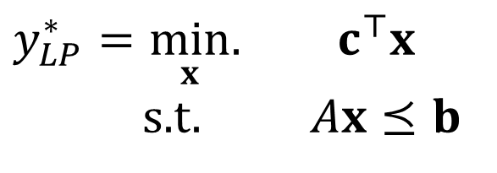

Poll 2:
Let $y_{IP}^{∗}$ be the optimal objective of an integer program $P$.
Let $x_{IP}^{∗}$ be an optimal point of an integer program $P$.
Let $y_{LP}^{∗}$ be the optimal objective of the LP-relaxed version of $P$.
Let $x_{LP}^{∗}$ be an optimal point of the LP-relaxed version of $P$.
Assume that $P$ is a minimization problem.
Which of the following are true?
$x_{IP}^{∗}=x_{LP}^{∗}$
$y_{IP}^{∗}≤y_{LP}^{∗}$
$y_{IP}^{∗}≥y_{LP}^{∗}$
$y_{IP}^{∗}=\min_{x}.{ c^{⊤}x}$
s.t. $Ax⪯b$
$x∈ℤ^{N}$
$y_{LP}^{∗}=\min_{x}.{ c^{⊤}x}$
s.t. $Ax⪯b$

Slide 25
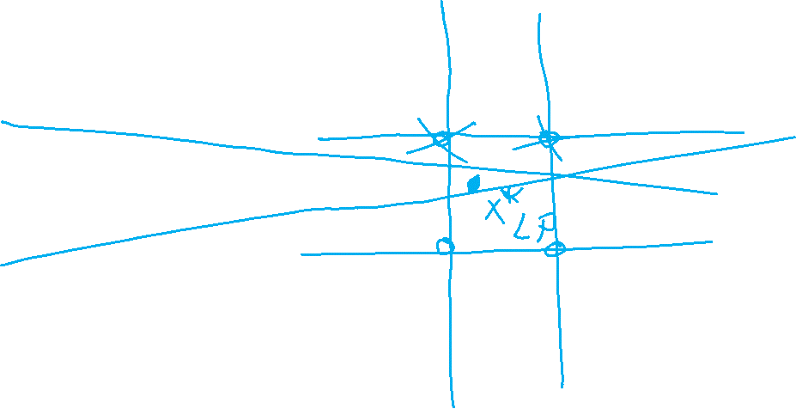
Poll 3:
True/False: It is sufficient to consider the integer points around the corresponding LP solution?

Slide 26
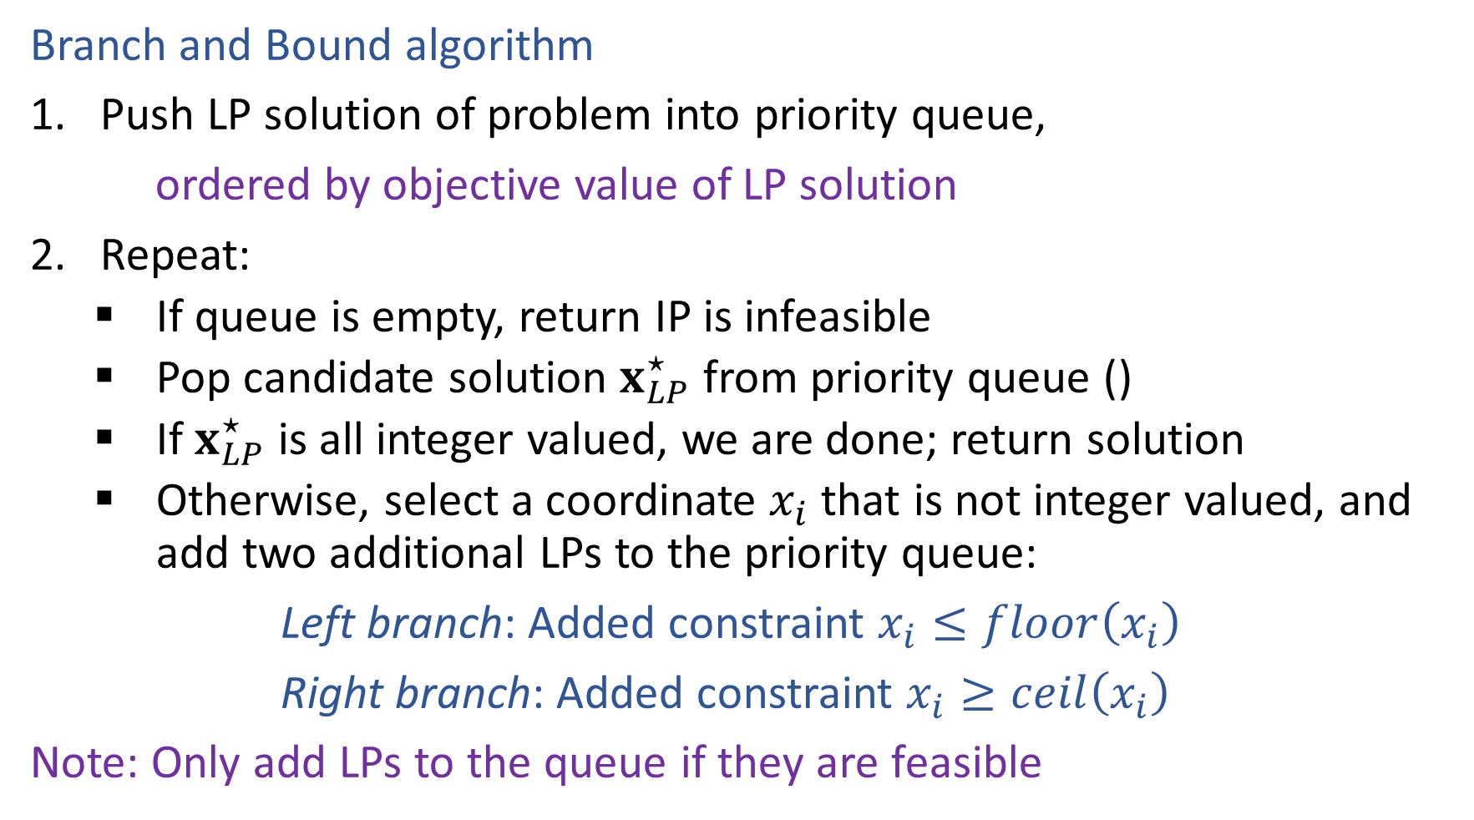
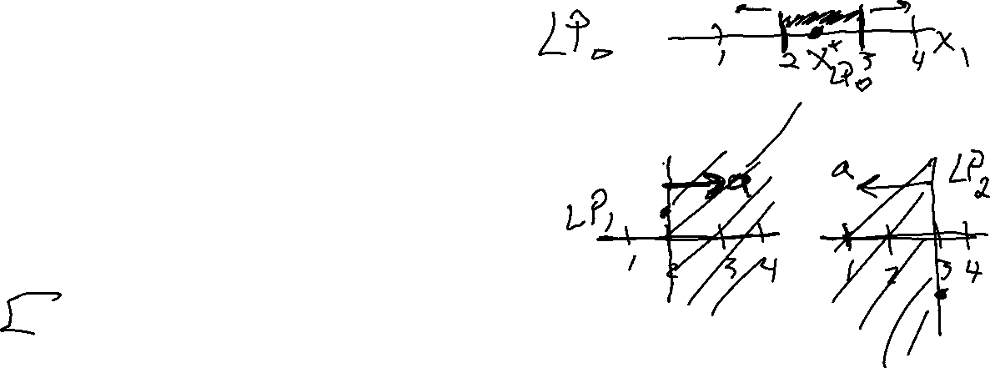
Solving an IP
Branch and Bound algorithm
Push LP solution of problem into priority queue,
ordered by objective value of LP solution
Repeat:
    If queue is empty, return IP is infeasible
    Pop candidate solution $x_{LP}^{⋆}$ from priority queue ()
    If $x_{LP}^{⋆}$ is all integer valued, we are done; return solution
    Otherwise, select a coordinate $x_{i}$ that is not integer valued, and add two additional LPs to the priority queue:
Left branch: Added constraint $x_{i}≤floor\left(x_{i}\right)$
Right branch: Added constraint $x_{i}≥ceil\left(x_{i}\right)$
Note: Only add LPs to the queue if they are feasible

Slide 27

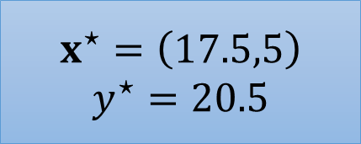



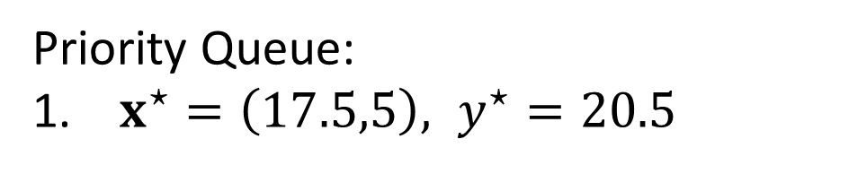
Branch and Bound Example
$$x^{⋆}=\left(17.5,5\right)$$
$$y^{⋆}=20.5$$
$$x_{1}≤17$$
$$x_{1}≥18$$
Priority Queue:
$x^{⋆}=\left(17.5,5\right), y^{⋆}=20.5$
$$c={\left[1, 0.6\right]}^{T}$$

Slide 28
Branch and Bound Example
15
10
5
10
15
20
25

Slide 29


Branch and Bound Example
15
10
$$x_{1}≤17$$
$$x_{1}≥18$$
5
10
15
20
25
15
15
10
10
5
5
10
15
20
25
10
15
20
25

Slide 30
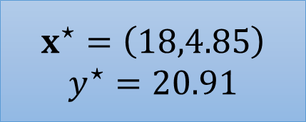

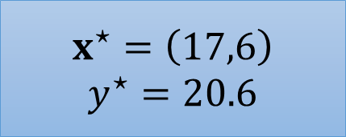
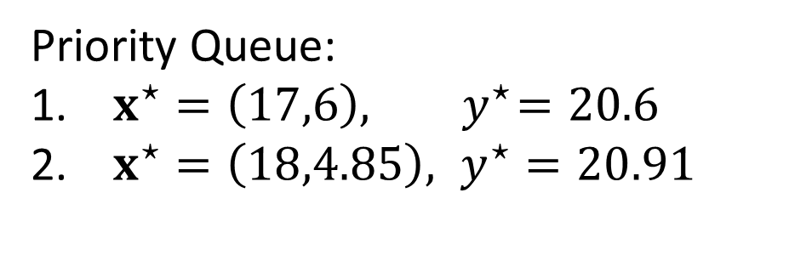
Branch and Bound Example
$$x^{⋆}=\left(17.5,5\right)$$
$$y^{⋆}=20.5$$
$$x_{1}≤17$$
$$x_{1}≥18$$
$$x^{⋆}=\left(17,6\right)$$
$$y^{⋆}=20.6$$
$$x^{⋆}=\left(18,4.85\right)$$
$$y^{⋆}=20.91$$
Priority Queue:
$x^{⋆}=\left(17,6\right), { y}^{⋆}=20.6$
$x^{⋆}=\left(18,4.85\right), y^{⋆}=20.91$
$$c={\left[1, 0.6\right]}^{T}$$

