Slide 1
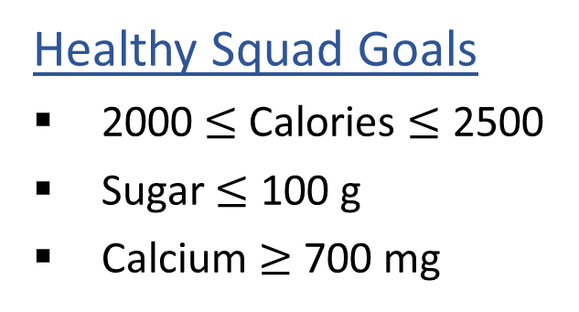
Warm-up: What to eat?
We are trying healthy by finding the optimal amount of food to purchase.
We can choose the amount of stir-fry (ounce) and boba (fluid ounces).
Healthy Squad Goals
2000 $≤$ Calories $≤$ 2500
Sugar $≤$ 100 g
Calcium $≥$ 700 mg
Food | Cost | Calories | Sugar | Calcium
Stir-fry (per oz) | 1 | 100 | 3 | 20
Boba (per fl oz) | 0.5 | 50 | 4 | 70
What is the cheapest way to stay “healthy” with this menu?
How much stir-fry (ounce) and boba (fluid ounces) should we buy?

Slide 2
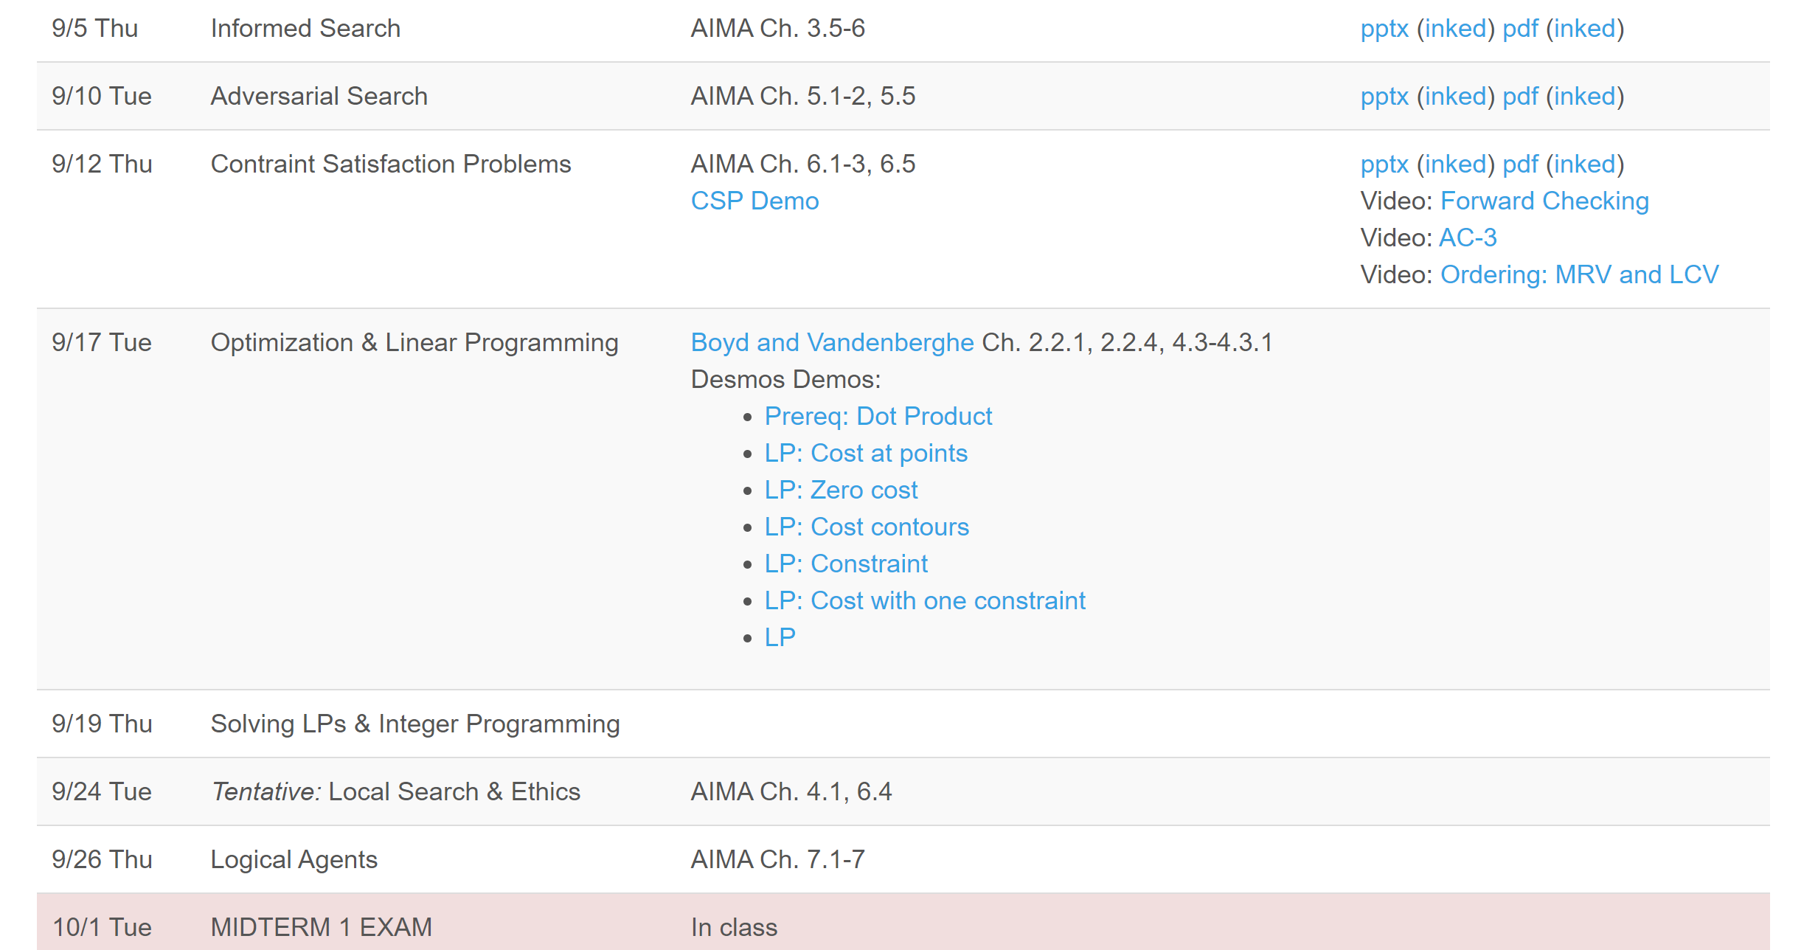
Questions about schedule update?

Slide 3
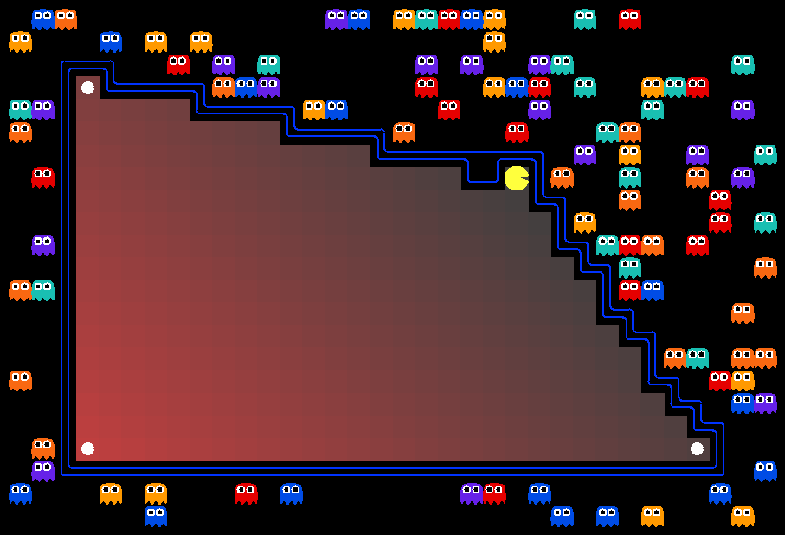
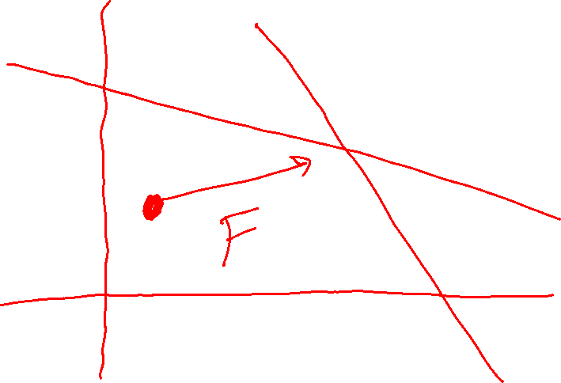
AI: Representation and Problem Solving
Linear Programming
Instructor: Pat Virtue
Slide credits: CMU AI with drawings from http://ai.berkeley.edu

Slide 4
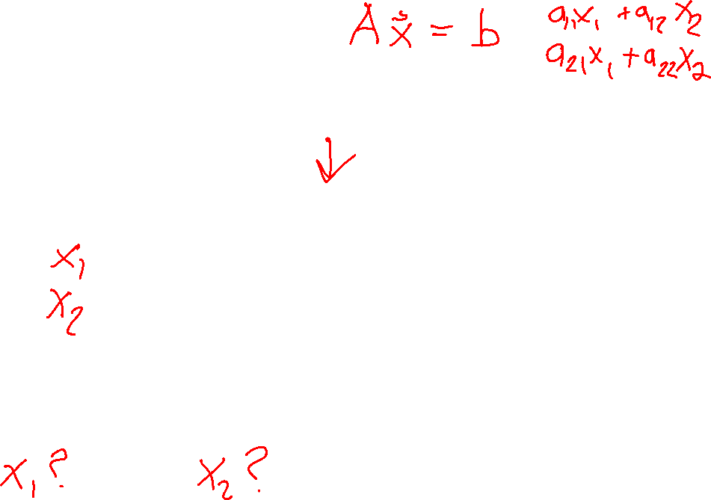
Warm-up: What to eat?
We are trying healthy by finding the optimal amount of food to purchase.
We can choose the amount of stir-fry (ounce) and boba (fluid ounces).
Healthy Squad Goals
2000 $≤$ Calories $≤$ 2500
Sugar $≤$ 100 g
Calcium $≥$ 700 mg
Food | Cost | Calories | Sugar | Calcium
Stir-fry (per oz) | 1 | 100 | 3 | 20
Boba (per fl oz) | 0.5 | 50 | 4 | 70
What is the cheapest way to stay “healthy” with this menu?
How much stir-fry (ounce) and boba (fluid ounces) should we buy?

Slide 5
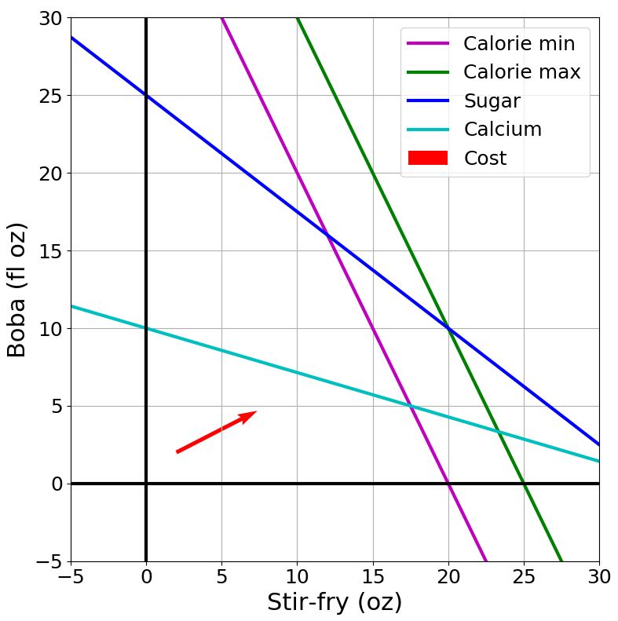
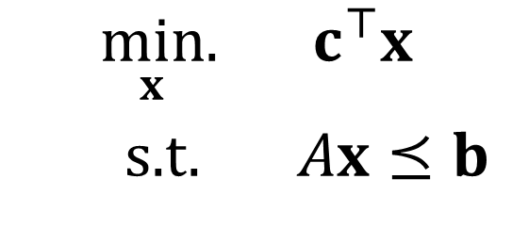
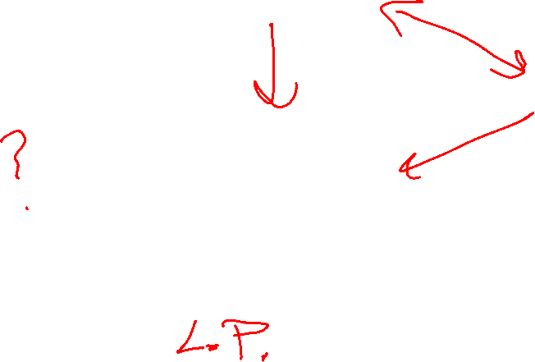
Optimization
Graphical Representation
Problem Description
Optimization Representation
$$\min_{x}.{ c^{⊤}x}$$
s.t. $Ax⪯b$

Slide 6
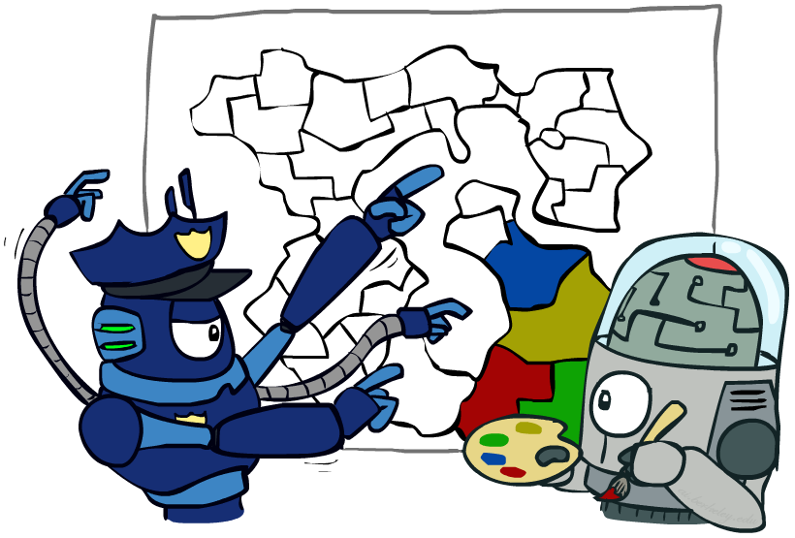
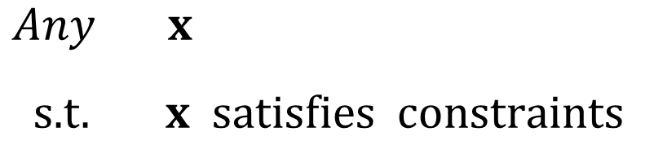
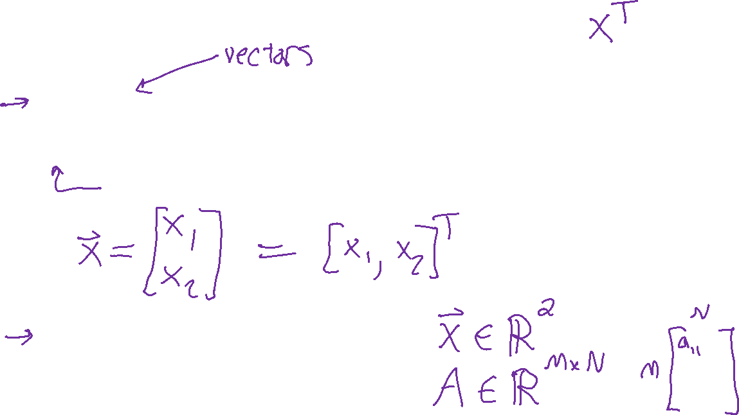
Constraint Satisfaction Problems
Map coloring
$\operatorname{Any}{ x}$
s.t. $x satisfies constraints$
"such that"
Assume vectors are column vectors
Notation Alert!

Slide 7

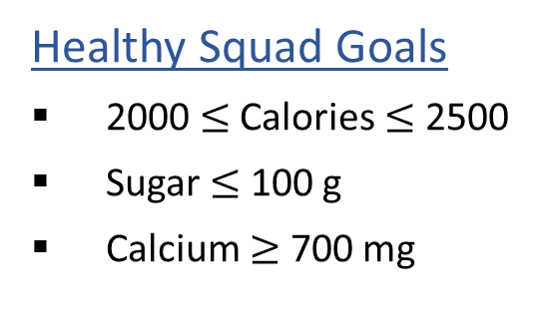


Optimization Formulation
Diet Problem
$\operatorname{Any}{ x}$
s.t. $x satisfies constraints$
Healthy Squad Goals
2000 $≤$ Calories $≤$ 2500
Sugar $≤$ 100 g
Calcium $≥$ 700 mg
Food | Cost | Calories | Sugar | Calcium
Stir-fry (per oz) | 1 | 100 | 3 | 20
Boba (per fl oz) | 0.5 | 50 | 4 | 70

Slide 8

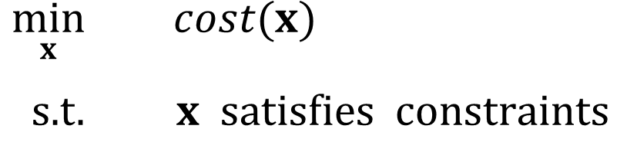

Optimization Formulation
Diet Problem
Objective function
$\min_{x}{ cost(x)}$
s.t. $x satisfies constraints$
Healthy Squad Goals
2000 $≤$ Calories $≤$ 2500
Sugar $≤$ 100 g
Calcium $≥$ 700 mg
Food | Cost | Calories | Sugar | Calcium
Stir-fry (per oz) | 1 | 100 | 3 | 20
Boba (per fl oz) | 0.5 | 50 | 4 | 70
Notation Alert!

Slide 9
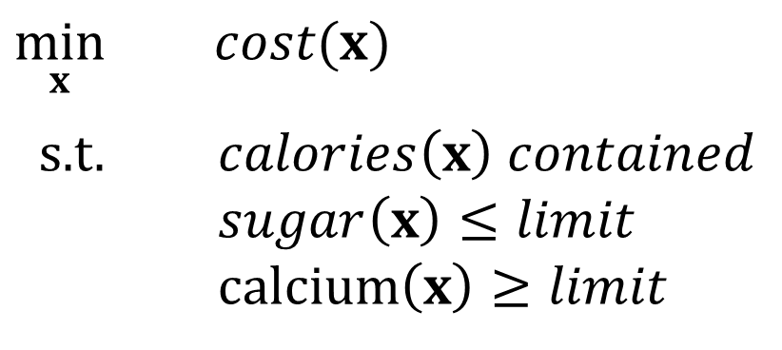

Optimization Formulation
Diet Problem
$\min_{x}{ cost(x)}$
s.t. $calories\left(x\right) contained$
$sugar\left(x\right)≤limit$
calcium$\left(x\right)≥limit$
Healthy Squad Goals
2000 $≤$ Calories $≤$ 2500
Sugar $≤$ 100 g
Calcium $≥$ 700 mg
Food | Cost | Calories | Sugar | Calcium
Stir-fry (per oz) | 1 | 100 | 3 | 20
Boba (per fl oz) | 0.5 | 50 | 4 | 70

Slide 10

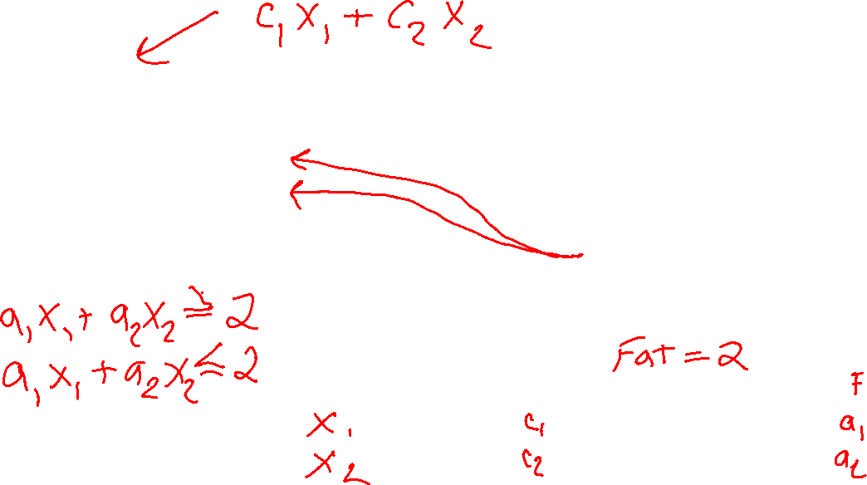
Optimization Formulation
Diet Problem
$\min_{x_{1}, { x}_{2}}{ {1 x}_{1}+0.5 x_{2}}$
s.t. $100 x_{1}+50 x_{2}≥2000$
$100 x_{1}+50 x_{2}≤2500$
$3 x_{1}+ 4 x_{2}≤100$
$20 x_{1}+70 x_{2}≥700$
Healthy Squad Goals
2000 $≤$ Calories $≤$ 2500
Sugar $≤$ 100 g
Calcium $≥$ 700 mg
Food | Cost | Calories | Sugar | Calcium
Stir-fry (per oz) | 1 | 100 | 3 | 20
Boba (per fl oz) | 0.5 | 50 | 4 | 70
Notation Alert!

Slide 11
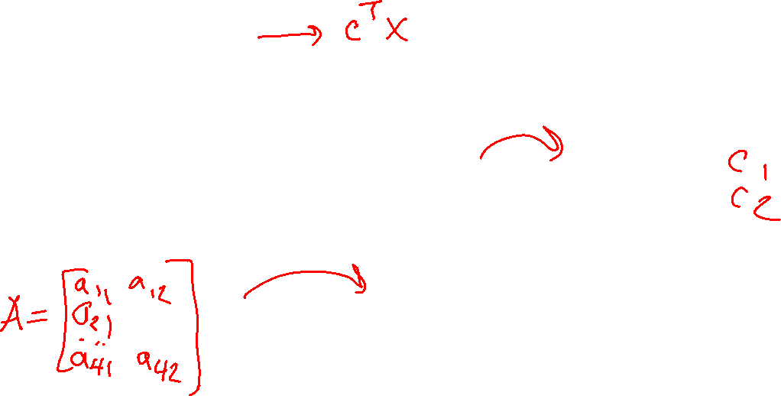


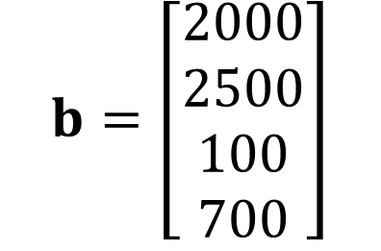
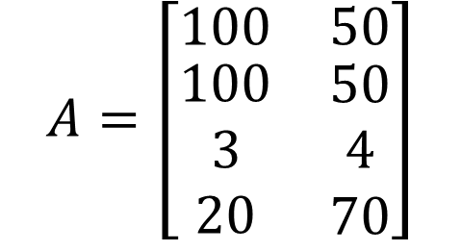
Optimization Formulation
Diet Problem
$\min_{x_{1}, { x}_{2}}{ {c_{1} x}_{1}+c_{2} x_{2}}$
s.t. $a_{1,1} x_{1}+a_{1,2} x_{2}≥b_{1}$
$a_{2,1} x_{1}+a_{2,2} x_{2}≤b_{2}$
$a_{3,1} x_{1}+a_{3,2} x_{2}≤b_{3}$
$a_{4,1} x_{1}+a_{4,2} x_{2}≥b_{4}$
Cost
$$c=\left[\begin{aligned}1 \\ 0.5\end{aligned}\right]$$
Stir-fry
Boba
Limit
$$A=\left[\begin{matrix}100 & 50 \\ \begin{aligned}100 \\ 3 \\ 20\end{aligned} & \begin{aligned}50 \\ 4 \\ 70\end{aligned}\end{matrix}\right]$$
$$b=\left[\begin{aligned}2000 \\ 2500 \\ 100 \\ 700\end{aligned}\right]$$
Calorie min
Calorie max
Sugar
Notation Alert!
Calcium

Slide 12
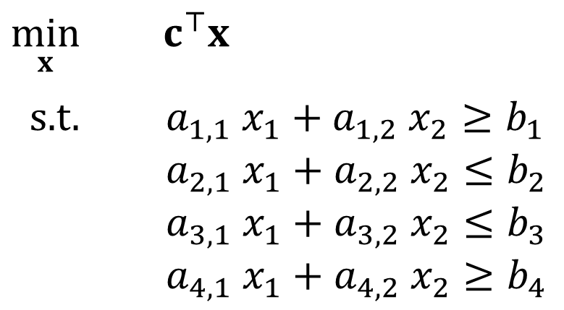
Optimization Formulation
Diet Problem
$\min_{x}{ c^{⊤}x}$
s.t. $a_{1,1} x_{1}+a_{1,2} x_{2}≥b_{1}$
$a_{2,1} x_{1}+a_{2,2} x_{2}≤b_{2}$
$a_{3,1} x_{1}+a_{3,2} x_{2}≤b_{3}$
$a_{4,1} x_{1}+a_{4,2} x_{2}≥b_{4}$
Cost
$$c=\left[\begin{aligned}1 \\ 0.5\end{aligned}\right]$$
Stir-fry
Boba
Limit
$$A=\left[\begin{matrix}100 & 50 \\ \begin{aligned}100 \\ 3 \\ 20\end{aligned} & \begin{aligned}50 \\ 4 \\ 70\end{aligned}\end{matrix}\right]$$
$$b=\left[\begin{aligned}2000 \\ 2500 \\ 100 \\ 700\end{aligned}\right]$$
Calorie min
Calorie max
Sugar
Notation Alert!
Calcium

Slide 13


Optimization Formulation
Diet Problem
$\min_{x}{ c^{⊤}x}$
s.t. $−a_{1,1} x_{1}−a_{1,2} x_{2}≤−b_{1}$
$a_{2,1} x_{1}+a_{2,2} x_{2}≤b_{2}$
$a_{3,1} x_{1}+a_{3,2} x_{2}≤b_{3}$
$−a_{4,1} x_{1}−a_{4,2} x_{2}≤−b_{4}$
Cost
$$c=\left[\begin{aligned}1 \\ 0.5\end{aligned}\right]$$
Stir-fry
Boba
Limit
$$A=\left[\begin{matrix}100 & 50 \\ \begin{aligned}100 \\ 3 \\ 20\end{aligned} & \begin{aligned}50 \\ 4 \\ 70\end{aligned}\end{matrix}\right]$$
$$b=\left[\begin{aligned}2000 \\ 2500 \\ 100 \\ 700\end{aligned}\right]$$
Calorie min
Calorie max
Sugar
Calcium

Slide 14
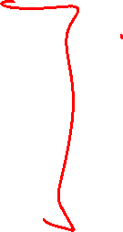

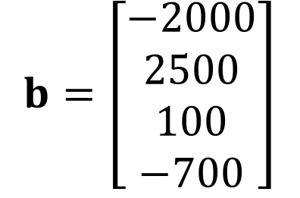
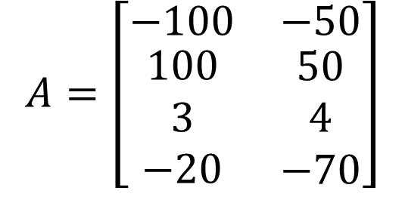
Optimization Formulation
Diet Problem
$\min_{x}{ c^{⊤}x}$
s.t. $a_{1,1} x_{1}+a_{1,2} x_{2}≤b_{1}$
$a_{2,1} x_{1}+a_{2,2} x_{2}≤b_{2}$
$a_{3,1} x_{1}+a_{3,2} x_{2}≤b_{3}$
$a_{4,1} x_{1}+a_{4,2} x_{2}≤b_{4}$
Cost
$$c=\left[\begin{aligned}1 \\ 0.5\end{aligned}\right]$$
Stir-fry
Boba
Limit
$$A=\left[\begin{matrix}−100 & −50 \\ \begin{aligned}100 \\ 3 \\ −20\end{aligned} & \begin{aligned}50 \\ 4 \\ −70\end{aligned}\end{matrix}\right]$$
$$b=\left[\begin{aligned}−2000 \\ 2500 \\ 100 \\ −700\end{aligned}\right]$$
Calorie min
Calorie max
Sugar
Calcium

Slide 15
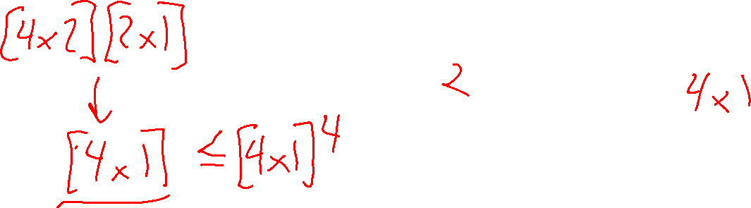
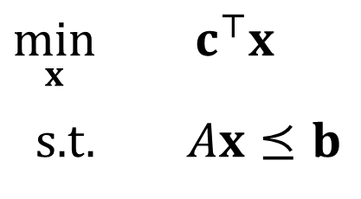
Optimization Formulation
Diet Problem
$\min_{x}{ c^{⊤}x}$
s.t. $Ax⪯b$
Cost
$$c=\left[\begin{aligned}1 \\ 0.5\end{aligned}\right]$$
Stir-fry
Boba
Limit
$$A=\left[\begin{matrix}−100 & −50 \\ \begin{aligned}100 \\ 3 \\ −20\end{aligned} & \begin{aligned}50 \\ 4 \\ −70\end{aligned}\end{matrix}\right]$$
$$b=\left[\begin{aligned}−2000 \\ 2500 \\ 100 \\ −700\end{aligned}\right]$$
Calorie min
Calorie max
Sugar
Notation Alert!
Calcium

Slide 16
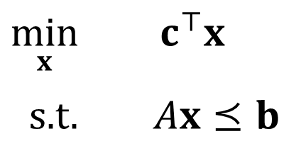
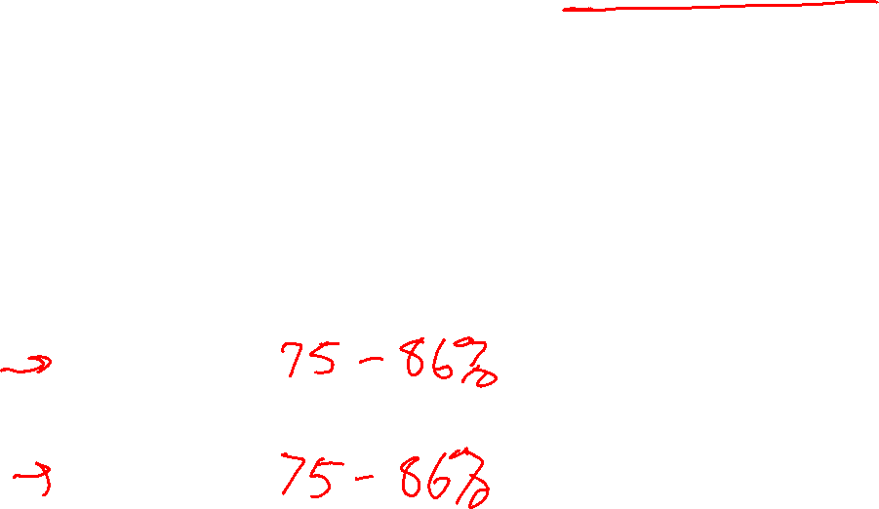
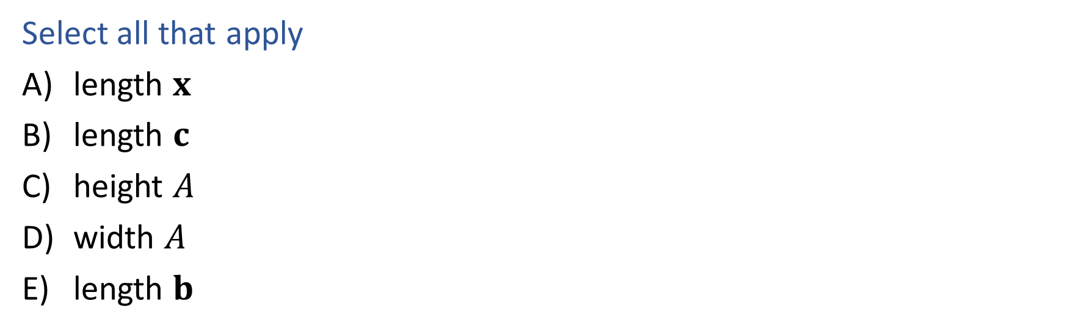
Poll 1
What has to increase to add more nutrition constraints?
$\min_{x}{ c^{⊤}x}$
s.t. $Ax⪯b$
Select all that apply
length $x$
length $c$
height $A$
width $A$
length $b$
Food | Cost | Calories | Sugar | Calcium
Stir-fry (per oz) | 1 | 100 | 3 | 20
Boba (per fl oz) | 0.5 | 50 | 4 | 70

Slide 17


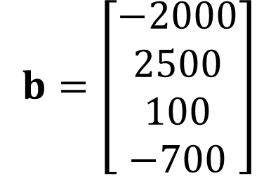
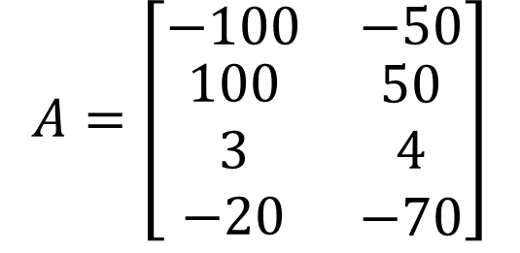
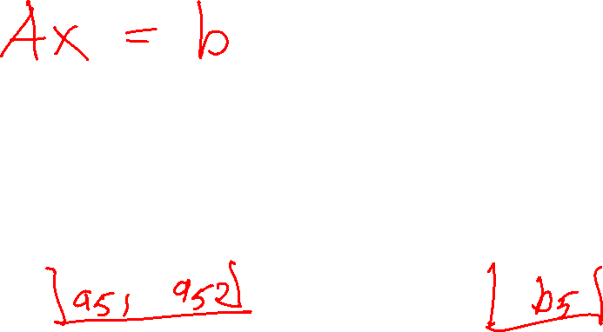
Poll 1
What has to increase to add more nutrition constraints?
$\min_{x}{ c^{⊤}x}$
s.t. $Ax⪯b$
$$A=\left[\begin{matrix}−100 & −50 \\ \begin{aligned}100 \\ 3 \\ −20\end{aligned} & \begin{aligned}50 \\ 4 \\ −70\end{aligned}\end{matrix}\right]$$
$$b=\left[\begin{aligned}−2000 \\ 2500 \\ 100 \\ −700\end{aligned}\right]$$
$$x=\left[\begin{aligned}x_{1} \\ x_{2}\end{aligned}\right]$$
$$c=\left[\begin{aligned}1 \\ 0.5\end{aligned}\right]$$

Slide 18
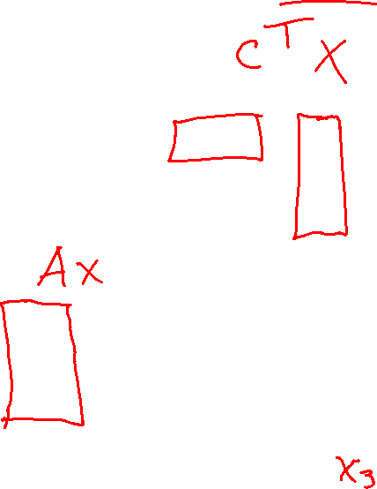
Poll 2
What has to increase to add more menu items?
$\min_{x}{ c^{⊤}x}$
s.t. $Ax⪯b$
Select all that apply
length $x$
length $c$
height $A$
width $A$
length $b$
Food | Cost | Calories | Sugar | Calcium
Stir-fry (per oz) | 1 | 100 | 3 | 20
Boba (per fl oz) | 0.5 | 50 | 4 | 70

Slide 19
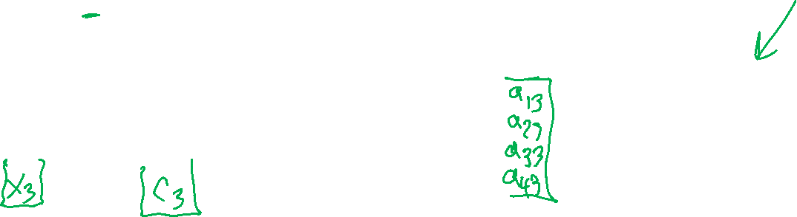
Poll 2
What has to increase to add more nutrition constraints?
$\min_{x}{ c^{⊤}x}$
s.t. $Ax⪯b$
$$A=\left[\begin{matrix}−100 & −50 \\ \begin{aligned}100 \\ 3 \\ −20\end{aligned} & \begin{aligned}50 \\ 4 \\ −70\end{aligned}\end{matrix}\right]$$
$$b=\left[\begin{aligned}−2000 \\ 2500 \\ 100 \\ −700\end{aligned}\right]$$
$$x=\left[\begin{aligned}x_{1} \\ x_{2}\end{aligned}\right]$$
$$c=\left[\begin{aligned}1 \\ 0.5\end{aligned}\right]$$

Slide 20
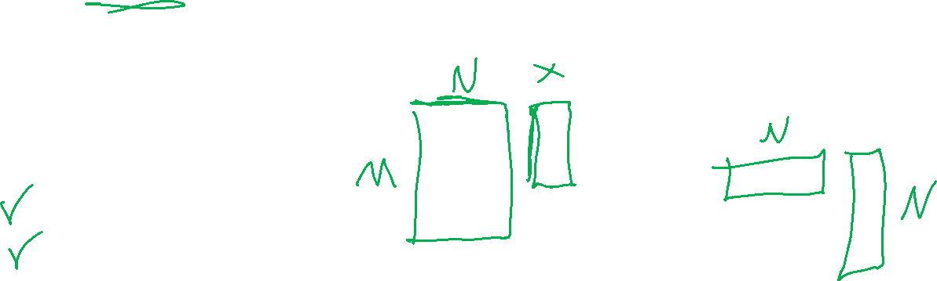
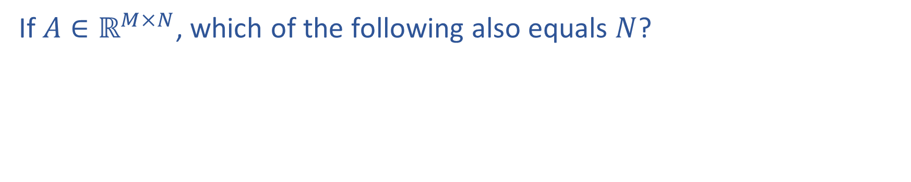
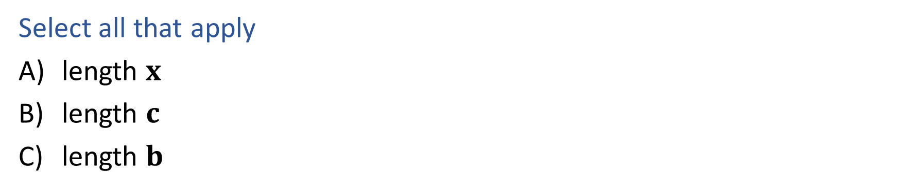
Question
If $A∈ℝ^{M×N}$, which of the following also equals $N$?
$\min_{x}{ c^{⊤}x}$
s.t. $Ax⪯b$
Select all that apply
length $x$
length $c$
length $b$
Notation Alert!

Slide 21
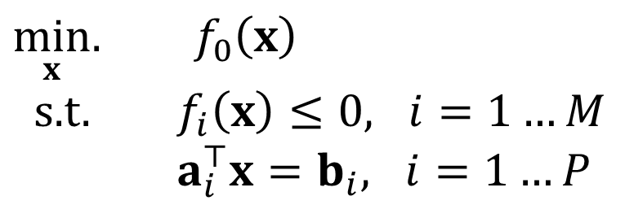
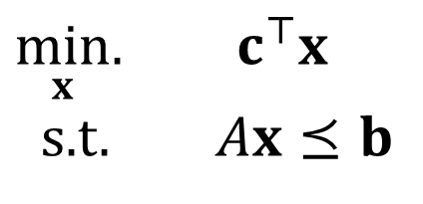

Linear Programming
Linear objective with linear constraints
$\min_{x}.{ c^{⊤}x}$
s.t. $Ax⪯b$
As opposed to general optimization
$\min_{x}.{ f_{0}\left(x\right)}$
s.t. $f_{i}\left(x\right)≤0, i=1…M$
$a_{i}^{⊤}x=b_{i}, i=1…P$

Slide 22
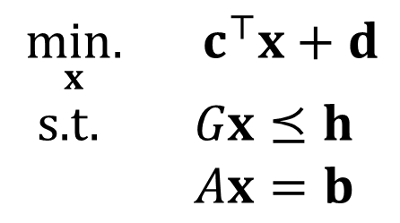
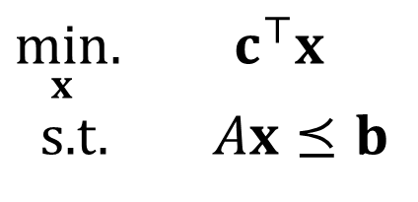
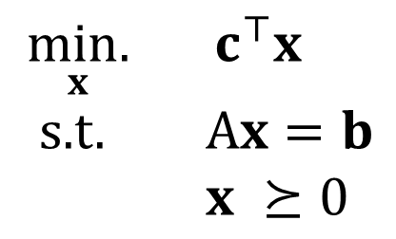
Linear Programming
Different formulations
Inequality form
General form
Standard form
$\min_{x}.{ c^{⊤}x}$
s.t. $Ax⪯b$
$\underset{x}{min.}{ c^{⊤}x}+d$
s.t. $Gx⪯h$
$Ax=b$
$\underset{x}{min.}{ c^{⊤}x}$
s.t. A$x=b$
$x ⪰0$
Important to pay attention to form!
Can switch between formulations!

Slide 23
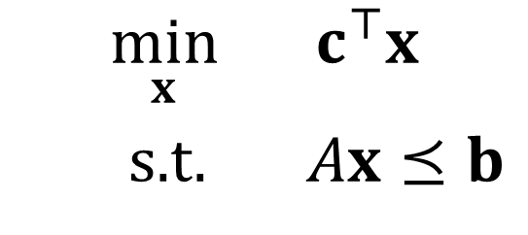
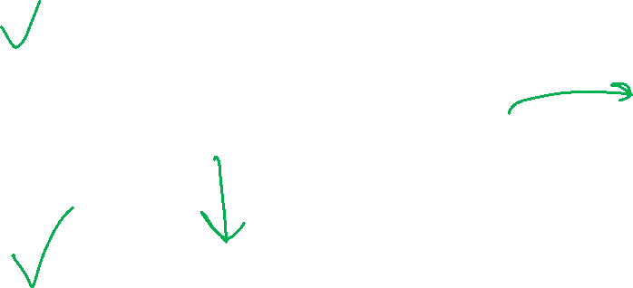
Optimization
Graphical Representation
Problem Description
Optimization Representation
$$\min_{x}{ c^{⊤}x}$$
s.t. $Ax⪯b$

Slide 24




Poll 3
Which of these points have cost $c^{⊤}x=0$?
for cost vector: $c=\left[\begin{matrix}−2 \\ 1\end{matrix}\right]$
$$x_{2}$$
II
I
III
$$x_{1}$$
IV

Slide 25




Cost Contours
Given the cost vector ${\left[c_{1}, c_{2}\right]}^{⊤}$ where will
$c^{⊤}x$ = 0 ?
$c^{⊤}x$ = 1 ?
$c^{⊤}x$ = 2 ?
$c^{⊤}x$ = -1 ?
$c^{⊤}x$ = -2 ?
$$x_{2}$$
$$c$$
$$x_{1}$$

Slide 26



Question
As the magnitude of $c$ increases, the distance between
the contours lines of the objective $c^{⊤}x$:
Increases
Decreases
https://www.desmos.com/calculator/8d9kxbdq9u

Slide 27



Graphics Representation
Geometry / Algebra I Quiz
What shape does this inequality represent?
$$a_{1} x_{1}+a_{2} x_{2}≤b_{1}$$

Slide 28





Graphics Representation
Geometry / Algebra I Quiz
What shape do these represent?
$$a_{1} x_{1}+a_{2} x_{2}=b_{1}$$
$$a_{1} x_{1}+a_{2} x_{2}≤b_{1}$$
$a_{1,1} x_{1}+a_{1,2} x_{2}≤b_{1}$
$a_{2,1} x_{1}+a_{2,2} x_{2}≤b_{2}$
$a_{3,1} x_{1}+a_{3,2} x_{2}≤b_{3}$
$a_{4,1} x_{1}+a_{4,2} x_{2}≤b_{4}$
Feasible region:
All points x that satisfy the constraints

Slide 29

Graphics Representation
Geometry / Algebra I Quiz
What shape do these represent?
$$a_{1} x_{1}+a_{2} x_{2}=b_{1}$$
$$a_{1} x_{1}+a_{2} x_{2}≤b_{1}$$
$a_{1,1} x_{1}+a_{1,2} x_{2}≤b_{1}$
$a_{2,1} x_{1}+a_{2,2} x_{2}≤b_{2}$
$a_{3,1} x_{1}+a_{3,2} x_{2}≤b_{3}$
$a_{4,1} x_{1}+a_{4,2} x_{2}≤b_{4}$
Feasible region:
All points x that satisfy the constraints

Slide 30

Graphics Representation
Geometry / Algebra I Quiz
What shape do these represent?
$$a_{1} x_{1}+a_{2} x_{2}=b_{1}$$
$$a_{1} x_{1}+a_{2} x_{2}≤b_{1}$$
https://www.desmos.com/calculator/lp0rqsb1w6

Slide 31

Graphics Representation
Geometry / Algebra I Quiz
What shape do these represent?
$$a_{1} x_{1}+a_{2} x_{2}=b_{1}$$
$$a_{1} x_{1}+a_{2} x_{2}≤b_{1}$$
$a_{1,1} x_{1}+a_{1,2} x_{2}≤b_{1}$
$a_{2,1} x_{1}+a_{2,2} x_{2}≤b_{2}$
$a_{3,1} x_{1}+a_{3,2} x_{2}≤b_{3}$
$a_{4,1} x_{1}+a_{4,2} x_{2}≤b_{4}$
https://www.desmos.com/calculator/plp1thgsbh

