Slide 1
Warm-up as you log in
Write the pseudo code for breadth first search and depth first search
Iterative version, not recursive
class TreeNode
TreeNode[] children()
boolean isGoal()
BFS(TreeNode start)…
DFS(TreeNode start)…

Slide 2
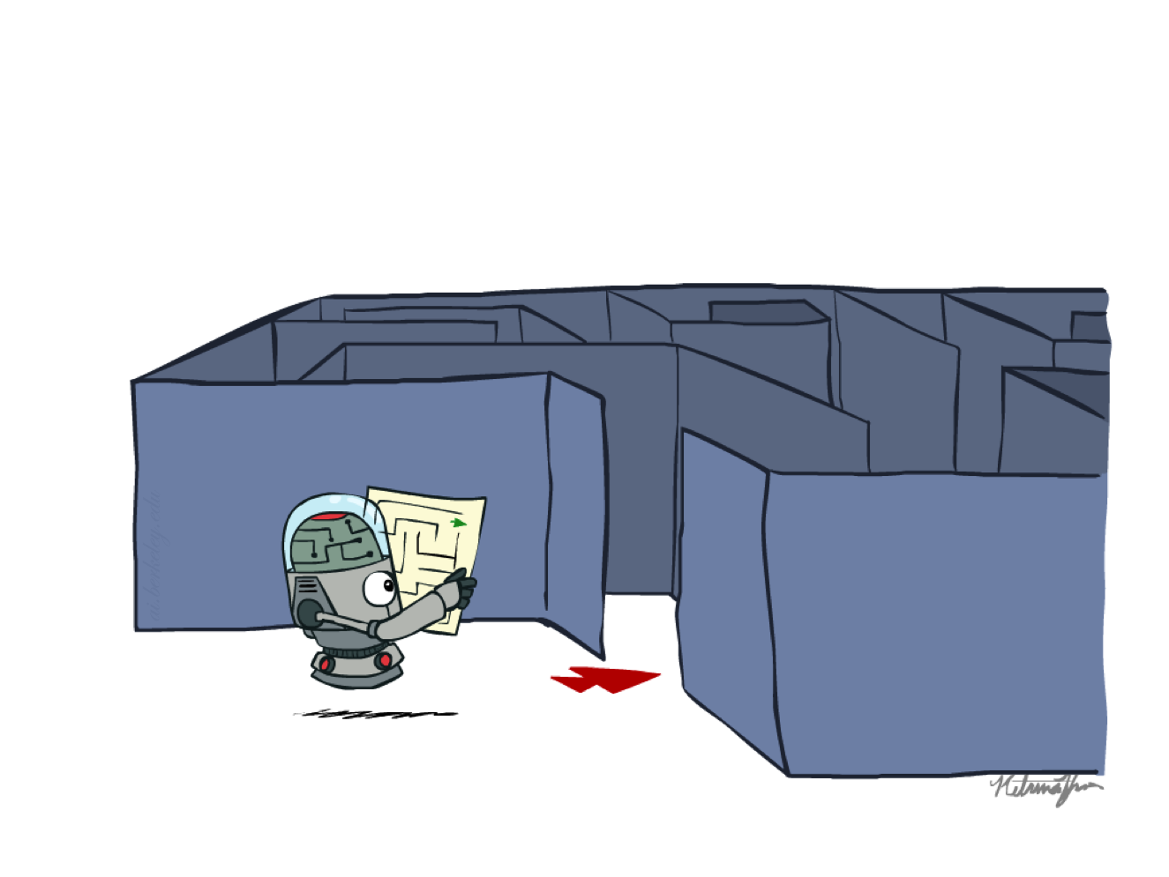

AI: Representation and Problem Solving
Agents and Search
Instructor: Pat Virtue
Slide credits: CMU AI, http://ai.berkeley.edu

Slide 3
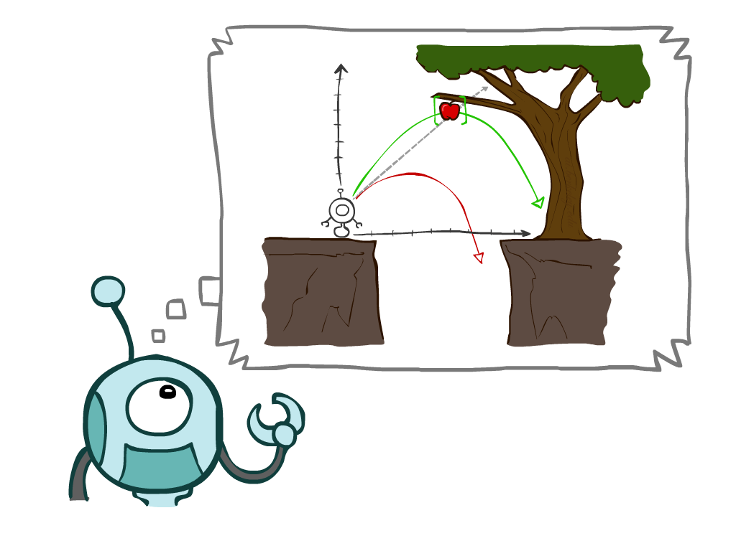

Outline
Agents and Environments
Search Problems
Uninformed Search Methods
Depth-First Search
Breadth-First Search
Uniform-Cost Search
Notes:
General theme in the class:
A goal we have in mind.
A mathematical abstraction to formalize this
Algorithms that operate on these abstractions

Slide 4
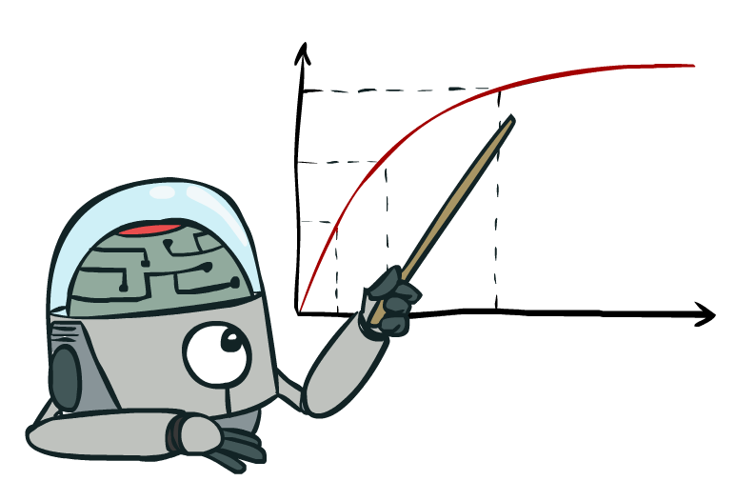

Rationality, contd.
What is rational depends on:
Performance measure
Agent’s prior knowledge of environment
Actions available to agent
Percept sequence to date
Being rational means maximizing your expected utility

Slide 5

Rational Agents
Are rational agents omniscient?
No – they are limited by the available percepts
Are rational agents clairvoyant?
No – they may lack knowledge of the environment dynamics
Do rational agents explore and learn?
Yes – in unknown environments these are essential
So rational agents are not necessarily successful, but they are autonomous (i.e., transcend initial program)

Slide 6
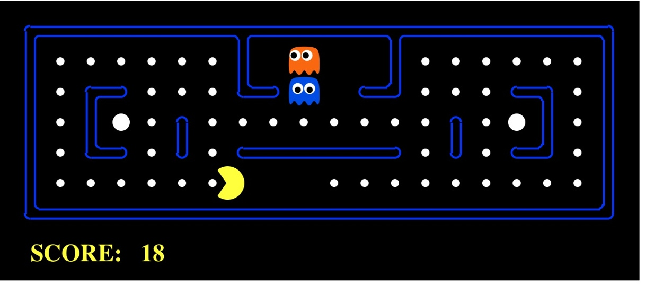

Task Environment - PEAS
Performance measure
-1 per step; +10 food; +500 win; -500 die; +200 hit scared ghost
Environment
Pacman dynamics (incl ghost behavior)
Actuators
North, South, East, West, (Stop)
Sensors
Entire state is visible

Slide 7


PEAS: Automated Taxi
Performance measure
Income, happy customer, vehicle costs, fines, insurance premiums
Environment
US streets, other drivers, customers
Actuators
Steering, brake, gas, display/speaker
Sensors
Camera, radar, accelerometer, engine sensors, microphone
Image: http://nypost.com/2014/06/21/how-google-might-put-taxi-drivers-out-of-business/

Slide 8
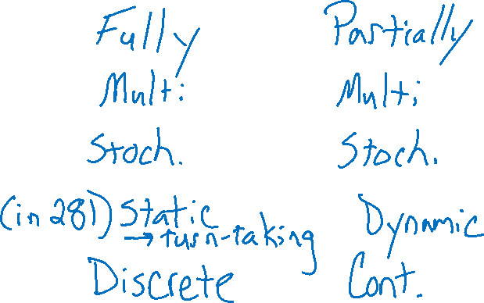
Environment Types
 | Pacman | Taxi
Fully or partially observable
Single agent or multi-agent
Deterministic or stochastic
Static or dynamic
Discrete or continuous

Slide 9

Reflex Agents
Reflex agents:
Choose action based on current percept (and maybe memory)
May have memory or a model of the world’s current state
Do not consider the future consequences of their actions
Consider how the world IS
Can a reflex agent be rational?
[Demo: reflex optimal (L2D1)]
[Demo: reflex optimal (L2D2)]
Notes:
Examples: blinking your eye (not using your entire thinking capabilities), vacuum cleaner moving towards nearest dirt

Slide 10
Demo Reflex Agent
[Demo: reflex optimal (L2D1)]
[Demo: reflex optimal (L2D2)]

Slide 11
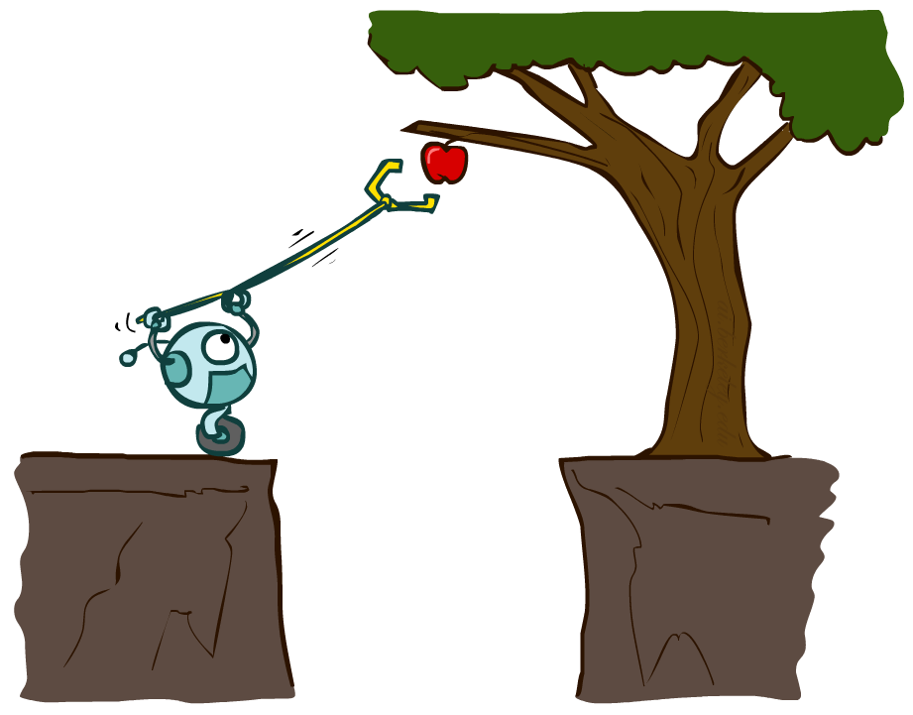

Agents that Plan Ahead
Planning agents:
Decisions based on predicted consequences of actions
Must have a transition model: how the world evolves in response to actions
Must formulate a goal
Consider how the world WOULD BE
Spectrum of deliberativeness:
Generate complete, optimal plan offline, then execute
Generate a simple, greedy plan, start executing, replan when something goes wrong

Slide 12

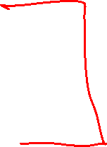
Search Problems

Slide 13







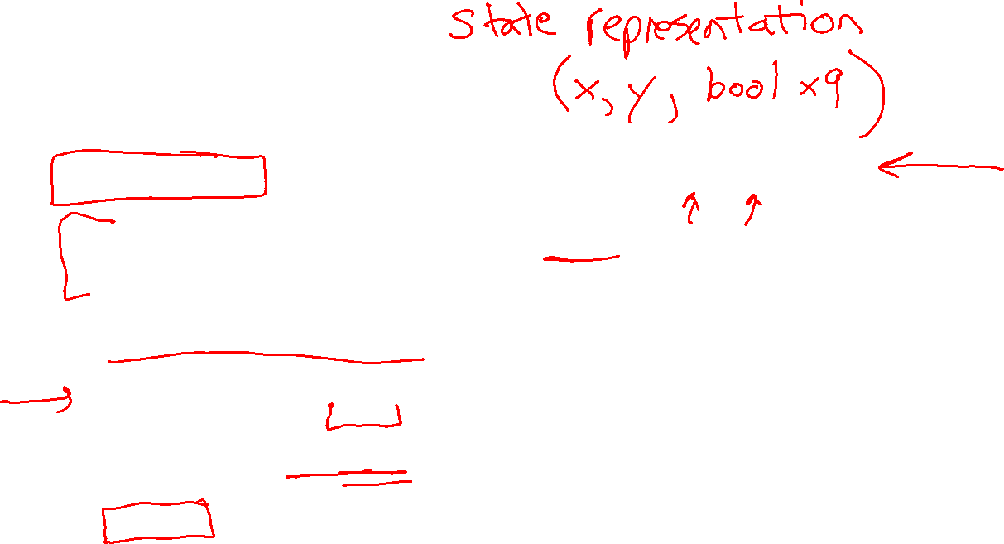
Search Problems
A search problem consists of:
A state space
For each state, a set
Actions(s) of allowable actions
A transition model Result(s,a)
A step cost function c(s,a,s’)
A start state and a goal test
A solution is a sequence of actions (a plan) which transforms the start state to a goal state
{N, E}
1
N
E
1
Notes:
Often comes back on exams
Goal test – sometimes more than one state that satisfies having achieved the goal, for example, “eat all the dots”
Abstraction

Slide 14

Search Problems Are Models

Slide 15
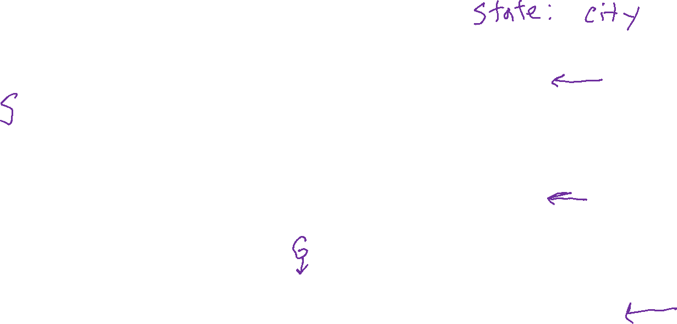
Example: Travelling in Romania
State space:
Cities
Actions:
Go to adjacent city
Transition model
Result(A, Go(B)) = B
Step cost
Distance along road link
Start state:
Arad
Goal test:
Is state == Bucharest?
Solution?
Notes:
Infinitely many solutions! Some better than others

Slide 16
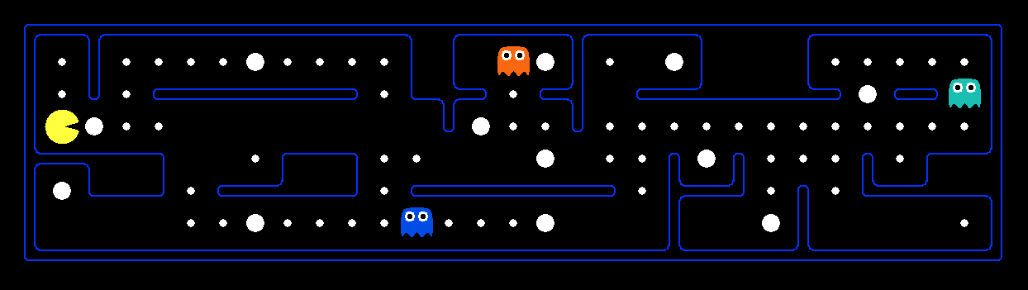
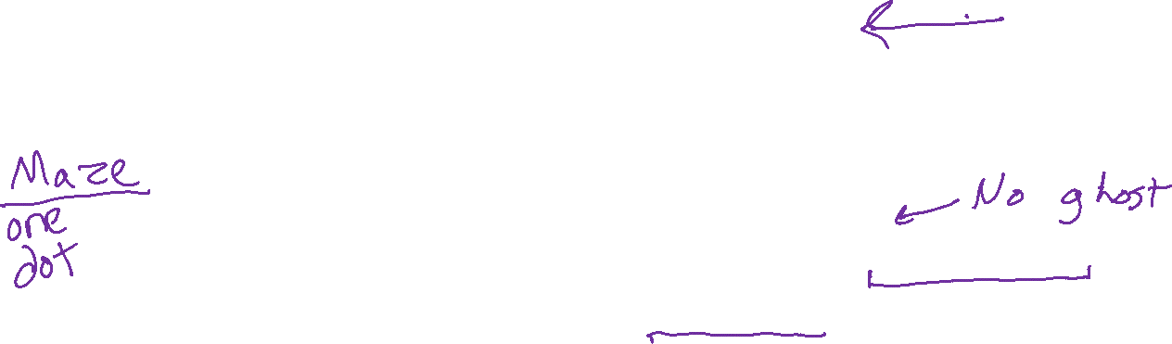
What’s in a State Space?
The real world state includes every last detail of the environment
A search state abstracts away details not needed to solve the problem
Problem: Pathing
State representation: (x,y) location
Actions: NSEW
Transition model: update location
Goal test: is (x,y)=END
Problem: Eat-All-Dots
State representation: {(x,y), dot booleans}
Actions: NSEW
Transition model: update location and possibly a dot boolean
Goal test: dots all false
Notes:
Wrong example for “eat-all-dots”: (x, y, dot count)

Slide 17
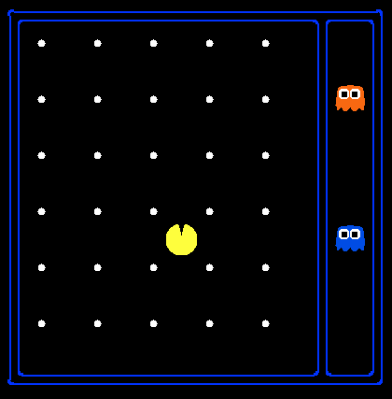
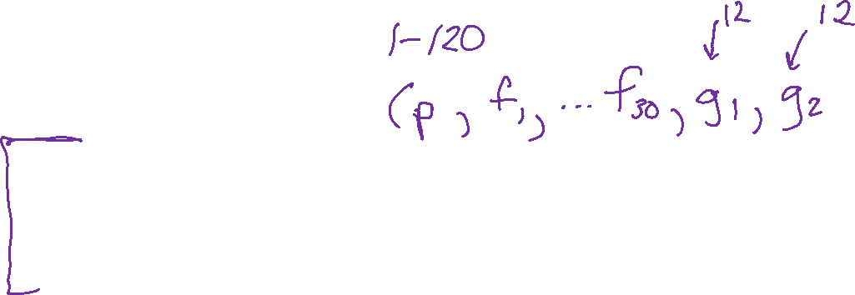
State Space Sizes?
World state:
Agent positions: 120
Food count: 30
Ghost positions: 12
Agent facing: NSEW
How many
World states?
120x(2³⁰)x(12²)x4
States for pathing?
120
States for eat-all-dots?
120x(2³⁰)
Notes:
90 * (2^30-1) + 30 * 2^29 = 145 billion
2^29 = 536 870 912

Slide 18
Safe Passage
Problem: eat all dots while keeping the ghosts perma-scared
What does the state representation have to specify?
(agent position, dot booleans, power pellet booleans, remaining scared time)

Slide 19
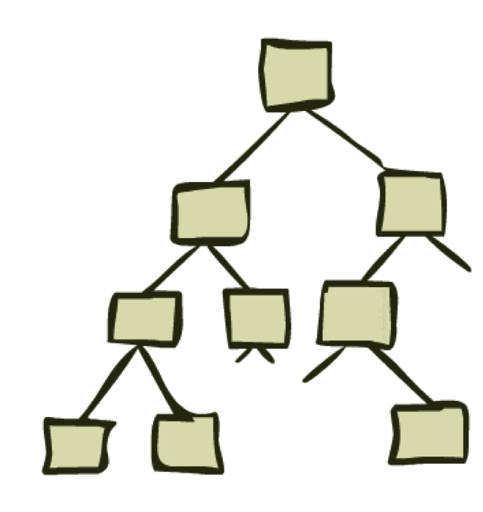
State Space Graphs and Search Trees

Slide 20
State Space Graphs
State space graph: A mathematical representation of a search problem
Nodes are (abstracted) world configurations
Arcs represent transitions resulting from actions
The goal test is a set of goal nodes (maybe only one)
In a state space graph, each state occurs only once!
We can rarely build this full graph in memory (it’s too big), but it’s a useful idea

Slide 21
More Examples
Notes:
Typical finite graph explicitly defined (theoretical CS)

Slide 22
More Examples
Notes:
Typical exponential (or infinite) graph implicitly defined (AI)

Slide 23

State Space Graphs vs. Search Trees
We build a search tree by traversing various paths in a state space graph, beginning from a specific start state.
State space graph
Resulting search tree
S
a
G
d
e
p
b
c
b
c
e
h
r
q
e
d
f
a
a
h
r
p
q
f
S
h
p
q
f
q
c
G
p
r
a
q
q
c
G
a
Important: Lots of repeated structure in the search tree!

Slide 24
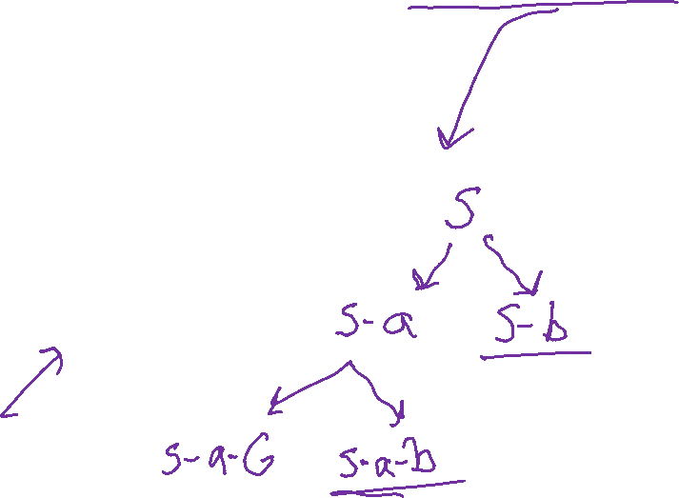
State Space Graphs vs. Search Trees
Consider this 4-state graph:
How big is its search tree (from S)?
S
a
a
b
S
G
b
G
G
a
b
G
a
b
G
∞
Important: Lots of repeated structure in the search tree!

Slide 25
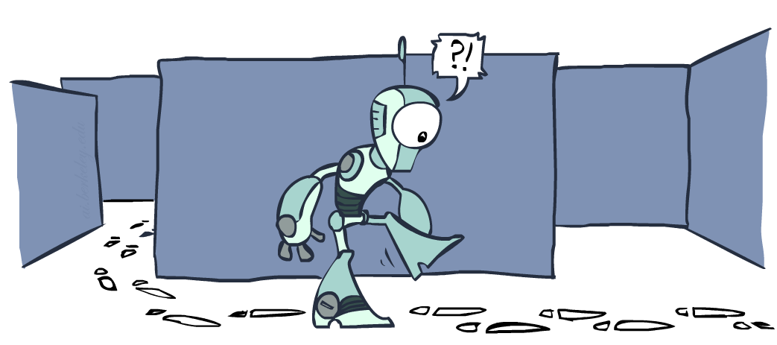
Tree Search vs Graph Search

Slide 26
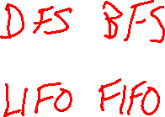
function TREE_SEARCH(problem) returns a solution, or failure
initialize the frontier as a specific work list (stack, queue, priority queue)
add initial state of problem to frontier loop do
if the frontier is empty then
return failure choose a node and remove it from the frontier if the node contains a goal state then
return the corresponding solution
for each resulting child from node
add child to the frontier

Slide 27
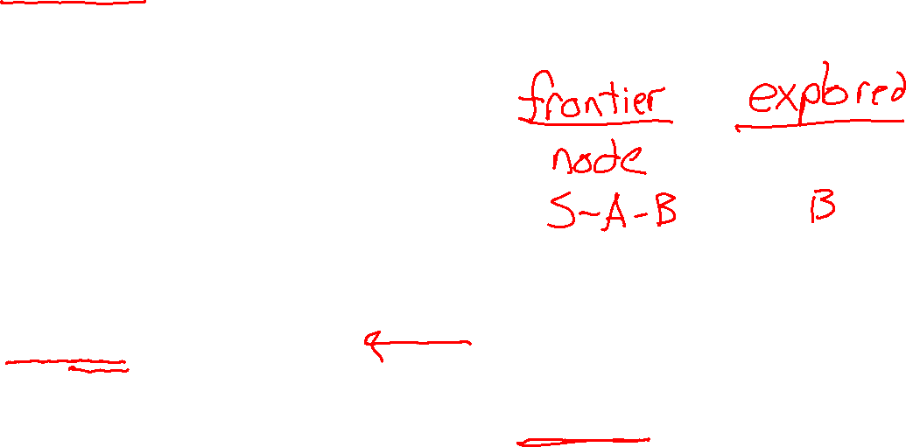
function GRAPH_SEARCH(problem) returns a solution, or failure
initialize the explored set to be empty
initialize the frontier as a specific work list (stack, queue, priority queue)
add initial state of problem to frontier loop do
if the frontier is empty then
return failure choose a node and remove it from the frontier if the node contains a goal state then
return the corresponding solution
add the node state to the explored set
for each resulting child from node
if the child state is not already in the frontier or explored set then
add child to the frontier

Slide 28
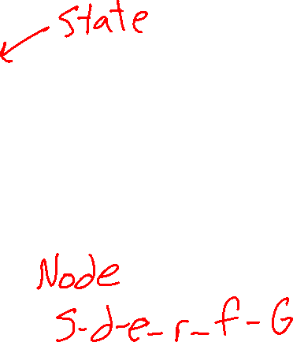
Depth-First (Tree) Search
Strategy: expand a deepest node first
Implementation: Frontier is a LIFO stack
a
G
a
c
b
c
b
e
d
e
d
f
f
S
h
h
p
p
r
q
r
q
S
d
e
p
b
c
e
h
r
q
a
a
h
r
p
q
f
p
q
f
q
c
G
q
c
G
a
a

Slide 29
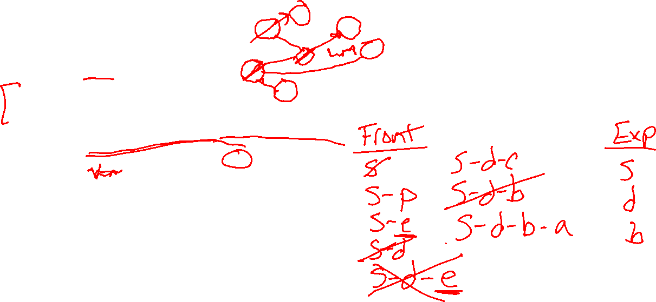
Depth-First (Graph) Search
Strategy: expand a deepest node first
Implementation: Frontier is a LIFO stack
Explored set prevents loops and repeated work
a
G
b
c
d
e
f
S
h
p
q
r
S
d
e
p
b
c
e
h
r
q
a
a
h
r
p
q
f
p
q
f
q
c
G
q
c
G
a
a

Slide 30

Poll 1
function GRAPH-SEARCH(problem) returns a solution, or failure
initialize the explored set to be empty
initialize the frontier as a specific work list (stack, queue, priority queue)
add initial state of problem to frontier loop do
if the frontier is empty then
return failure choose a node and remove it from the frontier if the node contains a goal state then
return the corresponding solution
add the node state to the explored set
for each resulting child from node
if the child state is not already in the frontier or explored set then
add child to the frontier

Slide 31

Poll 1
What is the relationship between these sets of states after each loop iteration in GRAPH_SEARCH?
(Loop invariants!!!)
A
B
C
Explored
Never Seen
Explored
Never Seen
Explored
Never Seen
Frontier
Frontier
Frontier

Slide 32
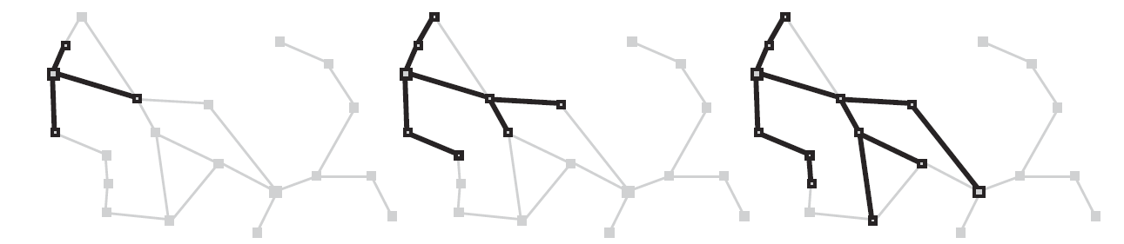
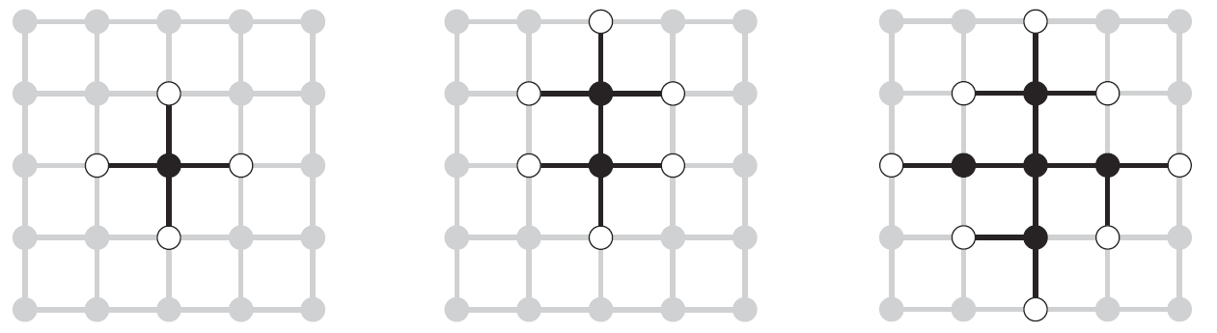

Graph Search
This graph search algorithm overlays a tree on a graph
The frontier states separate the explored states from never seen states
Images: AIMA, Figure 3.8, 3.9

Slide 33
A Note on Implementation
Nodes have
state, parent, action, path-cost
A child of parent_node by action a has:
state = result(parent_node.state,a)
parent = parent_node
action = a
path-cost = parent_node.path_cost + step_cost(parent_ node.state, a, self.state)
Extract solution by tracing back parent pointers, collecting actions

Slide 34
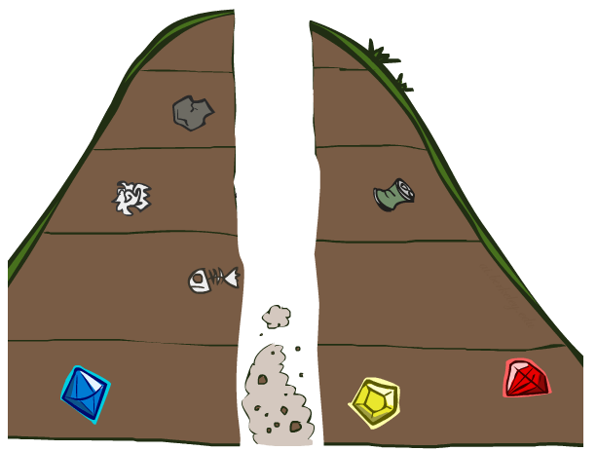
Search Algorithm Properties

Slide 35
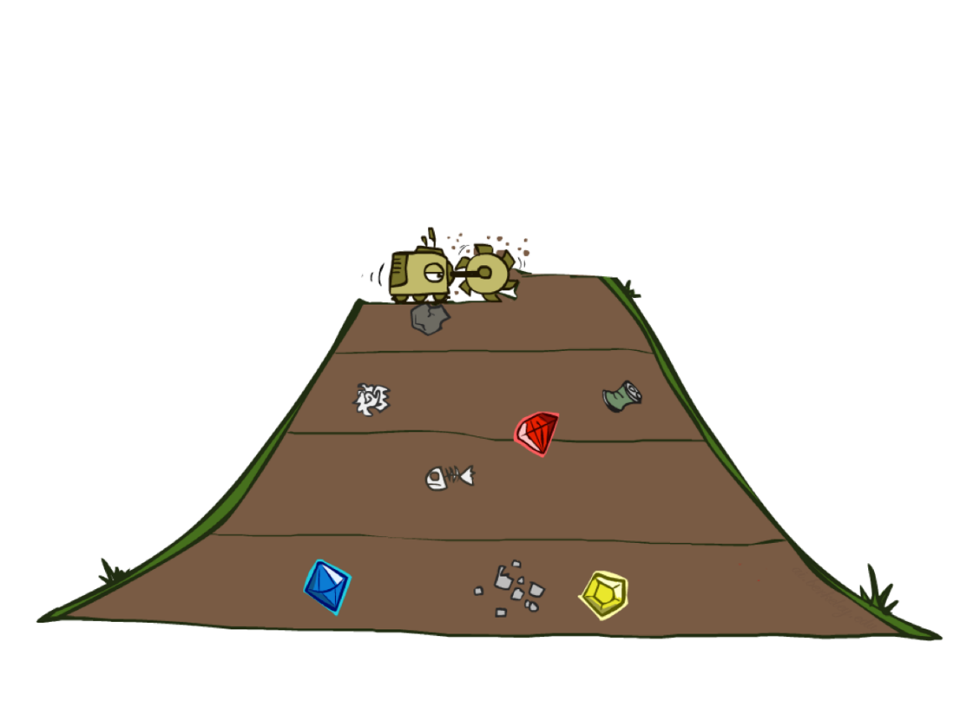
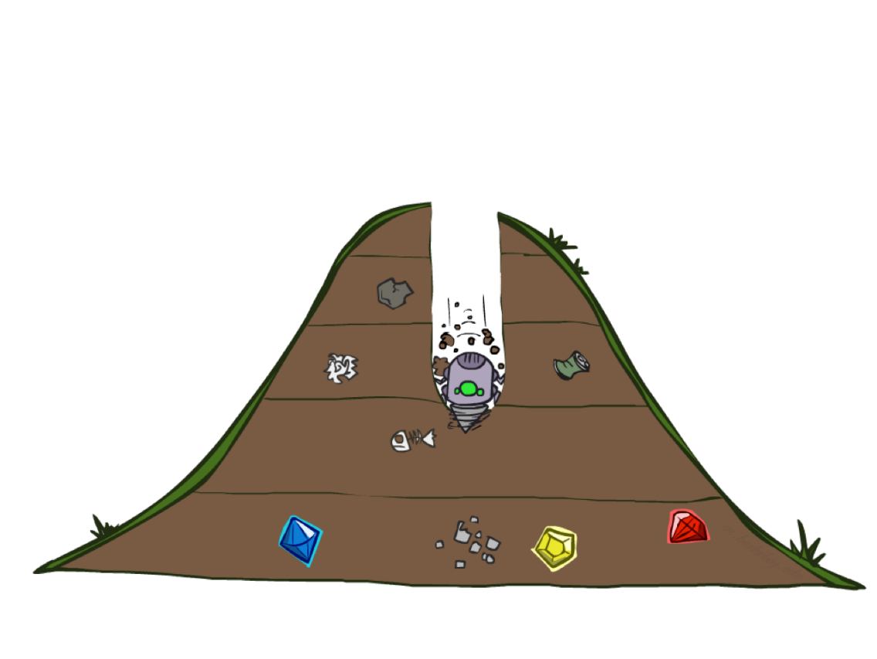
BFS vs DFS

Slide 36
BFS vs DFS
Is the following demo using BFS or DFS
[Demo: dfs/bfs maze water (L2D6)]

Slide 37
Poll 2
Is the following demo using BFS or DFS
[Demo: dfs/bfs maze water (L2D6)]

Slide 38
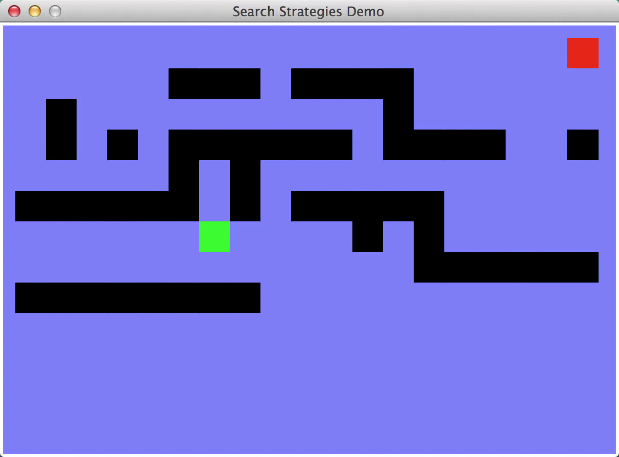
Video of Demo Maze Water DFS/BFS (part 1)

Slide 39

Video of Demo Maze Water DFS/BFS (part 2)

Slide 40
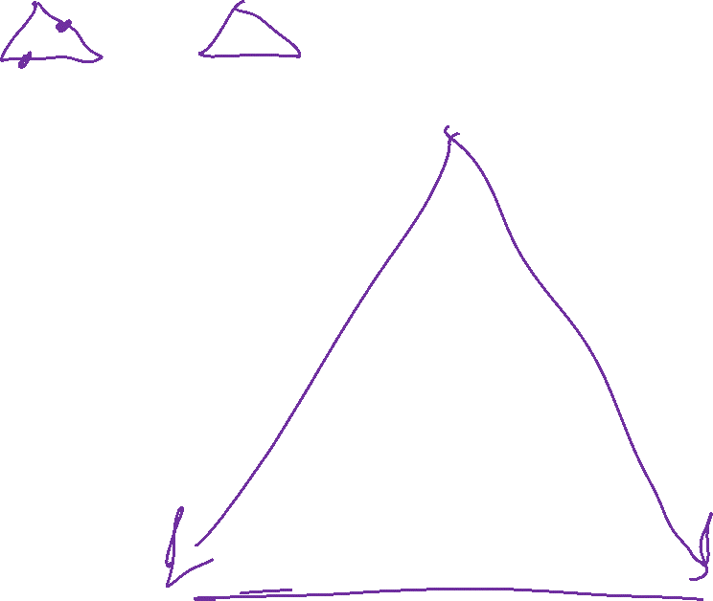
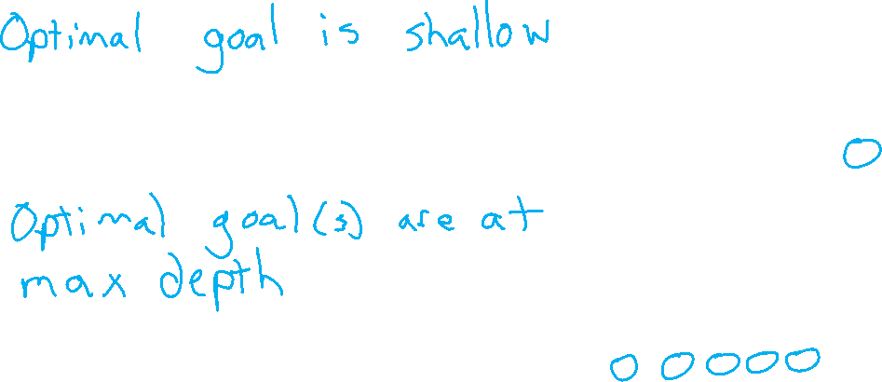
BFS vs DFS
When will BFS outperform DFS?
When will DFS outperform BFS?

Slide 41

Search Algorithm Properties
Complete: Guaranteed to find a solution if one exists?
Optimal: Guaranteed to find the least cost path?
Time complexity?
Space complexity?
Cartoon of search tree:
b is the branching factor
m is the maximum depth
solutions at various depths
Number of nodes in entire tree?
1 + b + b² + …. b^{m} = O(b^{m})
1 node
b
…
b nodes
b² nodes
m tiers
b^{m} nodes

Slide 42
Search Algorithm Properties
Complete: Guaranteed to find a solution if one exists?
Optimal: Guaranteed to find the least cost path?
Time complexity?
Space complexity?
Cartoon of search tree:
b is the branching factor
m is the maximum depth
solutions at various depths
Number of nodes in entire tree?
1 + b + b² + …. b^{m} = O(b^{m})
1 node
b
…
b nodes
b² nodes
m tiers
b^{m} nodes

Slide 43

Poll 2
1 node
Are these the properties for BFS or DFS?
Takes O(b^{m}) time
Uses O(bm) space on frontier
Complete with graph search
Not optimal unless all goals are in the same level (and the same step cost everywhere)
b
…
b nodes
b² nodes
m tiers
b^{m} nodes

Slide 44
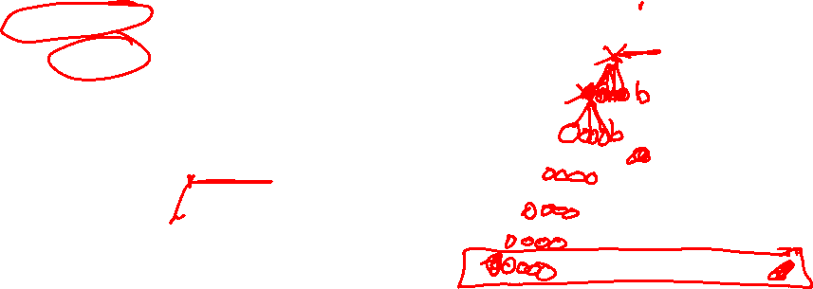
Depth-First Search (DFS) Properties
What nodes does DFS expand?
Some left prefix of the tree.
Could process the whole tree!
If m is finite, takes time O(b^{m})
How much space does the frontier take?
Only has siblings on path to root, so O(bm)
Is it complete?
m could be infinite, so only if we prevent cycles (graph search)
Is it optimal?
No, it finds the “leftmost” solution, regardless of depth or cost
1 node
b
…
b nodes
b² nodes
m tiers
b^{m} nodes

Slide 45

Breadth-First Search (BFS) Properties
What nodes does BFS expand?
Processes all nodes above shallowest solution
Let depth of shallowest solution be s
Search takes time O(b^{s})
How much space does the frontier take?
Has roughly the last tier, so O(b^{s})
Is it complete?
s must be finite if a solution exists, so yes!
Is it optimal?
Only if costs are all the same (more on costs later)
1 node
b
…
b nodes
s tiers
b² nodes
b^{s} nodes
b^{m} nodes

Slide 46

Iterative Deepening
Idea: get DFS’s space advantage with BFS’s time / shallow-solution advantages
Run a DFS with depth limit 1. If no solution…
Run a DFS with depth limit 2. If no solution…
Run a DFS with depth limit 3. …..
Isn’t that wastefully redundant?
Generally most work happens in the lowest level searched, so not so bad!
b
…

Slide 47
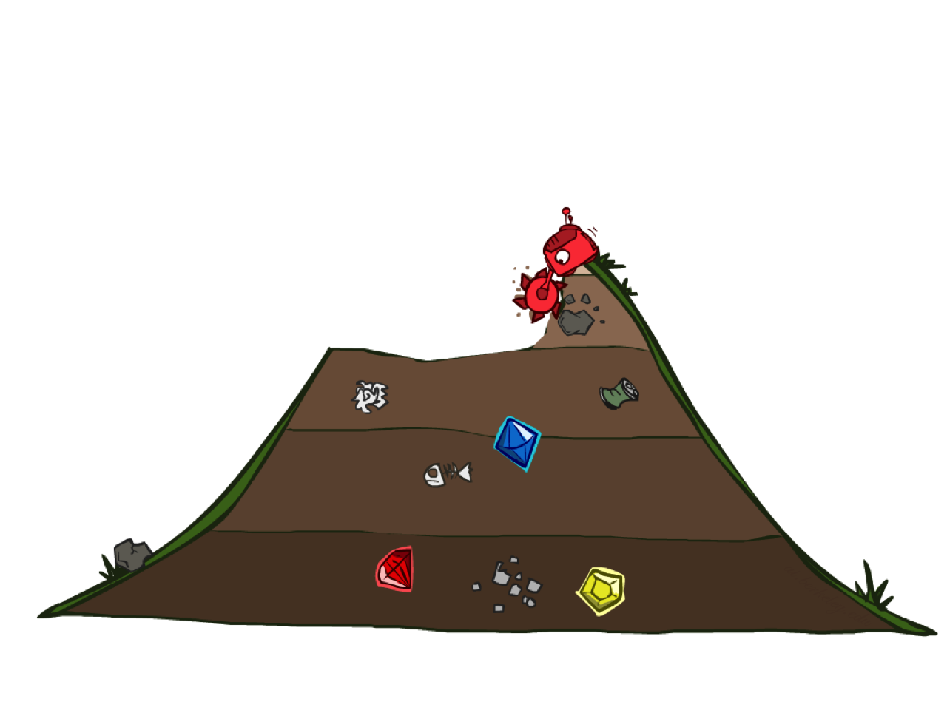
Uniform Cost Search

Slide 48
Finding a Least-Cost Path
a
GOAL
2
2
b
c
3
2
1
8
2
e
d
f
3
9
8
2
START
h
1
4
2
p
4
r
15
q

Slide 49
Depth-First (Tree) Search
Strategy: expand a deepest node first
Implementation: Frontier is a LIFO stack
a
G
a
c
b
c
b
e
d
e
d
f
f
S
h
h
p
p
r
q
r
q
S
d
e
p
b
c
e
h
r
q
a
a
h
r
p
q
f
p
q
f
q
c
G
q
c
G
a
a

Slide 50
Breadth-First (Tree) Search
Strategy: expand a shallowest node first
Implementation: Frontier is a FIFO queue
a
G
b
c
d
e
f
S
h
p
q
r
S
d
e
p
Search
Tiers
b
c
e
h
r
q
a
a
h
r
p
q
f
p
q
f
q
c
G
q
c
G
a
a

Slide 51
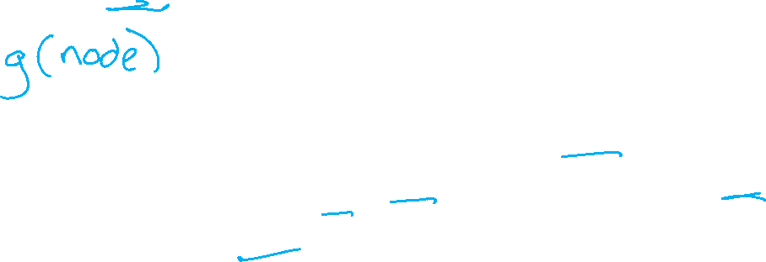
Uniform Cost (Tree) Search
2
G
a
Strategy: expand a cheapest node first:
Frontier is a priority queue (priority: cumulative cost)
b
c
1
8
2
2
e
3
d
f
9
8
2
S
h
1
1
p
q
r
15
0
S
d
3
e
9
p
1
b
4
e
5
h
17
r
11
q
16
c
11
Cost contours
a
6
a
h
13
r
7
p
q
f
p
q
f
8
q
c
G
q
c
a
11
G
10
a

Slide 52
function GRAPH_SEARCH(problem) returns a solution, or failure
initialize the explored set to be empty
initialize the frontier as a specific work list (stack, queue, priority queue)
add initial state of problem to frontier loop do
if the frontier is empty then
return failure choose a node and remove it from the frontier if the node contains a goal state then
return the corresponding solution
add the node state to the explored set
for each resulting child from node
if the child state is not already in the frontier or explored set then
add child to the frontier

Slide 53

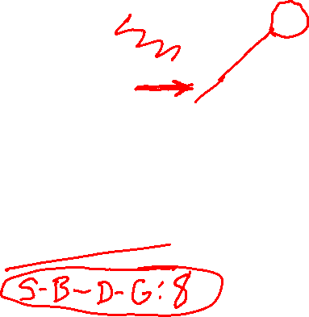
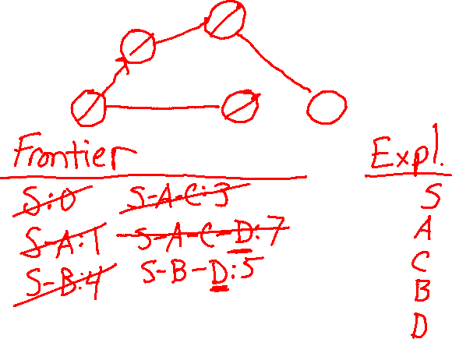
function UNIFORM-COST-SEARCH(problem) returns a solution, or failure
initialize the explored set to be empty
initialize the frontier as a priority queue using node path_cost as the priority
add initial state of problem to frontier with path_cost = 0 loop do
if the frontier is empty then
return failure choose a node and remove it from the frontier if the node contains a goal state then
return the corresponding solution
add the node state to the explored set
for each resulting child from node
if the child state is not already in the frontier or explored set then
add child to the frontier
else if the child is already in the frontier with higher path_cost then
replace that frontier node with child
2
C
A
4
G
1
3
S
B
D
4
1

Slide 54
Walk-through UCS
2
C
A
G
4
1
3
S
B
D
4
1

Slide 55
Walk-through UCS
C
C
2
C
Frontier
S: 0
S-A: 1
S-B: 4
S-A-C: 3
S-A-C-D: 7
S-B-D: 5 ??
Explored
S
A
C
B
A
G
A
A
4
1
3
S
B
D
B
S
B
D
S
4
1

Slide 56

Walk-through UCS
C
C
2
C
G
Frontier
S: 0
S-A: 1
S-B: 4
S-A-C: 3
S-A-C-D: 7
S-B-D: 5
S-B-D-G: 8
Explored
S
A
C
B
D
A
G
A
A
4
1
3
B
B
D
S
B
D
S
D
S
4
1
Replaced by better path to D!
Result: S-B-D-G (path cost 8)

Slide 57
UCS: Another Example
a
GOAL
2
2
b
c
3
2
1
8
2
e
3
d
f
START
9
8
2
h
1
4
2
p
4
r
q
15

Slide 58
UCS: Another Example
a
GOAL
2
2
b
c
3
2
Frontier
S: 0
S-d: 3
S-e: 9
S-p: 1
S-p-q: 16
S-d-b: 4
S-d-c: 11
S-d-e: 5 ??
Explored
S
p
d
1
8
2
e
3
d
f
START
9
8
2
h
1
4
2
p
4
r
q
15

Slide 59
UCS: Another Example
a
GOAL
2
2
b
c
3
2
Frontier
S: 0
S-d: 3
S-e: 9
S-p: 1
S-p-q: 16
S-d-b: 4
S-d-c: 11
S-d-e: 5
S-d-b-a: 6
S-d-e-h: 13
S-d-e-r: 7
Explored
S
p
d
b
e
a
r
f
1
8
S-d-e-r-f: 9
S-d-e-r-f-c: 12??
S-d-e-r-f-G: 11
2
e
3
d
f
START
9
8
2
h
1
4
2
p
4
r
q
15
Add S-d-e-r-f-c: 12 to frontier?
No, there is a better path to c on the frontier, S-d-c: 11
I see G on the frontier. Are we done?
No, the goal test doesn't come until after we pop a node from the frontier

Slide 60
UCS: Another Example
a
GOAL
2
2
b
c
3
2
Frontier
S: 0
S-d: 3
S-e: 9
S-p: 1
S-p-q: 16
S-d-b: 4
S-d-c: 11
S-d-e: 5
S-d-b-a: 6
S-d-e-h: 13
S-d-e-r: 7
Explored
S
p
d
b
e
a
r
f
c
1
8
S-d-e-r-f: 9
S-d-e-r-f-c: 12
S-d-e-r-f-G: 11
2
e
3
d
f
START
9
8
2
h
1
4
2
p
4
r
q
15
FYI: Breaking tie at cost 11 alphabetically
a is already on the explored set, so we don't consider adding S-d-c-a
Result: S-d-e-r-f-G with cost 11

Slide 61
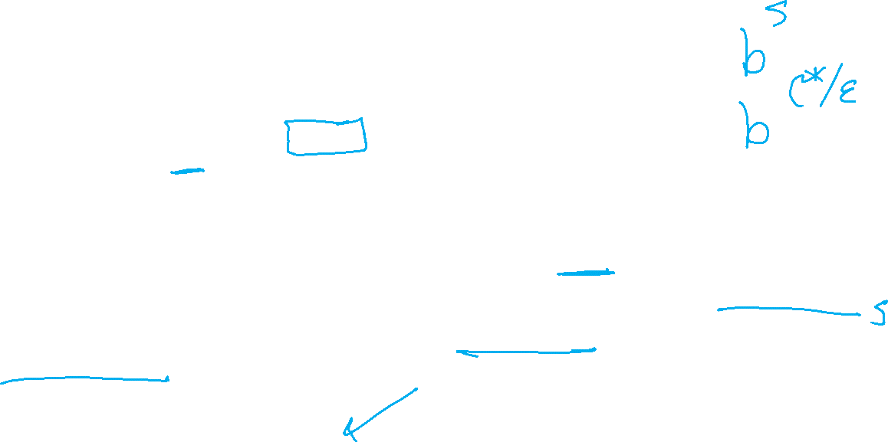
Uniform Cost Search (UCS) Properties
What nodes does UCS expand?
Processes all nodes with cost less than cheapest solution!
If that solution costs C* and arcs cost at least ε , then the “effective depth” is roughly C*/ε
Takes time O(b^{C*/ε}) (exponential in effective depth)
How much space does the frontier take?
Has roughly the last tier, so O(b^{C*/ε})
Is it complete?
Assuming best solution has a finite cost and minimum arc cost is positive, yes!
Is it optimal?
Yes! (Proof next lecture via A*)
b
c ≤ 1
…
C*/ε “tiers”
c ≤ 2
c ≤ 3

Slide 62
Uniform Cost Issues
Remember:
UCS explores increasing cost contours
The good:
UCS is complete and optimal!
The bad:
Explores options in every “direction”
No information about goal location
We’ll fix that!
…
c ≤ 1
c ≤ 2
c ≤ 3
Start
Goal

