Slide 1

Warm-up as you walk in
Candy Grab game!
Grab a pack of game pieces (candy/goldfish)
Groups of 3
Play the game!
Select 2 players (third play will observer)
11 pieces on the table
Take turns taking 1 or 2 pieces
Person that takes the last piece wins!
Keep playing the game (rotate which 2 are playing)
Think about how you might implement an Agent to play this in code:
class Agent:
def getAction(state)
return action

Slide 2
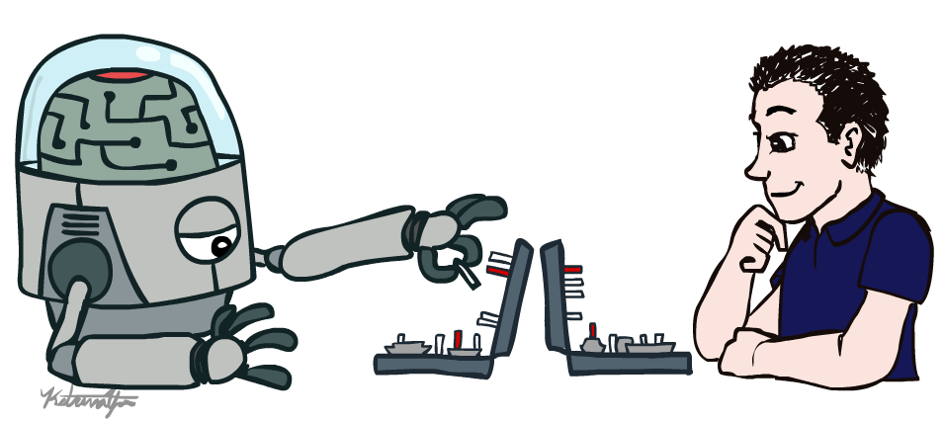
AI: Representation and Problem Solving
Introduction
Instructor: Pat Virtue
Slide credits: CMU AI & http://ai.berkeley.edu

Slide 3

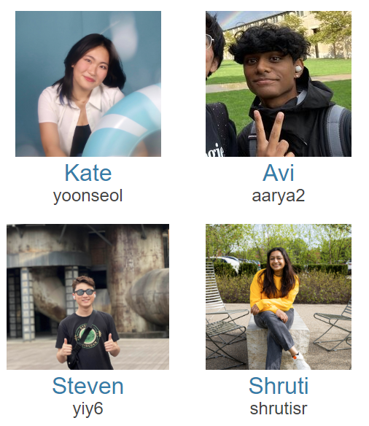

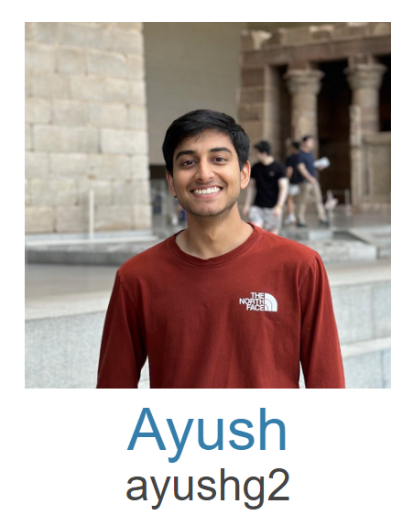


Course Team
Teaching Assistants
Instructor
Pat Virtue

Slide 4
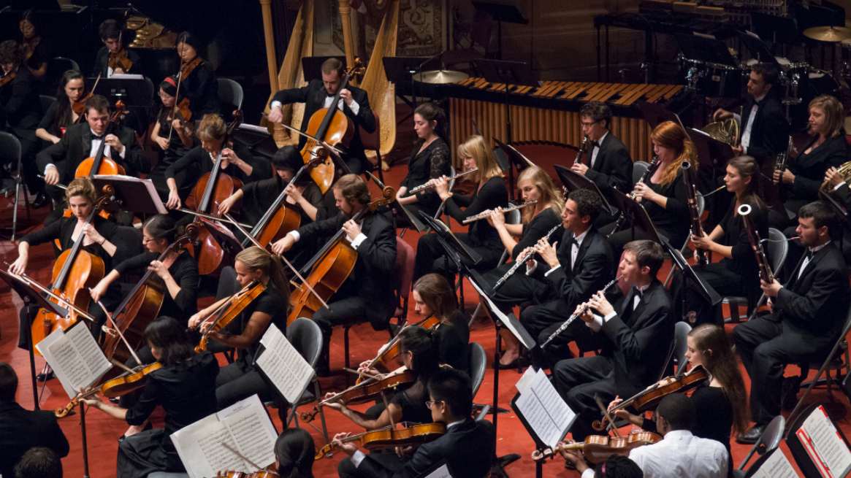
Course Team
Students!!

Slide 5


(Quick) Course Information
Website: https://www.cs.cmu.edu/~15281
Canvas: canvas.cmu.edu
Gradescope: gradescope.com
Communication: Piazza → Ed
(If Piazza/Ed doesn't work) E-mail: pvirtue@andrew.cmu.edu

Slide 6
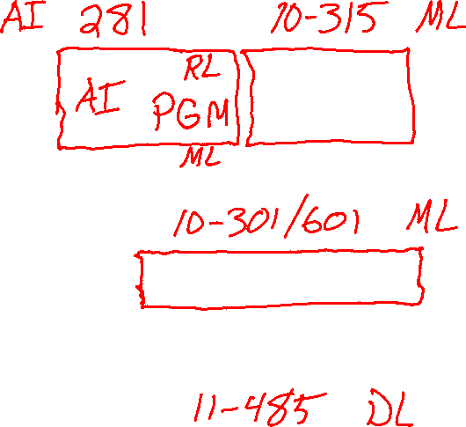

AI and ML Courses
15-281 and 10-315 (Intro ML)
Designed to go together
Topics divided among two courses for breadth
Two courses allows depth
15-281 has some machine learning topics but, notably, no neural networks (deep learning)
Reinforcement learning (RL)
Probabilisted Graphical Models (Bayes Nets, HMMs)
10-301/10-601 (Intro ML)
Has really good ML breadth (and also decent depth) but not AI breadth

Slide 7

Announcements
Recitation starting this Friday
Recommended. Materials are fair game for exams
Choosing sections
Assignments:
P0: Python & Autograder Tutorial
Required, but worth zero points
Already released
Due Thu 9/5, 10 pm
HW1 (online)
Released Thursday
Due Thu 9/5, 10 pm

Slide 8
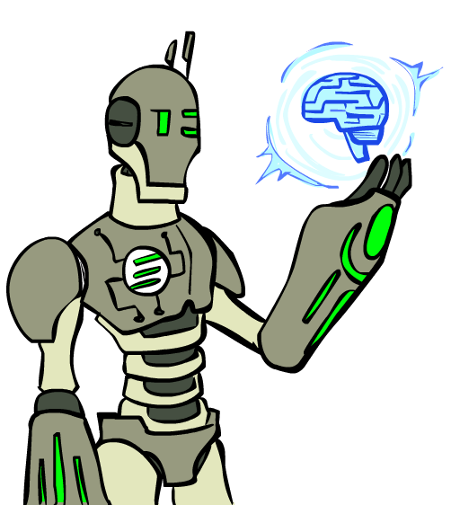

Today
Designing Agents
What is artificial intelligence?
A brief history of AI

Slide 9
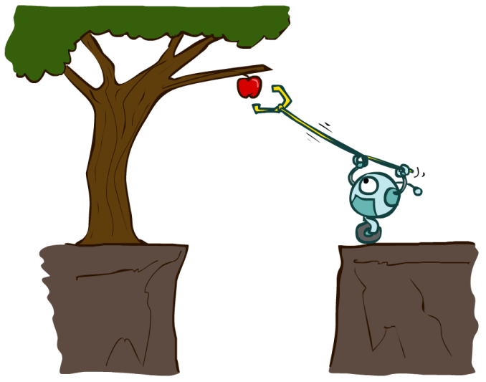

Designing Agents
An agent is an entity that perceives and acts.
Characteristics of the percepts, environment, and action space dictate techniques for selecting actions
This course is about:
General AI techniques for a variety of problem types
Learning to recognize when and how a new problem can be solved with an existing technique
Sensors
Agent
Percepts
Environment
?
Actuators
Actions

Slide 10
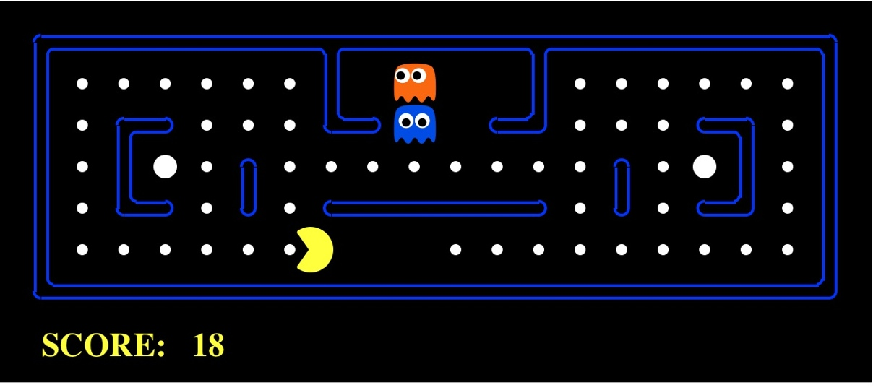

Pac-Man as an Agent
Agent
Environment
Sensors
Percepts
?
Actuators
Actions
Pac-Man is a registered trademark of Namco-Bandai Games, used here for educational purposes

Slide 11
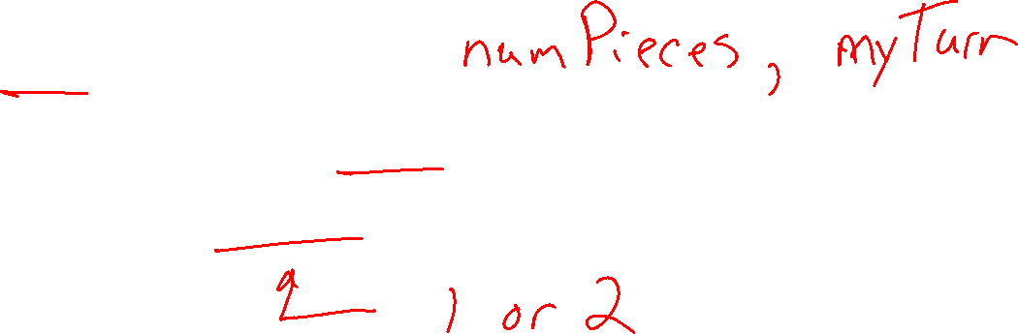
Nim Agent
class Agent
function getAction(state)
return action

Slide 12
Nim Agent
Agent 001 – Always choose 1
function getAction( numPiecesAvailable )
return 1

Slide 13
Nim Agent
Agent 002 – Always choose 2
function getAction( numPiecesAvailable )
return 2

Slide 14
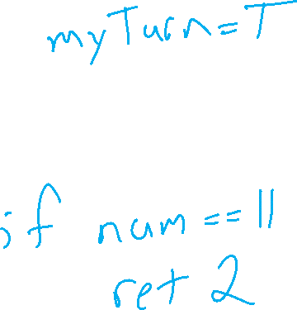
Nim Agent
Agent 004 – Choose the opposite of opponent
function getAction( numPiecesAvailable )
return ?

Slide 15
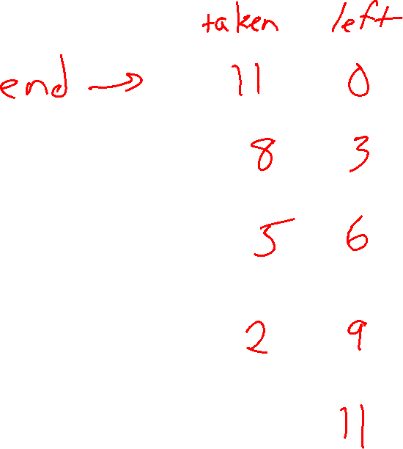

Nim Agent
Agent 007 – Whatever you think is best
function getAction( numPiecesAvailable )
return ?

Slide 16

Nim Agent
Agent 007 – Whatever you think is best
function getAction( numPiecesAvailable )
if numPiecesAvailable % 3 == 2
return 2
else
return 1

Slide 17

Participation Polls
See Piazza for link to Drive
Seat form
More details on participation later

Slide 18
Games – Three “Intelligent” Agents
Poll 1
Which agent code is the most “intelligent”?

Slide 19

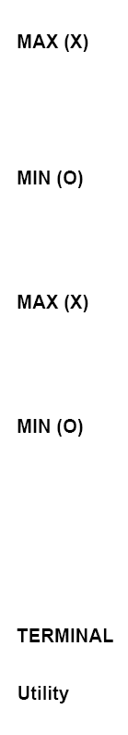

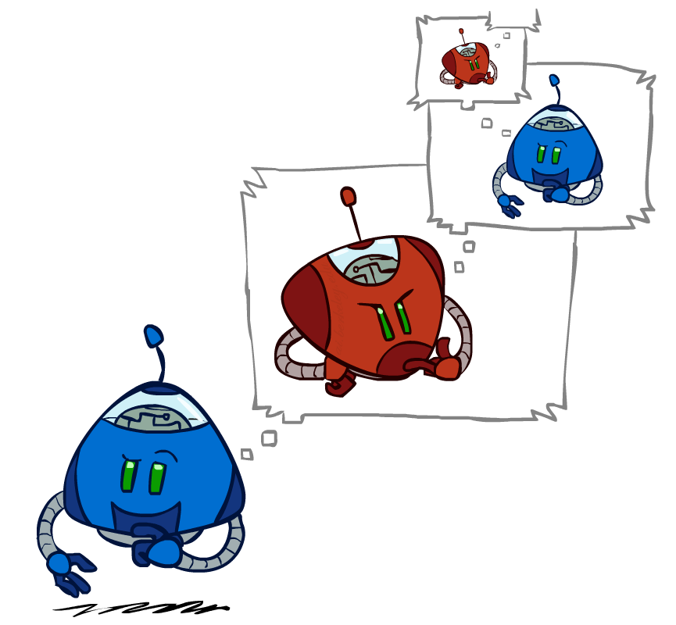
Games – Three “Intelligent” Agents
A: Search / Recursion
11
10
9
9
8
8
7
8
7
…
…
2
1
0
+1
+1
-1

Slide 20
Games – Three “Intelligent” Agents
B: Encode the pattern
10’s value:Win
9’s value:Lose
8’s value:Win
7’s value:Win
6’s value:Lose
5’s value:Win
4’s value:Win
3’s value:Lose
2’s value:Win
1’s value:Win
0’s value:Lose
function getAction( numPiecesAvailable )
if numPiecesAvailable % 3 == 2
return 2
else
return 1

Slide 21
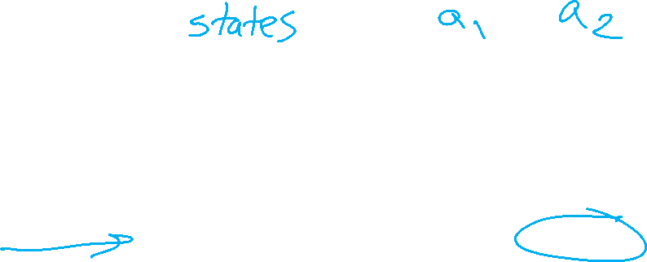
Games – Three “Intelligent” Agents
C: Record statistics of winning positions
Pieces Available | Take 1 | Take 2
2
3
4
5
6
7
Pieces Available | Take 1 | Take 2
2 |  | 100%
3
4 | 100%
5
6
7 |  | 100%
Pieces Available | Take 1 | Take 2
2 |  | 100%
3 | 0%
4 | 100%
5
6
7 |  | 50%
Pieces Available | Take 1 | Take 2
2 | 0% | 100%
3 | 2% | 0%
4 | 75% | 2%
5 | 4% | 68%
6 | 5% | 6%
7 | 60% | 5%

Slide 22
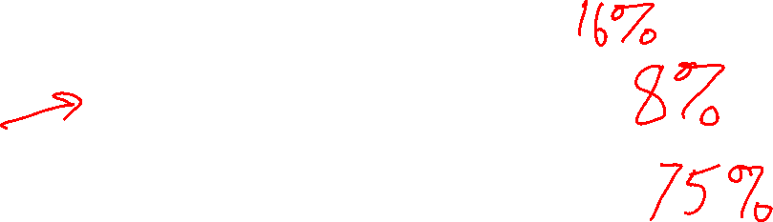
Poll 1
Games – Three “Intelligent” Agents
Which agent code is the most “intelligent”?
Search / Recursion
Encode multiple of 3 pattern
Keep stats on winning positions
Which agent code is the most “intelligent”?

Slide 23

Games – Three “Intelligent” Agents
C: Record statistics of winning positions
Pieces Available | Take 1 | Take 2
2
3
4
5
6
7
Pieces Available | Take 1 | Take 2
2 |  | 100%
3
4 | 100%
5
6
7 |  | 100%
Pieces Available | Take 1 | Take 2
2 |  | 100%
3 | 0%
4 | 100%
5
6
7 |  | 50%
Pieces Available | Take 1 | Take 2
2 | 0% | 100%
3 | 2% | 0%
4 | 75% | 2%
5 | 4% | 68%
6 | 5% | 6%
7 | 60% | 5%

Slide 24
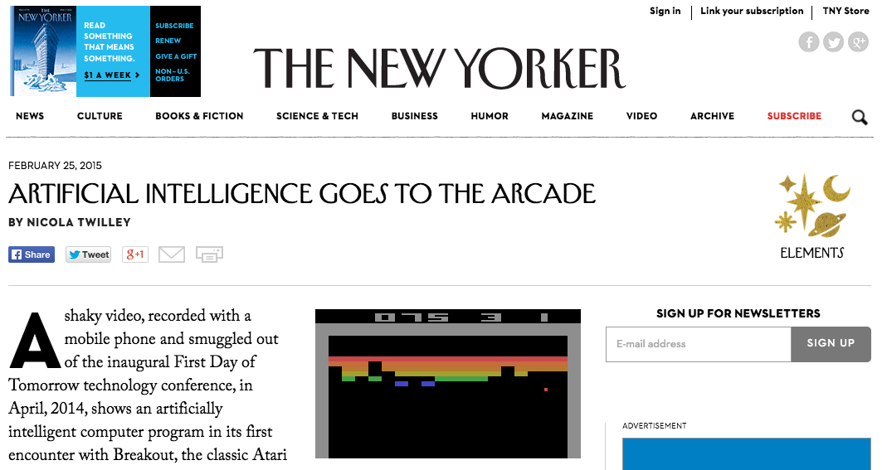

AI Breakthrough!
https://www.youtube.com/watch?v=EfGD2qveGdQ

Slide 25
What is "Aritifical Intelligence"?

Slide 26
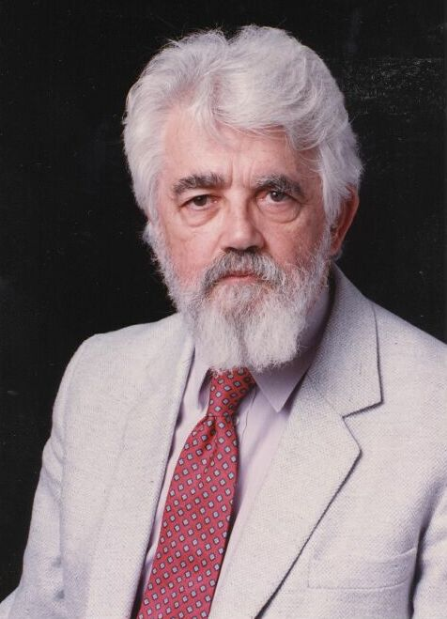

AI Definition by John McCarthy
What is artificial intelligence
It is the science and engineering of making intelligent machines, especially intelligent computer programs
What is intelligence
Intelligence is the computational part of the ability to achieve goals in the world
http://www-formal.stanford.edu/jmc/whatisai/whatisai.html

Slide 27
What do we mean by "Artificial Intelligence"?

Slide 28

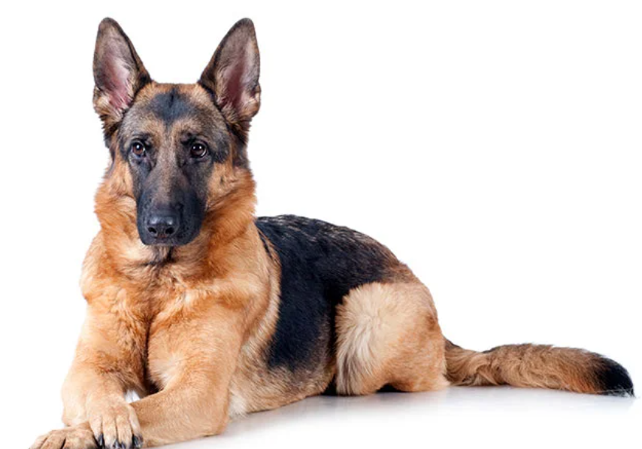
What do we mean by "Artificial Intelligence"?
Which of these is more intelligent?

Slide 29
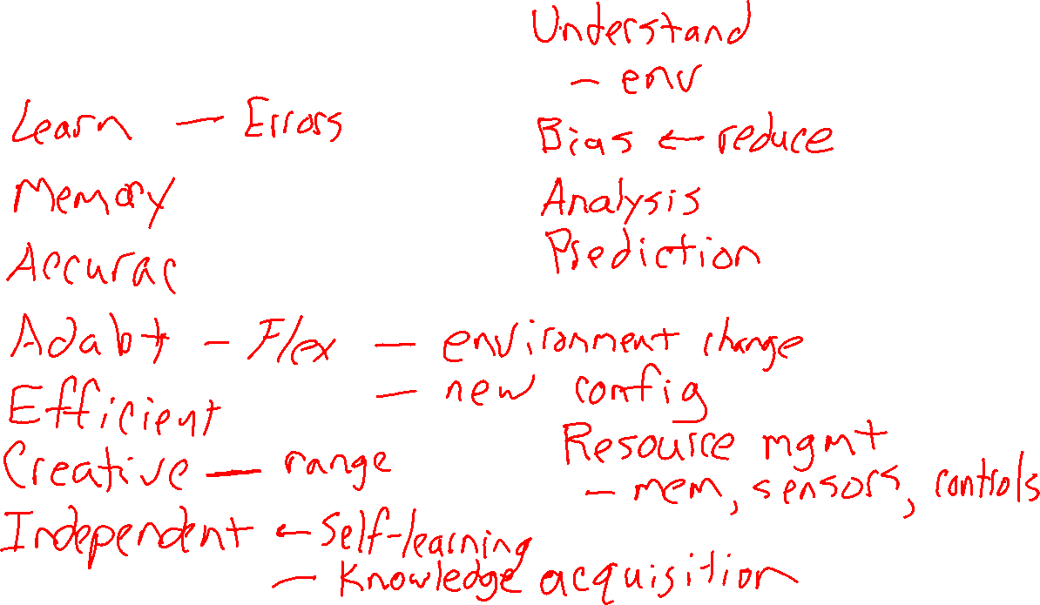
Attributes of Intelligence

Slide 30
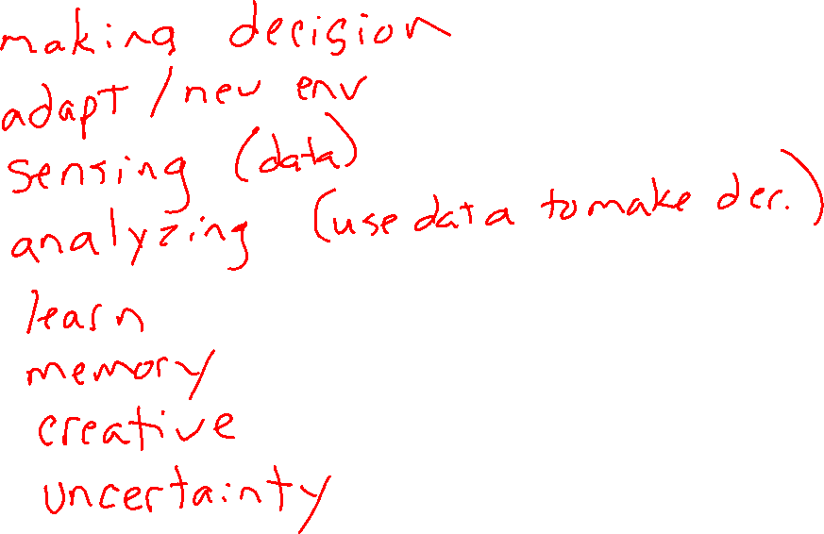
Attributes of Intelligence

Slide 31
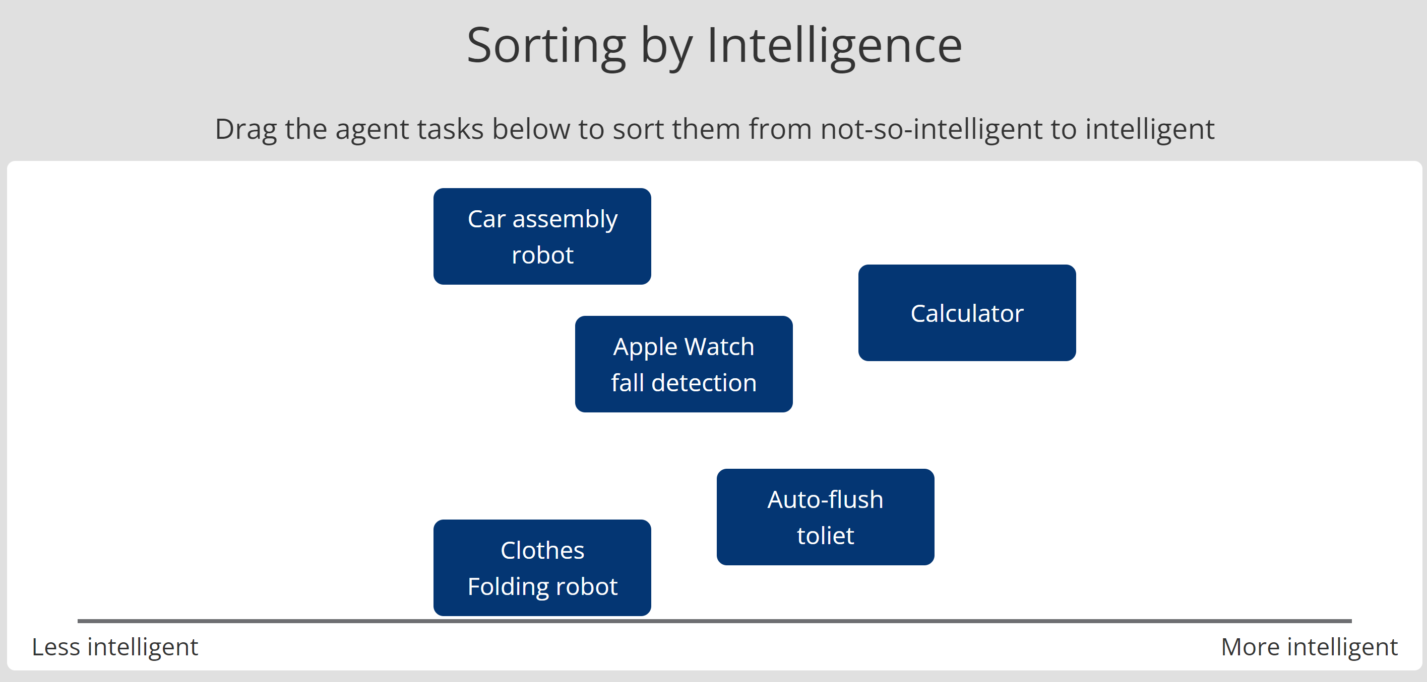
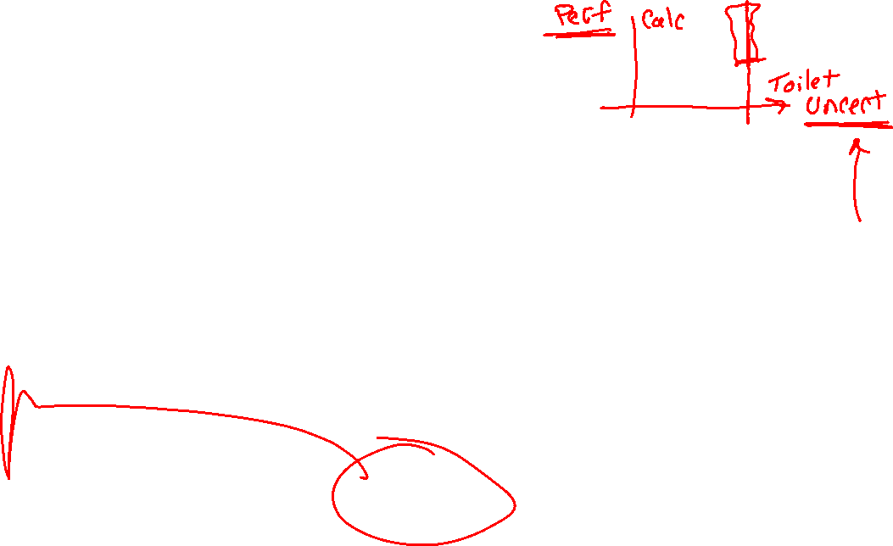
How intelligence are these agents?
Exercise:
https://www.cs.cmu.edu/~pvirtue/AIS/sorting-intelligence/sorting.html

Slide 32
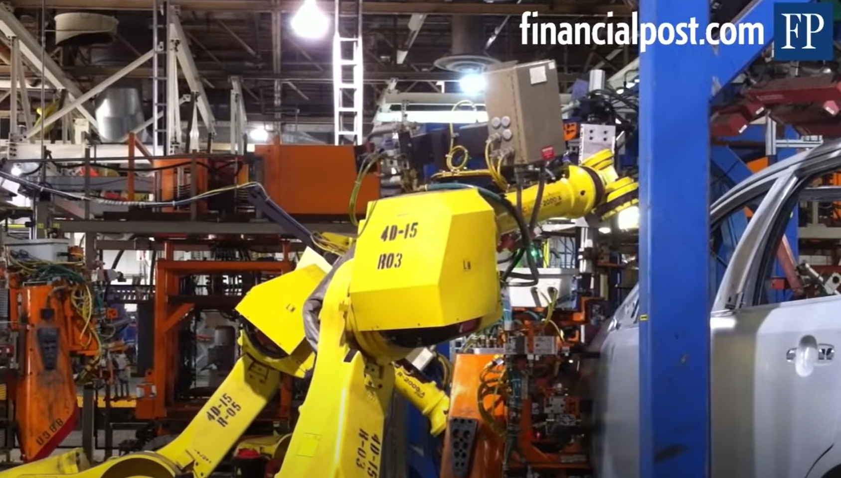
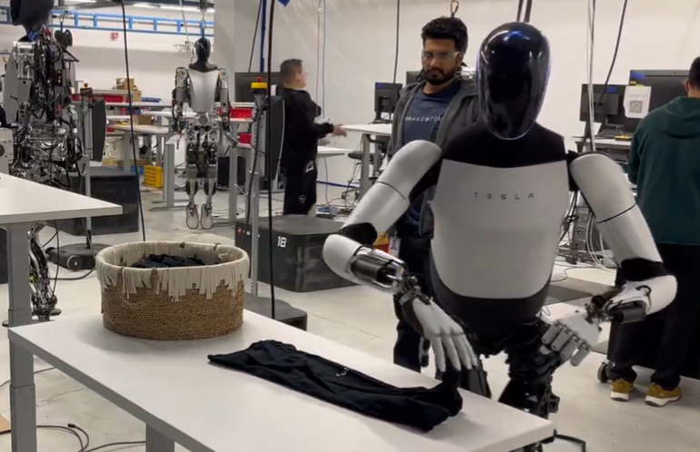

Which is more intelligent?
Robotics
Robot that assemble cars in factory
Robot that fold clothes
https://www.youtube.com/watch?v=pxLpsSkEtuY
https://x.com/elonmusk/status/1746964887949934958

Slide 33
Intelligence and Uncertainty

Slide 34
Intelligence and Uncertainty
Uncertainty in robotics
Robot that assemble cars in factory
Robot that fold clothes
https://www.youtube.com/watch?v=pxLpsSkEtuY
https://x.com/elonmusk/status/1746964887949934958

Slide 35


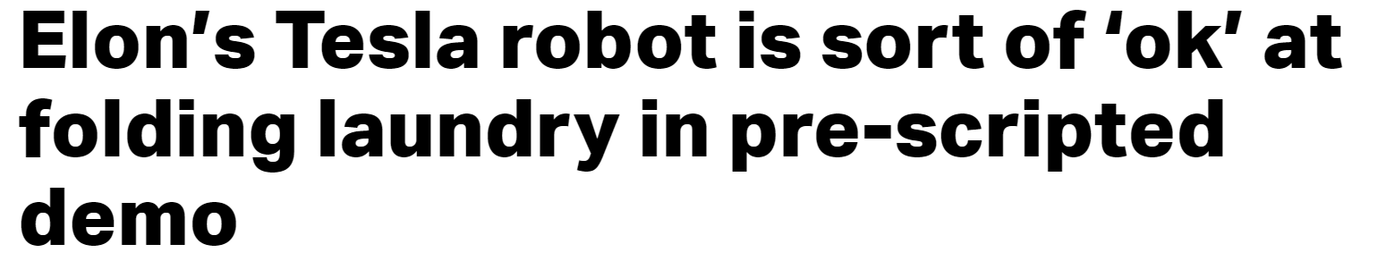
Intelligence and Uncertainty
Musk said that eventually, it will “certainly be able to do this fully autonomously,” however, and without the highly artificial constraints in place for this demo, including the fixed-height table and single article of clothing in the carefully placed basket.
https://techcrunch.com/2024/01/15/elons-tesla-robot-is-sort-of-ok-at-folding-laundry-in-pre-scripted-demo
https://x.com/elonmusk/status/1746964887949934958

Slide 36
Intelligence and Uncertainty
Another way to think about intelligence is to consider how much uncertainty is involved
Uncertainty comes into play whenever it is not feasible to determine exact information
Uncertainty requires decisions to be made

Slide 37
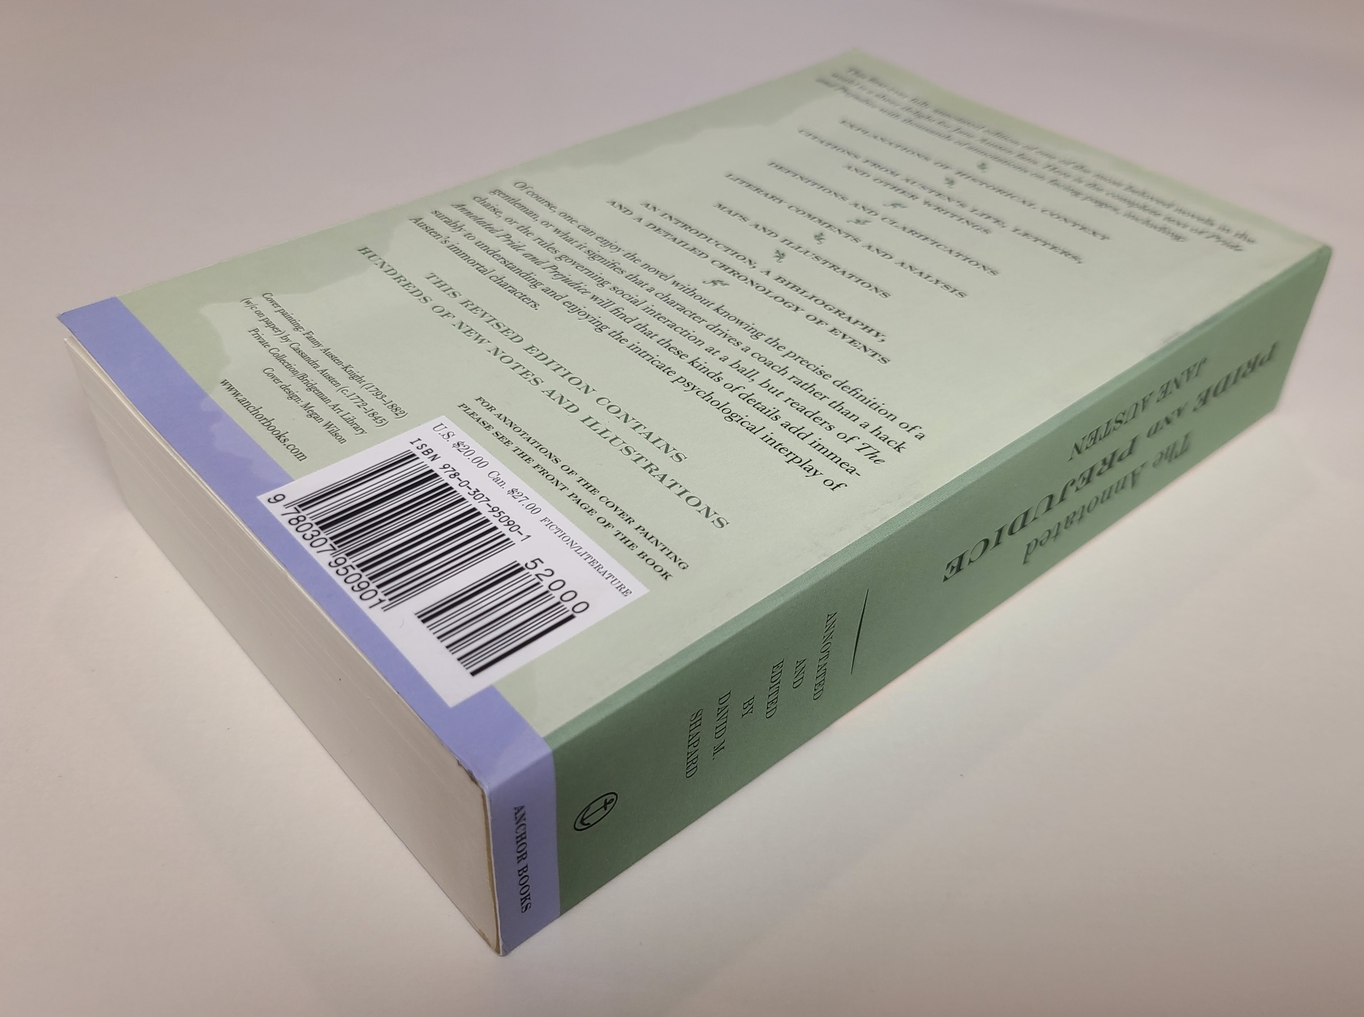
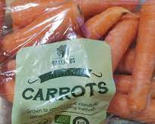
Intelligence and Uncertainty
ISBN 978-0-307-95090-1
Consider the uncertainty present in the following
Typing a product ID number into a website (book ISBN number into amazon.com)
Barcode reader scanning a book in a well-lit library
Barcode reader scanning a bag of carrots in a grocery store

Slide 38

Intelligence and Uncertainty
Uncertainty can have lots of sources, including anything we attribute to random chance
Hidden information
Cards in another player’s hand
Noise
Sensor noise
Way to complicated to model
Leaves blowing in the wind
Infinite number of possible configurations
More possibilities than any computer can compute in a reasonable time
Tic-tac-toe → Checkers → Chess

Slide 39

What do we mean by an intelligent agent?
Pat's version:
An agent that preforms well on tasks that involve uncertainty

Slide 40
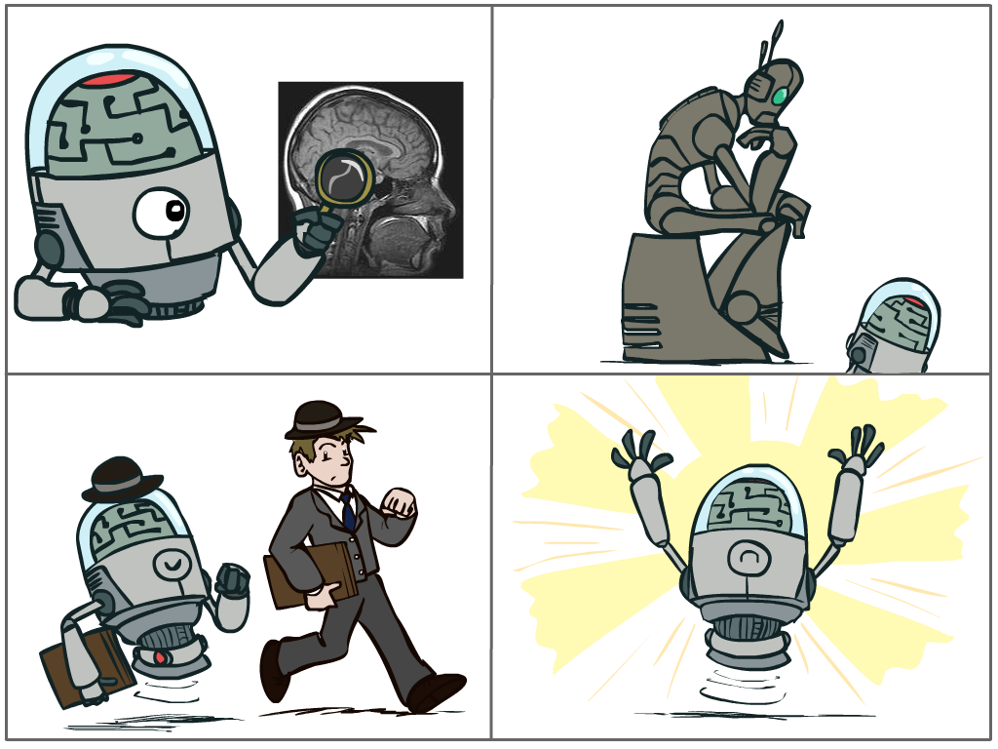
What is AI?
The science of making machines that:
Think like people
Think rationally
Act like people
Act rationally
Notes:
Top left: Think like people --- cognitive science, neuroscience
Bottom left: act like people --- actually very early definition, dating back to Alan Turing --- Turing test; problem to do really well you start focusing on things like don’t answer too quickly what the square root of 1412 is, don’t spell too well, and make sure you have a favorite movie etc. So it wasn’t really leading us to build intelligence
Think rationally – long tradition dating back to Aristotle --- but not a winner, because difficult to encode how to think, and in the end it’s not about how you think, it’s about how you end up acting

Slide 41
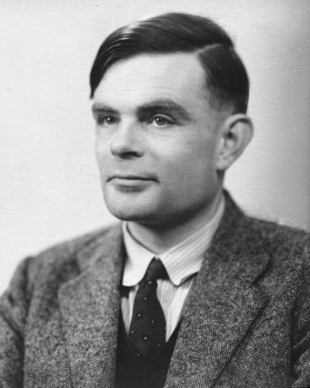
Turing Test
In 1950, Turing defined a test of whether a machine could “think”
“A human judge engages in a natural language conversation with one human and one machine, each of which tries to appear human. If judge can’t tell, machine passes the Turing test”
en.wikipedia.org/wiki/Turing_test
Notes:
Top left: Think like people --- cognitive science, neuroscience
Bottom left: act like people --- actually very early definition, dating back to Alan Turing --- Turing test; problem to do really well you start focusing on things like don’t answer too quickly what the square root of 1412 is, don’t spell too well, and make sure you have a favorite movie etc. So it wasn’t really leading us to build intelligence
Think rationally – long tradition dating back to Aristotle --- but not a winner, because difficult to encode how to think, and in the end it’s not about how you think, it’s about how you end up acting

Slide 42
What is AI?
The science of making machines that:
Think like people
Think rationally
Act like people
Act rationally
Notes:
Top left: Think like people --- cognitive science, neuroscience
Bottom left: act like people --- actually very early definition, dating back to Alan Turing --- Turing test; problem to do really well you start focusing on things like don’t answer too quickly what the square root of 1412 is, don’t spell too well, and make sure you have a favorite movie etc. So it wasn’t really leading us to build intelligence
Think rationally – long tradition dating back to Aristotle --- but not a winner, because difficult to encode how to think, and in the end it’s not about how you think, it’s about how you end up acting

Slide 43
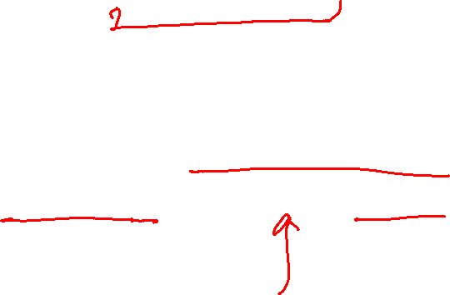
Rational Decisions
We’ll use the term rational in a very specific, technical way:
Rational: maximally achieving pre-defined goals
Rationality only concerns what decisions are made
(not the thought process behind them)
Goals are expressed in terms of the utility of outcomes
Being rational means maximizing your expected utility
Notes:
Example of utilities. 10 for A, 1 for each Friday with friends

Slide 44
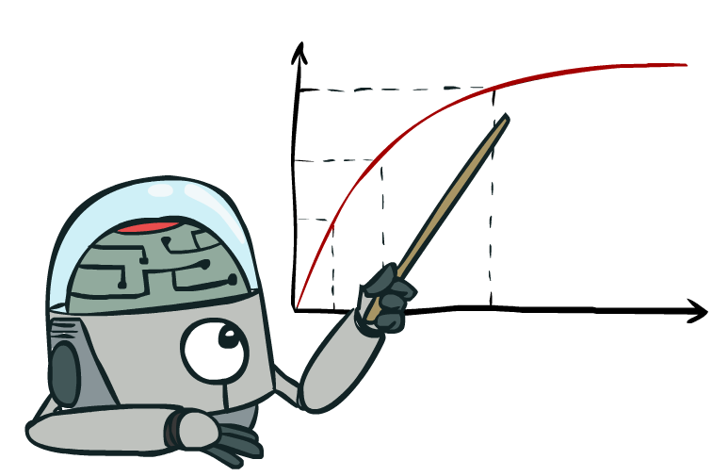

Maximize Your
Expected Utility

Slide 45
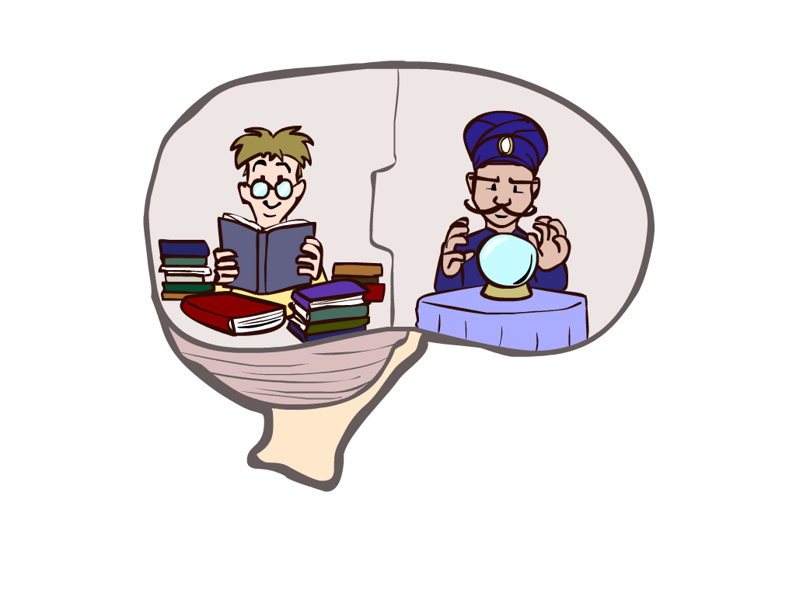
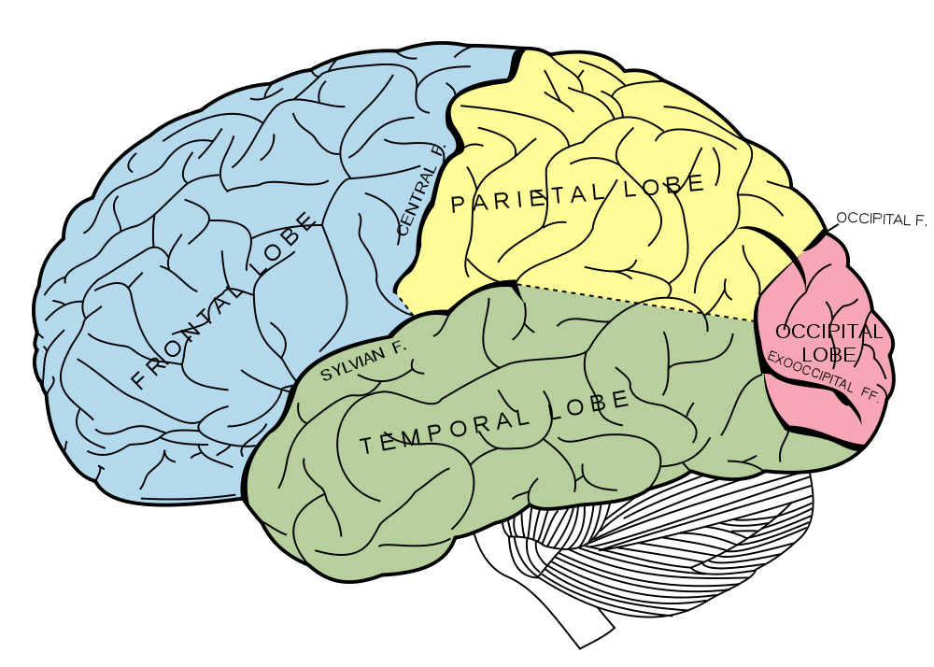

What About the Brain?
Brains (human minds) are very good at making rational decisions, but not perfect
Brains aren’t as modular as software, so hard to reverse engineer!
“Brains are to intelligence as wings are to flight”
Lessons learned from the brain: memory and simulation are key to decision making

Slide 46
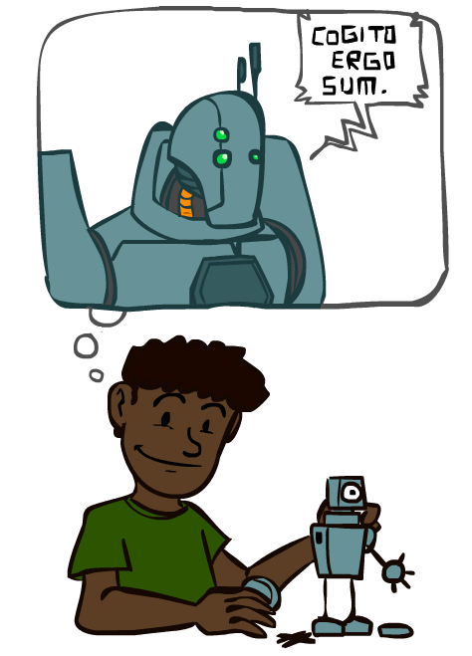
A Brief History of AI

Slide 47
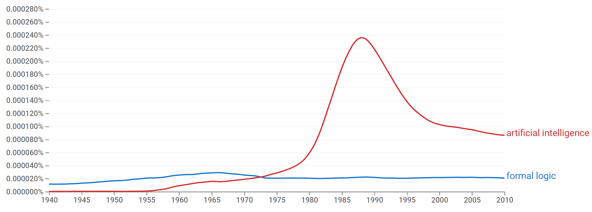
A Brief History of AI
Knowledge Based
Systems
1970-1990
AI
Excitement!
1950-1970
artificial intelligence
formal logic
https://books.google.com/ngrams

Slide 48
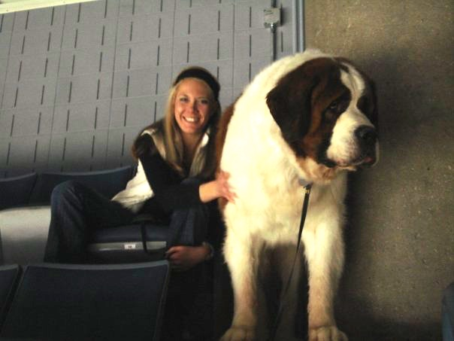
What went wrong?
Dog
Barks
Has Fur
Has four legs
Buster

Slide 49
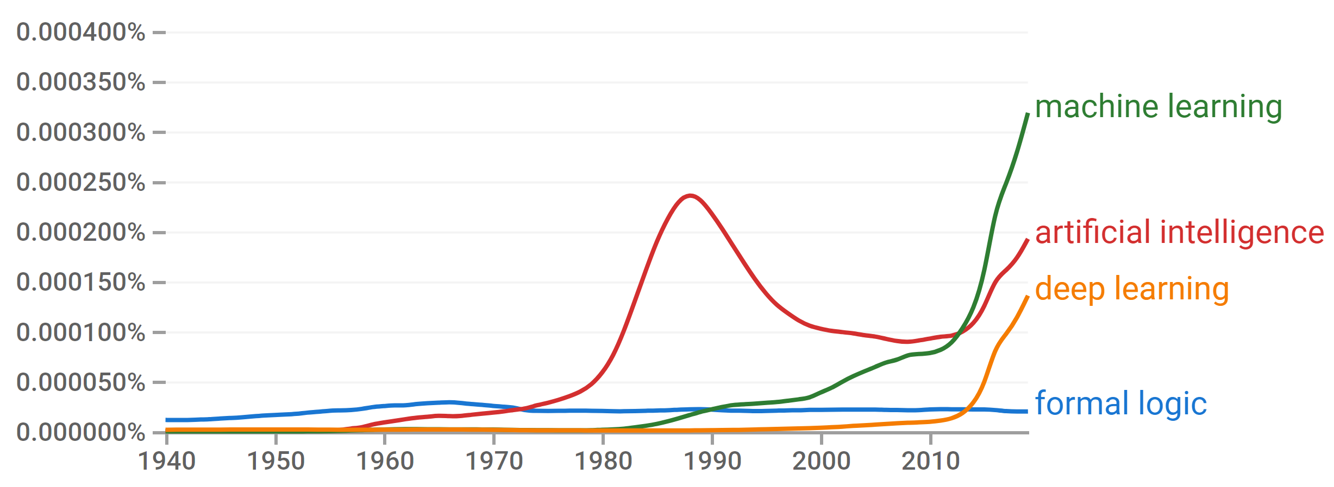
A Brief History of AI
Knowledge Based
Systems
1970-1990
AI
Excitement!
1950-1970
Statistical Approaches
1990-
Deep Learning Era
2012-
https://books.google.com/ngrams

Slide 50
A Brief History of AI
1940-1950: Early days
1943: McCulloch & Pitts: Boolean circuit model of brain
1950: Turing's “Computing Machinery and Intelligence”
1950—70: Excitement: Look, Ma, no hands!
1950s: Early AI programs, including Samuel's checkers program, Newell & Simon's Logic Theorist, Gelernter's Geometry Engine
1956: Dartmouth meeting: “Artificial Intelligence” adopted
1970—90: Knowledge-based approaches
1969—79: Early development of knowledge-based systems
1980—88: Expert systems industry booms
1988—93: Expert systems industry busts: “AI Winter”
1990—: Statistical approaches
Resurgence of probability, focus on uncertainty
General increase in technical depth
Agents and learning systems… “AI Spring”?
2012—: Deep learning
2012: ImageNet & AlexNet
Images: ai.berkeley.edu
Notes:
Million dollar computer with less computation than your phone
MT was

Slide 51
Artificial Intelligence vs Machine Learning?
Artificial Intelligence
Machine Learning
Deep Learning

Slide 52
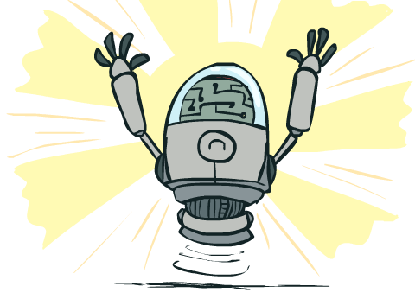
What Can AI Do?
Quiz: Which of the following can be done at present?
Play a decent game of table tennis?
Play a decent game of Jeopardy?
Drive safely along a curving mountain road?
Drive safely across Pittsburgh?
Buy a week's worth of groceries on the web?
Buy a week's worth of groceries at Giant Eagle?
Discover and prove a new mathematical theorem?
Converse successfully with another person for an hour?
Perform a surgical operation?
Put away the dishes and fold the laundry?
Translate spoken Chinese into spoken English in real time?
Generate intentionally funny memes?

Slide 53



AI Meme Generator
https://imgflip.com/ai-meme

