Slide 1

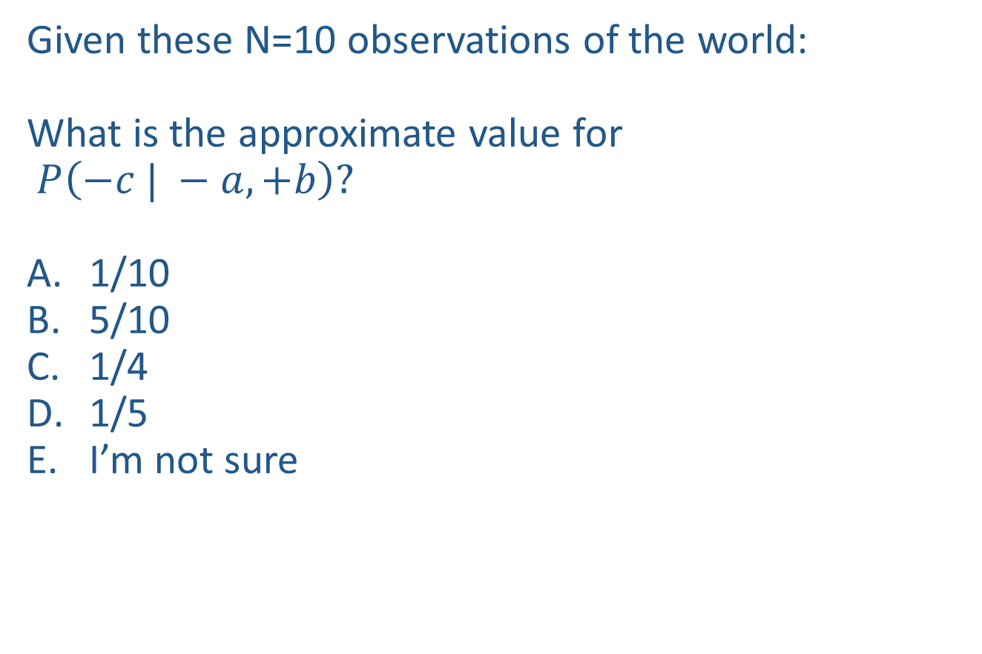

Warm-up as you walk in
Given these N=10 observations of the world:
What is the approximate value for
$P\left(−c | −a, +b\right)?$
1/10
5/10
1/4
1/5
I’m not sure
Counts
$$−a, −b, +c$$
$$+a,−b, +c$$
$$−a, −b,+c$$
$$−a, +b, +c$$
$$+a, −b, +c$$
$$−a, +b, −c$$
$$−a, +b, +c$$
$$−a, +b, +c$$
$$+a, −b, +c$$
$$−a, +b, +c$$
+a | +b | +c | 0
+a | +b | -c | 0
+a | -b | +c | 3
+a | -b | -c | 0
-a | +b | +c | 4
-a | +b | -c | 1
-a | -b | +c | 2
-a | -b | -c | 0

Slide 2
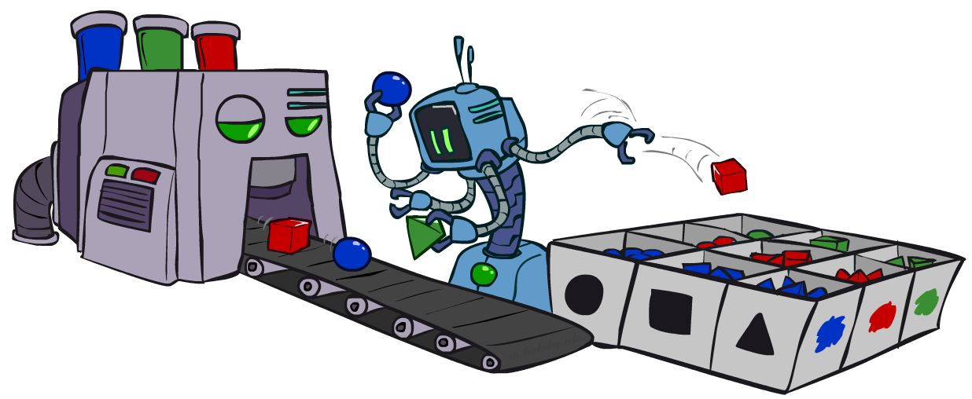
AI: Representation and Problem Solving
Bayes Nets Sampling
Instructor: Pat Virtue
Slide credits: CMU AI and http://ai.berkeley.edu

Slide 3


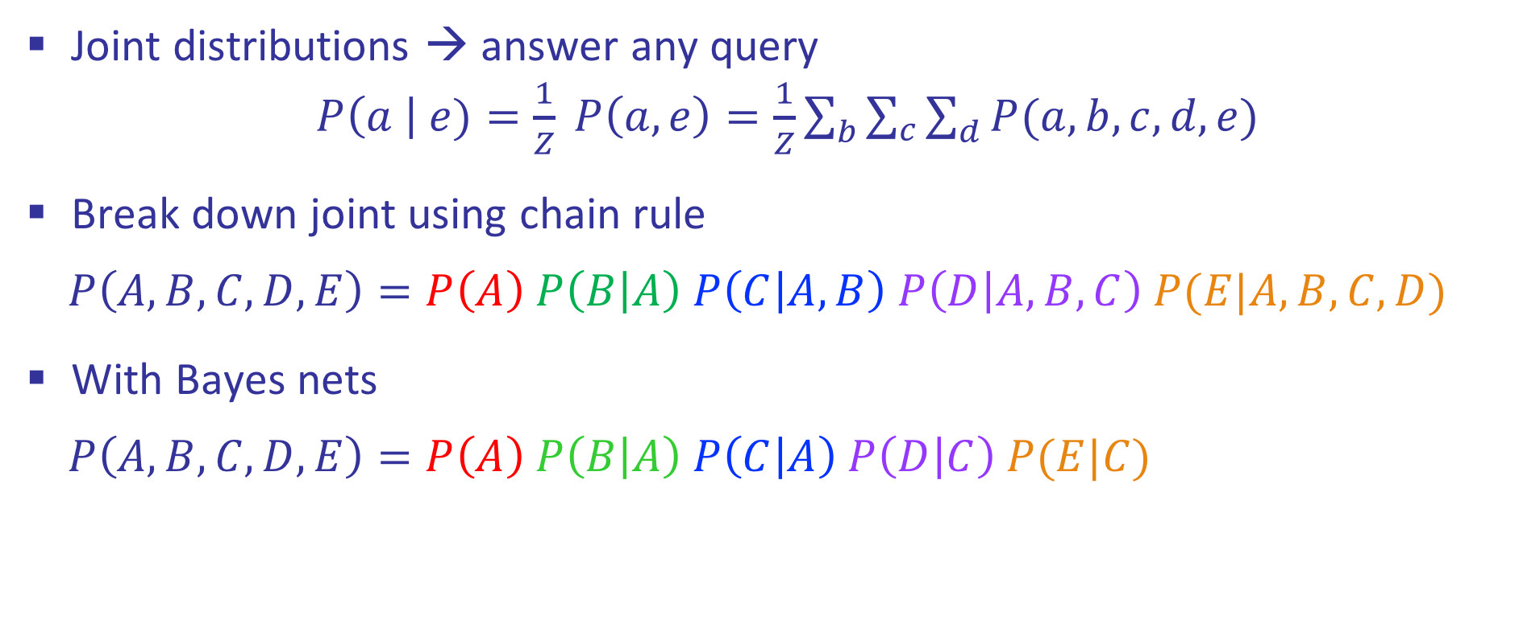



Review: Bayes Nets
Joint distributions → answer any query
$P\left(a \right| e)=\frac{1}{Z} P\left(a, e\right)=\frac{1}{Z}\sum_{b}{\sum_{c}{\sum_{d}{P(a,b, c, d, e)}}}$
Break down joint using chain rule
$$P\left(A,B,C,D,E\right)=P\left(A\right) P\left(B | A\right) P\left(C | A,B\right) P\left(D | A,B,C\right) P(E|A,B,C,D)$$
With Bayes nets
$$P\left(A,B,C,D,E\right)=P\left(A\right) P\left(B | A\right) P\left(C | A\right) P\left(D | C\right) P(E|C)$$
$$A$$
$$B$$
$$C$$
$$D$$
$$E$$

Slide 4

Bayes Nets
Part I: Representation
Part II: Exact inference
  Enumeration (always exponential complexity)
  Variable elimination (worst-case exponential complexity, often better)
  Inference is NP-hard in general
Part III: Approximate Inference

Slide 5
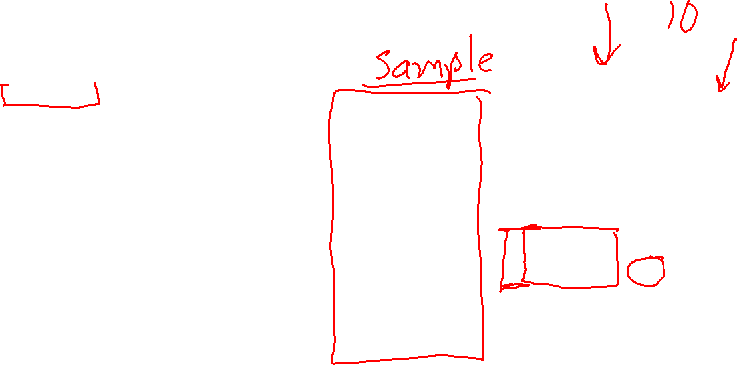
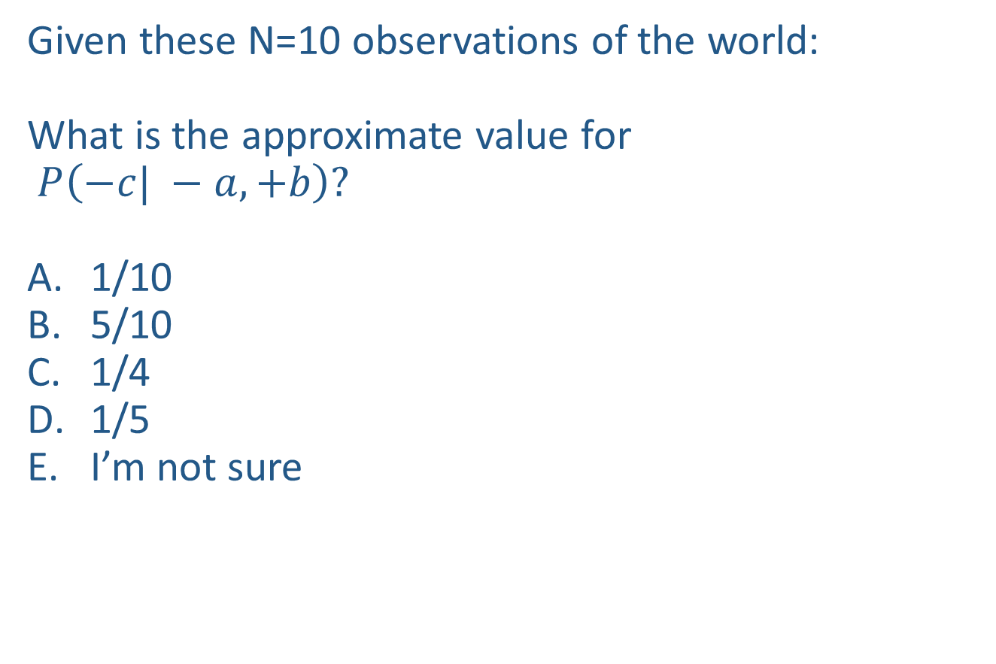
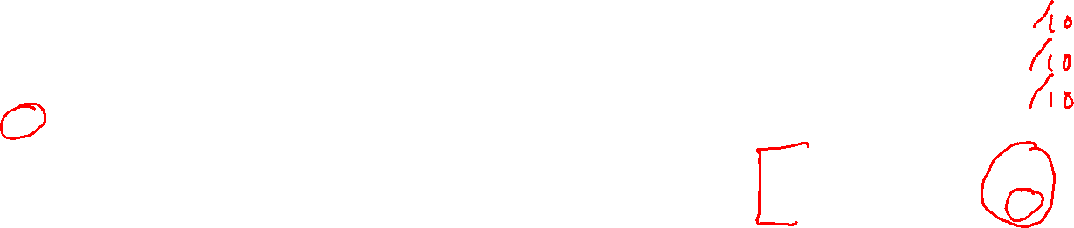
Warm-up as you walk in
Given these N=10 observations of the world:
What is the approximate value for
$P\left(−c| −a, +b\right)?$
1/10
5/10
1/4
1/5
I’m not sure
Counts
$$−a, −b, +c$$
$$+a,−b, +c$$
$$−a, −b,+c$$
$$−a, +b, +c$$
$$+a, −b, +c$$
$$−a, +b, −c$$
$$−a, +b, +c$$
$$−a, +b, +c$$
$$+a, −b, +c$$
$$−a, +b, +c$$
+a | +b | +c | 0
+a | +b | -c | 0
+a | -b | +c | 3
+a | -b | -c | 0
-a | +b | +c | 4
-a | +b | -c | 1
-a | -b | +c | 2
-a | -b | -c | 0

Slide 6


Approximate Inference: Sampling

Slide 7
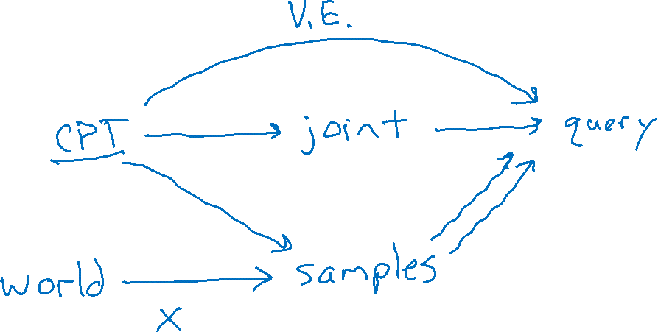
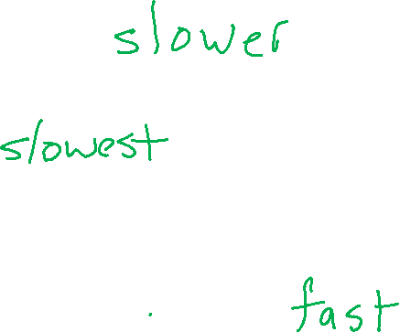
Inference vs Sampling

Slide 8
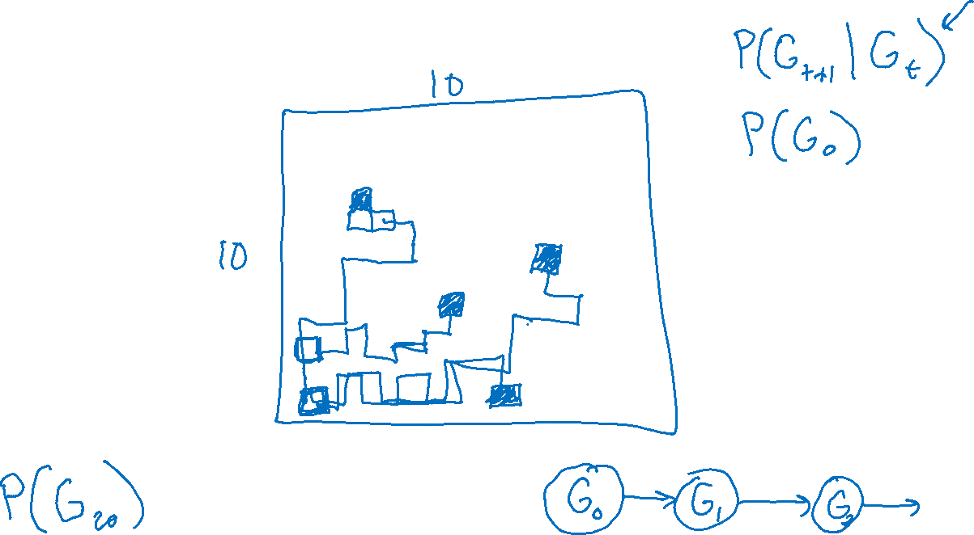
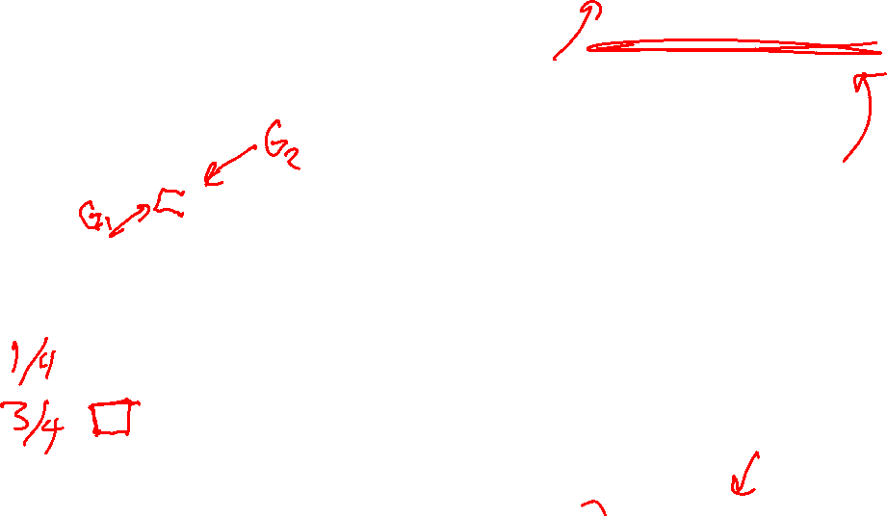
Motivation for Approximate Inference

Slide 9

Sampling
Sampling is a lot like repeated simulation
  Predicting the weather, basketball games, …
Basic idea
  Draw N samples from a sampling distribution S
  Compute an approximate posterior probability
  Show this converges to the true probability P
Why sample?
Learning: get samples from a distribution you don’t know
Inference: getting a sample is faster than computing the right answer (e.g. with variable elimination)

Slide 10
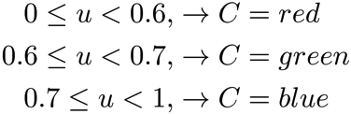


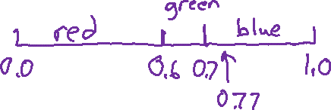
Sampling
Sampling from given distribution
  Step 1: Get sample u from uniform distribution over [0, 1)
    e.g. random() in python
  Step 2: Convert this sample u into an outcome for the given distribution by having each outcome associated with a sub-interval of [0,1) with sub-interval size equal to probability of the outcome
Example
  If random() returns u = 0.83, then our sample is C = blue
  E.g, after sampling 8 times:
C | P(C)
red | 0.6
green | 0.1
blue | 0.3

Slide 11




Sampling
How would you sample from a conditional distribution?
+a | 1/2
-a | 1/2
$$P(A)$$
$$A$$
+a | +b | 1/10
 | -b | 9/10
-a | +b | 1/2
 | -b | 1/2
$$P(B|A)$$
$$B$$

Slide 12

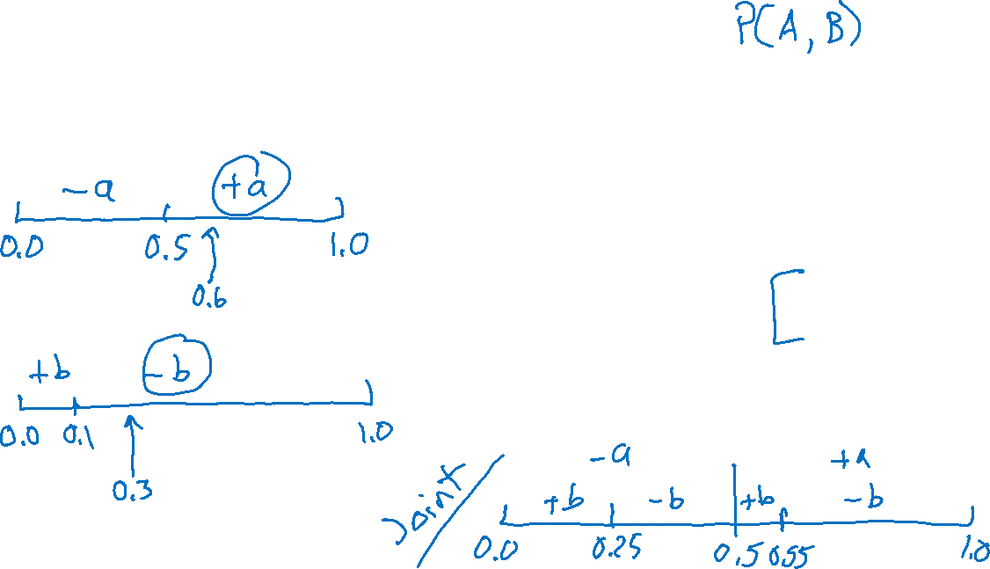



Sampling
How would you sample from a conditional distribution?
+a | 1/2
-a | 1/2
$$P(A)$$
$$A$$
+a | +b | 1/10
 | -b | 9/10
-a | +b | 1/2
 | -b | 1/2
$$P(B|A)$$
$$B$$

Slide 13
Sampling
How would you sample from a conditional distribution?
+a | 1/2
-a | 1/2
$$P(A)$$
$$A$$
+a | +b | 1/10
 | -b | 9/10
-a | +b | 1/2
 | -b | 1/2
$$P(B|A)$$
$$B$$

Slide 14
Sampling in Bayes’ Nets
Prior Sampling
Rejection Sampling
Likelihood Weighting
Gibbs Sampling

Slide 15
Handout
No evidence:
Prior Sampling
Some evidence:
Likelihood Weighted Sampling
All evidence:
Likelihood Weighted
Input: no evidence
for i=1, 2, …, m
    Sample x_{i} from P(X_{i} | Parents(X_{i}))
return (x₁, x₂, …, x_{m})
Input: evidence instantiation
w = 1.0
for i=1, 2, …, m
if X_{i} is an evidence variable
    X_{i} = observation x_{i} for X_{i}
    Set w = w * P(x_{i} | Parents(X_{i}))
else
    Sample x_{i} from P(X_{i} | Parents(X_{i}))
return (x₁, x₂, …, x_{m}), w
Input: evidence instantiation
w = 1.0
for i=1, 2, …, m
    Set w = w * P(x_{i} | Parents(X_{i}))
return w

Slide 16
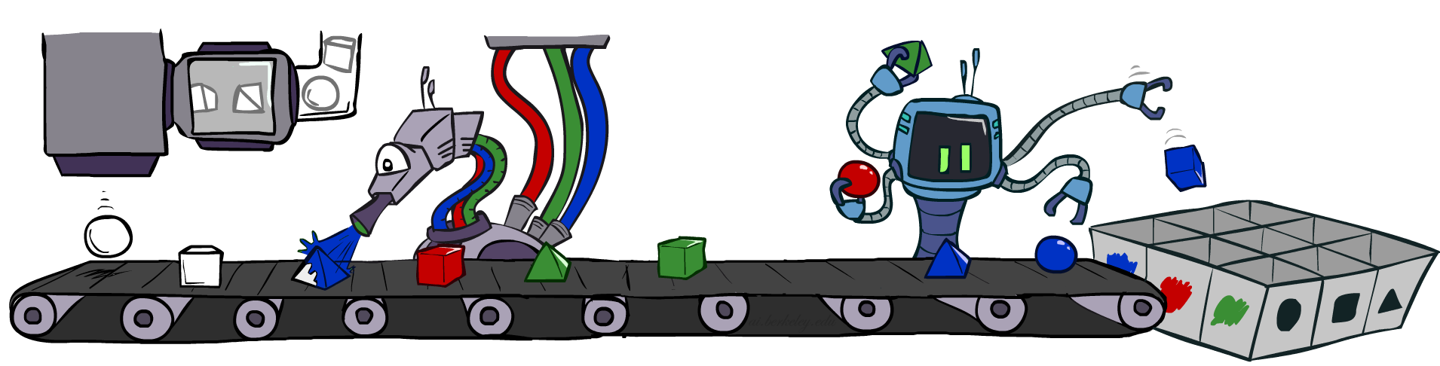
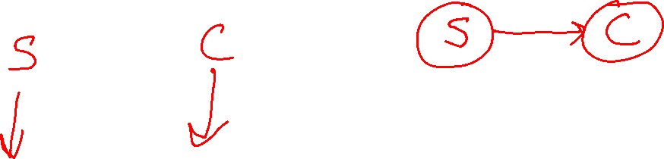
Prior Sampling

Slide 17




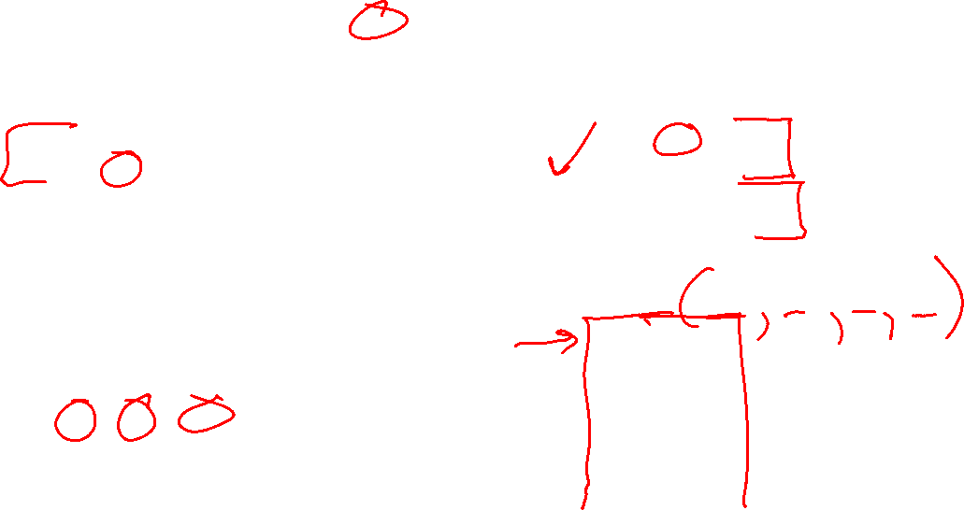
Prior Sampling
+c | 0.5
-c | 0.5
Cloudy
Cloudy
+c | +s | 0.1
 | -s | 0.9
-c | +s | 0.5
 | -s | 0.5
+c | +r | 0.8
 | -r | 0.2
-c | +r | 0.2
 | -r | 0.8
Sprinkler
Sprinkler
Rain
Rain
WetGrass
WetGrass
Samples:
+s | +r | +w | 0.99
 |  | -w | 0.01
 | -r | +w | 0.90
 |  | -w | 0.10
-s | +r | +w | 0.90
 |  | -w | 0.10
 | -r | +w | 0.01
 |  | -w | 0.99
+c, -s, +r, +w
-c, +s, -r, +w
…

Slide 18
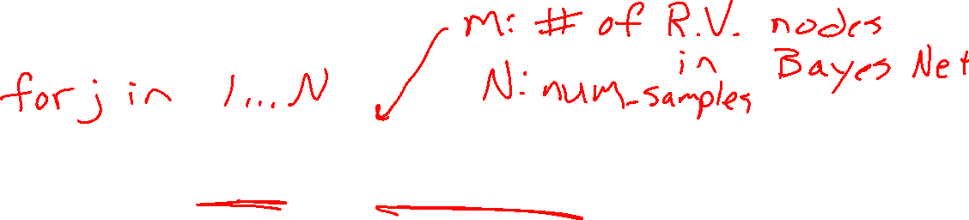
Prior Sampling
For i=1, 2, …, m
  Sample x_{i} from P(X_{i} | Parents(X_{i}))
Return (x₁, x₂, …, x_{m})

Slide 19
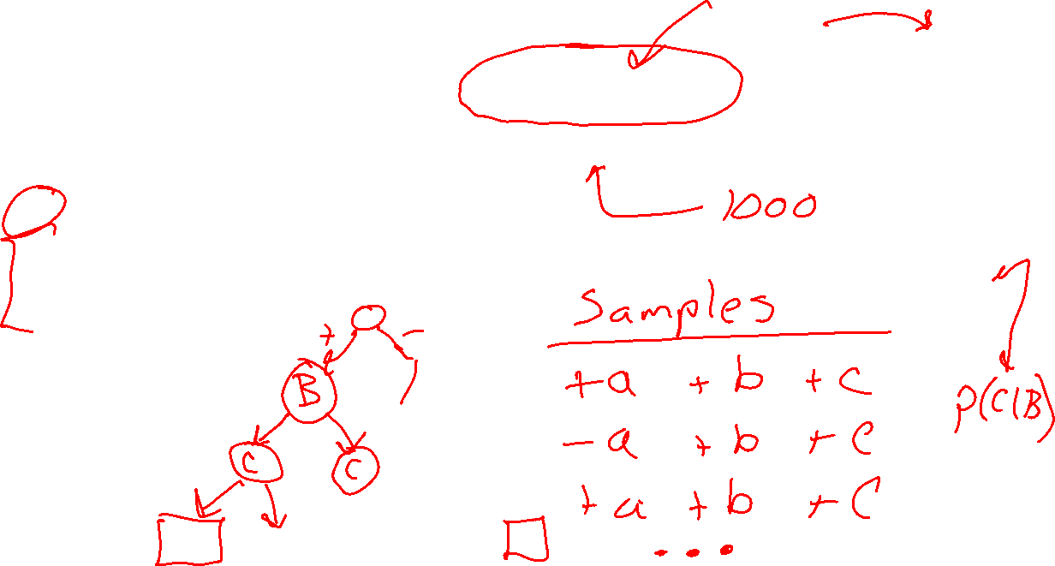
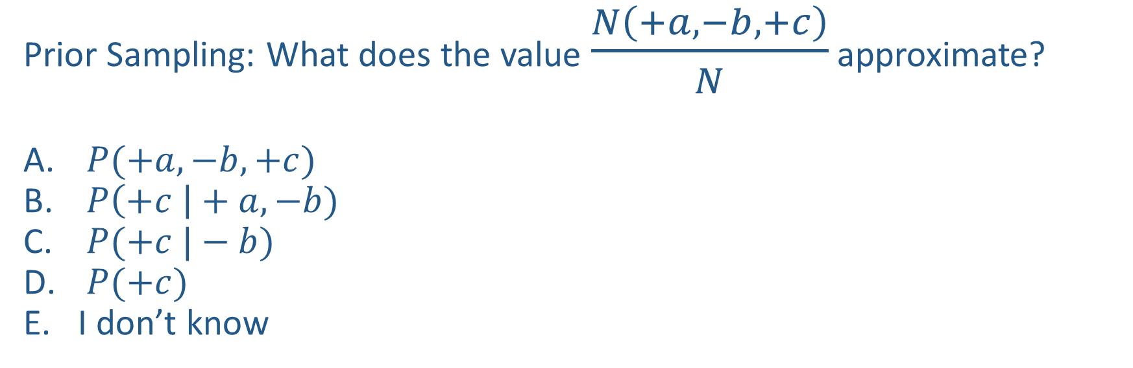

Poll 1
$$A$$
Prior Sampling: What does the value $\frac{N\left(+a, −b, +c\right)}{N}$ approximate?
$P(+a, −b, +c)$
$P\left(+c \right|+a, −b)$
$P(+c |−b)$
$P(+c)$
I don’t know
$$B$$
$$C$$

Slide 20
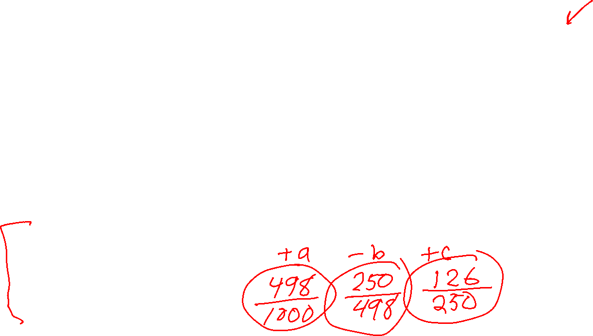
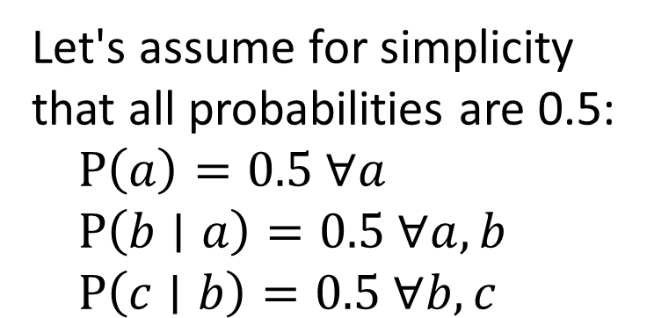
Poll 1
$$A$$
Prior Sampling: What does the value $\frac{N\left(+a, −b, +c\right)}{N}$ approximate?
$P(+a, −b, +c)$
$P\left(+c \right|+a, −b)$
$P(+c |−b)$
$P(+c)$
I don’t know
$$B$$
$$C$$
Let's assume for simplicity that all probabilities are 0.5:
$P\left(a\right)=0.5 ∀a$
$P\left(b∣a\right)=0.5 ∀a, b$
$P\left(c∣b\right)=0.5 ∀b,c$
Let's take 1000 samples:

Slide 21

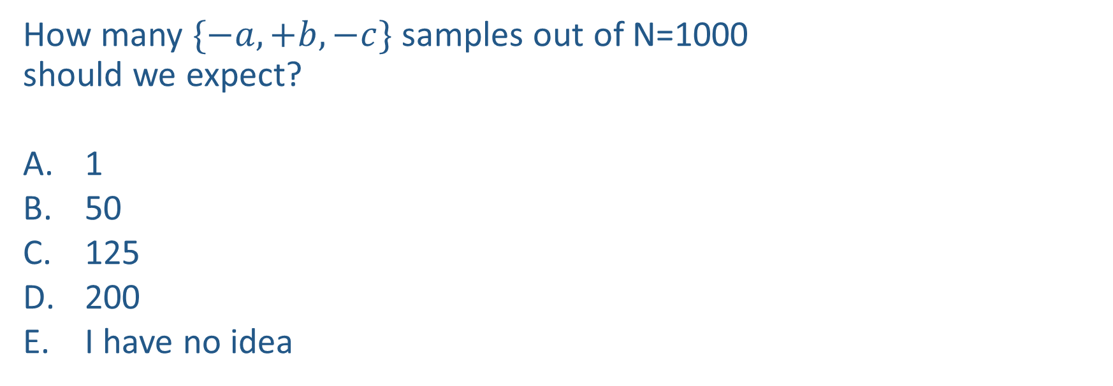

Poll 2
How many $\{−a,+b,−c\}$ samples out of N=1000
should we expect?
1
50
125
200
I have no idea
+a | 1/2
-a | 1/2
$$P(A)$$
$$A$$
+a | +b | 1/10
 | -b | 9/10
-a | +b | 1/2
 | -b | 1/2
$$P(B|A)$$
$$B$$
+b | +c | 4/5
 | -c | 1/5
-b | +c | 1
 | -c | 0
$$C$$
$$P(C|B)$$

Slide 22
Poll 2
How many $\{−a,+b,−c\}$ samples out of N=1000
should we expect?
1
50
125
200
I have no idea
+a | 1/2
-a | 1/2
$$P(A)$$
$$A$$
+a | +b | 1/10
 | -b | 9/10
-a | +b | 1/2
 | -b | 1/2
$$P(B|A)$$
$$B$$
+b | +c | 4/5
 | -c | 1/5
-b | +c | 1
 | -c | 0
$$C$$
$$P(C|B)$$

Slide 23
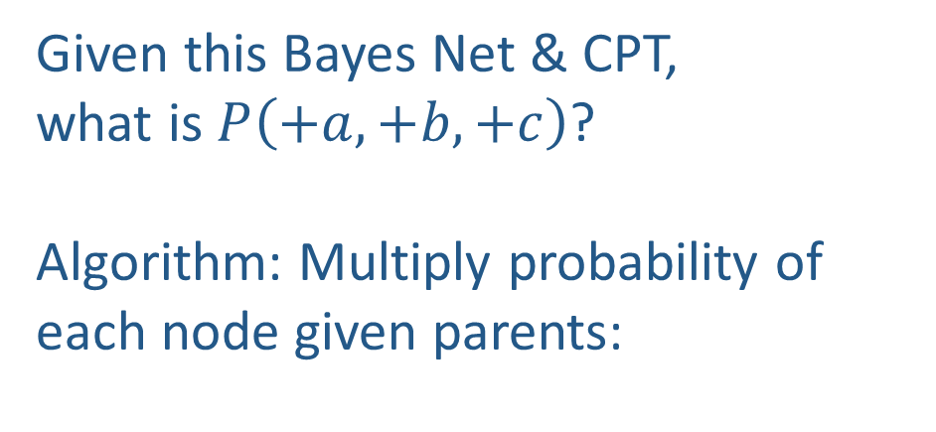
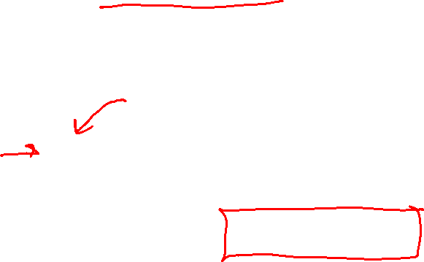
Probability of a sample
Given this Bayes Net & CPT,
what is $P\left(+a,+b,+c\right)$?
Algorithm: Multiply probability of each node given parents:
+a | 1/2
-a | 1/2
$$P(A)$$
$$A$$
+a | +b | 1/10
 | -b | 9/10
-a | +b | 1/2
 | -b | 1/2
$$P(B|A)$$
w = 1.0
for i=1, 2, …, m
  Set w = w * P(x_{i} | Parents(X_{i}))
return w
$$B$$
+b | +c | 4/5
 | -c | 1/5
-b | +c | 1
 | -c | 0
$$C$$
$$P(C|B)$$

Slide 24
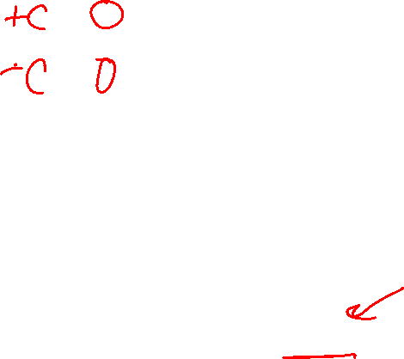
Example
We’ll get a bunch of samples from the BN:
  +c, -s, +r, +w
  +c, +s, +r, +w
  -c, +s, +r, -w
  +c, -s, +r, +w
  -c, -s, -r, +w
If we want to know P(W)
  We have counts <+w:4, -w:1>
  Normalize to get P(W) = <+w:0.8, -w:0.2>
  This will get closer to the true distribution with more samples
  Can estimate anything else, too
  What about P(C| +w)? P(C| +r, +w)? P(C| -r, -w)?
  Fast: can use fewer samples if less time (what’s the drawback?)
C
S
R
W

Slide 25
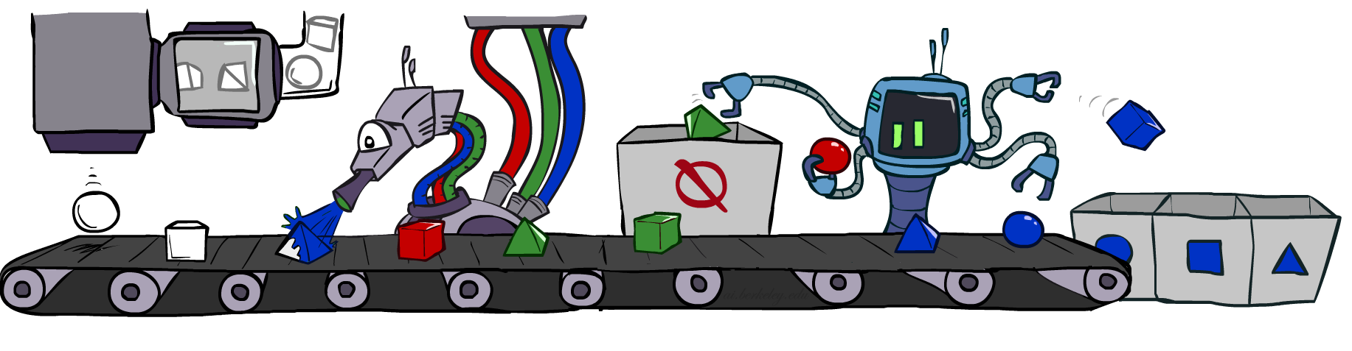
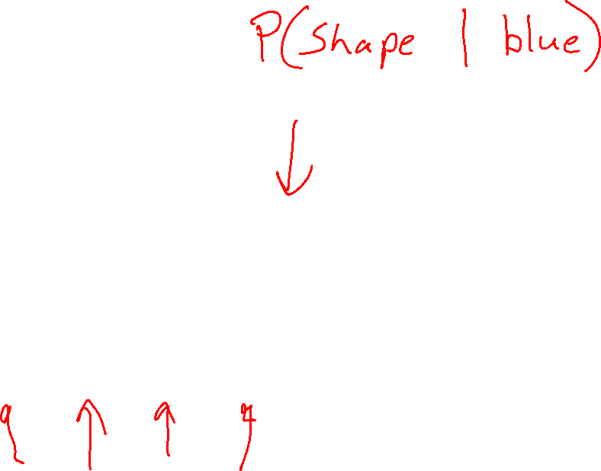
Rejection Sampling

Slide 26
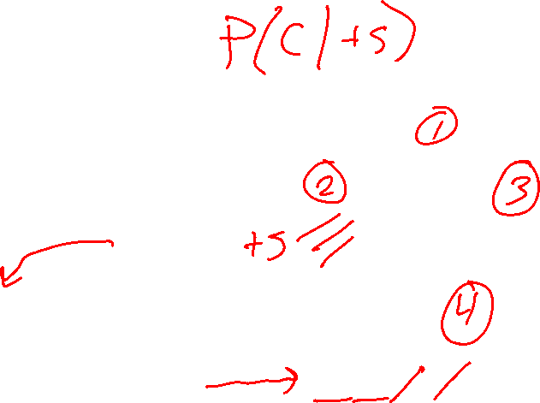
Rejection Sampling
Let's say we want P(C)
  No point keeping all samples around
  Just tally counts of C as we go
Let's say we want P(C| +s)
  Same thing: tally C outcomes, but ignore (reject) samples which don’t have S=+s
  This is called rejection sampling
  It is also consistent for conditional probabilities (i.e., correct in the limit)
C
S
R
W
  +c, -s, +r, +w
  +c, +s, +r, +w
  -c, +s, +r, -w
  +c, -s, +r, +w
  -c, -s, -r, +w

Slide 27
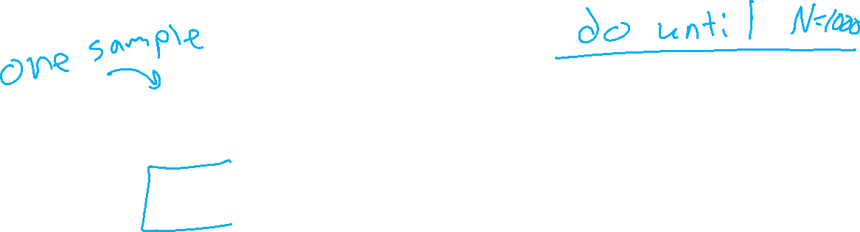
Rejection Sampling
IN: evidence instantiation
For i=1, 2, …, m
  Sample x_{i} from P(X_{i} | Parents(X_{i}))
  If x_{i} not consistent with evidence
    Reject: Return, and no sample is generated in this cycle
Return (x₁, x₂, …, x_{m})

Slide 28
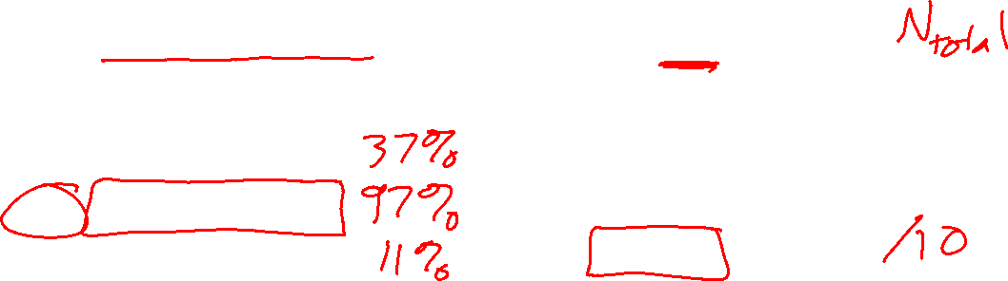
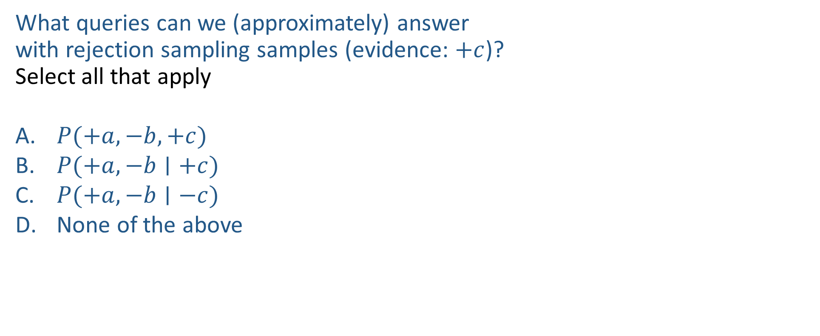
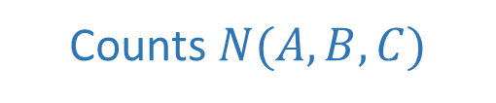
Poll 3
$$A$$
What queries can we (approximately) answer
with rejection sampling samples (evidence: $+c$)?
Select all that apply
$P(+a, −b, +c)$
$P(+a, −b∣+c)$
$P(+a, −b∣−c)$
None of the above
$$B$$
Counts $N(A,B,C)$
+a | +b | +c | 4
+a | +b | -c
+a | -b | +c | 3
+a | -b | -c
-a | +b | +c | 2
-a | +b | -c
-a | -b | +c | 1
-a | -b | -c
$$C$$

Slide 29

Poll 3
$$A$$
What queries can we (approximately) answer
with rejection sampling samples (evidence: $+c$)?
Select all that apply
$P(+a, −b, +c)$
$P(+a, −b∣+c)$
$P(+a, −b∣−c)$
None of the above
$$B$$
Counts $N(A,B,C)$
+a | +b | +c | 4
+a | +b | -c
+a | -b | +c | 3
+a | -b | -c
-a | +b | +c | 2
-a | +b | -c
-a | -b | +c | 1
-a | -b | -c
$$C$$
A and C: only if we also have total number of attempts

Slide 30
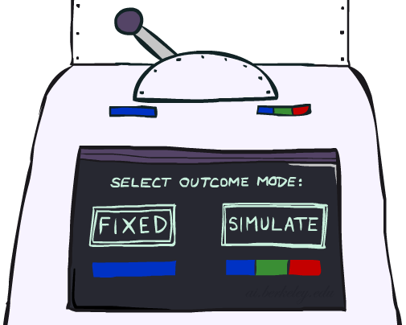
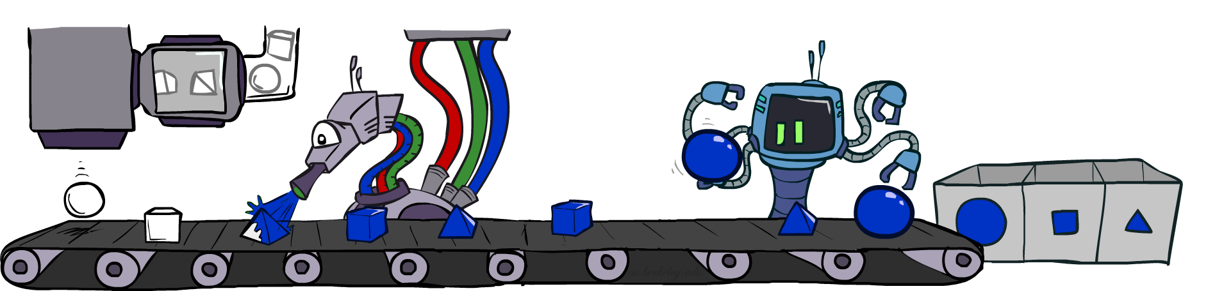
Likelihood Weighting

Slide 31
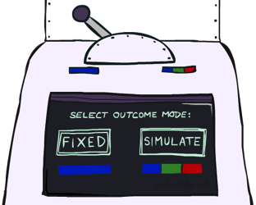


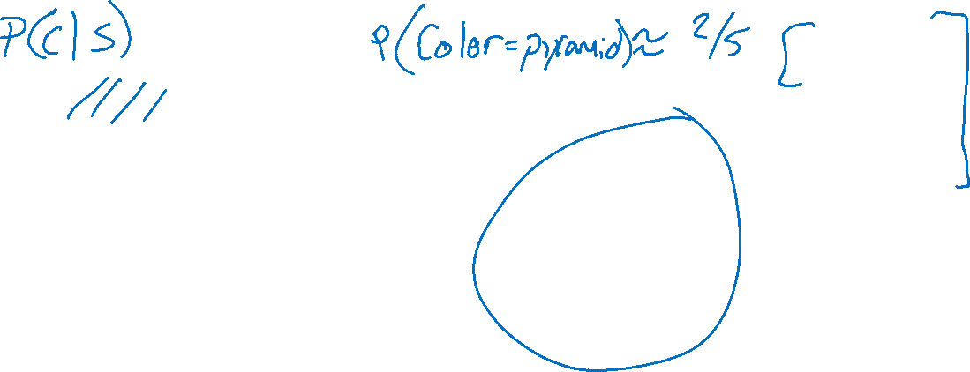
Likelihood Weighting
Problem with rejection sampling:
  If evidence is unlikely, rejects lots of samples
  Evidence not exploited as you sample
  Consider P(Shape|blue)
Idea: fix evidence variables and sample the rest
  Problem: sample distribution not consistent!
  Solution: weight by probability of evidence given parents
  pyramid, green
  pyramid, red
  sphere, blue
  cube, red
  sphere, green
  pyramid, blue
  pyramid, blue
  sphere, blue
  cube, blue
  sphere, blue
Shape
Color
Shape
Color

Slide 32



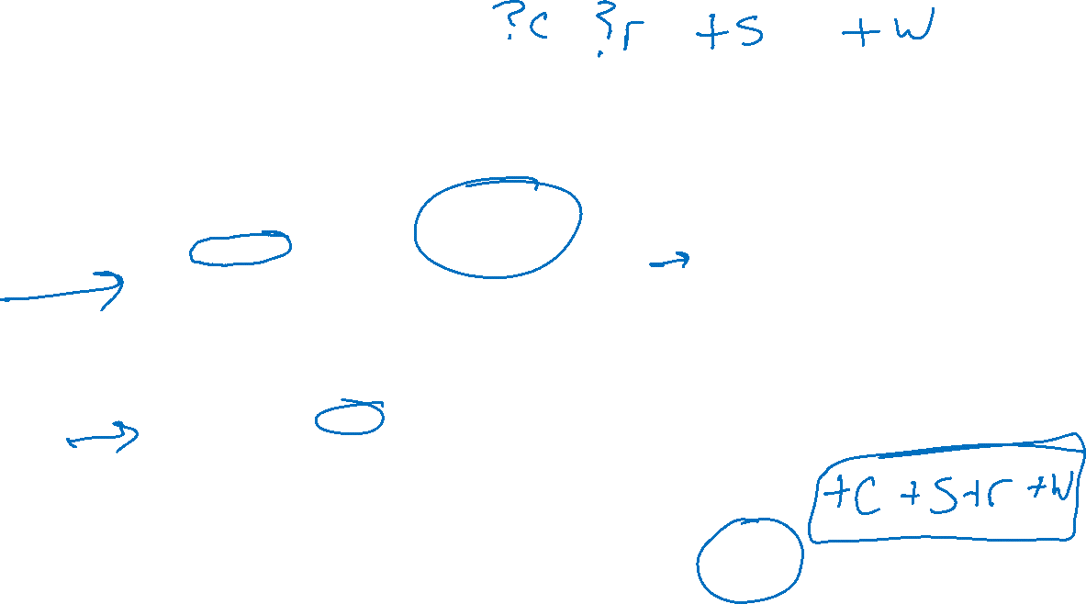
Likelihood Weighting
+c | 0.5
-c | 0.5
Cloudy
Cloudy
+c | +s | 0.1
 | -s | 0.9
-c | +s | 0.5
 | -s | 0.5
+c | +r | 0.8
 | -r | 0.2
-c | +r | 0.2
 | -r | 0.8
Sprinkler
Sprinkler
Rain
Rain
WetGrass
Samples:
WetGrass
+s | +r | +w | 0.99
 |  | -w | 0.01
 | -r | +w | 0.90
 |  | -w | 0.10
-s | +r | +w | 0.90
 |  | -w | 0.10
 | -r | +w | 0.01
 |  | -w | 0.99
+c, +s, +r, +w
…

Slide 33
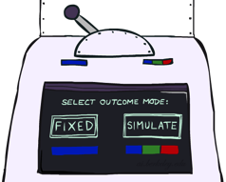
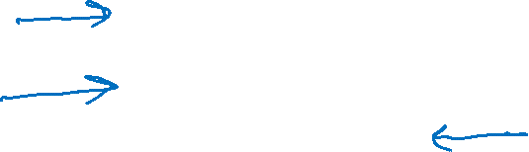
Likelihood Weighting
IN: evidence instantiation
w = 1.0
for i=1, 2, …, m
  if X_{i} is an evidence variable
    X_{i} = observation x_{i} for X_{i}
    Set w = w * P(x_{i} | Parents(X_{i}))
  else
    Sample x_{i} from P(X_{i} | Parents(X_{i}))
return (x₁, x₂, …, x_{m}), w

Slide 34
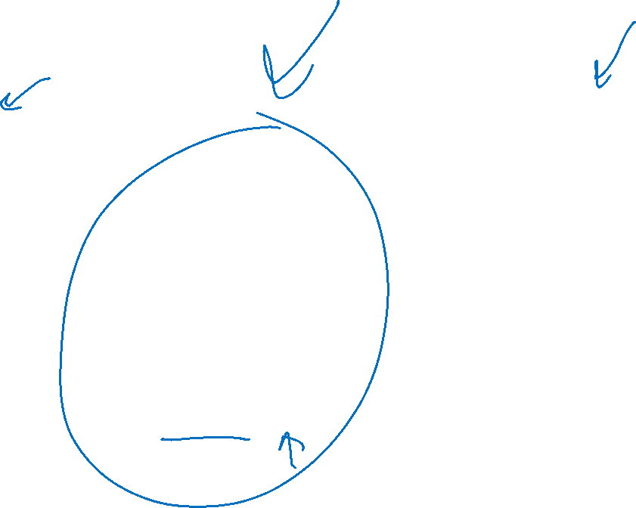
Likelihood Weighting
No evidence:
Prior Sampling
Some evidence:
Likelihood Weighted Sampling
All evidence:
Likelihood Weighted
Input: no evidence
for i=1, 2, …, m
    Sample x_{i} from P(X_{i} | Parents(X_{i}))
return (x₁, x₂, …, x_{m})
Input: evidence instantiation
w = 1.0
for i=1, 2, …, m
if X_{i} is an evidence variable
    X_{i} = observation x_{i} for X_{i}
    Set w = w * P(x_{i} | Parents(X_{i}))
else
    Sample x_{i} from P(X_{i} | Parents(X_{i}))
return (x₁, x₂, …, x_{m}), w
Input: evidence instantiation
w = 1.0
for i=1, 2, …, m
    Set w = w * P(x_{i} | Parents(X_{i}))
return w

Slide 35
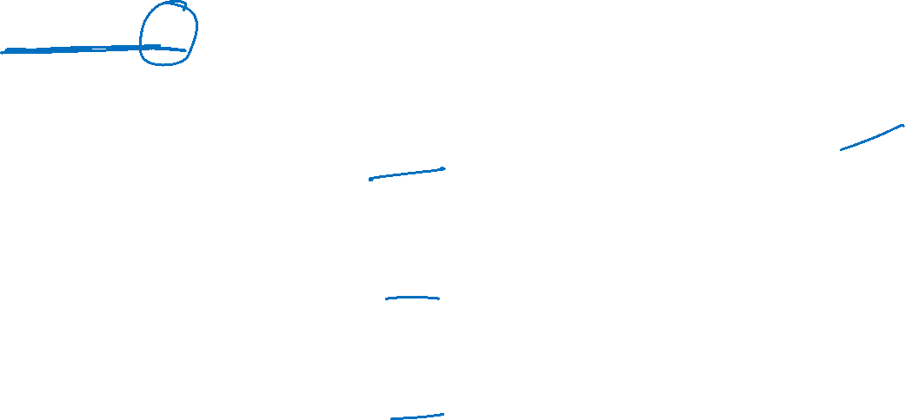
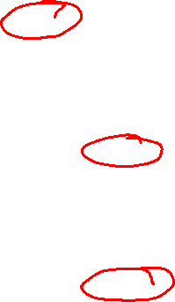
Remember Poll 2
How many $\{−a,+b,−c\}$ samples out of N=1000
should we expect?
1
50
125
200
I have no idea
+a | 1/2
-a | 1/2
$$P(A)$$
$$A$$
+a | +b | 1/10
 | -b | 9/10
-a | +b | 1/2
 | -b | 1/2
$$P(B|A)$$
$$B$$
+b | +c | 4/5
 | -c | 1/5
-b | +c | 1
 | -c | 0
$$C$$
$$P(C|B)$$

Slide 36





Likelihood Weighting
+a | 1/2
-a | 1/2
$$P(A)$$
$$A$$
+a | +b | 1/10
 | -b | 9/10
-a | +b | 1/2
 | -b | 1/2
$$P(B|A)$$
$$B$$
+b | +c | 4/5
 | -c | 1/5
-b | +c | 1
 | -c | 0
$$C$$
$$P(C|B)$$

Slide 37
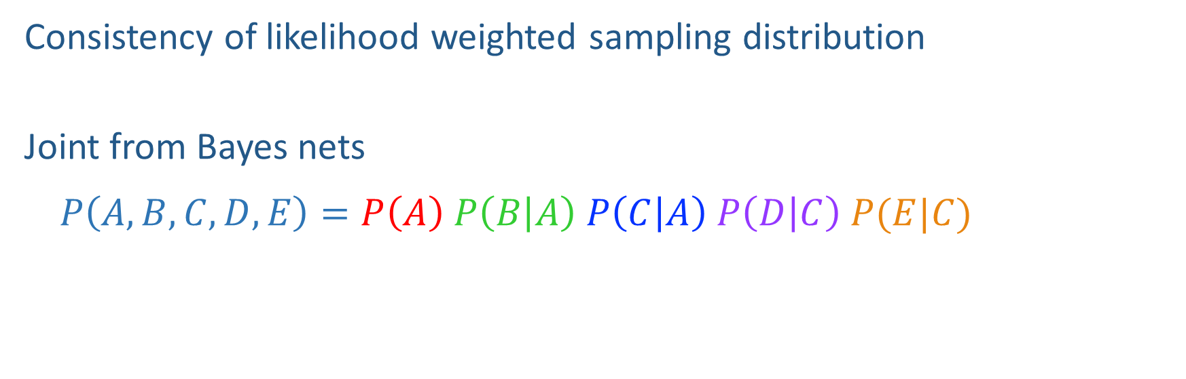
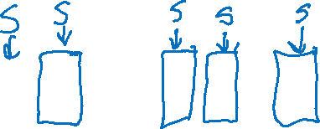
Likelihood Weighting Distribution
$$A$$
Consistency of likelihood weighted sampling distribution
Joint from Bayes nets
$$P\left(A,B,C,D,E\right)=P\left(A\right) P\left(B | A\right) P\left(C | A\right) P\left(D | C\right) P(E|C)$$
$$B$$
$$C$$
$$D$$
$$E$$

Slide 38
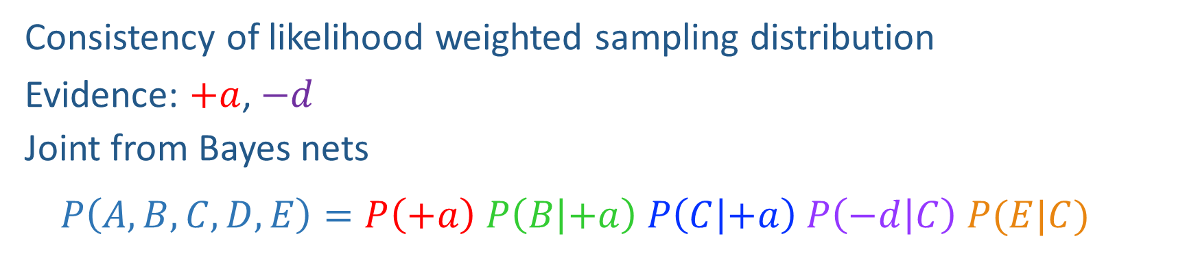

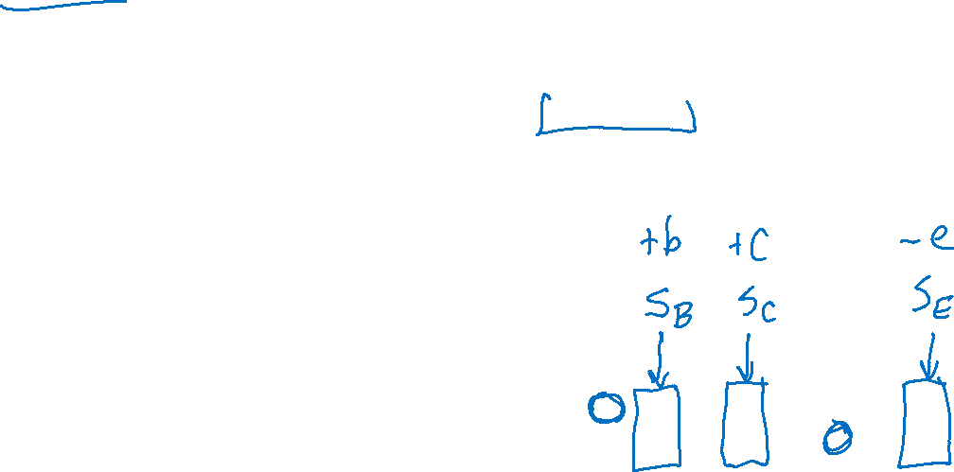
Likelihood Weighting Distribution
$$A$$
Consistency of likelihood weighted sampling distribution
Evidence: $+a$, $−d$
Joint from Bayes nets
$$P\left(A,B,C,D,E\right)=P\left(+a\right) P\left(B | +a\right) P\left(C | +a\right) P\left(−d | C\right) P(E|C)$$
$$B$$
$$C$$
$$D$$
$$E$$

Slide 39
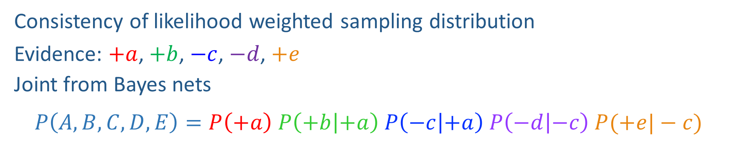

Likelihood Weighting Distribution
$$A$$
Consistency of likelihood weighted sampling distribution
Evidence: $+a$, $+b$, $−c$, $−d$, $+e$
Joint from Bayes nets
$$P\left(A,B,C,D,E\right)=P\left(+a\right) P\left(+b | +a\right) P\left(−c | +a\right) P\left(−d | −c\right) P(+e|−c)$$
$$B$$
$$C$$
$$D$$
$$E$$

Slide 40


Likelihood Weighting Distribution
$$A$$
Consistency of likelihood weighted sampling distribution
Evidence: None
Joint from Bayes nets
$$P\left(A,B,C,D,E\right)=P\left(A\right) P\left(B | A\right) P\left(C | A\right) P\left(D | C\right) P(E|C)$$
$$B$$
$$C$$
$$D$$
$$E$$

Slide 41




Likelihood Weighting
Sampling distribution if z sampled and e fixed evidence
Now, samples have weights
Together, weighted sampling distribution is consistent
Cloudy
C
S
R
W

Slide 42

Poll 4
Given a fixed query, two identical samples from likelihood weighted sampling will have the same exact weights.
True
False
It depends
I don’t know

Slide 43







Poll 4
Given a fixed query, two identical samples from likelihood weighted sampling will have the same exact weights.
True
False
It depends
I don’t know
Example:
$$P(A, C∣+b, −d)$$
$$+b$$
$$−d$$
$$A$$
$$B$$
$$C$$
$$D$$

Slide 44


Poll 5
What does the following likelihood weighted value approximate?
${weight}_{(+a,−b,+c)}⋅\frac{N\left(+a, −b, +c\right)}{N}$
$P(+a, −b, +c)$
$P\left(+a, −b \right|+c)$
I’m not sure

Slide 45

Poll 5
What does the following likelihood weighted value approximate?
${weight}_{(+a,−b,+c)}⋅\frac{N\left(+a, −b, +c\right)}{N}$
$P(+a, −b, +c)$
$P\left(+a, −b \right|+c)$
I’m not sure
$$weight_{\left(x_{1},x_{2}, x_{3},e_{1},e_{2},e_{3}\right)}=\prod_{i}{P\left(e_{i} ∣ Parents\left(e_{i}\right)\right)}$$
$$\frac{N\left(x_{1},x_{2}, x_{3},e_{1},e_{2},e_{3}\right)}{N}≈\prod_{j}{P\left(x_{j} ∣ Parents\left(x_{j}\right)\right)}$$
$$weight_{\left(x_{1},x_{2}, x_{3},e_{1},e_{2},e_{3}\right)}⋅\frac{N\left(x_{1},x_{2}, x_{3},e_{1},e_{2},e_{3}\right)}{N}≈P\left(x_{1},x_{2}, x_{3},e_{1},e_{2},e_{3}\right)$$

Slide 46

Likelihood Weighting
Likelihood weighting is good
  We have taken evidence into account as we generate the sample
  E.g. here, W's value will get picked based on the evidence values of S, R
  More of our samples will reflect the state of the world suggested by the evidence
Likelihood weighting doesn’t solve all our problems
  Evidence influences the choice of downstream variables, but not upstream ones (C isn’t more likely to get a value matching the evidence)
We would like to consider evidence when we sample every variable

Slide 47

Likelihood Weighting
Likelihood weighting doesn’t solve all our problems
  Evidence influences the choice of downstream variables, but not upstream ones (C isn’t more likely to get a value matching the evidence)
We would like to consider evidence when we sample every variable
→ Gibbs sampling

Slide 48

Gibbs Sampling

Slide 49
Gibbs Sampling
Procedure: keep track of a full instantiation x₁, x₂, …, x_{m}.
Start with an arbitrary instantiation consistent with the evidence.
Sample one variable at a time, conditioned on all the rest, but keep evidence fixed.
Keep repeating this for a long time.

Slide 50

Gibbs Sampling Example: P( S | +r)
Step 1: Fix evidence
  R = +r
Steps 3: Repeat
  Choose a non-evidence variable X
  Resample X from P( X | all other variables)
Step 2: Initialize other variables
  Randomly
C
C
S
+r
S
+r
W
W
C
C
C
C
C
C
S
+r
S
+r
S
+r
S
+r
S
+r
S
+r
W
W
W
W
W
W

Slide 51
Gibbs Sampling Example: P( S | +r)
Keep only the last sample from each iteration:
C
C
C
C
C
S
+r
S
+r
S
+r
S
+r
S
+r
W
W
W
W
W
C
C
C
C
C
S
+r
S
+r
S
+r
S
+r
S
+r
W
W
W
W
W
C
C
C
C
C
S
+r
S
+r
S
+r
S
+r
S
+r
W
W
W
W
W

Slide 52

Efficient Resampling of One Variable
Sample from P(S | +c, +r, -w)
Many things cancel out – only CPTs with S remain!
More generally: only CPTs that have resampled variable need to be considered, and joined together
C
S
+r
W

Slide 53
Gibbs Sampling
Procedure: keep track of a full instantiation x₁, x₂, …, x_{m}.
Start with an arbitrary instantiation consistent with the evidence.
Sample one variable at a time, conditioned on all the rest, but keep evidence fixed.
Keep repeating this for a long time.
Property: in the limit of repeating this infinitely many times the resulting sample is coming from the correct distribution
Rationale: both upstream and downstream variables condition on evidence.
In contrast: likelihood weighting only conditions on upstream evidence, and hence weights obtained in likelihood weighting can sometimes be very small. Sum of weights over all samples is indicative of how many “effective” samples were obtained, so want high weight.

Slide 54
Further Reading on Gibbs Sampling
Gibbs sampling produces sample from the query distribution P( Q | e ) in limit of re-sampling infinitely often
Gibbs sampling is a special case of more general methods called Markov chain Monte Carlo (MCMC) methods
  Metropolis-Hastings is one of the more famous MCMC methods (in fact, Gibbs sampling is a special case of Metropolis-Hastings)
You may read about Monte Carlo methods – they’re just sampling

Slide 55
Markov Chain Monte Carlo*
Idea: instead of sampling from scratch, create samples that are each like the last one.
Procedure: resample one variable at a time, conditioned on all the rest, but keep evidence fixed. E.g., for P(b|c):
Properties: Now samples are not independent (in fact they’re nearly identical), but sample averages are still consistent estimators!
What’s the point: both upstream and downstream variables condition on evidence.
+b
+a
+c
-b
+a
+c
-b
-a
+c

Slide 56





Bayes Net Sampling Summary
Prior Sampling P(Q, E)
Likelihood Weighting P( Q , e)
Rejection Sampling P( Q | e )
Gibbs Sampling P( Q | e )

