Slide 1
Wrap-up RL
RL II slide

Slide 2
Midterm 2
Topics
Logic
Planning
MDPs
RL
Probability (but not Bayes Nets)
See Piazza for details

Slide 3
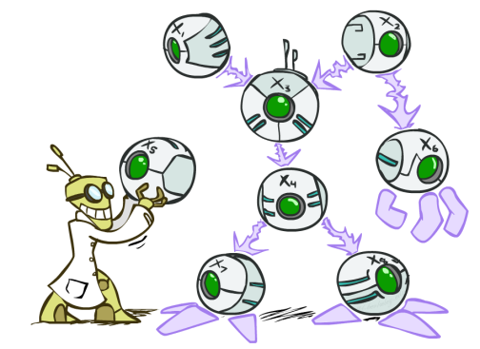
AI: Representation and Problem Solving
Bayes Nets
Instructor: Pat Virtue
Slide credits: CMU AI and http://ai.berkeley.edu

Slide 4



Omega Pizzeria!
What is the probability of getting a slice with:
  No mushrooms
  Spinach and no mushrooms
  Spinach, when asking for slice with no mushrooms
  Mushrooms
  Spinach
  No spinach
  No spinach and mushrooms
  No spinach when asking for no mushrooms
  No spinach when asking for mushrooms
  Spinach when asking for mushrooms
  No mushrooms and no spinach
Icons: CC, https://openclipart.org/detail/296791/pizza-slice

Slide 5
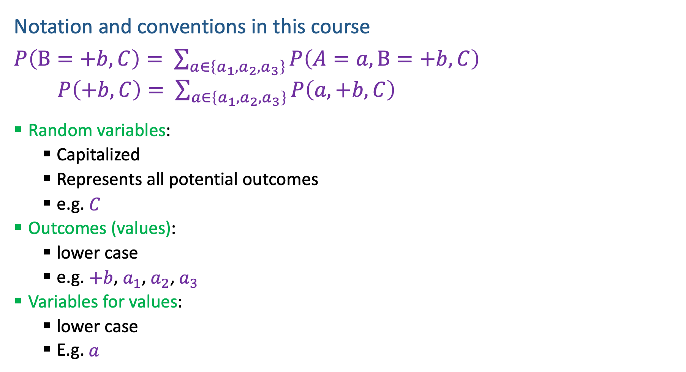
Probability Notation
Notation and conventions in this course
$P\left(B=+b, C\right)= \sum_{a∈\left\{a_{1}, a_{2},a_{3}\right\}}{P\left(A=a, B=+b, C\right)}$
  $P\left(+b, C\right)= \sum_{a∈\left\{a_{1}, a_{2},a_{3}\right\}}{P\left(a, +b, C\right)}$
  Random variables:
      Capitalized
      Represents all potential outcomes
      e.g. $C$
  Outcomes (values):
      lower case
      e.g. $+b$, $a_{1}$, $a_{2}$, $a_{3}$
  Variables for values:
      lower case
      E.g. $a$

Slide 6

Probability Notation
Notation and conventions in this course
$P\left(B=+b, C\right)= \sum_{a∈\left\{a_{1}, a_{2},a_{3}\right\}}{P\left(A=a, B=+b, C\right)}$
  $P\left(+b, C\right)= \sum_{a∈\left\{a_{1}, a_{2},a_{3}\right\}}{P\left(a, +b, C\right)}$

Slide 7

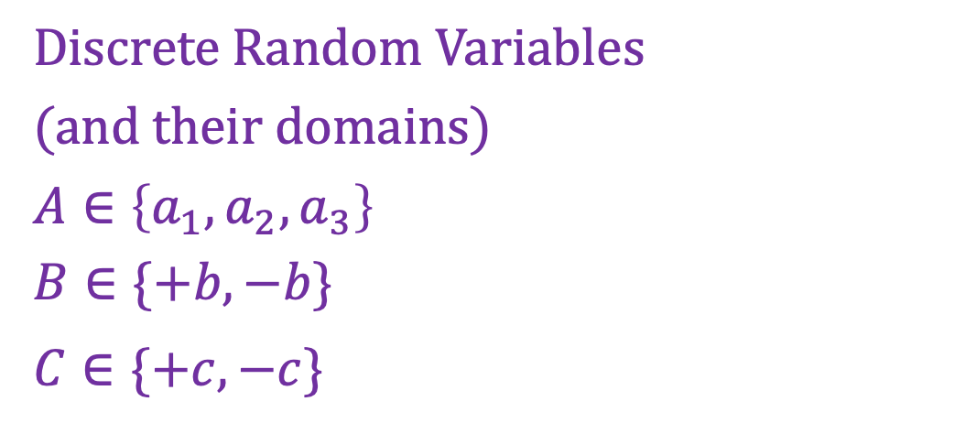


Discrete Probability Distributions
Partitions
  For each random variable
  Discrete outcomes
  Disjoint outcomes
  Accounts for entire event space
  Not always binary
Event space
Discrete Random Variables
(and their domains)
$A∈\left\{a_{1},a_{2}, a_{3}\right\}$
$B∈\{+b, −b\}$
$C∈\{+c, −c\}$
$$A$$
$$B$$
$$C$$

Slide 8
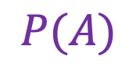
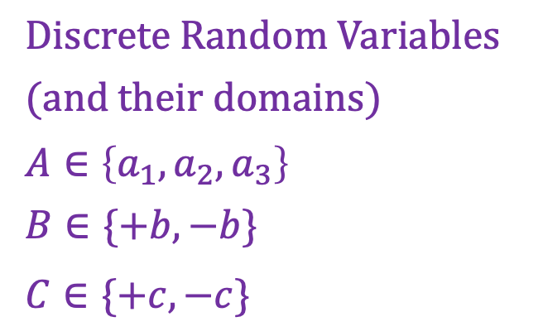
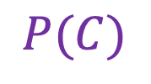
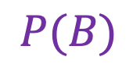
Discrete Probability Distributions
Discrete Random Variables
(and their domains)
$A∈\left\{a_{1},a_{2}, a_{3}\right\}$
$B∈\{+b, −b\}$
$C∈\{+c, −c\}$
Marginal distribution
$$P(A)$$
$$P(B)$$
$$P(C)$$

Slide 9
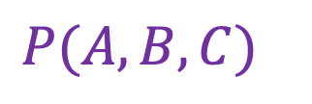
Discrete Probability Distributions
Discrete Random Variables
(and their domains)
$A∈\left\{a_{1},a_{2}, a_{3}\right\}$
$B∈\{+b, −b\}$
$C∈\{+c, −c\}$
Joint distribution
$P(A, B, C)$

Slide 10
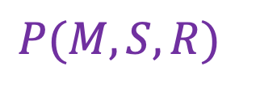
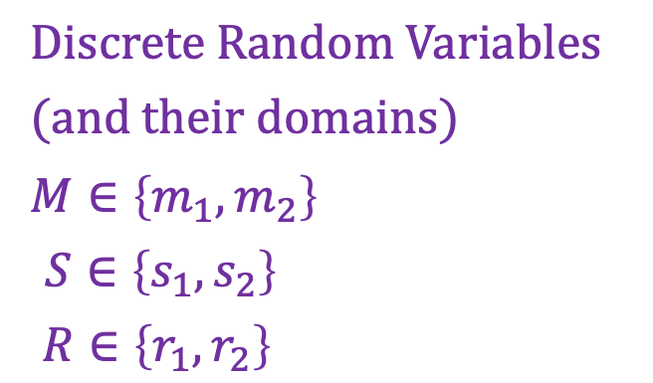
Discrete Probability Distributions
Discrete Random Variables
(and their domains)
$M∈\left\{m_{1},m_{2}\right\}$
$S∈\left\{s_{1},s_{2}\right\}$
$R∈\left\{r_{1},r_{2}\right\}$
Joint distribution
$P(M, S, R)$
Icons: CC, https://openclipart.org/detail/296791/pizza-slice

Slide 11
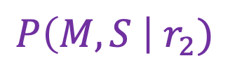
Discrete Probability Distributions
Discrete Random Variables
(and their domains)
$M∈\left\{m_{1},m_{2}\right\}$
$S∈\left\{s_{1},s_{2}\right\}$
$R∈\left\{r_{1},r_{2}\right\}$
Conditional distribution
$P\left(M, S \right| r_{2})$
Icons: CC, https://openclipart.org/detail/296791/pizza-slice

Slide 12
Discrete Probability Distributions
Discrete Random Variables
(and their domains)
$M∈\left\{m_{1},m_{2}\right\}$
$S∈\left\{s_{1},s_{2}\right\}$
$R∈\left\{r_{1},r_{2}\right\}$
Conditional distribution
$P\left(M, S \right| r_{2})$
Icons: CC, https://openclipart.org/detail/296791/pizza-slice

Slide 13
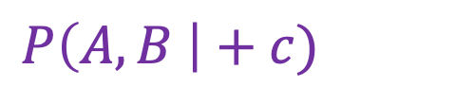
Discrete Probability Distributions
Discrete Random Variables
(and their domains)
$A∈\left\{a_{1},a_{2}, a_{3}\right\}$
$B∈\{+b, −b\}$
$C∈\{+c, −c\}$
Conditional distribution
$P\left(A, B \right|+c)$

Slide 14
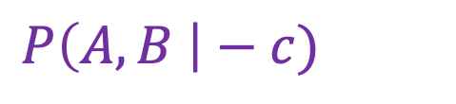
Discrete Probability Distributions
Discrete Random Variables
(and their domains)
$A∈\left\{a_{1},a_{2}, a_{3}\right\}$
$B∈\{+b, −b\}$
$C∈\{+c, −c\}$
Conditional distribution
$P\left(A, B \right|−c)$

Slide 15
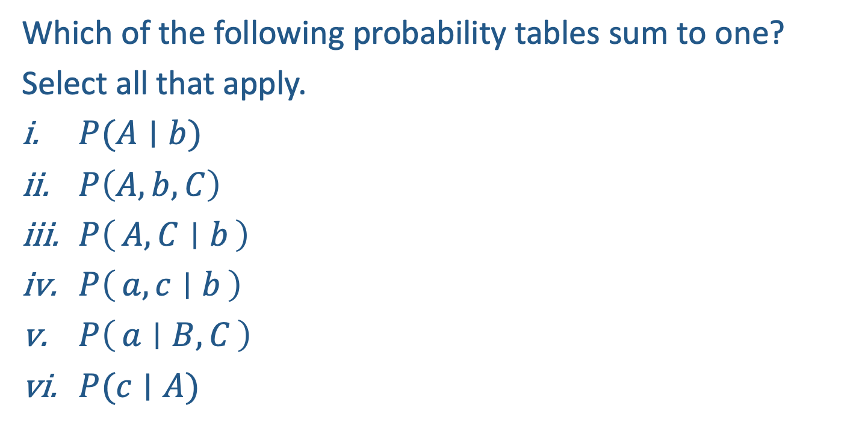
Poll 1
Which of the following probability tables sum to one?
Select all that apply.
$P(A∣b)$
$P\left(A, b, C\right)$
$P\left(A, C ∣ b\right)$
$P\left(a, c ∣ b\right)$
$P\left(a ∣ B, C\right)$
$P(c∣A)$

Slide 16

Poll 1
Which of the following probability tables sum to one?
Select all that apply.
$P(A∣b)$
$P\left(A, b, C\right)$
$P\left(A, C ∣ b\right)$
$P\left(a, b ∣ c\right)$
$P\left(a ∣ B, C\right)$
$P(c∣A)$

Slide 17

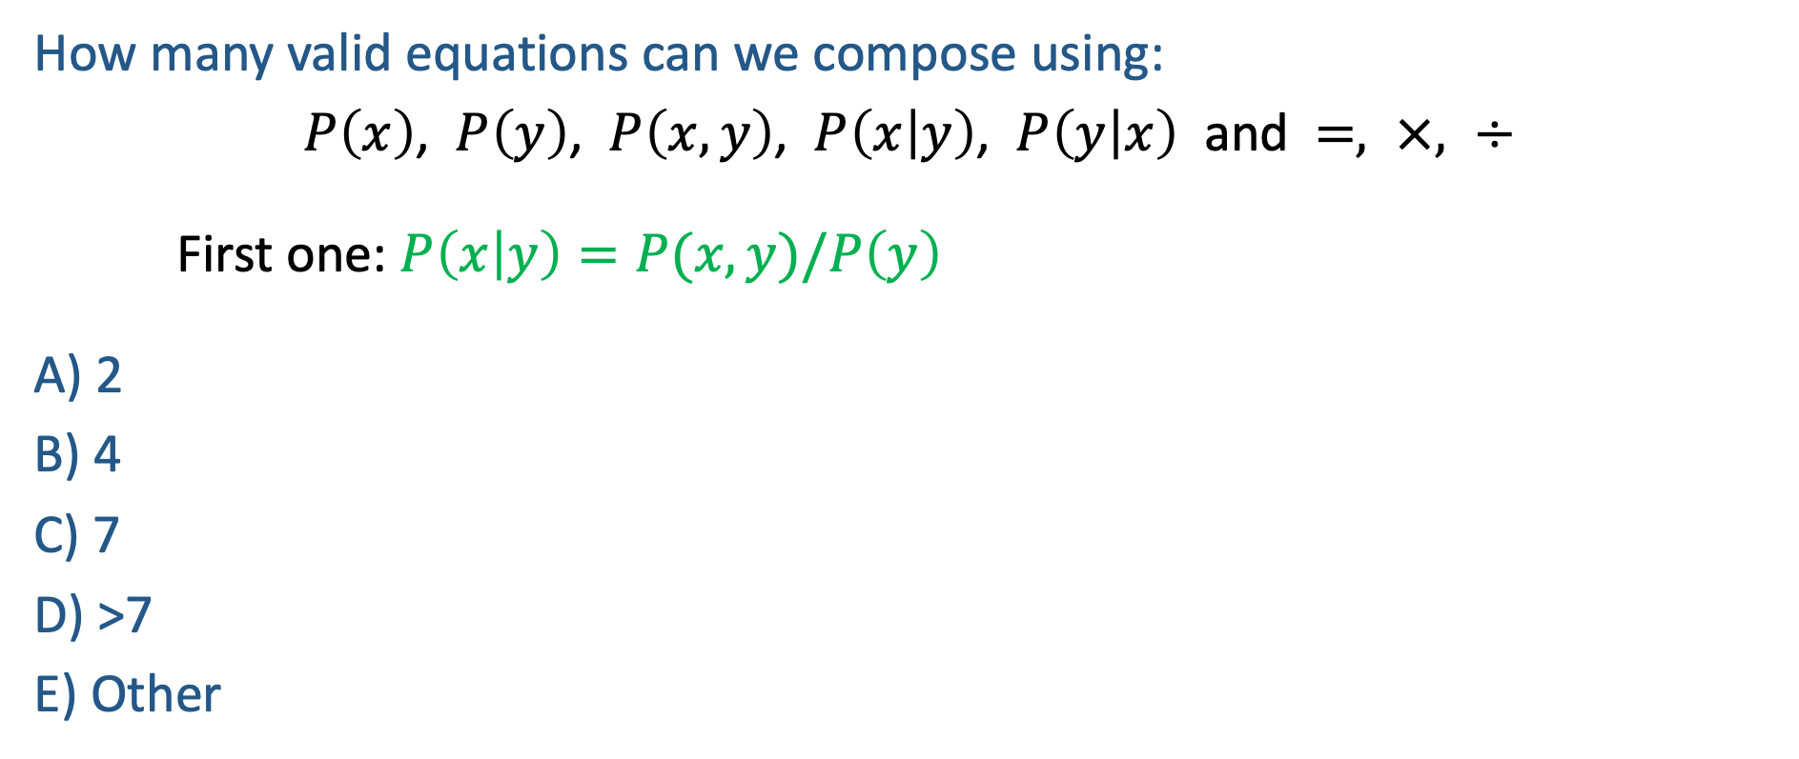

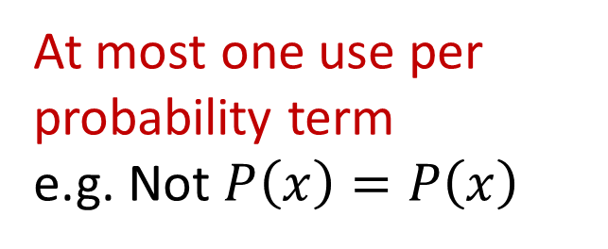
Poll 2
How many valid equations can we compose using:
$P\left(x\right)$, $P\left(y\right)$, $P\left(x,y\right)$, $P\left(x | y\right)$, $P\left(y | x\right)$ and $=, ×, ÷$
First one: $P\left(x | y\right)=P(x,y)/P\left(y\right)$
A) 2
B) 4
C) 7
D) >7
E) Other
At most one use per probability term
e.g. Not $P\left(x\right)=P\left(x\right)$
Must be different
e.g. Cannot also use
$$P(x,y)/P(y) =P(x|y)$$

Slide 18
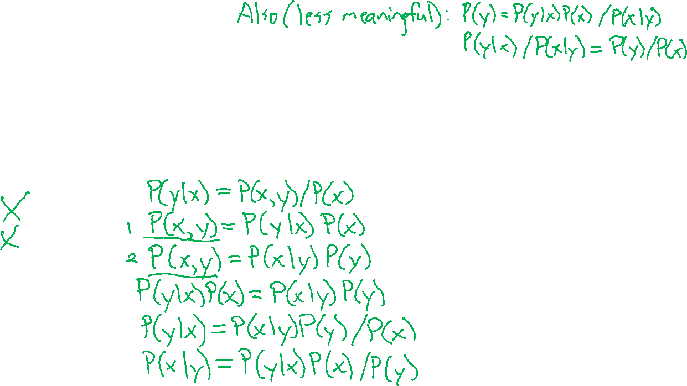
Poll 2
How many valid equations can we compose using:
$P\left(x\right)$, $P\left(y\right)$, $P\left(x,y\right)$, $P\left(x | y\right)$, $P\left(y | x\right)$ and $=, ×, ÷$
First one: $P\left(x | y\right)=P(x,y)/P\left(y\right)$
A) 2
B) 4
C) 7
D) >7
E) Other
At most one use per probability term
e.g. Not $P\left(x\right)=P\left(x\right)$
Must be different
e.g. Cannot also use
$$P(x,y)/P(y) =P(x|y)$$

Slide 19

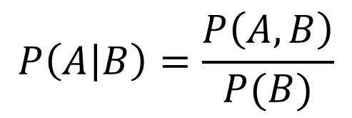
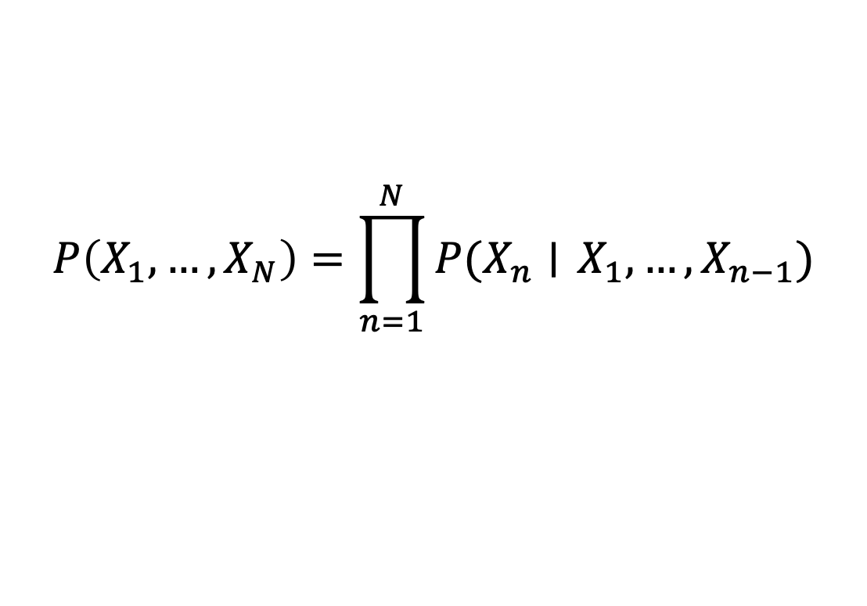
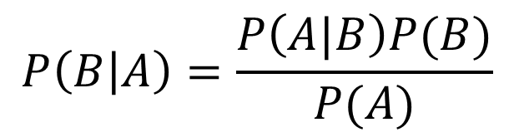
Probability Tools Summary
Our toolbox
Definition of conditional probability
Product Rule
Bayes’ theorem
Chain Rule
$$P\left(A | B\right)=\frac{P\left(A, B\right)}{P(B)}$$
$$P(A,B)=P\left(A | B\right)P(B)$$
$$P\left(B | A\right)=\frac{P\left(A|B\right)P(B)}{P(A)}$$
$$P\left(X_{1}, …, X_{N}\right)=\prod_{n=1}^{N}{P(X_{n}∣} X_{1},…, X_{n−1})$$

Slide 20
Answer Any Query from Joint Distribution
What is the probability of getting a slice with:
  No mushrooms
  Spinach and no mushrooms
  Spinach, when asking for slice with no mushrooms
  Mushrooms
  Spinach
  No spinach
  No spinach and mushrooms
  No spinach when asking for no mushrooms
  No spinach when asking for mushrooms
  Spinach when asking for mushrooms
  No mushrooms and no spinach
Icons: CC, https://openclipart.org/detail/296791/pizza-slice

Slide 21


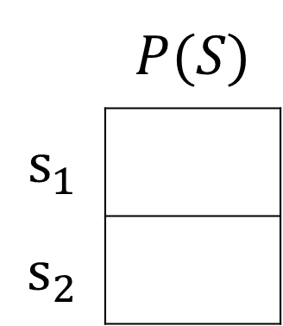
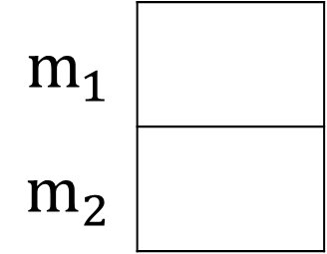

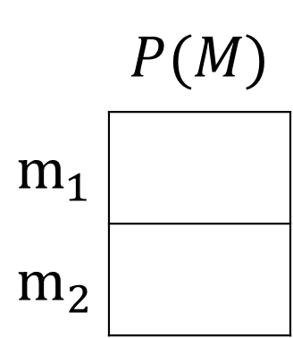


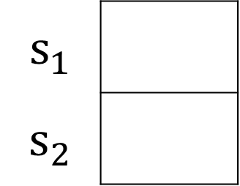
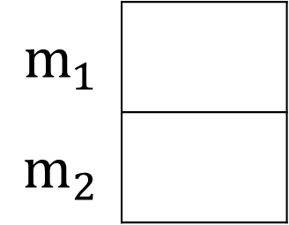


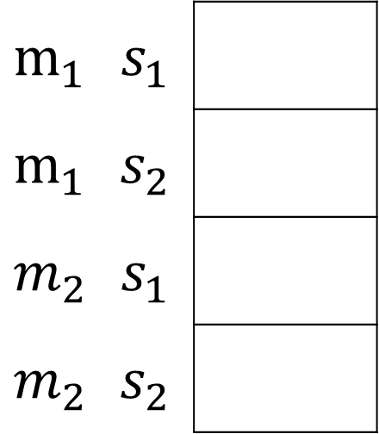
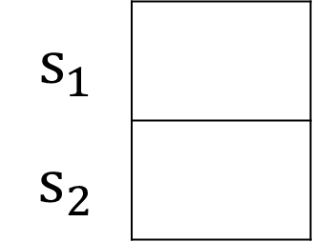

Answer Any Query from Joint Distribution
You can answer all of these questions:
$P(M|s_{1})$
$P(M|s_{2})$
 | $$P(M)$$
$$m_{1}$$
$$m_{2}$$
$P(M,S)$
$$m_{1}$$
$$m_{2}$$
$$m_{1}$$
$$m_{2}$$
$$12/20$$
$$m_{1}$$ | $$s_{1}$$
$$m_{1}$$ | $$s_{2}$$
$$m_{2}$$ | $$s_{1}$$
$$m_{2}$$ | $$s_{2}$$
$$6/20$$
$P(S|m_{1})$
$P(S|m_{2})$
 | $$P(S)$$
$$s_{1}$$
$$s_{2}$$
$$s_{1}$$
$$s_{2}$$
$$s_{1}$$
$$s_{2}$$
$$6/12$$

Slide 22
Answer Any Query from Joint Distribution
P(Weather)?
P(Weather | winter)?
P(Weather | winter, hot)?
Season | Temp | Weather | P(S, T, W)
summer | hot | sun | 0.30
summer | hot | rain | 0.05
summer | cold | sun | 0.10
summer | cold | rain | 0.05
winter | hot | sun | 0.10
winter | hot | rain | 0.05
winter | cold | sun | 0.15
winter | cold | rain | 0.20

Slide 23
Answer Any Query from Joint Distribution
P(Weather)?
Season | Temp | Weather | P(S, T, W)
summer | hot | sun | 0.30
summer | hot | rain | 0.05
summer | cold | sun | 0.10
summer | cold | rain | 0.05
winter | hot | sun | 0.10
winter | hot | rain | 0.05
winter | cold | sun | 0.15
winter | cold | rain | 0.20

Slide 24
Answer Any Query from Joint Distribution
P(Weather | winter)?
Season | Temp | Weather | P(S, T, W)
summer | hot | sun | 0.30
summer | hot | rain | 0.05
summer | cold | sun | 0.10
summer | cold | rain | 0.05
winter | hot | sun | 0.10
winter | hot | rain | 0.05
winter | cold | sun | 0.15
winter | cold | rain | 0.20

Slide 25
Answer Any Query from Joint Distribution
P(Weather | winter, hot)?
Season | Temp | Weather | P(S, T, W)
summer | hot | sun | 0.30
summer | hot | rain | 0.05
summer | cold | sun | 0.10
summer | cold | rain | 0.05
winter | hot | sun | 0.10
winter | hot | rain | 0.05
winter | cold | sun | 0.15
winter | cold | rain | 0.20

Slide 26

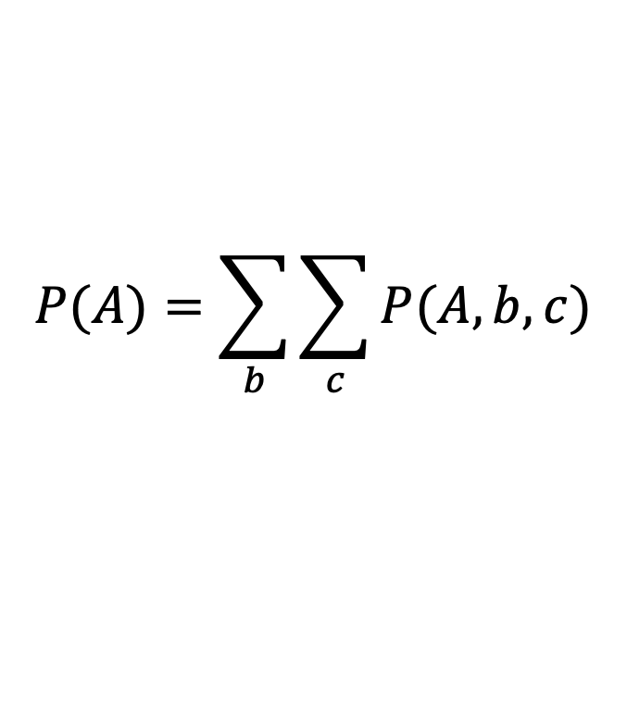
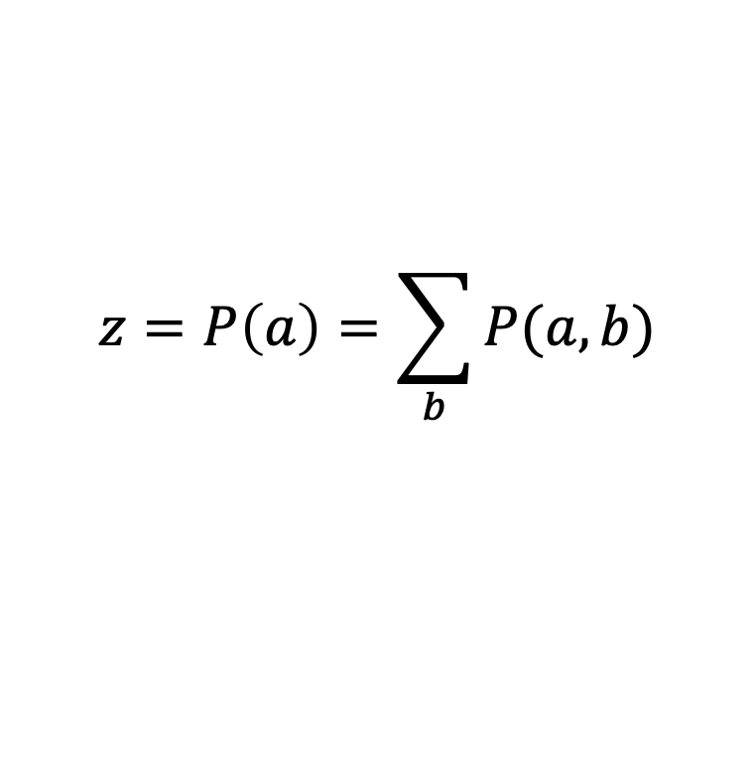
Additional Probability Tools
Marginalization (law of total probability) (summing out)
Normalization
$$P(A)=\sum_{b}{\sum_{c}{P(A, b, c)}}$$
$$P\left(B | a\right)=\frac{P(a,B)}{P(a)}$$
$P\left(B | a\right)∝P(a,B)$
$P\left(B | a\right)=\frac{1}{z}P(a,B)$
$$z=P\left(a\right)=\sum_{b}{P(a,b)}$$

Slide 27
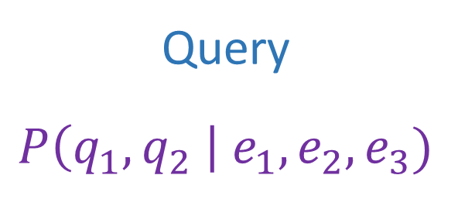
Answer Any Query from Joint Distribution
Joint distributions are the best!
Joint
Query
$$P\left(q_{1},q_{2} \right| e_{1}, e_{2},e_{3})$$

Slide 28
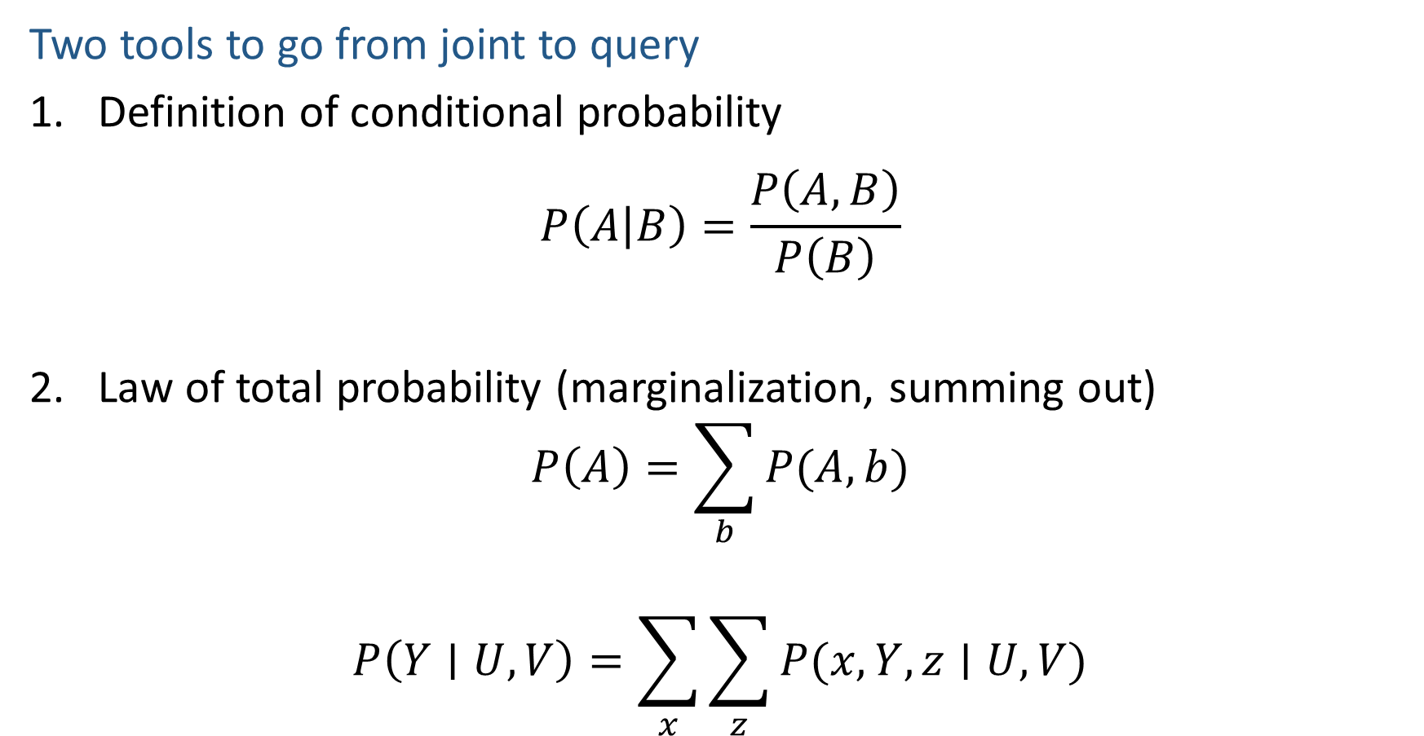
Answer Any Query from Joint Distribution
Two tools to go from joint to query
Definition of conditional probability
$$P\left(A | B\right)=\frac{P\left(A,B\right)}{P\left(B\right)}$$
Law of total probability (marginalization, summing out)
$$P\left(A\right)=\sum_{b}{P(A,b)}$$
$$P\left(Y∣U, V\right)=\sum_{x}{\sum_{z}{P(x, Y, z∣U, V)}}$$

Slide 29
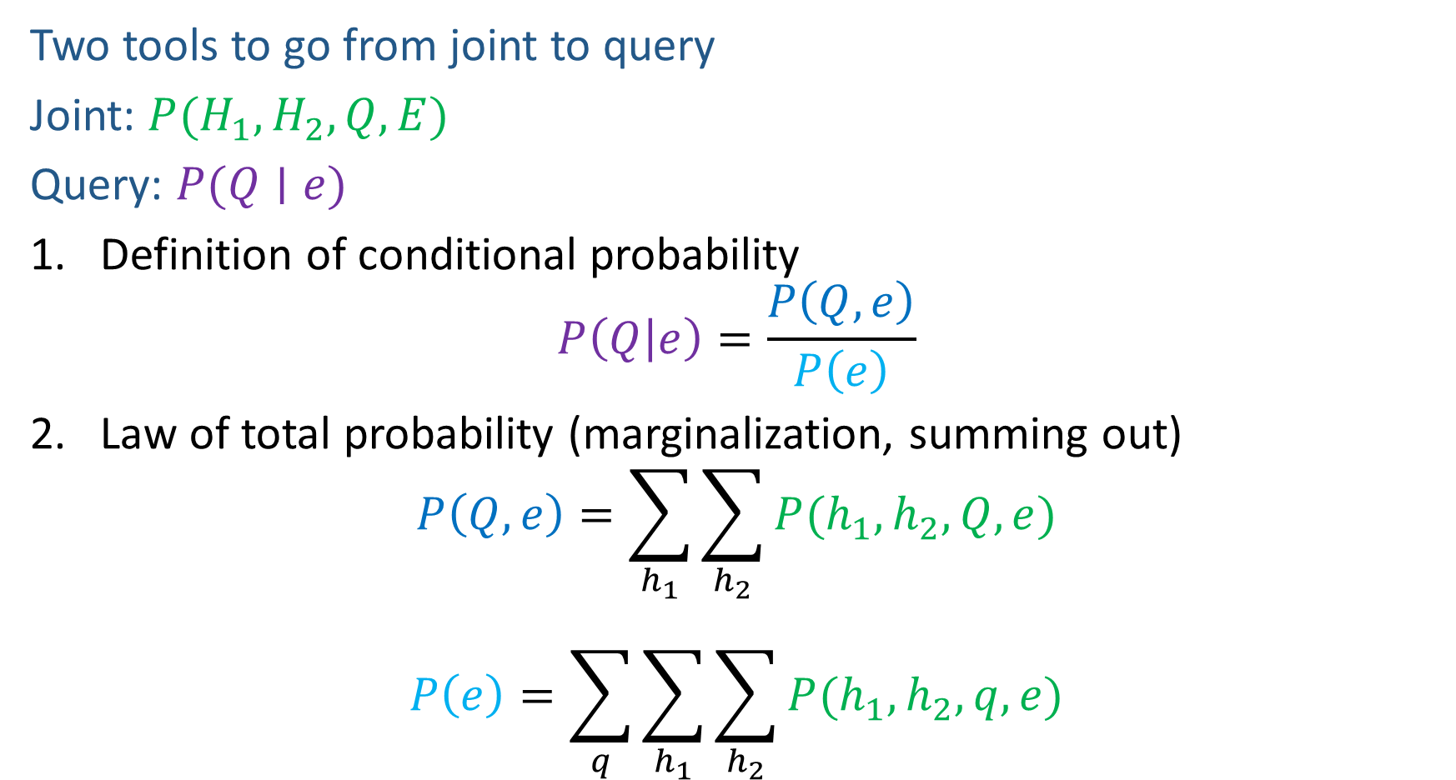
Answer Any Query from Joint Distribution
Two tools to go from joint to query
Joint: $P(H_{1}, H_{2}, Q, E)$
Query: $P(Q∣e)$
Definition of conditional probability
$$P\left(Q | e\right)=\frac{P\left(Q,e\right)}{P\left(e\right)}$$
Law of total probability (marginalization, summing out)
$$P\left(Q,e\right)=\sum_{h_{1}}{\sum_{h_{2}}{P(h_{1},h_{2},Q, e)}}$$
$$P\left(e\right)=\sum_{q}{\sum_{h_{1}}{\sum_{h_{2}}{P(h_{1},h_{2}, q,e)}}}$$

Slide 30
Answer Any Query from Joint Distribution
P(Weather)?
P(Weather | winter)?
P(Weather | winter, hot)?
Season | Temp | Weather | P(S, T, W)
summer | hot | sun | 0.30
summer | hot | rain | 0.05
summer | cold | sun | 0.10
summer | cold | rain | 0.05
winter | hot | sun | 0.10
winter | hot | rain | 0.05
winter | cold | sun | 0.15
winter | cold | rain | 0.20

Slide 31
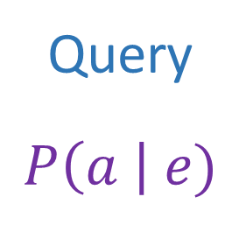
Answer Any Query from Joint Distribution
Joint distributions are the best!
Problems with joints
We aren’t given the joint table
    Usually some set of conditional probability tables
Joint
Query
$$P\left(a \right| e)$$

Slide 32
Build Joint Distribution Using Chain Rule
Conditional Probability Tables and Chain Rule
Joint
Query
$$P\left(a \right| e)$$
$P\left(A\right) P\left(B | A\right) P\left(C | A,B\right) P\left(D | A,B,C\right)$ $P(E|A, B,C,D)$

Slide 33
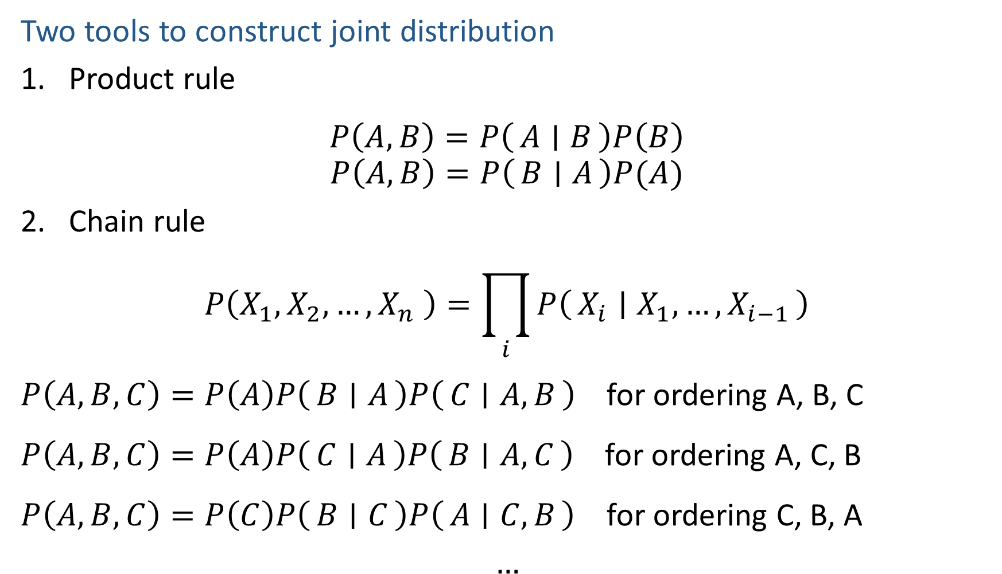
Build Joint Distribution Using Chain Rule
Two tools to construct joint distribution
Product rule
$$P\left(A,B\right)=P\left(A ∣ B\right)P\left(B\right)$$
$$P\left(A,B\right)=P\left(B ∣ A\right)P(A)$$
Chain rule
$$P\left(X_{1},X_{2},…,X_{n} \right)=\prod_{i}{P\left(X_{i} ∣ X_{1},…,X_{i−1}\right)}$$
$P\left(A,B,C\right)=P\left(A\right)P\left(B ∣ A\right)P\left(C ∣ A, B\right)$ for ordering A, B, C
$P\left(A,B,C\right)=P\left(A\right)P\left(C ∣ A\right)P\left(B ∣ A,C\right)$ for ordering A, C, B
$P\left(A,B,C\right)=P\left(C\right)P\left(B ∣ C\right)P\left(A ∣ C,B\right)$ for ordering C, B, A
$$…$$

Slide 34
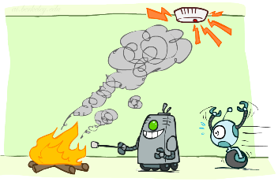
Build Joint Distribution Using Chain Rule
Binary random variables
  Fire
  Smoke
  Alarm

Slide 35
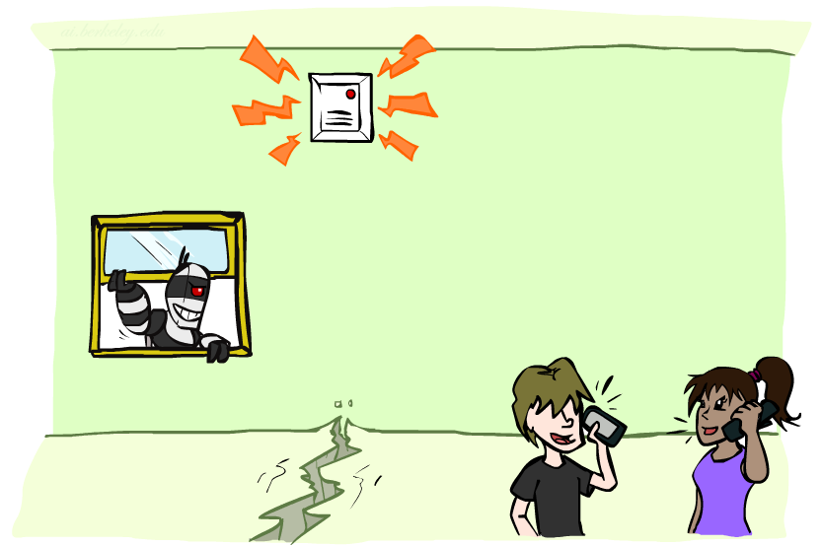

Poll 3
Variables
  B: Burglary
  A: Alarm goes off
  M: Mary calls
  J: John calls
  E: Earthquake!
  How many different ways can we write the chain rule?
  $1$
  $5$
  $5 choose 5$
  $5!$
  $5^{5}$

Slide 36
Build Joint Distribution Using Chain Rule
Conditional Probability Tables and Chain Rule
Joint
Query
$$P\left(a \right| e)$$
$P\left(A\right) P\left(B | A\right) P\left(C | A,B\right) P\left(D | A,B,C\right)$ $P(E|A, B,C,D)$

Slide 37
Answer Any Query from Condition Probability Tables
Process to go from (specific) conditional probability tables to query
Construct the joint distribution
    Product Rule or Chain Rule
Answer query from joint
    Definition of conditional probability
    Law of total probability (marginalization, summing out)

Slide 38
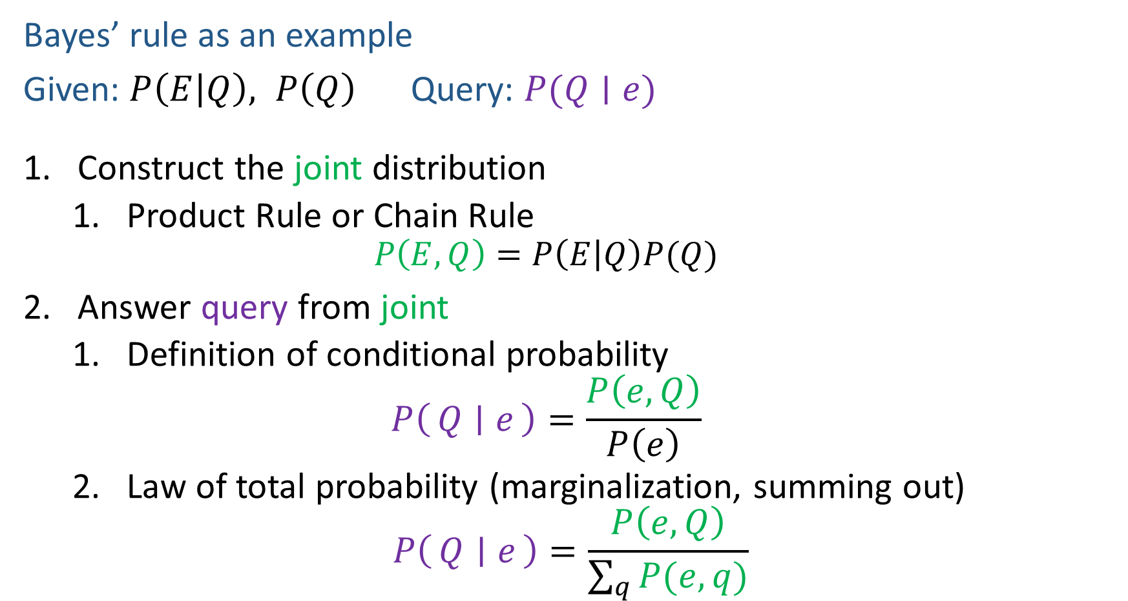
Answer Any Query from Condition Probability Tables
Bayes’ rule as an example
Given: $P\left(E | Q\right), P\left(Q\right)$ Query: $P(Q∣e)$
Construct the joint distribution
    Product Rule or Chain Rule
    $$P\left(E,Q\right)=P\left(E | Q\right)P(Q)$$
Answer query from joint
    Definition of conditional probability
    $$P\left(Q ∣ e\right)=\frac{P\left(e, Q\right)}{P\left(e\right)}$$
    Law of total probability (marginalization, summing out)
$$P\left(Q ∣ e\right)=\frac{P\left(e, Q\right)}{\sum_{q}{P(e,q)}}$$

Slide 39

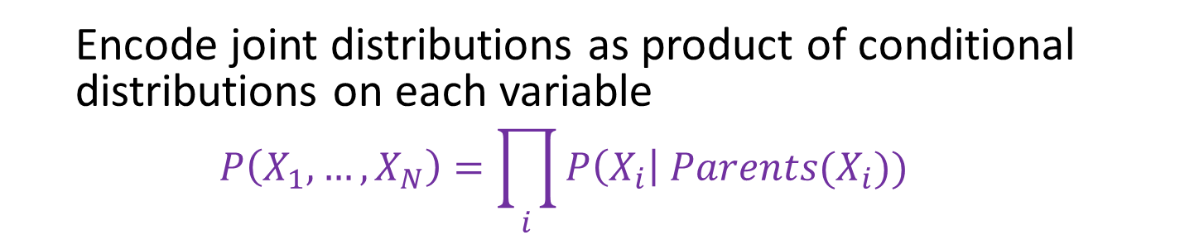



Bayesian Networks
Bayes net
One node per random variable
DAG
One CPT per node: P(node | Parents(node) )
$$A$$
$$B$$
$$C$$
$$D$$
$$P\left(A, B, C, D\right)=P\left(A\right) P\left(B | A\right) P\left(C | A,B\right) P\left(D | A,B,C\right)$$
  Encode joint distributions as product of conditional distributions on each variable
  $$P\left(X_{1},…,X_{N}\right)=\prod_{i}{P\left(X_{i}\right| Parents(X_{i})) }$$

Slide 40
Build Bayes Net Using Chain Rule
Binary random variables
  Fire
  Smoke
  Alarm

Slide 41





Question
$$B$$
$$A$$
Variables
  B: Burglary
  A: Alarm goes off
  M: Mary calls
  J: John calls
  E: Earthquake!
  Given the Bayes net, write the joint distribution?
$$M$$
$$E$$
$$J$$

Slide 42

Answer Any Query from Bayes Net
Joint
Bayes Net and
Conditional Probability Tables
$$A$$
Query
$$P\left(a \right| e)$$
$$B$$
$$C$$
$$D$$

Slide 43
Answer Any Query from Condition Probability Tables
Conditional Probability Tables and Chain Rule
Joint
Query
$$P\left(a \right| e)$$
$P\left(A\right) P\left(B | A\right) P\left(C | A,B\right) P\left(D | A,B,C\right)$ $P(E|A, B,C,D)$

Slide 44
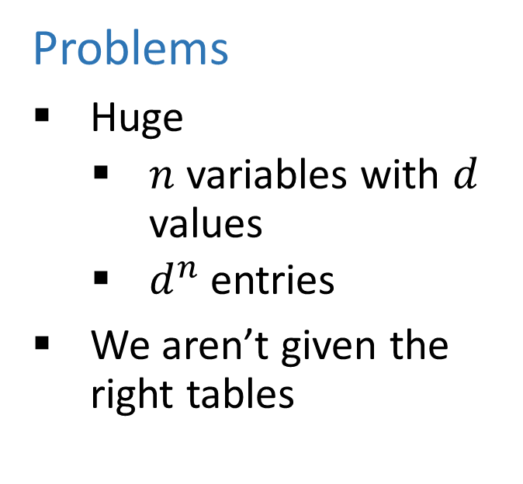
Answer Any Query from Condition Probability Tables
Conditional Probability Tables and Chain Rule
Problems
Huge
    $n$ variables with $d$ values
    $d^{n}$ entries
We aren’t given the right tables
$P\left(A\right) P\left(B | A\right) P\left(C | A,B\right) P\left(D | A,B,C\right)$ $P(E|A, B,C,D)$

Slide 45
Do We Need the Full Chain Rule?
Binary random variables
  Fire
  Smoke
  Alarm

Slide 46
Answer Any Query from Condition Probability Tables
Conditional Probability Tables and Chain Rule
Joint
Query
$$P\left(a \right| e)$$
$P\left(A\right) P\left(B | A\right) P\left(C | A,B\right) P\left(D | A,B,C\right)$ $P(E|A, B,C,D)$

Slide 47
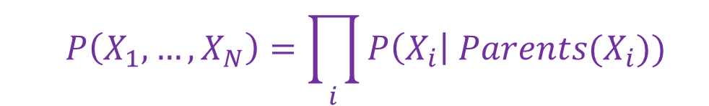
Answer Any Query from Condition Probability Tables
Bayes Net
Joint
Query
$$P\left(a \right| e)$$
$$P\left(A\right) P\left(B | A\right) P\left(C | A\right) P\left(D | C\right) P(E|C)$$
  $$P\left(X_{1},…,X_{N}\right)=\prod_{i}{P\left(X_{i}\right| Parents(X_{i})) }$$

