Slide 1
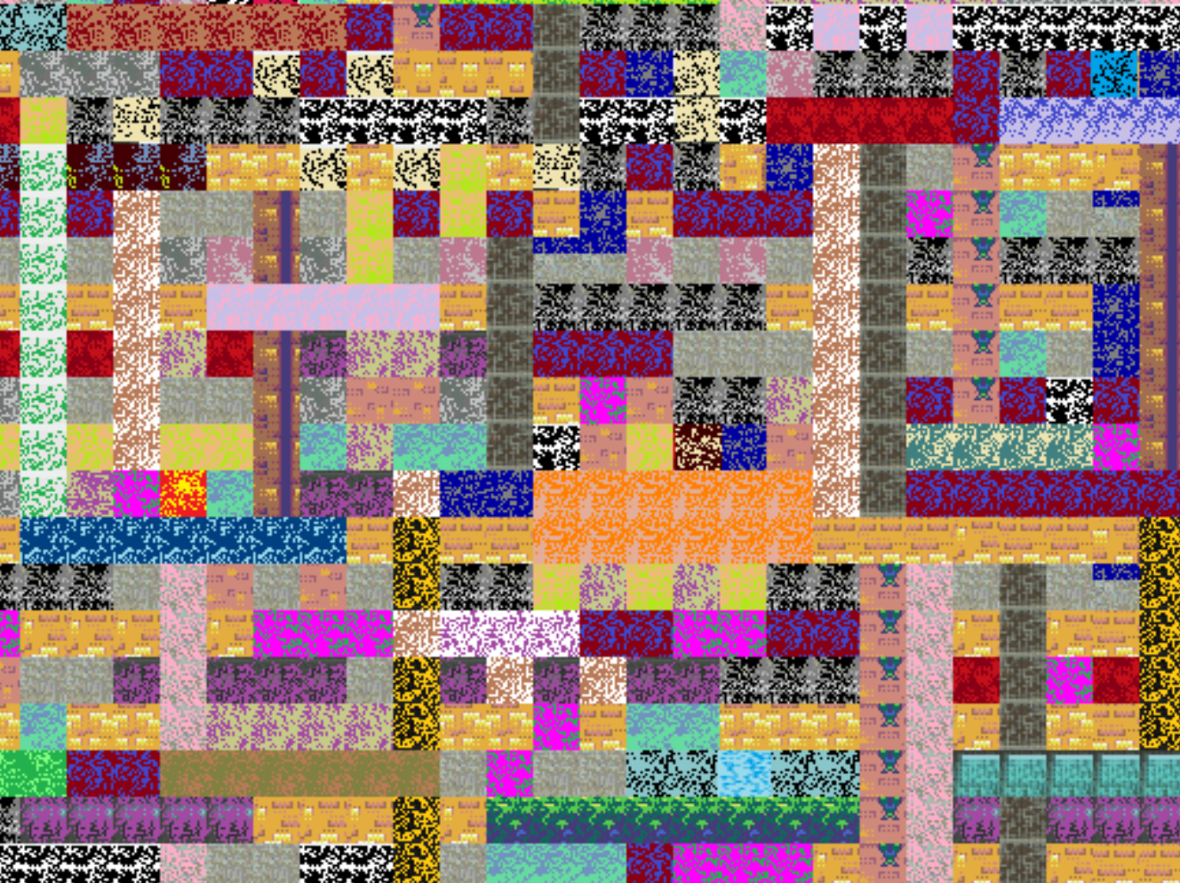
Warm-up as you log in
https://high-level-4.herokuapp.com/experiment
https://rachit-dubey.github.io/humanRL_website/

Slide 2
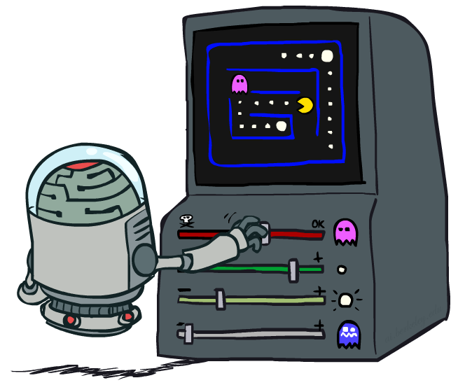
AI: Representation and Problem Solving
Reinforcement Learning II
Instructor: Pat Virtue
Slide credits: CMU AI and http://ai.berkeley.edu

Slide 3
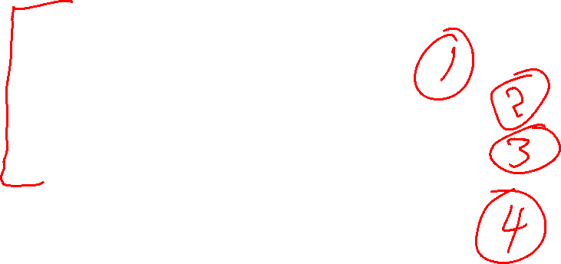
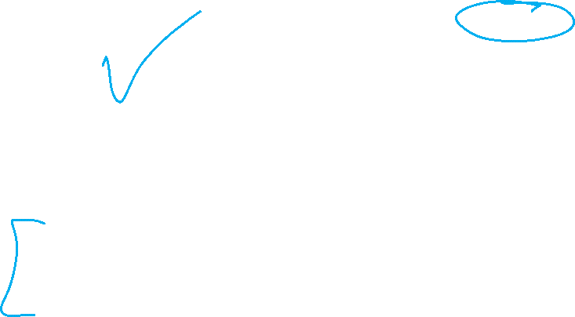
Overview: MDPs and Reinforcement Learning
Known MDP: Offline Solution
Value Iteration / Policy Iteration
Unknown MDP: Online Learning
Model-Based
Model-Free
Estimate MDP T(s,a,s') and R(s,a,s')
from samples of environment
Passive Reinforcement Learning
Direct Evaluation (simple)
TD Learning
Active Reinforcement Learning
Q-Learning

Slide 4

Online Learning Model-based Learning

Slide 5




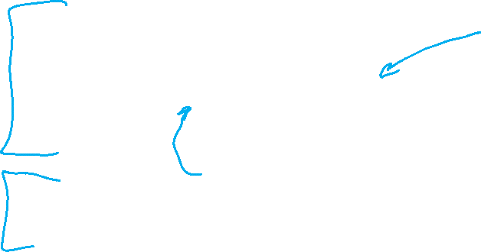
Model-Based Learning
Model-Based Idea:
Learn an approximate model based on experiences
Solve for values as if the learned model were correct
Step 1: Learn empirical MDP model
Count outcomes s’ for each s, a
Normalize to give an estimate of
Discover each when we experience (s, a, s’)
Step 2: Solve the learned MDP
For example, use value iteration, as before

Slide 6
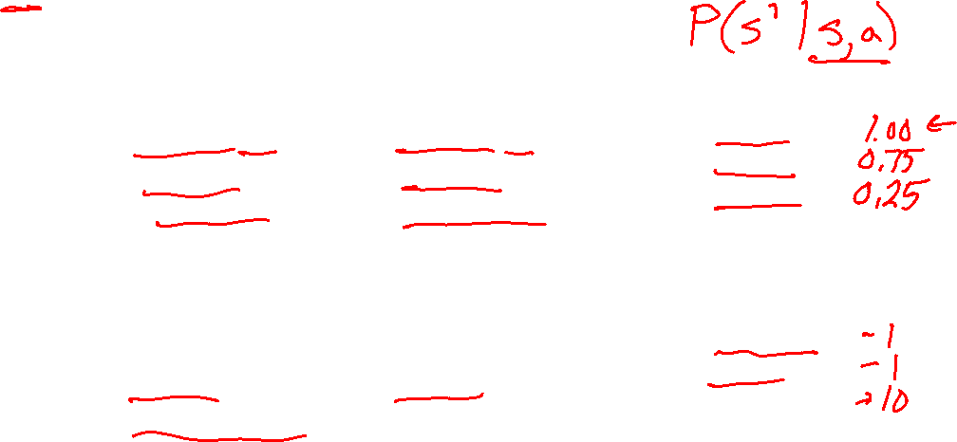
Example: Model-Based Learning
Episode: a sequence of states actions and rewards sampled from the environment
Input Policy π
Observed Episodes (Training)
Learned Model
Episode 1
Episode 2
T(s,a,s’).
T(B, east, C) =
T(C, east, D) =
T(C, east, A) =
…
R(s,a,s’).
R(B, east, C) =
R(C, east, D) =
R(D, exit, x) =
…
 | A
B | C | D
 | E
B, east, C, -1
C, east, D, -1
D, exit, x, +10
B, east, C, -1
C, east, D, -1
D, exit, x, +10
Episode 3
Episode 4
E, north, C, -1
C, east, D, -1
D, exit, x, +10
E, north, C, -1
C, east, A, -1
A, exit, x, -10
Assume: γ = 1

Slide 7
Example: Model-Based Learning
Input Policy π
Observed Episodes (Training)
Learned Model
Episode 1
Episode 2
T(s,a,s’).
T(B, east, C) = 1.00
T(C, east, D) = 0.75
T(C, east, A) = 0.25
…
R(s,a,s’).
R(B, east, C) = -1
R(C, east, D) = -1
R(D, exit, x) = +10
…
 | A
B | C | D
 | E
B, east, C, -1
C, east, D, -1
D, exit, x, +10
B, east, C, -1
C, east, D, -1
D, exit, x, +10
Episode 3
Episode 4
E, north, C, -1
C, east, D, -1
D, exit, x, +10
E, north, C, -1
C, east, A, -1
A, exit, x, -10
Assume: γ = 1

Slide 8
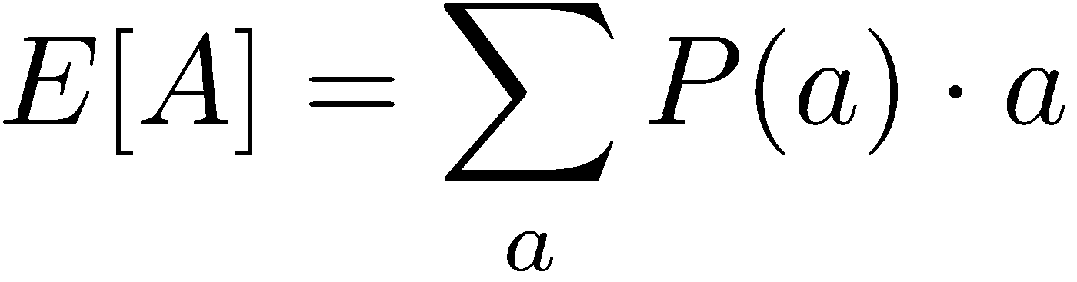
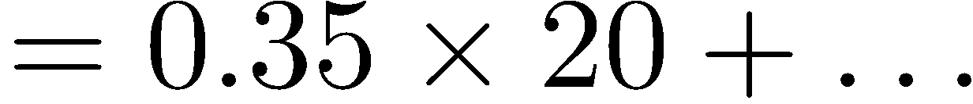
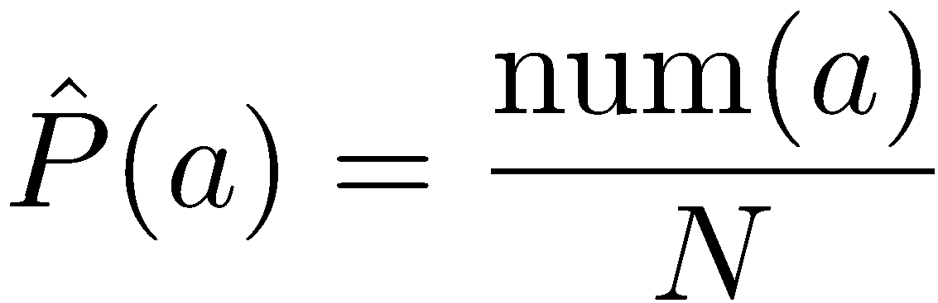
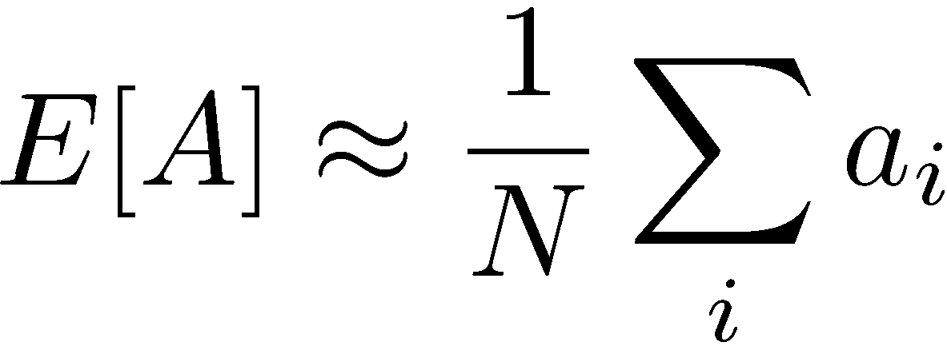
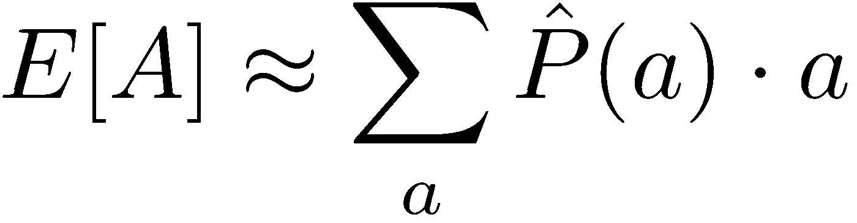
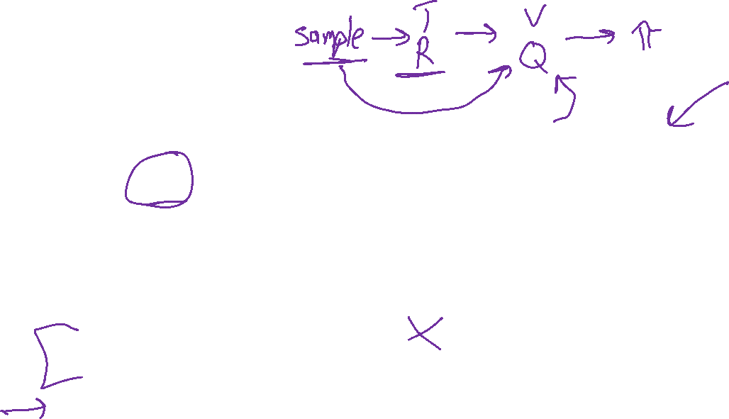
Example: Expected Age
Goal: Compute expected age of 15-281 students
Known P(A)
Without P(A), instead collect samples [a₁, a₂, … a_{N}]
Unknown P(A): “Model Based”
Unknown P(A): “Model Free”
Why does this work? Because samples appear with the right frequencies.

Slide 9
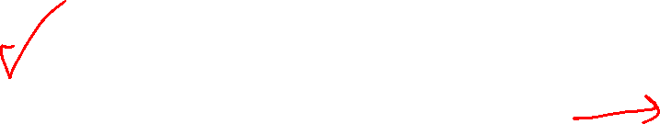
Overview: MDPs and Reinforcement Learning
Known MDP: Offline Solution
Value Iteration / Policy Iteration
Unknown MDP: Online Learning
Model-Based
Model-Free
Estimate MDP T(s,a,s') and R(s,a,s')
from samples of environment
Passive Reinforcement Learning
Direct Evaluation (simple)
TD Learning
Active Reinforcement Learning
Q-Learning

Slide 10
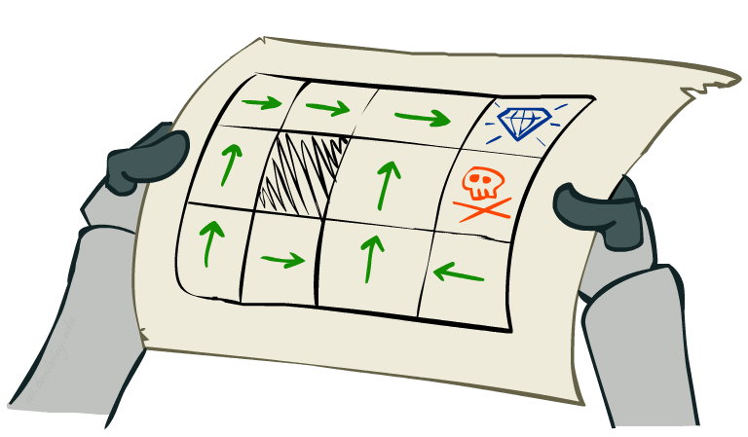
Online Learning Model-free Learning Passive Reinforcement Learning

Slide 11
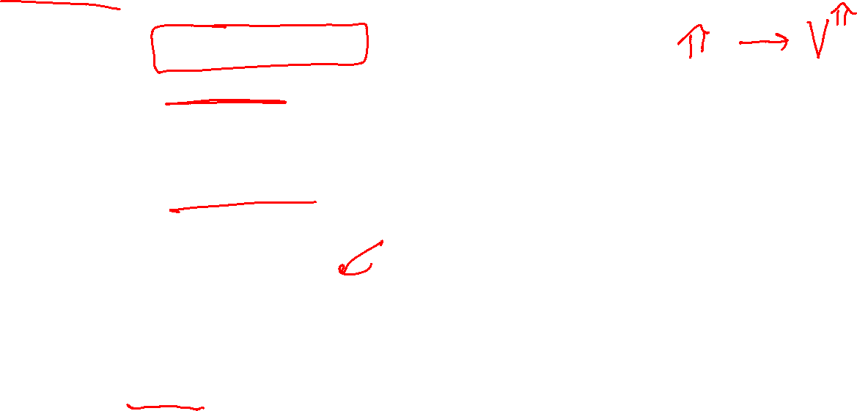
Passive Reinforcement Learning
Simplified task: policy evaluation
Input: a fixed policy π(s)
You don’t know the transitions T(s,a,s’)
You don’t know the rewards R(s,a,s’)
Goal: learn the state values
In this case:
Learner is “along for the ride”
No choice about what actions to take
Just execute the policy and learn from experience
This is NOT offline planning! You actually take actions in the world

Slide 12
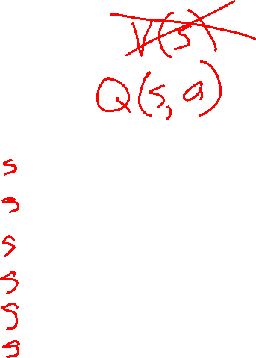
Simple Passive Learning: Direct Evaluation
Goal: Compute values for each state under π
Idea: Average together observed sample values
Act according to π
Every time you visit a state, write down what the sum of discounted rewards turned out to be
Average those samples
This is called direct evaluation
Pieces Available | Take 1 | Take 2
2 | 0 | 100
3 | 2 | 0
4 | 75 | 2
5 | 4 | 68
6 | 5 | 6
7 | 60 | 5

Slide 13
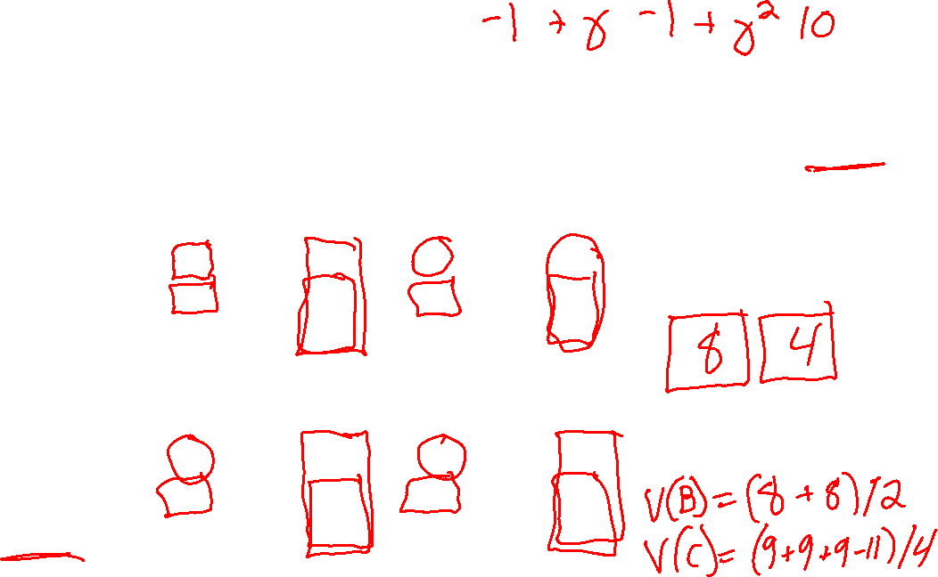

Example: Direct Evaluation
Input Policy π
Observed Episodes (Training)
Output Values
Episode 1
Episode 2
 | A
B | C | D
 | E
 | A
B | C | D
 | E
B, east, C, -1
C, east, D, -1
D, exit, x, +10
B, east, C, -1
C, east, D, -1
D, exit, x, +10
-10
+8
+4
+10
Episode 3
Episode 4
-2
E, north, C, -1
C, east, D, -1
D, exit, x, +10
E, north, C, -1
C, east, A, -1
A, exit, x, -10
Assume: γ = 1

Slide 14
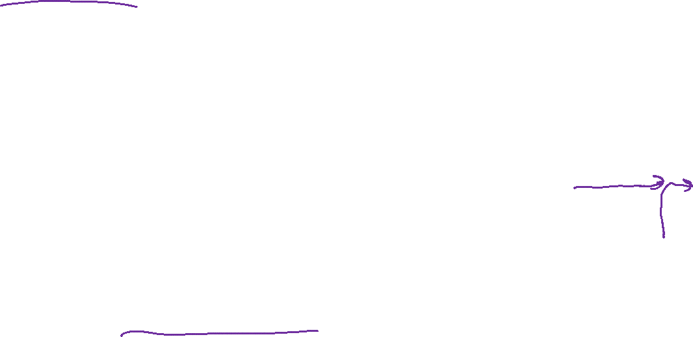
Problems with Direct Evaluation
What’s good about direct evaluation?
It’s easy to understand
It doesn’t require any knowledge of T, R
It eventually computes the correct average values, using just sample transitions
What bad about it?
It wastes information about state connections
Each state must be learned separately
So, it takes a long time to learn
Output Values
 | A
B | C | D
 | E
-10
+8
+4
+10
-2
If B and E both go to C under this policy, how can their values be different?

Slide 15
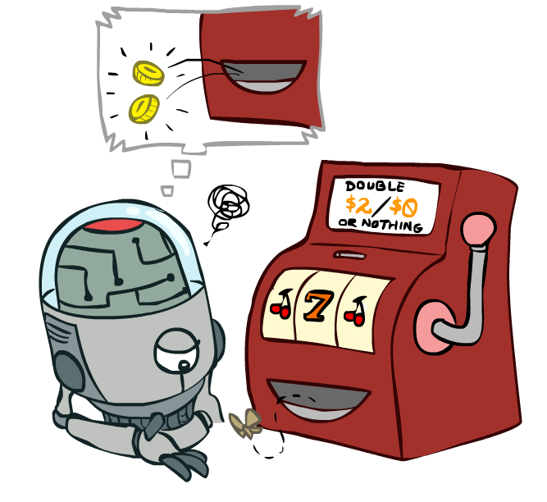
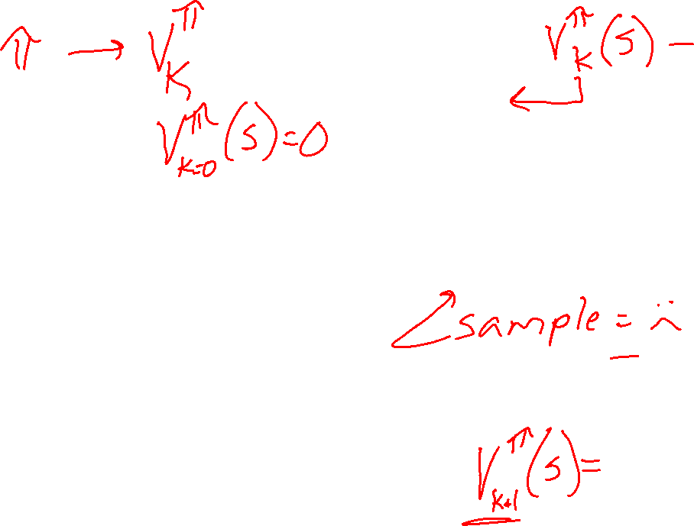
Online Learning Model-free Learning Passive Reinforcement Learning Temporal Difference Learning

Slide 16

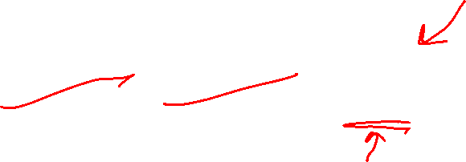
Why Not Use Policy Evaluation?
s
Simplified Bellman updates calculate V for a fixed policy:
Each round, replace V with a one-step-look-ahead layer over V
This approach fully exploited the connections between the states
Unfortunately, we need T and R to do it!
Key question: How can we do this update to V without knowing T and R?
In other words, how to we take a weighted average without knowing the weights?
π(s)
s, π(s)
s, π(s),s’
s’

Slide 17
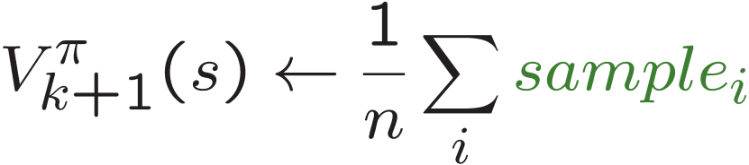
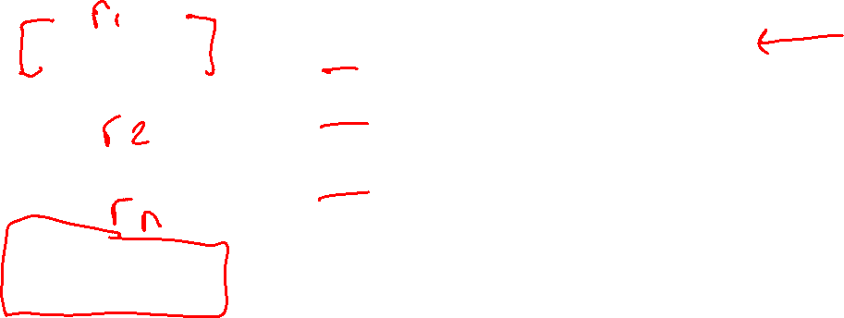
Sample-Based Policy Evaluation?
We want to improve our estimate of V by computing these averages:
Idea: Take samples of outcomes s’ (by doing the action!) and average
s
π(s)
s, π(s)
s, π(s),s’
s₁'
s₂'
s'
s₃'
Almost! But we can’t rewind time to get sample after sample from state s.

Slide 18
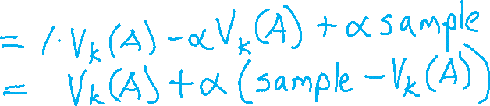
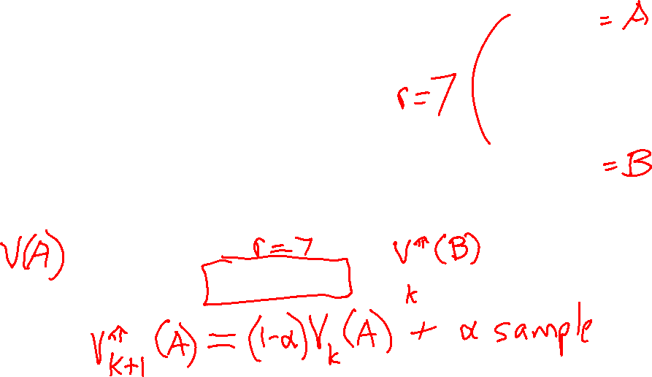
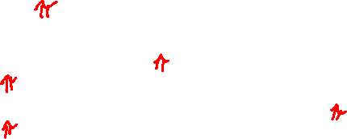
Temporal Difference Learning
s
Big idea: learn from every experience!
Update V(s) each time we experience a transition (s, a, s’, r)
Likely outcomes s’ will contribute updates more often
Temporal difference learning of values
Policy still fixed, still doing evaluation!
Move values toward value of whatever successor occurs: running average
π(s)
s, π(s)
s’
Sample of V(s):
Update to V(s):

Slide 19
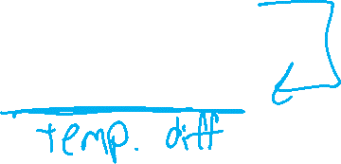
Temporal Difference Learning
s
Big idea: learn from every experience!
Update V(s) each time we experience a transition (s, a, s’, r)
Likely outcomes s’ will contribute updates more often
Temporal difference learning of values
Policy still fixed, still doing evaluation!
Move values toward value of whatever successor occurs: running average
π(s)
s, π(s)
s’
Sample of V(s):
Update to V(s):
Same update:

Slide 20

Exponential Moving Average
Exponential moving average
The running interpolation update:
Makes recent samples more important:
Forgets about the past (distant past values were wrong anyway)
Decreasing learning rate (alpha) can give converging averages

Slide 21
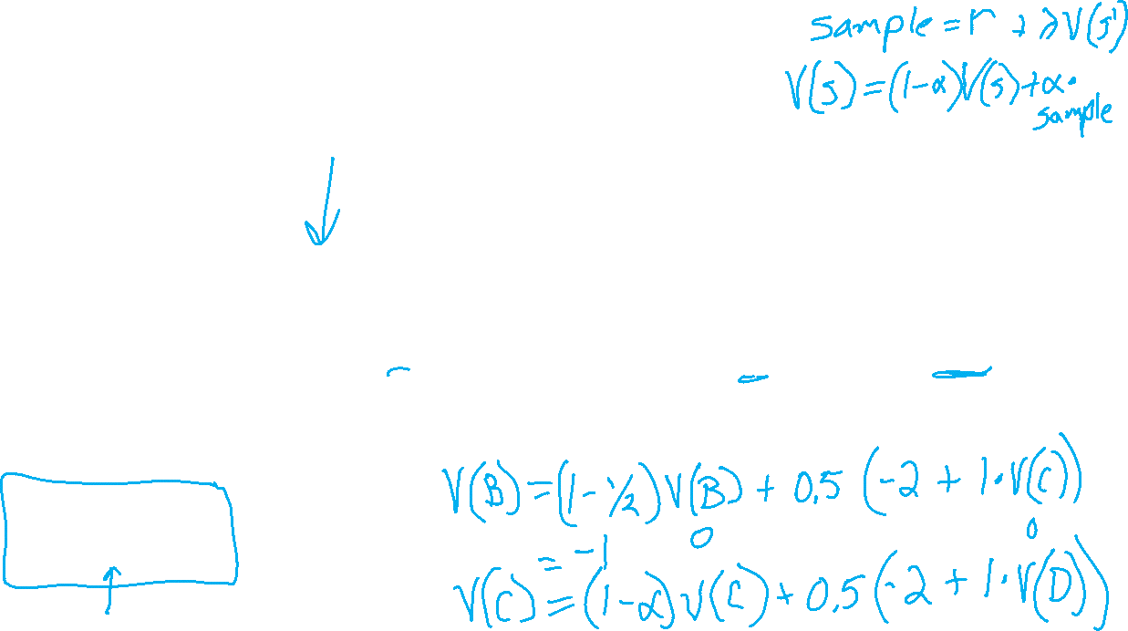
Example: Temporal Difference Learning
States
Observed Transitions
B, east, C, -2
C, east, D, -2
 | A
B | C | D
 | E
 | 0
0 | 0 | 8
 | 0
 | 0
-1 | 0 | 8
 | 0
 | 0
-1 | 3 | 8
 | 0
Assume: γ = 1, α = 1/2

Slide 22

Example: Temporal Difference Learning
States
Observed Transitions
B, east, C, -2
C, east, D, -2
 | A
B | C | D
 | E
 | 0
0 | 0 | 8
 | 0
 | 0
-1 | 0 | 8
 | 0
 | 0
-1 | 3 | 8
 | 0
Assume: γ = 1, α = 1/2

Slide 23
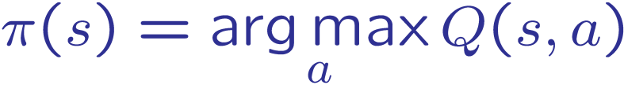
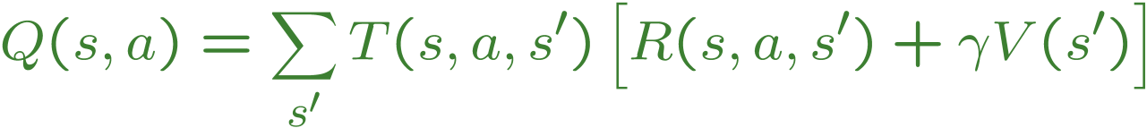
Problems with TD Value Learning
TD value leaning is a model-free way to do policy evaluation, mimicking Bellman updates with running sample averages
However, if we want to turn values into a (new) policy, we’re sunk:
Idea: learn Q-values, not values
Makes action selection model-free too!
s
a
s, a
s,a,s’
s’

Slide 24
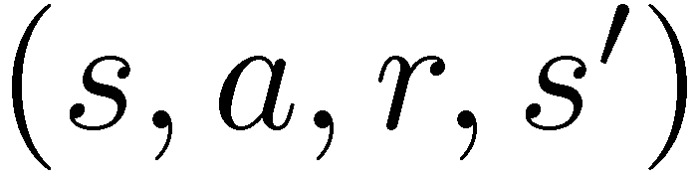
Model-Free Learning
s
Model-free (temporal difference) learning
Experience world through episodes
Update estimates each transition
Over time, updates will mimic Bellman updates
a
s, a
r
s’
a’
s’, a’
s’’

Slide 25

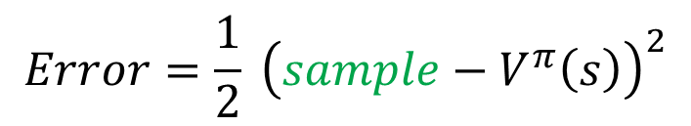


Temporal Difference Learning
Big idea: learn from every experience!
Update V(s) each time we experience a transition (s, a, s’, r)
Likely outcomes s’ will contribute updates more often
Temporal difference learning of values
Policy still fixed, still doing evaluation!
Move values toward value of whatever successor occurs: running average
s
π(s)
s, π(s)
s’
Sample of V(s):
$$sample= r+γ V^{π}\left(s^{′}\right)$$
Update to V(s):
$$V^{π}\left(s\right) ← {\left(1−α\right) V}^{π}\left(s\right)+(α) sample$$
Same update:
$$V^{π}\left(s\right) ← V^{π}(s) +α \left[sample− V^{π}\left(s\right)\right]$$
$$Error=\frac{1}{2} {\left(sample−V^{π}\left(s\right)\right)}^{2}$$
Same update:
$$V^{π}\left(s\right) ← V^{π}\left(s\right)−α∇Error$$

Slide 26
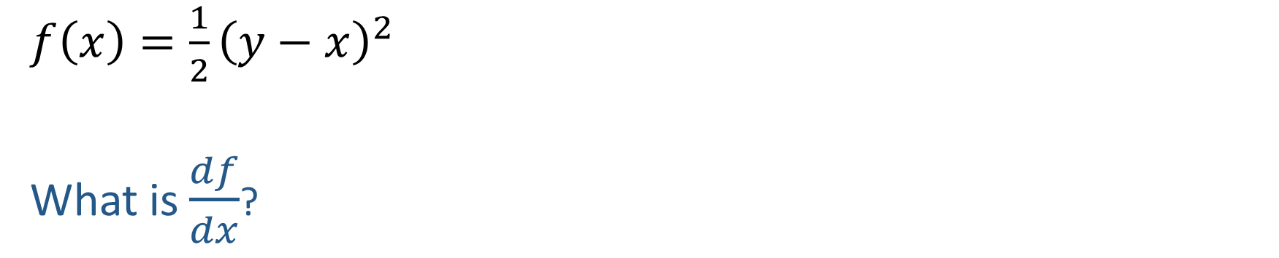
Quick Calculus Quiz
$f\left(x\right)=\frac{1}{2}{\left(y−x\right)}^{2}$
What is $\frac{df}{dx}$?

Slide 27

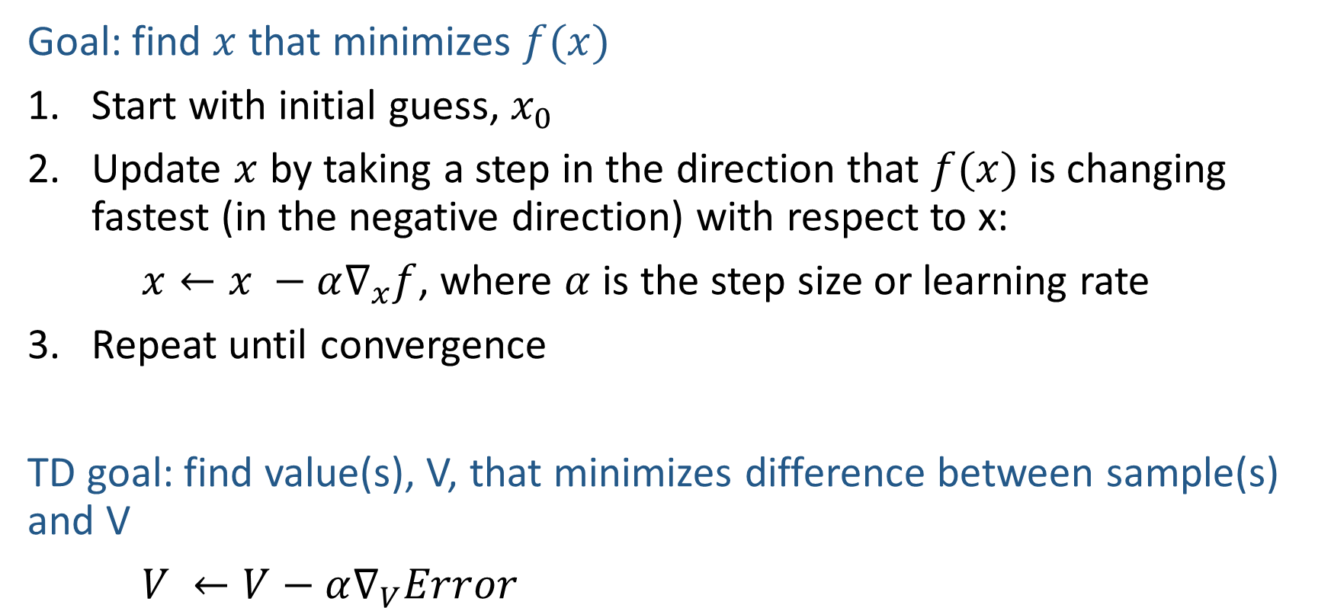
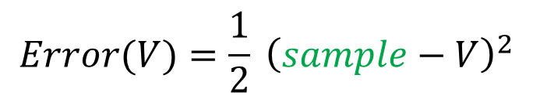
Gradient Descent
$$f\left(x\right)=\frac{1}{2}{\left(y−x\right)}^{2}$$
$$\frac{df}{dx}=−(y−x)$$
Goal: find $x$ that minimizes $f(x)$
Start with initial guess, $x_{0}$
Update $x$ by taking a step in the direction that $f(x)$ is changing fastest (in the negative direction) with respect to x:
$x←x −α∇_{x}f$, where $α$ is the step size or learning rate
Repeat until convergence
TD goal: find value(s), V, that minimizes difference between sample(s) and V
$V ←V−α∇_{V}Error$
$$Error(V)=\frac{1}{2} {\left(sample−V\right)}^{2}$$

Slide 28
Temporal Difference Learning
Big idea: learn from every experience!
Update V(s) each time we experience a transition (s, a, s’, r)
Likely outcomes s’ will contribute updates more often
Temporal difference learning of values
Policy still fixed, still doing evaluation!
Move values toward value of whatever successor occurs: running average
s
π(s)
s, π(s)
s’
Sample of V(s):
$$sample= r+γ V^{π}\left(s^{′}\right)$$
Update to V(s):
$$V^{π}\left(s\right) ← {\left(1−α\right) V}^{π}\left(s\right)+(α) sample$$
Same update:
$$V^{π}\left(s\right) ← V^{π}(s) +α \left[sample− V^{π}\left(s\right)\right]$$
$$Error=\frac{1}{2} {\left(sample−V^{π}\left(s\right)\right)}^{2}$$
Same update:
$$V^{π}\left(s\right) ← V^{π}\left(s\right)−α∇Error$$

Slide 29

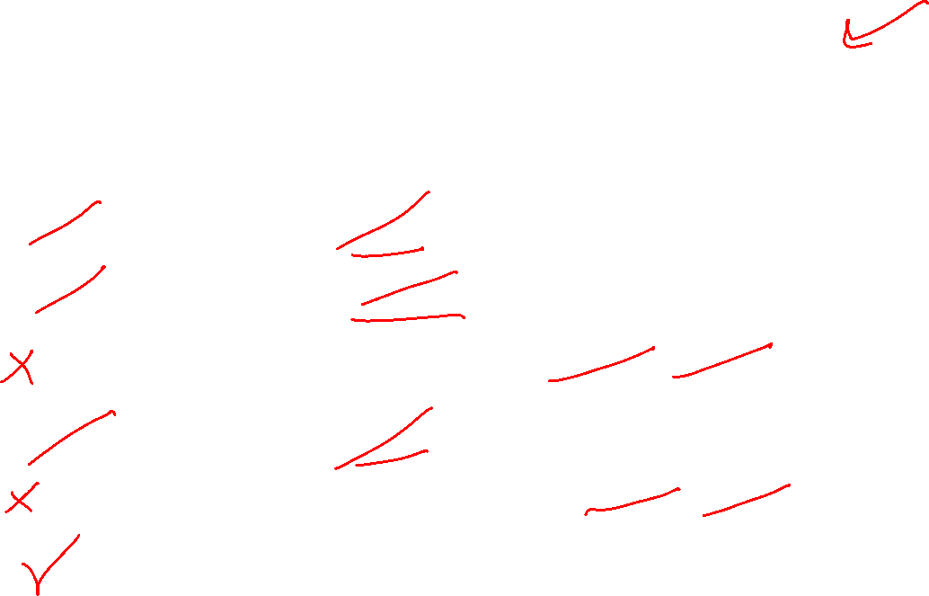
Poll 1
TD update:
$$V^{π}\left(s\right) = V^{π}(s) +α \left[r+γ V^{π}\left(s^{′}\right)− V^{π}\left(s\right)\right]$$
Which converts TD values into a policy?
$$V_{k+1}\left(s\right)=\max_{a}{\sum_{s′}{P\left(s^{′} | s,a\right)\left[R\left(s,a,s^{′}\right)+γV_{k}\left(s^{′}\right)\right]}}, ∀ s$$
$$Q_{k+1}\left(s,a\right)=\sum_{s′}{P\left(s^{′} | s,a\right)[R\left(s,a,s^{′}\right)+γ\max_{a^{′}}{Q_{k}(s^{′},a^{′})]}, } ∀ s,a$$
$$π_{V}\left(s\right)=\underset{a}{argmax}{\sum_{s′}{P\left(s^{′} | s,a\right)[R\left(s,a,s^{′}\right)+γV\left(s^{′}\right)]}}, ∀ s$$
$$V_{k+1}^{π}\left(s\right)=\sum_{s′}{P\left(s^{′} | s,π\left(s\right)\right)[R\left(s,π\left(s\right),s^{′}\right)+γV_{k}^{π}\left(s^{′}\right)]}, ∀ s$$
$$π_{new}\left(s\right)=\underset{a}{argmax}{\sum_{s′}{P\left(s^{′} | s,a\right)\left[R\left(s,a,s^{′}\right)+γV^{π_{old}}\left(s^{′}\right)\right]}}, ∀ s$$
A) Value iteration:
B) Q-iteration:
C) Policy extraction:
D) Policy evaluation:
E) Policy improvement:
F) None of the above

Slide 30
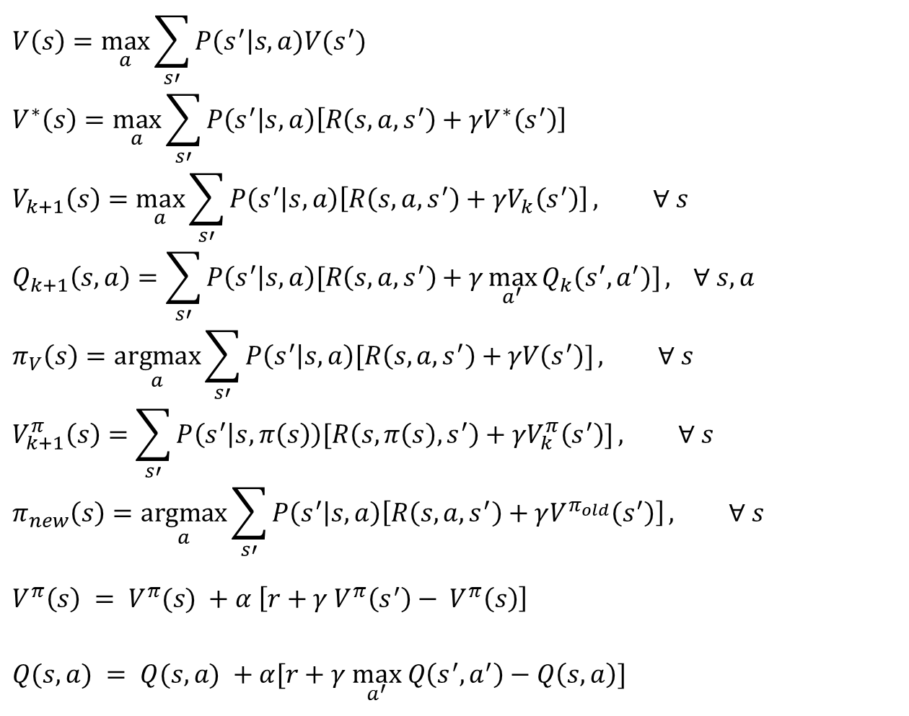
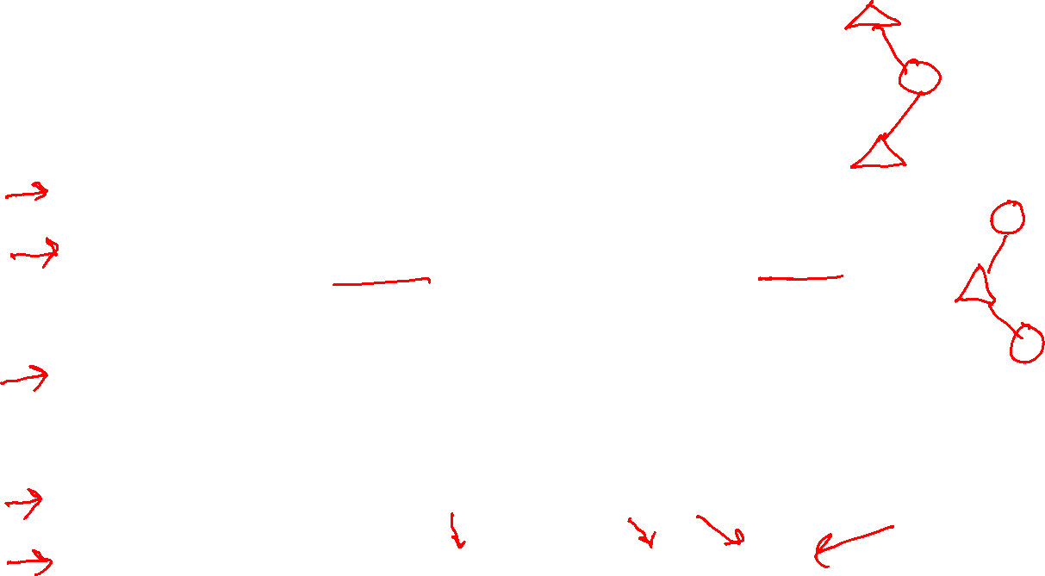
MDP/RL Notation
Standard expectimax:
$$V\left(s\right)=\max_{a}{\sum_{s′}{P\left(s^{′}\right|s,a)V(s^{′})}}$$
$$V^{∗}\left(s\right)=\max_{a}{\sum_{s′}{P\left(s^{′} | s,a\right)\left[R\left(s,a,s^{′}\right)+γV^{∗}\left(s^{′}\right)\right]}}$$
$$V_{k+1}\left(s\right)=\max_{a}{\sum_{s′}{P\left(s^{′} | s,a\right)\left[R\left(s,a,s^{′}\right)+γV_{k}\left(s^{′}\right)\right]}}, ∀ s$$
$$Q_{k+1}\left(s,a\right)=\sum_{s′}{P\left(s^{′} | s,a\right)[R\left(s,a,s^{′}\right)+γ\max_{a^{′}}{Q_{k}(s^{′},a^{′})]}, } ∀ s,a$$
$$π_{V}\left(s\right)=\underset{a}{argmax}{\sum_{s′}{P\left(s^{′} | s,a\right)[R\left(s,a,s^{′}\right)+γV\left(s^{′}\right)]}}, ∀ s$$
$$V_{k+1}^{π}\left(s\right)=\sum_{s′}{P\left(s^{′} | s,π\left(s\right)\right)[R\left(s,π\left(s\right),s^{′}\right)+γV_{k}^{π}\left(s^{′}\right)]}, ∀ s$$
$$π_{new}\left(s\right)=\underset{a}{argmax}{\sum_{s′}{P\left(s^{′} | s,a\right)\left[R\left(s,a,s^{′}\right)+γV^{π_{old}}\left(s^{′}\right)\right]}}, ∀ s$$
$$V^{π}\left(s\right) = V^{π}(s) +α \left[r+γ V^{π}\left(s^{′}\right)− V^{π}\left(s\right)\right]$$
$Q(s,a) = Q(s,a) +α[r+γ \max_{a^{′}} Q\left(s^{′},a^{′}\right)−Q\left(s, a\right)]$
Bellman equations:
Value iteration:
Q-iteration:
Policy extraction:
Policy evaluation:
Policy improvement:
Value (TD) learning:
Q-learning:

Slide 31
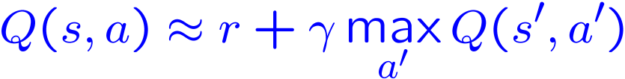
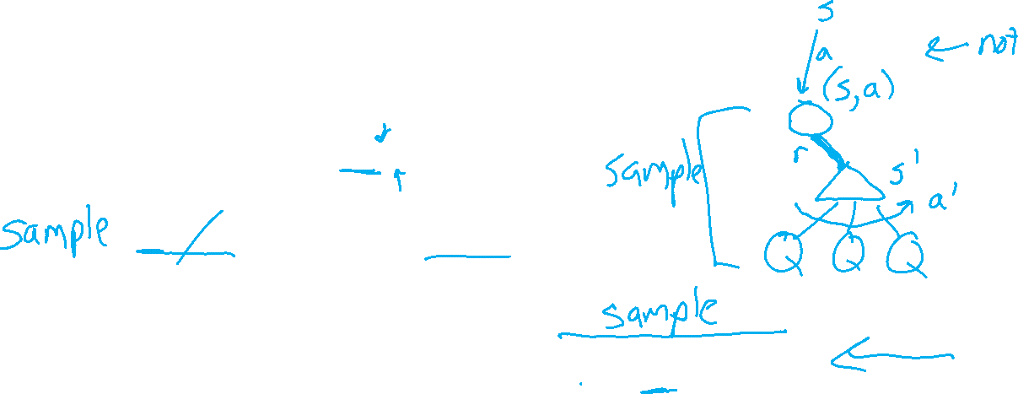
Q-Learning
We’d like to do Q-value updates to each Q-state:
But can’t compute this update without knowing T, R
Instead, compute average as we go
Receive a sample transition (s,a,r,s’)
This sample suggests
But we want to average over results from (s,a) (Why?)
So keep a running average

Slide 32

Q-Learning Properties
Amazing result: Q-learning converges to optimal policy -- even if you’re acting suboptimally!
This is called off-policy learning
Caveats:
You have to explore enough
You have to eventually make the learning rate
small enough
… but not decrease it too quickly
Basically, in the limit, it doesn’t matter how you select actions (!)

Slide 33
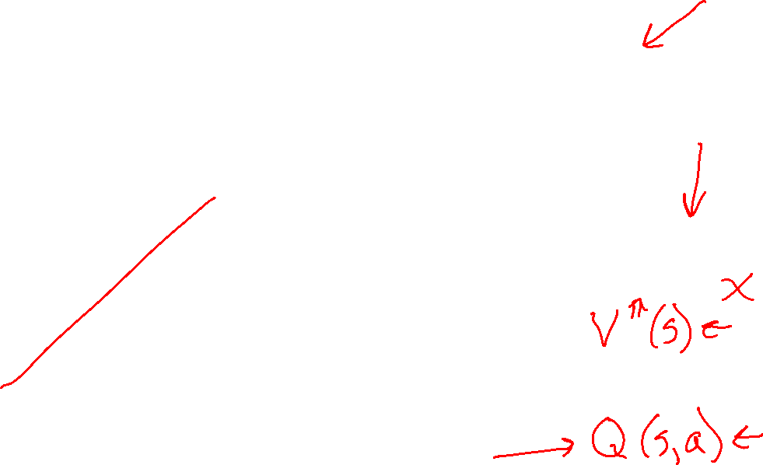

Overview: MDPs and Reinforcement Learning
Known MDP: Offline Solution
Value Iteration / Policy Iteration
Unknown MDP: Online Learning
Model-Based
Model-Free
Estimate MDP T(s,a,s') and R(s,a,s')
from samples of environment
Passive Reinforcement Learning
Direct Evaluation (simple)
TD Learning
Active Reinforcement Learning
Q-Learning

Slide 34
Demo Q-Learning Auto Cliff Grid
[Demo: Q-learning – auto – cliff grid (L11D1)]

Slide 35
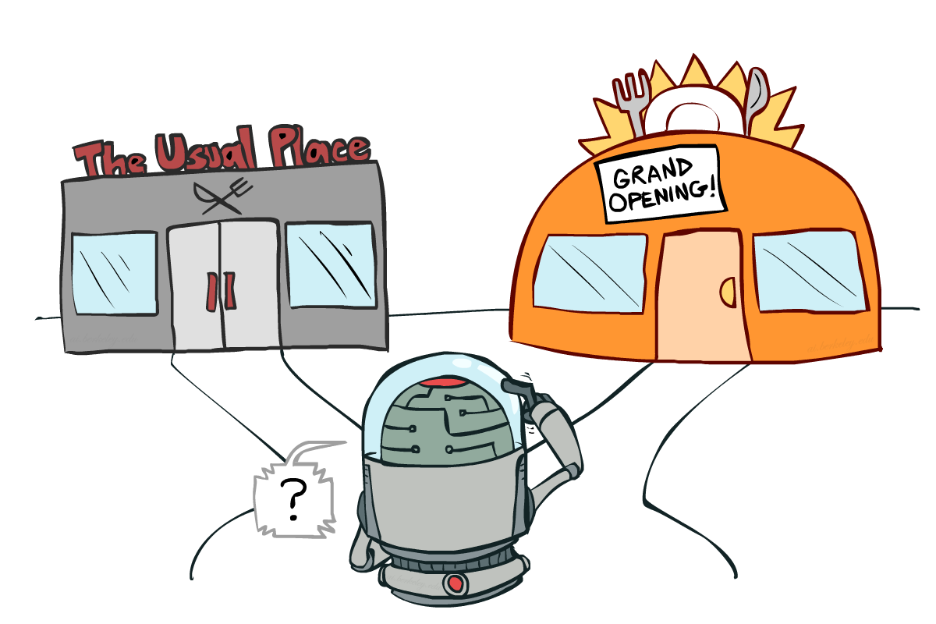
Exploration vs. Exploitation

Slide 36


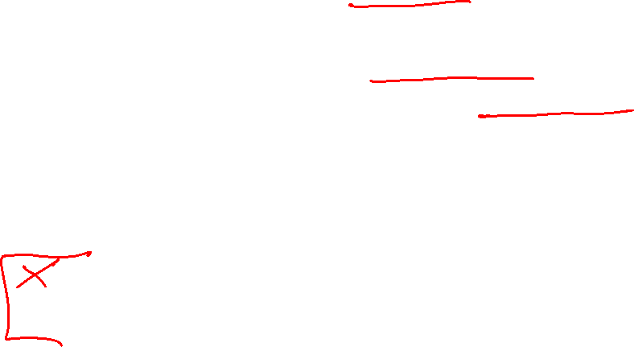
How to Explore?
Several schemes for forcing exploration
Simplest: random actions (ε-greedy)
Every time step, flip a coin
With (small) probability ε, act randomly
With (large) probability 1-ε, act on current policy
Problems with random actions?
You do eventually explore the space, but keep thrashing around once learning is done
One solution: lower ε over time
Another solution: exploration functions
[Demo: Q-learning – manual exploration – bridge grid (L11D2)] [Demo: Q-learning – epsilon-greedy -- crawler (L11D3)]

Slide 37
Demo Q-learning – Manual Exploration – Bridge Grid

Slide 38
Demo Q-learning – Epsilon-Greedy – Crawler

Slide 39
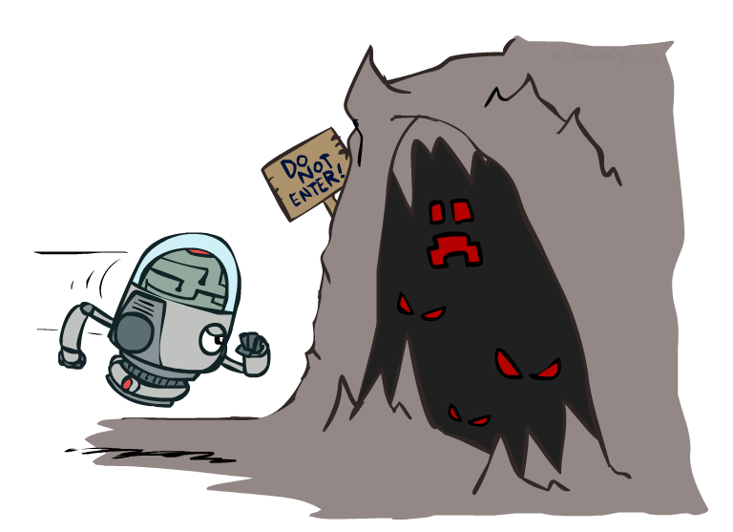

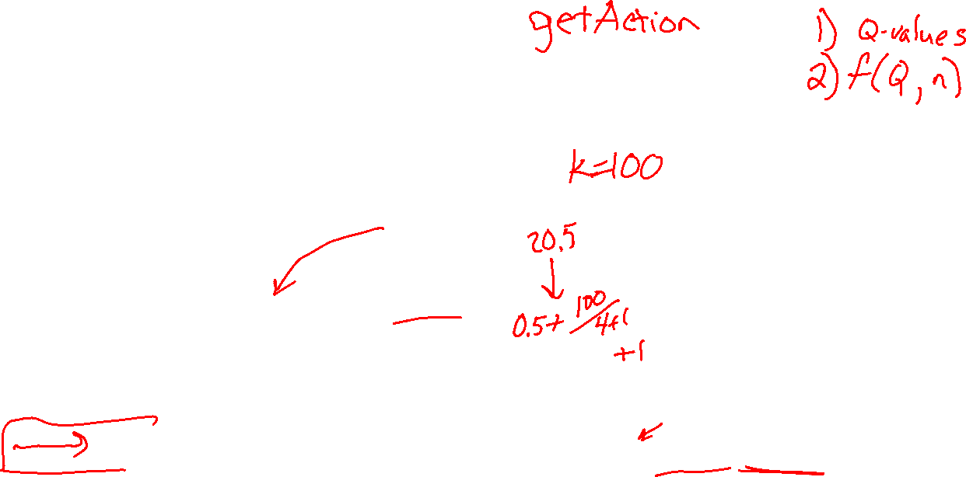
Exploration Functions
When to explore?
Random actions: explore a fixed amount
Better idea: explore areas whose badness is not
(yet) established, eventually stop exploring
Exploration function
Takes a value estimate u and a visit count n, and
returns an optimistic utility, e.g.
Note: this propagates the “bonus” back to states that lead to unknown states as well!
Regular Q-Update:
Modified Q-Update:
[Demo: exploration – Q-learning – crawler – exploration function (L11D4)]

Slide 40
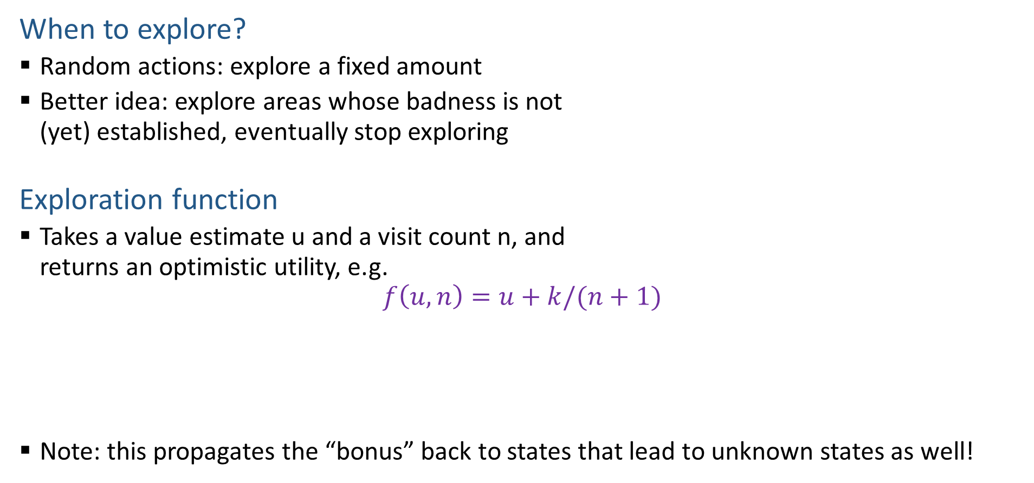

Exploration Functions
When to explore?
Random actions: explore a fixed amount
Better idea: explore areas whose badness is not
(yet) established, eventually stop exploring
Exploration function
Takes a value estimate u and a visit count n, and
returns an optimistic utility, e.g.
$$f\left(u, n\right)=u+k/(n+1)$$
Note: this propagates the “bonus” back to states that lead to unknown states as well!
Regular Q-Update: $Q\left(s, a\right)=Q\left(s,a\right)+α [r+γ\max_{a^{′}} Q\left(s^{′}, a^{′}\right) −Q\left(s, a\right)]$
Modified Q-Update: $Q\left(s, a\right)=Q\left(s,a\right)+α [r+γ\max_{a^{′}} f(Q\left(s^{′}, a^{′}\right), N\left(s^{′}, a^{′}\right)) −Q\left(s, a\right)]$
[Demo: exploration – Q-learning – crawler – exploration function (L11D4)]

Slide 41
Demo Q-learning – Exploration Function – Crawler

Slide 42
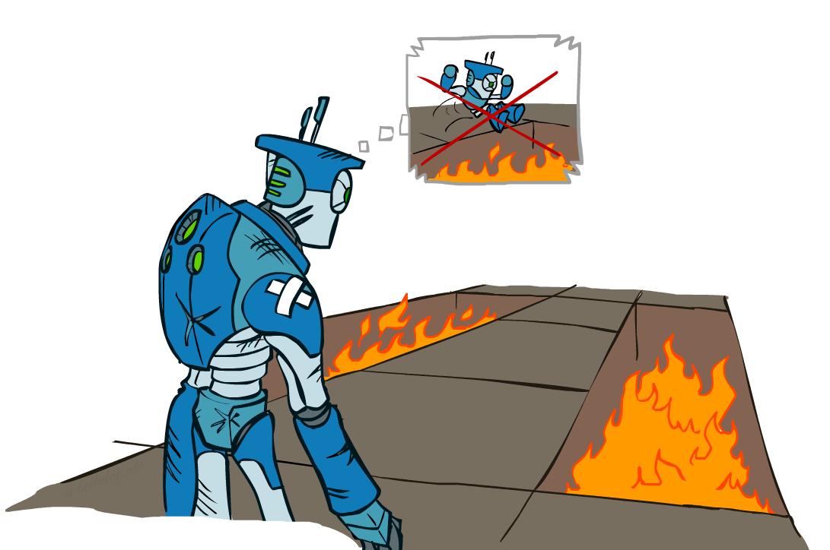
Regret
Even if you learn the optimal policy, you still make mistakes along the way!
Regret is a measure of your total mistake cost: the difference between your (expected) rewards, including youthful suboptimality, and optimal (expected) rewards
Minimizing regret goes beyond learning to be optimal – it requires optimally learning to be optimal
Example: random exploration and exploration functions both end up optimal, but random exploration has higher regret

Slide 43
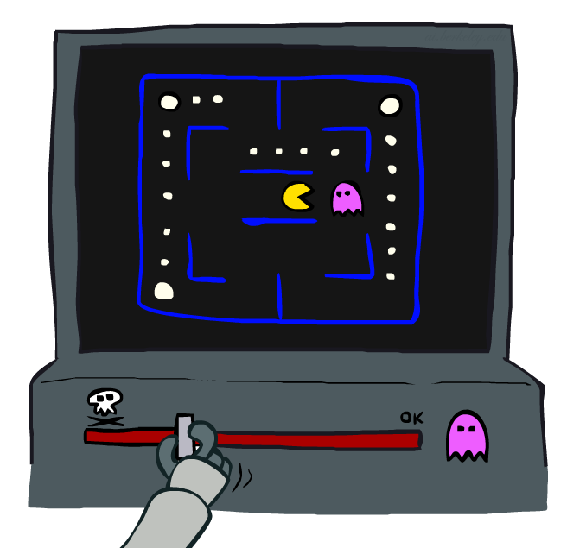
Approximate Q-Learning
Notes:
:34 in, :40 to go

Slide 44

Approximate Q-Learning
What happens when we change Candy Grab to start with 1000 pieces?
Pieces Available | Take 1 | Take 2
2 | 0% | 100%
3 | 2% | 0%
4 | 75% | 2%
5 | 4% | 68%
6 | 5% | 6%
7 | 60% | 5%

Slide 45



Generalizing Across States
Basic Q-Learning keeps a table of all q-values
In realistic situations, we cannot possibly learn about every single state!
Too many states to visit them all in training
Too many states to hold the q-tables in memory
Instead, we want to generalize:
Learn about some small number of training states from experience
Generalize that experience to new, similar situations
This is a fundamental idea in machine learning, and we’ll see it over and over again
[demo – RL pacman]

Slide 46





Example: Pacman
Let’s say we discover through experience that this state is bad:
In naïve q-learning, we know nothing about this state:
Or even this one!
[Demo: Q-learning – pacman – tiny – watch all (L11D5)]
[Demo: Q-learning – pacman – tiny – silent train (L11D6)]
[Demo: Q-learning – pacman – tricky – watch all (L11D7)]

Slide 47
Demo Q-Learning Pacman – Tiny – Watch All

Slide 48
Demo Q-Learning Pacman – Tiny – Silent Train

Slide 49
Demo Q-Learning Pacman – Tricky – Watch All

Slide 50

Feature-Based Representations
Solution: describe a state using a vector of features (properties)
Features are functions from states to real numbers (often 0/1) that capture important properties of the state
Example features:
Distance to closest ghost
Distance to closest dot
Number of ghosts
1 / (dist to dot)²
Is Pacman in a tunnel? (0/1)
…… etc.
Is it the exact state on this slide?
Can also describe a q-state (s, a) with features (e.g. action moves closer to food)

Slide 51

Linear Value Functions
Using a feature representation, we can write a q function (or value function) for any state using a few weights:
V_{w}(s) = w₁f₁(s) + w₂f₂(s) + … + w_{n}f_{n}(s)
Q_{w}(s,a) = w₁f₁(s,a) + w₂f₂(s,a) + … + w_{n}f_{n}(s,a)
Advantage: our experience is summed up in a few powerful numbers
Disadvantage: states may share features but actually be very different in value!

Slide 52

Updating a linear value function
Original Q learning rule tries to reduce prediction error at s, a:
Q(s,a) ← Q(s,a) + α ⋅ [r + γ max_{a’} Q (s’,a’) - Q(s,a) ]
Instead, we update the weights to try to reduce the error at s, a:
w_{i} ← w_{i} + α ⋅ [r + γ max_{a’} Q (s’,a’) - Q(s,a) ] ∂Q_{w}(s,a)/∂w_{i}
= w_{i} + α ⋅ [r + γ max_{a’} Q (s’,a’) - Q(s,a) ] f_{i}(s,a)

Slide 53



Quick Calculus Quiz
Last time
$$Error\left(x\right)=\frac{1}{2}{\left(y−x\right)}^{2}$$
$$\frac{dError}{dx}=−(y−x)$$
$Error(w)=\frac{1}{2}{\left(y−wf\left(x\right)\right)}^{2}$
What is $\frac{dError}{dw}$?

Slide 54



Updating a linear value function
Original Q learning rule tries to reduce prediction error at s, a:
Q(s,a) ← Q(s,a) + α ⋅ [r + γ max_{a’} Q (s’,a’) - Q(s,a) ]
Instead, we update the weights to try to reduce the error at s, a:
w_{i} ← w_{i} + α ⋅ [r + γ max_{a’} Q (s’,a’) - Q(s,a) ] ∂Q_{w}(s,a)/∂w_{i}
= w_{i} + α ⋅ [r + γ max_{a’} Q (s’,a’) - Q(s,a) ] f_{i}(s,a)
$Q_{w}\left(s, a\right)=w_{1}f_{1}\left(s, a\right)+w_{2}f_{2}\left(s, a\right)$
$\frac{∂Q}{∂w_{2}}=$
$$Error\left(w\right)=\frac{1}{2}{\left(y−wf\left(x\right)\right)}^{2}$$
$$\frac{dError}{dw}=−\left(y−wf\left(x\right)\right)f(x)$$

Slide 55

Updating a linear value function
Original Q learning rule tries to reduce prediction error at s, a:
Q(s,a) ← Q(s,a) + α ⋅ [r + γ max_{a’} Q (s’,a’) - Q(s,a) ]
Instead, we update the weights to try to reduce the error at s, a:
w_{i} ← w_{i} + α ⋅ [r + γ max_{a’} Q (s’,a’) - Q(s,a) ] ∂Q_{w}(s,a)/∂w_{i}
= w_{i} + α ⋅ [r + γ max_{a’} Q (s’,a’) - Q(s,a) ] f_{i}(s,a)
Qualitative justification:
Pleasant surprise: increase weights on +ve features, decrease on –ve ones
Unpleasant surprise: decrease weights on +ve features, increase on –ve ones

Slide 56



Approximate Q-Learning
Q-learning with linear Q-functions:
Intuitive interpretation:
Adjust weights of active features
E.g., if something unexpectedly bad happens, blame the features that were on: disprefer all states with that state’s features
Formal justification: online least squares
Exact Q’s
Approximate Q’s

Slide 57








Example: Q-Pacman
[Demo: approximate Q-learning pacman (L11D10)]

Slide 58
Demo Approximate Q-Learning -- Pacman

Slide 59

Q-Learning and Least Squares
Notes:
DK :57 in, :17 to go

Slide 60



Linear Approximation: Regression
40
26
24
20
22
20
30
20
40
0
0
20
30
10
20
0
10
0
Prediction:
Prediction:
Notes:
Figure 1: scatter(1:20,10+(1:20)+2*randn(1,20),'k','filled'); a=axis; a(3)=0; axis(a);

Slide 61





Optimization: Least Squares
Error or “residual”
Observation
Prediction
0
0
20
Notes:
Figure 1: scatter(1:20,10+(1:20)+2*randn(1,20),'k','filled'); a=axis; a(3)=0; axis(a);

Slide 62



Minimizing Error
Imagine we had only one point x, with features f(x), target value y, and weights w:
Approximate q update explained:
“target”
“prediction”

Slide 63
Recent Reinforcement Learning Milestones

Slide 64

TDGammon
1992 by Gerald Tesauro, IBM
4-ply lookahead using V(s) trained from 1,500,000 games of self-play
3 hidden layers, ~100 units each
Input: contents of each location plus several handcrafted features
Experimental results:
Plays approximately at parity with world champion
Led to radical changes in the way humans play backgammon

Slide 65


Deep Q-Networks
sample = r + γ max_{a’} Q_{w} (s’,a’)
Q_{w}(s,a): Neural network
Deep Mind, 2015
Used a deep learning network to represent Q:
Input is last 4 images (84x84 pixel values) plus score
49 Atari games, incl. Breakout, Space Invaders, Seaquest, Enduro
Image: Deep Mind

Slide 66




Images: Open AI, Atari

Slide 67





OpenAI Gym
2016+
Benchmark problems for learning agents
https://gym.openai.com/envs
Images: Open AI

Slide 68

AlphaGo, AlphaZero
Deep Mind, 2016+

Slide 69

Autonomous Vehicles?

