Slide 1
Overview: MDPs and Reinforcement Learning
Known MDP: Offline Solution
Goal Technique
Compute V*, Q*, π* Value / policy iteration
Evaluate a fixed policy π Policy evaluation
Unknown MDP: Model-Based
Unknown MDP: Model-Free
Goal Technique
Compute V*, Q*, π* VI/PI on approx. MDP
Eval fixed policy π PE on approx. MDP
Goal Technique
Compute V*, Q*, π* Q-learning
Eval fixed policy π TD/Value Learning

Slide 2
Wrap up MDPs
Switch to MDP II slides

Slide 3
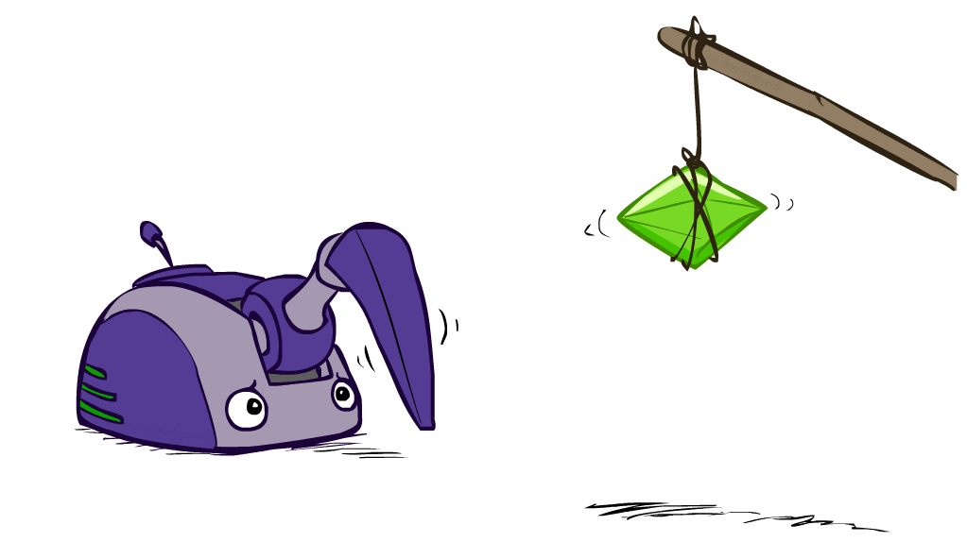
AI: Representation and Problem Solving
Reinforcement Learning
Instructor: Pat Virtue
Slide credits: CMU AI and http://ai.berkeley.edu

Slide 4
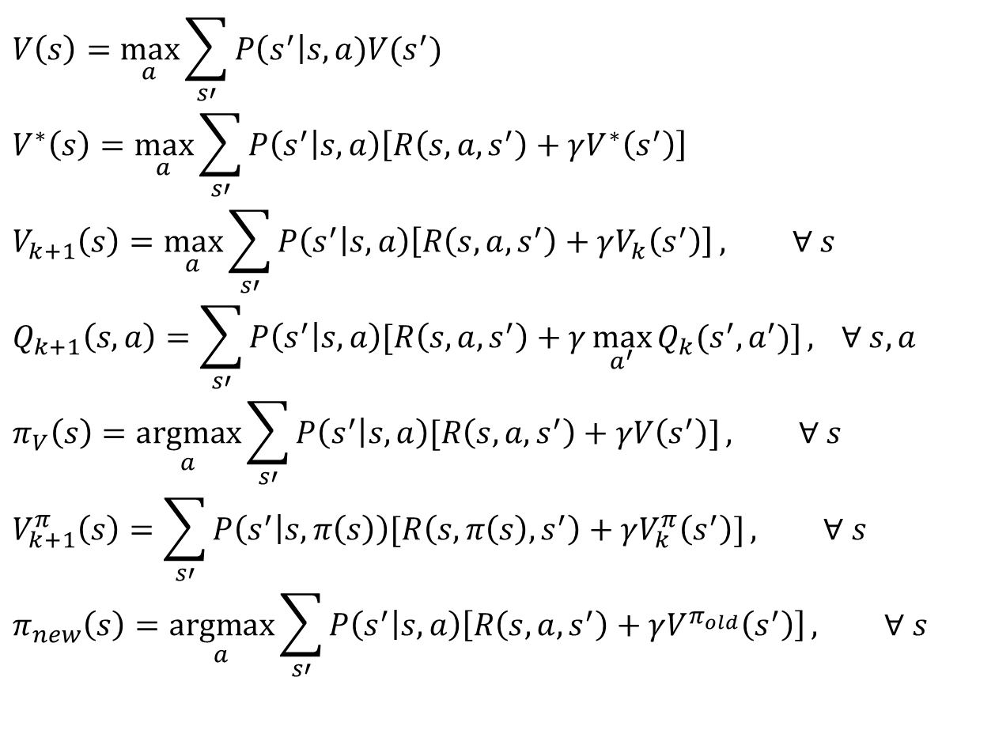
MDP Notation
$$V\left(s\right)=\max_{a}{\sum_{s′}{P\left(s^{′}\right|s,a)V(s^{′})}}$$
$$V^{∗}\left(s\right)=\max_{a}{\sum_{s′}{P\left(s^{′} | s,a\right)\left[R\left(s,a,s^{′}\right)+γV^{∗}\left(s^{′}\right)\right]}}$$
$$V_{k+1}\left(s\right)=\max_{a}{\sum_{s′}{P\left(s^{′} | s,a\right)\left[R\left(s,a,s^{′}\right)+γV_{k}\left(s^{′}\right)\right]}}, ∀ s$$
$$Q_{k+1}\left(s,a\right)=\sum_{s′}{P\left(s^{′} | s,a\right)[R\left(s,a,s^{′}\right)+γ\max_{a^{′}}{Q_{k}(s^{′},a^{′})]}, } ∀ s,a$$
$$π_{V}\left(s\right)=\underset{a}{argmax}{\sum_{s′}{P\left(s^{′} | s,a\right)[R\left(s,a,s^{′}\right)+γV\left(s^{′}\right)]}}, ∀ s$$
$$V_{k+1}^{π}\left(s\right)=\sum_{s′}{P\left(s^{′} | s,π\left(s\right)\right)[R\left(s,π\left(s\right),s^{′}\right)+γV_{k}^{π}\left(s^{′}\right)]}, ∀ s$$
$$π_{new}\left(s\right)=\underset{a}{argmax}{\sum_{s′}{P\left(s^{′} | s,a\right)\left[R\left(s,a,s^{′}\right)+γV^{π_{old}}\left(s^{′}\right)\right]}}, ∀ s$$
Standard expectimax:
Bellman equations:
Value iteration:
Q-iteration:
Policy extraction:
Policy evaluation:
Policy improvement:

Slide 5

Poll (unused)
Which of the following are used in policy iteration?
$$V_{k+1}\left(s\right)=\max_{a}{\sum_{s′}{P\left(s^{′} | s,a\right)\left[R\left(s,a,s^{′}\right)+γV_{k}\left(s^{′}\right)\right]}}, ∀ s$$
$$Q_{k+1}\left(s,a\right)=\sum_{s′}{P\left(s^{′} | s,a\right)[R\left(s,a,s^{′}\right)+γ\max_{a^{′}}{Q_{k}(s^{′},a^{′})]}, } ∀ s,a$$
$$π_{V}\left(s\right)=\underset{a}{argmax}{\sum_{s′}{P\left(s^{′} | s,a\right)[R\left(s,a,s^{′}\right)+γV\left(s^{′}\right)]}}, ∀ s$$
$$V_{k+1}^{π}\left(s\right)=\sum_{s′}{P\left(s^{′} | s,π\left(s\right)\right)[R\left(s,π\left(s\right),s^{′}\right)+γV_{k}^{π}\left(s^{′}\right)]}, ∀ s$$
$$π_{new}\left(s\right)=\underset{a}{argmax}{\sum_{s′}{P\left(s^{′} | s,a\right)\left[R\left(s,a,s^{′}\right)+γV^{π_{old}}\left(s^{′}\right)\right]}}, ∀ s$$
A. Value iteration:
B. Q-iteration:
C. Policy extraction:
D. Policy evaluation:
E. Policy improvement:

Slide 6

Poll (unused)
Which of the following are used in policy iteration?
$$V_{k+1}\left(s\right)=\max_{a}{\sum_{s′}{P\left(s^{′} | s,a\right)\left[R\left(s,a,s^{′}\right)+γV_{k}\left(s^{′}\right)\right]}}, ∀ s$$
$$Q_{k+1}\left(s,a\right)=\sum_{s′}{P\left(s^{′} | s,a\right)[R\left(s,a,s^{′}\right)+γ\max_{a^{′}}{Q_{k}(s^{′},a^{′})]}, } ∀ s,a$$
$$π_{V}\left(s\right)=\underset{a}{argmax}{\sum_{s′}{P\left(s^{′} | s,a\right)[R\left(s,a,s^{′}\right)+γV\left(s^{′}\right)]}}, ∀ s$$
$$V_{k+1}^{π}\left(s\right)=\sum_{s′}{P\left(s^{′} | s,π\left(s\right)\right)[R\left(s,π\left(s\right),s^{′}\right)+γV_{k}^{π}\left(s^{′}\right)]}, ∀ s$$
$$π_{new}\left(s\right)=\underset{a}{argmax}{\sum_{s′}{P\left(s^{′} | s,a\right)\left[R\left(s,a,s^{′}\right)+γV^{π_{old}}\left(s^{′}\right)\right]}}, ∀ s$$
A. Value iteration:
B. Q-iteration:
C. Policy extraction:
D. Policy evaluation:
E. Policy improvement:

Slide 7
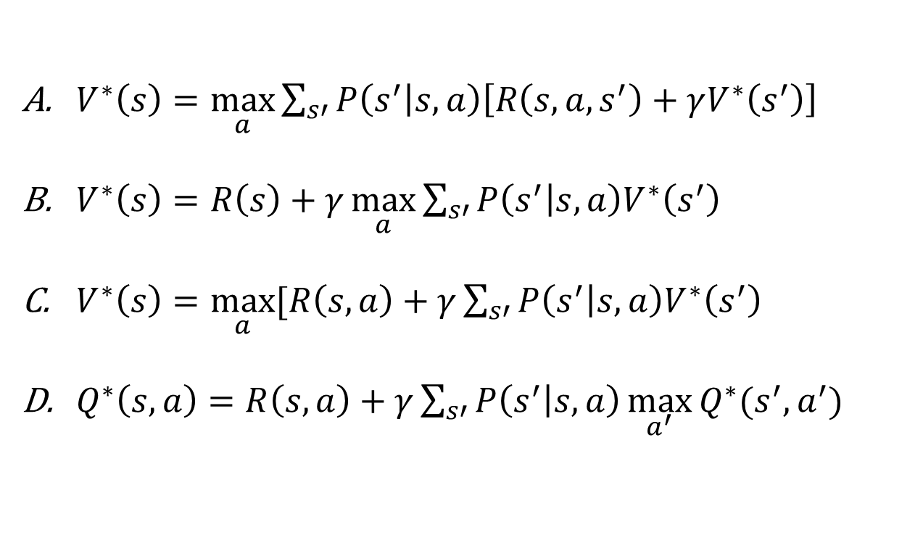
Poll (unused)
Rewards may depend on any combination of state, action, next state.
Which of the following are valid formulations of the Bellman equations?
$V^{∗}\left(s\right)=\max_{a}{\sum_{s′}{P\left(s^{′} | s,a\right)\left[R\left(s,a,s^{′}\right)+γV^{∗}\left(s^{′}\right)\right]}}$
$V^{∗}\left(s\right)=R\left(s\right)+γ\max_{a}{\sum_{s′}{P\left(s^{′} | s,a\right)V^{∗}\left(s^{′}\right)}}$
$V^{∗}\left(s\right)=\max_{a}{[R\left(s, a\right)+γ\sum_{s′}{P\left(s^{′} | s,a\right)V^{∗}\left(s^{′}\right)}}$
$Q^{∗}\left(s,a\right)=R\left(s, a\right)+γ\sum_{s′}{P\left(s^{′} | s,a\right)\max_{a^{′}}{Q^{∗}(s^{′},a^{′})} }$

Slide 8
Poll (unused)
Rewards may depend on any combination of state, action, next state.
Which of the following are valid formulations of the Bellman equations?
$V^{∗}\left(s\right)=\max_{a}{\sum_{s′}{P\left(s^{′} | s,a\right)\left[R\left(s,a,s^{′}\right)+γV^{∗}\left(s^{′}\right)\right]}}$
$V^{∗}\left(s\right)=R\left(s\right)+γ\max_{a}{\sum_{s′}{P\left(s^{′} | s,a\right)V^{∗}\left(s^{′}\right)}}$
$V^{∗}\left(s\right)=\max_{a}{[R\left(s, a\right)+γ\sum_{s′}{P\left(s^{′} | s,a\right)V^{∗}\left(s^{′}\right)}}$
$Q^{∗}\left(s,a\right)=R\left(s, a\right)+γ\sum_{s′}{P\left(s^{′} | s,a\right)\max_{a^{′}}{Q^{∗}(s^{′},a^{′})} }$

Slide 9
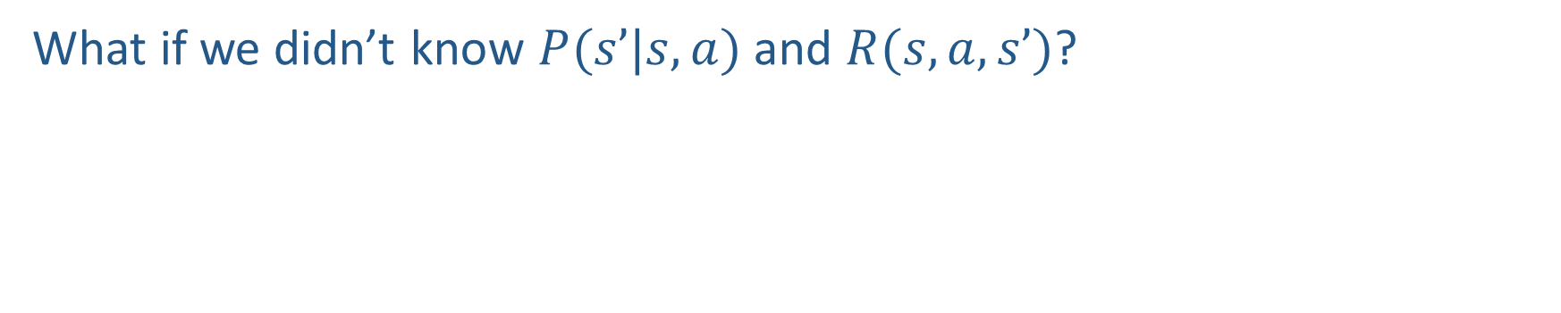
Reinforcement learning
What if we didn’t know $P(s’|s,a)$and $R(s,a,s’)$?
$$V_{k+1}\left(s\right)=\max_{a}{\sum_{s′}{P\left(s^{′} | s,a\right)\left[R\left(s,a,s^{′}\right)+γV_{k}\left(s^{′}\right)\right]}}, ∀ s$$
$$Q_{k+1}\left(s,a\right)=\sum_{s′}{P\left(s^{′} | s,a\right)[R\left(s,a,s^{′}\right)+γ\max_{a^{′}}{Q_{k}(s^{′},a^{′})]}, } ∀ s,a$$
$$π_{V}\left(s\right)=\underset{a}{argmax}{\sum_{s′}{P\left(s^{′} | s,a\right)[R\left(s,a,s^{′}\right)+γV\left(s^{′}\right)]}}, ∀ s$$
$$V_{k+1}^{π}\left(s\right)=\sum_{s′}{P\left(s^{′} | s,π\left(s\right)\right)[R\left(s,π\left(s\right),s^{′}\right)+γV_{k}^{π}\left(s^{′}\right)]}, ∀ s$$
$$π_{new}\left(s\right)=\underset{a}{argmax}{\sum_{s′}{P\left(s^{′} | s,a\right)\left[R\left(s,a,s^{′}\right)+γV^{π_{old}}\left(s^{′}\right)\right]}}, ∀ s$$
Value iteration:
Q-iteration:
Policy extraction:
Policy evaluation:
Policy improvement:

Slide 10
Reinforcement Learning
Agent
State: s
Reward: r
Actions: a
Environment
Basic idea:
All learning is based on observed samples of rewards and next states!
Receive feedback in the form of rewards
Must (learn to) act so as to maximize expected rewards
Notes:
Show robot-soccer learning to walk videos (UT Austin):
? Show snake robot:

Slide 11
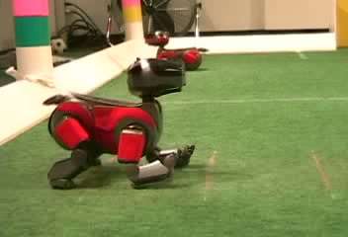
Example: Learning to Walk
Initial
[Kohl and Stone, ICRA 2004]
[Video: AIBO WALK – initial]

Slide 12
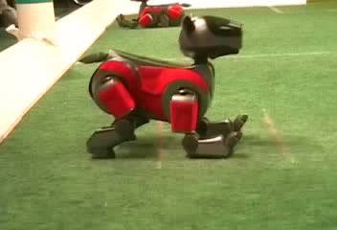
Example: Learning to Walk
Training
[Kohl and Stone, ICRA 2004]
[Video: AIBO WALK – training]

Slide 13
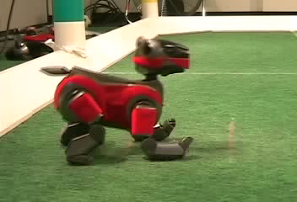
Example: Learning to Walk
Finished
[Kohl and Stone, ICRA 2004]
[Video: AIBO WALK – finished]

Slide 14
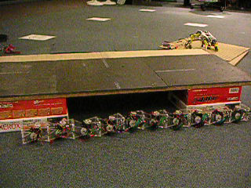
Example: Sidewinding
[Andrew Ng]
[Video: SNAKE – climbStep+sidewinding]

Slide 15

Example: Toddler Robot
[Tedrake, Zhang and Seung, 2005]
[Video: TODDLER – 40s]
Notes:
MIT

Slide 16
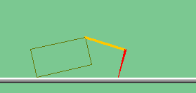
The Crawler!
[Demo: Crawler Bot (L10D1)] [You, in Project 3]
Notes:
At times no reward accumulated at all, just sitting still

Slide 17
Demo Crawler Bot

Slide 18
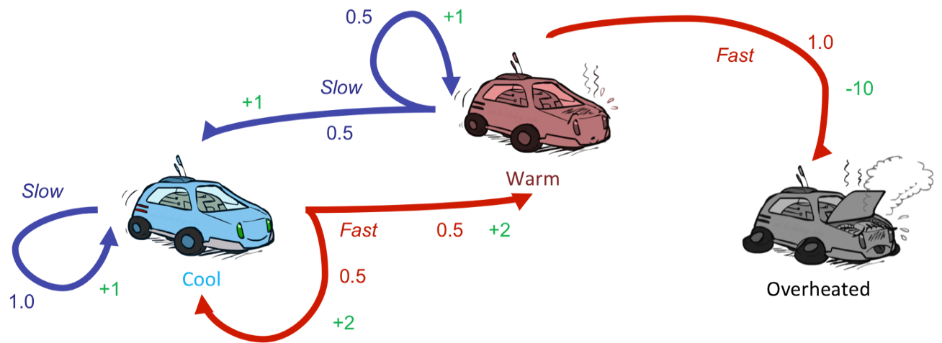
Reinforcement Learning
Still assume a Markov decision process (MDP):
A set of states s ∈ S
A set of actions (per state) A
A model T(s,a,s’)
A reward function R(s,a,s’)
Still looking for a policy π(s)
New twist: don’t know T or R
I.e. we don’t know which states are good or what the actions do
Must actually try actions and states out to learn

Slide 19
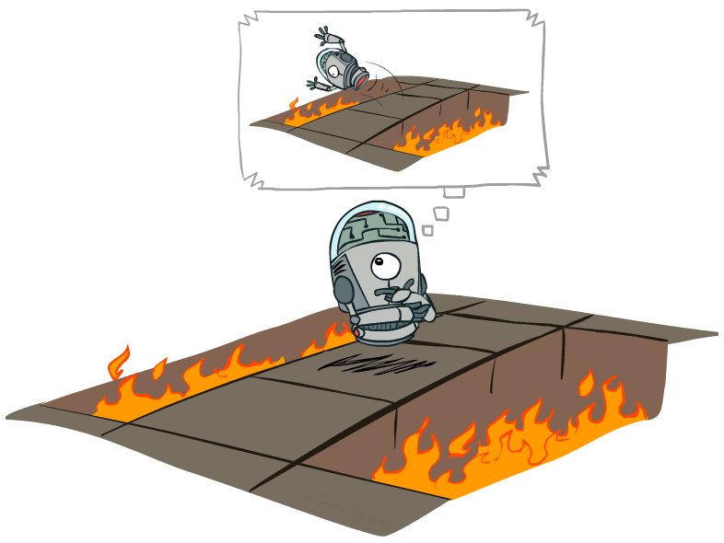
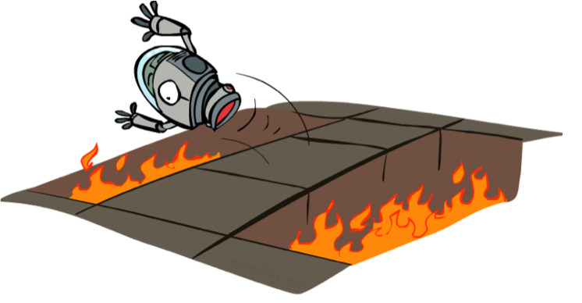
Offline (MDPs) vs. Online (RL)
Offline Solution
(Known MDP)
Online Learning
(Unknown MDP)

Slide 20
Overview: MDPs and Reinforcement Learning
Known MDP: Offline Solution
Value Iteration / Policy Iteration
Unknown MDP: Online Learning
Model-Based
Model-Free
Estimate MDP T(s,a,s') and R(s,a,s')
from samples of environment
Passive Reinforcement Learning
Direct Evaluation (simple)
TD Learning
Active Reinforcement Learning
Q-Learning

Slide 21

Online Learning Model-based Learning

Slide 22




Model-Based Learning
Model-Based Idea:
Learn an approximate model based on experiences
Solve for values as if the learned model were correct
Step 1: Learn empirical MDP model
Count outcomes s’ for each s, a
Normalize to give an estimate of
Discover each when we experience (s, a, s’)
Step 2: Solve the learned MDP
For example, use value iteration, as before

Slide 23
Example: Model-Based Learning
Episode: a sequence of states actions and rewards sampled from the environment
Input Policy π
Observed Episodes (Training)
Learned Model
Episode 1
Episode 2
T(s,a,s’).
T(B, east, C) =
T(C, east, D) =
T(C, east, A) =
…
R(s,a,s’).
R(B, east, C) =
R(C, east, D) =
R(D, exit, x) =
…
 | A
B | C | D
 | E
B, east, C, -1
C, east, D, -1
D, exit, x, +10
B, east, C, -1
C, east, D, -1
D, exit, x, +10
Episode 3
Episode 4
E, north, C, -1
C, east, D, -1
D, exit, x, +10
E, north, C, -1
C, east, A, -1
A, exit, x, -10
Assume: γ = 1

Slide 24
Example: Model-Based Learning
Input Policy π
Observed Episodes (Training)
Learned Model
Episode 1
Episode 2
T(s,a,s’).
T(B, east, C) = 1.00
T(C, east, D) = 0.75
T(C, east, A) = 0.25
…
R(s,a,s’).
R(B, east, C) = -1
R(C, east, D) = -1
R(D, exit, x) = +10
…
 | A
B | C | D
 | E
B, east, C, -1
C, east, D, -1
D, exit, x, +10
B, east, C, -1
C, east, D, -1
D, exit, x, +10
Episode 3
Episode 4
E, north, C, -1
C, east, D, -1
D, exit, x, +10
E, north, C, -1
C, east, A, -1
A, exit, x, -10
Assume: γ = 1

Slide 25
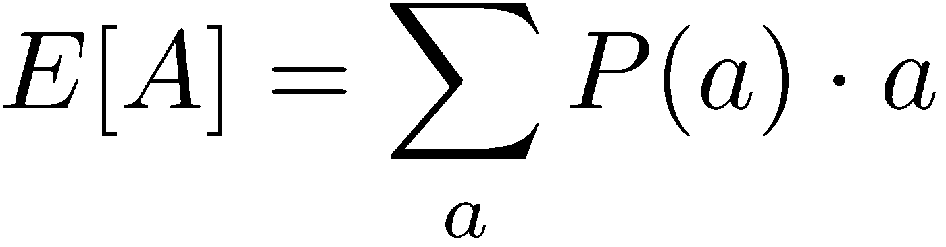
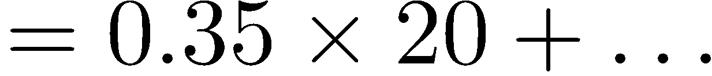
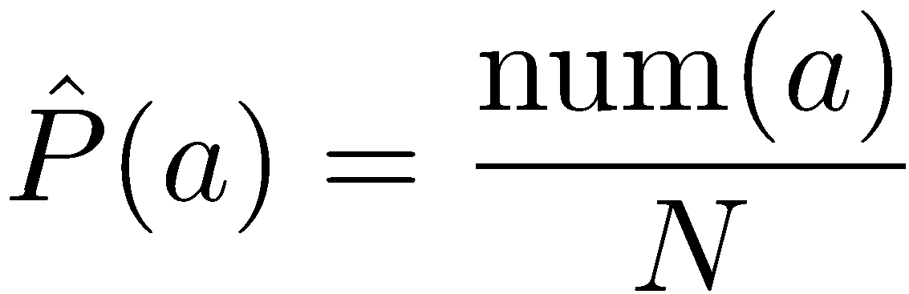
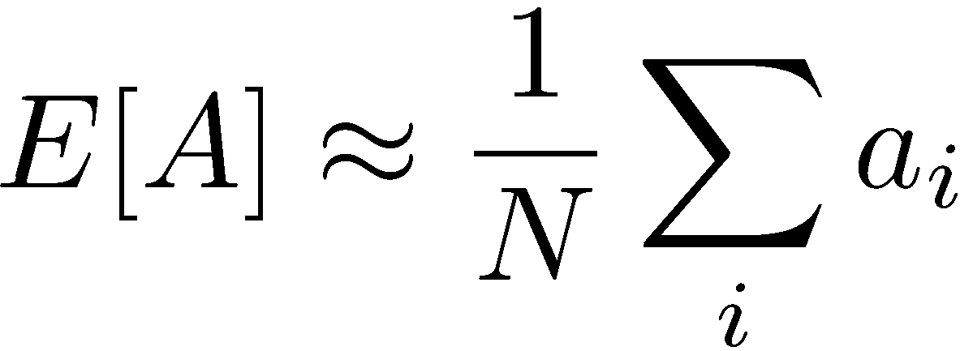
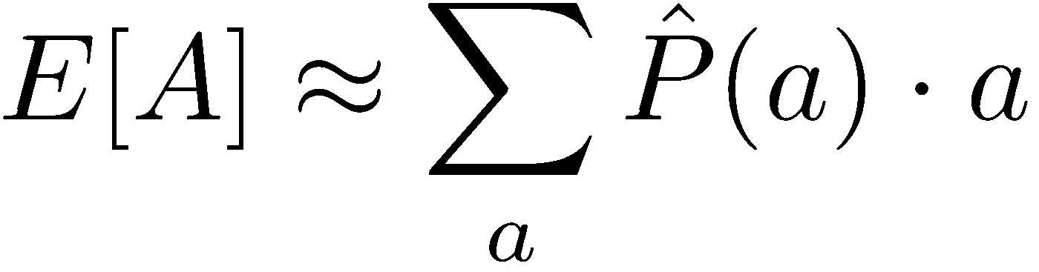
Example: Expected Age
Goal: Compute expected age of 15-281 students
Known P(A)
Without P(A), instead collect samples [a₁, a₂, … a_{N}]
Unknown P(A): “Model Based”
Unknown P(A): “Model Free”
Why does this work? Because samples appear with the right frequencies.

Slide 26
Overview: MDPs and Reinforcement Learning
Known MDP: Offline Solution
Value Iteration / Policy Iteration
Unknown MDP: Online Learning
Model-Based
Model-Free
Estimate MDP T(s,a,s') and R(s,a,s')
from samples of environment
Passive Reinforcement Learning
Direct Evaluation (simple)
TD Learning
Active Reinforcement Learning
Q-Learning

Slide 27
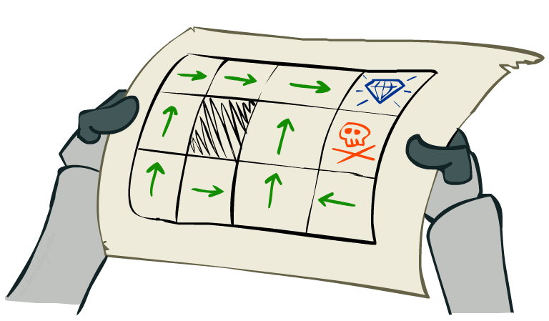
Online Learning Model-free Learning Passive Reinforcement Learning

Slide 28
Passive Reinforcement Learning
Simplified task: policy evaluation
Input: a fixed policy π(s)
You don’t know the transitions T(s,a,s’)
You don’t know the rewards R(s,a,s’)
Goal: learn the state values
In this case:
Learner is “along for the ride”
No choice about what actions to take
Just execute the policy and learn from experience
This is NOT offline planning! You actually take actions in the world.

Slide 29
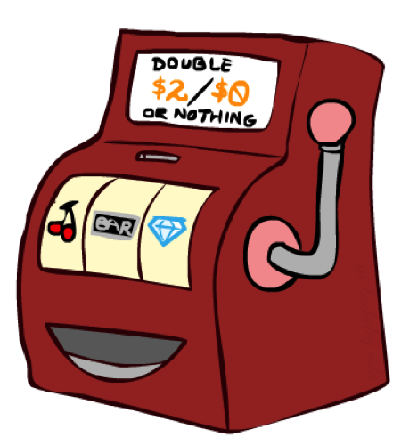
Simple Passive Learning: Direct Evaluation
Goal: Compute values for each state under π
Idea: Average together observed sample values
Act according to π
Every time you visit a state, write down what the sum of discounted rewards turned out to be
Average those samples
This is called direct evaluation

Slide 30
Simple Passive Learning: Direct Evaluation
Goal: Compute values for each state under π
Idea: Average together observed sample values
Act according to π
Every time you visit a state, write down what the sum of discounted rewards turned out to be
Average those samples
This is called direct evaluation
Pieces Available | Take 1 | Take 2
2 | 0% | 100%
3 | 2% | 0%
4 | 75% | 2%
5 | 4% | 68%
6 | 5% | 6%
7 | 60% | 5%

Slide 31
Example: Direct Evaluation
Input Policy π
Observed Episodes (Training)
Output Values
Episode 1
Episode 2
 | A
B | C | D
 | E
 | A
B | C | D
 | E
B, east, C, -1
C, east, D, -1
D, exit, x, +10
B, east, C, -1
C, east, D, -1
D, exit, x, +10
-10
+8
+4
+10
Episode 3
Episode 4
-2
E, north, C, -1
C, east, D, -1
D, exit, x, +10
E, north, C, -1
C, east, A, -1
A, exit, x, -10
Assume: γ = 1

Slide 32
Problems with Direct Evaluation
What’s good about direct evaluation?
It’s easy to understand
It doesn’t require any knowledge of T, R
It eventually computes the correct average values, using just sample transitions
What bad about it?
It wastes information about state connections
Each state must be learned separately
So, it takes a long time to learn
Output Values
 | A
B | C | D
 | E
-10
+8
+4
+10
-2
If B and E both go to C under this policy, how can their values be different?

Slide 33
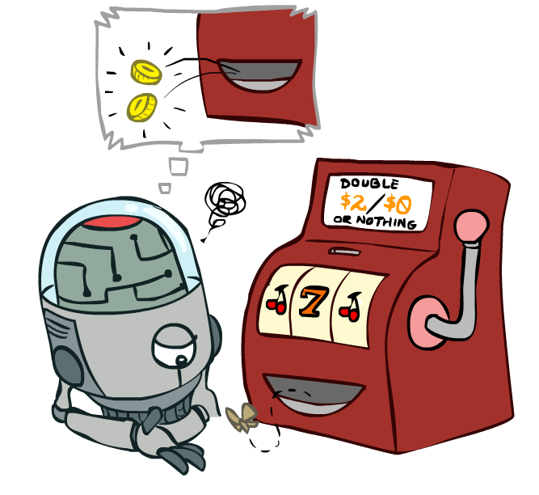
Online Learning Model-free Learning Passive Reinforcement Learning Temporal Difference Learning

Slide 34

Why Not Use Policy Evaluation?
s
Simplified Bellman updates calculate V for a fixed policy:
Each round, replace V with a one-step-look-ahead layer over V
This approach fully exploited the connections between the states
Unfortunately, we need T and R to do it!
Key question: How can we do this update to V without knowing T and R?
In other words, how to we take a weighted average without knowing the weights?
π(s)
s, π(s)
s, π(s),s’
s’

Slide 35
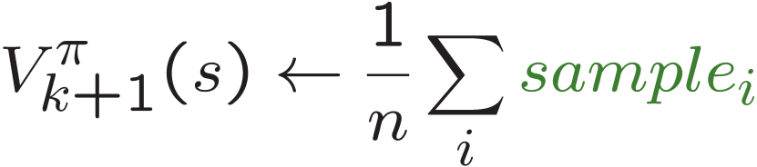
Sample-Based Policy Evaluation?
We want to improve our estimate of V by computing these averages:
Idea: Take samples of outcomes s’ (by doing the action!) and average
s
π(s)
s, π(s)
s, π(s),s’
s₁'
s₂'
s'
s₃'
Almost! But we can’t rewind time to get sample after sample from state s.

Slide 36
Temporal Difference Learning
s
Big idea: learn from every experience!
Update V(s) each time we experience a transition (s, a, s’, r)
Likely outcomes s’ will contribute updates more often
Temporal difference learning of values
Policy still fixed, still doing evaluation!
Move values toward value of whatever successor occurs: running average
π(s)
s, π(s)
s’
Sample of V(s):
Update to V(s):

Slide 37
Temporal Difference Learning
s
Big idea: learn from every experience!
Update V(s) each time we experience a transition (s, a, s’, r)
Likely outcomes s’ will contribute updates more often
Temporal difference learning of values
Policy still fixed, still doing evaluation!
Move values toward value of whatever successor occurs: running average
π(s)
s, π(s)
s’
Sample of V(s):
Update to V(s):
Same update:

Slide 38

Exponential Moving Average
Exponential moving average
The running interpolation update:
Makes recent samples more important:
Forgets about the past (distant past values were wrong anyway)
Decreasing learning rate (alpha) can give converging averages

Slide 39
Example: Temporal Difference Learning
States
Observed Transitions
B, east, C, -2
C, east, D, -2
 | A
B | C | D
 | E
 | 0
0 | 0 | 8
 | 0
 | 0
-1 | 0 | 8
 | 0
 | 0
-1 | 3 | 8
 | 0
Assume: γ = 1, α = 1/2

Slide 40
Example: Temporal Difference Learning
States
Observed Transitions
B, east, C, -2
C, east, D, -2
 | A
B | C | D
 | E
 | 0
0 | 0 | 8
 | 0
 | 0
-1 | 0 | 8
 | 0
 | 0
-1 | 3 | 8
 | 0
Assume: γ = 1, α = 1/2

Slide 41
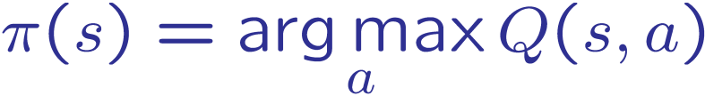
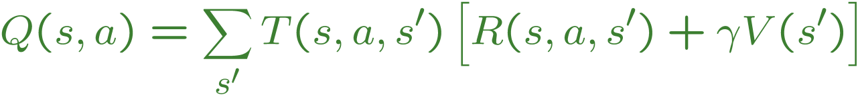
Problems with TD Value Learning
TD value leaning is a model-free way to do policy evaluation, mimicking Bellman updates with running sample averages
However, if we want to turn values into a (new) policy, we’re sunk:
Idea: learn Q-values, not values
Makes action selection model-free too!
s
a
s, a
s,a,s’
s’

Slide 42
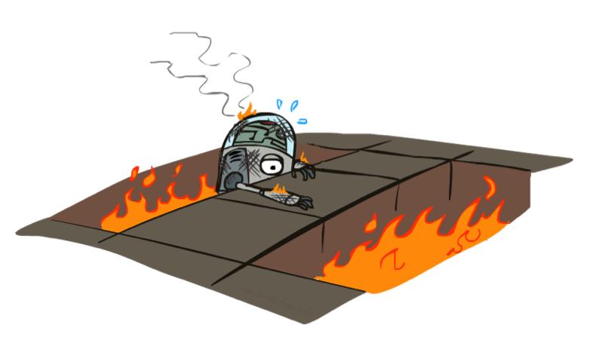
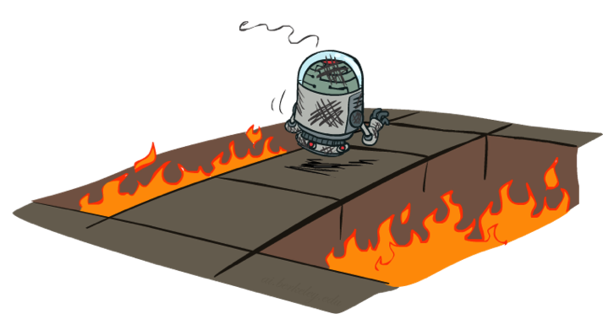
Online Learning Model-free Learning Active Reinforcement Learning Q-learning

Slide 43
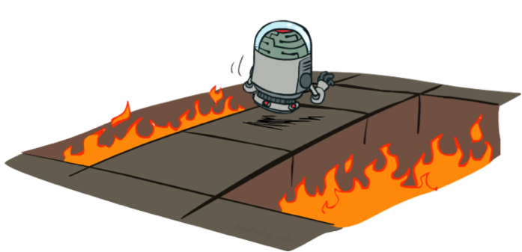
Active Reinforcement Learning
Full reinforcement learning: optimal policies (like value iteration)
You don’t know the transitions T(s,a,s’)
You don’t know the rewards R(s,a,s’)
You choose the actions now
Goal: learn the optimal policy / values
In this case:
Learner makes choices!
Fundamental tradeoff: exploration vs. exploitation
This is NOT offline planning! You actually take actions in the world and find out what happens…

Slide 44
Detour: Q-Value Iteration
Value iteration: find successive (depth-limited) values
Start with V₀(s) = 0, which we know is right
Given V_{k}, calculate the depth k+1 values for all states:
But Q-values are more useful, so compute them instead
Start with Q₀(s,a) = 0, which we know is right
Given Q_{k}, calculate the depth k+1 q-values for all q-states:

Slide 45

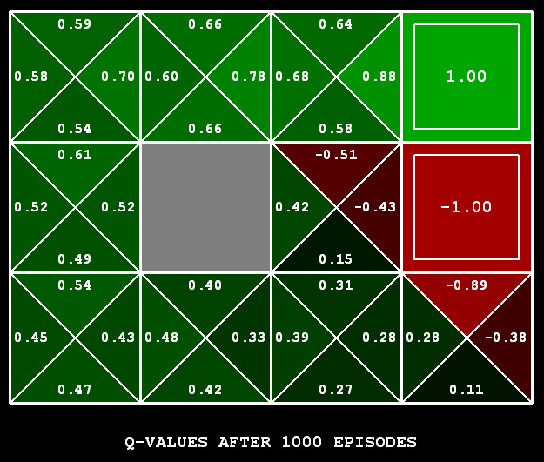
Q-Learning
Q-Learning: sample-based Q-value iteration
Learn Q(s,a) values as you go
Receive a sample (s,a,s’,r)
Consider your old estimate:
Consider your new sample estimate:
Incorporate the new estimate into a running average:
[Demo: Q-learning – gridworld (L10D2)]
[Demo: Q-learning – crawler (L10D3)]

Slide 46
Demo Q-Learning -- Gridworld

Slide 47
Demo Q-Learning -- Crawler

Slide 48

Q-Learning Properties
Amazing result: Q-learning converges to optimal policy -- even if you’re acting suboptimally!
This is called off-policy learning
Caveats:
You have to explore enough
You have to eventually make the learning rate
small enough
… but not decrease it too quickly
Basically, in the limit, it doesn’t matter how you select actions (!)

