Slide 1
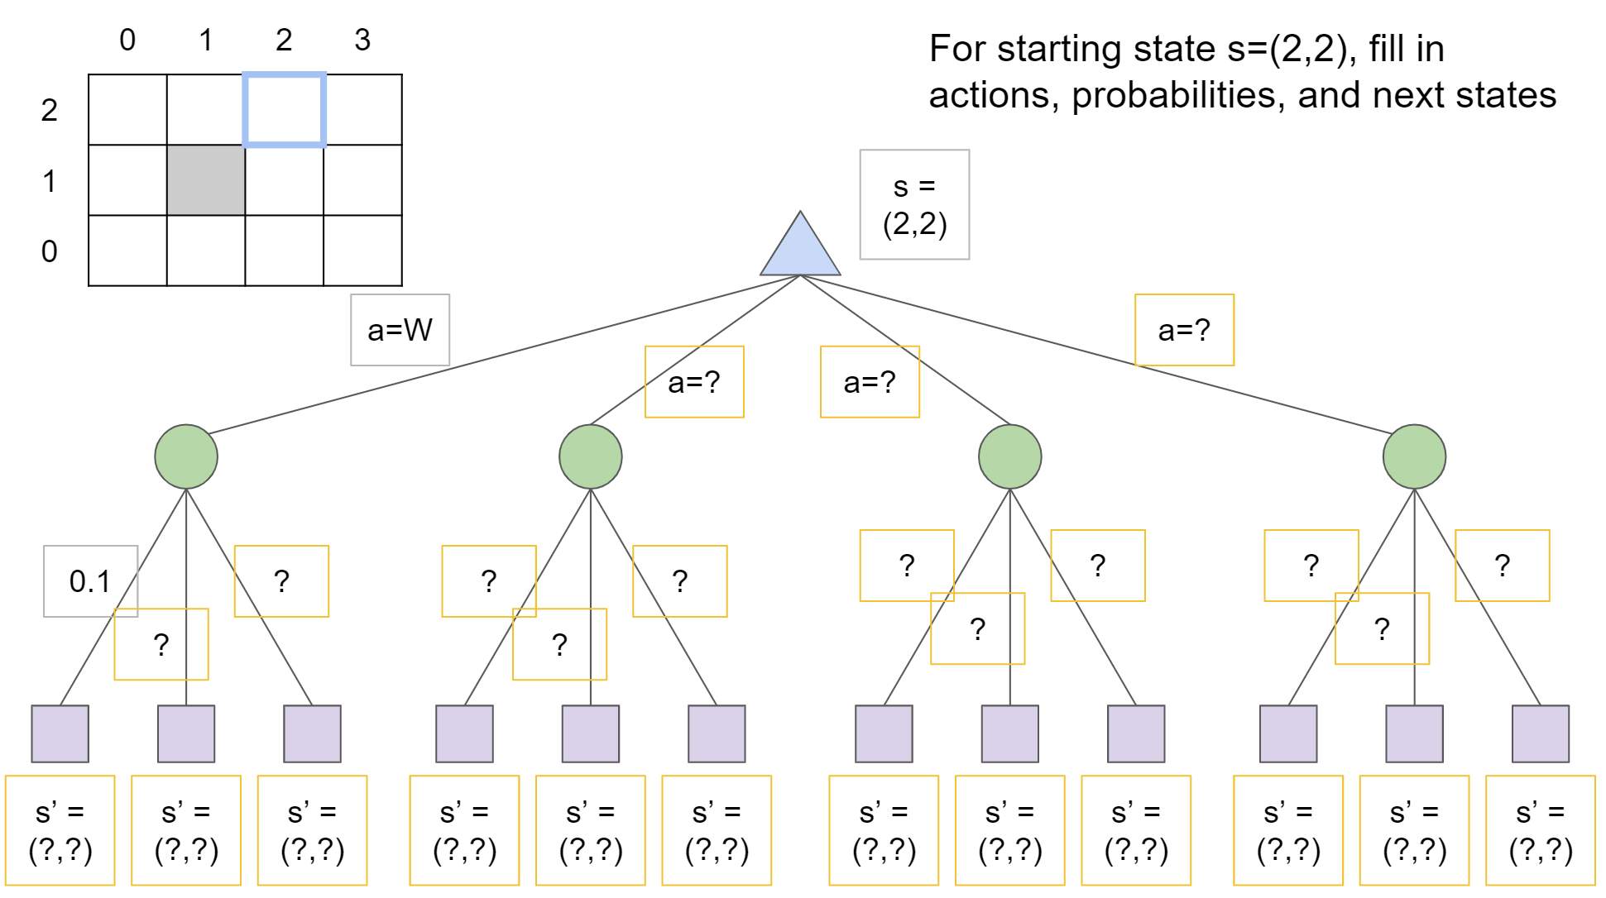
Warm-up as you walk in: Grid World

Slide 2
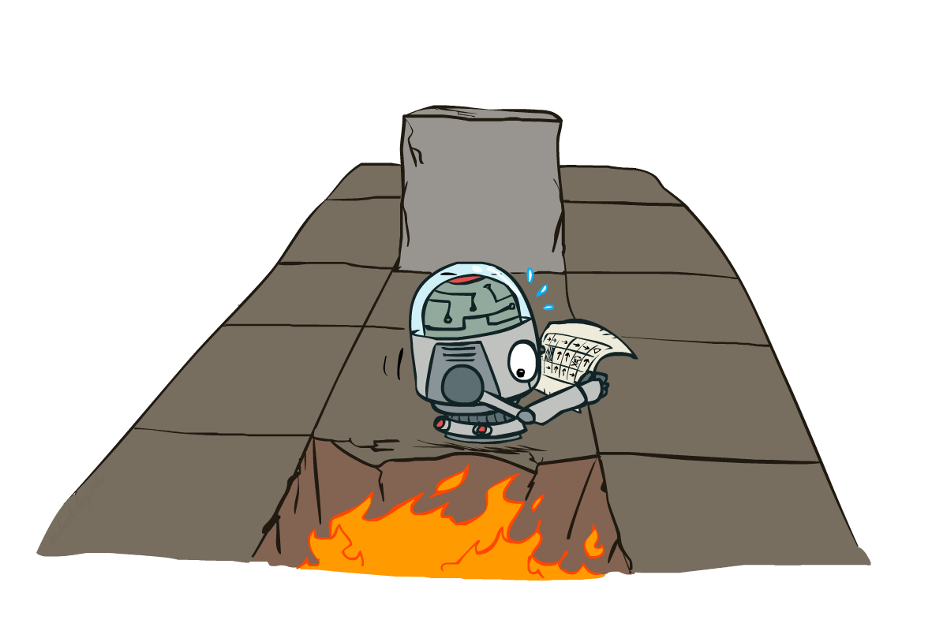
AI: Representation and Problem Solving
Markov Decision Processes II
Instructor: Pat Virtue
Slide credits: CMU AI and http://ai.berkeley.edu

Slide 3
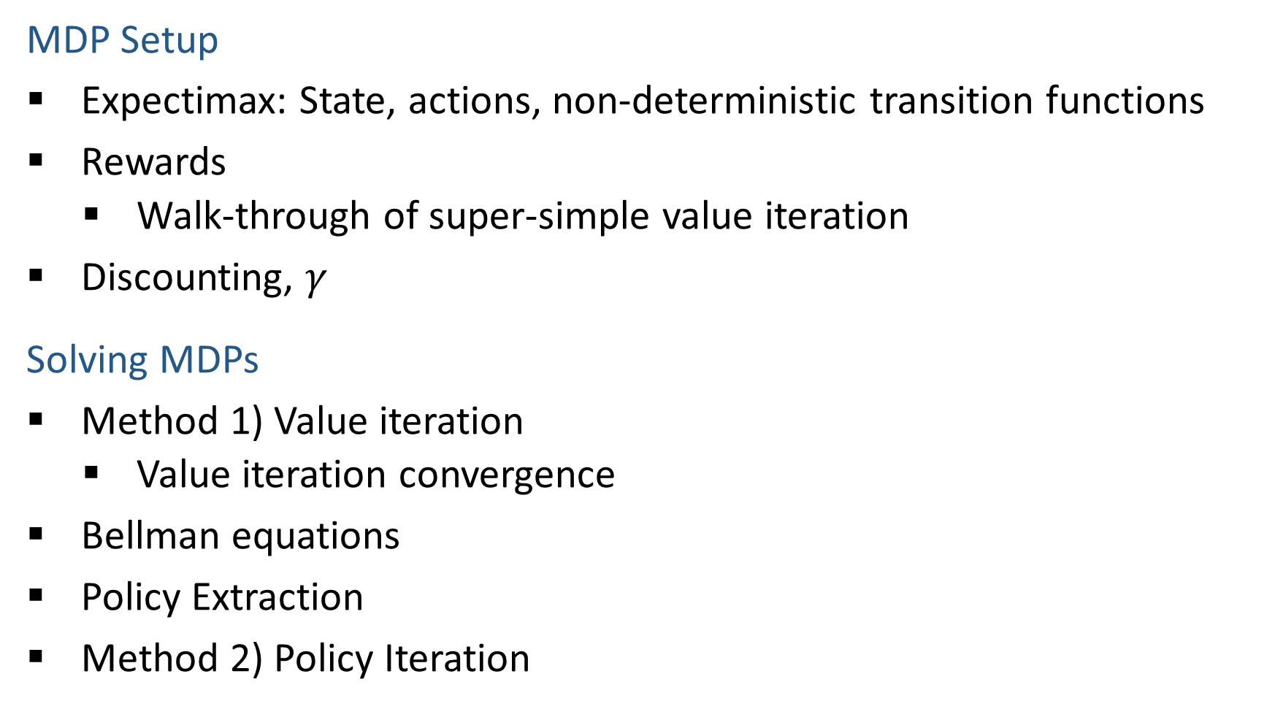
Outline
MDP Setup
Expectimax: State, actions, non-deterministic transition functions
Rewards
Walk-through of super-simple value iteration
Discounting, $γ$
Solving MDPs
Method 1) Value iteration
Value iteration convergence
Bellman equations
Policy Extraction
Method 2) Policy Iteration
A | B | C | D | E

Slide 4
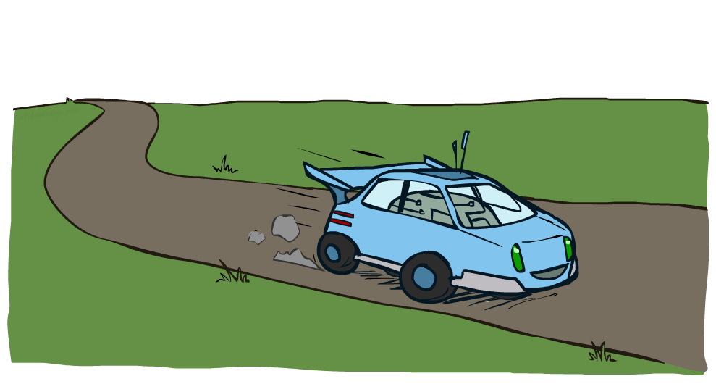
MDP Example: Racing

Slide 5
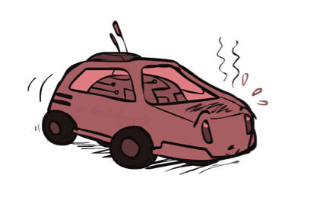
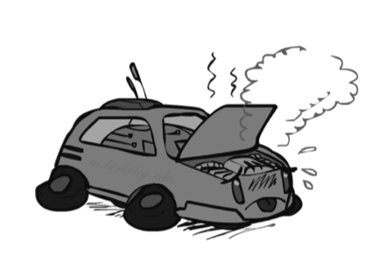

MDP Example: Racing
A robot car wants to travel far, quickly
Three states: Cool, Warm, Overheated
Two actions: Slow, Fast
Going faster gets double reward
1.0
0.5
Fast
(r=-10)
0.5
+1
Slow (r=1)
1.0
Fast
Slow
-10
0.5
+1
0.5
Slow (r=1)
Warm
Slow
Fast
0.5
+2
Fast
(r=2)
0.5
Cool
0.5
Overheated
+1
1.0
1.0
+2
0.5

Slide 6




Racing Search Tree

Slide 7
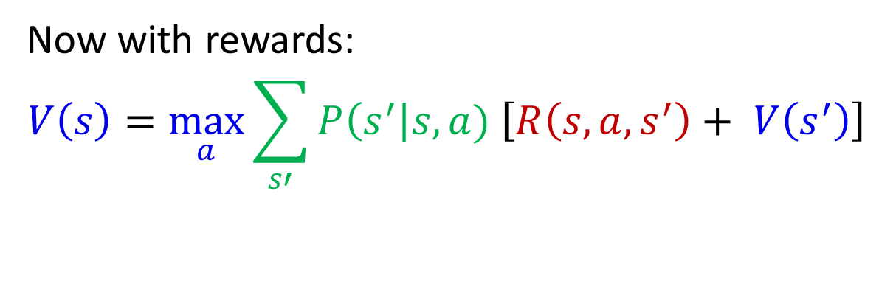
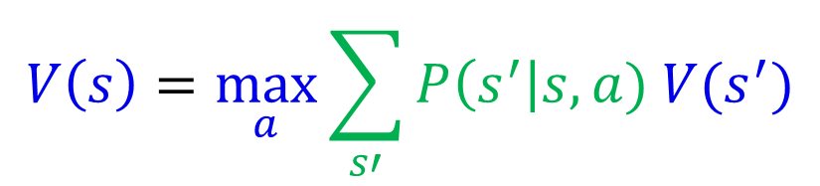
Recursive Expectimax
$$V\left(s\right)=\max_{a}{\sum_{s′}{P\left(s^{′}\right|s,a) V(s^{′})}}$$
Now with rewards:
$$V\left(s\right)=\max_{a}{\sum_{s′}{P\left(s^{′}\right|s,a) \left[R\left(s, a, s^{′}\right)+ V\left(s^{′}\right)\right]}}$$
s
a
s, a
s,a,s’
s’

Slide 8
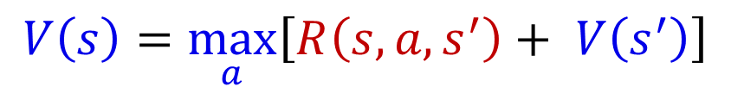
Simple Deterministic Example
T (Terminal)
R(A, Exit, T) = 10
R(A, Exit, T) = 1
Actions: B, C, D: East, West
Actions: A, E: Exit
Transitions: deterministic
Rewards only for transitioning to terminal state
A | B | C | D | E
$$V\left(s\right)=\max_{a}\left[R\left(s, a, s^{′}\right)+ V\left(s^{′}\right)\right]$$

Slide 9
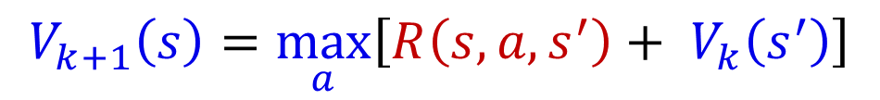
Simple Deterministic Example
T (Terminal)
R(A, Exit, T) = 10
R(A, Exit, T) = 1
Actions: B, C, D: East, West
Actions: A, E: Exit
Transitions: deterministic
Rewards only for transitioning to terminal state
A | B | C | D | E
$$V_{k+1}\left(s\right)=\max_{a}\left[R\left(s, a, s^{′}\right)+ V_{k}\left(s^{′}\right)\right]$$

Slide 10
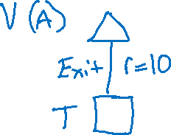
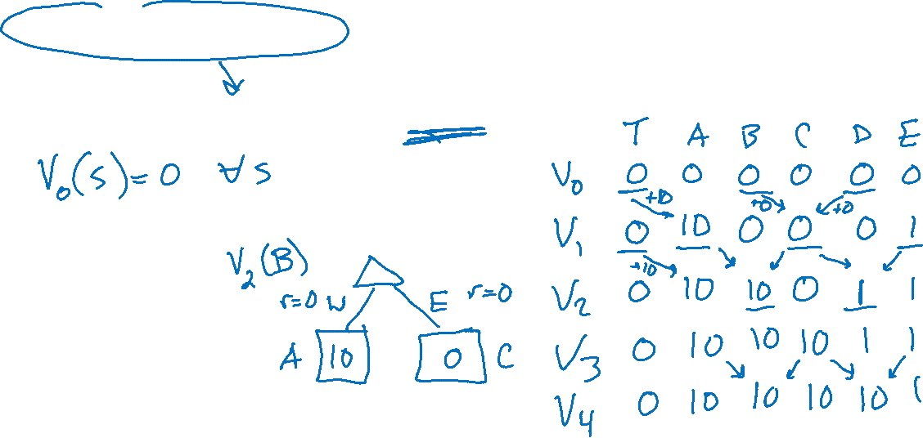
Simple Deterministic Example
T (Terminal)
R(A, Exit, T) = 10
R(A, Exit, T) = 1
Actions: B, C, D: East, West
Actions: A, E: Exit
Transitions: deterministic
Rewards only for transitioning to terminal state
A | B | C | D | E
$$V_{k+1}\left(s\right)=\max_{a}\left[R\left(s, a, s^{′}\right)+ V_{k}\left(s^{′}\right)\right]$$

Slide 11
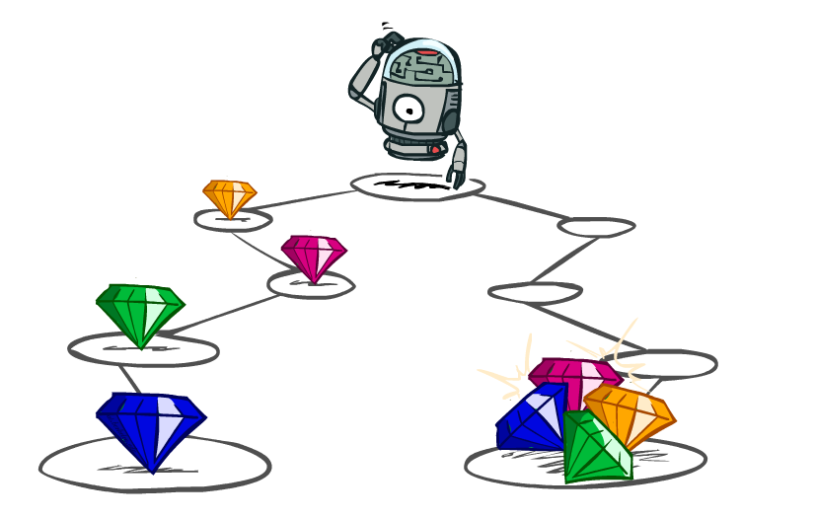
Utilities of Sequences

Slide 12
Utilities of Sequences
What preferences should an agent have over reward sequences?
More or less?
Now or later?
[1, 2, 2]
or
[2, 3, 4]
[0, 0, 1]
or
[1, 0, 0]

Slide 13

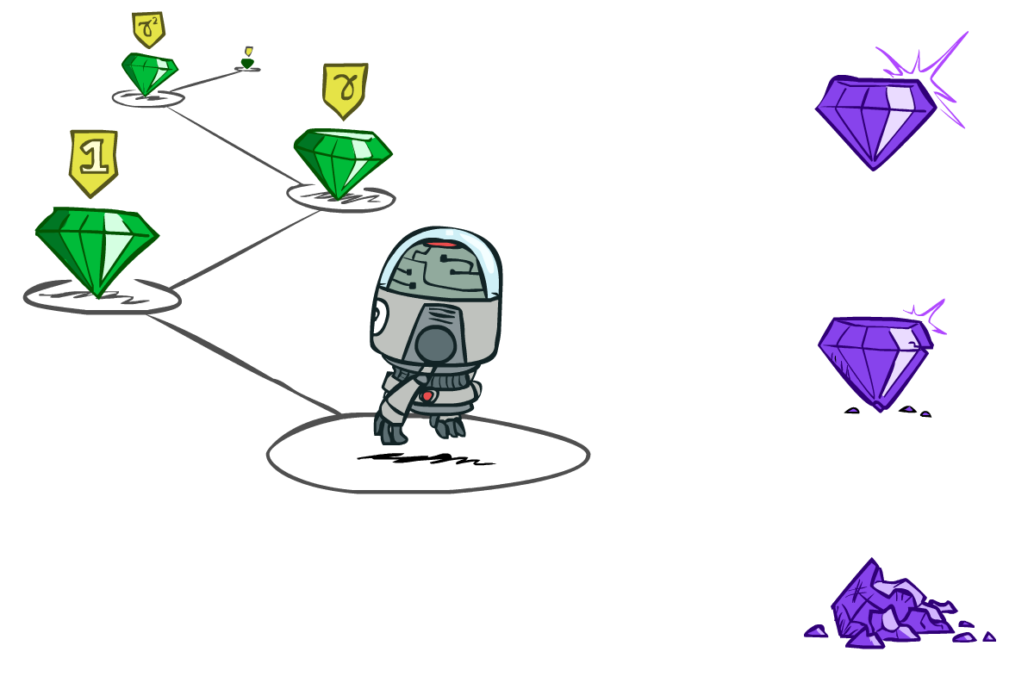

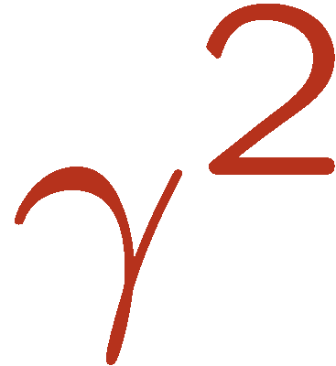

Discounting
It’s reasonable to maximize the sum of rewards
It’s also reasonable to prefer rewards now to rewards later
One solution: values of rewards decay exponentially
Worth Now
Worth Next Step
Worth In Two Steps

Slide 14

Discounting
How to discount?
Each time we descend a level, we multiply in the discount once
Why discount?
Sooner rewards probably do have higher utility than later rewards
Also helps our algorithms converge
Important: use 0 < γ < 1
Notes:
Rewards in the future (deeper in the tree) matter less
Interesting: running expectimax, if having to truncate the search, then not losing much; e.g., less then \gamma^d / (1-\gamma)

Slide 15
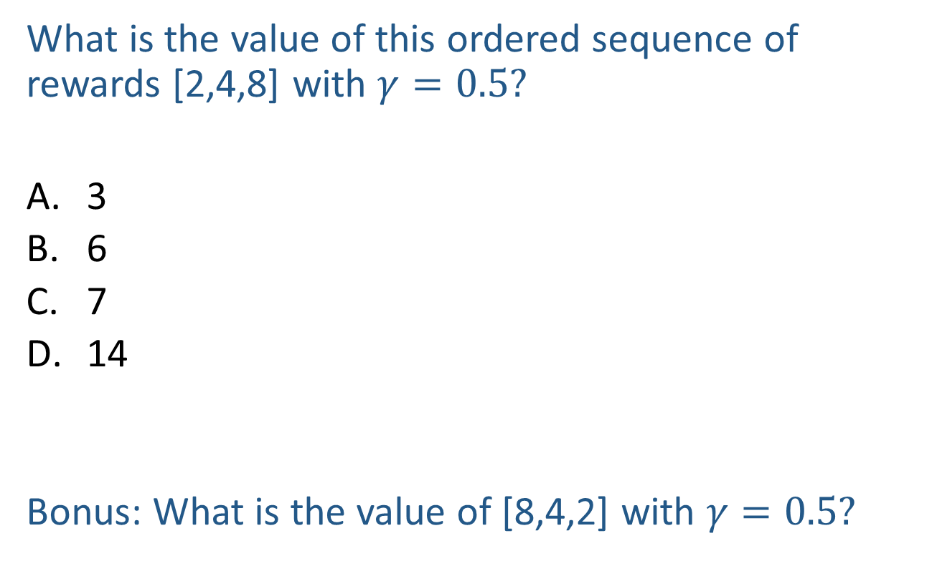
Poll
What is the value of this ordered sequence of rewards [2,4,8] with $γ=0.5?$
3
6
7
14
Bonus: What is the value of [8,4,2] with $γ=0.5?$
Notes:
Rewards in the future (deeper in the tree) matter less
Interesting: running expectimax, if having to truncate the search, then not losing much; e.g., less then \gamma^d / (1-\gamma)

Slide 16
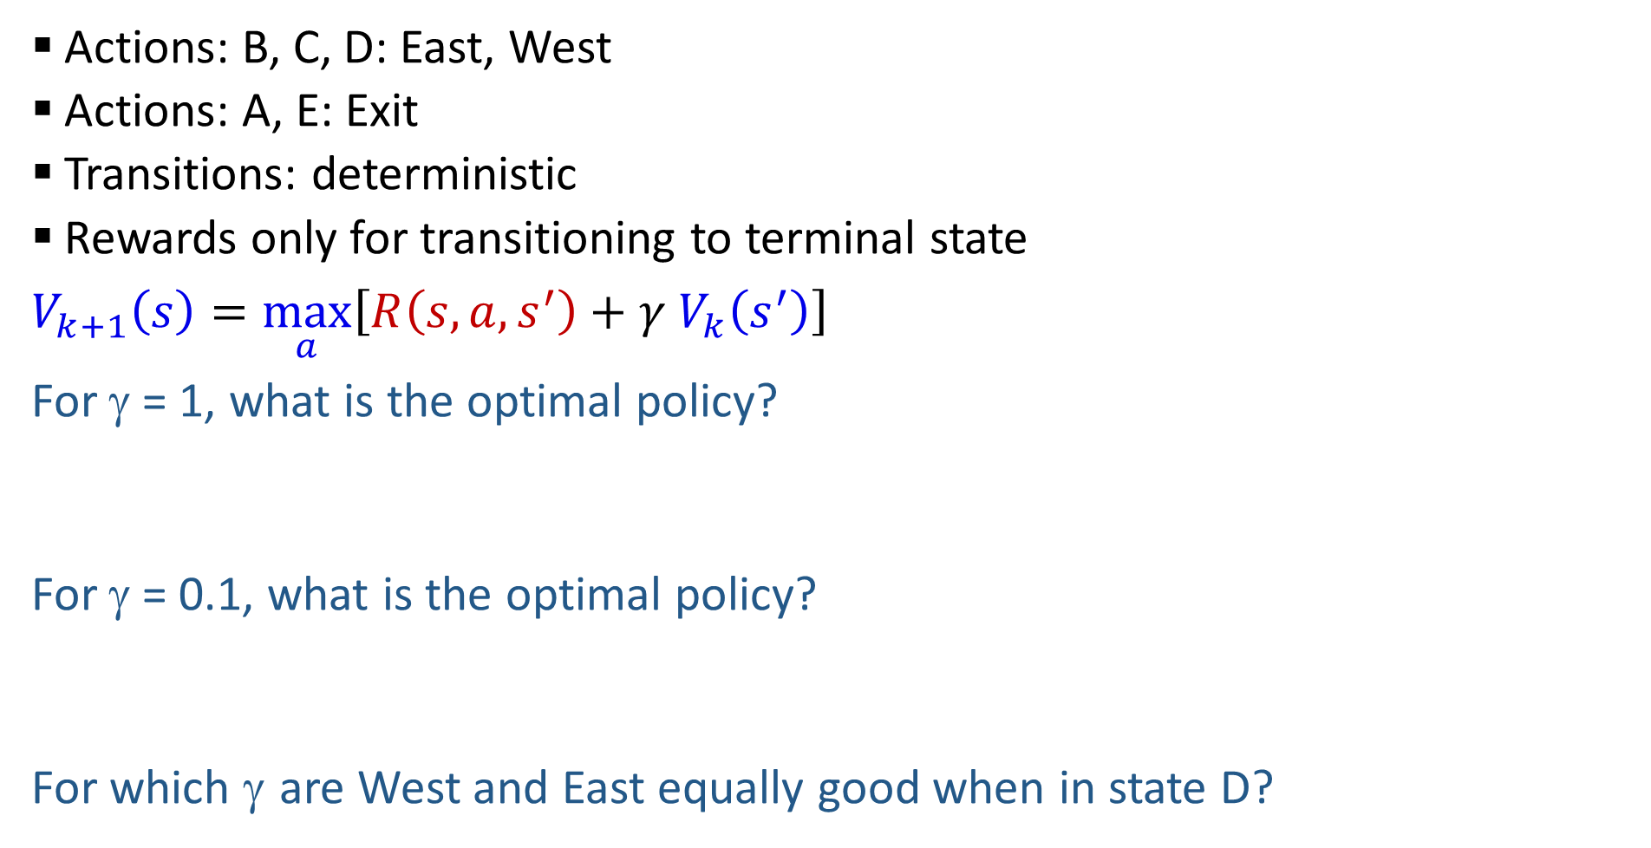
Discounting
T (Terminal)
R(A, Exit, T) = 10
R(A, Exit, T) = 1
Actions: B, C, D: East, West
Actions: A, E: Exit
Transitions: deterministic
Rewards only for transitioning to terminal state
$V_{k+1}\left(s\right)=\max_{a}\left[R\left(s, a, s^{′}\right)+γ V_{k}\left(s^{′}\right)\right]$
For γ = 1, what is the optimal policy?
For γ = 0.1, what is the optimal policy?
For which γ are West and East equally good when in state D?
A | B | C | D | E

Slide 17
Discounting
T (Terminal)
R(A, Exit, T) = 10
R(A, Exit, T) = 1
Actions: B, C, D: East, West
Actions: A, E: Exit
Transitions: deterministic
Rewards only for transitioning to terminal state
$V_{k+1}\left(s\right)=\max_{a}\left[R\left(s, a, s^{′}\right)+γ V_{k}\left(s^{′}\right)\right]$
For γ = 1, what is the optimal policy?
For γ = 0.1, what is the optimal policy?
For which γ are West and East equally good when in state D?
A | B | C | D | E

Slide 18

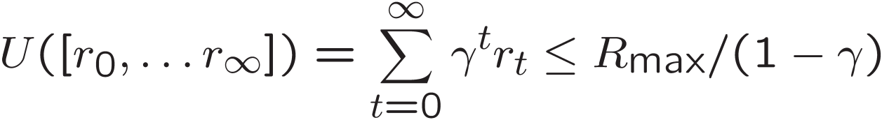
Infinite Utilities?!
Problem: What if the game lasts forever? Do we get infinite rewards?
Solutions:
Finite horizon: (similar to depth-limited search)
Terminate episodes after a fixed T steps (e.g. life)
Discounting: use 0 < γ < 1
Smaller γ means smaller “horizon” → shorter term focus
Absorbing state: guarantee that for every policy, a terminal state will eventually be reached (like “overheated” for racing)

Slide 19
Recap: Defining MDPs
Markov decision processes:
Set of states S
Start state s₀
Set of actions A
Transitions P(s’|s,a) (or T(s,a,s’))
Rewards R(s,a,s’) (and discount γ)
MDP quantities so far:
Policy = Choice of action for each state
Utility = sum of (discounted) rewards
s
a
s, a
s,a,s’
s’

Slide 20

Solving MDPs

Slide 21
Optimal Quantities
The value (utility) of a state s:
V*(s) = expected utility starting in s and acting optimally
The value (utility) of a q-state (s,a):
Q*(s,a) = expected utility starting out having taken action a from state s and (thereafter) acting optimally
The optimal policy:
π*(s) = optimal action from state s
s
s is a state
a
(s, a) is a q-state
s, a
s,a,s’
(s,a,s’) is a transition
s’
[Demo – gridworld values (L8D4)]
Notes:
[Note: this demo doesn’t show anything in action, just pops up V and Q values.]

Slide 22
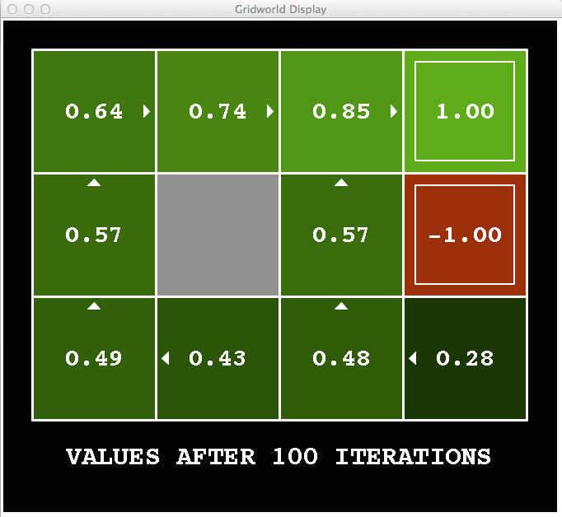
Snapshot of Demo – Gridworld V Values
Noise = 0.2
Discount = 0.9
Living reward = 0
Notes:
This demo doesn’t show anything in action, it just shows the V and Q values.

Slide 23
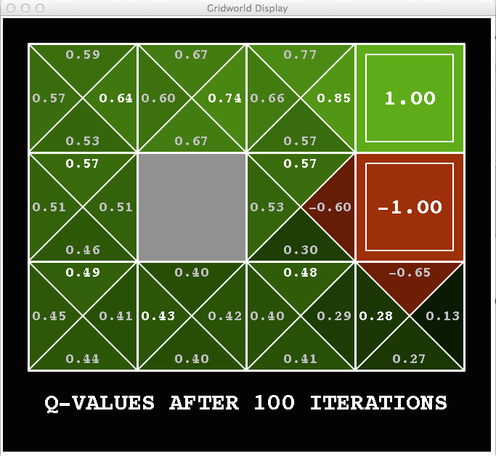
Snapshot of Demo – Gridworld Q Values
Noise = 0.2
Discount = 0.9
Living reward = 0
Notes:
This demo doesn’t show anything in action, it just shows the V and Q values.

Slide 24

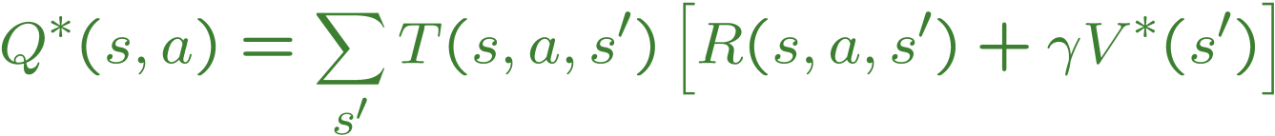
Values of States
Fundamental operation: compute the (expectimax) value of a state
Expected utility under optimal action
Average sum of (discounted) rewards
This is just what expectimax computed!
Recursive definition of value:
s
a
s, a
s,a,s’
s’

Slide 25
Racing Search Tree

Slide 26


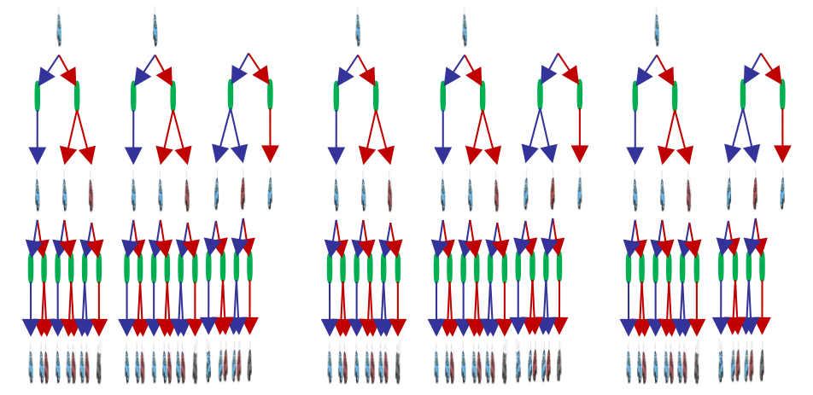

Racing Search Tree
We’re doing way too much work with expectimax!
Problem: States are repeated
Idea: Only compute needed quantities once
Problem: Tree goes on forever
Idea: Do a depth-limited computation, but with increasing depths until change is small
Note: deep parts of the tree eventually don’t matter if γ < 1

Slide 27


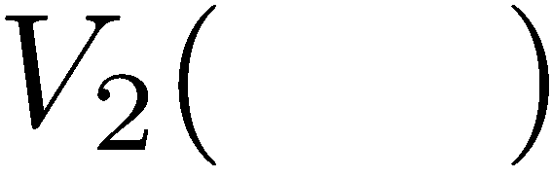


Time-Limited Values
Key idea: time-limited values
Define V_{k}(s) to be the optimal value of s if the game ends in k more time steps
Equivalently, it’s what a depth-k expectimax would give from s
[Demo – time-limited values (L8D6)]
Notes:
This demo generates the time-limited values for gridworld as snapshotted onto the next slides.

Slide 28
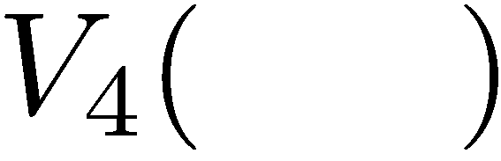

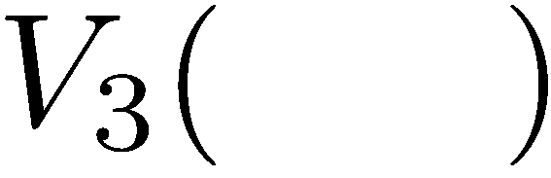
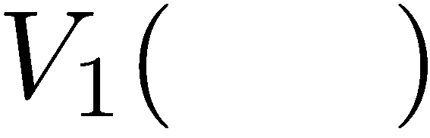
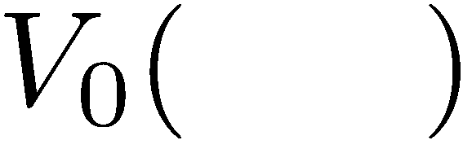
Computing Time-Limited Values

Slide 29
Value Iteration

Slide 30


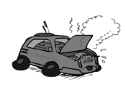
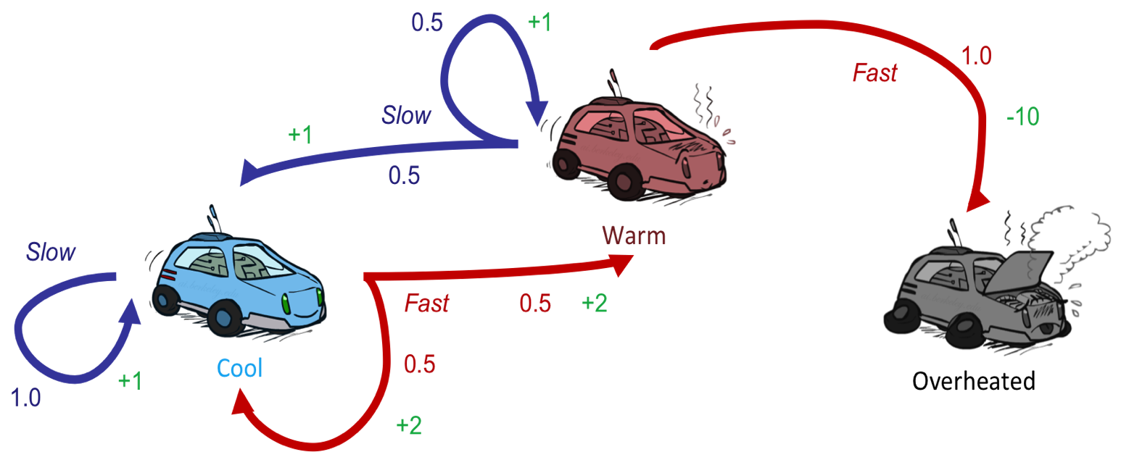
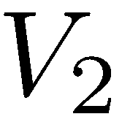
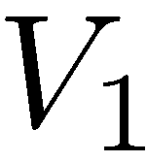
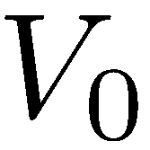

Example: Value Iteration
0.5
1.0
Fast
(R=-10)
Slow (R=1)
0.5
3.5 2.5 0
Slow (R=1)
Fast
(R=2)
0.5
2 1 0
1.0
0.5
Assume no discount!
0 0 0

Slide 31
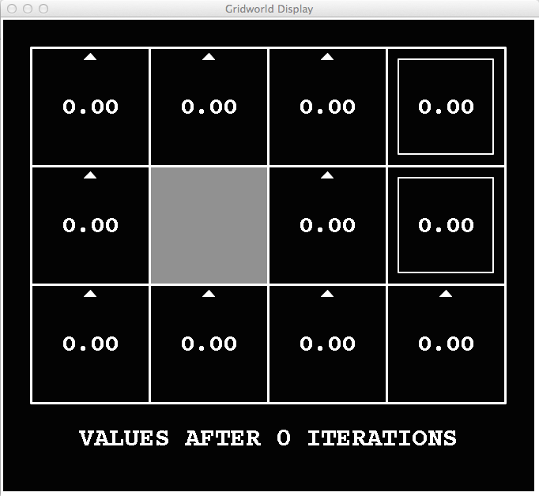
k=0
Noise = 0.2
Discount = 0.9
Living reward = 0
Notes:
Assuming zero living reward

Slide 32
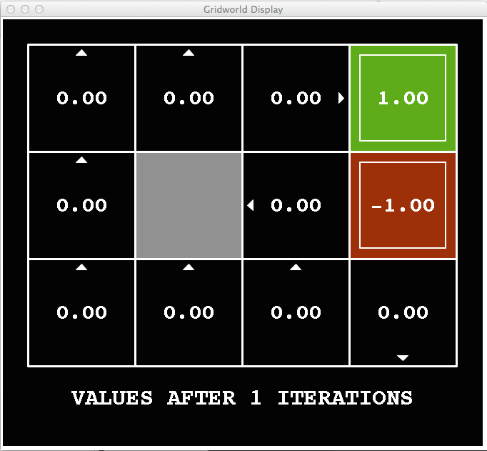
k=1
Noise = 0.2
Discount = 0.9
Living reward = 0
Notes:
Assuming zero living reward

Slide 33
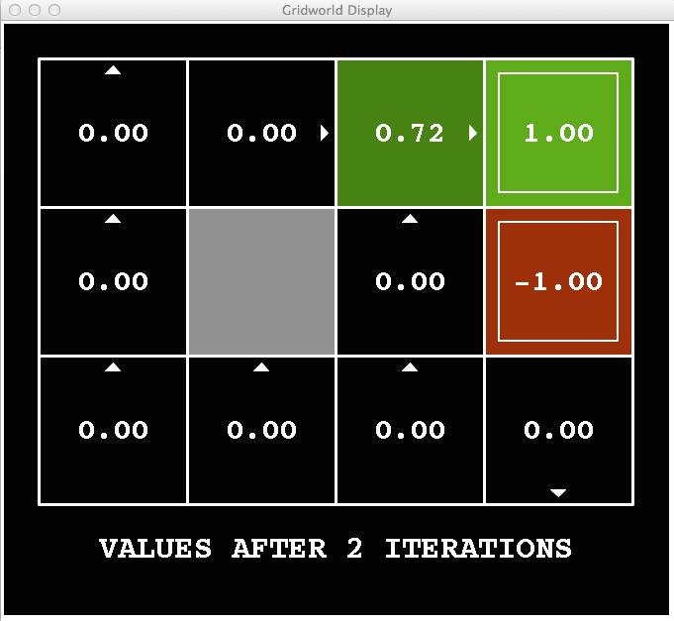
k=2
Noise = 0.2
Discount = 0.9
Living reward = 0
Notes:
Assuming zero living reward

Slide 34
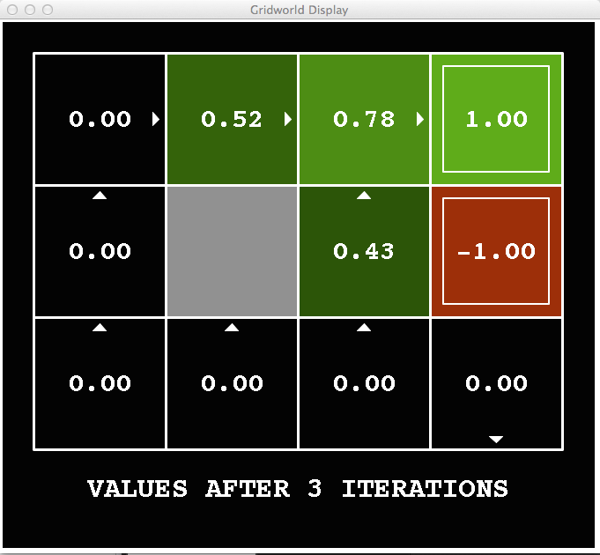
k=3
Noise = 0.2
Discount = 0.9
Living reward = 0
Notes:
Assuming zero living reward

Slide 35
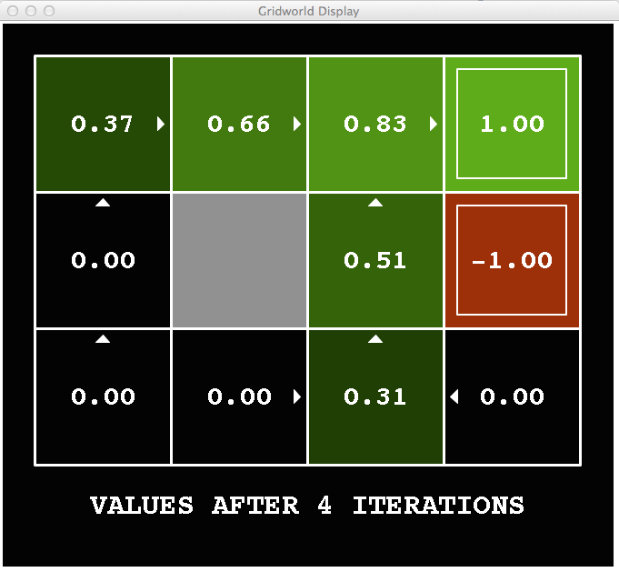
k=4
Noise = 0.2
Discount = 0.9
Living reward = 0
Notes:
Assuming zero living reward

Slide 36
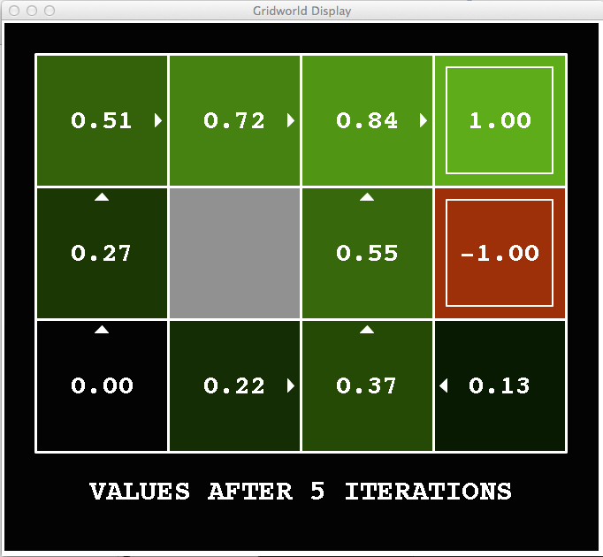
k=5
Noise = 0.2
Discount = 0.9
Living reward = 0
Notes:
Assuming zero living reward

Slide 37
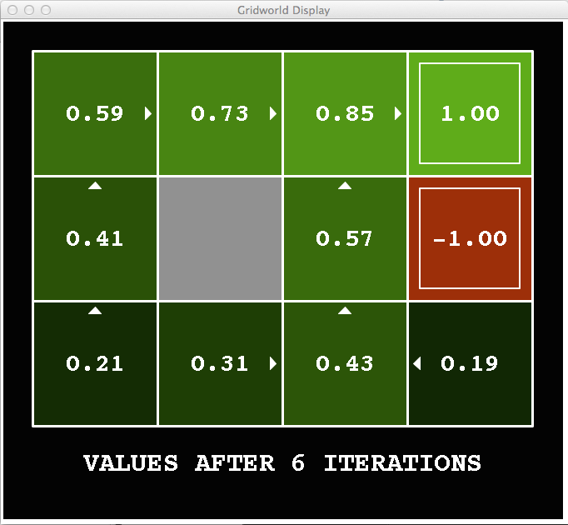
k=6
Noise = 0.2
Discount = 0.9
Living reward = 0
Notes:
Assuming zero living reward

Slide 38
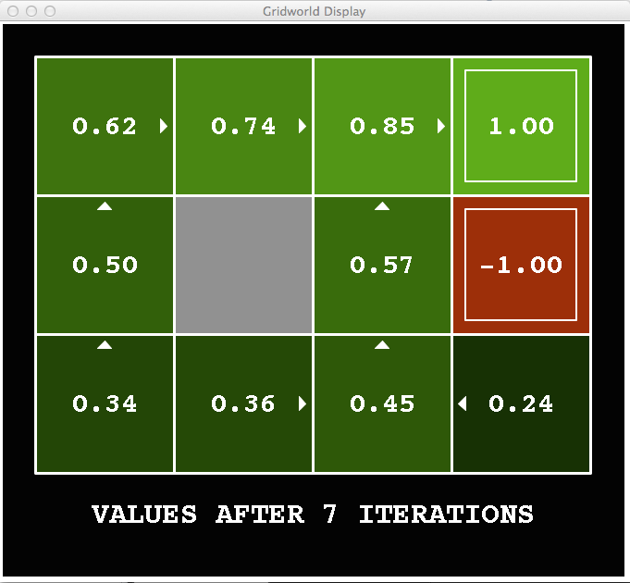
k=7
Noise = 0.2
Discount = 0.9
Living reward = 0
Notes:
Assuming zero living reward

Slide 39
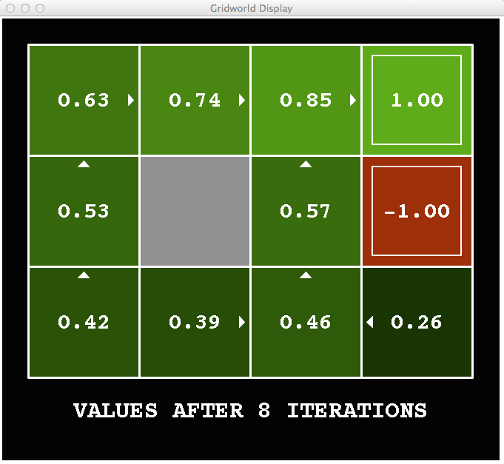
k=8
Noise = 0.2
Discount = 0.9
Living reward = 0
Notes:
Assuming zero living reward

Slide 40
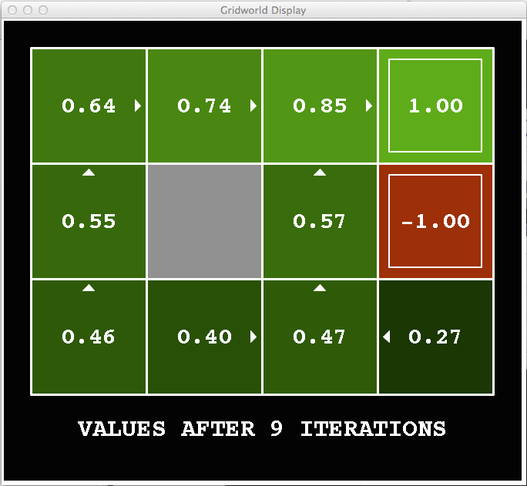
k=9
Noise = 0.2
Discount = 0.9
Living reward = 0
Notes:
Assuming zero living reward

Slide 41

k=10
Noise = 0.2
Discount = 0.9
Living reward = 0
Notes:
Assuming zero living reward

Slide 42

k=11
Noise = 0.2
Discount = 0.9
Living reward = 0
Notes:
Assuming zero living reward

Slide 43

k=12
Noise = 0.2
Discount = 0.9
Living reward = 0
Notes:
Assuming zero living reward

Slide 44

k=100
Noise = 0.2
Discount = 0.9
Living reward = 0
Notes:
Assuming zero living reward

Slide 45

Value Iteration

Slide 46
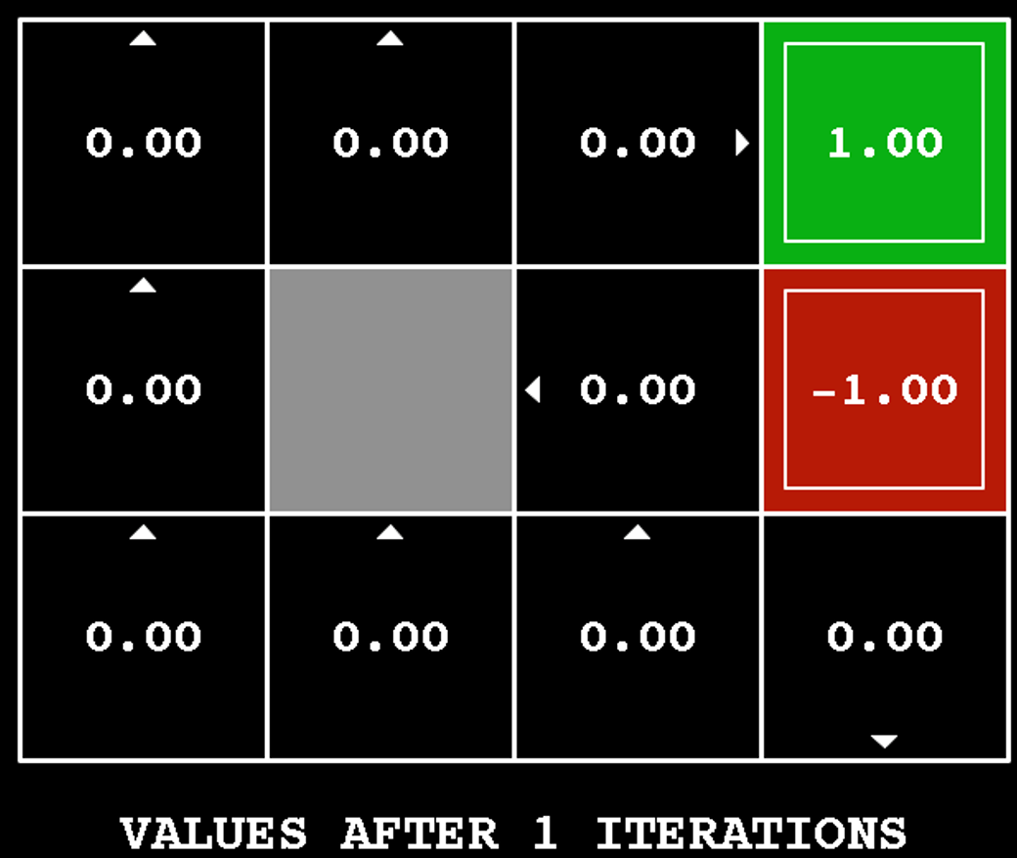
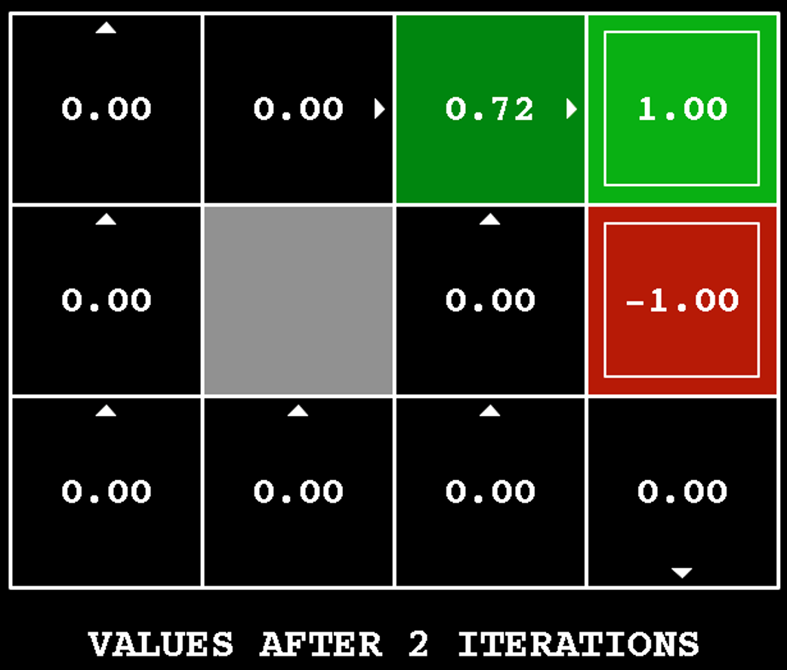
Value Iteration
Start with V₀(s) = 0: no time steps left means an expected reward sum of zero
Given vector of V_{k}(s) values, do one ply of expectimax from each state:
Repeat until convergence
V_{k+1}(s)
a
s, a
s,a,s’
V_{k}(s’)
...
Notes:
Discuss computational complexity: S * A * S times number of iterations
Note: updates not in place [if in place, it means something else and not even clear what it means]

Slide 47

Poll 1
What is the complexity of each iteration in Value Iteration?
S -- set of states; A -- set of actions
I: $O(|S||A|)$
II: $O({\left|S\right|}^{2}|A|)$
III: $O(|S|{\left|A\right|}^{2})$
IV: $O({\left|S\right|}^{2}{\left|A\right|}^{2})$
V: $O({\left|S\right|}^{2})$
V_{k+1}(s)
a
s, a
s,a,s’
V_{k}(s’)

Slide 48
Poll 1
What is the complexity of each iteration in Value Iteration?
S -- set of states; A -- set of actions
I: $O(|S||A|)$
II: $O({\left|S\right|}^{2}|A|)$
III: $O(|S|{\left|A\right|}^{2})$
IV: $O({\left|S\right|}^{2}{\left|A\right|}^{2})$
V: $O({\left|S\right|}^{2})$
V_{k+1}(s)
a
s, a
s,a,s’
V_{k}(s’)

Slide 49
Value Iteration
Start with V₀(s) = 0: no time steps left means an expected reward sum of zero
Given vector of V_{k}(s) values, do one ply of expectimax from each state:
Repeat until convergence
Complexity of each iteration: O(S²A)
Theorem: will converge to unique optimal values
Basic idea: approximations get refined towards optimal values
Policy may converge long before values do
V_{k+1}(s)
a
s, a
s,a,s’
V_{k}(s’)
Notes:
Discuss computational complexity: S * A * S times number of iterations
Note: updates not in place [if in place, it means something else and not even clear what it means]

Slide 50
Optimal Quantities
s
The value (utility) of a state s:
V*(s) = expected utility starting in s and acting optimally
a
s, a
s,a,s’
s’
[Demo: gridworld values (L9D1)]
Notes:
Demo just shows V and Q values, snapshots on next slides.

Slide 51
Optimal Quantities
s
The value (utility) of a state s:
V*(s) = expected utility starting in s and acting optimally
The value (utility) of a q-state (s,a):
Q*(s,a) = expected utility starting out having taken action a from state s and (thereafter) acting optimally
a
s, a
s,a,s’
s’
[Demo: gridworld values (L9D1)]
Notes:
Demo just shows V and Q values, snapshots on next slides.

Slide 52
Optimal Quantities
s
The value (utility) of a state s:
V*(s) = expected utility starting in s and acting optimally
The value (utility) of a q-state (s,a):
Q*(s,a) = expected utility starting out having taken action a from state s and (thereafter) acting optimally
The optimal policy:
π*(s) = optimal action from state s
a
s, a
s,a,s’
s’
[Demo: gridworld values (L9D1)]
Notes:
Demo just shows V and Q values, snapshots on next slides.

Slide 53
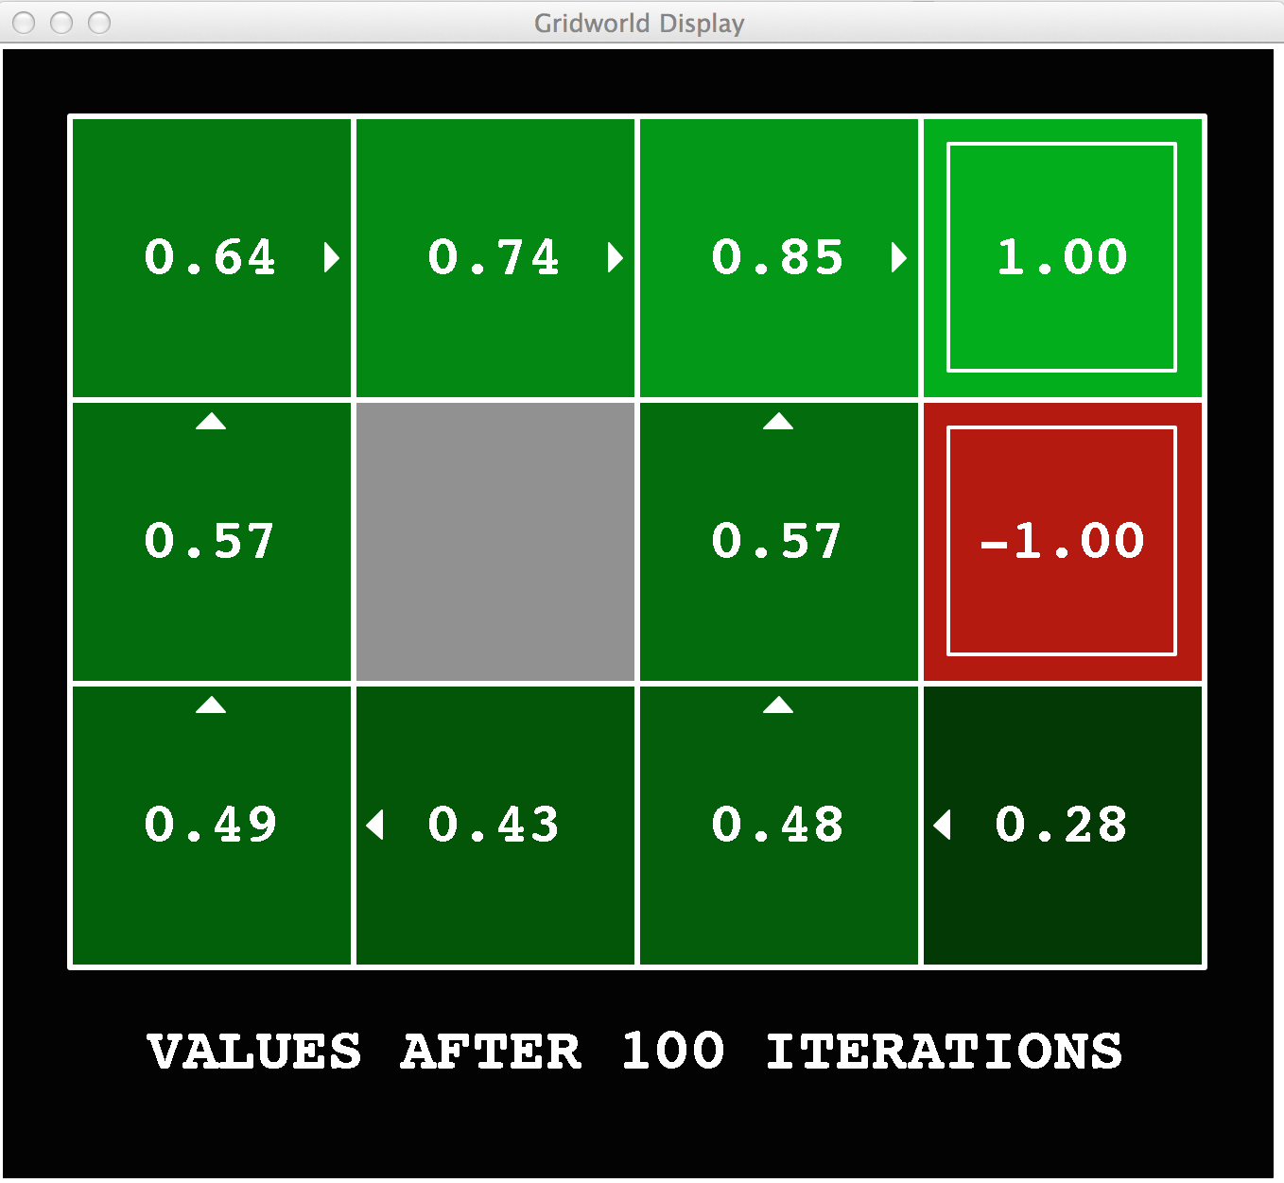
Gridworld Values V*

Slide 54
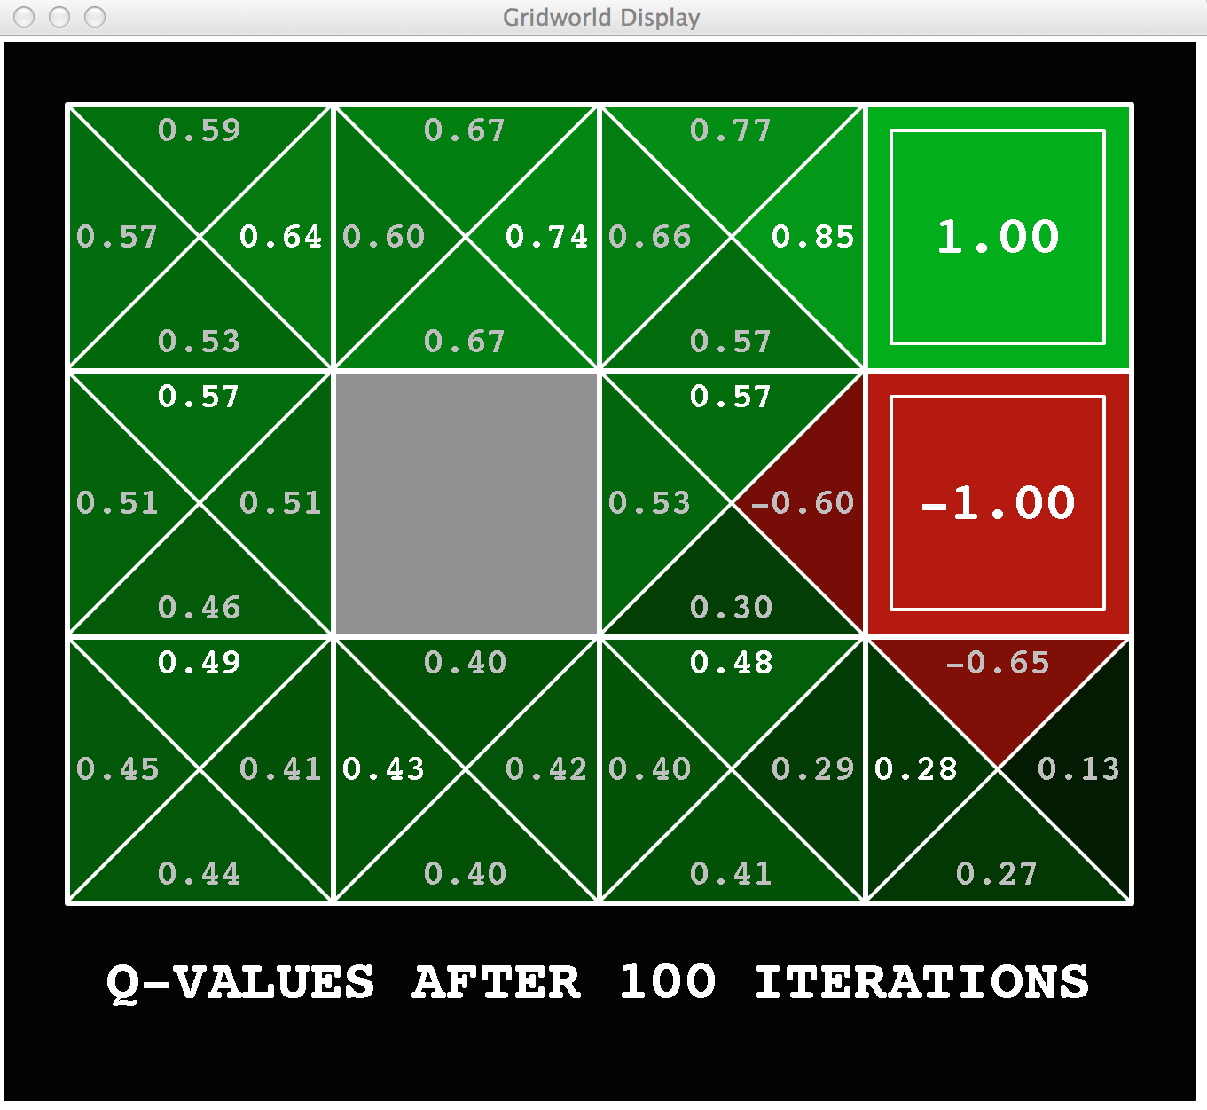
Gridworld: Q*

Slide 55

The Bellman Equations
How to be optimal:
Step 1: Take correct first action
Step 2: Keep being optimal

Slide 56
The Bellman Equations
s
Definition of “optimal utility” via expectimax recurrence gives a simple one-step lookahead relationship amongst optimal utility values
a
s, a
s,a,s’
s’
Notes:
Let’s start by equations that characterize these quantities through mutual recursions. [step through this by writing on slide, one step at a time]
Recursive characterization of V* in terms of V*; not necessarily helpful; but it is a characterization.
Note: this is a set of equations that needs to be satisfied; but it could have multiple solutions (it does not, but at this stage of our knowledge it could).

Slide 57

The Bellman Equations
s
Definition of “optimal utility” via expectimax recurrence gives a simple one-step lookahead relationship amongst optimal utility values
a
s, a
s,a,s’
s’
Notes:
Let’s start by equations that characterize these quantities through mutual recursions. [step through this by writing on slide, one step at a time]
Recursive characterization of V* in terms of V*; not necessarily helpful; but it is a characterization.
Note: this is a set of equations that needs to be satisfied; but it could have multiple solutions (it does not, but at this stage of our knowledge it could).

Slide 58
The Bellman Equations
s
Definition of “optimal utility” via expectimax recurrence gives a simple one-step lookahead relationship amongst optimal utility values
a
s, a
s,a,s’
s’
Notes:
Let’s start by equations that characterize these quantities through mutual recursions. [step through this by writing on slide, one step at a time]
Recursive characterization of V* in terms of V*; not necessarily helpful; but it is a characterization.
Note: this is a set of equations that needs to be satisfied; but it could have multiple solutions (it does not, but at this stage of our knowledge it could).

Slide 59
The Bellman Equations
s
Definition of “optimal utility” via expectimax recurrence gives a simple one-step lookahead relationship amongst optimal utility values
These are the Bellman equations, and they characterize optimal values in a way we’ll use over and over
a
s, a
s,a,s’
s’
Notes:
Let’s start by equations that characterize these quantities through mutual recursions. [step through this by writing on slide, one step at a time]
Recursive characterization of V* in terms of V*; not necessarily helpful; but it is a characterization.
Note: this is a set of equations that needs to be satisfied; but it could have multiple solutions (it does not, but at this stage of our knowledge it could).

Slide 60
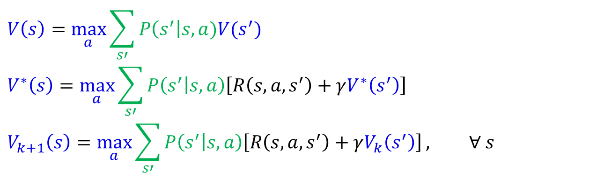
MDP Notation
$$V\left(s\right)=\max_{a}{\sum_{s′}{P\left(s^{′}\right|s,a)V(s^{′})}}$$
$$V^{∗}\left(s\right)=\max_{a}{\sum_{s′}{P\left(s^{′} | s,a\right)\left[R\left(s,a,s^{′}\right)+γV^{∗}\left(s^{′}\right)\right]}}$$
$$V_{k+1}\left(s\right)=\max_{a}{\sum_{s′}{P\left(s^{′} | s,a\right)\left[R\left(s,a,s^{′}\right)+γV_{k}\left(s^{′}\right)\right]}}, ∀ s$$
Standard expectimax:
Bellman equations:
Value iteration:

Slide 61
Value Iteration
s
Bellman equations characterize the optimal values:
Value iteration computes them:
Value iteration is just a fixed point solution method
a
s, a
s,a,s’
Notes:
Discuss computational complexity: S * A * S times number of iterations
Note: updates not in place [if in place, it means something else and not even clear what it means]

Slide 62
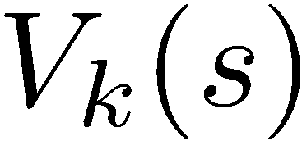
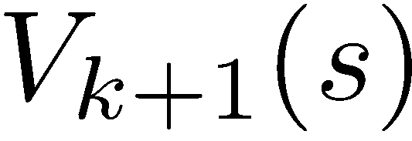
Value Iteration Convergence
How do we know the V_{k} vectors are going to converge?
Case 1: If the tree has maximum depth M, then V_{M} holds the actual untruncated values
Case 2: If the discount is less than 1
Sketch: For any state V_{k} and V_{k+1} can be viewed as depth k+1 expectimax results in nearly identical search trees
The difference is that on the bottom layer, V_{k+1} has actual rewards while V_{k} has zeros
That last layer is at best all R_{MAX}
It is at worst R_{MIN}
But everything is discounted by γ^{k} that far out
So V_{k} and V_{k+1} are at most γ^{k} max|R| different
So as k increases, the values converge

Slide 63
Outline
MDP Setup
Expectimax: State, actions, non-deterministic transition functions
Rewards
Walk-through of super-simple value iteration
Discounting, $γ$
Solving MDPs
Method 1) Value iteration
Value iteration convergence
Bellman equations
Policy Extraction
Method 2) Policy Iteration
A | B | C | D | E

Slide 64


Solved MDP! Now what?
What are we going to do with these values??
$$V^{∗}\left(s\right)$$
$$Q^{∗}\left(s,a\right)$$

Slide 65
Poll 2
If you need to extract a policy, would you rather have
A) Values, B) Q-values?

Slide 66
Poll 2
If you need to extract a policy, would you rather have
A) Values, B) Q-values ?

Slide 67

Policy Extraction

Slide 68



Computing Actions from Values
Let’s imagine we have the optimal values V*(s)
How should we act?
It’s not obvious!
We need to do a mini-expectimax (one step)
This is called policy extraction, since it gets the policy implied by the values

Slide 69


Computing Actions from Q-Values
Let’s imagine we have the optimal q-values:
How should we act?
Completely trivial to decide!
Important lesson: actions are easier to select from q-values than values!

Slide 70
Value Iteration Notes
Value iteration repeats the Bellman updates:
Things to notice when running value iteration:
It’s slow – O(S²A) per iteration
The “max” at each state rarely changes
The optimal policy appears before the values converge (but we don’t know that the policy is optimal until the values converge)
s
a
s, a
s,a,s’
s’
[Demo: value iteration (L9D2)]
Notes:
Demo steps through value iteration; snapshots of values shown on next slides.

Slide 71
k=0
Noise = 0.2
Discount = 0.9
Living reward = 0
Notes:
Assuming zero living reward

Slide 72
k=1
Noise = 0.2
Discount = 0.9
Living reward = 0
Notes:
Assuming zero living reward

Slide 73
k=2
Noise = 0.2
Discount = 0.9
Living reward = 0
Notes:
Assuming zero living reward

Slide 74
k=3
Noise = 0.2
Discount = 0.9
Living reward = 0
Notes:
Assuming zero living reward

Slide 75
k=4
Noise = 0.2
Discount = 0.9
Living reward = 0
Notes:
Assuming zero living reward

Slide 76
k=5
Noise = 0.2
Discount = 0.9
Living reward = 0
Notes:
Assuming zero living reward

Slide 77
k=6
Noise = 0.2
Discount = 0.9
Living reward = 0
Notes:
Assuming zero living reward

Slide 78
k=7
Noise = 0.2
Discount = 0.9
Living reward = 0
Notes:
Assuming zero living reward

Slide 79
k=8
Noise = 0.2
Discount = 0.9
Living reward = 0
Notes:
Assuming zero living reward

Slide 80
k=9
Noise = 0.2
Discount = 0.9
Living reward = 0
Notes:
Assuming zero living reward

Slide 81
k=10
Noise = 0.2
Discount = 0.9
Living reward = 0
Notes:
Assuming zero living reward

Slide 82
k=11
Noise = 0.2
Discount = 0.9
Living reward = 0
Notes:
Assuming zero living reward

Slide 83
k=12
Noise = 0.2
Discount = 0.9
Living reward = 0
Notes:
Assuming zero living reward

Slide 84
k=100
Noise = 0.2
Discount = 0.9
Living reward = 0
Notes:
Assuming zero living reward

Slide 85
Outline
MDP Setup
Expectimax: State, actions, non-deterministic transition functions
Rewards
Walk-through of super-simple value iteration
Discounting, $γ$
Solving MDPs
Method 1) Value iteration
Value iteration convergence
Bellman equations
Policy Extraction
Method 2) Policy Iteration
A | B | C | D | E

Slide 86


Policy Iteration

Slide 87
Two Methods for Solving MDPs
Value iteration + policy extraction
Step 1: Value iteration: calculate values for all states by running one ply of the Bellman equations using values from previous iteration until convergence
Step 2: Policy extraction: compute policy by running one ply of the Bellman equations using values from value iteration
Policy iteration
Step 1: Policy evaluation: calculate values for some fixed policy (not optimal values!) until convergence
Step 2: Policy improvement: update policy by running one ply of the Bellman equations using values from policy evaluation
Repeat steps until policy converges

Slide 88
Policy Evaluation

Slide 89


Example: Policy Evaluation
Always Go Right
Always Go Forward

Slide 90


Example: Policy Evaluation
Always Go Right
Always Go Forward

Slide 91
Policy Evaluation: Fixed Policies
Normally: Do the optimal action
Fixed policy: Do what π says to do
s
s
a
π(s)
s, a
s, π(s)
s,a,s’
s, π(s),s’
s’
s’
Expectimax trees max over all actions to compute the optimal values
If we fixed some policy π(s), then the tree would be simpler – only one action per state
… though the tree’s value would depend on which policy we fixed

Slide 92
Policy Evaluation: Utilities for a Fixed Policy
Another basic operation: compute the utility value of a state s under a fixed (generally non-optimal) policy
Define the utility of a state s, under a fixed policy π:
V^{π}(s) = expected sum of discounted rewards starting in s and following π
Recursive relation (one-step look-ahead / Bellman equation):
s
π(s)
s, π(s)
s, π(s),s’
s’

Slide 93

Policy Evaluation
How do we calculate the V’s for a fixed policy π?
Idea 1: Turn recursive Bellman equations into updates
(like value iteration)
Efficiency: O(S²) per iteration
Idea 2: Without the maxes, the Bellman equations are just a linear system
Solve with your favorite linear system solver
s
π(s)
s, π(s)
s, π(s),s’
s’

Slide 94
Policy Improvement

Slide 95
Policy Iteration:
Evaluation: For fixed current policy π, find values with policy evaluation:
Iterate until values converge:
Improvement: For fixed values, get a better policy using policy extraction
One-step look-ahead:
Policy iteration
It’s still optimal!
Can converge faster under some conditions

Slide 96

Two Methods for Solving MDPs
Value iteration + policy extraction
Step 1: Value iteration:
$V_{k+1}\left(s\right)=\max_{a}{\sum_{s′}{P\left(s^{′} | s,a\right)\left[R\left(s,a,s^{′}\right)+γV_{k}\left(s^{′}\right)\right]}}, ∀ s$ until convergence
Step 2: Policy extraction:
$π_{V}\left(s\right)=\underset{a}{argmax}{\sum_{s′}{P\left(s^{′} | s,a\right)[R\left(s,a,s^{′}\right)+γV\left(s^{′}\right)]}}, ∀ s$
Policy iteration
Step 1: Policy evaluation:
$V_{k+1}^{π}\left(s\right)=\sum_{s′}{P\left(s^{′} | s,π\left(s\right)\right)[R\left(s,π\left(s\right),s^{′}\right)+γV_{k}^{π}\left(s^{′}\right)]}, ∀ s$ until convergence
Step 2: Policy improvement:
$π_{new}\left(s\right)=\underset{a}{argmax}{\sum_{s′}{P\left(s^{′} | s,a\right)\left[R\left(s,a,s^{′}\right)+γV^{π_{old}}\left(s^{′}\right)\right]}}, ∀ s$
Repeat steps until policy converges

Slide 97
Comparison
Both value iteration and policy iteration compute the same thing (all optimal values)
In value iteration:
Every iteration updates both the values and (implicitly) the policy
We don’t track the policy, but taking the max over actions implicitly recomputes it
In policy iteration:
We do several passes that update values with fixed policy (each pass is fast because we consider only one action, not all of them; however we do many passes)
After the policy is evaluated, a new policy is chosen (with (arg)max like value iteration)
The new policy will be better (or we’re done)
(Both are dynamic programs for solving MDPs)

Slide 98
Summary: MDP Algorithms
So you want to….
Compute optimal values: use value iteration or policy iteration
Compute values for a particular policy: use policy evaluation
Turn your values into a policy: use policy extraction (one-step lookahead)
These all look the same!
They basically are – they are all variations of Bellman updates
They all use one-step lookahead expectimax fragments
They differ only in whether we plug in a fixed policy or max over actions

Slide 99

MDP Notation
$$V\left(s\right)=\max_{a}{\sum_{s′}{P\left(s^{′}\right|s,a)V(s^{′})}}$$
$$V^{∗}\left(s\right)=\max_{a}{\sum_{s′}{P\left(s^{′} | s,a\right)\left[R\left(s,a,s^{′}\right)+γV^{∗}\left(s^{′}\right)\right]}}$$
$$V_{k+1}\left(s\right)=\max_{a}{\sum_{s′}{P\left(s^{′} | s,a\right)\left[R\left(s,a,s^{′}\right)+γV_{k}\left(s^{′}\right)\right]}}, ∀ s$$
$$Q_{k+1}\left(s,a\right)=\sum_{s′}{P\left(s^{′} | s,a\right)[R\left(s,a,s^{′}\right)+γ\max_{a^{′}}{Q_{k}(s^{′},a^{′})]}, } ∀ s,a$$
$$π_{V}\left(s\right)=\underset{a}{argmax}{\sum_{s′}{P\left(s^{′} | s,a\right)[R\left(s,a,s^{′}\right)+γV\left(s^{′}\right)]}}, ∀ s$$
$$V_{k+1}^{π}\left(s\right)=\sum_{s′}{P\left(s^{′} | s,π\left(s\right)\right)[R\left(s,π\left(s\right),s^{′}\right)+γV_{k}^{π}\left(s^{′}\right)]}, ∀ s$$
$$π_{new}\left(s\right)=\underset{a}{argmax}{\sum_{s′}{P\left(s^{′} | s,a\right)\left[R\left(s,a,s^{′}\right)+γV^{π_{old}}\left(s^{′}\right)\right]}}, ∀ s$$
Standard expectimax:
Bellman equations:
Value iteration:
Q-iteration:
Policy extraction:
Policy evaluation:
Policy improvement:

Slide 100

MDP Notation
$$V\left(s\right)=\max_{a}{\sum_{s′}{P\left(s^{′}\right|s,a)V(s^{′})}}$$
$$V^{∗}\left(s\right)=\max_{a}{\sum_{s′}{P\left(s^{′} | s,a\right)\left[R\left(s,a,s^{′}\right)+γV^{∗}\left(s^{′}\right)\right]}}$$
$$V_{k+1}\left(s\right)=\max_{a}{\sum_{s′}{P\left(s^{′} | s,a\right)\left[R\left(s,a,s^{′}\right)+γV_{k}\left(s^{′}\right)\right]}}, ∀ s$$
$$Q_{k+1}\left(s,a\right)=\sum_{s′}{P\left(s^{′} | s,a\right)[R\left(s,a,s^{′}\right)+γ\max_{a^{′}}{Q_{k}(s^{′},a^{′})]}, } ∀ s,a$$
$$π_{V}\left(s\right)=\underset{a}{argmax}{\sum_{s′}{P\left(s^{′} | s,a\right)[R\left(s,a,s^{′}\right)+γV\left(s^{′}\right)]}}, ∀ s$$
$$V_{k+1}^{π}\left(s\right)=\sum_{s′}{P\left(s^{′} | s,π\left(s\right)\right)[R\left(s,π\left(s\right),s^{′}\right)+γV_{k}^{π}\left(s^{′}\right)]}, ∀ s$$
$$π_{new}\left(s\right)=\underset{a}{argmax}{\sum_{s′}{P\left(s^{′} | s,a\right)\left[R\left(s,a,s^{′}\right)+γV^{π_{old}}\left(s^{′}\right)\right]}}, ∀ s$$
Standard expectimax:
Bellman equations:
Value iteration:
Q-iteration:
Policy extraction:
Policy evaluation:
Policy improvement:

Slide 101
MDP Notation
$$V\left(s\right)=\max_{a}{\sum_{s′}{P\left(s^{′}\right|s,a)V(s^{′})}}$$
$$V^{∗}\left(s\right)=\max_{a}{\sum_{s′}{P\left(s^{′} | s,a\right)\left[R\left(s,a,s^{′}\right)+γV^{∗}\left(s^{′}\right)\right]}}$$
$$V_{k+1}\left(s\right)=\max_{a}{\sum_{s′}{P\left(s^{′} | s,a\right)\left[R\left(s,a,s^{′}\right)+γV_{k}\left(s^{′}\right)\right]}}, ∀ s$$
$$Q_{k+1}\left(s,a\right)=\sum_{s′}{P\left(s^{′} | s,a\right)[R\left(s,a,s^{′}\right)+γ\max_{a^{′}}{Q_{k}(s^{′},a^{′})]}, } ∀ s,a$$
$$π_{V}\left(s\right)=\underset{a}{argmax}{\sum_{s′}{P\left(s^{′} | s,a\right)[R\left(s,a,s^{′}\right)+γV\left(s^{′}\right)]}}, ∀ s$$
$$V_{k+1}^{π}\left(s\right)=\sum_{s′}{P\left(s^{′} | s,π\left(s\right)\right)[R\left(s,π\left(s\right),s^{′}\right)+γV_{k}^{π}\left(s^{′}\right)]}, ∀ s$$
$$π_{new}\left(s\right)=\underset{a}{argmax}{\sum_{s′}{P\left(s^{′} | s,a\right)\left[R\left(s,a,s^{′}\right)+γV^{π_{old}}\left(s^{′}\right)\right]}}, ∀ s$$
Standard expectimax:
Bellman equations:
Value iteration:
Q-iteration:
Policy extraction:
Policy evaluation:
Policy improvement:

Slide 102

MDP Notation
$$V\left(s\right)=\max_{a}{\sum_{s′}{P\left(s^{′}\right|s,a)V(s^{′})}}$$
$$V^{∗}\left(s\right)=\max_{a}{\sum_{s′}{P\left(s^{′} | s,a\right)\left[R\left(s,a,s^{′}\right)+γV^{∗}\left(s^{′}\right)\right]}}$$
$$V_{k+1}\left(s\right)=\max_{a}{\sum_{s′}{P\left(s^{′} | s,a\right)\left[R\left(s,a,s^{′}\right)+γV_{k}\left(s^{′}\right)\right]}}, ∀ s$$
$$Q_{k+1}\left(s,a\right)=\sum_{s′}{P\left(s^{′} | s,a\right)[R\left(s,a,s^{′}\right)+γ\max_{a^{′}}{Q_{k}(s^{′},a^{′})]}, } ∀ s,a$$
$$π_{V}\left(s\right)=\underset{a}{argmax}{\sum_{s′}{P\left(s^{′} | s,a\right)[R\left(s,a,s^{′}\right)+γV\left(s^{′}\right)]}}, ∀ s$$
$$V_{k+1}^{π}\left(s\right)=\sum_{s′}{P\left(s^{′} | s,π\left(s\right)\right)[R\left(s,π\left(s\right),s^{′}\right)+γV_{k}^{π}\left(s^{′}\right)]}, ∀ s$$
$$π_{new}\left(s\right)=\underset{a}{argmax}{\sum_{s′}{P\left(s^{′} | s,a\right)\left[R\left(s,a,s^{′}\right)+γV^{π_{old}}\left(s^{′}\right)\right]}}, ∀ s$$
Standard expectimax:
Bellman equations:
Value iteration:
Q-iteration:
Policy extraction:
Policy evaluation:
Policy improvement:

