Slide 1


AI: Representation and Problem Solving
Logical Agent Algorithms
Instructor: Pat Virtue
Slide credits: CMU AI, http://ai.berkeley.edu

Slide 2

Plan
Last Time:
Propositional logic
Models and Knowledge Bases
Satisifiability and Entailment
Today: Logical Agent Algorithms
Entailment
Model checking: Truth table entailment
Theorem proving: (Forward chaining), resolution
Satisfiability: DPLL
Planning with logic

Slide 3
Plan
Last Time:
Propositional logic
Models and Knowledge Bases
Satisifiability and Entailment

Slide 4
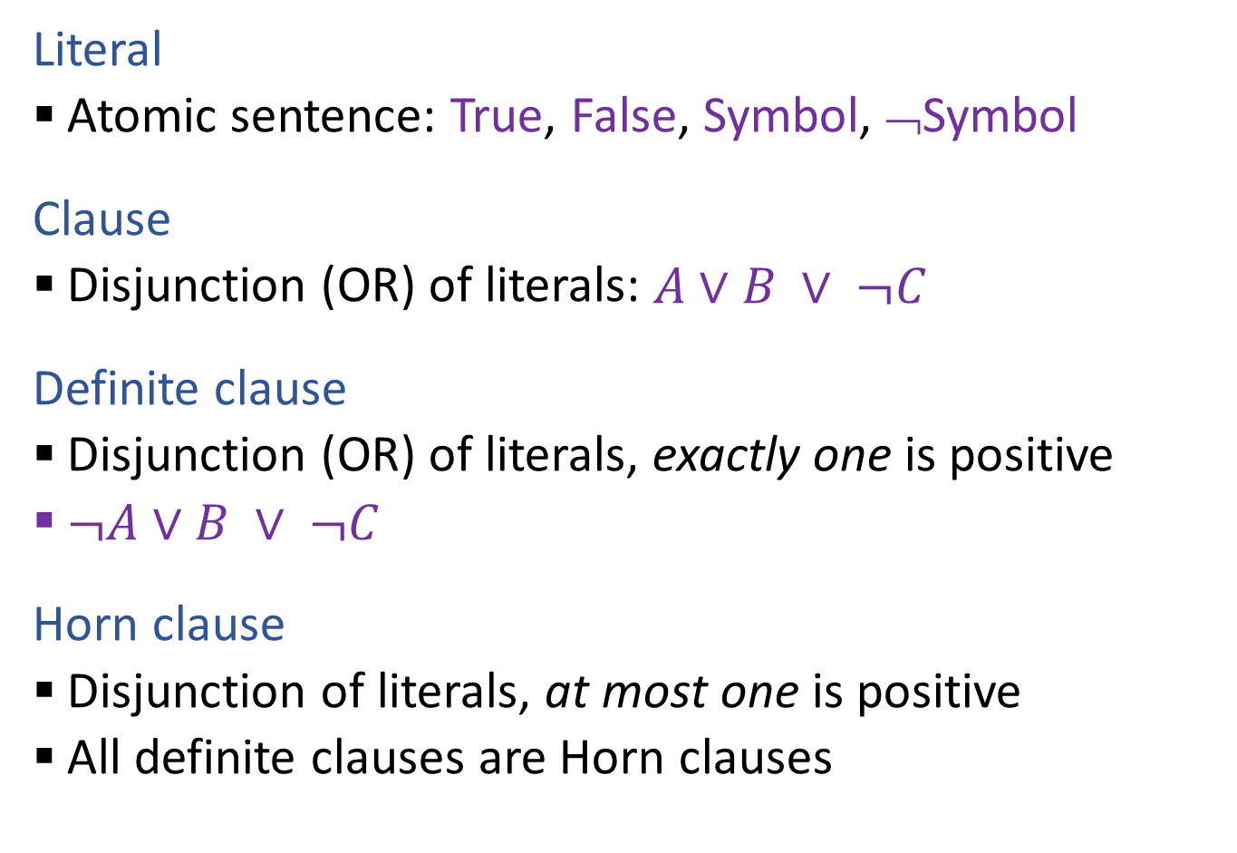

Propositional Logic Vocab
Literal
Atomic sentence: True, False, Symbol, ¬Symbol
Clause
Disjunction (OR) of literals: $A∨B ∨ ¬C$
Definite clause
Disjunction (OR) of literals, exactly one is positive
$¬A∨B ∨ ¬C$
Horn clause
Disjunction of literals, at most one is positive
All definite clauses are Horn clauses

Slide 5
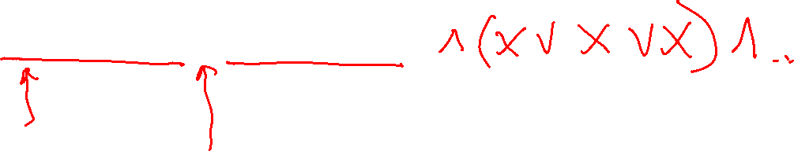
PL: Conjunctive Normal Form (CNF)
Every sentence can be expressed as a conjunction (AND) of clauses
Each clause is a disjunction (OR) of literals
Each literal is a symbol or a negated symbol
Example: (¬A v ¬C v B) ∧ (¬A v ¬B v C)

Slide 6

PL: Conjunctive Normal Form (CNF)
Every sentence can be expressed as a conjunction of clauses
Each clause is a disjunction of literals
Each literal is a symbol or a negated symbol
Conversion to CNF by a sequence of standard transformations:
At_1,1_0 ⇒ (Wall_0,1 ⇔ Blocked_W_0)
At_1,1_0 ⇒ ((Wall_0,1 ⇒ Blocked_W_0) ∧ (Blocked_W_0 ⇒Wall_0,1))
¬At_1,1_0 v ((¬Wall_0,1 v Blocked_W_0) ∧ (¬Blocked_W_0 v Wall_0,1))
(¬At_1,1_0 v ¬Wall_0,1 v Blocked_W_0) ∧ (¬At_1,1_0 v ¬Blocked_W_0 v Wall_0,1)

Slide 7

PL: Conjunctive Normal Form (CNF)
Replace biconditional by two implications
Every sentence can be expressed as a conjunction of clauses
Each clause is a disjunction of literals
Each literal is a symbol or a negated symbol
Conversion to CNF by a sequence of standard transformations:
At_1,1_0 ⇒ (Wall_0,1 ⇔ Blocked_W_0)
At_1,1_0 ⇒ ((Wall_0,1 ⇒ Blocked_W_0) ∧ (Blocked_W_0 ⇒Wall_0,1))
¬At_1,1_0 v ((¬Wall_0,1 v Blocked_W_0) ∧ (¬Blocked_W_0 v Wall_0,1))
(¬At_1,1_0 v ¬Wall_0,1 v Blocked_W_0) ∧ (¬At_1,1_0 v ¬Blocked_W_0 v Wall_0,1)
Replace α ⇒ β by ¬α v β
Distribute v over ∧

Slide 8
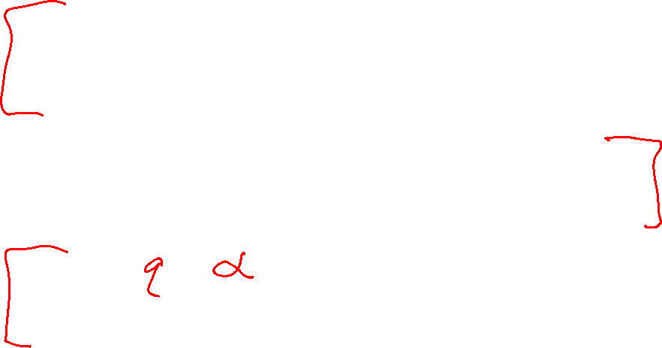
Logical Agent Vocab
Model
Complete assignment of symbols to True/False
Sentence
Logical statement
Composition of logic symbols and operators
KB
Collection of sentences representing facts and rules we know about the world
Query
Sentence we want to know if it is provably True, provably False, or unsure.

Slide 9
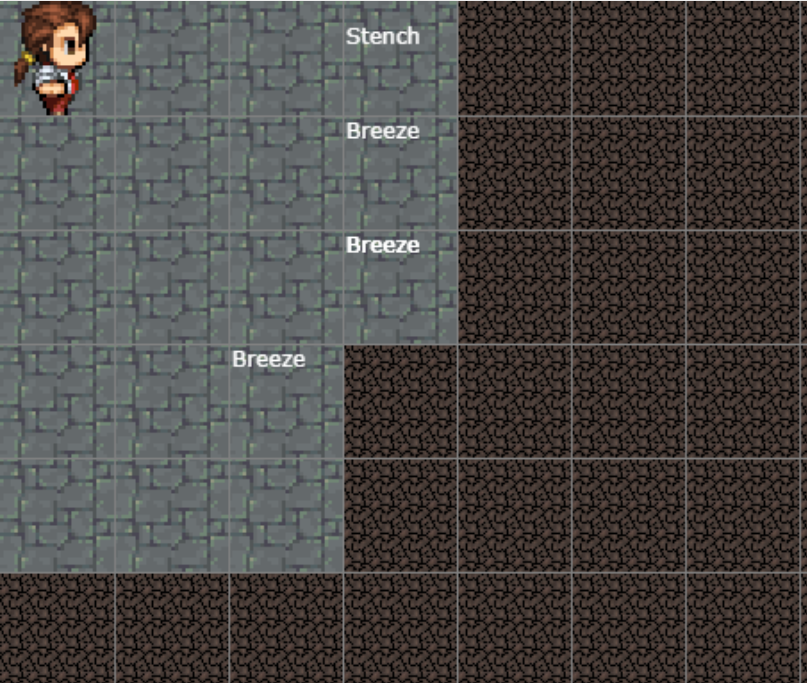

Provably True, Provably False, or Unsure
http://thiagodnf.github.io/wumpus-world-simulator/

Slide 10
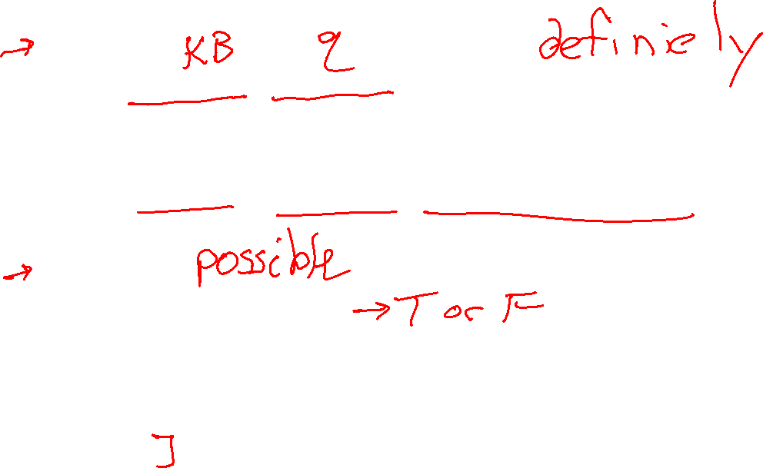
Logical Agent Vocab
Entailment
Input: sentence1, sentence2
Each model that satisfies sentence1 must also satisfy sentence2
"If I know 1 holds, then I know 2 holds"
(ASK), TT-ENTAILS, FC-ENTAILS, RESOLUTION-ENTAILS
Satisfy
Input: model, sentence
Is this sentence true in this model?
Does this model satisfy this sentence
"Does this particular state of the world work?’
PL-TRUE

Slide 11
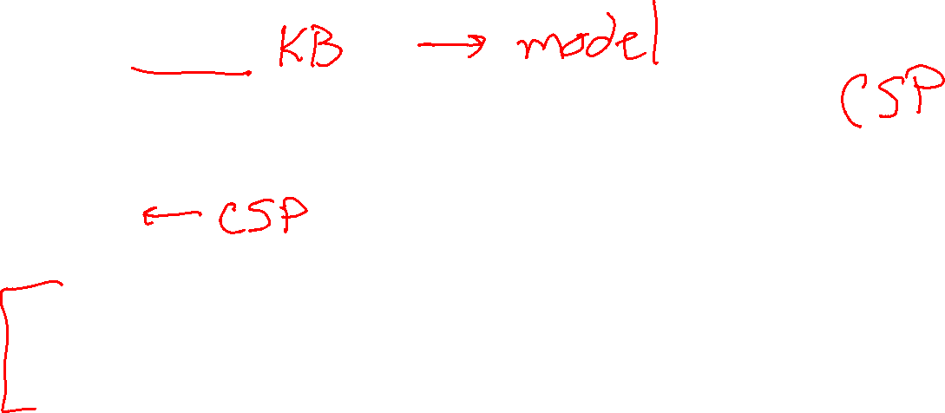
Logical Agent Vocab
Satisfiable
Input: sentence
Can find at least one model that satisfies this sentence
(We often want to know what that model is)
"Is it possible to make this sentence true?"
DPLL
Valid
Input: sentence
sentence is true in all possible models

Slide 12
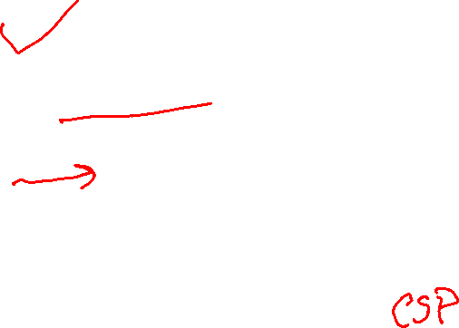
Outline
Logical Agent Algorithms
Vocab
PL_TRUE
Entailment
Model checking: Truth table entailment
Theorem proving:
(Forward chaining), resolution
Satisfiability: DPLL
Planning with logic

Slide 13

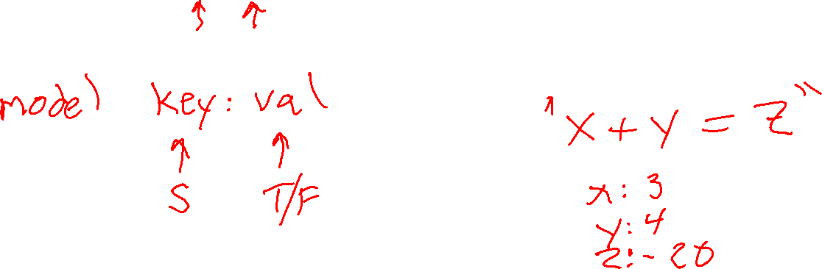
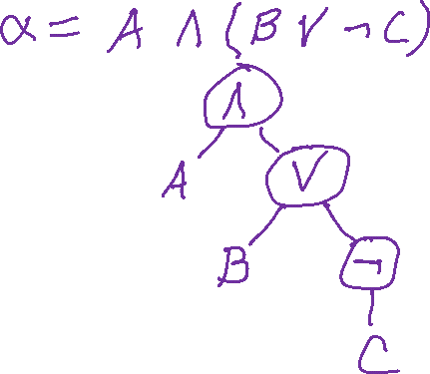
Propositional Logic
Check if sentence is true in given model
In other words, does the model satisfy the sentence?
function PL-TRUE?(α,model) returns true or false
But are models and propositional logic sentences $α$ represented?

Slide 14

Propositional Logic
Check if sentence is true in given model
In other words, does the model satisfy the sentence?
function PL-TRUE?(α,model) returns true or false
if α is a symbol then return Lookup(α, model)
if Op(α) = ¬ then return not(PL-TRUE?(Arg1(α),model))
if Op(α) = ∧ then return and(PL-TRUE?(Arg1(α),model),
PL-TRUE?(Arg2(α),model))
etc.
(Sometimes called “recursion over syntax”)

Slide 15
Outline
Logical Agent Algorithms
Vocab
PL_TRUE
Entailment
Model checking: Truth table entailment
Theorem proving:
(Forward chaining), resolution
Satisfiability: DPLL
Planning with logic

Slide 16
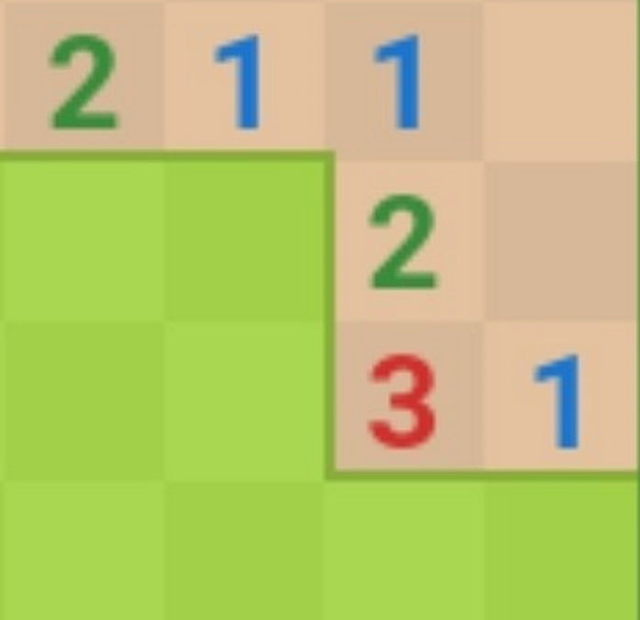

Inference: Proofs
A proof is a demonstration of entailment between α and β
Method 1: model-checking
For every possible world, if α is true make sure that is β true too
OK for propositional logic (finitely many worlds); not easy for first-order logic

Slide 17
Simple Model Checking
function TT-ENTAILS?(KB, α) Returns true or false

Slide 18
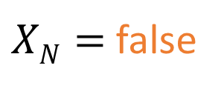

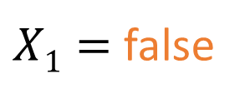
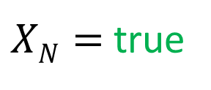
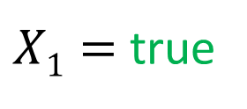

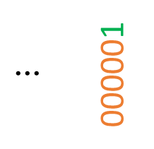

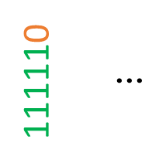
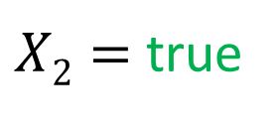
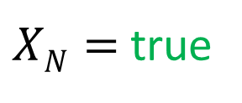
Simple Model Checking
function TT-ENTAILS?(KB, α)
Same recursion as backtracking
$X1=$true
$X1=$false
$X2=$true
$X2=$ false
$XN=$true
$XN=$ false
$XN=$true
$XN=$ false
KB?
α?
111110
$$⋮$$
$$⋮$$
000001
111111
101001
000000

Slide 19

Simple Model Checking
function TT-ENTAILS?(KB, α) Returns true or false return TT-CHECK-ALL(KB, α, symbols(KB) ∪ symbols(α), {})
function TT-CHECK-ALL(KB, α, symbols, model) Returns true or false
Recursively check to make sure all models
that satisfy the KB also satisfy α

Slide 20
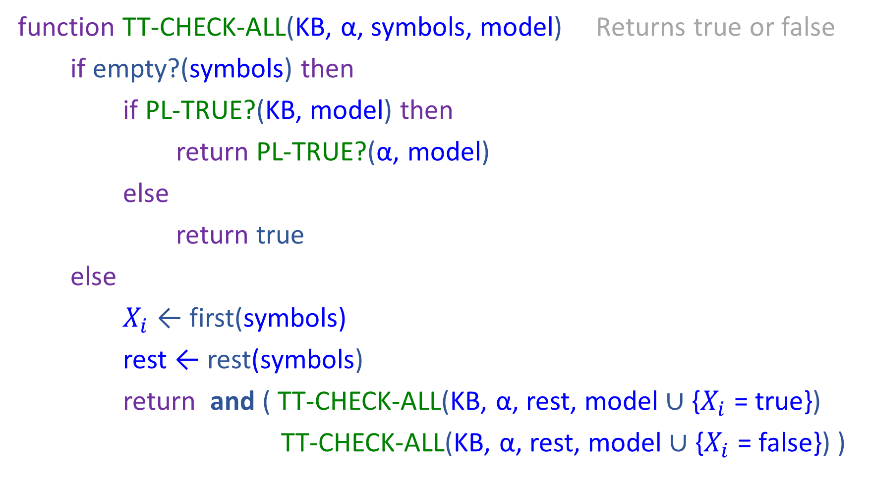
Simple Model Checking
function TT-CHECK-ALL(KB, α, symbols, model) Returns true or false
if empty?(symbols) then
if PL-TRUE?(KB, model) then
return PL-TRUE?(α, model)
else
return true
else
$X_{i}$ ← first(symbols) rest ← rest(symbols) return and ( TT-CHECK-ALL(KB, α, rest, model ∪ {$X_{i}$ = true})
TT-CHECK-ALL(KB, α, rest, model ∪ {$X_{i}$ = false}) )

Slide 21
Simple Model Checking
Same recursion as backtracking
O(2^{N}) time, linear space
Can we do better?
$X1=$true
$X1=$false
$X2=$true
$X2=$ false
$XN=$true
$XN=$ false
$XN=$true
$XN=$ false
KB?
α?
111110
$$⋮$$
$$⋮$$
000001
111111
101001
000000

Slide 22

Inference: Proofs
A proof is a demonstration of entailment between α and β
Method 1: model-checking
For every possible world, if α is true make sure that is β true too
OK for propositional logic (finitely many worlds); not easy for first-order logic
Method 2: theorem-proving
Search for a sequence of proof steps (applications of inference rules) leading from α to β
E.g., from P ∧ (P ⇒ Q), infer Q by Modus Ponens
Properties
Sound algorithm: everything it claims to prove is in fact entailed
Complete algorithm: every sentence that is entailed can be proved

Slide 23
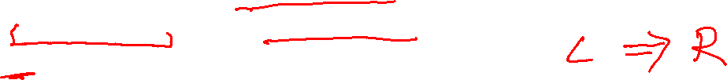
Simple Theorem Proving: Forward Chaining
Forward chaining applies Modus Ponens to generate new facts:
Given X₁ ∧ X₂ ∧ … X_{n} ⇒ Y and X₁, X₂, …, X_{n}
Infer Y
Forward chaining keeps applying this rule, adding new facts, until nothing more can be added

Slide 24
Simple Theorem Proving: Forward Chaining
Forward chaining applies Modus Ponens to generate new facts:
Given X₁ ∧ X₂ ∧ … X_{n} ⇒ Y and X₁, X₂, …, X_{n}
Infer Y
Forward chaining keeps applying this rule, adding new facts, until nothing more can be added
Requires KB to contain only definite clauses:
(Conjunction of symbols) ⇒ symbol; or
A single symbol (note that X is equivalent to True ⇒ X)

Slide 25
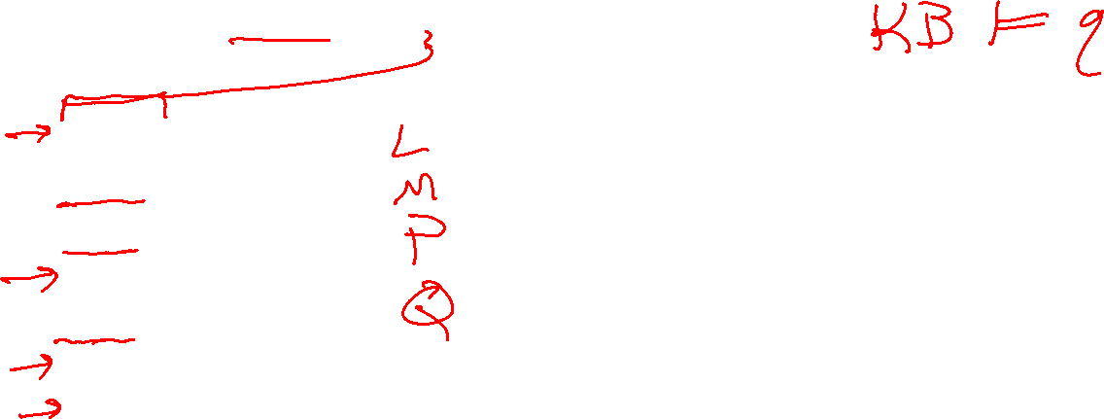
Forward Chaining Algorithm
function PL-FC-ENTAILS?(KB, q) Returns true or false
KB Clauses
P ⇒ Q
L ∧ M ⇒ P
B ∧ L ⇒ M
A ∧ P ⇒ L
A ∧ B ⇒ L
A
B

Slide 26
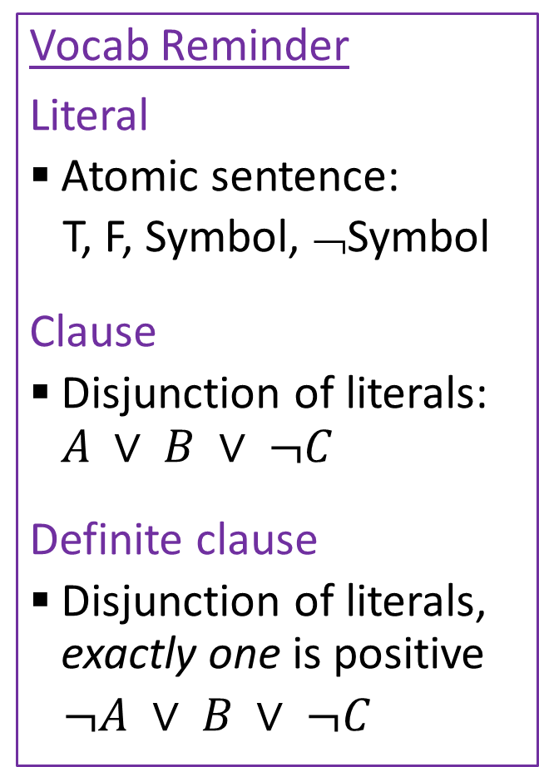

Properties
Vocab Reminder
Literal
Atomic sentence:
T, F, Symbol, ¬Symbol
Clause
Disjunction of literals: $A ∨ B ∨ ¬C$
Definite clause
Disjunction of literals, exactly one is positive
$¬A ∨ B ∨ ¬C$
Forward Chaining is:
Sound and complete for definite-clause KBs
Complexity: linear time ☺
Resolution is another theorem-proving algorithm that is:
Sound and complete for any PL KBs!
Complexity: exponential time ☹

Slide 27

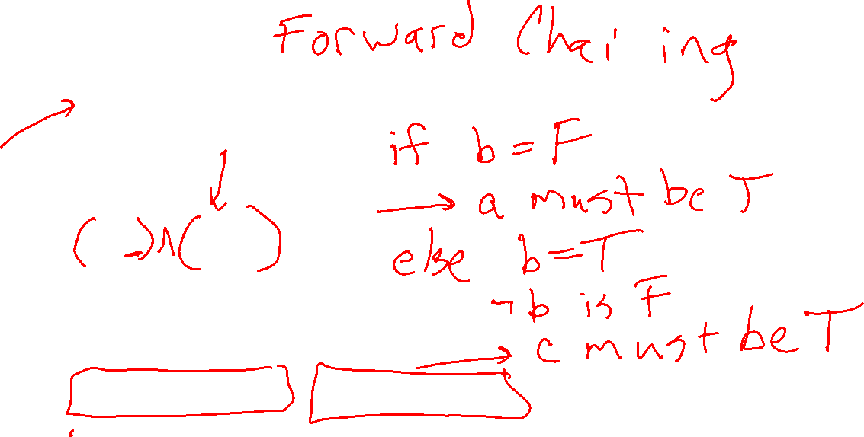
Inference Rules
Modus Ponens
$\frac{α⇒β, α}{β}$
Unit Resolution
$\frac{a∨b, ¬b∨c}{a∨c}$
General Resolution
$\frac{a_{1}∨…∨a_{m}∨b, ¬b∨c_{1}∨…∨c_{n}}{a_{1}∨…∨a_{m}∨c_{1}∨…∨c_{n}}$
Notation Alert!

Slide 28
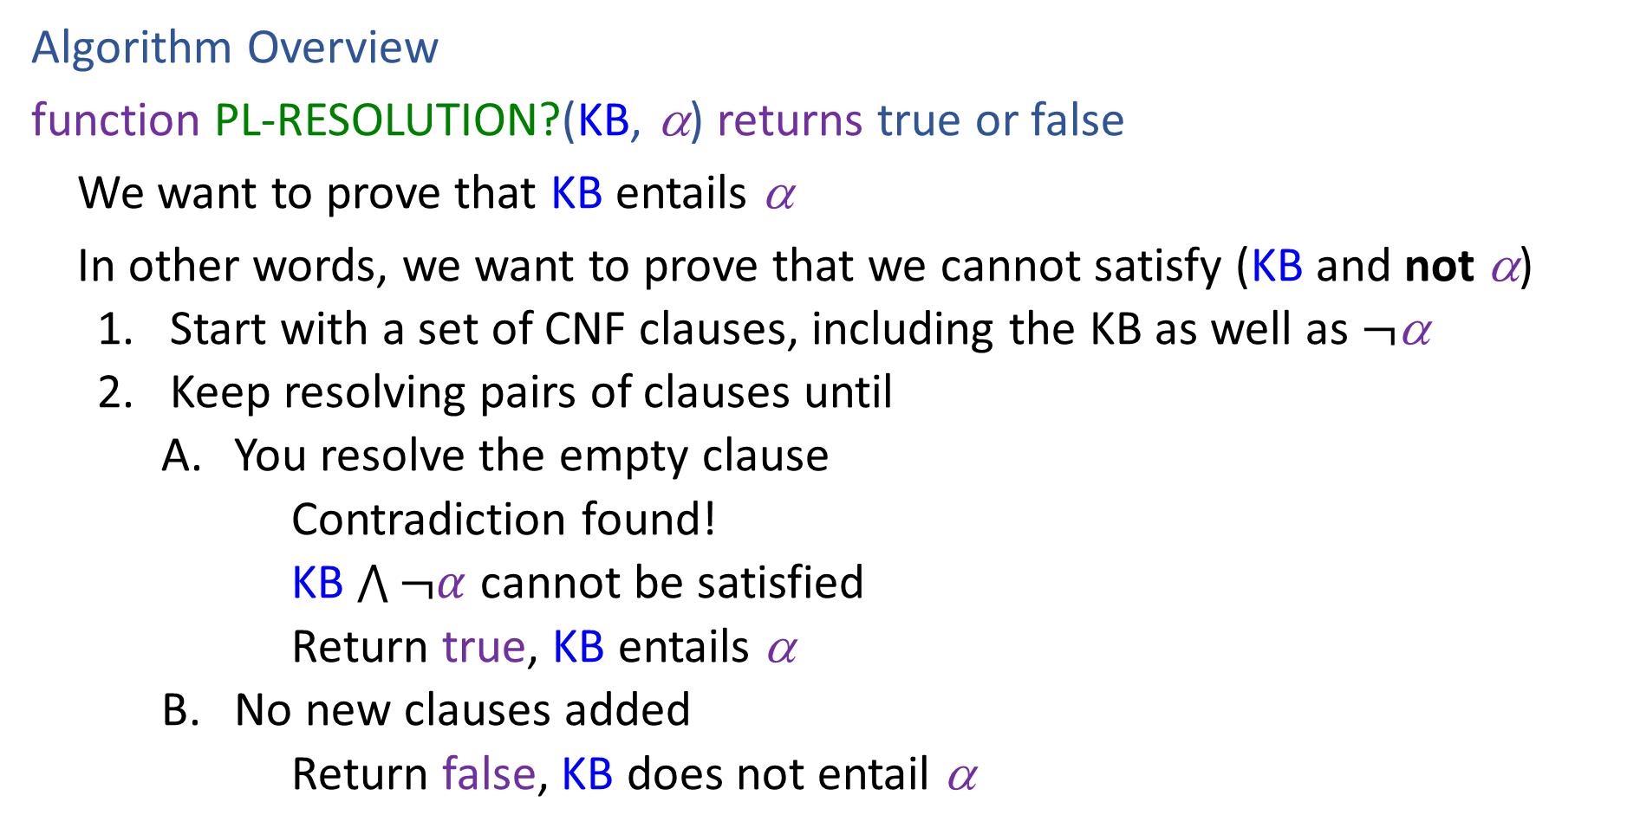
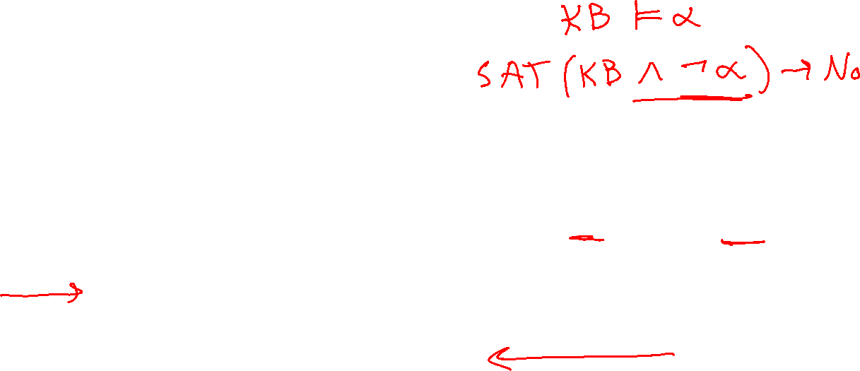
Resolution
Algorithm Overview
function PL-RESOLUTION?(KB, α) returns true or false
We want to prove that KB entails α
In other words, we want to prove that we cannot satisfy (KB and not α)
Start with a set of CNF clauses, including the KB as well as $¬$α
Keep resolving pairs of clauses until
You resolve the empty clause
Contradiction found!
KB $\bigwedge{¬α}$ cannot be satisfied
Return true, KB entails α
No new clauses added
Return false, KB does not entail α

Slide 29
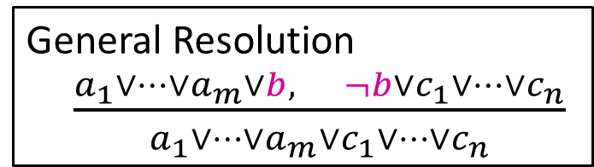


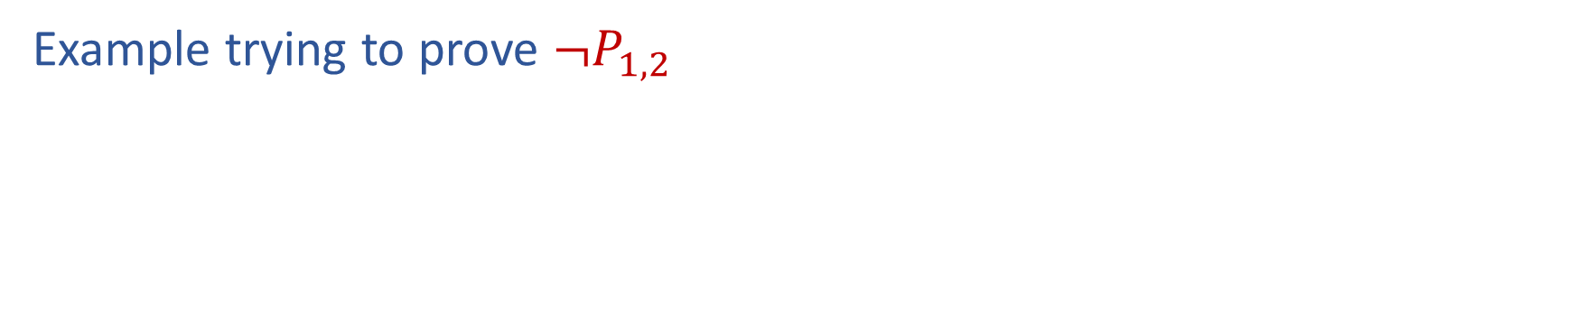




Resolution
General Resolution
$\frac{a_{1}∨…∨a_{m}∨b, ¬b∨c_{1}∨…∨c_{n}}{a_{1}∨…∨a_{m}∨c_{1}∨…∨c_{n}}$
Example trying to prove $¬P_{1,2}$
Knowledge Base
$$¬P_{2,1}∨B_{1,1}$$
$$¬B_{1,1}∨P_{1,2}∨P_{2,1}$$
$$¬P_{1,2}∨B_{1,1}$$
$$¬B_{1,1}$$
$$¬¬P_{1,2}$$

Slide 30



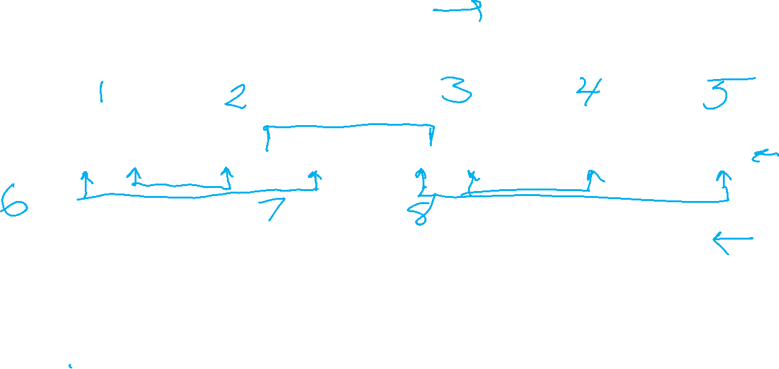




Resolution
General Resolution
$\frac{a_{1}∨…∨a_{m}∨b, ¬b∨c_{1}∨…∨c_{n}}{a_{1}∨…∨a_{m}∨c_{1}∨…∨c_{n}}$
Example trying to prove $¬P_{1,2}$
Knowledge Base
$$¬P_{2,1}∨B_{1,1}$$
$$¬B_{1,1}∨P_{1,2}∨P_{2,1}$$
$$¬P_{1,2}∨B_{1,1}$$
$$¬B_{1,1}$$
$$P_{1,2}$$
$$¬B_{1,1}∨P_{1,2}∨B_{1,1}$$
$$P_{1,2}∨P_{2,1}∨¬P_{2,1}$$
$$¬B_{1,1}∨P_{2,1}∨B_{1,1}$$
$$P_{1,2}∨P_{2,1}∨¬P_{1,2}$$
$$¬P_{2,1}$$
$$¬P_{1,2}$$

Slide 31
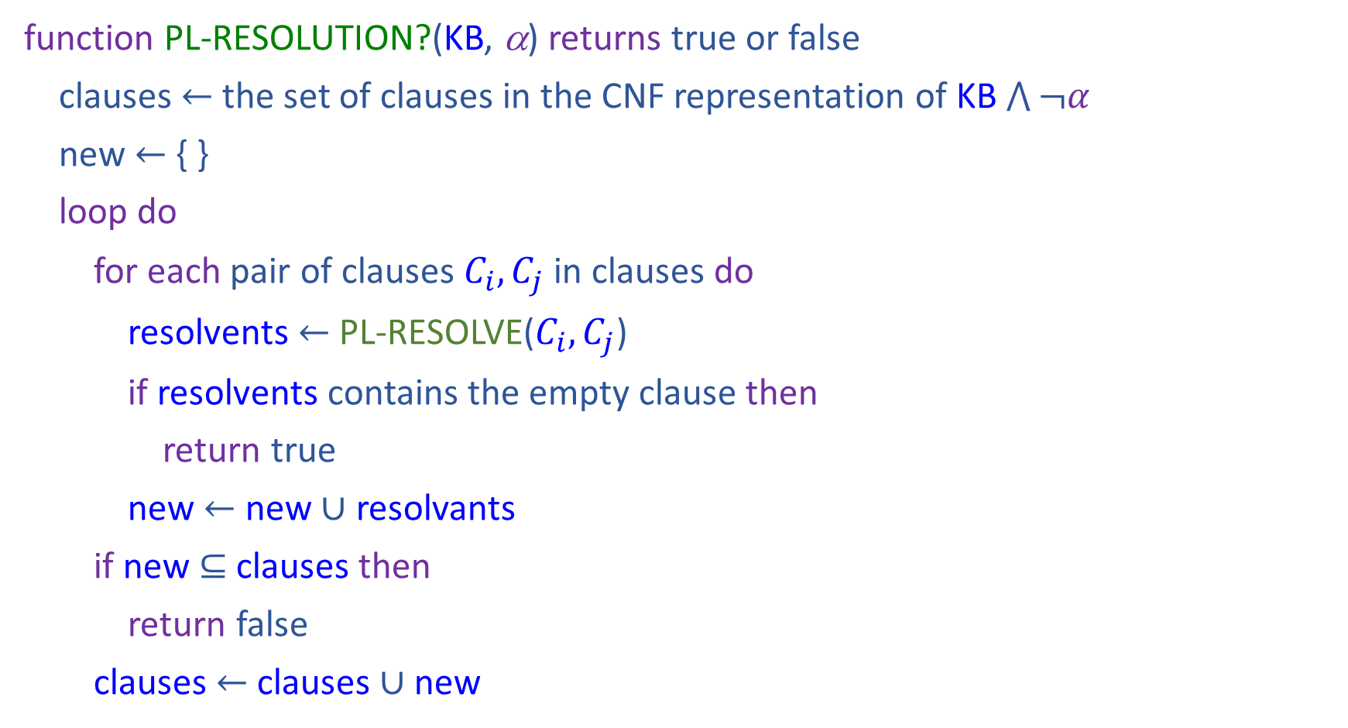

Resolution
function PL-RESOLUTION?(KB, α) returns true or false
clauses $←$ the set of clauses in the CNF representation of KB $\bigwedge{¬α}$
new $←${ }
loop do
for each pair of clauses $C_{i}, C_{j}$ in clauses do
resolvents $←$ PL-RESOLVE($C_{i}, C_{j}$)
if resolvents contains the empty clause then
return true
new $←$ new $∪$ resolvants
if new $⊆$ clauses then
return false
clauses $←$ clauses $∪$ new

Slide 32
Properties
Vocab Reminder
Literal
Atomic sentence:
T, F, Symbol, ¬Symbol
Clause
Disjunction of literals: $A ∨ B ∨ ¬C$
Definite clause
Disjunction of literals, exactly one is positive
$¬A ∨ B ∨ ¬C$
Forward Chaining is:
Sound and complete for definite-clause KBs
Complexity: linear time ☺
Resolution is another theorem-proving algorithm that is:
Sound and complete for any PL KBs!
Complexity: exponential time ☹

Slide 33
Outline
Logical Agent Algorithms
Vocab
PL_TRUE
Entailment
Model checking: Truth table entailment
Theorem proving:
(Forward chaining), resolution
Satisfiability: DPLL
Planning with logic

Slide 34
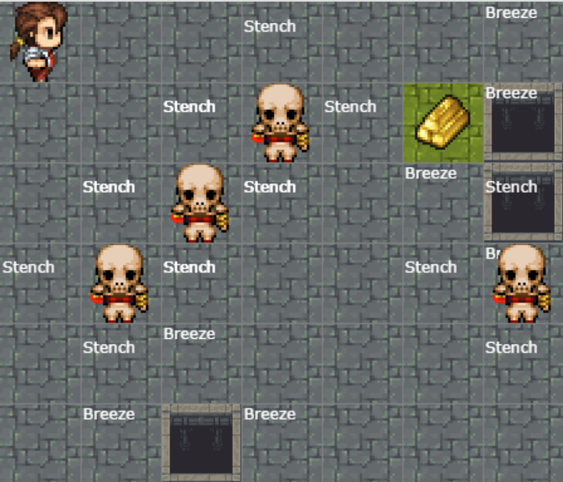
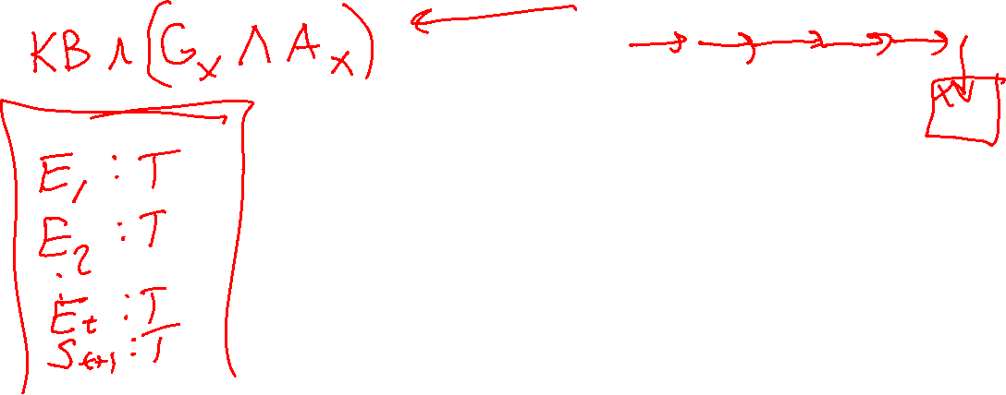
Satisfiability and Entailment
A sentence is satisfiable if it is true in at least one world (e.g. CSPs!)
http://thiagodnf.github.io/wumpus-world-simulator/

Slide 35

Satisfiability and Entailment
A sentence is satisfiable if it is true in at least one world (cf CSPs!)
Suppose we have a hyper-efficient SAT solver; how can we use it to test entailment?
Suppose α |= β
Then α ⇒ β is true in all worlds
Hence ¬(α ⇒ β) is false in all worlds
Hence α ∧ ¬β is false in all worlds, i.e., unsatisfiable
So, add the negated conclusion to what you know, test for (un)satisfiability; also known as reductio ad absurdum
Efficient SAT solvers operate on conjunctive normal form

Slide 36
Efficient SAT solvers
DPLL (Davis-Putnam-Logemann-Loveland) is the core of modern solvers
Essentially a backtracking search over models with some extras:
Early termination: stop if
all clauses are satisfied; e.g., (A ∨ B) ∧ (A ∨ ¬C) is satisfied by {A=true}
any clause is falsified; e.g., (A ∨ B) ∧ (A ∨ ¬C) is satisfied by {A=false, B=false}
Pure literals: if all occurrences of a symbol in as-yet-unsatisfied clauses have the same sign, then give the symbol that value
E.g., A is pure and positive in (A ∨ B) ∧ (A ∨ ¬C) ∧ (C ∨ ¬B) so set it to true
Unit clauses: if a clause is left with a single literal, set symbol to satisfy clause
E.g., if A=false, (A ∨ B) ∧ (A ∨ ¬C) becomes (false ∨ B) ∧ (false ∨ ¬C), i.e. (B) ∧ (¬C)
Satisfying the unit clauses often leads to further propagation, new unit clauses, etc.

Slide 37

DPLL algorithm
function DPLL(clauses, symbols, model) returns true or false
if every clause in clauses is true in model then return true if some clause in clauses is false in model then return false
P, value ←FIND-PURE-SYMBOL(symbols, clauses, model) if P is non-null then return DPLL(clauses, symbols–P, model∪{P=value})
P, value ←FIND-UNIT-CLAUSE(clauses, model) if P is non-null then return DPLL(clauses, symbols–P, model∪{P=value})
P ← First(symbols)
rest ← Rest(symbols)
return or(DPLL(clauses, rest, model∪{P=true}),
DPLL(clauses, rest, model∪{P=false}))

Slide 38
Outline
Logical Agent Algorithms
Vocab
PL_TRUE
Entailment
Model checking: Truth table entailment
Theorem proving:
(Forward chaining), resolution
Satisfiability: DPLL
Planning with logic

Slide 39
Planning as Satisfiability
Given a hyper-efficient SAT solver, can we use it to make plans?
Yes, for fully observable, deterministic case: planning problem is solvable iff there is some satisfying assignment for actions etc.

Slide 40
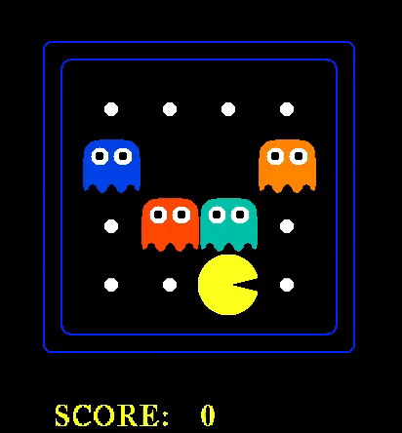

Slide 41
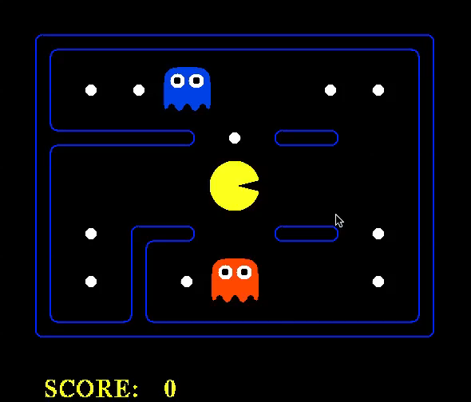

Slide 42
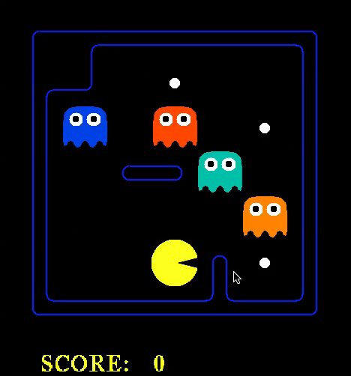

Slide 43
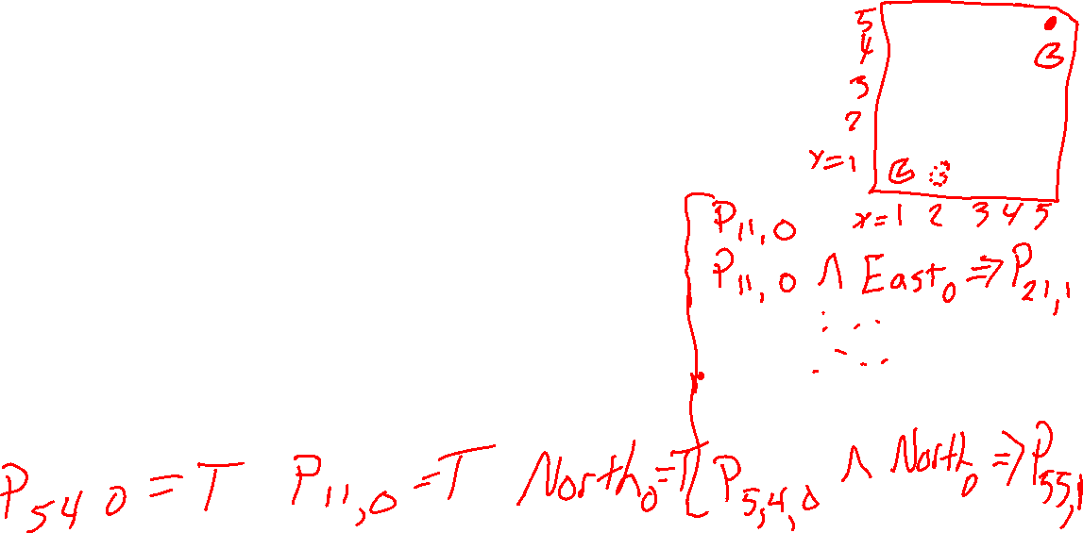
Planning as Satisfiability
Given a hyper-efficient SAT solver, can we use it to make plans?
Yes, for fully observable, deterministic case: planning problem is solvable iff there is some satisfying assignment for actions etc.
For T = 1 to infinity, set up the KB as follows and run SAT solver:
Initial state, domain constraints
Transition model sentences up to time T
Goal is true at time T
Precondition axioms: At_1,1_0 ∧ N_0 ⇒ ¬Wall_1,2 etc.
Action exclusion axioms: ¬(N_0 ∧ W_0) ∧ ¬(N_0 ∧ S_0) ∧ .. etc.

Slide 44
Initial State
The agent may know its initial location:
At_1,1_0
Or, it may not:
At_1,1_0 v At_1,2_0 v At_1,3_0 v … v At_3,3_0
We also need a domain constraint – cannot be in two places at once!
¬(At_1,1_0 ∧ At_1,2_0) ∧ ¬(At_1,1_0 ∧ At_1,3_0) ∧ …
¬(At_1,1_1 ∧ At_1,2_1) ∧ ¬(At_1,1_1 ∧ At_1,3_1) ∧ …
…

Slide 45
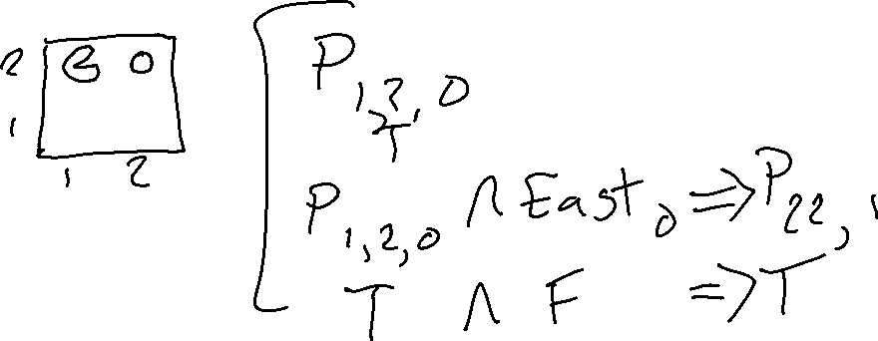
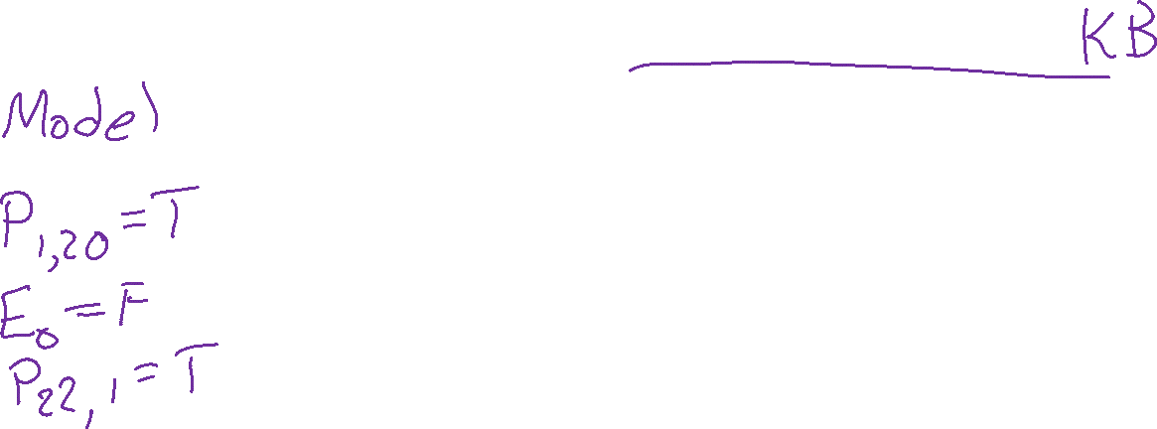
Fluents and Effect Axioms
A fluent is a state variable that changes over time
How does each state variable or fluent at each time gets its value?
Fluents for PL Pacman are Pacman_x,y_t , e.g., Pacman _3,3_17

Slide 46
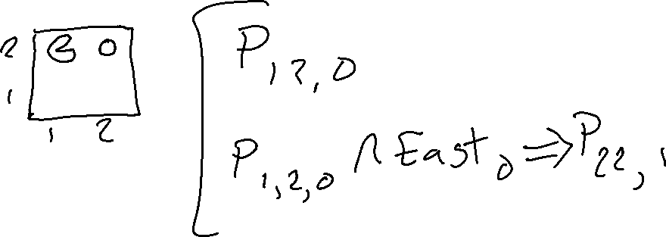
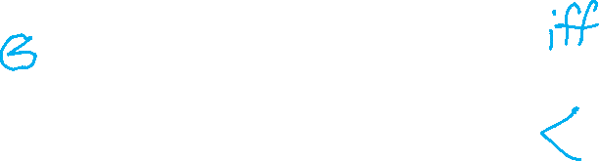
Fluents and Effect Axioms
A fluent is a state variable that changes over time
How does each state variable or fluent at each time gets its value?
Fluents for PL Pacman are Pacman_x,y_t , e.g., Pacman _3,3_17

Slide 47
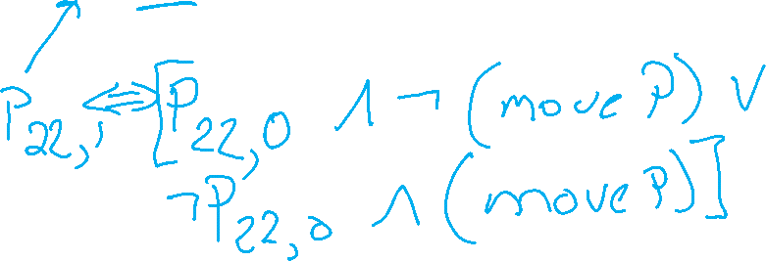
Fluents and Successor-state Axioms
A fluent is a state variable that changes over time
How does each state variable or fluent at each time gets its value?
Fluents for PL Pacman are Pacman_x,y_t , e.g., Pacman _3,3_17
A state variable gets its value according to a successor-state axiom
X_{t} ⇔ [X_{t-1} ∧ ¬(some action_{t-1} made it false)] v
[¬X_{t-1} ∧ (some action_{t-1} made it true)]

Slide 48
Fluents and Successor-state Axioms
A fluent is a state variable that changes over time
How does each state variable or fluent at each time gets its value?
Fluents for PL Pacman are Pacman_x,y_t , e.g., Pacman _3,3_17
A state variable gets its value according to a successor-state axiom
X_{t} ⇔ [X_{t-1} ∧ ¬(some action_{t-1} made it false)] v
[¬X_{t-1} ∧ (some action_{t-1} made it true)]
For Pacman location:
Pacman _3,3_17 ⇔ [Pacman _3,3_16 ∧ ¬((¬Wall_3,4 ∧ N_16) v (¬Wall_4,3 ∧ E_16) v …)]
v [¬ Pacman _3,3_16 ∧ ((Pacman _3,2_16 ∧ ¬Wall_3,3 ∧ N_16) v
(Pacman _2,3_16 ∧ ¬Wall_3,3 ∧ N_16) v …)]

Slide 49
Fluents and Successor-state Axioms
A fluent is a state variable that changes over time
How does each state variable or fluent at each time gets its value?
Fluents for PL Pacman are Pacman_x,y_t , e.g., Pacman _3,3_17
A state variable gets its value according to a successor-state axiom
X_{t} ⇔ [X_{t-1} ∧ ¬(some action_{t-1} made it false)] v
[¬X_{t-1} ∧ (some action_{t-1} made it true)]
For Pacman location:
Pacman _3,3_17 ⇔ [Pacman _3,3_16 ∧ ¬((¬Wall_3,4 ∧ N_16) v (¬Wall_4,3 ∧ E_16) v …)]
v [¬ Pacman _3,3_16 ∧ ((Pacman _3,2_16 ∧ ¬Wall_3,3 ∧ N_16) v
(Pacman _2,3_16 ∧ ¬Wall_3,3 ∧ N_16) v …)]

