Slide 1

AI: Representation and Problem Solving
Constraint Satisfaction Problems (CSPs)
Instructors: Fei Fang & Pat Virtue
Slide credits: CMU AI, http://ai.berkeley.edu

Slide 2


What is Search For?
Planning: sequences of actions
  The path to the goal is the important thing
  Paths have various costs, depths
  Heuristics give problem-specific guidance
Identification: assignments to variables
  The goal itself is important, not the path
  All paths at the same depth (for some formulations)
Are the warm-up assignments planning or identification problems?

Slide 3

Constraint Satisfaction Problems

Slide 4


Constraint Satisfaction Problems
CSP is a special class of search problems
  Mostly identification problems
  Have specialized algorithms for them
Standard search problems:
  State is a “black box”: arbitrary data structure
  Goal test can be any function over states
  Successor function can also be anything
Constraint satisfaction problems (CSPs):
  State is defined by variables X_{i} with values from a domain D (sometimes D depends on i)
  Goal test is a set of constraints specifying allowable combinations of values for subsets of variables
Notes:
Goal test has structure, it ‘s more like a manual describing a set of constraints that have to hold true

Slide 5
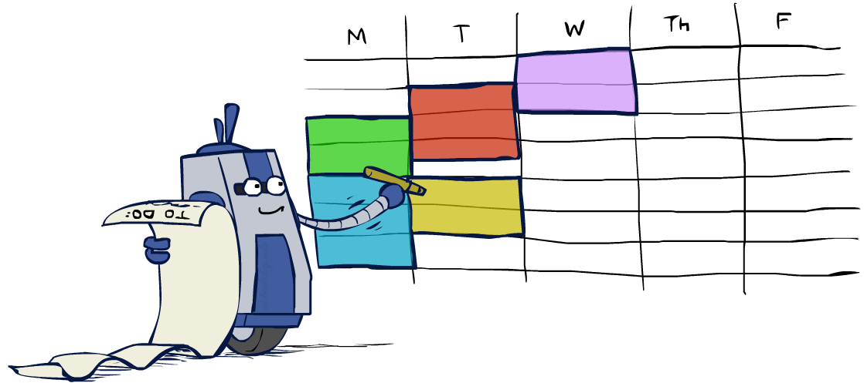
Why study CSPs?
Many real-world problems can be formulated as CSPs
Assignment problems: e.g., who teaches what class
Timetabling problems: e.g., which class is offered when and where?
Hardware configuration
Transportation scheduling
Factory scheduling
Circuit layout
Fault diagnosis
… lots more!
Sometimes involve real-valued variables…

Slide 6
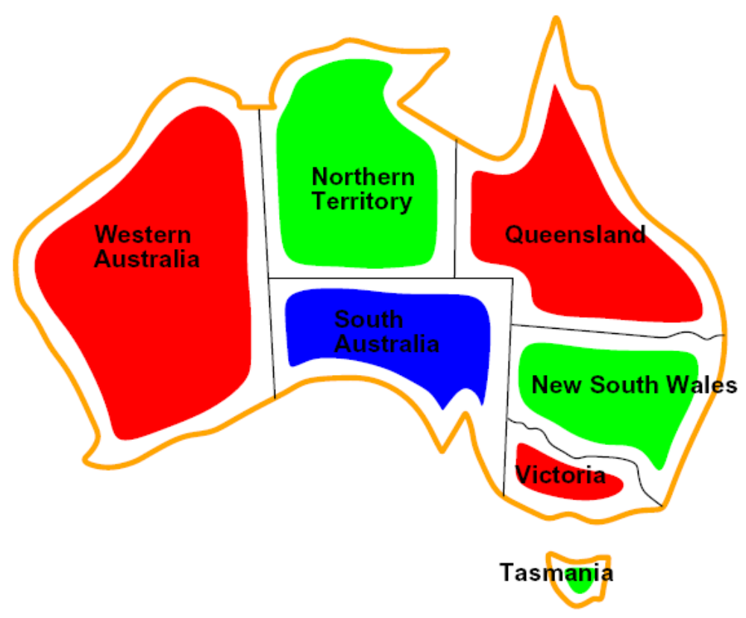
CSP Examples

Slide 7


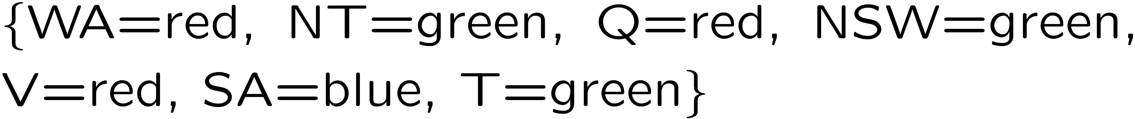
Example: Map Coloring
Variables:
Domains:
Constraints: adjacent regions must have different colors
Solutions are assignments satisfying all constraints, e.g.:
Implicit:
Explicit:

Slide 8
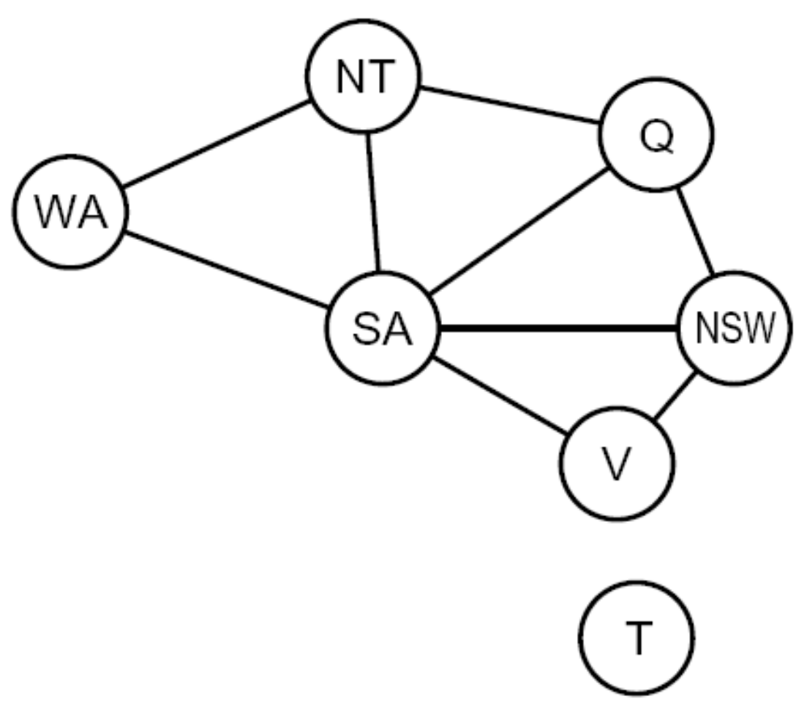
Constraint Graphs

Slide 9
Constraint Graphs
Binary CSP: each constraint relates (at most) two variables
Binary constraint graph: nodes are variables, arcs show constraints
General-purpose CSP algorithms use the graph structure to speed up search. E.g., Tasmania is an independent subproblem!
Notes:
Demo:
Run constraint.jar or constraint.exe, load the 5 queens problem.
Demo is just showing the n-queens applet as illustration of constraint graph, but later in lecture we’ll interact with the applet.
aispace.org will have the latest version

Slide 10

Varieties of CSPs and Constraints

Slide 11
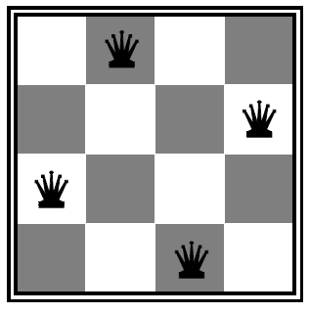

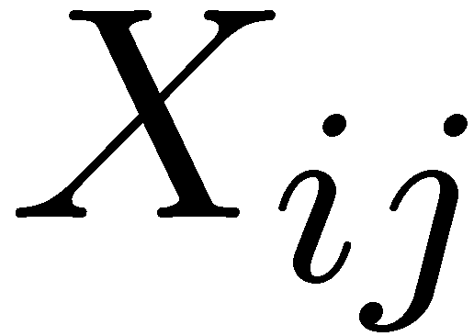

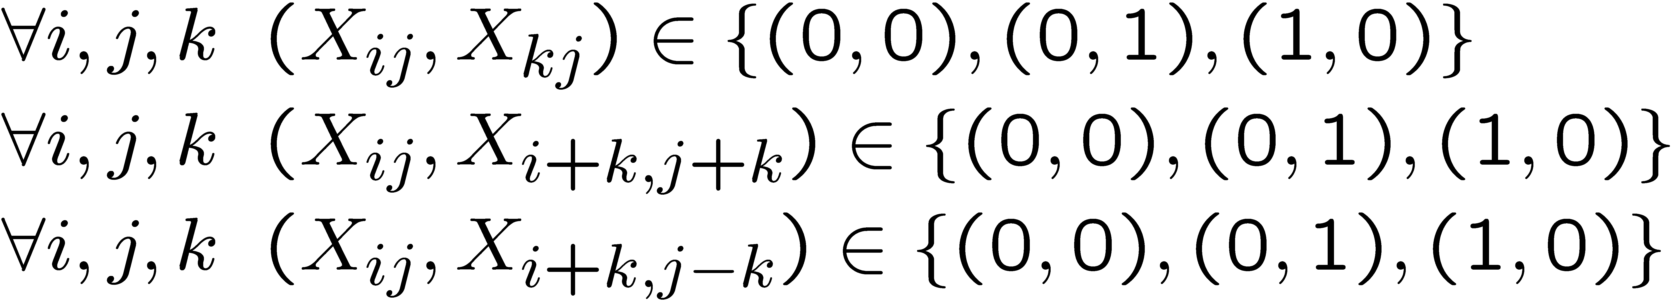
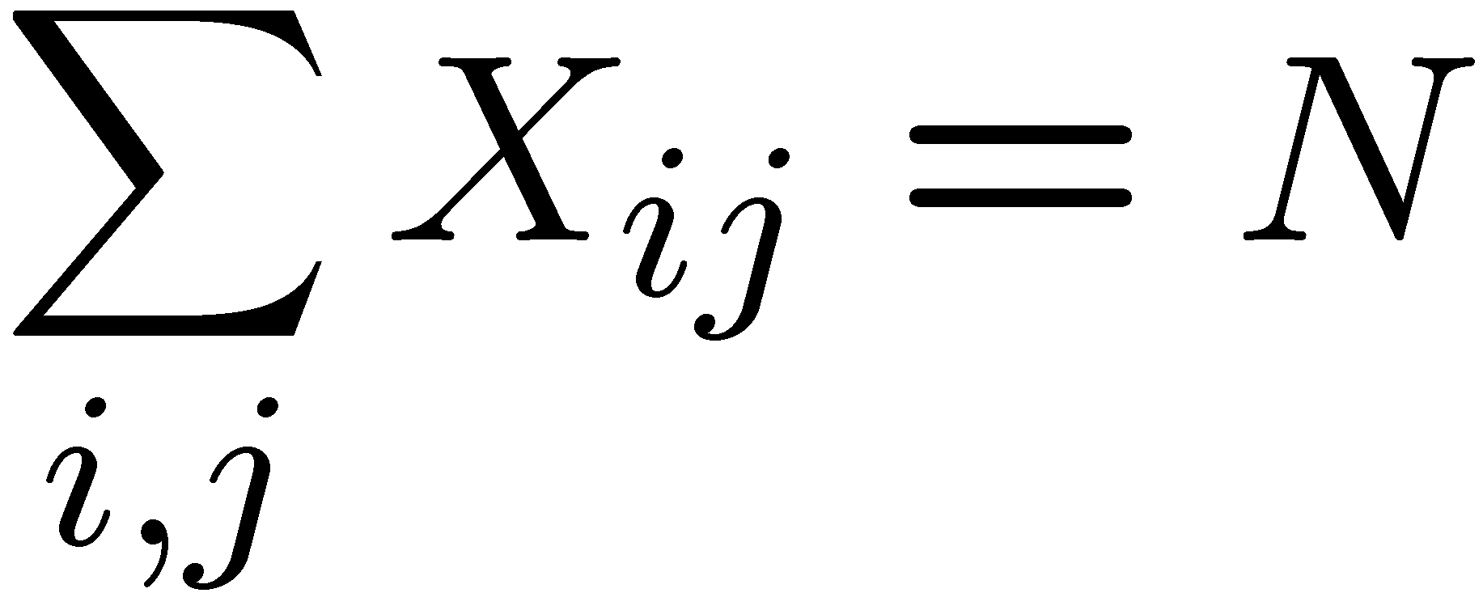
Example: N-Queens
Formulation 1:
  Variables:
  Domains:
  Constraints

Slide 12







Example: N-Queens
Formulation 2:
  Variables:
  Domains:
  Constraints:
Implicit:
Explicit:

Slide 13

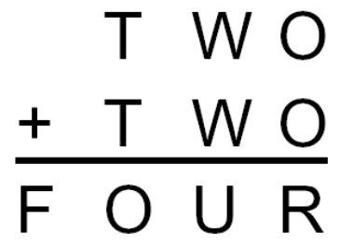

Example: Cryptarithmetic
Variables:
Domains:
Constraints:
Notes:
0=7, R=4, W=6, U=2, T=8, F=1; 867 + 867 = 1734

Slide 14
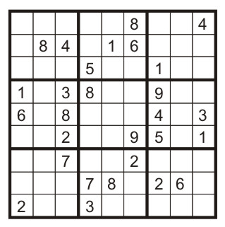
Example: Sudoku
Variables: Each (open) square
Domains: {1,2,…,9}
Constraints:
9-way alldiff for each column
9-way alldiff for each row
9-way alldiff for each region
(or can have a bunch of pairwise inequality constraints)

Slide 15


Varieties of CSPs
We will cover today
Discrete Variables
  Finite domains
    Size d means O(d^{n}) complete assignments
    E.g., Boolean CSPs, including Boolean satisfiability (NP-complete)
  Infinite domains (integers, strings, etc.)
    E.g., job scheduling, variables are start/end times for each job
    Linear constraints solvable, nonlinear undecidable
Continuous variables
  E.g., start/end times for Hubble Telescope observations
  Linear constraints solvable in polynomial time
We will cover in later lecture (linear programming)

Slide 16


Varieties of Constraints
Varieties of Constraints
  Unary constraints involve a single variable (equivalent to reducing domains), e.g.:
  Binary constraints involve pairs of variables, e.g.:
  Higher-order constraints involve 3 or more variables:
  e.g., cryptarithmetic column constraints
Focus of today
Preferences (soft constraints):
  E.g., red is better than green
  Often representable by a cost for each variable assignment
  Gives constrained optimization problems

Slide 17

Solving CSPs

Slide 18

Standard Search Formulation
Standard search formulation of CSPs
States defined by the values assigned so far (partial assignments)
  Initial state: the empty assignment, {}
  Successor function: assign a value to an unassigned variable
  Goal test: the current assignment is complete and satisfies all constraints
We’ll start with the straightforward, naïve approach, then improve it
$→$Can be any unassigned variable

Slide 19
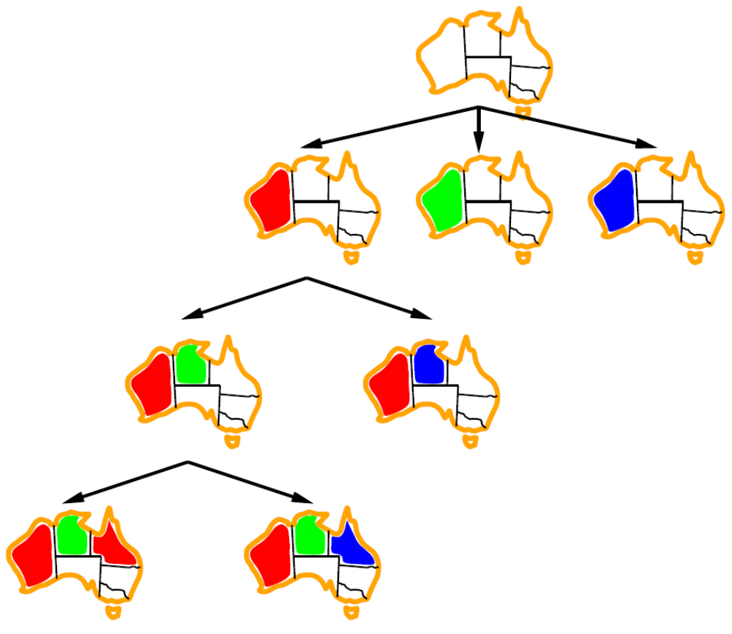
Depth First Search
At each node, assign a value from the domain to the variable
Check feasibility (constraints) when the assignment is complete

Slide 20
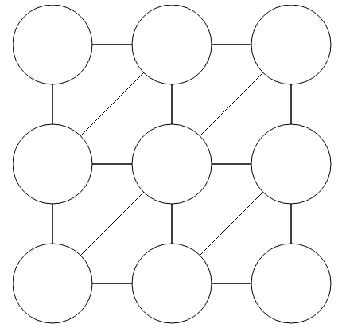
Demo – Naïve Search
Keep these questions in mind:
Q1. How is the naïve search process in the demo different from the DFS process we just described?
Q2. Why the naïve search is “naïve”? How to make it more efficient?

Slide 21

Backtracking Search

Slide 22
Backtracking Search
Backtracking search is the basic uninformed algorithm for solving CSPs
Backtracking search = DFS + two improvements
Idea 1: One variable at a time
  Variable assignments are commutative
    [WA = red then NT = green] same as [NT = green then WA = red]
  Only need to consider assign value to a single variable at each step
Idea 2: Check constraints as you go
  Consider only values which do not conflict previous assignments
  May need some computation to check the constraints
  “Incremental goal test”
Can solve n-queens for n ≈ 25

Slide 23

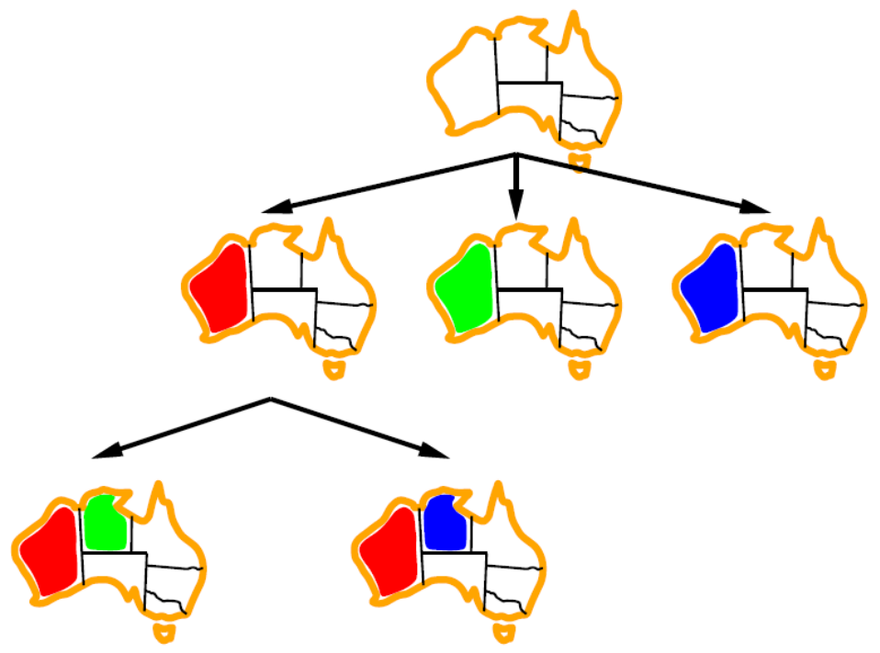
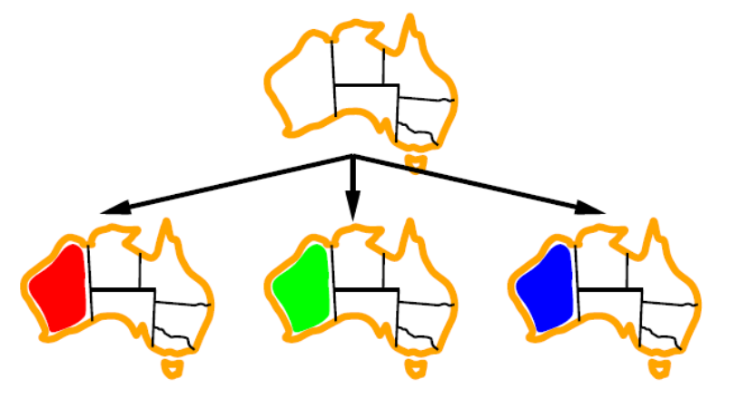
Backtracking Example

Slide 24
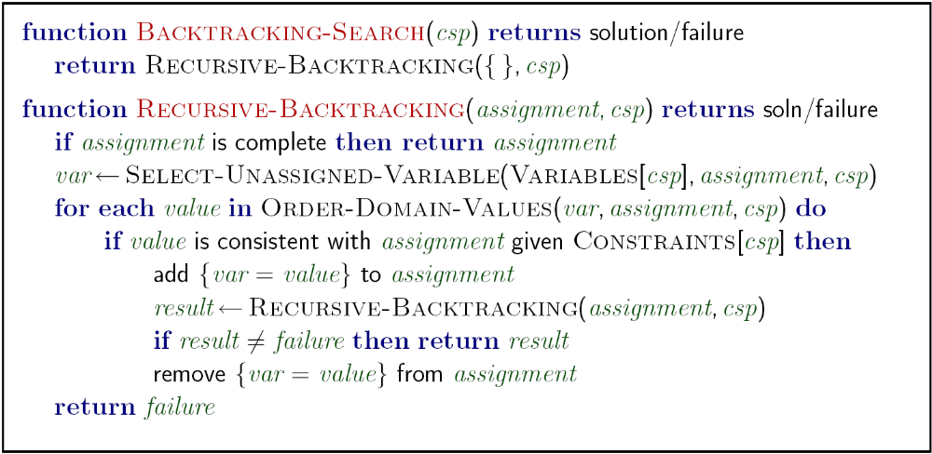
Backtracking Search
Notes:
Demo:
CS188 javascript demos -> source -> exercises -> csps -> CSPs demos -> CSPs demos.html
Settings:
Graph = Simple
Algorithm = Backtracking
Ordering = None
Filtering = None

Slide 25
Backtracking Search
No need to check consistency for a complete assignment
Notes:
Demo:
CS188 javascript demos -> source -> exercises -> csps -> CSPs demos -> CSPs demos.html
Settings:
Graph = Simple
Algorithm = Backtracking
Ordering = None
Filtering = None

Slide 26
Backtracking Search
Checks consistency at each assignment
Notes:
Demo:
CS188 javascript demos -> source -> exercises -> csps -> CSPs demos -> CSPs demos.html
Settings:
Graph = Simple
Algorithm = Backtracking
Ordering = None
Filtering = None

Slide 27
Backtracking Search
Backtracking = DFS + variable-ordering + fail-on-violation
What are the choice points?
Notes:
Demo:
CS188 javascript demos -> source -> exercises -> csps -> CSPs demos -> CSPs demos.html
Settings:
Graph = Simple
Algorithm = Backtracking
Ordering = None
Filtering = None

Slide 28
Demo – Backtracking

Slide 29

Improving Backtracking
General-purpose ideas give huge gains in speed
Filtering: Can we detect inevitable failure early?
Ordering:
  Which variable should be assigned next?
  In what order should its values be tried?
Structure: Can we exploit the problem structure?

Slide 30

Filtering

Slide 31
Filtering: Forward Checking
Filtering: Keep track of domains for unassigned variables and cross off bad options
Forward checking: A simple way for filtering
  After a variable is assigned a value, check related constraints and cross off values of unassigned variables which violate the constraints
  Failure detected if some variables have no values remaining
Notes:
Demo:
CS188 javascript demos -> source -> exercises -> csps -> CSPs demos -> CSPs demos.html
Settings:
Graph = Simple
Algorithm = Backtracking
Ordering = None
Filtering = Forward Checking

Slide 32
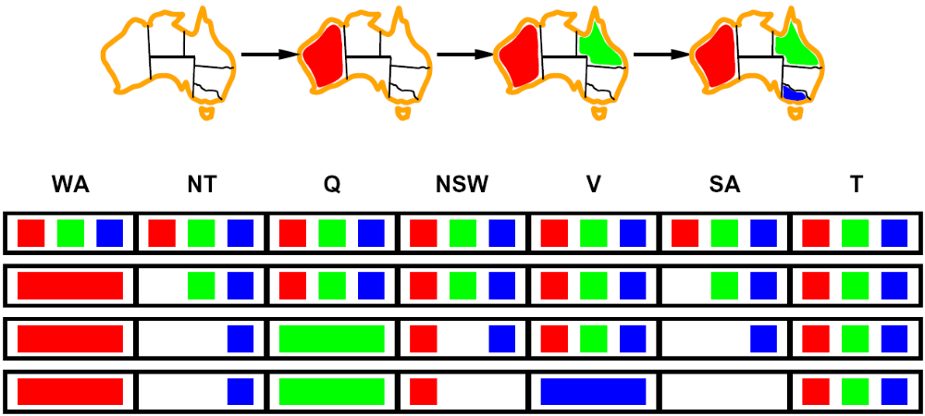
Filtering: Forward Checking
Filtering: Keep track of domains for unassigned variables and cross off bad options
Forward checking: A simple way for filtering
  After a variable is assigned a value, check related constraints and cross off values of unassigned variables which violate the constraints
  Failure detected if some variables have no values remaining
NT
Q
WA
SA
NSW
V
T
Notes:
Demo:
CS188 javascript demos -> source -> exercises -> csps -> CSPs demos -> CSPs demos.html
Settings:
Graph = Simple
Algorithm = Backtracking
Ordering = None
Filtering = Forward Checking

Slide 33
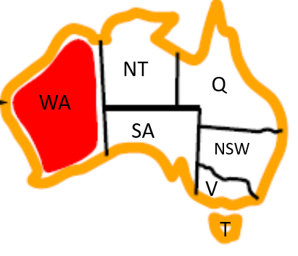
Filtering: Forward Checking
Filtering: Keep track of domains for unassigned variables and cross off bad options
Forward checking: A simple way for filtering
  After a variable is assigned a value, check related constraints and cross off values of unassigned variables which violate the constraints
  Failure detected if some variables have no values remaining
Recall: Binary constraint graph for a binary CSP (i.e., each constraint has most two variables): nodes are variables, edges show constraints
Notes:
Demo:
CS188 javascript demos -> source -> exercises -> csps -> CSPs demos -> CSPs demos.html
Settings:
Graph = Simple
Algorithm = Backtracking
Ordering = None
Filtering = Forward Checking

Slide 34
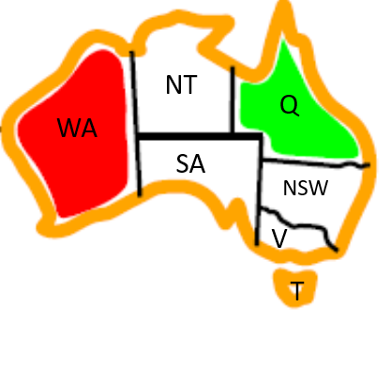
Filtering: Forward Checking
Filtering: Keep track of domains for unassigned variables and cross off bad options
Forward checking: A simple way for filtering
  After a variable is assigned a value, check related constraints and cross off values of unassigned variables which violate the constraints
  Failure detected if some variables have no values remaining
Notes:
Demo:
CS188 javascript demos -> source -> exercises -> csps -> CSPs demos -> CSPs demos.html
Settings:
Graph = Simple
Algorithm = Backtracking
Ordering = None
Filtering = Forward Checking

Slide 35
Filtering: Forward Checking
Filtering: Keep track of domains for unassigned variables and cross off bad options
Forward checking: A simple way for filtering
  After a variable is assigned a value, check related constraints and cross off values of unassigned variables which violate the constraints
  Failure detected if some variables have no values remaining
FAIL – variable with no possible values
Notes:
Demo:
CS188 javascript demos -> source -> exercises -> csps -> CSPs demos -> CSPs demos.html
Settings:
Graph = Simple
Algorithm = Backtracking
Ordering = None
Filtering = Forward Checking

Slide 36
Demo – Backtracking with Forward Checking

Slide 37
Filtering: Constraint Propagation
Limitations of simple forward checking: propagates information from assigned to unassigned variables, but doesn't provide early detection for all failures
  NT and SA cannot both be blue! Why didn’t we detect this yet?
Constraint propagation: reason from constraint to constraint
Notes:
Demo:
CS188 javascript demos -> source -> exercises -> csps -> CSPs demos -> CSPs demos.html
Settings:
Graph = Simple
Algorithm = Backtracking
Ordering = None
Filtering = Forward Checking

Slide 38

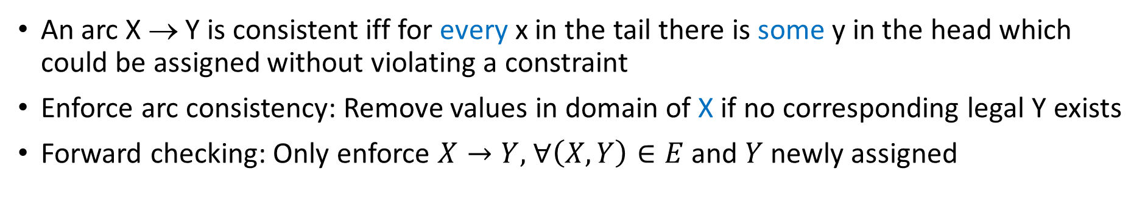
Consistency of A Single Arc
An arc X → Y is consistent iff for every x in the tail there is some y in the head which could be assigned without violating a constraint
Enforce arc consistency: Remove values in domain of X if no corresponding legal Y exists
Forward checking: Only enforce $X→Y,$ $∀\left(X,Y\right)∈E$ and $Y$ newly assigned
(Remove values from the tail!)
Recall: Binary constraint graph for a binary CSP (i.e., each constraint has most two variables): nodes are variables, edges show constraints

Slide 39
Consistency of A Single Arc
An arc X → Y is consistent iff for every x in the tail there is some y in the head which could be assigned without violating a constraint
Enforce arc consistency: Remove values in domain of X if no corresponding legal Y exists
Forward checking: Only enforce $X→Y,$ $∀\left(X,Y\right)∈E$ and $Y$ newly assigned

Slide 40
How to Enforce Arc Consistency of Entire CSP
A simplistic algorithm: Cycle over the pairs of variables, enforcing arc-consistency, repeating the cycle until no domains change for a whole cycle
AC-3 (short for Arc Consistency Algorithm #3): A more efficient algorithm ignoring constraints that have not been modified since they were last analyzed
NT
Q
WA
SA
NSW
V
T

Slide 41
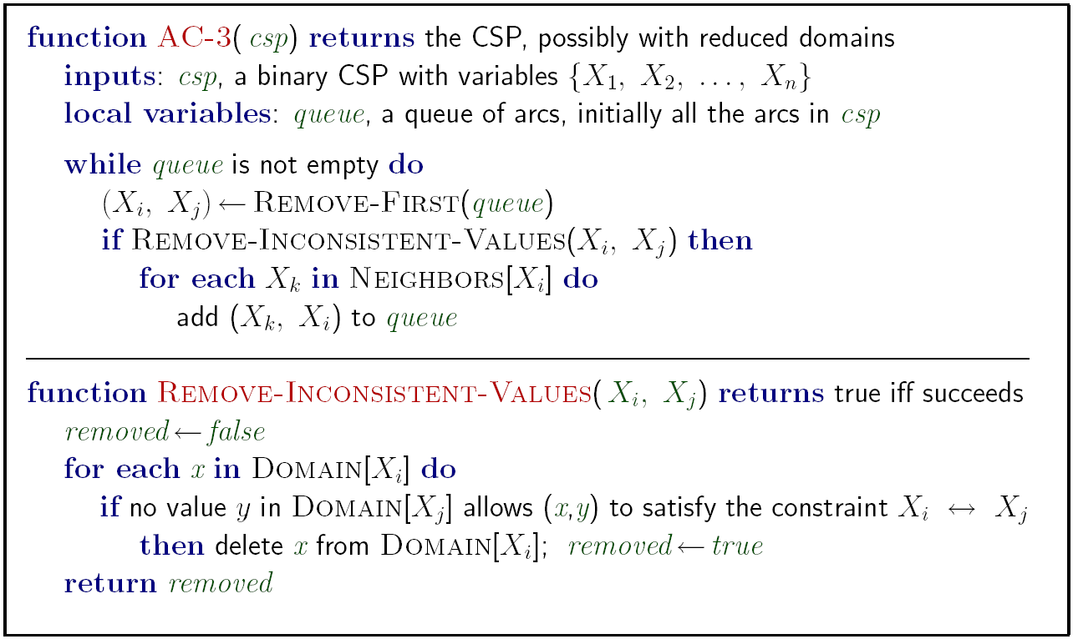
AC-3: Enforce Arc Consistency of Entire CSP
Constraint Propagation!
Notes:
Auto-consistency (note initially nothing gets deleted/pruned since there are consistent options for all constraints for initial variable domains)
Flashes whenever something needs to be re-checked

Slide 42
AC-3: Enforce Arc Consistency of Entire CSP
Queue:
SA->WA
NT->WA
NT
Q
WA
SA
NSW
V
T
Remember: Delete from the tail!

Slide 43
AC-3: Enforce Arc Consistency of Entire CSP
Queue:
NT->WA
WA->SA
NT->SA
Q->SA
NSW->SA
V->SA
NT
Q
WA
SA
NSW
V
T
Remember: Delete from the tail!

Slide 44
AC-3: Enforce Arc Consistency of Entire CSP
Queue:
WA->SA
NT->SA
Q->SA
NSW->SA
V->SA
WA->NT
SA->NT
Q->NT
NT
Q
WA
SA
NSW
V
T
Remember: Delete from the tail!

Slide 45
AC-3: Enforce Arc Consistency of Entire CSP
Queue:
WA->SA
NT->SA
Q->SA
NSW->SA
V->SA
WA->NT
SA->NT
Q->NT
NT
Q
WA
SA
NSW
V
T
Remember: Delete from the tail!

Slide 46
AC-3: Enforce Arc Consistency of Entire CSP
Queue:
NT->SA
Q->SA
NSW->SA
V->SA
WA->NT
SA->NT
Q->NT
NT
Q
WA
SA
NSW
V
T
Remember: Delete from the tail!

Slide 47
AC-3: Enforce Arc Consistency of Entire CSP
Queue:
Q->SA
NSW->SA
V->SA
WA->NT
SA->NT
Q->NT
NT
Q
WA
SA
NSW
V
T
Remember: Delete from the tail!

Slide 48
AC-3: Enforce Arc Consistency of Entire CSP
Queue:
NSW->SA
V->SA
WA->NT
SA->NT
Q->NT
NT
Q
WA
SA
NSW
V
T
Remember: Delete from the tail!

Slide 49
AC-3: Enforce Arc Consistency of Entire CSP
Queue:
NT
Q
WA
SA
NSW
V
T
Remember: Delete from the tail!

Slide 50
AC-3: Enforce Arc Consistency of Entire CSP
Queue:
NT->Q
SA->Q
NSW->Q
NT
Q
WA
SA
NSW
V
T
Remember: Delete from the tail!

Slide 51
AC-3: Enforce Arc Consistency of Entire CSP
Queue:
SA->Q
NSW->Q
WA->NT
SA->NT
Q->NT
NT
Q
WA
SA
NSW
V
T
Remember: Delete from the tail!

Slide 52
AC-3: Enforce Arc Consistency of Entire CSP
Queue:
NSW->Q
WA->NT
SA->NT
Q->NT
WA->SA
NT->SA
Q->SA
NSW->SA
V->SA
NT
Q
WA
SA
NSW
V
T
Remember: Delete from the tail!

Slide 53
AC-3: Enforce Arc Consistency of Entire CSP
Queue:
WA->NT
SA->NT
Q->NT
WA->SA
NT->SA
Q->SA
NSW->SA
V->SA
V->NSW
Q->NSW
SA->NSW
NT
Q
WA
SA
NSW
V
T
Remember: Delete from the tail!

Slide 54
AC-3: Enforce Arc Consistency of Entire CSP
Queue:
WA->NT
SA->NT
Q->NT
WA->SA
NT->SA
Q->SA
NSW->SA
V->SA
V->NSW
Q->NSW
SA->NSW
NT
Q
WA
SA
NSW
V
T
Remember: Delete from the tail!

Slide 55
AC-3: Enforce Arc Consistency of Entire CSP
Queue:
SA->NT
Q->NT
WA->SA
NT->SA
Q->SA
NSW->SA
V->SA
V->NSW
Q->NSW
SA->NSW
NT
Q
WA
SA
NSW
V
T
!!!
Remember: Delete from the tail!

Slide 56
AC-3: Enforce Arc Consistency of Entire CSP
Queue:
SA->NT
Q->NT
WA->SA
NT->SA
Q->SA
NSW->SA
V->SA
V->NSW
Q->NSW
SA->NSW
Backtrack on the assignment of Q
Arc consistency detects failure earlier than forward checking
Can be run as a preprocessor or after each assignment
What’s the downside of enforcing arc consistency?
NT
Q
WA
SA
NSW
V
T
!!!
Remember: Delete from the tail!

Slide 57
Limitations of Arc Consistency
After enforcing arc consistency:
  Can have one solution left
  Can have multiple solutions left
  Can have no solutions left (and not know it)
Arc consistency only checks local consistency conditions
Arc consistency still runs inside a backtracking search!
What went wrong here?
Notes:
Demo:
CS188 javascript demos -> source -> exercises -> csps -> CSPs demos -> CSPs demos.html
Settings:
Graph = Complex
Algorithm = Backtracking
Ordering = None
Filtering = Forward Checking (first) / Arc Consistency (second)

Slide 58

Backtracking Search with AC-3
AC-3($csp$)
Where do you run AC-3?
Notes:
Demo:
CS188 javascript demos -> source -> exercises -> csps -> CSPs demos -> CSPs demos.html
Settings:
Graph = Simple
Algorithm = Backtracking
Ordering = None
Filtering = None

Slide 59
Demo – Backtracking with AC-3

Slide 60
Demo – Coloring with a Complex Graph
Compare
Backtracking with Forward Checking
Backtracking with AC-3

Slide 61
Complexity of a single run of AC-3
Recall that the whole backtracking algorithm with AC-3 will call AC-3 many times
Notes:
Auto-consistency (note initially nothing gets deleted/pruned since there are consistent options for all constraints for initial variable domains)
Flashes whenever something needs to be re-checked

Slide 62
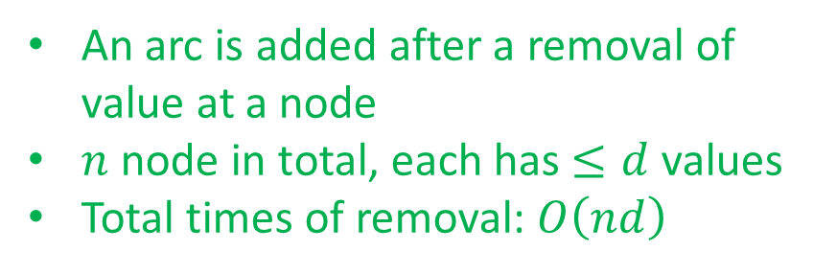
Complexity of a single run of AC-3
An arc is added after a removal of value at a node
$n$ node in total, each has $≤d$ values
Total times of removal: $O\left(nd\right)$
Notes:
Auto-consistency (note initially nothing gets deleted/pruned since there are consistent options for all constraints for initial variable domains)
Flashes whenever something needs to be re-checked

Slide 63
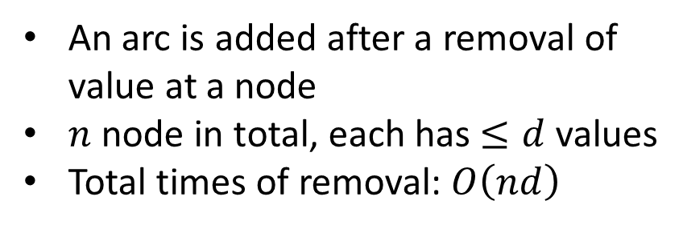
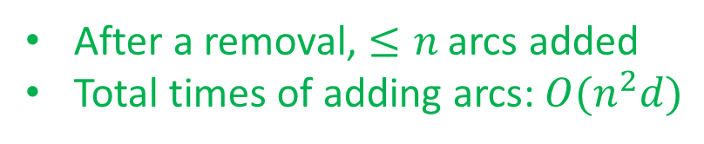
Complexity of a single run of AC-3
An arc is added after a removal of value at a node
$n$ node in total, each has $≤d$ values
Total times of removal: $O\left(nd\right)$
After a removal, $≤n$ arcs added
Total times of adding arcs: $O(n^{2}d)$
Notes:
Auto-consistency (note initially nothing gets deleted/pruned since there are consistent options for all constraints for initial variable domains)
Flashes whenever something needs to be re-checked

Slide 64
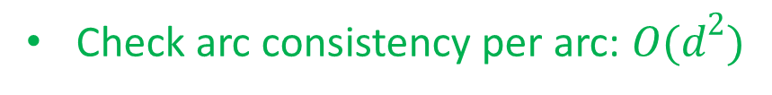
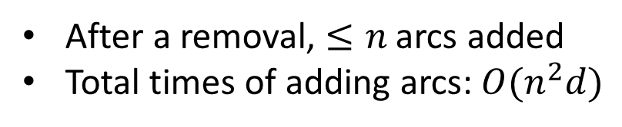
Complexity of a single run of AC-3
An arc is added after a removal of value at a node
$n$ node in total, each has $≤d$ values
Total times of removal: $O\left(nd\right)$
After a removal, $≤n$ arcs added
Total times of adding arcs: $O(n^{2}d)$
Check arc consistency per arc: $O(d^{2})$
Complexity of a single run of AC-3 is at most $O(n^{2}d^{3})$
(Not required) Zhang&Yap (2001) show that its complexity is $O(n^{2}d^{2})$
Notes:
Auto-consistency (note initially nothing gets deleted/pruned since there are consistent options for all constraints for initial variable domains)
Flashes whenever something needs to be re-checked

Slide 65

Ordering

Slide 66

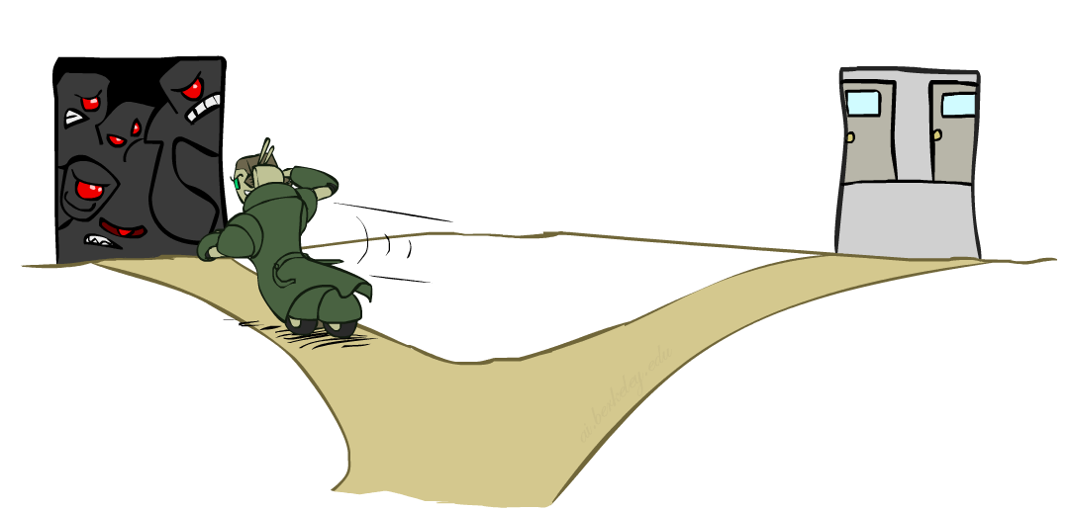
Ordering: Minimum Remaining Values
Variable Ordering: Minimum remaining values (MRV):
  Choose the variable with the fewest legal left values in its domain
Why min rather than max?
Also called “most constrained variable”
“Fail-fast” ordering

Slide 67
Demo – Coloring with a Complex Graph
Compare
Backtracking with Forward Checking
Backtracking with AC-3
Backtracking + Forward Checking + Minimum Remaining Values (MRV)

Slide 68
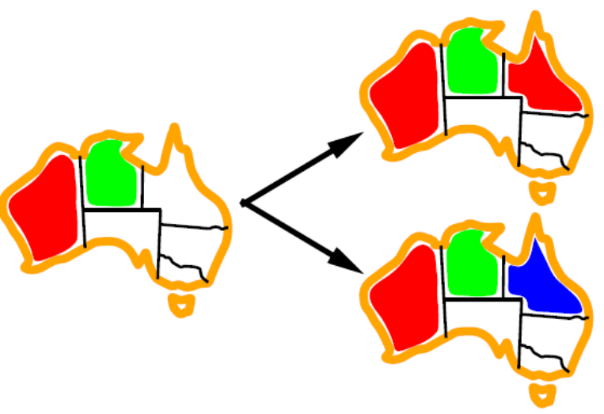
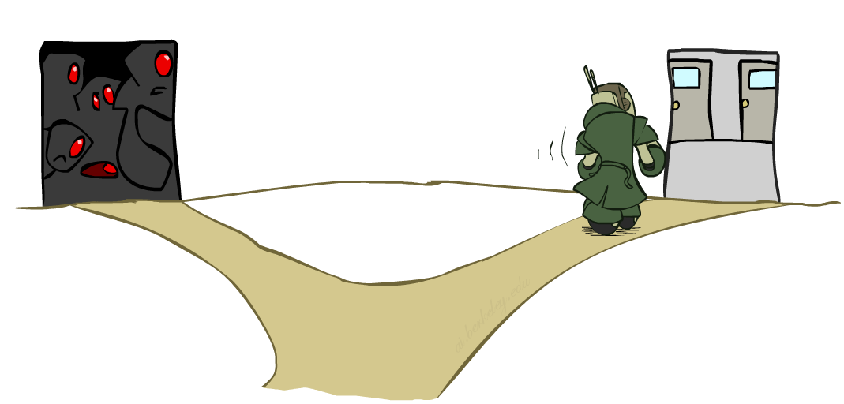
Ordering: Least Constraining Value
Value Ordering: Least Constraining Value
  Given a choice of variable, choose the least constraining value
  i.e., the one that rules out the fewest values in the remaining variables
  Note that it may take some computation to determine this! (E.g., rerunning filtering)
Why least rather than most?
Combining these ordering ideas makes
1000 queens feasible

Slide 69
Demo – Coloring with a Complex Graph
Compare
Backtracking with Forward Checking
Backtracking with AC-3
Backtracking + Forward Checking + Minimum Remaining Values (MRV)
Backtracking + AC-3 + MRV + LCV

Slide 70
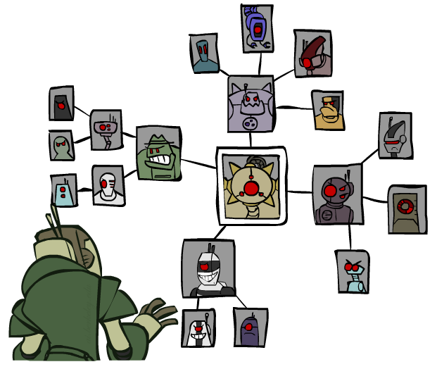
Structure

Slide 71
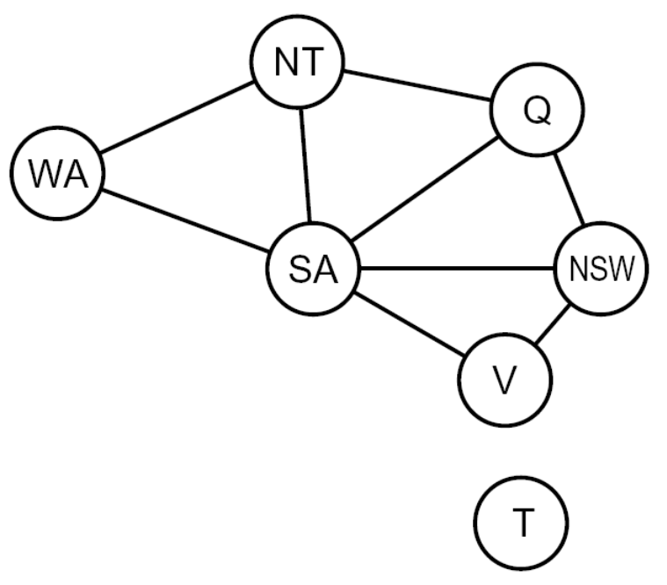
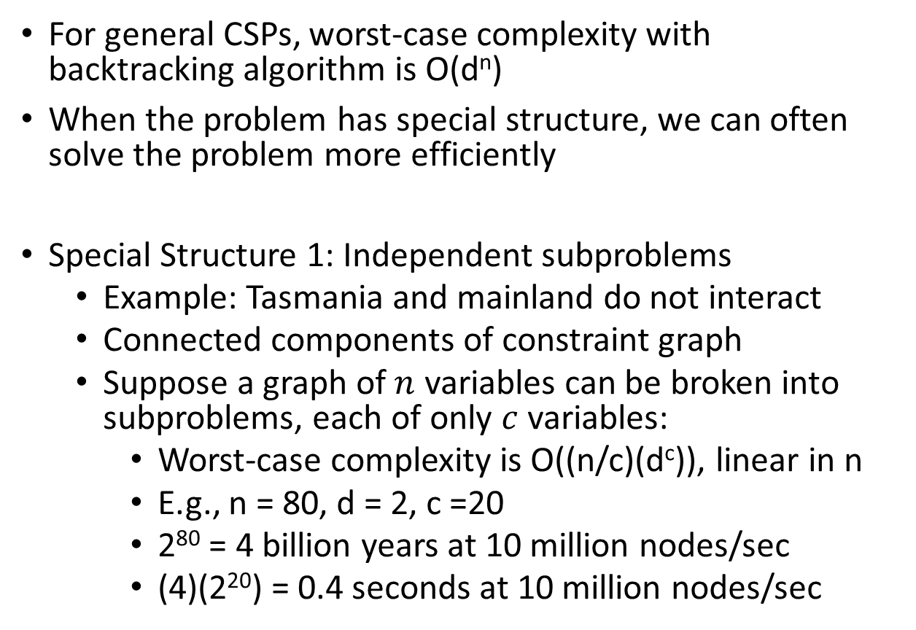
Problem Structure
For general CSPs, worst-case complexity with backtracking algorithm is O(d^{n})
When the problem has special structure, we can often solve the problem more efficiently
Special Structure 1: Independent subproblems
  Example: Tasmania and mainland do not interact
  Connected components of constraint graph
  Suppose a graph of $n$ variables can be broken into subproblems, each of only $c$ variables:
    Worst-case complexity is O((n/c)(d^{c})), linear in n
    E.g., n = 80, d = 2, c =20
    2⁸⁰ = 4 billion years at 10 million nodes/sec
    (4)(2²⁰) = 0.4 seconds at 10 million nodes/sec

Slide 72
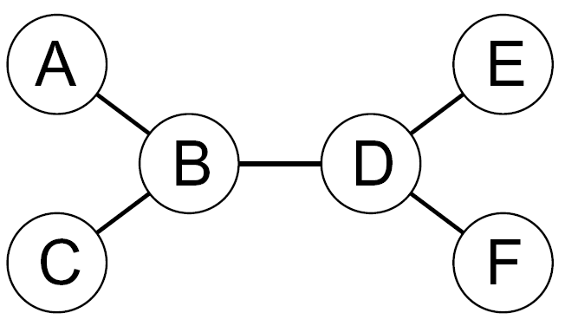
Tree-Structured CSPs
Theorem: if the constraint graph has no loops, the CSP can be solved in O(nd²) time
  Much smaller compare to general CSPs, where worst-case time is O(d^{n})
  How?

Slide 73
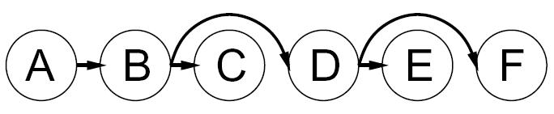

Tree-Structured CSPs
Algorithm for tree-structured CSPs:
  Order: Choose a root variable, order variables so that parents precede children

Slide 74

Tree-Structured CSPs
Algorithm for tree-structured CSPs:
  Order: Choose a root variable, order variables so that parents precede children
  Remove backward: For i = n : 2, apply RemoveInconsistent(Parent(X_{i}),X_{i})

Slide 75
Tree-Structured CSPs
Algorithm for tree-structured CSPs:
  Order: Choose a root variable, order variables so that parents precede children
  Remove backward: For i = n : 2, apply RemoveInconsistent(Parent(X_{i}),X_{i})
  Assign forward: For i = 1 : n, assign X_{i} consistently with Parent(X_{i})
Runtime: O(nd²) (why?)

Slide 76
Tree-Structured CSPs
Claim 1: After backward pass, all root-to-leaf arcs are consistent
Proof: Each X→Y was made consistent at one point and Y’s domain could not have been reduced thereafter (because Y’s children were processed before Y)

Slide 77
Tree-Structured CSPs
Claim 2: If root-to-leaf arcs are consistent, forward assignment will not backtrack
Proof: Induction on position

Slide 78
Tree-Structured CSPs
Why doesn’t this algorithm work with cycles in the constraint graph?
Note: we’ll see this basic idea again with Bayes’ nets

Slide 79
How to deal with non-binary CSPs?
Variables:
Domains:
Constraints:
Notes:
0=7, R=4, W=6, U=2, T=8, F=1; 867 + 867 = 1734

Slide 80
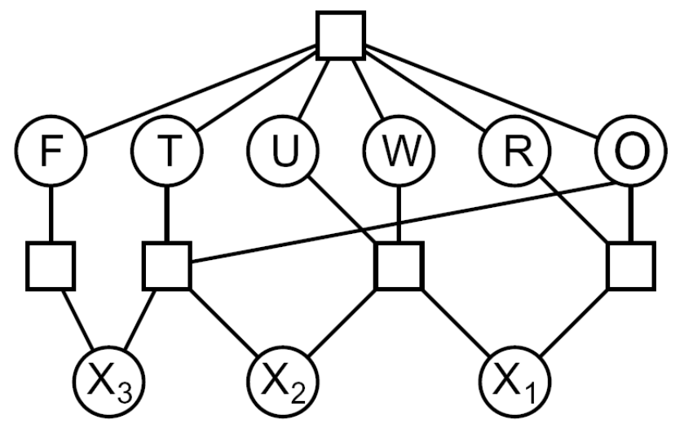
Constraint graph for non-binary CSPs
Variable nodes: nodes to represent the variables
Constraint nodes: auxiliary nodes to represent the constraints
Edges: connects a constraint node and its corresponding variables
Constraints:

Slide 81
Solve non-binary CSPs
Naïve search?
  Yes!
Backtracking?
  Yes!
Forward Checking?
  Need to generalize the original FC operation
  (nFC0) After a variable is assigned a value, find all constraints with only one unassigned variable and cross off values of that unassigned variable which violate the constraint
  There exist other ways to do generalized forward checking

Slide 82
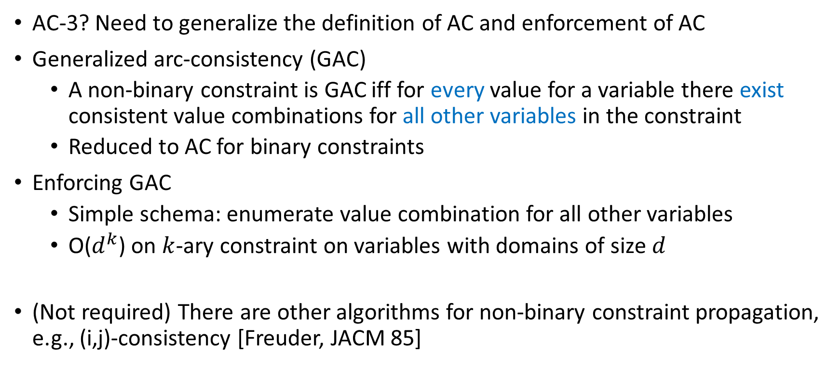
Solve non-binary CSPs
AC-3? Need to generalize the definition of AC and enforcement of AC
Generalized arc-consistency (GAC)
  A non-binary constraint is GAC iff for every value for a variable there exist consistent value combinations for all other variables in the constraint
  Reduced to AC for binary constraints
Enforcing GAC
  Simple schema: enumerate value combination for all other variables
  O($d^{k}$) on $k$-ary constraint on variables with domains of size $d$
(Not required) There are other algorithms for non-binary constraint propagation, e.g., (i,j)-consistency [Freuder, JACM 85]

Slide 83
Summary: CSPs
CSPs are a special kind of search problem:
  States are partial assignments
  Goal test defined by constraints
Basic solution: backtracking search
Speed-ups:
  Ordering
  Filtering
  Structure

Slide 84
Additional Resources (Not required)
Demos, exercises: http://aispace.org/
References
  Zhang, Yuanlin, and Roland HC Yap. "Making AC-3 an optimal algorithm." In IJCAI, vol. 1, pp. 316-321. 2001.
  Freuder, Eugene C. "A sufficient condition for backtrack-bounded search." Journal of the ACM (JACM) 32, no. 4 (1985): 755-761.

