Slide 1
Announcements
Midterm 1 Exam
Tue 10/1, in class
Assignments:
HW4
    Due tonight, 10 pm
P2: Logic and Planning
    Due Sat 10/5, 10 pm

Slide 2
AI: Representation and Problem Solving
Classical Planning
Instructors: Pat Virtue & Fei Fang
Slide credits: CMU AI

Slide 3





Planning as Satisfiability (SATPlan)
How to set up the KB? KB often includes sentences describing
  Transition model sentences up to time T
  Write down how each fluent at each time gets its value based on successor-state axiom:
Wall
2
$$j$$
1
1
2
$$i$$

Slide 4
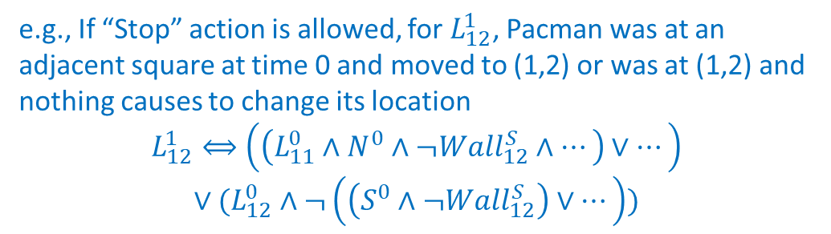
Planning as Satisfiability (SATPlan)
How to set up the KB? KB often includes sentences describing
  Transition model sentences up to time T
  Write down how each fluent at each time gets its value based on successor-state axiom:
Wall
e.g., If “Stop” action is allowed, for $L_{12}^{1}$, Pacman was at an adjacent square at time 0 and moved to (1,2) or was at (1,2) and nothing causes to change its location
$$L_{12}^{1}⟺\left(\left(L_{11}^{0}∧N^{0}∧¬Wall_{12}^{S}∧…\right)∨…\right)$$
$$∨(L_{12}^{0}∧¬\left(\left(S^{0}∧¬Wall_{12}^{S}\right)∨…\right))$$
2
$$j$$
1
1
2
$$i$$

Slide 5
Planning as Satisfiability (SATPlan)
How to set up the KB? KB often includes sentences describing
  Transition model sentences up to time T
  Write down how each fluent at each time gets its value based on successor-state axiom:
Wall
2
$$j$$
1
1
2
$$i$$

Slide 6
Planning, Thus Far
Goal States
completely specified
Goal Statements
partially specified
Preference models
objective function
Increasing Generality

Slide 7
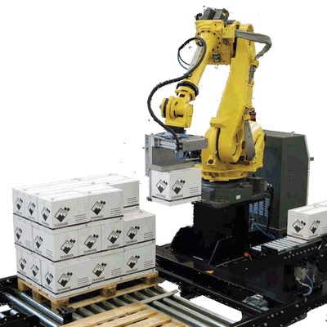
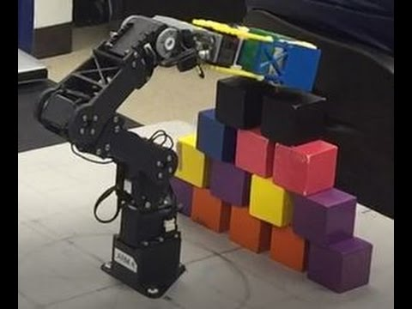

Robot Block Stacking
Start state: A, B, C on table
Goal: Block B on C and C on A
Actions: ?

Slide 8
Modeling Block Stacking States
Robot Arm
A
B
C
Start state: A, B, C on table
Goal: Block B on C and C on A
Actions: ?

Slide 9
Goals in the World
Goal States
completely specified
Goal Statements
partially specified
Preference models
objective function
Increasing Generality

Slide 10
Block Stacking States

Slide 11
Block Stacking States

Slide 12
Block Stacking States

Slide 13
Block Stacking States

Slide 14
Block Stacking States

Slide 15
States are Informationless
S1
S2
S3
S4
S5
S6
S7
S8
S9
S10
S11
S12
S13
S14
S15
S16
S17
S18
S19
S20
S21
S22
Notes:
This is a familiar data structure – a graph

Slide 16
Initial and Goal States

Slide 17
Plan from Initial to Goal State

Slide 18
Goals in the World
Goal States
completely specified
Goal Statements
partially specified
Preference models
objective function
BFS, DFS, A*
Increasing Generality

Slide 19
Goals in the World
Goal States
completely specified
Goal Statements
partially specified
Preference models
objective function
BFS, DFS, A*
Increasing Generality

Slide 20
Goals in the World
Goal States
completely specified
Goal Statements
partially specified
Preference models
objective function
BFS, DFS, A*
CSP, LP, IP
Increasing Generality

Slide 21
CSP for Blocks World
Goal: Block B on C and C on A
Constraint Satisfaction Problem:
Height(B) > Height(C)
Height(C) > Height(A)

Slide 22
Goals in the World
Goal States
completely specified
Goal Statements
partially specified
Preference models
objective function
BFS, DFS, A*
CSP, LP, IP
Increasing Generality

Slide 23
Goals in the World
Goal States
completely specified
Goal Statements
partially specified
Preference models
objective function
BFS, DFS, A*
CSP, LP, IP
Increasing Generality

Slide 24
Goals in the World
Goal States
completely specified
Goal Statements
partially specified
Preference models
objective function
BFS, DFS, A*
Logic
CSP, LP, IP
Increasing Generality

Slide 25
Logical Agents
Create a Knowledge Base
Symbols
Implications

Slide 26
Logical Agents
Create a Knowledge Base
Symbols – each is true or false
Implications – conjunctions imply new info

Slide 27
Symbolic Descriptions
Every state has the same objects
Properties and relationships of those objects change (i.e., locations)
Define states as set of symbols that represent whether those properties are true

Slide 28
Logical Agents
Create a Knowledge Base
Symbols
Robot Arm
A
B
C

Slide 29
Logical Agents
Create a Knowledge Base
Symbols
A-on-Table A-In-Hand
B-on-Table B-In-Hand
C-on-Table C-In-Hand
Hand-Empty
A-on-B B-on-A
A-on-C C-on-A
B-on-C C-on-B
Robot Arm
A
B
C

Slide 30
Logical Agents
Create a Knowledge Base
Symbols
A-on-Table A-In-Hand
B-on-Table B-In-Hand
C-on-Table C-In-Hand
Hand-Empty
A-on-B B-on-A
A-on-C C-on-A
B-on-C C-on-B
Robot Arm
A
B
C

Slide 31
Logical Agents
Create a Knowledge Base
Implications
What are the successor state
axioms for A-on-Table[t]?
Robot Arm
A
B
C

Slide 32
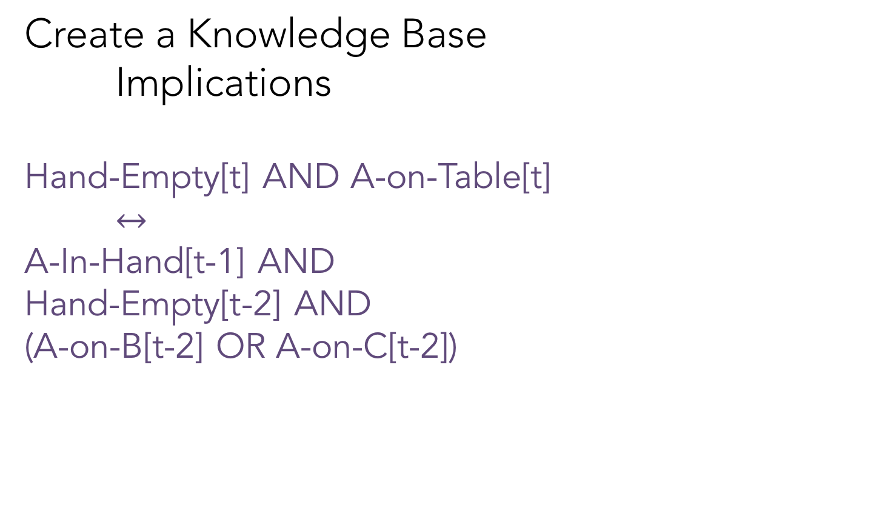
Logical Agents
Create a Knowledge Base
Implications
Hand-Empty[t] AND A-on-Table[t]
$↔$
A-In-Hand[t-1] AND
Hand-Empty[t-2] AND
(A-on-B[t-2] OR A-on-C[t-2])
Robot Arm
A
B
C

Slide 33
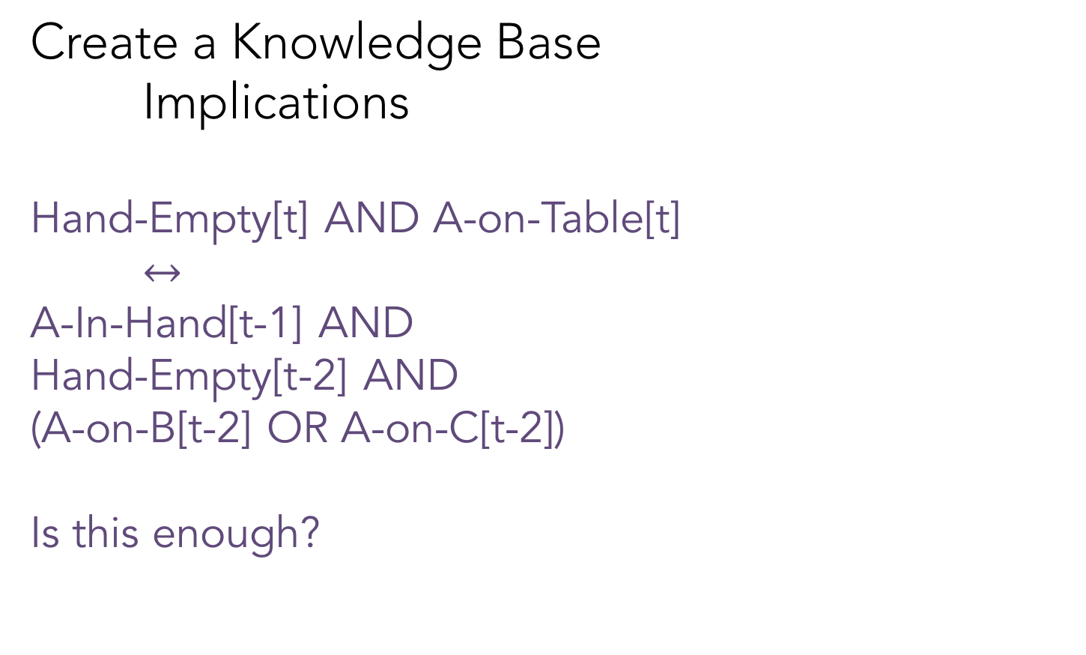
Logical Agents
Create a Knowledge Base
Implications
Hand-Empty[t] AND A-on-Table[t]
$↔$
A-In-Hand[t-1] AND
Hand-Empty[t-2] AND
(A-on-B[t-2] OR A-on-C[t-2])
Is this enough?
Robot Arm
A
B
C

Slide 34
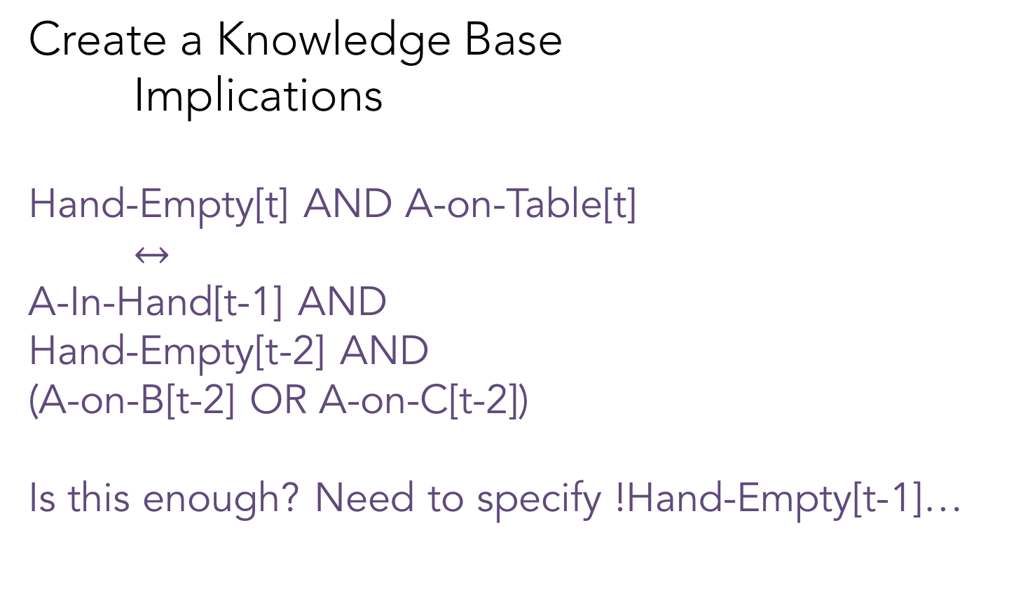
Logical Agents
Create a Knowledge Base
Implications
Hand-Empty[t] AND A-on-Table[t]
$↔$
A-In-Hand[t-1] AND
Hand-Empty[t-2] AND
(A-on-B[t-2] OR A-on-C[t-2])
Is this enough? Need to specify !Hand-Empty[t-1]…
Robot Arm
A
B
C

Slide 35
Logical Agents
Create a Knowledge Base
Symbols
Implications
Check whether the KB entails a query
Query – a subset of symbols in model

Slide 36
Logical Agents
Create a Knowledge Base
Symbols
Implications
Check whether the KB entails a query
Query – a subset of symbols in model
B-on-C[t] AND C-on-A[t] AND HandEmpty[t]?

Slide 37
Partially-Specified
We didn’t tell you what all goal symbols needed to be, only some
There are potentially many goal states that could satisfy this goal
We only need to search for one satisfying assignment of variables

Slide 38
Challenges of Logic Planning
We need symbols for each time step
Easy to incorrectly specify an implication
So many symbols means it is hard to debug

Slide 39
Classical Planning
Also partially-specified
Create a Knowledge Base
Symbols Predicates
Implications Operators
Check whether the KB entails a query
A goal state (conjunction of predicates)

Slide 40
Predicates
Can be symbols
A-on-Table, A-In-Hand,
B-on-Table, B-In-Hand,
C-on-Table, C-In-Hand,
Hand-Empty,
A-on-B, B-on-A,
A-on-C, C-on-A,
B-on-C, C-on-B
Clear-A, Clear-B,
Clear-C

Slide 41
Predicates
Can be symbols
A-on-Table, A-In-Hand,
B-on-Table, B-In-Hand,
C-on-Table, C-In-Hand,
Hand-Empty,
A-on-B, B-on-A,
A-on-C, C-on-A,
B-on-C, C-on-B
Clear-A, Clear-B,
Clear-C
Can be functional
Instances: A, B, C
Propositions:
In-Hand(A)
On-Table(B)
On-Block(B,C)
HandEmpty()
Clear(A)

Slide 42
Predicates
Are there other functions that we could use?

Slide 43
Predicates
Are there other functions that we could use?
YES!!
Your challenge is finding a representation that works for your environment

Slide 44
Piazza Poll: Which propositions apply to this state?
Instances: A, B, C
Propositions:
1) In-Hand(A)
2) In-Hand(B)
3) In-Hand(C)
4) On-Table(A)
5) On-Table(B)
6) On-Table(C)
7) On-Block(B,C)
8) On-Block(A,B)
9) HandEmpty()
Robot Arm
A
B
C

Slide 45
Piazza Poll: Which propositions apply to this state?
Instances: A, B, C
Propositions:
1) In-Hand(A)
2) In-Hand(B)
3) In-Hand(C)
4) On-Table(A)
5) On-Table(B)
6) On-Table(C)
7) On-Block(B,C)
8) On-Block(A,B)
9) HandEmpty()
A
C
B

Slide 46
Classical Planning
Also partially-specified
Create a Knowledge Base
Symbols Predicates
Implications Operators
Check whether the KB entails a query
A goal state (conjunction of predicates)

Slide 47
Models of Operators (Actions)
Actions can be applied only if all conditions are met
Actions change the state of the world
Represented as effects that add/delete predicates
Unlike the implications, we can represent actions with symbolic descriptions (e.g., pick-up, put-down)

Slide 48
Block Stacking States – Conjunctions of Predicates

Slide 49
Block Stacking Operators (Actions)

Slide 50
What actions are represented?
What are the rules for applying actions?

Slide 51
Actions for Block Stacking
Blocks are picked up and put down by the hand
Blocks can be picked up only if they are clear
Hand can pick up a block only if the hand is empty
Hand can put down blocks on blocks or on the table

Slide 52
Pick Up Block from Table Example
Preconditions

Slide 53
Pick Up Block from Table Example
Preconditions
HandEmpty
On-Table(b)
Clear(b)

Slide 54
Pick Up Block from Table Example
Preconditions Effects?
HandEmpty
On-Table(b)
Clear(b)

Slide 55
Pick Up Block from Table Example
Preconditions Effects
HandEmpty Add: Holding(b)
On-Table(b) Delete: On-Table(b)
Clear(b) HandEmpty

Slide 56
Pick Block from Block Example
Preconditions Effects

Slide 57
Operators for Block Stacking
Pickup_from_Table(b):
Pre: HandEmpty, Clear(b), On-Table(b)
Add: Holding(b)
Delete: HandEmpty, On-Table(b)
Pickup_from_Block(b,c):
Pre: HandEmpty, On(b,c), b!=c
Add: Holding(b), Clear(c)
Delete: HandEmpty, On(b,c)

Slide 58
Operators for Block Stacking
Pickup_from_Table(b):
Pre: HandEmpty, Clear(b), On-Table(b)
Add: Holding(b)
Delete: HandEmpty, On-Table(b)
Putdown_on_Table(b):
Pre: Holding(b)
Add: HandEmpty, On-Table(b)
Delete: Holding(b)
Pickup_from_Block(b,c):
Pre: HandEmpty, On(b,c), b!=c
Add: Holding(b), Clear(c)
Delete: HandEmpty, On(b,c)
Putdown_on_Block(b,c):
Pre: Holding(b), Clear(c)
Add: HandEmpty, On(b,c)
Delete: Clear(c), Holding(b)

Slide 59
Example Plan of Actions
HandEmpty & On-Table(R) & On(T,R) & Clear(T) & On-Table(O) & Clear(O)

Slide 60
Example Plan of Actions
HandEmpty & On-Table(R) & On(T,R) & Clear(T) & On-Table(O) & Clear(O)
Pickup_from_Block(b,c):
Pre: HandEmpty, On(b,c), b!=c
Add: Holding(b), Clear(c)
Delete: HandEmpty, On(b,c)
Pickup_from_Table(b):
Pre: HandEmpty, Clear(b), On-Table(b)
Add: Holding(b)
Delete: HandEmpty, On-Table(b)

Slide 61
Example Plan of Actions
HandEmpty & On-Table(R) & On(T,R) & Clear(T) & On-Table(O) & Clear(O)
Pickup_from_Block(b,c):
Pre: HandEmpty, On(b,c), b!=c
Add: Holding(b), Clear(c)
Delete: HandEmpty, On(b,c)
Pickup_from_Table(b):
Pre: HandEmpty, Clear(b), On-Table(b)
Add: Holding(b)
Delete: HandEmpty, On-Table(b)

Slide 62
Example Plan of Actions
HandEmpty & On-Table(R) & On(T,R) & Clear(T) & On-Table(O) & Clear(O)
Pickup_from_Block(T,R)
Pickup_from_Block(b,c):
Pre: HandEmpty, On(b,c), Clear(c), b!=c
Add: Holding(b), Clear(c)
Delete: HandEmpty, On(b,c)

Slide 63
Example Plan of Actions
HandEmpty & On-Table(R) & On(T,R) & Clear(T) & On-Table(O) & Clear(O)
Pickup_from_Block(T,R)
On-Table(R) & Clear(T) & On-Table(O) & Clear(O)
Pickup_from_Block(b,c):
Pre: HandEmpty, On(b,c), Clear(c), b!=c
Add: Holding(b), Clear(c)
Delete: HandEmpty, On(b,c)

Slide 64
Example Plan of Actions
HandEmpty & On-Table(R) & On(T,R) & Clear(T) & On-Table(O) & Clear(O)
Pickup_from_Block(T,R)
On-Table(R) & Clear(T) & On-Table(O) & Clear(O) & Holding(T) & Clear(R)
Pickup_from_Block(b,c):
Pre: HandEmpty, On(b,c), Clear(c), b!=c
Add: Holding(b), Clear(c)
Delete: HandEmpty, On(b,c)

Slide 65
Example Plan of Actions
HandEmpty & On-Table(R) & On(T,R) & Clear(T) & On-Table(O) & Clear(O)
Pickup_from_Block(T,R)
On-Table(R) & Clear(T) & On-Table(O) & Clear(O) & Holding(T) & Clear(R)

Slide 66
Example Plan of Actions
HandEmpty & On-Table(R) & On(T,R) & Clear(T) & On-Table(O) & Clear(O)
Pickup_from_Block(T,R)
On-Table(R) & Clear(T) & On-Table(O) & Clear(O) & Holding(T) & Clear(R)
Putdown_on_Table(T)
Putdown_on_Table(b):
Pre: Holding(b)
Add: HandEmpty, On-Table(b)
Delete: Holding(b)

Slide 67
Example Plan of Actions
HandEmpty & On-Table(R) & On(T,R) & Clear(T) & On-Table(O) & Clear(O)
Pickup_from_Block(T,R)
On-Table(R) & Clear(T) & On-Table(O) & Clear(O) & Holding(T) & Clear(R)
Putdown_on_Table(T)
On-Table(R) & Clear(T) & On-Table(O) & Clear(O) & Clear(R)
Putdown_on_Table(b):
Pre: Holding(b)
Add: HandEmpty, On-Table(b)
Delete: Holding(b)

Slide 68
Example Plan of Actions
HandEmpty & On-Table(R) & On(T,R) & Clear(T) & On-Table(O) & Clear(O)
Pickup_from_Block(T,R)
On-Table(R) & Clear(T) & On-Table(O) & Clear(O) & Holding(T) & Clear(R)
Putdown_on_Table(T)
On-Table(R) & Clear(T) & On-Table(O) & Clear(O) & Clear(R) & HandEmpty & On-Table(T)
Putdown_on_Table(b):
Pre: Holding(b)
Add: HandEmpty, On-Table(b)
Delete: Holding(b)

Slide 69
Example Plan of Actions
HandEmpty & On-Table(R) & On(T,R) & Clear(T) & On-Table(O) & Clear(O)
Pickup_from_Block(T,R)
On-Table(R) & Clear(T) & On-Table(O) & Clear(O) & Holding(T) & Clear(R)
Putdown_on_Table(T)
On-Table(R) & Clear(T) & On-Table(O) & Clear(O) & Clear(R) & HandEmpty & On-Table(T)

Slide 70
Example Plan of Actions
HandEmpty & On-Table(R) & On(T,R) & Clear(T) & On-Table(O) & Clear(O)
Pickup_from_Block(T,R)
On-Table(R) & Clear(T) & On-Table(O) & Clear(O) & Holding(T) & Clear(R)
Putdown_on_Table(T)
On-Table(R) & Clear(T) & On-Table(O) & Clear(O) & Clear(R) & HandEmpty & On-Table(T)
Pickup_from_Table(O)
Pickup_from_Table(b):
Pre: HandEmpty, Clear(b), On-Table(b)
Add: Holding(b)
Delete: HandEmpty, On-Table(b)

Slide 71
Example Plan of Actions
HandEmpty & On-Table(R) & On(T,R) & Clear(T) & On-Table(O) & Clear(O)
Pickup_from_Block(T,R)
On-Table(R) & Clear(T) & On-Table(O) & Clear(O) & Holding(T) & Clear(R)
Putdown_on_Table(T)
On-Table(R) & Clear(T) & On-Table(O) & Clear(O) & Clear(R) & HandEmpty & On-Table(T)
Pickup_from_Table(O)
On-Table(R) & Clear(T) & Clear(O) & Clear(R) & On-Table(T) & Holding(O)
Pickup_from_Table(b):
Pre: HandEmpty, Clear(b), On-Table(b)
Add: Holding(b)
Delete: HandEmpty, On-Table(b)

Slide 72
Example Plan of Actions
HandEmpty & On-Table(R) & On(T,R) & Clear(T) & On-Table(O) & Clear(O)
Pickup_from_Block(T,R)
On-Table(R) & Clear(T) & On-Table(O) & Clear(O) & Holding(T) & Clear(R)
Putdown_on_Table(T)
On-Table(R) & Clear(T) & On-Table(O) & Clear(O) & Clear(R) & HandEmpty & On-Table(T)
Pickup_from_Table(O)
On-Table(R) & Clear(T) & Clear(O) & Clear(R) & On-Table(T) & Holding(O)
Putdown_on_Block(O,R)
On-Table(R) & Clear(T) & Clear(O) & On-Table(T) & On(O,R) & HandEmpty

Slide 73
Properties of Planners
Soundness
  A planning algorithm is sound if all solutions found are legal plans
    All preconditions and goals are satisfied
    No constraints are violated (temporal, variable binding)
Completeness
  A planning algorithm is complete if a solution can be found whenever one actually exists
  A planning algorithm is strictly complete if all solutions are included in the search space
Optimality
  A planning algorithm is optimal if the order in which solutions are found is consistent with some measure of plan quality

Slide 74
Techniques for Planning
Start
Goal

Slide 75
BFS – Find shortest action sequence
Start
Goal

Slide 76
Reachability Graph Representation
States: Conjunctions of Predicates
Arrows = Actions
Every state in level K is reachable in K actions
Space complexity in terms of # predicates p?

Slide 77
Reachability Graph Representation
States: Conjunctions of Predicates
Arrows = Actions
Every state in level K is reachable in K actions
Space complexity in terms of # predicates? 2^{p}

Slide 78
Poll: Is BFS sound, complete, optimal?
Start
Goal
Soundness - all solutions found are legal plans
Completeness - a solution can be found whenever one actually exists
Optimality - the order in which solutions are found is consistent with some measure of plan quality

Slide 79
Linear Planning
Idea: Since we have a conjunction of goal predicates, let’s try to solve one at a time
Maintain a stack of achievable goals
Use BFS (or anything else) to find a plan to achieve that single goal
Add a goal back on the stack if a later change makes it violated

Slide 80
Linear Planning Example
Goal Stack:
On-Table(T)
On-Table(R)
On(O,R)
Clear(O)
Clear(T)
Action Plan:

Slide 81
Linear Planning Example
Goal Stack:
On-Table(T)
On-Table(R)
On(O,R)
Clear(O)
Clear(T)
Action Plan:

Slide 82
Linear Planning Example
Goal Stack:
On-Table(R)
On(O,R)
Clear(O)
Clear(T)
Action Plan:
On-Table(T)
Pickup(T)
Put-Table(T)

Slide 83
Linear Planning Example
Goal Stack:
On-Table(R)
On(O,R)
Clear(O)
Clear(T)
Action Plan:
On-Table(T)
Pickup(T)
Put-Table(T)

Slide 84
Linear Planning Example
Goal Stack:
On(O,R)
Clear(O)
Clear(T)
Action Plan:
On-Table(T)
Pickup(T)
Put-Table(T)
On-Table(R)

Slide 85
Linear Planning Example
Goal Stack:
On(O,R)
Clear(O)
Clear(T)
Action Plan:
On-Table(T)
Pickup(T)
Put-Table(T)
On-Table(R)

Slide 86
Linear Planning Example
Goal Stack:
Clear(O)
Clear(T)
Action Plan:
On-Table(T)
Pickup(T)
Put-Table(T)
On-Table(R)
On(O,R)
Pickup(O)
Put(O,R)

Slide 87
Linear Planning Example
Goal Stack:
Clear(O)
Clear(T)
Action Plan:
On-Table(T)
Pickup(T)
Put-Table(T)
On-Table(R)
On(O,R)
Pickup(O)
Put(O,R)

Slide 88
Linear Planning Example
Goal Stack:
Action Plan:
On-Table(T)
Pickup(T)
Put-Table(T)
On-Table(R)
On(O,R)
Pickup(O)
Put(O,R)
Clear(O)
Clear(T)

Slide 89
Linear Planning Example 2
Goal Stack:
On(R,O)
On-Table(T)
On(O,T)
Clear(R)
Action Plan:

Slide 90
Linear Planning Example 2
Goal Stack:
On(R,O)
On-Table(T)
On(O,T)
Clear(R)
Action Plan:

Slide 91
Linear Planning Example 2
Goal Stack:
On-Table(T)
On(O,T)
Clear(R)
Action Plan:
On(R,O)
Pickup(T)
Put-Table(T)
Pickup(R)
Put(R,O)

Slide 92
Linear Planning Example 2
Goal Stack:
On-Table(T)
On(O,T)
Clear(R)
Action Plan:
On(R,O)
Pickup(T)
Put-Table(T)
Pickup(R)
Put(R,O)

Slide 93
Linear Planning Example 2
Goal Stack:
On(O,T)
Clear(R)
Action Plan:
On(R,O)
Pickup(T)
Put-Table(T)
Pickup(R)
Put(R,O)
On-Table(T)

Slide 94
Linear Planning Example 2
Goal Stack:
On(O,T)
Clear(R)
Action Plan:
On(R,O)
Pickup(T)
Put-Table(T)
Pickup(R)
Put(R,O)
On-Table(T)

Slide 95
Linear Planning Example 2
Goal Stack:
Clear(R)
Action Plan:
On(R,O)
Pickup(T)
Put-Table(T)
Pickup(R)
Put(R,O)
On-Table(T)
On(O,T)
Pickup(R)
Put-Table(R)
Pickup(O)
Put(O,T)

Slide 96
Linear Planning Example 2
Goal Stack:
On(R,O)
Clear(R)
Action Plan:
On(R,O)
Pickup(T)
Put-Table(T)
Pickup(R)
Put(R,O)
On-Table(T)
On(O,T)
Pickup(R)
Put-Table(R)
Pickup(O)
Put(O,T)

Slide 97
Linear Planning Example 2
Goal Stack:
Clear(R)
Action Plan:
On(R,O)
Pickup(T)
Put-Table(T)
Pickup(R)
Put(R,O)
On-Table(T)
On(O,T)
Pickup(R)
Put-Table(R)
Pickup(O)
Put(O,T)
Action Plan (cont’d):
On(R,O)
Pickup(R)
Put(R,O)

Slide 98
Linear Planning Example 2
Goal Stack:
Action Plan:
On(R,O)
Pickup(T)
Put-Table(T)
Pickup(R)
Put(R,O)
On-Table(T)
On(O,T)
Pickup(R)
Put-Table(R)
Pickup(O)
Put(O,T)
Action Plan (cont’d):
On(R,O)
Pickup(R)
Put(R,O)
Clear(R)

Slide 99
Linear Planning Example 2
Goal Stack:
Action Plan:
On(R,O)
Pickup(T)
Put-Table(T)
Pickup(R)
Put(R,O)
On-Table(T)
On(O,T)
Pickup(R)
Put-Table(R)
Pickup(O)
Put(O,T)
Action Plan (cont’d):
On(R,O)
Pickup(R)
Put(R,O)
Clear(R)
What happened?
Is linear planning sound?
Is linear planning complete?
Is linear planning optimal?

Slide 100
Sussman’s Anomaly
A weakness of linear planning is that sometimes you get really long plans
One goal can be achieved
The second goal immediately undoes it
Note: This isn’t just a choice of goals. The anomaly happens no matter which goal is first

Slide 101
Linear Planning Example 2
Goal Stack:
Action Plan:
On(R,O)
Pickup(T)
Put-Table(T)
Pickup(R)
Put(R,O)
On-Table(T)
On(O,T)
Pickup(R)
Put-Table(R)
Pickup(O)
Put(O,T)
Action Plan (cont’d):
On(R,O)
Pickup(R)
Put(R,O)
Clear(R)
What happened?
Is linear planning sound? Yes
Is linear planning complete? No
Is linear planning optimal? No

Slide 102
Non-Linear Planning
Idea: Interleave goals to achieve plans
Maintain a set of unachieved goals
Search all interleavings of goals
Add a goal back to the set if a later change makes it violated

Slide 103
Non-Linear Planning (Example 2)
Goal Set:
On(R,O)
On-Table(T)
On(O,T)
Clear(R)
Action Plan:

Slide 104
Non-Linear Planning (Example 2)
Goal Set:
On(R,O)
On-Table(T)
On(O,T)
Clear(R)
Action Plan:
On(R,O)
Pickup(T)
Put-Table(T)
STOP-SWITCH-GOALS

Slide 105
Non-Linear Planning (Example 2)
Goal Set:
On(R,O)
On-Table(T)
On(O,T)
Clear(R)
Action Plan:
On(R,O)
Pickup(T)
Put-Table(T)
STOP-SWITCH-GOALS
On(O,T)
Pickup(O)
Put(O,T)

Slide 106
Non-Linear Planning (Example 2)
Goal Set:
On(R,O)
On-Table(T)
On(O,T)
Clear(R)
Action Plan:
On(R,O)
Pickup(T)
Put-Table(T)
STOP-SWITCH-GOALS
On(O,T)
Pickup(O)
Put(O,T)
On(R,O)
Pickup(R)
Put(R,O)

Slide 107
Non-Linear Planning (Example 2)
Goal Set:
On(R,O)
On-Table(T)
On(O,T)
Clear(R)
Action Plan:
On(R,O)
Pickup(T)
Put-Table(T)
STOP-SWITCH-GOALS
On(O,T)
Pickup(O)
Put(O,T)
On(R,O)
Pickup(R)
Put(R,O)
6 vs 10 actions

Slide 108
Non-Linear Planning
Idea: Interleave goals to achieve plans
Maintain a set of unachieved goals
Search all interleavings of goals
Add a goal back to the set if a later change makes it violated
It is complete, but takes longer to search
It can produce shorter plans
  Optimal plans if all interleavings are searched

Slide 109
Reachability Graph Representation
States: Conjunctions of Predicates
Arrows = Actions
Every state in level K is reachable in K actions
Space complexity in terms of # predicates p?

Slide 110
Planning Graph Representation
Key idea: Construct an approximation of the reachability graph in polynomial space
  The planning graph computes the possibly reachable states although they aren’t necessarily feasible

Slide 111
Planning Graph Representation
Key idea: Construct an approximation of the reachability graph in polynomial space
  The planning graph computes the possibly reachable states although they aren’t necessarily feasible
Planning graphs contain two types of layers
Proposition layers – all reachable predicates
Action layers – actions that could be taken
Both layers represent one time step

Slide 112
GraphPlan
Two alternating stages:
  Extend: One time step (two layers) in the planning graph
  Search: Find a valid plan in the planning graph
GraphPlan finds a plan or proves that no plan has fewer time steps
  Each time step can contain multiple actions

Slide 113
Building a Planning Graph
Start the planning graph with all starting predicates
HandEmpty
On-Table(R)
On-Table(O)
On(T,R)
Clear(T)
Clear(O)

Slide 114
Building a Planning Graph
Extend the graph with all applicable actions
Designate all effects (add/delete)
HandEmpty
On-Table(R)
On-Table(O)
On(T,R)
Clear(T)
Clear(O)
HandEmpty
On-Table(R)
On-Table(O)
On(T,R)
Clear(T)
Clear(O)
Clear(R)
Holding(T)
Holding(O)
Pickup(T)
Pickup(O)

Slide 115
Building a Planning Graph
Extend the graph with all applicable actions, noops
Designate all effects (add/delete)
HandEmpty
On-Table(R)
On-Table(O)
On(T,R)
Clear(T)
Clear(O)
HandEmpty
On-Table(R)
On-Table(O)
On(T,R)
Clear(T)
Clear(O)
Clear(R)
Holding(T)
Holding(O)
Pickup(T)
Pickup(O)

Slide 116
Building a Planning Graph
Extend the graph
Determine exclusive actions
HandEmpty
On-Table(R)
On-Table(O)
On(T,R)
Clear(T)
Clear(O)
HandEmpty
On-Table(R)
On-Table(O)
On(T,R)
Clear(T)
Clear(O)
Clear(R)
Holding(T)
Holding(O)
Actions A and B are exclusive (mutex) at action-level i, if:
  Interference: one action deletes a precondition of the other
  Inconsistency: one action is the negation of the other
  Competing Needs: p is a precondition of A and q is a precondition of B, and p and q are exclusive in proposition-level i – 1
Pickup(T)
Pickup(O)

Slide 117
Building a Planning Graph
Extend the graph with all applicable actions, noops
Determine exclusive actions
HandEmpty
On-Table(R)
On-Table(O)
On(T,R)
Clear(T)
Clear(O)
HandEmpty
On-Table(R)
On-Table(O)
On(T,R)
Clear(T)
Clear(O)
Clear(R)
Holding(T)
Holding(O)
Actions A and B are exclusive (mutex) at action-level i, if:
  Interference: one action deletes a precondition of the other
  Inconsistency: one action is the negation of the other
  Competing Needs: p is a precondition of A and q is a precondition of B, and p and q are exclusive in proposition-level i – 1
Pickup(T)
Pickup(O)

Slide 118
Building a Planning Graph
Extend the graph with all applicable actions, noops
Determine exclusive actions
HandEmpty
On-Table(R)
On-Table(O)
On(T,R)
Clear(T)
Clear(O)
HandEmpty
On-Table(R)
On-Table(O)
On(T,R)
Clear(T)
Clear(O)
Clear(R)
Holding(T)
Holding(O)
Actions A and B are exclusive (mutex) at action-level i, if:
  Interference: one action deletes a precondition of the other
  Inconsistency: one action is the negation of the other
  Competing Needs: p is a precondition of A and q is a precondition of B, and p and q are exclusive in proposition-level i – 1
Pickup(T)
Pickup(O)

Slide 119
Building a Planning Graph
Extend the graph with all applicable actions, noops
Determine exclusive actions, propositions
HandEmpty
On-Table(R)
On-Table(O)
On(T,R)
Clear(T)
Clear(O)
HandEmpty
On-Table(R)
On-Table(O)
On(T,R)
Clear(T)
Clear(O)
Clear(R)
Holding(T)
Holding(O)
Two propositions p and q are exclusive (mutex) at a
proposition-level if ALL actions (including no-ops) that add p are exclusive of ALL actions that add q
Pickup(T)
Pickup(O)

Slide 120
Search the Planning Graph
Extend until first time all goals are present at a proposition level
  May not be a solution, at that level
For each goal at level i (in some arbitrary order)
  Select an action at level i-1 that achieves that goal and is not exclusive with any other action already selected at that level
  Add all its preconditions to the set of goals at level i-2
  Do this for all the goals at level i
    Use already selected actions, when possible
  Backtrack if no non-exclusive action exists
If search is exhausted, extend planning graph one more proposition level

Slide 121
Extend a Level
Extend the graph with all applicable actions, noops
Determine exclusive actions, propositions
HandEmpty
On-Table(R)
On-Table(O)
On(T,R)
Clear(T)
Clear(O)
HandEmpty
On-Table(R)
On-Table(O)
On(T,R)
Clear(T)
Clear(O)
Clear(R)
Holding(T)
Holding(O)
Pickup(T)
Pickup(O)

Slide 122
Building a Planning Graph
Extend the graph with all applicable actions, noops
Determine exclusive actions, propositions
HandEmpty
On-Table(R)
On-Table(O)
On(T,R)
Clear(T)
Clear(O)
HandEmpty
On-Table(R)
On-Table(O)
On(T,R)
Clear(T)
Clear(O)
Clear(R)
Holding(T)
Holding(O)
HandEmpty
On-Table(R)
On-Table(T)
On-Table(O)
On(O,T)
On(T,R)
On(T,O)
Clear(T)
Clear(O)
Clear(R)
Holding(T)
Holding(O)
Pickup(T)
Pickup(T)
Put(T,R)
Put(T,O)
Pickup(O)
Put-Table(T)
Pickup(O)
Put-Table(O)
Put(O,T)
Pickup(R)

Slide 123
Building a Planning Graph
Extend the graph with all applicable actions, noops
Determine exclusive actions, propositions
HandEmpty
On-Table(R)
On-Table(O)
On(T,R)
Clear(T)
Clear(O)
HandEmpty
On-Table(R)
On-Table(O)
On(T,R)
Clear(T)
Clear(O)
Clear(R)
Holding(T)
Holding(O)
HandEmpty
On-Table(R)
On-Table(T)
On-Table(O)
On(O,T)
On(T,R)
On(T,O)
Clear(T)
Clear(O)
Clear(R)
Holding(T)
Holding(O)
Pickup(T)
Pickup(T)
Put(T,R)
Put(T,O)
Pickup(O)
Put-Table(T)
Pickup(O)
Put-Table(O)
Put(O,T)
Pickup(R)

Slide 124
Building a Planning Graph
Extend the graph with all applicable actions, noops
Determine exclusive actions, propositions
HandEmpty
On-Table(R)
On-Table(O)
On(T,R)
Clear(T)
Clear(O)
HandEmpty
On-Table(R)
On-Table(O)
On(T,R)
Clear(T)
Clear(O)
Clear(R)
Holding(T)
Holding(O)
HandEmpty
On-Table(R)
On-Table(T)
On-Table(O)
On(O,T)
On(T,R)
On(T,O)
Clear(T)
Clear(O)
Clear(R)
Holding(T)
Holding(O)
Pickup(T)
Pickup(T)
Put(T,R)
Put(T,O)
Pickup(O)
Put-Table(T)
Pickup(O)
Put-Table(O)
ALL LEVEL 2 ACTIONS
MUTALLY EXCLUSIVE…
WHAT KIND?
Put(O,T)
Pickup(R)

Slide 125
Building a Planning Graph
Extend the graph with all applicable actions, noops
Determine exclusive actions, propositions
HandEmpty
On-Table(R)
On-Table(O)
On(T,R)
Clear(T)
Clear(O)
HandEmpty
On-Table(R)
On-Table(O)
On(T,R)
Clear(T)
Clear(O)
Clear(R)
Holding(T)
Holding(O)
HandEmpty
On-Table(R)
On-Table(T)
On-Table(O)
On(O,T)
On(T,R)
On(T,O)
Clear(T)
Clear(O)
Clear(R)
Holding(T)
Holding(O)
Pickup(T)
Pickup(T)
Put(T,R)
Put(T,O)
Pickup(O)
Put-Table(T)
Pickup(O)
Put-Table(O)
PICK and PUT are Inconsistent
Pick requires HandEmpty
Put requires !HandEmpty
Put(O,T)
Pickup(R)

Slide 126
Building a Planning Graph
Extend the graph with all applicable actions, noops
Determine exclusive actions, propositions
HandEmpty
On-Table(R)
On-Table(O)
On(T,R)
Clear(T)
Clear(O)
HandEmpty
On-Table(R)
On-Table(O)
On(T,R)
Clear(T)
Clear(O)
Clear(R)
Holding(T)
Holding(O)
HandEmpty
On-Table(R)
On-Table(T)
On-Table(O)
On(O,T)
On(T,R)
On(T,O)
Clear(T)
Clear(O)
Clear(R)
Holding(T)
Holding(O)
Pickup(T)
Pickup(T)
Put(T,R)
Put(T,O)
Pickup(O)
Put-Table(T)
Pickup(O)
Put-Table(O)
2 PICK actions are Interference
A pick requires HandEmpty
but the other deletes it
Put(O,T)
Pickup(R)

Slide 127
Planning Graph Heuristics
Key idea: Construct an approximation of the reachability graph in polynomial space
  The planning graph computes the possibly reachable states although they aren’t necessarily feasible
What kinds of heuristics could we apply to the planning graph?
Is the solution GraphPlan finds admissible?

Slide 128
How can we program GraphPlan?

Slide 129
How can we program GraphPlan?
Literals: Each thing in our model
i = Instance(“name”,TYPE)
Variables: Can take on any TYPE thing
v_a = Variable(“v_name”,TYPE)
Propositions: Relationships
Proposition(“relation”, v_a)
Proposition(“relation”, i)
Proposition(“relation2”, v, i)
Proposition(“relation2”, v_a, v_b)

Slide 130
Example
A = Instance(“blockA”, BLOCK)
B = Instance(“blockB”, BLOCK)
C = Instance(“blockC”, BLOCK)
Proposition(”on”, B, A)
Proposition(”on-table”, A)
Proposition(”on-table”, C)
Proposition(”clear”, B)
Proposition(”clear”, C)
Proposition(“handempty”, True)

Slide 131
Example
A = Instance(“blockA”, BLOCK)
B = Instance(“blockB”, BLOCK)
C = Instance(“blockC”, BLOCK)
a. Proposition(”on”, B, A)
b. Proposition(“on”, B, C)
c. Proposition(”on-table”, A)
d. Proposition(”on-table”, C)
e. Proposition(”clear”, B)
f. Proposition(”clear”, C)

Slide 132
How can we program operators?
Operators: the actions we take change state
o = Operator(“name”,
[], #preconditions
[], #add effects
[]) # delete effects

Slide 133
How can we program operators?
Operators: the actions we take change state
pickup_table = Operator(“pick_table”,
[Proposition(“Handempty”,True),
Proposition(“clear”, v_block),
Proposition(“on-table”, v_block)],
[Proposition(“holding”, v_block)], [Proposition(“Handempty”,True),
Proposition(“on-table”, v_block]
)

Slide 134
How can we program operators?
Operators: the actions we take change state
pickup_table = Operator(“pick_table”,
[Proposition(“Handempty”,True),
Proposition(“clear”, v_block),
Proposition(“on-table”, v_block)],
[Proposition(“holding”, v_block)], [Proposition(“Handempty”,True),
Proposition(“on-table”, v_block]
)
Lists are conjunctions
Lists are conjunctions
Lists are conjunctions

Slide 135
How can we program operators?
Operators: the actions we take change state
pickup_table = Operator(“pick_table”,
[Proposition(“Handempty”,True),
Proposition(“clear”, v_block),
Proposition(“on-table”, v_block)],
[Proposition(“holding”, v_block)], [Proposition(“Handempty”,True),
Proposition(“on-table”, v_block]
)
Variable with matching name must match subsequent propositions

Slide 136
How can we program operators?
Operators: the actions we take change state
pickup_table = Operator(“pick_table”,
[Proposition(“Handempty”,True),
Proposition(“clear”, v_block),
Proposition(“on-table”, v_block2)],
[Proposition(“holding”, v_block)], [Proposition(“Handempty”,True),
Proposition(“on-table”, v_block]
)
Variable with matching name must match subsequent propositions
Variables that don’t match name don’t have to be the same

Slide 137
We will give you a GraphPlan Solver
Solver takes all instances, all operators, the start state and the goal state and produces a plan

Slide 138
Another Example - Rocket Ship
Suppose we have a rocket ship that can only be used once. It has to carry two payloads.

Slide 139
Another Example - Rocket Ship
Suppose we have a rocket ship that can only be used once. It has to carry two payloads.
Literals?

Slide 140
Another Example - Rocket Ship
Suppose we have a rocket ship that can only be used once. It has to carry two payloads.
Literals: Rocket, G, O, LocA, LocB

Slide 141
Another Example - Rocket Ship
Suppose we have a rocket ship that can only be used once. It has to carry two payloads.
Literals: Rocket, G, O, LocA, LocB
Start state:
At(Rocket, LocA), Has-Fuel(),
Unloaded(G,LocA), Unloaded(O,LocA)

Slide 142
Another Example - Rocket Ship
Suppose we have a rocket ship that can only be used once. It has to carry two payloads.
Literals: Rocket, G, O, LocA, LocB
Start state:
At(Rocket, LocA), Has-Fuel(),
Unloaded(G,LocA), Unloaded(O,LocA)
Goal state:
At(Rocket, LocB), Unloaded(G,LocB), Unloaded(O,LocB)

Slide 143
Another Example - Rocket Ship
Literals: Rocket, G, O, LocA, LocB
Start state:
At(Rocket, LocA), Has-Fuel(),
Unloaded(G,LocA), Unloaded(O,LocA)
Goal state:
At(Rocket, LocB), Unloaded(G,LocB), Unloaded(O,LocB)
Move: Load: Unload:

Slide 144
Another Example - Rocket Ship
Literals: Rocket, G, O, LocA, LocB
Start state:
At(Rocket, LocA), Has-Fuel(),
Unloaded(G,LocA), Unloaded(O,LocA)
Goal state:
At(Rocket, LocB), Unloaded(G,LocB), Unloaded(O,LocB)
Move:
P:
A:
D:

Slide 145
Another Example - Rocket Ship
Literals: Rocket, G, O, LocA, LocB
Start state:
At(Rocket, LocA), Has-Fuel(),
Unloaded(G,LocA), Unloaded(O,LocA)
Goal state:
At(Rocket, LocB), Unloaded(G,LocB), Unloaded(O,LocB)
Move:
P: At(Rocket,L)
A:
D:

Slide 146
Another Example - Rocket Ship
Literals: Rocket, G, O, LocA, LocB
Start state:
At(Rocket, LocA), Has-Fuel(),
Unloaded(G,LocA), Unloaded(O,LocA)
Goal state:
At(Rocket, LocB), Unloaded(G,LocB), Unloaded(O,LocB)
Move:
P: At(Rocket,L)
A:
D:

Slide 147
Another Example - Rocket Ship
Literals: Rocket, G, O, LocA, LocB
Start state:
At(Rocket, LocA), Has-Fuel(),
Unloaded(G,LocA), Unloaded(O,LocA)
Goal state:
At(Rocket, LocB), Unloaded(G,LocB), Unloaded(O,LocB)
Variables: L
Move:
P: At(Rocket,L)
A:
D:

Slide 148
Another Example - Rocket Ship
Literals: Rocket, G, O, LocA, LocB
Start state:
At(Rocket, LocA), Has-Fuel(),
Unloaded(G,LocA), Unloaded(O,LocA)
Goal state:
At(Rocket, LocB), Unloaded(G,LocB), Unloaded(O,LocB)
Variables: L
Move:
P: At(Rocket,L), Has-Fuel()
A:
D:

Slide 149
Another Example - Rocket Ship
Literals: Rocket, G, O, LocA, LocB
Start state:
At(Rocket, LocA), Has-Fuel(),
Unloaded(G,LocA), Unloaded(O,LocA)
Goal state:
At(Rocket, LocB), Unloaded(G,LocB), Unloaded(O,LocB)
Variables: L
Move:
P: At(Rocket,L), Has-Fuel()
A: At(Rocket,Dest)
D:

Slide 150
Another Example - Rocket Ship
Literals: Rocket, G, O, LocA, LocB
Start state:
At(Rocket, LocA), Has-Fuel(),
Unloaded(G,LocA), Unloaded(O,LocA)
Goal state:
At(Rocket, LocB), Unloaded(G,LocB), Unloaded(O,LocB)
Variables: L, Dest
Move:
P: At(Rocket,L), Has-Fuel()
A: At(Rocket,Dest)
D:

Slide 151
Another Example - Rocket Ship
Literals: Rocket, G, O, LocA, LocB
Start state:
At(Rocket, LocA), Has-Fuel(),
Unloaded(G,LocA), Unloaded(O,LocA)
Goal state:
At(Rocket, LocB), Unloaded(G,LocB), Unloaded(O,LocB)
Variables: L, Dest
Move:
P: At(Rocket,L), Has-Fuel(), L!=Dest
A: At(Rocket,Dest)
D:

Slide 152
Another Example - Rocket Ship
Literals: Rocket, G, O, LocA, LocB
Start state:
At(Rocket, LocA), Has-Fuel(),
Unloaded(G,LocA), Unloaded(O,LocA)
Goal state:
At(Rocket, LocB), Unloaded(G,LocB), Unloaded(O,LocB)
Variables: L, Dest
Move:
P: At(Rocket,L), Has-Fuel(), L!=Dest
A: At(Rocket,Dest)
D: Has-Fuel(),At(Rocket,L)

Slide 153
Another Example - Rocket Ship
Literals: Rocket, G, O, LocA, LocB
Start state:
At(Rocket, LocA), Has-Fuel(),
Unloaded(G,LocA), Unloaded(O,LocA)
Goal state:
At(Rocket, LocB), Unloaded(G,LocB), Unloaded(O,LocB)
Variables: L, Dest
Load:
P:
A:
D:

Slide 154
Another Example - Rocket Ship
Literals: Rocket, G, O, LocA, LocB
Start state:
At(Rocket, LocA), Has-Fuel(),
Unloaded(G,LocA), Unloaded(O,LocA)
Goal state:
At(Rocket, LocB), Unloaded(G,LocB), Unloaded(O,LocB)
Variables: L, Dest
Load:
P: At(Rocket,L), Unloaded(Pkg,L)
A:
D:

Slide 155
Another Example - Rocket Ship
Literals: Rocket, G, O, LocA, LocB
Start state:
At(Rocket, LocA), Has-Fuel(),
Unloaded(G,LocA), Unloaded(O,LocA)
Goal state:
At(Rocket, LocB), Unloaded(G,LocB), Unloaded(O,LocB)
Variables: L, Dest
Load:
P: At(Rocket,L), Unloaded(Pkg,L)
A:
D:

Slide 156
Another Example - Rocket Ship
Literals: Rocket, G, O, LocA, LocB
Start state:
At(Rocket, LocA), Has-Fuel(),
Unloaded(G,LocA), Unloaded(O,LocA)
Goal state:
At(Rocket, LocB), Unloaded(G,LocB), Unloaded(O,LocB)
Variables: L, Dest, Pkg
Load:
P: At(Rocket,L), Unloaded(Pkg,L)
A:
D:

Slide 157
Another Example - Rocket Ship
Literals: Rocket, G, O, LocA, LocB
Start state:
At(Rocket, LocA), Has-Fuel(),
Unloaded(G,LocA), Unloaded(O,LocA)
Goal state:
At(Rocket, LocB), Unloaded(G,LocB), Unloaded(O,LocB)
Variables: L, Dest, Pkg
Load:
P: At(Rocket,L), Unloaded(Pkg,L)
A: Loaded(Pkg,Rocket)
D: Unloaded(Pkg,L)

Slide 158
Another Example - Rocket Ship
Literals: Rocket, G, O, LocA, LocB
Start state:
At(Rocket, LocA), Has-Fuel(),
Unloaded(G,LocA), Unloaded(O,LocA)
Goal state:
At(Rocket, LocB), Unloaded(G,LocB), Unloaded(O,LocB)
Variables: L, Dest, Pkg
Unload:
P: At(Rocket,Dest), Loaded(Pkg,Rocket)
A: Unloaded(Pkg,Dest)
D: Loaded(Pkg,Rocket)

Slide 159
Rocket Ship Planning Graph
At(Rocket,LocA)
Has-Fuel()
Unloaded(G,LocA)
Unloaded(O,LocA)
At(Rocket,LocB)
At(Rocket,LocA)
Has-Fuel()
Unloaded(G,LocA)
Unloaded(O,LocA)
Loaded(G,Rocket)
Loaded(O,Rocket)
Move
Load(G)
Load(O)

Slide 160
Rocket Ship Planning Graph
At(Rocket,LocA)
Has-Fuel()
Unloaded(G,LocA)
Unloaded(O,LocA)
At(Rocket,LocB)
At(Rocket,LocA)
Has-Fuel()
Unloaded(G,LocA)
Unloaded(O,LocA)
Loaded(G,Rocket)
Loaded(O,Rocket)
Move
Mutex Propositions:
- At(Rocket,LocB) and
At(Rocket,LocA) because
Move and noop are mutex actions
- What else?
Load(G)
Load(O)
Mutex Actions
Interference:
Move deletes At which is a precondition of Load
Inconsistent:
Move deletes At but noop adds it
Move deletes Has-Fuel but noop adds it
Notes:
Both Loaded conflict with At(B)
Both Loaded conflict with Unloaded

Slide 161
Rocket Ship Planning Graph
At(Rocket,LocA)
Has-Fuel()
Unloaded(G,LocA)
Unloaded(O,LocA)
At(Rocket,LocB)
At(Rocket,LocA)
Has-Fuel()
Unloaded(G,LocA)
Unloaded(O,LocA)
Loaded(G,Rocket)
Loaded(O,Rocket)
At(Rocket,LocB)
At(Rocket,LocA)
Has-Fuel()
Unloaded(G,LocA)
Unloaded(O,LocA)
Loaded(G,Rocket)
Loaded(O,Rocket)
Move
Move
Load(G)
Load(G)
Load(O)
Load(O)

Slide 162
Rocket Ship Planning Graph
At(Rocket,LocA)
Has-Fuel()
Unloaded(G,LocA)
Unloaded(O,LocA)
At(Rocket,LocB)
At(Rocket,LocA)
Has-Fuel()
Unloaded(G,LocA)
Unloaded(O,LocA)
Loaded(G,Rocket)
Loaded(O,Rocket)
At(Rocket,LocB)
At(Rocket,LocA)
Has-Fuel()
Unloaded(G,LocA)
Unloaded(O,LocA)
Loaded(G,Rocket)
Loaded(O,Rocket)
Move
Move
Load(G)
Load(G)
Load(O)
Load(O)
At time 1: Move can be performed OR both Load actions
At time 2: Possible plans include:
Load(G), Load(O), Move(LocB)
Load(G), Move(LocB)
Load(O), Move(LocB)

Slide 163
Rocket Ship Planning Graph
At(Rocket,LocA)
Has-Fuel()
Unloaded(G,LocA)
Unloaded(O,LocA)
At(Rocket,LocB)
At(Rocket,LocA)
Has-Fuel()
Unloaded(G,LocA)
Unloaded(O,LocA)
Loaded(G,Rocket)
Loaded(O,Rocket)
At(Rocket,LocB)
At(Rocket,LocA)
Has-Fuel()
Unloaded(G,LocA)
Unloaded(O,LocA)
Loaded(G,Rocket)
Loaded(O,Rocket)
Move
Move
Load(G)
Load(G)
Load(O)
Load(O)
At time 3: What will happen?

Slide 164
Rocket Ship Planning Graph
At(Rocket,LocA)
Has-Fuel()
Unloaded(G,LocA)
Unloaded(O,LocA)
At(Rocket,LocB)
At(Rocket,LocA)
Has-Fuel()
Unloaded(G,LocA)
Unloaded(O,LocA)
Loaded(G,Rocket)
Loaded(O,Rocket)
At(Rocket,LocB)
At(Rocket,LocA)
Has-Fuel()
Unloaded(G,LocA)
Unloaded(O,LocA)
Loaded(G,Rocket)
Loaded(O,Rocket)
Move
Move
Load(G)
Load(G)
Load(O)
Load(O)
At time 3: What will happen?
Is the planning graph estimate of 3 timesteps admissible?
Are there other admissible heuristics that could use the planning graph?

Slide 165
Planning, Thus Far
Goal States
completely specified
Goal Statements
partially specified
Preference models
objective function
Increasing Generality

Slide 166
How do these different algorithms fit together?
Suppose I have a robot that can take items to different people, deliver messages, etc.

Slide 167
How do these different algorithms fit together?
Suppose I have a robot that can take items to different people, deliver messages, etc.
How can I plan the
robot’s tasks? Where
should it go, and it
what order?

Slide 168
How do these different algorithms fit together?
Suppose I have a robot that can take items to different people, deliver messages, etc.
How can I plan the
robot’s tasks? Where
should it go, and it
what order?
Classical Planning

Slide 169
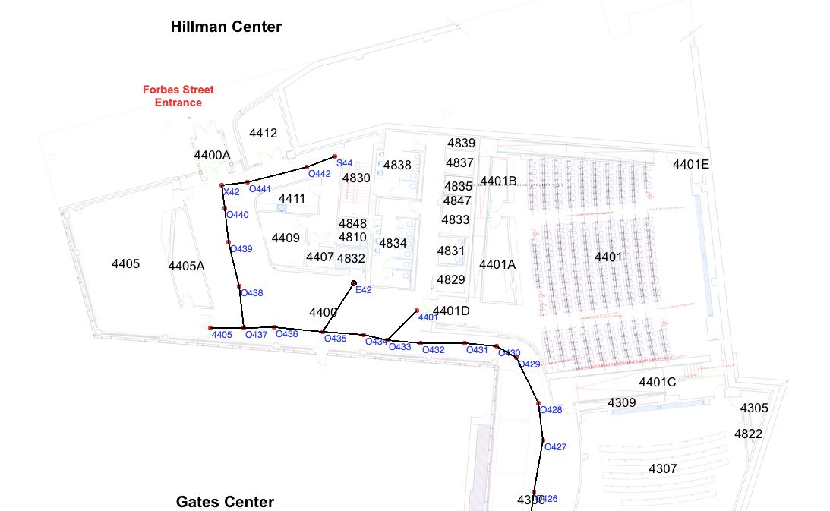
How do these different algorithms fit together?
Suppose I have a robot that can take items to different people, deliver messages, etc.
Once you have the
sequence of locations,
how does it plan a
path to each destination?
BFS

Slide 170
How do these different algorithms fit together?
Suppose I have a robot that can take items to different people, deliver messages, etc.
Once the robot has a
list of locations to
navigate, how does it
get there?
Motor motion control
Rapidly-exploring Random Trees (obstacles)

Slide 171
How do these different algorithms fit together?
Suppose I have a robot that can take items to different people, deliver messages, etc.
Hierarchical Planning:
High-level: classical
Mid-level: BFS
Low-level: motors

Slide 172
Planning, Thus Far
Goal States
completely specified
Goal Statements
partially specified
Preference models
objective function
Probabilistic States and Actions
Increasing Generality

Slide 173
Summary
Informationless states and actions
Easy to program
Can take a lot of memory
Hard to change the problem (e.g., adding a block)
Predicates and Properties
Potentially avoids the memory issues
Many alternate definitions
Need separate actions for different conditions
Other concerns like uncertainty unmodeled

Slide 175
Another Example: Getting Dressed
States?
Actions?
Goal?

Slide 176
Another Example: Robot Navigation
States?
Actions?
Goal?

