Slide 1


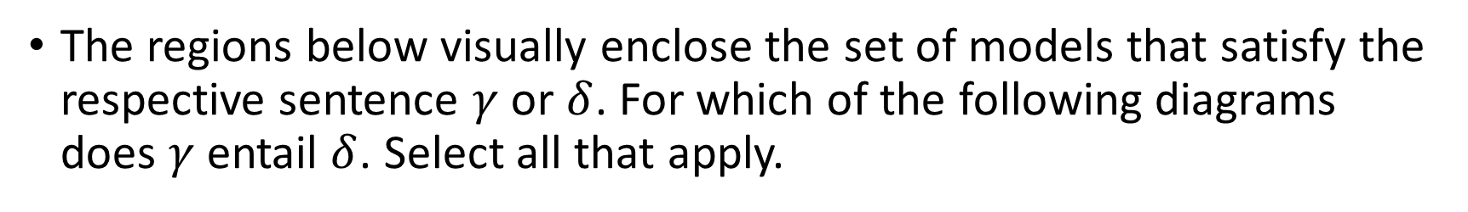








Warm-up
The regions below visually enclose the set of models that satisfy the respective sentence $γ$ or $δ$. For which of the following diagrams does $γ$ entail $δ$. Select all that apply.
A)
B)
C)
$$γ$$
$$δ$$
$$γ$$
$$δ$$
$$γ$$
$$δ$$
D)
E)
$$γ$$
$$δ$$
$$δ$$
$$γ$$
Notes:
0=7, R=4, W=6, U=2, T=8, F=1; 867 + 867 = 1734

Slide 2

AI: Representation and Problem Solving
Boolean Satisfiability Problem (SAT)
& Logical Agents
Instructors: Fei Fang & Pat Virtue
Slide credits: CMU AI, http://ai.berkeley.edu

Slide 3
Learning Objectives
Describe the definition of (Boolean) Satisfiability Problem (SAT)
Describe the definition of Conjunctive Normal Form (CNF)
Describe the following algorithms for solving SAT
  DPLL, CDCL, WalkSAT, GSAT
Determine whether a sentence is satisfiable
Describe Successor-State Axiom
Describe and implement SATPlan (Planning as Satisfiability)
(Hybrid Agent)

Slide 4
Logical Agent Vocab: Recap
Symbol: Variable that can be true or false
Model: Complete assignment of symbols to True/False
Operators: ¬ A (not), A ∧ B (conjunction), A ∨ B (disjunction), A ⇒ B (implication), A ⇔ B (biconditional)
Sentence: A logical statement composed of logic symbols and operators
KB: Collection of sentences representing facts and rules we know about the world
Query: Sentence we want to know if it is provably True, provably False, or unsure.

Slide 5
Logical Agent Vocab: Recap
Entail
  Does sentence1 entail sentence2?
  Input: sentence1, sentence2
  Output: True if each model that satisfies sentence1 must also satisfy sentence2; False otherwise
  "If I know 1 holds, then I know 2 holds"
Satisfy
  Does model satisfy sentence?
  Input: model, sentence
  Output: True if this sentence is true in this model; False otherwise
  "Does this particular state of the world work?”
Notes:
Forward chaining
Propositional logic

Slide 6
(Boolean) Satisfiability Problem (SAT)
Satisfiable
  Is sentence satisfiable?
  Input: sentence
  Output: True if at least one model satisfies sentence
  "Is it possible to make this sentence true?”
SAT problem is the problem of determining the satisfiability of a sentence
  SAT is a typical problem for logical agents
  SAT is the first problem proved to be NP-complete
  If satisfiable, we often want to know what that model is

Slide 7
SAT and Entailment
A sentence is satisfiable if it is true in at least one world
Suppose we have a hyper-efficient SAT solver; how can we use it to test entailment?
  Suppose α |= β
  Then α ⇒ β is true in all worlds
  Hence ¬(α ⇒ β) is false in all worlds
  Hence α ∧ ¬β is false in all worlds, i.e., unsatisfiable
More generally, to prove a sentence is valid (i.e., true in all models), introduce the negated claim and test for unsatisfiability; also known as reductio ad absurdum (reduction to absurdity)

Slide 8
SAT and CSPs
SAT problems are essentially CSPs with Boolean variables
  Can apply backtracking based algorithms
  Can apply local search algorithms
Naïve way to solve SAT: Truth table enumeration
Efficient SAT solvers operate on conjunctive normal form
  Often based on backtracking and local search

Slide 9
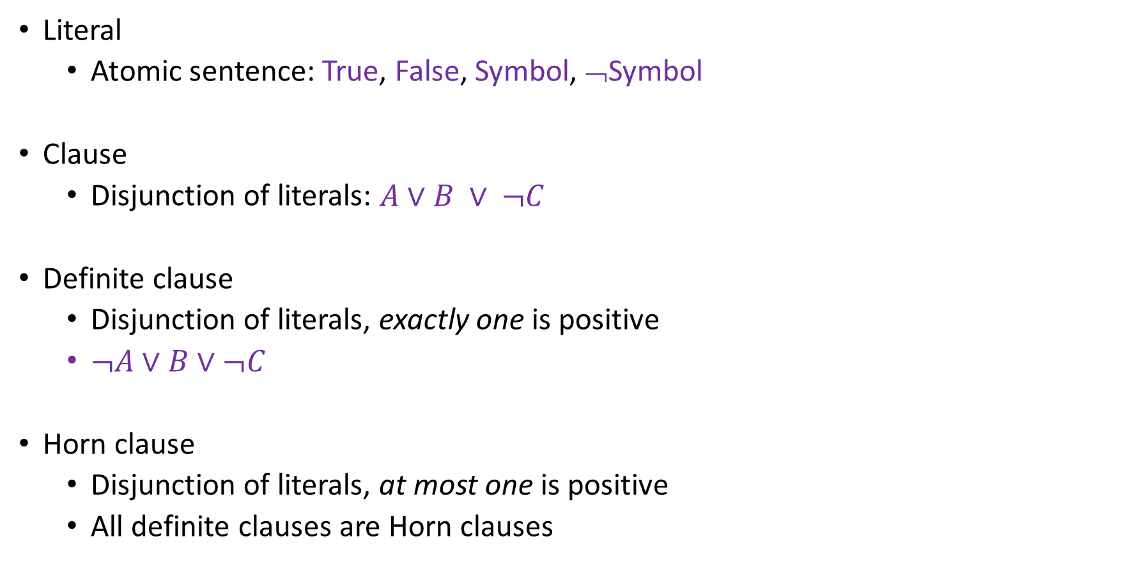
Propositional Logical Vocab: Recap
Literal
  Atomic sentence: True, False, Symbol, ¬Symbol
Clause
  Disjunction of literals: $A∨B ∨ ¬C$
Definite clause
  Disjunction of literals, exactly one is positive
  $¬A∨B∨¬C$
Horn clause
  Disjunction of literals, at most one is positive
  All definite clauses are Horn clauses

Slide 10
Conjunctive Normal Form (CNF)
Every sentence can be expressed as a conjunction of clauses
Each clause is a disjunction of literals
Each literal is a symbol or a negated symbol
We can convert a sentence to CNF through a sequence of standard transformations

Slide 11
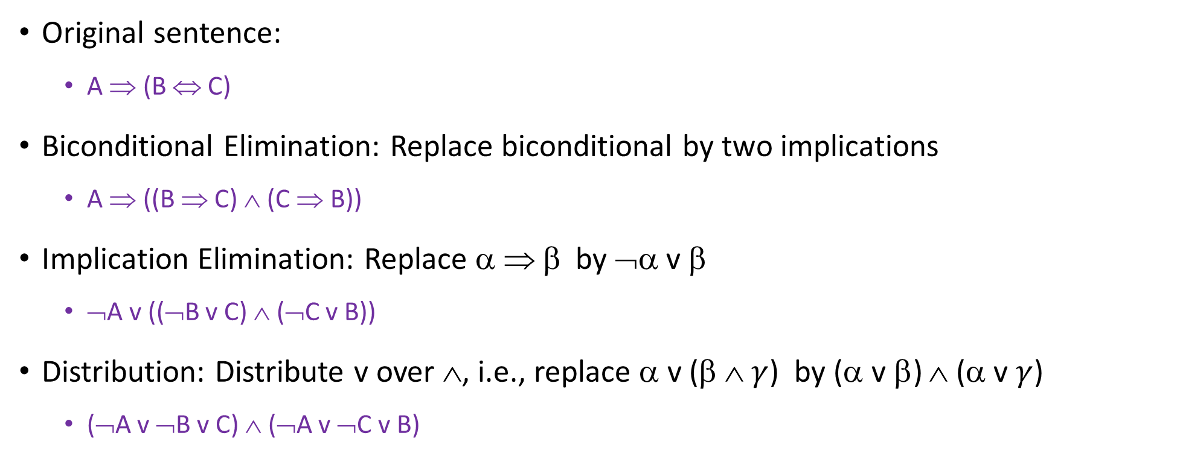
Conjunctive Normal Form (CNF)
Original sentence:
  A ⇒ (B ⇔ C)
Biconditional Elimination: Replace biconditional by two implications
  A ⇒ ((B ⇒ C) ∧ (C ⇒ B))
Implication Elimination: Replace α ⇒ β by ¬α v β
  ¬A v ((¬B v C) ∧ (¬C v B))
Distribution: Distribute v over ∧, i.e., replace α v (β ∧ $γ$) by (α v β) ∧ (α v $γ$)
  (¬A v ¬B v C) ∧ (¬A v ¬C v B)

Slide 12
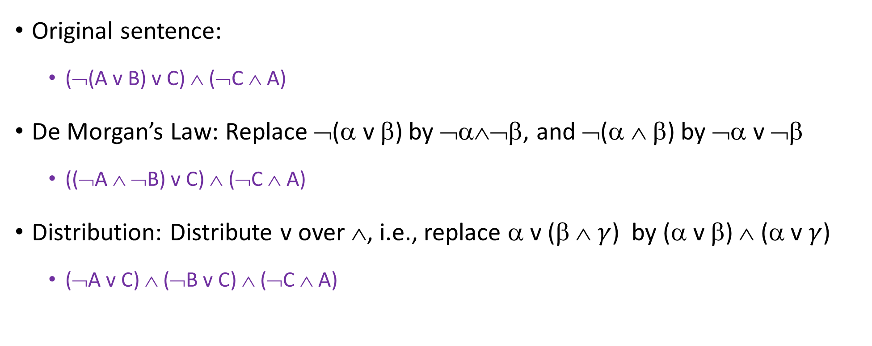
Conjunctive Normal Form (CNF)
Original sentence:
  (¬(A v B) v C) ∧ (¬C ∧ A)
De Morgan’s Law: Replace ¬(α v β) by ¬α∧¬β, and ¬(α ∧ β) by ¬α v ¬β
  ((¬A ∧ ¬B) v C) ∧ (¬C ∧ A)
Distribution: Distribute v over ∧, i.e., replace α v (β ∧ $γ$) by (α v β) ∧ (α v $γ$)
  (¬A v C) ∧ (¬B v C) ∧ (¬C ∧ A)

Slide 13
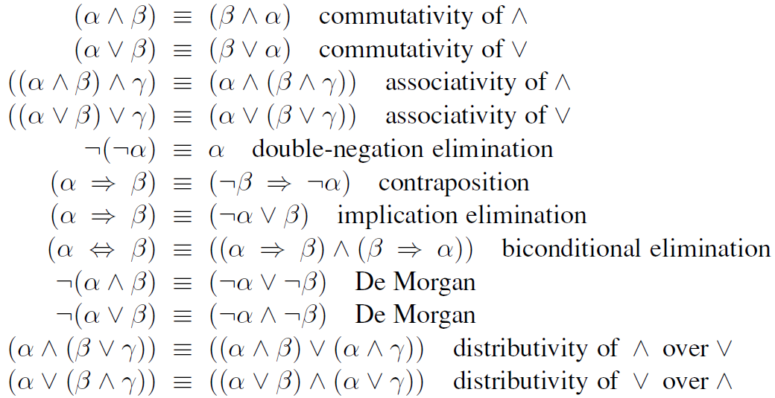
Other Logical Equivalences

Slide 14
DPLL Algorithm
DPLL (Davis-Putnam-Logemann-Loveland) is the core of modern SAT solvers
Essentially a backtracking search over models with several tricks:
  Early termination: stop if
    all clauses are satisfied; e.g., (A ∨ B) ∧ (A ∨ ¬C) is satisfied by {A=true}
    any clause is falsified; e.g., (A ∨ B) ∧ (A ∨ ¬C) is satisfied by {A=false, B=false}
SAT solver can stop with partial models; no need to assign all variables (can assign arbitrarily if a complete model is needed).
Stop when a conflict is found. Similar to backtracking algorithm for general CSPs.

Slide 15
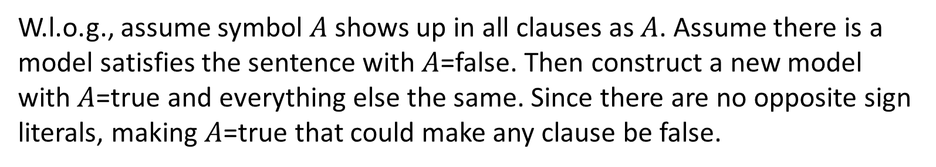
DPLL Algorithm
DPLL (Davis-Putnam-Logemann-Loveland) is the core of modern SAT solvers
Essentially a backtracking search over models with several tricks:
  Early termination
  Pure symbols: if all occurrences of a symbol in as-yet-unsatisfied clauses have the same sign, then give the symbol that value
    E.g., A is pure and positive in (A ∨ B) ∧ (A ∨ ¬C) ∧ (C ∨ ¬B) so set it to true
Claim: If a sentence has a model to satisfy it, then it has a model in which the pure symbols are assigned values that make their literals true. Why?
W.l.o.g., assume symbol $A$ shows up in all clauses as $A$. Assume there is a model satisfies the sentence with $A$=false. Then construct a new model with $A$=true and everything else the same. Since there are no opposite sign literals, making $A$=true that could make any clause be false.

Slide 16
DPLL Algorithm
DPLL (Davis-Putnam-Logemann-Loveland) is the core of modern SAT solvers
Essentially a backtracking search over models with several tricks:
  Early termination
  Pure symbols: if all occurrences of a symbol in as-yet-unsatisfied clauses have the same sign, then give the symbol that value
    E.g., A is pure and positive in (A ∨ B) ∧ (A ∨ ¬C) ∧ (C ∨ ¬B) so set it to true
Note: In determining the purity of a symbol, the algorithm can ignore clauses that are already known to be true in the model constructed so far

Slide 17
DPLL Algorithm
DPLL (Davis-Putnam-Logemann-Loveland) is the core of modern SAT solvers
Essentially a backtracking search over models with several tricks:
  Early termination
  Pure symbols
  Unit clauses: A unit clause is a clause in which all literals but one are already assigned false by the model (i.e., left with a single literal that can potentially satisfy the clause). Set the remaining symbol of a unit clause to satisfy it.
    E.g., if A=false and the sentence (in CNF) has a clause (A ∨ B), then set B true
    Unit propagation: Assigning values to the symbol in a unit clause can lead to new unit clauses. Iteratively find unit clauses until no more remains.
Similar to Generalized Forward Checking (nFC0) for general CSPs
Similar to Constraint Propagation for general CSPs

Slide 18
DPLL Algorithm
function DPLL(clauses, symbols, model) returns true or false
if every clause in clauses is true in model then return true
if some clause in clauses is false in model then return false
P, value ←FIND-PURE-SYMBOL(symbols, clauses, model)
if P is non-null then return DPLL(clauses, symbols–P, model∪{P=value})
P, value ←FIND-UNIT-CLAUSE(clauses, model)
if P is non-null then return DPLL(clauses, symbols–P, model∪{P=value})
P ← First(symbols)
rest ← Rest(symbols)
return or(DPLL(clauses, rest, model∪{P=true}),
DPLL(clauses, rest, model∪{P=false}))
Early termination
Essentially backtracking

Slide 19
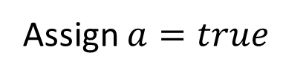
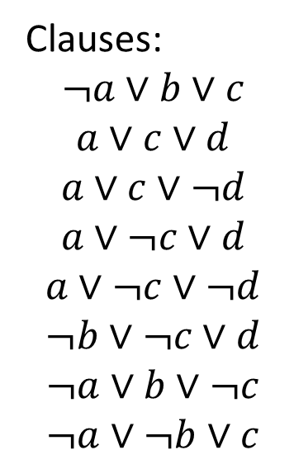
DPLL Algorithm
Clauses:
$$¬a∨b∨c$$
$$a∨c∨d$$
$$a∨c∨¬d$$
$$a∨¬c∨d$$
$$a∨¬c∨¬d$$
$$¬b∨¬c∨d$$
$$¬a∨b∨¬c$$
$$¬a∨¬b∨c$$
Assign $a=true$

Slide 20
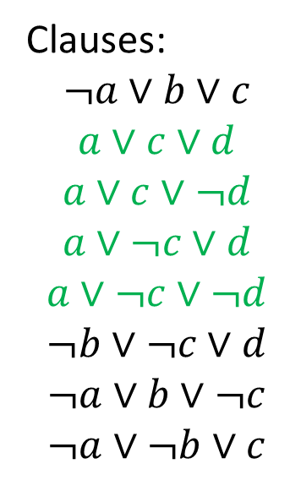
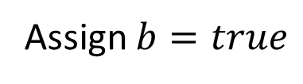
DPLL Algorithm
Clauses:
$$¬a∨b∨c$$
$$a∨c∨d$$
$$a∨c∨¬d$$
$$a∨¬c∨d$$
$$a∨¬c∨¬d$$
$$¬b∨¬c∨d$$
$$¬a∨b∨¬c$$
$$¬a∨¬b∨c$$
Assign $a=true$
Assign $b=true$

Slide 21
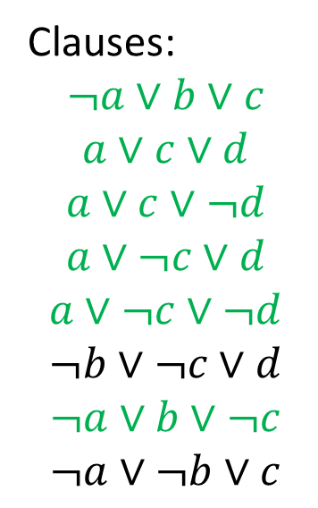
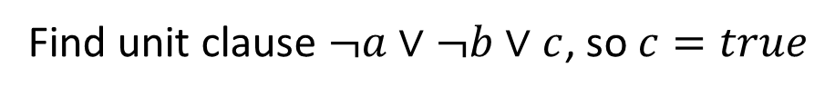
DPLL Algorithm
Clauses:
$$¬a∨b∨c$$
$$a∨c∨d$$
$$a∨c∨¬d$$
$$a∨¬c∨d$$
$$a∨¬c∨¬d$$
$$¬b∨¬c∨d$$
$$¬a∨b∨¬c$$
$$¬a∨¬b∨c$$
Assign $a=true$
Assign $b=true$
Find unit clause $¬a∨¬b∨c$, so $c=true$

Slide 22
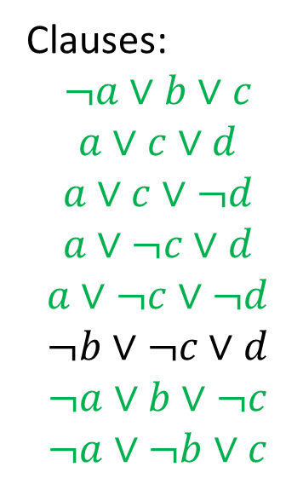
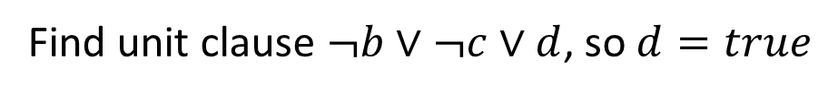
DPLL Algorithm
Clauses:
$$¬a∨b∨c$$
$$a∨c∨d$$
$$a∨c∨¬d$$
$$a∨¬c∨d$$
$$a∨¬c∨¬d$$
$$¬b∨¬c∨d$$
$$¬a∨b∨¬c$$
$$¬a∨¬b∨c$$
Assign $a=true$
Assign $b=true$
Find unit clause $¬a∨¬b∨c$, so $c=true$
Find unit clause $¬b∨¬c∨d$, so $d=true$

Slide 23
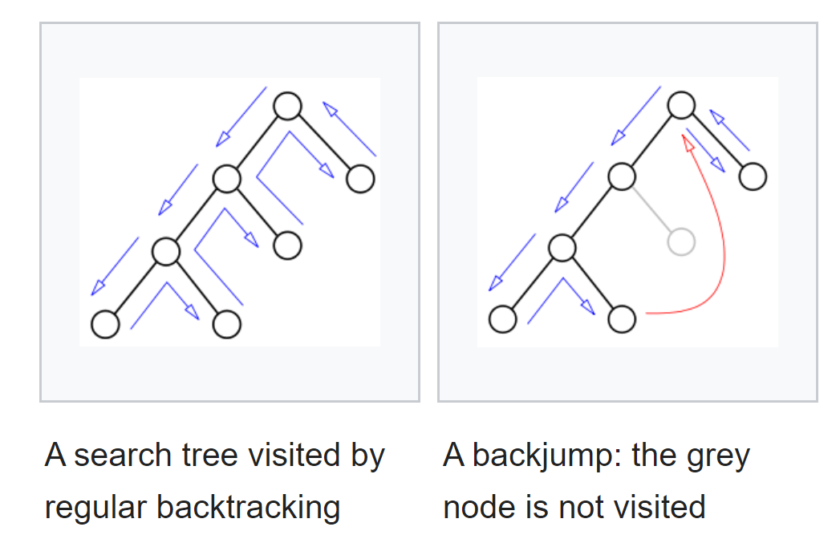
Backjumping
Backjumping is a technique in backtracking algorithms
Go up more than one level in the search tree when backtrack
https://en.wikipedia.org/wiki/Backjumping

Slide 24
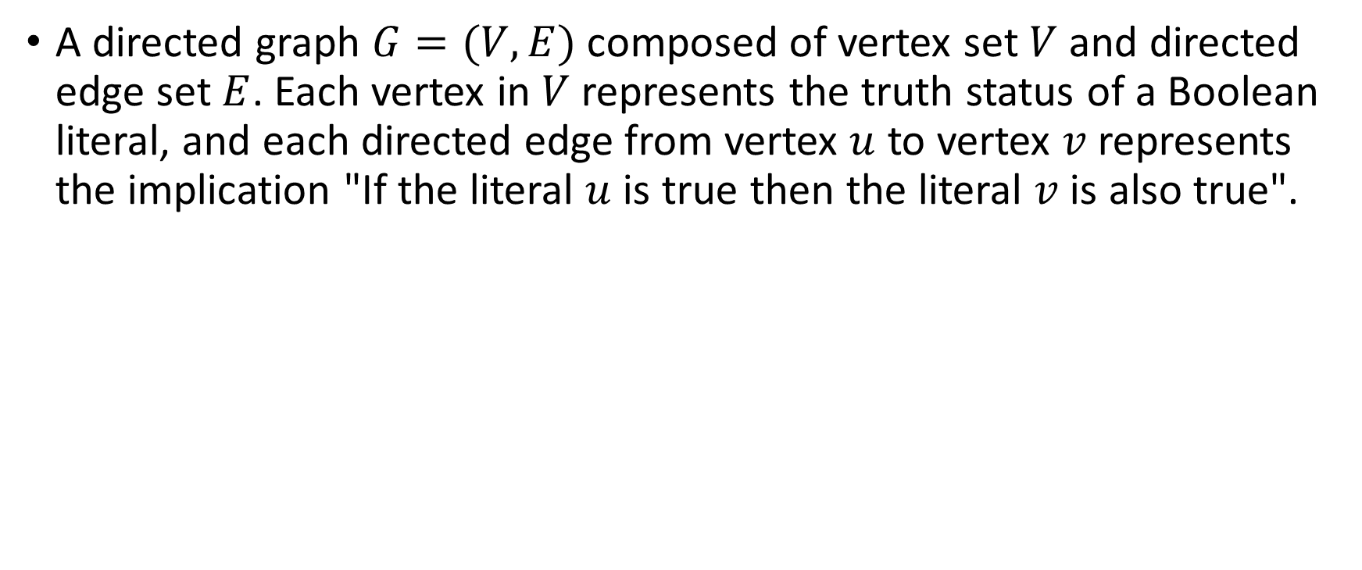


Implication Graph
A directed graph $G=(V, E)$ composed of vertex set $V$ and directed edge set $E$. Each vertex in $V$ represents the truth status of a Boolean literal, and each directed edge from vertex $u$ to vertex $v$ represents the implication "If the literal $u$ is true then the literal $v$ is also true".
Example: Given a clause (A ∨ B), $A$=false implies $B$=true
$$B$$
$$¬A$$
https://en.wikipedia.org/wiki/Implication_graph

Slide 25
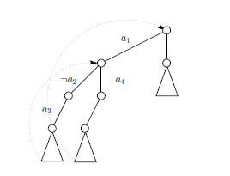
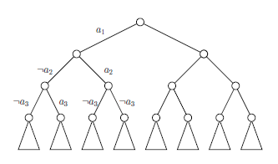
Conflict Driven Clause Learning (CDCL)
Use implication graph
Use non-chronological backjumping
DPLL
CDCL

Slide 26
Conflict Driven Clause Learning (CDCL)
Select a variable and assign True or False
Apply unit propagation to build the implication graph
If there is any conflict
  Find the cut in the implication graph that led to the conflict
  Derive a new clause which is the negation of the assignments that led to the conflict
  Backjump to the appropriate decision level, where the first-assigned variable involved in the conflict was assigned
Otherwise continue from step 1 until all variable values are assigned
https://en.wikipedia.org/wiki/Conflict-driven_clause_learning

Slide 27
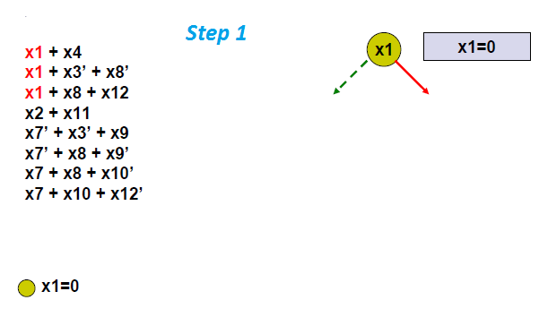
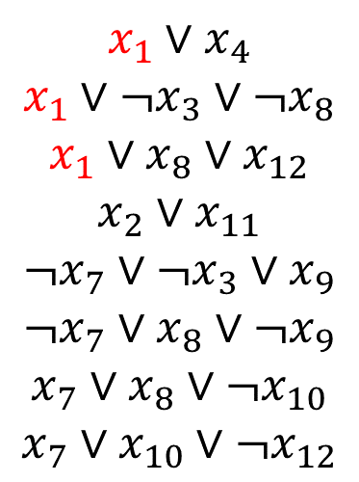
Conflict Driven Clause Learning (CDCL)
$$x_{1}∨x_{4}$$
$$x_{1}∨¬x_{3}∨¬x_{8}$$
$$x_{1}∨x_{8}∨x_{12}$$
$$x_{2}∨x_{11}$$
$$¬x_{7}∨¬x_{3}∨x_{9}$$
$$¬x_{7}∨x_{8}∨¬x_{9}$$
$$x_{7}∨x_{8}∨¬x_{10}$$
$$x_{7}∨x_{10}∨¬x_{12}$$

Slide 28
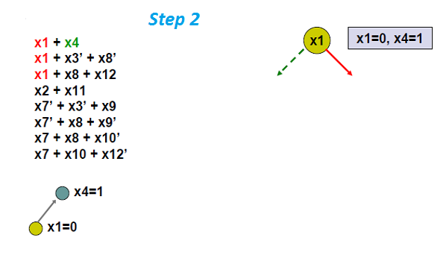
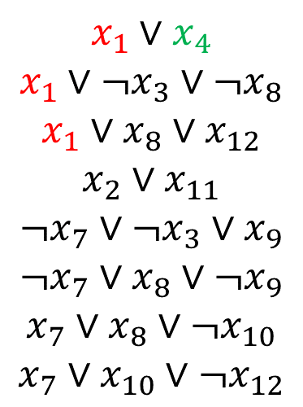
Conflict Driven Clause Learning (CDCL)
$$x_{1}∨x_{4}$$
$$x_{1}∨¬x_{3}∨¬x_{8}$$
$$x_{1}∨x_{8}∨x_{12}$$
$$x_{2}∨x_{11}$$
$$¬x_{7}∨¬x_{3}∨x_{9}$$
$$¬x_{7}∨x_{8}∨¬x_{9}$$
$$x_{7}∨x_{8}∨¬x_{10}$$
$$x_{7}∨x_{10}∨¬x_{12}$$
Build the implication graph

Slide 29
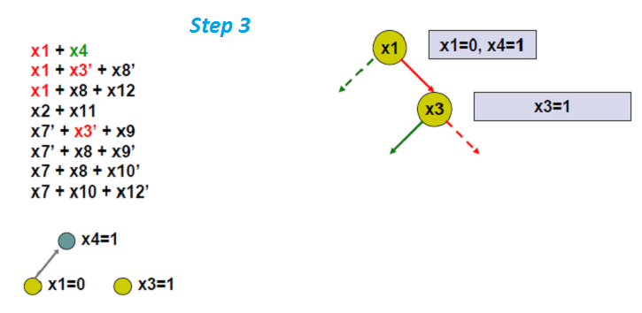
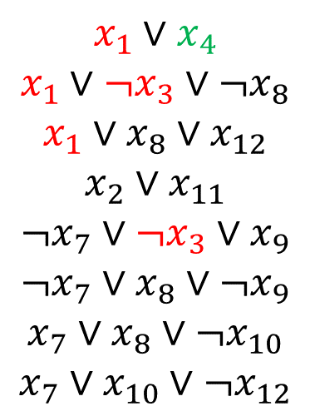
Conflict Driven Clause Learning (CDCL)
$$x_{1}∨x_{4}$$
$$x_{1}∨¬x_{3}∨¬x_{8}$$
$$x_{1}∨x_{8}∨x_{12}$$
$$x_{2}∨x_{11}$$
$$¬x_{7}∨¬x_{3}∨x_{9}$$
$$¬x_{7}∨x_{8}∨¬x_{9}$$
$$x_{7}∨x_{8}∨¬x_{10}$$
$$x_{7}∨x_{10}∨¬x_{12}$$

Slide 30
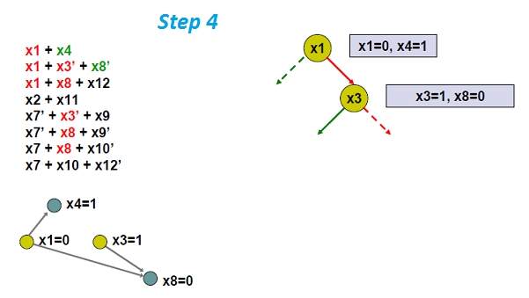
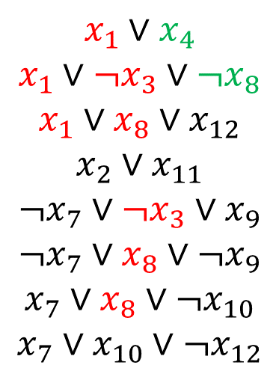
Conflict Driven Clause Learning (CDCL)
$$x_{1}∨x_{4}$$
$$x_{1}∨¬x_{3}∨¬x_{8}$$
$$x_{1}∨x_{8}∨x_{12}$$
$$x_{2}∨x_{11}$$
$$¬x_{7}∨¬x_{3}∨x_{9}$$
$$¬x_{7}∨x_{8}∨¬x_{9}$$
$$x_{7}∨x_{8}∨¬x_{10}$$
$$x_{7}∨x_{10}∨¬x_{12}$$

Slide 31
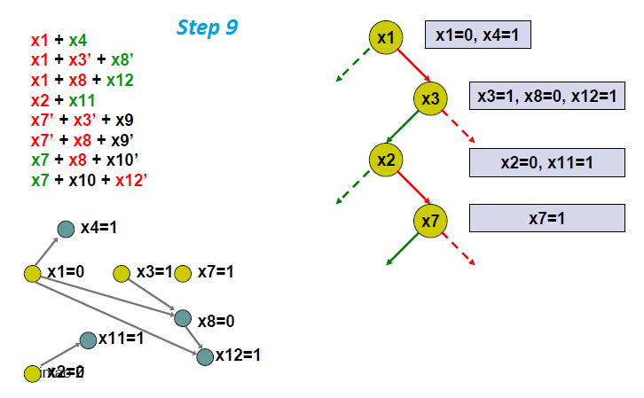
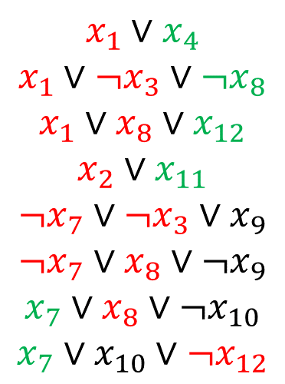
Conflict Driven Clause Learning (CDCL)
$$x_{1}∨x_{4}$$
$$x_{1}∨¬x_{3}∨¬x_{8}$$
$$x_{1}∨x_{8}∨x_{12}$$
$$x_{2}∨x_{11}$$
$$¬x_{7}∨¬x_{3}∨x_{9}$$
$$¬x_{7}∨x_{8}∨¬x_{9}$$
$$x_{7}∨x_{8}∨¬x_{10}$$
$$x_{7}∨x_{10}∨¬x_{12}$$

Slide 32
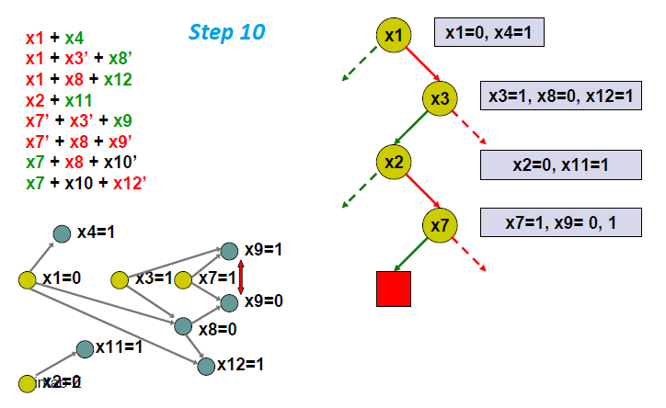
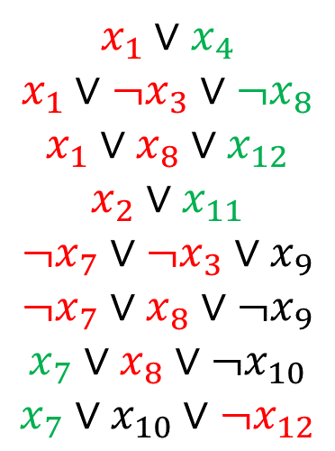
Conflict Driven Clause Learning (CDCL)
$$x_{1}∨x_{4}$$
$$x_{1}∨¬x_{3}∨¬x_{8}$$
$$x_{1}∨x_{8}∨x_{12}$$
$$x_{2}∨x_{11}$$
$$¬x_{7}∨¬x_{3}∨x_{9}$$
$$¬x_{7}∨x_{8}∨¬x_{9}$$
$$x_{7}∨x_{8}∨¬x_{10}$$
$$x_{7}∨x_{10}∨¬x_{12}$$
There is a conflict!

Slide 33
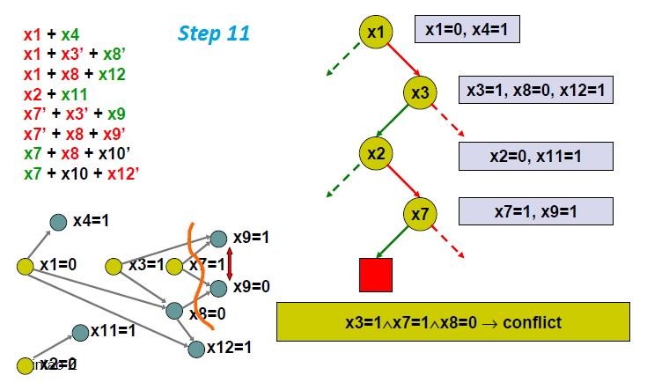
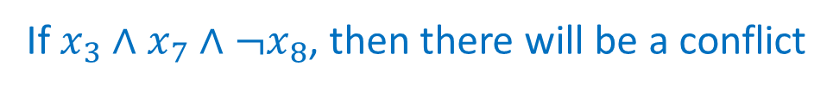
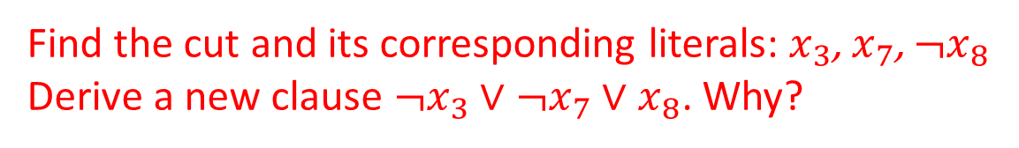
Conflict Driven Clause Learning (CDCL)
$$x_{1}∨x_{4}$$
$$x_{1}∨¬x_{3}∨¬x_{8}$$
$$x_{1}∨x_{8}∨x_{12}$$
$$x_{2}∨x_{11}$$
$$¬x_{7}∨¬x_{3}∨x_{9}$$
$$¬x_{7}∨x_{8}∨¬x_{9}$$
$$x_{7}∨x_{8}∨¬x_{10}$$
$$x_{7}∨x_{10}∨¬x_{12}$$
Find the cut and its corresponding literals: $x_{3}$, $x_{7}$, $¬x_{8}$
Derive a new clause $¬x_{3}∨¬x_{7}∨x_{8}$. Why?
If $x_{3}∧x_{7}∧¬x_{8}$, then there will be a conflict

Slide 34
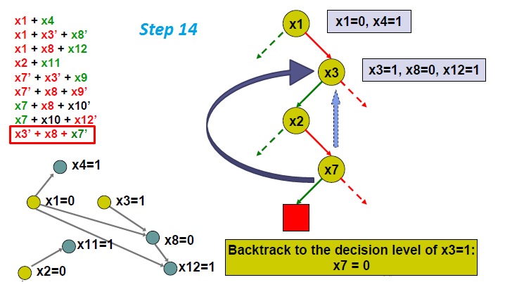
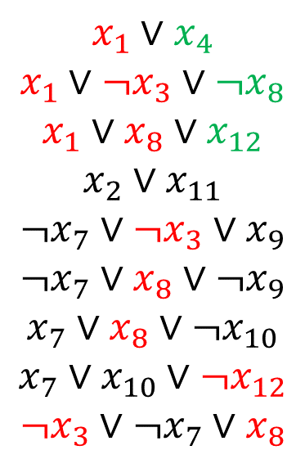
Conflict Driven Clause Learning (CDCL)
$$x_{1}∨x_{4}$$
$$x_{1}∨¬x_{3}∨¬x_{8}$$
$$x_{1}∨x_{8}∨x_{12}$$
$$x_{2}∨x_{11}$$
$$¬x_{7}∨¬x_{3}∨x_{9}$$
$$¬x_{7}∨x_{8}∨¬x_{9}$$
$$x_{7}∨x_{8}∨¬x_{10}$$
$$x_{7}∨x_{10}∨¬x_{12}$$
$$¬x_{3}∨¬x_{7}∨x_{8}$$
Backjump to the level where the first-assigned variable involved in the conflict was assigned.

Slide 35
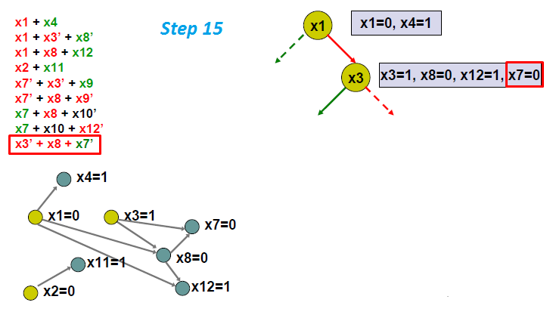
Conflict Driven Clause Learning (CDCL)
$$x_{1}∨x_{4}$$
$$x_{1}∨¬x_{3}∨¬x_{8}$$
$$x_{1}∨x_{8}∨x_{12}$$
$$x_{2}∨x_{11}$$
$$¬x_{7}∨¬x_{3}∨x_{9}$$
$$¬x_{7}∨x_{8}∨¬x_{9}$$
$$x_{7}∨x_{8}∨¬x_{10}$$
$$x_{7}∨x_{10}∨¬x_{12}$$
$$¬x_{3}∨¬x_{7}∨x_{8}$$
Continue Unit propagation.
Backtrack to the level where the “problem” is instead of merely trying to fix the “symptom”

Slide 36
Conflict Driven Clause Learning (CDCL)
Select a variable and assign True or False
Apply unit propagation to build the implication graph
If there is any conflict
  Find the cut in the implication graph that led to the conflict
  Derive a new clause which is the negation of the assignments that led to the conflict
  Backjump to the appropriate decision level, where the first-assigned variable involved in the conflict was assigned
Otherwise continue from step 1 until all variable values are assigned
Similar ideas can be applied to general CSPs
https://en.wikipedia.org/wiki/Conflict-driven_clause_learning

Slide 37
Local Search Algorithms for SAT
WALK-SAT
  Randomly choose an unsatisfied clause
  With probability p, flip a randomly selected symbol in the clause
  Otherwise, flip a symbol in the clause that maximizes the # of satisfied clauses

Slide 38
WALKSAT
function WALKSAT(clauses, p, max_flips) returns a model or failure
inputs: clauses, a set of clauses
p, the probability of choosing to do a random walk, typically around 0.5
max_flips, number of flips allowed before giving up
model ← a random assignment of true/false to the symbols in clauses
for i = 1 to max_flips do
if model satisfies clauses then return model
clause ←a randomly selected clause from clauses that is false in model
with probability p flip the value in model of
a randomly selected symbol from clause
else flip whichever symbol in clause maximizes the # of satisfied clauses
return failure

Slide 39
Local Search Algorithms for SAT
WALK-SAT
  Randomly choose an unsatisfied clause
  With probability p, flip a randomly selected symbol in the clause
  Otherwise, flip a symbol in the clause that maximizes the # of satisfied clauses
GSAT [Selman, Levesque, Mitchell AAAI-92]
  Similar to hill climbing but with random restarts and allows for downhill/sideway moves if no better moves available

Slide 40
GSAT
function GSAT(sentence, max_restarts, max_climbs) returns a model or failure
for i = 1 to max_restarts do
model ← a random assignment of true/false to the symbols in clauses
for j = 1 to max_climbs do
if model satisfies sentence then return model
model ← randomly choose one of the best successors
return failure
Avg. total flips
2000
1600
1200
800
400
50 variables, 215 3SAT clauses
Greediness is not essential as long as climbs and sideways moves are preferred over downward moves.
max-climbs
100 200

Slide 41
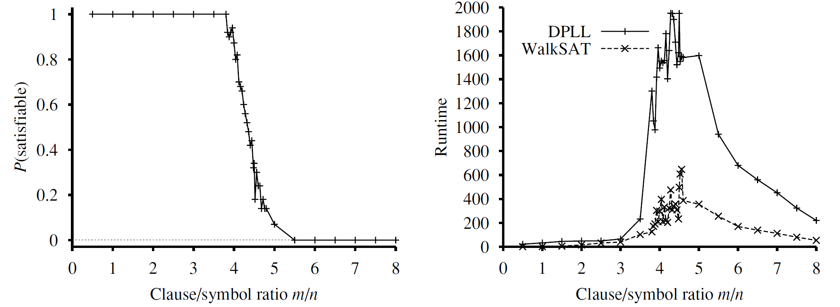
Phase Transition of SAT

Slide 42
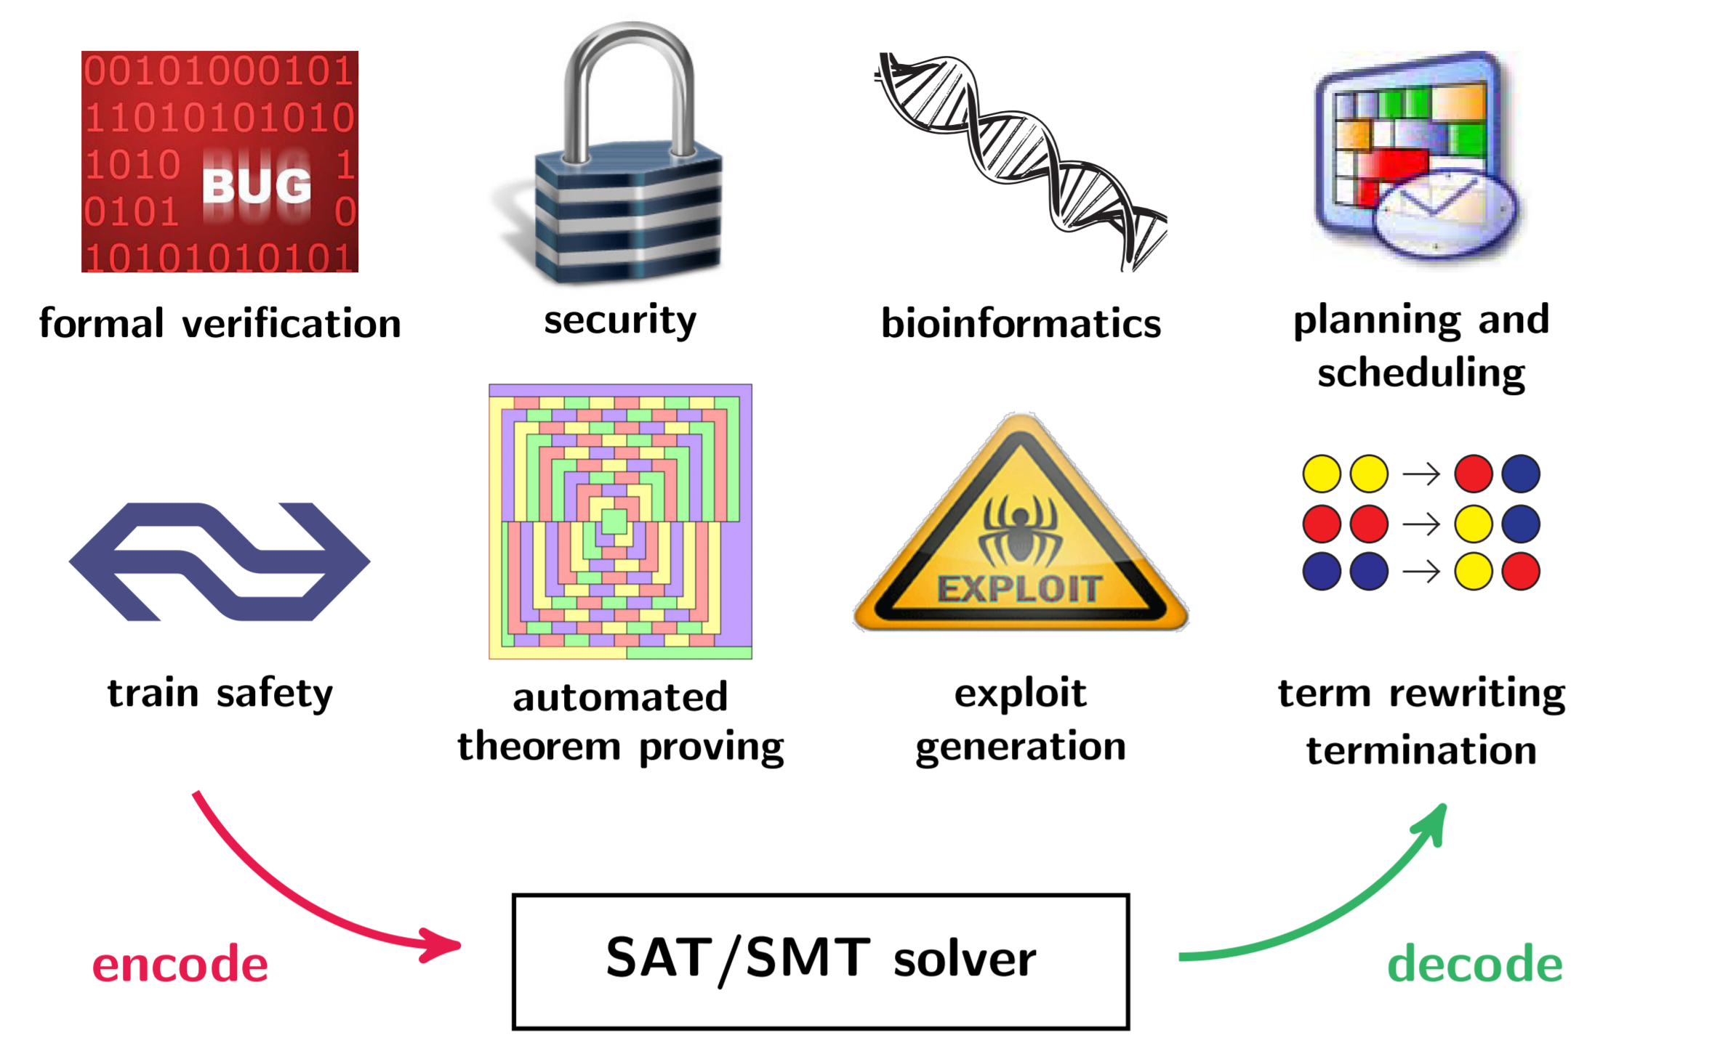
SAT Applications

Slide 43
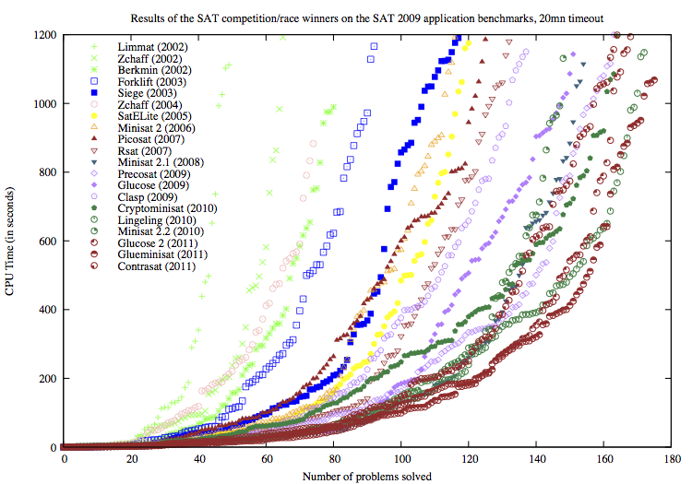
Evolution of SAT Solvers

Slide 44
Agent based on Propositional Logic
Agent
Environment
Sensors
Percepts
Knowledge Base
Inference
Actuators
Actions

Slide 45



Planning as Satisfiability (SATPlan)
Given a hyper-efficient SAT solver, can we use it to make plans for an agent so that it is guaranteed to achieve certain goals?
For fully observable, deterministic case: Yes, planning problem is solvable iff there is some satisfying assignment for actions etc. (No sensor needed due to full observability; KB does not grow)
Wall
How can Pacman eat all food given that the ghost will move South, then E, then N, then stop there?

Slide 46
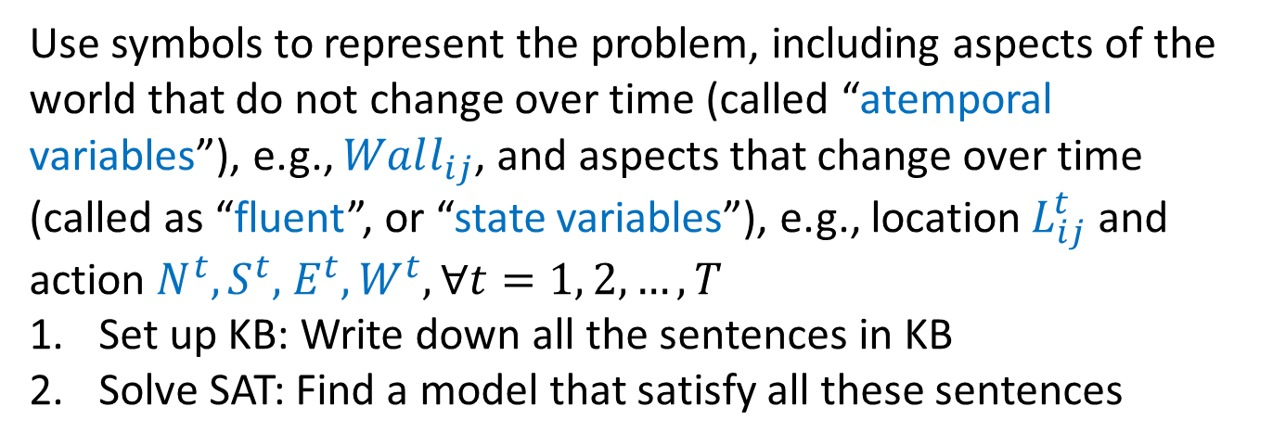
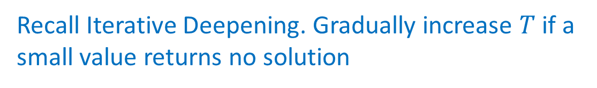
Planning as Satisfiability (SATPlan)
How can Pacman eat all food given that the ghost will move South, then E, then N, then stop there?
Wall
Use symbols to represent the problem, including aspects of the world that do not change over time (called “atemporal variables”), e.g., $Wall_{ij}$, and aspects that change over time (called as “fluent”, or “state variables”), e.g., location $L_{ij}^{t}$ and action $N^{t},S^{t},$ $E^{t},W^{t},∀t=1, 2, …,T$
Set up KB: Write down all the sentences in KB
Solve SAT: Find a model that satisfy all these sentences
What should be the value of T?
Recall Iterative Deepening. Gradually increase $T$ if a small value returns no solution

Slide 47
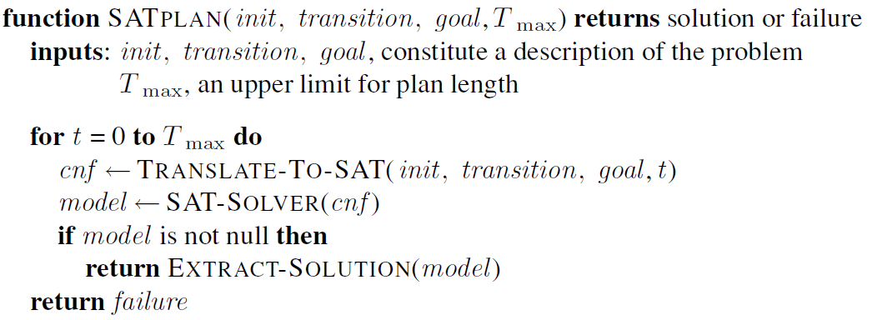

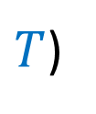

Planning as Satisfiability (SATPlan)
$T_{max}$: Max length of planning horizon
$$T$$
$T$ is the length of planning horizon. Gradually increase.
$T$)
Set up the KB
Run SAT solver

Slide 48
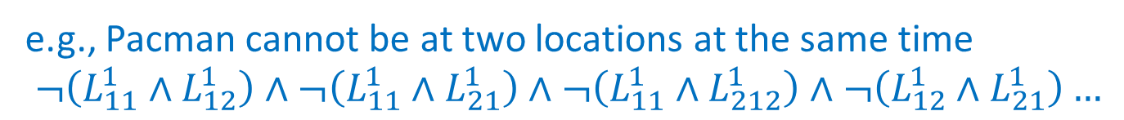


Planning as Satisfiability (SATPlan)
How to set up the KB? KB often includes sentences describing
  Initial state
  Domain constraints
Wall
e.g., $L_{11}^{0}$, $Food_{21}^{0}$, $Ghost_{12}^{0}$, $GhostMoveS^{0}$, $¬Wall_{12}^{S}$, $Wall_{12}^{E}$, …
2
$$j$$
e.g., Pacman cannot be at two locations at the same time
$$¬\left(L_{11}^{1}∧L_{12}^{1}\right)∧¬\left(L_{11}^{1}∧L_{21}^{1}\right)∧¬\left(L_{11}^{1}∧L_{212}^{1}\right)∧¬\left(L_{12}^{1}∧L_{21}^{1}\right)…$$
1
1
2
$$i$$

Slide 49
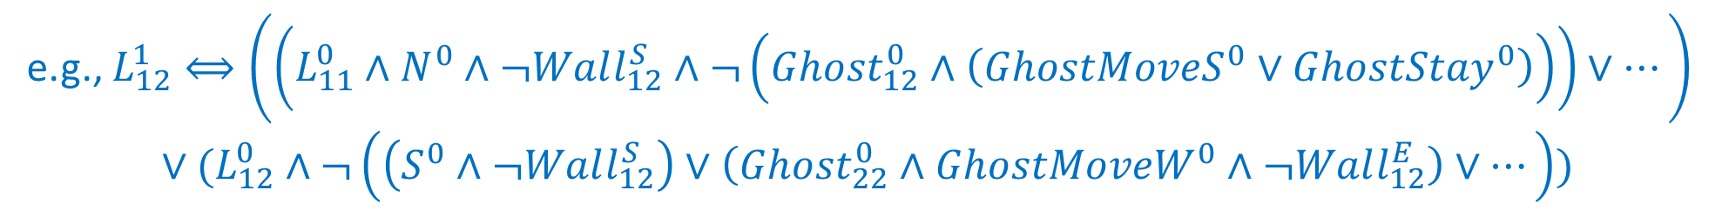


Planning as Satisfiability (SATPlan)
How to set up the KB? KB often includes sentences describing
Wall
  Transition model sentences up to time T
  Write down how each fluent at each time gets its value based on successor-state axiom:
2
$$j$$
1
1
2
$$i$$
e.g., $L_{12}^{1}⟺\left(\left(L_{11}^{0}∧N^{0}∧¬Wall_{12}^{S}∧¬\left(Ghost_{12}^{0}∧\left(GhostMoveS^{0}∨GhostStay^{0}\right)\right)\right)∨…\right)$
$$∨(L_{12}^{0}∧¬\left(\left(S^{0}∧¬Wall_{12}^{S}\right)∨\left(Ghost_{22}^{0}∧GhostMoveW^{0}∧¬Wall_{12}^{E}\right)∨…\right))$$

Slide 50
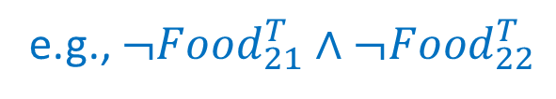
Planning as Satisfiability (SATPlan)
How to set up the KB? KB often includes sentences describing
Wall
  Goal is achieved at time T
2
e.g., $¬Food_{21}^{T}∧¬Food_{22}^{T}$
$$j$$
1
1
2
$$i$$

Slide 51
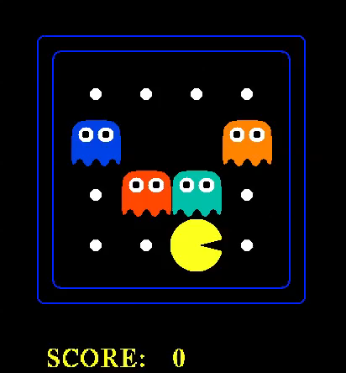

Slide 52
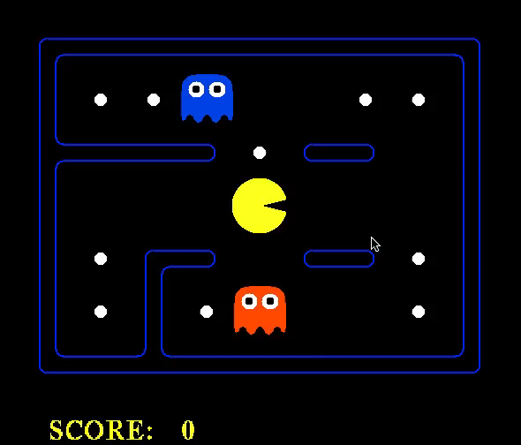

Slide 53
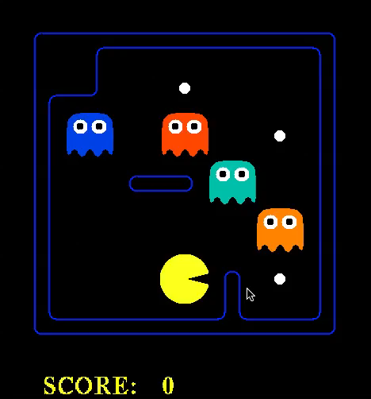

Slide 54
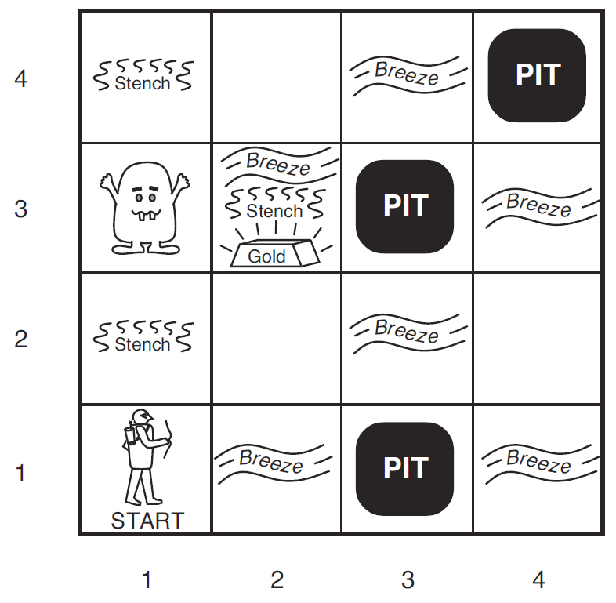

Wumpus World
The world is not fully observable from the beginning
KB consists of
  Facts
  Rules
  Percept and Actions
Keep adding sentences to the KB with new percepts and actions
At any time step, we can Ask the KB about the current state, e.g., whether a square is safe
$B_{ij}$ = breeze felt; $S_{ij}$ = stench smelt
$P_{ij}$ = pit here; $W_{ij}$ = wumpus here; $G$ = gold

Slide 55
Hybrid Agent
Plan actions by combining search and logical inference
Maintain and update a KB as well as a current plan
Construct a plan based on a decreasing priority of goals
In Wumpus world
  Ask KB to work out which squares are safe and which have yet to be visited
  If there is glitter, construct a plan to grad the gold and go back safely
  If there is no current plan, use A* search to plan a route that only goes through safe squares to the closest unvisited safe square
  If no such safe squares to explore, ask questions to determine whether to shoot at one of the possible wumpus locations

Slide 56
Summary
Many problems can be reduced to SAT
Efficient SAT solvers operates on CNF and uses ideas in solving CSPs such as backtracking and local search
Can frame a planning problem as a satisfiability problem

Slide 57
Learning Objectives
Describe the definition of (Boolean) Satisfiability Problem (SAT)
Describe the definition of Conjunctive Normal Form (CNF)
Describe the following algorithms for solving SAT
  DPLL, CDCL, WalkSAT, GSAT
Determine whether a sentence is satisfiable
Describe Successor-State Axiom
Describe and implement SATPlan (Planning as Satisfiability)
(Hybrid Agent)

