Slide 1
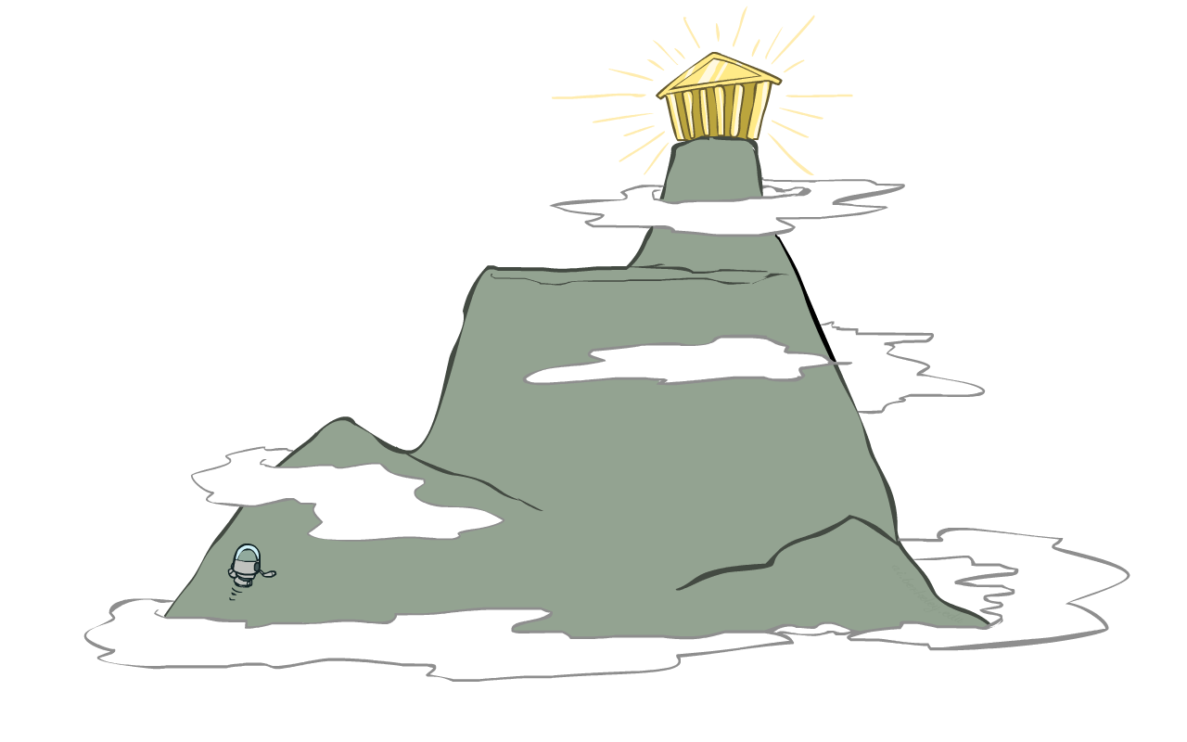
Local Search Warm-up
How to find the top of Mount Everest in a thick fog while suffering from amnesia?

Slide 2
AI: Representation and Problem Solving
Local Search
Instructors: Fei Fang & Pat Virtue
Slide credits: CMU AI, http://ai.berkeley.edu

Slide 3
Learning Objectives
Describe and implement the following local search algorithms
  Iterative improvement algorithm with min-conflict heuristic for CSPs
  Hill Climbing (Greedy Local Search)
  Random Walk
  Simulated Annealing
  Beam Search
  Genetic Algorithm
Identify completeness and optimality of local search algorithms
Compare different local search algorithms as well as contrast with classical search algorithms
Select appropriate local search algorithms for real-world problems

Slide 4
Local Search
Can be applied to identification problems (e.g., CSPs), as well as some planning and optimization problems
Typically use a complete-state formulation, e.g., all variables assigned in a CSP (may not satisfy all the constraints)

Slide 5
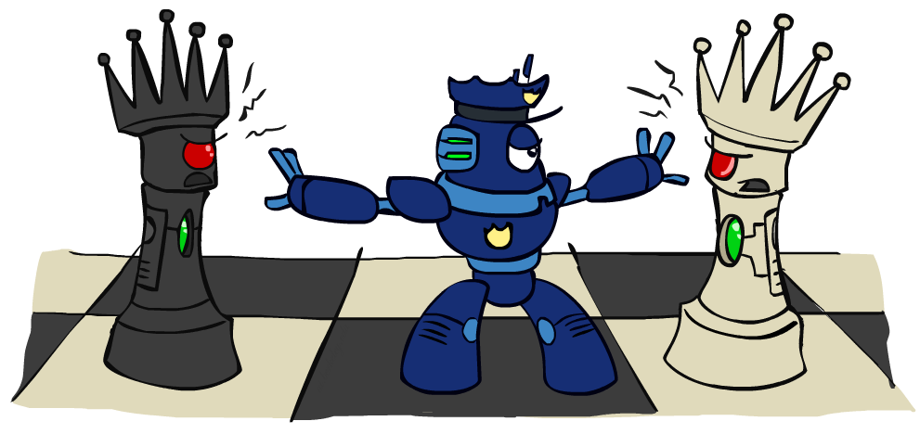
Iterative Improvement for CSPs

Slide 6
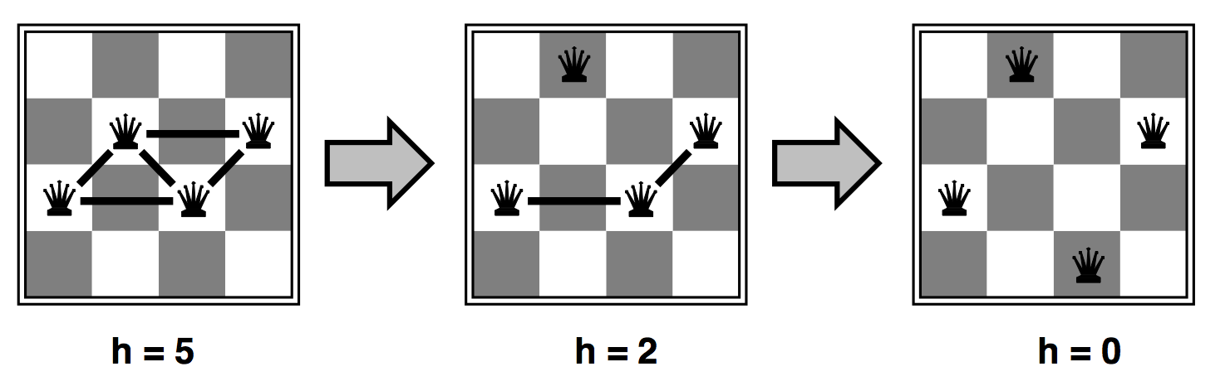

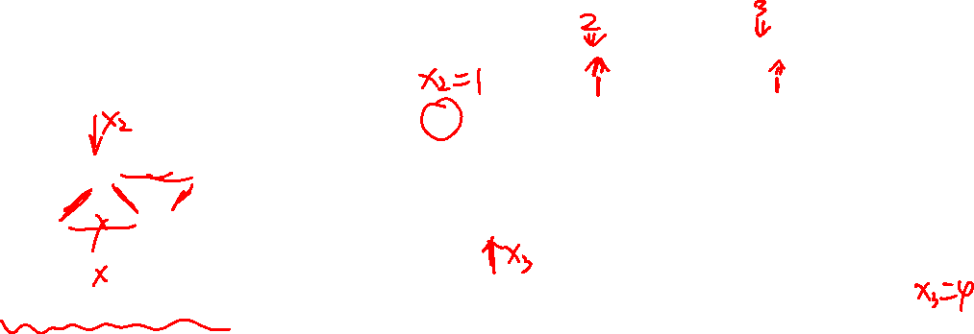
Iterative Improvement for CSPs
Start with an arbitrary assignment, iteratively reassign variable values
While not solved,
  Variable selection: randomly select a conflicted variable
  Value selection with min-conflicts heuristic $h$: Choose a value that violates the fewest constraints (break tie randomly)
For $n$-Queens: Variables $x_{i}∈\{1..n\}$; Constraints $x_{i}≠x_{j}$, $\left|x_{i}−x_{j}\right|≠\left|i−j\right|,∀i≠j$
Notes:
(row index of queen in column $i$)

Slide 7

Demo – $n$-Queens
[Demo: n-queens – iterative improvement (L5D1)]

Slide 8
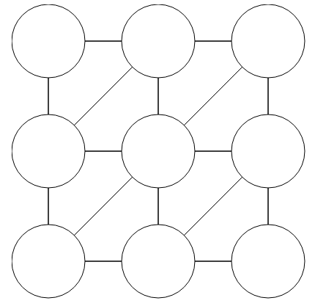
Demo – Graph Coloring
Notes:
[Demo: coloring – iterative improvement]

Slide 9
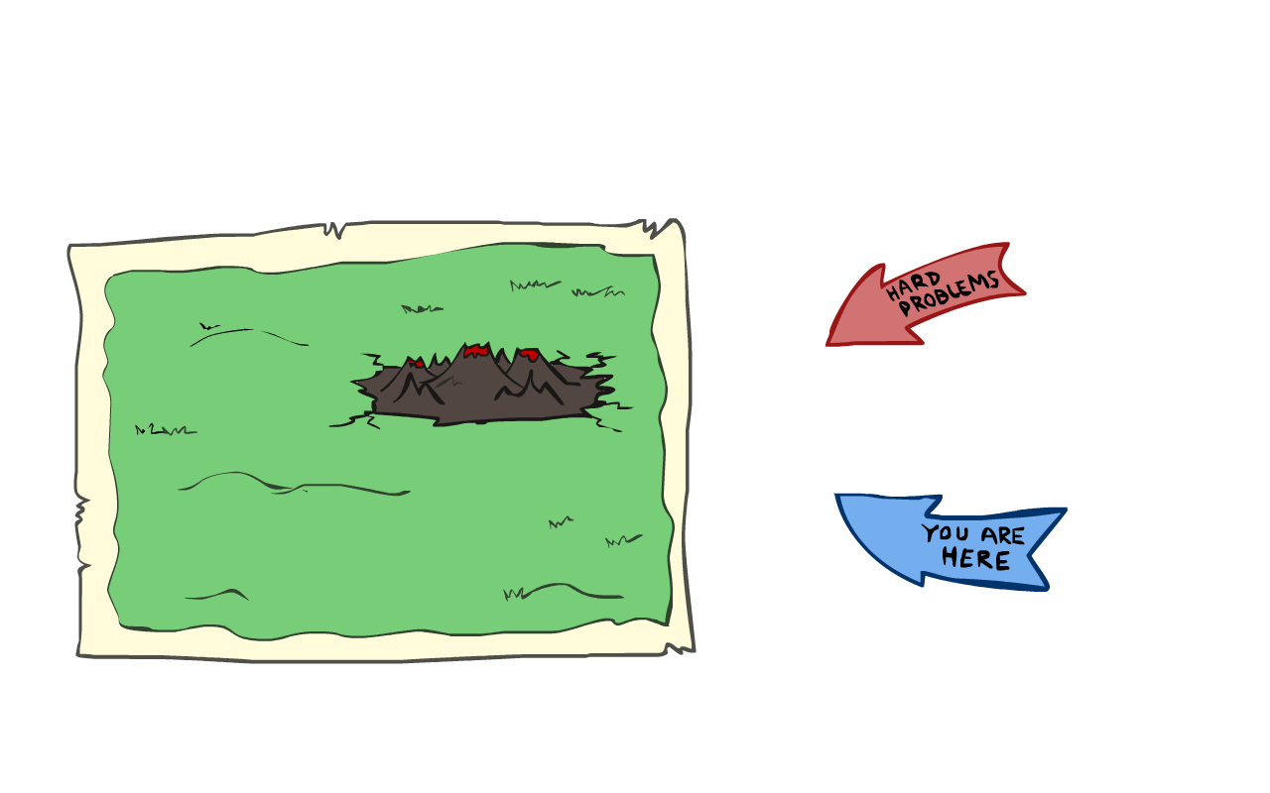
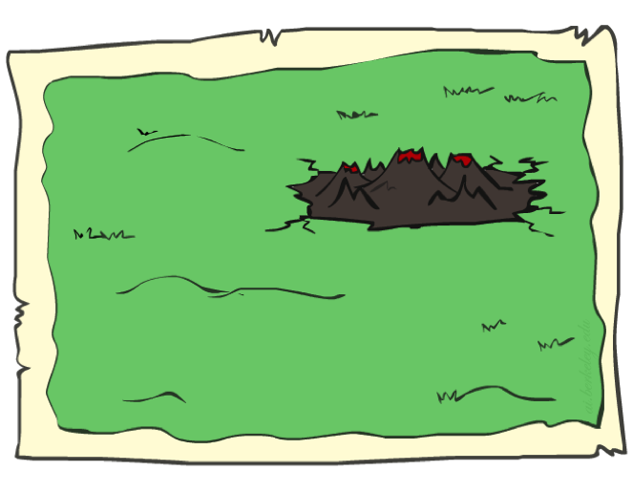
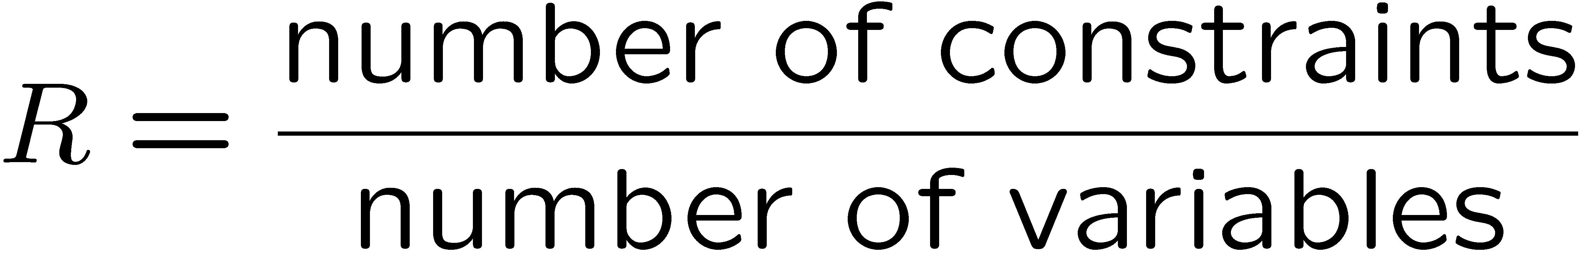
Iterative Improvement for CSPs
Given random initial state, can solve n-queens in almost constant time for arbitrary n with high probability (e.g., n = 10,000,000)!
Same for any randomly-generated CSP except in a narrow range of the ratio

Slide 10
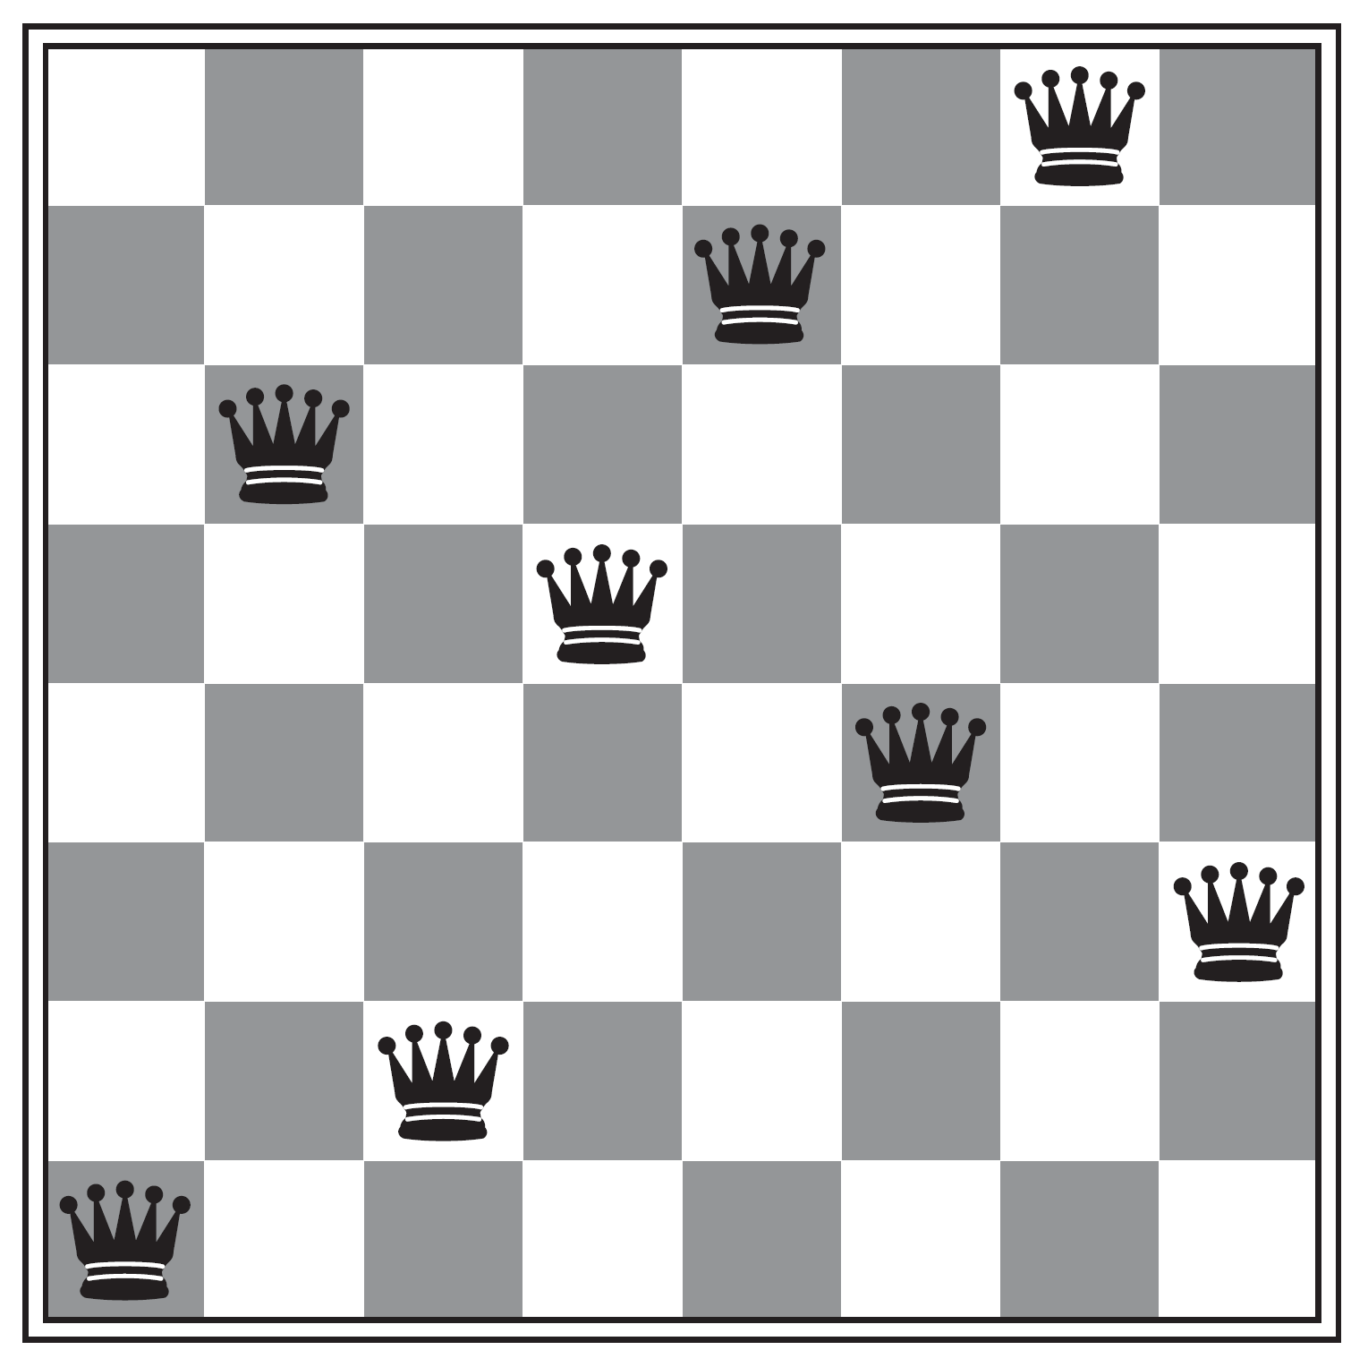

Local Search
A local search algorithm is…
  Complete if it always finds a goal if one exists
  Optimal if it always finds a global minimum/maximum
$$h=1$$
Is Iterative Improvement for CSPs complete?
No! May get stuck in a local optima

Slide 11

State-Space Landscape
In identification problems, could be a function measuring how close you are to a valid solution, e.g., $−1×$ #conflicts in n-Queens/CSP
What’s the difference between shoulder and flat local maximum (both are plateaux)?

Slide 12
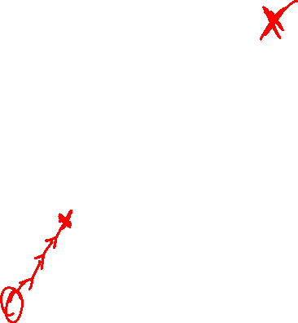
Hill Climbing (Greedy Local Search)
Simple, general idea:
  Start wherever
  Repeat: move to the best “neighboring” state (successor state)
  If no neighbors better than current, quit
Complete?
No!
Optimal?
No!

Slide 13
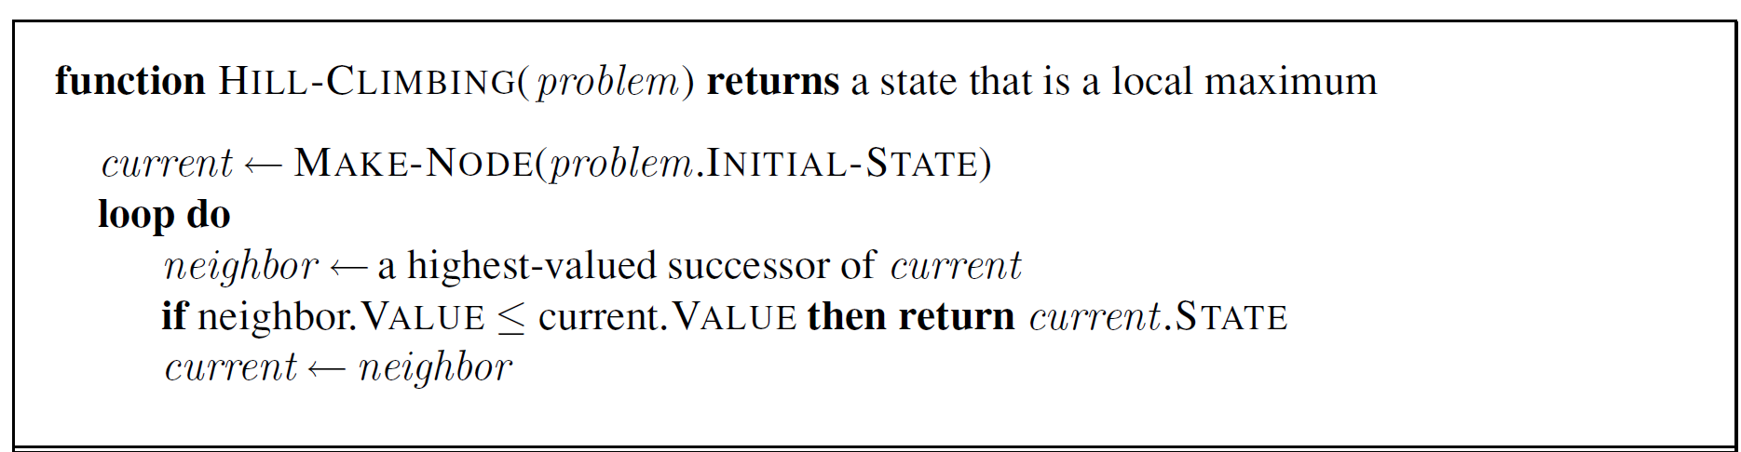
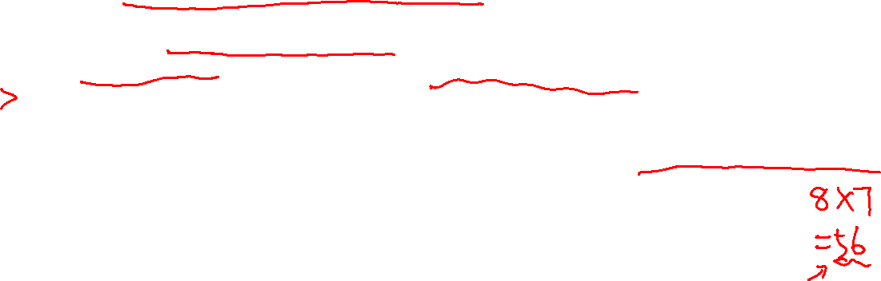

Hill Climbing (Greedy Local Search)
How to apply Hill Climbing to $n$-Queens? How is it different from Iterative Improvement?
Define a state as a board with $n$ queens on it, one in each column
Define a successor (neighbor) of a state as one that is generated by moving a single queen to another square in the same column
How many successors?

Slide 14


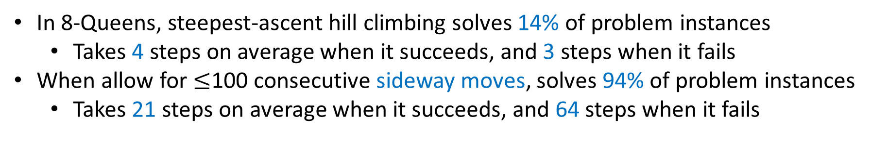
Hill Climbing (Greedy Local Search)
What if there is a tie?
Typically break ties randomly
What if we do not stop here?
Make a sideway move if “$=$”
In 8-Queens, steepest-ascent hill climbing solves 14% of problem instances
  Takes 4 steps on average when it succeeds, and 3 steps when it fails
When allow for $≤$100 consecutive sideway moves, solves 94% of problem instances
  Takes 21 steps on average when it succeeds, and 64 steps when it fails

Slide 15
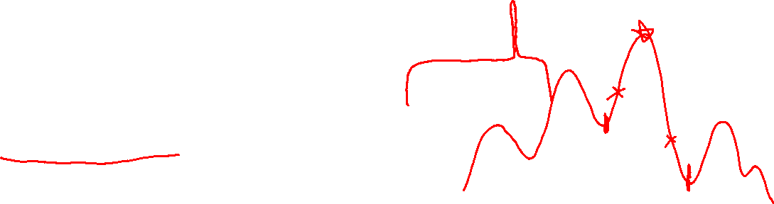
Variants of Hill Climbing
Random-restart hill climbing
  “If at first you don’t succeed, try, try again.”
  Complete!
  What kind of landscape will random-restarts hill climbing work the best?
Stochastic hill climbing
  Choose randomly from the uphill moves, with probability dependent on the “steepness” (i.e., amount of improvement)
  Converge slower than steepest ascent, but may find better solutions
First-choice hill climbing
  Generate successors randomly (one by one) until a better one is found
  Suitable when there are too many successors to enumerate

Slide 16


Variants of Hill Climbing
What if variables are continuous, e.g. find $x∈[0,1]$ that maximizes $f\left(x\right)$?
  Gradient ascent
    Use gradient to find best direction
    Use the magnitude of the gradient to determine how big a step you move
Value space of variables

Slide 17
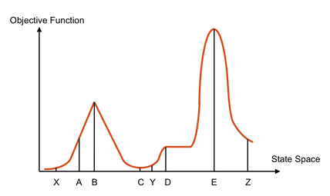
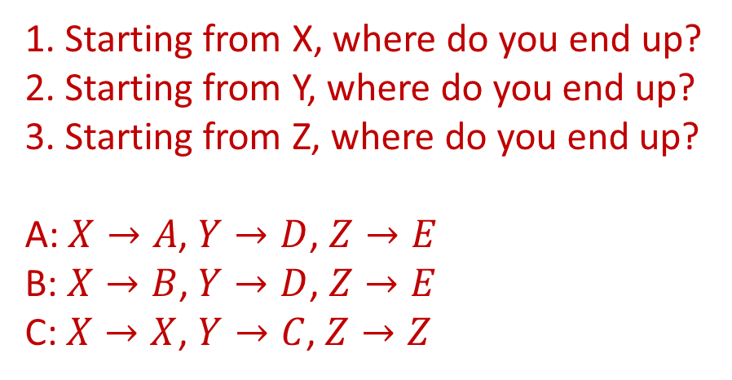
Piazza Poll: Hill Climbing
1. Starting from X, where do you end up?
2. Starting from Y, where do you end up?
3. Starting from Z, where do you end up?
A: $X→A$, $Y→D$, $Z→E$
B: $X→B$, $Y→D$, $Z→E$
C: $X→X$, $Y→C$, $Z→Z$

Slide 18
Random Walk
Uniformly randomly choose a neighbor to move to
Complete but inefficient!

Slide 19

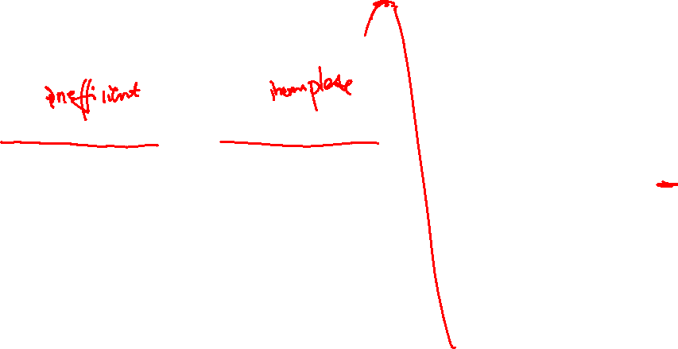
Simulated Annealing
Combines random walk and hill climbing
Complete and efficient
Inspired by statistical physics
Annealing – Metallurgy
  Heating metal to high temperature then cooling
  Reaching low energy state
Simulated Annealing – Local Search
  Allow for downhill moves and make them rarer as time goes on
  Escape local maxima and reach global maxima

Slide 20
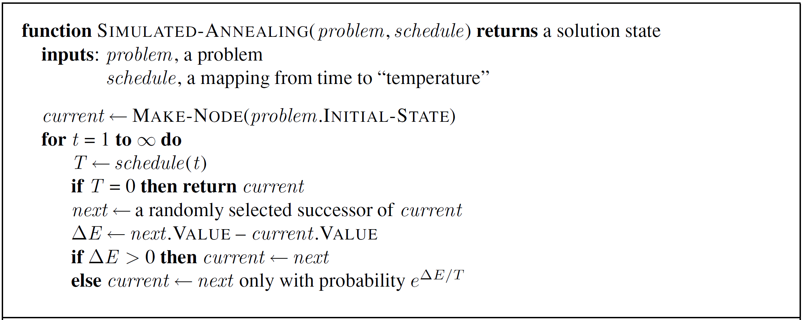
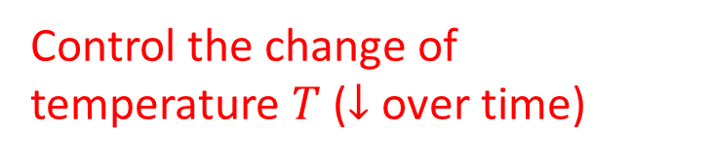

Simulated Annealing
Control the change of temperature $T$ ($↓$ over time)
Almost the same as hill climbing except for a random successor
Unlike hill climbing, move downhill with some prob.

Slide 21
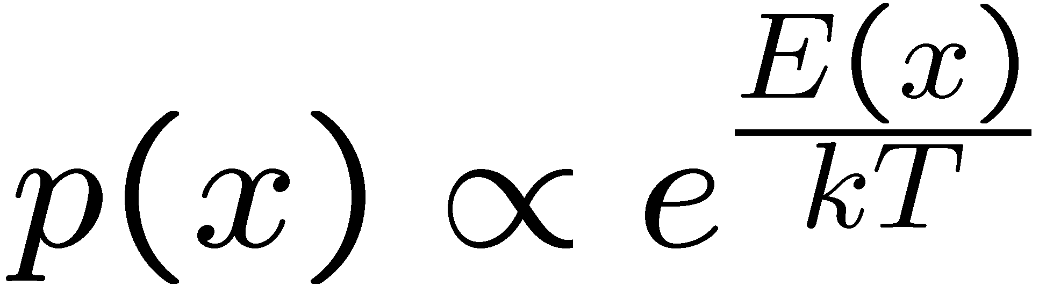
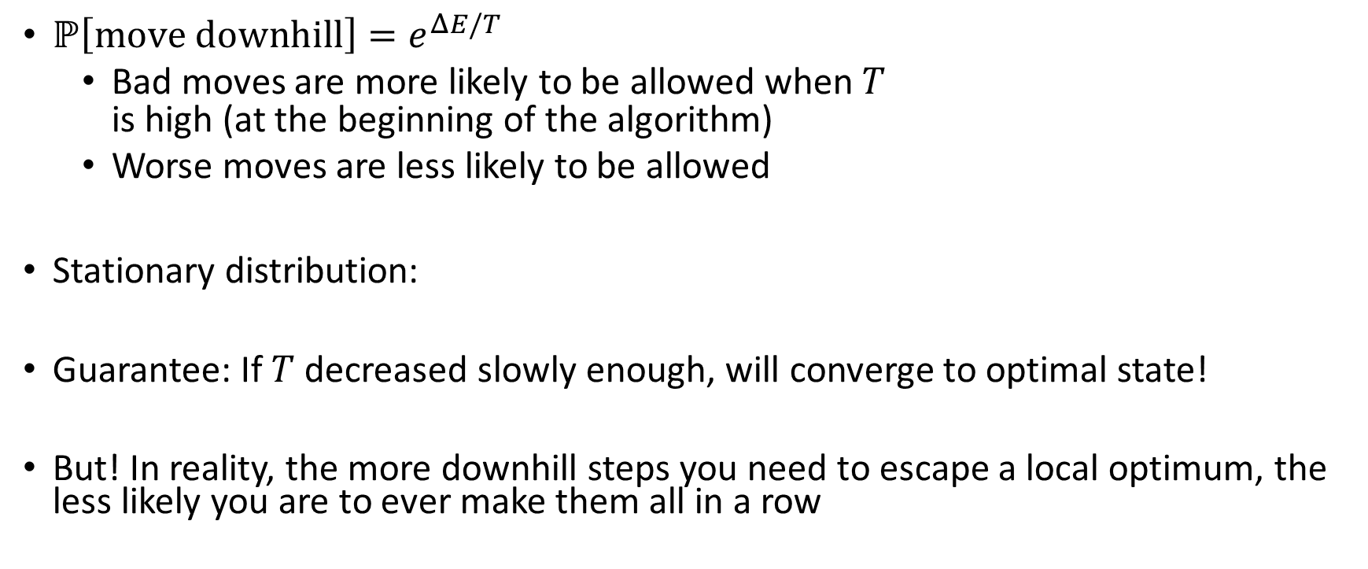

Simulated Annealing
$ℙ\left[move downhill\right]=e^{ΔE/T}$
  Bad moves are more likely to be allowed when $T$
  is high (at the beginning of the algorithm)
  Worse moves are less likely to be allowed
Stationary distribution:
Guarantee: If $T$ decreased slowly enough, will converge to optimal state!
But! In reality, the more downhill steps you need to escape a local optimum, the less likely you are to ever make them all in a row

Slide 22


Local Beam Search
Keep track of $k$ states
In each iteration
  Generate all successors of all $k$ states
  Only retain the best $k$ successors among them all
How is this different from $K$ local searches with different initial states in parallel?
The searches communicate! “Come over here, the grass is greener!”
Analogous to evolution / natural selection!

Slide 23
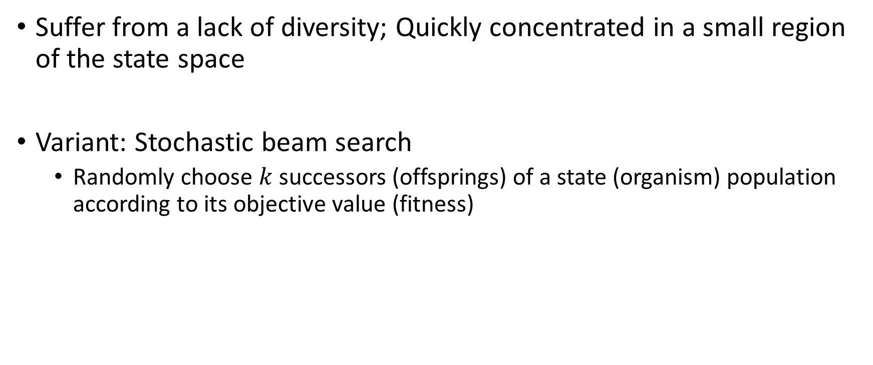
Limitations and Variants of Local Beam Search
Suffer from a lack of diversity; Quickly concentrated in a small region of the state space
Variant: Stochastic beam search
  Randomly choose $k$ successors (offsprings) of a state (organism) population according to its objective value (fitness)

Slide 24
Genetic Algorithms
Inspired by evolutionary biology
  Nature provides an objective function (reproductive fitness) that Darwinian evolution could be seen as attempting to optimize
A variant of stochastic beam search
  Successors are generated by combining two parent states instead of modifying a single state (sexual reproduction rather than asexual reproduction)

Slide 25
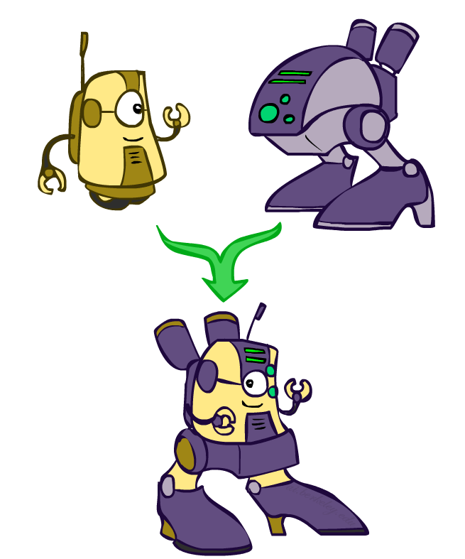
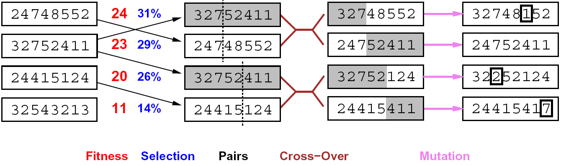

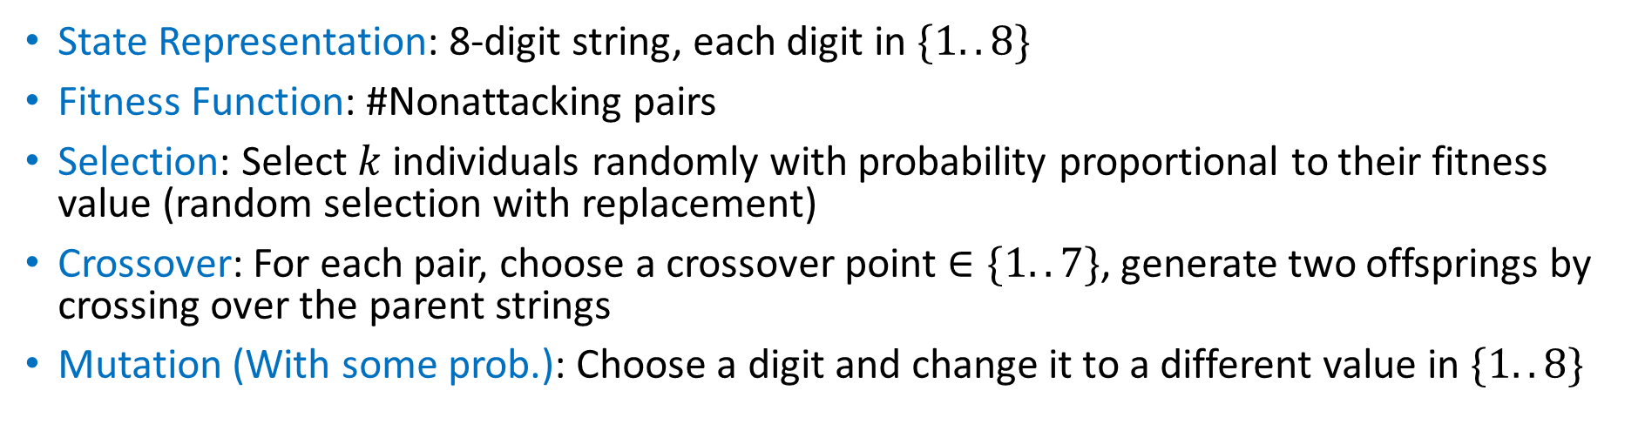

Genetic Algorithms for 8-Queens
State Representation: 8-digit string, each digit in $\{1..8\}$
Fitness Function: #Nonattacking pairs
Selection: Select $k$ individuals randomly with probability proportional to their fitness value (random selection with replacement)
Crossover: For each pair, choose a crossover point $∈\{1..7\}$, generate two offsprings by crossing over the parent strings
Mutation (With some prob.): Choose a digit and change it to a different value in $\{1..8\}$
What if $k$ is an odd number?
Notes:
(Fitness Proportionate Selection)

Slide 26
Genetic Algorithms for 8-Queens
Why does crossover make sense here?
Would crossover work well without a selection operator?

Slide 27
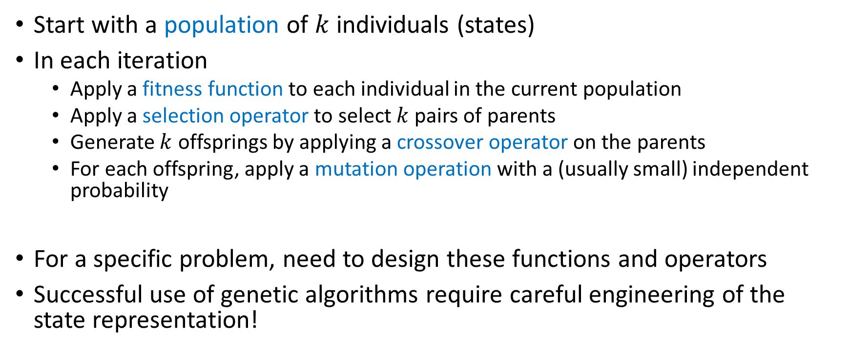
Genetic Algorithms
Start with a population of $k$ individuals (states)
In each iteration
  Apply a fitness function to each individual in the current population
  Apply a selection operator to select $k$ pairs of parents
  Generate $k$ offsprings by applying a crossover operator on the parents
  For each offspring, apply a mutation operation with a (usually small) independent probability
For a specific problem, need to design these functions and operators
Successful use of genetic algorithms require careful engineering of the state representation!

Slide 28
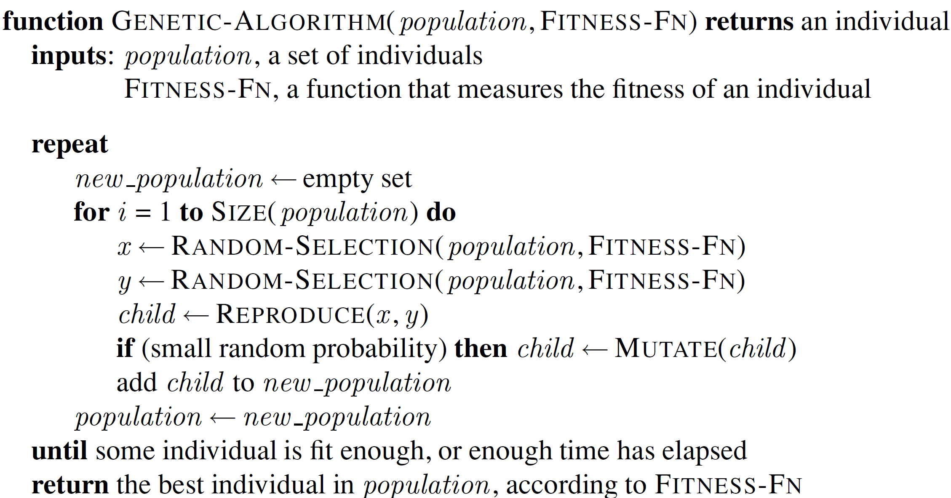
Genetic Algorithms
How is this different from the illustrated procedure on 8-Queens?

Slide 29
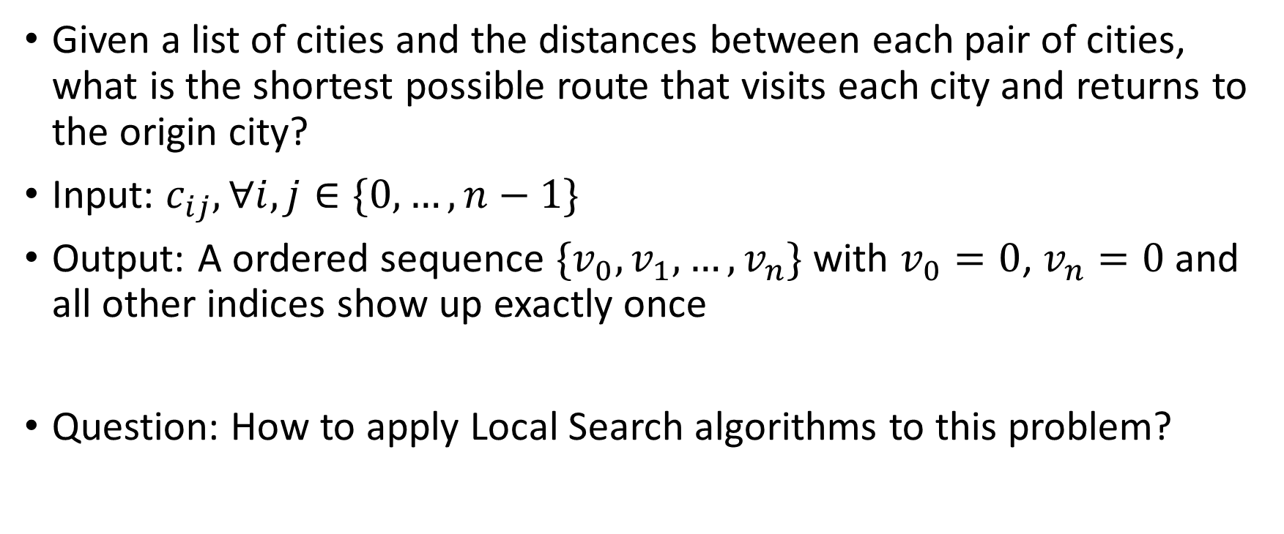
Exercise: Traveling Salesman Problem
Given a list of cities and the distances between each pair of cities, what is the shortest possible route that visits each city and returns to the origin city?
Input: $c_{ij},∀i,j∈\{0,…,n−1\}$
Output: A ordered sequence $\{v_{0},v_{1},…,v_{n}\}$ with $v_{0}=0$, $v_{n}=0$ and all other indices show up exactly once
Question: How to apply Local Search algorithms to this problem?

Slide 30
Summary: Local Search
Maintain a constant number of current nodes or states, and move to “neighbors” or generate “offsprings” in each iteration
  Do not maintain a search tree or multiple paths
  Typically do not retain the path to the node
Advantages
  Use little memory
  Can potentially solve large-scale problems or get a reasonable (suboptimal or almost feasible) solution

Slide 31
Learning Objectives
Describe and implement the following local search algorithms
  Iterative improvement algorithm with min-conflict heuristic for CSPs
  Hill Climbing (Greedy Local Search)
  Random Walk
  Simulated Annealing
  Beam Search
  Genetic Algorithm
Identify completeness and optimality of local search algorithms
Compare different local search algorithms as well as contrast with classical search algorithms
Select appropriate local search algorithms for real-world problems

