Slide 1
Announcements
Assignments
HW12
    Due tomorrow, 12/6, 10 pm
Final Exam
Thur, 12/12, 1-4 pm, GHC 4401
See Piazza for details
Recitation → Review session, Fri, 3-4:20 pm, GHC 4401
Practice exam and learning objectives coming soon!
    Practice exam solution session: Wed, 12/11, 12-2pm, GHC 4215

Slide 2
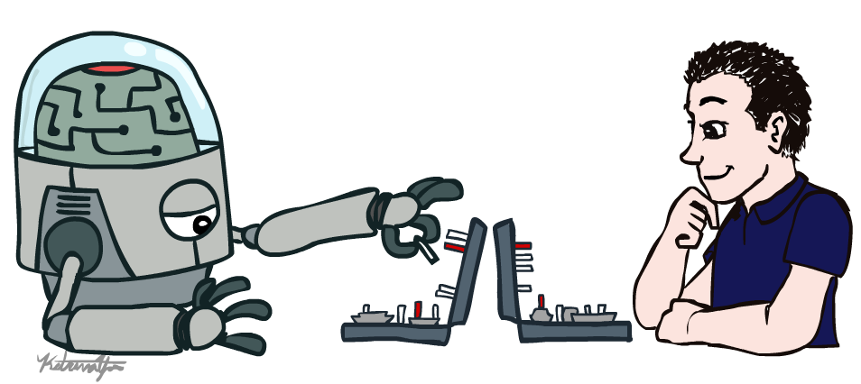
AI: Representation and Problem Solving
Human-Compatible AI
Instructors: Pat Virtue & Fei Fang
Slide credits: CMU AI and http://ai.berkeley.edu

Slide 3
Intelligent Agents
From first lecture
  Candy Grab
  11 pieces on the table
  Take turns taking either 1 or 2 pieces
  Person that takes the last piece wins!
class Agent
function getAction(state)
return action

Slide 4
Three “Intelligent” Agents
Piazza Poll 1
Which agent code is the most “intelligent”?

Slide 5

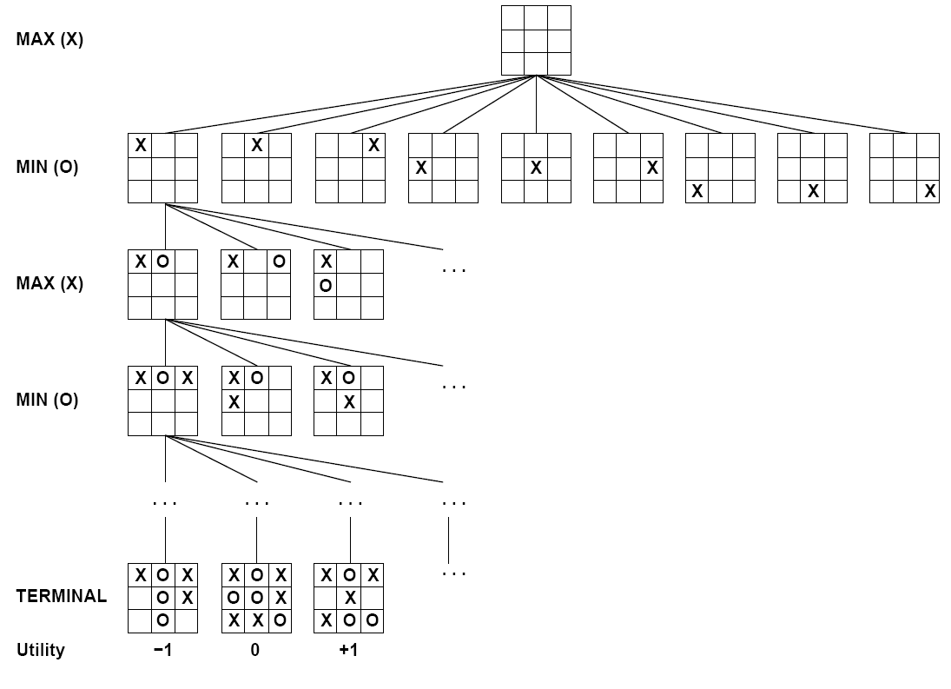

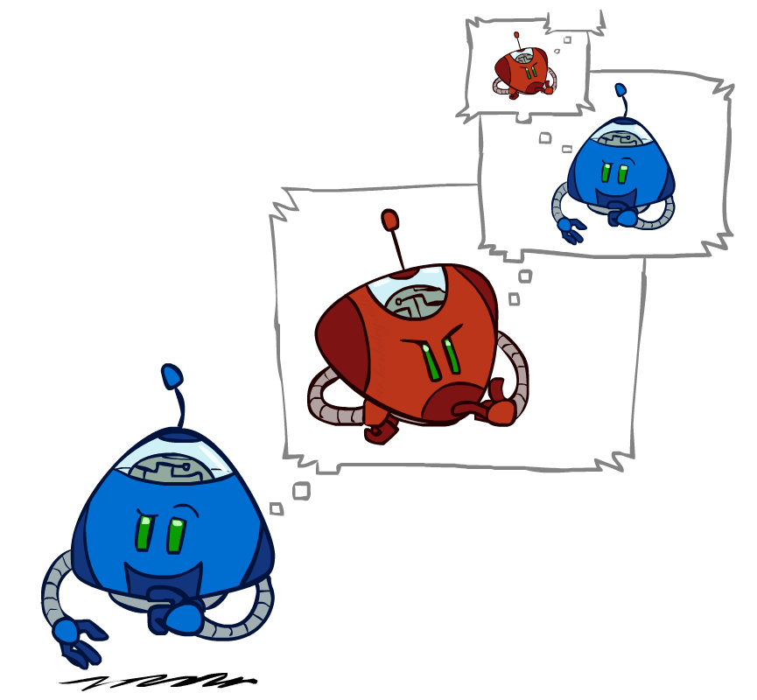
Games – Three “Intelligent” Agents
A: Search

Slide 6
Games – Three “Intelligent” Agents
B: Encode the pattern
10's value:Win
9's value:Lose
8's value:Win
7's value:Win
6's value:Lose
5's value:Win
4's value:Win
3's value:Lose
2's value:Win
1's value:Win
0's value:Lose
function getAction( numPiecesAvailable )
if numPiecesAvailable % 3 == 2
return 2
else
return 1

Slide 7
Games – Three “Intelligent” Agents
C: Record statistics of winning positions
Pieces Available | Take 1 | Take 2
2
3
4
5
6
7
Pieces Available | Take 1 | Take 2
2 |  | 100%
3
4 | 100%
5
6
7 |  | 100%
Pieces Available | Take 1 | Take 2
2 |  | 100%
3 | 0%
4 | 100%
5
6
7 |  | 50%
Pieces Available | Take 1 | Take 2
2 | 0% | 100%
3 | 2% | 0%
4 | 75% | 2%
5 | 4% | 68%
6 | 5% | 6%
7 | 60% | 5%

Slide 8
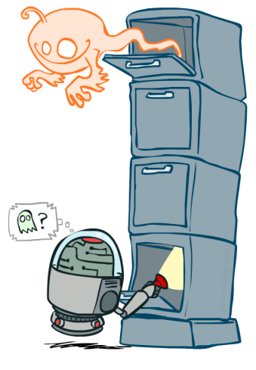
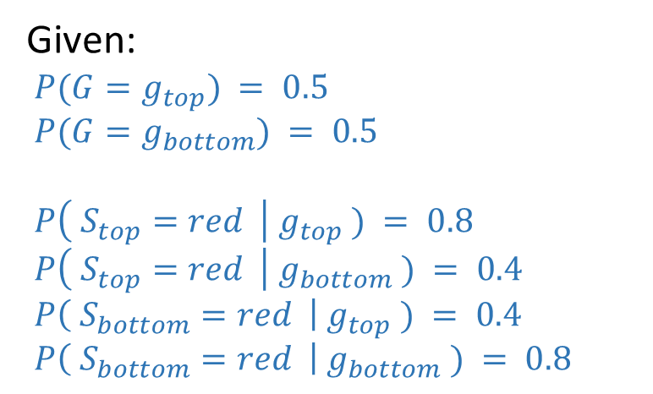
Value of Information
0.50
Ghostbusters
Given:
$P(G=g_{top}) = 0.5$
$P(G=g_{bottom}) = 0.5$
$P\left( S_{top}=red \right| g_{top} ) = 0.8$
$P\left( S_{top}=red \right| g_{bottom} ) = 0.4$
$P\left( S_{bottom}=red \right| g_{top} ) = 0.4$
$P\left( S_{bottom}=red \right| g_{bottom} ) = 0.8$
0.50

Slide 9
Value of Information

Slide 10
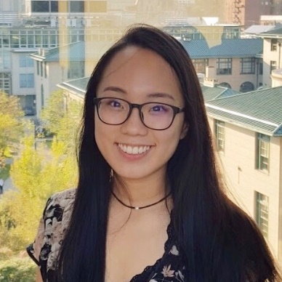
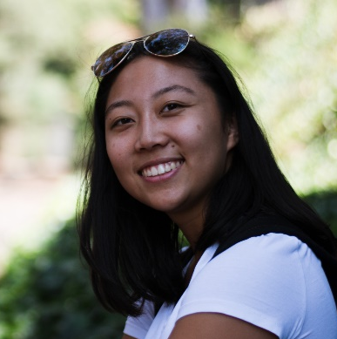

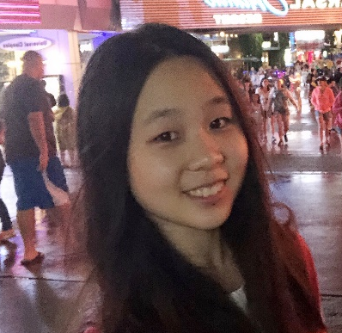

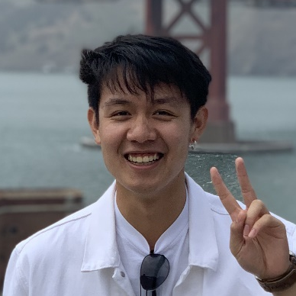
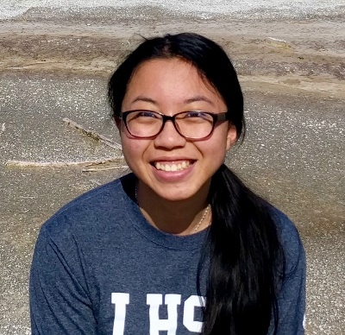
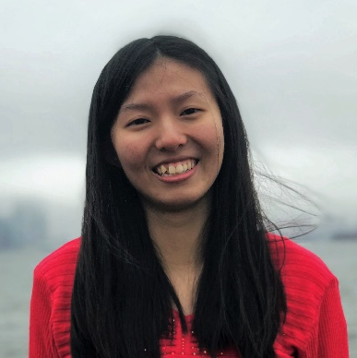
FCE: https://cmu.smartevals.com/
TA survey: https://www.ugrad.cs.cmu.edu/ta/F19/feedback/
Angela Yang
Claire Wang (Head TA)
George Brown
Michelle Ma
Sean Pereira
Chakara (Tian) Owarang
Tina Wu
Vicky Zeng

Slide 11

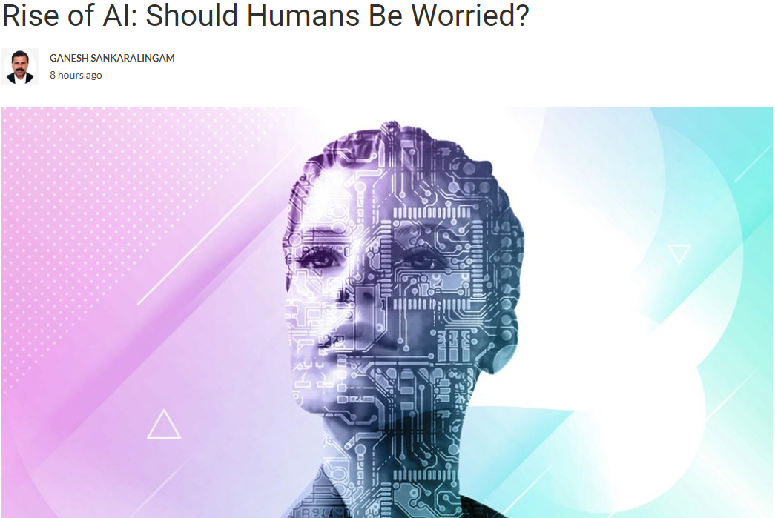
AI in the News
https://martechseries.com/mts-insights/guest-authors/rise-ai-humans-worried/

Slide 12
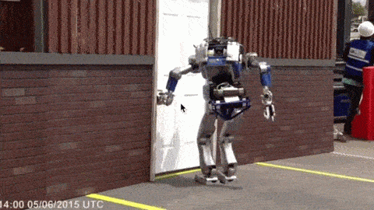
Should We Worry about Today’s A.I.?

Slide 13
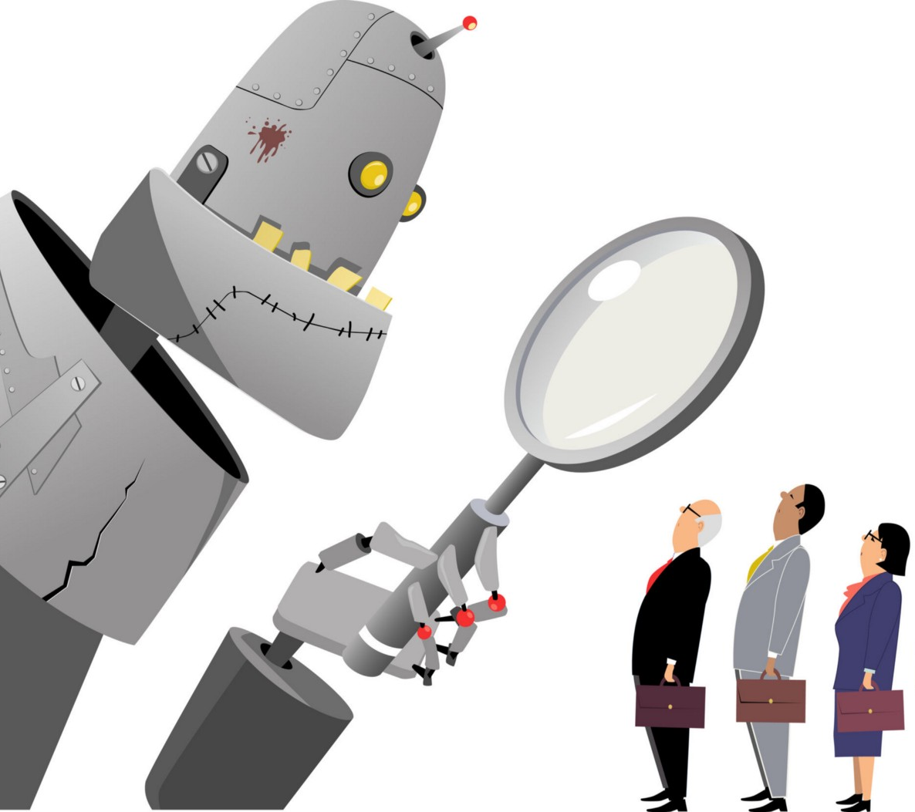
Should We Worry about Today’s A.I.?
Bias
Images:
https://medium.com/@turalt/ai-isnt-biased-we-are-b74ec94d1698

Slide 14

AI Bias
Alexandra Chouldechova
CMU, Statistics and Public Policy
http://www.contrib.andrew.cmu.edu/~achoulde/
https://fatconference.org/

Slide 15
Should We Worry about Today’s A.I.?
Bias
Weapons
Images:
https://medium.com/@turalt/ai-isnt-biased-we-are-b74ec94d1698
http://futureoflife.org/2016/09/20/podcast-what-is-nuclear-risk/

Slide 16
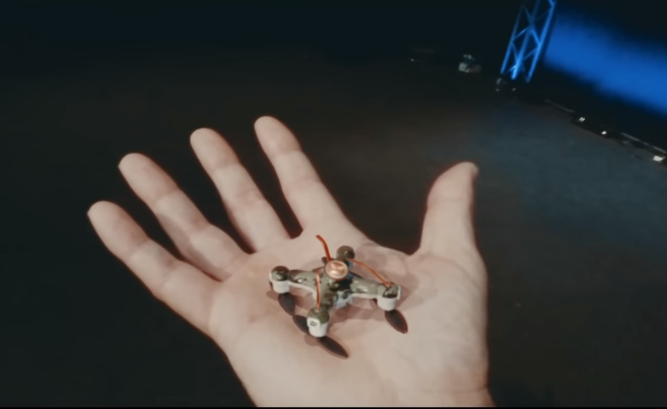
AI Weapons
https://fatconference.org/

Slide 17
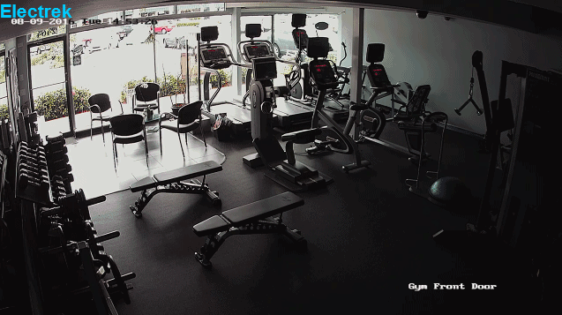
Should We Worry about Today’s A.I.?
Bias
Weapons
Liability
Images:
https://medium.com/@turalt/ai-isnt-biased-we-are-b74ec94d1698
http://futureoflife.org/2016/09/20/podcast-what-is-nuclear-risk/
https://electrek.co/2016/09/25/tesla-model-s-crashes-into-gym-driver-claims-autonomous-acceleration-tesla-says-drivers-fault/

Slide 18
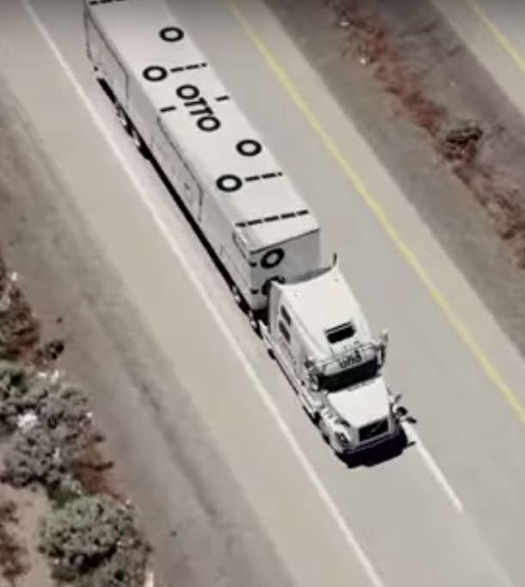
Should We Worry about Today’s A.I.?
Bias
Weapons
Liability
Jobs
Images:
https://medium.com/@turalt/ai-isnt-biased-we-are-b74ec94d1698
http://futureoflife.org/2016/09/20/podcast-what-is-nuclear-risk/
https://electrek.co/2016/09/25/tesla-model-s-crashes-into-gym-driver-claims-autonomous-acceleration-tesla-says-drivers-fault/
http://ot.to/

Slide 19
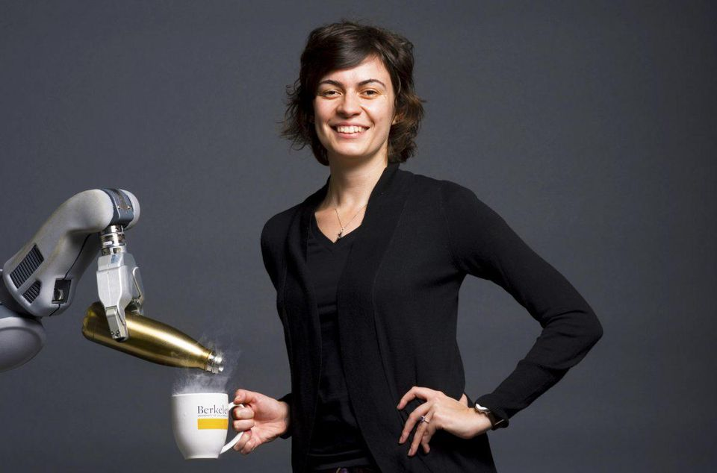
AI Challenge: Humans
Handing humans a drink
Anca Dragan
UC Berkeley, EECS
CMU PhD

Slide 20
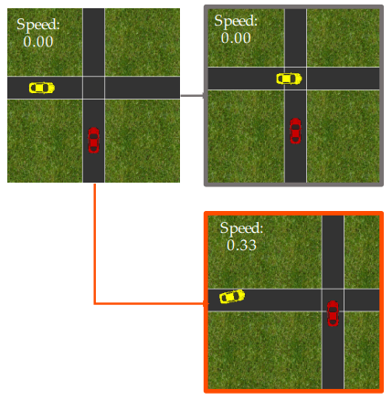
AI Challenge: Humans
Driving with humans
Dorsa Sadigh
Stanford, CS
https://stanford-iliad.github.io/pdfs/publications/sadigh2016planning.pdf

Slide 21
Narrow A.I.
Images:
https://medium.com/@turalt/ai-isnt-biased-we-are-b74ec94d1698
http://futureoflife.org/2016/09/20/podcast-what-is-nuclear-risk/
https://electrek.co/2016/09/25/tesla-model-s-crashes-into-gym-driver-claims-autonomous-acceleration-tesla-says-drivers-fault/
http://ot.to/

Slide 22


AI in the News
Nov. 5, 2017
https://mobile.nytimes.com/2017/11/05/technology/machine-learning-artificial-intelligence-ai.html

Slide 23
Should we worry about future A.I.?
Singularity
Weak AI
Strong AI
Narrow AI
Limited number of applications
Artificial General Intelligence (AGI)
Recursive self-improvement
Beyond human control

Slide 24
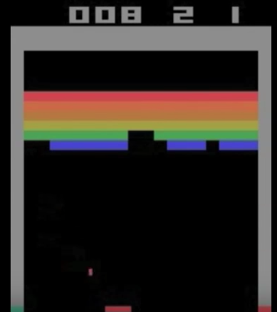
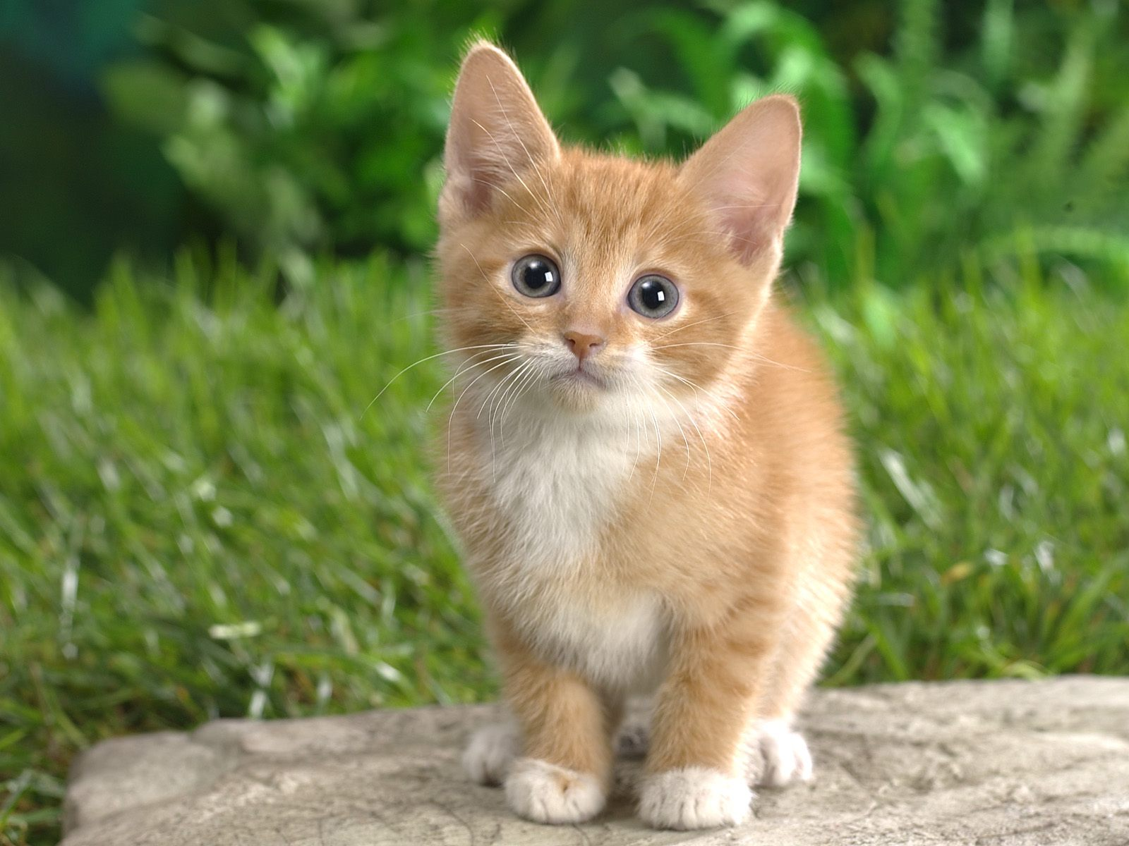
Should we worry about future A.I.?
What motivates agents?
Candy grab
  Ana: “taking 2 makes it 8”
  Bob: “taking 1 makes it 7”
  Ana: “taking 2 makes it 5”
  Bob: “taking 2 makes it 3”
  Ana: “taking 1 makes it 2”
  Bob: “taking 2 makes it 0”
    I WIN!
CAT

Slide 25
Should we worry about future A.I.?
Question: What is the specific motivation behind these techniques?
Search
Logical inference
Linear programming
RL
Inference Bayes nets

Slide 26
Should we worry about future A.I.?
Question: What motivation could cause problems?

Slide 27
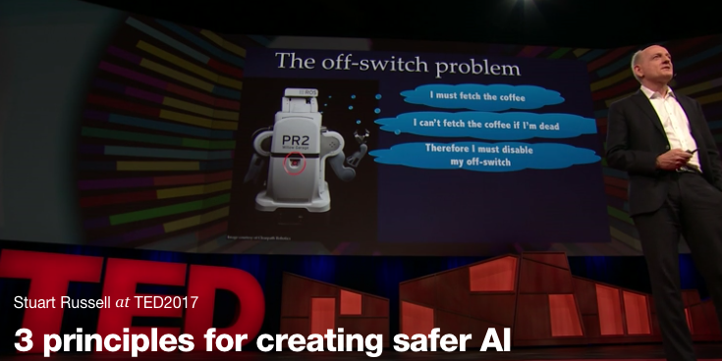
Should we worry about future A.I.?
Stuart Russell, UC Berkeley Center for Human-Compatible AI
https://www.ted.com/talks/stuart_russell_how_ai_might_make_us_better_people

Slide 28
Three simple ideas
1. The robot’s only objective is to maximize the realization of human values
2. The robot is initially uncertain about what those values are
3. The best source of information about human values is human behavior
Slides: Stuart Russell, IJCAI 2017

Slide 29
AIMA 1,2,3: objective given to machine
Human objective
Human behaviour
Machine behaviour
Slides: Stuart Russell, IJCAI 2017

Slide 30
AIMA 4: objective is a latent variable
Human objective
Human behaviour
Machine behaviour
Slides: Stuart Russell, IJCAI 2017

Slide 31
The off-switch problem
A robot, given an objective, has an incentive to disable its own off-switch
  (You can’t fetch the coffee if you’re dead)
How can we prevent this?
Answer: robot must allow for uncertainty about the true human objective
  The human will only switch off the robot if that leads to better outcomes for the true human objective
  Theorem: it’s in the robot’s interest to allow it
  Theorem: Such a robot is provably beneficial
Slides: Stuart Russell, IJCAI 2017, with work by Dylan Hadfield-Menell

Slide 32
Off-switch model
R
a
s
w(a)
U = U_{a}
H
U = 0
¬ s
s
R
U = 0
a
U = U_{a}
w(a) preferred to a or s
Slides: Stuart Russell, IJCAI 2017, with work by Dylan Hadfield-Menell

Slide 33
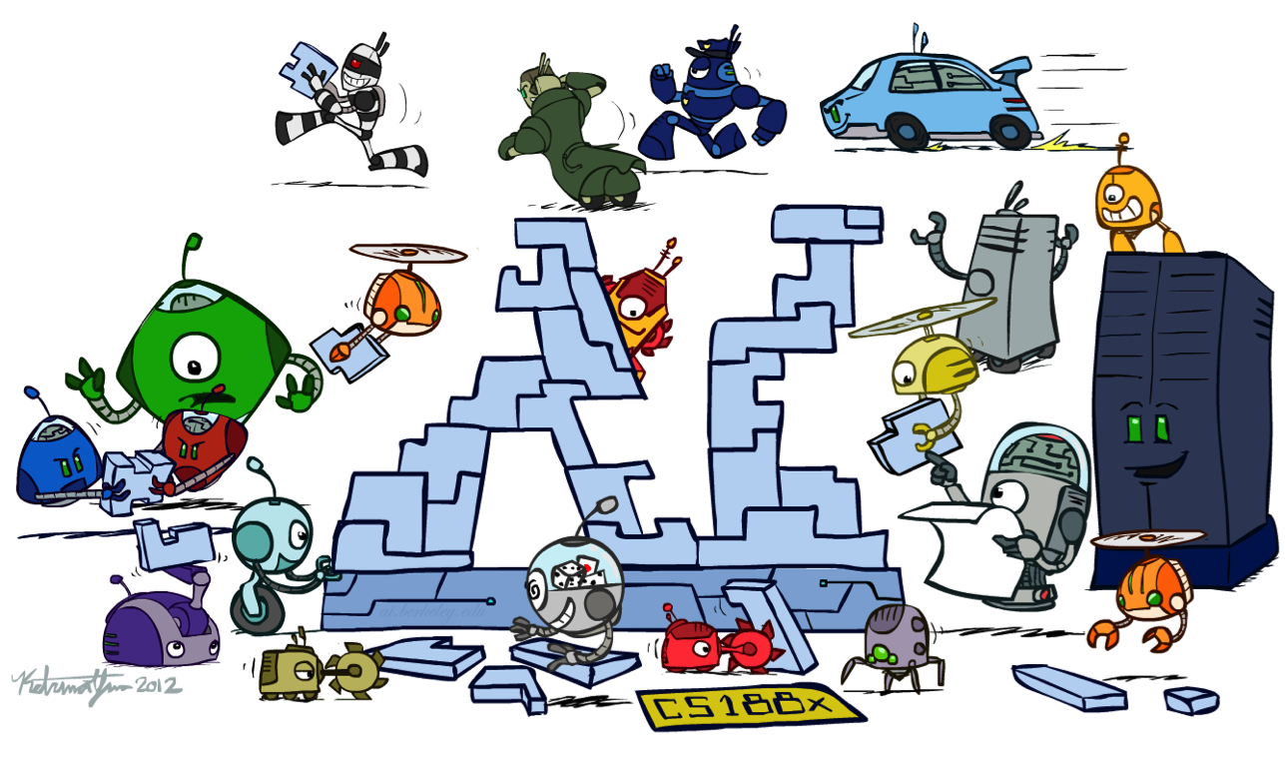
Conclusion

Slide 34
Thanks to Our Course Staff!!
Administrative Assistant
Liv Zane
Videographer
John Lombardo
Teaching Assistants
Angela Yang
Claire Wang (Head TA)
George Brown
Michelle Ma
Sean Pereira
Chakara (Tian) Owarang
Tina Wu
Vicky Zeng

