Slide 1
Announcements
Assignments
HW12
Due tomorrow, 12/6, 10 pm
Final Exam
Thur, 12/12, 1-4 pm, GHC 4401
See Piazza for details
Recitation → Review session, Fri, 3-4:20 pm, GHC 4401
Practice exam and learning objectives coming soon!
Practice exam solution session: Wed, 12/11, 12-2pm, GHC 4215

Slide 2
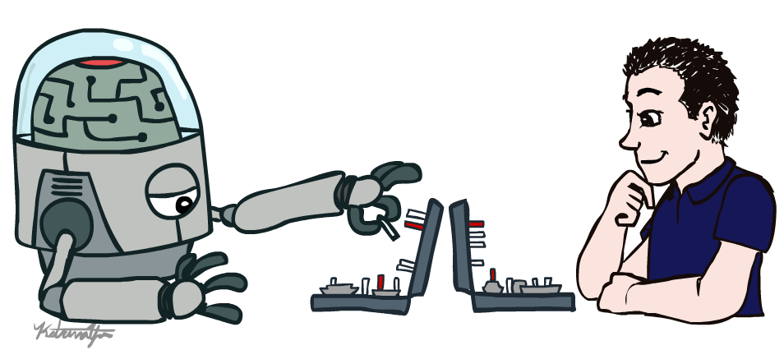
AI: Representation and Problem Solving
Human-Compatible AI
Instructors: Pat Virtue & Fei Fang
Slide credits: CMU AI and http://ai.berkeley.edu

Slide 3
Intelligent Agents
From first lecture
Candy Grab
11 pieces on the table
Take turns taking either 1 or 2 pieces
Person that takes the last piece wins!
class Agent
function getAction(state)
return action

Slide 4
Three “Intelligent” Agents
Piazza Poll 1
Which agent code is the most “intelligent”?

Slide 5

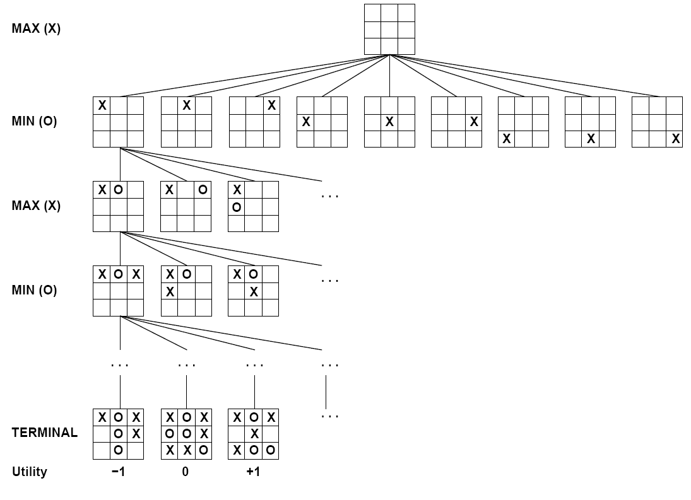

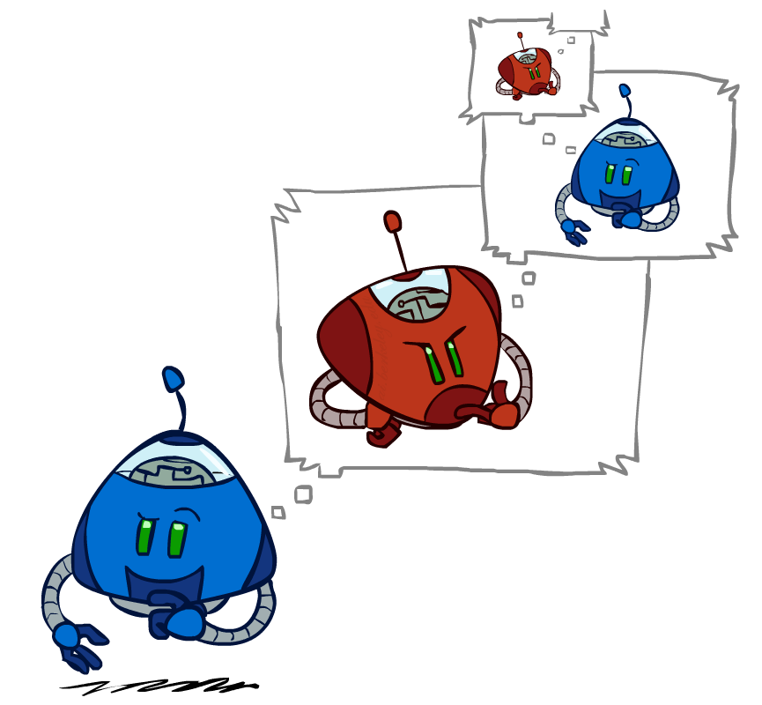
Games – Three “Intelligent” Agents
A: Search

Slide 6
Games – Three “Intelligent” Agents
B: Encode the pattern
10's value:Win
9's value:Lose
8's value:Win
7's value:Win
6's value:Lose
5's value:Win
4's value:Win
3's value:Lose
2's value:Win
1's value:Win
0's value:Lose
function getAction( numPiecesAvailable )
if numPiecesAvailable % 3 == 2
return 2
else
return 1

Slide 7
Games – Three “Intelligent” Agents
C: Record statistics of winning positions
Pieces Available | Take 1 | Take 2
2
3
4
5
6
7
Pieces Available | Take 1 | Take 2
2 |  | 100%
3
4 | 100%
5
6
7 |  | 100%
Pieces Available | Take 1 | Take 2
2 |  | 100%
3 | 0%
4 | 100%
5
6
7 |  | 50%
Pieces Available | Take 1 | Take 2
2 | 0% | 100%
3 | 2% | 0%
4 | 75% | 2%
5 | 4% | 68%
6 | 5% | 6%
7 | 60% | 5%

Slide 8
Piazza Poll 1
Three “Intelligent” Agents
Which agent code is the most “intelligent”?
Search
Encode multiple of 3 pattern
Keep stats on winning positions

Slide 9

Piazza Poll 2
Which 381 technique is the most intelligent?
Search
Logical inference
Numeric optimization
Q-learning
Approximate Q-learning
Exact inference Bayes nets
Approximate inference Bayes nets

Slide 10
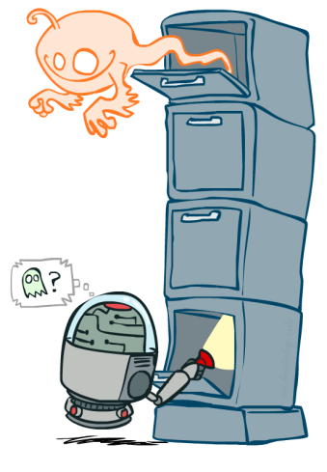
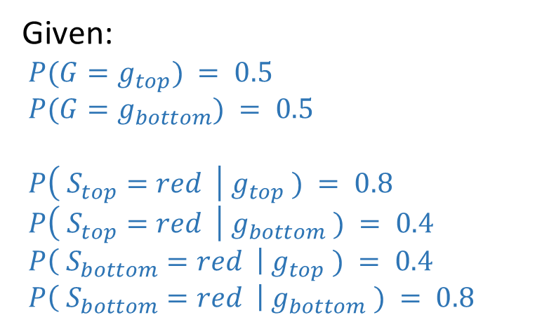

Value of Information
0.50
Ghostbusters
Given:
$P(G=g_{top}) = 0.5$
$P(G=g_{bottom}) = 0.5$
$P\left( S_{top}=red \right| g_{top} ) = 0.8$
$P\left( S_{top}=red \right| g_{bottom} ) = 0.4$
$P\left( S_{bottom}=red \right| g_{top} ) = 0.4$
$P\left( S_{bottom}=red \right| g_{bottom} ) = 0.8$
0.50

Slide 11
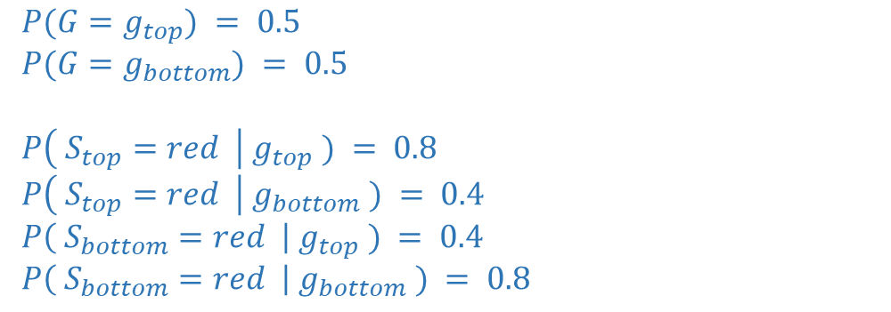
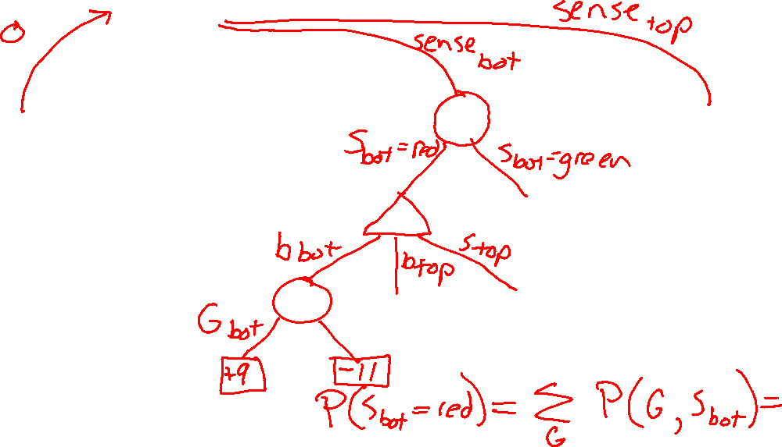
Value of Information
$P(G=g_{top}) = 0.5$
$P(G=g_{bottom}) = 0.5$
$P\left( S_{top}=red \right| g_{top} ) = 0.8$
$P\left( S_{top}=red \right| g_{bottom} ) = 0.4$
$P\left( S_{bottom}=red \right| g_{top} ) = 0.4$
$P\left( S_{bottom}=red \right| g_{bottom} ) = 0.8$

Slide 12
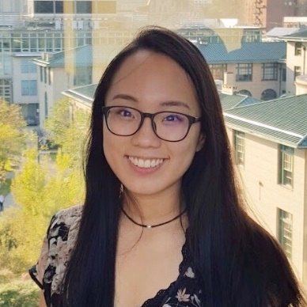
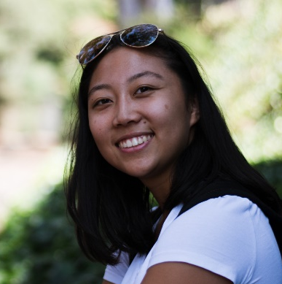

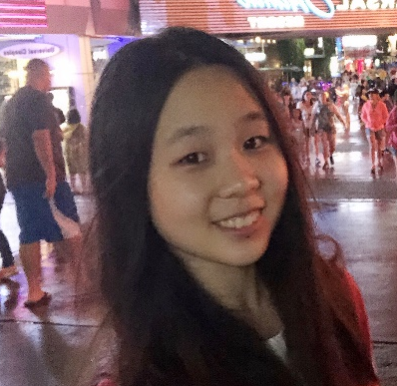


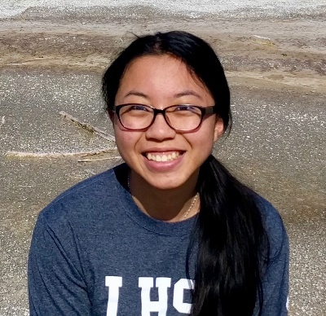
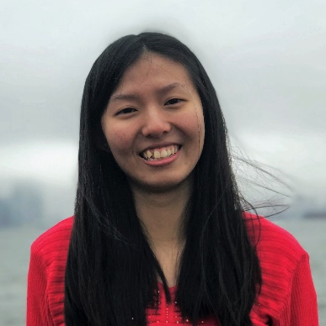
FCE: https://cmu.smartevals.com/
TA survey: https://www.ugrad.cs.cmu.edu/ta/F19/feedback/
Angela Yang
Claire Wang (Head TA)
George Brown
Michelle Ma
Sean Pereira
Chakara (Tian) Owarang
Tina Wu
Vicky Zeng

Slide 13
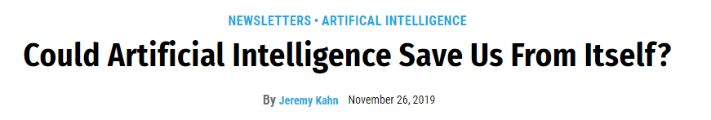

AI in the News
https://fortune.com/2019/11/26/ai-is-the-problem-and-the-solution/

Slide 14
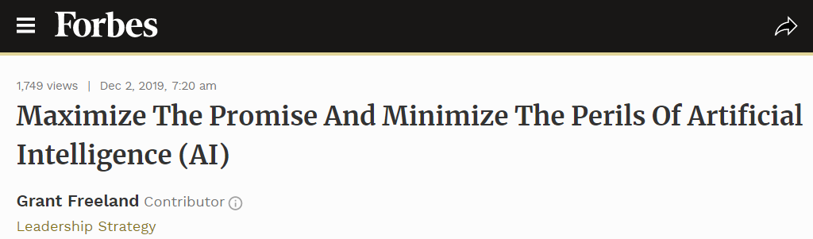
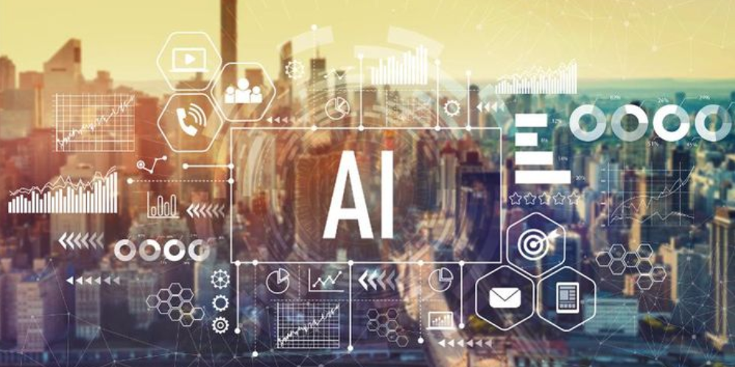
AI in the News
https://www.forbes.com/sites/grantfreeland/2019/12/02/maximize-the-promise-and-minimize-the-perils-of-artificial-intelligence-ai/amp/

Slide 15
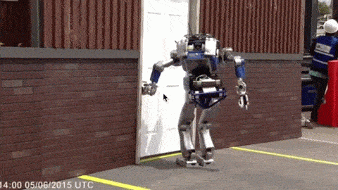
Should We Worry about Today’s A.I.?

Slide 16
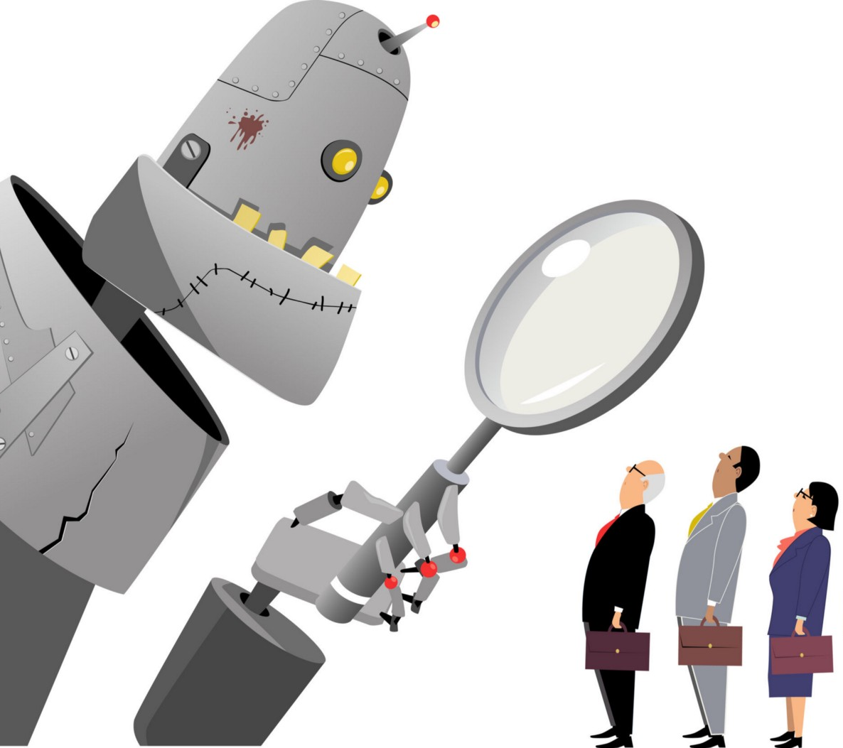
Should We Worry about Today’s A.I.?
Bias
Images:
https://medium.com/@turalt/ai-isnt-biased-we-are-b74ec94d1698

Slide 17

AI Bias
Alexandra Chouldechova
CMU, Statistics and Public Policy
http://www.contrib.andrew.cmu.edu/~achoulde/
https://fatconference.org/

Slide 18
Should We Worry about Today’s A.I.?
Bias
Weapons
Images:
https://medium.com/@turalt/ai-isnt-biased-we-are-b74ec94d1698
http://futureoflife.org/2016/09/20/podcast-what-is-nuclear-risk/

Slide 19
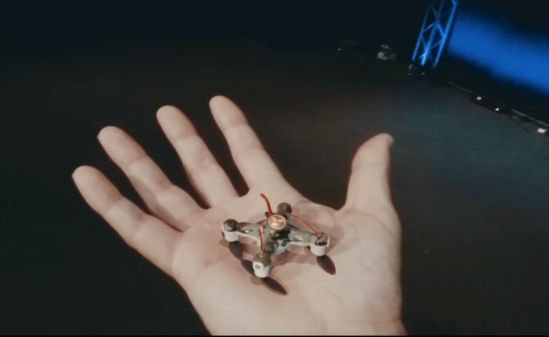
AI Weapons
https://fatconference.org/

Slide 20
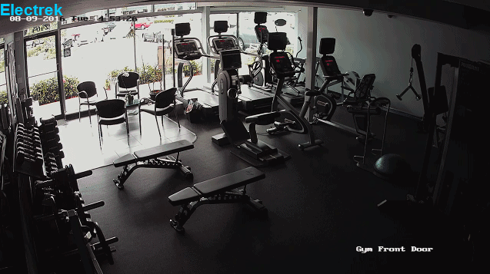
Should We Worry about Today’s A.I.?
Bias
Weapons
Liability
Images:
https://medium.com/@turalt/ai-isnt-biased-we-are-b74ec94d1698
http://futureoflife.org/2016/09/20/podcast-what-is-nuclear-risk/
https://electrek.co/2016/09/25/tesla-model-s-crashes-into-gym-driver-claims-autonomous-acceleration-tesla-says-drivers-fault/

Slide 21
Piazza Poll 3
AI Explainability
Which of the following techniques have explainable results?
(SELECT ALL THAT APPLY)
Search
Logical inference
Numeric optimization
Q-learning
Approximate Q-learning
Exact inference Bayes nets
Approximate inference Bayes nets
Deep learning

Slide 22
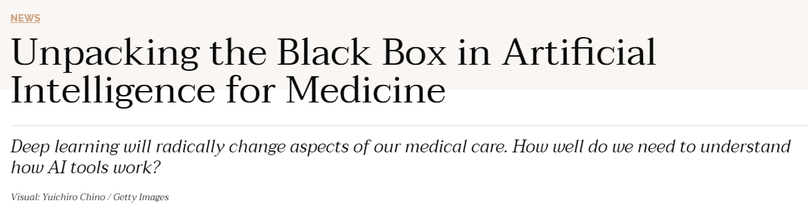
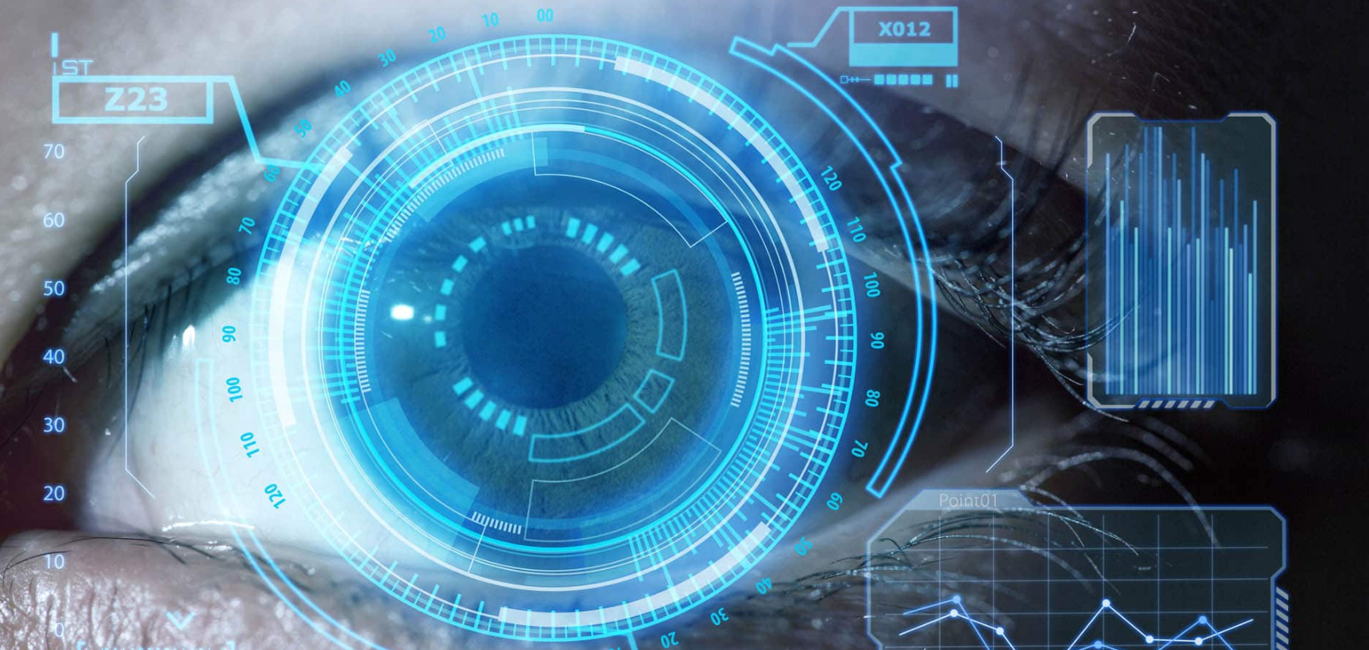
AI in the News
https://undark.org/2019/12/04/black-box-artificial-intelligence/

Slide 23
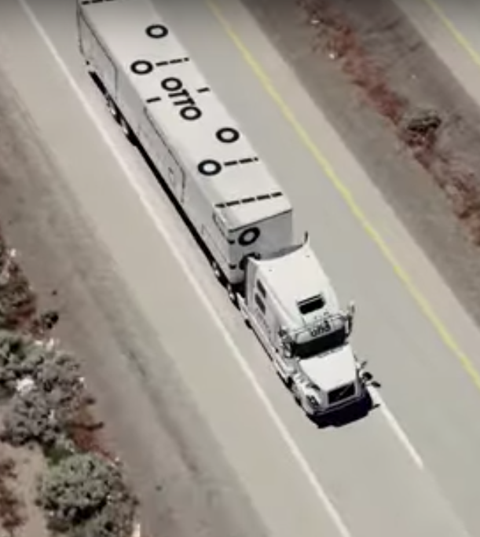
Should We Worry about Today’s A.I.?
Bias
Weapons
Liability
Jobs
Images:
https://medium.com/@turalt/ai-isnt-biased-we-are-b74ec94d1698
http://futureoflife.org/2016/09/20/podcast-what-is-nuclear-risk/
https://electrek.co/2016/09/25/tesla-model-s-crashes-into-gym-driver-claims-autonomous-acceleration-tesla-says-drivers-fault/
http://ot.to/

Slide 24
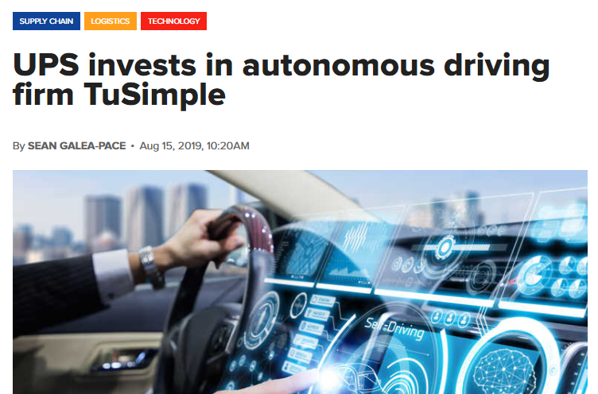
AI in the News
https://www.supplychaindigital.com/technology/ups-invests-autonomous-driving-firm-tusimple

Slide 25
Piazza Poll 4
Is it ok if autonomous vehicles completely replace human drivers?

Slide 26
Piazza Poll 4
Is it ok if autonomous vehicles completely replace human drivers?
AI in the News
https://www.brookings.edu/research/what-jobs-are-affected-by-ai-better-paid-better-educated-workers-face-the-most-exposure/
https://www.vox.com/platform/amp/policy-and-politics/2019/12/3/20965464/2020-presidential-candidates-jobs-automation-ai
https://www.irishtimes.com/business/technology/short-window-to-stop-ai-taking-control-of-society-warns-ex-google-employee-1.4104535

Slide 27
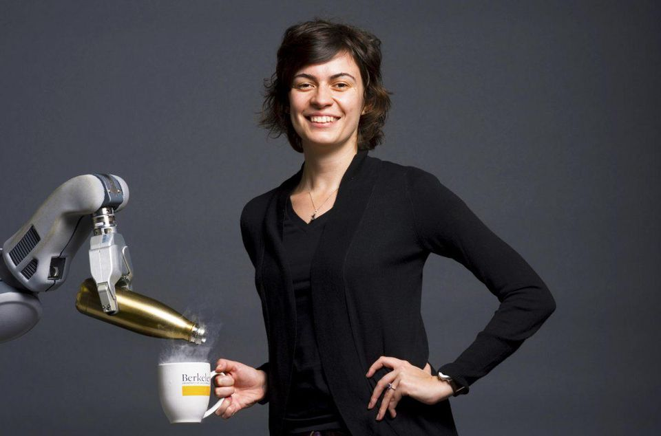
AI Challenge: Humans
Handing humans a drink
Anca Dragan
UC Berkeley, EECS
CMU PhD

Slide 28
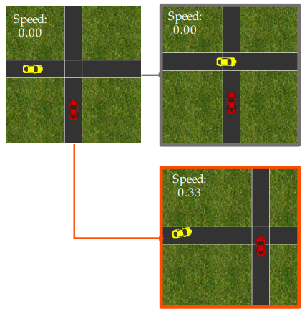

AI Challenge: Humans
Driving with humans
Dorsa Sadigh
Stanford, CS
https://stanford-iliad.github.io/pdfs/publications/sadigh2016planning.pdf

Slide 29
Piazza Poll 5
Once autonomous vehicles are readily available, should it be illegal for humans to drive?

Slide 30
Narrow A.I.
Images:
https://medium.com/@turalt/ai-isnt-biased-we-are-b74ec94d1698
http://futureoflife.org/2016/09/20/podcast-what-is-nuclear-risk/
https://electrek.co/2016/09/25/tesla-model-s-crashes-into-gym-driver-claims-autonomous-acceleration-tesla-says-drivers-fault/
http://ot.to/

Slide 31


AI in the News
Nov. 5, 2017
https://mobile.nytimes.com/2017/11/05/technology/machine-learning-artificial-intelligence-ai.html

Slide 32
Should we worry about future A.I.?
Singularity
Weak AI
Strong AI
Narrow AI
Limited number of applications
Artificial General Intelligence (AGI)
Recursive self-improvement
Beyond human control

Slide 33
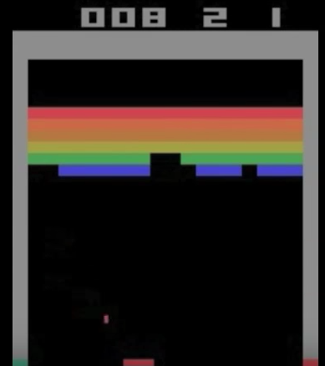
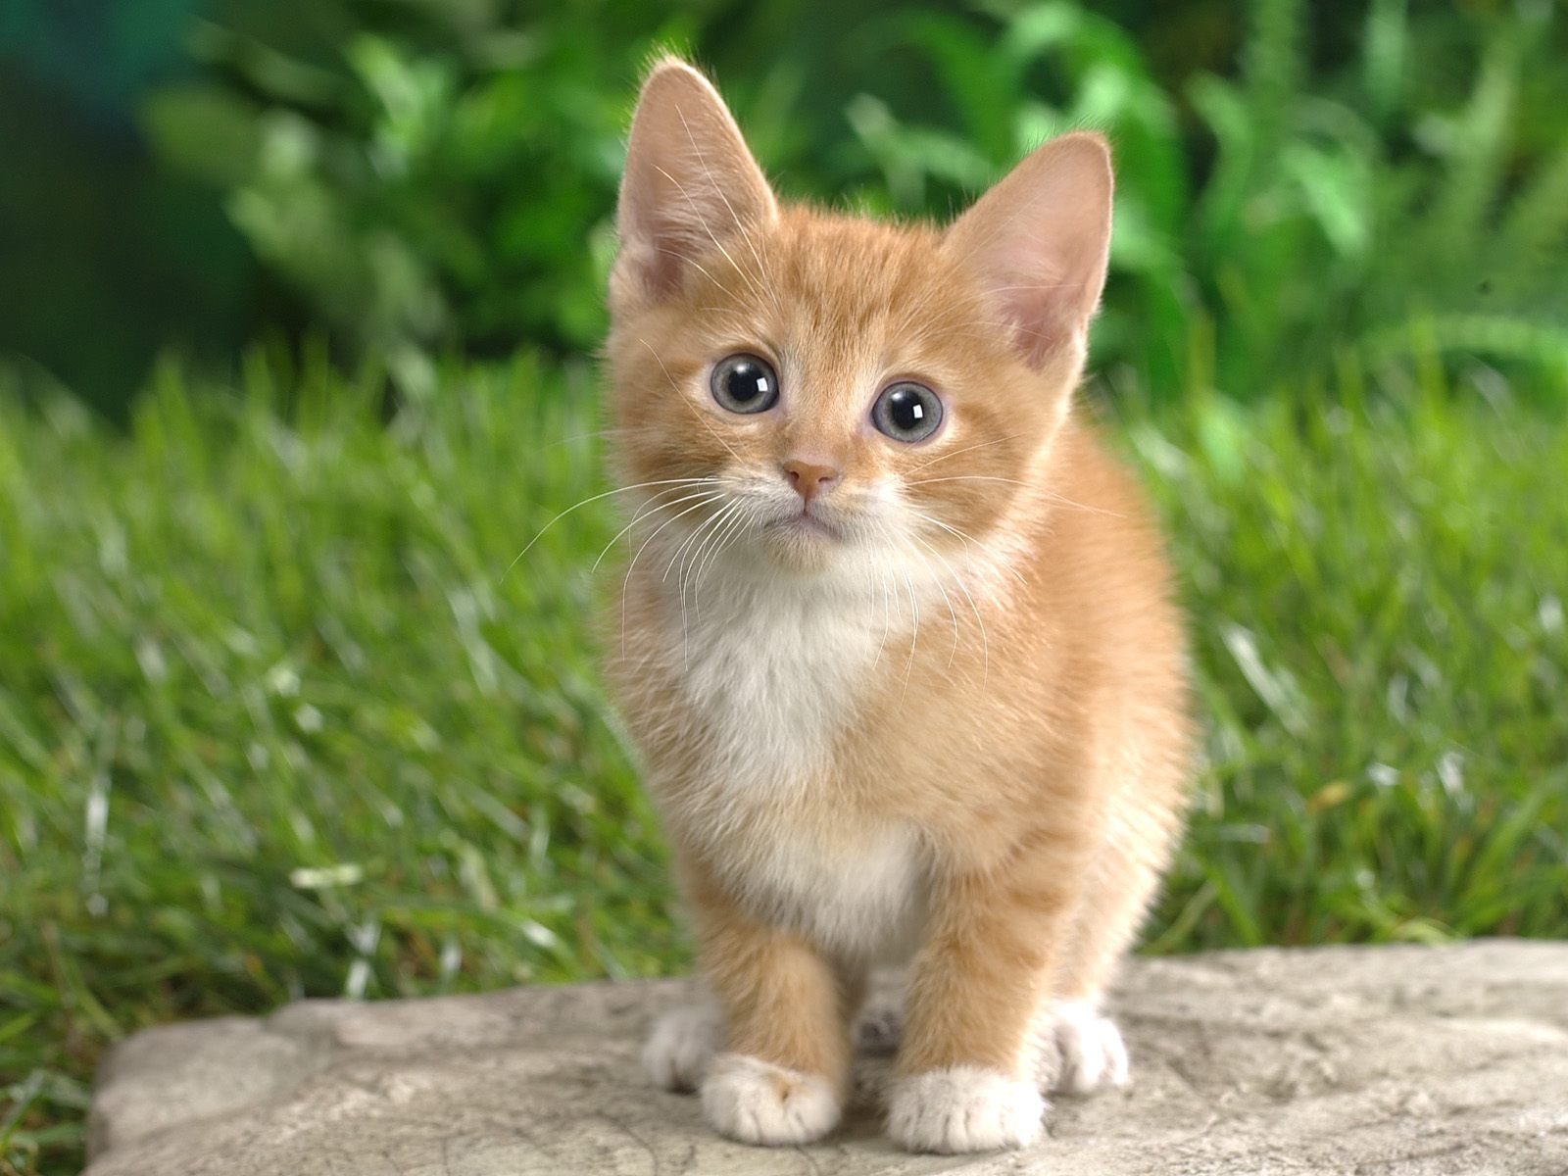
Should we worry about future A.I.?
What motivates agents?
Candy grab
Ana: “taking 2 makes it 8”
Bob: “taking 1 makes it 7”
Ana: “taking 2 makes it 5”
Bob: “taking 2 makes it 3”
Ana: “taking 1 makes it 2”
Bob: “taking 2 makes it 0”
I WIN!
CAT

Slide 34
Should we worry about future A.I.?
Question: What is the specific motivation behind these techniques?
Search
Logical inference
Linear programming
RL
Inference Bayes nets

Slide 35
Should we worry about future A.I.?
Question: What motivation could cause problems?

Slide 36
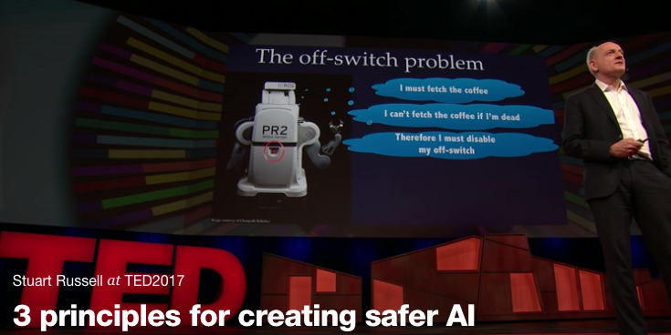
Should we worry about future A.I.?
Stuart Russell, UC Berkeley Center for Human-Compatible AI
https://www.ted.com/talks/stuart_russell_how_ai_might_make_us_better_people

Slide 37
Three simple ideas
1. The robot’s only objective is to maximize the realization of human values
2. The robot is initially uncertain about what those values are
3. The best source of information about human values is human behavior
Slides: Stuart Russell, IJCAI 2017

Slide 38
AIMA 1,2,3: objective given to machine
Human objective
Human behaviour
Machine behaviour
Slides: Stuart Russell, IJCAI 2017

Slide 39
AIMA 4: objective is a latent variable
Human objective
Human behaviour
Machine behaviour
Slides: Stuart Russell, IJCAI 2017

Slide 40
The off-switch problem
A robot, given an objective, has an incentive to disable its own off-switch
(You can’t fetch the coffee if you’re dead)
How can we prevent this?
Answer: robot must allow for uncertainty about the true human objective
The human will only switch off the robot if that leads to better outcomes for the true human objective
Theorem: it’s in the robot’s interest to allow it
Theorem: Such a robot is provably beneficial
Slides: Stuart Russell, IJCAI 2017, with work by Dylan Hadfield-Menell

Slide 41
Off-switch model
R
a
s
w(a)
U = U_{a}
H
U = 0
¬ s
s
R
U = 0
a
U = U_{a}
w(a) preferred to a or s
Slides: Stuart Russell, IJCAI 2017, with work by Dylan Hadfield-Menell

Slide 42
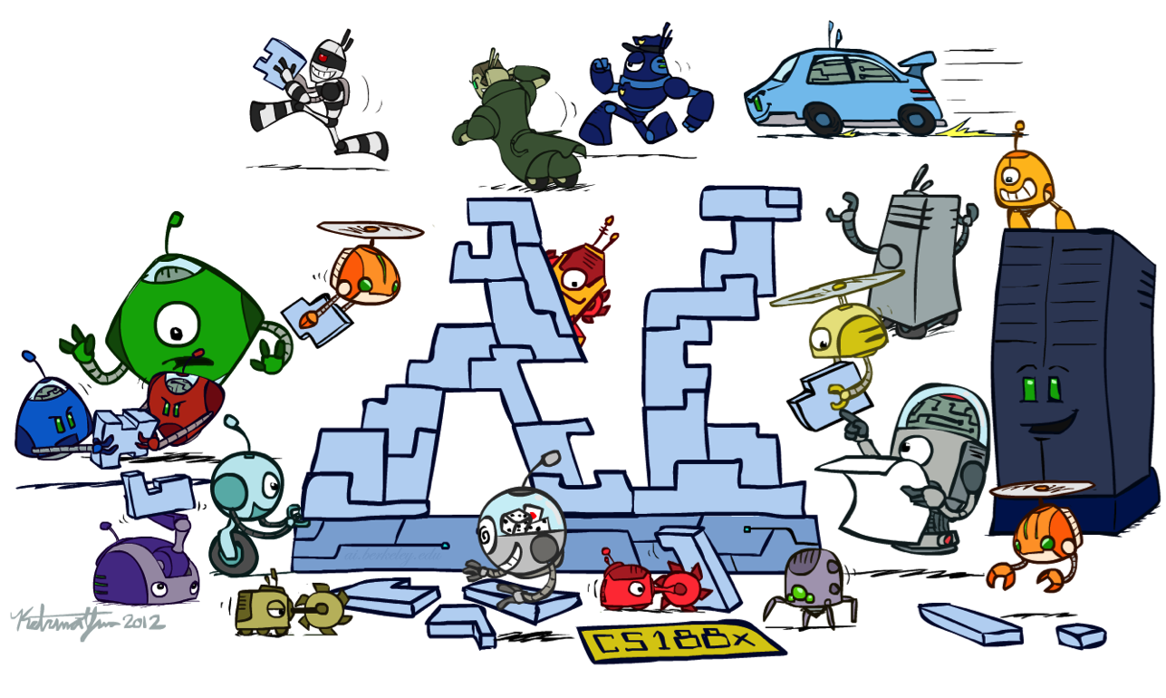
Conclusion

Slide 43
Thanks to Our Course Staff!!
Administrative Assistant
Liv Zane
Videographer
John Lombardo
Teaching Assistants
Angela Yang
Claire Wang (Head TA)
George Brown
Michelle Ma
Sean Pereira
Chakara (Tian) Owarang
Tina Wu
Vicky Zeng

