Slide 1
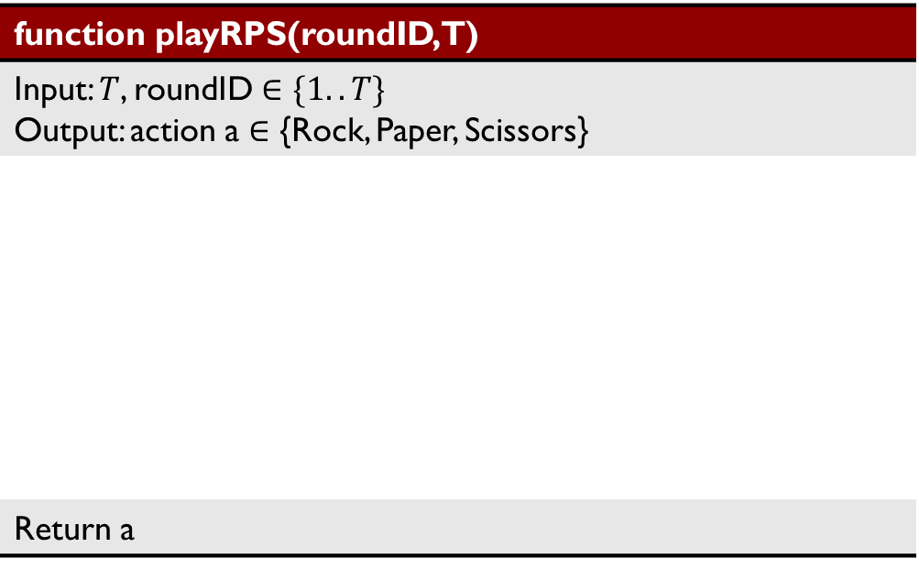
Warm-up
Design an AI to play Rock-Paper-Scissors for T rounds
function playRPS(roundID,T)
Input: $T$, roundID $∈\{1..T\}$ Output: action a $∈$ {Rock, Paper, Scissors}
Return a

Slide 2
Announcement
Assignments
P5: Ghostbusters and Bayes' Nets; Due 11/25 Mon, 10 pm
HW11 (online); Due 11/27 Wed, 10 pm
Piazza post for in-class questions

Slide 3
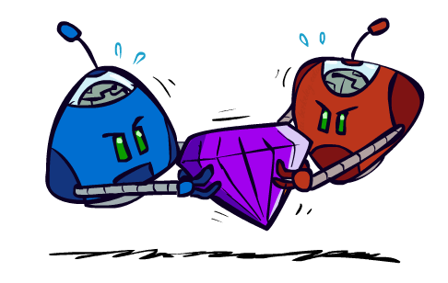
AI: Representation and Problem Solving Game Theory: Equilibrium
Instructors: Fei Fang & Pat Virtue
Slide credits: CMU AI and http://ai.berkeley.edu

Slide 4
Learning Objectives
Formulate a problem as a game
Describe and compare the basic concepts in game theory
Normal-form game, extensive-form game
Zero-sum game, general-sum game
Pure strategy, mixed strategy, support, best response, dominance
Dominant strategy equilibrium, Nash equilibrium, Minimax strategy, maximin strategy, Stackelberg equilibrium
Describe iterative removal algorithm
Describe minimax theorem
Compute equilibria for bimatrix games
Pure strategy Nash equilibrium
Mixed strategy Nash equilibrium (including using LP for zero-sum games)
Stackelberg equilibrium (only pure strategy equilibrium is required)

Slide 5

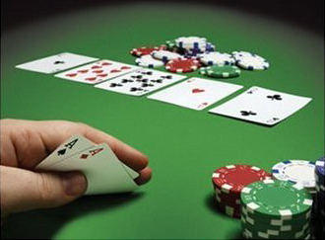

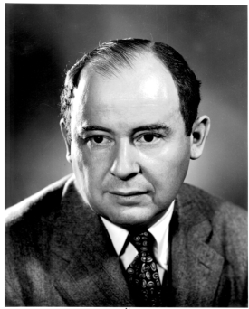

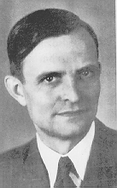
From Games to Game Theory
The study of mathematical models of conflict and cooperation between intelligent decision makers
Used in economics, political science etc
John von Neumann John Nash Heinrich Freiherr von Stackelberg
Winners of Nobel Memorial Prize in Economic Sciences
Notes:
We all play games, from … to … to party boardgames such as werewolf.
In most of the games, we have to play in a very strategic way to win.
Game theory is the study of strategic decision making.
More specifically, game theory is the study of mathematical models of conflict and cooperation between intelligent decision-makers. The games studied in game theory must have elements including the players, information, actions and payoffs.
Although the first known discussion of game theory is for a two-player card game, game theory is not only designed for entertaining games. Modern game theory has been used in economics and political science. Nobel Prize winners John von Neumann, John Nash, Heinrich Freiherr von Stackelberg

Slide 6
Recall: Adversarial Search
Zero-sum, perfect information, two player games with turn-taking moves
3
12
8
2
4
6
14
5
2

Slide 7
Classical Games and Payoff Matrices
Rock-Paper-Scissors (RPS)
Rock beats Scissors
Scissors beats Paper
Paper beats Rock
Player 2
 | Rock | Paper | Scissors
Rock | 0, 0 | -1, 1 | 1, -1
Paper | 1, -1 | 0, 0 | -1, 1
Scissors | -1, 1 | 1, -1 | 0, 0
Player 1
Notes:
A two-player normal-form game with finite actions can be represented by a (bi)matrix
Player 1: Row player, Player 2: Column player
Often first number is for row player, second for column player

Slide 8
Classical Games and Payoff Matrices
Prisoner’s Dilemma (PD)
If both Cooperate: 1 year in jail each
If one Defect, one Cooperate: 0 year for (D), 3 years for (C)
If both Defect: 2 years in jail each
Let’s play!
Player 2
 | Cooperate | Defect
Cooperate | -1,-1 | -3,0
Defect | 0,-3 | -2,-2
Player 1
Notes:
Two members of a criminal gang are arrested and imprisoned. Each prisoner is in solitary confinement with no means of communicating with the other. The prosecutors lack sufficient evidence to convict the pair on the principal charge, but they have enough to convict both on a lesser charge. Simultaneously, the prosecutors offer each prisoner a bargain. Each prisoner is given the opportunity either to betray the other by testifying that the other committed the crime, or to cooperate with the other by remaining silent. The possible outcomes are:
If A and B each betray the other, each of them serves two years in prison
If A betrays B but B remains silent, A will be set free and B will serve three years in prison (and vice versa)
If A and B both remain silent, both of them will serve only one year in prison (on the lesser charge).

Slide 9
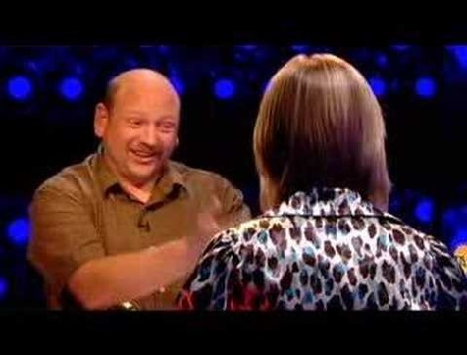
Variation: Split or Steal
https://youtu.be/p3Uos2fzIJ0

Slide 10
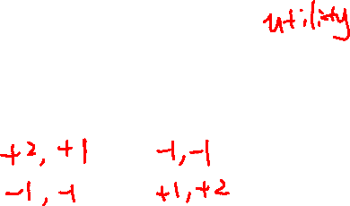
Classical Games and Payoff Matrices
Football vs Concert (FvsC)
Historically known as Battle of Sexes
If football together: Alex ☺☺, Berry ☺
If concert together: Alex ☺, Berry ☺☺
If not together: Alex ☹, Berry ☹
Fill in the payoff matrix
Berry
 | Football | Concert
Football
Concert
Alex

Slide 11
Classical Games and Payoff Matrices
Football vs Concert (FvsC)
Historically known as Battle of Sexes
If football together: Alex ☺☺, Berry ☺
If concert together: Alex ☺, Berry ☺☺
If not together: Alex ☹, Berry ☹
Berry
 | Football | Concert
Football | 2,1 | 0,0
Concert | 0,0 | 1,2
Alex

Slide 12
Normal-Form Games
A game in normal form consists of the following elements
Set of players
Set of actions for each player
Payoffs / Utility functions
Determines the utility for each player given the actions chosen by all players (referred to as action profile)
Bimatrix game is special case: two players, finite action sets
Players move simultaneously and the game ends immediately afterwards
What are the players, set of actions and utility functions of Football vs Concert (FvsC) game?
Notes:
A normal-form game is a representation of a game in game theory. It directly specifies the set of players' strategies where a strategy is a complete plan of action for every stage of the game, regardless of whether that stage actually arises in play.

Slide 13

Warm-up
Design an AI to play Rock-Paper-Scissors for T rounds
If T=1, roundID=1, what action does your AI choose?
function playRPS(roundID,T)
Input: $T$, roundID $∈\{1..T\}$ Output: action a $∈$ {Rock, Paper, Scissors}
Return a

Slide 14
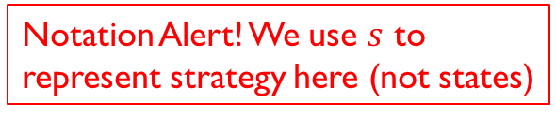

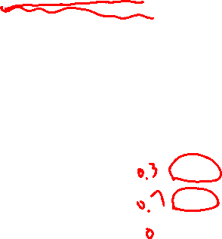
Strategy
Pure strategy: choose an action deterministically
Mixed strategy: choose actions according to a probability distribution
Notation: $s=(0.3,0.7,0)$
Support: set of actions chosen with non-zero probability
Notation Alert! We use $s$ to represent strategy here (not states)
Does your AI play a deterministic strategy or a mixed strategy?
Player 2
What is the support size of your AI’s strategy?
 | Rock | Paper | Scissors
Rock | 0, 0 | -1, 1 | 1, -1
Paper | 1, -1 | 0, 0 | -1, 1
Scissors | -1, 1 | 1, -1 | 0, 0
Player 1

Slide 15
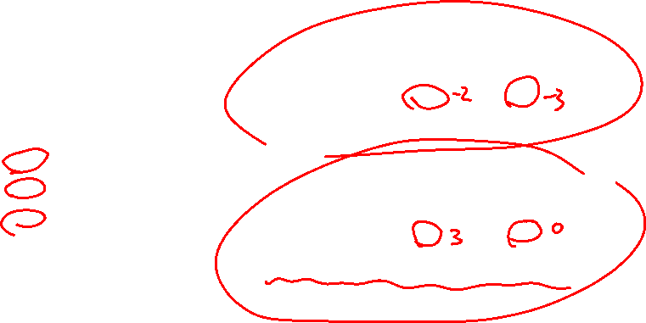
Zero-sum vs General-sum
Zero-sum Game
No matter what actions are chosen by the players, the utilities for all the players sum up to zero or a constant
General-sum Game
The sum of utilities of all the players is not a constant
Which ones are
general-sum games?
Player 2
 | Cooperate | Defect
Cooperate | -1,-1 | -3,0
Defect | 0,-3 | -2,-2
Player 2
Player 1
 | Rock | Paper | Scissors
Rock | 0,0 | -1,1 | 1,-1
Paper | 1,-1 | 0,0 | -1,1
Scissor | -1,1 | 1,-1 | 0,0
Player 1
Berry
 | Football | Concert
Football | 2,1 | 0,0
Concert | 0,0 | 1,2
Alex

Slide 16
Zero-sum vs General-sum
Zero-sum Game
No matter what actions are chosen by the players, the utilities for all the players sum up to zero or a constant
General-sum Game
The sum of utilities of all the players is not a constant
Which ones are
general-sum games?
Player 2
 | Cooperate | Defect
Cooperate | -1,-1 | -3,0
Defect | 0,-3 | -2,-2
Player 2
Player 1
 | Rock | Paper | Scissors
Rock | 0,0 | -1,1 | 1,-1
Paper | 1,-1 | 0,0 | -1,1
Scissor | -1,1 | 1,-1 | 0,0
Player 1
Berry
 | Football | Concert
Football | 2,1 | 0,0
Concert | 0,0 | 1,2
Alex

Slide 17
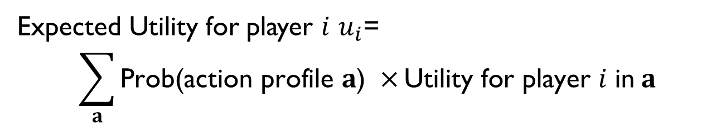
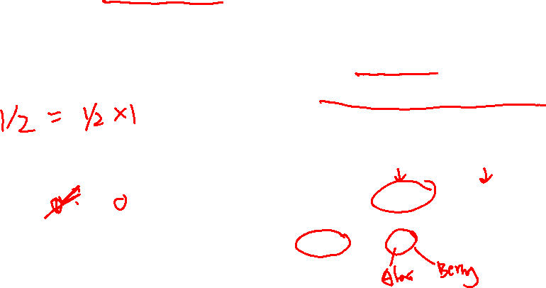
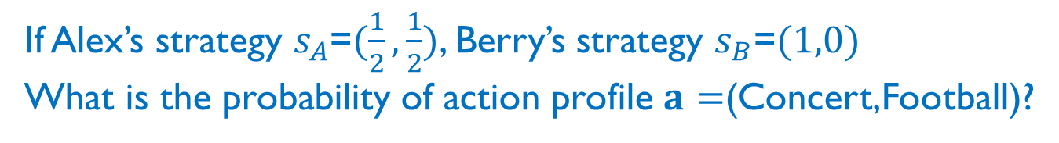
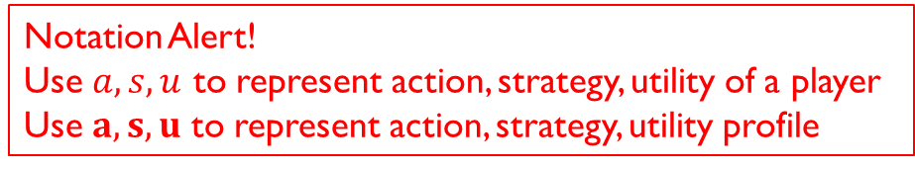
Expected Utility
Notation Alert!
Use $a, s,u$ to represent action, strategy, utility of a player
Use $a,s,u$ to represent action, strategy, utility profile
Given the strategies of all players,
Expected Utility for player $i$ $u_{i}$=
$$\sum_{a}{\text{Prob}\text{(}\text{action} \text{profile} a\text{) }×}\text{Utility} \text{for} \text{player} i \text{in} a$$
Can skip action profiles with probability $0$ or utility $0$
If Alex’s strategy $s_{A}$=$(\frac{1}{2},\frac{1}{2})$, Berry’s strategy $s_{B}$=$(1,0)$
What is the probability of action profile $a=$(Concert,Football)?
What is Alex’s utility in this action profile?
Berry
 | Football | Concert
Football | 2,1 | 0,0
Concert | 0,0 | 1,2
Alex

Slide 18


Expected Utility
Notation Alert!
Use $a, s,u$ to represent action, strategy, utility of a player
Use $a,s,u$ to represent action, strategy, utility profile
Given the strategies of all players,
Expected Utility for player $i$ $u_{i}$=
$$\sum_{a}{\text{Prob}\text{(}\text{action} \text{profile} a\text{) }×}\text{Utility} \text{for} \text{player} i \text{in} a$$
Can skip action profiles with probability $0$ or utility $0$
If Alex’s strategy $s_{A}$=$(\frac{1}{2},\frac{1}{2})$, Berry’s strategy $s_{B}$=$(1,0)$
What is the probability of action profile $a=$(Concert,Football)?
$$\frac{1}{2}×1=\frac{1}{2}$$
What is Alex’s utility in this action profile?
Berry
$$0$$
 | Football | Concert
Football | 2,1 | 0,0
Concert | 0,0 | 1,2
Alex

Slide 19
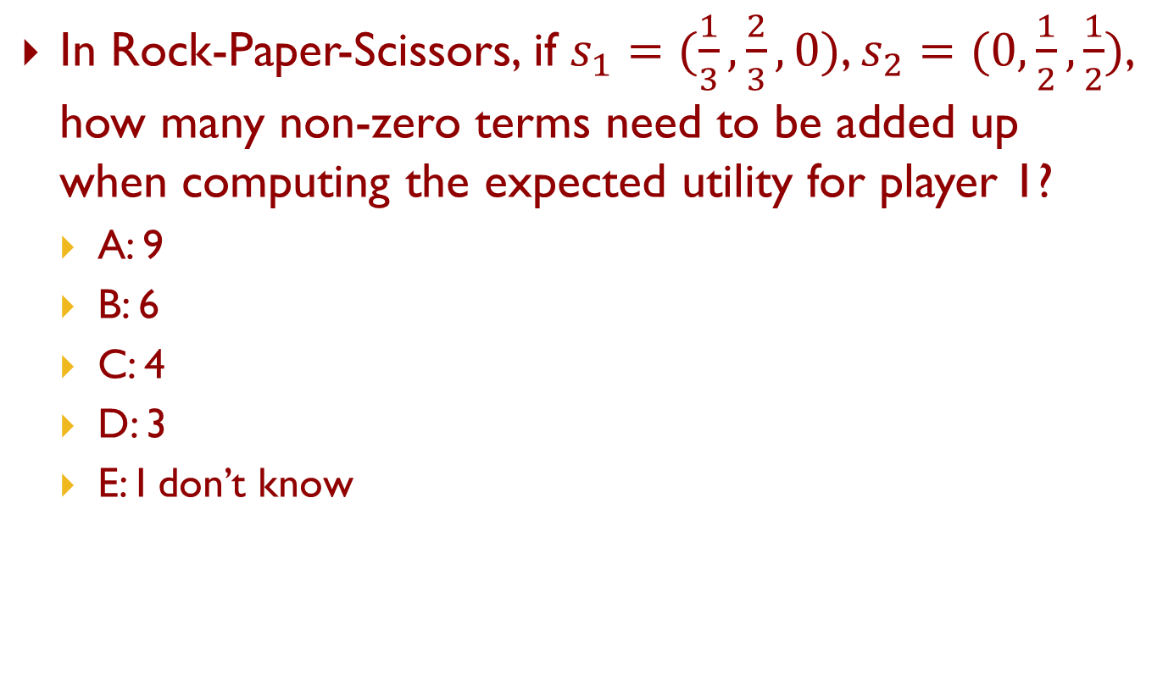
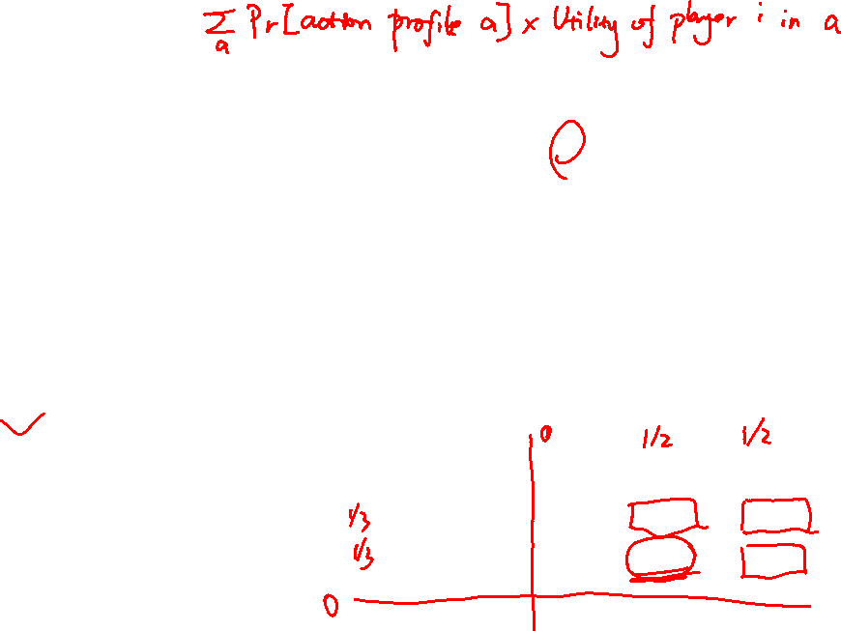
Piazza Poll 1
In Rock-Paper-Scissors, if $s_{1}=(\frac{1}{3},\frac{2}{3},0)$, $s_{2}=(0,\frac{1}{2},\frac{1}{2})$, how many non-zero terms need to be added up when computing the expected utility for player 1?
A: 9
B: 6
C: 4
D: 3
E: I don’t know
Player 2
 | Rock | Paper | Scissors
Rock | 0, 0 | -1, 1 | 1, -1
Paper | 1, -1 | 0, 0 | -1, 1
Scissors | -1, 1 | 1, -1 | 0, 0
Player 1

Slide 20

Piazza Poll 1
In Rock-Paper-Scissors, if $s_{1}=(\frac{1}{3},\frac{2}{3},0)$, $s_{2}=(0,\frac{1}{2},\frac{1}{2})$, how many non-zero terms need to be added up when computing the expected utility for player 1?
A: 9
B: 6
C: 4
D: 3
E: I don’t know
$$u_{1}=0×\frac{1}{3}×0+\left(−1\right)×\frac{1}{3}×\frac{1}{2}+1×\frac{1}{3}×\frac{1}{2}$$
$$+1×\frac{2}{3}×0+0×\frac{2}{3}×\frac{1}{2}+(−1)×\frac{2}{3}×\frac{1}{2}$$
$$+\left(−1\right)×0×0+1×0×\frac{1}{2}+0×0×\frac{1}{2}=−\frac{1}{3}$$
Player 2
 | Rock | Paper | Scissors
Rock | 0, 0 | -1, 1 | 1, -1
Paper | 1, -1 | 0, 0 | -1, 1
Scissors | -1, 1 | 1, -1 | 0, 0
Player 1

Slide 21

Best Response
Best Response (BR): Given the strategies or actions of all players but player $i$ (denoted as $s_{−i}$ or $a_{−i}$), Player $i$’s best response to $s_{−i}$ or $a_{−i}$ is the set of actions or strategies of player $i$ that can lead to the highest expected utility for player $i$
In RPS, what is Player 1’s best response to Rock (i.e., assuming Player 2 plays Rock)?
In Prisoner’s Dilemma, what is Player 1’s best response to Cooperate? What is Player 1’s best response to Defect?
Player 2
 | Cooperate | Defect
Cooperate | -1,-1 | -3,0
Defect | 0,-3 | -2,-2
Player 1

Slide 22
Best Response
Best Response (BR): Given the strategies or actions of all players but player $i$ (denoted as $s_{−i}$ or $a_{−i}$), Player $i$’s best response to $s_{−i}$ or $a_{−i}$ is the set of actions or strategies of player $i$ that can lead to the highest expected utility for player $i$
In RPS, what is Player 1’s best response to Rock (i.e., assuming Player 2 plays Rock)?
Paper
In Prisoner’s Dilemma, what is Player 1’s best response to Cooperate? What is Player 1’s best response to Defect?
Player 2
Defect, Defect
 | Cooperate | Defect
Cooperate | -1,-1 | -3,0
Defect | 0,-3 | -2,-2
Player 1

Slide 23
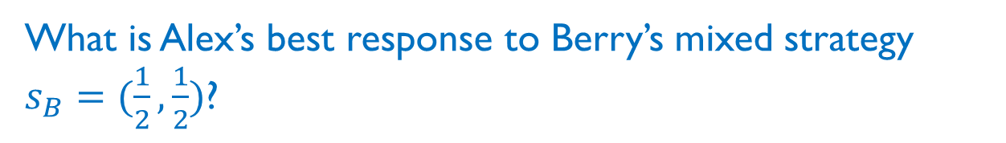
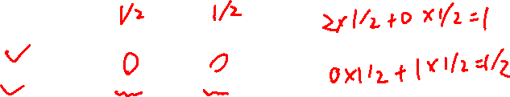
Best Response
Best Response (BR): Given the strategies or actions of all players but player $i$ (denoted as $s_{−i}$ or $a_{−i}$), Player $i$’s best response to $s_{−i}$ or $a_{−i}$ is the set of actions or strategies of player $i$ that can lead to the highest expected utility for player $i$
What is Alex’s best response to Berry’s mixed strategy $s_{B}=(\frac{1}{2},\frac{1}{2})$?
Berry
 | Football | Concert
Football | 2,1 | 0,0
Concert | 0,0 | 1,2
Alex

Slide 24
Best Response
Best Response (BR): Given the strategies or actions of all players but player $i$ (denoted as $s_{−i}$ or $a_{−i}$), Player $i$’s best response to $s_{−i}$ or $a_{−i}$ is the set of actions or strategies of player $i$ that can lead to the highest expected utility for player $i$
What is Alex’s best response to Berry’s mixed strategy $s_{B}=(\frac{1}{2},\frac{1}{2})$?
Football
Berry
 | Football | Concert
Football | 2,1 | 0,0
Concert | 0,0 | 1,2
Alex

Slide 25
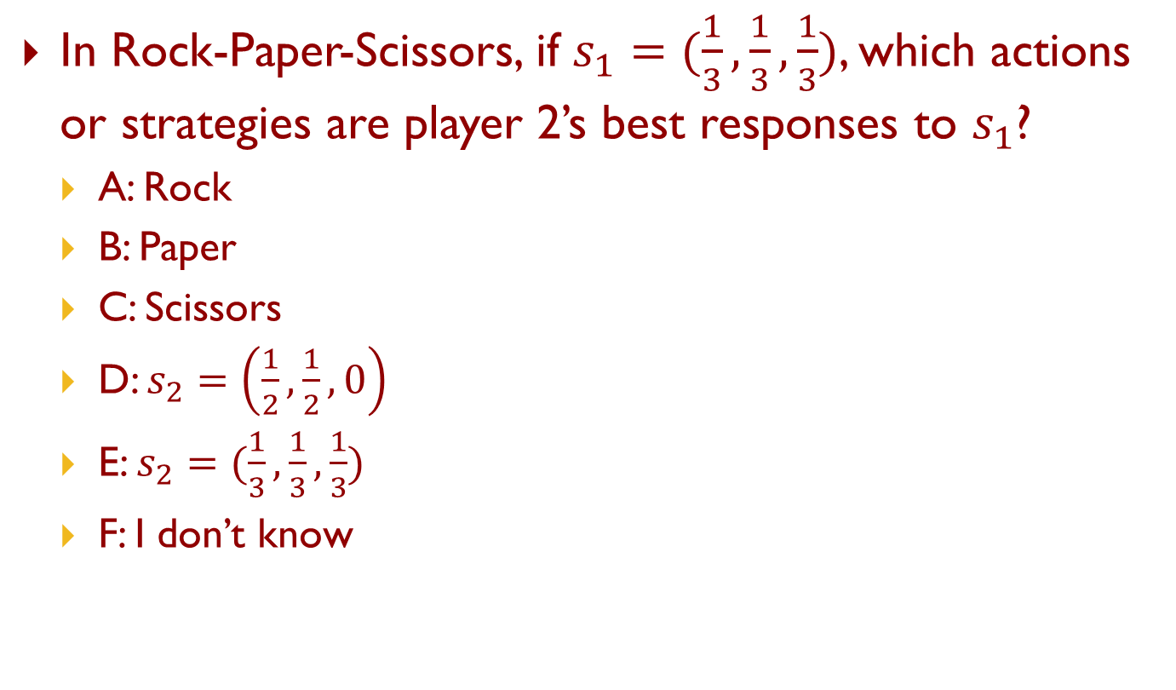
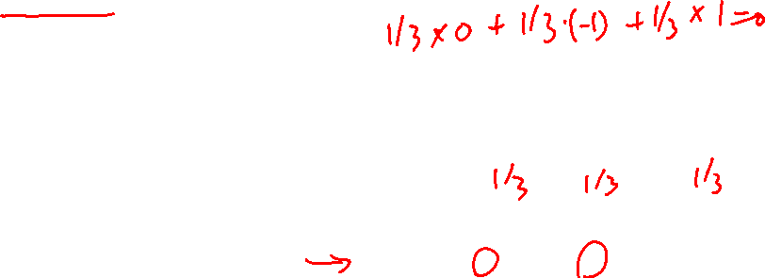
Piazza Poll 2
In Rock-Paper-Scissors, if $s_{1}=(\frac{1}{3},\frac{1}{3},\frac{1}{3})$, which actions or strategies are player 2’s best responses to $s_{1}$?
A: Rock
B: Paper
C: Scissors
D: $s_{2}=\left(\frac{1}{2},\frac{1}{2},0\right)$
E: $s_{2}=(\frac{1}{3},\frac{1}{3},\frac{1}{3})$
F: I don’t know
Player 2
 | Rock | Paper | Scissors
Rock | 0, 0 | -1, 1 | 1, -1
Paper | 1, -1 | 0, 0 | -1, 1
Scissors | -1, 1 | 1, -1 | 0, 0
Player 1

Slide 26
Best Response
Theorem 1 (Nash 1951): A mixed strategy is BR iff all actions in the support are BR
Player 2
 | Rock | Paper | Scissors
Rock | 0, 0 | -1, 1 | 1, -1
Paper | 1, -1 | 0, 0 | -1, 1
Scissors | -1, 1 | 1, -1 | 0, 0
Player 1

Slide 27
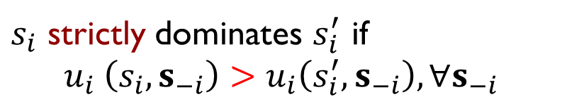
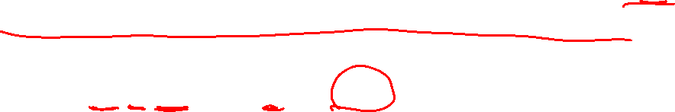

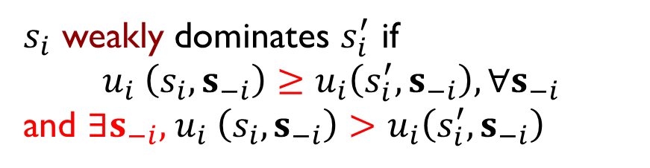
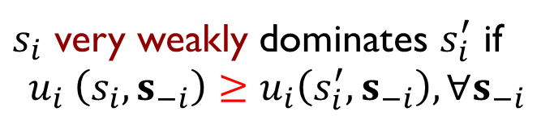
Dominance
$s_{i}$ and $s_{i}′$ are two strategies for player $i$
$s_{i}$ strictly dominates $s_{i}′$if $s_{i}$ is always better than $s_{i}′$, no matter what strategies are chosen by other players
$s_{i}$ strictly dominates $s_{i}^{′}$ if
$$u_{i} \left(s_{i},s_{−i}\right)>u_{i}\left(s_{i}^{′},s_{−i}\right),∀s_{−i}$$
always better
$s_{i}$ very weakly dominates $s_{i}^{′}$ if
$$u_{i} \left(s_{i},s_{−i}\right)≥u_{i}\left(s_{i}^{′},s_{−i}\right),∀s_{−i}$$
never worse
$s_{i}$ weakly dominates $s_{i}^{′}$ if
$$u_{i} \left(s_{i},s_{−i}\right)≥u_{i}\left(s_{i}^{′},s_{−i}\right),∀s_{−i}$$
and $∃s_{−i}\text{,} u_{i} \left(s_{i},s_{−i}\right)>u_{i}\left(s_{i}^{′},s_{−i}\right)$
never worse and sometimes better

Slide 28
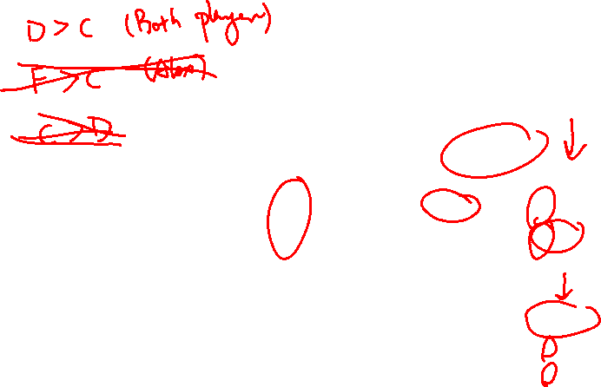
Dominance
Can you find any dominance relationships between the pure strategies in these games?
Player 2
 | Cooperate | Defect
Cooperate | -1,-1 | -3,0
Defect | 0,-3 | -2,-2
Player 2
Player 1
 | Rock | Paper | Scissors
Rock | 0,0 | -1,1 | 1,-1
Paper | 1,-1 | 0,0 | -1,1
Scissor | -1,1 | 1,-1 | 0,0
Player 1
Berry
 | Football | Concert
Football | 2,1 | 0,0
Concert | 0,0 | 1,2
Alex

Slide 29
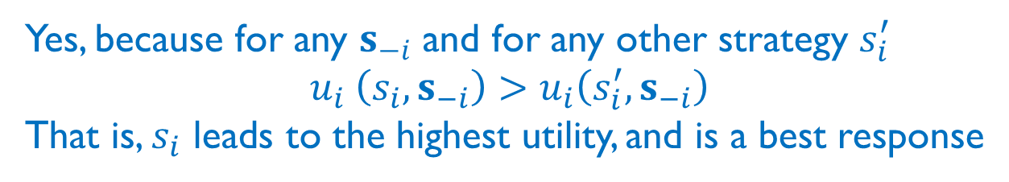

Dominance
If $s_{i}$ strictly dominates $s_{i}^{′},∀s_{i}^{′}∈S_{i}\backslash \{s_{i}\}$, is $s_{i}$ a best response to $s_{−i},∀s_{−i}$?
Yes, because for any $s_{−i}$ and for any other strategy $s_{i}^{′}$
$$u_{i} \left(s_{i},s_{−i}\right)>u_{i}\left(s_{i}^{′},s_{−i}\right)$$
That is, $s_{i}$ leads to the highest utility, and is a best response

Slide 30
Solution Concepts in Games
How should one player play and what should we expect all the players to play?
Dominant strategy and dominant strategy equilibrium
Nash Equilibrium
Minimax strategy
Maximin strategy
(Stackelberg Equilibrium)

Slide 31
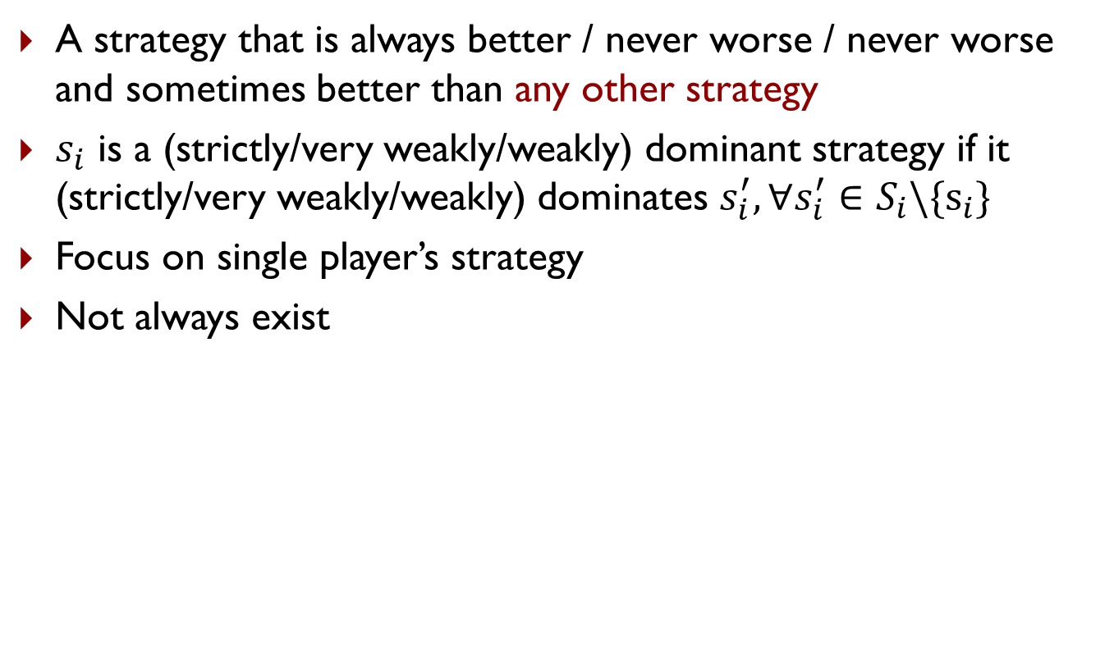
Dominant Strategy
A strategy that is always better / never worse / never worse and sometimes better than any other strategy
$s_{i}$ is a (strictly/very weakly/weakly) dominant strategy if it (strictly/very weakly/weakly) dominates $s_{i}^{′}, ∀s_{i}^{′}∈S_{i}\backslash \{s_{i}\}$
Focus on single player’s strategy
Not always exist
Is there a strictly dominant strategy for player 1 in PD?
Player 2
 | Cooperate | Defect
Cooperate | -1,-1 | -3,0
Defect | 0,-3 | -2,-2
Player 1

Slide 32
Dominant Strategy Equilibrium
Sometimes called dominant strategy solution
Every player plays a dominant strategy
Focus on strategy profile for all players
Not always exist
What is the dominant strategy equilibrium for PD?
Player 2
 | Cooperate | Defect
Cooperate | -1,-1 | -3,0
Defect | 0,-3 | -2,-2
Player 1

Slide 33
Solution Concepts in Games
How should one player play and what should we expect all the players to play?
Dominant strategy and dominant strategy equilibrium
Nash Equilibrium
Minimax strategy
Maximin strategy
(Stackelberg Equilibrium)

Slide 34
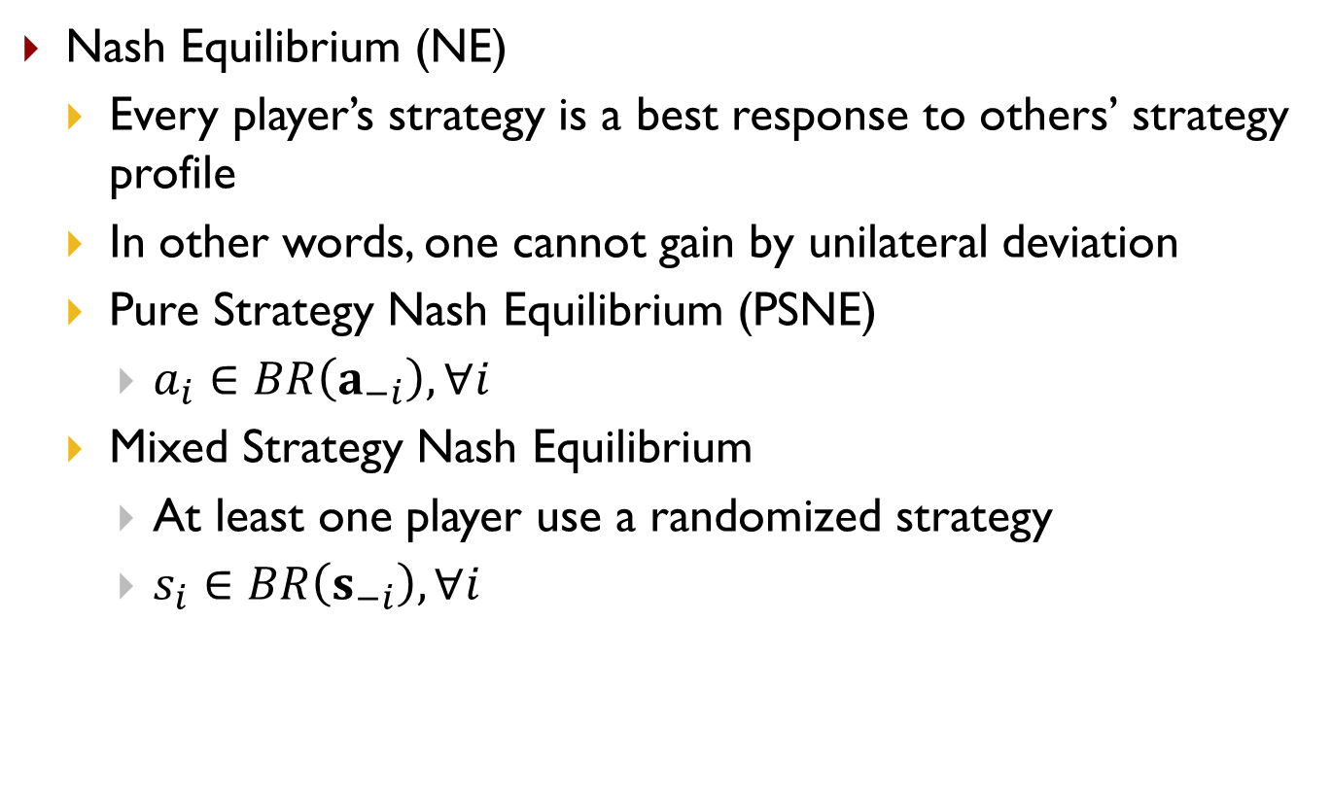
Nash Equilibrium
Nash Equilibrium (NE)
Every player’s strategy is a best response to others’ strategy profile
In other words, one cannot gain by unilateral deviation
Pure Strategy Nash Equilibrium (PSNE)
$a_{i}∈BR\left(a_{−i}\right),∀i$
Mixed Strategy Nash Equilibrium
At least one player use a randomized strategy
$s_{i}∈BR\left(s_{−i}\right),∀i$

Slide 35
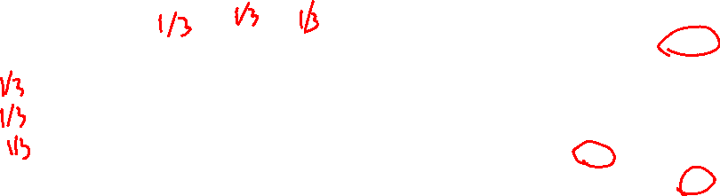
Nash Equilibrium
What are the PSNEs in these games?
What is the mixed strategy NE in RPS?
Player 2
 | Cooperate | Defect
Cooperate | -1,-1 | -3,0
Defect | 0,-3 | -2,-2
Player 2
Player 1
 | Rock | Paper | Scissors
Rock | 0,0 | -1,1 | 1,-1
Paper | 1,-1 | 0,0 | -1,1
Scissor | -1,1 | 1,-1 | 0,0
Player 1
Berry
 | Football | Concert
Football | 2,1 | 0,0
Concert | 0,0 | 1,2
Alex

Slide 36
Nash Equilibrium
What are the PSNEs in these games?
RPS: None. Prisoner’s Dilemma: (D,D). Football vs Concert: (F,F),(C,C)
What is the mixed strategy NE in RPS?
(1/3,1/3,1/3) for both players
Player 2
 | Cooperate | Defect
Cooperate | -1,-1 | -3,0
Defect | 0,-3 | -2,-2
Player 2
Player 1
 | Rock | Paper | Scissors
Rock | 0,0 | -1,1 | 1,-1
Paper | 1,-1 | 0,0 | -1,1
Scissor | -1,1 | 1,-1 | 0,0
Player 1
Berry
 | Football | Concert
Football | 2,1 | 0,0
Concert | 0,0 | 1,2
Alex

Slide 37
Nash Equilibrium
Theorem 2 (Nash 1951): NE always exists in finite games
Finite number of players, finite number of actions
NE: can be pure or mixed
Proof: Through Brouwer's fixed point theorem

Slide 38
Find PSNE
Find pure strategy Nash Equilibrium (PSNE)
Enumerate all action profile
For each action profile, check if it is NE
For each player, check other available actions to see if he should deviate
Other approaches?
Player 2
 | L | C | R
U | 10,3 | 1,5 | 5,4
M | 3,1 | 2,4 | 5,2
D | 0,10 | 1,8 | 7,0
Player 1
Notes:
for each player to see if there is no incentive for this player to deviate, i.e., there exists another action of this player that lead to higher payoff, given the actions of other players

Slide 39
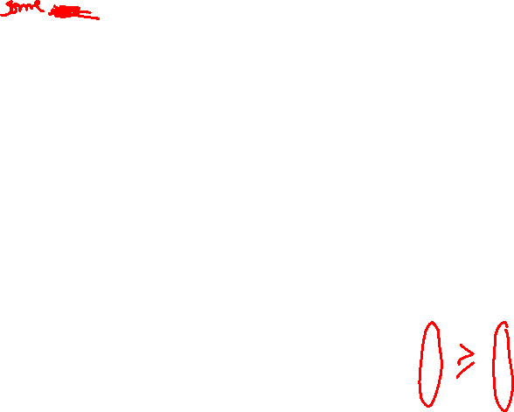
Find PSNE
A strictly dominated strategy is one that is always worse than any other strategy
Strictly dominated strategies cannot be part of an NE
Why?
Which are the strictly dominated strategies for player 1?
How about player 2?
Player 2
 | L | C | R
U | 10,3 | 1,5 | 5,4
M | 3,1 | 2,4 | 5,2
D | 0,10 | 1,8 | 7,0
Player 1

Slide 40

Find PSNE
A strictly dominated strategy is one that is always worse than some other strategy
Strictly dominated strategies cannot be part of an NE
Why?
Which are the strictly dominated strategies for player 1?
How about player 2?
Player 2
 | L | C | R
U | 10,3 | 1,5 | 5,4
M | 3,1 | 2,4 | 5,2
D | 0,10 | 1,8 | 7,0
Player 1
$$≥$$

Slide 41
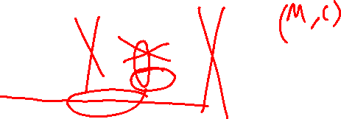
Find PSNE through Iterative Removal
Remove strictly dominated actions (pure strategies) and then find PSNE in the remaining game
Repeat the process until no actions can be removed
This is the Iterative Removal algorithm (also known as Iterative Elimination of Strictly Dominated Strategies)
Can have new strictly dominated actions in the remaining game!
Find PSNE in this game using iterative removal
Player 2
 | L | C | R
U | 10,3 | 1,5 | 5,4
M | 3,1 | 2,4 | 5,2
D | 0,10 | 1,8 | 7,0
Player 1

Slide 42
Find PSNE through Iterative Removal
Remove strictly dominated actions (pure strategies) and then find PSNE in the remaining game
Repeat the process until no actions can be removed
This is the Iterative Removal algorithm (also known as Iterative Elimination of Strictly Dominated Strategies)
Can have new strictly dominated actions in the remaining game!
Find PSNE in this game using iterative removal
 | L | C | R
U | 10,3 | 1,5 | 5,4
M | 3,1 | 2,4 | 5,2
D | 0,10 | 1,8 | 7,0
 | L | C
U | 10,3 | 1,5
M | 3,1 | 2,4
D | 0,10 | 1,8
 | L | C
U | 10,3 | 1,5
M | 3,1 | 2,4
 | C
U | 1,5
M | 2,4
 | C
M | 2,4

Slide 43
Find PSNE through Iterative Removal
When the algorithm terminates, if the remaining game has only one action for each player, then that is the unique NE of the game and the game is called dominance solvable
It may not be a dominant strategy equilibrium
When the remaining game has more than one action for some players, find PSNE in the remaining game
Order of removal does not matter
Player 2
 | L | C | R
U | 10,3 | 1,5 | 5,4
M | 3,1 | 2,4 | 5,2
D | 0,10 | 1,8 | 7,0
Player 1

Slide 44
Find Mixed Strategy Nash Equilibrium
Can we still apply iterative removal?
Yes! The removed strategies cannot be part of any NE
You can always apply iterative removal first
Notes:
, i.e., no strictly dominated strategies in the remaining game
Now assume you are given a 2 by 2 bimatrix game after iterative removal. Further, you are told that in a NE, all the actions are chosen with non-zero probability. What are the necessary conditions for a mixed strategy NE?
Check the FvsC game, in addition to PSNEs (F,F) and (C,C), there is a mixed strategy NE shown below.

Slide 45
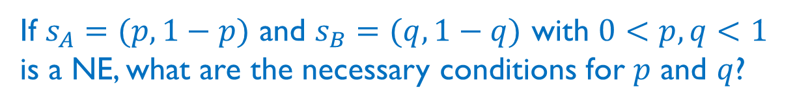
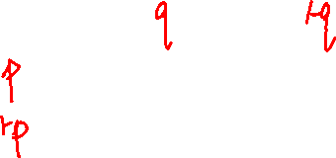
Find Mixed Strategy Nash Equilibrium
How to find mixed strategy NE (after iterative removal)?
Berry
 | Football | Concert
Football | 2,1 | 0,0
Concert | 0,0 | 1,2
Alex
If $s_{A}=(p,1−p)$ and $s_{B}=(q,1−q)$ with $0<p,q<1$ is a NE, what are the necessary conditions for $p$ and $q$?
Notes:
, i.e., no strictly dominated strategies in the remaining game
Now assume you are given a 2 by 2 bimatrix game after iterative removal. Further, you are told that in a NE, all the actions are chosen with non-zero probability. What are the necessary conditions for a mixed strategy NE?
Check the FvsC game, in addition to PSNEs (F,F) and (C,C), there is a mixed strategy NE shown below.

Slide 46
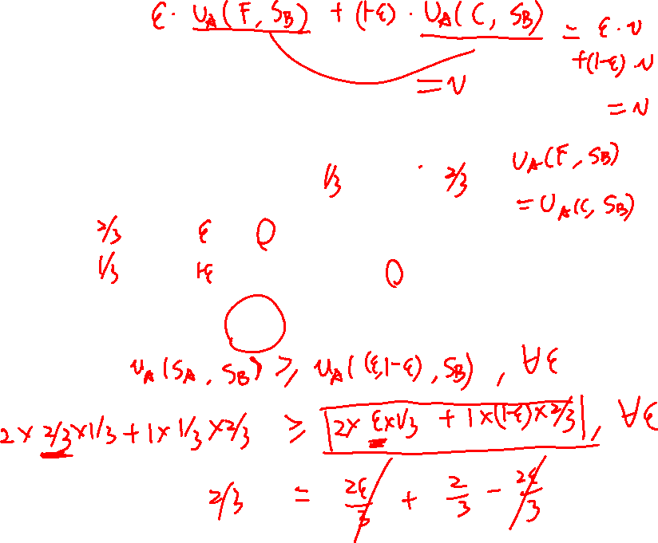
Find Mixed Strategy Nash Equilibrium
How to find mixed strategy NE (after iterative removal)?
Berry
 | Football | Concert
Football | 2,1 | 0,0
Concert | 0,0 | 1,2
Alex
Is $s_{A}=(\frac{2}{3},\frac{1}{3})$ and $s_{B}=(\frac{1}{3},\frac{2}{3})$ an NE?
Notes:
, i.e., no strictly dominated strategies in the remaining game
Now assume you are given a 2 by 2 bimatrix game after iterative removal. Further, you are told that in a NE, all the actions are chosen with non-zero probability. What are the necessary conditions for a mixed strategy NE?
Check the FvsC game, in addition to PSNEs (F,F) and (C,C), there is a mixed strategy NE shown below.

Slide 47
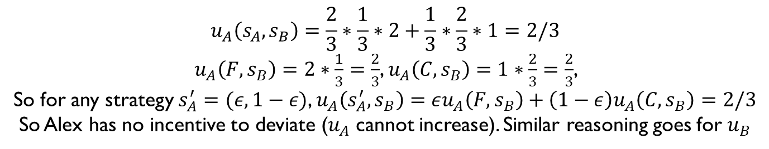
Find Mixed Strategy Nash Equilibrium
How to find mixed strategy NE (after iterative removal)?
Berry
 | Football | Concert
Football | 2,1 | 0,0
Concert | 0,0 | 1,2
Alex
Is $s_{A}=(\frac{2}{3},\frac{1}{3})$ and $s_{B}=(\frac{1}{3},\frac{2}{3})$ an NE?
$$u_{A}\left(s_{A},s_{B}\right)=\frac{2}{3}∗\frac{1}{3}∗2+\frac{1}{3}∗\frac{2}{3}∗1=2/3$$
$u_{A}\left(F,s_{B}\right)=2∗\frac{1}{3}=\frac{2}{3}$, $u_{A}\left(C,s_{B}\right)=1∗\frac{2}{3}=\frac{2}{3}$,
So for any strategy $s_{A}^{′}=(ε,1−ε)$, $u_{A}\left(s_{A}^{′},s_{B}\right)=εu_{A}\left(F,s_{B}\right)+\left(1−ε\right)u_{A}\left(C,s_{B}\right)$ $=2/3$
So Alex has no incentive to deviate ($u_{A}$ cannot increase). Similar reasoning goes for $u_{B}$
Notes:
, i.e., no strictly dominated strategies in the remaining game
Now assume you are given a 2 by 2 bimatrix game after iterative removal. Further, you are told that in a NE, all the actions are chosen with non-zero probability. What are the necessary conditions for a mixed strategy NE?
Check the FvsC game, in addition to PSNEs (F,F) and (C,C), there is a mixed strategy NE shown below.

Slide 48
Find Mixed Strategy Nash Equilibrium
How to find mixed strategy NE (after iterative removal)?
Berry
 | Football | Concert
Football | 2,1 | 0,0
Concert | 0,0 | 1,2
Alex
If $s_{A}=(p,1−p)$ and $s_{B}=(q,1−q)$ with $0<p,q<1$ is a NE, what are the necessary conditions for $p$ and $q$?
Notes:
, i.e., no strictly dominated strategies in the remaining game
Now assume you are given a 2 by 2 bimatrix game after iterative removal. Further, you are told that in a NE, all the actions are chosen with non-zero probability. What are the necessary conditions for a mixed strategy NE?
Check the FvsC game, in addition to PSNEs (F,F) and (C,C), there is a mixed strategy NE shown below.

Slide 49
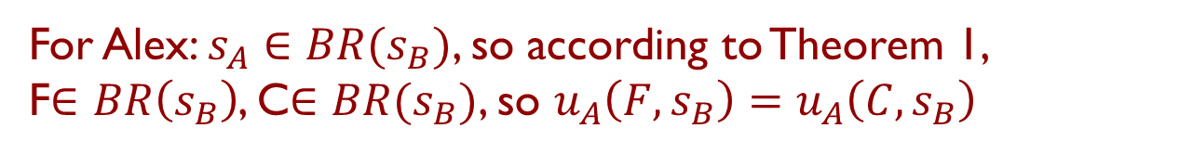
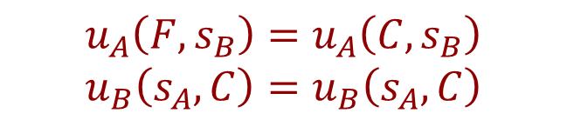
Find Mixed Strategy Nash Equilibrium
How to find mixed strategy NE (after iterative removal)?
Berry
 | Football | Concert
Football | 2,1 | 0,0
Concert | 0,0 | 1,2
Alex
If $s_{A}=(p,1−p)$ and $s_{B}=(q,1−q)$ with $0<p,q<1$ is a NE, what are the necessary conditions for $p$ and $q$?
$$u_{A}\left(F,s_{B}\right)=u_{A}\left(C,s_{B}\right)$$
$$u_{B}\left(s_{A},C\right)=u_{B}\left(s_{A},C\right)$$
Why?
For Alex: $s_{A}∈BR(s_{B})$, so according to Theorem 1,
F$∈BR\left(s_{B}\right)$, C$∈BR(s_{B})$, so $u_{A}\left(F,s_{B}\right)=u_{A}\left(C,s_{B}\right)$
Notes:
, i.e., no strictly dominated strategies in the remaining game
Now assume you are given a 2 by 2 bimatrix game after iterative removal. Further, you are told that in a NE, all the actions are chosen with non-zero probability. What are the necessary conditions for a mixed strategy NE?
Check the FvsC game, in addition to PSNEs (F,F) and (C,C), there is a mixed strategy NE shown below.

Slide 50
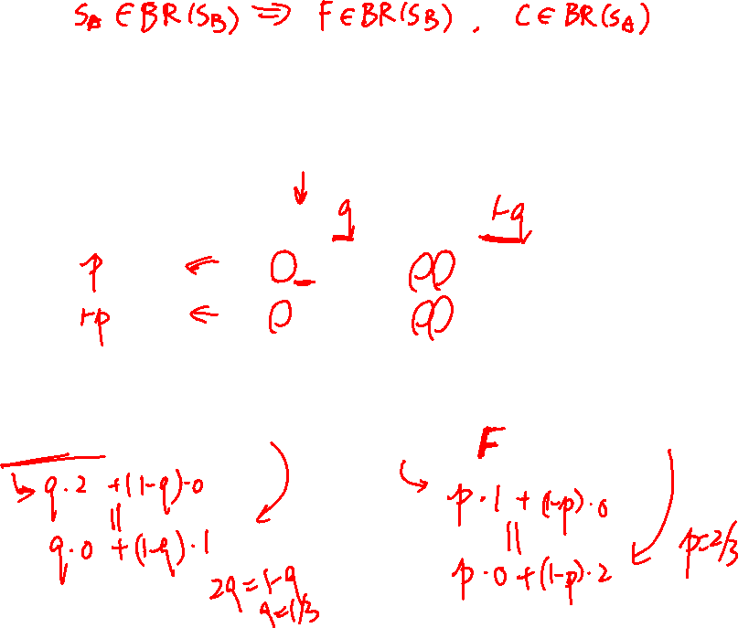


Find Mixed Strategy Nash Equilibrium
How to find mixed strategy NE (after iterative removal)?
Berry
 | Football | Concert
Football | 2,1 | 0,0
Concert | 0,0 | 1,2
Alex
If $s_{A}=(p,1−p)$ and $s_{B}=(q,1−q)$ with $0<p,q<1$ is a NE, what are the necessary conditions for $p$ and $q$?
$$u_{A}\left(F,s_{B}\right)=u_{A}\left(C,s_{B}\right)$$
$$u_{B}\left(s_{A},C\right)=u_{B}\left(s_{A},C\right)$$
Notes:
, i.e., no strictly dominated strategies in the remaining game
Now assume you are given a 2 by 2 bimatrix game after iterative removal. Further, you are told that in a NE, all the actions are chosen with non-zero probability. What are the necessary conditions for a mixed strategy NE?
Check the FvsC game, in addition to PSNEs (F,F) and (C,C), there is a mixed strategy NE shown below.

Slide 51
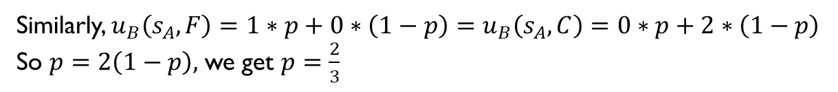
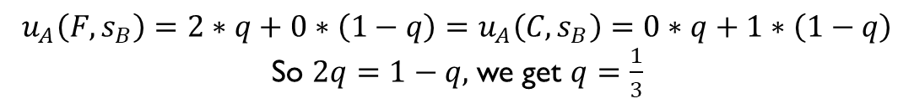
Find Mixed Strategy Nash Equilibrium
How to find mixed strategy NE (after iterative removal)?
Berry
 | Football | Concert
Football | 2,1 | 0,0
Concert | 0,0 | 1,2
Alex
If $s_{A}=(p,1−p)$ and $s_{B}=(q,1−q)$ with $0<p,q<1$ is a NE, what are the necessary conditions for $p$ and $q$?
$$u_{A}\left(F,s_{B}\right)=u_{A}\left(C,s_{B}\right)$$
$$u_{B}\left(s_{A},C\right)=u_{B}\left(s_{A},C\right)$$
$$u_{A}\left(F,s_{B}\right)=2∗q+0∗\left(1−q\right)=u_{A}\left(C,s_{B}\right)=0∗q+1∗\left(1−q\right)$$
So $2q=1−q,$ we get $q=\frac{1}{3}$
Similarly, $u_{B}\left(s_{A},F\right)=1∗p+0∗\left(1−p\right)=u_{B}\left(s_{A},C\right)=0∗p+2∗\left(1−p\right)$
So $p=2\left(1−p\right),$ we get $p=\frac{2}{3}$
Notes:
, i.e., no strictly dominated strategies in the remaining game
Now assume you are given a 2 by 2 bimatrix game after iterative removal. Further, you are told that in a NE, all the actions are chosen with non-zero probability. What are the necessary conditions for a mixed strategy NE?
Check the FvsC game, in addition to PSNEs (F,F) and (C,C), there is a mixed strategy NE shown below.

Slide 52
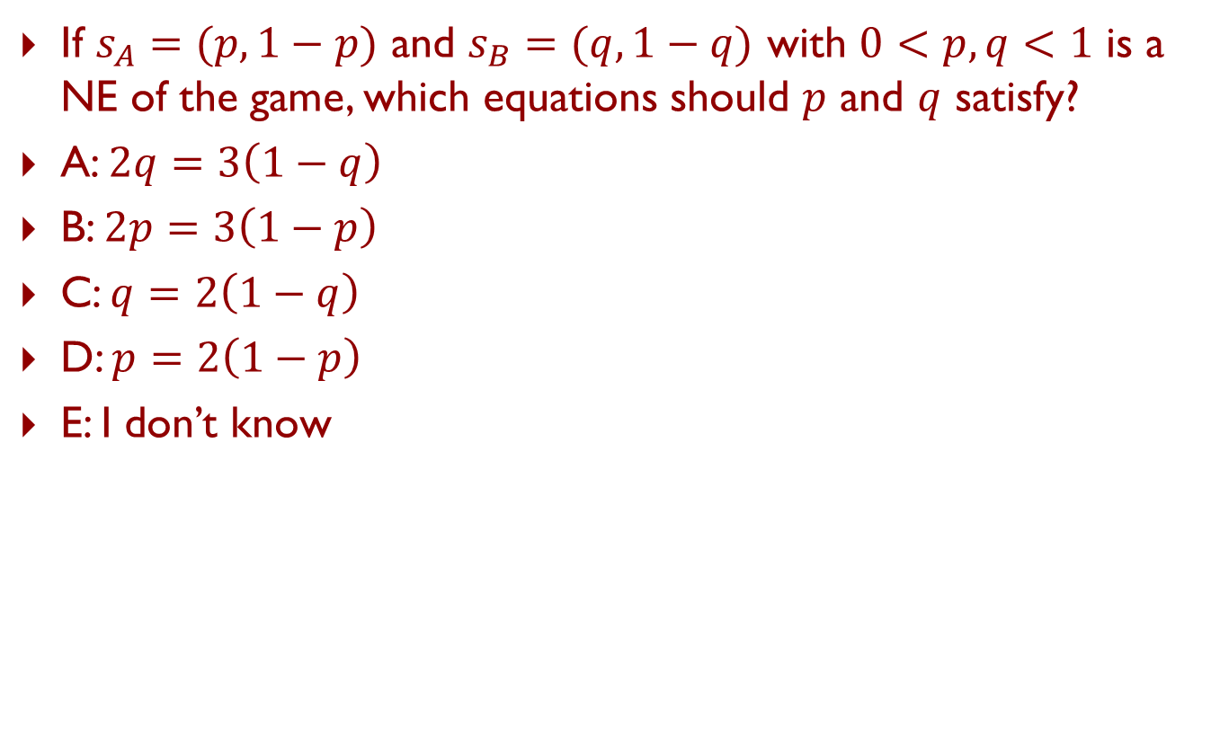
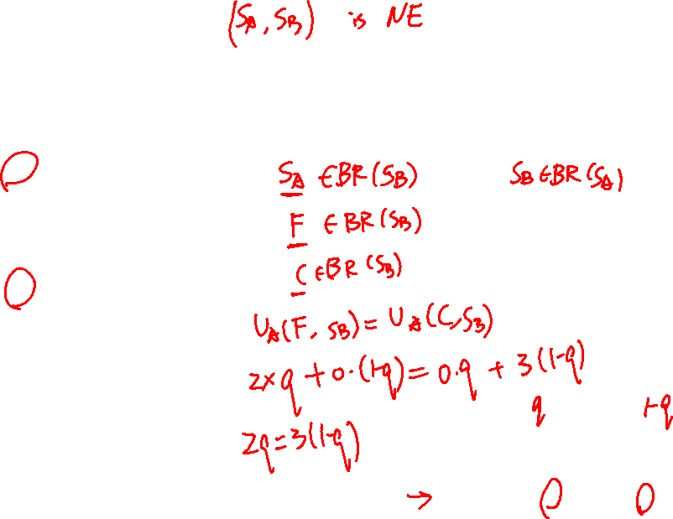
Piazza Poll 3
If $s_{A}=(p,1−p)$ and $s_{B}=(q,1−q)$ with $0<p,q<1$ is a NE of the game, which equations should $p$ and $q$ satisfy?
A: $2q=3\left(1−q\right)$
B: $2p=3\left(1−p\right)$
C: $q=2\left(1−q\right)$
D: $p=2\left(1−p\right)$
E: I don’t know
Berry
 | Football | Concert
Football | 2,1 | 0,0
Concert | 0,0 | 3,2
Alex
Notes:
2/3

Slide 53




Piazza Poll 3
If $s_{A}=(p,1−p)$ and $s_{B}=(q,1−q)$ with $0<p,q<1$ is a NE of the game, which equations should $p$ and $q$ satisfy?
A: $2q=3\left(1−q\right)$
B: $2p=3\left(1−p\right)$
C: $q=2\left(1−q\right)$
D: $p=2\left(1−p\right)$
E: I don’t know
$$u_{A}\left(F,s_{B}\right)=u_{A}\left(C,s_{B}\right)$$
$$u_{B}\left(s_{A},C\right)=u_{B}\left(s_{A},C\right)$$
$$u_{A}\left(F,s_{B}\right)=2∗q+0∗\left(1−q\right)$$
$$u_{A}\left(C,s_{B}\right)=0∗q+3∗\left(1−q\right)$$
Berry
 | Football | Concert
Football | 2,1 | 0,0
Concert | 0,0 | 3,2
$$u_{B}\left(s_{A},F\right)=1∗p+0∗\left(1−p\right)$$
$$u_{B}\left(s_{A},C\right)=0∗p+2∗\left(1−p\right)$$
Alex
Notes:
2/3

Slide 54
Solution Concepts in Games
How should one player play and what should we expect all the players to play?
Dominant strategy and dominant strategy equilibrium
Nash Equilibrium
Minimax strategy
Maximin strategy
(Stackelberg Equilibrium)

Slide 55
Maximin and Minimax Strategy
Both focus on single player’s strategy
Maximin Strategy
Maximize worst case expected utility
Maximin value (also called safety level)
Minimax Strategy
Minimize best case expected utility for the other player (just want to harm your opponent)
Minimax value

Slide 56
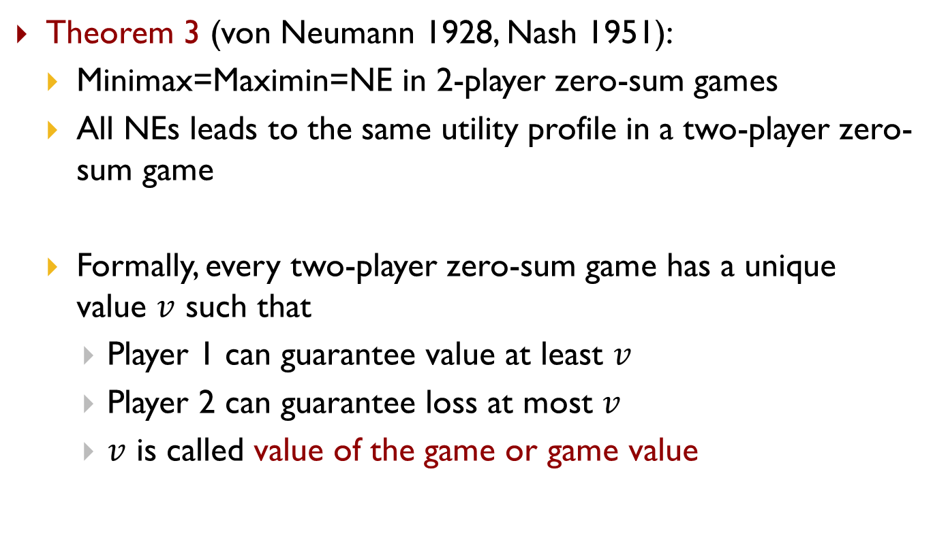

Minimax Theorem
Theorem 3 (von Neumann 1928, Nash 1951):
Minimax=Maximin=NE in 2-player zero-sum games
All NEs leads to the same utility profile in a two-player zero-sum game
Formally, every two-player zero-sum game has a unique value $v$ such that
Player 1 can guarantee value at least $v$
Player 2 can guarantee loss at most $v$
$v$ is called value of the game or game value

Slide 57
Solution Concepts in Games
How should one player play and what should we expect all the players to play?
Dominant strategy and dominant strategy equilibrium
Nash Equilibrium
Minimax strategy
Maximin strategy
(Stackelberg Equilibrium)

Slide 58


Power of Commitment
What’s the PSNEs in this game and the players’ utilities?
What action should player 2 choose if player 1 commits to playing $b$? What is player 1’s utility?
What action should player 2 choose if player 1 commits to playing $a$ and $b$ uniformly randomly? What is player 1’s utility?
Player 2
 | c | d
a | 2,1 | 4,0
b | 1,0 | 3,2
Player 1

Slide 59

Power of Commitment
What’s the PSNEs in this game and the players’ utilities?
What action should player 2 choose if player 1 commits to playing $b$? What is player 1’s utility?
What action should player 2 choose if player 1 commits to playing $a$ and $b$ uniformly randomly? What is player 1’s utility?
$(a,c)$, 2
d, 3
d, 3.5
Player 2
 | c | d
a | 2,1 | 4,0
b | 1,0 | 3,2
Player 1

Slide 60
Stackelberg Equilibrium
Stackelberg Game
Leader commits to a strategy first
Follower responds after observing the leader’s strategy
Stackelberg Equilibrium
Follower best responds to leader’s strategy
Leader commits to a strategy that maximize her utility assuming follower best responds
Player 2
 | c | d
a | 2,1 | 4,0
b | 1,0 | 3,2
Player 1

Slide 61


Stackelberg Equilibrium
If the leader can only commit to a pure strategy, or you know that the leader’s strategy in equilibrium is a pure strategy, the equilibrium can be found by enumerating leader’s pure strategy
In general, the leader can commit to a mixed strategy and $u^{SSE}≥u^{NE}$ (first-mover advantage)!
Berry
Player 2
 | Football | Concert
Football | 2,1 | 0,0
Concert | 0,0 | 1,2
 | c | d
a | 2,1 | 4,0
b | 1,0 | 3,2
Player 1
Alex

Slide 62

Warm-up
Design an AI to play Rock-Paper-Scissors for T rounds
If T=2, roundID=1, what action does your AI choose in each round?
function playRPS(roundID,T)
Input: $T$, roundID $∈\{1..T\}$ Output: action a $∈$ {Rock, Paper, Scissors}
Return a

Slide 63
Extensive-Form Games
Normal-form game: players, actions, utilities for each action profile, simultaneous movement
Extensive-form game
Set of players
Sequencing of players' possible moves
Player’s actions at every decision point
(Possibly imperfect) information each player has about the other player's moves when they make a decision
Payoffs for all possible game outcomes
Notes:
Normal-form and extensive-form are just representations/specifications of a strategic game

Slide 64














Extensive-Form Games
Player 1
Left
Right
Center
Player 2
$$3,2$$
$$l$$
$$r$$
$$l$$
$$r$$
$$c$$
$$c$$
$$3,5$$
$$7,2$$
$$6,6$$
$$0,0$$
$$5,3$$
$$10,0$$
Can we represent this game in normal form?
Can we solve this game using algs for adversarial search?

Slide 65




Protecting Staten Island Ferry
Ferry Line
Notes:
The Staten Island Ferry in New York provides a crucial link between Manhattan and the Staten Island. It carries roughly 60,000 passengers a day on weekdays. So the ferries may present as attractive targets for an attacker, who may ram a suicide boat packed with explosives into the ferry as happened with attacks on French supertanker Limburg and USS Cole. So how to protect the ferries?

Slide 66


Protecting Staten Island Ferry
Notes:
If you are a Marvel fan, you may recall that it is the Spider Man and Iron Man who tried their best to protect the ferry from sinking.

Slide 67


Protecting Staten Island Ferry
Notes:
But in the real world, the heroes are from US Coast Guard, who run patrol boats which are equipped with machine guns and can stop attackers within a certain radius.

Slide 68




Previous USCG Approach
Notes:
However, there are many ferries running at the same time and the US Coast Guard only have limited patrol boats. What they used to do is that they choose one of the ferries and follow along with it all the way, leaving other ferries unprotected.

Slide 69

Game-Theoretic Patrols
In collaboration with US Coast Guard (Contact: Joe Direnzo, Craig Baldwin)
Notes:
Our game-theoretic solution is actually deployed in the field since April 2013 and it has completely changed their maneuver in conducting patrols. As shown in this video, the patrol boat is making a U-turn which would never happen in their previous patrols.

Slide 70

Problem
Optimal Patrol Strategy for Protecting Moving Targets with Multiple Mobile Resources
Fei Fang, Albert Xin Jiang, Milind Tambe
In AAMAS-13: The Twelfth International Conference on Autonomous Agents and Multiagent Systems, May 2013
Notes:
In this problem, there are many routes the patrol boat can take along the ferry line, and any deterministic route can be easily exploited by the attacker. So it is crucial to randomize but the problem is how.

Slide 71


Game Model and Linear Programming-based Solution
Stackelberg game: Leader – Defender, Follower – Attacker
Attacker’s payoff: $u_{i}(t)$ if not protected, 0 otherwise
Zero-sum $→$ Strong Stackelberg Equilibrium=Nash Equilibrium =Minimax (Minimize Attacker’s Maximum Expected Utility)
$$\min_{p_{r},v }{v}$$
s.t. $v≥𝔼[U^{att}(i,t)] =u_{i}\left(t\right)×ℙ[unprotected(i,t)],∀i,t$
Adversary
$$p_{r}$$
 | 10:00:00 AM Target 1 | 10:00:01 AM Target 1 | … | 10:30:00 AM Target 3 | …
Purple Route
Orange Route
Blue Route
……
0,
-5,
0
5
-4,
30%
4
Defender
40%
$$\sum_{r}{p_{r}}≤1$$
20%
Notes:
We model it as a Stakcleberg game, or leader-follower game, where the defender is the leader and commits to a randomized strategy first, in this case a probability distribution over possible patrol routes, and the attacker is the follower, who observes the defender’s strategy and then choose a target and a time to attack. This table shows the payoff matrix. We assume the attacker gets a payoff of $u_{i}(t)$ if he attacks target $i$ at time $t$ and succeeded, meaning, no defender is close to ferry to protect it, say within 100 meters. Otherwise he gets 0. We assume it is a zero-sum game, meaning what the attacker gets is what the defender loses. In this case, solution concepts like Strong Stackelberg Equilibrium, Nash Equilibrium and Minimax Strategy coincide. So assuming the attacker is perfectly rational, the optimal defender strategy is the one that minimizes the attacker’s maximum possible expected utility, which can be computed through linear programming. The decision various are the probabilities of taking each route, and the attacker’s expected utility is calculated as the target utility at that time, multiplied by the probability he can succeed in attacking.
(e.g., >100m)

Slide 72
Evaluation: Simulation & Real-World Feedback
Reduce potential risk by 50%
Deployed by US Coast Guard
USCG evaluation
Point defense to zone defense
Increased randomness
Professional mariners:
Apparent increase in Coast Guard patrols
Notes:
On randomly chosen utility functions, we show that the potential risk, measured by maximum attacker expected utility, is cut down by half when using our algorithm. As our work is brought to the real-world, it has resulted in a radical shift in the patrolling tactics of the US Coast Guard. And the feedback to us is terrific. They call this shift as from point defense to zone defense, an analogy from the basketball game because before they are defending against potential attacks to one ferry and now they are defending against potential attacks to high risk zones. They think our solution has improved the randomness of the patrols. Professional mariners also mentioned that there is an apparent increase in Coast Guard patrols using new patrol schedules.

