Slide 1

Warm-up as you walk in
For the following Bayes net, write the query P(X₄ | e_{1:4}) in terms of the conditional probability tables associated with the Bayes net.
P(X₄ | e₁,e₂,e₃,e₄) =
X₁
X₂
X₃
X₄
e₁
e₂
e₃
e₄

Slide 2
Announcements
Assignments
HW10
    Due Wed 11/20
P5
    Due Mon 11/25
TA for next semester!
CSD (15-281): https://www.ugrad.cs.cmu.edu/ta/S20/
MLD (10-315): https://www.ml.cmu.edu/academics/ta.html

Slide 3
Sampling Wrap-up

Slide 4
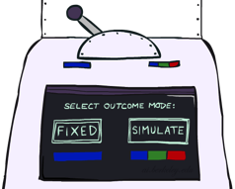

Likelihood Weighting
IN: evidence instantiation
w = 1.0
for i=1, 2, …, n
  if X_{i} is an evidence variable
    X_{i} = observation x_{i} for X_{i}
    Set w = w * P(x_{i} | Parents(X_{i}))
  else
    Sample x_{i} from P(X_{i} | Parents(X_{i}))
return (x₁, x₂, …, x_{n}), w

Slide 5

Likelihood Weighting
No evidence:
Prior Sampling
Some evidence:
Likelihood Weighted Sampling
All evidence:
Likelihood Weighted
Input: no evidence
for i=1, 2, …, n
    Sample x_{i} from P(X_{i} | Parents(X_{i}))
return (x₁, x₂, …, x_{n})
Input: evidence instantiation
w = 1.0
for i=1, 2, …, n
if X_{i} is an evidence variable
    X_{i} = observation x_{i} for X_{i}
    Set w = w * P(x_{i} | Parents(X_{i}))
else
    Sample x_{i} from P(X_{i} | Parents(X_{i}))
return (x₁, x₂, …, x_{n}), w
Input: evidence instantiation
w = 1.0
for i=1, 2, …, n
    Set w = w * P(x_{i} | Parents(X_{i}))
return w

Slide 6


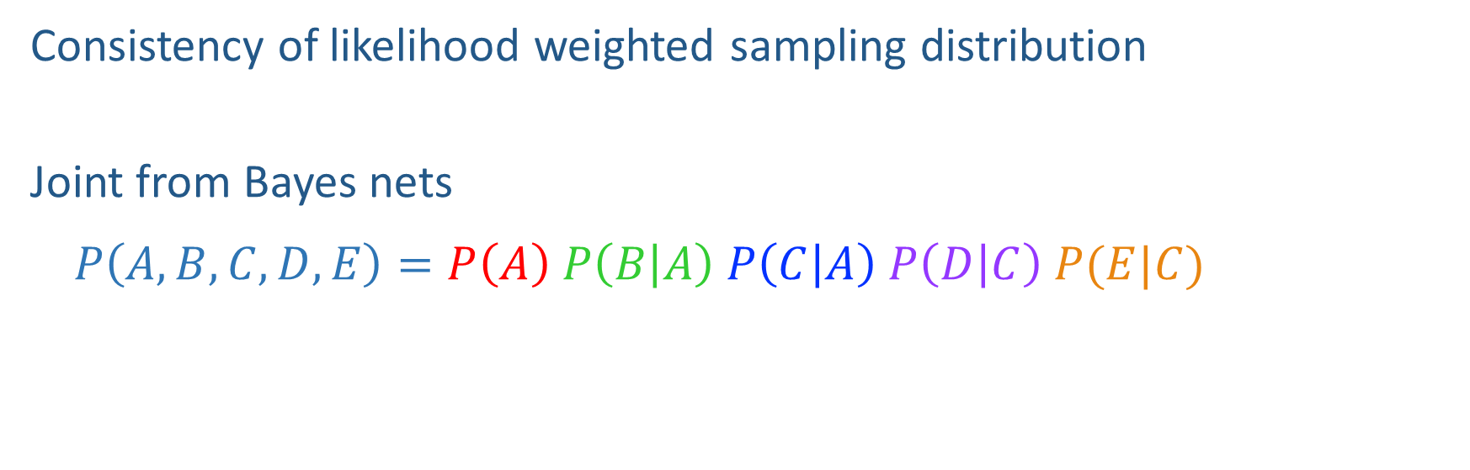



Likelihood Weighting Distribution
$$A$$
Consistency of likelihood weighted sampling distribution
Joint from Bayes nets
$$P\left(A,B,C,D,E\right)=P\left(A\right) P\left(B | A\right) P\left(C | A\right) P\left(D | C\right) P(E|C)$$
$$B$$
$$C$$
$$D$$
$$E$$

Slide 7
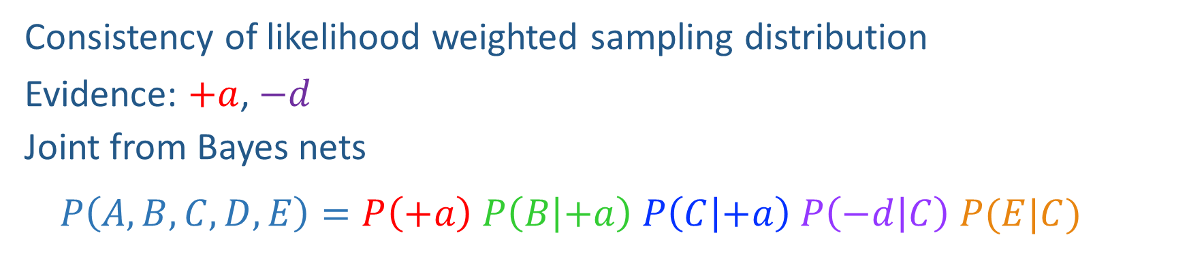

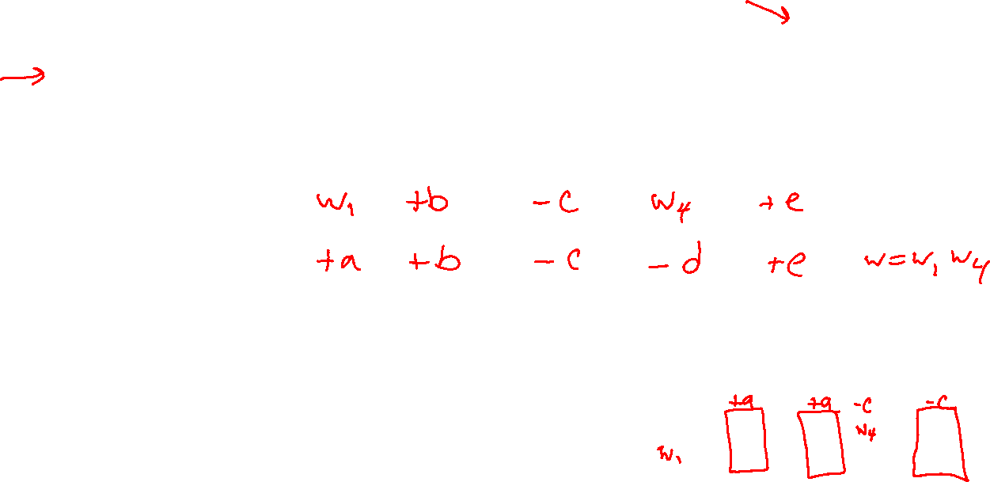
Likelihood Weighting Distribution
$$A$$
Consistency of likelihood weighted sampling distribution
Evidence: $+a$, $−d$
Joint from Bayes nets
$$P\left(A,B,C,D,E\right)=P\left(+a\right) P\left(B | +a\right) P\left(C | +a\right) P\left(−d | C\right) P(E|C)$$
$$B$$
$$C$$
$$D$$
$$E$$

Slide 8
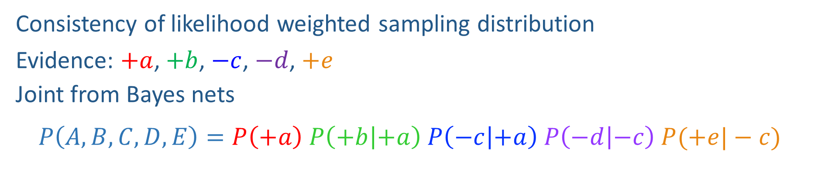
Likelihood Weighting Distribution
$$A$$
Consistency of likelihood weighted sampling distribution
Evidence: $+a$, $+b$, $−c$, $−d$, $+e$
Joint from Bayes nets
$$P\left(A,B,C,D,E\right)=P\left(+a\right) P\left(+b | +a\right) P\left(−c | +a\right) P\left(−d | −c\right) P(+e|−c)$$
$$B$$
$$C$$
$$D$$
$$E$$

Slide 9

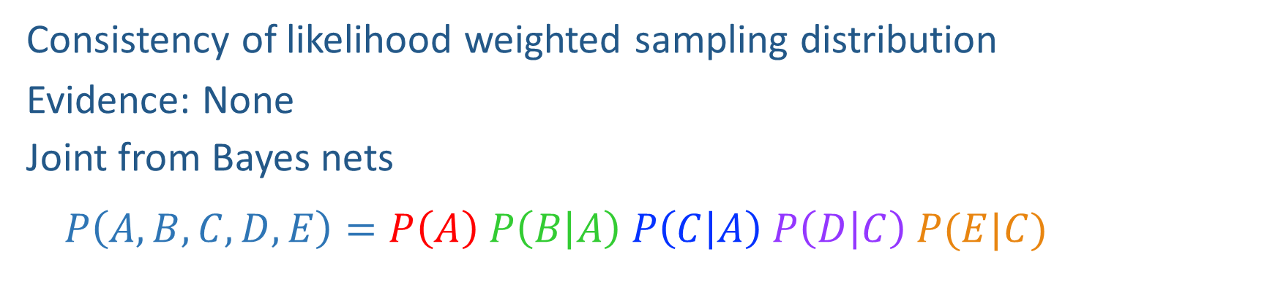
Likelihood Weighting Distribution
$$A$$
Consistency of likelihood weighted sampling distribution
Evidence: None
Joint from Bayes nets
$$P\left(A,B,C,D,E\right)=P\left(A\right) P\left(B | A\right) P\left(C | A\right) P\left(D | C\right) P(E|C)$$
$$B$$
$$C$$
$$D$$
$$E$$

Slide 10
Piazza Poll 1
Two identical samples from likelihood weighted sampling will have the same exact weights.
True
False
It depends
I don’t know

Slide 11
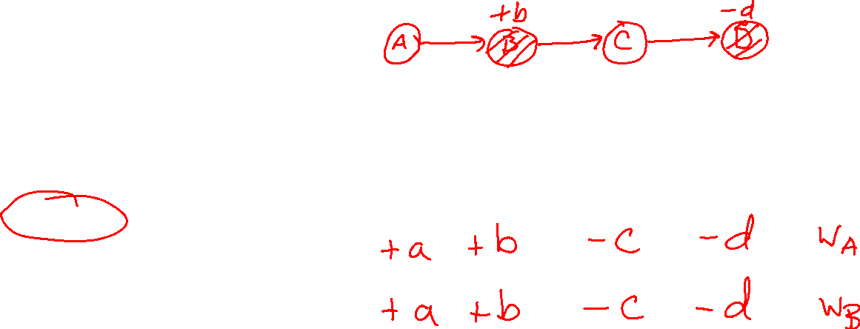
Piazza Poll 1
Two identical samples from likelihood weighted sampling will have the same exact weights.
True
False
It depends
I don’t know

Slide 12
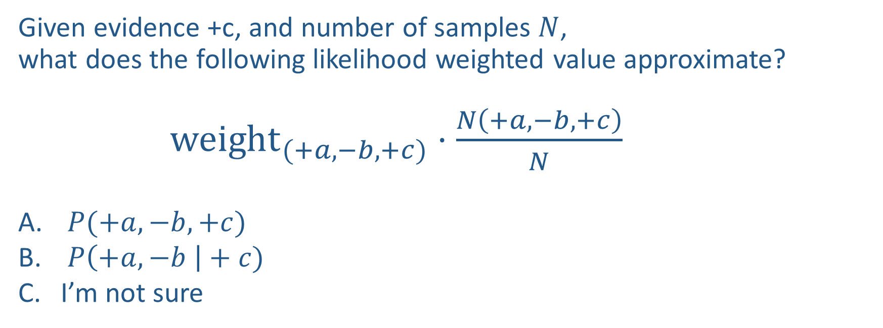
Piazza Poll 2
Given evidence +c, and number of samples $N$,
what does the following likelihood weighted value approximate?
${weight}_{(+a,−b,+c)}⋅\frac{N\left(+a, −b, +c\right)}{N}$
$P(+a, −b, +c)$
$P\left(+a, −b \right|+c)$
I’m not sure

Slide 13
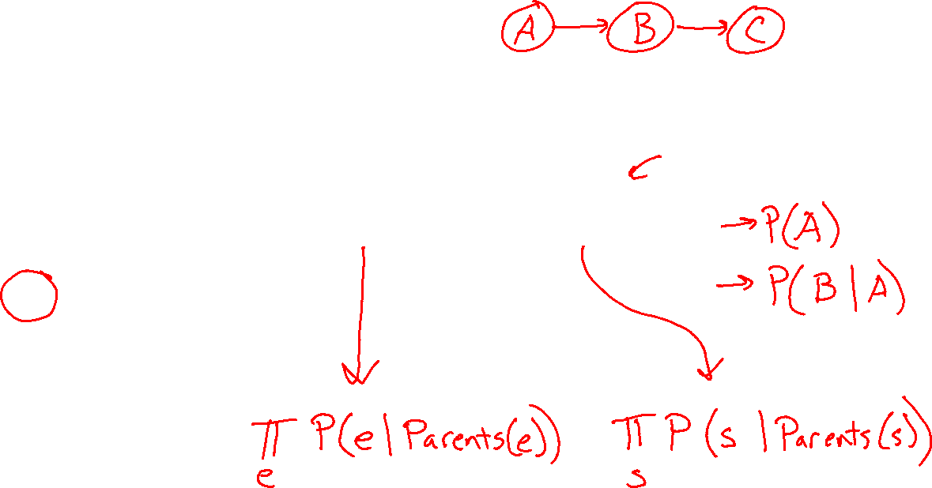
Piazza Poll 2
Given evidence +c, and number of samples $N$,
what does the following likelihood weighted value approximate?
${weight}_{(+a,−b,+c)}⋅\frac{N\left(+a, −b, +c\right)}{N}$
$P(+a, −b, +c)$
$P\left(+a, −b \right|+c)$
I’m not sure

Slide 14
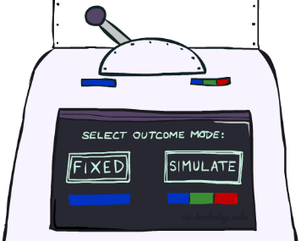
Likelihood Weighting
Likelihood weighting is good
  We have taken evidence into account as we generate the sample
  E.g. here, W’s value will get picked based on the evidence values of S, R
  More of our samples will reflect the state of the world suggested by the evidence
Likelihood weighting doesn’t solve all our problems
  Evidence influences the choice of downstream variables, but not upstream ones (C isn’t more likely to get a value matching the evidence)
We would like to consider evidence when we sample every variable

Slide 15
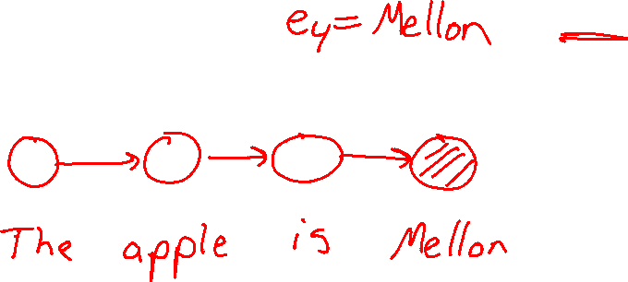
Likelihood Weighting
Likelihood weighting doesn’t solve all our problems
  Evidence influences the choice of downstream variables, but not upstream ones (C isn’t more likely to get a value matching the evidence)
We would like to consider evidence when we sample every variable
→ Gibbs sampling

Slide 16

Gibbs Sampling

Slide 17
Gibbs Sampling
Procedure: keep track of a full instantiation x₁, x₂, …, x_{n}.
Start with an arbitrary instantiation consistent with the evidence.
Sample one variable at a time, conditioned on all the rest, but keep evidence fixed.
Keep repeating this for a long time.

Slide 18
Gibbs Sampling Example: P( S | +r)
Step 1: Fix evidence
  R = +r
Steps 3: Repeat
  Choose a non-evidence variable X
  Resample X from P( X | all other variables)
Step 2: Initialize other variables
  Randomly
C
C
S
+r
S
+r
W
W
C
C
C
C
C
C
S
+r
S
+r
S
+r
S
+r
S
+r
S
+r
W
W
W
W
W
W

Slide 19
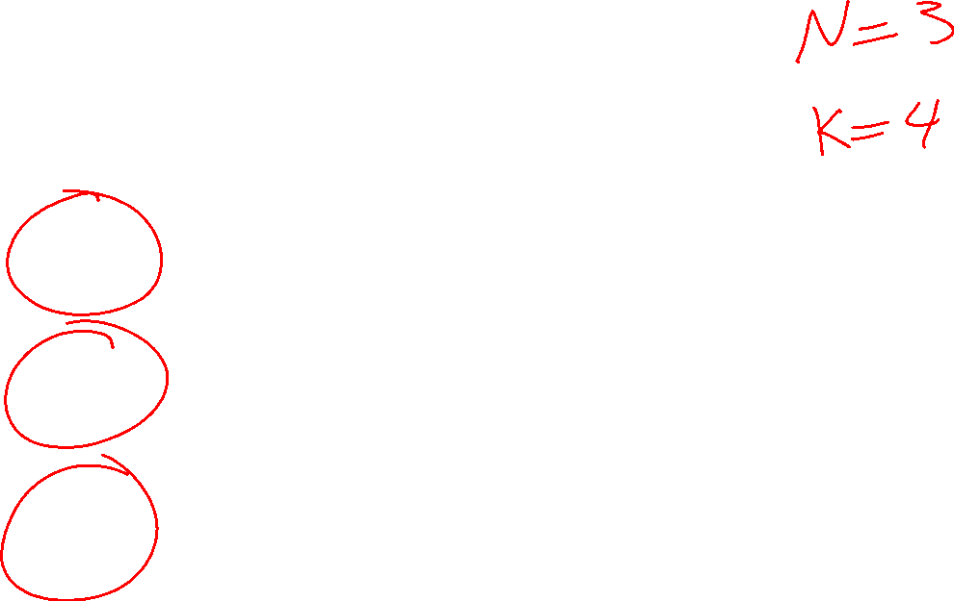
Gibbs Sampling Example: P( S | +r)
Keep only the last sample from each iteration:
C
C
C
C
C
S
+r
S
+r
S
+r
S
+r
S
+r
W
W
W
W
W
C
C
C
C
C
S
+r
S
+r
S
+r
S
+r
S
+r
W
W
W
W
W
C
C
C
C
C
S
+r
S
+r
S
+r
S
+r
S
+r
W
W
W
W
W

Slide 20
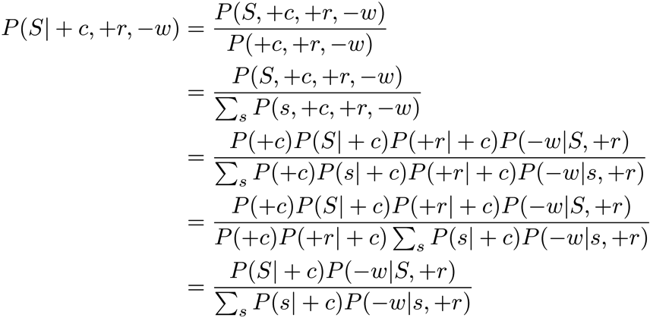

Efficient Resampling of One Variable
Sample from P(S | +c, +r, -w)
Many things cancel out – only CPTs with S remain!
More generally: only CPTs that have resampled variable need to be considered, and joined together
C
S
+r
W

Slide 21
Gibbs Sampling
Procedure: keep track of a full instantiation x₁, x₂, …, x_{n}.
Start with an arbitrary instantiation consistent with the evidence.
Sample one variable at a time, conditioned on all the rest, but keep evidence fixed.
Keep repeating this for a long time.
Property: in the limit of repeating this infinitely many times the resulting sample is coming from the correct distribution
Rationale: both upstream and downstream variables condition on evidence.
In contrast: likelihood weighting only conditions on upstream evidence, and hence weights obtained in likelihood weighting can sometimes be very small. Sum of weights over all samples is indicative of how many “effective” samples were obtained, so want high weight.

Slide 22
Gibbs Sampling
Gibbs sampling produces sample from the query distribution P( Q | e ) in limit of re-sampling infinitely often
Gibbs sampling is a special case of more general methods called Markov chain Monte Carlo (MCMC) methods
  Metropolis-Hastings is one of the more famous MCMC methods (in fact, Gibbs sampling is a special case of Metropolis-Hastings)
You may read about Monte Carlo methods – they’re just sampling

Slide 23
Markov Chain Monte Carlo*
Idea: instead of sampling from scratch, create samples that are each like the last one.
Procedure: resample one variable at a time, conditioned on all the rest, but keep evidence fixed. E.g., for P(b|c):
Properties: Now samples are not independent (in fact they’re nearly identical), but sample averages are still consistent estimators!
What’s the point: both upstream and downstream variables condition on evidence.
+b
+a
+c
-b
+a
+c
-b
-a
+c

Slide 24





Bayes’ Net Sampling Summary
Prior Sampling P(Q, E)
Likelihood Weighting P( Q , e)
Rejection Sampling P( Q | e )
Gibbs Sampling P( Q | e )

Slide 25

AI: Representation and Problem Solving
Hidden Markov Models
Instructors: Pat Virtue & Fei Fang
Slide credits: CMU AI and http://ai.berkeley.edu

Slide 26
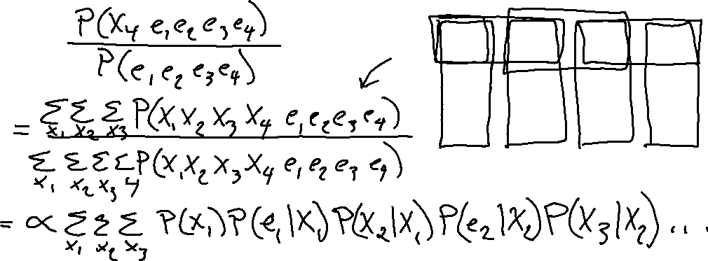
Warm-up as you walk in
For the following Bayes net, write the query P(X₄ | e_{1:4}) in terms of the conditional probability tables associated with the Bayes net.
P(X₄ | e₁,e₂,e₃,e₄) =
X₁
X₂
X₃
X₄
e₁
e₂
e₃
e₄

Slide 27
Reasoning over Time or Space
Often, we want to reason about a sequence of observations
  Speech recognition
  Robot localization
  User attention
  Medical monitoring
Need to introduce time (or space) into our models

Slide 28



Markov Models
  Value of X at a given time is called the state
  Parameters: called transition probabilities or dynamics, specify how the state evolves over time (also, initial state probabilities)
  Stationarity assumption: transition probabilities the same at all times
  Same as MDP transition model, but no choice of action
X₁
X₂
X₃
X₄

Slide 29

Conditional Independence
Basic conditional independence:
  Past and future independent given the present
  Each time step only depends on the previous
  This is called the (first order) Markov property
Note that the chain is just a (growable) BN
  We can always use generic BN reasoning on it if we truncate the chain at a fixed length

Slide 30
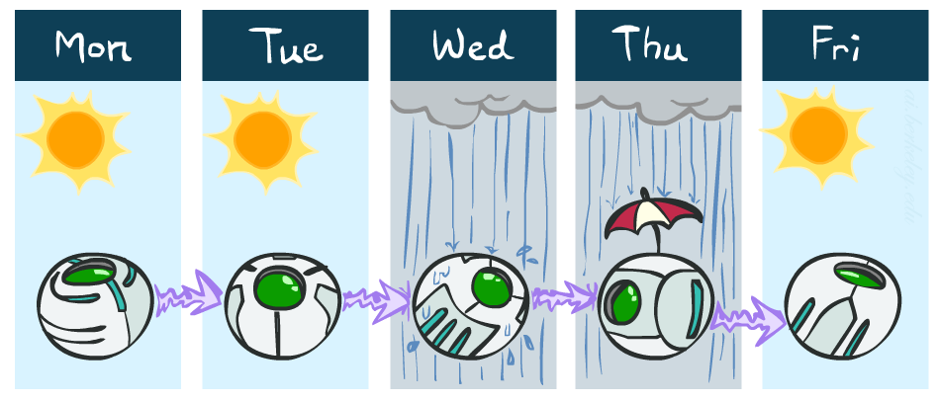
Example: Markov Chain Weather
States: X = {rain, sun}
Initial distribution: 1.0 sun
CPT P(X_{t} | X_{t-1}):
Two new ways of representing the same CPT
X_{t-1} | X_{t} | P(X_{t}|X_{t-1})
sun | sun | 0.9
sun | rain | 0.1
rain | sun | 0.3
rain | rain | 0.7
0.9
0.3
0.9
rain
sun
sun
sun
0.1
0.3
rain
rain
0.7
0.7
0.1

Slide 31
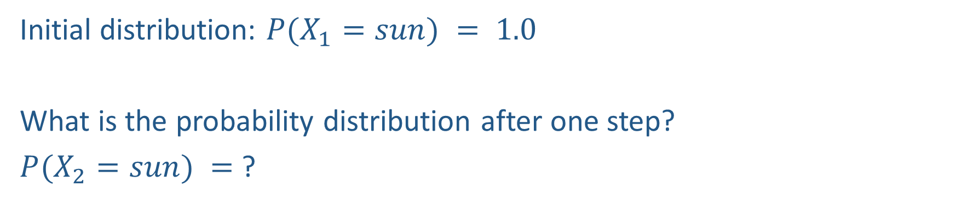
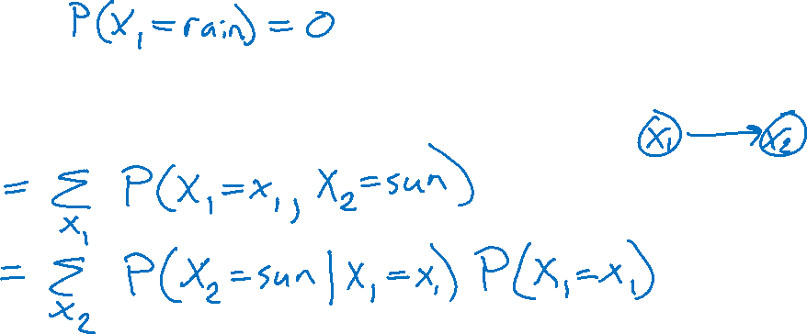
Example: Markov Chain Weather
0.9
0.3
rain
sun
Initial distribution: $P(X_{1}=sun) = 1.0$
What is the probability distribution after one step?
$P(X_{2}=sun) =$ ?
0.7
0.1

Slide 32
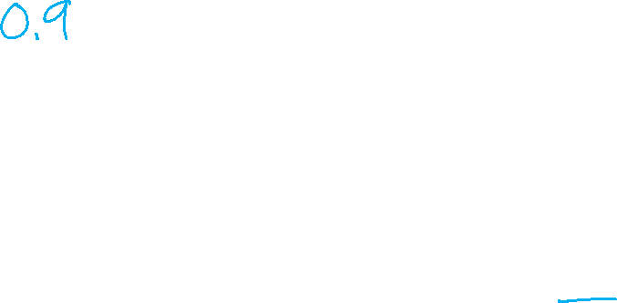
Example: Markov Chain Weather
0.9
0.3
rain
sun
Initial distribution: $P(X_{1}=sun) = 1.0$
What is the probability distribution after one step?
$P(X_{2}=sun) =$ ?
0.7
0.1

Slide 33
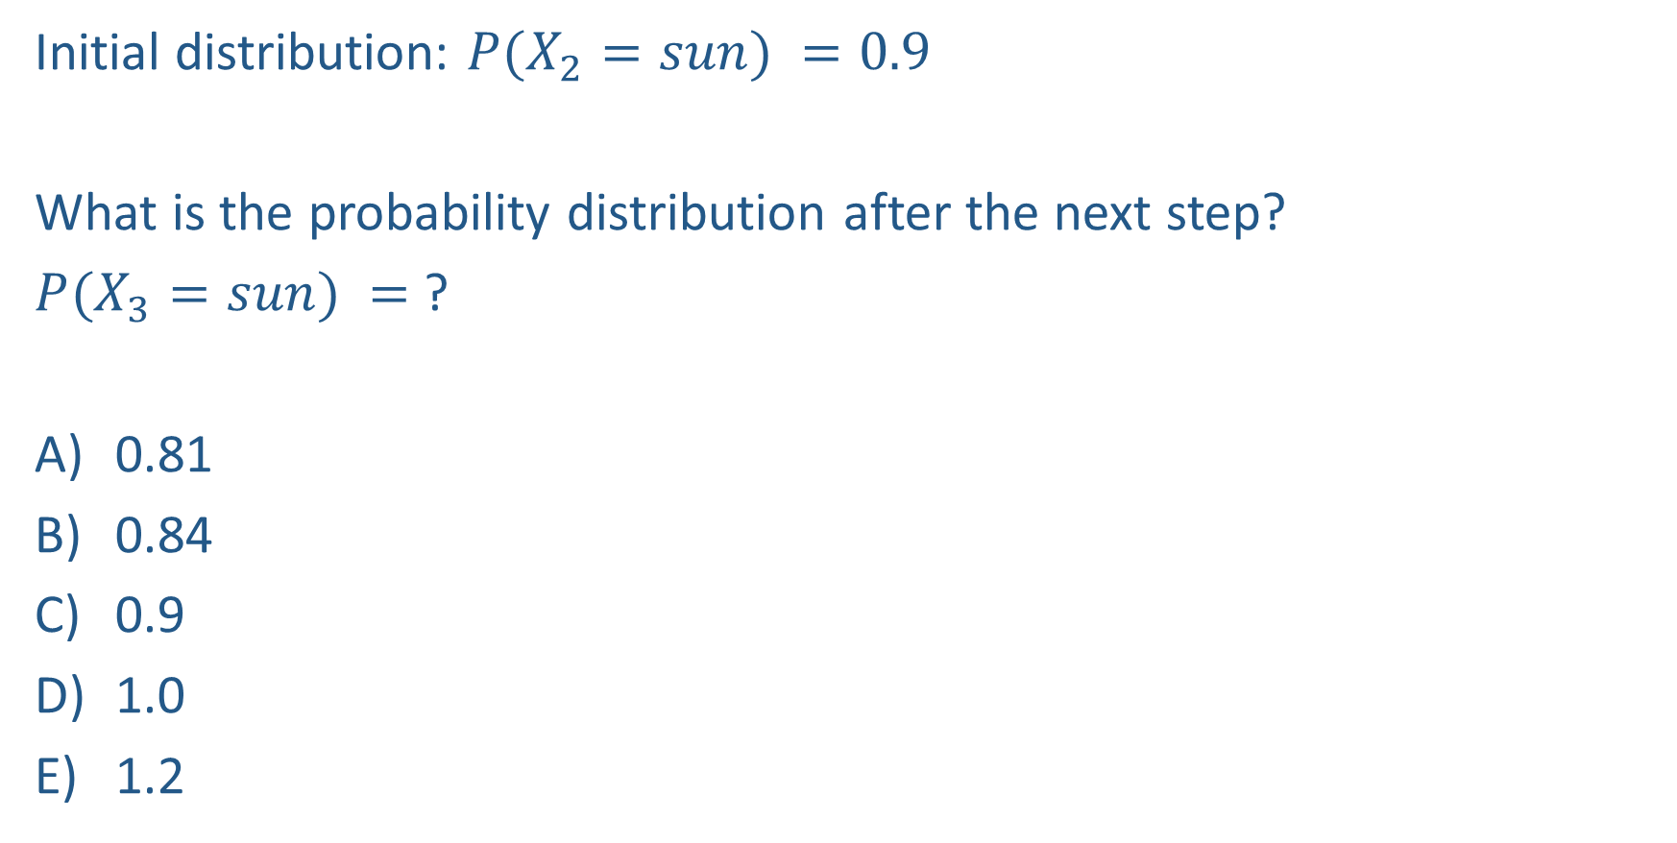

Piazza Poll 3
0.9
0.3
rain
sun
Initial distribution: $P(X_{2}=sun) =0.9$
What is the probability distribution after the next step?
$P(X_{3}=sun) =$ ?
0.81
0.84
0.9
1.0
1.2
0.7
0.1

Slide 34
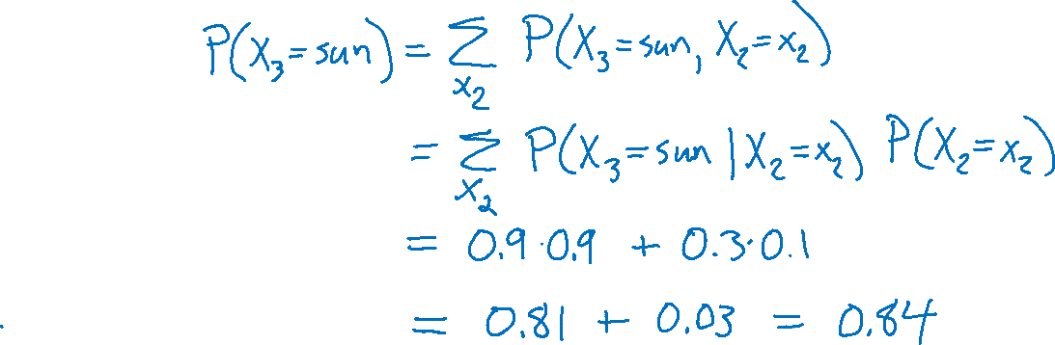
Piazza Poll 3
0.9
0.3
rain
sun
Initial distribution: $P(X_{2}=sun) =0.9$
What is the probability distribution after the next step?
$P(X_{3}=sun) =$ ?
0.81
0.84
0.9
1.0
1.2
0.7
0.1

Slide 35

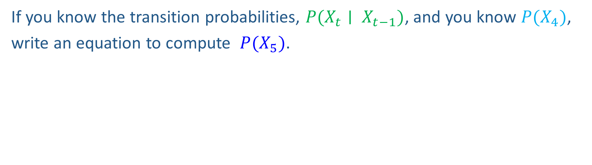
Markov Chain Inference
X₁
X₂
X₃
X₄
If you know the transition probabilities, $P(X_{t}∣ X_{t−1})$, and you know $P(X_{4})$,
write an equation to compute $P(X_{5})$.

Slide 36
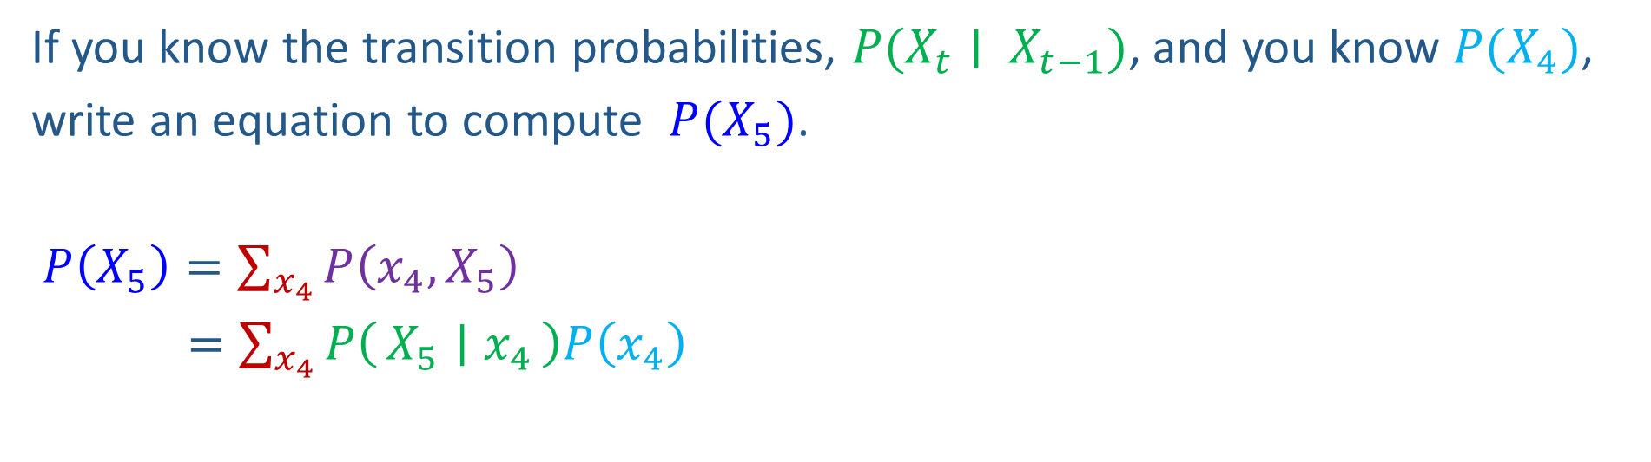
Markov Chain Inference
X₁
X₂
X₃
X₄
If you know the transition probabilities, $P(X_{t}∣ X_{t−1})$, and you know $P(X_{4})$,
write an equation to compute $P(X_{5})$.
$P\left(X_{5}\right)=\sum_{x_{4}}{P\left(x_{4},X_{5}\right)}$
$=\sum_{x_{4}}{P\left(X_{5} ∣ x_{4}\right)P\left(x_{4}\right)}$

Slide 37
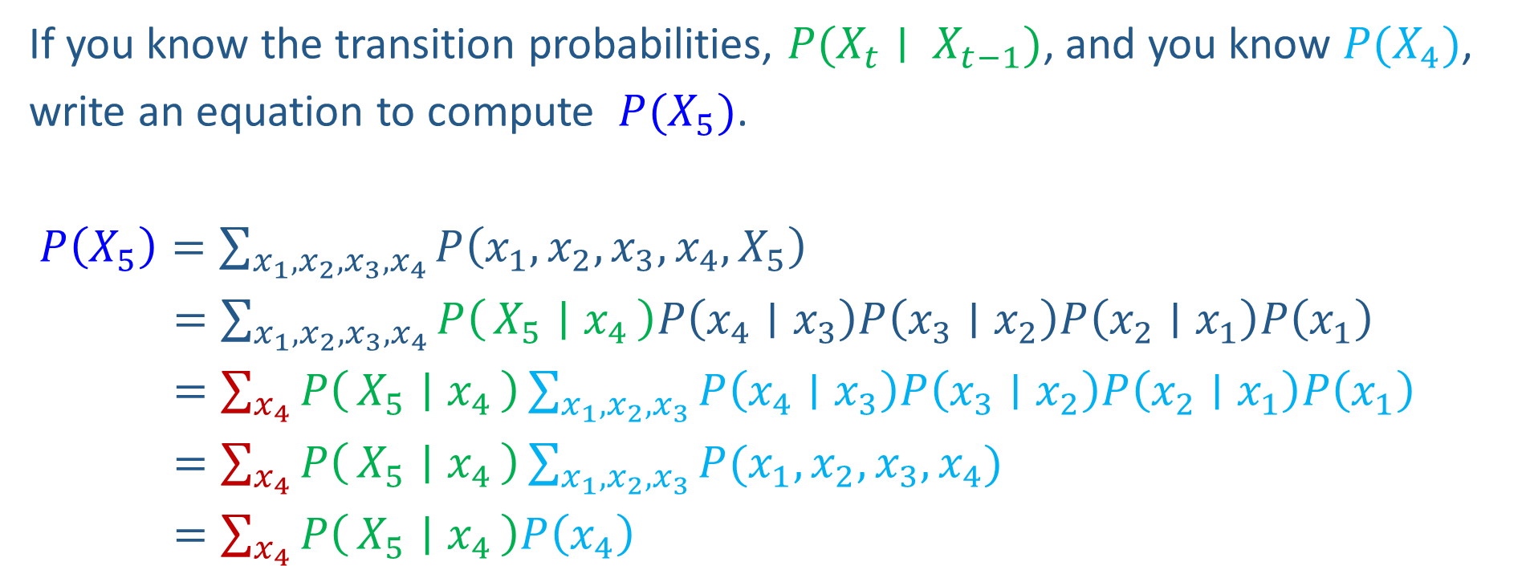
Markov Chain Inference
X₁
X₂
X₃
X₄
If you know the transition probabilities, $P(X_{t}∣ X_{t−1})$, and you know $P(X_{4})$,
write an equation to compute $P(X_{5})$.
$P\left(X_{5}\right)=\sum_{{x_{1},x_{2}, x_{3},x}_{4}}{P\left({x_{1},x_{2},x_{3},x}_{4},X_{5}\right)}$
$=\sum_{{x_{1},x_{2}, x_{3},x}_{4}}{P\left(X_{5} ∣ x_{4}\right)P\left(x_{4}∣x_{3}\right)P\left(x_{3}∣x_{2}\right)P\left(x_{2}∣x_{1}\right)P\left(x_{1}\right)}$
$=\sum_{x_{4}}{P\left(X_{5} ∣ x_{4}\right)}\sum_{x_{1},x_{2}, x_{3}}{P\left(x_{4}∣x_{3}\right)P\left(x_{3}∣x_{2}\right)P\left(x_{2}∣x_{1}\right)P\left(x_{1}\right)}$
$=\sum_{x_{4}}{P\left(X_{5} ∣ x_{4}\right)}\sum_{x_{1},x_{2}, x_{3}}{P(x_{1},x_{2},x_{3},x_{4})}$
$=\sum_{x_{4}}{P\left(X_{5} ∣ x_{4}\right)P\left(x_{4}\right)}$

Slide 38
Weather prediction
States {rain, sun}
Initial distribution P(X₀)
  Transition model P(X_{t} | X_{t-1})
P(X₀)
sun | rain
0.5 | 0.5
Two new ways of representing the same CPT
0.9
0.3
0.9
X_{t-1} | P(X_{t}|X_{t-1})
 | sun | rain
sun | 0.9 | 0.1
rain | 0.3 | 0.7
rain
sun
sun
sun
0.1
0.3
rain
rain
0.7
0.7
0.1

Slide 39
Weather prediction
X_{t-1} | P(X_{t}|X_{t-1})
 | sun | rain
sun | 0.9 | 0.1
rain | 0.3 | 0.7
Time 0: P(X₀) =<0.5,0.5>
What is the weather like at time 1?
  P(X₁) =
∑_{x0} P(X₀=x_{0,} X₁)
  = ∑_{x0} P(X₁| X₀=x₀) P(X₀=x₀)
  = 0.5<0.9,0.1> + 0.5<0.3,0.7>
  = <0.6,0.4>
X₀
X₁

Slide 40
Weather prediction, contd.
X_{t-1} | P(X_{t}|X_{t-1})
 | sun | rain
sun | 0.9 | 0.1
rain | 0.3 | 0.7
Time 1: P(X₁) =<0.6,0.4>
What is the weather like at time 2?
  P(X₂) =
∑_{x1} P(X₁=x₁, X₂)
  = ∑_{x1} P(X₂| X₁=x₁) P(X₁=x₁)
  = 0.6<0.9,0.1> + 0.4<0.3,0.7>
  = <0.66,0.34>
X₀
X₁
X₂

Slide 41
Weather prediction, contd.
X_{t-1} | P(X_{t}|X_{t-1})
 | sun | rain
sun | 0.9 | 0.1
rain | 0.3 | 0.7
Time 2: P(X₂) =<0.66,0.34>
What is the weather like at time 3?
  P(X₃) =
∑_{x2} P(X₂=x₂, X₃)
  = ∑_{x2} P(X₃| X₂=x₂) P(X₂=x₂)
  = 0.66<0.9,0.1> + 0.34<0.3,0.7>
  = <0.696,0.304>
X₁
X₂
X₃

Slide 42
Forward algorithm (simple form)
Probability from previous iteration
What is the state at time t?
  P(X_{t}) = ∑_{xt-1} P(X_{t-1}=x_{t-1}, X_{t})
  = ∑_{xt-1} P(X_{t}| X_{t-1}=x_{t-1}) P(X_{t-1}=x_{t-1})
Iterate this update starting at t=0
Transition model

Slide 43

Hidden Markov Models

Slide 44
HMM as a Bayes Net Warm-up
For the following Bayes net, write the query P(X₄ | e_{1:4}) in terms of the conditional probability tables associated with the Bayes net.
P(X₄ | e₁,e₂,e₃,e₄) =
X₁
X₂
X₃
X₄
e₁
e₂
e₃
e₄

Slide 45
Hidden Markov Models
Usually the true state is not observed directly
Hidden Markov models (HMMs)
  Underlying Markov chain over states X
  You observe evidence E at each time step
  X_{t} is a single discrete variable; E_{t} may be continuous and may consist of several variables
X₀
X₁
X₂
X₃
X₅
E₁
E₂
E₃
E₅

Slide 46

Dynamic Bayes Nets (DBNs)
We want to track multiple variables over time, using multiple sources of evidence
Idea: Repeat a fixed Bayes net structure at each time
Variables from time t can condition on those from t-1
t =1
t =2
t =3
G₁ª
G₂ª
G₃ª
G₁^{b}
G₂^{b}
G₃^{b}
E₁ª
E₁^{b}
E₂ª
E₂^{b}
E₃ª
E₃^{b}

Slide 47

Example: Weather HMM
An HMM is defined by:
  Initial distribution: P(X₀)
  Transition model: P(X_{t} | X_{t-1})
  Sensor model: P(E_{t} | X_{t})
W_{t-1} | P(W_{t}|W_{t-1})
 | sun | rain
sun | 0.9 | 0.1
rain | 0.3 | 0.7
Weather _{t-1}
Weather _{t}
Weather _{t+1}
W_{t} | P(U_{t}|W_{t})
 | true | false
sun | 0.2 | 0.8
rain | 0.9 | 0.1
Umbrella _{t-1}
Umbrella _{t}
Umbrella _{t+1}
Notes:
demo

Slide 48


Example: Ghostbusters HMM
  State: location of moving ghost
  Observations: Color recorded by ghost sensor at clicked squares
  P(X₀) = uniform
  P(X_{t} | X_{t-1}) = usually move clockwise, but sometimes move randomly or stay in place
P(C_{tij} | X_{t}) = same sensor model as before:
red means close, green means far away.
1/6
1/6
1/2
0
1/6
0
0
0
0
1/9
1/9
1/9
1/9
1/9
1/9
P( X₂ | X₁=(2,3) )
1/9
1/9
1/9
P(X₁)
X₀
X₁
X₂
X₃
X₅
C_{1ij}
C_{2ij}
C_{3ij}
[Demo: Ghostbusters – Circular Dynamics – HMM (L14D2)]
Notes:
Dan has some demo for this.

Slide 49
HMM as Probability Model
  Joint distribution for Markov model:
  P(X₀,…, X_{T}) = P(X₀) ∏_{t=1:T} P(X_{t} | X_{t-1})
  Joint distribution for hidden Markov model:
  P(X₀, X₁,E₁, …, X_{T},E_{T}) = P(X₀) ∏_{t=1:T} P(X_{t} | X_{t-1}) P(E_{t} | X_{t})
  Future states are independent of the past given the present
  Current evidence is independent of everything else given the current state
  Are evidence variables independent of each other?
X₀
X₁
X₂
X₃
X₅
Useful notation: X_{a:b} = X_{a} , X_{a+1}, …, X_{b}
For example: P(X_{1:2} | e_{1:3}) = P(X₁, X₂, | e₁ , e₂, e₃)
E₁
E₂
E₃
E₅
Notes:
Add conditional independence consequences here

Slide 50
Real HMM Examples
Speech recognition HMMs:
  Observations are acoustic signals (continuous valued)
  States are specific positions in specific words (so, tens of thousands)
Machine translation HMMs:
  Observations are words (tens of thousands)
  States are translation options
Robot tracking:
  Observations are range readings (continuous)
  States are positions on a map (continuous)
Molecular biology:
  Observations are nucleotides ACGT
  States are coding/non-coding/start/stop/splice-site etc.

Slide 51
Other HMM Queries
Filtering: P(X_{t}|e_{1:t})
Prediction: P(X_{t+k}|e_{1:t})
X₁
X₂
X₃
X₄
X₁
X₂
X₃
X₄
e₁
e₂
e₃
e₄
e₁
e₂
e₃
Smoothing: P(X_{k}|e_{1:t}), k<t
Explanation: P(X_{1:t}|e_{1:t})
X₁
X₂
X₃
X₄
X₁
X₂
X₃
X₄
e₁
e₂
e₃
e₄
e₁
e₂
e₃
e₄

Slide 52

Inference Tasks
Filtering: P(X_{t}|e_{1:t})
  belief state—input to the decision process of a rational agent
Prediction: P(X_{t+k}|e_{1:t}) for k > 0
  evaluation of possible action sequences; like filtering without the evidence
Smoothing: P(X_{k}|e_{1:t}) for 0 ≤ k < t
  better estimate of past states, essential for learning
Most likely explanation: argmax_{x1:t} P(x_{1:t} | e_{1:t})
  speech recognition, decoding with a noisy channel

Slide 53
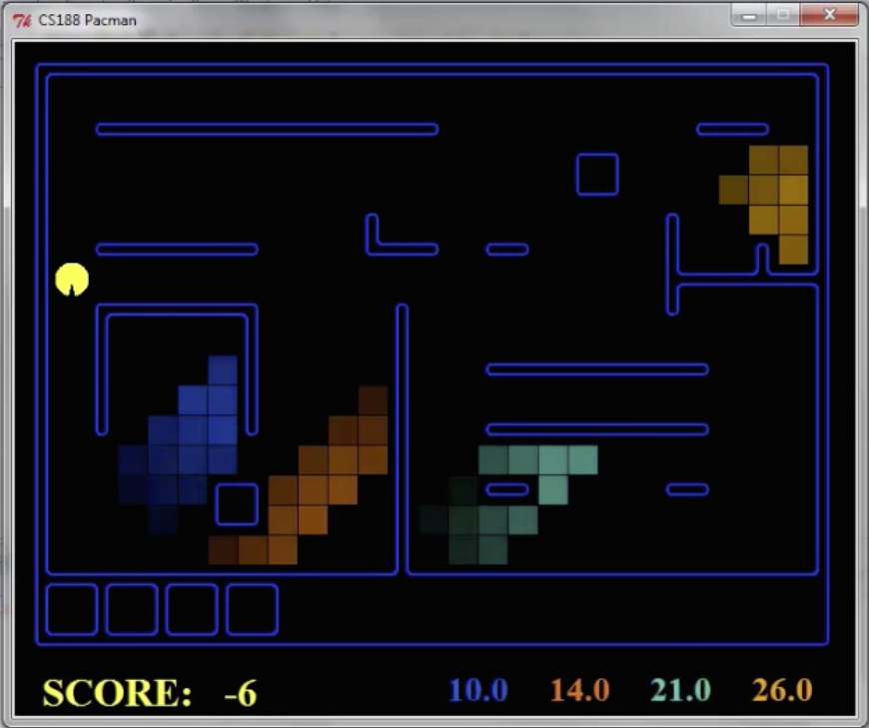
Pacman – Hunting Invisible Ghosts with Sonar
[Demo: Pacman – Sonar – No Beliefs(L14D1)]

Slide 54
Filtering Algorithm
P(X_{t+1}|e_{1:t+1}) = α P(e_{t+1}|X_{t+1}) ∑_{xt} P(X_{t+1}| x_{t}) P(x_{t} | e_{1:t})
f_{1:t+1} = Forward(f_{1:t} , e_{t+1})
Normalize
Update
Predict

Slide 55
Filtering Algorithm
Query: What is the current state, given all of the current and past evidence?
Marching forward through the HMM network
X₁
X₂
e₁
e₂

Slide 56
Filtering Algorithm
Query: What is the current state, given all of the current and past evidence?
Marching forward through the HMM network
X₁
X₂
X₃
e₁
e₂
e₃

Slide 57
Filtering Algorithm
Query: What is the current state, given all of the current and past evidence?
Marching forward through the HMM network
X₁
X₂
X₃
X₄
e₁
e₂
e₃
e₄

Slide 58
Filtering Algorithm
Query: What is the current state, given all of the current and past evidence?
Marching forward through the HMM network
X₁
X₂
X₃
X₄
e₁
e₂
e₃
e₄

Slide 59

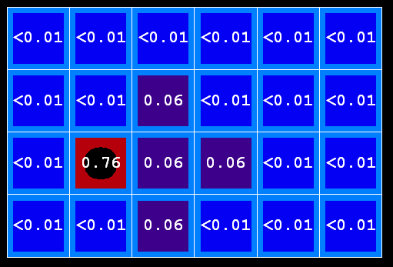
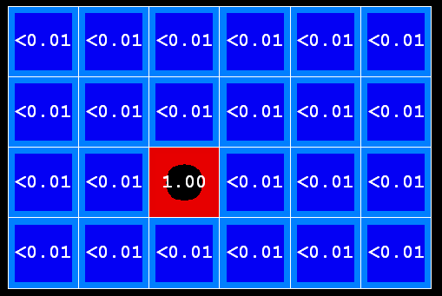
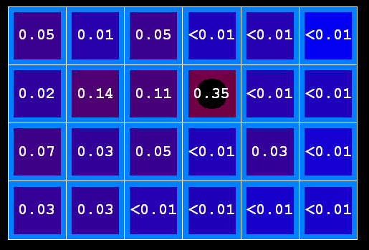
Example: Prediction step
As time passes, uncertainty “accumulates”
(Transition model: ghosts usually go clockwise)
T = 1
T = 2
T = 5

Slide 60


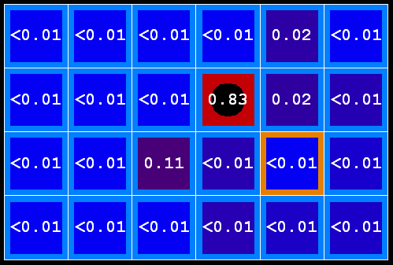
Example: Update step
As we get observations, beliefs get reweighted, uncertainty “decreases”
Before observation
After observation

Slide 61
Demo Ghostbusters – Circular Dynamics -- HMM

Slide 62
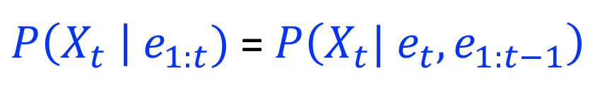


Filtering Algorithm
Query: What is the current state, given all of the current and past evidence?
Matching math with Bayes net
$P\left(X_{t} \right| e_{1:t})$ =$P\left(X_{t}{| e_{t}, e}_{1:t−1}\right)$
X₁
X₂
X₃
X₄
$$=α P\left(X_{t}, {e_{t}| e}_{1:t−1}\right)$$
e₁
e₂
e₃
e₄
Def. of cond. probability with $X_{t}$, $e_{t}$
Notes:
Explain propto

Slide 63
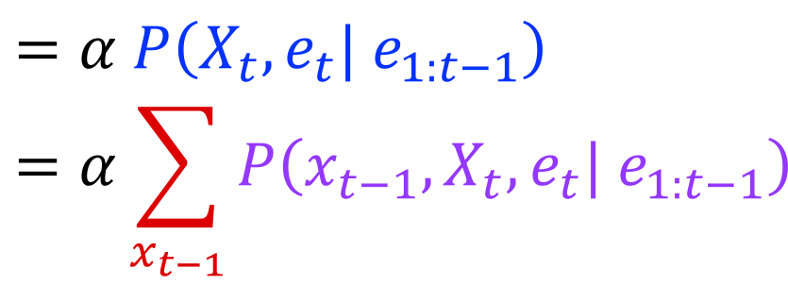

Filtering Algorithm
Query: What is the current state, given all of the current and past evidence?
Matching math with Bayes net
$P\left(X_{t} \right| e_{1:t})$ =$P\left(X_{t}{| e_{t}, e}_{1:t−1}\right)$
X₁
X₂
X₃
X₄
$$=α P\left(X_{t}, {e_{t}| e}_{1:t−1}\right)$$
$$=α\sum_{x_{t−1}}{P\left(x_{t−1},X_{t}, e_{t}| e_{1:t−1}\right)}$$
e₁
e₂
e₃
e₄
Summation over variable $X_{t−1}$

Slide 64
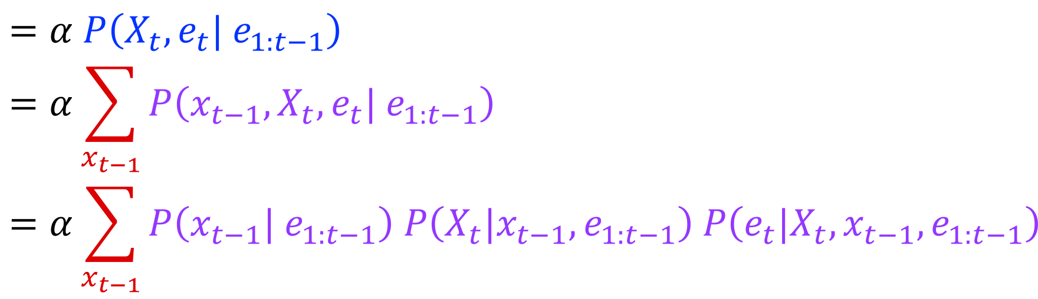

Filtering Algorithm
Query: What is the current state, given all of the current and past evidence?
Matching math with Bayes net
$P\left(X_{t} \right| e_{1:t})$ =$P\left(X_{t}{| e_{t}, e}_{1:t−1}\right)$
X₁
X₂
X₃
X₄
$$=α P\left(X_{t}, {e_{t}| e}_{1:t−1}\right)$$
$$=α\sum_{x_{t−1}}{P\left(x_{t−1},X_{t}, e_{t}| e_{1:t−1}\right)}$$
$$=α\sum_{x_{t−1}}{P\left(x_{t−1}| e_{1:t−1}\right) P\left(X_{t}|x_{t−1},e_{1:t−1}\right) P\left(e_{t}|X_{t},x_{t−1},e_{1:t−1}\right)}$$
e₁
e₂
e₃
e₄
Chain rule with $x_{t−1}$, $X_{t}$, and $e_{t}$

Slide 65
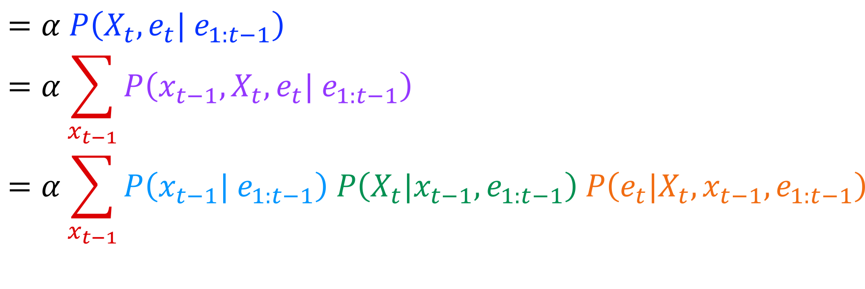
Filtering Algorithm
Query: What is the current state, given all of the current and past evidence?
Matching math with Bayes net
$P\left(X_{t} \right| e_{1:t})$ =$P\left(X_{t}{| e_{t}, e}_{1:t−1}\right)$
X₁
X₂
X₃
X₄
$$=α P\left(X_{t}, {e_{t}| e}_{1:t−1}\right)$$
$$=α\sum_{x_{t−1}}{P\left(x_{t−1},X_{t}, e_{t}| e_{1:t−1}\right)}$$
$$=α\sum_{x_{t−1}}{P\left(x_{t−1}| e_{1:t−1}\right) P\left(X_{t}|x_{t−1},e_{1:t−1}\right) P\left(e_{t}|X_{t},x_{t−1},e_{1:t−1}\right)}$$
e₁
e₂
e₃
e₄
Chain rule with $x_{t−1}$, $X_{t}$, and $e_{t}$

Slide 66
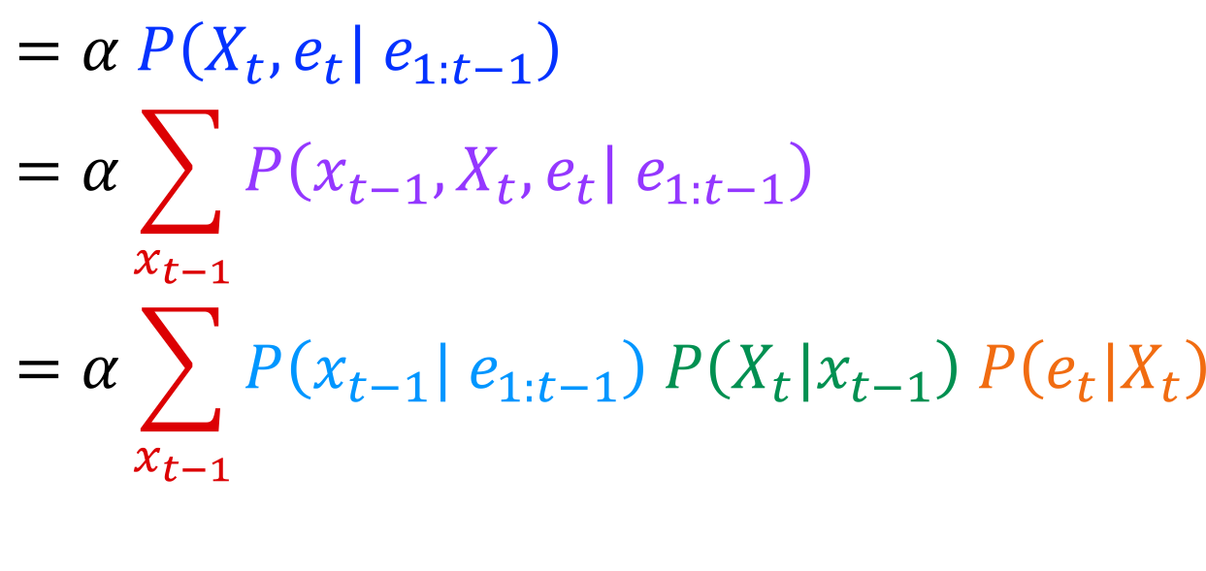

Filtering Algorithm
Query: What is the current state, given all of the current and past evidence?
Matching math with Bayes net
$P\left(X_{t} \right| e_{1:t})$ =$P\left(X_{t}{| e_{t}, e}_{1:t−1}\right)$
X₁
X₂
X₃
X₄
$$=α P\left(X_{t}, {e_{t}| e}_{1:t−1}\right)$$
$$=α\sum_{x_{t−1}}{P\left(x_{t−1},X_{t}, e_{t}| e_{1:t−1}\right)}$$
$$=α\sum_{x_{t−1}}{P\left(x_{t−1}| e_{1:t−1}\right) P\left(X_{t}|x_{t−1}\right) P\left(e_{t}|X_{t}\right)}$$
e₁
e₂
e₃
e₄
Bayes net conditional independence

Slide 67
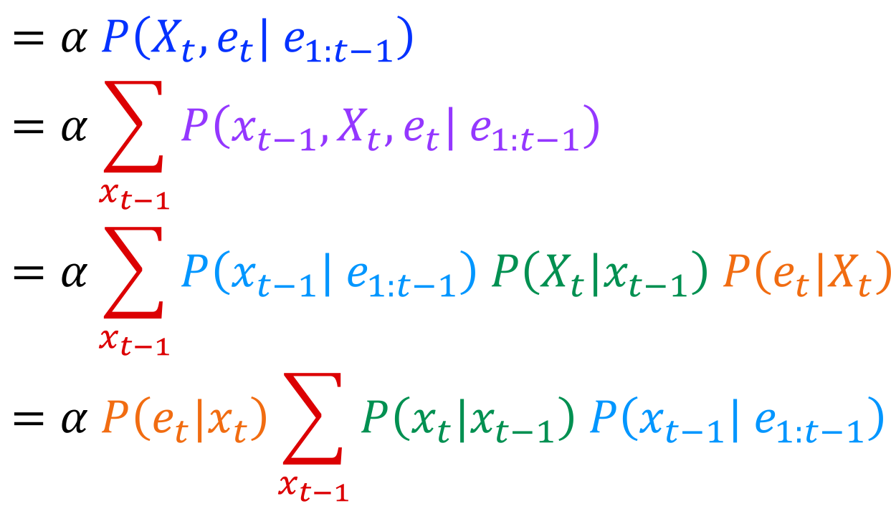

Filtering Algorithm
Query: What is the current state, given all of the current and past evidence?
Matching math with Bayes net
$P\left(X_{t} \right| e_{1:t})$ =$P\left(X_{t}{| e_{t}, e}_{1:t−1}\right)$
X₁
X₂
X₃
X₄
$$=α P\left(X_{t}, {e_{t}| e}_{1:t−1}\right)$$
$$=α\sum_{x_{t−1}}{P\left(x_{t−1},X_{t}, e_{t}| e_{1:t−1}\right)}$$
$$=α\sum_{x_{t−1}}{P\left(x_{t−1}| e_{1:t−1}\right) P\left(X_{t}|x_{t−1}\right) P\left(e_{t}|X_{t}\right)}$$
$$=α P\left(e_{t}|x_{t}\right)\sum_{x_{t−1}}{P\left(x_{t}|x_{t−1}\right) P\left(x_{t−1}| e_{1:t−1}\right) }$$
e₁
e₂
e₃
e₄
Pulling $P\left(e_{t}|X_{t}\right)$ out of the summation

Slide 68
Filtering Algorithm
Query: What is the current state, given all of the current and past evidence?
Matching math with Bayes net
$P\left(X_{t} \right| e_{1:t})$ =$P\left(X_{t}{| e_{t}, e}_{1:t−1}\right)$
X₁
X₂
X₃
X₄
$$=α P\left(X_{t}, {e_{t}| e}_{1:t−1}\right)$$
$$=α\sum_{x_{t−1}}{P\left(x_{t−1},X_{t}, e_{t}| e_{1:t−1}\right)}$$
$$=α\sum_{x_{t−1}}{P\left(x_{t−1}| e_{1:t−1}\right) P\left(X_{t}|x_{t−1}\right) P\left(e_{t}|X_{t}\right)}$$
$$=α P\left(e_{t}|x_{t}\right)\sum_{x_{t−1}}{P\left(x_{t}|x_{t−1}\right) P\left(x_{t−1}| e_{1:t−1}\right) }$$
e₁
e₂
e₃
e₄
Recursion!

Slide 69
Filtering Algorithm
Query: What is the current state, given all of the current and past evidence?
Matching math with Bayes net
$P\left(X_{t} \right| e_{1:t})$ =$P\left(X_{t}{| e_{t}, e}_{1:t−1}\right)$
X₁
X₂
X₃
X₄
$$=α P\left(X_{t}, {e_{t}| e}_{1:t−1}\right)$$
$$=α\sum_{x_{t−1}}{P\left(x_{t−1},X_{t}, e_{t}| e_{1:t−1}\right)}$$
$$=α\sum_{x_{t−1}}{P\left(x_{t−1}| e_{1:t−1}\right) P\left(X_{t}|x_{t−1}\right) P\left(e_{t}|X_{t}\right)}$$
$$=α P\left(e_{t}|x_{t}\right)\sum_{x_{t−1}}{P\left(x_{t}|x_{t−1}\right) P\left(x_{t−1}| e_{1:t−1}\right) }$$
e₁
e₂
e₃
e₄
Recursion!

Slide 70
Filtering Algorithm
P(X_{t+1}|e_{1:t+1}) = α P(e_{t+1}|X_{t+1}) ∑_{xt} P(X_{t+1}| x_{t}) P(x_{t} | e_{1:t})
f_{1:t+1} = Forward(f_{1:t} , e_{t+1})
Cost per time step: O(|X|²) where |X| is the number of states
Time and space costs are constant, independent of t
O(|X|²) is infeasible for models with many state variables
We get to invent really cool approximate filtering algorithms
Normalize
Update
Predict

Slide 71
Other HMM Queries
Filtering: P(X_{t}|e_{1:t})
Prediction: P(X_{t}|e_{1:t-1})
X₁
X₂
X₃
X₄
X₁
X₂
X₃
X₄
e₁
e₂
e₃
e₄
e₁
e₂
e₃
Smoothing: P(X_{t}|e_{1:N}), t<N
Explanation: P(X_{1:N}|e_{1:N})
X₁
X₂
X₃
X₄
X₁
X₂
X₃
X₄
e₁
e₂
e₃
e₄
e₁
e₂
e₃
e₄

Slide 72
Next Time: Particle Filtering and Applications of HMMs

