Slide 1

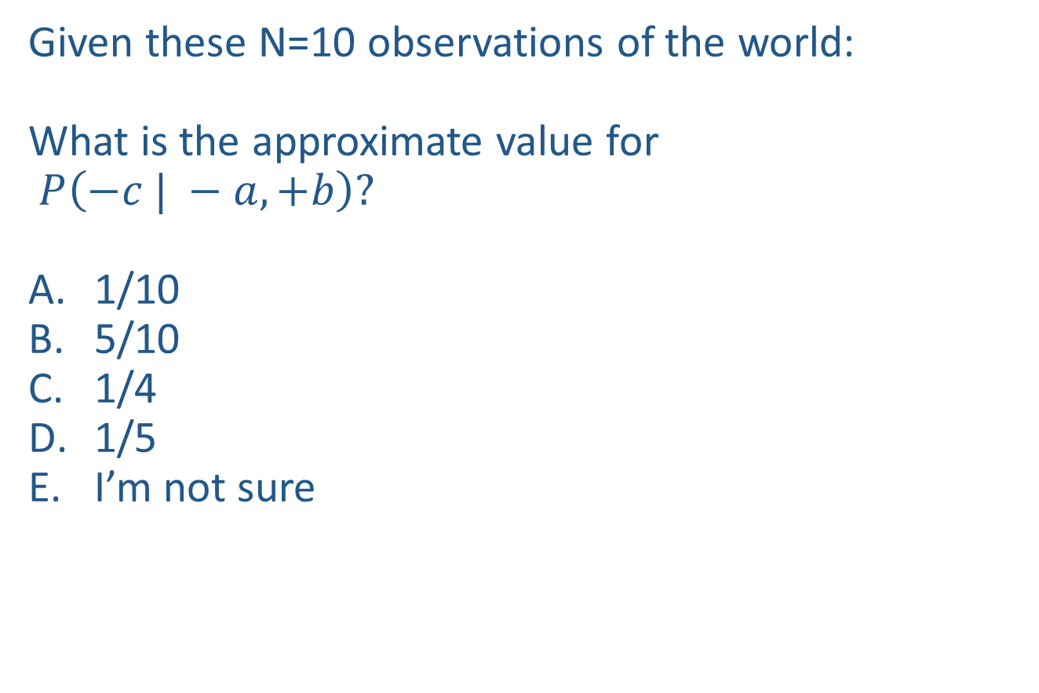
Warm-up as you walk in
Given these N=10 observations of the world:
What is the approximate value for
$P\left(−c | −a, +b\right)?$
1/10
5/10
1/4
1/5
I’m not sure
Counts
$$−a, −b, +c$$
$$+a,−b, +c$$
$$−a, −b,+c$$
$$−a, +b, +c$$
$$+a, −b, +c$$
$$−a, +b, −c$$
$$−a, +b, +c$$
$$−a, +b, +c$$
$$+a, −b, +c$$
$$−a, +b, +c$$
+a | +b | +c | 0
+a | +b | -c | 0
+a | -b | +c | 3
+a | -b | -c | 0
-a | +b | +c | 4
-a | +b | -c | 1
-a | -b | +c | 2
-a | -b | -c | 0

Slide 2
Announcements
Assignments:
HW10 and P5 out after mideterm
Midterm:
Tue 11/12, in-class
    See Piazza for details
Piazza:
Lecture thread on piazza

Slide 3
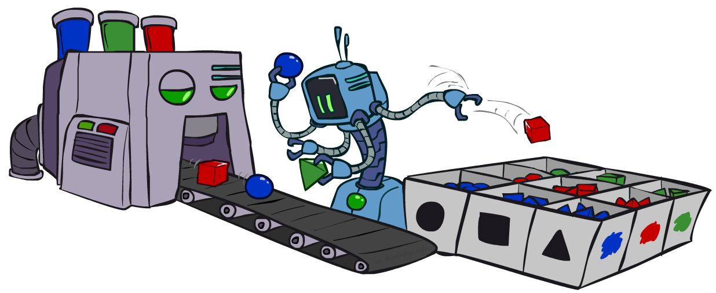
AI: Representation and Problem Solving
Bayes Nets Sampling
Instructors: Pat Virtue & Fei Fang
Slide credits: CMU AI and http://ai.berkeley.edu

Slide 4


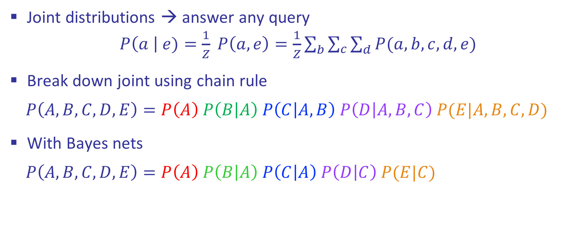



Review: Bayes Nets
Joint distributions → answer any query
$P\left(a \right| e)=\frac{1}{Z} P\left(a, e\right)=\frac{1}{Z}\sum_{b}{\sum_{c}{\sum_{d}{P(a,b, c, d, e)}}}$
Break down joint using chain rule
$$P\left(A,B,C,D,E\right)=P\left(A\right) P\left(B | A\right) P\left(C | A,B\right) P\left(D | A,B,C\right) P(E|A,B,C,D)$$
With Bayes nets
$$P\left(A,B,C,D,E\right)=P\left(A\right) P\left(B | A\right) P\left(C | A\right) P\left(D | C\right) P(E|C)$$
$$A$$
$$B$$
$$C$$
$$D$$
$$E$$

Slide 5

Bayes Nets
Part I: Representation
Part II: Exact inference
  Enumeration (always exponential complexity)
  Variable elimination (worst-case exponential complexity, often better)
  Inference is NP-hard in general
Part III: Approximate Inference

Slide 6
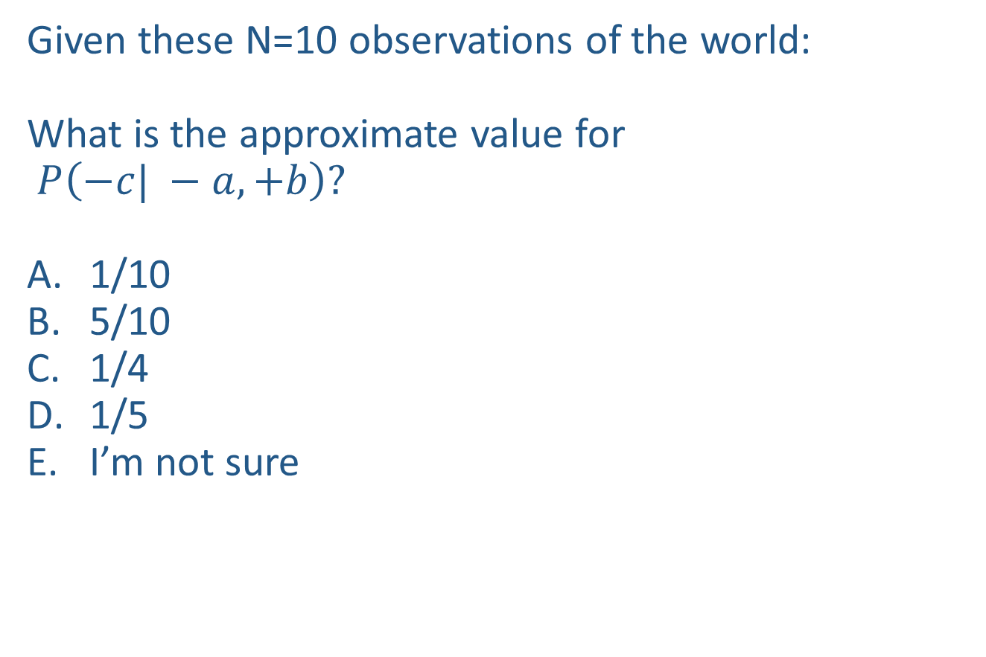
Warm-up as you walk in
Given these N=10 observations of the world:
What is the approximate value for
$P\left(−c| −a, +b\right)?$
1/10
5/10
1/4
1/5
I’m not sure
Counts
$$−a, −b, +c$$
$$+a,−b, +c$$
$$−a, −b,+c$$
$$−a, +b, +c$$
$$+a, −b, +c$$
$$−a, +b, −c$$
$$−a, +b, +c$$
$$−a, +b, +c$$
$$+a, −b, +c$$
$$−a, +b, +c$$
+a | +b | +c | 0
+a | +b | -c | 0
+a | -b | +c | 3
+a | -b | -c | 0
-a | +b | +c | 4
-a | +b | -c | 1
-a | -b | +c | 2
-a | -b | -c | 0

Slide 7

Approximate Inference: Sampling

Slide 8
Inference vs Sampling

Slide 9
Motivation for Approximate Inference

Slide 10

Sampling
Sampling is a lot like repeated simulation
  Predicting the weather, basketball games, …
Basic idea
  Draw N samples from a sampling distribution S
  Compute an approximate posterior probability
  Show this converges to the true probability P
Why sample?
Learning: get samples from a distribution you don’t know
Inference: getting a sample is faster than computing the right answer (e.g. with variable elimination)

Slide 11
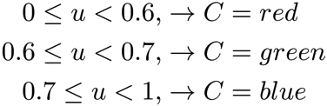

Sampling
Sampling from given distribution
  Step 1: Get sample u from uniform distribution over [0, 1)
    e.g. random() in python
  Step 2: Convert this sample u into an outcome for the given distribution by having each outcome associated with a sub-interval of [0,1) with sub-interval size equal to probability of the outcome
Example
  If random() returns u = 0.83, then our sample is C = blue
  E.g, after sampling 8 times:
C | P(C)
red | 0.6
green | 0.1
blue | 0.3

Slide 12




Sampling
How would you sample from a conditional distribution?
+a | 1/2
-a | 1/2
$$P(A)$$
$$A$$
+a | +b | 1/10
 | -b | 9/10
-a | +b | 1/2
 | -b | 1/2
$$P(B|A)$$
$$B$$

Slide 13
Sampling in Bayes’ Nets
Prior Sampling
Rejection Sampling
Likelihood Weighting
Gibbs Sampling

Slide 14
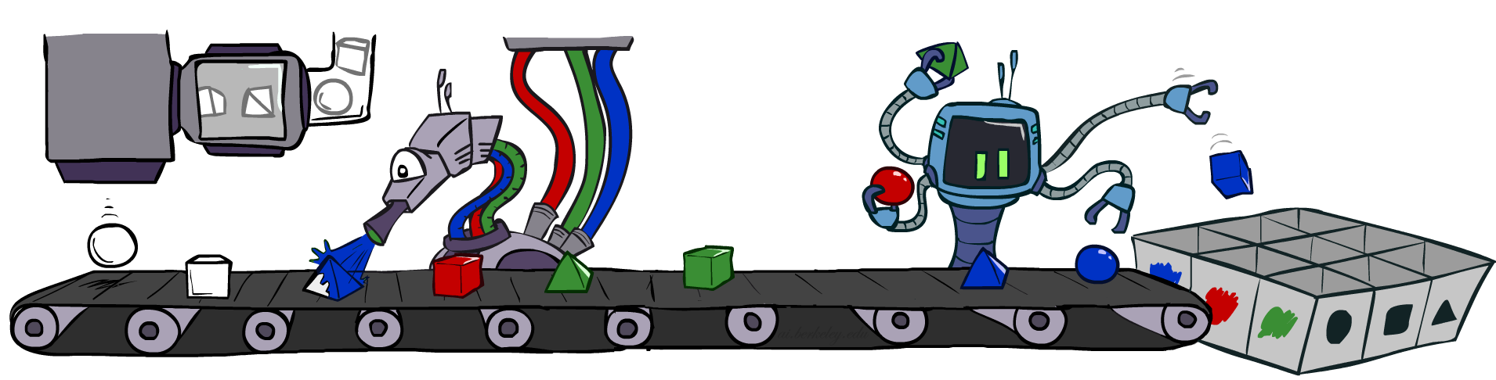
Prior Sampling

Slide 15




Prior Sampling
+c | 0.5
-c | 0.5
Cloudy
Cloudy
+c | +s | 0.1
 | -s | 0.9
-c | +s | 0.5
 | -s | 0.5
+c | +r | 0.8
 | -r | 0.2
-c | +r | 0.2
 | -r | 0.8
Sprinkler
Sprinkler
Rain
Rain
WetGrass
WetGrass
Samples:
+s | +r | +w | 0.99
 |  | -w | 0.01
 | -r | +w | 0.90
 |  | -w | 0.10
-s | +r | +w | 0.90
 |  | -w | 0.10
 | -r | +w | 0.01
 |  | -w | 0.99
+c, -s, +r, +w
-c, +s, -r, +w
…

Slide 16
Prior Sampling
For i=1, 2, …, n
  Sample x_{i} from P(X_{i} | Parents(X_{i}))
Return (x₁, x₂, …, x_{n})

Slide 17
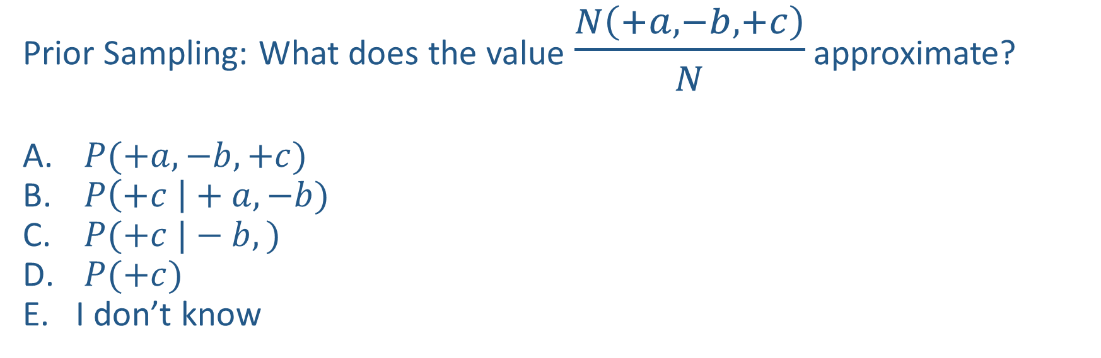

Piazza Poll 1
$$A$$
Prior Sampling: What does the value $\frac{N\left(+a, −b, +c\right)}{N}$ approximate?
$P(+a, −b, +c)$
$P\left(+c \right|+a, −b)$
$P(+c |−b,)$
$P(+c)$
I don’t know
$$B$$
$$C$$

Slide 18
Piazza Poll 1
$$A$$
Prior Sampling: What does the value $\frac{N\left(+a, −b, +c\right)}{N}$ approximate?
$P(+a, −b, +c)$
$P\left(+c \right|+a, −b)$
$P(+c |−b,)$
$P(+c)$
I don’t know
$$B$$
$$C$$

Slide 19

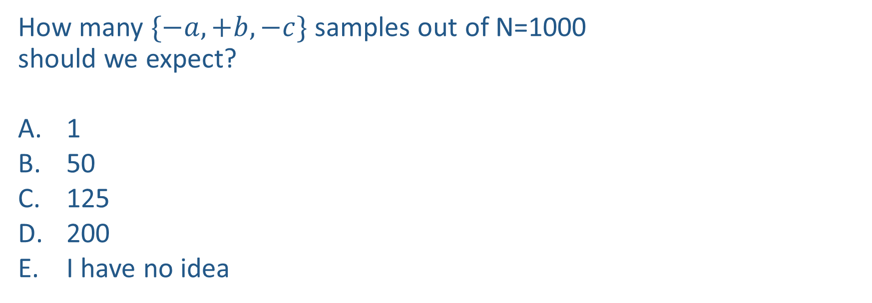
Piazza Poll 2
How many $\{−a,+b,−c\}$ samples out of N=1000
should we expect?
1
50
125
200
I have no idea
+a | 1/2
-a | 1/2
$$P(A)$$
$$A$$
+a | +b | 1/10
 | -b | 9/10
-a | +b | 1/2
 | -b | 1/2
$$P(B|A)$$
$$B$$
+b | +c | 4/5
 | -c | 1/5
-b | +c | 1
 | -c | 0
$$C$$
$$P(C|B)$$

Slide 20
Piazza Poll 2
How many $\{−a,+b,−c\}$ samples out of N=1000
should we expect?
1
50
125
200
I have no idea
+a | 1/2
-a | 1/2
$$P(A)$$
$$A$$
+a | +b | 1/10
 | -b | 9/10
-a | +b | 1/2
 | -b | 1/2
$$P(B|A)$$
$$B$$
+b | +c | 4/5
 | -c | 1/5
-b | +c | 1
 | -c | 0
$$C$$
$$P(C|B)$$

Slide 21
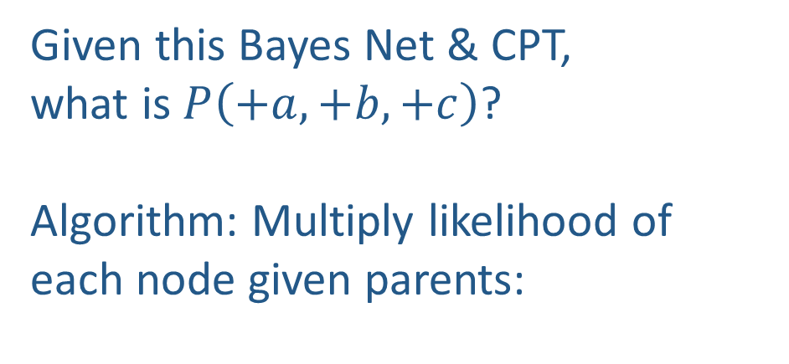
Probability of a sample
Given this Bayes Net & CPT,
what is $P\left(+a,+b,+c\right)$?
Algorithm: Multiply likelihood of each node given parents:
+a | 1/2
-a | 1/2
$$P(A)$$
$$A$$
+a | +b | 1/10
 | -b | 9/10
-a | +b | 1/2
 | -b | 1/2
$$P(B|A)$$
w = 1.0
for i=1, 2, …, n
  Set w = w * P(x_{i} | Parents(X_{i}))
return w
$$B$$
+b | +c | 4/5
 | -c | 1/5
-b | +c | 1
 | -c | 0
$$C$$
$$P(C|B)$$

Slide 22
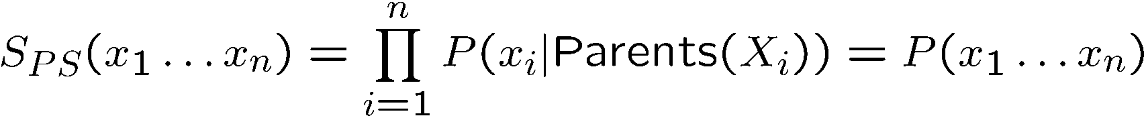

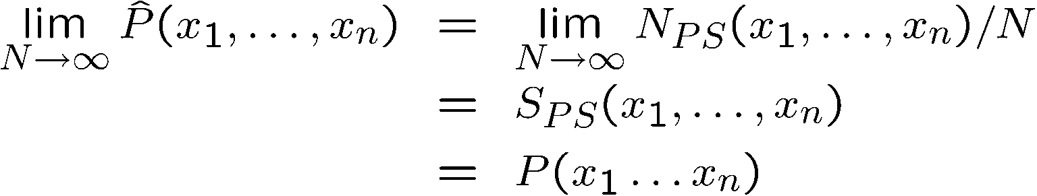
Prior Sampling
This process generates samples with probability:
…i.e. the BN’s joint probability
Let the number of samples of an event be
Then

Slide 23



Prior Sampling
+a | 1/2
-a | 1/2
$$P(A)$$
$$A$$
+a | +b | 1/10
 | -b | 9/10
-a | +b | 1/2
 | -b | 1/2
$$P(B|A)$$
$$B$$
+b | +c | 4/5
 | -c | 1/5
-b | +c | 1
 | -c | 0
$$C$$
$$P(C|B)$$

Slide 24
Example
We’ll get a bunch of samples from the BN:
  +c, -s, +r, +w
  +c, +s, +r, +w
  -c, +s, +r, -w
  +c, -s, +r, +w
  -c, -s, -r, +w
If we want to know P(W)
  We have counts <+w:4, -w:1>
  Normalize to get P(W) = <+w:0.8, -w:0.2>
  This will get closer to the true distribution with more samples
  Can estimate anything else, too
  What about P(C| +w)? P(C| +r, +w)? P(C| -r, -w)?
  Fast: can use fewer samples if less time (what’s the drawback?)
C
S
R
W

Slide 25
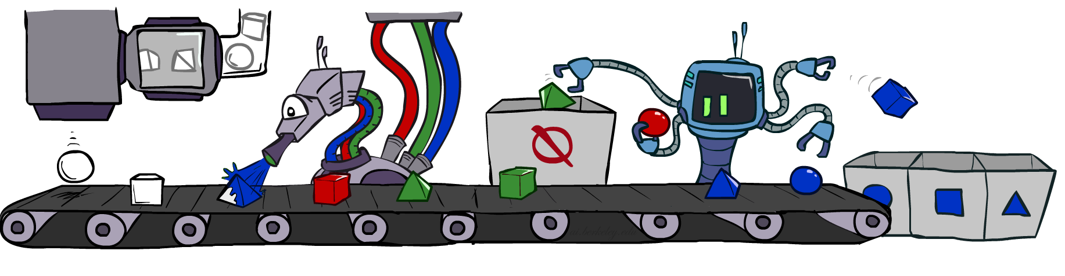
Rejection Sampling

Slide 26
Rejection Sampling
Let’s say we want P(C)
  No point keeping all samples around
  Just tally counts of C as we go
Let’s say we want P(C| +s)
  Same thing: tally C outcomes, but ignore (reject) samples which don’t have S=+s
  This is called rejection sampling
  It is also consistent for conditional probabilities (i.e., correct in the limit)
C
S
R
W
  +c, -s, +r, +w
  +c, +s, +r, +w
  -c, +s, +r, -w
  +c, -s, +r, +w
  -c, -s, -r, +w

Slide 27
Rejection Sampling
IN: evidence instantiation
For i=1, 2, …, n
  Sample x_{i} from P(X_{i} | Parents(X_{i}))
  If x_{i} not consistent with evidence
    Reject: Return, and no sample is generated in this cycle
Return (x₁, x₂, …, x_{n})

Slide 28

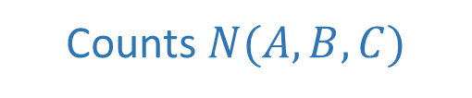
Piazza Poll 3
$$A$$
What queries can we (approximately) answer
with rejection sampling samples (evidence: $+c$)?
$P(+a, −b, +c)$
$P(+a, −b |+c)$
Both
Neither
I have no idea
$$B$$
Counts $N(A,B,C)$
+a | +b | +c | 4
+a | +b | -c
+a | -b | +c | 3
+a | -b | -c
-a | +b | +c | 2
-a | +b | -c
-a | -b | +c | 1
-a | -b | -c
$$C$$

Slide 29
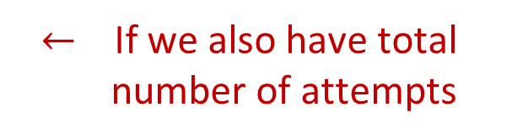
Piazza Poll 3
$$A$$
What queries can we (approximately) answer
with rejection sampling samples (evidence: $+c$)?
$P(+a, −b, +c)$
$P(+a, −b |+c)$
Both
Neither
I have no idea
$$B$$
Counts $N(A,B,C)$
+a | +b | +c | 4
+a | +b | -c
+a | -b | +c | 3
+a | -b | -c
-a | +b | +c | 2
-a | +b | -c
-a | -b | +c | 1
-a | -b | -c
$$C$$
$←$ If we also have total number of attempts

Slide 30
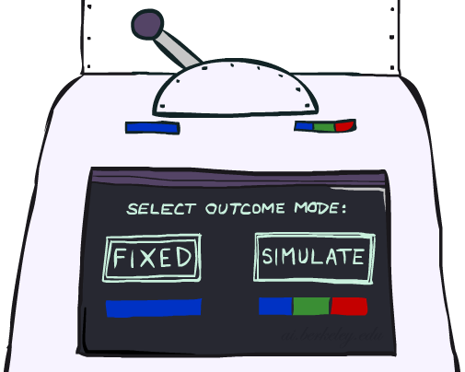
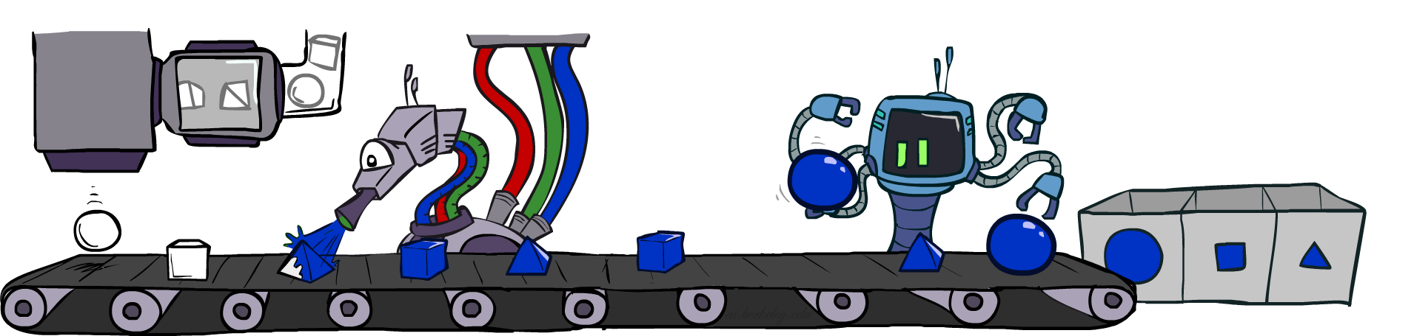
Likelihood Weighting

Slide 31
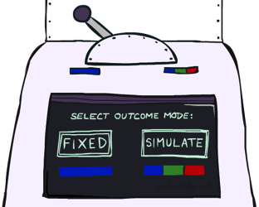


Likelihood Weighting
Problem with rejection sampling:
  If evidence is unlikely, rejects lots of samples
  Evidence not exploited as you sample
  Consider P(Shape|blue)
Idea: fix evidence variables and sample the rest
  Problem: sample distribution not consistent!
  Solution: weight by probability of evidence given parents
  pyramid, green
  pyramid, red
  sphere, blue
  cube, red
  sphere, green
  pyramid, blue
  pyramid, blue
  sphere, blue
  cube, blue
  sphere, blue
Shape
Color
Shape
Color

Slide 32



Likelihood Weighting
+c | 0.5
-c | 0.5
Cloudy
Cloudy
+c | +s | 0.1
 | -s | 0.9
-c | +s | 0.5
 | -s | 0.5
+c | +r | 0.8
 | -r | 0.2
-c | +r | 0.2
 | -r | 0.8
Sprinkler
Sprinkler
Rain
Rain
WetGrass
Samples:
WetGrass
+s | +r | +w | 0.99
 |  | -w | 0.01
 | -r | +w | 0.90
 |  | -w | 0.10
-s | +r | +w | 0.90
 |  | -w | 0.10
 | -r | +w | 0.01
 |  | -w | 0.99
+c, +s, +r, +w
…

Slide 33
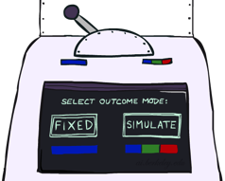
Likelihood Weighting
IN: evidence instantiation
w = 1.0
for i=1, 2, …, n
  if X_{i} is an evidence variable
    X_{i} = observation x_{i} for X_{i}
    Set w = w * P(x_{i} | Parents(X_{i}))
  else
    Sample x_{i} from P(X_{i} | Parents(X_{i}))
return (x₁, x₂, …, x_{n}), w

Slide 34
Likelihood Weighting
No evidence:
Prior Sampling
Some evidence:
Likelihood Weighted Sampling
All evidence:
Likelihood Weighted
Input: no evidence
for i=1, 2, …, n
    Sample x_{i} from P(X_{i} | Parents(X_{i}))
return (x₁, x₂, …, x_{n})
Input: evidence instantiation
w = 1.0
for i=1, 2, …, n
if X_{i} is an evidence variable
    X_{i} = observation x_{i} for X_{i}
    Set w = w * P(x_{i} | Parents(X_{i}))
else
    Sample x_{i} from P(X_{i} | Parents(X_{i}))
return (x₁, x₂, …, x_{n}), w
Input: evidence instantiation
w = 1.0
for i=1, 2, …, n
    Set w = w * P(x_{i} | Parents(X_{i}))
return w

Slide 35
Remember Piazza Poll 2
How many $\{−a,+b,−c\}$ samples out of N=1000
should we expect?
1
50
125
200
I have no idea
+a | 1/2
-a | 1/2
$$P(A)$$
$$A$$
+a | +b | 1/10
 | -b | 9/10
-a | +b | 1/2
 | -b | 1/2
$$P(B|A)$$
$$B$$
+b | +c | 4/5
 | -c | 1/5
-b | +c | 1
 | -c | 0
$$C$$
$$P(C|B)$$

Slide 36
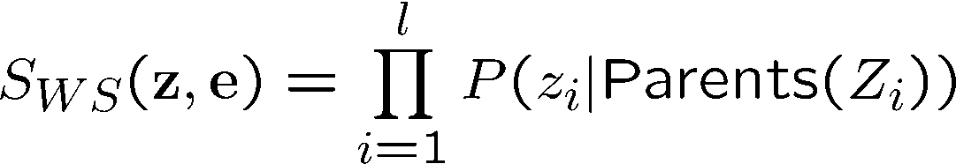
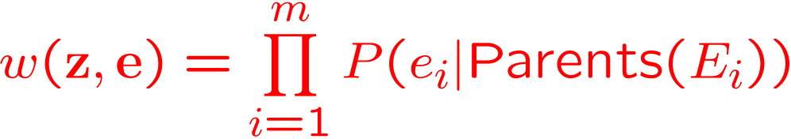
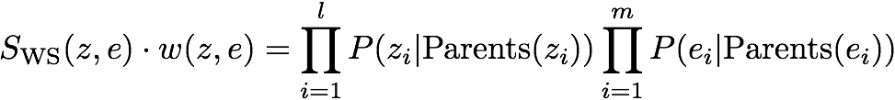

Likelihood Weighting
Sampling distribution if z sampled and e fixed evidence
Now, samples have weights
Together, weighted sampling distribution is consistent
Cloudy
C
S
R
W

Slide 37

Likelihood Weighting
+a | 1/2
-a | 1/2
$$P(A)$$
$$A$$
+a | +b | 1/10
 | -b | 9/10
-a | +b | 1/2
 | -b | 1/2
$$P(B|A)$$
$$B$$
+b | +c | 4/5
 | -c | 1/5
-b | +c | 1
 | -c | 0
$$C$$
$$P(C|B)$$

Slide 38
Piazza Poll 4
Two identical samples from likelihood weighted sampling will have the same exact weights.
True
False
It depends
I don’t know

Slide 39
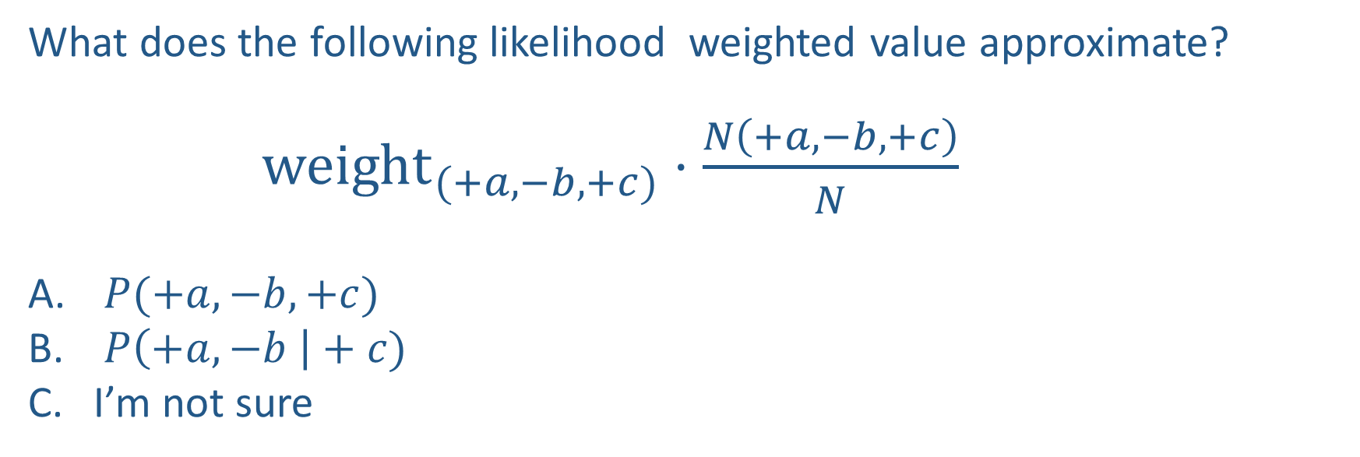
Piazza Poll 5
What does the following likelihood weighted value approximate?
${weight}_{(+a,−b,+c)}⋅\frac{N\left(+a, −b, +c\right)}{N}$
$P(+a, −b, +c)$
$P\left(+a, −b \right|+c)$
I’m not sure

Slide 40
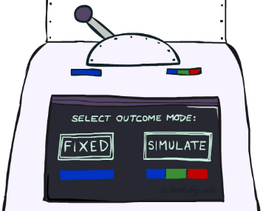
Likelihood Weighting
Likelihood weighting is good
  We have taken evidence into account as we generate the sample
  E.g. here, W’s value will get picked based on the evidence values of S, R
  More of our samples will reflect the state of the world suggested by the evidence
Likelihood weighting doesn’t solve all our problems
  Evidence influences the choice of downstream variables, but not upstream ones (C isn’t more likely to get a value matching the evidence)
We would like to consider evidence when we sample every variable

Slide 41
Likelihood Weighting
Likelihood weighting doesn’t solve all our problems
  Evidence influences the choice of downstream variables, but not upstream ones (C isn’t more likely to get a value matching the evidence)
We would like to consider evidence when we sample every variable
→ Gibbs sampling

Slide 42
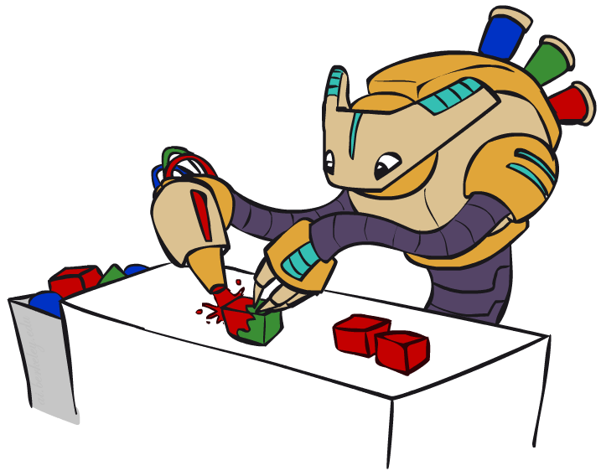
Gibbs Sampling

Slide 43
Gibbs Sampling
Procedure: keep track of a full instantiation x₁, x₂, …, x_{n}.
Start with an arbitrary instantiation consistent with the evidence.
Sample one variable at a time, conditioned on all the rest, but keep evidence fixed.
Keep repeating this for a long time.
Property: in the limit of repeating this infinitely many times the resulting sample is coming from the correct distribution
Rationale: both upstream and downstream variables condition on evidence.
In contrast: likelihood weighting only conditions on upstream evidence, and hence weights obtained in likelihood weighting can sometimes be very small. Sum of weights over all samples is indicative of how many “effective” samples were obtained, so want high weight.

Slide 44
Gibbs Sampling Example: P( S | +r)
Step 1: Fix evidence
  R = +r
Steps 3: Repeat
  Choose a non-evidence variable X
  Resample X from P( X | all other variables)
Step 2: Initialize other variables
  Randomly
C
C
S
+r
S
+r
W
W
C
C
C
C
C
C
S
+r
S
+r
S
+r
S
+r
S
+r
S
+r
W
W
W
W
W
W

Slide 45
Gibbs Sampling Example: P( S | +r)
Keep only the last sample from each iteration:
C
C
C
C
C
S
+r
S
+r
S
+r
S
+r
S
+r
W
W
W
W
W
C
C
C
C
C
S
+r
S
+r
S
+r
S
+r
S
+r
W
W
W
W
W
C
C
C
C
C
S
+r
S
+r
S
+r
S
+r
S
+r
W
W
W
W
W

Slide 46
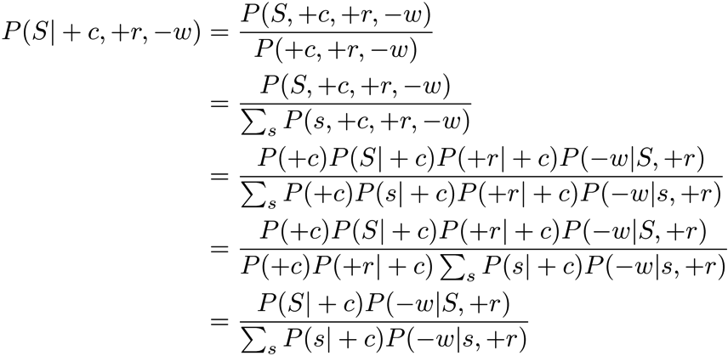
Efficient Resampling of One Variable
Sample from P(S | +c, +r, -w)
Many things cancel out – only CPTs with S remain!
More generally: only CPTs that have resampled variable need to be considered, and joined together
C
S
+r
W

Slide 47
Further Reading on Gibbs Sampling
Gibbs sampling produces sample from the query distribution P( Q | e ) in limit of re-sampling infinitely often
Gibbs sampling is a special case of more general methods called Markov chain Monte Carlo (MCMC) methods
  Metropolis-Hastings is one of the more famous MCMC methods (in fact, Gibbs sampling is a special case of Metropolis-Hastings)
You may read about Monte Carlo methods – they’re just sampling

Slide 48
Markov Chain Monte Carlo*
Idea: instead of sampling from scratch, create samples that are each like the last one.
Procedure: resample one variable at a time, conditioned on all the rest, but keep evidence fixed. E.g., for P(b|c):
Properties: Now samples are not independent (in fact they’re nearly identical), but sample averages are still consistent estimators!
What’s the point: both upstream and downstream variables condition on evidence.
+b
+a
+c
-b
+a
+c
-b
-a
+c

Slide 49



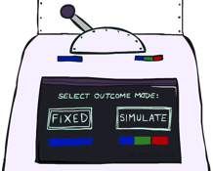

Bayes’ Net Sampling Summary
Prior Sampling P(Q, E)
Likelihood Weighting P( Q , e)
Rejection Sampling P( Q | e )
Gibbs Sampling P( Q | e )

