Slide 1
Warm-up as you walk in
What is the notation behind these generic queries?
What is the probability of this given what I know?
What are the probabilities of all the possible outcomes (given what I know)?
Which outcome is the most likely outcome (given what I know)?

Slide 2
Announcements
Assignments:
HW9 (online)
    Due tonight, 10 pm
Midterm:
Tue 11/12, in-class
    See Piazza for details
        Practice exam
        Friday: Recitation review
        Sunday: Review practice exam solutions

Slide 3
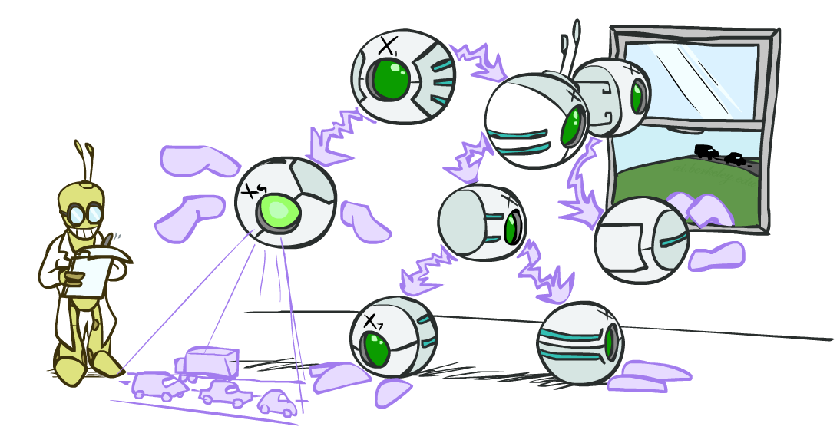
AI: Representation and Problem Solving
Bayes Nets Inference
Instructors: Pat Virtue & Fei Fang
Slide credits: CMU AI and http://ai.berkeley.edu

Slide 4
Warm-up as you walk in
What is the notation behind these generic queries?
What is the probability of this given what I know?
What are the probabilities of all the possible outcomes (given what I know)?
Which outcome is the most likely outcome (given what I know)?

Slide 5

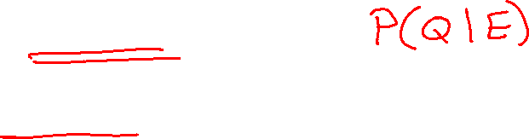
Queries
What is the probability of this given what I know?
$P\left(q ∣ e\right)$
What are the probabilities of all the possible outcomes (given what I know)?
$P\left(Q ∣ e\right)$
Which outcome is the most likely outcome (given what I know)?
${argmax}_{q∈Q} P\left(q ∣ e\right)$

Slide 6

Queries
What is the probability of this given what I know?
$P\left(q ∣ e\right)=\frac{P(q, e)}{P(e)}$
What are the probabilities of all the possible outcomes (given what I know)?
$P\left(Q ∣ e\right)=\frac{P\left(Q, e\right)}{P\left(e\right)}$
Which outcome is the most likely outcome (given what I know)?
${argmax}_{q∈Q} P\left(q ∣ e\right)={argmax}_{q∈Q}\frac{P\left(q, e\right)}{P\left(e\right)}$

Slide 7

Queries
What is the probability of this given what I know?
$P\left(q ∣ e\right)=\frac{P(q, e)}{P(e)}=\frac{\sum_{h_{1}}{\sum_{h_{2}}{P\left(q, h_{1}, h_{2}, e\right)}}}{P(e)}$
What are the probabilities of all the possible outcomes (given what I know)?
$P\left(Q ∣ e\right)=\frac{P\left(Q, e\right)}{P\left(e\right)}=\frac{\sum_{h_{1}}{\sum_{h_{2}}{P\left(Q, h_{1}, h_{2}, e\right)}}}{P(e)}$
Which outcome is the most likely outcome (given what I know)?
${argmax}_{q∈Q} P\left(q ∣ e\right)={argmax}_{q∈Q}\frac{P\left(q, e\right)}{P\left(e\right)}={argmax}_{q∈Q}\frac{\sum_{h_{1}}{\sum_{h_{2}}{P\left(q, h_{1}, h_{2}, e\right)}}}{P(e)}$

Slide 8
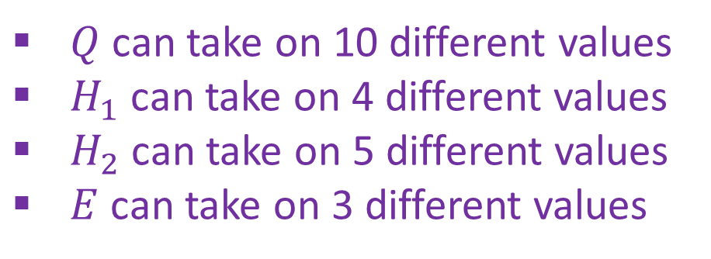
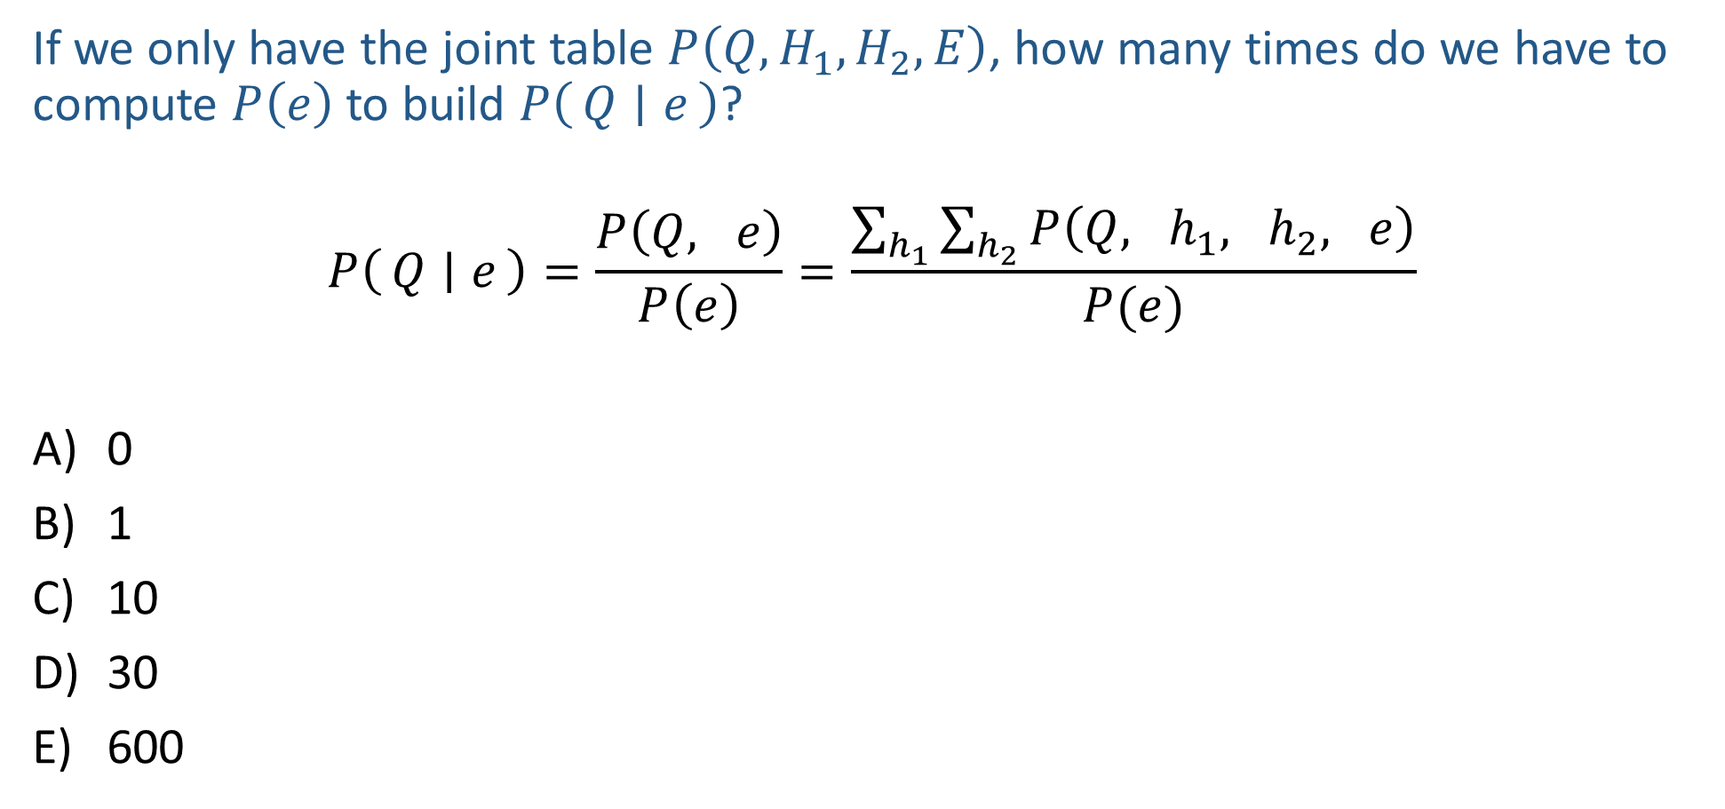
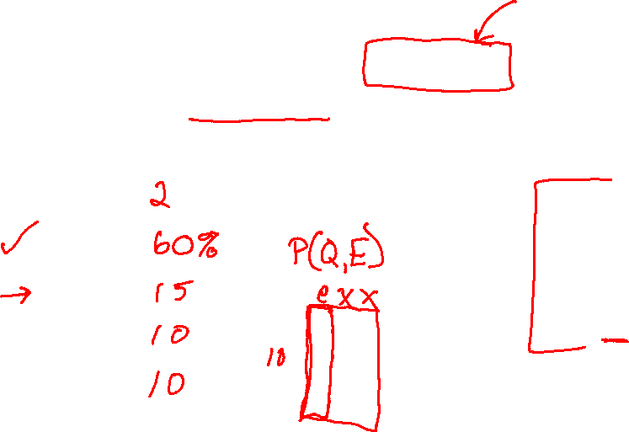
Piazza Poll 1
If we only have the joint table $P\left(Q,H_{1}, H_{2}, E\right)$, how many times do we have to compute $P\left(e\right)$ to build $P\left(Q ∣ e\right)$?
$$P\left(Q ∣ e\right)=\frac{P\left(Q, e\right)}{P\left(e\right)}=\frac{\sum_{h_{1}}{\sum_{h_{2}}{P\left(Q, h_{1}, h_{2}, e\right)}}}{P(e)}$$
0
1
10
30
600
$Q$ can take on 10 different values
$H_{1}$ can take on 4 different values
$H_{2}$ can take on 5 different values
$E$ can take on 3 different values

Slide 9
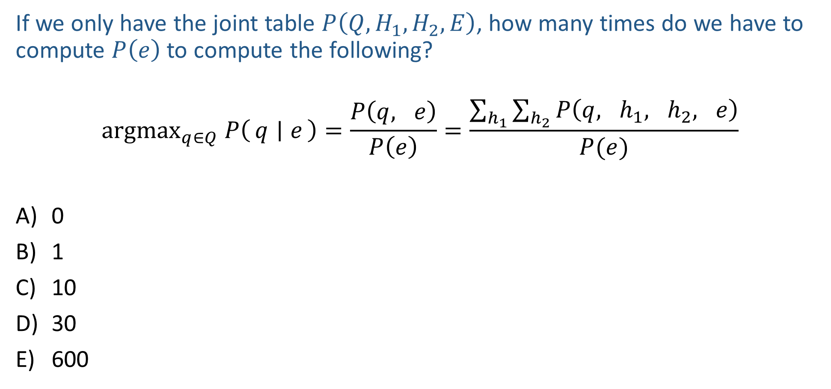
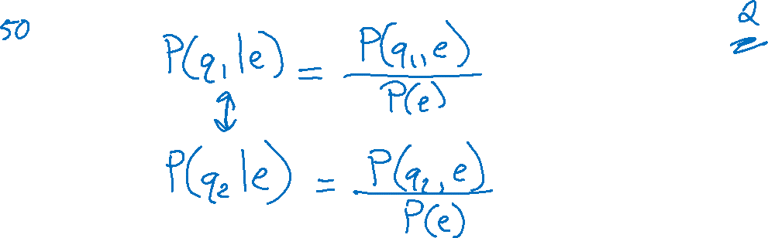
Piazza Poll 2
If we only have the joint table $P\left(Q,H_{1}, H_{2}, E\right)$, how many times do we have to compute $P\left(e\right)$ to compute the following?
$${argmax}_{q∈Q} P\left(q ∣ e\right)=\frac{P\left(q, e\right)}{P\left(e\right)}=\frac{\sum_{h_{1}}{\sum_{h_{2}}{P\left(q, h_{1}, h_{2}, e\right)}}}{P(e)}$$
0
1
10
30
600
$Q$ can take on 10 different values
$H_{1}$ can take on 4 different values
$H_{2}$ can take on 5 different values
$E$ can take on 3 different values

Slide 10
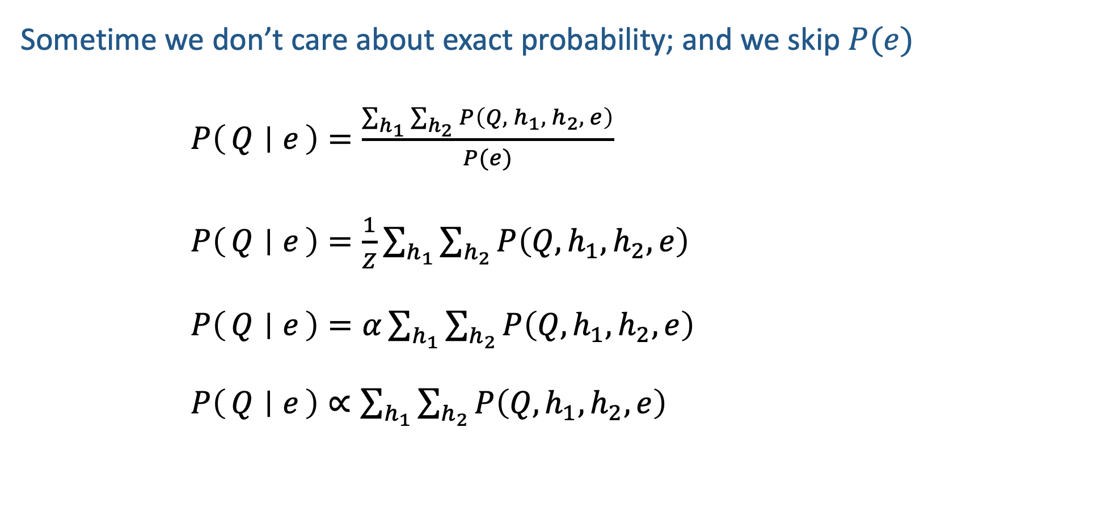

Normalization
Sometime we don’t care about exact probability; and we skip $P(e)$
$P\left(Q ∣ e\right)=\frac{\sum_{h_{1}}{\sum_{h_{2}}{P\left(Q, h_{1}, h_{2}, e\right)}}}{P(e)}$
$P\left(Q ∣ e\right)=\frac{1}{Z}\sum_{h_{1}}{\sum_{h_{2}}{P\left(Q, h_{1}, h_{2}, e\right)}}$
$P\left(Q ∣ e\right)=α\sum_{h_{1}}{\sum_{h_{2}}{P\left(Q, h_{1}, h_{2}, e\right)}}$
$P\left(Q ∣ e\right)∝\sum_{h_{1}}{\sum_{h_{2}}{P\left(Q, h_{1}, h_{2}, e\right)}}$

Slide 11
Bayes Nets in the Wild
Wheel of Fortune

Slide 12

Bayes Nets in the Wild
Example: Speech Recognition
“artificial $⋅⋅⋅⋅⋅⋅⋅⋅⋅⋅⋅$”
Find most probable next word given “artificial” and the audio for second word.

Slide 13
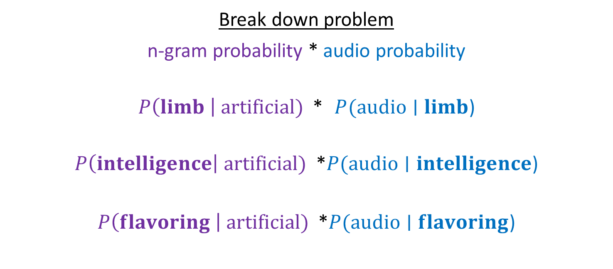
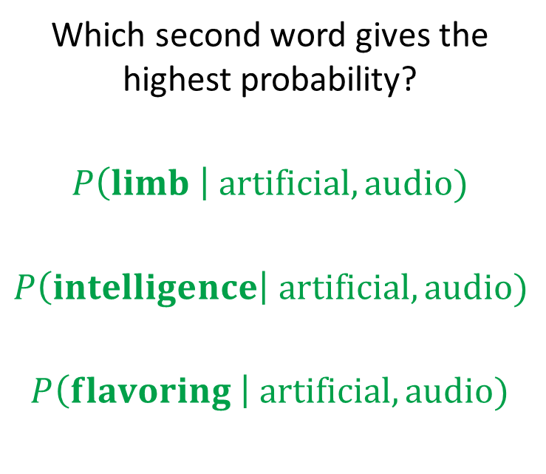
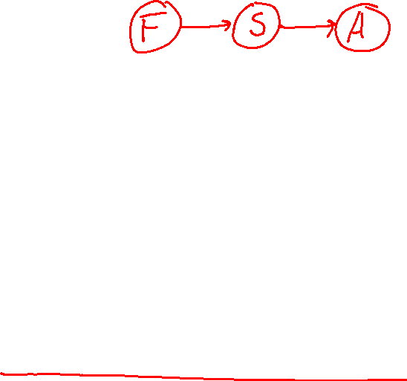
Bayes Nets in the Wild
Example: Speech Recognition
“artificial $⋅⋅⋅⋅⋅⋅⋅⋅⋅⋅⋅$”
Find most probable next word given “artificial” and the audio for second word.
Which second word gives the highest probability?
$$P\left(limb \right| artificial, audio)$$
$$P\left(intelligence\right| artificial, audio)$$
$$P\left(flavoring \right| artificial, audio)$$
Break down problem
n-gram probability * audio probability
$P\left(limb \right| artificial)$ * $P(audio∣limb$)
$P\left(intelligence\right| artificial)$ *$P(audio∣intelligence$)
$P\left(flavoring \right| artificial)$ *$P(audio∣flavoring$)

Slide 14

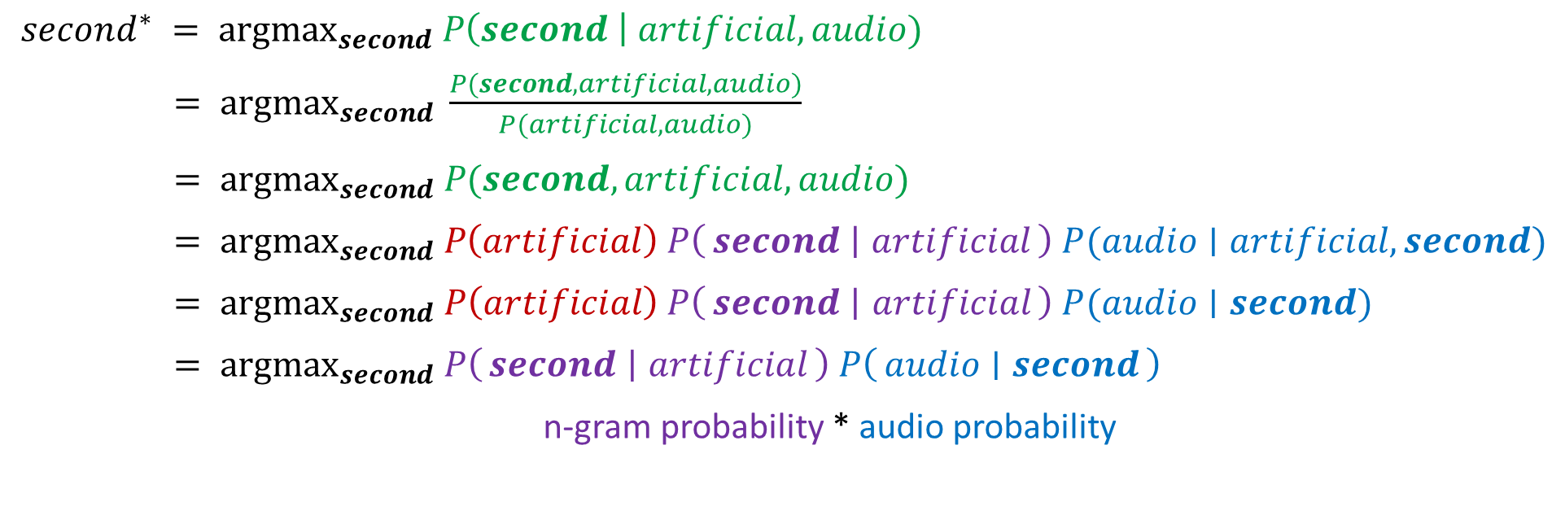
Bayes Nets in the Wild
$second^{∗} = {argmax}_{second} P\left(second \right| artificial, audio)$
$= {argmax}_{second} \frac{P(second, artificial, audio)}{P(artificial, audio)}$
$= {argmax}_{second} P(second, artificial, audio)$
$= {argmax}_{second} P\left(artificial\right) P\left(second ∣ artificial\right) P(audio∣artificial, second)$
$= {argmax}_{second} P\left(artificial\right) P\left(second ∣ artificial\right) P(audio∣second)$
$= {argmax}_{second} P\left(second ∣ artificial\right) P\left(audio ∣ second\right)$
n-gram probability * audio probability

Slide 15

Inference
Inference: calculating some useful quantity from a probability model (joint probability distribution)
Examples:
  Posterior marginal probability
    P(Q|e₁,..,e_{k})
    e.g., what disease might I have?
  Most likely explanation:
    argmax_{q,r,s} P(Q=q,R=r,S=s|e₁,..,e_{k})
    e.g., what was just said?

Slide 16

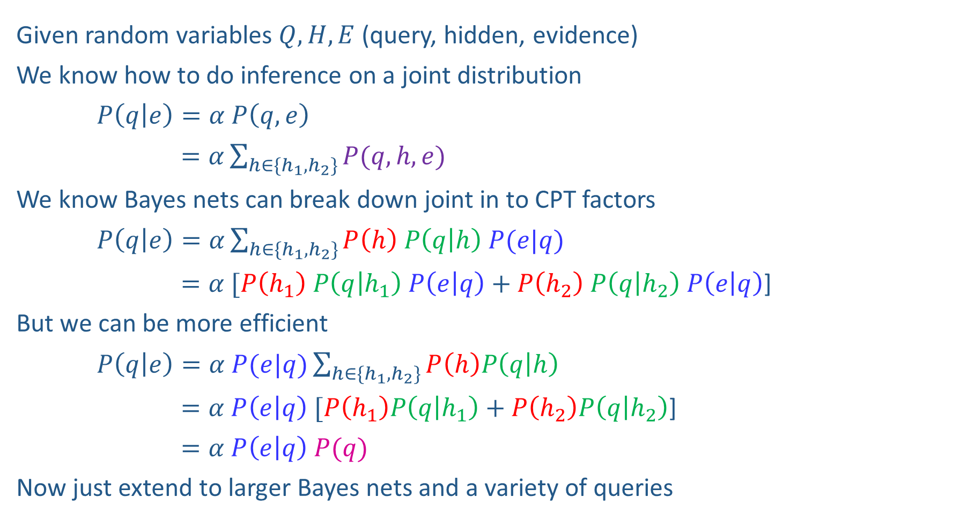


Inference Overview
Given random variables$Q, H, E$ (query, hidden, evidence)
We know how to do inference on a joint distribution
$P\left(q | e\right)=α P\left(q,e\right)$
$=α\sum_{h∈\{h_{1},h_{2}\}}{P(q,h,e)}$
We know Bayes nets can break down joint in to CPT factors
$P\left(q | e\right)=α\sum_{h∈\{h_{1},h_{2}\}}{P\left(h\right) P\left(q | h\right) P(e|q)}$
$=α [P\left(h_{1}\right) P\left(q | h_{1}\right) P\left(e | q\right)+P\left(h_{2}\right) P\left(q | h_{2}\right) P\left(e | q\right)$]
But we can be more efficient
$P\left(q | e\right)=α P(e|q)\sum_{h∈\{h_{1},h_{2}\}}{P\left(h\right)P\left(q | h\right) }$
$=α P\left(e | q\right) [P\left(h_{1}\right)P\left(q | h_{1}\right)+P\left(h_{2}\right)P\left(q | h_{2}\right)$]
$=α P\left(e | q\right) P(q)$
Now just extend to larger Bayes nets and a variety of queries
Enumeration
$$H$$
$$Q$$
$$E$$
Variable
Elimination

Slide 17
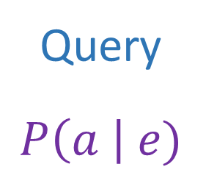
Answer Any Query from Bayes Net
Bayes Net
Joint
Query
$$P\left(a \right| e)$$
$$P\left(A\right) P\left(B | A\right) P\left(C | A\right) P\left(D | C\right) P(E|C)$$

Slide 18
Next: Answer Any Query from Bayes Net
Bayes Net
Query
$$P\left(a \right| e)$$
$$P\left(A\right) P\left(B | A\right) P\left(C | A\right) P\left(D | C\right) P(E|C)$$

Slide 19
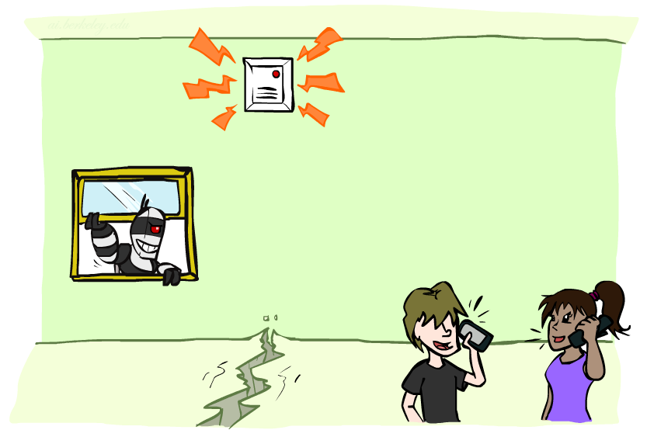
Example: Alarm Network
Variables
  B: Burglary
  A: Alarm goes off
  M: Mary calls
  J: John calls
  E: Earthquake!

Slide 20

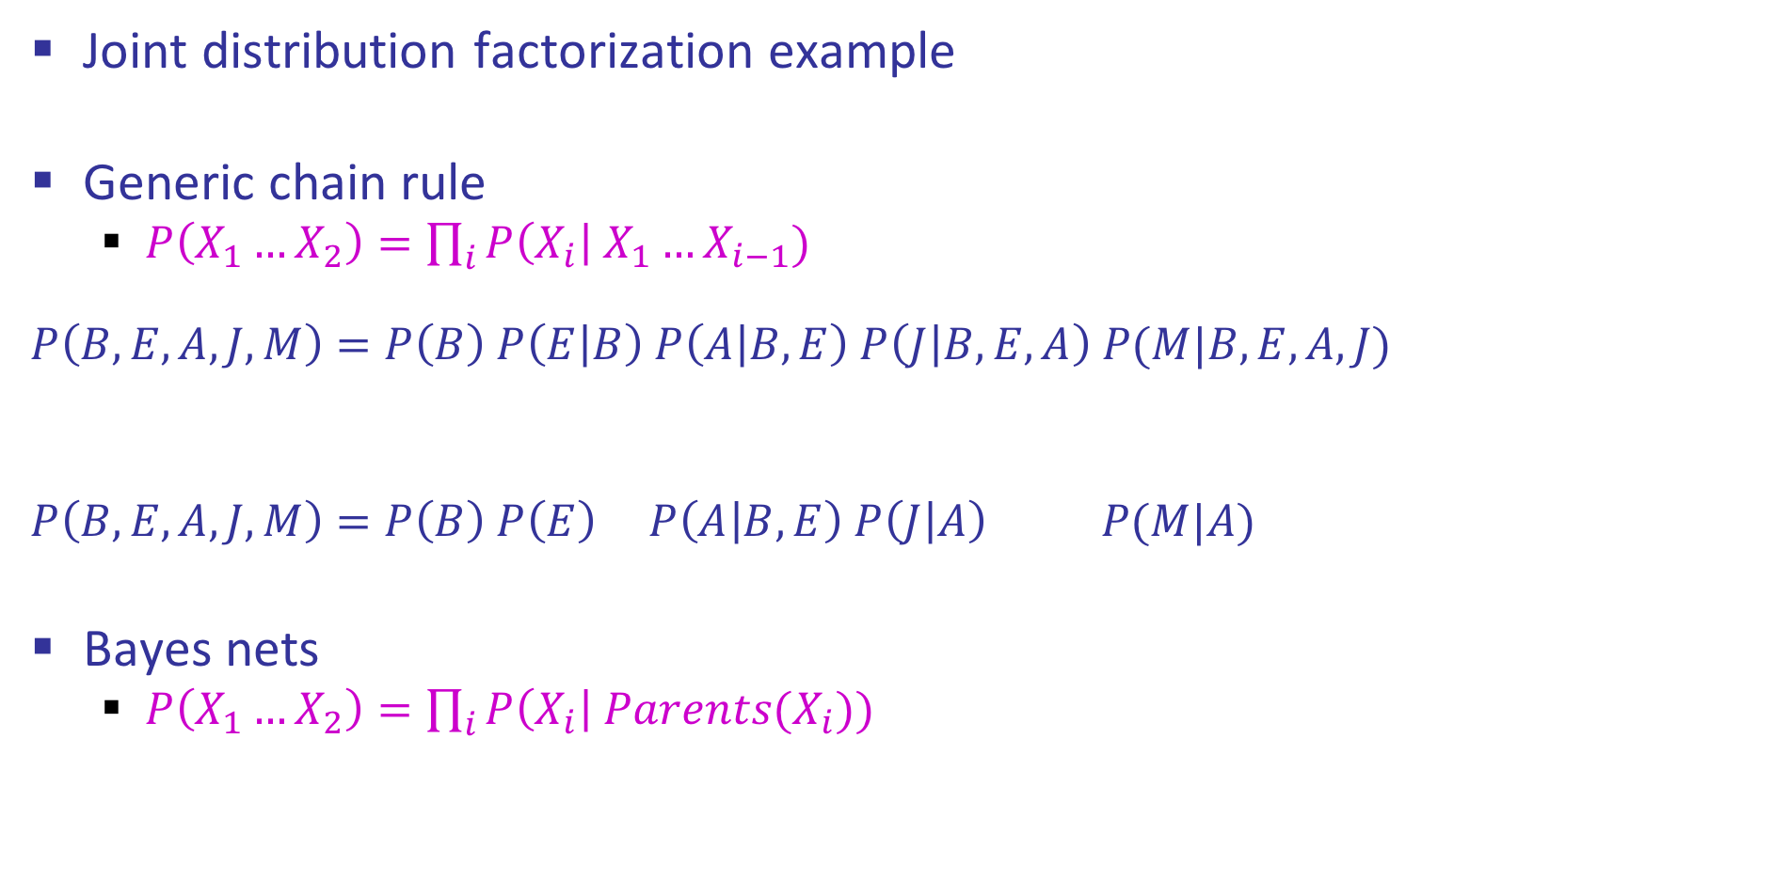

Example: Alarm Network
Joint distribution factorization example
Generic chain rule
  $P\left(X_{1}…X_{2}\right)=\prod_{i}{P\left(X_{i}\right| X_{1}…X_{i−1}) }$
  $$P\left(B,E,A,J,M\right)=P\left(B\right) P\left(E | B\right) P\left(A | B,E\right) P\left(J | B,E,A\right) P(M|B,E,A,J)$$
  $$P\left(B,E,A,J,M\right)=P\left(B\right) P\left(E\right) P\left(A | B,E\right) P\left(J | A\right) P(M|A)$$
Bayes nets
  $P\left(X_{1}…X_{2}\right)=\prod_{i}{P\left(X_{i}\right| Parents(X_{i})) }$
Burglary
Earthquake
Alarm
John calls
Mary calls

Slide 21
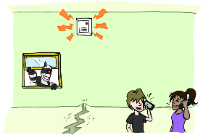
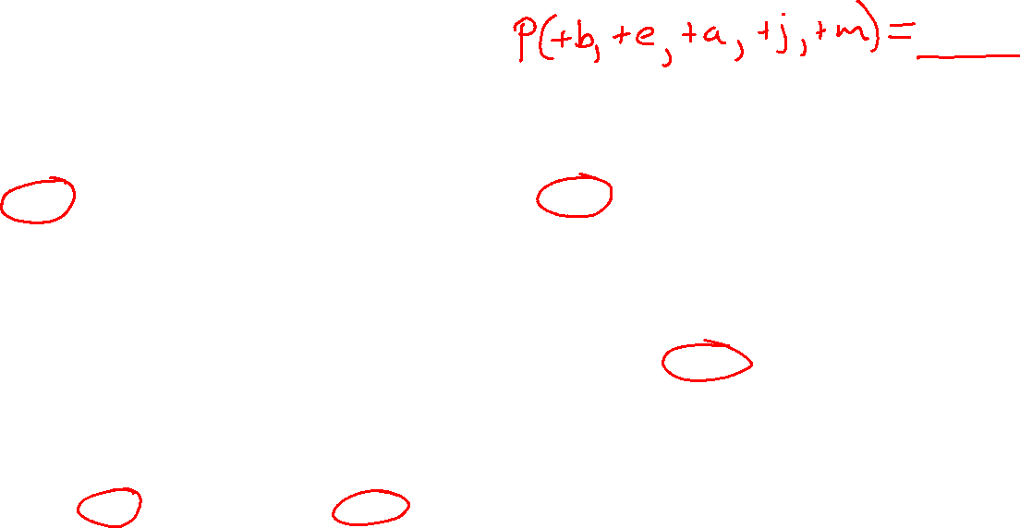
Example: Alarm Network
B | P(B)
+b | 0.001
-b | 0.999
E | P(E)
+e | 0.002
-e | 0.998
Burglary
Earthqk
Alarm
B | E | A | P(A|B,E)
+b | +e | +a | 0.95
+b | +e | -a | 0.05
+b | -e | +a | 0.94
+b | -e | -a | 0.06
-b | +e | +a | 0.29
-b | +e | -a | 0.71
-b | -e | +a | 0.001
-b | -e | -a | 0.999
John calls
Mary calls
A | J | P(J|A)
+a | +j | 0.9
+a | -j | 0.1
-a | +j | 0.05
-a | -j | 0.95
A | M | P(M|A)
+a | +m | 0.7
+a | -m | 0.3
-a | +m | 0.01
-a | -m | 0.99
Notes:
demo

Slide 22

Example: Alarm Network
$$P\left(+b, −e, −a, −j,−m\right)=P\left(+b\right) ∗ P\left(−e\right) ∗ P\left(−a | +b, −e\right) ∗ P\left(−j | −a\right) ∗ P\left(−m | −a\right)$$
$=0.001 ∗ 0.998 ∗ 0.06 ∗ 0.95 ∗ 0.99$
$$P\left(+b, −e, −a, −j,−m\right)=P\left(−e\right) ∗ P\left(−a | +b, −e\right) ∗P\left(+b\right) ∗P\left(−j | −a\right) ∗ P\left(−m | −a\right)$$
$=0.998 ∗ 0.06 ∗ 0.001 ∗ 0.95 ∗ 0.99$
Notes:
demo

Slide 23

Example: Alarm Network
$$P\left(+b, −e, −a, −j,−m\right)=P\left(+b\right) ∗ P\left(−e\right) ∗ P\left(−a | +b, −e\right) ∗ P\left(−j | −a\right) ∗ P\left(−m | −a\right)$$
$=0.001 ∗ 0.998 ∗ 0.06 ∗ 0.95 ∗ 0.99$
$$P\left(+b, −e, −a, −j,−m\right)=P\left(−e\right) ∗ P\left(−a | +b, −e\right) ∗P\left(+b\right) ∗P\left(−j | −a\right) ∗ P\left(−m | −a\right)$$
$=0.998 ∗ 0.06 ∗ 0.001 ∗ 0.95 ∗ 0.99$
$$P\left(+b, −e, −a, −j,−m\right)=P\left(−e\right) ∗ P\left(−a | +b, −e\right) ∗P\left(+b\right) P\left(−j | −a\right) ∗ P\left(−m | −a\right)$$
$=0.998 ∗ 0.06 ∗ 0.0095 ∗ 0.99$
Multiplication order can change (commutativity)
Multiplication pairs don’t have to make sense (associativity)
Notes:
demo

Slide 24
Factors
$$P\left(+b, −e, −a, −j,−m\right)=P\left(+b\right) ∗ P\left(−e\right) ∗ P\left(−a | +b, −e\right) ∗ P\left(−j | −a\right) ∗ P\left(−m | −a\right)$$
$=0.001 ∗ 0.998 ∗ 0.06 ∗ 0.95 ∗ 0.99$
Notes:
demo

Slide 25
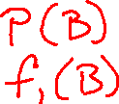
Factors
$$P\left(+b, −e, −a, −j,−m\right)=f_{1}\left(+b\right) ∗f_{2}\left(−e\right) ∗f_{3}\left(−a, +b, −e\right)∗f_{4}(−j,−a) ∗f_{5}\left(−m, −a\right)$$
$=0.001 ∗ 0.998 ∗ 0.06 ∗ 0.95 ∗ 0.99$
$$P\left(+b, −e, −a, −j,−m\right)=f_{2}\left(−e\right) ∗f_{3}\left(−a, +b, −e\right)∗f_{1}\left(+b\right) ∗f_{4}(−j,−a)∗f_{5}\left(−m, −a\right)$$
$=0.998 ∗ 0.06 ∗ 0.001 ∗ 0.95 ∗ 0.99$
$$P\left(+b, −e, −a, −j,−m\right)=f_{2}\left(−e\right) ∗f_{3}\left(−a, +b, −e\right)∗{ f}_{6}\left(+b,j,−a\right) ∗f_{5}\left(−m, −a\right)$$
$=0.998 ∗ 0.06 ∗ 0.0095 ∗ 0.99$
Multiplication order can change (commutativity)
Multiplication pairs don’t have to make sense (associativity)
Notes:
demo

Slide 26

Factor Tables
$$P\left(+b, −e, −a, −j,−m\right)=P\left(+b\right) ∗ P\left(−e\right) ∗ P\left(−a | +b, −e\right) ∗ P\left(−j | −a\right) ∗ P\left(−m | −a\right)$$
$=0.001 ∗ 0.998 ∗ 0.06 ∗ 0.95 ∗ 0.99$
$$P\left(B, E, A, J,M\right)=P(B)∗ P\left(E\right) ∗ P\left(A | B, E\right) ∗ P\left(J | A\right) ∗ P\left(M | A\right)$$
Notes:
demo

Slide 27
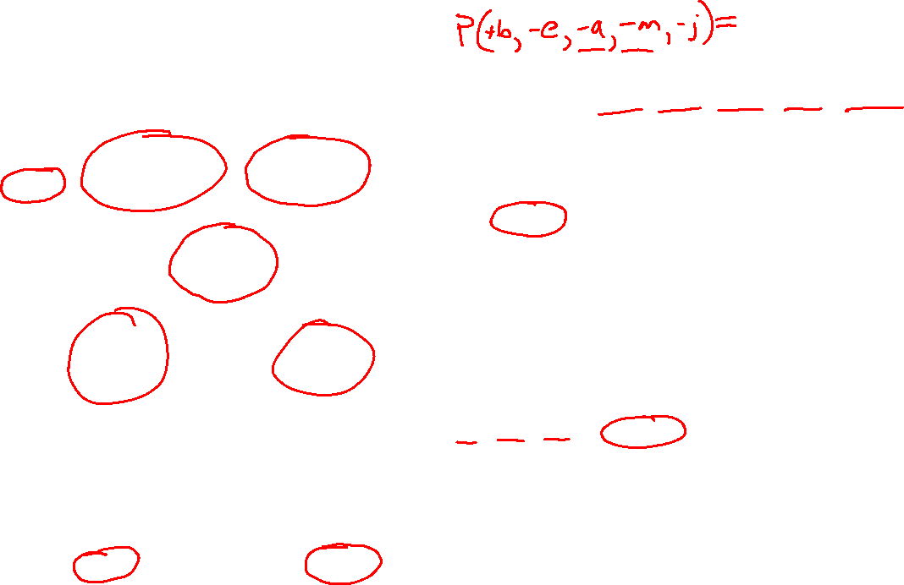
Example: Alarm Network
B | P(B)
+b | 0.001
-b | 0.999
E | P(E)
+e | 0.002
-e | 0.998
Burglary
Earthqk
Alarm
B | E | A | P(A|B,E)
+b | +e | +a | 0.95
+b | +e | -a | 0.05
+b | -e | +a | 0.94
+b | -e | -a | 0.06
-b | +e | +a | 0.29
-b | +e | -a | 0.71
-b | -e | +a | 0.001
-b | -e | -a | 0.999
John calls
Mary calls
A | J | P(J|A)
+a | +j | 0.9
+a | -j | 0.1
-a | +j | 0.05
-a | -j | 0.95
A | M | P(M|A)
+a | +m | 0.7
+a | -m | 0.3
-a | +m | 0.01
-a | -m | 0.99
Notes:
demo

Slide 28
Inference by Enumeration in Bayes Net
Reminder of inference by enumeration:
  Any probability of interest can be computed by summing entries from the joint distribution
  Entries from the joint distribution can be obtained from a BN by multiplying the corresponding conditional probabilities
  P(B | j, m) = α P(B, j, m)
  = α ∑_{e,a} P(B, e, a, j, m)
  = α ∑_{e,a} P(B) P(e) P(a|B,e) P(j|a) P(m|a)
So inference in Bayes nets means computing sums of products of numbers: sounds easy!!
Problem: sums of exponentially many products!
B
E
A
J
M

Slide 29
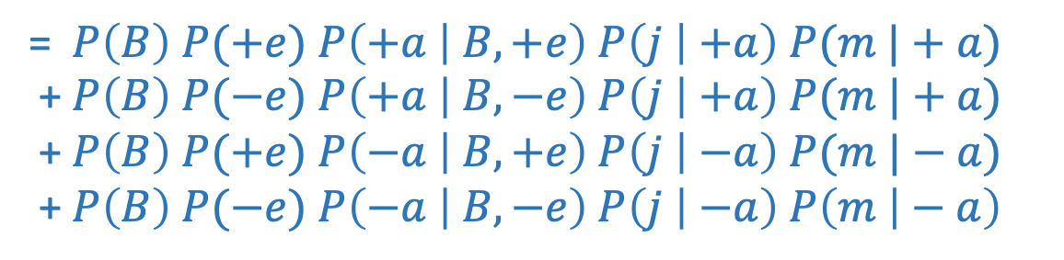
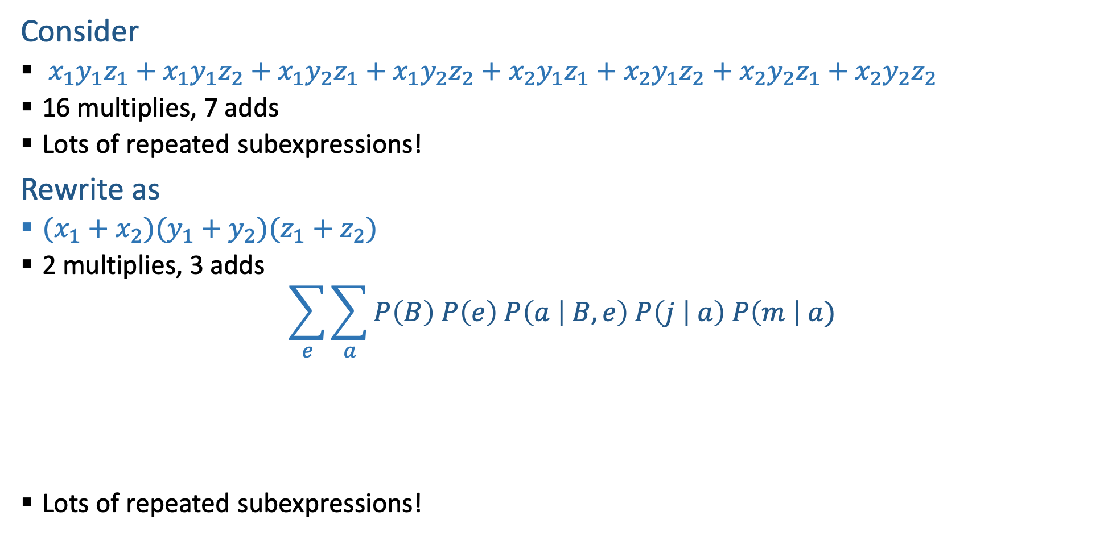
Can we do better?
Consider
  $x_{1}y_{1}z_{1}+x_{1}y_{1}z_{2}+x_{1}y_{2}z_{1}+x_{1}y_{2}z_{2}+x_{2}y_{1}z_{1}+x_{2}y_{1}z_{2}+x_{2}y_{2}z_{1}+x_{2}y_{2}z_{2}$
  16 multiplies, 7 adds
  Lots of repeated subexpressions!
Rewrite as
  $(x_{1}+x_{2})(y_{1}+y_{2})(z_{1}+z_{2})$
  2 multiplies, 3 adds
$$\sum_{e}{\sum_{a}{P\left(B\right) P\left(e\right) P\left(a | B,e\right) P\left(j | a\right) P\left(m \right| a)}}$$
  Lots of repeated subexpressions!
= $P\left(B\right) P(+e)$ $P\left(+a | B,+e\right) P\left(j | +a\right) P(m |+a)$
+ $P\left(B\right) P(−e)$ $P\left(+a | B,−e\right) P\left(j | +a\right) P(m |+a)$
+ $P\left(B\right) P(+e)$ $P\left(−a | B,+e\right) P\left(j | −a\right) P(m |−a)$
+ $P\left(B\right) P(−e)$ $P\left(−a | B,−e\right) P\left(j | −a\right) P\left(m | − a\right)$

Slide 30

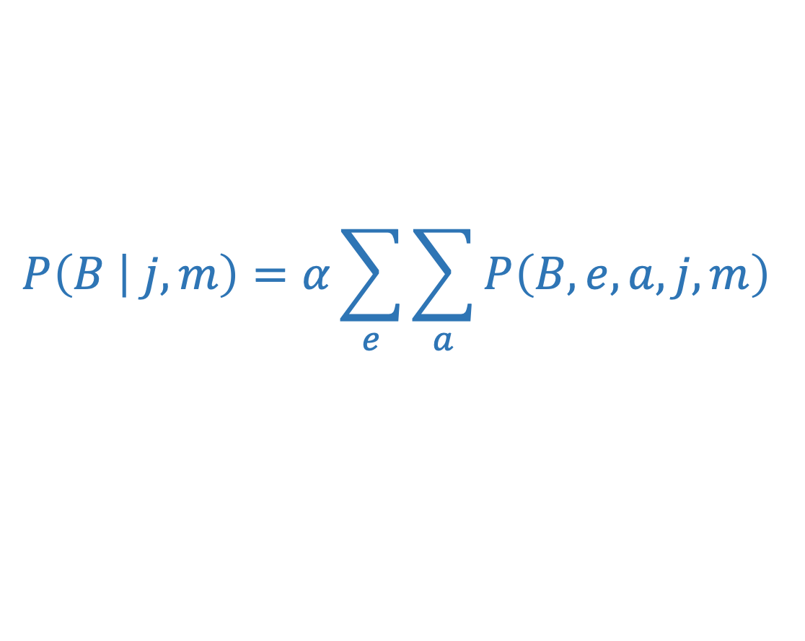

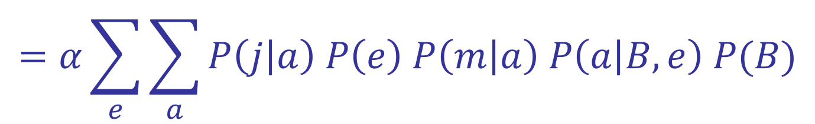






Variable elimination: The basic ideas
Move summations inwards as far as possible
$$P\left(B | j,m\right)=α\sum_{e}{\sum_{a}{P\left(B,e,a,j,m\right) }}$$
$$=α\sum_{e}{\sum_{a}{P\left(j | a\right) P\left(e\right) P\left(m | a\right) P\left(a | B,e\right) P(B)}}$$
$$\sum_{e}{ }$$
$$\sum_{a}{ }$$
$$=α$$
$$P\left(B\right)$$
$$P\left(e\right)$$
$$P\left(j | a\right)$$
$$P(m|a)$$
$$P\left(a | B,e\right)$$

Slide 31







Variable elimination: The basic ideas
Move summations inwards as far as possible
$$P\left(B | j,m\right)=α\sum_{e}{\sum_{a}{P\left(B,e,a,j,m\right) }}$$
$$=α\sum_{e}{\sum_{a}{P\left(j | a\right) P\left(e\right) P\left(m | a\right) P\left(a | B,e\right) P(B)}}$$
$$\sum_{e}{ }$$
$$\sum_{a}{ }$$
$$=α$$
$$P\left(j | a\right)$$
$$P\left(e\right)$$
$$P(m|a)$$
$$P\left(a | B,e\right)$$
$$P\left(B\right)$$

Slide 32
Variable Elimination
function VariableElimination(Q , e, bn) returns a distribution over Q
factors ← [ ]
for each var in ORDER(bn.vars) do
factors ← [MAKE-FACTOR(var, e)|factors]
if var is a hidden variable then
factors ← SUM-OUT(var,factors)
return NORMALIZE(POINTWISE-PRODUCT(factors))

Slide 33
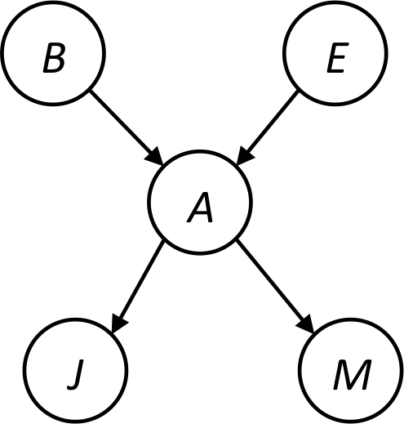


Example
Query P(B | j,m)
  P(B) P(E) P(A|B,E) P(j|A) P(m|A)
Choose A
  P(A|B,E)
  P(j|A)
  P(m|A)
  P(A,j,m|B,E)
  P(j,m|B,E)
  P(B) P(E) P(j,m|B,E)

Slide 34
Example
  P(B) P(E) P(j,m|B,E)
Choose E
  P(E)
  P(j,m|B,E)
  P(E,j,m|B)
  P(j,m|B)
  P(B) P(j,m|B)
Finish with B
  P(B)
  P(j,m|B)
  P(j,m,B)
Normalize
  P(B | j,m)

Slide 35
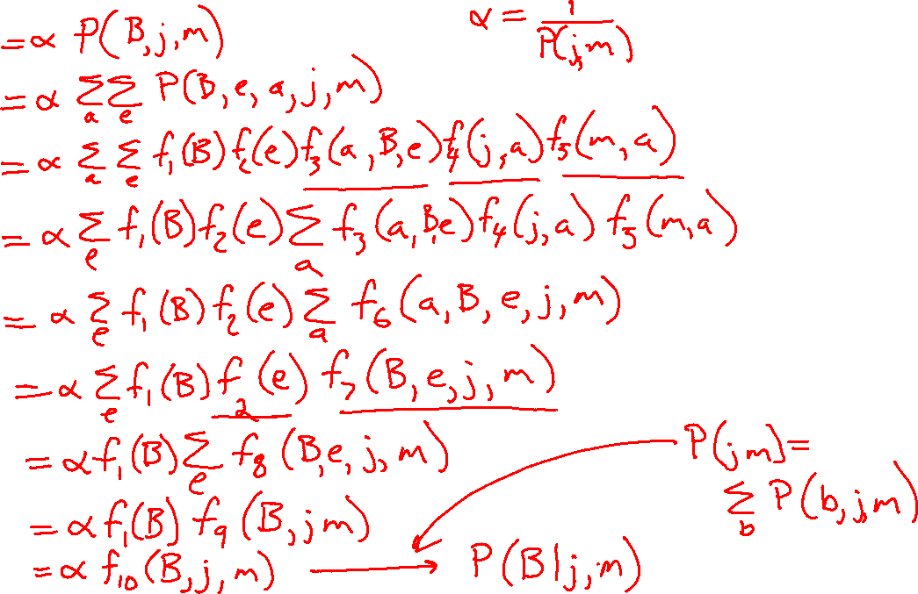
P(B | j, m)

Slide 36
Order matters
  Order the terms D, Z, A, B C
    P(D) = α ∑_{z,a,b,c} P(D|z) P(z) P(a|z) P(b|z) P(c|z)
    = α ∑_{z} P(D|z) P(z) ∑_{a} P(a|z) ∑_{b} P(b|z) ∑_{c} P(c|z)
    Largest factor has 2 variables (D,Z)
  Order the terms A, B C, D, Z
    P(D) = α ∑_{a,b,c,z} P(a|z) P(b|z) P(c|z) P(D|z) P(z)
    = α ∑_{a} ∑_{b} ∑_{c} ∑_{z} P(a|z) P(b|z) P(c|z) P(D|z) P(z)
    Largest factor has 4 variables (A,B,C,D)
  In general, with n leaves, factor of size 2^{n}
Z
A
B
C
D

Slide 37
VE: Computational and Space Complexity
The computational and space complexity of variable elimination is determined by the largest factor (and it’s space that kills you)
The elimination ordering can greatly affect the size of the largest factor.
  E.g., previous slide’s example 2^{n} vs. 2
Does there always exist an ordering that only results in small factors?
  No!

Slide 38
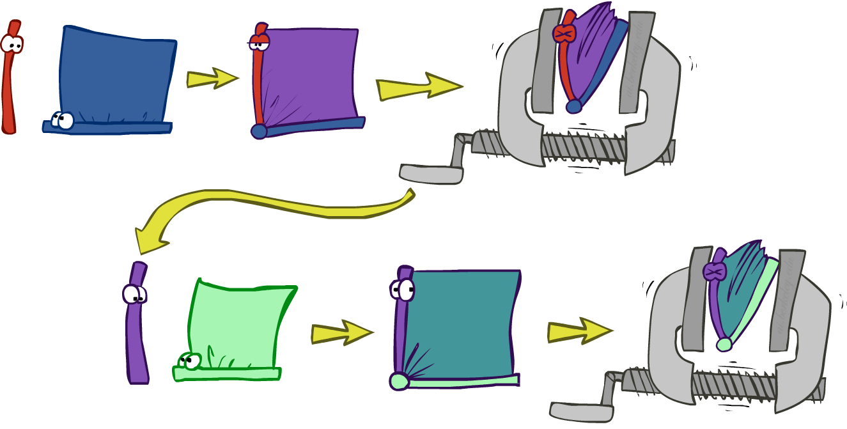
Variable elimination: The basic ideas
Move summations inwards as far as possible
  P(B | j, m) = α ∑_{e}∑_{a}P(B) P(e) P(a|B,e) P(j|a) P(m|a)
  = α P(B) ∑_{e} P(e) ∑_{a} P(a|B,e) P(j|a) P(m|a)
Do the calculation from the inside out
  I.e., sum over a first, then sum over e
  Problem: P(a|B,e) isn’t a single number, it’s a bunch of different numbers depending on the values of B and e
  Solution: use arrays of numbers (of various dimensions) with appropriate operations on them; these are called factors

Slide 39

Operation 1: Pointwise product
First basic operation: pointwise product of factors (similar to a database join, not matrix multiply!)
  New factor has union of variables of the two original factors
  Each entry is the product of the corresponding entries from the original factors
Example: P(A) x P(J|A) = P(A,J)
P(J|A)
P(A,J)
P(A)
A \ J | true | false
true | 0.9 | 0.1
false | 0.05 | 0.95
A \ J | true | false
true
false
 | 0.09 | 0.01
 | 0.045 | 0.855
true | 0.1
false | 0.9
x
=

Slide 40
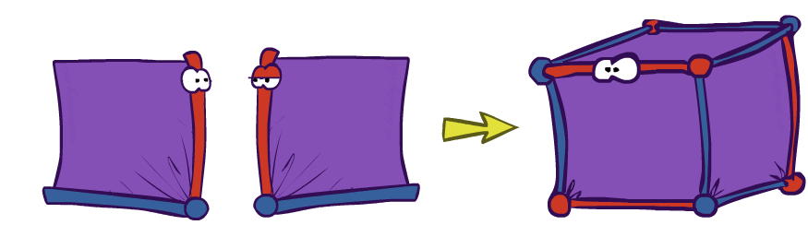
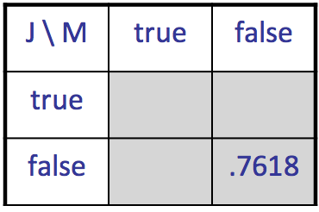
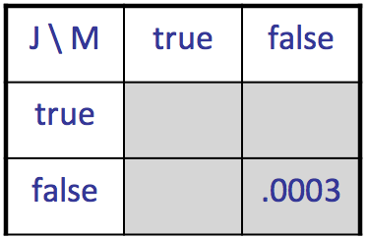
Example: Making larger factors
Example: P(J|A) x P(M|A) = P(J,M|A)
P(J,M|A)
P(J|A)
P(M|A)
A \ J | true | false
true | 0.99 | 0.01
false | 0.145 | 0.855
A \ M | true | false
true | 0.97 | 0.03
false | 0.019 | 0.891
x
=
A=false
A=true

Slide 41
Example: Making larger factors
Example: f₁(U,V) x f₂(V,W) x f₃(W,X) = f₄(U,V,W,X)
Sizes: [10,10] x [10,10] x [10,10] = [10,10,10,10]
I.e., 300 numbers blows up to 10,000 numbers!
Factor blowup can make VE very expensive

Slide 42
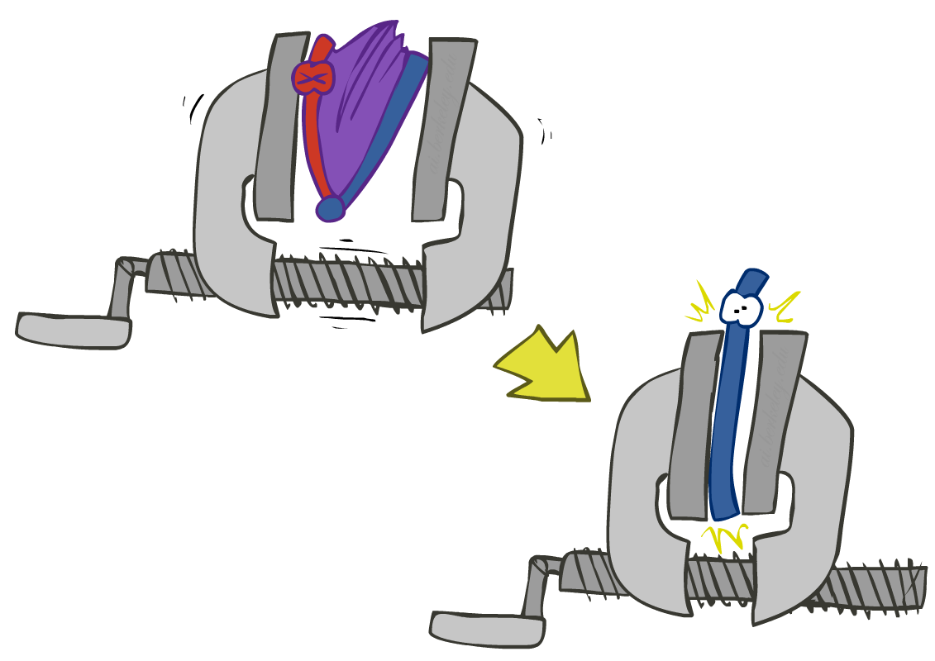
Operation 2: Summing out a variable
Second basic operation: summing out (or eliminating) a variable from a factor
  Shrinks a factor to a smaller one
Example: ∑_{j} P(A,J) = P(A,j) + P(A,¬j) = P(A)
P(A,J)
P(A)
A \ J | true | false
true | 0.09 | 0.01
false | 0.045 | 0.855
Sum out J
true | 0.1
false | 0.9

Slide 43

Summing out from a product of factors
Project the factors each way first, then sum the products
  Example: ∑_{a} P(a|B,e) P(j|a) P(m|a)
  = P(a|B,e) P(j|a) P(m|a) + P(¬a|B,e) P(j|¬a) P(m|¬a)
  = P(a,j,m|B,e) + P(¬a,j,m|B,e)
  = P(j,m|B,e)

Slide 44

Variable Elimination

Slide 45
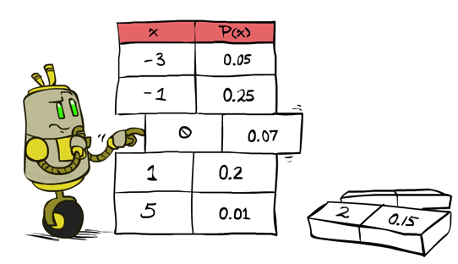
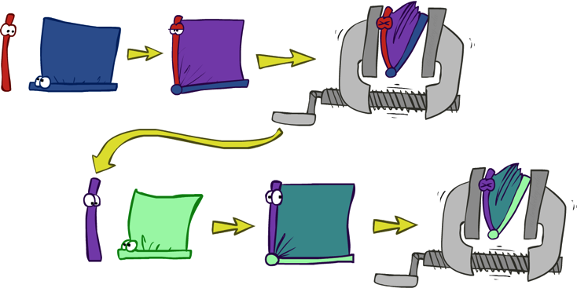


Variable Elimination
    Query: P(Q|E₁=e₁,.., E_{k}=e_{k})
Start with initial factors:
  Local CPTs (but instantiated by evidence)
While there are still hidden variables (not Q or evidence):
  Pick a hidden variable H
  Join all factors mentioning H
  Eliminate (sum out) H
Join all remaining factors and normalize

Slide 46
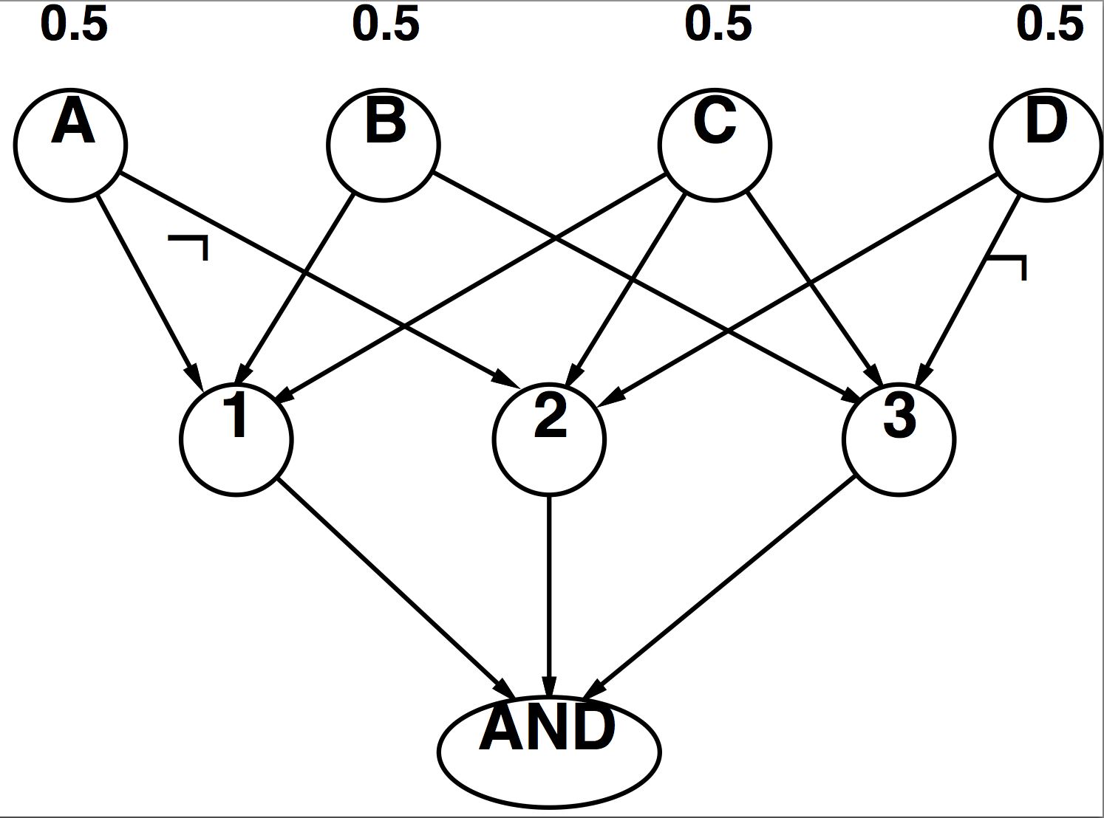
Worst Case Complexity? Reduction from SAT
CNF clauses:
  A v B v C
  C v D v ¬A
  B v C v ¬D
P(AND) > 0 iff clauses are satisfiable
  => NP-hard
P(AND) = S x 0.5^{n} where S is the number of satisfying assignments for clauses
  => #P-hard
Notes:
Make this model simpler (no reason for fan-in constraint)

Slide 47
Polytrees
A polytree is a directed graph with no undirected cycles
For poly-trees the complexity of variable elimination is linear in the network size if you eliminate from the leave towards the roots
  This is essentially the same theorem as for tree-structured CSPs

Slide 48

Bayes Nets
Part I: Representation
Part II: Exact inference
  Enumeration (always exponential complexity)
  Variable elimination (worst-case exponential complexity, often better)
  Inference is NP-hard in general
Part III: Approximate Inference

