Slide 1

Announcements
Assignments:
P4
Due tonight, 10 pm
Check your slip days!
HW9 (online)
Due Tue 11/5, 10 pm
Midterm:
Tue 11/12, in-class
See Piazza for details

Slide 2
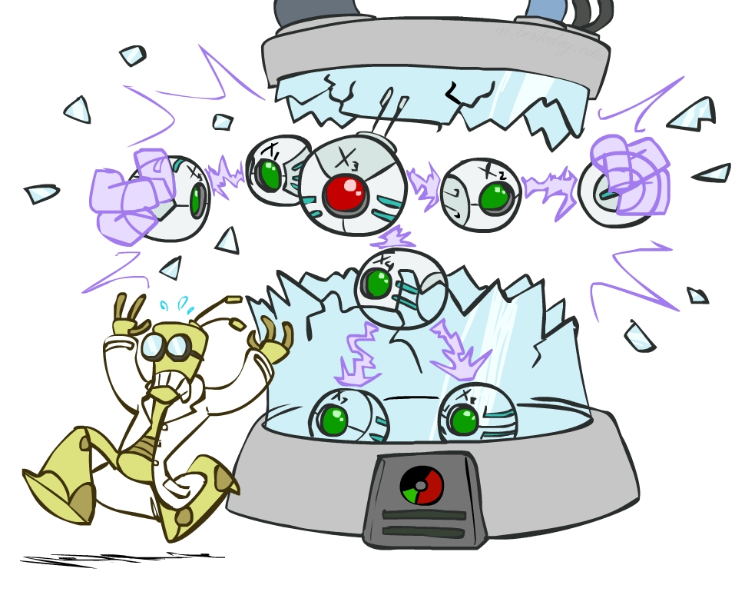
AI: Representation and Problem Solving
Bayes Nets: Independence
Instructors: Pat Virtue & Fei Fang
Slide credits: CMU AI and http://ai.berkeley.edu

Slide 3

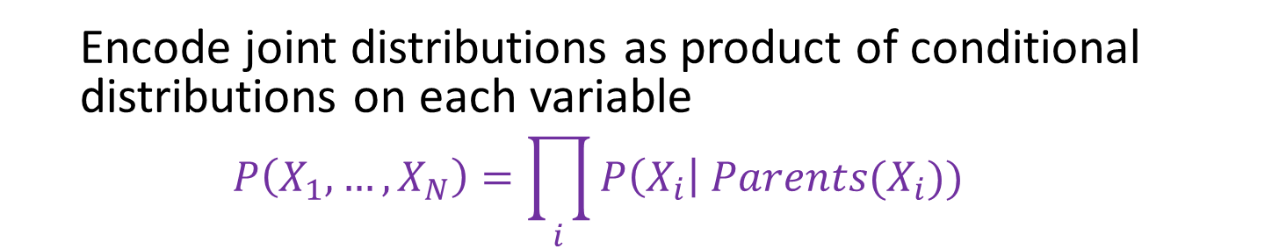



Bayesian Networks
Bayes net
One node per random variable
DAG
One CPT per node: P(node | Parents(node) )
$$A$$
$$B$$
$$C$$
$$D$$
$$P\left(A, B, C, D\right)=P\left(A\right) P(B) P\left(C | A,B\right) P\left(D | C\right)$$
Encode joint distributions as product of conditional distributions on each variable
$$P\left(X_{1},…,X_{N}\right)=\prod_{i}{P\left(X_{i}\right| Parents(X_{i})) }$$

Slide 4

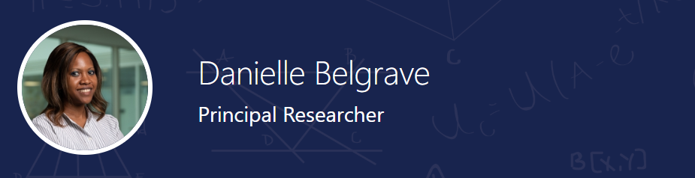
Danielle Belgrave, Microsoft Research
https://www.microsoft.com/en-us/research/people/dabelgra/
Developmental Profiles of Eczema, Wheeze, and Rhinitis:
Two Population-Based Birth Cohort Studies
Danielle Belgrave, et al. PLOS Medicine, 2014
https://journals.plos.org/plosmedicine/article?id=10.1371/journal.pmed.1001748

Slide 5
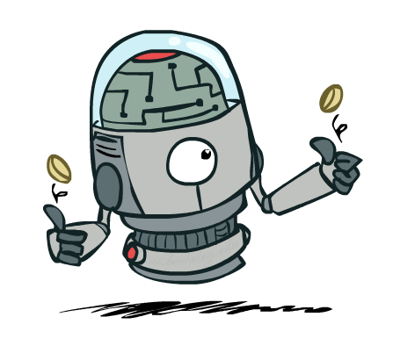
Independence

Slide 6

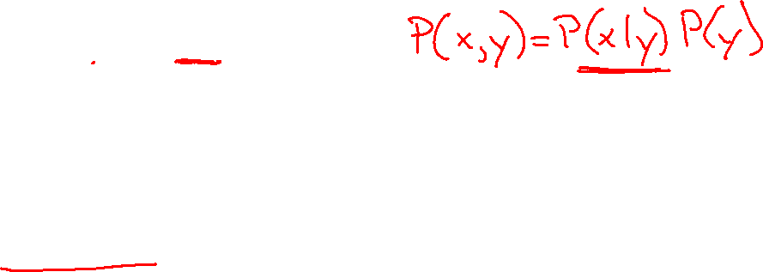
Independence
Two variables X and Y are (absolutely) independent if
∀x,y P(x, y) = P(x) P(y)
This says that their joint distribution factors into a product of two simpler distributions
Combine with product rule P(x,y) = P(x|y)P(y) we obtain another form:
∀x,y P(x | y) = P(x) or ∀x,y P(y | x) = P(y)
Example: two dice rolls Roll₁ and Roll₂
P(Roll₁=5, Roll₂=5) = P(Roll₁=5) P(Roll₂=5) = 1/6 x 1/6 = 1/36
P(Roll₂=5 | Roll₁=5) = P(Roll₂=5)

Slide 7


Example: Independence
n fair, independent coin flips:
P(X₁)
P(X₂)
P(X_{n})
H | 0.5
T | 0.5
H | 0.5
T | 0.5
H | 0.5
T | 0.5
P(X₁,X₂,...,X_{n})
2^{n}

Slide 8
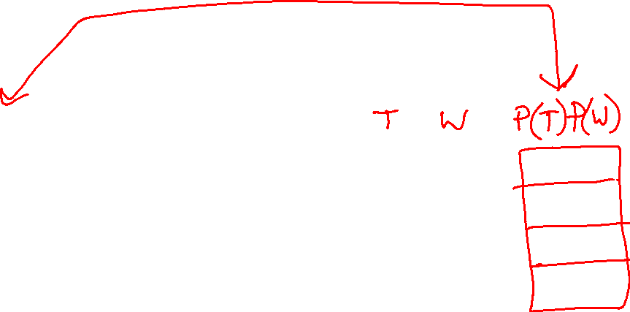



Piazza Poll 1
Are T and W independent?
$$P(T)$$
T | P
hot | 0.5
cold | 0.5
$$P_{1}\left(T,W\right)$$
T | W | P
hot | sun | 0.4
hot | rain | 0.1
cold | sun | 0.2
cold | rain | 0.3
$$P(W)$$
W | P
sun | 0.6
rain | 0.4

Slide 9


Piazza Poll 1
$$P(T)$$
T | P
hot | 0.5
cold | 0.5
$$P_{1}\left(T,W\right)$$
$P_{2}\left(T,W\right)=P\left(T\right)P(W)$
T | W | P
hot | sun | 0.4
hot | rain | 0.1
cold | sun | 0.2
cold | rain | 0.3
T | W | P
hot | sun | 0.3
hot | rain | 0.2
cold | sun | 0.3
cold | rain | 0.2
$$P(W)$$
W | P
sun | 0.6
rain | 0.4

Slide 10
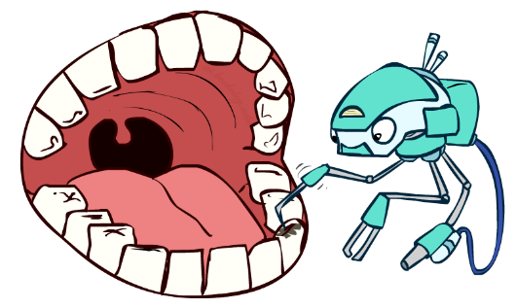
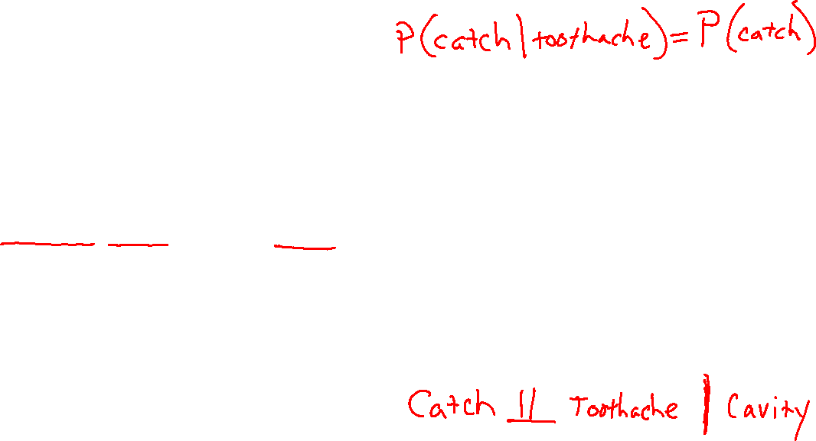
Conditional Independence
P(Toothache, Cavity, Catch)
If I have a cavity, the probability that the probe catches in it doesn't depend on whether I have a toothache:
P(+catch | +toothache, +cavity) = P(+catch | +cavity)
The same independence holds if I don’t have a cavity:
P(+catch | +toothache, -cavity) = P(+catch| -cavity)
Catch is conditionally independent of Toothache given Cavity:
P(Catch | Toothache, Cavity) = P(Catch | Cavity)
Equivalent statements:
P(Toothache | Catch , Cavity) = P(Toothache | Cavity)
P(Toothache, Catch | Cavity) = P(Toothache | Cavity) P(Catch | Cavity)
One can be derived from the other easily

Slide 11
Conditional Independence
Unconditional (absolute) independence very rare (why?)
Conditional independence is our most basic and robust form of knowledge about uncertain environments.
X is conditionally independent of Y given Z
if and only if:
∀x,y,z P(x | y, z) = P(x | z)
or, equivalently, if and only if
∀x,y,z P(x, y | z) = P(x | z) P(y | z)

Slide 12
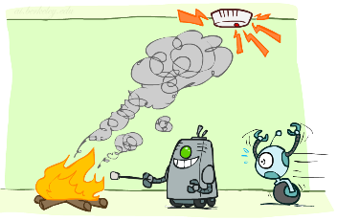
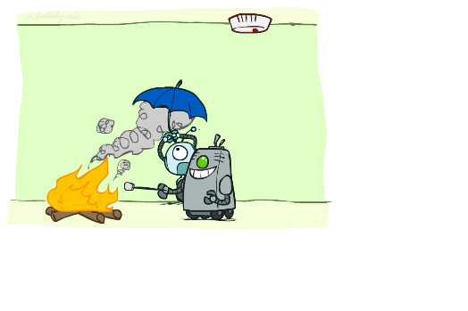
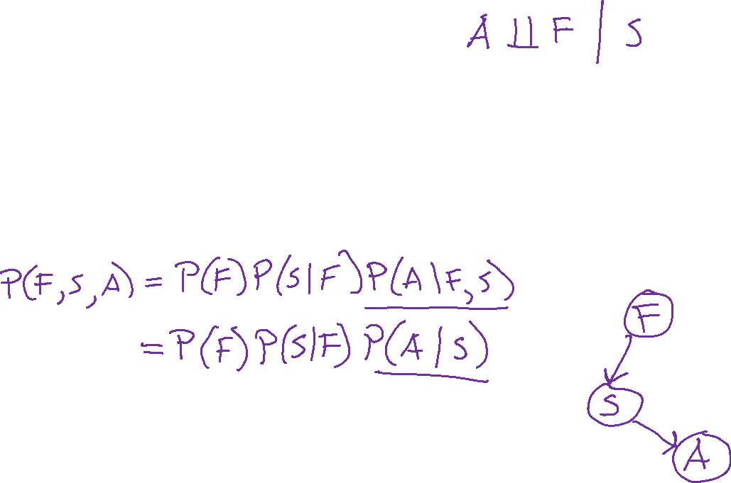
Conditional Independence
What about this domain:
Fire
Smoke
Alarm

Slide 13
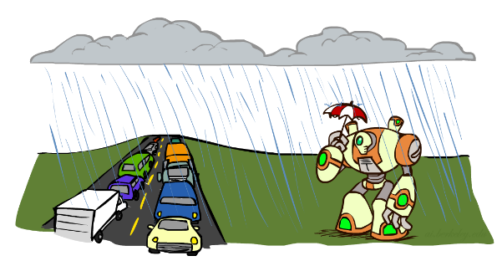
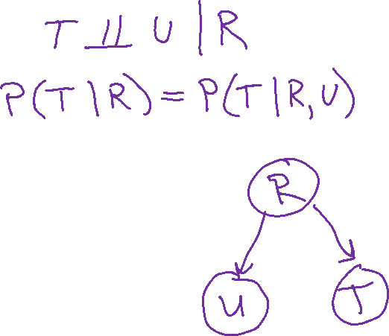
Conditional Independence
What about this domain:
Traffic
Umbrella
Raining

Slide 14

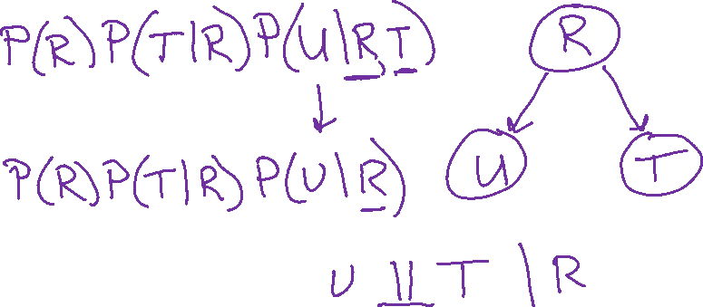
Conditional Independence and the Chain Rule
Chain rule:
P(x₁, x₂,…, x_{n}) = ∏_{i} P(x_{i} | x₁,…, x_{i-1})
Trivial decomposition:
P(Rain, Traffic, Umbrella) =
With assumption of conditional independence:
P(Rain, Traffic, Umbrella) =
Notes:
Will be obvious from ghostbusters example

Slide 15
Conditional Independence and the Chain Rule
Chain rule:
P(x₁, x₂,…, x_{n}) = ∏_{i} P(x_{i} | x₁,…, x_{i-1})
Trivial decomposition:
P(Rain, Traffic, Umbrella) = P(Rain) P(Traffic | Rain) P(Umbrella | Rain, Traffic)
With assumption of conditional independence:
P(Rain, Traffic, Umbrella) = P(Rain) P(Traffic | Rain) P(Umbrella | Rain)
Bayes nets / graphical models help us express conditional independence assumptions
Notes:
Will be obvious from ghostbusters example

Slide 16
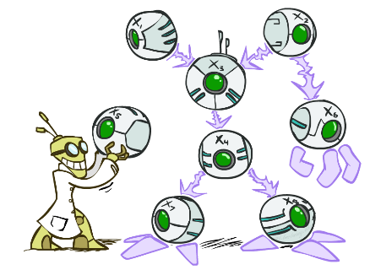
Bayes’ Nets: Big Picture
Two problems with using full joint distribution tables as our probabilistic models:
Unless there are only a few variables, the joint is WAY too big to represent explicitly
Hard to learn (estimate) anything empirically about more than a few variables at a time
Bayes nets: a technique for describing complex joint distributions (models) using simple, local distributions (conditional probabilities)
More properly called graphical models
We describe how variables locally interact
Local interactions chain together to give global, indirect interactions

Slide 17
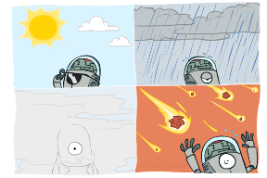
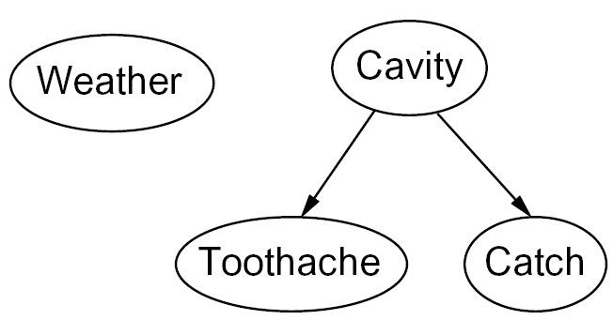

Graphical Model Notation
Nodes: variables (with domains)
Can be assigned (observed) or unassigned (unobserved)
Arcs: interactions
Similar to CSP constraints
Indicate “direct influence” between variables
Formally: encode conditional independence
For now: imagine that arrows mean direct causation (in general, they don’t!)

Slide 18

Example: Coin Flips
N independent coin flips
No interactions between variables: absolute independence
X₁
X₂
X_{n}

Slide 19
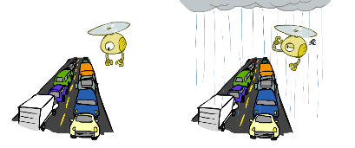
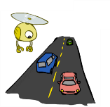
Example: Traffic
Variables:
R: It rains
T: There is traffic
Model 1: independence
Why is an agent using model 2 better?
Model 2: rain causes traffic
R
R
T
T

Slide 20
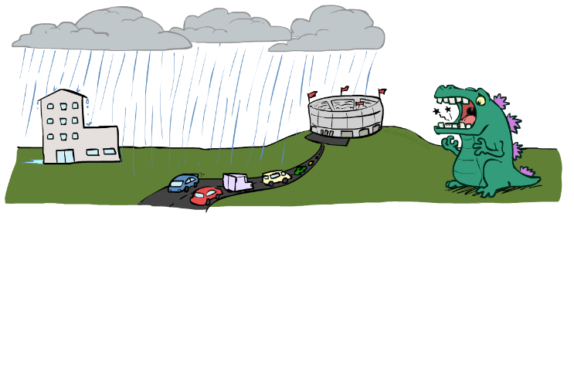

Example: Traffic II
Let’s build a causal graphical model!
Variables
T: Traffic
R: It rains
L: Low pressure
D: Roof drips
B: Ballgame
C: Cavity

Slide 21
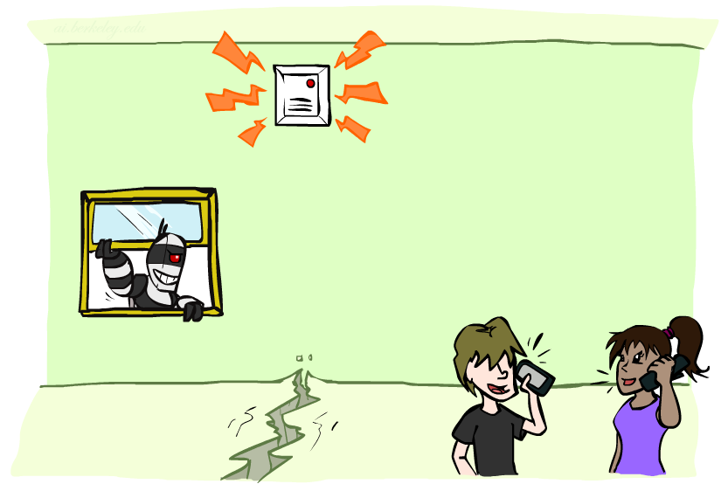
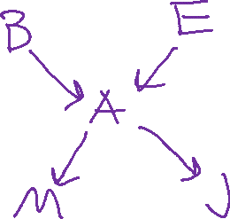
Example: Alarm Network
Variables
B: Burglary
A: Alarm goes off
M: Mary calls
J: John calls
E: Earthquake!

Slide 22
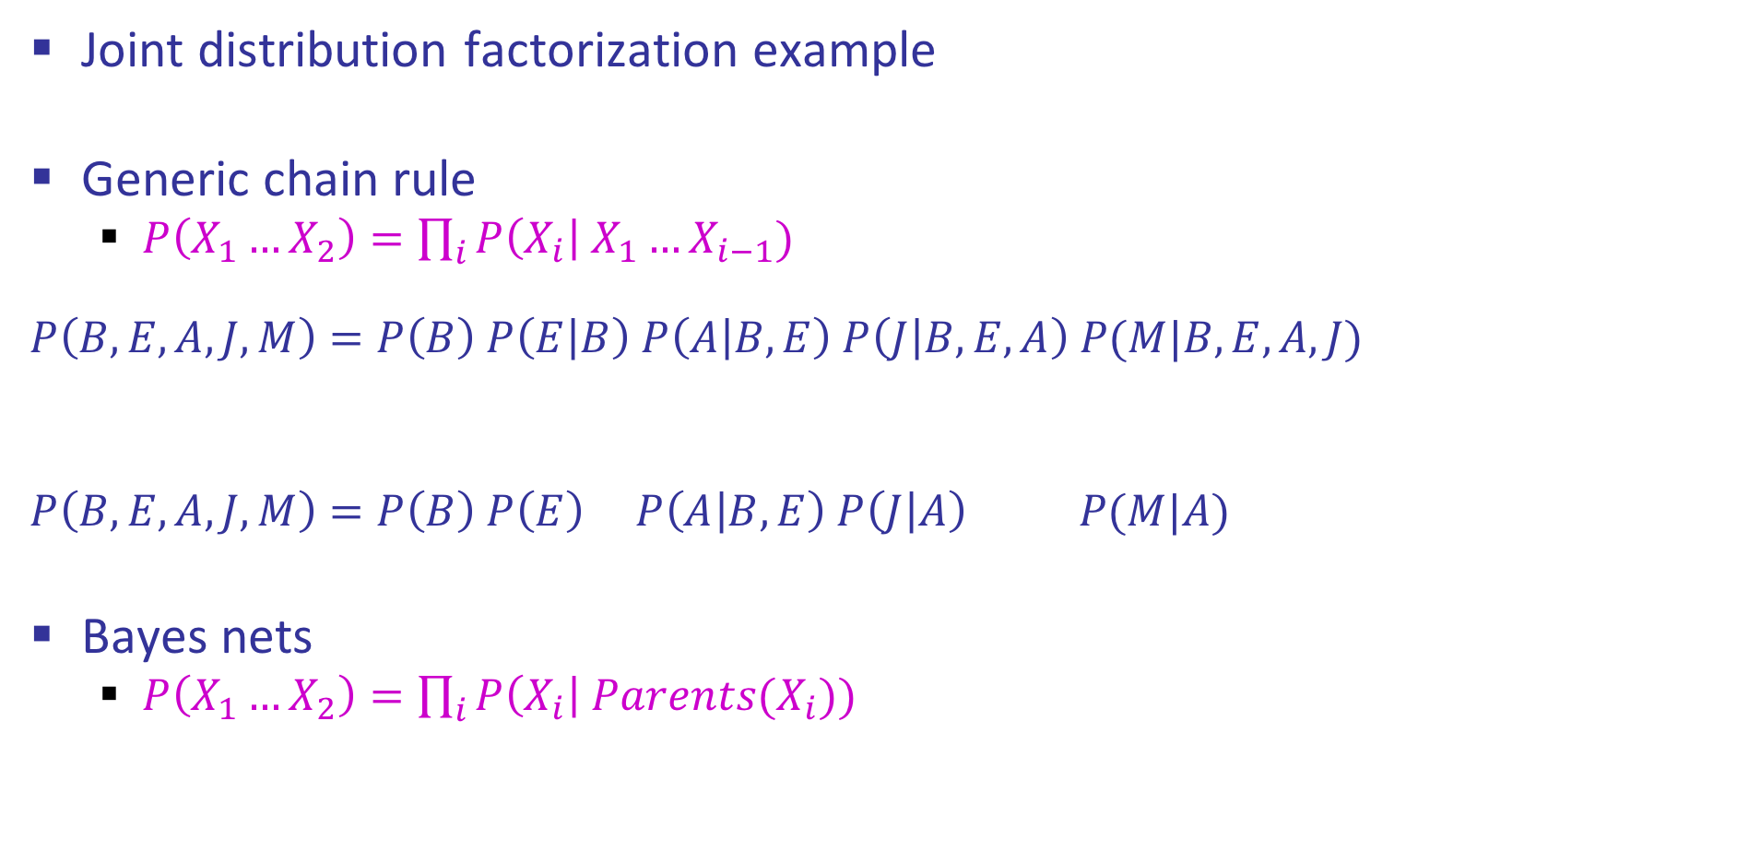
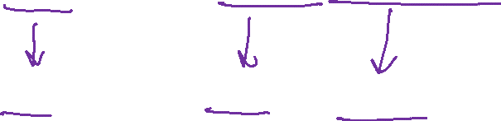
Semantics Example
Joint distribution factorization example
Generic chain rule
$P\left(X_{1}…X_{2}\right)=\prod_{i}{P\left(X_{i}\right| X_{1}…X_{i−1}) }$
$$P\left(B,E,A,J,M\right)=P\left(B\right) P\left(E | B\right) P\left(A | B,E\right) P\left(J | B,E,A\right) P(M|B,E,A,J)$$
$$P\left(B,E,A,J,M\right)=P\left(B\right) P\left(E\right) P\left(A | B,E\right) P\left(J | A\right) P(M|A)$$
Bayes nets
$P\left(X_{1}…X_{2}\right)=\prod_{i}{P\left(X_{i}\right| Parents(X_{i})) }$
Burglary
Earthquake
Alarm
John calls
Mary calls

Slide 23
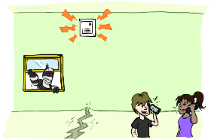
Example: Alarm Network
B | P(B)
+b | 0.001
-b | 0.999
E | P(E)
+e | 0.002
-e | 0.998
Burglary
Earthqk
Alarm
B | E | A | P(A|B,E)
+b | +e | +a | 0.95
+b | +e | -a | 0.05
+b | -e | +a | 0.94
+b | -e | -a | 0.06
-b | +e | +a | 0.29
-b | +e | -a | 0.71
-b | -e | +a | 0.001
-b | -e | -a | 0.999
John calls
Mary calls
A | J | P(J|A)
+a | +j | 0.9
+a | -j | 0.1
-a | +j | 0.05
-a | -j | 0.95
A | M | P(M|A)
+a | +m | 0.7
+a | -m | 0.3
-a | +m | 0.01
-a | -m | 0.99
Notes:
demo

Slide 24
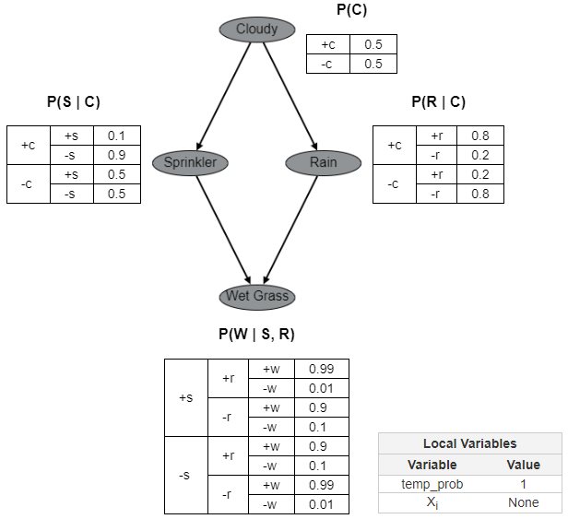
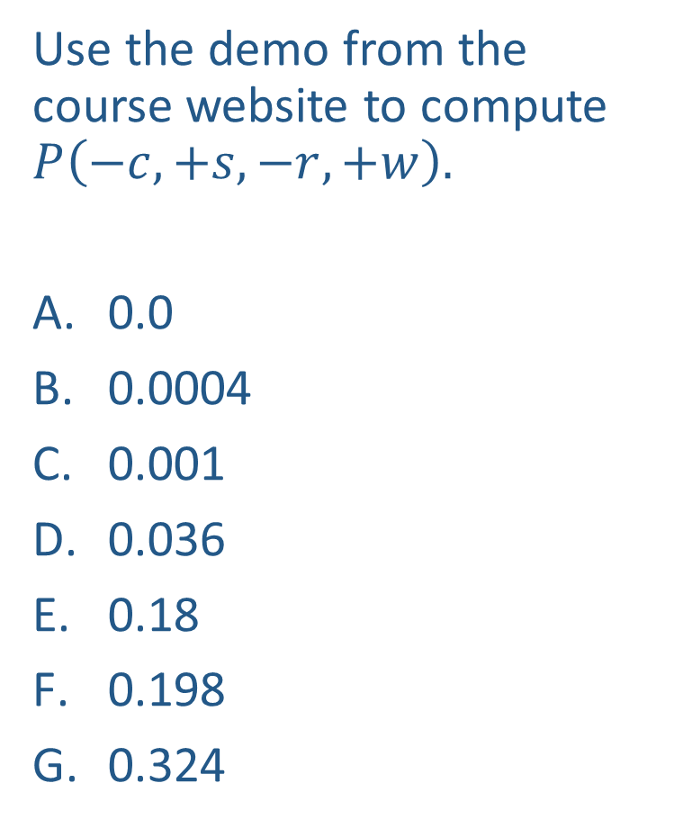
Piazza Poll 2
Use the demo from the course website to compute $P\left(−c, +s, −r, +w\right).$
0.0
0.0004
0.001
0.036
0.18
0.198
0.324

Slide 25
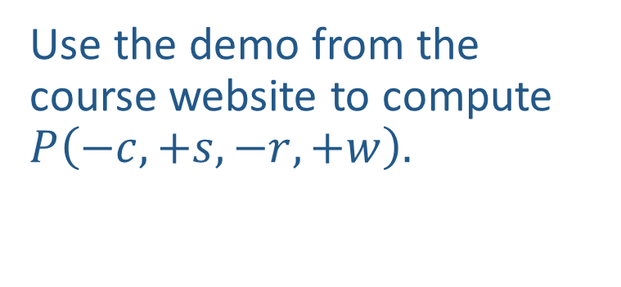
Piazza Poll 2
Use the demo from the course website to compute $P\left(−c, +s, −r, +w\right).$

Slide 26
















Piazza Poll 3
Match the product of CPTs to the Bayes net.
I.
II.
III.
$$A$$
$$A$$
$$B$$
$$A$$
$$B$$
$$C$$
$$B$$
$$C$$
$$C$$
$$P\left(A\right) P\left(B | A\right) P\left(C | B\right)$$
$$P\left(A\right) P\left(B | A\right) P\left(C | A\right)$$
$$P\left(A\right) P\left(B\right) P\left(C | A, B\right)$$
$$P\left(A\right) P\left(B\right) P\left(C | A, B\right)$$
$$P\left(A\right) P\left(B | A\right) P\left(C | B\right)$$
$$P\left(A\right) P\left(B | A\right) P\left(C | A\right)$$
$$P\left(A\right) P\left(B | A\right) P\left(C | A\right)$$
$$P\left(A\right) P\left(B\right) P\left(C | A, B\right)$$
$$P\left(A\right) P\left(B | A\right) P\left(C | B\right)$$

Slide 27
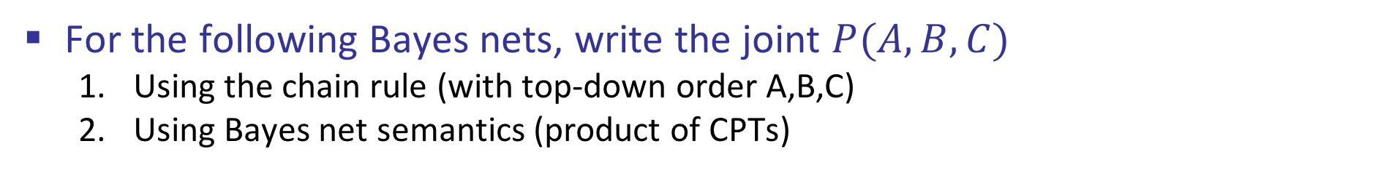
Conditional Independence Semantics
For the following Bayes nets, write the joint $P(A,B,C)$
Using the chain rule (with top-down order A,B,C)
Using Bayes net semantics (product of CPTs)
$$A$$
$$A$$
$$B$$
$$A$$
$$B$$
$$C$$
$$B$$
$$C$$
$$C$$

Slide 28
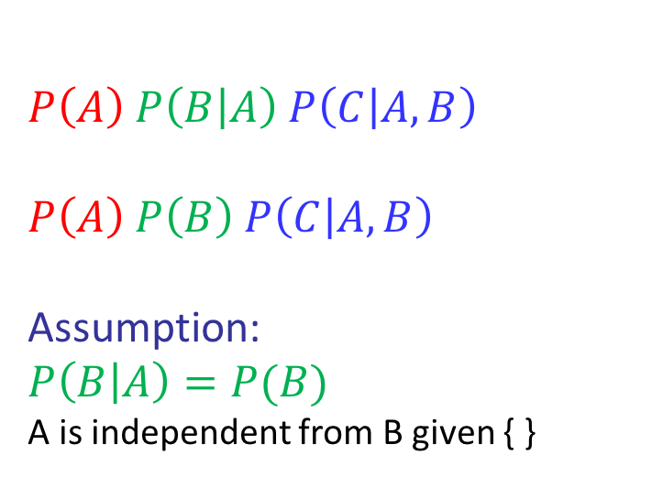
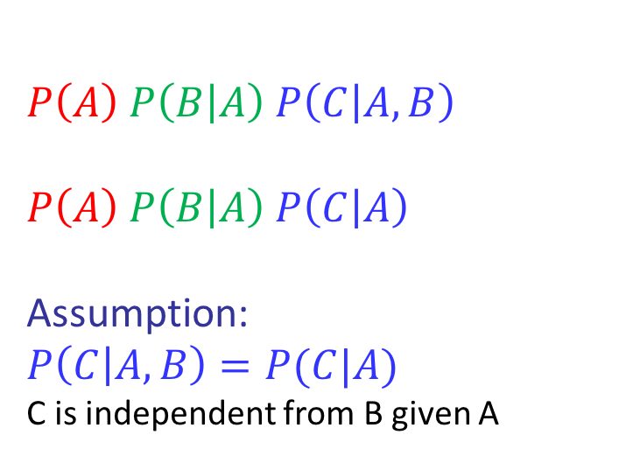
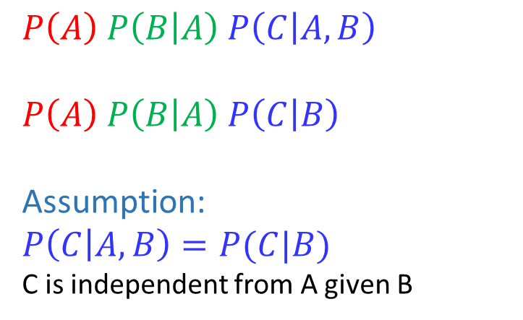

Conditional Independence Semantics
For the following Bayes nets, write the joint $P(A,B,C)$
Using the chain rule (with top-down order A,B,C)
Using Bayes net semantics (product of CPTs)
$$A$$
$$A$$
$$B$$
$$A$$
$$B$$
$$C$$
$$B$$
$$C$$
$$C$$
$$P\left(A\right) P\left(B | A\right) P\left(C | A,B\right)$$
$$P\left(A\right) P\left(B | A\right) P\left(C | B\right)$$
Assumption:
$$P\left(C | A,B\right)=P(C|B)$$
C is independent from A given B
$$P\left(A\right) P\left(B | A\right) P\left(C | A,B\right)$$
$$P\left(A\right) P\left(B | A\right) P\left(C | A\right)$$
Assumption:
$$P\left(C | A,B\right)=P(C|A)$$
C is independent from B given A
$$P\left(A\right) P\left(B | A\right) P\left(C | A,B\right)$$
$$P\left(A\right) P\left(B\right) P\left(C | A, B\right)$$
Assumption:
$$P\left(B | A\right)=P(B)$$
A is independent from B given { }

Slide 29
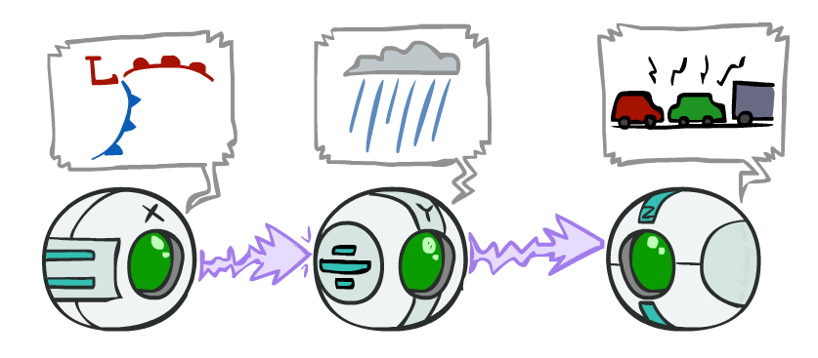
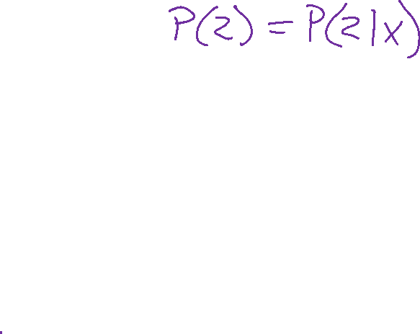
Causal Chains
This configuration is a “causal chain”
Guaranteed X independent of Z ? No!
One example set of CPTs for which X is not independent of Z is sufficient to show this independence is not guaranteed.
Example:
Low pressure causes rain causes traffic,
high pressure causes no rain causes no
traffic
In numbers:
P( +y | +x ) = 1, P( -y | - x ) = 1,
P( +z | +y ) = 1, P( -z | -y ) = 1
X: Low pressure Y: Rain Z: Traffic

Slide 30
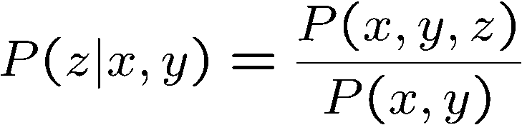
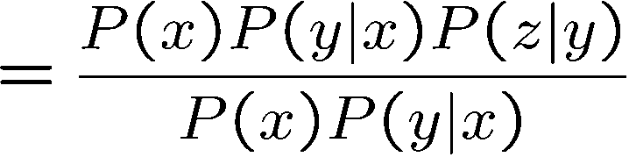

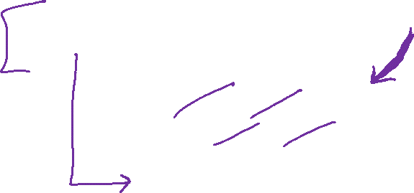
Causal Chains
This configuration is a “causal chain”
Guaranteed X independent of Z given Y?
Evidence along the chain “blocks” the influence
X: Low pressure Y: Rain Z: Traffic
Yes!

Slide 31
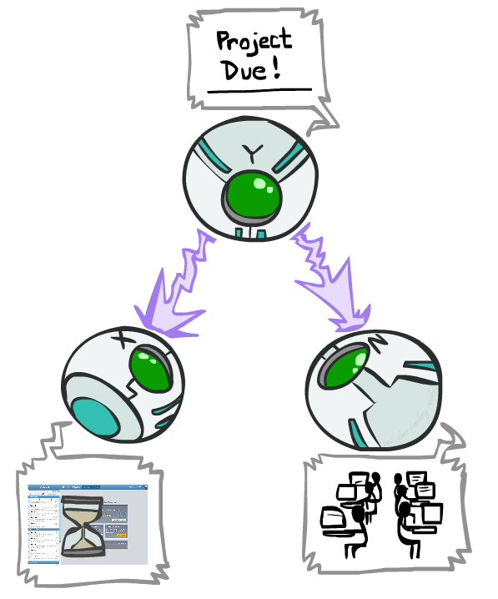
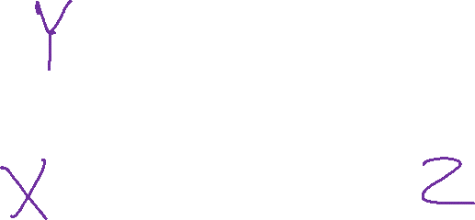
Common Cause
This configuration is a “common cause”
Guaranteed X independent of Z ? No!
One example set of CPTs for which X is not independent of Z is sufficient to show this independence is not guaranteed.
Example:
Project due causes both forums busy
and lab full
In numbers:
P( +x | +y ) = 1, P( -x | -y ) = 1,
P( +z | +y ) = 1, P( -z | -y ) = 1
Y: Project due
X: Forums busy
Z: Lab full

Slide 32
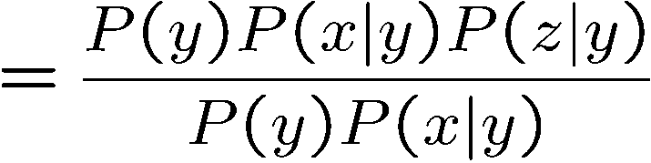
Common Cause
This configuration is a “common cause”
Guaranteed X and Z independent given Y?
Observing the cause blocks influence between effects.
Y: Project due
X: Forums busy
Z: Lab full
Yes!

Slide 33
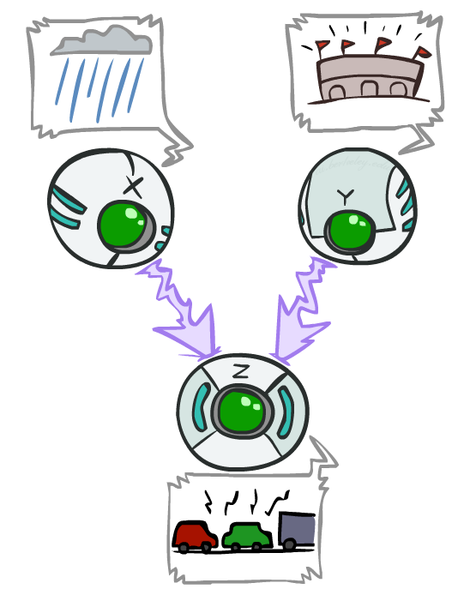
Common Effect
Last configuration: two causes of one effect (v-structures)
Are X and Y independent?
Yes: the ballgame and the rain cause traffic, but they are not correlated
Still need to prove they must be (try it!)
Are X and Y independent given Z?
No: seeing traffic puts the rain and the ballgame in competition as explanation.
This is backwards from the other cases
Observing an effect activates influence between possible causes.
X: Raining
Y: Ballgame
Z: Traffic

Slide 34
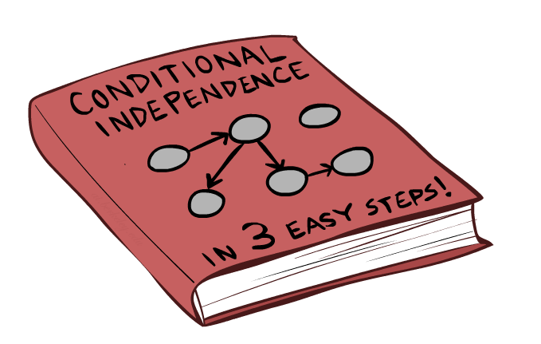
Bayes Net Independence

Slide 35

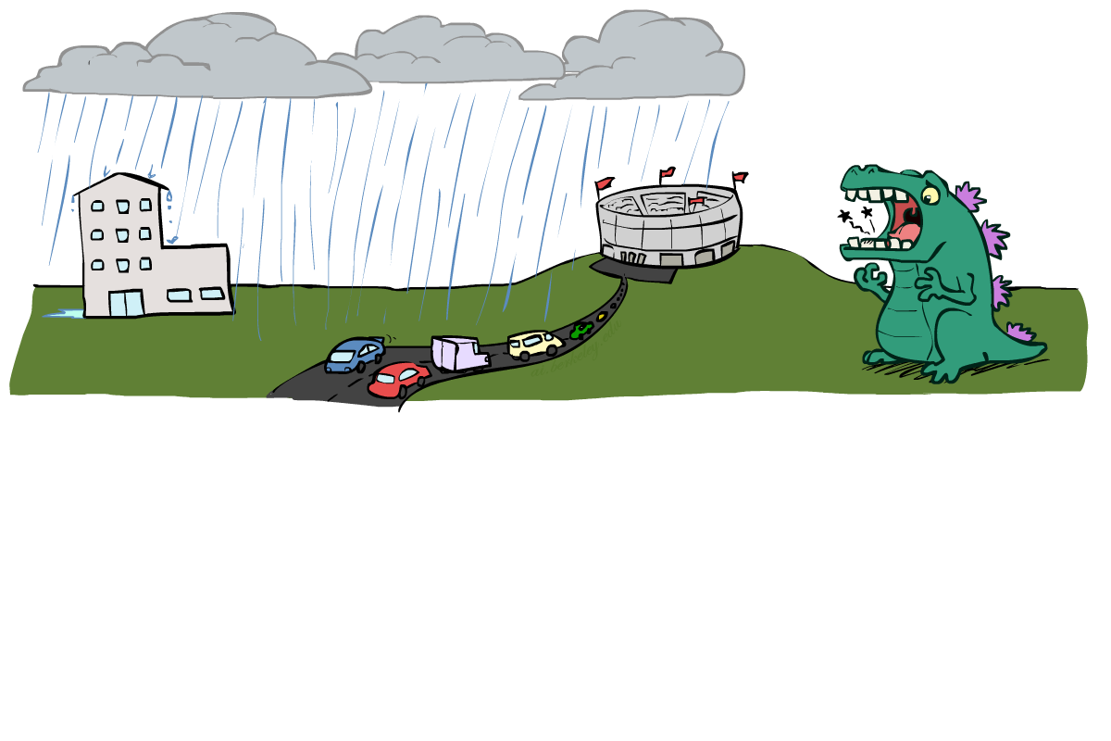

Reachability
L
Recipe: shade evidence nodes, look for paths in the resulting graph
Attempt 1: if two nodes are connected by an undirected path not blocked by a shaded node, they are conditionally independent
Almost works, but not quite
Where does it break?
Answer: the v-structure at T doesn’t count as a link in a path unless “active”
R
B
D
T

Slide 36
Active / Inactive Paths
Question: Are X and Y conditionally independent given evidence variables {Z}?
Yes, if X and Y “d-separated” by Z
Consider all (undirected) paths from X to Y
No active paths = independence!
A path is active if each triple is active:
Causal chain A → B → C where B is unobserved (either direction)
Common cause A ← B → C where B is unobserved
Common effect (aka v-structure)
A → B ← C where B or one of its descendents is observed
All it takes to block a path is a single inactive segment
Active Triples
Inactive Triples

Slide 37

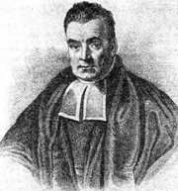
Bayes Ball
Question: Are X and Y conditionally independent given evidence variables {Z}?
Active Triples
Inactive Triples
Shachter, Ross D. "Bayes-Ball: Rational Pastime (for Determining Irrelevance and Requisite Information in Belief Networks and Influence Diagrams)." Proceedings of the Fourteenth conference on Uncertainty in Artificial Intelligence. 1998.

Slide 38
Bayes Ball
Question: Are X and Y conditionally independent given evidence variables {Z}?
Shade in Z
Drop a ball at X
The ball can pass through any active path and is blocked by any inactive path (ball can move either direction on an edge)
If the ball reaches Y, then X and Y are NOT conditionally independent given Z
Active Triples
Inactive Triples

Slide 39
Bayes Ball
Active Paths
Inactive Paths

Slide 40
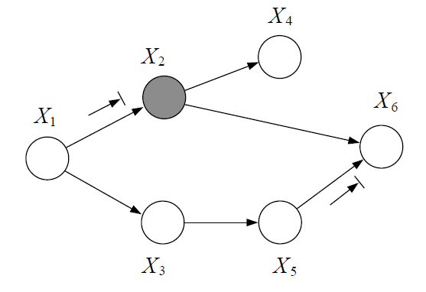
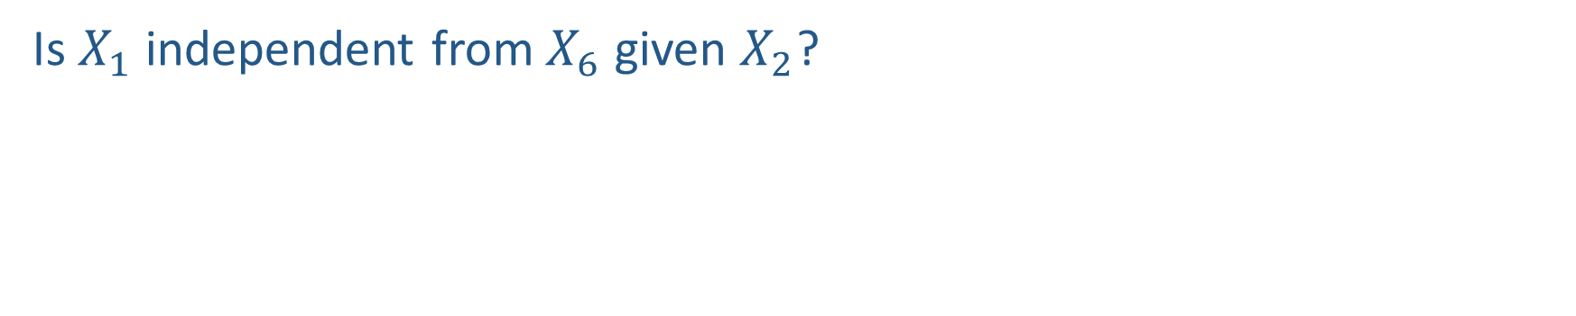
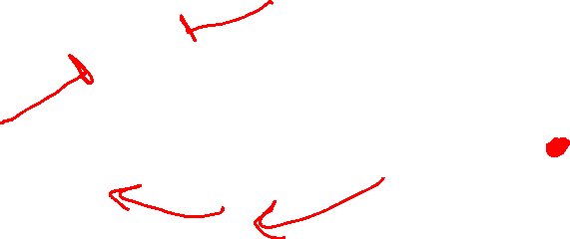
Piazza Poll 4
Is $X_{1}$ independent from $X_{6}$ given $X_{2}$?

Slide 41
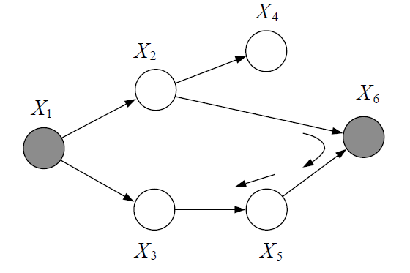
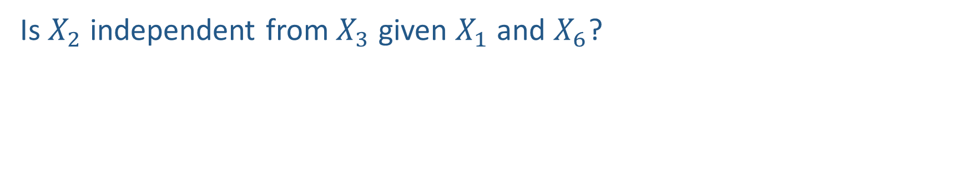
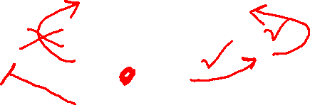
Piazza Poll 5
Is $X_{2}$ independent from $X_{3}$ given $X_{1}$ and $X_{6}$?

Slide 42
Conditional Independence Semantics
Every variable is conditionally independent of its non-descendants given its parents

Slide 43
Markov blanket
A variable’s Markov blanket consists of parents, children, children’s other parents
Every variable is conditionally independent of all other variables given its Markov blanket

Slide 44


Answer Any Query from Joint Distribution
Joint distributions are the best!
Problems with joints
We aren’t given the joint table
Usually some set of conditional probability tables
Huge
$n$ variables with $d$ values
$d^{n}$ entries
Joint
Query
$$P\left(a \right| e)$$

Slide 45
Answer Any Query from Bayes Net
Bayes Net
Joint
Query
$$P\left(a \right| e)$$
$$P\left(A\right) P\left(B | A\right) P\left(C | A\right) P\left(D | C\right) P(E|C)$$

Slide 46
Next: Answer Any Query from Bayes Net
Bayes Net
Query
$$P\left(a \right| e)$$
$$P\left(A\right) P\left(B | A\right) P\left(C | A\right) P\left(D | C\right) P(E|C)$$

