Slide 1
Announcements
Assignments:
HW8 (written)
Due tonight, 10 pm
P4
Due Thu 10/31, 10 pm
Check your slip days!
Midterm:
Tue 11/12, in-class
Course Feedback:
Results

Slide 2
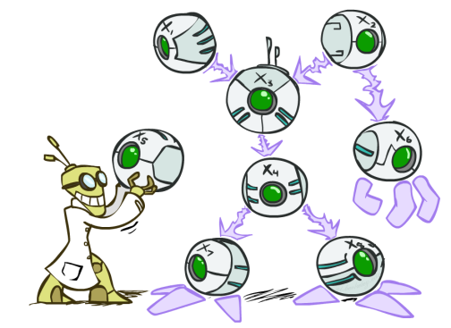
AI: Representation and Problem Solving
Bayes Nets
Instructors: Pat Virtue & Fei Fang
Slide credits: CMU AI and http://ai.berkeley.edu

Slide 3

Probability Notation
Notation and conventions in this course
$P\left(+b, C\right)= \sum_{a∈\left\{a_{1}, a_{2},a_{3}\right\}}{P\left(a, +b, C\right)}$

Slide 4
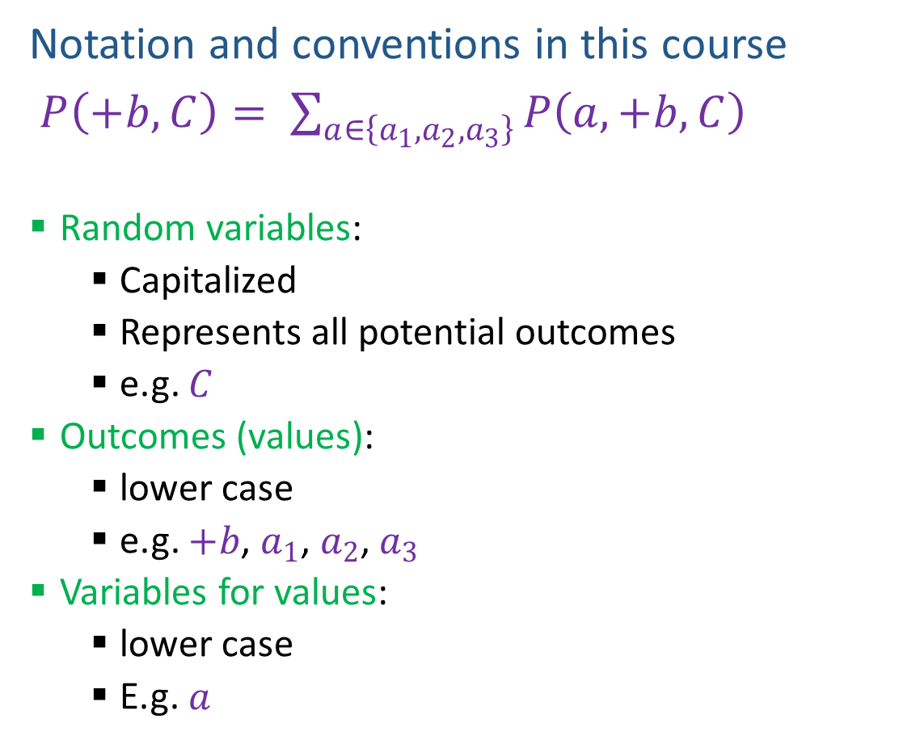
Probability Notation
Notation and conventions in this course
$P\left(+b, C\right)= \sum_{a∈\left\{a_{1}, a_{2},a_{3}\right\}}{P\left(a, +b, C\right)}$
Random variables:
Capitalized
Represents all potential outcomes
e.g. $C$
Outcomes (values):
lower case
e.g. $+b$, $a_{1}$, $a_{2}$, $a_{3}$
Variables for values:
lower case
E.g. $a$
For each random variable
Discrete outcomes
Disjoint outcomes
Not always binary

Slide 5
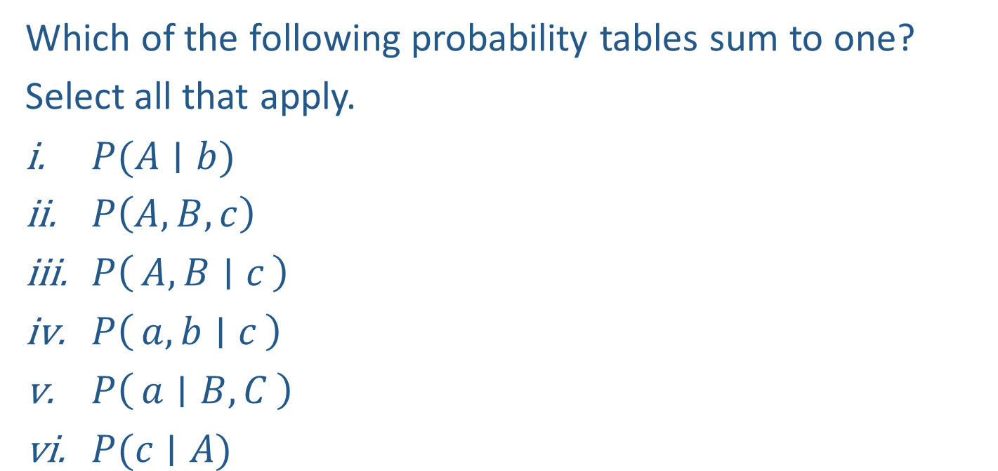
Piazza Poll 1
Which of the following probability tables sum to one?
Select all that apply.
$P(A∣b)$
$P\left(A, B, c\right)$
$P\left(A, B ∣ c\right)$
$P\left(a, b ∣ c\right)$
$P\left(a ∣ B, C\right)$
$P(c∣A)$

Slide 6
Piazza Poll 1
Which of the following probability tables sum to one?
Select all that apply.
$P(A∣b)$
$P\left(A, B, c\right)$
$P\left(A, B ∣ c\right)$
$P\left(a, b ∣ c\right)$
$P\left(a ∣ B, C\right)$
$P(c∣A)$

Slide 7



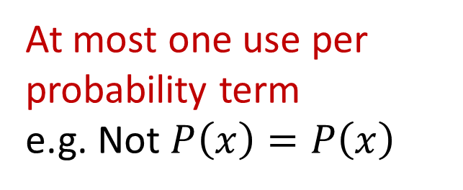
Piazza Poll 2
How many valid equations can we compose using:
$P\left(x\right)$, $P\left(y\right)$, $P\left(x,y\right)$, $P\left(x | y\right)$, $P\left(y | x\right)$ and $=, ×, ÷$
First one: $P\left(x | y\right)=P(x,y)/P\left(y\right)$
A) 2
B) 4
C) 7
D) Other
At most one use per probability term
e.g. Not $P\left(x\right)=P\left(x\right)$
Must be different
e.g. Cannot also use
$$P(x,y)/P(y) =P(x|y)$$

Slide 8
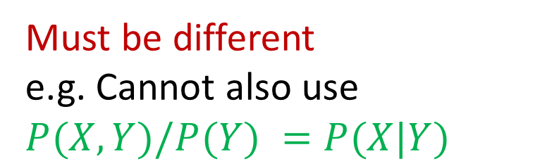
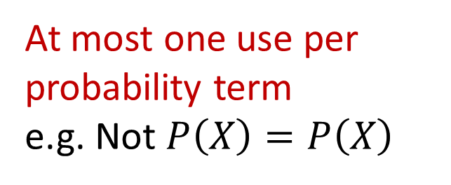
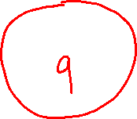
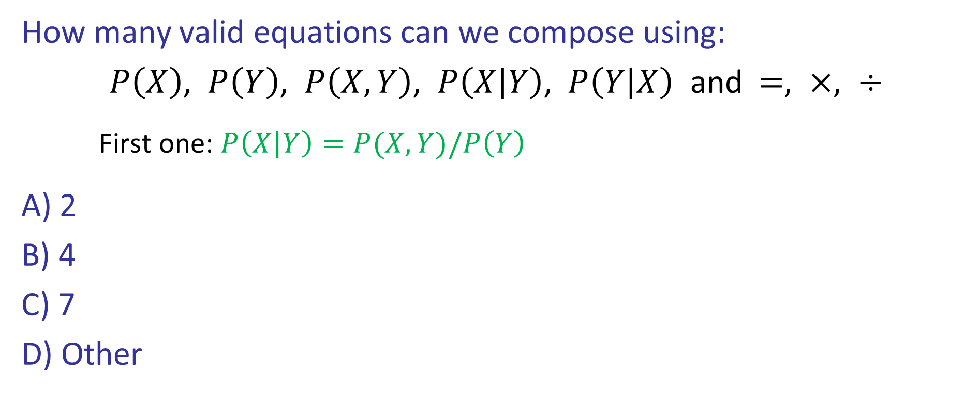

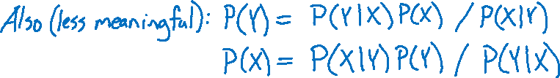
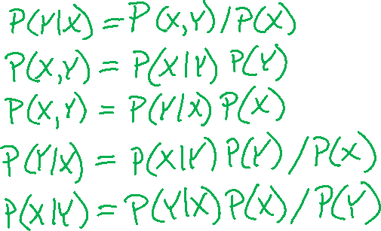
Piazza Poll 2
How many valid equations can we compose using:
$P\left(X\right)$, $P\left(Y\right)$, $P\left(X,Y\right)$, $P\left(X | Y\right)$, $P\left(Y | X\right)$ and $=, ×, ÷$
First one: $P\left(X | Y\right)=P(X,Y)/P\left(Y\right)$
A) 2
B) 4
C) 7
D) Other
At most one use per probability term
e.g. Not $P\left(X\right)=P\left(X\right)$
Must be different
e.g. Cannot also use
$$P(X,Y)/P(Y) =P(X|Y)$$

Slide 9

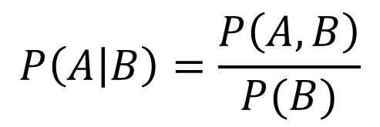
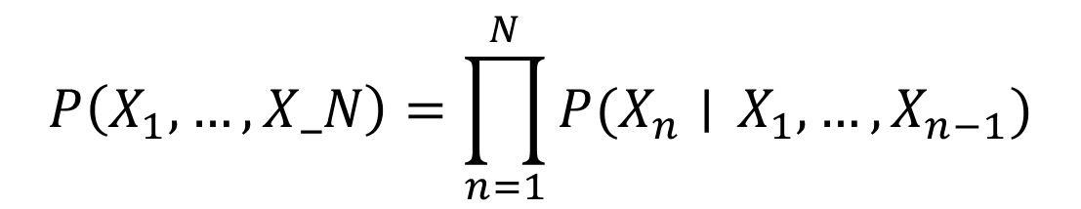
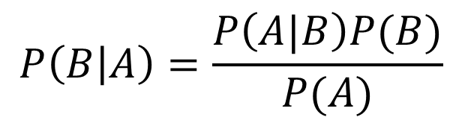
Probability Tools Summary
Our toolbox
Definition of conditional probability
Product Rule
Bayes’ theorem
Chain Rule
$$P\left(A | B\right)=\frac{P\left(A, B\right)}{P(B)}$$
$$P(A,B)=P\left(A | B\right)P(B)$$
$$P\left(B | A\right)=\frac{P\left(A|B\right)P(B)}{P(A)}$$
$$P\left(X_{1}, …, X_N\right)=\prod_{n=1}^{N}{P(X_{n}∣} X_{1},…, X_{n−1})$$

Slide 10



Answer Any Query from Joint Distribution
What is the probability of getting a slice with:
No mushrooms
Spinach and no mushrooms
Spinach, when asking for slice with no mushrooms
Mushrooms
Spinach
No spinach
No spinach and mushrooms
No spinach when asking for no mushrooms
No spinach when asking for mushrooms
Spinach when asking for mushrooms
No mushrooms and no spinach
Icons: CC, https://openclipart.org/detail/296791/pizza-slice

Slide 11


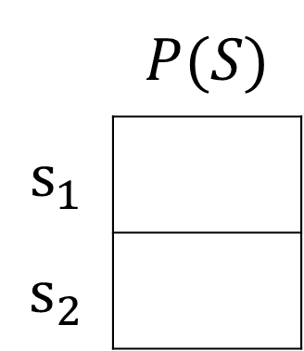
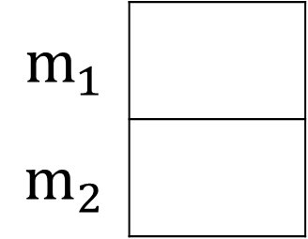

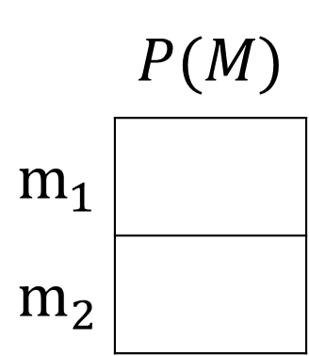


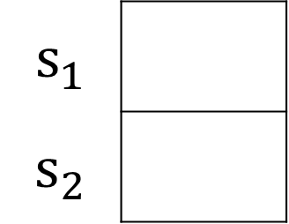
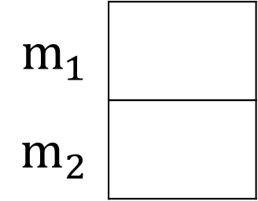


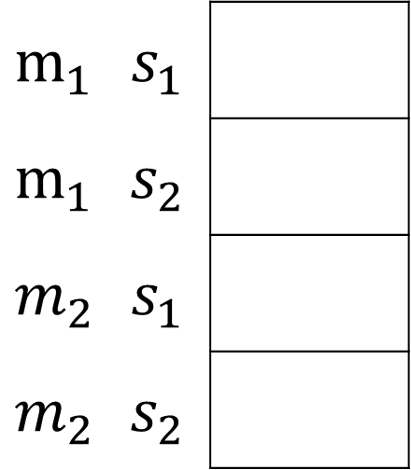
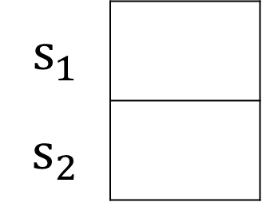

Answer Any Query from Joint Distribution
You can answer all of these questions:
$P(M|s_{1})$
$P(M|s_{2})$
 | $$P(M)$$
$$m_{1}$$
$$m_{2}$$
$P(M,S)$
$$m_{1}$$
$$m_{2}$$
$$m_{1}$$
$$m_{2}$$
$$12/20$$
$$m_{1}$$ | $$s_{1}$$
$$m_{1}$$ | $$s_{2}$$
$$m_{2}$$ | $$s_{1}$$
$$m_{2}$$ | $$s_{2}$$
$$6/20$$
$P(S|m_{1})$
$P(S|m_{2})$
 | $$P(S)$$
$$s_{1}$$
$$s_{2}$$
$$s_{1}$$
$$s_{2}$$
$$s_{1}$$
$$s_{2}$$
$$6/12$$

Slide 12
Answer Any Query from Joint Distribution
P(Weather)?
P(Weather | winter)?
P(Weather | winter, hot)?
Season | Temp | Weather | P(S, T, W)
summer | hot | sun | 0.30
summer | hot | rain | 0.05
summer | cold | sun | 0.10
summer | cold | rain | 0.05
winter | hot | sun | 0.10
winter | hot | rain | 0.05
winter | cold | sun | 0.15
winter | cold | rain | 0.20

Slide 13
Answer Any Query from Joint Distribution
P(Weather)?
Season | Temp | Weather | P(S, T, W)
summer | hot | sun | 0.30
summer | hot | rain | 0.05
summer | cold | sun | 0.10
summer | cold | rain | 0.05
winter | hot | sun | 0.10
winter | hot | rain | 0.05
winter | cold | sun | 0.15
winter | cold | rain | 0.20

Slide 14
Answer Any Query from Joint Distribution
P(Weather | winter)?
Season | Temp | Weather | P(S, T, W)
summer | hot | sun | 0.30
summer | hot | rain | 0.05
summer | cold | sun | 0.10
summer | cold | rain | 0.05
winter | hot | sun | 0.10
winter | hot | rain | 0.05
winter | cold | sun | 0.15
winter | cold | rain | 0.20

Slide 15
Answer Any Query from Joint Distribution
P(Weather | winter, hot)?
Season | Temp | Weather | P(S, T, W)
summer | hot | sun | 0.30
summer | hot | rain | 0.05
summer | cold | sun | 0.10
summer | cold | rain | 0.05
winter | hot | sun | 0.10
winter | hot | rain | 0.05
winter | cold | sun | 0.15
winter | cold | rain | 0.20

Slide 16
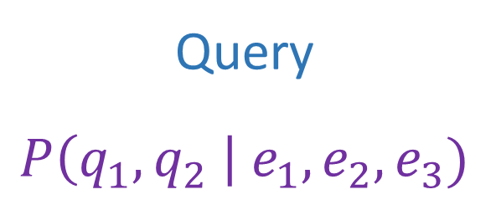
Answer Any Query from Joint Distribution
Joint distributions are the best!
Joint
Query
$$P\left(q_{1},q_{2} \right| e_{1}, e_{2},e_{3})$$

Slide 17
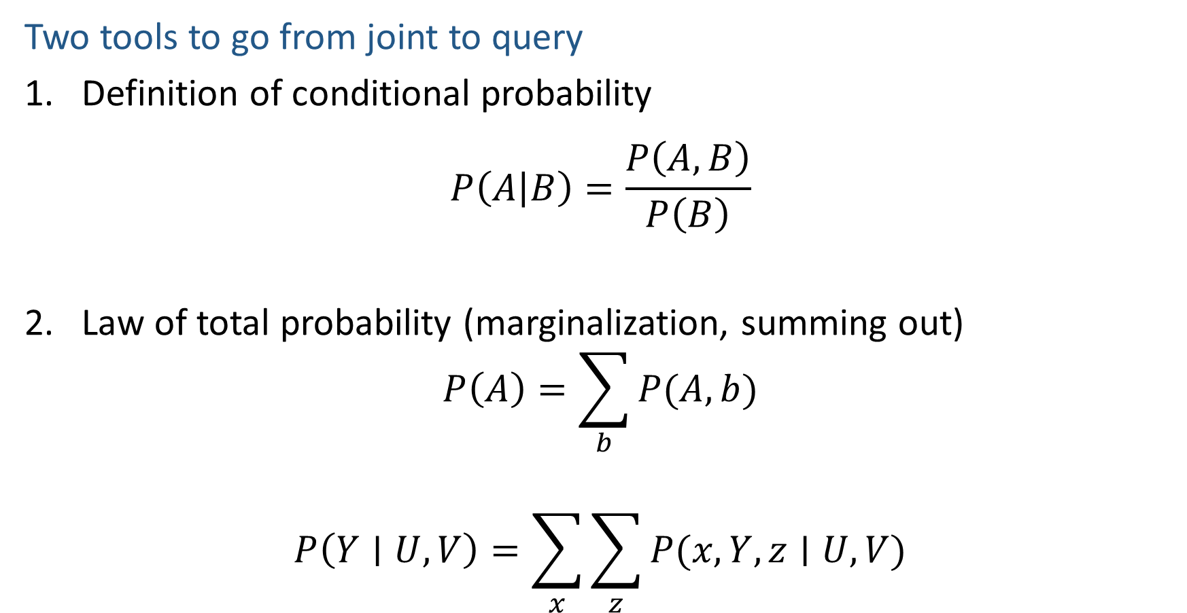
Answer Any Query from Joint Distribution
Two tools to go from joint to query
Definition of conditional probability
$$P\left(A | B\right)=\frac{P\left(A,B\right)}{P\left(B\right)}$$
Law of total probability (marginalization, summing out)
$$P\left(A\right)=\sum_{b}{P(A,b)}$$
$$P\left(Y∣U, V\right)=\sum_{x}{\sum_{z}{P(x, Y, z∣U, V)}}$$

Slide 18
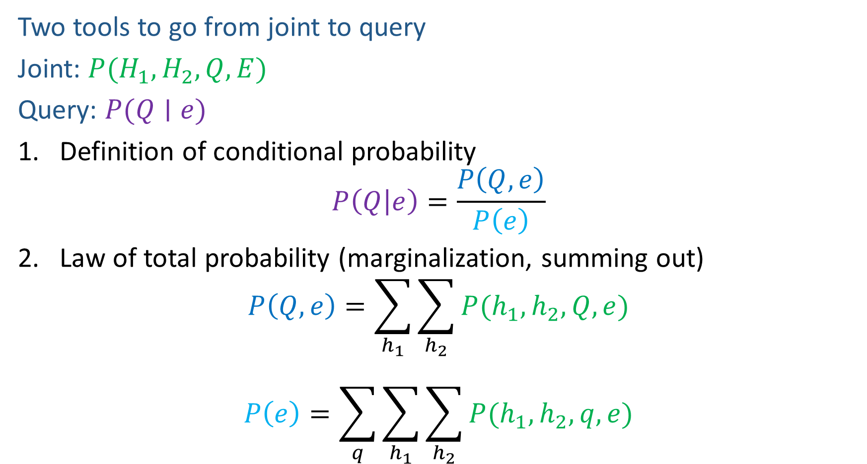
Answer Any Query from Joint Distribution
Two tools to go from joint to query
Joint: $P(H_{1}, H_{2}, Q, E)$
Query: $P(Q∣e)$
Definition of conditional probability
$$P\left(Q | e\right)=\frac{P\left(Q,e\right)}{P\left(e\right)}$$
Law of total probability (marginalization, summing out)
$$P\left(Q,e\right)=\sum_{h_{1}}{\sum_{h_{2}}{P(h_{1},h_{2},Q, e)}}$$
$$P\left(e\right)=\sum_{q}{\sum_{h_{1}}{\sum_{h_{2}}{P(h_{1},h_{2}, q,e)}}}$$

Slide 19
Answer Any Query from Joint Distribution
P(Weather)?
P(Weather | winter)?
P(Weather | winter, hot)?
Season | Temp | Weather | P(S, T, W)
summer | hot | sun | 0.30
summer | hot | rain | 0.05
summer | cold | sun | 0.10
summer | cold | rain | 0.05
winter | hot | sun | 0.10
winter | hot | rain | 0.05
winter | cold | sun | 0.15
winter | cold | rain | 0.20

Slide 20
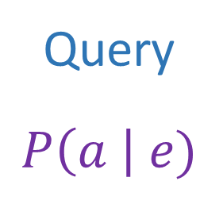
Answer Any Query from Joint Distribution
Joint distributions are the best!
Problems with joints
We aren’t given the joint table
Usually some set of conditional probability tables
Joint
Query
$$P\left(a \right| e)$$

Slide 21
Build Joint Distribution Using Chain Rule
Conditional Probability Tables and Chain Rule
Joint
Query
$$P\left(a \right| e)$$
$P\left(A\right) P\left(B | A\right) P\left(C | A,B\right) P\left(D | A,B,C\right)$ $P(E|A, B,C,D)$

Slide 22
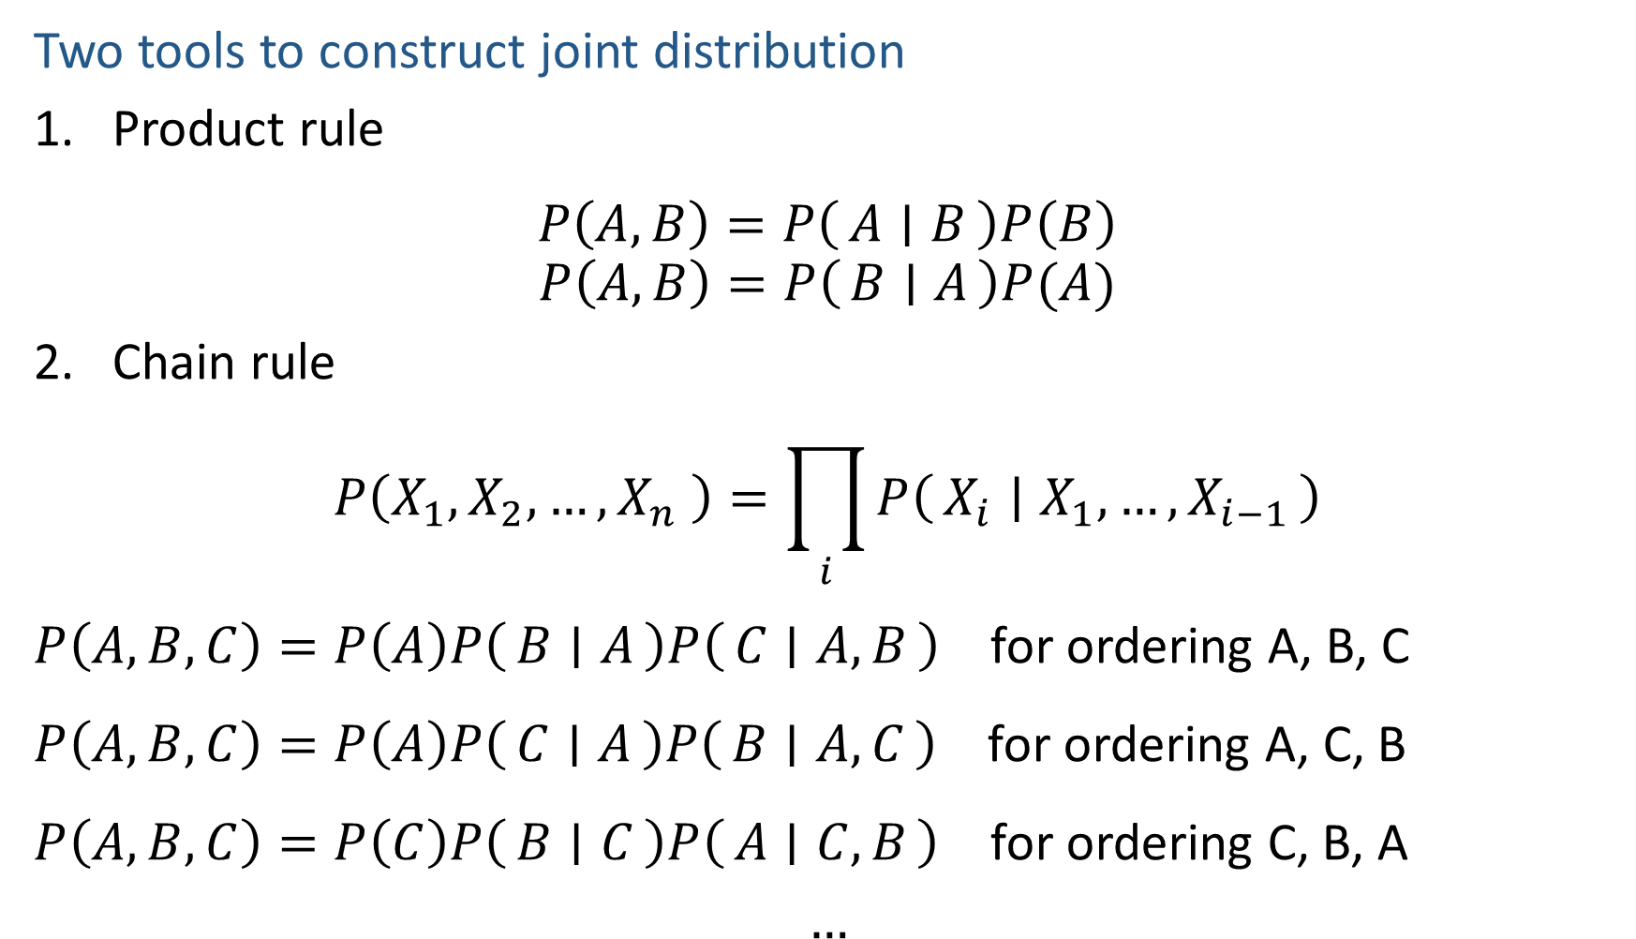
Build Joint Distribution Using Chain Rule
Two tools to construct joint distribution
Product rule
$$P\left(A,B\right)=P\left(A ∣ B\right)P\left(B\right)$$
$$P\left(A,B\right)=P\left(B ∣ A\right)P(A)$$
Chain rule
$$P\left(X_{1},X_{2},…,X_{n} \right)=\prod_{i}{P\left(X_{i} ∣ X_{1},…,X_{i−1}\right)}$$
$P\left(A,B,C\right)=P\left(A\right)P\left(B ∣ A\right)P\left(C ∣ A, B\right)$ for ordering A, B, C
$P\left(A,B,C\right)=P\left(A\right)P\left(C ∣ A\right)P\left(B ∣ A,C\right)$ for ordering A, C, B
$P\left(A,B,C\right)=P\left(C\right)P\left(B ∣ C\right)P\left(A ∣ C,B\right)$ for ordering C, B, A
$$…$$

Slide 23
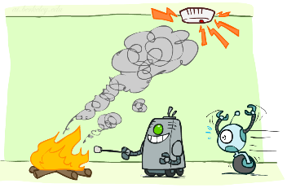
Build Joint Distribution Using Chain Rule
Binary random variables
Fire
Smoke
Alarm

Slide 24
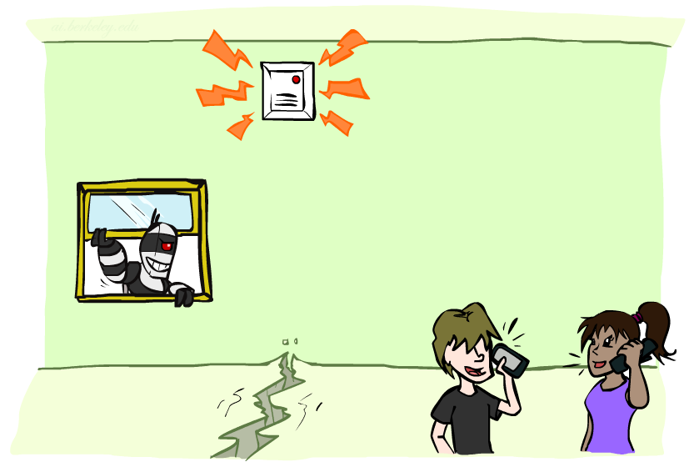

Piazza Poll 3
Variables
B: Burglary
A: Alarm goes off
M: Mary calls
J: John calls
E: Earthquake!
How many different ways can we write the chain rule?
$1$
$5$
$5 choose 5$
$5!$
$5^{5}$

Slide 25
Build Joint Distribution Using Chain Rule
Conditional Probability Tables and Chain Rule
Joint
Query
$$P\left(a \right| e)$$
$P\left(A\right) P\left(B | A\right) P\left(C | A,B\right) P\left(D | A,B,C\right)$ $P(E|A, B,C,D)$

Slide 26
Answer Any Query from Condition Probability Tables
Process to go from (specific) conditional probability tables to query
Construct the joint distribution
Product Rule or Chain Rule
Answer query from joint
Definition of conditional probability
Law of total probability (marginalization, summing out)

Slide 27
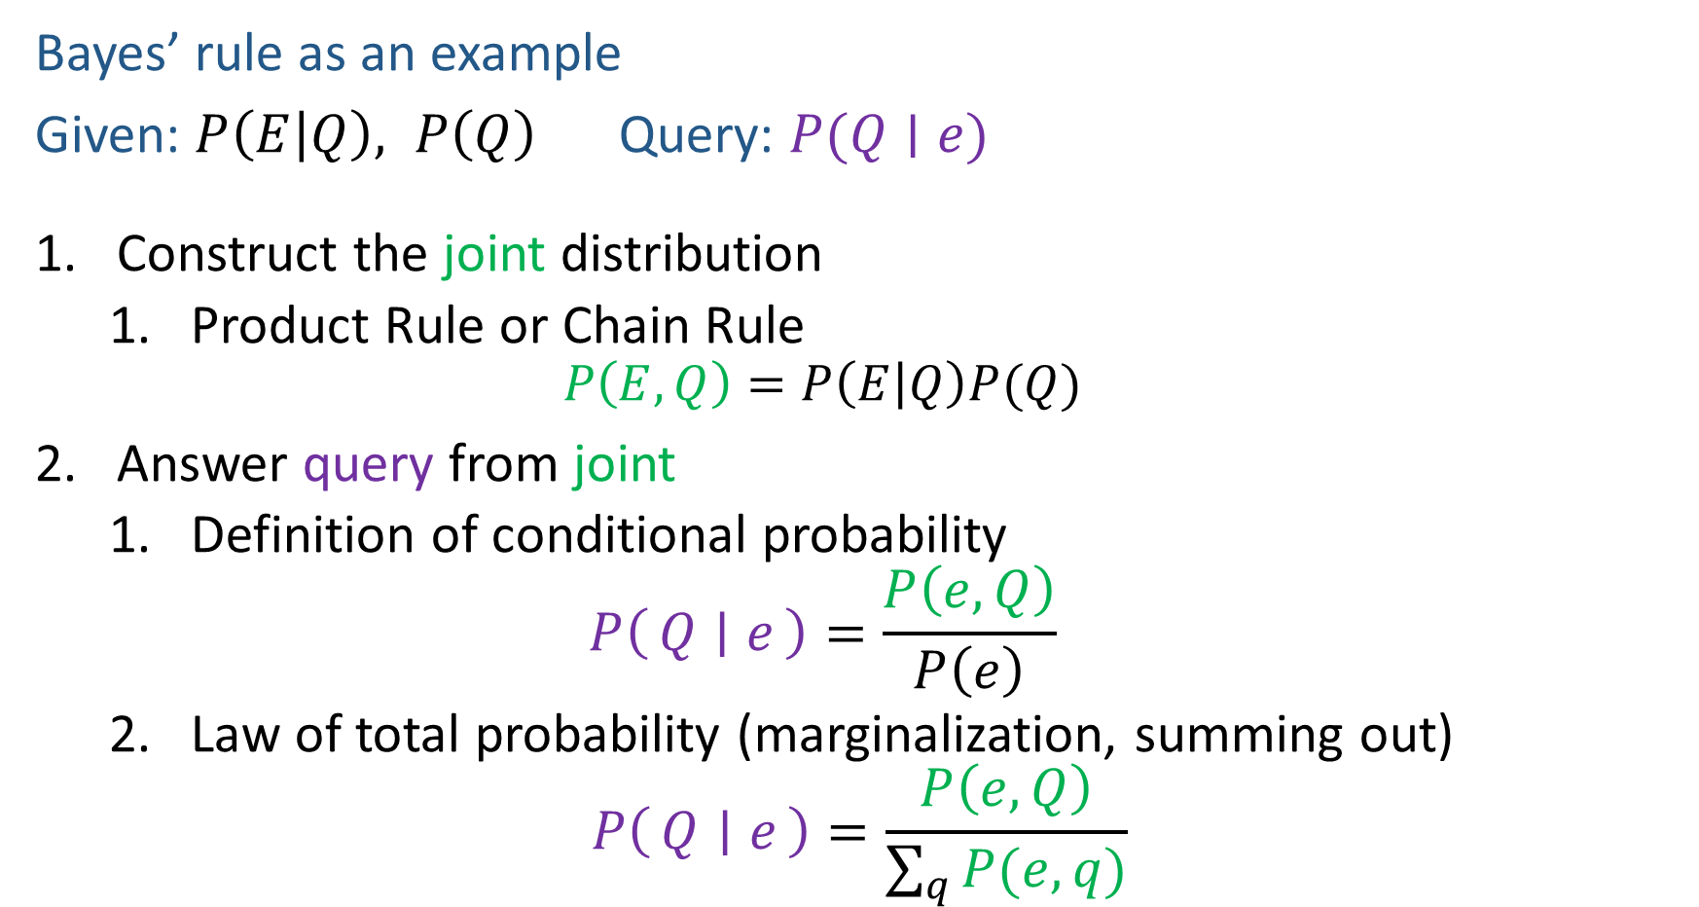
Answer Any Query from Condition Probability Tables
Bayes’ rule as an example
Given: $P\left(E | Q\right), P\left(Q\right)$ Query: $P(Q∣e)$
Construct the joint distribution
Product Rule or Chain Rule
$$P\left(E,Q\right)=P\left(E | Q\right)P(Q)$$
Answer query from joint
Definition of conditional probability
$$P\left(Q ∣ e\right)=\frac{P\left(e, Q\right)}{P\left(e\right)}$$
Law of total probability (marginalization, summing out)
$$P\left(Q ∣ e\right)=\frac{P\left(e, Q\right)}{\sum_{q}{P(e,q)}}$$

Slide 28

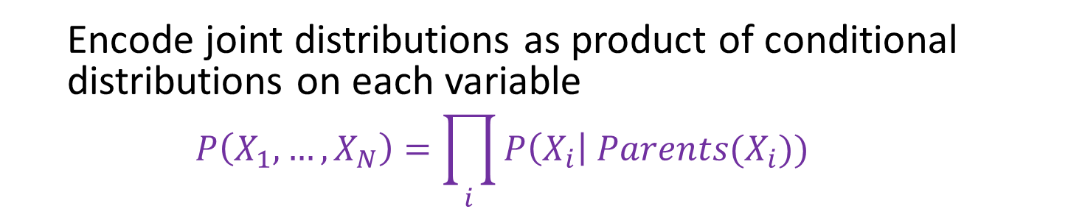



Bayesian Networks
Bayes net
One node per random variable
DAG
One CPT per node: P(node | Parents(node) )
$$A$$
$$B$$
$$C$$
$$D$$
$$P\left(A, B, C, D\right)=P\left(A\right) P\left(B | A\right) P\left(C | A,B\right) P\left(D | A,B,C\right)$$
Encode joint distributions as product of conditional distributions on each variable
$$P\left(X_{1},…,X_{N}\right)=\prod_{i}{P\left(X_{i}\right| Parents(X_{i})) }$$

Slide 29
Build Bayes Net Using Chain Rule
Binary random variables
Fire
Smoke
Alarm

Slide 30





Question
$$B$$
$$A$$
Variables
B: Burglary
A: Alarm goes off
M: Mary calls
J: John calls
E: Earthquake!
Given the Bayes net, write the joint distribution?
$$M$$
$$E$$
$$J$$

Slide 31

Answer Any Query from Bayes Net
Joint
Bayes Net and
Conditional Probability Tables
$$A$$
Query
$$P\left(a \right| e)$$
$$B$$
$$C$$
$$D$$

Slide 32
Answer Any Query from Condition Probability Tables
Conditional Probability Tables and Chain Rule
Joint
Query
$$P\left(a \right| e)$$
$P\left(A\right) P\left(B | A\right) P\left(C | A,B\right) P\left(D | A,B,C\right)$ $P(E|A, B,C,D)$

Slide 33
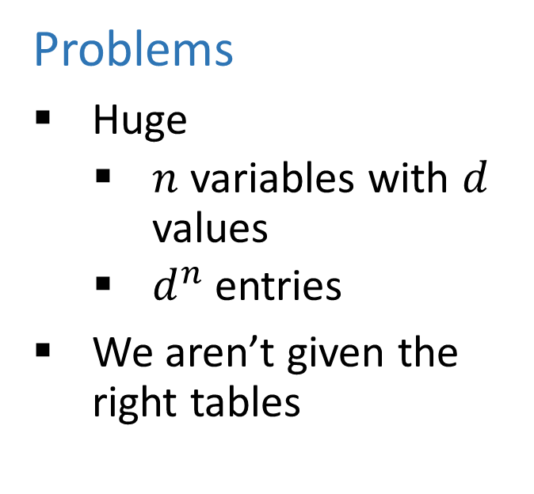
Answer Any Query from Condition Probability Tables
Conditional Probability Tables and Chain Rule
Problems
Huge
$n$ variables with $d$ values
$d^{n}$ entries
We aren’t given the right tables
$P\left(A\right) P\left(B | A\right) P\left(C | A,B\right) P\left(D | A,B,C\right)$ $P(E|A, B,C,D)$

Slide 34
Danielle Belgrave, Microsoft Research

Slide 35
Do We Need the Full Chain Rule?
Binary random variables
Fire
Smoke
Alarm

Slide 36
Answer Any Query from Condition Probability Tables
Conditional Probability Tables and Chain Rule
Joint
Query
$$P\left(a \right| e)$$
$P\left(A\right) P\left(B | A\right) P\left(C | A,B\right) P\left(D | A,B,C\right)$ $P(E|A, B,C,D)$

Slide 37
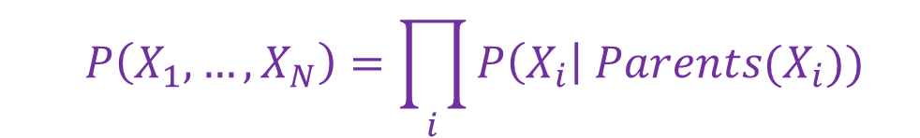
Answer Any Query from Condition Probability Tables
Bayes Net
Joint
Query
$$P\left(a \right| e)$$
$$P\left(A\right) P\left(B | A\right) P\left(C | A\right) P\left(D | C\right) P(E|C)$$
$$P\left(X_{1},…,X_{N}\right)=\prod_{i}{P\left(X_{i}\right| Parents(X_{i})) }$$

