Slide 1
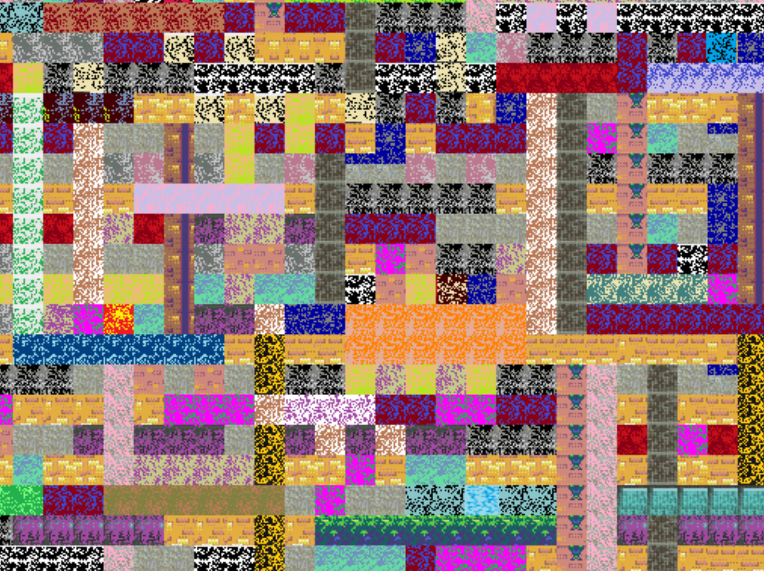
Warm-up as you walk in
https://high-level-4.herokuapp.com/experiment
https://rach0012.github.io/humanRL_website/

Slide 2
Announcements
Assignments:
HW8 (written)
    Due 10/29 Tue, 10 pm
P4
    Due 10/31 Thu, 10 pm
Piazza in-class post is ready to go

Slide 3
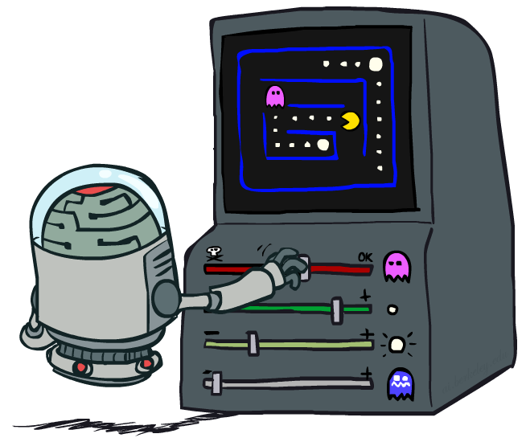
AI: Representation and Problem Solving
Reinforcement Learning II
Instructors: Fei Fang & Pat Virtue
Slide credits: CMU AI and http://ai.berkeley.edu

Slide 4
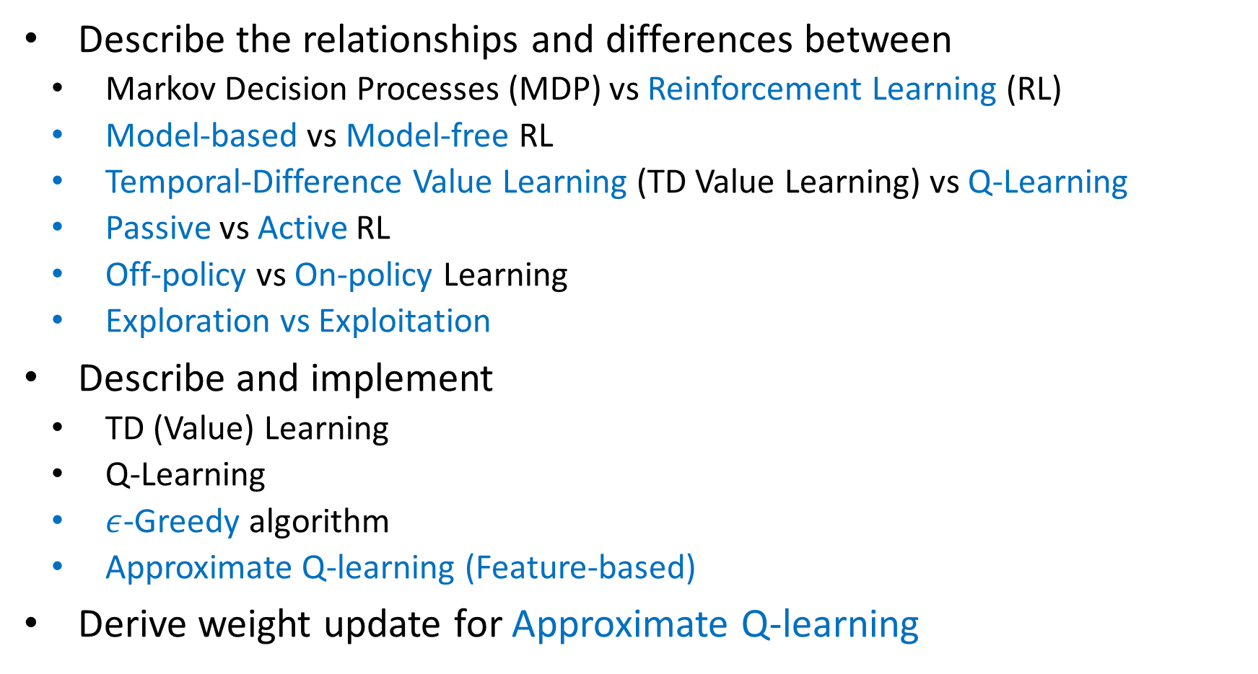
Learning Objective (RL I&II)
Describe the relationships and differences between
  Markov Decision Processes (MDP) vs Reinforcement Learning (RL)
  Model-based vs Model-free RL
  Temporal-Difference Value Learning (TD Value Learning) vs Q-Learning
  Passive vs Active RL
  Off-policy vs On-policy Learning
  Exploration vs Exploitation
Describe and implement
  TD (Value) Learning
  Q-Learning
  $ε$-Greedy algorithm
  Approximate Q-learning (Feature-based)
Derive weight update for Approximate Q-learning
This Lecture

Slide 5
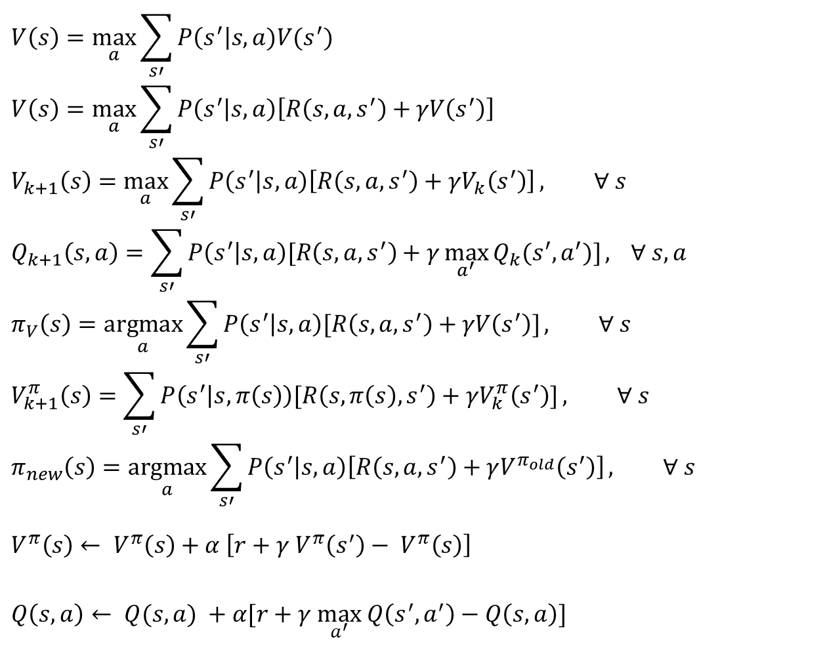
MDP/RL Notation
Standard expectimax:
$$V\left(s\right)=\max_{a}{\sum_{s′}{P\left(s^{′}\right|s,a)V(s^{′})}}$$
$$V\left(s\right)=\max_{a}{\sum_{s′}{P\left(s^{′} | s,a\right)\left[R\left(s,a,s^{′}\right)+γV\left(s^{′}\right)\right]}}$$
$$V_{k+1}\left(s\right)=\max_{a}{\sum_{s′}{P\left(s^{′} | s,a\right)\left[R\left(s,a,s^{′}\right)+γV_{k}\left(s^{′}\right)\right]}}, ∀ s$$
$$Q_{k+1}\left(s,a\right)=\sum_{s′}{P\left(s^{′} | s,a\right)[R\left(s,a,s^{′}\right)+γ\max_{a^{′}}{Q_{k}(s^{′},a^{′})]}, } ∀ s,a$$
$$π_{V}\left(s\right)=\underset{a}{argmax}{\sum_{s′}{P\left(s^{′} | s,a\right)[R\left(s,a,s^{′}\right)+γV\left(s^{′}\right)]}}, ∀ s$$
$$V_{k+1}^{π}\left(s\right)=\sum_{s′}{P\left(s^{′} | s,π\left(s\right)\right)[R\left(s,π\left(s\right),s^{′}\right)+γV_{k}^{π}\left(s^{′}\right)]}, ∀ s$$
$$π_{new}\left(s\right)=\underset{a}{argmax}{\sum_{s′}{P\left(s^{′} | s,a\right)\left[R\left(s,a,s^{′}\right)+γV^{π_{old}}\left(s^{′}\right)\right]}}, ∀ s$$
$$V^{π}\left(s\right)← V^{π}\left(s\right)+α \left[r+γ V^{π}\left(s^{′}\right)− V^{π}\left(s\right)\right]$$
$Q\left(s,a\right)← Q(s,a) +α[r+γ \max_{a^{′}} Q\left(s^{′},a^{′}\right)−Q\left(s, a\right)]$
Bellman equations:
Value iteration:
Q-iteration:
Policy extraction:
Policy evaluation:
Policy improvement:
TD (value) learning:
Q-learning:

Slide 6

Reinforcement Learning
We still assume an MDP:
  A set of states s ∈ S
  A set of actions (per state) A
  A model T(s,a,s’)
  A reward function R(s,a,s’)
Still looking for a policy π(s)
New twist: don’t know T or R, so must try out actions
Big idea: Compute all averages over T using sample outcomes

Slide 7
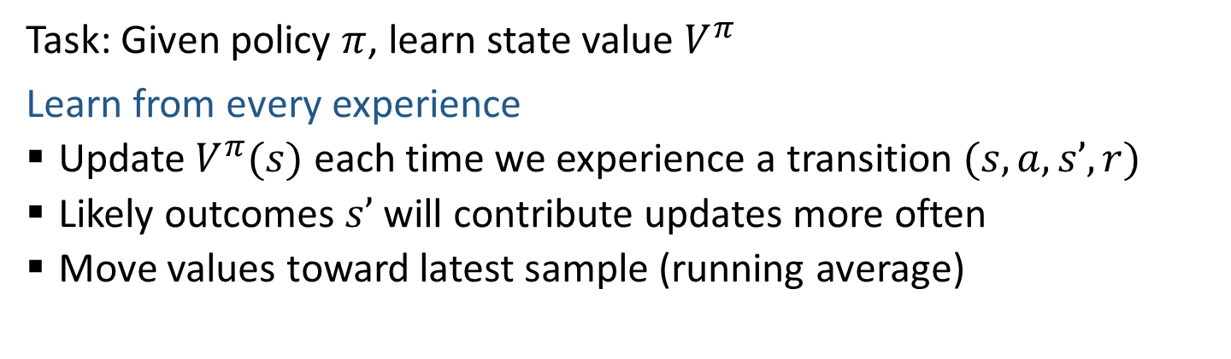
Temporal Difference (Value) Learning
Task: Given policy $π$, learn state value $V^{π}$
Learn from every experience
  Update $V^{π}(s)$ each time we experience a transition $(s, a, s’, r)$
  Likely outcomes $s’$ will contribute updates more often
  Move values toward latest sample (running average)
s
π(s)
s, π(s)
s’
Sample of V(s):
Update to V(s):
Equivalent to:

Slide 8
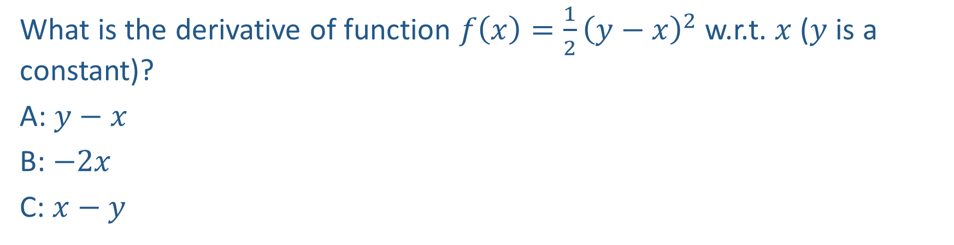
Piazza Poll 1
What is the derivative of function $f\left(x\right)=\frac{1}{2}{\left(y−x\right)}^{2}$w.r.t. $x$ ($y$ is a constant)?
A: $y−x$
B: $−2x$
C: $x−y$

Slide 9
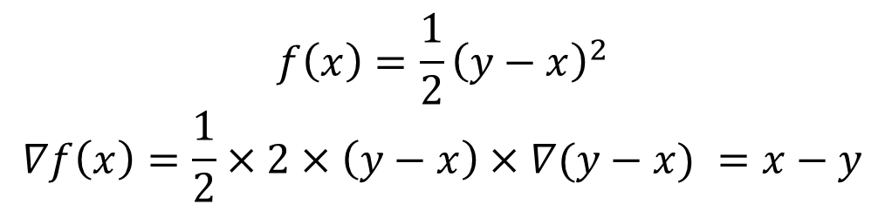
Piazza Poll 1
What is the derivative of function $f\left(x\right)=\frac{1}{2}{\left(y−x\right)}^{2}$w.r.t. $x$ ($y$ is a constant)?
A: $y−x$
B: $−2x$
C: $x−y$
$$f\left(x\right)=\frac{1}{2}{\left(y−x\right)}^{2}$$
$$∇f\left(x\right)=\frac{1}{2}×2×\left(y−x\right)×∇(y−x) =x−y$$

Slide 10
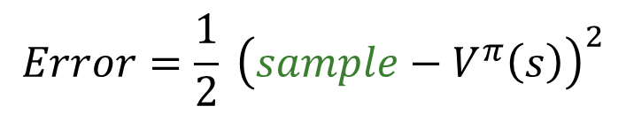

Temporal Difference (Value) Learning
Task: Given policy $π$, learn state value $V^{π}$
Learn from every experience
  Update $V^{π}(s)$ each time we experience a transition $(s, a, s’, r)$
  Likely outcomes $s’$ will contribute updates more often
  Move values toward latest sample (running average)
s
π(s)
s, π(s)
Sample of V(s):
s’
Update to V(s):
Equivalent to:
$$Error=\frac{1}{2} {\left(sample−V^{π}\left(s\right)\right)}^{2}$$
Equivalent to:
$$V^{π}\left(s\right) ← V^{π}\left(s\right)−α∇Error$$

Slide 11
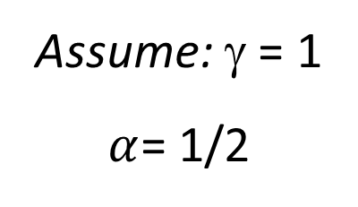
Example: Temporal Difference (Value) Learning
$V^{π}\left(s\right)←V^{π}\left(s\right)+α[r+γV^{π}(s^{′})−V^{π}(s)]$
Input Policy π
Observed Transitions
B, east, C, -2
C, east, D, -2
 | A
B | C | D
 | E
 | 0
0 | 0 | 8
 | 0
 | 0
-1 | 0 | 8
 | 0
 | 0
-1 | 3 | 8
 | 0
Assume: γ = 1
$α$= 1/2

Slide 12
Example: Temporal Difference (Value) Learning
$V^{π}\left(s\right)←V^{π}\left(s\right)+α[r+γV^{π}(s^{′})−V^{π}(s)]$
Input Policy π
Observed Transitions
B, east, C, -2
C, east, D, -2
 | A
B | C | D
 | E
 | 0
0 | 0 | 8
 | 0
 | 0
-1 | 0 | 8
 | 0
 | 0
-1 | 3 | 8
 | 0
$$V^{π}\left(B\right)←V^{π}\left(B\right)+0.5∗\left[−2+1∗V^{π}\left(C\right)−V^{π}\left(B\right)\right]=0+0.5∗\left(−2\right)=−1$$
Assume: γ = 1
$α$= 1/2
$$V^{π}\left(C\right)←V^{π}\left(C\right)+0.5∗\left[−2+1∗V^{π}\left(D\right)−V^{π}(C)\right]=0+0.5∗\left(−2+8\right)=3$$

Slide 13
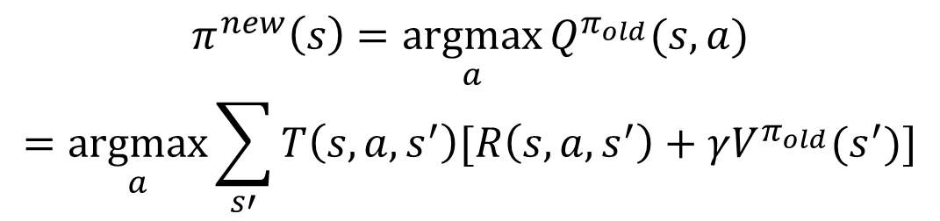
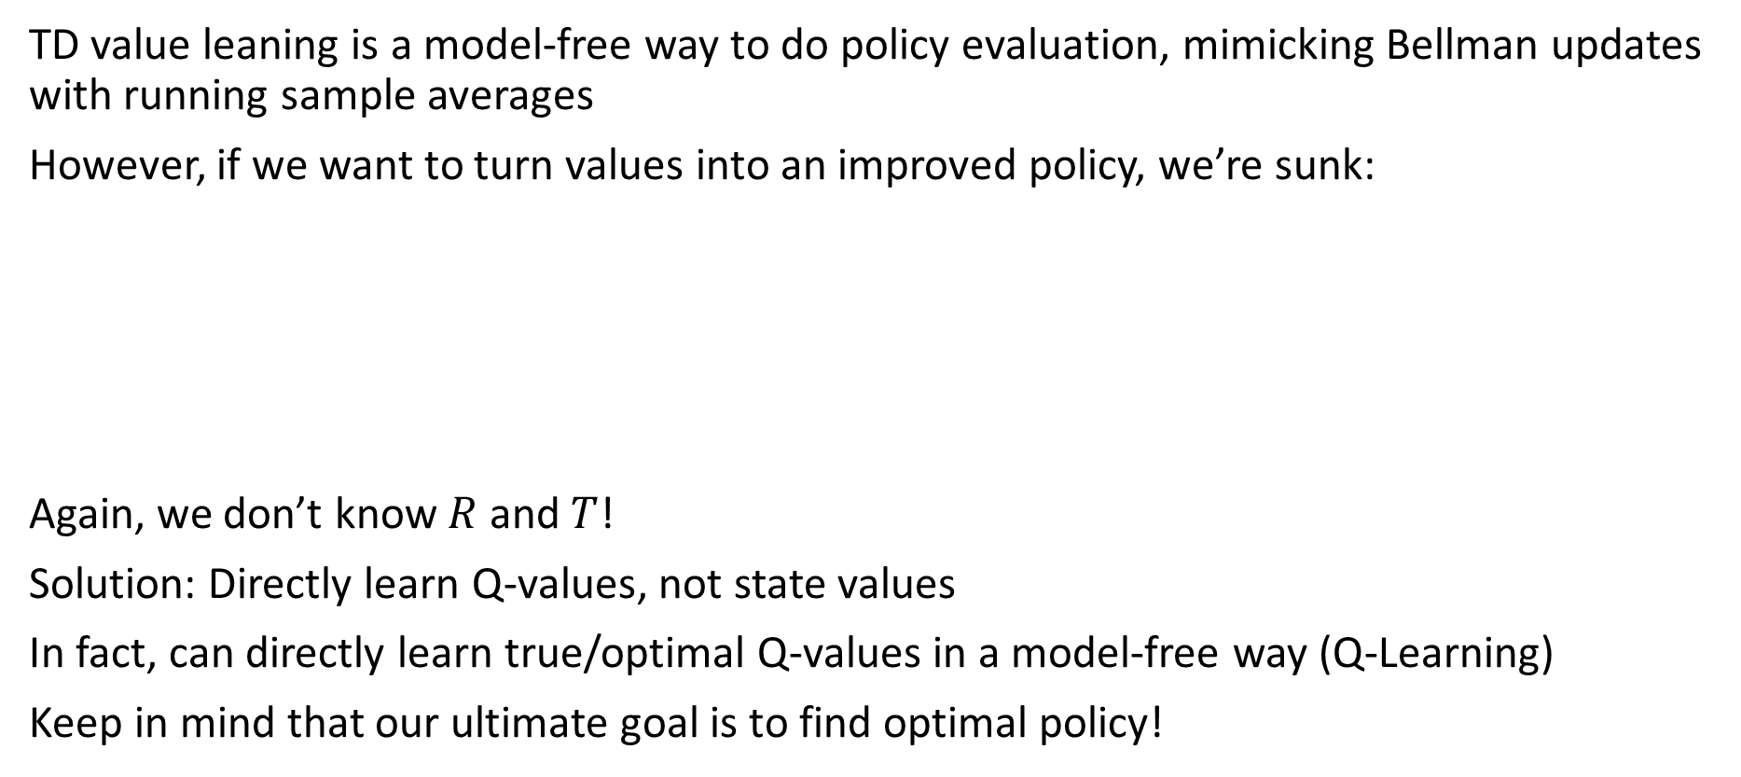
Problems with TD Value Learning
TD value leaning is a model-free way to do policy evaluation, mimicking Bellman updates with running sample averages
However, if we want to turn values into an improved policy, we’re sunk:
Again, we don’t know $R$ and $T$!
Solution: Directly learn Q-values, not state values
In fact, can directly learn true/optimal Q-values in a model-free way (Q-Learning)
Keep in mind that our ultimate goal is to find optimal policy!
s
$$π^{new}\left(s\right)=\underset{a}{argmax}{Q^{π_{old}}(s,a)}$$
$$=\underset{a}{argmax}{\sum_{s′}{T\left(s,a,s^{′}\right)[R\left(s,a,s^{′}\right)+γV^{π_{old}}(s^{′})]}}$$
a
s, a
s,a,s’
s’

Slide 14
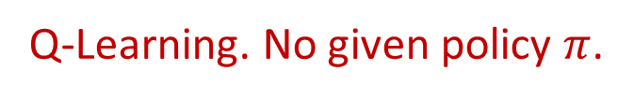

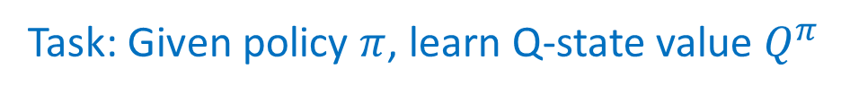
Extending TD Learning to Q-Value
s
Task: Given policy $π$, learn state value $V^{π}$
a
$V^{π}\left(s\right)←V^{π}\left(s\right)+α[R\left(s,a,s^{′}\right)+γV^{π}(s^{′})−V^{π}(s)]$
where $a=π(s)$
s, a
Task: Given policy $π$, learn Q-state value $Q^{π}$
s,a,s’
s’
Task: Directly learn true/optimal Q-state value $Q$
Q-Learning. No given policy $π$.

Slide 15
Extending TD Learning to Q-Value
s
Task: Given policy $π$, learn state value $V^{π}$
a
$V^{π}\left(s\right)←V^{π}\left(s\right)+α[R\left(s,a,s^{′}\right)+γV^{π}(s^{′})−V^{π}(s)]$
where $a=π(s)$
s, a
Task: Given policy $π$, learn Q-state value $Q^{π}$
s,a,s’
s’
$Q^{π}\left(s,a\right)←Q^{π}\left(s,a\right)+α[R\left(s,a,s^{′}\right)+γQ^{π}(s^{′},π\left(s^{′}\right))−Q^{π}(s,a)]$
where $a=π(s)$
Task: Directly learn true/optimal Q-state value $Q$
$$Q\left(s,a\right)←Q\left(s,a\right)+α[R\left(s,a,s^{′}\right)+γ\max_{a′}{Q(s^{′},a^{′})}−Q(s,a)]$$
Q-Learning. No given policy $π$.

Slide 16
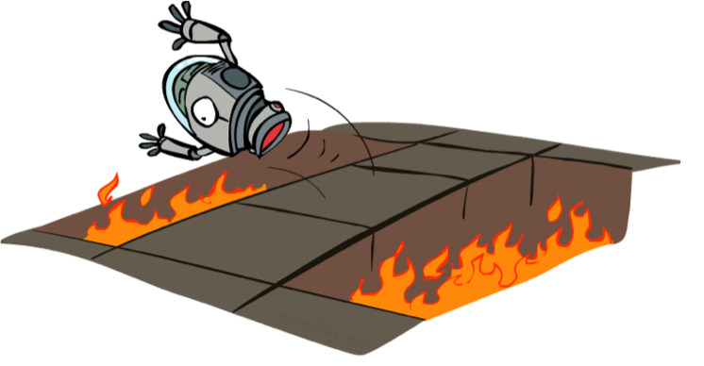
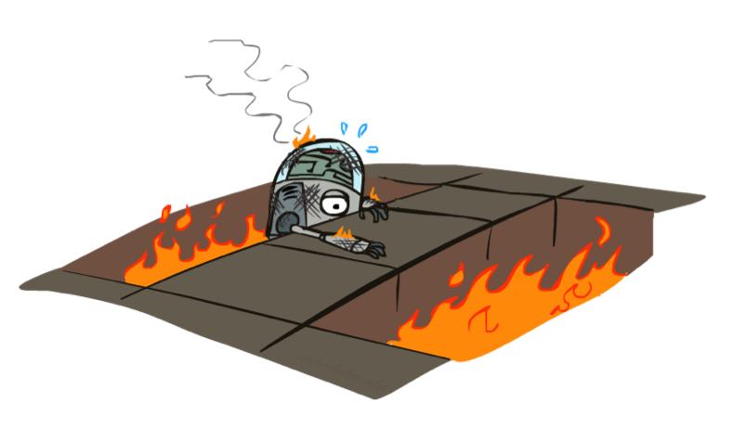
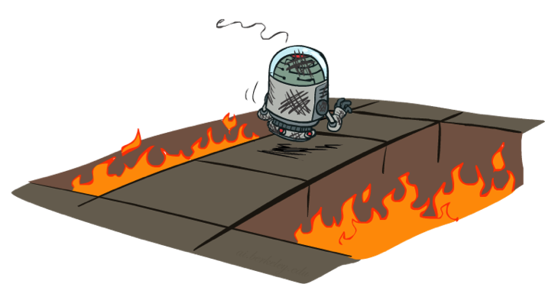
Active Reinforcement Learning

Slide 17
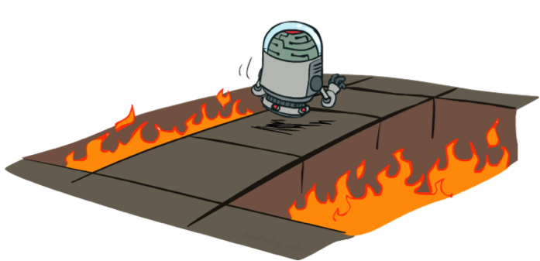
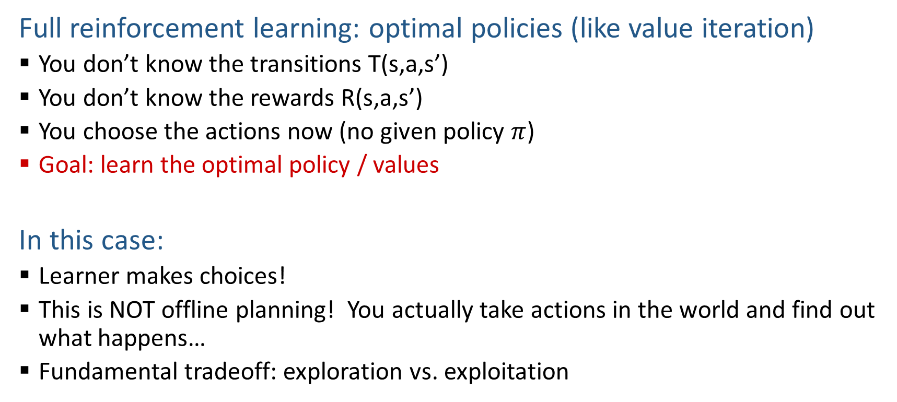
Active Reinforcement Learning
Full reinforcement learning: optimal policies (like value iteration)
  You don’t know the transitions T(s,a,s’)
  You don’t know the rewards R(s,a,s’)
  You choose the actions now (no given policy $π$)
  Goal: learn the optimal policy / values
In this case:
  Learner makes choices!
  This is NOT offline planning! You actually take actions in the world and find out what happens…
  Fundamental tradeoff: exploration vs. exploitation

Slide 18
Demo Q-Learning -- Gridworld
[Demo: Q-learning – gridworld (L10D2)]

Slide 19
Demo Q-Learning -- Crawler
[Demo: Q-learning – crawler (L10D3)]

Slide 20
Detour: Q-Value Iteration
Value iteration: find successive (depth-limited) values
  Start with V₀(s) = 0, which we know is right
  Given V_{k}, calculate the depth k+1 values for all states:
But Q-values are more useful, so compute them instead
  Start with Q₀(s,a) = 0, which we know is right
  Given Q_{k}, calculate the depth k+1 q-values for all q-states:

Slide 21
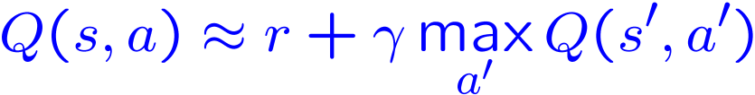
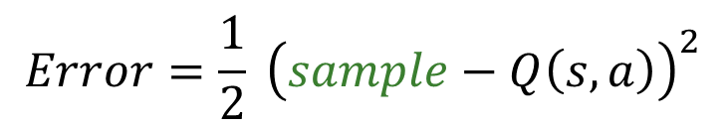
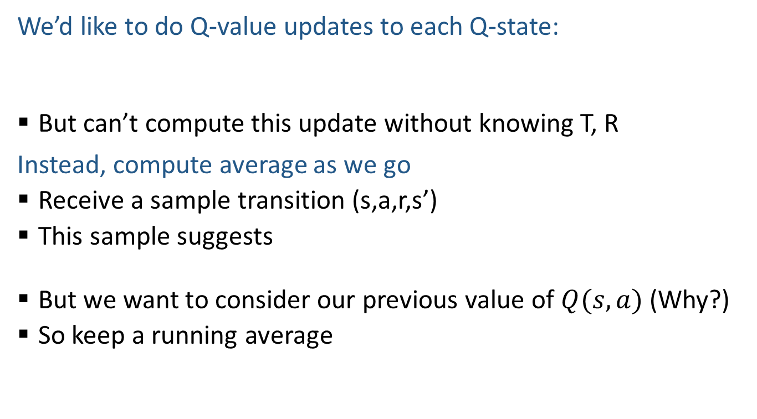

Q-Learning
We’d like to do Q-value updates to each Q-state:
  But can’t compute this update without knowing T, R
Instead, compute average as we go
  Receive a sample transition (s,a,r,s’)
  This sample suggests
  But we want to consider our previous value of $Q(s,a)$ (Why?)
  So keep a running average
$Q\left(s,a\right)← Q(s,a) +α[r+γ \max_{a^{′}} Q\left(s^{′},a^{′}\right)−Q\left(s, a\right)]$
$$Error=\frac{1}{2} {\left(sample−Q\left(s,a\right)\right)}^{2}$$
$$Q\left(s,a\right)←Q\left(s,a\right)−α∇Error$$

Slide 22
Demo Q-Learning Auto Cliff Grid
[Demo: Q-learning – auto – cliff grid (L11D1)]

Slide 23

Q-Learning Properties
Amazing result: Q-learning converges to the Q-value of the optimal policy -- even if you’re acting suboptimally!
This is called off-policy learning: you learn the value of the optimal policy while your behavior policy (how you act) is a different policy
In contrast, on-policy learning (e.g., TD value learning) estimates the value of a policy while acting according to it
Notes:
you learn the value of the optimal policy while your behavior policy (how you act) is a different policy

Slide 24
Q-Learning Properties
Caveats:
  You have to explore enough
  You have to eventually make the learning rate small enough
  … but not decrease it too quickly
  Basically, in the limit, it doesn’t matter how you select actions (!)
Notes:
you learn the value of the optimal policy while your behavior policy (how you act) is a different policy

Slide 25
The Story So Far: MDPs and RL
Known MDP: Offline Solution
Goal Technique
Compute V*, Q*, π* Value / policy iteration
Evaluate a fixed policy π Policy evaluation
Unknown MDP: Model-Based
Unknown MDP: Model-Free
Goal Technique
Compute V*, Q*, π* VI/PI on approx. MDP
Evaluate a fixed policy π PE on approx. MDP
Goal Technique
Compute V*, Q*, π* Q-learning
Evaluate a fixed policy π TD/Value Learning

Slide 26
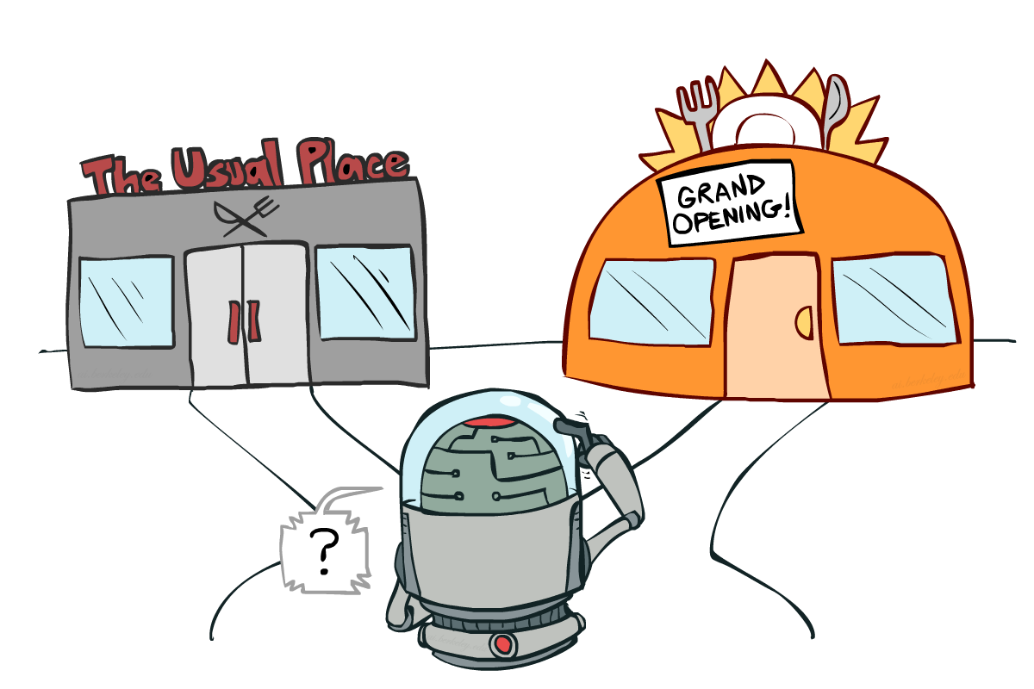
Exploration vs. Exploitation

Slide 27

How to Explore?
Several schemes for forcing exploration
  Simplest: random actions (ε-greedy)
    Every time step, flip a coin
    With (small) probability ε, act randomly
    With (large) probability 1-ε, act on current policy
  Problems with random actions?
    You do eventually explore the space, but keep thrashing around once learning is done
    One solution: lower ε over time
    Another solution: exploration functions
[Demo: Q-learning – manual exploration – bridge grid (L11D2)] [Demo: Q-learning – epsilon-greedy -- crawler (L11D3)]

Slide 28
Demo Q-learning – Manual Exploration – Bridge Grid

Slide 29
Demo Q-learning – Epsilon-Greedy – Crawler

Slide 30
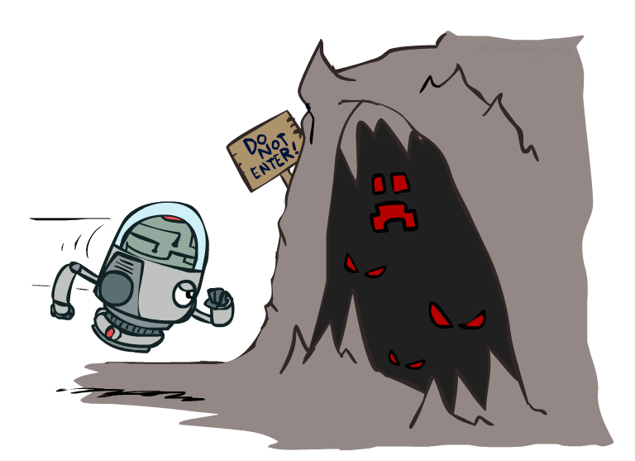

Exploration Functions
When to explore?
  Random actions: explore a fixed amount
  Better idea: explore areas whose badness is not
  (yet) established, eventually stop exploring
Exploration function
  Takes a value estimate u and a visit count n, and
  returns an optimistic utility, e.g.
  Note: this propagates the “bonus” back to states that lead to unknown states as well!
Regular Q-Update:
Modified Q-Update:
[Demo: exploration – Q-learning – crawler – exploration function (L11D4)]

Slide 31
Demo Q-learning – Exploration Function – Crawler

Slide 32
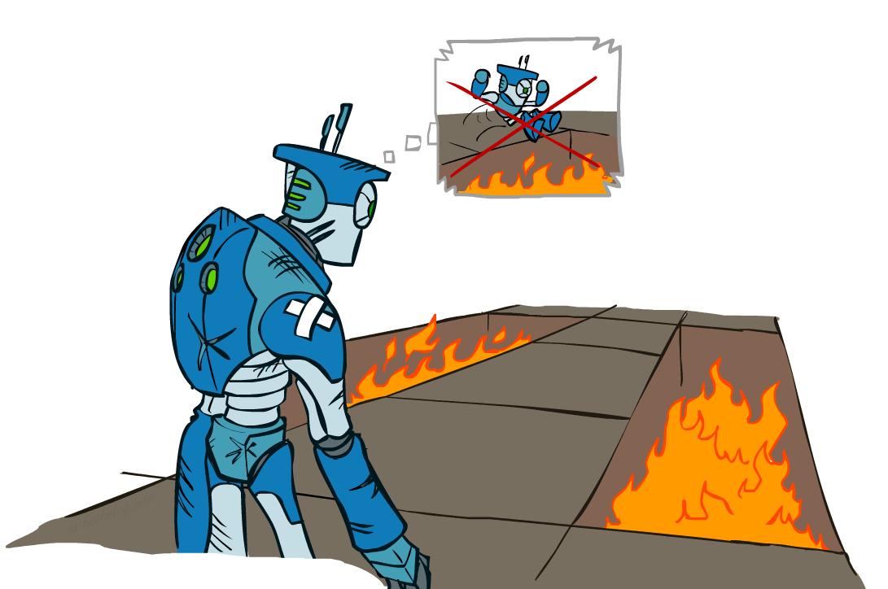
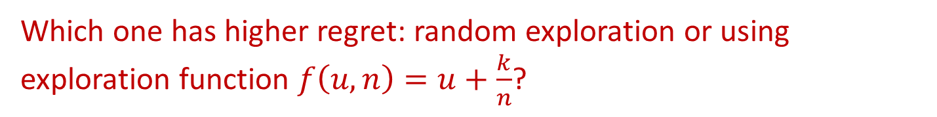
Regret
Even if you learn the optimal policy, you still make mistakes along the way!
Regret: the difference between your (expected) rewards, including youthful suboptimality, and (expected) rewards if you use an optimal policy in hindsight
Minimizing regret requires optimally learning to be optimal
Which one has higher regret: random exploration or using exploration function $f\left(u,n\right)=u+\frac{k}{n}$?

Slide 33
Regret
Even if you learn the optimal policy, you still make mistakes along the way!
Regret: the difference between your (expected) rewards, including youthful suboptimality, and (expected) rewards if you use an optimal policy in hindsight
Minimizing regret requires optimally learning to be optimal
Which one has higher regret: random exploration or using exploration function $f\left(u,n\right)=u+\frac{k}{n}$?
The former

Slide 34

Approximate Q-Learning
Notes:
:34 in, :40 to go

Slide 35

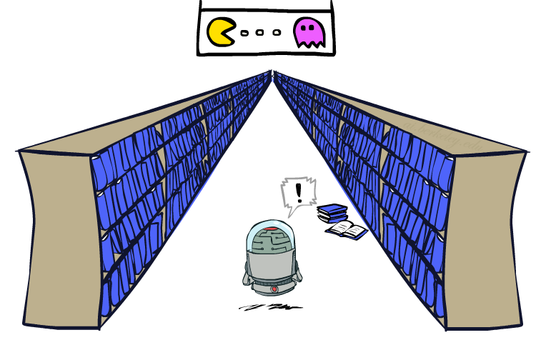
Generalizing Across States
Basic Q-Learning keeps a table of all q-values
In realistic situations, we cannot possibly learn about every single state!
  Too many states to visit them all in training
  Too many states to hold the q-tables in memory
Instead, we want to generalize:
  Learn about some small number of training states from experience
  Generalize that experience to new, similar situations
  This is a fundamental idea in machine learning, and we’ll see it over and over again
[demo – RL pacman]

Slide 36
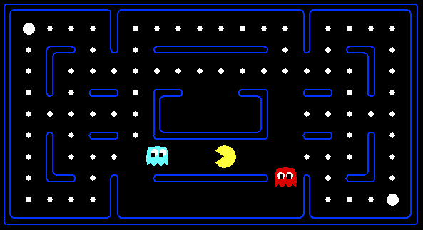



Example: Pacman
Let’s say we discover through experience that this state is bad:
In naïve q-learning, we know nothing about this state:
Or even this one!
[Demo: Q-learning – pacman – tiny – watch all (L11D5)]
[Demo: Q-learning – pacman – tiny – silent train (L11D6)]
[Demo: Q-learning – pacman – tricky – watch all (L11D7)]

Slide 37
Demo Q-Learning Pacman – Tiny – Watch All

Slide 38
Demo Q-Learning Pacman – Tiny – Silent Train

Slide 39
Demo Q-Learning Pacman – Tricky – Watch All

Slide 40
Feature-Based Representations
Solution: describe a state using a vector of features (properties)
  Features are functions from states to real numbers (often 0/1) that capture important properties of the state
  Example features:
    Distance to closest ghost
    Distance to closest dot
    Number of ghosts
    1 / (dist to dot)²
    Is Pacman in a tunnel? (0/1)
    …… etc.
    Is it the exact state on this slide?
  Can also describe a q-state (s, a) with features (e.g. action moves closer to food)

Slide 41
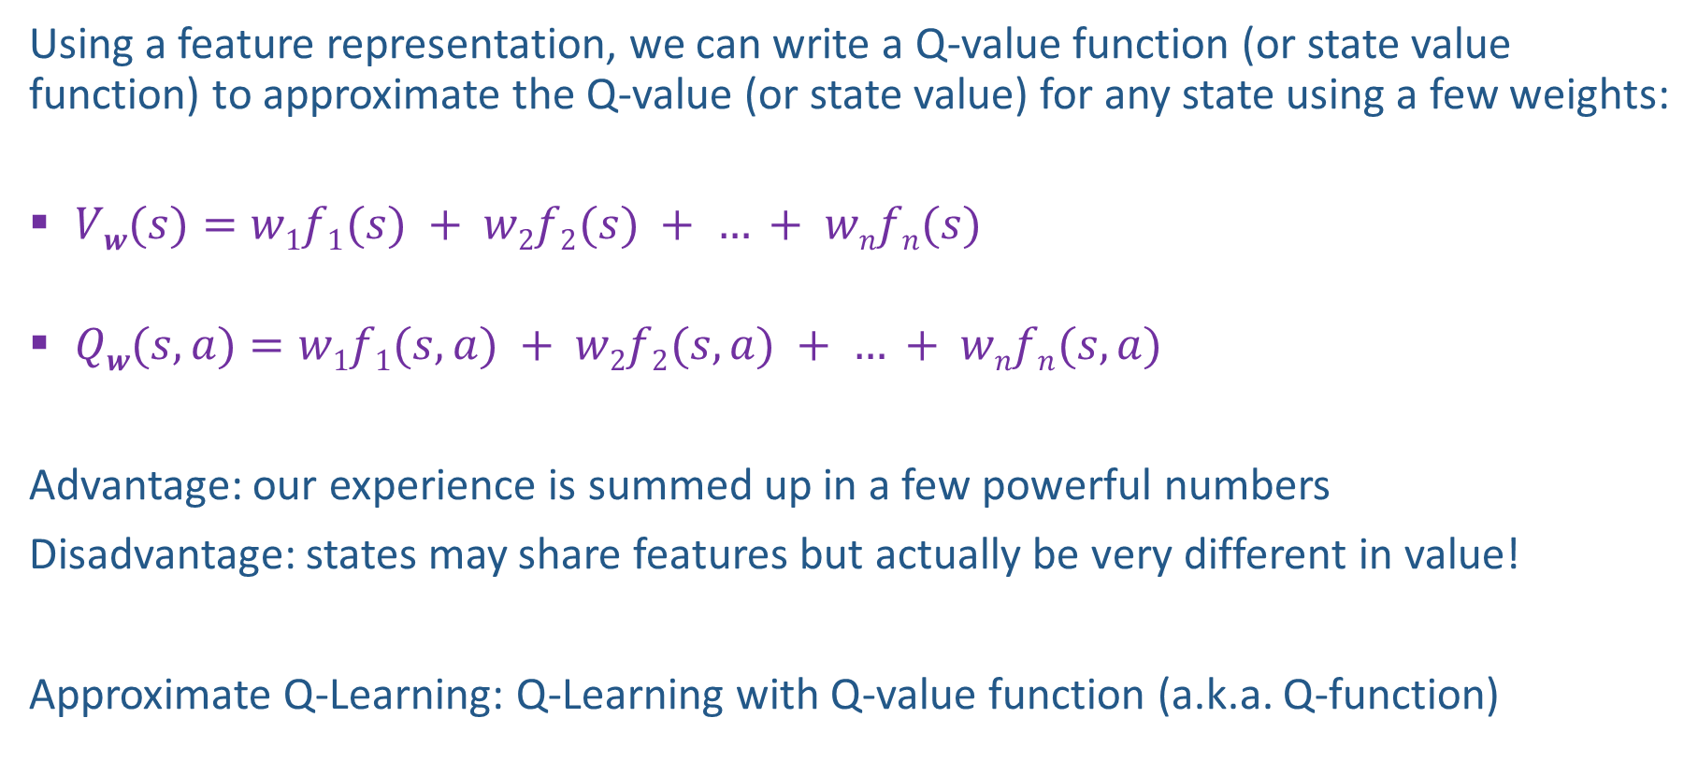
Linear Value Functions
Using a feature representation, we can write a Q-value function (or state value function) to approximate the Q-value (or state value) for any state using a few weights:
  $Vw(s)=w1f1(s) + w2f2(s) + … + wnfn(s)$
  $Qw(s,a)=w1f1(s,a) + w2f2(s,a) + … + wnfn(s,a)$
Advantage: our experience is summed up in a few powerful numbers
Disadvantage: states may share features but actually be very different in value!
Approximate Q-Learning: Q-Learning with Q-value function (a.k.a. Q-function)

Slide 42
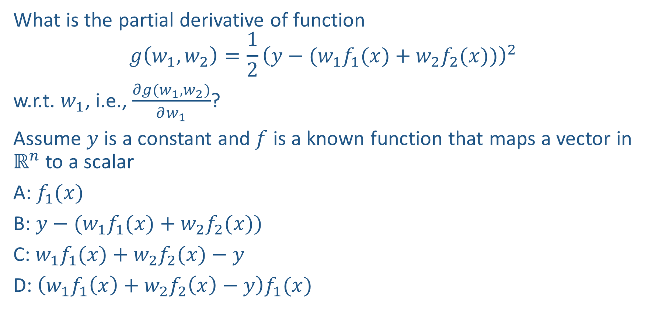
Piazza Poll 2
What is the partial derivative of function
$$g\left(w_{1},w_{2}\right)=\frac{1}{2}{\left(y−(w_{1}f_{1}(x)+w_{2}f_{2}(x))\right)}^{2}$$
w.r.t. $w_{1}$, i.e., $\frac{∂g(w_{1},w_{2})}{∂w_{1}}$?
Assume $y$ is a constant and $f$ is a known function that maps a vector in $ℝ^{n}$ to a scalar
A: $f_{1}(x)$
B: $y−(w_{1}f_{1}(x)+w_{2}f_{2}(x))$
C: $w_{1}f_{1}(x)+w_{2}f_{2}(x)−y$
D: $\left(w_{1}f_{1}\left(x\right)+w_{2}f_{2}\left(x\right)−y\right)f_{1}(x)$

Slide 43
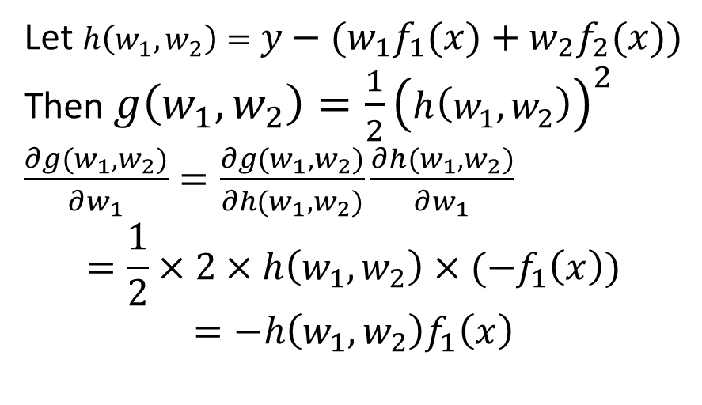
Piazza Poll 2
What is the partial derivative of function
$$g\left(w_{1},w_{2}\right)=\frac{1}{2}{\left(y−(w_{1}f_{1}(x)+w_{2}f_{2}(x))\right)}^{2}$$
w.r.t. $w_{1}$, i.e., $\frac{∂g(w_{1},w_{2})}{∂w_{1}}$?
Assume $y$ is a constant and $f$ is a known function that maps a vector in $ℝ^{n}$ to a scalar
A: $f_{1}(x)$
B: $y−(w_{1}f_{1}(x)+w_{2}f_{2}(x))$
C: $w_{1}f_{1}(x)+w_{2}f_{2}(x)−y$
D: $\left(w_{1}f_{1}\left(x\right)+w_{2}f_{2}\left(x\right)−y\right)f_{1}(x)$
Let $h\left(w_{1},w_{2}\right)=y−(w_{1}f_{1}(x)+w_{2}f_{2}(x))$
Then $g\left(w_{1},w_{2}\right)=\frac{1}{2}{\left(h\left(w_{1},w_{2}\right)\right)}^{2}$
$\frac{∂g(w_{1},w_{2})}{∂w_{1}}=\frac{∂g(w_{1},w_{2})}{∂h(w_{1},w_{2})}\frac{∂h(w_{1},w_{2})}{∂w_{1}}$
$$=\frac{1}{2}×2×h\left(w_{1},w_{2}\right)×(−f_{1}\left(x\right))$$
$$=−h\left(w_{1},w_{2}\right)f_{1}\left(x\right)$$

Slide 44
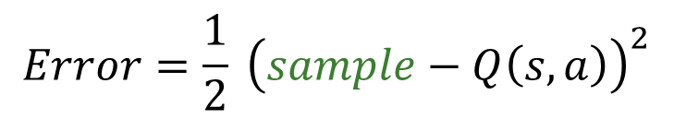
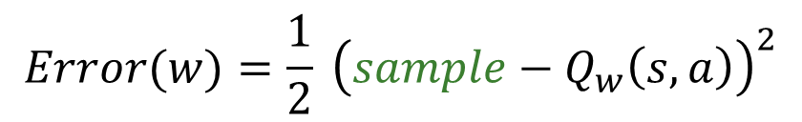

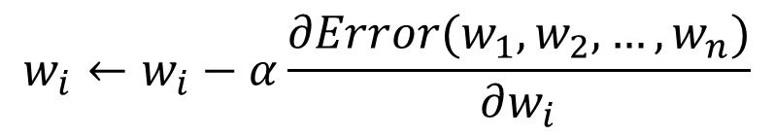
Updating a linear value function
Original Q-learning: Update Q values directly (stored in a table)
Can be viewed as trying to reduce prediction error at s, a:
Approximate Q-Learning with Linear Q-Value Function:
Update weights to reduce prediction error at s, a:
$Q\left(s,a\right)← Q(s,a) +α[r+γ \max_{a^{′}} Q\left(s^{′},a^{′}\right)−Q\left(s, a\right)]$
Latest sample
Previous estimate
Difference
$$Error=\frac{1}{2} {\left(sample−Q\left(s,a\right)\right)}^{2}$$
$$Q\left(s,a\right)←Q\left(s,a\right)−α∇Error$$
$$Qw(s,a)=w1f1(s,a) + … + wnfn(s,a)$$
$$w_{i}←w_{i}−α\frac{∂Error(w_{1},w_{2},…,w_{n})}{∂w_{i}}$$
$$Error(w)=\frac{1}{2} {\left(sample−Q_{w}\left(s,a\right)\right)}^{2}$$

Slide 45
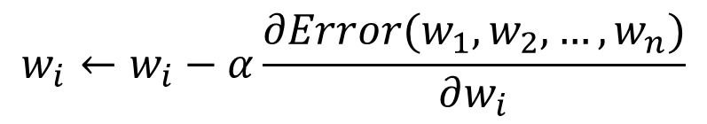

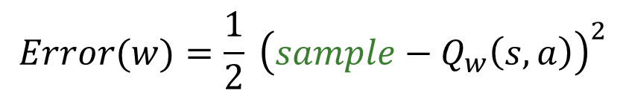
Updating a linear value function
$$Qw(s,a)=w1f1(s,a) + … + wnfn(s,a)$$
$$w_{i}←w_{i}−α\frac{∂Error(w_{1},w_{2},…,w_{n})}{∂w_{i}}$$
$$Error(w)=\frac{1}{2} {\left(sample−Q_{w}\left(s,a\right)\right)}^{2}$$
$$\frac{∂Error(w)}{∂w_{i}}=(Q_{w}\left(s,a\right)−sample)\frac{∂Q_{w}\left(s,a\right)}{∂w_{i}}$$
$$=\left(Q_{w}\left(s,a\right)−sample\right)f_{i}(s,a)$$
Final Update Rule for Approximate Q-Learning with Linear Q-Value Function:
$$w_{i}←w_{i}+α\left(r+γ \max_{a^{′}} Q_{w}\left(s^{′},a^{′}\right)−Q_{w}\left(s,a\right)\right)f_{i}(s,a)$$
Original Q-Learning Update Rule:
$Q\left(s,a\right)← Q(s,a) +α[r+γ \max_{a^{′}} Q\left(s^{′},a^{′}\right)−Q\left(s, a\right)]$

Slide 46

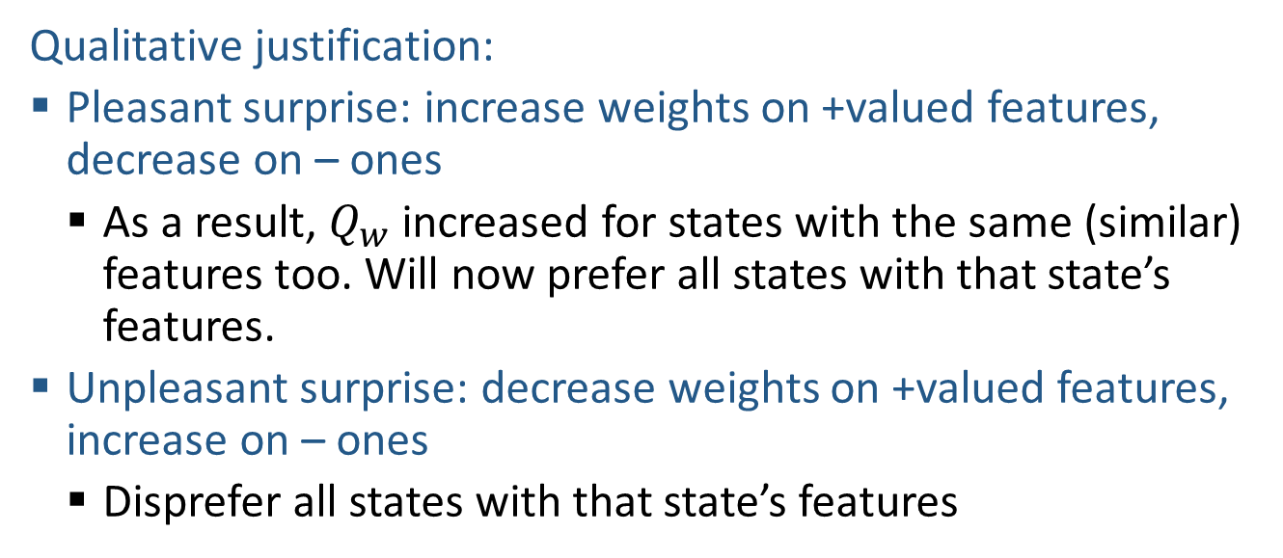
Approximate Q-Learning
Update Rule for Approximate Q-Learning with Linear Q-Value Function:
$$w_{i}←w_{i}+α\left(r+γ \max_{a^{′}} Q_{w}\left(s^{′},a^{′}\right)−Q_{w}\left(s,a\right)\right)f_{i}(s,a)$$
Qualitative justification:
  Pleasant surprise: increase weights on +valued features, decrease on – ones
    As a result, $Q_{w}$ increased for states with the same (similar) features too. Will now prefer all states with that state’s features.
  Unpleasant surprise: decrease weights on +valued features, increase on – ones
    Disprefer all states with that state’s features

Slide 47

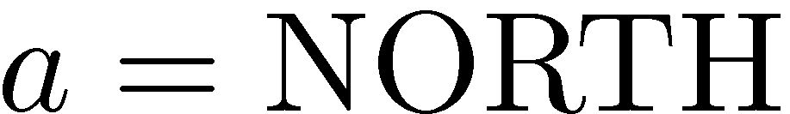
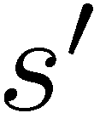
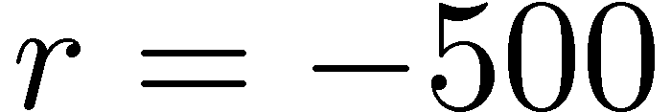


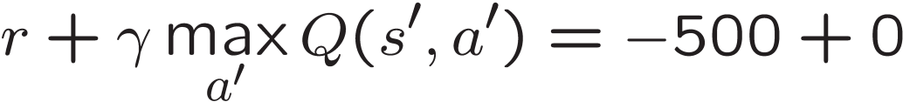
Example: Q-Pacman
[Demo: approximate Q-learning pacman (L11D10)]

Slide 48
Demo Approximate Q-Learning -- Pacman

Slide 49
What if non-linear value function?
Update Rule for Q-Learning:
$Q\left(s,a\right)← Q(s,a) +α[r+γ \max_{a^{′}} Q\left(s^{′},a^{′}\right)−Q\left(s, a\right)]$
Update Rule for Approximate Q-Learning with Linear Q-Value Function:
$$w_{i}←w_{i}+α\left(r+γ \max_{a^{′}} Q_{w}\left(s^{′},a^{′}\right)−Q_{w}\left(s,a\right)\right)f_{i}(s,a)$$
Update Rule for Approximate Q-Learning with differentiable Q-function $Q_{w}(s,a)$:

Slide 50
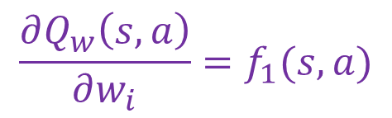
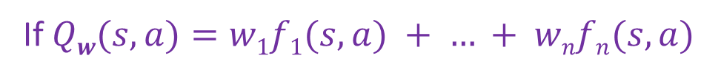
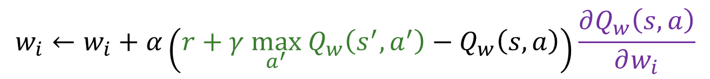
What if non-linear value function?
Update Rule for Q-Learning:
$Q\left(s,a\right)← Q(s,a) +α[r+γ \max_{a^{′}} Q\left(s^{′},a^{′}\right)−Q\left(s, a\right)]$
Update Rule for Approximate Q-Learning with Linear Q-Value Function:
$$w_{i}←w_{i}+α\left(r+γ \max_{a^{′}} Q_{w}\left(s^{′},a^{′}\right)−Q_{w}\left(s,a\right)\right)f_{i}(s,a)$$
Update Rule for Approximate Q-Learning with differentiable Q-function $Q_{w}(s,a)$:
$$w_{i}←w_{i}+α\left(r+γ \max_{a^{′}} Q_{w}\left(s^{′},a^{′}\right)−Q_{w}\left(s,a\right)\right)\frac{∂Q_{w}\left(s,a\right)}{∂w_{i}}$$
If $Qw(s,a)=w1f1(s,a) + … + wnfn(s,a)$
$$\frac{∂Q_{w}\left(s,a\right)}{∂w_{i}}=f_{1}(s,a)$$

Slide 51

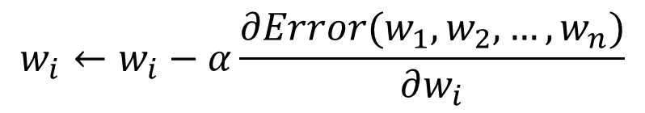
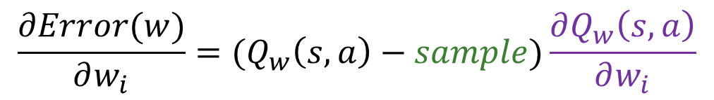
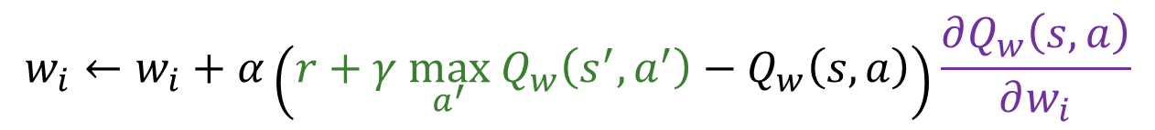
What if non-linear value function?
Update Rule for Approximate Q-Learning with Q-function $Q_{w}(s,a)$:
$$w_{i}←w_{i}+α\left(r+γ \max_{a^{′}} Q_{w}\left(s^{′},a^{′}\right)−Q_{w}\left(s,a\right)\right)\frac{∂Q_{w}\left(s,a\right)}{∂w_{i}}$$
Why?
$$w_{i}←w_{i}−α\frac{∂Error(w_{1},w_{2},…,w_{n})}{∂w_{i}}$$
$$Error(w)=\frac{1}{2} {\left(sample−Q_{w}\left(s,a\right)\right)}^{2}$$
$$\frac{∂Error(w)}{∂w_{i}}=(Q_{w}\left(s,a\right)−sample)\frac{∂Q_{w}\left(s,a\right)}{∂w_{i}}$$
$$w_{i}−α\frac{∂Error\left(w_{1},w_{2},…,w_{n}\right)}{∂w_{i}}=w_{i}+α\left(r+γ \max_{a^{′}} Q_{w}\left(s^{′},a^{′}\right)−Q_{w}\left(s,a\right)\right)\frac{∂Q_{w}\left(s,a\right)}{∂w_{i}}$$

Slide 52

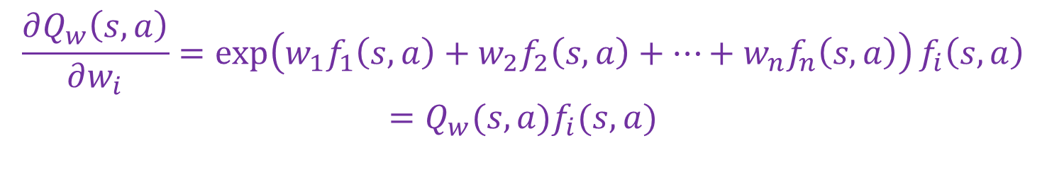
What if non-linear value function?
Update Rule for Approximate Q-Learning with Q-function $Q_{w}(s,a)$:
$$w_{i}←w_{i}+α\left(r+γ \max_{a^{′}} Q_{w}\left(s^{′},a^{′}\right)−Q_{w}\left(s,a\right)\right)\frac{∂Q_{w}\left(s,a\right)}{∂w_{i}}$$
Example: $Q_{w}(s,a)=exp⁡(w_{1}f_{1}(s,a)+w_{2}f_{2}(s,a)+…+w_{n}f_{n}(s,a))$
$$\frac{∂Q_{w}\left(s,a\right)}{∂w_{i}}=\exp\left(w_{1}f_{1}\left(s,a\right)+w_{2}f_{2}\left(s,a\right)+…+w_{n}f_{n}\left(s,a\right)\right)f_{i}\left(s,a\right)$$
$$=Q_{w}(s,a)f_{i}(s,a)$$
Update Rule:
$$w_{i}←w_{i}+α\left(r+γ \max_{a^{′}} Q_{w}\left(s^{′},a^{′}\right)−Q_{w}\left(s,a\right)\right)Q_{w}(s,a)f_{i}(s,a)$$

Slide 53
Recent Reinforcement Learning Milestones

Slide 54
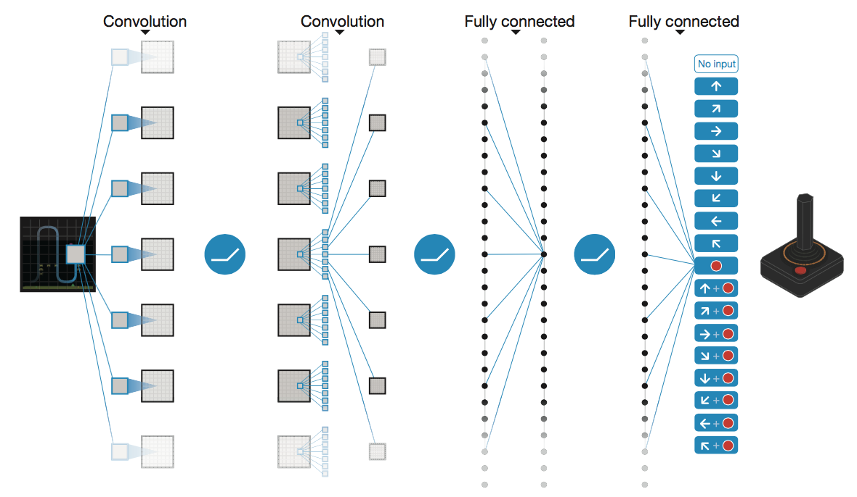
Deep Q-Networks
Deep Mind, 2015
Used a deep learning network to represent Q:
  Input is last 4 images (84x84 pixel values) plus score
49 Atari games, incl. Breakout, Space Invaders, Seaquest, Enduro

Slide 55
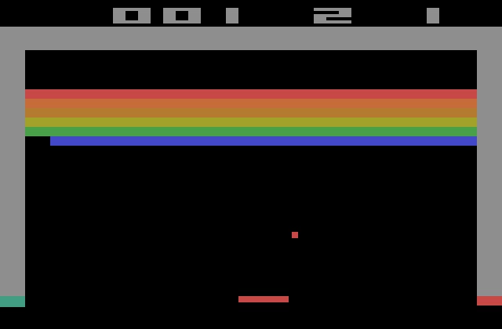
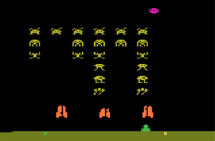



Slide 56




OpenAI Gym
2016+
Benchmark problems for learning agents
https://gym.openai.com/envs

Slide 57
TDGammon
1992 by Gerald Tesauro, IBM
4-ply lookahead using V(s) trained from 1,500,000 games of self-play
3 hidden layers, ~100 units each
Input: contents of each location plus several handcrafted features
Experimental results:
  Plays approximately at parity with world champion
  Led to radical changes in the way humans play backgammon

Slide 58

AlphaGo, AlphaZero
Deep Mind, 2016+

Slide 59




(Deep) Q-Learning for Combating (Naïve) Poacher
Wildlife protection
  Rangers make flexible decisions instead of sticking to a fixed patrol route
  Rangers and poachers may leave traces as they move
Footprints
Lighters
Old poacher camp
Tree marking
Deep Reinforcement Learning for Green Security Games with Real-Time Information Yufei Wang, Zheyuan Ryan Shi, Lantao Yu, Yi Wu, Rohit Singh, Lucas Joppa, Fei Fang In AAAI-19
Notes:
What’s missing?
Defender and/or attacker make flexible decisions rather than stick to a premeditated plan

Slide 60

(Deep) Q-Learning for Combating (Naïve) Poacher
Poacher
Snares
Ranger
Patrol Post

Slide 61
Autonomous Vehicles?

Slide 62
Backup Slides

Slide 63

Q-Learning and Least Squares
Notes:
DK :57 in, :17 to go

Slide 64



Linear Approximation: Regression
40
26
24
20
22
20
30
20
40
0
0
20
30
10
20
0
10
0
Prediction:
Prediction:
Notes:
Figure 1: scatter(1:20,10+(1:20)+2*randn(1,20),'k','filled'); a=axis; a(3)=0; axis(a);

Slide 65





Optimization: Least Squares
Error or “residual”
Observation
Prediction
0
0
20
Notes:
Figure 1: scatter(1:20,10+(1:20)+2*randn(1,20),'k','filled'); a=axis; a(3)=0; axis(a);

Slide 66



Minimizing Error
Imagine we had only one point x, with features f(x), target value y, and weights w:
Approximate q update explained:
“target”
“prediction”

