Slide 1
Announcements
Assignments:
HW7 (online)
  Due today, 10 pm
HW8 (written)
    Will be released after HW7 is due. Due 10/29 Tue, 10 pm
P4
    Due 10/31 Thu, 10 pm
Recitation worksheet for last week’s material is available online
Piazza in-class post is ready to go
Piazza Poll: Don’t worry too much if you attended a lecture and missed one take of a poll or you missed a lecture which had many polls ☺. We will take that into account.

Slide 2

AI: Representation and Problem Solving
Reinforcement Learning
Instructors: Fei Fang & Pat Virtue
Slide credits: CMU AI and http://ai.berkeley.edu

Slide 3
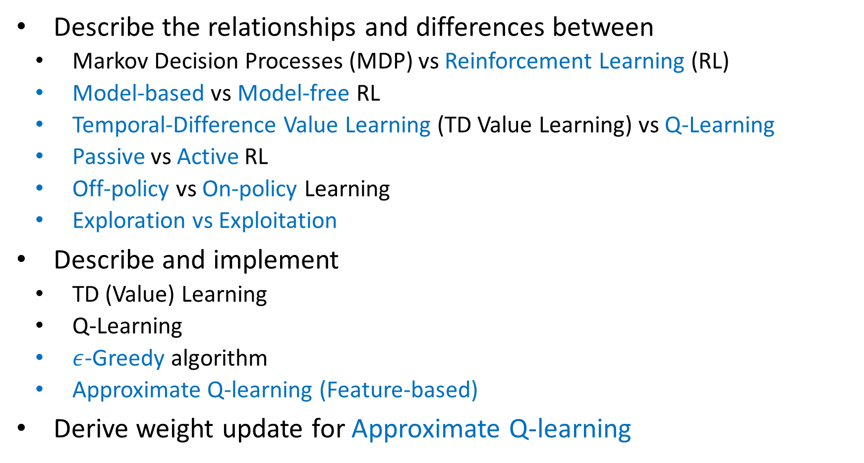
Learning Objective (RL I&II)
Describe the relationships and differences between
  Markov Decision Processes (MDP) vs Reinforcement Learning (RL)
  Model-based vs Model-free RL
  Temporal-Difference Value Learning (TD Value Learning) vs Q-Learning
  Passive vs Active RL
  Off-policy vs On-policy Learning
  Exploration vs Exploitation
Describe and implement
  TD (Value) Learning
  Q-Learning
  $ε$-Greedy algorithm
  Approximate Q-learning (Feature-based)
Derive weight update for Approximate Q-learning
Next Lecture

Slide 4
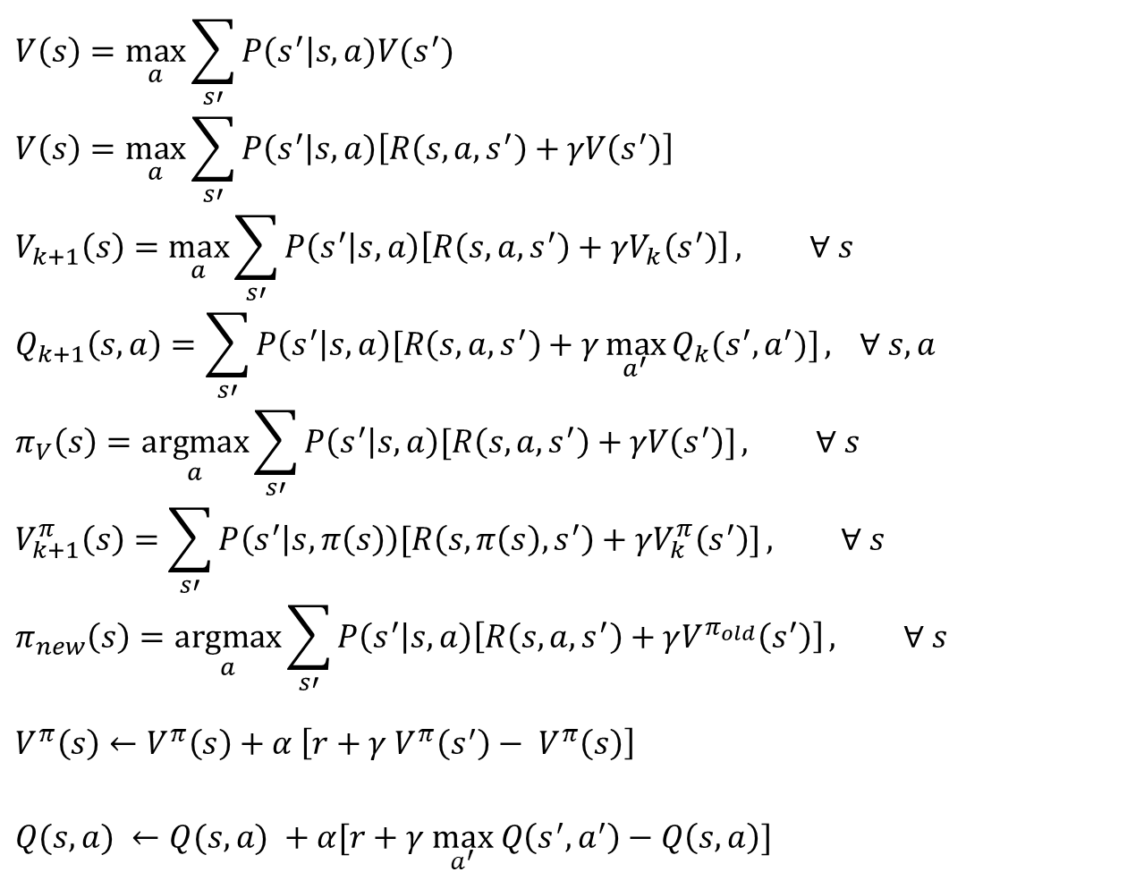
MDP/RL Notation
Standard expectimax:
$$V\left(s\right)=\max_{a}{\sum_{s′}{P\left(s^{′}\right|s,a)V(s^{′})}}$$
$$V\left(s\right)=\max_{a}{\sum_{s′}{P\left(s^{′} | s,a\right)\left[R\left(s,a,s^{′}\right)+γV\left(s^{′}\right)\right]}}$$
$$V_{k+1}\left(s\right)=\max_{a}{\sum_{s′}{P\left(s^{′} | s,a\right)\left[R\left(s,a,s^{′}\right)+γV_{k}\left(s^{′}\right)\right]}}, ∀ s$$
$$Q_{k+1}\left(s,a\right)=\sum_{s′}{P\left(s^{′} | s,a\right)[R\left(s,a,s^{′}\right)+γ\max_{a^{′}}{Q_{k}(s^{′},a^{′})]}, } ∀ s,a$$
$$π_{V}\left(s\right)=\underset{a}{argmax}{\sum_{s′}{P\left(s^{′} | s,a\right)[R\left(s,a,s^{′}\right)+γV\left(s^{′}\right)]}}, ∀ s$$
$$V_{k+1}^{π}\left(s\right)=\sum_{s′}{P\left(s^{′} | s,π\left(s\right)\right)[R\left(s,π\left(s\right),s^{′}\right)+γV_{k}^{π}\left(s^{′}\right)]}, ∀ s$$
$$π_{new}\left(s\right)=\underset{a}{argmax}{\sum_{s′}{P\left(s^{′} | s,a\right)\left[R\left(s,a,s^{′}\right)+γV^{π_{old}}\left(s^{′}\right)\right]}}, ∀ s$$
$$V^{π}\left(s\right)←V^{π}\left(s\right)+α \left[r+γ V^{π}\left(s^{′}\right)− V^{π}\left(s\right)\right]$$
$Q(s,a) ←Q(s,a) +α[r+γ \max_{a^{′}} Q\left(s^{′},a^{′}\right)−Q\left(s, a\right)]$
Bellman equations:
Value iteration:
Q-iteration:
Policy extraction:
Policy evaluation:
Policy improvement:
TD (value) learning:
Q-learning:

Slide 5
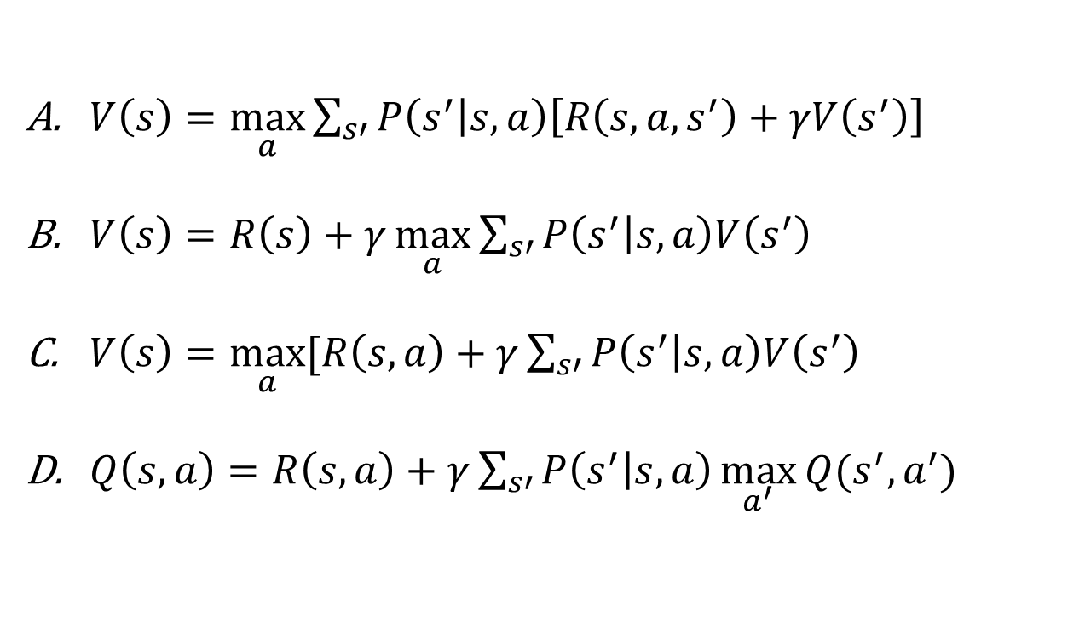
Piazza Poll 1
Rewards may depend on any combination of state, action, next state.
Which of the following are valid formulations of the Bellman equations?
$V\left(s\right)=\max_{a}{\sum_{s′}{P\left(s^{′} | s,a\right)\left[R\left(s,a,s^{′}\right)+γV\left(s^{′}\right)\right]}}$
$V\left(s\right)=R\left(s\right)+γ\max_{a}{\sum_{s′}{P\left(s^{′} | s,a\right)V\left(s^{′}\right)}}$
$V\left(s\right)=\max_{a}{[R\left(s, a\right)+γ\sum_{s′}{P\left(s^{′} | s,a\right)V\left(s^{′}\right)}}$
$Q\left(s,a\right)=R\left(s, a\right)+γ\sum_{s′}{P\left(s^{′} | s,a\right)\max_{a^{′}}{Q(s^{′},a^{′})} }$

Slide 6

Piazza Poll 1
Rewards may depend on any combination of state, action, next state.
Which of the following are valid formulations of the Bellman equations?
$V\left(s\right)=\max_{a}{\sum_{s′}{P\left(s^{′} | s,a\right)\left[R\left(s,a,s^{′}\right)+γV\left(s^{′}\right)\right]}}$
$V\left(s\right)=R\left(s\right)+γ\max_{a}{\sum_{s′}{P\left(s^{′} | s,a\right)V\left(s^{′}\right)}}$
$V\left(s\right)=\max_{a}{[R\left(s, a\right)+γ\sum_{s′}{P\left(s^{′} | s,a\right)V\left(s^{′}\right)}}$
$Q\left(s,a\right)=R\left(s, a\right)+γ\sum_{s′}{P\left(s^{′} | s,a\right)\max_{a^{′}}{Q(s^{′},a^{′})} }$

Slide 7

Recall
Which of the following are used in policy iteration?
$$V_{k+1}\left(s\right)=\max_{a}{\sum_{s′}{P\left(s^{′} | s,a\right)\left[R\left(s,a,s^{′}\right)+γV_{k}\left(s^{′}\right)\right]}}, ∀ s$$
$$Q_{k+1}\left(s,a\right)=\sum_{s′}{P\left(s^{′} | s,a\right)[R\left(s,a,s^{′}\right)+γ\max_{a^{′}}{Q_{k}(s^{′},a^{′})]}, } ∀ s,a$$
$$π_{V}\left(s\right)=\underset{a}{argmax}{\sum_{s′}{P\left(s^{′} | s,a\right)[R\left(s,a,s^{′}\right)+γV\left(s^{′}\right)]}}, ∀ s$$
$$V_{k+1}^{π}\left(s\right)=\sum_{s′}{P\left(s^{′} | s,π\left(s\right)\right)[R\left(s,π\left(s\right),s^{′}\right)+γV_{k}^{π}\left(s^{′}\right)]}, ∀ s$$
$$π_{new}\left(s\right)=\underset{a}{argmax}{\sum_{s′}{P\left(s^{′} | s,a\right)\left[R\left(s,a,s^{′}\right)+γV^{π_{old}}\left(s^{′}\right)\right]}}, ∀ s$$
Value iteration:
Q-iteration:
Policy extraction:
Policy evaluation:
Policy improvement:

Slide 8
Recall
Which of the following are used in policy iteration?
$$V_{k+1}\left(s\right)=\max_{a}{\sum_{s′}{P\left(s^{′} | s,a\right)\left[R\left(s,a,s^{′}\right)+γV_{k}\left(s^{′}\right)\right]}}, ∀ s$$
$$Q_{k+1}\left(s,a\right)=\sum_{s′}{P\left(s^{′} | s,a\right)[R\left(s,a,s^{′}\right)+γ\max_{a^{′}}{Q_{k}(s^{′},a^{′})]}, } ∀ s,a$$
$$π_{V}\left(s\right)=\underset{a}{argmax}{\sum_{s′}{P\left(s^{′} | s,a\right)[R\left(s,a,s^{′}\right)+γV\left(s^{′}\right)]}}, ∀ s$$
$$V_{k+1}^{π}\left(s\right)=\sum_{s′}{P\left(s^{′} | s,π\left(s\right)\right)[R\left(s,π\left(s\right),s^{′}\right)+γV_{k}^{π}\left(s^{′}\right)]}, ∀ s$$
$$π_{new}\left(s\right)=\underset{a}{argmax}{\sum_{s′}{P\left(s^{′} | s,a\right)\left[R\left(s,a,s^{′}\right)+γV^{π_{old}}\left(s^{′}\right)\right]}}, ∀ s$$
Value iteration:
Q-iteration:
Policy extraction:
Policy evaluation:
Policy improvement:

Slide 9

Reinforcement Learning

Slide 10

Reinforcement learning
What if we didn’t know $P(s’|s,a)$and $R(s,a,s’)$?
$$V_{k+1}\left(s\right)=\max_{a}{\sum_{s′}{P\left(s^{′} | s,a\right)\left[R\left(s,a,s^{′}\right)+γV_{k}\left(s^{′}\right)\right]}}, ∀ s$$
$$Q_{k+1}\left(s,a\right)=\sum_{s′}{P\left(s^{′} | s,a\right)[R\left(s,a,s^{′}\right)+γ\max_{a^{′}}{Q_{k}(s^{′},a^{′})]}, } ∀ s,a$$
$$π_{V}\left(s\right)=\underset{a}{argmax}{\sum_{s′}{P\left(s^{′} | s,a\right)[R\left(s,a,s^{′}\right)+γV\left(s^{′}\right)]}}, ∀ s$$
$$V_{k+1}^{π}\left(s\right)=\sum_{s′}{P\left(s^{′} | s,π\left(s\right)\right)[R\left(s,π\left(s\right),s^{′}\right)+γV_{k}^{π}\left(s^{′}\right)]}, ∀ s$$
$$π_{new}\left(s\right)=\underset{a}{argmax}{\sum_{s′}{P\left(s^{′} | s,a\right)\left[R\left(s,a,s^{′}\right)+γV^{π_{old}}\left(s^{′}\right)\right]}}, ∀ s$$
Value iteration:
Q-iteration:
Policy extraction:
Policy evaluation:
Policy improvement:

Slide 11
Reinforcement Learning
Agent
State: s
Reward: r
Actions: a
Environment
Basic idea:
  Receive feedback in the form of rewards
  Agent’s utility is defined by the reward function
  Must (learn to) act so as to maximize expected rewards
  All learning is based on observed samples of outcomes!
Notes:
Show robot-soccer learning to walk videos (UT Austin):
? Show snake robot:

Slide 12
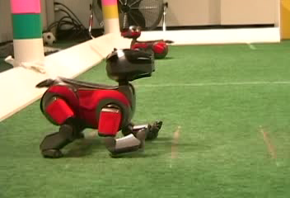
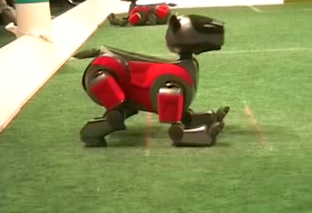
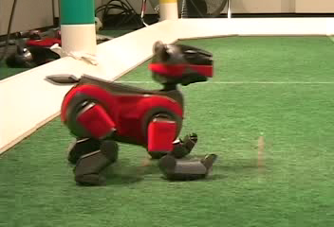
Example: Learning to Walk
Initial
A Learning Trial
After Learning [1K Trials]
[Kohl and Stone, ICRA 2004]
Notes:
Peter Stone, Austin

Slide 13

Example: Learning to Walk
Initial
[Kohl and Stone, ICRA 2004]
[Video: AIBO WALK – initial]

Slide 14

Example: Learning to Walk
Training
[Kohl and Stone, ICRA 2004]
[Video: AIBO WALK – training]

Slide 15

Example: Learning to Walk
Finished
[Kohl and Stone, ICRA 2004]
[Video: AIBO WALK – finished]

Slide 16
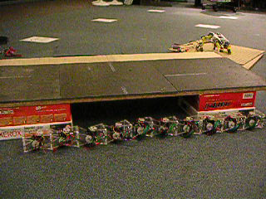
Example: Sidewinding
[Andrew Ng]
[Video: SNAKE – climbStep+sidewinding]

Slide 17

Example: Toddler Robot
[Tedrake, Zhang and Seung, 2005]
[Video: TODDLER – 40s]
Notes:
MIT

Slide 18
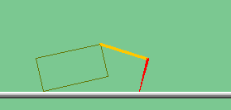
The Crawler!
[Demo: Crawler Bot (L10D1)] [You, in Project 3]
Notes:
At times no reward accumulated at all, just sitting still

Slide 19
Demo Crawler Bot

Slide 20
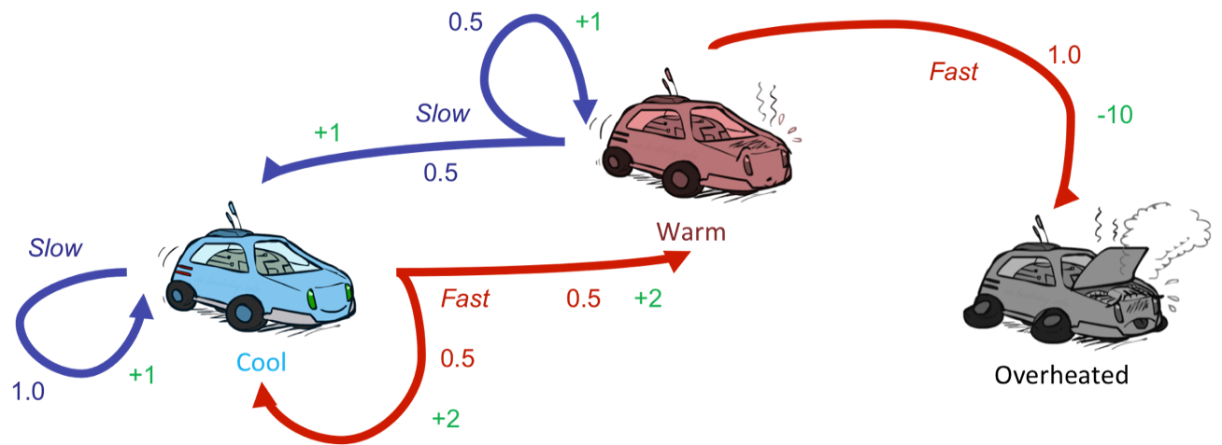
Reinforcement Learning
Still assume a Markov decision process (MDP):
  A set of states s ∈ S
  A set of actions (per state) A
  A model T(s,a,s’)
  A reward function R(s,a,s’)
Still looking for a policy π(s)
New twist: don’t know T or R
  I.e. we don’t know which states are good or what the actions do
  Must actually try actions and states out to learn

Slide 21
Reinforcement Learning
s
  Experience world through episodes
  You need many episodes ☺
  Learn from your experience
  Key questions:
  When experiencing the world, how to take the actions?
  Given the experience, how to learn from it?
a
s, a
r
s’
a’
s’, a’
s’’

Slide 22
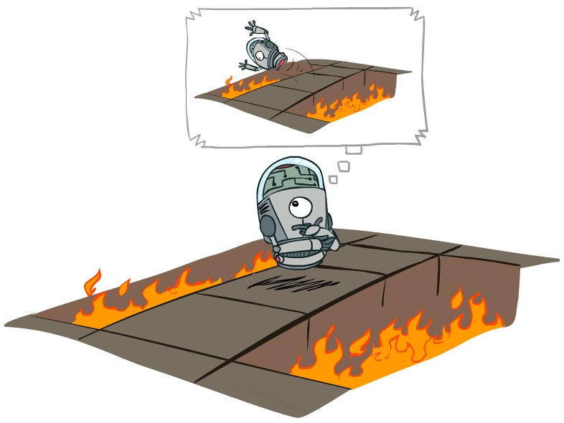
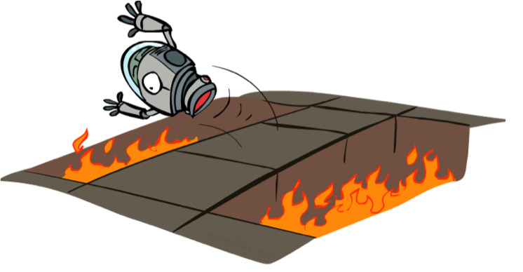
Offline (MDPs) vs. Online (RL)
Planning offline
Learning to play online
(Trial and error)

Slide 23

Model-Based Learning

Slide 24




Model-Based Learning
Model-Based Idea:
  Learn an approximate model based on experiences
  Solve for values as if the learned model were correct
Step 1: Learn empirical MDP model
  Count outcomes s’ for each s, a
  Normalize to give an estimate of
  Discover each when we experience (s, a, s’)
Step 2: Solve the learned MDP
  For example, use value iteration, as before

Slide 25
Example: Model-Based Learning
A policy π
Observed Episodes (Training)
Learned Model
Episode 1
Episode 2
T(s,a,s’).
T(B, east, C) =
T(C, east, D) =
T(C, east, A) =
…
R(s,a,s’).
R(B, east, C) =
R(C, east, D) =
R(D, exit, x) =
…
 | A
B | C | D
 | E
B, east, C, -1
C, east, D, -1
D, exit, x, +10
B, east, C, -1
C, east, D, -1
D, exit, x, +10
Episode 3
Episode 4
E, north, C, -1
C, east, D, -1
D, exit, x, +10
E, north, C, -1
C, east, A, -1
A, exit, x, -10
Assume: γ = 1

Slide 26
Example: Model-Based Learning
A policy π
Observed Episodes (Training)
Learned Model
Episode 1
Episode 2
T(s,a,s’).
T(B, east, C) = 1.00
T(C, east, D) = 0.75
T(C, east, A) = 0.25
…
R(s,a,s’).
R(B, east, C) = -1
R(C, east, D) = -1
R(D, exit, x) = +10
…
 | A
B | C | D
 | E
B, east, C, -1
C, east, D, -1
D, exit, x, +10
B, east, C, -1
C, east, D, -1
D, exit, x, +10
Episode 3
Episode 4
E, north, C, -1
C, east, D, -1
D, exit, x, +10
E, north, C, -1
C, east, A, -1
A, exit, x, -10
Assume: γ = 1
Any requirement for $π$ to learn a reasonable $\hat{T}$ and $\hat{R}$?

Slide 27
Mid-Semester Feedback
5-min break
We would like to encourage you to fill the 15-281 mid-semester feedback forms online (links on Piazza, one for the course and one for the Tas)

Slide 28

Model-Free Learning
How can we find the optimal policy without building an explicit MDP model (R and T)?

Slide 29
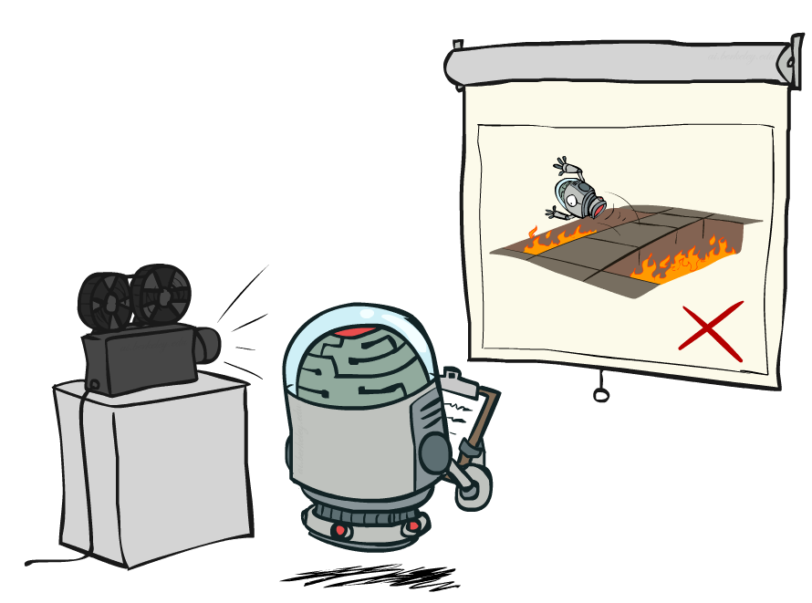
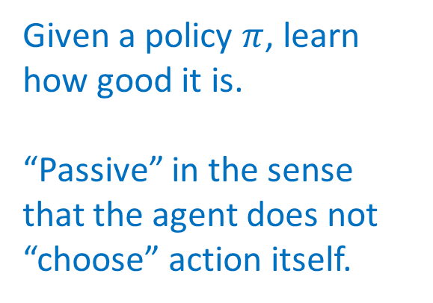
Passive Reinforcement Learning
Given a policy $π$, learn how good it is.
“Passive” in the sense that the agent does not “choose” action itself.

Slide 30
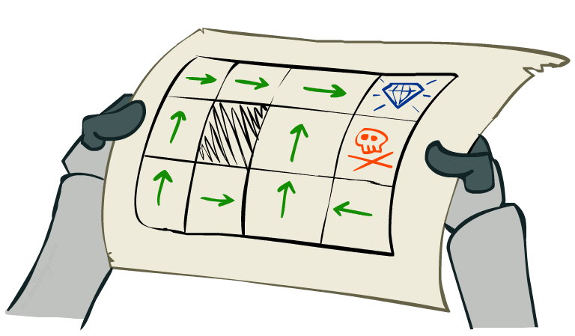
Passive Reinforcement Learning
Simplified task: policy evaluation
  Input: a fixed policy π(s)
  You don’t know the transitions T(s,a,s’)
  You don’t know the rewards R(s,a,s’)
  Goal: learn the state values
In this case:
  Learner is “along for the ride”
  No choice about what actions to take
  Just execute the policy and learn from experience
  This is NOT offline planning! You actually take actions in the world.

Slide 31
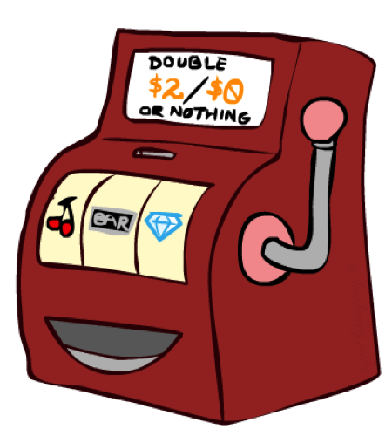
Direct Evaluation
Goal: Compute values for each state under π
Idea: Average together observed sample values
  Act according to π
  Every time you visit a state, write down what the sum of discounted rewards turned out to be
  Average those samples
This is called direct evaluation

Slide 32
Example: Direct Evaluation
Input Policy π
Observed Episodes (Training)
Output Values
Episode 1
Episode 2
 | A
B | C | D
 | E
B, east, C, -1
C, east, D, -1
D, exit, x, +10
B, east, C, -1
C, east, D, -1
D, exit, x, +10
 | A
B | C | D
 | E
Episode 3
Episode 4
E, north, C, -1
C, east, D, -1
D, exit, x, +10
E, north, C, -1
C, east, A, -1
A, exit, x, -10
Assume: γ = 1

Slide 33
Example: Direct Evaluation
Input Policy π
Observed Episodes (Training)
Output Values
Episode 1
Episode 2
 | A
B | C | D
 | E
 | A
B | C | D
 | E
B, east, C, -1
C, east, D, -1
D, exit, x, +10
B, east, C, -1
C, east, D, -1
D, exit, x, +10
-10
+8
+4
+10
Episode 3
Episode 4
-2
E, north, C, -1
C, east, D, -1
D, exit, x, +10
E, north, C, -1
C, east, A, -1
A, exit, x, -10
Assume: γ = 1

Slide 34
Problems with Direct Evaluation
What’s good about direct evaluation?
  It’s easy to understand
  It doesn’t require any knowledge of T, R
  It eventually computes the correct average values, using just sample transitions
What bad about it?
  It wastes information about state connections (Markov property)
  Each state must be learned separately
  So, it takes a long time to learn
Output Values
 | A
B | C | D
 | E
-10
+8
+4
+10
-2
If B and E both go to C under this policy, how can their values be different?

Slide 35
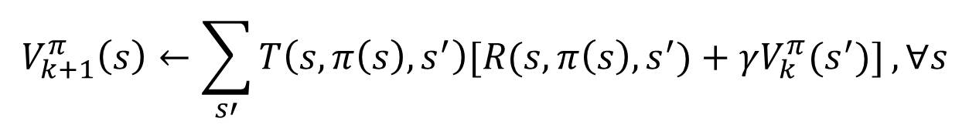
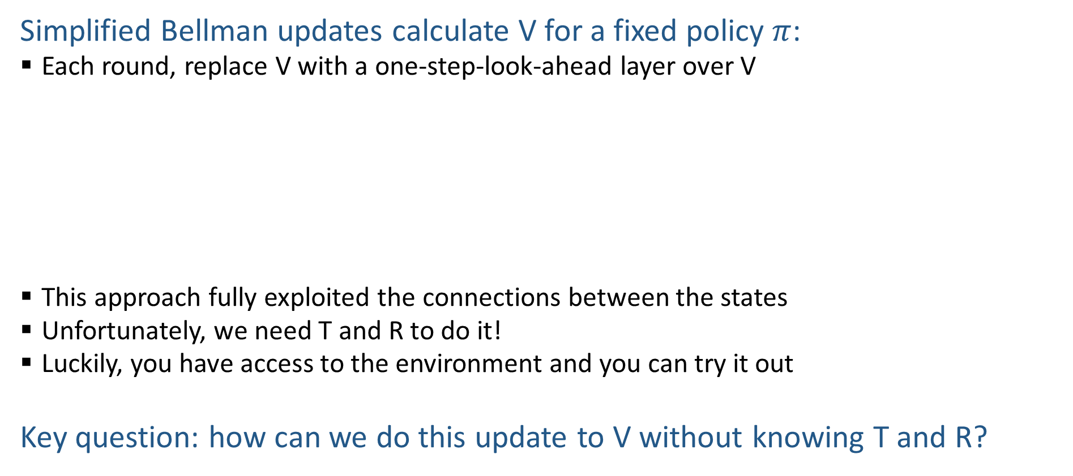

Can We Use Policy Evaluation?
s
Simplified Bellman updates calculate V for a fixed policy $π$:
  Each round, replace V with a one-step-look-ahead layer over V
  This approach fully exploited the connections between the states
  Unfortunately, we need T and R to do it!
  Luckily, you have access to the environment and you can try it out
Key question: how can we do this update to V without knowing T and R?
π(s)
$$V_{0}^{π}\left(s\right)=0,∀s$$
s, π(s)
$$V_{k+1}^{π}\left(s\right)←\sum_{s′}{T\left(s,π\left(s\right),s^{′}\right)[R(s,π\left(s\right),s^{′})+γV_{k}^{π}(s^{′})]},∀s$$
s, π(s),s’
s’

Slide 36
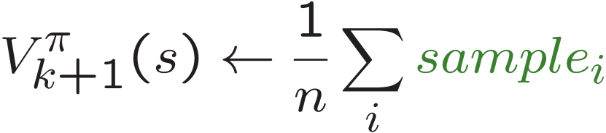
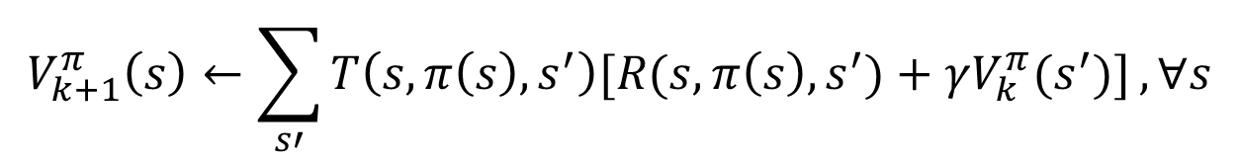
Can We Use Policy Evaluation?
$$V_{k+1}^{π}\left(s\right)←\sum_{s′}{T\left(s,π\left(s\right),s^{′}\right)[R(s,π\left(s\right),s^{′})+γV_{k}^{π}(s^{′})]},∀s$$
How will you evaluate a biased coin / average age of students in 15-281?
First idea: Take samples of outcomes s’ (by taking the action!) and average
s
π(s)
s, π(s)
s, π(s),s’
s'
s₂'
s₁'
s₃'
Almost! But we can’t rewind time to get sample after sample from state s.

Slide 37

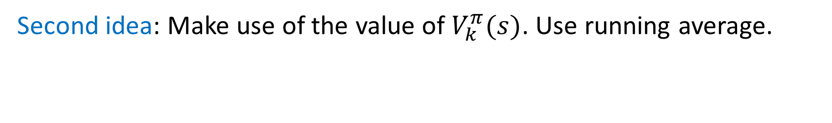

Can We Use Policy Evaluation?
$$V_{k+1}^{π}\left(s\right)←\sum_{s′}{T\left(s,π\left(s\right),s^{′}\right)[R(s,π\left(s\right),s^{′})+γV_{k}^{π}(s^{′})]},∀s$$
In the extreme case, we can just take one sample ($n=1$)
$$V_{k+1}^{π}\left(s\right)←sample$$
But this is very high variance!
Second idea: Make use of the value of $V_{k}^{π}(s)$. Use running average.
$$V_{k+1}^{π}\left(s\right)←\left(1−α\right)V_{k}^{π}\left(s\right)+α×sample$$

Slide 38

Exponential Moving Average
Exponential moving average
  The running interpolation update:
  Makes recent samples more important:
  Forgets about the past (distant past values were wrong anyway)
Decreasing learning rate (alpha) can give converging averages

Slide 39
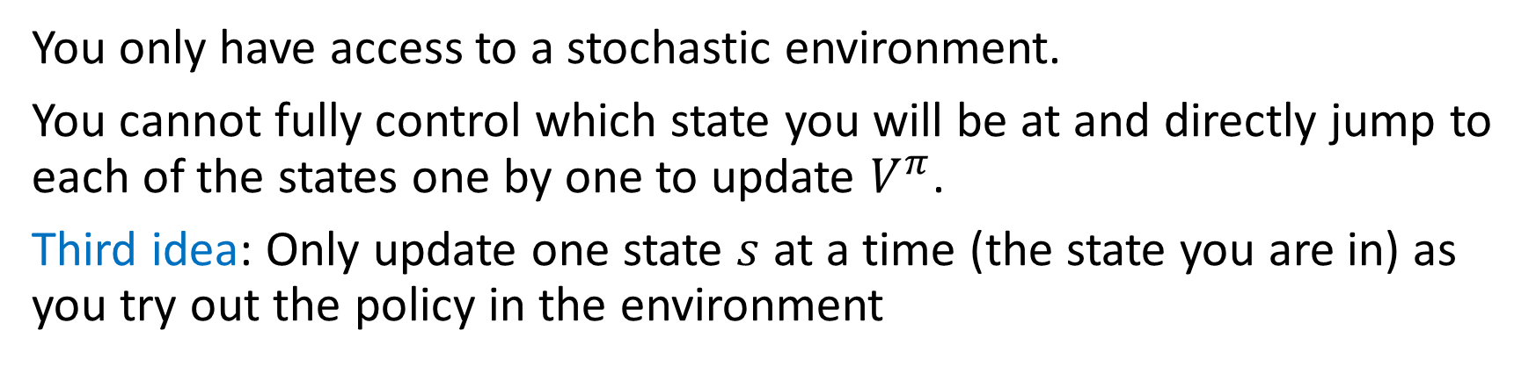
Can We Use Policy Evaluation?
$$V_{k+1}^{π}\left(s\right)←\sum_{s′}{T\left(s,π\left(s\right),s^{′}\right)[R(s,π\left(s\right),s^{′})+γV_{k}^{π}(s^{′})]},∀s$$
You only have access to a stochastic environment.
You cannot fully control which state you will be at and directly jump to each of the states one by one to update $V^{π}$.
Third idea: Only update one state $s$ at a time (the state you are in) as you try out the policy in the environment
 | A
B | C | D
 | E
B, east, C, -2
$sample$=$R\left(s,π\left(s\right),s^{′}\right)+γV_{k}^{π}\left(s^{′}\right)=−2+1∗V^{π}\left(C\right)=−2$

Slide 40
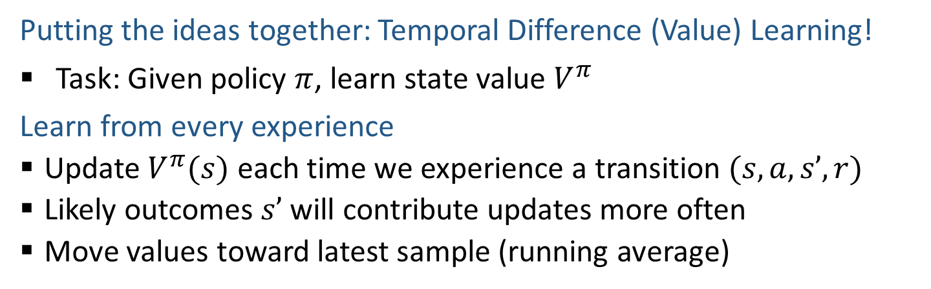
Temporal Difference (Value) Learning
Putting the ideas together: Temporal Difference (Value) Learning!
Task: Given policy $π$, learn state value $V^{π}$
Learn from every experience
  Update $V^{π}(s)$ each time we experience a transition $(s, a, s’, r)$
  Likely outcomes $s’$ will contribute updates more often
  Move values toward latest sample (running average)
s
π(s)
s, π(s)
s’
Sample of V(s):
Update to V(s):
Equivalent to:

