Slide 1
Announcements
Assignments:
P3: Optimization; Due today, 10 pm
HW7 (online) 10/22 Tue, 10 pm
Recitations canceled on: October 18 (Mid-Semester Break) and October 25 (Day for Community Engagement)
We will provide recitation worksheet (reference for midterm/final)
Piazza post for In-class Questions

Slide 2
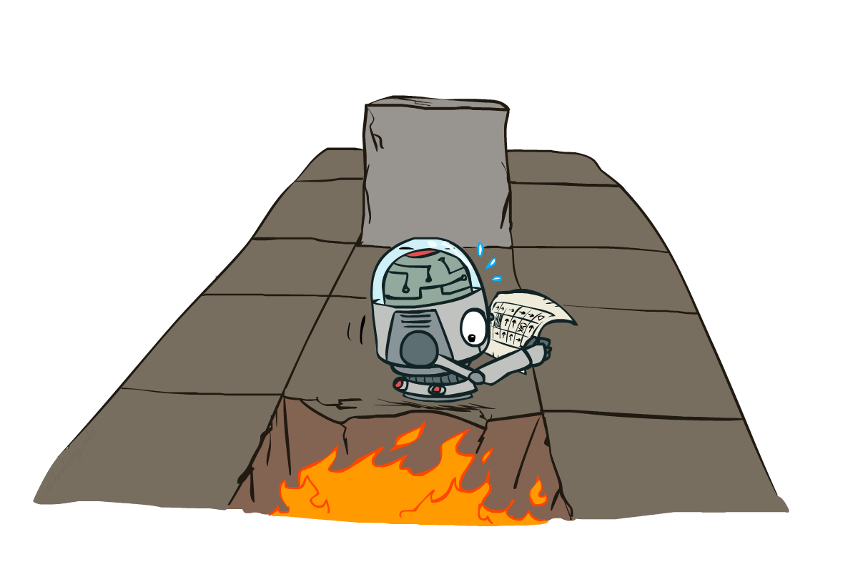
AI: Representation and Problem Solving
Markov Decision Processes II
Instructors: Fei Fang & Pat Virtue
Slide credits: CMU AI and http://ai.berkeley.edu

Slide 3
Learning Objectives
Write Bellman Equation for state-value and Q-value for optimal policy and a given policy
Describe and implement value iteration algorithm (through Bellman update) for solving MDPs
Describe and implement policy iteration algorithm (through policy evaluation and policy improvement) for solving MDPs
Understand convergence for value iteration and policy iteration
Understand concept of exploration, exploitation, regret

Slide 4
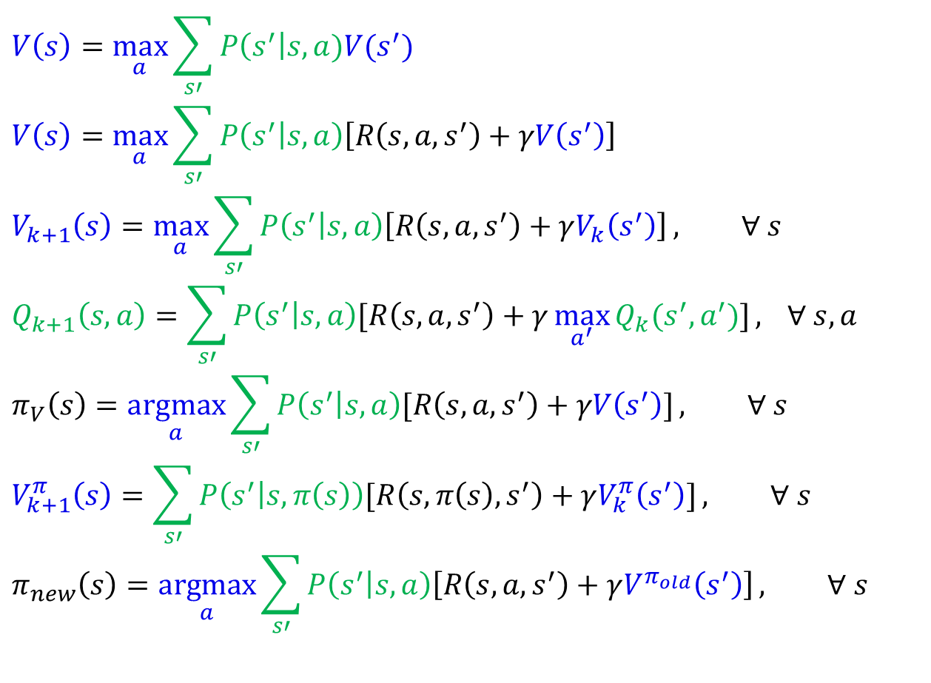
MDP Notation
$$V\left(s\right)=\max_{a}{\sum_{s′}{P\left(s^{′}\right|s,a)V(s^{′})}}$$
$$V\left(s\right)=\max_{a}{\sum_{s′}{P\left(s^{′} | s,a\right)\left[R\left(s,a,s^{′}\right)+γV\left(s^{′}\right)\right]}}$$
$$V_{k+1}\left(s\right)=\max_{a}{\sum_{s′}{P\left(s^{′} | s,a\right)\left[R\left(s,a,s^{′}\right)+γV_{k}\left(s^{′}\right)\right]}}, ∀ s$$
$$Q_{k+1}\left(s,a\right)=\sum_{s′}{P\left(s^{′} | s,a\right)[R\left(s,a,s^{′}\right)+γ\max_{a^{′}}{Q_{k}(s^{′},a^{′})]}, } ∀ s,a$$
$$π_{V}\left(s\right)=\underset{a}{argmax}{\sum_{s′}{P\left(s^{′} | s,a\right)[R\left(s,a,s^{′}\right)+γV\left(s^{′}\right)]}}, ∀ s$$
$$V_{k+1}^{π}\left(s\right)=\sum_{s′}{P\left(s^{′} | s,π\left(s\right)\right)[R\left(s,π\left(s\right),s^{′}\right)+γV_{k}^{π}\left(s^{′}\right)]}, ∀ s$$
$$π_{new}\left(s\right)=\underset{a}{argmax}{\sum_{s′}{P\left(s^{′} | s,a\right)\left[R\left(s,a,s^{′}\right)+γV^{π_{old}}\left(s^{′}\right)\right]}}, ∀ s$$
Standard expectimax:
Bellman equations:
Value iteration:
Q-iteration:
Policy extraction:
Policy evaluation:
Policy improvement:

Slide 5


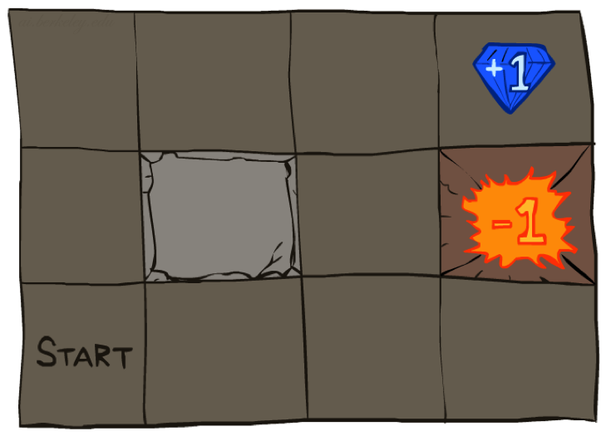
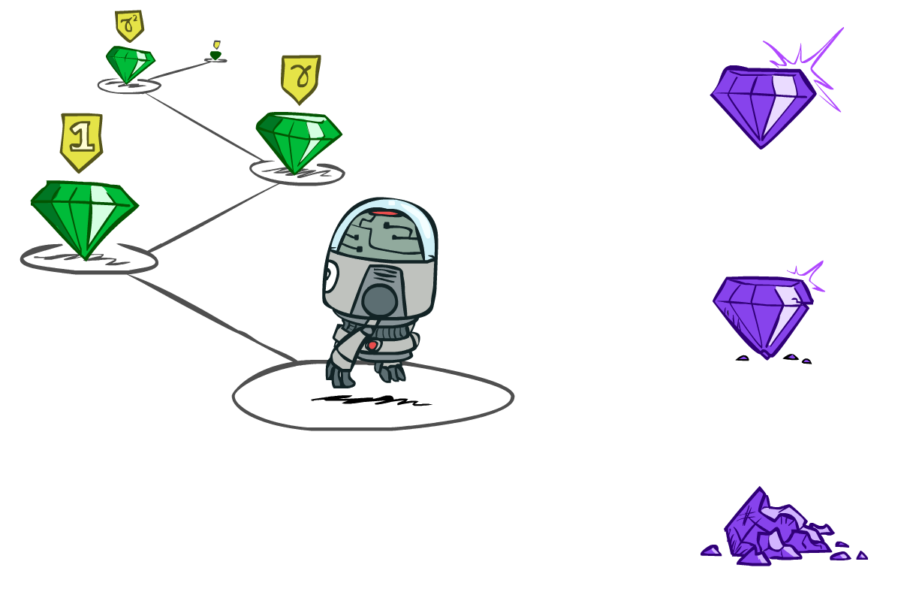

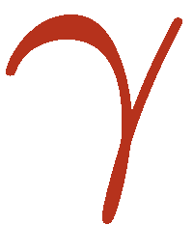



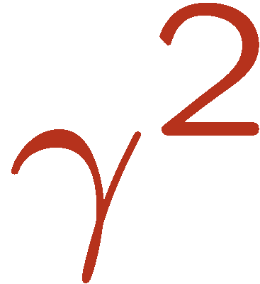
Example: Grid World
Goal: maximize sum of (discounted) rewards
Notes:
If agent takes action North, then 80% of the time agent ends with going to the cell on the North (if there is no wall there)
10%, action North takes the agent West; 10% East
If there is a wall in the direction the agent would have been taken, the agent stays put
Small “living” reward each step (can be negative)
Big rewards come at the end (good or bad)

Slide 6
MDP Quantities
Markov decision processes:
  States S
  Actions A
  Transitions P(s’|s,a) (or T(s,a,s’))
  Rewards R(s,a,s’) (and discount γ)
  Start state s₀
MDP quantities:
  Policy = map of states to actions
  Utility = sum of (discounted) rewards
  (State) Value = expected utility starting from a state (max node)
  Q-Value = expected utility starting from a state-action pair, i.e., q-state (chance node)
s
a
s, a
s,a,s’
s’

Slide 7
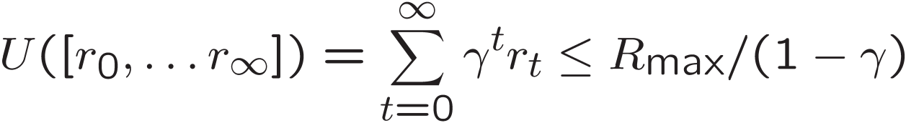
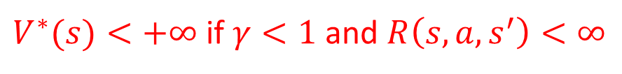
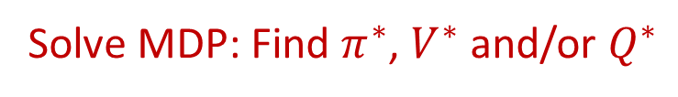
MDP Optimal Quantities
s
The optimal policy:
  π*(s) = optimal action from state s
The (true) value (or utility) of a state s:
  V*(s) = expected utility starting in s and acting optimally
The (true) value (or utility) of a q-state (s,a):
  Q*(s,a) = expected utility starting out having taken action a from state s and (thereafter) acting optimally
a
s, a
s,a,s’
s’
$V^{∗}(s)<+∞$ if $γ<1$ and $R\left(s,a,s^{′}\right)<∞$
Solve MDP: Find $π^{∗}$, $V^{∗}$ and/or $Q^{∗}$
[Demo: gridworld values (L9D1)]
Notes:
Demo just shows V and Q values, snapshots on next slides.

Slide 8
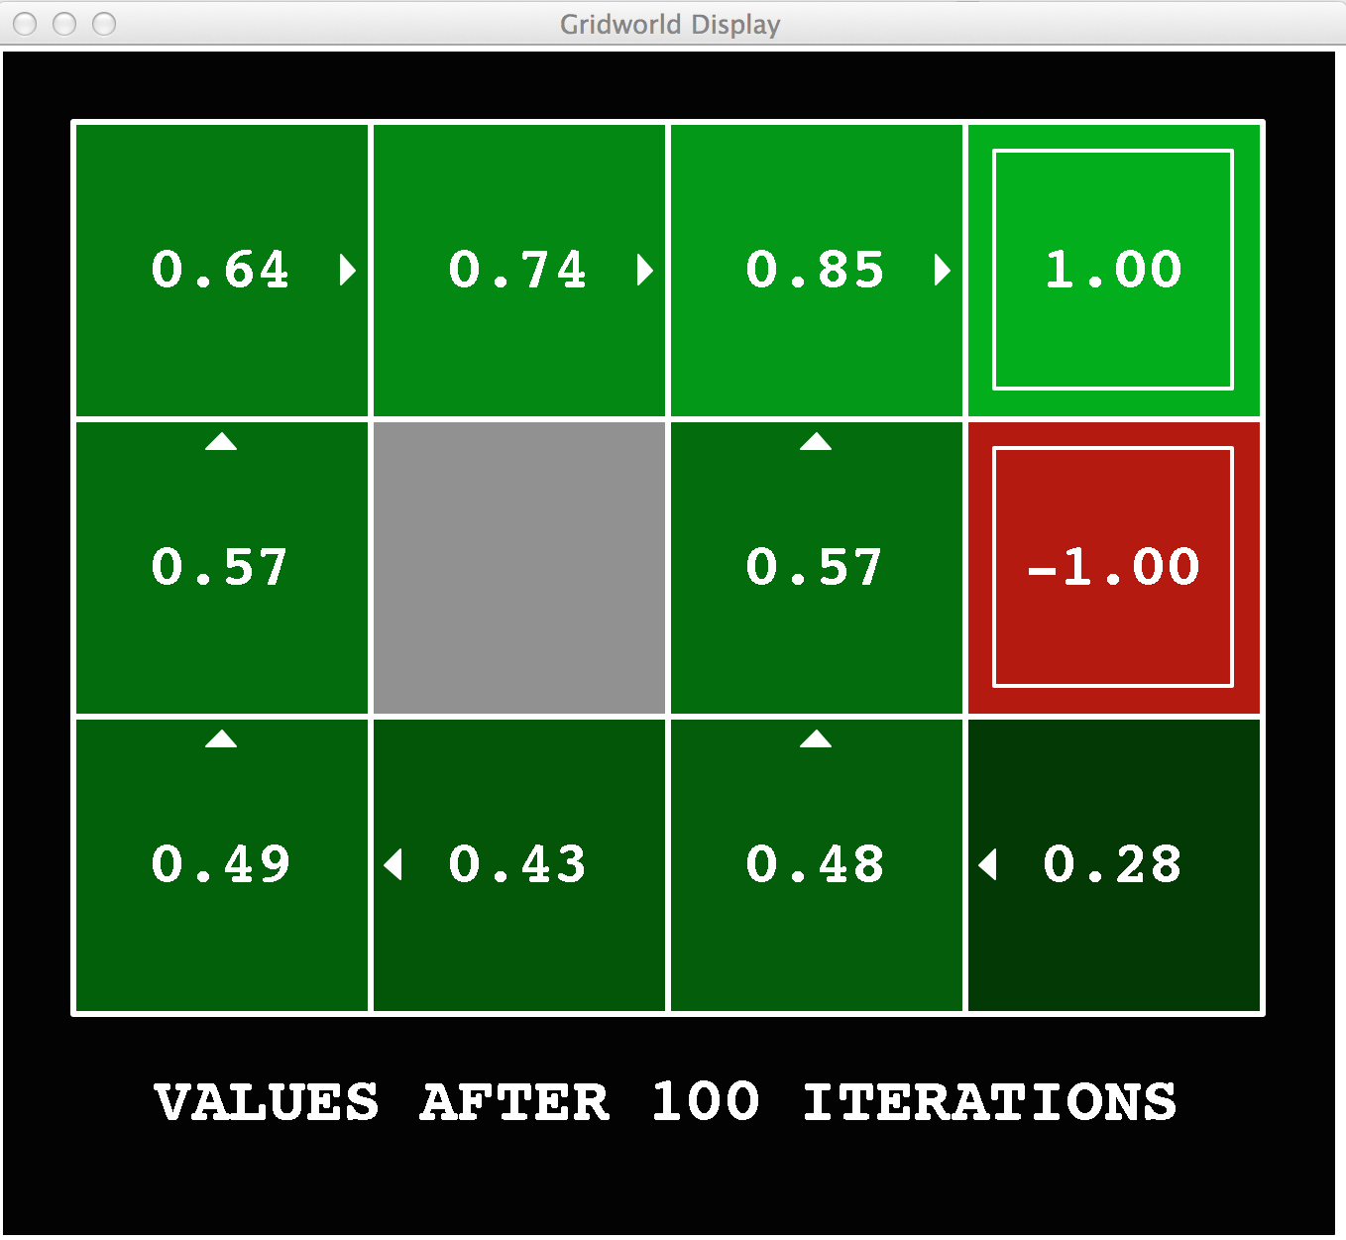
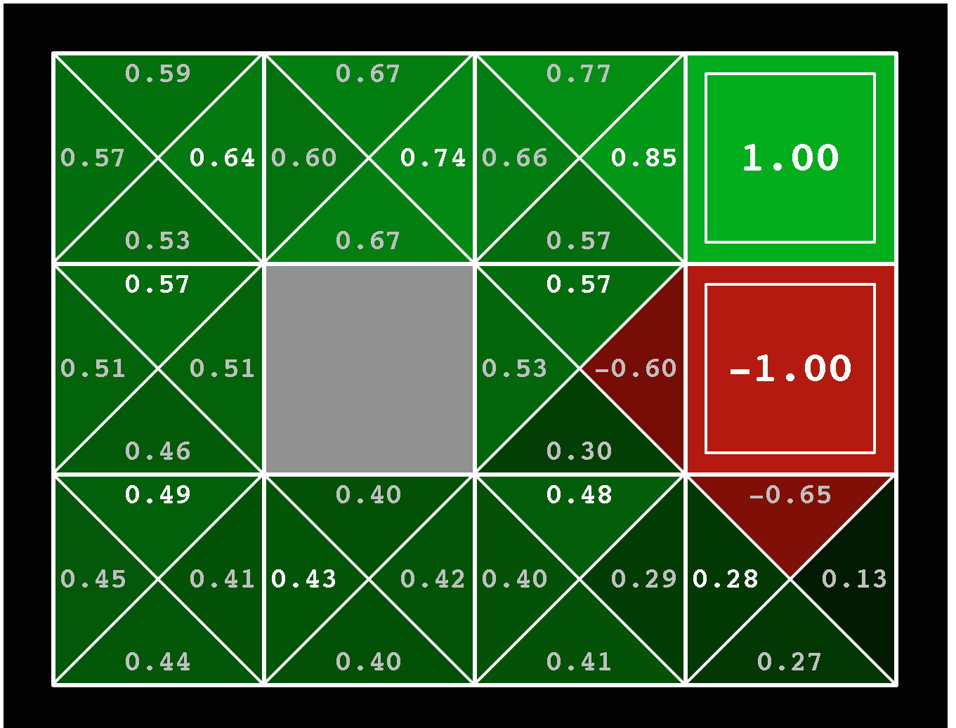
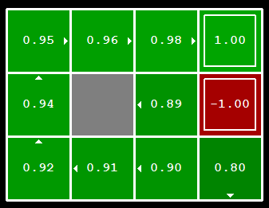
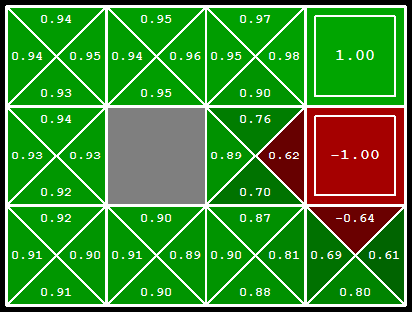
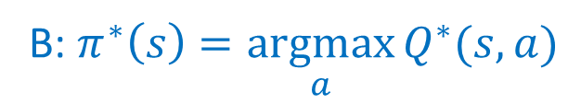
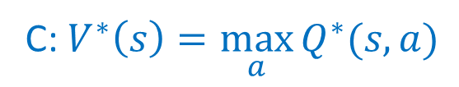
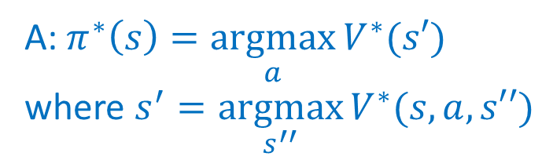
Piazza Poll 1
Which ones are true about optimal policy $π^{∗}(s)$, true values $V^{∗}(s)$ and true Q-Values $Q^{∗}(s,a)$?
A: $π^{∗}\left(s\right)=\underset{a}{argmax}{V^{∗}(s′)}$
where $s^{′}=\underset{s^{′′}}{argmax}{V^{∗}(s,a,s′′)}$
B: $π^{∗}\left(s\right)=\underset{a}{argmax}{Q^{∗}(s,a)}$
C: $V^{∗}\left(s\right)=\max_{a}{Q^{∗}(s,a)}$

Slide 9
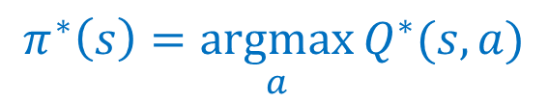
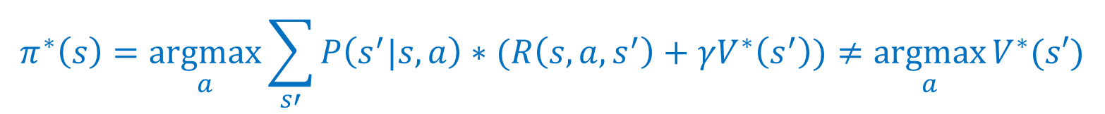
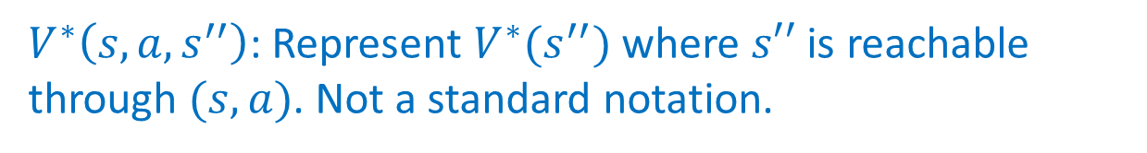
Piazza Poll 1
$V^{∗}\left(s,a,s^{′′}\right)$: Represent $V^{∗}(s^{′′})$ where $s′′$ is reachable through $(s,a)$. Not a standard notation.
$$π^{∗}\left(s\right)=\underset{a}{argmax}{\sum_{s′}{P\left(s^{′}|s,a\right)∗(R\left(s,a,s^{′}\right)+γV^{∗}\left(s^{′}\right))}}≠\underset{a}{argmax}{V^{∗}(s′)}$$
$$π^{∗}\left(s\right)=\underset{a}{argmax}{Q^{∗}(s,a)}$$

Slide 10
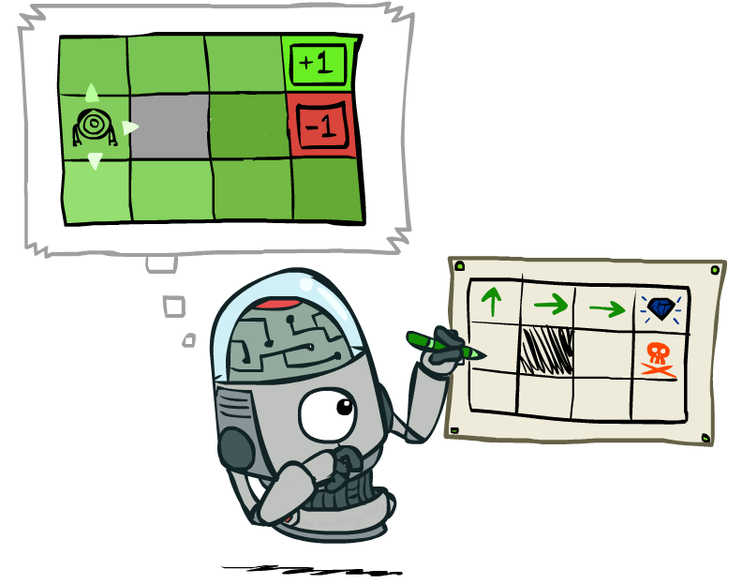
Computing Optimal Policy from Values

Slide 11

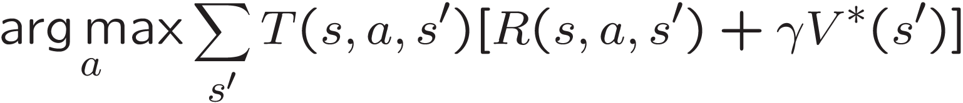
Computing Optimal Policy from Values
Let’s imagine we have the optimal values V*(s)
How should we act?
We need to do a mini-expectimax (one step)
Sometimes this is called policy extraction, since it gets the policy implied by the values
s
a
s, a
s,a,s’
s’

Slide 12
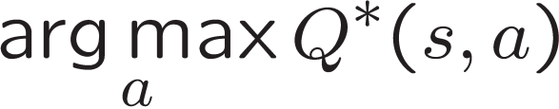
Computing Optimal Policy from Q-Values
Let’s imagine we have the optimal q-values:
How should we act?
  Completely trivial to decide!
Important lesson: actions are easier to select from q-values than values!

Slide 13

The Bellman Equations
How to be optimal:
Step 1: Take correct first action
Step 2: Keep being optimal

Slide 14

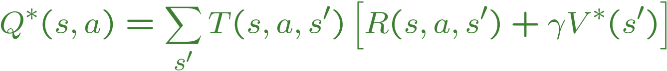
The Bellman Equations
s
Definition of “optimal utility” leads to Bellman Equations, which characterize the relationship amongst optimal utility values
Necessary and sufficient conditions for optimality
Solution is unique
a
s, a
s,a,s’
s’
Expectimax-like computation
Notes:
Let’s start by equations that characterize these quantities through mutual recursions. [step through this by writing on slide, one step at a time]
Recursive characterization of V* in terms of V*; not necessarily helpful; but it is a characterization.
Note: this is a set of equations that needs to be satisfied; but it could have multiple solutions (it does not, but at this stage of our knowledge it could).

Slide 15
The Bellman Equations
s
Definition of “optimal utility” leads to Bellman Equations, which characterize the relationship amongst optimal utility values
Necessary and sufficient conditions for optimality
Solution is unique
a
s, a
s,a,s’
s’
Expectimax-like computation with one-step lookahead and a “perfect” heuristic at leaf nodes
Notes:
Let’s start by equations that characterize these quantities through mutual recursions. [step through this by writing on slide, one step at a time]
Recursive characterization of V* in terms of V*; not necessarily helpful; but it is a characterization.
Note: this is a set of equations that needs to be satisfied; but it could have multiple solutions (it does not, but at this stage of our knowledge it could).

Slide 16
Solving Expectimax

Slide 17
Solving MDP
Limited Lookahead

Slide 18
Solving MDP
Limited Lookahead

Slide 19
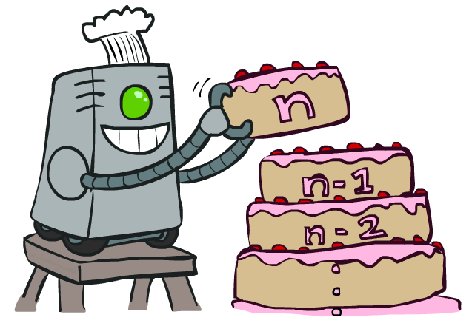
Value Iteration

Slide 20
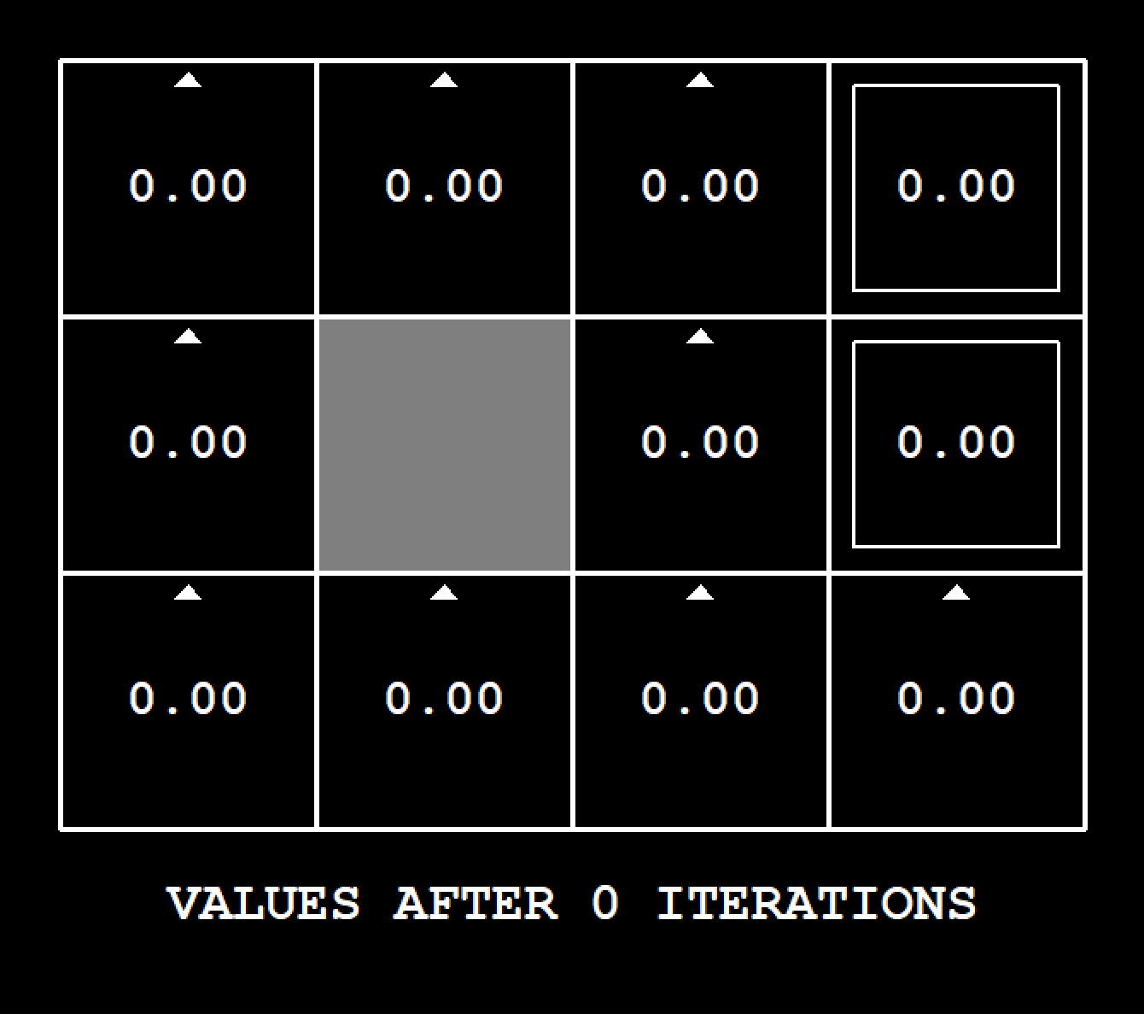
Demo Value Iteration
[Demo: value iteration (L8D6)]

Slide 21
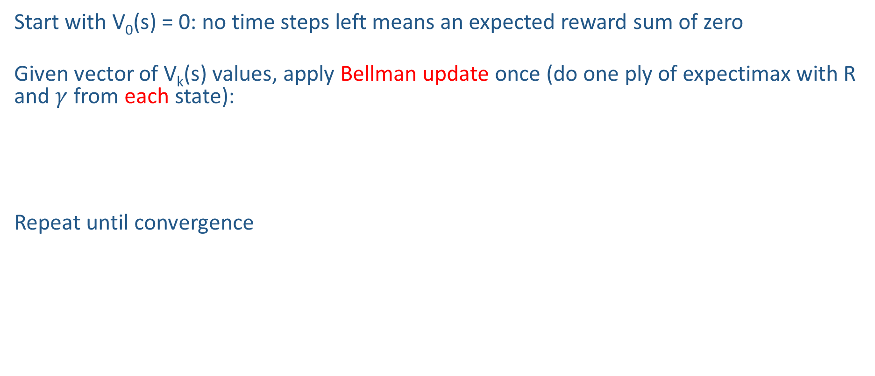
Value Iteration
Start with V₀(s) = 0: no time steps left means an expected reward sum of zero
Given vector of V_{k}(s) values, apply Bellman update once (do one ply of expectimax with R and $γ$ from each state):
Repeat until convergence
V_{k+1}(s)
a
s, a
s,a,s’
V_{k}(s’)
Will this process converge?
Yes!
Notes:
Discuss computational complexity: S * A * S times number of iterations
Note: updates not in place [if in place, it means something else and not even clear what it means]

Slide 22
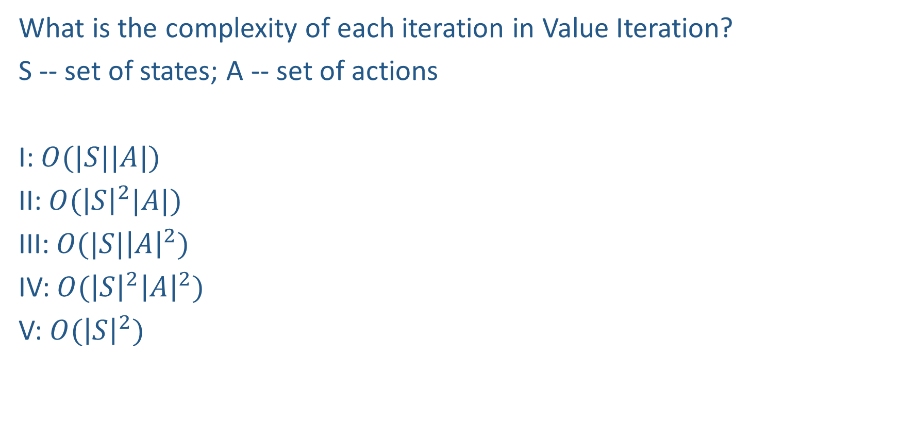
Piazza Poll 2
What is the complexity of each iteration in Value Iteration?
S -- set of states; A -- set of actions
I: $O(|S||A|)$
II: $O({\left|S\right|}^{2}|A|)$
III: $O(|S|{\left|A\right|}^{2})$
IV: $O({\left|S\right|}^{2}{\left|A\right|}^{2})$
V: $O({\left|S\right|}^{2})$
V_{k+1}(s)
a
s, a
s,a,s’
V_{k}(s’)

Slide 23
Piazza Poll 2
What is the complexity of each iteration in Value Iteration?
S -- set of states; A -- set of actions
I: $O(|S||A|)$
II: $O({\left|S\right|}^{2}|A|)$
III: $O(|S|{\left|A\right|}^{2})$
IV: $O({\left|S\right|}^{2}{\left|A\right|}^{2})$
V: $O({\left|S\right|}^{2})$
V_{k+1}(s)
a
s, a
s,a,s’
V_{k}(s’)

Slide 24
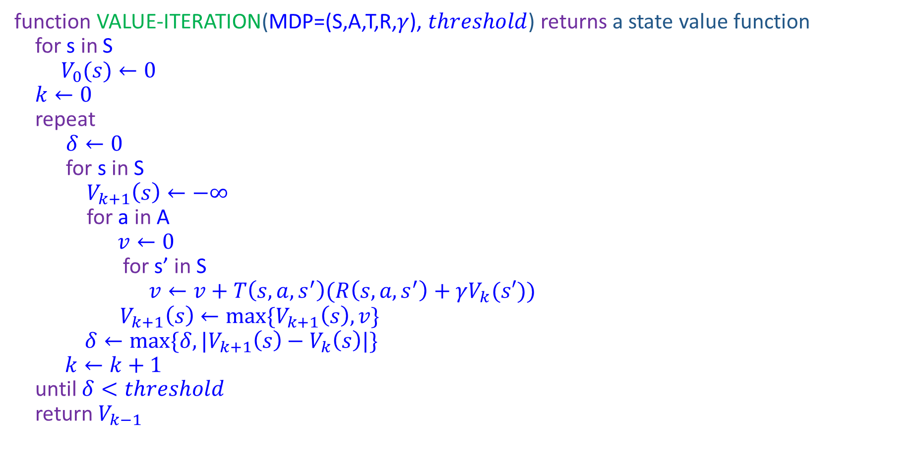
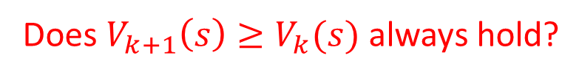
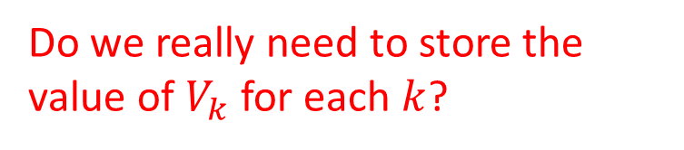
Value Iteration
function VALUE-ITERATION(MDP=(S,A,T,R,$γ$), $threshold$) returns a state value function
for s in S
$V_{0}(s)←0$
$k←0$
repeat
$δ←0$
for s in S
$V_{k+1}\left(s\right)←−∞$
for a in A
$v←0$
for s’ in S
$v←v+T\left(s,a,s^{′}\right)(R\left(s,a,s^{′}\right)+γV_{k}(s′))$
$V_{k+1}\left(s\right)←max⁡\{V_{k+1}\left(s\right),v\}$
$δ←max⁡\{δ,|V_{k+1}\left(s\right)−V_{k}\left(s\right)|\}$
$k←k+1$
until $δ<threshold$
return $V_{k−1}$
Do we really need to store the value of $V_{k}$ for each $k$?
Does $V_{k+1}\left(s\right)≥V_{k}(s)$ always hold?

Slide 25
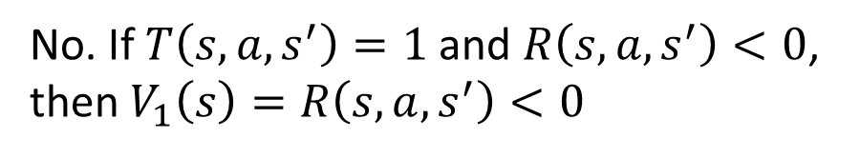
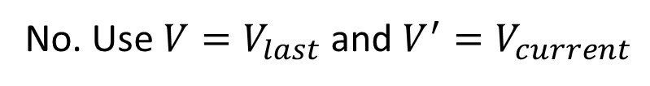
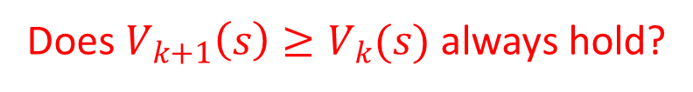
Value Iteration
function VALUE-ITERATION(MDP=(S,A,T,R,$γ$), $threshold$) returns a state value function
for s in S
$V_{0}(s)←0$
$k←0$
repeat
$δ←0$
for s in S
$V_{k+1}\left(s\right)←−∞$
for a in A
$v←0$
for s’ in S
$v←v+T\left(s,a,s^{′}\right)(R\left(s,a,s^{′}\right)+γV_{k}(s′))$
$V_{k+1}\left(s\right)←max⁡\{V_{k+1}\left(s\right),v\}$
$δ←max⁡\{δ,|V_{k+1}\left(s\right)−V_{k}\left(s\right)|\}$
$k←k+1$
until $δ<threshold$
return $V_{k−1}$
Do we really need to store the value of $V_{k}$ for each $k$?
No. Use $V=V_{last}$ and $V^{′}=V_{current}$
Does $V_{k+1}\left(s\right)≥V_{k}(s)$ always hold?
No. If $T\left(s,a,s^{′}\right)=1$ and $R\left(s,a,s^{′}\right)<0$, then $V_{1}\left(s\right)=R\left(s,a,s^{′}\right)<0$

Slide 26
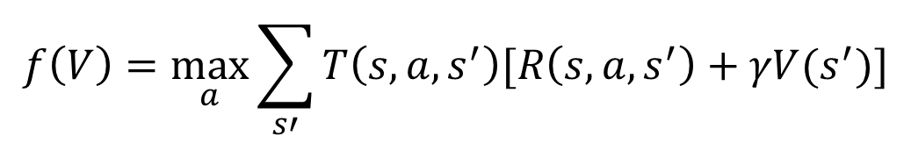

Bellman Equation vs Value Iteration vs Bellman Update
s
Bellman equations characterize the optimal values:
Value iteration computes them by applying Bellman update repeatedly
Value iteration is a method for solving Bellman Equation
$V_{k}$ vectors are also interpretable as time-limited values
Value iteration finds the fixed point of the function
a
s, a
s,a,s’
$$f\left(V\right)=\max_{a}{\sum_{s′}{T\left(s,a,s^{′}\right)[R\left(s,a,s^{′}\right)+γV(s^{′})]}}$$
Notes:
Discuss computational complexity: S * A * S times number of iterations
Note: updates not in place [if in place, it means something else and not even clear what it means]

Slide 27
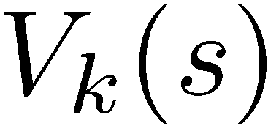
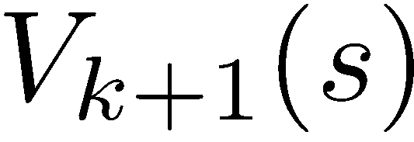
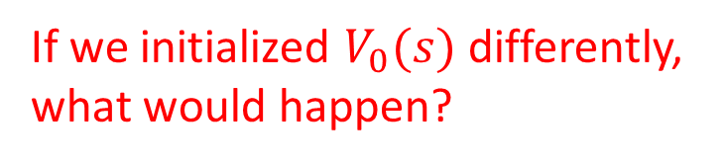
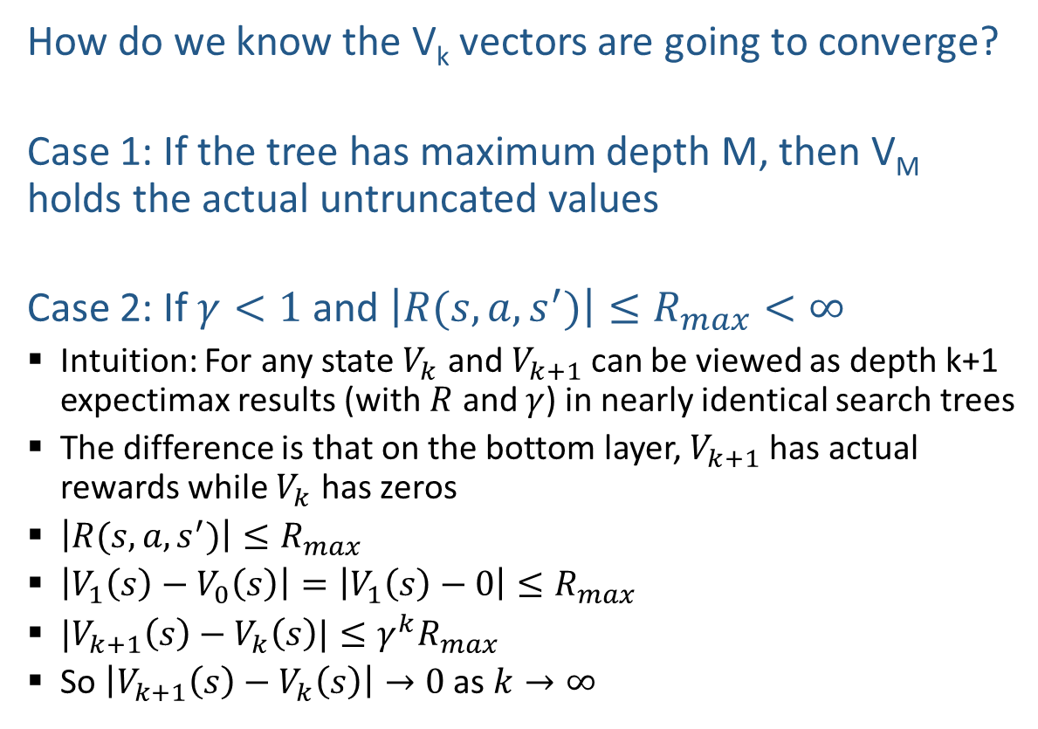
Value Iteration Convergence
How do we know the V_{k} vectors are going to converge?
Case 1: If the tree has maximum depth M, then V_{M} holds the actual untruncated values
Case 2: If $γ<1$ and $\left|R(s,a,s^{′})\right|≤R_{max}<∞$
  Intuition: For any state $V_{k}$ and $V_{k+1}$ can be viewed as depth k+1 expectimax results (with $R$ and $γ$) in nearly identical search trees
  The difference is that on the bottom layer, $V_{k+1}$ has actual rewards while $V_{k}$ has zeros
  $\left|R(s,a,s^{′})\right|≤R_{max}$
  $\left|V_{1}\left(s\right)−V_{0}\left(s\right)\right|=\left|V_{1}\left(s\right)−0\right|≤R_{max}$
  $|V_{k+1}\left(s\right)−V_{k}\left(s\right)|≤γ^{k}R_{max}$
  So $\left|V_{k+1}\left(s\right)−V_{k}\left(s\right)\right|→0$ as $k→∞$
If we initialized $V_{0}(s)$ differently, what would happen?

Slide 28
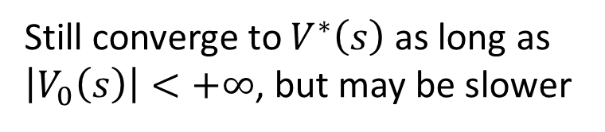
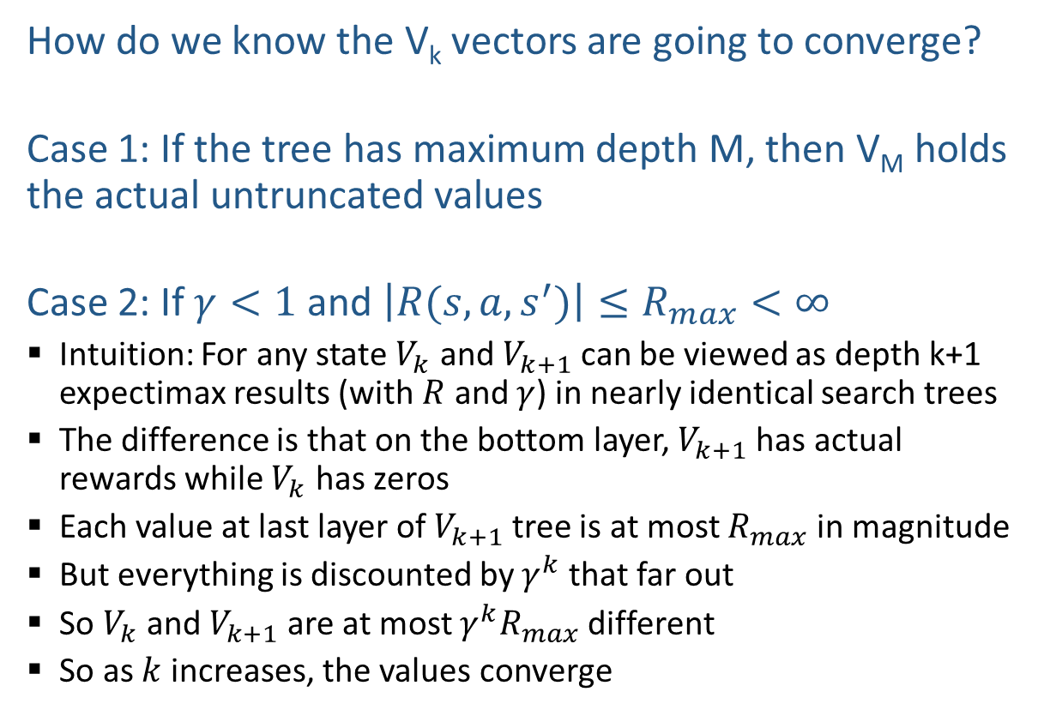
Value Iteration Convergence
How do we know the V_{k} vectors are going to converge?
Case 1: If the tree has maximum depth M, then V_{M} holds the actual untruncated values
Case 2: If $γ<1$ and $\left|R(s,a,s^{′})\right|≤R_{max}<∞$
  Intuition: For any state $V_{k}$ and $V_{k+1}$ can be viewed as depth k+1 expectimax results (with $R$ and $γ$) in nearly identical search trees
  The difference is that on the bottom layer, $V_{k+1}$ has actual rewards while $V_{k}$ has zeros
  Each value at last layer of $V_{k+1}$ tree is at most $R_{max}$ in magnitude
  But everything is discounted by $γ^{k}$ that far out
  So $V_{k}$ and $V_{k+1}$ are at most $γ^{k}R_{max}$ different
  So as $k$ increases, the values converge
If we initialized $V_{0}(s)$ differently, what would happen?
Still converge to $V^{∗}\left(s\right)$ as long as $\left|V_{0}\left(s\right)\right|<+∞$, but may be slower

Slide 29
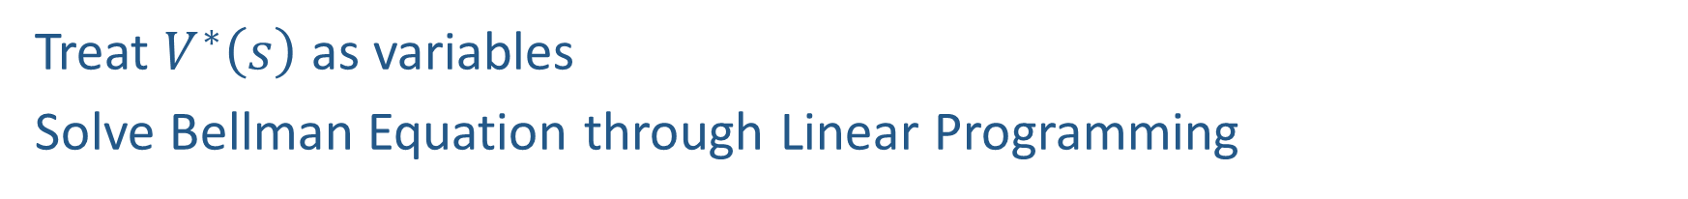
Other ways to solve Bellman Equation?
Treat $V^{∗}\left(s\right)$ as variables
Solve Bellman Equation through Linear Programming

Slide 30
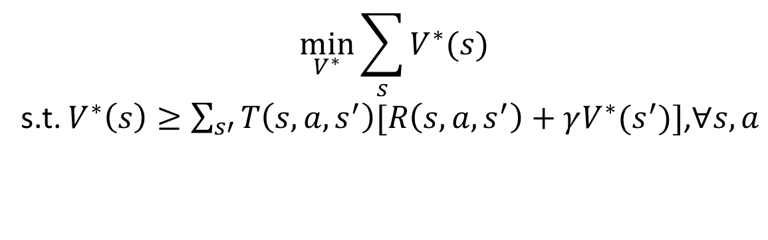
Other ways to solve Bellman Equation?
Treat $V^{∗}\left(s\right)$ as variables
Solve Bellman Equation through Linear Programming
$$\min_{V^{∗}}{\sum_{s}{V^{∗}(s)}}$$
s.t. $V^{∗}\left(s\right)≥\sum_{s′}{T\left(s,a,s^{′}\right)[R\left(s,a,s^{′}\right)+γV^{∗}(s^{′})]}$,$∀s,a$

Slide 31

Policy Iteration for Solving MDPs

Slide 32

Policy Evaluation

Slide 33
Fixed Policies
Do the optimal action
Do what π says to do
s
s
a
π(s)
s, a
s, π(s)
s,a,s’
s, π(s),s’
s’
s’
Expectimax trees max over all actions to compute the optimal values
If we fixed some policy π(s), then the tree would be simpler – only one action per state
  … though the tree’s value would depend on which policy we fixed

Slide 34
Utilities for a Fixed Policy
Another basic operation: compute the utility of a state s under a fixed (generally non-optimal) policy
Define the utility of a state s, under a fixed policy π:
  V^{π}(s) = expected total discounted rewards starting in s and following π
Recursive relation (one-step look-ahead / Bellman equation):
s
π(s)
s, π(s)
s, π(s),s’
s’

Slide 35
Compare

Slide 36
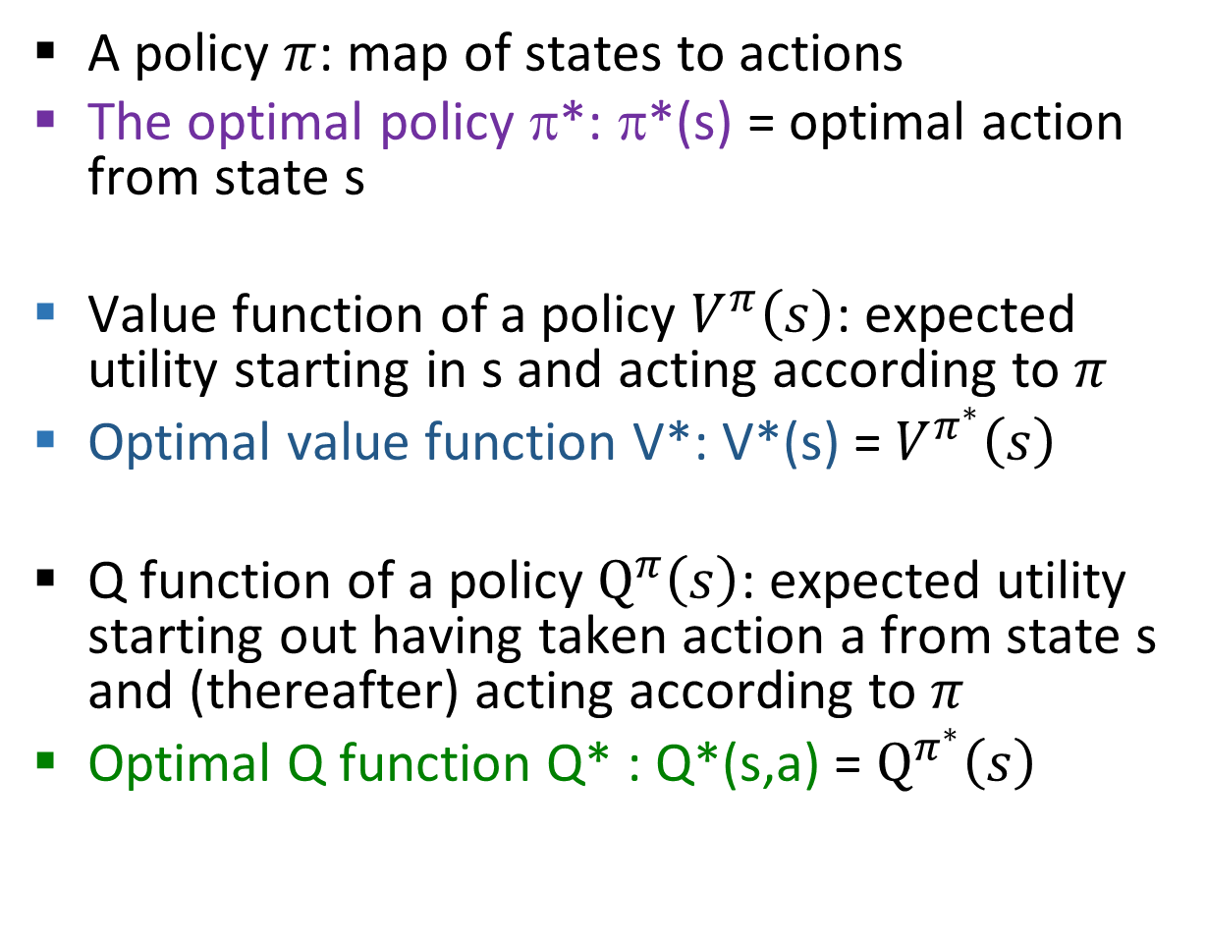
MDP Quantities
A policy $π$: map of states to actions
The optimal policy π*: π*(s) = optimal action from state s
Value function of a policy $V^{π}\left(s\right)$: expected utility starting in s and acting according to $π$
Optimal value function V*: V*(s) = $V^{π^{∗}}\left(s\right)$
Q function of a policy $Q^{π}\left(s\right)$: expected utility starting out having taken action a from state s and (thereafter) acting according to $π$
Optimal Q function Q* : Q*(s,a) = $Q^{π^{∗}}\left(s\right)$
s
s is a state
a
(s, a) is a state-action pair
s, a
s,a,s’
(s,a,s’) is a
transition
s’
Solve MDP: Find $π^{∗}$, $V^{∗}$ and/or $Q^{∗}$
Notes:
V*(s) = expected utility starting in s and acting optimally
Q*(s,a) = expected utility starting out having taken action a from state s and (thereafter) acting optimally
[Note: this demo doesn’t show anything in action, just pops up V and Q values.]

Slide 37
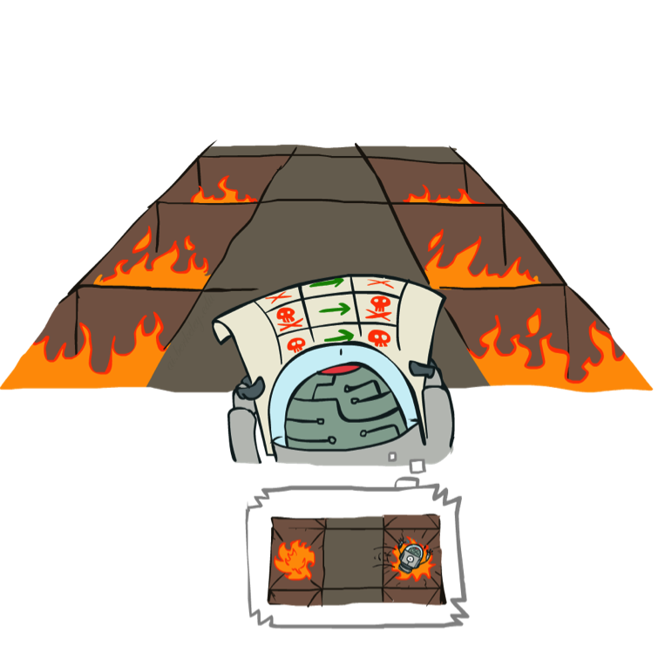
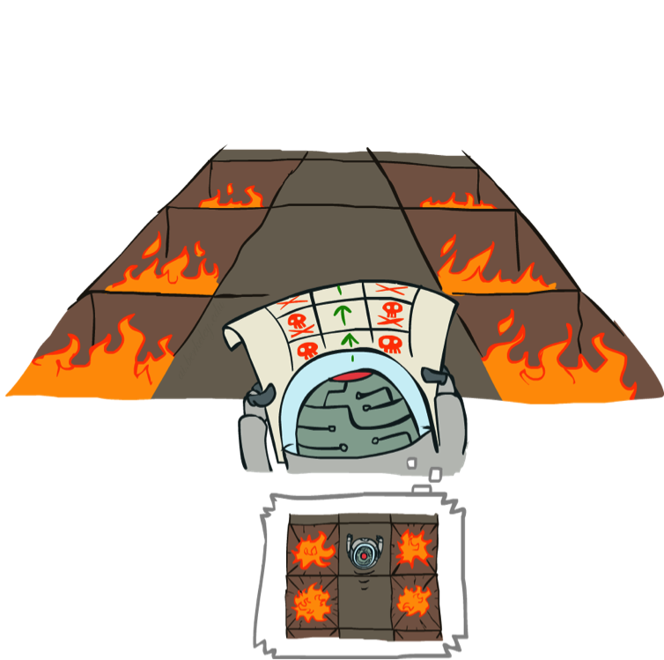
Example: Policy Evaluation
Always Go Right
Always Go Forward

Slide 38
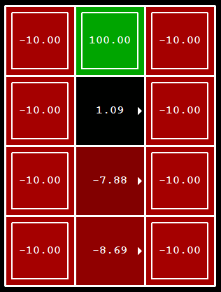
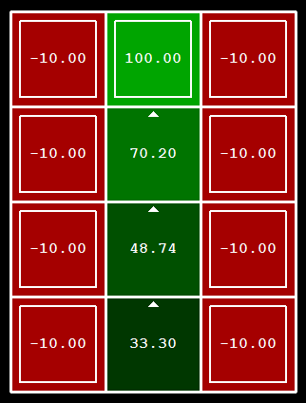
Example: Policy Evaluation
Always Go Right
Always Go Forward

Slide 39

Policy Evaluation
How do we calculate the V’s for a fixed policy π?
Idea 1: Turn recursive Bellman equations into updates
(like value iteration)
s
π(s)
s, π(s)
s, π(s),s’
s’

Slide 40
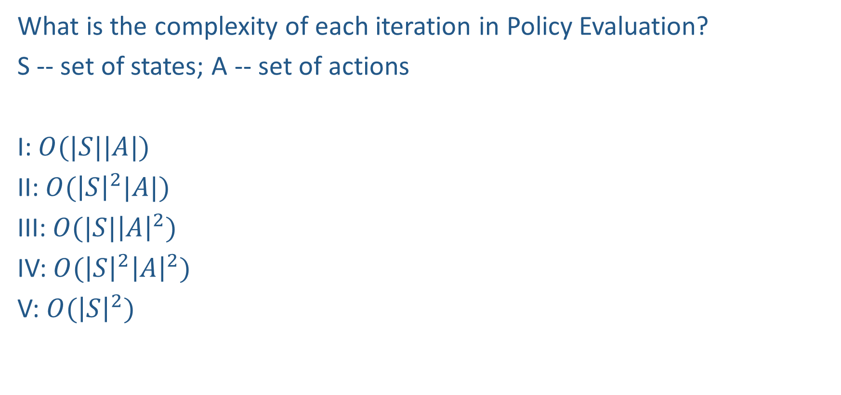
Piazza Poll 3
What is the complexity of each iteration in Policy Evaluation?
S -- set of states; A -- set of actions
I: $O(|S||A|)$
II: $O({\left|S\right|}^{2}|A|)$
III: $O(|S|{\left|A\right|}^{2})$
IV: $O({\left|S\right|}^{2}{\left|A\right|}^{2})$
V: $O({\left|S\right|}^{2})$
V_{k+1}(s)
a
s, a
s,a,s’
V_{k}(s’)

Slide 41
Piazza Poll 3
What is the complexity of each iteration in Policy Evaluation?
S -- set of states; A -- set of actions
I: $O(|S||A|)$
II: $O({\left|S\right|}^{2}|A|)$
III: $O(|S|{\left|A\right|}^{2})$
IV: $O({\left|S\right|}^{2}{\left|A\right|}^{2})$
V: $O({\left|S\right|}^{2})$
V_{k+1}(s)
a
s, a
s,a,s’
V_{k}(s’)

Slide 42
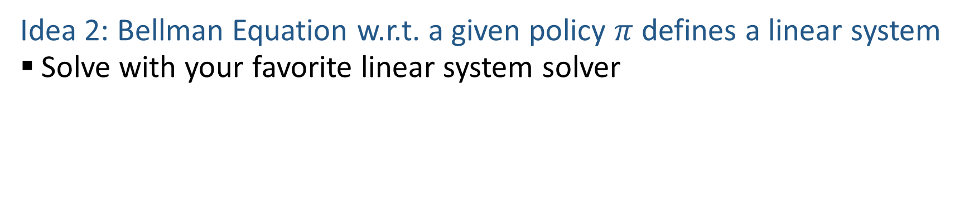

Policy Evaluation
Idea 2: Bellman Equation w.r.t. a given policy $π$ defines a linear system
  Solve with your favorite linear system solver
Treat $V^{π}\left(s\right)$ as variables
How many variables?
How many constraints?

Slide 43

Policy Iteration

Slide 44

Problems with Value Iteration
Value iteration repeats the Bellman updates:
Problem 1: It’s slow – O(${\left|S\right|}^{2}|A|$) per iteration
Problem 2: The “max” at each state rarely changes
Problem 3: The policy often converges long before the values
s
a
s, a
s,a,s’
s’
[Demo: value iteration (L9D2)]
Notes:
Demo steps through value iteration; snapshots of values shown on next slides.

Slide 45

k=0
Noise = 0.2
Discount = 0.9
Living reward = 0
Notes:
Assuming zero living reward

Slide 46

k=1
Noise = 0.2
Discount = 0.9
Living reward = 0
Notes:
Assuming zero living reward

Slide 47

k=2
Noise = 0.2
Discount = 0.9
Living reward = 0
Notes:
Assuming zero living reward

Slide 48

k=3
Noise = 0.2
Discount = 0.9
Living reward = 0
Notes:
Assuming zero living reward

Slide 49

k=4
Noise = 0.2
Discount = 0.9
Living reward = 0
Notes:
Assuming zero living reward

Slide 50

k=5
Noise = 0.2
Discount = 0.9
Living reward = 0
Notes:
Assuming zero living reward

Slide 51

k=6
Noise = 0.2
Discount = 0.9
Living reward = 0
Notes:
Assuming zero living reward

Slide 52

k=7
Noise = 0.2
Discount = 0.9
Living reward = 0
Notes:
Assuming zero living reward

Slide 53

k=8
Noise = 0.2
Discount = 0.9
Living reward = 0
Notes:
Assuming zero living reward

Slide 54

k=9
Noise = 0.2
Discount = 0.9
Living reward = 0
Notes:
Assuming zero living reward

Slide 55

k=10
Noise = 0.2
Discount = 0.9
Living reward = 0
Notes:
Assuming zero living reward

Slide 56

k=11
Noise = 0.2
Discount = 0.9
Living reward = 0
Notes:
Assuming zero living reward

Slide 57

k=12
Noise = 0.2
Discount = 0.9
Living reward = 0
Notes:
Assuming zero living reward

Slide 58

k=100
Noise = 0.2
Discount = 0.9
Living reward = 0
Notes:
Assuming zero living reward

Slide 59
Policy Iteration
Alternative approach for optimal values:
  Step 1: Policy evaluation: calculate utilities for some fixed policy (may not be optimal!) until convergence
  Step 2: Policy improvement: update policy using one-step look-ahead with resulting converged (but not optimal!) utilities as future values
  Repeat steps until policy converges
This is policy iteration
  It’s still optimal!
  Can converge (much) faster under some conditions

Slide 60
Policy Iteration
Policy Evaluation: For fixed current policy π, find values w.r.t. the policy
  Iterate until values converge:
Policy Improvement: For fixed values, get a better policy with one-step look-ahead:
Similar to how you derive optimal policy $π^{∗}$ given optimal value $V^{∗}$

Slide 61

Piazza Poll 4
True/False: $V^{π_{i+1}}\left(s\right)≥V^{π_{i}}\left(s\right),∀s$

Slide 62

Piazza Poll 4
True/False: $V^{π_{i+1}}\left(s\right)≥V^{π_{i}}\left(s\right),∀s$
$$V^{π_{i}}\left(s\right)=\sum_{s′}{T\left(s,π^{i}(s),s^{′}\right)[R\left(s,π^{i}(s),s^{′}\right)+γV^{π_{i}}\left(s′\right)] }$$
If I take first step according to $π_{i+1}$ and then follow $π_{i}$, we get an expected utility of
$${\tilde{V}}_{1}(s)=\max_{a}{\sum_{s′}{T\left(s,a,s^{′}\right)[R\left(s,a,s^{′}\right)+γV^{π_{i}}\left(s′\right)] }}$$
Which is $≥V^{π_{i}}\left(s\right)$
What if I take two steps according to $π_{i+1}$?

Slide 63
Comparison
Both value iteration and policy iteration compute the same thing (all optimal values)
In value iteration:
  Every iteration updates both the values and (implicitly) the policy
  We don’t track the policy, but taking the max over actions implicitly recomputes it
In policy iteration:
  We do several passes that update utilities with fixed policy (each pass is fast because we consider only one action, not all of them)
  After the policy is evaluated, a new policy is chosen (slow like a value iteration pass)
  The new policy will be better (or we’re done)
(Both are dynamic programs for solving MDPs)

Slide 64
Summary: MDP Algorithms
So you want to….
  Turn values into a policy: use one-step lookahead
  Compute optimal values: use value iteration or policy iteration
  Compute values for a particular policy: use policy evaluation
These all look the same!
  They basically are – they are all variations of Bellman updates
  They all use one-step lookahead expectimax fragments
  They differ only in whether we plug in a fixed policy or max over actions

Slide 65

MDP Notation
$$V\left(s\right)=\max_{a}{\sum_{s′}{P\left(s^{′}\right|s,a)V(s^{′})}}$$
$$V\left(s\right)=\max_{a}{\sum_{s′}{P\left(s^{′} | s,a\right)\left[R\left(s,a,s^{′}\right)+γV\left(s^{′}\right)\right]}}$$
$$V_{k+1}\left(s\right)=\max_{a}{\sum_{s′}{P\left(s^{′} | s,a\right)\left[R\left(s,a,s^{′}\right)+γV_{k}\left(s^{′}\right)\right]}}, ∀ s$$
$$Q_{k+1}\left(s,a\right)=\sum_{s′}{P\left(s^{′} | s,a\right)[R\left(s,a,s^{′}\right)+γ\max_{a^{′}}{Q_{k}(s^{′},a^{′})]}, } ∀ s,a$$
$$π_{V}\left(s\right)=\underset{a}{argmax}{\sum_{s′}{P\left(s^{′} | s,a\right)[R\left(s,a,s^{′}\right)+γV\left(s^{′}\right)]}}, ∀ s$$
$$V_{k+1}^{π}\left(s\right)=\sum_{s′}{P\left(s^{′} | s,π\left(s\right)\right)[R\left(s,π\left(s\right),s^{′}\right)+γV_{k}^{π}\left(s^{′}\right)]}, ∀ s$$
$$π_{new}\left(s\right)=\underset{a}{argmax}{\sum_{s′}{P\left(s^{′} | s,a\right)\left[R\left(s,a,s^{′}\right)+γV^{π_{old}}\left(s^{′}\right)\right]}}, ∀ s$$
Standard expectimax:
Bellman equations:
Value iteration:
Q-iteration:
Policy extraction:
Policy evaluation:
Policy improvement:

Slide 66
MDP Notation
$$V\left(s\right)=\max_{a}{\sum_{s′}{P\left(s^{′}\right|s,a)V(s^{′})}}$$
$$V\left(s\right)=\max_{a}{\sum_{s′}{P\left(s^{′} | s,a\right)\left[R\left(s,a,s^{′}\right)+γV\left(s^{′}\right)\right]}}$$
$$V_{k+1}\left(s\right)=\max_{a}{\sum_{s′}{P\left(s^{′} | s,a\right)\left[R\left(s,a,s^{′}\right)+γV_{k}\left(s^{′}\right)\right]}}, ∀ s$$
$$Q_{k+1}\left(s,a\right)=\sum_{s′}{P\left(s^{′} | s,a\right)[R\left(s,a,s^{′}\right)+γ\max_{a^{′}}{Q_{k}(s^{′},a^{′})]}, } ∀ s,a$$
$$π_{V}\left(s\right)=\underset{a}{argmax}{\sum_{s′}{P\left(s^{′} | s,a\right)[R\left(s,a,s^{′}\right)+γV\left(s^{′}\right)]}}, ∀ s$$
$$V_{k+1}^{π}\left(s\right)=\sum_{s′}{P\left(s^{′} | s,π\left(s\right)\right)[R\left(s,π\left(s\right),s^{′}\right)+γV_{k}^{π}\left(s^{′}\right)]}, ∀ s$$
$$π_{new}\left(s\right)=\underset{a}{argmax}{\sum_{s′}{P\left(s^{′} | s,a\right)\left[R\left(s,a,s^{′}\right)+γV^{π_{old}}\left(s^{′}\right)\right]}}, ∀ s$$
Standard expectimax:
Bellman equations:
Value iteration:
Q-iteration:
Policy extraction:
Policy evaluation:
Policy improvement:

Slide 67
MDP Notation
$$V\left(s\right)=\max_{a}{\sum_{s′}{P\left(s^{′}\right|s,a)V(s^{′})}}$$
$$V\left(s\right)=\max_{a}{\sum_{s′}{P\left(s^{′} | s,a\right)\left[R\left(s,a,s^{′}\right)+γV\left(s^{′}\right)\right]}}$$
$$V_{k+1}\left(s\right)=\max_{a}{\sum_{s′}{P\left(s^{′} | s,a\right)\left[R\left(s,a,s^{′}\right)+γV_{k}\left(s^{′}\right)\right]}}, ∀ s$$
$$Q_{k+1}\left(s,a\right)=\sum_{s′}{P\left(s^{′} | s,a\right)[R\left(s,a,s^{′}\right)+γ\max_{a^{′}}{Q_{k}(s^{′},a^{′})]}, } ∀ s,a$$
$$π_{V}\left(s\right)=\underset{a}{argmax}{\sum_{s′}{P\left(s^{′} | s,a\right)[R\left(s,a,s^{′}\right)+γV\left(s^{′}\right)]}}, ∀ s$$
$$V_{k+1}^{π}\left(s\right)=\sum_{s′}{P\left(s^{′} | s,π\left(s\right)\right)[R\left(s,π\left(s\right),s^{′}\right)+γV_{k}^{π}\left(s^{′}\right)]}, ∀ s$$
$$π_{new}\left(s\right)=\underset{a}{argmax}{\sum_{s′}{P\left(s^{′} | s,a\right)\left[R\left(s,a,s^{′}\right)+γV^{π_{old}}\left(s^{′}\right)\right]}}, ∀ s$$
Standard expectimax:
Bellman equations:
Value iteration:
Q-iteration:
Policy extraction:
Policy evaluation:
Policy improvement:

Slide 68

MDP Notation
$$V\left(s\right)=\max_{a}{\sum_{s′}{P\left(s^{′}\right|s,a)V(s^{′})}}$$
$$V\left(s\right)=\max_{a}{\sum_{s′}{P\left(s^{′} | s,a\right)\left[R\left(s,a,s^{′}\right)+γV\left(s^{′}\right)\right]}}$$
$$V_{k+1}\left(s\right)=\max_{a}{\sum_{s′}{P\left(s^{′} | s,a\right)\left[R\left(s,a,s^{′}\right)+γV_{k}\left(s^{′}\right)\right]}}, ∀ s$$
$$Q_{k+1}\left(s,a\right)=\sum_{s′}{P\left(s^{′} | s,a\right)[R\left(s,a,s^{′}\right)+γ\max_{a^{′}}{Q_{k}(s^{′},a^{′})]}, } ∀ s,a$$
$$π_{V}\left(s\right)=\underset{a}{argmax}{\sum_{s′}{P\left(s^{′} | s,a\right)[R\left(s,a,s^{′}\right)+γV\left(s^{′}\right)]}}, ∀ s$$
$$V_{k+1}^{π}\left(s\right)=\sum_{s′}{P\left(s^{′} | s,π\left(s\right)\right)[R\left(s,π\left(s\right),s^{′}\right)+γV_{k}^{π}\left(s^{′}\right)]}, ∀ s$$
$$π_{new}\left(s\right)=\underset{a}{argmax}{\sum_{s′}{P\left(s^{′} | s,a\right)\left[R\left(s,a,s^{′}\right)+γV^{π_{old}}\left(s^{′}\right)\right]}}, ∀ s$$
Standard expectimax:
Bellman equations:
Value iteration:
Q-iteration:
Policy extraction:
Policy evaluation:
Policy improvement:

Slide 69



Double Bandits

Slide 70
Double-Bandit MDP
No discount
100 time steps
Both states have the same value
Actions: Blue, Red
States: Win, Lose
0.25 $0
0.75
$2
W
L
0.25
$0
$1
1.0
$1
1.0
0.75 $2
Actually a simple MDP where the current state does not impact transition or reward:
$P\left(s^{′}|s,a\right)=P\left(s^{′}|a\right)$ and $R\left(s,a,s^{′}\right)=R(a,s^{′})$

Slide 71
Offline Planning
No discount
100 time steps
Both states have the same value
Solving MDPs is offline planning
  You determine all quantities through computation
  You need to know the details of the MDP
  You do not actually play the game!
0.25 $0
Value
0.75
$2
0.25
$0
Play Red
150
W
L
$1
1.0
$1
1.0
0.75 $2
Play Blue
100

Slide 72
Let’s Play!
$2
$2
$0
$2
$2
$2
$2
$0
$0
$0

Slide 73
Online Planning
Rules changed! Red’s win chance is different.
?? $0
??
$2
W
L
??
$0
$1
1.0
$1
1.0
?? $2

Slide 74
Let’s Play!
$0
$0
$0
$2
$0
$2
$0
$0
$0
$0

Slide 75
What Just Happened?
That wasn’t planning, it was learning!
  Specifically, reinforcement learning
  There was an MDP, but you couldn’t solve it with just computation
  You needed to actually act to figure it out
Important ideas in reinforcement learning that came up
  Exploration: you have to try unknown actions to get information
  Exploitation: eventually, you have to use what you know
  Regret: even if you learn intelligently, you make mistakes
  Sampling: because of chance, you have to try things repeatedly
  Difficulty: learning can be much harder than solving a known MDP

Slide 76
Next Time: Reinforcement Learning!

