Slide 1
Warm-up as You Walk In
Given
Set actions (persistent/static)
Set states (persistent/static)
Function T(s,a,s_prime)
Write the pseudo code for:
function V(s) return value
that implements:

Slide 2
Announcements
Assignments:
P3: Optimization; Due 10/17 Thu, 10 pm
HW6 (online) 10/15 Tue, 10 pm
HW7 (online) 10/22 Tue, 10 pm; Will be released today
Lectures: 4 lectures by Dr. Fei Fang on MDP/RL, followed by 4 lectures by Dr. Pat Virtue on Bayes’ Nets
Recitations canceled on October 18 (Mid-Semester Break) and October 25 (Day for Community Engagement). Recitation worksheet available (reference for midterm/final)
New: Piazza post for In-class Questions

Slide 3
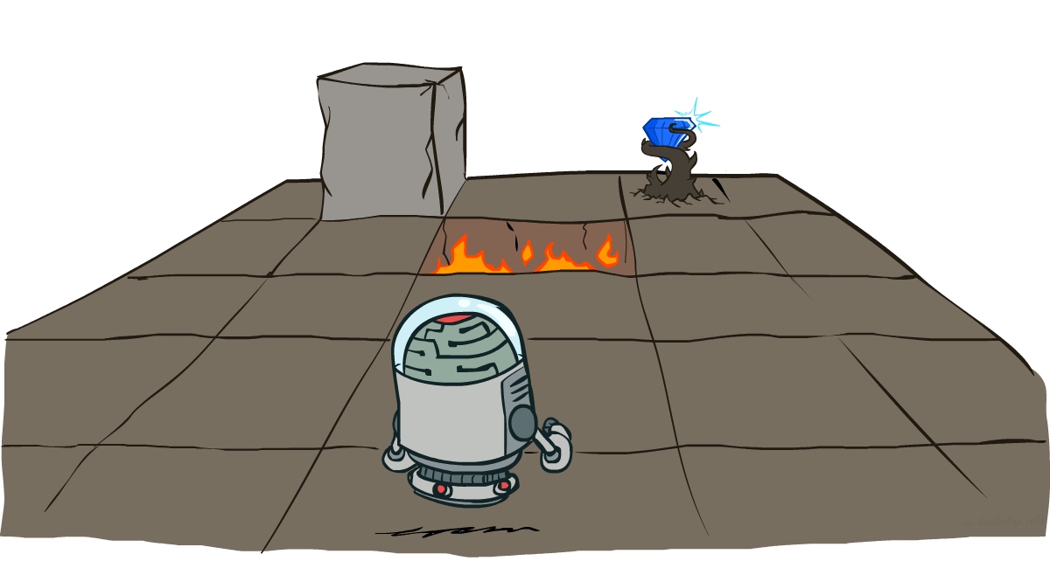
AI: Representation and Problem Solving
Markov Decision Processes
Instructors: Fei Fang & Pat Virtue
Slide credits: CMU AI and http://ai.berkeley.edu

Slide 4
Learning Objectives
Describe the definition of Markov Decision Process
Compute utility of a reward sequence given discount factor
Define policy and optimal policy of an MDP
Define state-value and (true) state value of an MDP
Define Q-value and (true) Q value of an MDP
Derive optimal policy from (true) state value or (true) Q-values
Next Lecture

Slide 5
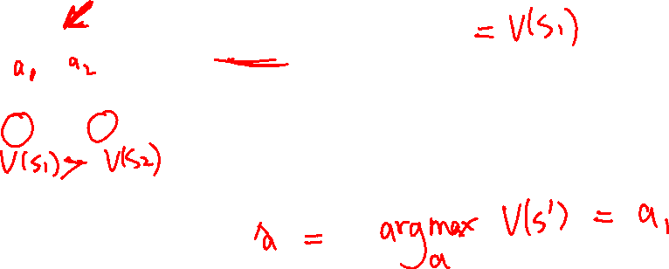
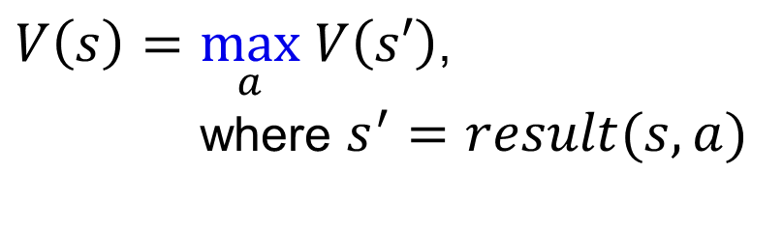
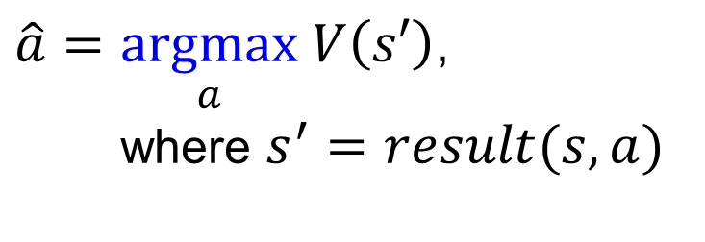
Recall: Minimax Notation
$V\left(s\right)=\max_{a} V\left(s′\right)$,
where $s^{′}=result(s, a)$
$\hat{a}=\underset{a}{argmax} V\left(s′\right)$,
where $s^{′}=result(s, a)$

Slide 6

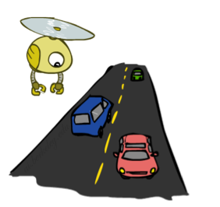
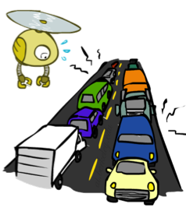
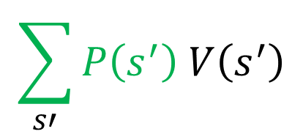

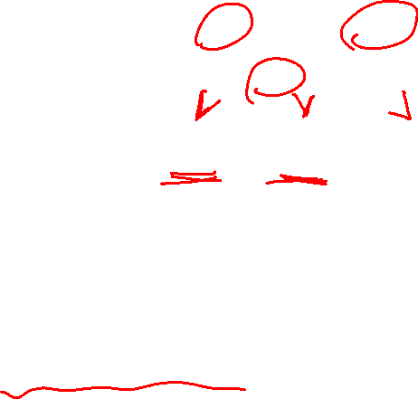
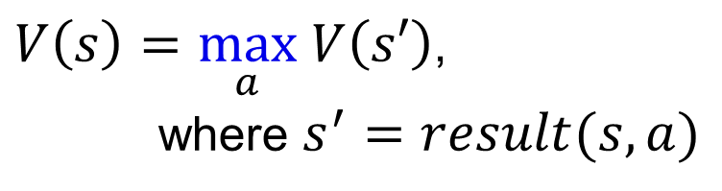
Recall: Expectations
Time:
20 min
30 min
60 min
+
+
x
x
x
Probability:
0.25
0.50
0.25
0.25
0.25
0.5
20
30
60
Max node notation
Chance node notation
$$\sum_{s′}{P\left(s^{′}\right) V\left(s^{′}\right)}$$
$V\left(s\right)=\max_{a} V\left(s′\right)$,
where $s^{′}=result(s, a)$
$$V\left(s\right)=$$

Slide 7
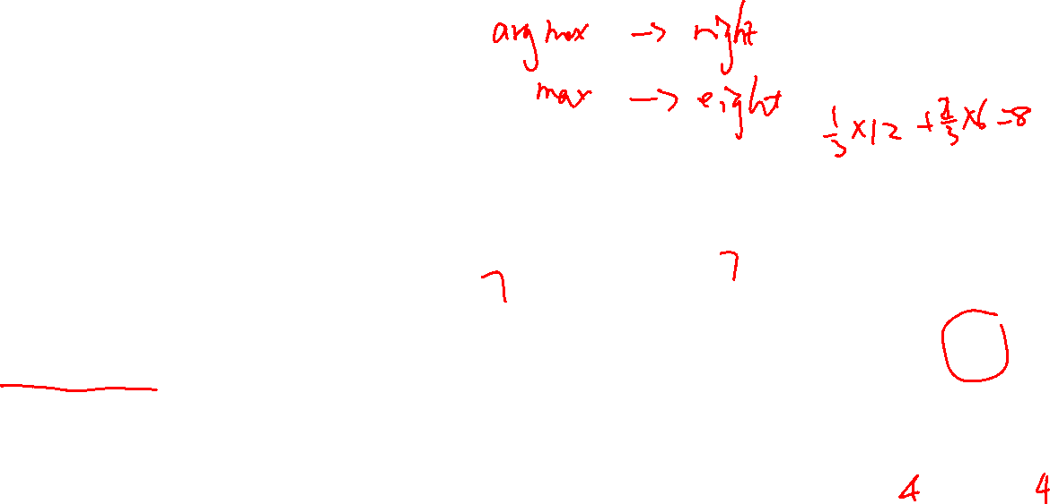
Piazza Poll 1
Expectimax tree search:
Which action do we choose?
A) Left
B) Center
C) Right
D) Eight
Left
Right
Center
1/4
1/2
1/2
1/2
1/3
2/3
1/4
12
8
4
8
6
12
6

Slide 8
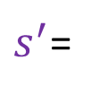
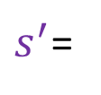

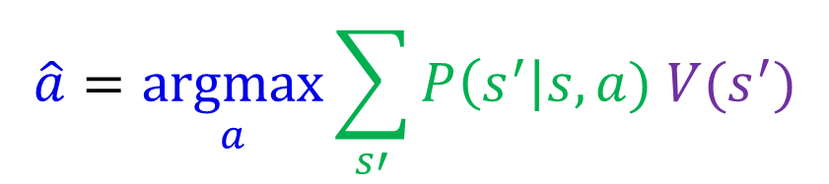


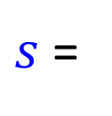


Piazza Poll 1
$$\hat{a}=\underset{a}{argmax}{\sum_{s′}{P\left(s^{′}\right|s,a) V(s^{′})}}$$
Expectimax tree search:
Which action do we choose?
A) Left
B) Center
C) Right
D) Eight
$s$ =
a = Left
a = Right
a = Center
1/4
1/2
1/2
1/2
1/3
2/3
1/4
$s^{′}$=
12
$s^{′}$=
8
$s^{′}$=
4
$s^{′}$=
8
$s^{′}$=
6
$s^{′}$=
12
$s^{′}$=
6

Slide 9
Piazza Poll 1
$$\hat{a}=\underset{a}{argmax}{\sum_{s′}{P\left(s^{′}\right|s,a) V(s^{′})}}$$
Expectimax tree search:
Which action do we choose?
A) Left
B) Center
C) Right
D) Eight
$s$ =
Max{7,7,8}=8
a = Left
a = Right
a = Center
3+2+2=7
4+3=7
4+4=8
1/4
1/2
1/2
1/2
1/3
2/3
1/4
$s^{′}$=
12
$s^{′}$=
8
$s^{′}$=
4
$s^{′}$=
8
$s^{′}$=
6
$s^{′}$=
12
$s^{′}$=
6

Slide 10
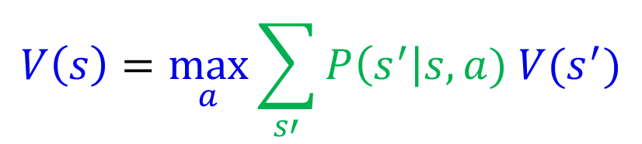
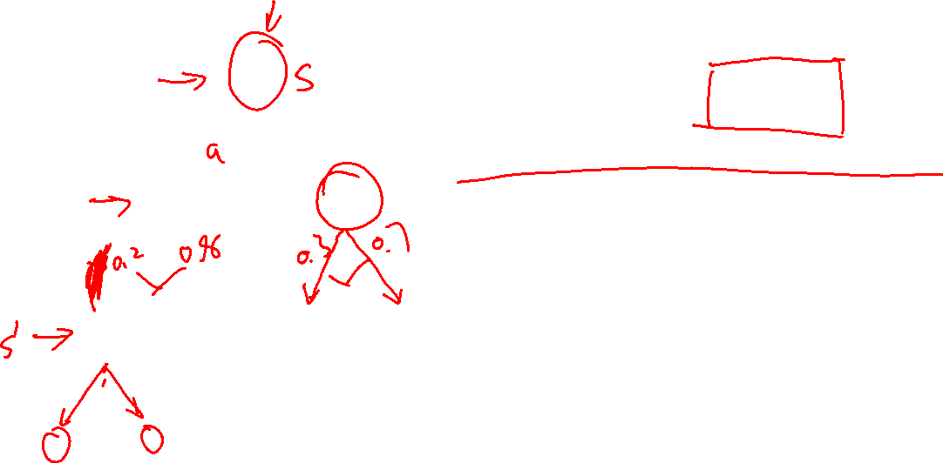
Expectimax Notation
$$V\left(s\right)=\max_{a}{\sum_{s′}{P\left(s^{′}\right|s,a) V(s^{′})}}$$

Slide 11
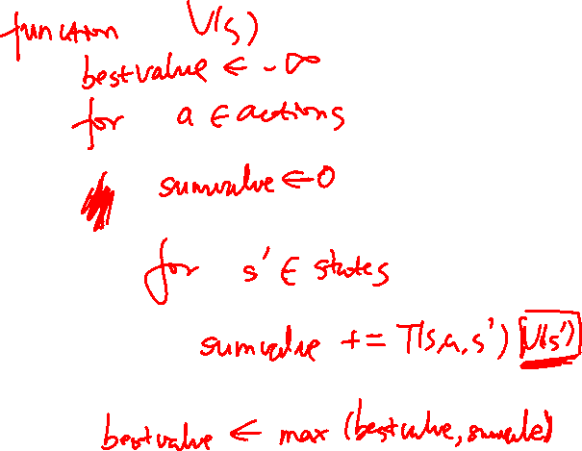
Warm-up as You Walk In
Given
Set actions (persistent/static)
Set states (persistent/static)
Function T(s,a,s_prime)
Write the pseudo code for:
function V(s) return value
that implements:

Slide 12
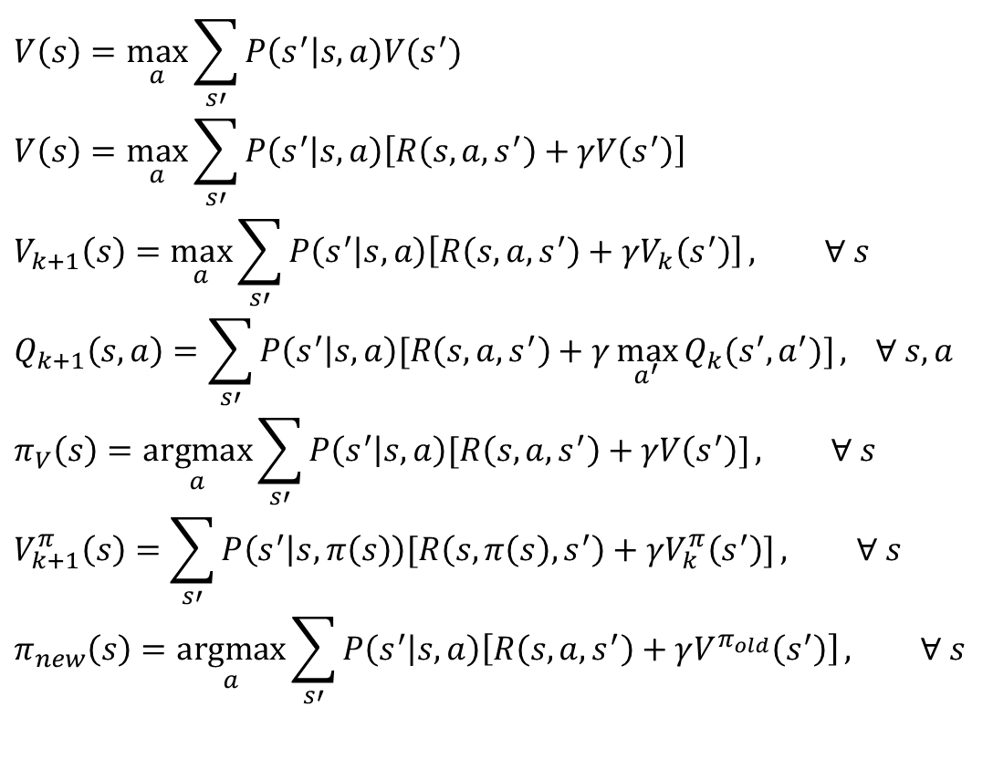
MDP Notation
$$V\left(s\right)=\max_{a}{\sum_{s′}{P\left(s^{′}\right|s,a)V(s^{′})}}$$
$$V\left(s\right)=\max_{a}{\sum_{s′}{P\left(s^{′} | s,a\right)\left[R\left(s,a,s^{′}\right)+γV\left(s^{′}\right)\right]}}$$
$$V_{k+1}\left(s\right)=\max_{a}{\sum_{s′}{P\left(s^{′} | s,a\right)\left[R\left(s,a,s^{′}\right)+γV_{k}\left(s^{′}\right)\right]}}, ∀ s$$
$$Q_{k+1}\left(s,a\right)=\sum_{s′}{P\left(s^{′} | s,a\right)[R\left(s,a,s^{′}\right)+γ\max_{a^{′}}{Q_{k}(s^{′},a^{′})]}, } ∀ s,a$$
$$π_{V}\left(s\right)=\underset{a}{argmax}{\sum_{s′}{P\left(s^{′} | s,a\right)[R\left(s,a,s^{′}\right)+γV\left(s^{′}\right)]}}, ∀ s$$
$$V_{k+1}^{π}\left(s\right)=\sum_{s′}{P\left(s^{′} | s,π\left(s\right)\right)[R\left(s,π\left(s\right),s^{′}\right)+γV_{k}^{π}\left(s^{′}\right)]}, ∀ s$$
$$π_{new}\left(s\right)=\underset{a}{argmax}{\sum_{s′}{P\left(s^{′} | s,a\right)\left[R\left(s,a,s^{′}\right)+γV^{π_{old}}\left(s^{′}\right)\right]}}, ∀ s$$
Standard expectimax:
Bellman equations:
Value iteration:
Q-iteration:
Policy extraction:
Policy evaluation:
Policy improvement:

Slide 13
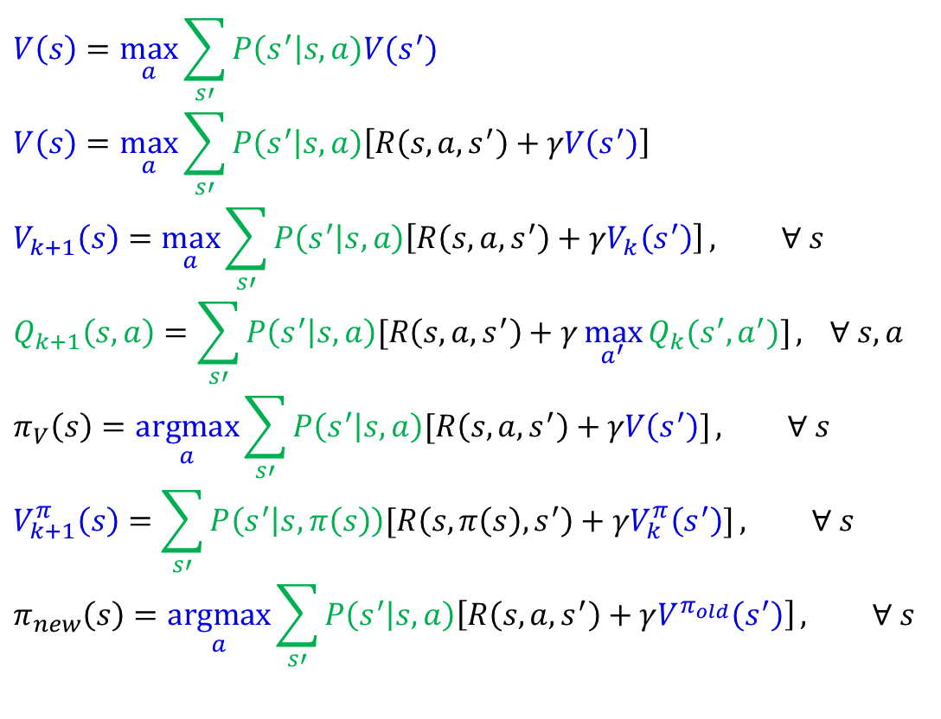
MDP Notation
$$V\left(s\right)=\max_{a}{\sum_{s′}{P\left(s^{′}\right|s,a)V(s^{′})}}$$
$$V\left(s\right)=\max_{a}{\sum_{s′}{P\left(s^{′} | s,a\right)\left[R\left(s,a,s^{′}\right)+γV\left(s^{′}\right)\right]}}$$
$$V_{k+1}\left(s\right)=\max_{a}{\sum_{s′}{P\left(s^{′} | s,a\right)\left[R\left(s,a,s^{′}\right)+γV_{k}\left(s^{′}\right)\right]}}, ∀ s$$
$$Q_{k+1}\left(s,a\right)=\sum_{s′}{P\left(s^{′} | s,a\right)[R\left(s,a,s^{′}\right)+γ\max_{a^{′}}{Q_{k}(s^{′},a^{′})]}, } ∀ s,a$$
$$π_{V}\left(s\right)=\underset{a}{argmax}{\sum_{s′}{P\left(s^{′} | s,a\right)[R\left(s,a,s^{′}\right)+γV\left(s^{′}\right)]}}, ∀ s$$
$$V_{k+1}^{π}\left(s\right)=\sum_{s′}{P\left(s^{′} | s,π\left(s\right)\right)[R\left(s,π\left(s\right),s^{′}\right)+γV_{k}^{π}\left(s^{′}\right)]}, ∀ s$$
$$π_{new}\left(s\right)=\underset{a}{argmax}{\sum_{s′}{P\left(s^{′} | s,a\right)\left[R\left(s,a,s^{′}\right)+γV^{π_{old}}\left(s^{′}\right)\right]}}, ∀ s$$
Standard expectimax:
Bellman equations:
Value iteration:
Q-iteration:
Policy extraction:
Policy evaluation:
Policy improvement:

Slide 14
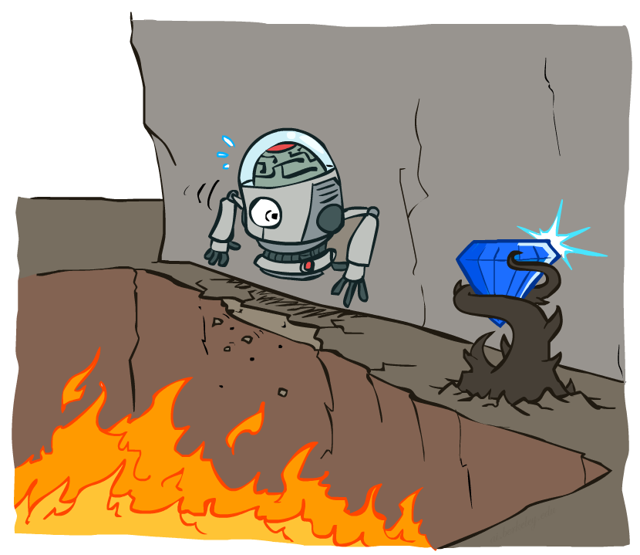
Non-Deterministic Search

Slide 15
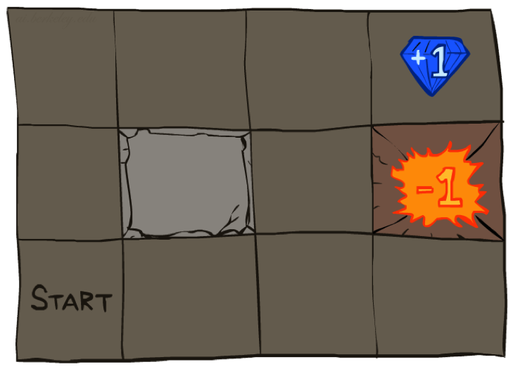




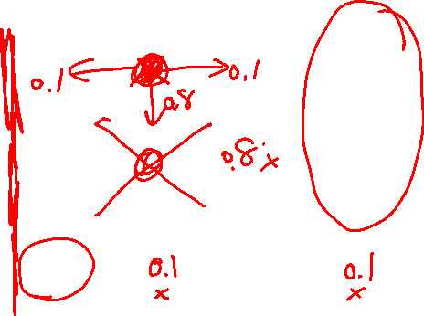
Example: Grid World
A maze-like problem
The agent lives in a grid
Walls block the agent’s path
Noisy movement: actions do not always go as planned
If agent takes action North
80% of the time: Get to the cell on the North (if there is no wall there)
10%: West; 10%: East
If path after roll dice blocked by wall, stays put
The agent receives rewards each time step
“Living” reward (can be negative)
Additional reward at pit or target (good or bad) and will exit the grid world afterward
Goal: maximize sum of rewards
Notes:
If agent takes action North, then 80% of the time agent ends with going to the cell on the North (if there is no wall there)
10%, action North takes the agent West; 10% East
If there is a wall in the direction the agent would have been taken, the agent stays put
Small “living” reward each step (can be negative)
Big rewards come at the end (good or bad)

Slide 16
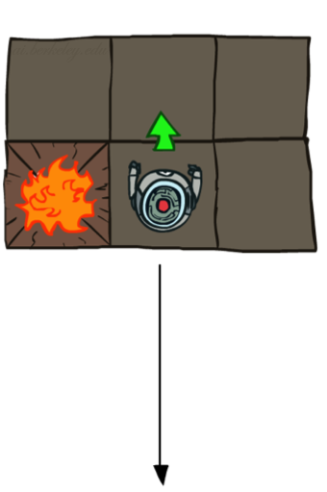
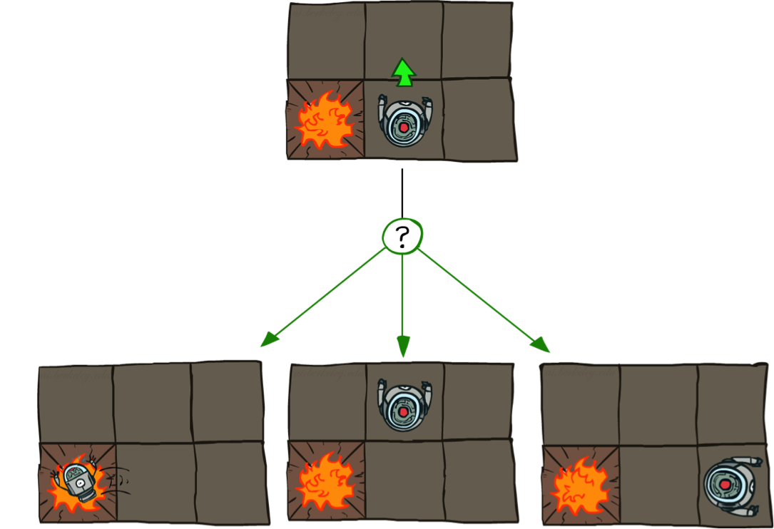
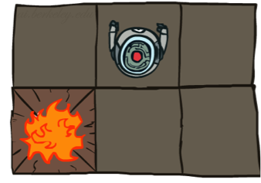
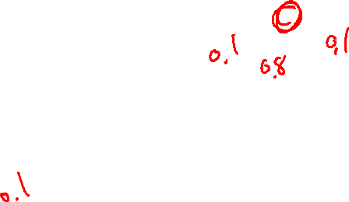
Grid World Actions
Deterministic Grid World
Stochastic Grid World

Slide 17
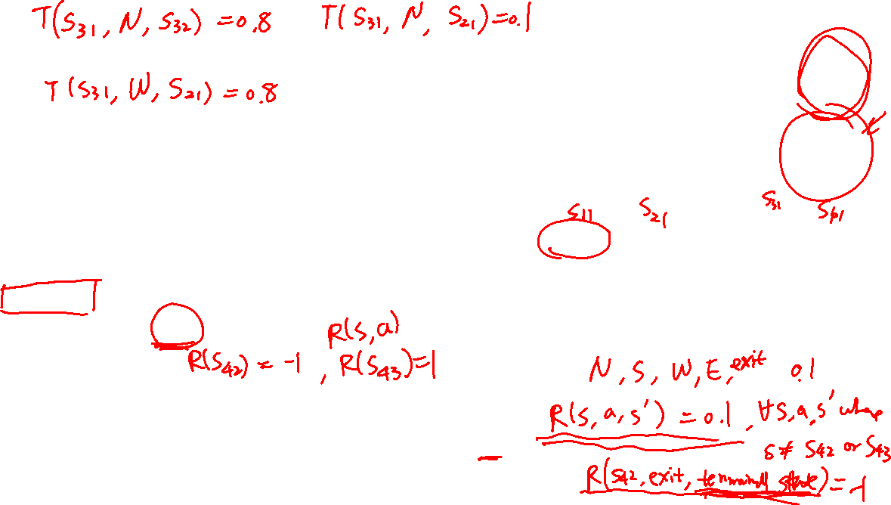

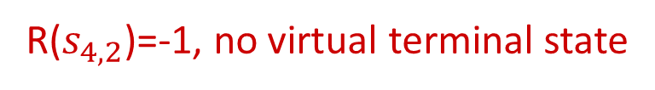
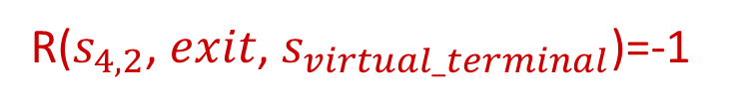
Markov Decision Processes
An MDP is defined by a tuple (S,A,T,R):
S: a set of states
A: a set of actions
T: a transition function
T(s, a, s’) where s ∈ S, a ∈ A, s’ ∈ S is P(s’| s, a)
R: a reward function
R(s, a, s’) is reward at this time step
Sometimes just R(s) or R(s’)
Sometimes also have
$γ$: discount factor (introduced later)
$μ$: distribution of initial state (or just a start state $s_{0}$)
Terminal states: processes end after reaching these states
The Grid World problem as an MDP
R($s_{4,2}$, $exit$, $s_{virtual_terminal}$)=-1
R($s_{4,2}$)=-1, no virtual terminal state
How to define the terminal states and reward function for the Grid World problem?
Notes:
T(s,a,s’): Probability that a from s leads to s’
T is also called the model or the dynamics
In search problems: did not talk about actions, but about successor functions --- now the information inside the successor function is unpacked into actions, transitions and reward
Write out S, A, example entry in T, entry in R
Reward function different from the book : R(s,a,s’)
In book simpler for equations, but not useful for the projects.
Need to modify expectimax a tiny little bit to account for rewards along the way, but that’s something you should be able to do, and so you can already solve MDP’s (not in most efficient way)

Slide 18
Demo of Gridworld
[Demo – gridworld manual intro (L8D1)]

Slide 19
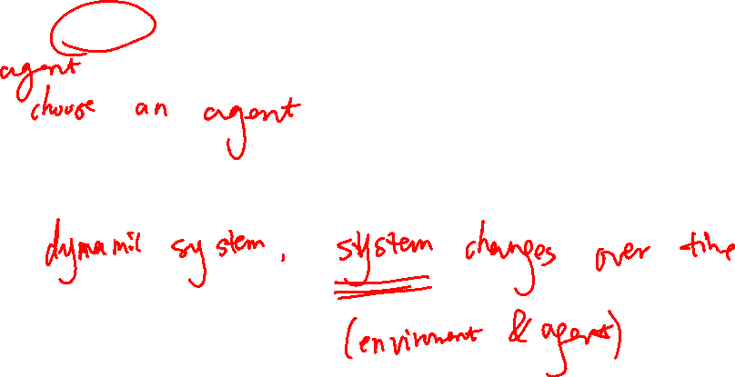
Markov Decision Processes
An MDP is defined by a tuple (S,A,T,R)
Why is it called Markov Decision Process?
Decision:
Process:
Notes:
T(s,a,s’): Probability that a from s leads to s’
T is also called the model or the dynamics
In search problems: did not talk about actions, but about successor functions --- now the information inside the successor function is unpacked into actions, transitions and reward
Write out S, A, example entry in T, entry in R
Reward function different from the book : R(s,a,s’)
In book simpler for equations, but not useful for the projects.
Need to modify expectimax a tiny little bit to account for rewards along the way, but that’s something you should be able to do, and so you can already solve MDP’s (not in most efficient way)

Slide 20
Markov Decision Processes
An MDP is defined by a tuple (S,A,T,R)
Why is it called Markov Decision Process?
Decision:
Process:
Agent decides what action to take in each time step
The system (environment + agent) is changing over time
Notes:
T(s,a,s’): Probability that a from s leads to s’
T is also called the model or the dynamics
In search problems: did not talk about actions, but about successor functions --- now the information inside the successor function is unpacked into actions, transitions and reward
Write out S, A, example entry in T, entry in R
Reward function different from the book : R(s,a,s’)
In book simpler for equations, but not useful for the projects.
Need to modify expectimax a tiny little bit to account for rewards along the way, but that’s something you should be able to do, and so you can already solve MDP’s (not in most efficient way)

Slide 21
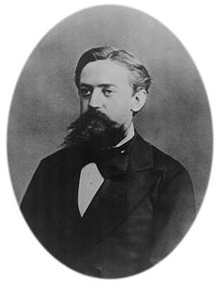

What is Markov about MDPs?
Markov property: Conditional on the present state, the future and the past are independent
In MDP, it means outcome of an action depend only on current state
Recall in search, successor function only depends on current state (not the history)
Andrey Markov
(1856-1922)
Russian mathematician
Notes:
Roughly speaking, a process satisfies the Markov property if one can make predictions for the future of the process based solely on its present state just as well as one could knowing the process's full history, hence independently from such history, that is, conditional on the present state of the system, its future and past states are independent.
(sometimes characterized as "memorylessness")
Like search: successor function only depended on current state
Can make this happen by stuffing more into the state;
Very similar to search problems: when solving a maze with food pellets, we stored which food pellets were eaten

Slide 22


Policies
In deterministic single-agent search problems, we wanted an optimal plan, or sequence of actions, from start to a goal
For MDPs, we focus on policies
Policy = map of states to actions
π(s) gives an action for state s
We want an optimal policy π*: S → A
An optimal policy is one that maximizes expected utility if followed

Slide 23
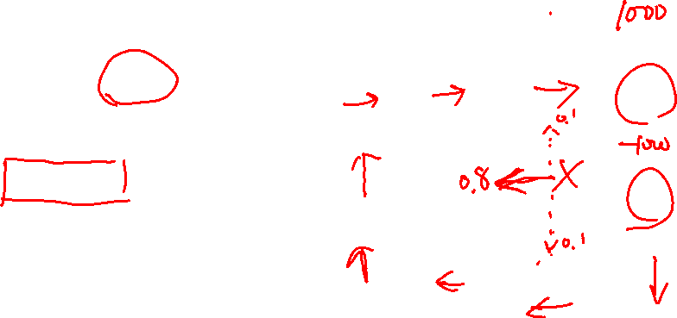
Policies
Recall: An MDP is defined S,A,T,R
Keep S,A,T fixed, optimal policy may vary given different R
What is the optimal policy if R(s,a,s’)=-1000 for all states other than pit and target?
What is the optimal policy if R(s,a,s’)=0 for all states other than pit and target, and reward=1000 and -1000 at pit and target respectively?

Slide 24
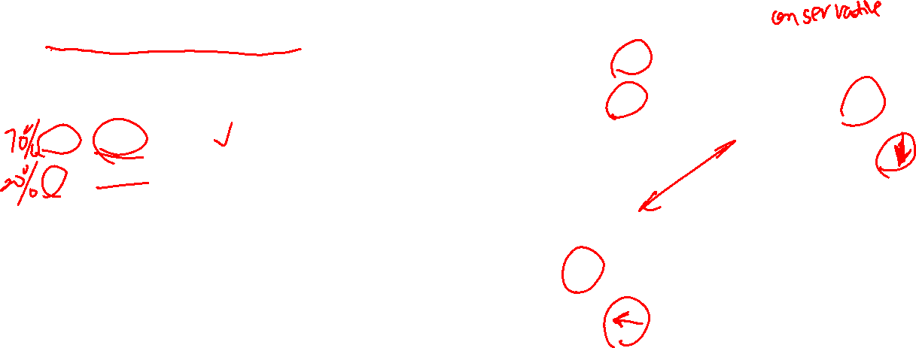
Piazza Poll 2
Which sequence of optimal policies matches
the following sequence of living rewards:
{-0.01, -0.03, -0.04, -2.0}
{B, A, C, D}
{B, C, A, D}
{C, B, A, D}
{D, A, C, B}
A)
B)
C)
D)
Notes:
R(s) = the “living reward”

Slide 25
Piazza Poll 2
Which sequence of optimal policies matches
the following sequence of living rewards:
{-0.01, -0.03, -0.04, -2.0}
{B, A, C, D}
{B, C, A, D}
{C, B, A, D}
{D, A, C, B}
A)
B)
C)
D)
Notes:
R(s) = the “living reward”

Slide 26
Piazza Poll 2
Optimal Policies
R(s) = -0.01
R(s) = -0.03
R(s) = -0.4
R(s) = -2.0
Notes:
R(s) = the “living reward”

Slide 27
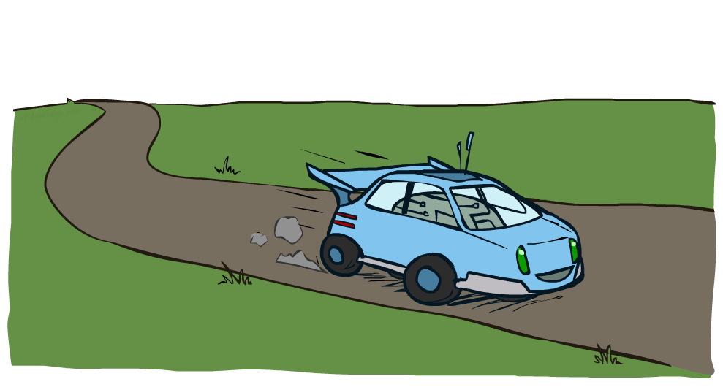
Example: Racing

Slide 28
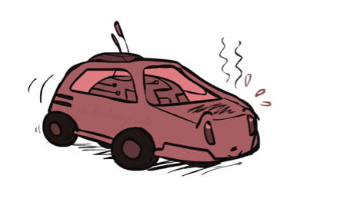
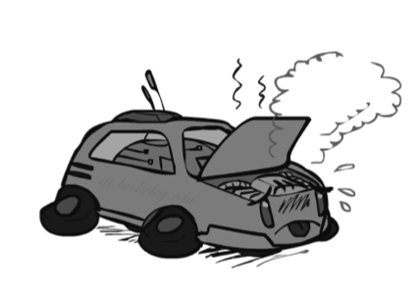

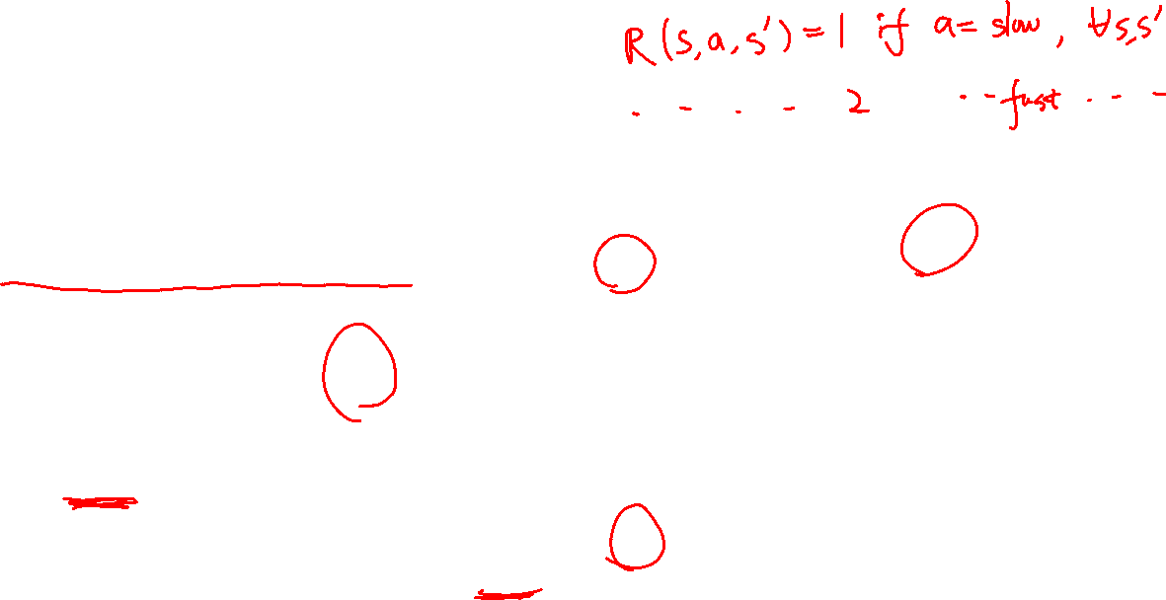
Example: Racing
A robot car wants to travel far, quickly
Three states: Cool, Warm, Overheated
Two actions: Slow, Fast
Going faster gets double reward
1.0
0.5
Fast
(R=-10)
0.5
+1
Slow (R=1)
1.0
Fast
Slow
-10
0.5
+1
0.5
Slow (R=1)
Warm
Slow
Fast
0.5
+2
Fast
(R=2)
0.5
Cool
0.5
Overheated
+1
1.0
1.0
+2
0.5

Slide 29


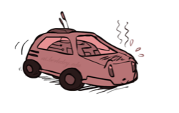

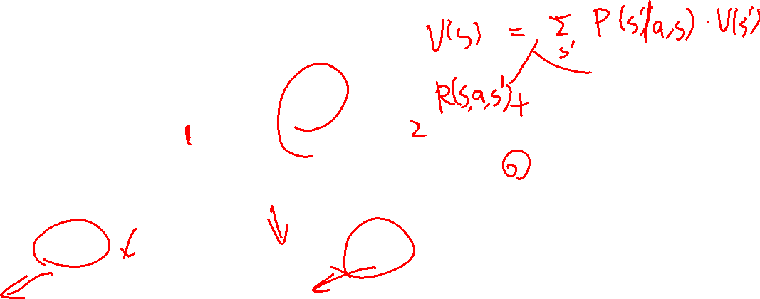
Racing Search Tree
Can we use expectimax for MDP directly?

Slide 30
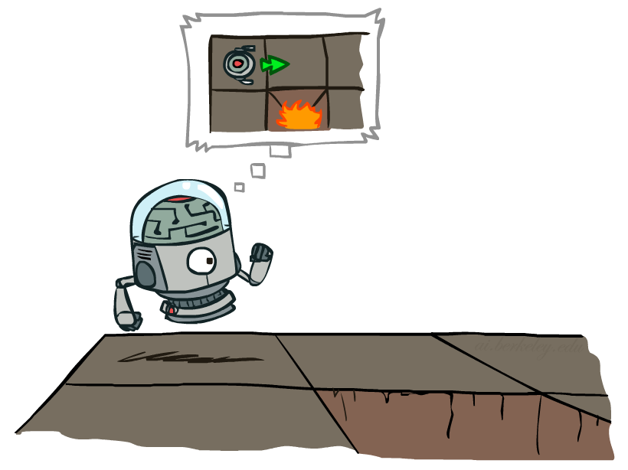

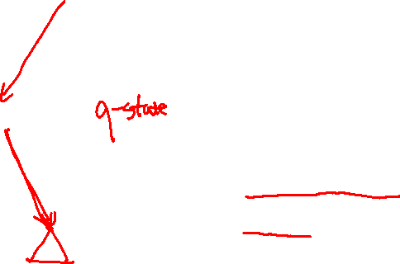
MDP Search Trees
Each MDP state projects an expectimax-like search tree
s
s is a state
a
(s, a) is a q-state
s, a
(s,a,s’) called a transition
T(s,a,s’) = P(s’|s,a)
R(s,a,s’)
s,a,s’
s’
Notes:
In MDP chance node represents uncertainty about what might happen based on (s,a) [as opposed to being a random adversary]
Q-state (s,a) is when you were in a state and took an action

Slide 31
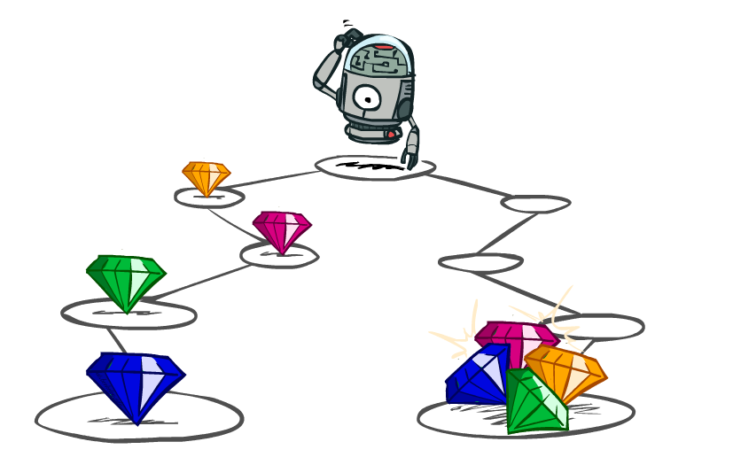
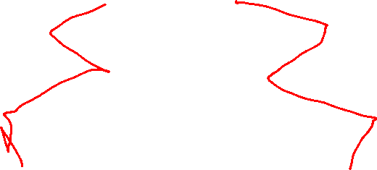
Utilities of Sequences

Slide 32
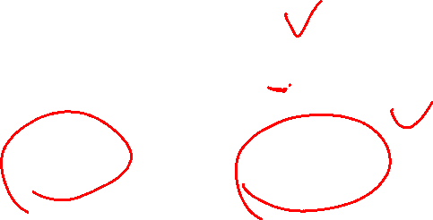
Utilities of Sequences
What preferences should an agent have over reward sequences?
More or less?
Now or later?
[1, 2, 2]
or
[2, 3, 4]
[0, 0, 1]
or
[1, 0, 0]

Slide 33
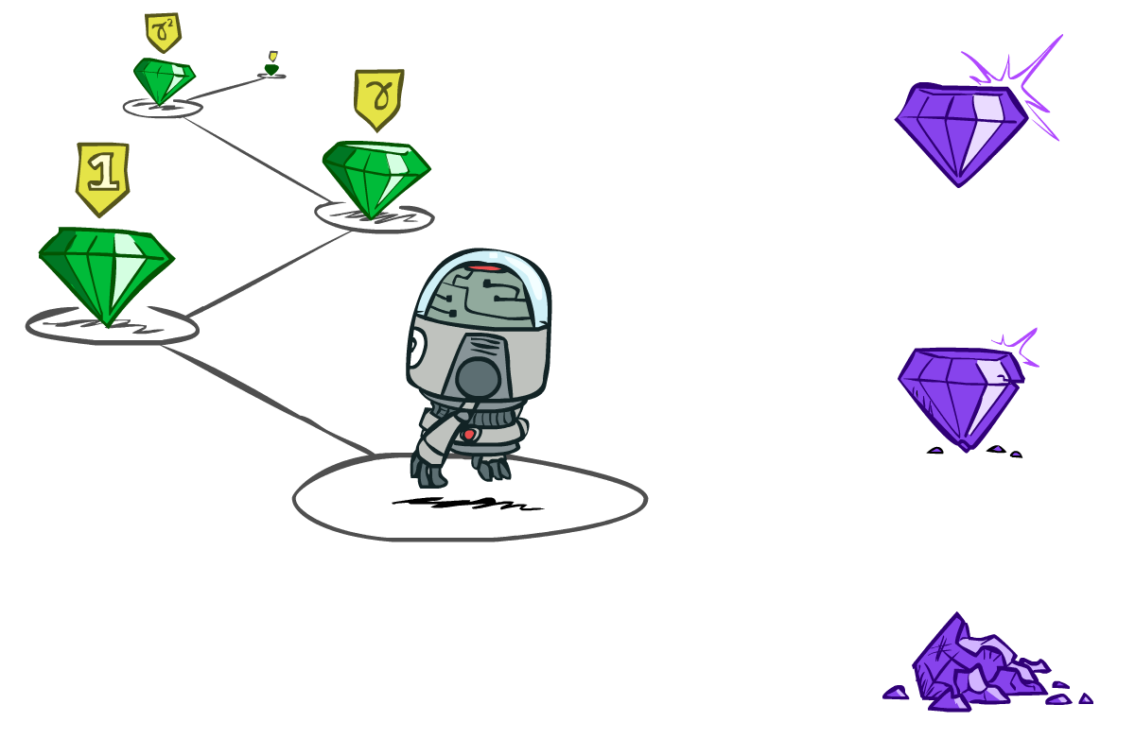

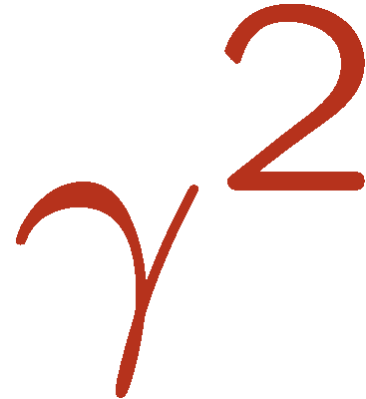

Discounting
It’s reasonable to maximize the sum of rewards
It’s also reasonable to prefer rewards now to rewards later
One solution: utility of rewards decay exponentially
Worth Now
Worth Next Step
Worth In Two Steps

Slide 34

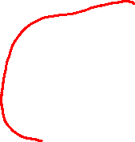
Discounting
How to discount?
Each time we descend a level, we multiply in the discount once
Why discount?
Sooner rewards probably do have higher utility than later rewards
Also helps our algorithms converge
Notes:
Rewards in the future (deeper in the tree) matter less
Interesting: running expectimax, if having to truncate the search, then not losing much; e.g., less then \gamma^d / (1-\gamma)

Slide 35
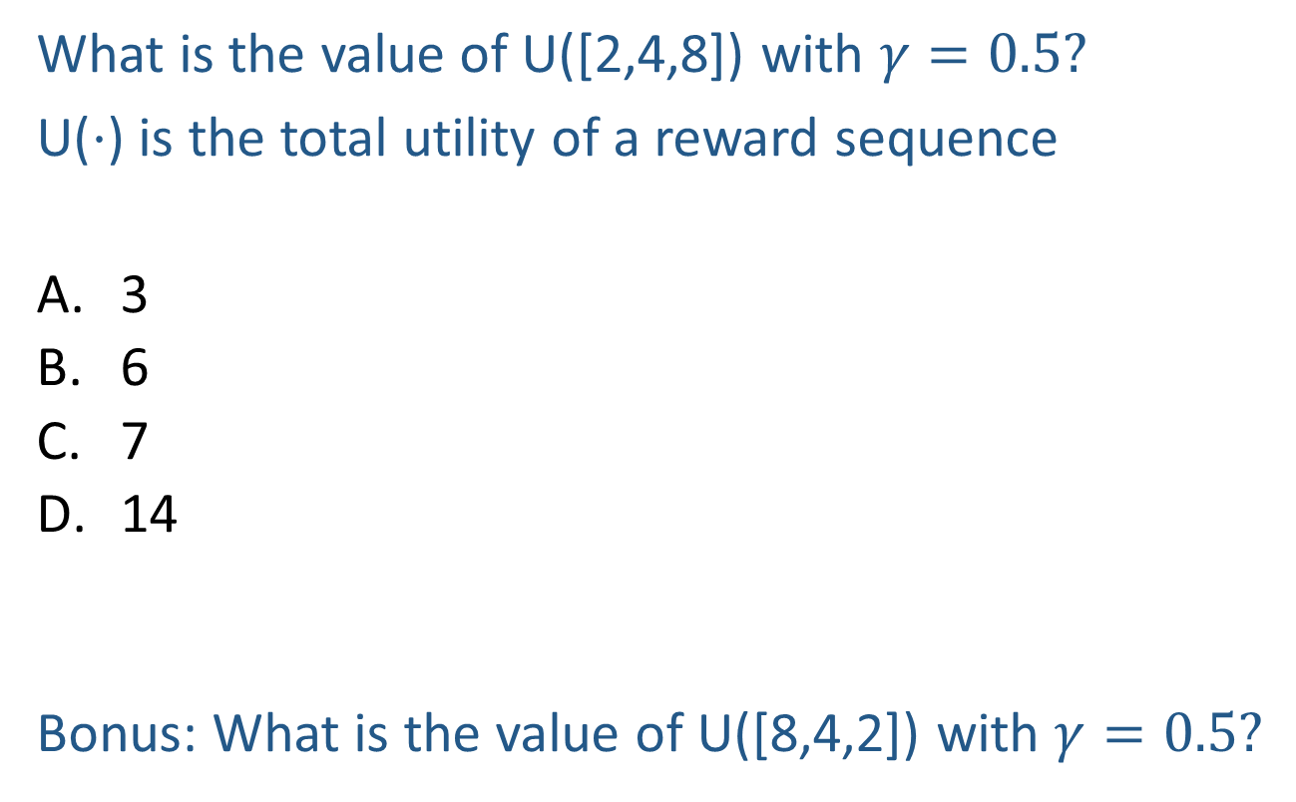
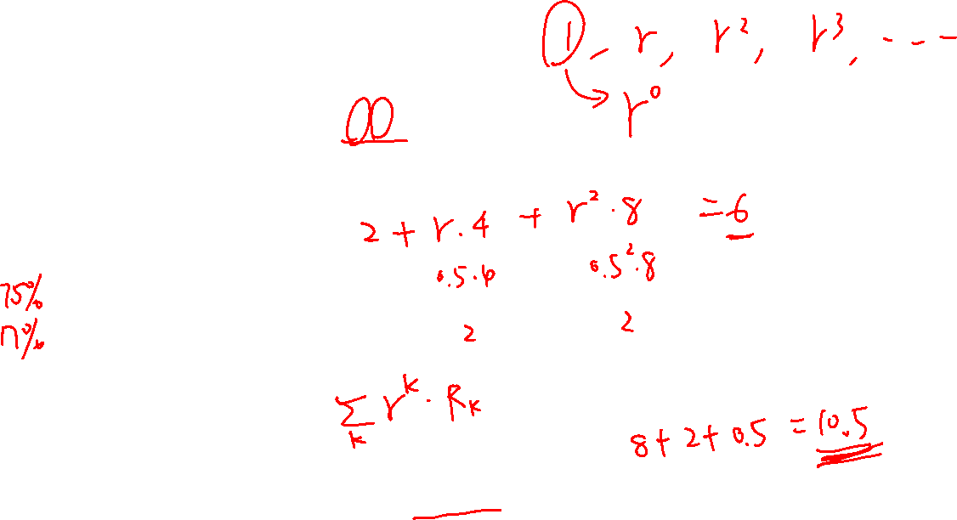
Piazza Poll 3
What is the value of U([2,4,8]) with $γ=0.5?$
U($⋅$) is the total utility of a reward sequence
3
6
7
14
Bonus: What is the value of U([8,4,2]) with $γ=0.5?$
Notes:
Rewards in the future (deeper in the tree) matter less
Interesting: running expectimax, if having to truncate the search, then not losing much; e.g., less then \gamma^d / (1-\gamma)

Slide 36
Piazza Poll 3
What is the value of U([2,4,8]) with $γ=0.5?$
U($⋅$) is the total utility of a reward sequence
3
6
7
14
Bonus: What is the value of U([8,4,2]) with $γ=0.5?$
$$γ^{0}×2+γ^{1}×4+γ^{2}×8=2+0.5×4+0.5×0.5×8=2+2+2=6$$
$$γ^{0}×8+γ^{1}×4+γ^{2}×2=8+0.5×4+0.5×0.5×2=8+2+0.5=10.5$$
Notes:
Rewards in the future (deeper in the tree) matter less
Interesting: running expectimax, if having to truncate the search, then not losing much; e.g., less then \gamma^d / (1-\gamma)

Slide 37




Stationary Preferences
Theorem: if we assume stationary preferences:
Then: there are only two ways to define utilities
Additive utility:
Discounted utility:

Slide 38

Question
What is the minimum and maximum possible length of reward sequence in this grid world problem?
0.8
0.1
0.1

Slide 39

Question
What is the minimum and maximum possible length of reward sequence in this grid world problem?
0.8
5, $+∞$
0.1
0.1

Slide 40





Infinite Utilities?!
What if the sequence is infinite? Do we get infinite utility?
With discounting $γ$ where 0 < γ < 1
Smaller γ means smaller “horizon” – shorter term focus
Assume $\left|r_{t}\right|≤R_{max}$

Slide 41




Optimal Policy with Discounting
Given:
Actions: East, West, and Exit (only available in exit states a, e)
Transitions: deterministic
For $γ=1$, what is the optimal policy?
For $γ=0.1$, what is the optimal policy?
For which $γ$ are West and East equally good when in state d?

Slide 42

Optimal Policy with Discounting
Given:
Actions: East, West, and Exit (only available in exit states a, e)
Transitions: deterministic
For $γ=1$, what is the optimal policy?
For $γ=0.1$, what is the optimal policy?
For which $γ$ are West and East equally good when in state d?
$$γ^{3}×10=γ^{1}×1$$

Slide 43

MDP Quantities
Markov decision processes:
States S
Actions A
Transitions P(s’|s,a) (or T(s,a,s’))
Rewards R(s,a,s’) (and discount γ)
Start state s₀
MDP quantities so far:
Policy = map of states to actions
Utility = sum of (discounted) rewards
s
a
s, a
s,a,s’
s’

Slide 44
Solving MDPs

Slide 45

MDP Quantities
Markov decision processes:
States S
Actions A
Transitions P(s’|s,a) (or T(s,a,s’))
Rewards R(s,a,s’) (and discount γ)
Start state s₀
MDP quantities:
Policy = map of states to actions
Utility = sum of (discounted) rewards
(State) Value = expected utility starting from a state (max node)
Q-Value = expected utility starting from a state-action pair, i.e., q-state (chance node)
s
a
s, a
s,a,s’
s’

Slide 46


MDP Optimal Quantities
s
The optimal policy:
π*(s) = optimal action from state s
The (true) value (or utility) of a state s:
V*(s) = expected utility starting in s and acting optimally
The (true) value (or utility) of a q-state (s,a):
Q*(s,a) = expected utility starting out having taken action a from state s and (thereafter) acting optimally
a
s, a
s,a,s’
s’
Solve MDP: Find $π^{∗}$, $V^{∗}$ and/or $Q^{∗}$
[Demo: gridworld values (L9D1)]
Notes:
Demo just shows V and Q values, snapshots on next slides.

Slide 47


Snapshot of Demo – Gridworld V Values
What is the optimal policy?
Noise = 0.2
Discount = 0.9
Living reward = 0
Notes:
This demo doesn’t show anything in action, it just shows the V and Q values.

Slide 48


Snapshot of Demo – Gridworld V Values
What is the optimal policy?
May not equal $\underset{a}{argmax}{V^{∗}(s′)}$ where $s^{′}$ is the most likely state after taking action $a$
V*(s) = expected utility starting in s and acting optimally
$$π^{∗}\left(s\right)=\underset{a}{argmax}{\sum_{s′}{P\left(s^{′}|s,a\right)∗(R\left(s,a,s^{′}\right)+γV^{∗}\left(s^{′}\right))}}$$
$$=\underset{a}{argmax}{\sum_{s′}{P\left(s^{′}|s,a\right)V^{∗}\left(s^{′}\right))}}$$
=0
Noise = 0.2
Discount = 0.9
Living reward = 0
Notes:
This demo doesn’t show anything in action, it just shows the V and Q values.

Slide 49


Snapshot of Demo – Gridworld Q Values
What is the optimal policy?
Noise = 0.2
Discount = 0.9
Living reward = 0
Notes:
This demo doesn’t show anything in action, it just shows the V and Q values.

Slide 50

Snapshot of Demo – Gridworld Q Values
$$π^{∗}\left(s\right)=\underset{a}{argmax}{Q^{∗}(s,a)}$$
What is the optimal policy?
Q*(s,a) = expected utility starting out having taken action a from state s and (thereafter) acting optimally
Noise = 0.2
Discount = 0.9
Living reward = 0
Notes:
This demo doesn’t show anything in action, it just shows the V and Q values.

Slide 51

Snapshot of Demo – Gridworld V Values
What is the optimal policy?
Noise = 0.2
Discount = 0.9
Living reward = -0.1
Notes:
This demo doesn’t show anything in action, it just shows the V and Q values.

Slide 52

Snapshot of Demo – Gridworld V Values
$$π^{∗}\left(s\right)=\underset{a}{argmax}{\sum_{s′}{P\left(s^{′}|s,a\right)∗(R\left(s,a,s^{′}\right)+γV^{∗}\left(s^{′}\right))}}≠\underset{a}{argmax}{V^{∗}(s′)}$$
What is the optimal policy?
Noise = 0.2
Discount = 0.9
Living reward = -0.1
Notes:
This demo doesn’t show anything in action, it just shows the V and Q values.

Slide 53

Snapshot of Demo – Gridworld Q Values
What is the optimal policy?
Noise = 0.2
Discount = 0.9
Living reward = -0.1
Notes:
This demo doesn’t show anything in action, it just shows the V and Q values.

Slide 54

Snapshot of Demo – Gridworld Q Values
$$π^{∗}\left(s\right)=\underset{a}{argmax}{Q^{∗}(s,a)}$$
What is the optimal policy?
Noise = 0.2
Discount = 0.9
Living reward = -0.1
Notes:
This demo doesn’t show anything in action, it just shows the V and Q values.

Slide 55
Backup Slides

Slide 56


Snapshot of Demo – Gridworld V Values
What is $V^{∗}(s_{1,1})$?
V*(s)
What is $π^{∗}(s_{1,1})$?
?
Noise = 0.2
Discount = 0.9
Living reward = 0
Notes:
This demo doesn’t show anything in action, it just shows the V and Q values.

Slide 57

Snapshot of Demo – Gridworld V Values
Let $V^{∗}\left(s_{1,1}\right)=x$.
If $π^{∗}\left(s_{1,1}\right)=$North: x=0+0.9*(0.8*0.57+0.1*x+0.1*0.43) $⇒$ x=0.493
If $π^{∗}\left(s_{1,1}\right)=$South: x=0+0.9*(0.8*x+0.1*x+0.1*0.43) $⇒$ x=0.203
But when x=0.203, taking action North leads to higher expected value. Contradiction.
What is $V^{∗}(s_{1,1})$?
What is $π^{∗}(s_{1,1})$?
Noise = 0.2
Discount = 0.9
Living reward = 0
Notes:
This demo doesn’t show anything in action, it just shows the V and Q values.

