Slide 1
Announcements
Midterm1
Grade Released
Assignments:
    HW5 (written)
      Due 10/8 Tue, 10 pm
    HW6 (online)
      Will be released today, Due 10/15 Tue, 10 pm
    P3: Optimization – expected average completion time < P2
      Due 10/17 Thu, 10 pm
    Final exam: Thursday, Dec 12, 1-4pm, location TBD

Slide 2
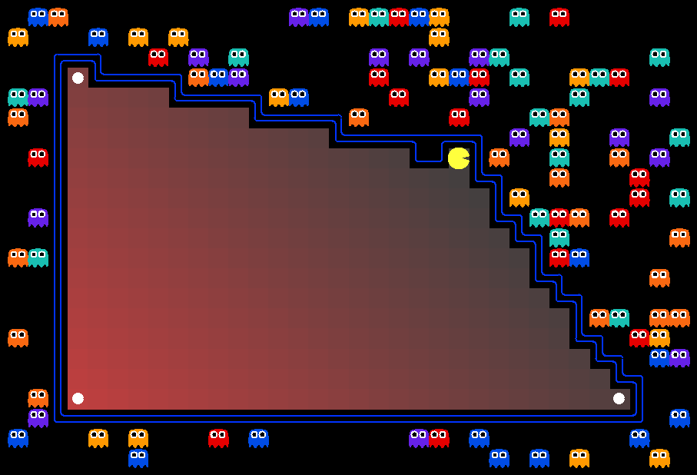
AI: Representation and Problem Solving
Integer Programming
Instructors: Fei Fang & Pat Virtue
Slide credits: CMU AI, http://ai.berkeley.edu

Slide 3
Learning Objectives
Formulate a problem as a Integer (Linear) Program (IP or ILP)
Write down the Linear Program (LP) relaxation of an IP
Plot the graphical representation of an IP and find the optimal solution
Understand the relationship between optimal solution of an IP and the optimal solution of the relaxed LP
Describe and implement branch-and-bound algorithm

Slide 4
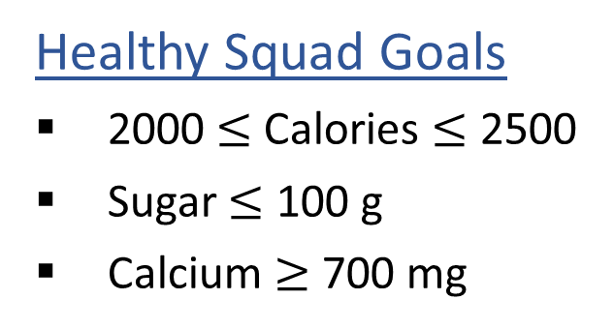
Linear Programming
We are trying healthy by finding the optimal amount of food to purchase.
We can choose the amount of stir-fry (ounce) and boba (fluid ounces).
Healthy Squad Goals
2000 $≤$ Calories $≤$ 2500
Sugar $≤$ 100 g
Calcium $≥$ 700 mg
Food | Cost | Calories | Sugar | Calcium
Stir-fry (per oz) | 1 | 100 | 3 | 20
Boba (per fl oz) | 0.5 | 50 | 4 | 70
What is the cheapest way to stay “healthy” with this menu?
How much stir-fry (ounce) and boba (fluid ounces) should we buy?

Slide 5
Linear Programming → Integer Programming
We are trying healthy by finding the optimal amount of food to purchase.
We can choose the amount of stir-fry (bowls) and boba (glasses).
Healthy Squad Goals
2000 $≤$ Calories $≤$ 2500
Sugar $≤$ 100 g
Calcium $≥$ 700 mg
Food | Cost | Calories | Sugar | Calcium
Stir-fry (per bowl) | 1 | 100 | 3 | 20
Boba (per glass) | 0.5 | 50 | 4 | 70
What is the cheapest way to stay “healthy” with this menu?
How much stir-fry (ounce) and boba (fluid ounces) should we buy?

Slide 6


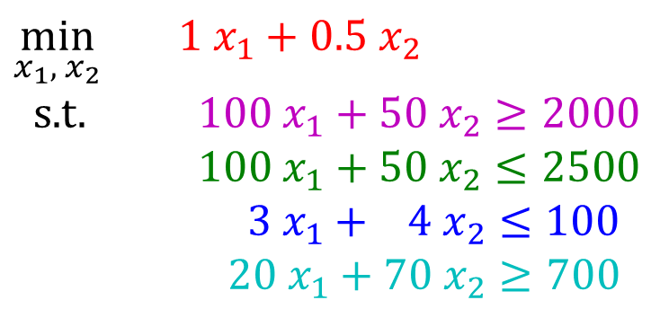
Problem Formulation
Formulate Diet Problem with integer constraints as an optimization problem
$\min_{x_{1}, { x}_{2}}{ {1 x}_{1}+0.5 x_{2}}$
s.t. $100 x_{1}+50 x_{2}≥2000$
$100 x_{1}+50 x_{2}≤2500$
$3 x_{1}+ 4 x_{2}≤100$
$20 x_{1}+70 x_{2}≥700$
Healthy Squad Goals
2000 $≤$ Calories $≤$ 2500
Sugar $≤$ 100 g
Calcium $≥$ 700 mg
$$x_{1},x_{2}∈ℤ^{N}$$
Food | Cost | Calories | Sugar | Calcium
Stir-fry (per oz) | 1 | 100 | 3 | 20
Boba (per fl oz) | 0.5 | 50 | 4 | 70

Slide 7
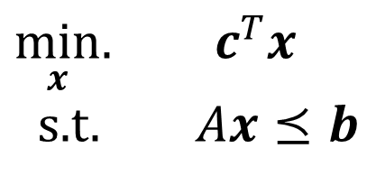
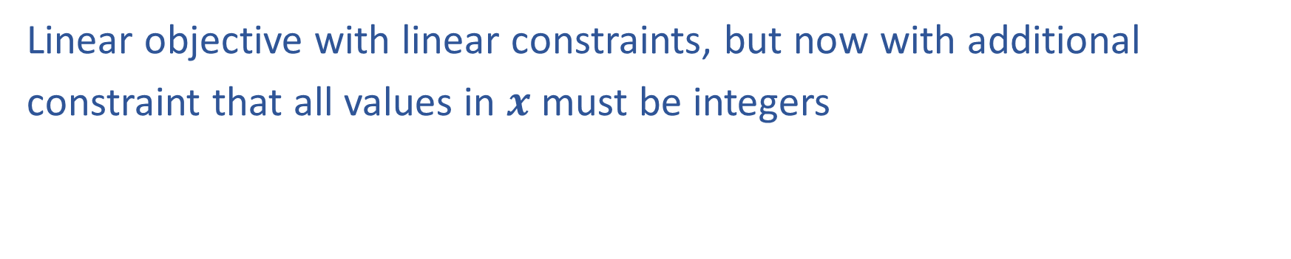
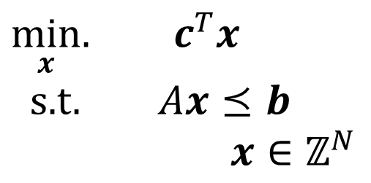
Linear Programming vs Integer Programming
Linear objective with linear constraints, but now with additional
constraint that all values in $x$ must be integers
$\min_{x}.{ c^{T}x}$
s.t. $Ax⪯b$
$\min_{x}.{ c^{T}x}$
s.t. $Ax⪯b$
$x∈ℤ^{N}$
We could also do:
Even more constrained: Binary Integer Programming (BIP)
A hybrid: Mixed Integer Linear Programming (MIP or MILP)
Notation Alert!

Slide 8
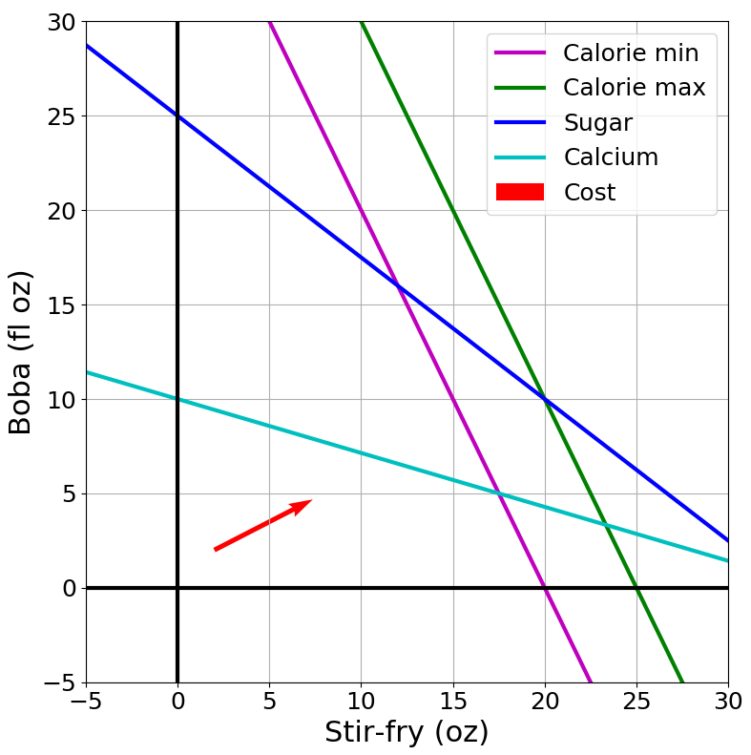
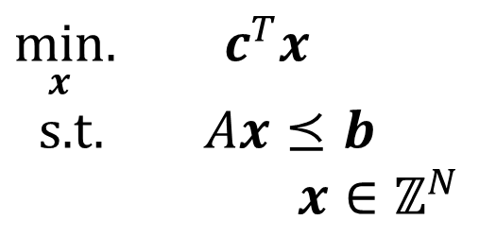
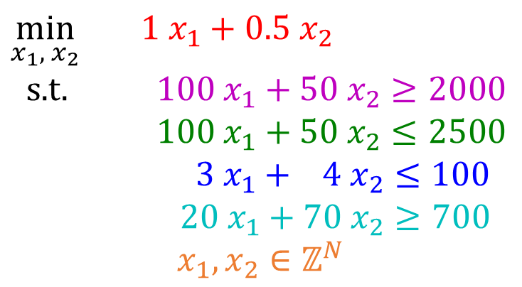
Integer Programming: Graphical Representation
Just add a grid of integer points onto our LP representation
$\min_{x}.{ c^{T}x}$
s.t. $Ax⪯b$
$x∈ℤ^{N}$
$\min_{x_{1}, { x}_{2}}{ {1 x}_{1}+0.5 x_{2}}$
s.t. $100 x_{1}+50 x_{2}≥2000$
$100 x_{1}+50 x_{2}≤2500$
$3 x_{1}+ 4 x_{2}≤100$
$20 x_{1}+70 x_{2}≥700$
$$x_{1},x_{2}∈ℤ^{N}$$

Slide 9
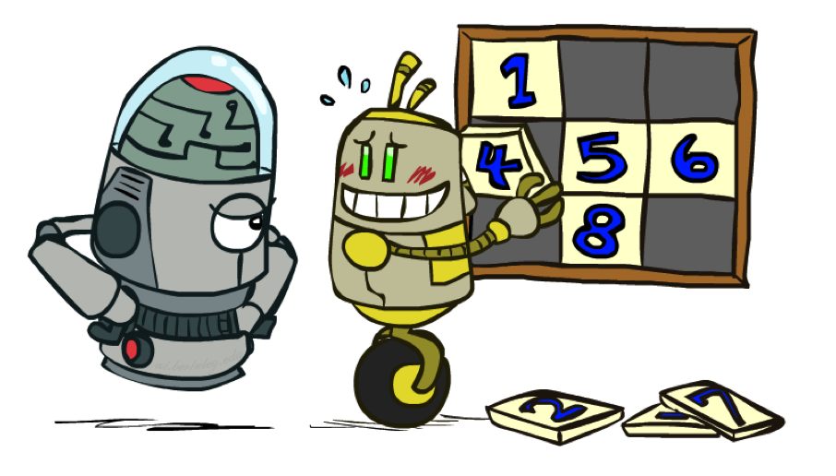
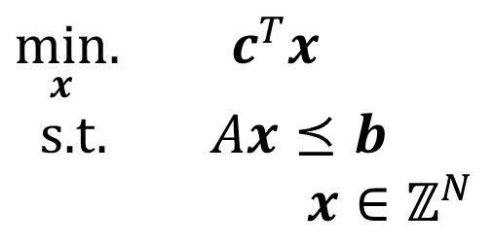
LP Relaxation
Relax IP to LP by dropping integer constraints
$\min_{x}.{ c^{T}x}$
s.t. $Ax⪯b$
$x∈ℤ^{N}$
Remember heuristics?

Slide 10
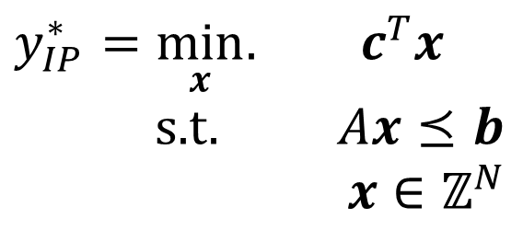
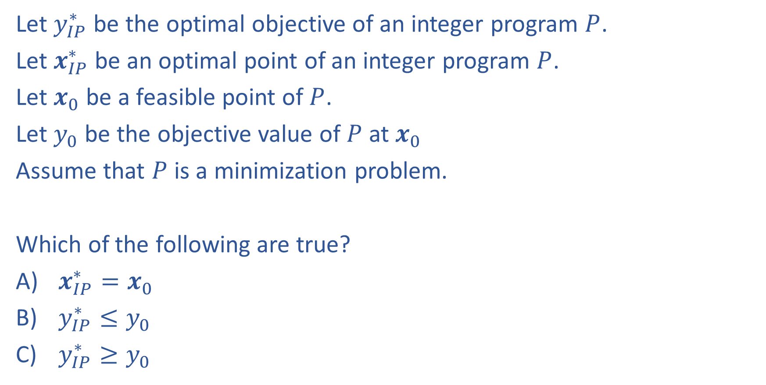
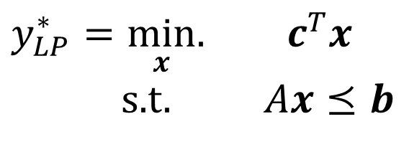
Question
Let $y_{IP}^{∗}$ be the optimal objective of an integer program $P$.
Let $x_{IP}^{∗}$ be an optimal point of an integer program $P$.
Let $x_{0}$ be a feasible point of $P$.
Let $y_{0}$ be the objective value of $P$ at $x_{0}$
Assume that $P$ is a minimization problem.
Which of the following are true?
$x_{IP}^{∗}=x_{0}$
$y_{IP}^{∗}≤y_{0}$
$y_{IP}^{∗}≥y_{0}$
$y_{IP}^{∗}=\min_{x}.{ c^{T}x}$
s.t. $Ax⪯b$
$x∈ℤ^{N}$
$y_{LP}^{∗}=\min_{x}.{ c^{T}x}$
s.t. $Ax⪯b$

Slide 11

Question
Let $y_{IP}^{∗}$ be the optimal objective of an integer program $P$.
Let $x_{IP}^{∗}$ be an optimal point of an integer program $P$.
Let $x_{0}$ be a feasible point of $P$.
Let $y_{0}$ be the objective value of $P$ at $x_{0}$
Assume that $P$ is a minimization problem.
Which of the following are true?
$x_{IP}^{∗}=x_{0}$
$y_{IP}^{∗}≤y_{0}$
$y_{IP}^{∗}≥y_{0}$
$y_{IP}^{∗}=\min_{x}.{ c^{T}x}$
s.t. $Ax⪯b$
$x∈ℤ^{N}$
Upper bound
$$y_{LP}^{∗}≤y_{IP}^{∗}≤y_{0}$$
$y_{LP}^{∗}=\min_{x}.{ c^{T}x}$
s.t. $Ax⪯b$
Lower bound

Slide 12
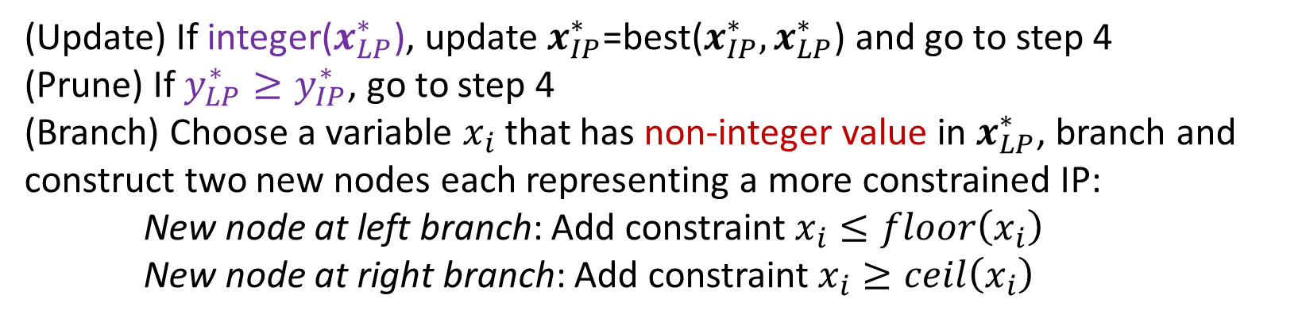
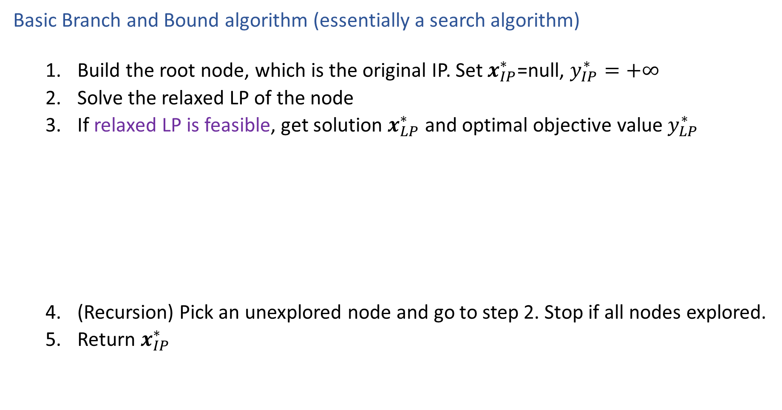
Solving an IP
Basic Branch and Bound algorithm (essentially a search algorithm)
    Build the root node, which is the original IP. Set $x_{IP}^{∗}$=null, $y_{IP}^{∗}=+∞$
    Solve the relaxed LP of the node
    If relaxed LP is feasible, get solution $x_{LP}^{∗}$ and optimal objective value $y_{LP}^{∗}$
    (Recursion) Pick an unexplored node and go to step 2. Stop if all nodes explored.
    Return $x_{IP}^{∗}$
Assuming a minimization IP
(Update) If integer($x_{LP}^{∗}$), update $x_{IP}^{∗}$=best($x_{IP}^{∗},x_{LP}^{∗}$) and go to step 4
(Prune) If $y_{LP}^{∗}≥y_{IP}^{∗}$, go to step 4
(Branch) Choose a variable $x_{i}$ that has non-integer value in $x_{LP}^{∗}$, branch and construct two new nodes each representing a more constrained IP:
New node at left branch: Add constraint $x_{i}≤floor\left(x_{i}\right)$
New node at right branch: Add constraint $x_{i}≥ceil\left(x_{i}\right)$
What if it is a maximization IP?

Slide 13
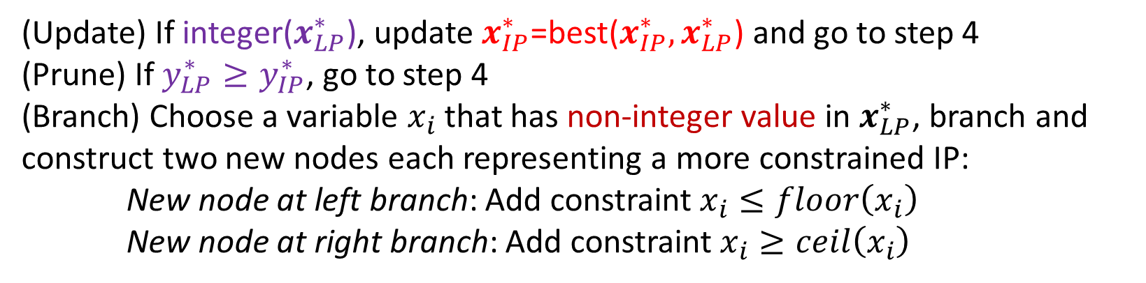
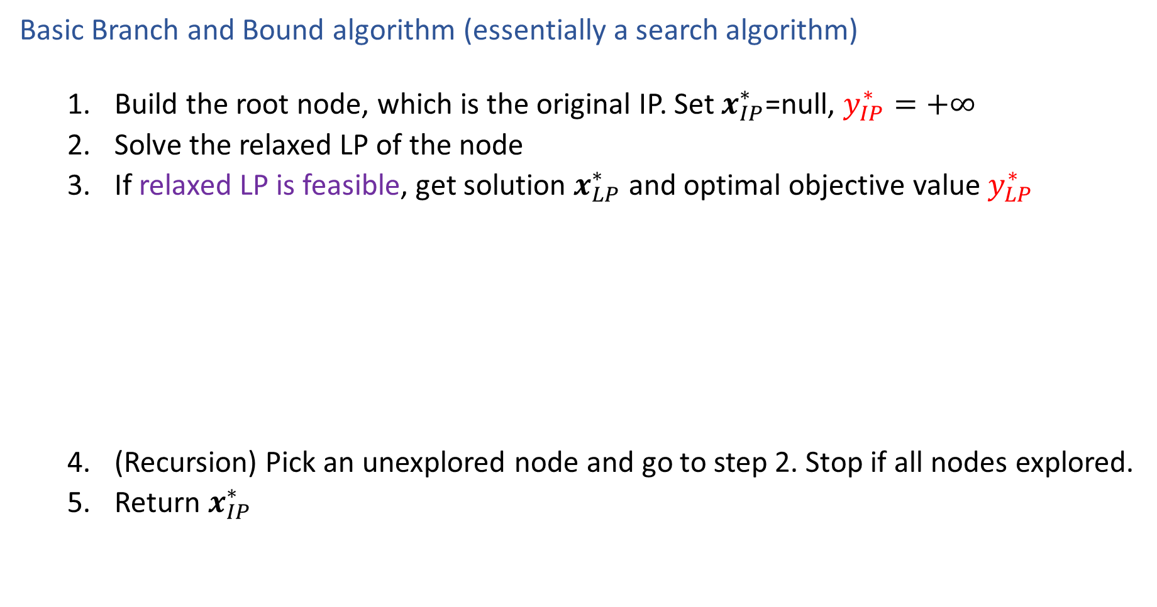
Solving an IP
Basic Branch and Bound algorithm (essentially a search algorithm)
    Build the root node, which is the original IP. Set $x_{IP}^{∗}$=null, $y_{IP}^{∗}=+∞$
    Solve the relaxed LP of the node
    If relaxed LP is feasible, get solution $x_{LP}^{∗}$ and optimal objective value $y_{LP}^{∗}$
    (Recursion) Pick an unexplored node and go to step 2. Stop if all nodes explored.
    Return $x_{IP}^{∗}$
Assuming a minimization IP
(Upper bound of IP)
(Lower bound for the IP of the node)
(Update) If integer($x_{LP}^{∗}$), update $x_{IP}^{∗}$=best($x_{IP}^{∗},x_{LP}^{∗}$) and go to step 4
(Prune) If $y_{LP}^{∗}≥y_{IP}^{∗}$, go to step 4
(Branch) Choose a variable $x_{i}$ that has non-integer value in $x_{LP}^{∗}$, branch and construct two new nodes each representing a more constrained IP:
New node at left branch: Add constraint $x_{i}≤floor\left(x_{i}\right)$
New node at right branch: Add constraint $x_{i}≥ceil\left(x_{i}\right)$
(Update upper bound)
What if it is a maximization IP?

Slide 14
Branch and Bound Example
15
10
5
10
15
20
25

Slide 15
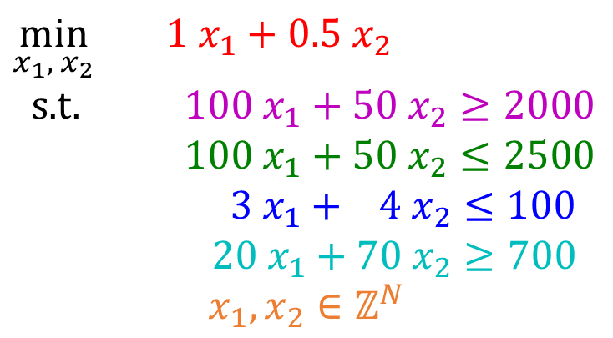
Branch and Bound Example
$\min_{x_{1}, { x}_{2}}{ {1 x}_{1}+0.5 x_{2}}$
s.t. $100 x_{1}+50 x_{2}≥2000$
$100 x_{1}+50 x_{2}≤2500$
$3 x_{1}+ 4 x_{2}≤100$
$20 x_{1}+70 x_{2}≥700$
$$x_{1},x_{2}∈ℤ^{N}$$
15
10
5
Is it necessary to solve this branch?
10
15
20
25
15
15
10
10
5
5
10
15
20
25
10
15
20
25

Slide 16


Branch and Bound Example
$\min_{x_{1}, { x}_{2}}{ {1 x}_{1}+0.5 x_{2}}$
s.t. $100 x_{1}+50 x_{2}≥2000$
$100 x_{1}+50 x_{2}≤2500$
$3 x_{1}+ 4 x_{2}≤100$
$20 x_{1}+70 x_{2}≥700$
$$x_{1},x_{2}∈ℤ^{N}$$
15
Optimal solution for LP relaxation: (17.5,5)
Optimal value (lower bound for IP): 20
10
5
10
15
20
25
Add constraint $x_{1}≤17$
Optimal solution for relaxed LP: (17,6)
Optimal value (lower bound for this branch): 20
An integer solution found (update upper bound of IP)
Stop
Add $x_{1}≥18$
15
Optimal solution
15
Optimal solution for relaxed LP: (18,4.86)
Optimal value (lower bound for this branch): 20.43
Worse than upper bound
Stop
10
10
5
5
10
15
20
25
10
15
20
25

Slide 17
Solving an IP
Basic Branch and Bound algorithm (essentially a search algorithm)
    Build the root node, which is the original IP. Set $x_{IP}^{∗}$=null, $y_{IP}^{∗}=+∞$
    Solve the relaxed LP of the node
    If relaxed LP is feasible, get solution $x_{LP}^{∗}$ and optimal objective value $y_{LP}^{∗}$
    (Recursion) Pick an unexplored node and go to step 2. Stop if all nodes explored.
    Return $x_{IP}^{∗}$
Assuming a minimization IP
(Update) If integer($x_{LP}^{∗}$), update $x_{IP}^{∗}$=best($x_{IP}^{∗},x_{LP}^{∗}$) and go to step 4
(Prune) If $y_{LP}^{∗}≥y_{IP}^{∗}$, go to step 4
(Branch) Choose a variable $x_{i}$ that has non-integer value in $x_{LP}^{∗}$, branch and construct two new nodes each representing a more constrained IP:
New node at left branch: Add constraint $x_{i}≤floor\left(x_{i}\right)$
New node at right branch: Add constraint $x_{i}≥ceil\left(x_{i}\right)$
Anything we can do to make the search more efficient?

Slide 18
Recall: Informed Search
function BEST-FIRST-SEARCH (problem, EVAL-FN) returns a solution sequence
inputs: problem, a problem
EVAL-FN, an evaluation function
Queuing-Fn ← a function that orders nodes by EVAL-FN
return GENERAL-SEARCH (problem, Queuing-Fn)
function GREEDY-SEARCH (problem) returns a solution or failure
return BEST-FIRST-SEARCH (problem, h)

Slide 19
Solving an IP
Basic Branch and Bound algorithm (essentially a search algorithm)
    Build the root node, which is the original IP. Set $x_{IP}^{∗}$=null, $y_{IP}^{∗}=+∞$
    Solve the relaxed LP of the node
    If relaxed LP is feasible, get solution $x_{LP}^{∗}$ and optimal objective value $y_{LP}^{∗}$
    (Recursion) Pick an unexplored node and go to step 2. Stop if all nodes explored.
    Return $x_{IP}^{∗}$
Assuming a minimization IP
(Update) If integer($x_{LP}^{∗}$), update $x_{IP}^{∗}$=best($x_{IP}^{∗},x_{LP}^{∗}$) and go to step 4
(Prune) If $y_{LP}^{∗}≥y_{IP}^{∗}$, go to step 4
(Branch) Choose a variable $x_{i}$ that has non-integer value in $x_{LP}^{∗}$, branch and construct two new nodes each representing a more constrained IP:
New node at left branch: Add constraint $x_{i}≤floor\left(x_{i}\right)$
New node at right branch: Add constraint $x_{i}≥ceil\left(x_{i}\right)$
What can be used as an evaluation function?
Optimal value of the LP relaxation!

Slide 20
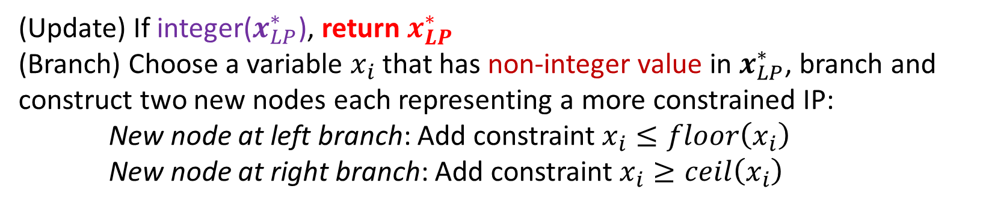
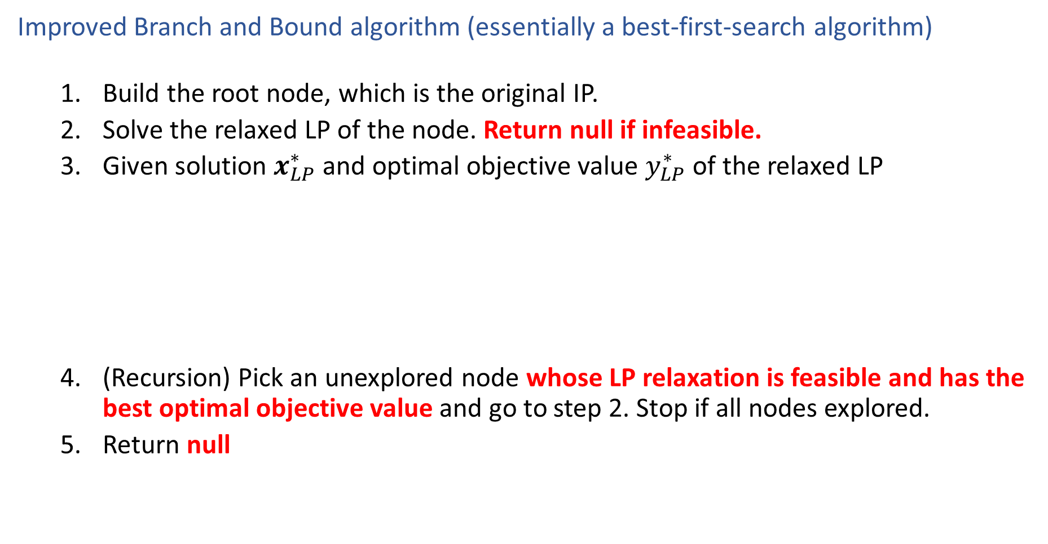
Solving an IP
Improved Branch and Bound algorithm (essentially a best-first-search algorithm)
    Build the root node, which is the original IP.
    Solve the relaxed LP of the node. Return null if infeasible.
    Given solution $x_{LP}^{∗}$ and optimal objective value $y_{LP}^{∗}$ of the relaxed LP
    (Recursion) Pick an unexplored node whose LP relaxation is feasible and has the best optimal objective value and go to step 2. Stop if all nodes explored.
    Return null
Assuming a minimization IP
(Update) If integer($x_{LP}^{∗}$), return $x_{LP}^{∗}$
(Branch) Choose a variable $x_{i}$ that has non-integer value in $x_{LP}^{∗}$, branch and construct two new nodes each representing a more constrained IP:
New node at left branch: Add constraint $x_{i}≤floor\left(x_{i}\right)$
New node at right branch: Add constraint $x_{i}≥ceil\left(x_{i}\right)$
Why still optimal?
All the unexplored nodes have no better LP relaxation values!

Slide 21

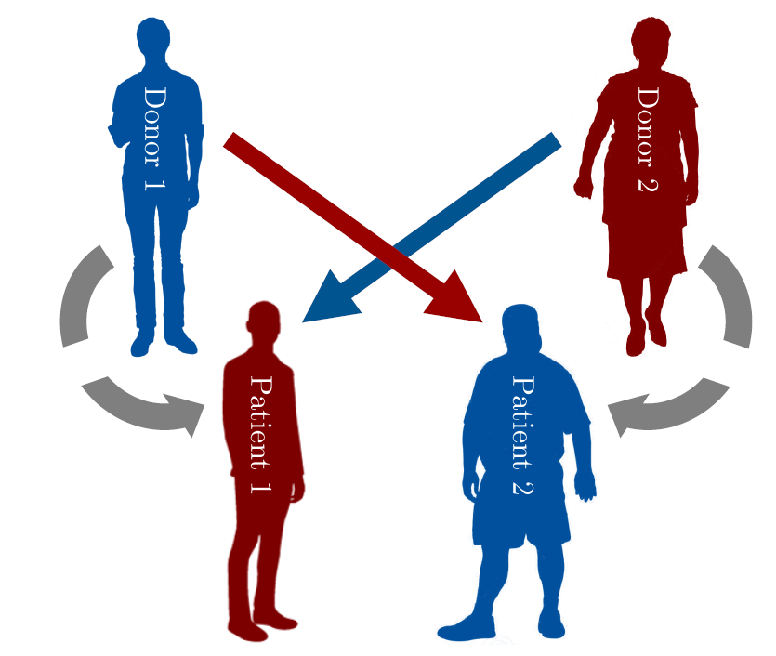
Formulate a Problem as an IP
Kidney Exchange

Slide 22
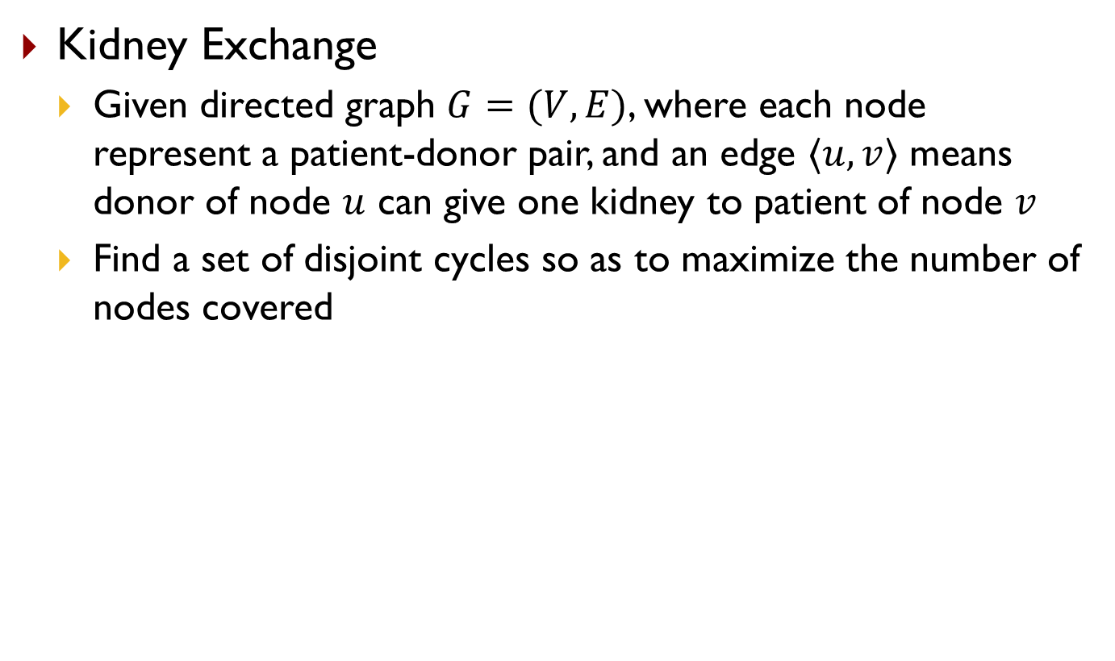
Formulate a Problem as an IP
Kidney Exchange
  Given directed graph $G=(V,E)$, where each node represent a patient-donor pair, and an edge $〈u,v〉$ means donor of node $u$ can give one kidney to patient of node $v$
  Find a set of disjoint cycles so as to maximize the number of nodes covered
6
2
1
4
5
3
7
8

Slide 23
Formulate a Problem as an IP
Kidney Exchange
  Given directed graph $G=(V,E)$, where each node represent a patient-donor pair, and an edge $〈u,v〉$ means donor of node $u$ can give one kidney to patient of node $v$
  Find a set of disjoint cycles so as to maximize the number of nodes covered
Hint: enumerate all the cycles
6
2
1
4
5
3
7
8

Slide 24
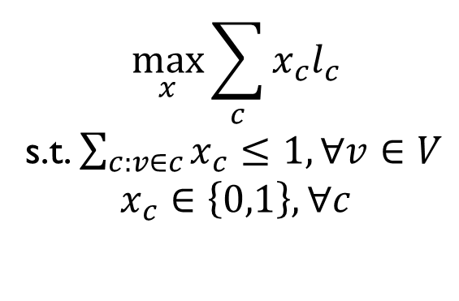
Formulate a Problem as an IP
Kidney Exchange
  Given directed graph $G=(V,E)$, where each node represent a patient-donor pair, and an edge $〈u,v〉$ means donor of node $u$ can give one kidney to patient of node $v$
  Find a set of disjoint cycles so as to maximize the number of nodes covered
Hint: enumerate all the cycles
6
2
$$\max_{x}{\sum_{c}{x_{c}l_{c}}}$$
s.t. $\sum_{c:v∈c}{x_{c}}≤1,∀v∈V$
$$x_{c}∈\left\{0,1\right\},∀c$$
1
4
5
3
7
8

Slide 25
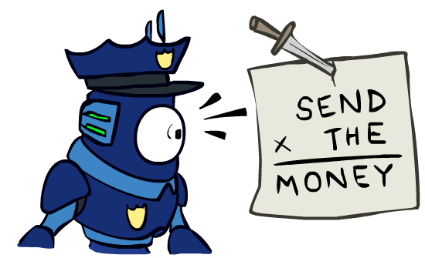
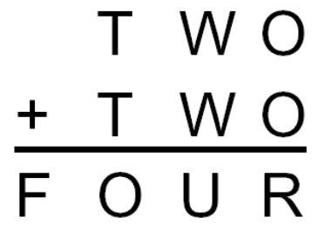
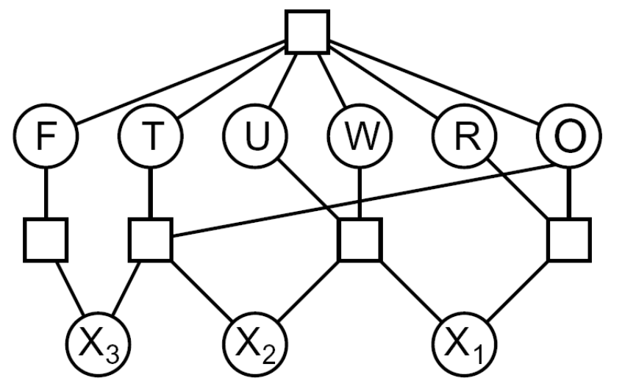
Formulate a Problem as an IP
Cryptarithmetic
Variables:
IP:
Notes:
0=7, R=4, W=6, U=2, T=8, F=1; 867 + 867 = 1734

Slide 26
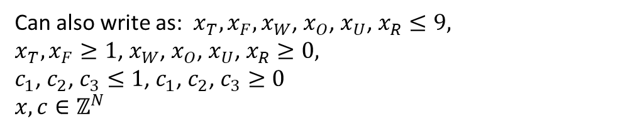
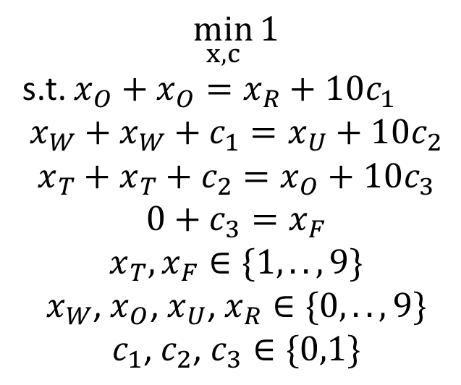
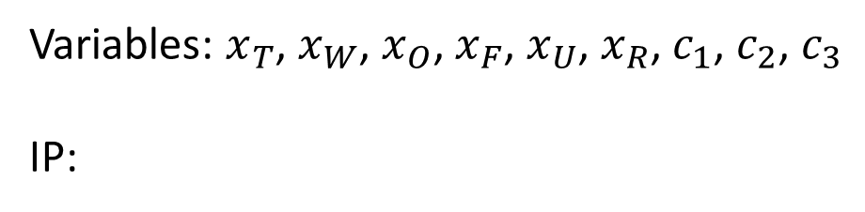
Formulate a Problem as an IP
Cryptarithmetic
Variables: $x_{T}$, $x_{W}$, $x_{O}$, $x_{F}$, $x_{U}$, $x_{R}$, $c_{1}$, $c_{2}$, $c_{3}$
IP:
$$\min_{x,c}{1}$$
s.t. $x_{O}+x_{O}=x_{R}+10c_{1}$
$$x_{W}+x_{W}+c_{1}=x_{U}+10c_{2}$$
$$x_{T}+x_{T}+c_{2}=x_{O}+10c_{3}$$
$$0+c_{3}=x_{F}$$
$$x_{T},x_{F}∈\{1,..,9\}$$
$$x_{W}\text{, }x_{O}\text{, }x_{U}\text{, }x_{R}∈\{0,..,9\}$$
$$c_{1}\text{, }c_{2}\text{, }c_{3}∈\{0,1\}$$
Can also write as: $x_{T},x_{F},x_{W}\text{, }x_{O}\text{, }x_{U}\text{, }x_{R}≤9,$
$x_{T},x_{F}≥1$, $x_{W}\text{, }x_{O}\text{, }x_{U}\text{, }x_{R}≥0,$
$c_{1}\text{, }c_{2}\text{, }c_{3}≤1$, $c_{1}\text{, }c_{2}\text{, }c_{3}≥0$
$x,c∈ℤ^{N}$
Notes:
0=7, R=4, W=6, U=2, T=8, F=1; 867 + 867 = 1734

