Slide 1
Announcements
Midterm1
Grade Released
Assignments:
    HW5 (written)
      Due 10/8 Tue, 10 pm
    HW6 (online)
      Will be released today, Due 10/15 Tue, 10 pm
    P3: Optimization – expected average completion time < P2
      Due 10/17 Thu, 10 pm
    Final exam: Thursday, Dec 12, 1-4pm, location TBD

Slide 2
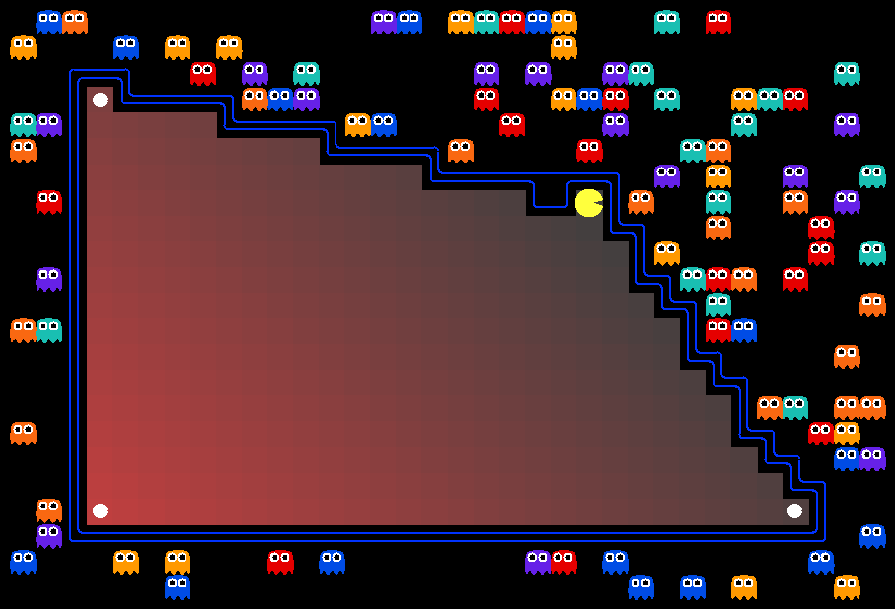
AI: Representation and Problem Solving
Integer Programming
Instructors: Fei Fang & Pat Virtue
Slide credits: CMU AI, http://ai.berkeley.edu

Slide 3
Learning Objectives
Formulate a problem as a Integer (Linear) Program (IP or ILP)
Write down the Linear Program (LP) relaxation of an IP
Plot the graphical representation of an IP and find the optimal solution
Understand the relationship between optimal solution of an IP and the optimal solution of the relaxed LP
Describe and implement branch-and-bound algorithm

Slide 4
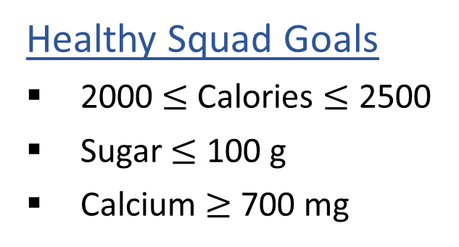

Linear Programming
We are trying healthy by finding the optimal amount of food to purchase.
We can choose the amount of stir-fry (ounce) and boba (fluid ounces).
Healthy Squad Goals
2000 $≤$ Calories $≤$ 2500
Sugar $≤$ 100 g
Calcium $≥$ 700 mg
Food | Cost | Calories | Sugar | Calcium
Stir-fry (per oz) | 1 | 100 | 3 | 20
Boba (per fl oz) | 0.5 | 50 | 4 | 70
What is the cheapest way to stay “healthy” with this menu?
How much stir-fry (ounce) and boba (fluid ounces) should we buy?

Slide 5
Linear Programming → Integer Programming
We are trying healthy by finding the optimal amount of food to purchase.
We can choose the amount of stir-fry (bowls) and boba (glasses).
Healthy Squad Goals
2000 $≤$ Calories $≤$ 2500
Sugar $≤$ 100 g
Calcium $≥$ 700 mg
Food | Cost | Calories | Sugar | Calcium
Stir-fry (per bowl) | 1 | 100 | 3 | 20
Boba (per glass) | 0.5 | 50 | 4 | 70
What is the cheapest way to stay “healthy” with this menu?
How much stir-fry (ounce) and boba (fluid ounces) should we buy?

Slide 6

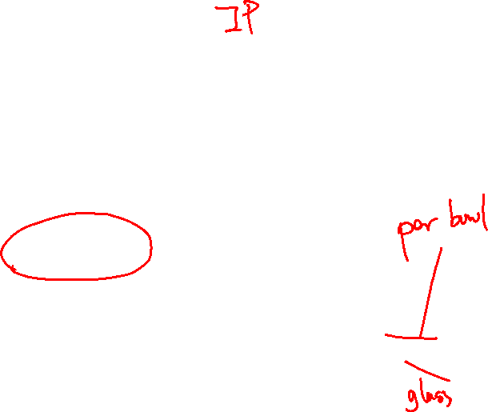


Problem Formulation
Formulate Diet Problem with integer constraints as an optimization problem
$\min_{x_{1}, { x}_{2}}{ {1 x}_{1}+0.5 x_{2}}$
s.t. $100 x_{1}+50 x_{2}≥2000$
$100 x_{1}+50 x_{2}≤2500$
$3 x_{1}+ 4 x_{2}≤100$
$20 x_{1}+70 x_{2}≥700$
Healthy Squad Goals
2000 $≤$ Calories $≤$ 2500
Sugar $≤$ 100 g
Calcium $≥$ 700 mg
$$x_{1},x_{2}∈ℤ$$
Food | Cost | Calories | Sugar | Calcium
Stir-fry (per oz) | 1 | 100 | 3 | 20
Boba (per fl oz) | 0.5 | 50 | 4 | 70

Slide 7
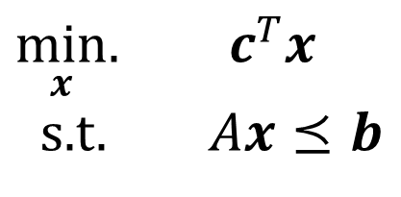
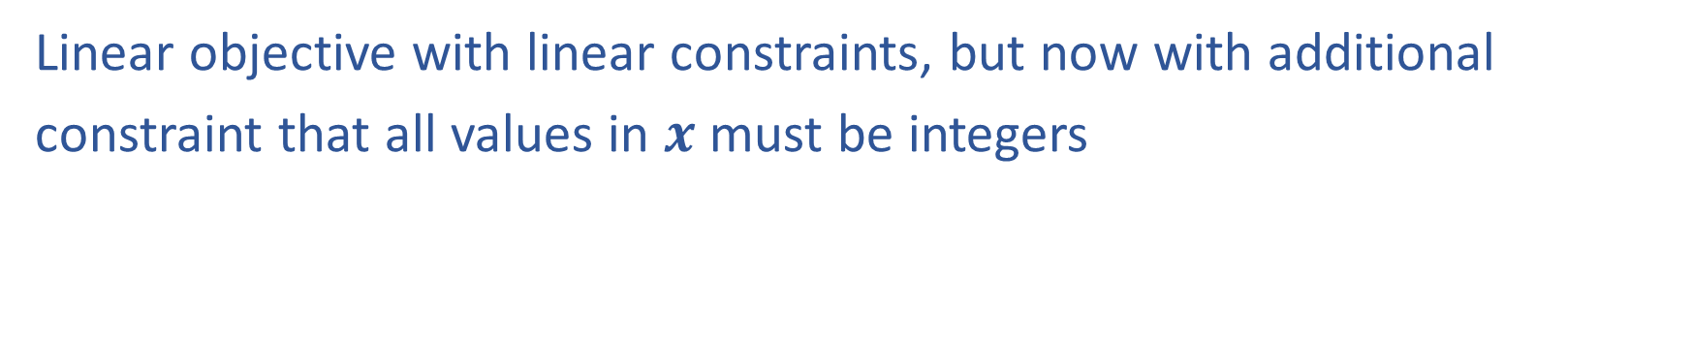
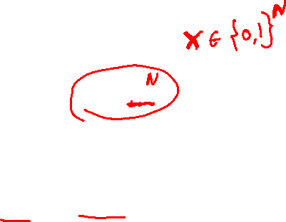
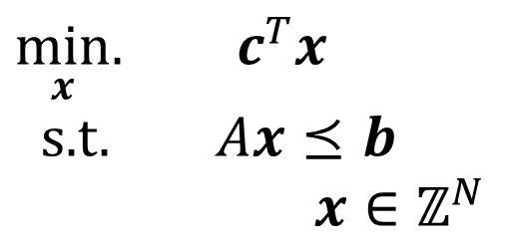
Linear Programming vs Integer Programming
Linear objective with linear constraints, but now with additional
constraint that all values in $x$ must be integers
$\min_{x}.{ c^{T}x}$
s.t. $Ax⪯b$
$\min_{x}.{ c^{T}x}$
s.t. $Ax⪯b$
$x∈ℤ^{N}$
We could also do:
Even more constrained: Binary Integer Programming (BIP)
A hybrid: Mixed Integer Linear Programming (MIP or MILP)
Notation Alert!

Slide 8
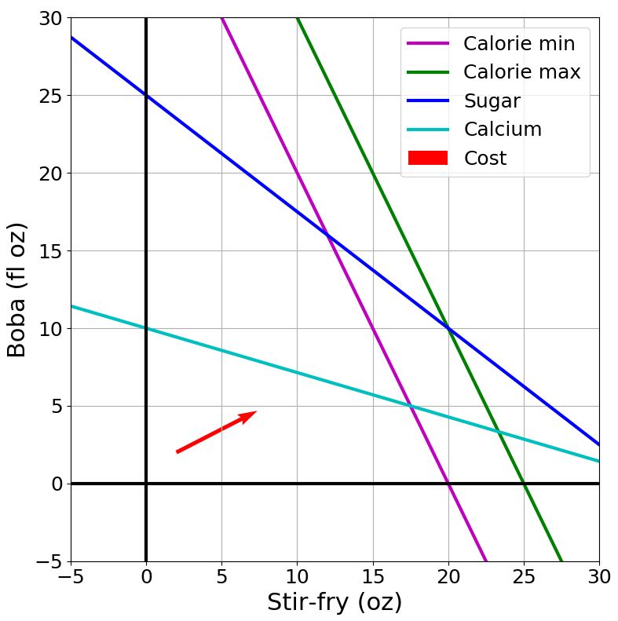

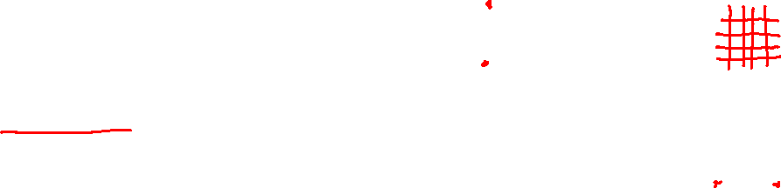
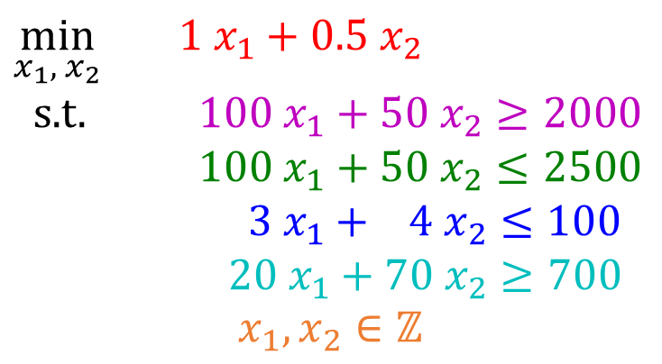
Integer Programming: Graphical Representation
Just add a grid of integer points onto our LP representation
$\min_{x}.{ c^{T}x}$
s.t. $Ax⪯b$
$x∈ℤ^{N}$
$\min_{x_{1}, { x}_{2}}{ {1 x}_{1}+0.5 x_{2}}$
s.t. $100 x_{1}+50 x_{2}≥2000$
$100 x_{1}+50 x_{2}≤2500$
$3 x_{1}+ 4 x_{2}≤100$
$20 x_{1}+70 x_{2}≥700$
$$x_{1},x_{2}∈ℤ$$

Slide 9
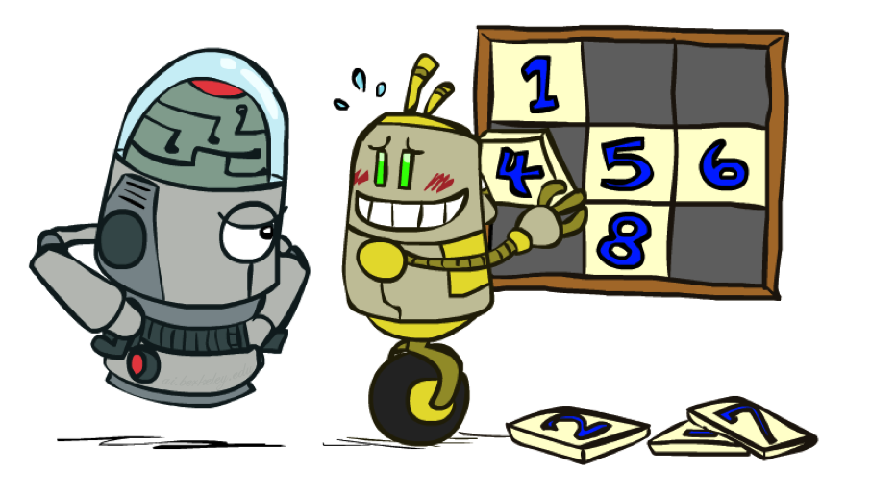

LP Relaxation
Relax IP to LP by dropping integer constraints
$\min_{x}.{ c^{T}x}$
s.t. $Ax⪯b$
$x∈ℤ^{N}$
Remember heuristics?

Slide 10
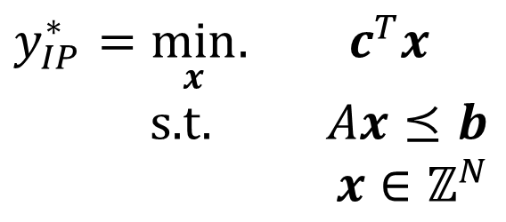
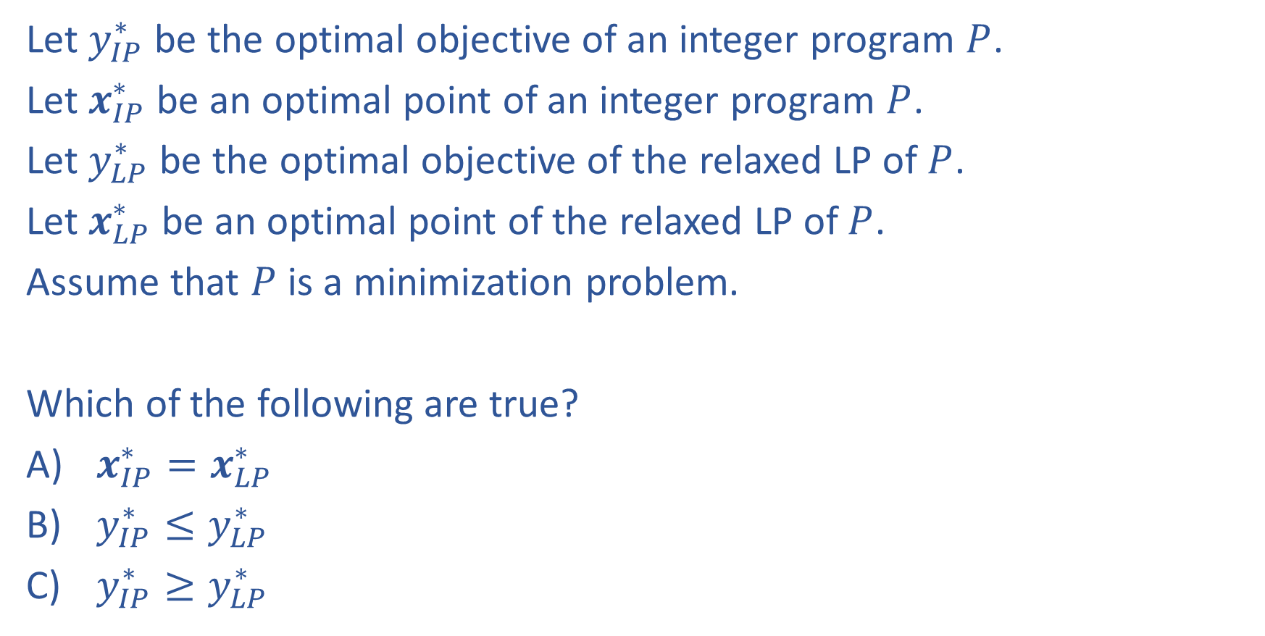
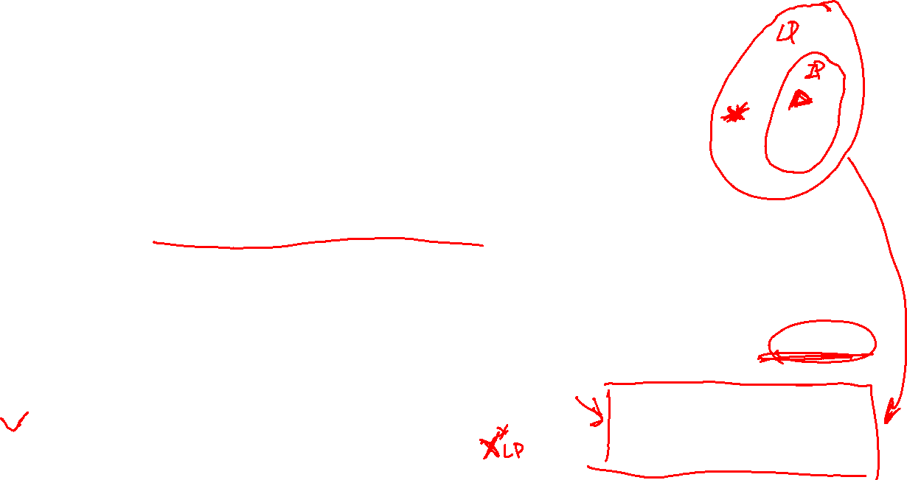
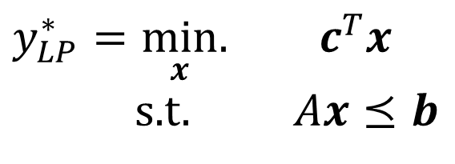
Piazza Poll 1:
Let $y_{IP}^{∗}$ be the optimal objective of an integer program $P$.
Let $x_{IP}^{∗}$ be an optimal point of an integer program $P$.
Let $y_{LP}^{∗}$ be the optimal objective of the relaxed LP of $P$.
Let $x_{LP}^{∗}$ be an optimal point of the relaxed LP of $P$.
Assume that $P$ is a minimization problem.
Which of the following are true?
$x_{IP}^{∗}=x_{LP}^{∗}$
$y_{IP}^{∗}≤y_{LP}^{∗}$
$y_{IP}^{∗}≥y_{LP}^{∗}$
$y_{IP}^{∗}=\min_{x}.{ c^{T}x}$
s.t. $Ax⪯b$
$x∈ℤ^{N}$
$y_{LP}^{∗}=\min_{x}.{ c^{T}x}$
s.t. $Ax⪯b$

Slide 11
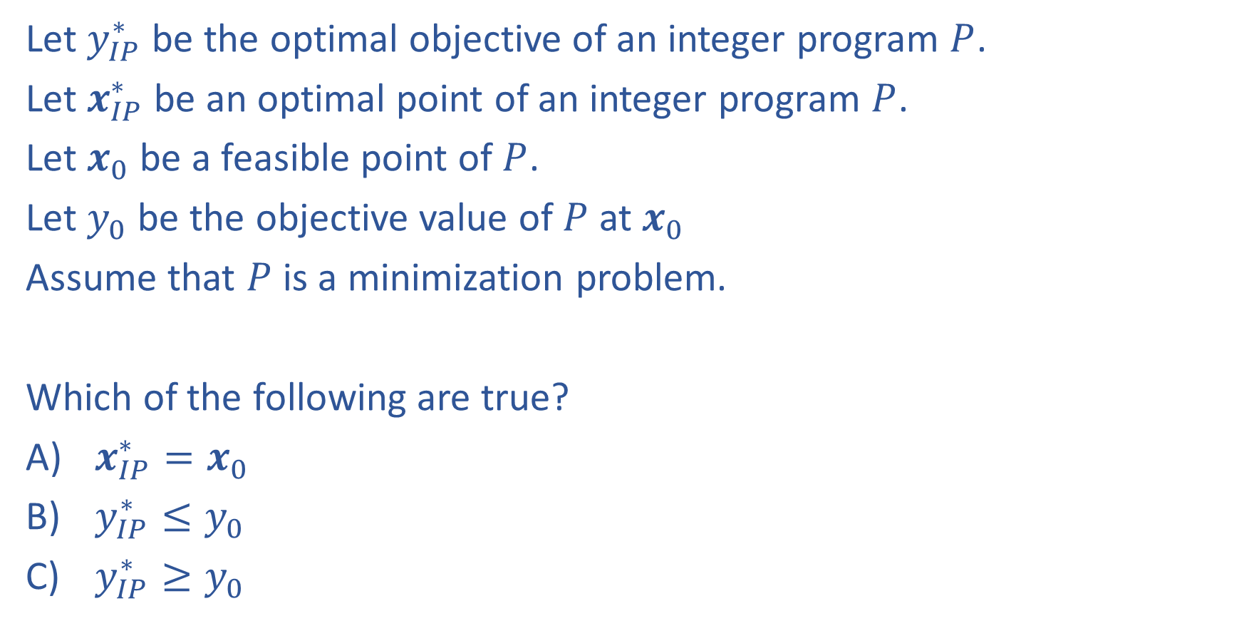
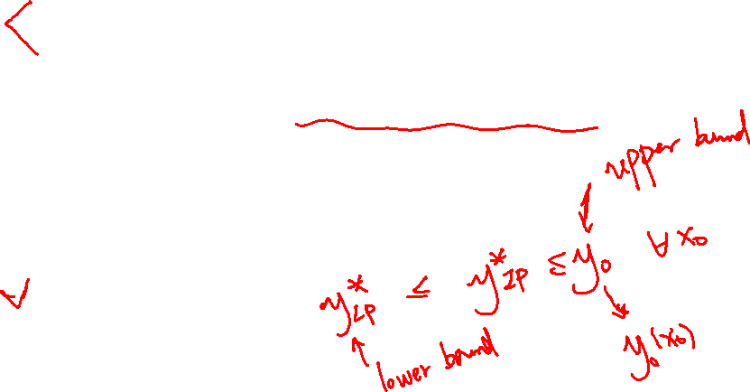
Question
Let $y_{IP}^{∗}$ be the optimal objective of an integer program $P$.
Let $x_{IP}^{∗}$ be an optimal point of an integer program $P$.
Let $x_{0}$ be a feasible point of $P$.
Let $y_{0}$ be the objective value of $P$ at $x_{0}$
Assume that $P$ is a minimization problem.
Which of the following are true?
$x_{IP}^{∗}=x_{0}$
$y_{IP}^{∗}≤y_{0}$
$y_{IP}^{∗}≥y_{0}$
$y_{IP}^{∗}=\min_{x}.{ c^{T}x}$
s.t. $Ax⪯b$
$x∈ℤ^{N}$
$y_{LP}^{∗}=\min_{x}.{ c^{T}x}$
s.t. $Ax⪯b$

Slide 12

Question
Let $y_{IP}^{∗}$ be the optimal objective of an integer program $P$.
Let $x_{IP}^{∗}$ be an optimal point of an integer program $P$.
Let $x_{0}$ be a feasible point of $P$.
Let $y_{0}$ be the objective value of $P$ at $x_{0}$
Assume that $P$ is a minimization problem.
Which of the following are true?
$x_{IP}^{∗}=x_{0}$
$y_{IP}^{∗}≤y_{0}$
$y_{IP}^{∗}≥y_{0}$
$y_{IP}^{∗}=\min_{x}.{ c^{T}x}$
s.t. $Ax⪯b$
$x∈ℤ^{N}$
Upper bound
$$y_{LP}^{∗}≤y_{IP}^{∗}≤y_{0}$$
$y_{LP}^{∗}=\min_{x}.{ c^{T}x}$
s.t. $Ax⪯b$
Lower bound

Slide 13
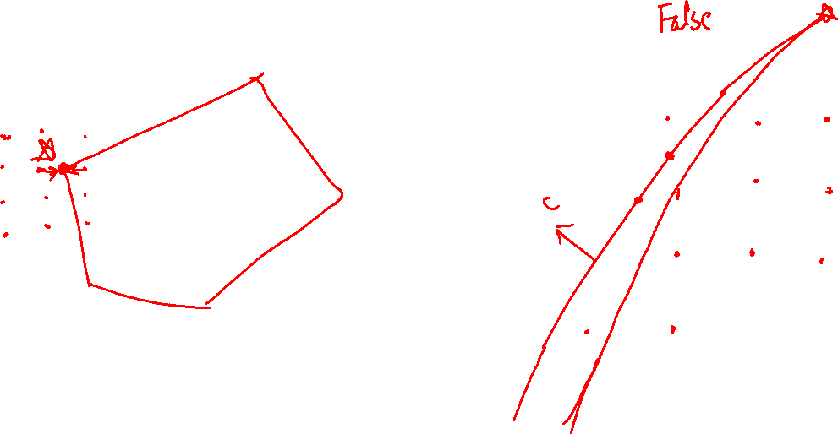
Piazza Poll 2:
True/False: It is sufficient to consider the integer points that are the closest to an optimal solution of the LP relaxation?

Slide 14
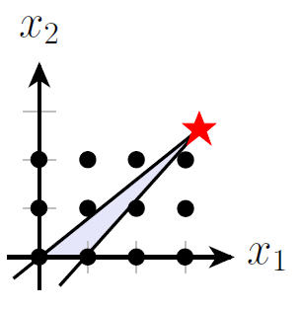
Piazza Poll 2:
True/False: It is sufficient to consider the integer points that are the closest to an optimal solution of the LP relaxation?
An LP can have infinite number of optimal solutions
So as IP
Integer points that are closest to an optimal solution of LP relaxation of IP may not be feasible
Integer points that are closest to an optimal solution of LP relaxation of IP may not be optimal (depends on the objective function)

Slide 15
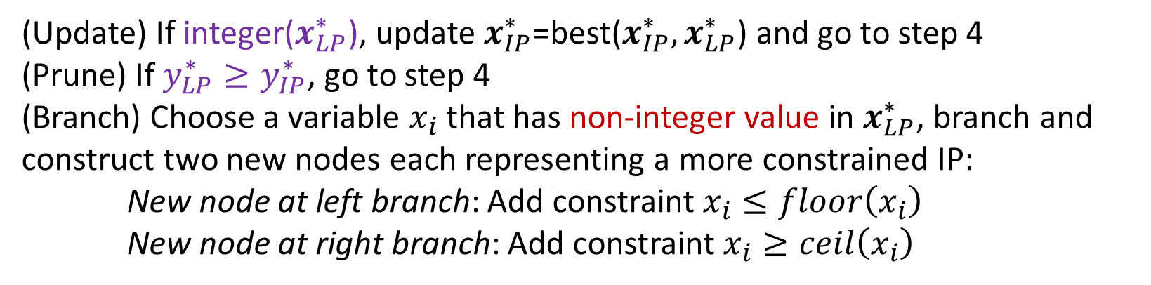

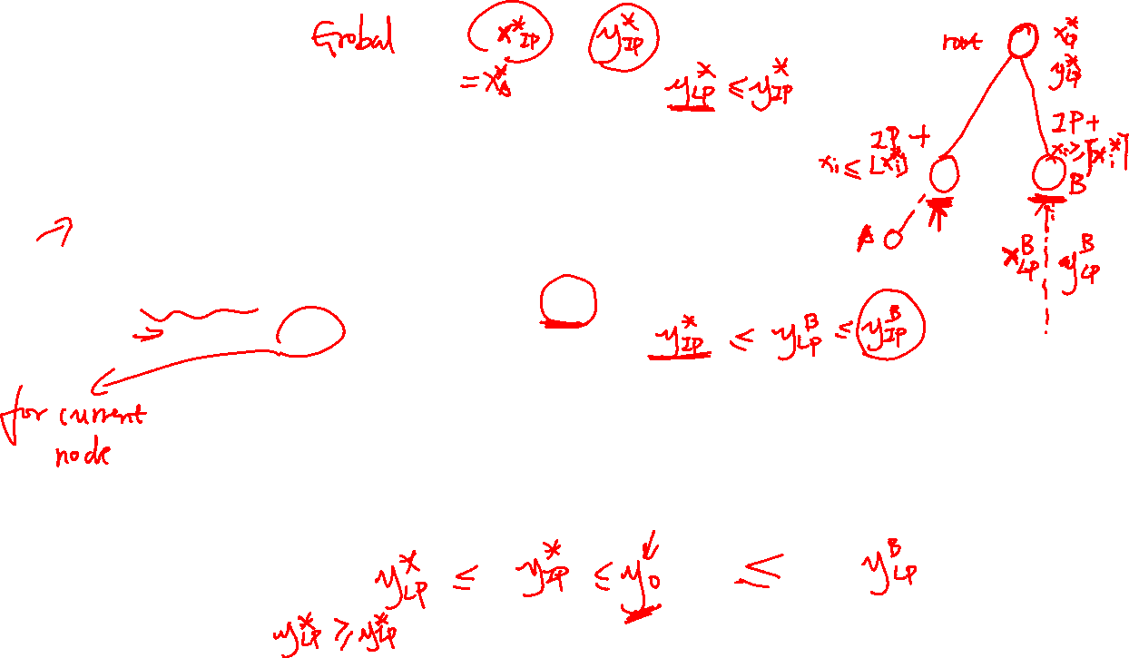
Solving an IP
Basic Branch and Bound algorithm (essentially a search algorithm)
    Build the root node, which is the original IP. Set $x_{IP}^{∗}$=null, $y_{IP}^{∗}=+∞$
    Solve the relaxed LP of the node
    If relaxed LP is feasible, get solution $x_{LP}^{∗}$ and optimal objective value $y_{LP}^{∗}$
    (Recursion) Pick an unexplored node and go to step 2. Stop if all nodes explored.
    Return $x_{IP}^{∗}$
Assuming a minimization IP
(Update) If integer($x_{LP}^{∗}$), update $x_{IP}^{∗}$=best($x_{IP}^{∗},x_{LP}^{∗}$) and go to step 4
(Prune) If $y_{LP}^{∗}≥y_{IP}^{∗}$, go to step 4
(Branch) Choose a variable $x_{i}$ that has non-integer value in $x_{LP}^{∗}$, branch and construct two new nodes each representing a more constrained IP:
New node at left branch: Add constraint $x_{i}≤floor\left(x_{i}\right)$
New node at right branch: Add constraint $x_{i}≥ceil\left(x_{i}\right)$
What if it is a maximization IP?

Slide 16
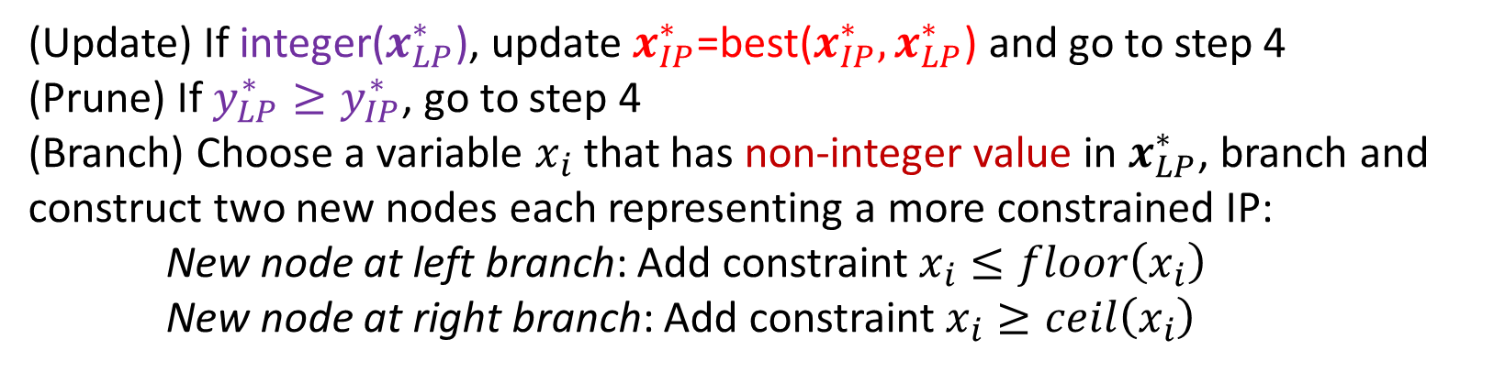

Solving an IP
Basic Branch and Bound algorithm (essentially a search algorithm)
    Build the root node, which is the original IP. Set $x_{IP}^{∗}$=null, $y_{IP}^{∗}=+∞$
    Solve the relaxed LP of the node
    If relaxed LP is feasible, get solution $x_{LP}^{∗}$ and optimal objective value $y_{LP}^{∗}$
    (Recursion) Pick an unexplored node and go to step 2. Stop if all nodes explored.
    Return $x_{IP}^{∗}$
Assuming a minimization IP
(Upper bound of IP)
(Lower bound for the IP of the node)
(Update) If integer($x_{LP}^{∗}$), update $x_{IP}^{∗}$=best($x_{IP}^{∗},x_{LP}^{∗}$) and go to step 4
(Prune) If $y_{LP}^{∗}≥y_{IP}^{∗}$, go to step 4
(Branch) Choose a variable $x_{i}$ that has non-integer value in $x_{LP}^{∗}$, branch and construct two new nodes each representing a more constrained IP:
New node at left branch: Add constraint $x_{i}≤floor\left(x_{i}\right)$
New node at right branch: Add constraint $x_{i}≥ceil\left(x_{i}\right)$
(Update upper bound)
What if it is a maximization IP?

Slide 17
Branch and Bound Example
15
10
5
10
15
20
25

Slide 18
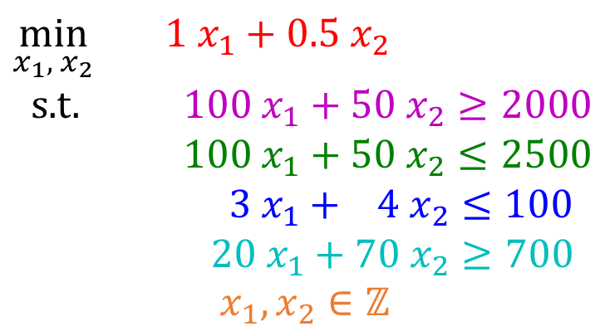
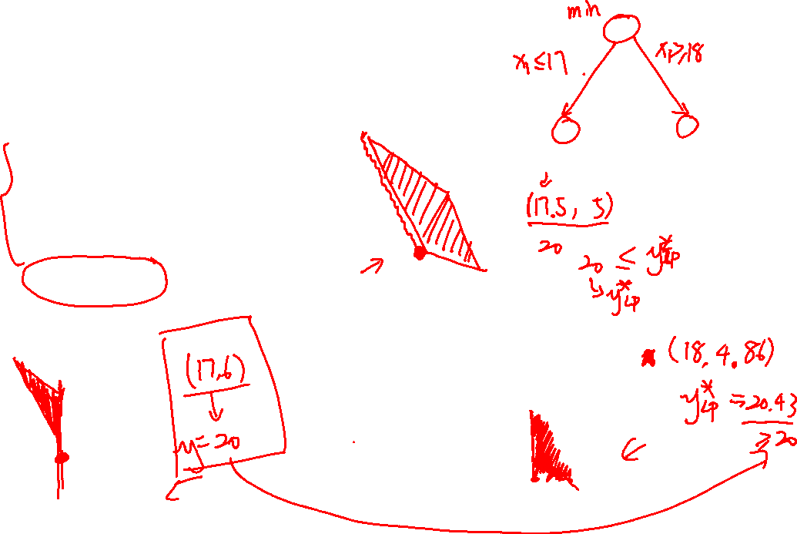
Branch and Bound Example
$\min_{x_{1}, { x}_{2}}{ {1 x}_{1}+0.5 x_{2}}$
s.t. $100 x_{1}+50 x_{2}≥2000$
$100 x_{1}+50 x_{2}≤2500$
$3 x_{1}+ 4 x_{2}≤100$
$20 x_{1}+70 x_{2}≥700$
$$x_{1},x_{2}∈ℤ$$
15
10
5
Is it necessary to solve this branch?
10
15
20
25
15
15
10
10
5
5
10
15
20
25
10
15
20
25

Slide 19


Branch and Bound Example
$\min_{x_{1}, { x}_{2}}{ {1 x}_{1}+0.5 x_{2}}$
s.t. $100 x_{1}+50 x_{2}≥2000$
$100 x_{1}+50 x_{2}≤2500$
$3 x_{1}+ 4 x_{2}≤100$
$20 x_{1}+70 x_{2}≥700$
$$x_{1},x_{2}∈ℤ$$
15
Optimal solution for LP relaxation: (17.5,5)
Optimal value (lower bound for IP): 20
10
5
10
15
20
25
Add constraint $x_{1}≤17$
Optimal solution for relaxed LP: (17,6)
Optimal value (lower bound for this branch): 20
An integer solution found (update upper bound of IP)
Stop
Add $x_{1}≥18$
15
Optimal solution
15
Optimal solution for relaxed LP: (18,4.86)
Optimal value (lower bound for this branch): 20.43
Worse than upper bound
Stop
10
10
5
5
10
15
20
25
10
15
20
25

Slide 20
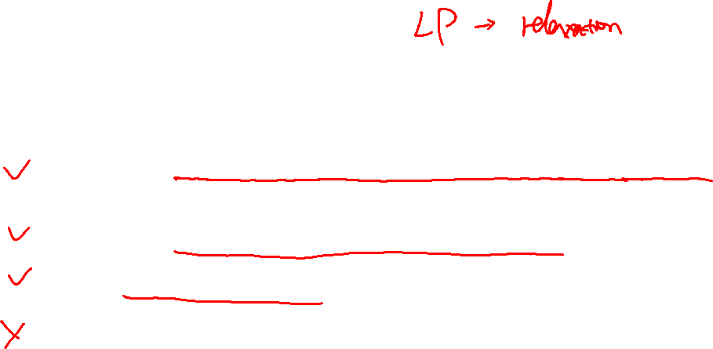
Piazza Poll 3:
When does the branch-and-bound algorithm choose not to branch the current node? (Select all that apply)
        A. When the LP returns an equal or worse objective value than the best feasible IP objective value you have seen before
        B: When you hit an integer result from the LP
        C: When LP is infeasible
        D: When the LP returns a better objective value than the best feasible IP objective value you have seen before

Slide 21

Solving an IP
Basic Branch and Bound algorithm (essentially a search algorithm)
    Build the root node, which is the original IP. Set $x_{IP}^{∗}$=null, $y_{IP}^{∗}=+∞$
    Solve the relaxed LP of the node
    If relaxed LP is feasible, get solution $x_{LP}^{∗}$ and optimal objective value $y_{LP}^{∗}$
    (Recursion) Pick an unexplored node and go to step 2. Stop if all nodes explored.
    Return $x_{IP}^{∗}$
Assuming a minimization IP
(Update) If integer($x_{LP}^{∗}$), update $x_{IP}^{∗}$=best($x_{IP}^{∗},x_{LP}^{∗}$) and go to step 4
(Prune) If $y_{LP}^{∗}≥y_{IP}^{∗}$, go to step 4
(Branch) Choose a variable $x_{i}$ that has non-integer value in $x_{LP}^{∗}$, branch and construct two new nodes each representing a more constrained IP:
New node at left branch: Add constraint $x_{i}≤floor\left(x_{i}\right)$
New node at right branch: Add constraint $x_{i}≥ceil\left(x_{i}\right)$
Anything we can do to make the search more efficient?

Slide 22
Recall: Informed Search
function BEST-FIRST-SEARCH (problem, EVAL-FN) returns a solution sequence
inputs: problem, a problem
EVAL-FN, an evaluation function
Queuing-Fn ← a function that orders nodes by EVAL-FN
return GENERAL-SEARCH (problem, Queuing-Fn)
function GREEDY-SEARCH (problem) returns a solution or failure
return BEST-FIRST-SEARCH (problem, h)

Slide 23
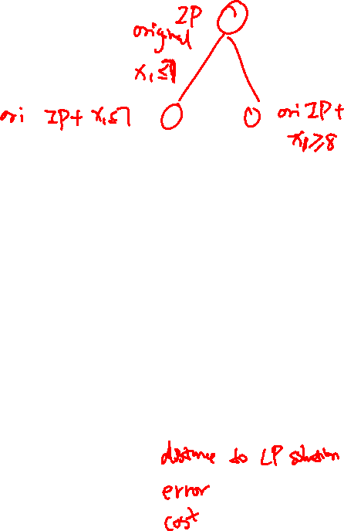
Solving an IP
Basic Branch and Bound algorithm (essentially a search algorithm)
    Build the root node, which is the original IP. Set $x_{IP}^{∗}$=null, $y_{IP}^{∗}=+∞$
    Solve the relaxed LP of the node
    If relaxed LP is feasible, get solution $x_{LP}^{∗}$ and optimal objective value $y_{LP}^{∗}$
    (Recursion) Pick an unexplored node and go to step 2. Stop if all nodes explored.
    Return $x_{IP}^{∗}$
Assuming a minimization IP
(Update) If integer($x_{LP}^{∗}$), update $x_{IP}^{∗}$=best($x_{IP}^{∗},x_{LP}^{∗}$) and go to step 4
(Prune) If $y_{LP}^{∗}≥y_{IP}^{∗}$, go to step 4
(Branch) Choose a variable $x_{i}$ that has non-integer value in $x_{LP}^{∗}$, branch and construct two new nodes each representing a more constrained IP:
New node at left branch: Add constraint $x_{i}≤floor\left(x_{i}\right)$
New node at right branch: Add constraint $x_{i}≥ceil\left(x_{i}\right)$
What can be used as an evaluation function?
Optimal value of the LP relaxation!

Slide 24
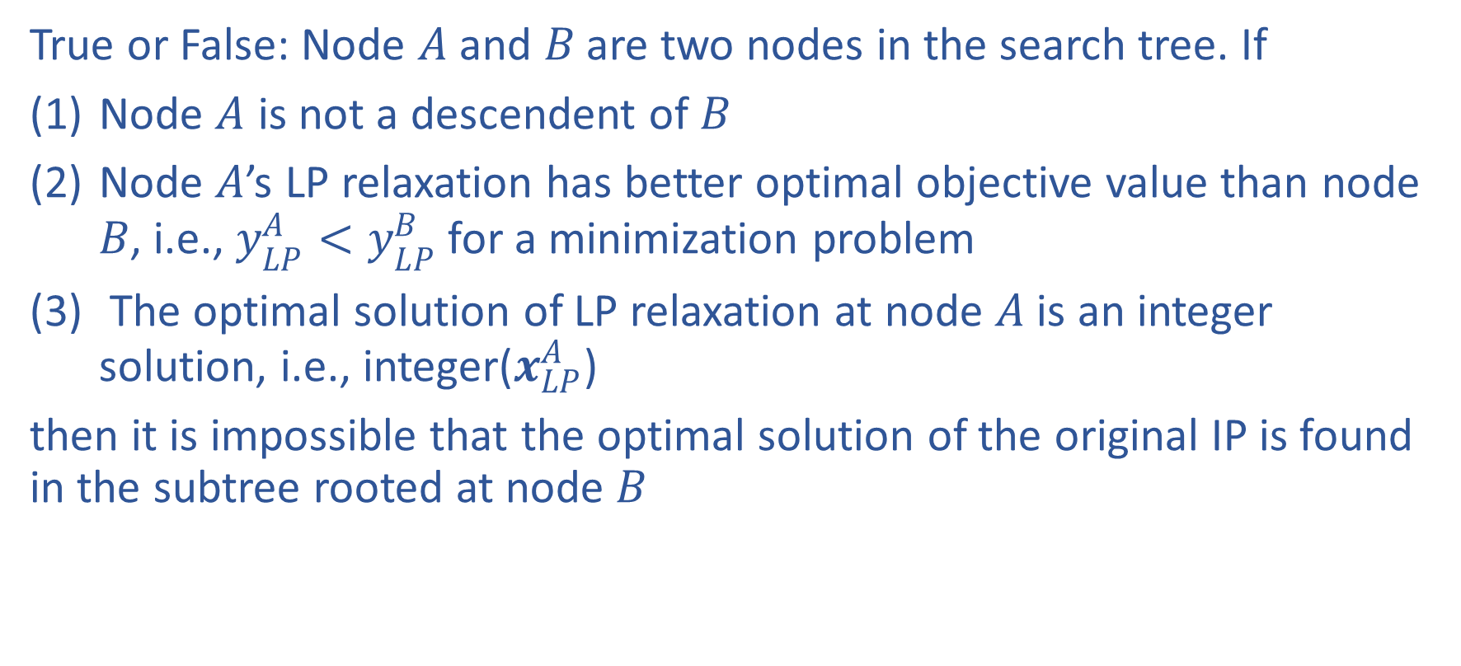
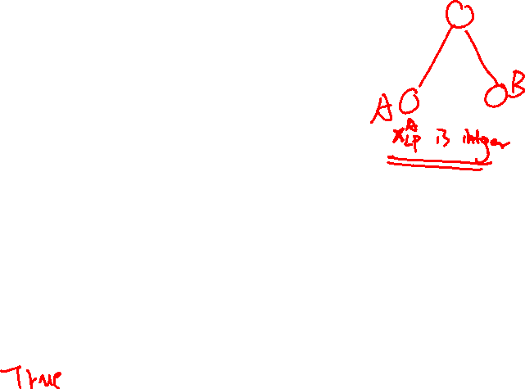
Piazza Poll 4:
True or False: Node $A$ and $B$ are two nodes in the search tree. If
Node $A$ is not a descendent of $B$
Node $A$’s LP relaxation has better optimal objective value than node $B$, i.e., $y_{LP}^{A}<y_{LP}^{B}$ for a minimization problem
The optimal solution of LP relaxation at node $A$ is an integer solution, i.e., integer($x_{LP}^{A}$)
then it is impossible that the optimal solution of the original IP is found in the subtree rooted at node $B$

Slide 25
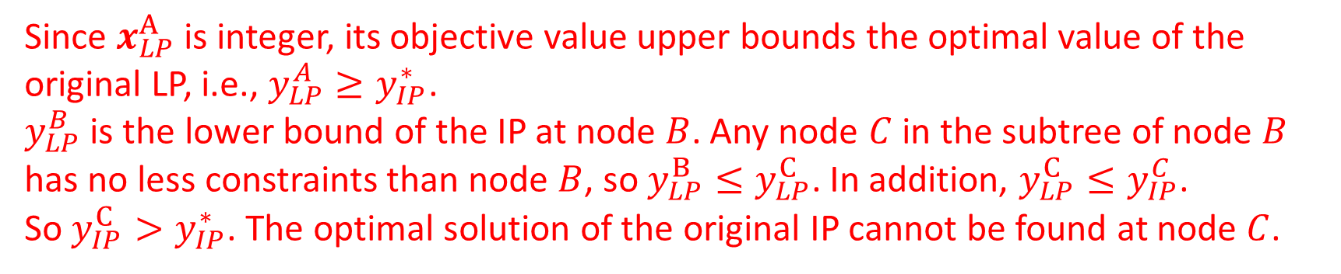
Piazza Poll 4:
True or False: Node $A$ and $B$ are two nodes in the search tree. If
Node $A$ is not a descendent of $B$
Node $A$’s LP relaxation has better optimal objective value than node $B$, i.e., $y_{LP}^{A}<y_{LP}^{B}$ for a minimization problem
The optimal solution of LP relaxation at node $A$ is an integer solution, i.e., integer($x_{LP}^{A}$)
then it is impossible that the optimal solution of the original IP is found in the subtree rooted at node $B$
Since $x_{LP}^{A}$ is integer, its objective value upper bounds the optimal value of the original LP, i.e., $y_{LP}^{A}≥y_{IP}^{∗}$.
$y_{LP}^{B}$ is the lower bound of the IP at node $B$. Any node $C$ in the subtree of node $B$ has no less constraints than node $B$, so $y_{LP}^{B}≤y_{LP}^{C}$. In addition, $y_{LP}^{C}≤y_{IP}^{C}$.
So $y_{IP}^{C}>y_{IP}^{∗}$. The optimal solution of the original IP cannot be found at node $C$.

Slide 26
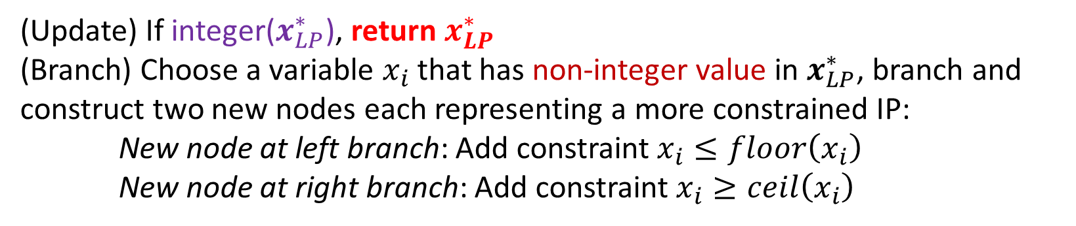

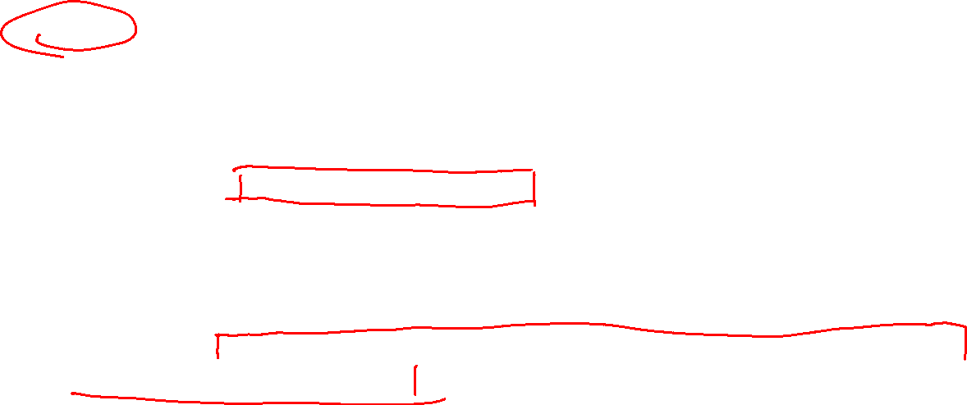
Solving an IP
Improved Branch and Bound algorithm (essentially a best-first-search algorithm)
    Build the root node, which is the original IP.
    Solve the relaxed LP of the node. Return null if infeasible.
    Given solution $x_{LP}^{∗}$ and optimal objective value $y_{LP}^{∗}$ of the relaxed LP
    (Recursion) Pick an unexplored node whose LP relaxation is feasible and has the best optimal objective value and go to step 2. Stop if all nodes explored/infeasible.
    Return null
Assuming a minimization IP
(Update) If integer($x_{LP}^{∗}$), return $x_{LP}^{∗}$
(Branch) Choose a variable $x_{i}$ that has non-integer value in $x_{LP}^{∗}$, branch and construct two new nodes each representing a more constrained IP:
New node at left branch: Add constraint $x_{i}≤floor\left(x_{i}\right)$
New node at right branch: Add constraint $x_{i}≥ceil\left(x_{i}\right)$
Why still optimal?
All the unexplored nodes have no better LP relaxation values!

Slide 27
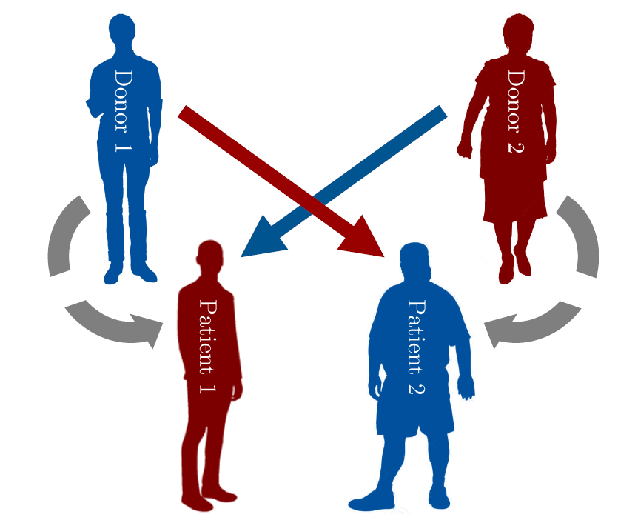
Formulate a Problem as an IP
Kidney Exchange

Slide 28
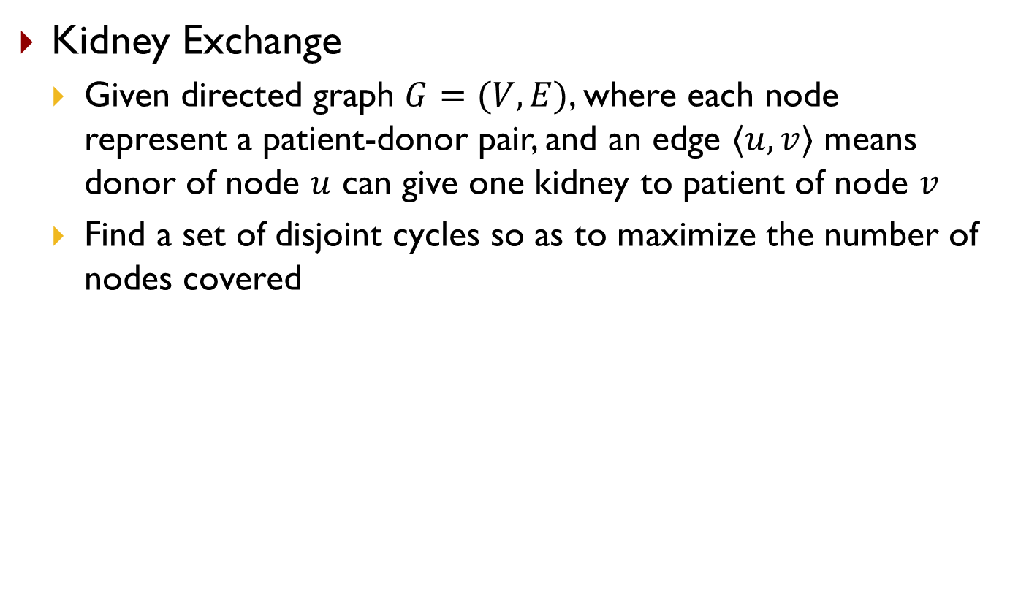
Formulate a Problem as an IP
Kidney Exchange
  Given directed graph $G=(V,E)$, where each node represent a patient-donor pair, and an edge $〈u,v〉$ means donor of node $u$ can give one kidney to patient of node $v$
  Find a set of disjoint cycles so as to maximize the number of nodes covered
6
2
1
4
5
3
7
8

Slide 29
Piazza Poll 5
Given the graph below, what is the maximum number of patients that can get a kidney through kidney exchange assuming the length of each cycle should be less than or equal to 3?
  A: 3
  B: 6
  C: 7
  D: 8
6
2
1
4
5
3
7
8

Slide 30
Formulate a Problem as an IP
Kidney Exchange
  Given directed graph $G=(V,E)$, where each node represent a patient-donor pair, and an edge $〈u,v〉$ means donor of node $u$ can give one kidney to patient of node $v$
  Find a set of disjoint cycles so as to maximize the number of nodes covered
Hint: enumerate all the cycles
6
2
1
4
5
3
7
8

Slide 31
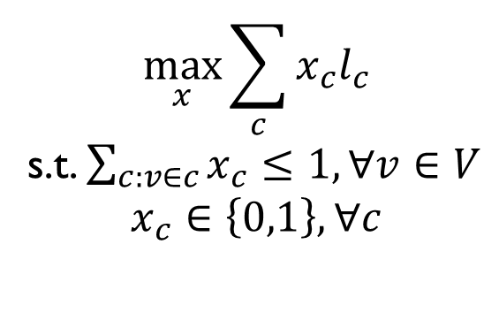
Formulate a Problem as an IP
Kidney Exchange
  Given directed graph $G=(V,E)$, where each node represent a patient-donor pair, and an edge $〈u,v〉$ means donor of node $u$ can give one kidney to patient of node $v$
  Find a set of disjoint cycles so as to maximize the number of nodes covered
Hint: enumerate all the cycles
6
2
$$\max_{x}{\sum_{c}{x_{c}l_{c}}}$$
s.t. $\sum_{c:v∈c}{x_{c}}≤1,∀v∈V$
$$x_{c}∈\left\{0,1\right\},∀c$$
1
4
5
3
7
8

Slide 32
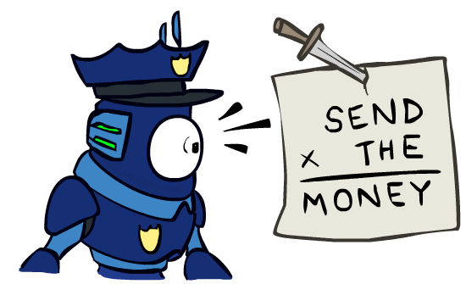
Formulate a Problem as an IP
Cryptarithmetic
Variables:
IP:
Notes:
0=7, R=4, W=6, U=2, T=8, F=1; 867 + 867 = 1734

Slide 33
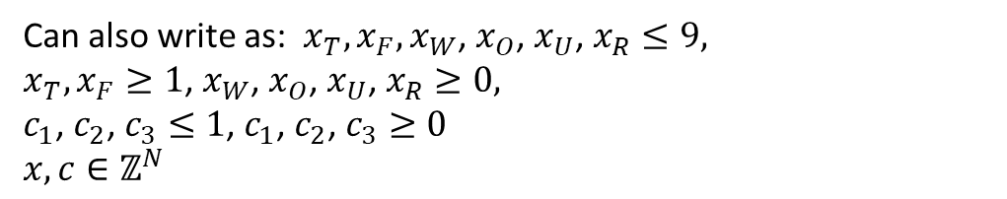
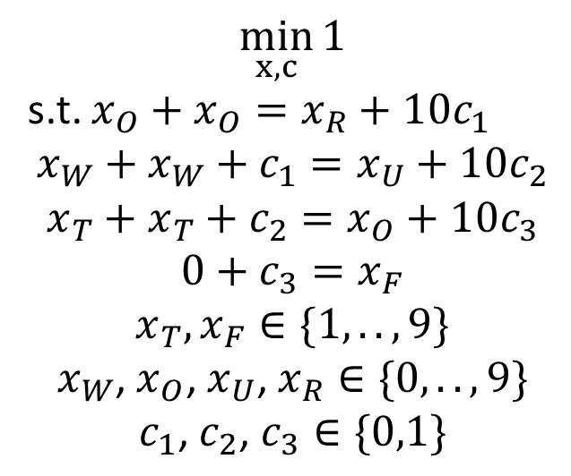
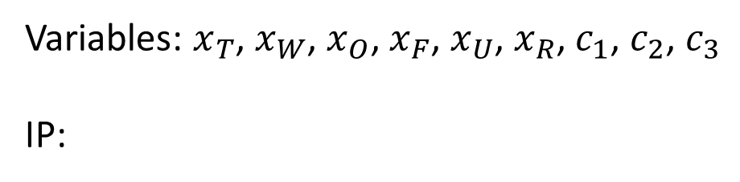
Formulate a Problem as an IP
Cryptarithmetic
Variables: $x_{T}$, $x_{W}$, $x_{O}$, $x_{F}$, $x_{U}$, $x_{R}$, $c_{1}$, $c_{2}$, $c_{3}$
IP:
$$\min_{x,c}{1}$$
s.t. $x_{O}+x_{O}=x_{R}+10c_{1}$
$$x_{W}+x_{W}+c_{1}=x_{U}+10c_{2}$$
$$x_{T}+x_{T}+c_{2}=x_{O}+10c_{3}$$
$$0+c_{3}=x_{F}$$
$$x_{T},x_{F}∈\{1,..,9\}$$
$$x_{W}\text{, }x_{O}\text{, }x_{U}\text{, }x_{R}∈\{0,..,9\}$$
$$c_{1}\text{, }c_{2}\text{, }c_{3}∈\{0,1\}$$
Can also write as: $x_{T},x_{F},x_{W}\text{, }x_{O}\text{, }x_{U}\text{, }x_{R}≤9,$
$x_{T},x_{F}≥1$, $x_{W}\text{, }x_{O}\text{, }x_{U}\text{, }x_{R}≥0,$
$c_{1}\text{, }c_{2}\text{, }c_{3}≤1$, $c_{1}\text{, }c_{2}\text{, }c_{3}≥0$
$x,c∈ℤ^{N}$
Notes:
0=7, R=4, W=6, U=2, T=8, F=1; 867 + 867 = 1734

