Slide 1
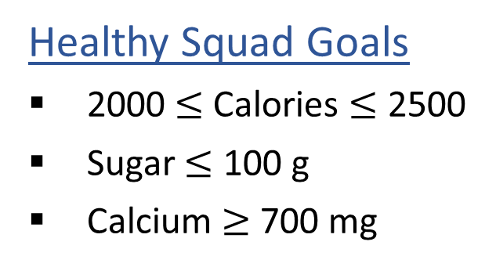
Warm-up: What to eat?
We are trying healthy by finding the optimal amount of food to purchase.
We can choose the amount of stir-fry (ounce) and boba (fluid ounces).
Healthy Squad Goals
2000 $≤$ Calories $≤$ 2500
Sugar $≤$ 100 g
Calcium $≥$ 700 mg
Food | Cost | Calories | Sugar | Calcium
Stir-fry (per oz) | 1 | 100 | 3 | 20
Boba (per fl oz) | 0.5 | 50 | 4 | 70
What is the cheapest way to stay “healthy” with this menu?
How much stir-fry (ounce) and boba (fluid ounces) should we buy?

Slide 2
Announcements
Assignments:
P2
    Due Thu 10/3, 10 pm
P3
    Will be released later today
    Due Thu 10/17, 10 pm
HW5 (written)
    Released Tue 10/1
    Due Tue 10/8, 10 pm
Sat 10/5, 10 pm

Slide 3
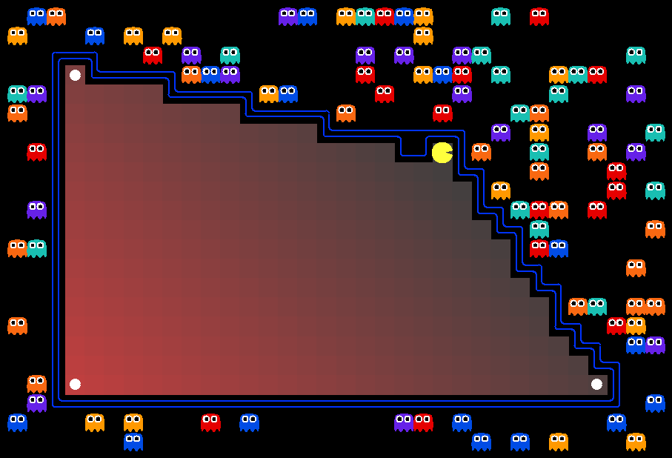
AI: Representation and Problem Solving
Optimization & Linear Programming
Instructors: Pat Virtue & Stephanie Rosenthal
Slide credits: CMU AI, http://ai.berkeley.edu

Slide 4
Learning Objectives
Formulate a problem as a Linear Program (LP)
Convert a LP into a required form, e.g., inequality form
Plot the graphical representation of a linear optimization problem with two variables and find the optimal solution
Understand the relationship between optimal solution of an LP and the intersections of constraints
Describe and implement a LP solver based on vertex enumeration
Describe the high-level idea of Simplex algorithm
Next Lecture

Slide 5
Recap
What have we learned so far?
  What do they have in common?
This lecture:
Continuous space
General formulation

Slide 6
Recap
What have we learned so far?
  Search: Depth/Breadth-first search, A* search, local search
  Constraint Satisfaction Problem: 8-queen, graph coloring
  Logic and Planning: Propositional Logic, SAT, First-order Logic
  What do they have in common?
    Variables/Symbols, Finite options
This lecture:
Move to continuous space (with connections to the discrete space)
Provide a general formulation that can be used to represent many of the previously seen problems

Slide 7
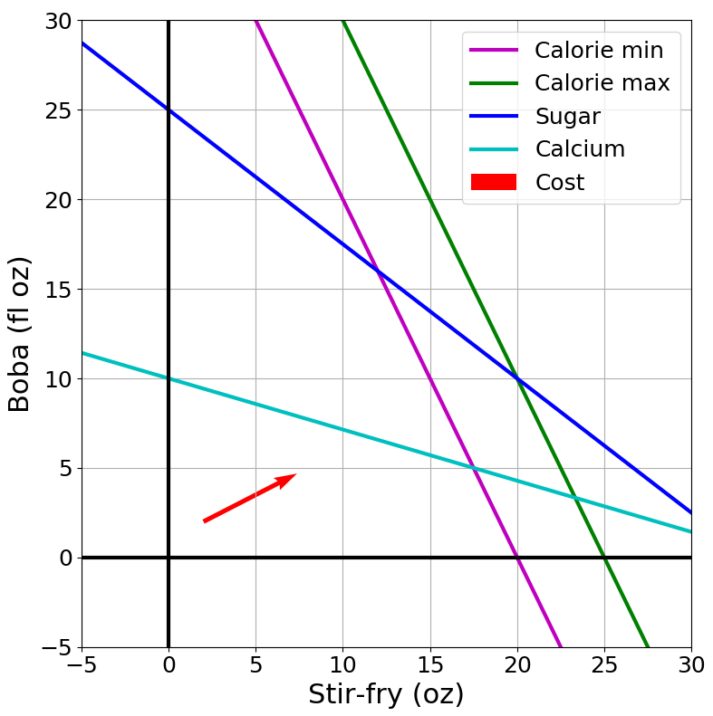
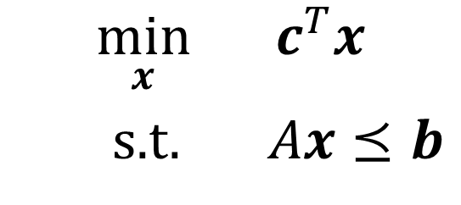
Focus of Today: (Linear) Optimization Problem
Problem Description
Graphical Representation
Linear Programming
Linear Program Formulation
$$\min_{x}{ c^{T}x}$$
s.t. $Ax⪯b$
Notation Alert!

Slide 8
Diet Problem: What to eat?
We are trying healthy by finding the optimal amount of food to purchase.
We can choose the amount of stir-fry (ounce) and boba (fluid ounces).
Healthy Squad Goals
2000 $≤$ Calories $≤$ 2500
Sugar $≤$ 100 g
Calcium $≥$ 700 mg
Food | Cost | Calories | Sugar | Calcium
Stir-fry (per oz) | 1 | 100 | 3 | 20
Boba (per fl oz) | 0.5 | 50 | 4 | 70
What is the cheapest way to stay “healthy” with this menu?
How much stir-fry (ounce) and boba (fluid ounces) should we buy?

Slide 9

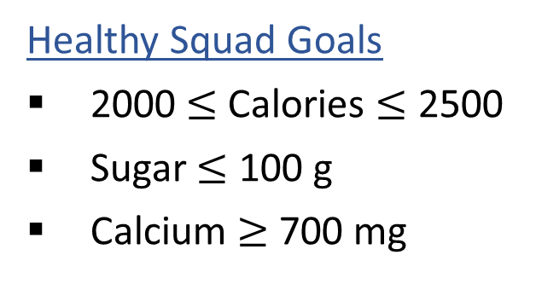
Problem Formulation
Can we formulate it as a Constraint Satisfaction Problem?
Variable:
Domain:
Constraint:
What are the issues with this CSP formulation?
Healthy Squad Goals
2000 $≤$ Calories $≤$ 2500
Sugar $≤$ 100 g
Calcium $≥$ 700 mg
Food | Cost | Calories | Sugar | Calcium
Stir-fry (per oz) | 1 | 100 | 3 | 20
Boba (per fl oz) | 0.5 | 50 | 4 | 70
What is the cheapest way to stay “healthy” with this menu?
How much stir-fry (ounce) and boba (fluid ounces) should we buy?

Slide 10
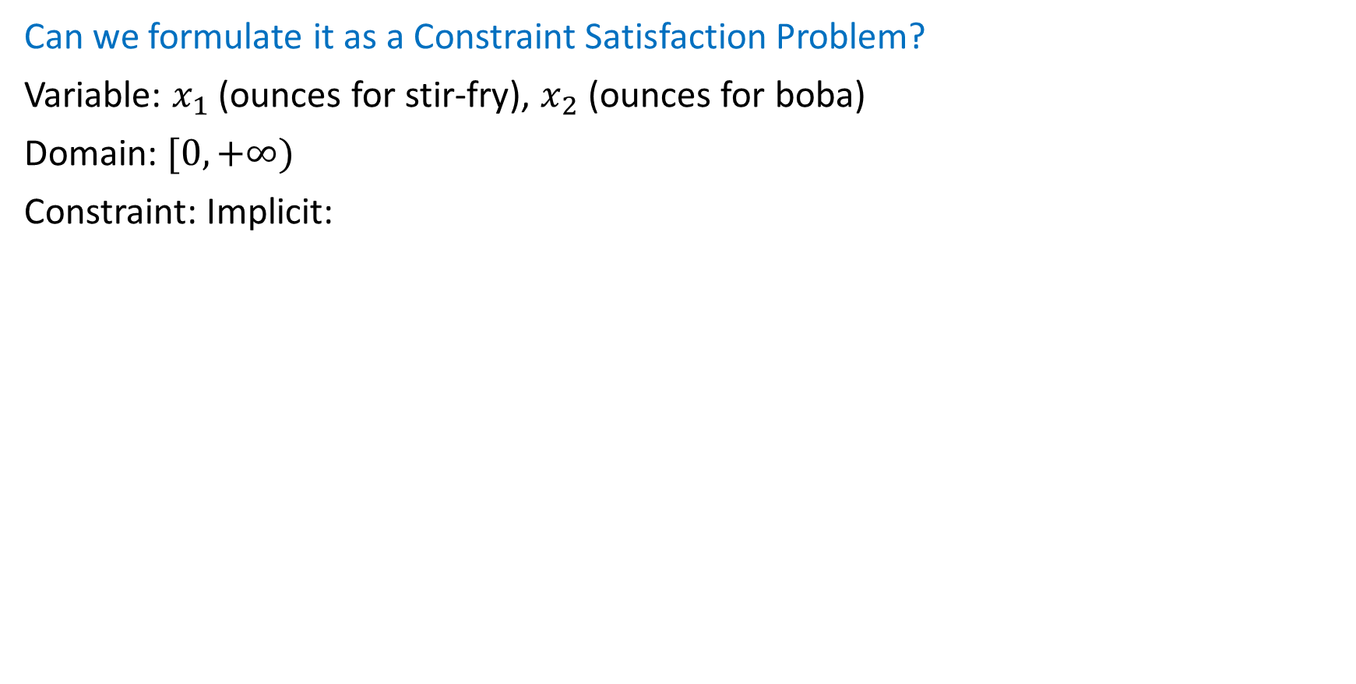
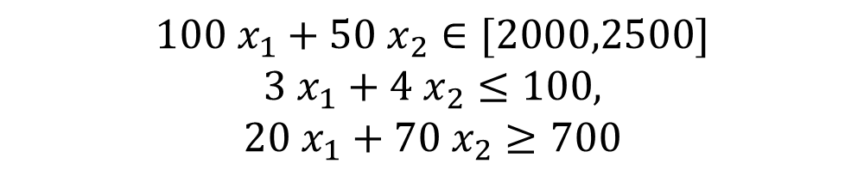
Problem Formulation
Can we formulate it as a Constraint Satisfaction Problem?
Variable: $x_{1}$ (ounces for stir-fry), $x_{2}$ (ounces for boba)
Domain: $[0,+∞)$
Constraint: Implicit:
$$100 x_{1}+50 x_{2}∈[2000,2500]$$
$3 x_{1}+4 x_{2}≤100$,
$$20 x_{1}+70 x_{2}≥700$$
What are the issues with this CSP formulation?
Healthy Squad Goals
2000 $≤$ Calories $≤$ 2500
Sugar $≤$ 100 g
Calcium $≥$ 700 mg
Food | Cost | Calories | Sugar | Calcium
Stir-fry (per oz) | 1 | 100 | 3 | 20
Boba (per fl oz) | 0.5 | 50 | 4 | 70
What is the cheapest way to stay “healthy” with this menu?
How much stir-fry (ounce) and boba (fluid ounces) should we buy?

Slide 11
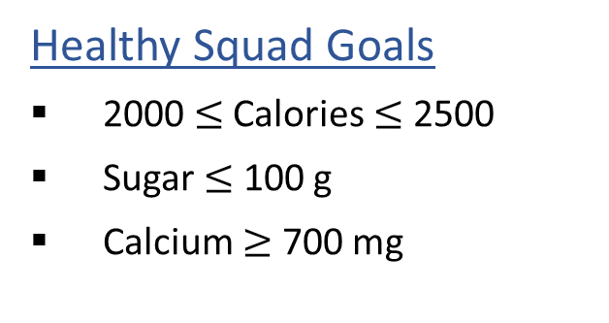
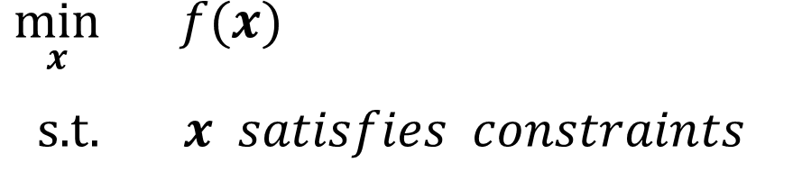
Problem Formulation
Optimization problem: Finding the best solution from all feasible solutions
From CSP to Optimization Problem
Variable
Domain
Constraint
Healthy Squad Goals
2000 $≤$ Calories $≤$ 2500
Sugar $≤$ 100 g
Calcium $≥$ 700 mg
Objective
$\min_{x}{ f(x)}$
s.t. $x satisfies constraints$
Food | Cost | Calories | Sugar | Calcium
Stir-fry (per oz) | 1 | 100 | 3 | 20
Boba (per fl oz) | 0.5 | 50 | 4 | 70
Notation Alert!

Slide 12
Problem Formulation
Optimization problem: Finding the best solution from all feasible solutions
From CSP to Optimization Problem
(Optimization) Variable
Domain
Constraint
Can be represented as constraints
Healthy Squad Goals
2000 $≤$ Calories $≤$ 2500
Sugar $≤$ 100 g
Calcium $≥$ 700 mg
Optimization Objective
Objective
$\min_{x}{ f(x)}$
s.t. $x satisfies constraints$
Food | Cost | Calories | Sugar | Calcium
Stir-fry (per oz) | 1 | 100 | 3 | 20
Boba (per fl oz) | 0.5 | 50 | 4 | 70
Notation Alert!

Slide 13
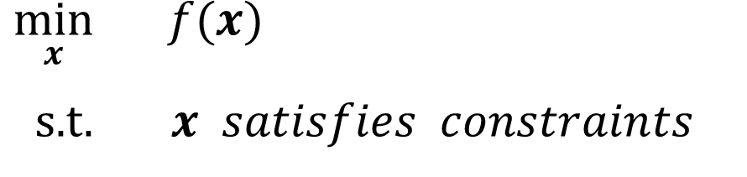
Problem Formulation
Formulate Diet Problem as an optimization problem
$\min_{x}{ f(x)}$
s.t. $x satisfies constraints$
Variable:
Objective:
Constraints:
Healthy Squad Goals
2000 $≤$ Calories $≤$ 2500
Sugar $≤$ 100 g
Calcium $≥$ 700 mg
Food | Cost | Calories | Sugar | Calcium
Stir-fry (per oz) | 1 | 100 | 3 | 20
Boba (per fl oz) | 0.5 | 50 | 4 | 70

Slide 14

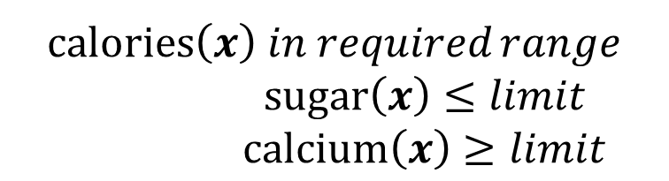
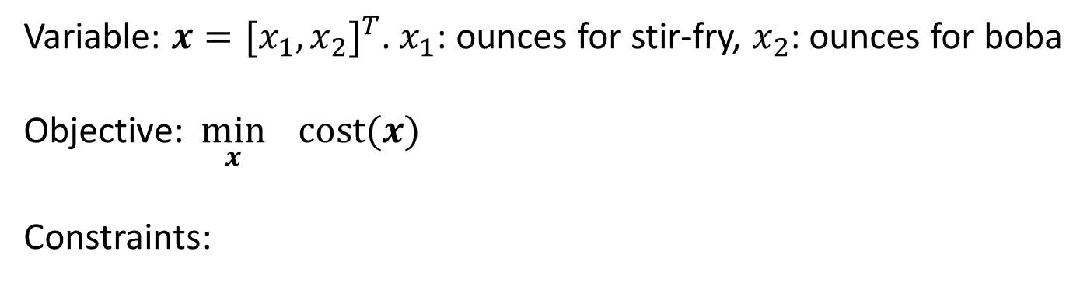
Problem Formulation
Formulate Diet Problem as an optimization problem
$\min_{x}{ f(x)}$
s.t. $x satisfies constraints$
Variable: $x={[x_{1},x_{2}]}^{T}$. $x_{1}$: ounces for stir-fry, $x_{2}$: ounces for boba
Objective: $\min_{x}{ cost(x)}$
Constraints:
Healthy Squad Goals
2000 $≤$ Calories $≤$ 2500
Sugar $≤$ 100 g
Calcium $≥$ 700 mg
$calories\left(x\right)$ 𝑖𝑛 𝑟𝑒𝑞𝑢𝑖𝑟𝑒𝑑 𝑟𝑎𝑛𝑔𝑒
$sugar\left(x\right)≤limit$
$calcium\left(x\right)≥limit$
Food | Cost | Calories | Sugar | Calcium
Stir-fry (per oz) | 1 | 100 | 3 | 20
Boba (per fl oz) | 0.5 | 50 | 4 | 70
Can be ignored in this problem. Why?
$$x_{1}≥0,x_{2}≥0$$

Slide 15


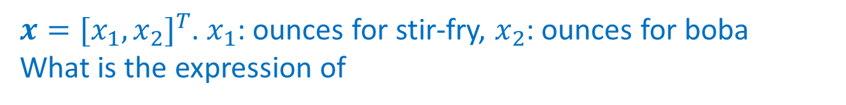
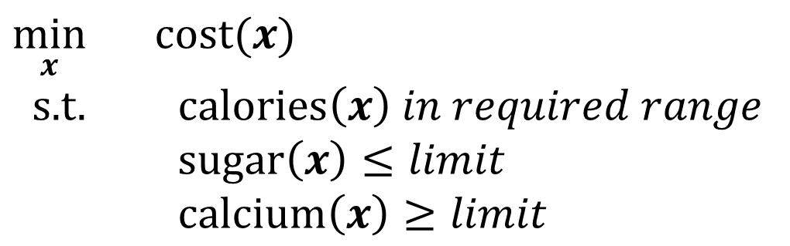


Problem Formulation
Formulate Diet Problem as an optimization problem
$\min_{x}{ cost(x)}$
s.t. $calories\left(x\right)$ 𝑖𝑛 𝑟𝑒𝑞𝑢𝑖𝑟𝑒𝑑 𝑟𝑎𝑛𝑔𝑒
$sugar\left(x\right)≤limit$
$calcium\left(x\right)≥limit$
Healthy Squad Goals
2000 $≤$ Calories $≤$ 2500
Sugar $≤$ 100 g
Calcium $≥$ 700 mg
$x={[x_{1},x_{2}]}^{T}$. $x_{1}$: ounces for stir-fry, $x_{2}$: ounces for boba
What is the expression of
$$cost(x)$$
$$calories\left(x\right)$$
Food | Cost | Calories | Sugar | Calcium
Stir-fry (per oz) | 1 | 100 | 3 | 20
Boba (per fl oz) | 0.5 | 50 | 4 | 70
$$sugar\left(x\right)$$
$$calcium\left(x\right)$$

Slide 16




Problem Formulation
Formulate Diet Problem as an optimization problem
$\min_{x}{ cost(x)}$
s.t. $calories\left(x\right)$ 𝑖𝑛 𝑟𝑒𝑞𝑢𝑖𝑟𝑒𝑑 𝑟𝑎𝑛𝑔𝑒
$sugar\left(x\right)≤limit$
$calcium\left(x\right)≥limit$
Healthy Squad Goals
2000 $≤$ Calories $≤$ 2500
Sugar $≤$ 100 g
Calcium $≥$ 700 mg
$x={[x_{1},x_{2}]}^{T}$. $x_{1}$: ounces for stir-fry, $x_{2}$: ounces for boba
What is the expression of
$$cost\left(x\right)=x_{1}+0.5x_{2}$$
$$calories\left(x\right)=100x_{1}+50x_{2}$$
Food | Cost | Calories | Sugar | Calcium
Stir-fry (per oz) | 1 | 100 | 3 | 20
Boba (per fl oz) | 0.5 | 50 | 4 | 70
$$sugar\left(x\right)=3x_{1}+4x_{2}$$
$$calcium\left(x\right)=20x_{1}+70x_{2}$$

Slide 17
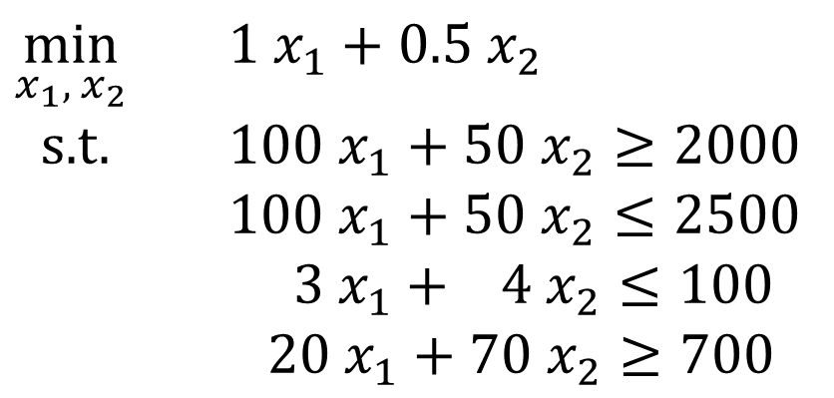
Problem Formulation
Formulate Diet Problem as an optimization problem
$\min_{x_{1}, { x}_{2}}{ {1 x}_{1}+0.5 x_{2}}$
s.t. $100 x_{1}+50 x_{2}≥2000$
$100 x_{1}+50 x_{2}≤2500$
$3 x_{1}+ 4 x_{2}≤100$
$20 x_{1}+70 x_{2}≥700$
Healthy Squad Goals
2000 $≤$ Calories $≤$ 2500
Sugar $≤$ 100 g
Calcium $≥$ 700 mg
Food | Cost | Calories | Sugar | Calcium
Stir-fry (per oz) | 1 | 100 | 3 | 20
Boba (per fl oz) | 0.5 | 50 | 4 | 70

Slide 18
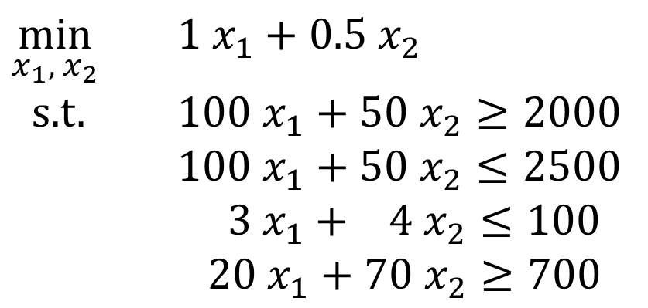
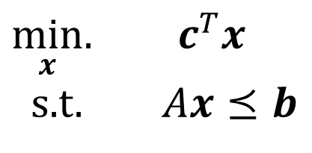
Linear Programming
Linear Programming:
Technique for the optimization of a linear objective function subject to linear equality and linear inequality constraints
Example Linear program
Linear program in Inequality Form
$\min_{x_{1}, { x}_{2}}{ {1 x}_{1}+0.5 x_{2}}$
s.t. $100 x_{1}+50 x_{2}≥2000$
$100 x_{1}+50 x_{2}≤2500$
$3 x_{1}+ 4 x_{2}≤100$
$20 x_{1}+70 x_{2}≥700$
$\min_{x}.{ c^{T}x}$
s.t. $Ax⪯b$

Slide 19

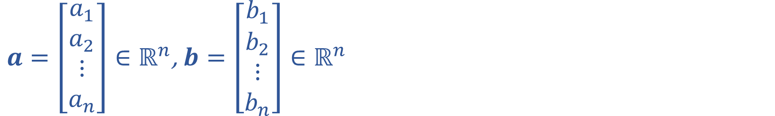
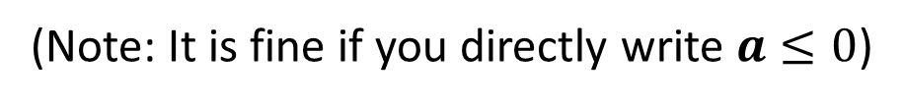

Recap of Linear Algebra
$a=\left[\begin{matrix}a_{1} \\ a_{2} \\ \begin{aligned}⋮ \\ a_{n}\end{aligned}\end{matrix}\right]∈ℝ^{n}$, $b=\left[\begin{matrix}b_{1} \\ b_{2} \\ \begin{aligned}⋮ \\ b_{n}\end{aligned}\end{matrix}\right]∈ℝ^{n}$
What is $a+b$? $a−b$?
What does $a⪯0$ mean?
(Note: It is fine if you directly write $a≤0$)

Slide 20

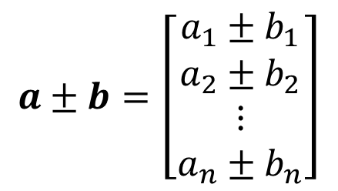
Recap of Linear Algebra
$a=\left[\begin{matrix}a_{1} \\ a_{2} \\ \begin{aligned}⋮ \\ a_{n}\end{aligned}\end{matrix}\right]∈ℝ^{n}$, $b=\left[\begin{matrix}b_{1} \\ b_{2} \\ \begin{aligned}⋮ \\ b_{n}\end{aligned}\end{matrix}\right]∈ℝ^{n}$
What is $a+b$? $a−b$?
What does $a⪯0$ mean?
$$a±b=\left[\begin{matrix}a_{1}±b_{1} \\ a_{2}±b_{2} \\ \begin{aligned}⋮ \\ a_{n}±b_{n}\end{aligned}\end{matrix}\right]$$
$$∀i, a_{i}≤0$$
(Note: It is fine if you directly write $a≤0$)

Slide 21
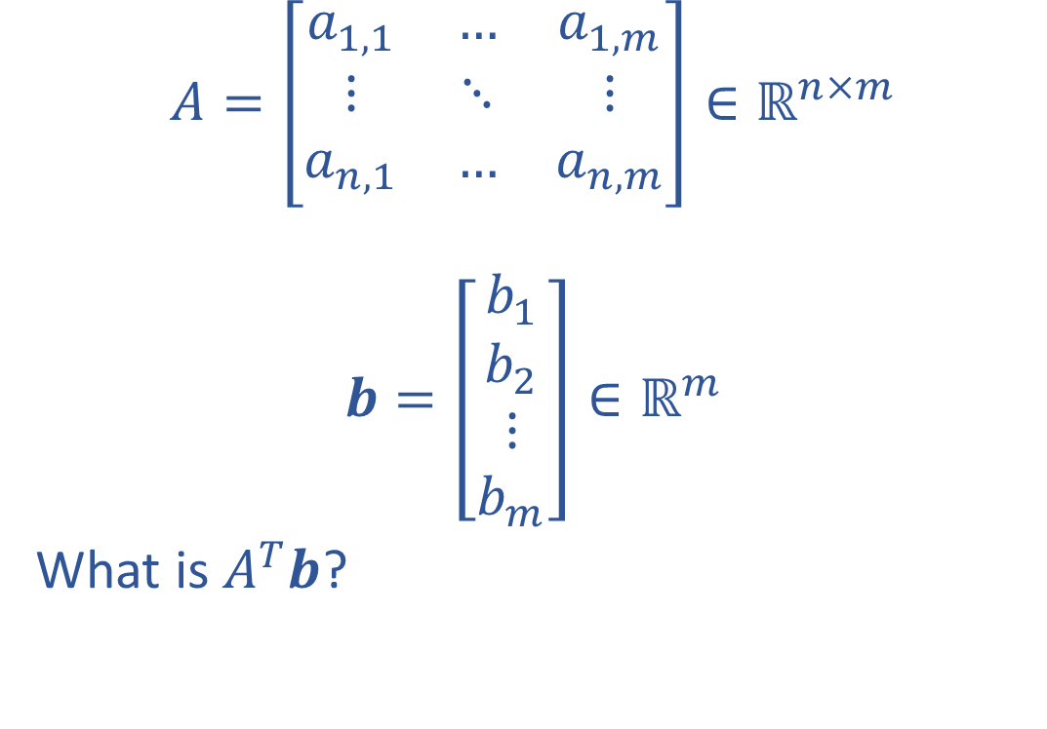
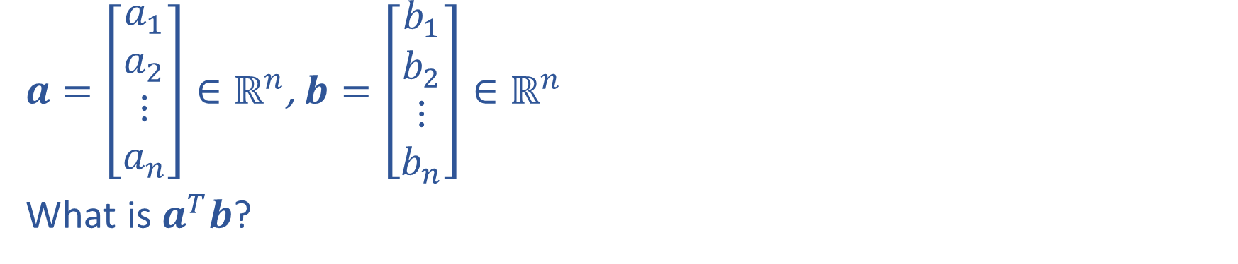
Recap of Linear Algebra
$$A=\left[\begin{matrix}a_{1,1} & … & a_{1,m} \\ ⋮ & ⋱ & ⋮ \\ a_{n,1} & … & a_{n,m}\end{matrix}\right]∈ℝ^{n×m}$$
$$b=\left[\begin{matrix}b_{1} \\ b_{2} \\ \begin{aligned}⋮ \\ b_{m}\end{aligned}\end{matrix}\right]∈ℝ^{m}$$
What is $A^{T}b$?
$a=\left[\begin{matrix}a_{1} \\ a_{2} \\ \begin{aligned}⋮ \\ a_{n}\end{aligned}\end{matrix}\right]∈ℝ^{n}$, $b=\left[\begin{matrix}b_{1} \\ b_{2} \\ \begin{aligned}⋮ \\ b_{n}\end{aligned}\end{matrix}\right]∈ℝ^{n}$
What is $a^{T}b$?

Slide 22
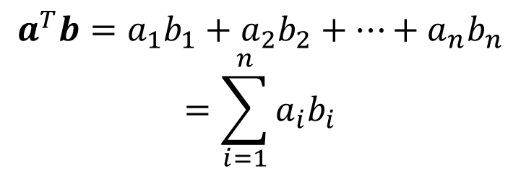
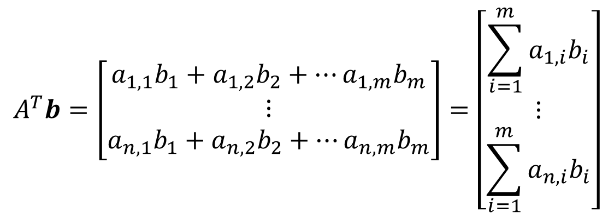
Recap of Linear Algebra
$$A=\left[\begin{matrix}a_{1,1} & … & a_{1,m} \\ ⋮ & ⋱ & ⋮ \\ a_{n,1} & … & a_{n,m}\end{matrix}\right]∈ℝ^{n×m}$$
$$b=\left[\begin{matrix}b_{1} \\ b_{2} \\ \begin{aligned}⋮ \\ b_{m}\end{aligned}\end{matrix}\right]∈ℝ^{m}$$
What is $A^{T}b$?
$a=\left[\begin{matrix}a_{1} \\ a_{2} \\ \begin{aligned}⋮ \\ a_{n}\end{aligned}\end{matrix}\right]∈ℝ^{n}$, $b=\left[\begin{matrix}b_{1} \\ b_{2} \\ \begin{aligned}⋮ \\ b_{n}\end{aligned}\end{matrix}\right]∈ℝ^{n}$
What is $a^{T}b$?
$$a^{T}b=a_{1}b_{1}+a_{2}b_{2}+…+a_{n}b_{n}$$
$$=\sum_{i=1}^{n}{a_{i}b_{i}}$$
$$A^{T}b=\left[\begin{matrix}a_{1,1}b_{1}+a_{1,2}b_{2}+…a_{1,m}b_{m} \\ ⋮ \\ a_{n,1}b_{1}+a_{n,2}b_{2}+…a_{n,m}b_{m}\end{matrix}\right]=\left[\begin{matrix}\sum_{i=1}^{m}{a_{1,i}b_{i}} \\ ⋮ \\ \sum_{i=1}^{m}{a_{n,i}b_{i}}\end{matrix}\right]$$

Slide 23
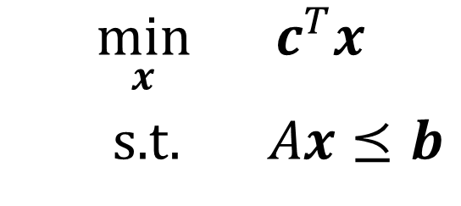
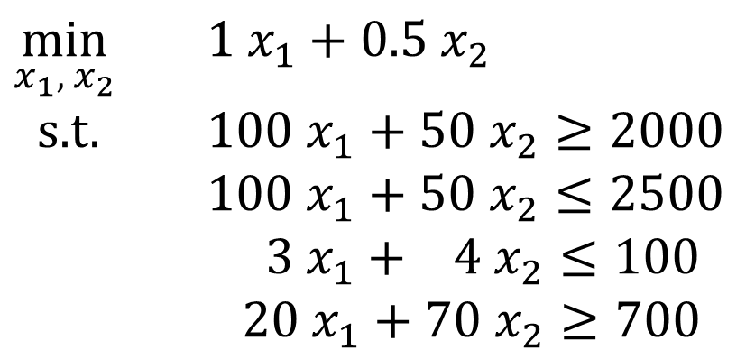

Problem Formulation
$\min_{x_{1}, { x}_{2}}{ {1 x}_{1}+0.5 x_{2}}$
s.t. $100 x_{1}+50 x_{2}≥2000$
$100 x_{1}+50 x_{2}≤2500$
$3 x_{1}+ 4 x_{2}≤100$
$20 x_{1}+70 x_{2}≥700$
Convert it into the following inequality form, what should $c$, $A$, and $b$ be?
$$\min_{x}{ c^{T}x}$$
s.t. $Ax⪯b$

Slide 24
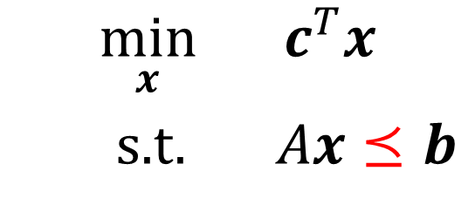


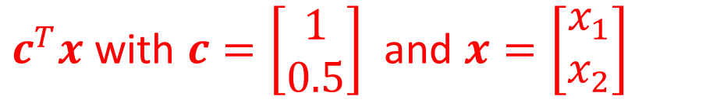
Problem Formulation
$c^{T}x$ with $c=\left[\begin{aligned}1 \\ 0.5\end{aligned}\right]$ and $x=\left[\begin{aligned}x_{1} \\ x_{2}\end{aligned}\right]$
$\min_{x_{1}, { x}_{2}}{ {1 x}_{1}+0.5 x_{2}}$
s.t. $100 x_{1}+50 x_{2}≥2000$
$100 x_{1}+50 x_{2}≤2500$
$3 x_{1}+ 4 x_{2}≤100$
$20 x_{1}+70 x_{2}≥700$
$$−100 x_{1}−50 x_{2}≤−2000$$
$$−20 x_{1}−70 x_{2}≤−700$$
Convert it into the following inequality form, what should $c$, $A$, and $b$ be?
$$\min_{x}{ c^{T}x}$$
s.t. $Ax⪯b$

Slide 25
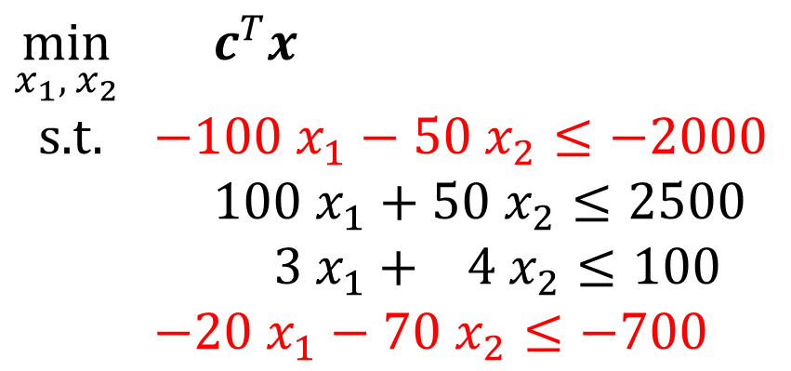
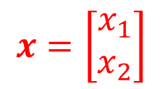
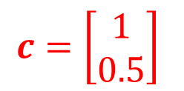
Problem Formulation
$$c=\left[\begin{aligned}1 \\ 0.5\end{aligned}\right]$$
$$x=\left[\begin{aligned}x_{1} \\ x_{2}\end{aligned}\right]$$
$\min_{x_{1}, { x}_{2}}{ c^{T}x}$
s.t. $−100 x_{1}−50 x_{2}≤−2000$
$100 x_{1}+50 x_{2}≤2500$
$3 x_{1}+ 4 x_{2}≤100$
$−20 x_{1}−70 x_{2}≤−700$
Convert it into the following inequality form, what should $c$, $A$, and $b$ be?
$$\min_{x}{ c^{T}x}$$
s.t. $Ax⪯b$

Slide 26
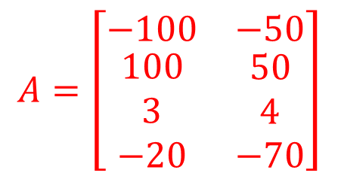
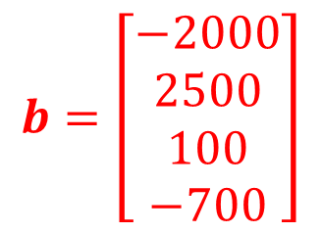
Problem Formulation
$$c=\left[\begin{aligned}1 \\ 0.5\end{aligned}\right]$$
$$x=\left[\begin{aligned}x_{1} \\ x_{2}\end{aligned}\right]$$
$\min_{x_{1}, { x}_{2}}{ c^{T}x}$
s.t. $−100 x_{1}−50 x_{2}≤−2000$
$100 x_{1}+50 x_{2}≤2500$
$3 x_{1}+ 4 x_{2}≤100$
$−20 x_{1}−70 x_{2}≤−700$
$$A=\left[\begin{matrix}−100 & −50 \\ \begin{aligned}100 \\ 3 \\ −20\end{aligned} & \begin{aligned}50 \\ 4 \\ −70\end{aligned}\end{matrix}\right]$$
$$b=\left[\begin{aligned}−2000 \\ 2500 \\ 100 \\ −700\end{aligned}\right]$$
Convert it into the following inequality form, what should $c$, $A$, and $b$ be?
$$\min_{x}{ c^{T}x}$$
s.t. $Ax⪯b$

Slide 27
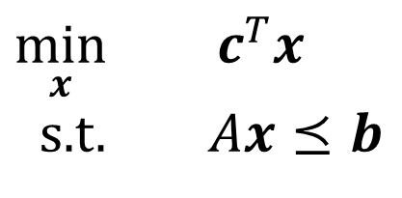
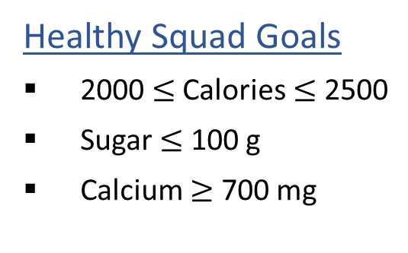
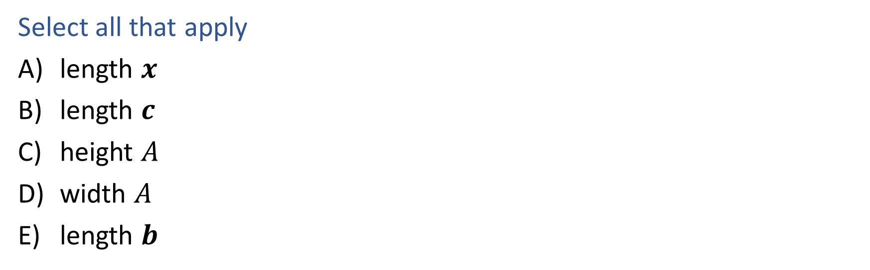
Question
What has to increase to add more menu items?
$\min_{x}{ c^{T}x}$
s.t. $Ax⪯b$
Healthy Squad Goals
2000 $≤$ Calories $≤$ 2500
Sugar $≤$ 100 g
Calcium $≥$ 700 mg
Select all that apply
length $x$
length $c$
height $A$
width $A$
length $b$
Food | Cost | Calories | Sugar | Calcium
Stir-fry (per oz) | 1 | 100 | 3 | 20
Boba (per fl oz) | 0.5 | 50 | 4 | 70
New Item | … | … | … | …

Slide 28
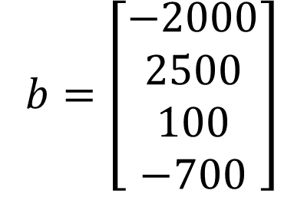
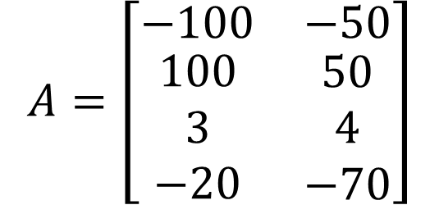
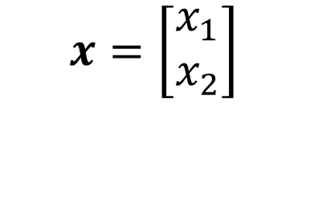
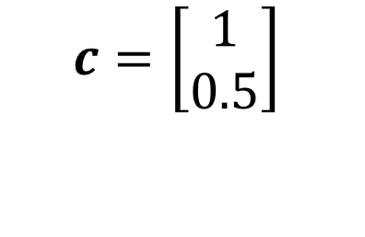
Question
What has to increase to add more menu items?
$\min_{x}{ c^{T}x}$
s.t. $Ax⪯b$
Healthy Squad Goals
2000 $≤$ Calories $≤$ 2500
Sugar $≤$ 100 g
Calcium $≥$ 700 mg
$$x=\left[\begin{aligned}x_{1} \\ x_{2}\end{aligned}\right]$$
$$c=\left[\begin{aligned}1 \\ 0.5\end{aligned}\right]$$
$$A=\left[\begin{matrix}−100 & −50 \\ \begin{aligned}100 \\ 3 \\ −20\end{aligned} & \begin{aligned}50 \\ 4 \\ −70\end{aligned}\end{matrix}\right]$$
$$b=\left[\begin{aligned}−2000 \\ 2500 \\ 100 \\ −700\end{aligned}\right]$$
Food | Cost | Calories | Sugar | Calcium
Stir-fry (per oz) | 1 | 100 | 3 | 20
Boba (per fl oz) | 0.5 | 50 | 4 | 70
Beef (per oz) | 2 | 80 | 1 | 30

Slide 29
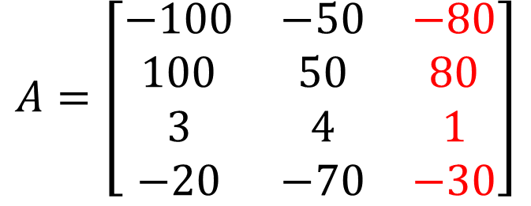
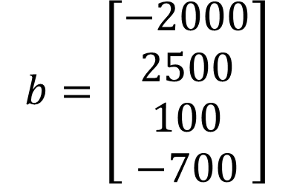
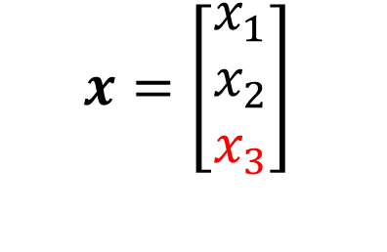
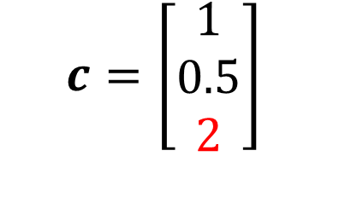
Question
What has to increase to add more menu items?
$\min_{x}{ c^{T}x}$
s.t. $Ax⪯b$
Healthy Squad Goals
2000 $≤$ Calories $≤$ 2500
Sugar $≤$ 100 g
Calcium $≥$ 700 mg
$$x=\left[\begin{aligned}x_{1} \\ x_{2} \\ x_{3}\end{aligned}\right]$$
$$c=\left[\begin{aligned}1 \\ 0.5 \\ 2\end{aligned}\right]$$
$$A=\left[\begin{matrix}−100 & −50 & −80 \\ 100 & 50 & 80 \\ 3 & 4 & 1 \\ −20 & −70 & −30\end{matrix}\right]$$
$$b=\left[\begin{aligned}−2000 \\ 2500 \\ 100 \\ −700\end{aligned}\right]$$
Food | Cost | Calories | Sugar | Calcium
Stir-fry (per oz) | 1 | 100 | 3 | 20
Boba (per fl oz) | 0.5 | 50 | 4 | 70
Beef (per oz) | 2 | 80 | 1 | 30

Slide 30
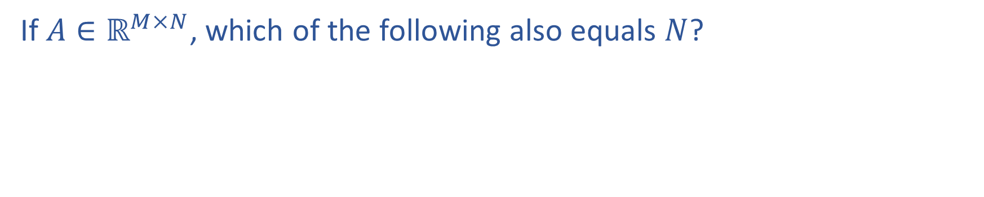
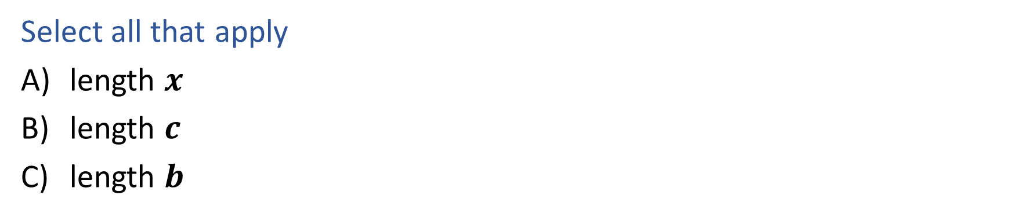
Question
If $A∈ℝ^{M×N}$, which of the following also equals $N$?
$\min_{x}{ c^{T}x}$
s.t. $Ax⪯b$
Select all that apply
length $x$
length $c$
length $b$

Slide 31
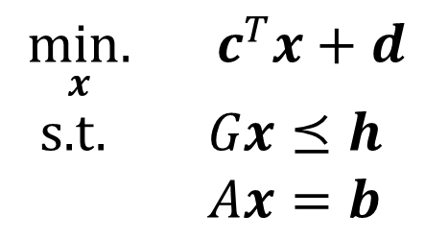
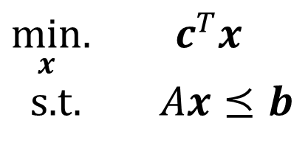
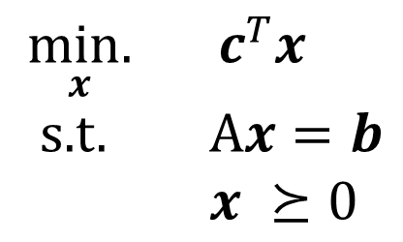
Linear Programming
Different forms
Inequality form
General form
Standard form
$\min_{x}.{ c^{T}x}$
s.t. $Ax⪯b$
$\underset{x}{min.}{ c^{T}x}+d$
s.t. $Gx⪯h$
$Ax=b$
$\underset{x}{min.}{ c^{T}x}$
s.t. A$x=b$
$x ⪰0$
Important to pay attention to form!
Can switch between formulations!
Note: Different books have different definitions. We will refer to the forms in this slide (also consistent with B&V book).

Slide 32
Focus of Today: (Linear) Optimization Problem
Problem Description
Graphical Representation
Linear Programming
Linear Program Formulation
$$\min_{x}{ c^{T}x}$$
s.t. $Ax⪯b$

Slide 33




Shape of Linear Equality
Geometry / Algebra Question
What is the equality present this line?
$$x_{2}$$
$$2$$
$$3$$
$$x_{1}$$

Slide 34

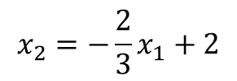

Shape of Linear Equality
Geometry / Algebra Question
What is the equality present this line?
$$x_{2}=−\frac{2}{3}x_{1}+2$$
$$x_{2}$$
To make sure the line intersects with the axes at (3,0) and (0,2)
$$2$$
$$3x_{2}+2x_{1}=6$$
$$2x_{1}+3x_{2}=6$$
$$3$$
$$x_{1}$$

Slide 35

Shape of Linear Inequality
Geometry / Algebra Question
What shape does this inequality represent?
$$a_{1} x_{1}+a_{2} x_{2}≤b_{1}$$

Slide 36


Shape of Linear Inequality
Geometry / Algebra Question
What shape does this inequality represent?
$$a_{1} x_{1}+a_{2} x_{2}≤b_{1}$$
$$2x_{1}+3x_{2}≥6$$
$$≡$$
$$−2x_{1}−3x_{2}≤−6$$
Half Plane
$$x_{2}$$
$$a_{1} x_{1}+a_{2} x_{2}=b_{1}$$
Line
$$2$$
$$2x_{1}+3x_{2}=6$$
$$3$$
$$x_{1}$$

Slide 37

Shape of Linear Inequality
Geometry / Algebra Question
What shape does these inequalities jointly represent?
$a_{1,1} x_{1}+a_{1,2} x_{2}≤b_{1}$
$a_{2,1} x_{1}+a_{2,2} x_{2}≤b_{2}$
$a_{3,1} x_{1}+a_{3,2} x_{2}≤b_{3}$
$a_{4,1} x_{1}+a_{4,2} x_{2}≤b_{4}$

Slide 38
Shape of Linear Inequality
Geometry / Algebra Question
What shape does these inequalities jointly represent?
$a_{1,1} x_{1}+a_{1,2} x_{2}≤b_{1}$
$a_{2,1} x_{1}+a_{2,2} x_{2}≤b_{2}$
$a_{3,1} x_{1}+a_{3,2} x_{2}≤b_{3}$
$a_{4,1} x_{1}+a_{4,2} x_{2}≤b_{4}$
$$x_{2}$$
Intersection of half planes
Could be polyhedron
Could be empty
$$x_{1}$$

Slide 39


Lowering Cost
Given the cost vector ${\left[c_{1}, c_{2}\right]}^{T}$ and initial point $x^{(0)}$,
Which unit vector step $△x$ will cause $x^{(1)}=x^{(0)}+△x$
to have the lowest cost $c^{T}x^{(1)}$?
B
A
$$c$$
C
D

Slide 40


Lowering Cost
Given the cost vector ${\left[c_{1}, c_{2}\right]}^{T}$ and initial point $x^{(0)}$,
Which unit vector step $△x$ will cause $x^{(1)}=x^{(0)}+△x$
to have the lowest cost $c^{T}x^{(1)}$?
$$c^{T}x^{(1)}=c^{T}\left(x^{\left(0\right)}+△x\right)=c^{T}x^{(0)}+c^{T}△x$$
$$c$$
$$c^{T}△x=\left|c\right|\left|△x\right|\cos\left(c,△x\right)$$
$$△x$$
$\cos\left(c,△x\right)=−1$ when $c$ and $△x$have opposite directions

Slide 41




Cost Contours
Given the cost vector ${\left[c_{1}, c_{2}\right]}^{T}$ where will
$c^{T}x$ = 0 ?
$$x_{2}$$
$$c$$
$$x_{1}$$

Slide 42

Cost Contours
Given the cost vector ${\left[c_{1}, c_{2}\right]}^{T}$ where will
$c^{T}x$ = 0 ?
$$x_{2}$$
$$c$$
$$c$$
$$x_{1}$$

Slide 43


Cost Contours
$$c$$
Given the cost vector ${\left[c_{1}, c_{2}\right]}^{T}$ where will
$c^{T}x$ = 0 ?
$c^{T}x$ = 1 ?
$c^{T}x$ = 2 ?
$c^{T}x$ = -1 ?
$c^{T}x$ = -2 ?
$$x_{2}$$
$$x_{1}$$

Slide 44




Cost Contours
$$c$$
Given the cost vector ${\left[c_{1}, c_{2}\right]}^{T}$ where will
$c^{T}x$ = 0 ?
$c^{T}x$ = 1 ?
$c^{T}x$ = 2 ?
$c^{T}x$ = -1 ?
$c^{T}x$ = -2 ?
$$x_{2}$$
$c^{T}x$ = 2
$c^{T}x$ = 1
$c^{T}x$ = 0
$c^{T}x$ = -1
$$x_{1}$$

Slide 45


Optimizing Cost
Given the cost vector ${\left[c_{1}, c_{2}\right]}^{T}$, which point in the red polyhedron below can minimize $c^{T}x$?
$$x_{2}$$
$$c$$
$c^{T}x$ = 2
$c^{T}x$ = 1
$c^{T}x$ = 0
$c^{T}x$ = -1
$$x_{1}$$

Slide 46
Optimizing Cost
Given the cost vector ${\left[c_{1}, c_{2}\right]}^{T}$, which point in the red polyhedron below can minimize $c^{T}x$?
$$x_{2}$$
$$c$$
$c^{T}x$ = 2
$c^{T}x$ = 1
$c^{T}x$ = 0
$c^{T}x$ = -1
$$x_{1}$$
Optimal point

Slide 47





LP Graphical Representation
Inequality form
$$c$$
$\min_{x}.{ c^{T}x}$
s.t. $Ax⪯b$
Objective Function
Feasible Region
$$x_{2}$$
$a_{1,1} x_{1}+a_{1,2} x_{2}≤b_{1}$
$a_{2,1} x_{1}+a_{2,2} x_{2}≤b_{2}$
$a_{3,1} x_{1}+a_{3,2} x_{2}≤b_{3}$
$a_{4,1} x_{1}+a_{4,2} x_{2}≤b_{4}$
$$x_{1}$$

Slide 48
Focus of Today: (Linear) Optimization Problem
Problem Description
Graphical Representation
Linear Programming
Linear Program Formulation
$$\min_{x}{ c^{T}x}$$
s.t. $Ax⪯b$

Slide 49
Warm-up: What to eat?
We are trying healthy by finding the optimal amount of food to purchase.
We can choose the amount of stir-fry (ounce) and boba (fluid ounces).
Healthy Squad Goals
2000 $≤$ Calories $≤$ 2500
Sugar $≤$ 100 g
Calcium $≥$ 700 mg
Food | Cost | Calories | Sugar | Calcium
Stir-fry (per oz) | 1 | 100 | 3 | 20
Boba (per fl oz) | 0.5 | 50 | 4 | 70
What is the cheapest way to stay “healthy” with this menu?
How much stir-fry (ounce) and boba (fluid ounces) should we buy?

Slide 50




Healthy Squad Goals
2000 $≤$ Calories $≤$ 2500
Sugar $≤$ 100 g
Calcium $≥$ 700 mg
$\min_{x_{1}, { x}_{2}}{ {1 x}_{1}+0.5 x_{2}}$
s.t. $100 x_{1}+50 x_{2}≥2000$
$100 x_{1}+50 x_{2}≤2500$
$3 x_{1}+ 4 x_{2}≤100$
$20 x_{1}+70 x_{2}≥700$
$$x_{2}$$
What is the feasible region?
What is the optimal solution?
$$x_{1}$$

Slide 51
Healthy Squad Goals
2000 $≤$ Calories $≤$ 2500
Sugar $≤$ 100 g
Calcium $≥$ 700 mg
$\min_{x_{1}, { x}_{2}}{ {1 x}_{1}+0.5 x_{2}}$
s.t. $100 x_{1}+50 x_{2}≥2000$
$100 x_{1}+50 x_{2}≤2500$
$3 x_{1}+ 4 x_{2}≤100$
$20 x_{1}+70 x_{2}≥700$
$$x_{2}$$
Optimal point
What is the feasible region?
What is the optimal solution?
$$x_{1}$$

Slide 52


Healthy Squad Goals
Calories $≥$ 2500
Sugar $≥$ 100 g
Calcium $≥$ 700 mg
$\min_{x_{1}, { x}_{2}}{ {1 x}_{1}+0.5 x_{2}}$
s.t. $100 x_{1}+50 x_{2}≥2500$
$3 x_{1}+ 4 x_{2}≥100$
$$x_{2}$$
What is the feasible region?
What is the optimal solution?
$$x_{1}$$

Slide 53
Healthy Squad Goals
Calories $≥$ 2500
Sugar $≥$ 100 g
Calcium $≥$ 700 mg
$\min_{x_{1}, { x}_{2}}{ {1 x}_{1}+0.5 x_{2}}$
s.t. $100 x_{1}+50 x_{2}≥2500$
$3 x_{1}+ 4 x_{2}≥100$
Optimal point
$$x_{2}$$
What is the feasible region?
What is the optimal solution?
$$x_{1}$$

Slide 54


Healthy Squad Goals
Calories $≤2000$
Sugar $≤$ 100 g
$\min_{x_{1}, { x}_{2}}{ {1 x}_{1}+0.5 x_{2}}$
s.t. $100 x_{1}+50 x_{2}≤2000$
$3 x_{1}+ 4 x_{2}≤100$
$$x_{2}$$
What is the feasible region?
What is the optimal solution?
$$x_{1}$$

Slide 55
Healthy Squad Goals
Calories $≤2000$
Sugar $≤$ 100 g
$\min_{x_{1}, { x}_{2}}{ {1 x}_{1}+0.5 x_{2}}$
s.t. $100 x_{1}+50 x_{2}≤2000$
$3 x_{1}+ 4 x_{2}≤100$
$$x_{2}$$
What is the feasible region?
What is the optimal solution?
Problem unbounded!
$$x_{1}$$

Slide 56

Healthy Squad Goals
Calories $≤2000$
Sugar $≤$ 100 g
$\min_{x_{1}, { x}_{2}}{ {1 x}_{1}+0.5 x_{2}}$
s.t. $100 x_{1}+50 x_{2}≤2000$
$3 x_{1}+ 4 x_{2}≤100$
$$x_{1}≥0$$
$$x_{2}≥0$$
$$x_{2}$$
What is the feasible region?
What is the optimal solution?
$$x_{1}$$

Slide 57
Healthy Squad Goals
Calories $≤2000$
Sugar $≤$ 100 g
$\min_{x_{1}, { x}_{2}}{ {1 x}_{1}+0.5 x_{2}}$
s.t. $100 x_{1}+50 x_{2}≤2000$
$3 x_{1}+ 4 x_{2}≤100$
$$x_{1}≥0$$
$$x_{2}≥0$$
$$x_{2}$$
What is the feasible region?
What is the optimal solution?
Optimal point
$$x_{1}$$

Slide 58


Healthy Squad Goals
2000 $≤$ Calories $≤$ 2500
Sugar $≥$ 100 g
Calcium $≤$ 700 mg
$\min_{x_{1}, { x}_{2}}{ {1 x}_{1}+0.5 x_{2}}$
s.t. $100 x_{1}+50 x_{2}≥2000$
$100 x_{1}+50 x_{2}≤2500$
$3 x_{1}+ 4 x_{2}≥100$
$20 x_{1}+70 x_{2}≤700$
$$x_{2}$$
What is the feasible region?
What is the optimal solution?
$$x_{1}$$

Slide 59
Healthy Squad Goals
2000 $≤$ Calories $≤$ 2500
Sugar $≥$ 100 g
Calcium $≤$ 700 mg
$\min_{x_{1}, { x}_{2}}{ {1 x}_{1}+0.5 x_{2}}$
s.t. $100 x_{1}+50 x_{2}≥2000$
$100 x_{1}+50 x_{2}≤2500$
$3 x_{1}+ 4 x_{2}≥100$
$20 x_{1}+70 x_{2}≤700$
$$x_{2}$$
What is the feasible region?
What is the optimal solution?
Infeasible!
$$x_{1}$$

Slide 60
Solving an LP
Solutions are at feasible intersections
of constraint boundaries!
Algorithms
Vertex enumeration: Find all vertices of feasible region (feasible intersections), check objective value

Slide 61



Solving an LP
But, how do we find the intersections?
$$A=\left[\begin{matrix}−100 & −50 \\ \begin{aligned}100 \\ 3 \\ −20\end{aligned} & \begin{aligned}50 \\ 4 \\ −70\end{aligned}\end{matrix}\right]$$
$$b=\left[\begin{aligned}−2000 \\ 2500 \\ 100 \\ −700\end{aligned}\right]$$
Calorie min
$\min_{x}{ c^{T}x}$
s.t. $Ax⪯b$
Calorie max
Sugar
Calcium
A point is the intersection of two lines
Pick two lines: two rows in $A$ matrix time $x$ equals the corresponding rows in $b$
Intersection
$$100 x_{1}+50 x_{2}=2000$$
$$3 x_{1}+ 4 x_{2}=100$$
Not any pair of rows can lead to an intersection
$$100 x_{1}+50 x_{2}=2000$$
$$100 x_{1}+50 x_{2}=2500$$

Slide 62
Solving an LP
Solutions are at feasible intersections
of constraint boundaries!
Algorithms
Vertex enumeration: Find all vertices of feasible region (feasible intersections), check objective value
Simplex: Start with an arbitrary vertex. Iteratively move to a best neighboring vertex until no better neighbor found
Simplex is most similar to which Local Search algorithm?
Hill Climbing!

Slide 63
Solving an LP
Solutions are at feasible intersections
of constraint boundaries!
Algorithms
Vertex enumeration: Find all vertices of feasible region (feasible intersections), check objective value
Simplex: Start with an arbitrary vertex. Iteratively move to a best neighboring vertex until no better neighbor found

Slide 64




Solving an LP
But, how do we find a neighboring intersection?
$$A=\left[\begin{matrix}−100 & −50 \\ \begin{aligned}100 \\ 3 \\ −20\end{aligned} & \begin{aligned}50 \\ 4 \\ −70\end{aligned}\end{matrix}\right]$$
$$b=\left[\begin{aligned}−2000 \\ 2500 \\ 100 \\ −700\end{aligned}\right]$$
Calorie min
$\min_{x}{ c^{T}x}$
s.t. $Ax⪯b$
Calorie max
Sugar
Calcium
Intersection determined by: two rows in $A$ matrix time $x$ equals the corresponding rows in $b$
$$100 x_{1}+50 x_{2}=2000$$
$$3 x_{1}+ 4 x_{2}=100$$
Intersection
A neighboring intersection only have one different row
Neighboring intersection
$$100 x_{1}+50 x_{2}=2000$$
$$20 x_{1}+70 x_{2}=700$$
$$100 x_{1}+50 x_{2}=2500$$
$$3 x_{1}+ 4 x_{2}=100$$
Neighboring intersection

Slide 65
Focus of Today: (Linear) Optimization Problem
Problem Description
Graphical Representation
Linear Programming
Linear Program Formulation
$$\min_{x}{ c^{T}x}$$
s.t. $Ax⪯b$

Slide 66

“Marty, your not thinking fourth-dimensionally”

Slide 67
Shapes in higher dimensions
How do these linear shapes extend to 3-D, N-D?
$$a_{1} x_{1}+a_{2} x_{2}=b_{1}$$
$$a_{1} x_{1}+a_{2} x_{2}≤b_{1}$$
$a_{1,1} x_{1}+a_{1,2} x_{2}≤b_{1}$
$a_{2,1} x_{1}+a_{2,2} x_{2}≤b_{2}$
$a_{3,1} x_{1}+a_{3,2} x_{2}≤b_{3}$
$a_{4,1} x_{1}+a_{4,2} x_{2}≤b_{4}$

Slide 68

What are intersections in higher dimensions?
How do these linear shapes extend to 3-D, N-D?
$$A=\left[\begin{matrix}−100 & −50 \\ \begin{aligned}100 \\ 3 \\ −20\end{aligned} & \begin{aligned}50 \\ 4 \\ −70\end{aligned}\end{matrix}\right]$$
$$b=\left[\begin{aligned}−2000 \\ 2500 \\ 100 \\ −700\end{aligned}\right]$$
Calorie min
$\min_{x}{ c^{T}x}$
s.t. $Ax⪯b$
Calorie max
Sugar
Calcium

Slide 69

How do we find intersections in higher dimensions?
Still looking at subsets of rows in the $A$ matrix
$$A=\left[\begin{matrix}−100 & −50 \\ \begin{aligned}100 \\ 3 \\ −20\end{aligned} & \begin{aligned}50 \\ 4 \\ −70\end{aligned}\end{matrix}\right]$$
$$b=\left[\begin{aligned}−2000 \\ 2500 \\ 100 \\ −700\end{aligned}\right]$$
Calorie min
$\min_{x}{ c^{T}x}$
s.t. $Ax⪯b$
Calorie max
Sugar
Calcium

Slide 70
Summary
Linear optimization problem handles continuous space but is closely connected to discrete space (only need to consider vertices)
For a problem with two variables, graphical representation is helpful
LP is a special class of optimization problems
Optimization Problems
Convex Problems
Gradient Descent
Linear Programming
Simplex

Slide 71


Gradient Descent/Ascent
Find $x∈[a,b]$ that minimize / maximizes $f\left(x\right)$?
  Gradient descent / ascent
    Use gradient to find best direction
    Use the magnitude of the gradient to determine how big a step you move
Convex Problems: Any local optima is global optima. Therefore, for convex problems, gradient descent/ascent leads to globally optimal solution.
Value space of variables

