Slide 1

Demystifying AI
Regression
Instructor: Pat Virtue

Slide 2
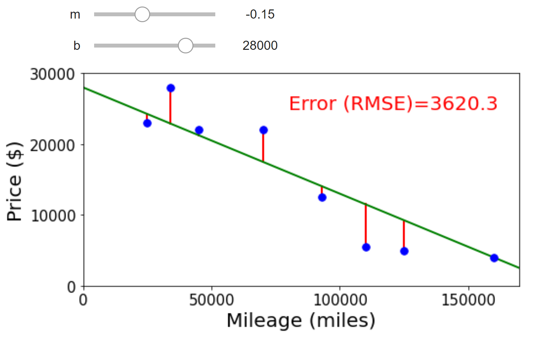
Regression
Regression: learning a model to predict a numerical output (but not numbers that just represent categories, that would be classification)
Example
Trying to see how much I should sell my car for. Looking up data from car websites, I find the mileage for a set of cars and the selling price for each car.

Slide 3
Poll 1
Linear model to predict car price:
Which of the following do need when doing prediction? Assume we have already finished training.
Select ALL that apply.
Mileage values from dataset
Price values from dataset
Final mean squared error from training
m parameter (slope)
b parameter (intercept)

Slide 4
ML: Linear Regression
Using (training) data to learn a model that we’ll later use for prediction
Training Data
Model
Training
Prediction
Model
Input
Predicted
Output

Slide 5
Training: Finding the Best Parameters
Searching for parameters that minimize mean squared error
y
x

Slide 6
Training a Model
Random search
Repeatedly choosing random combinations of parameters
Keep the parameters that have the lowest loss (mean squared error)
Grid search
Looping over a fixed set of parameter combinations
Keep the parameters that have the lowest loss (mean squared error)

Slide 7
Implementing Grid Search
Shared Drive Folder / Lec_9_10_Regression / Group N
regression_2_grid_search.ipynb

Slide 8
Visualizing our Parameter Search
Shared Drive Folder / Lec_9_10_Regression / Group N
regression_3_search_visualization.ipynb

Slide 9
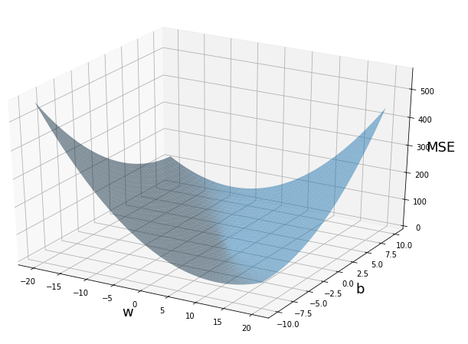
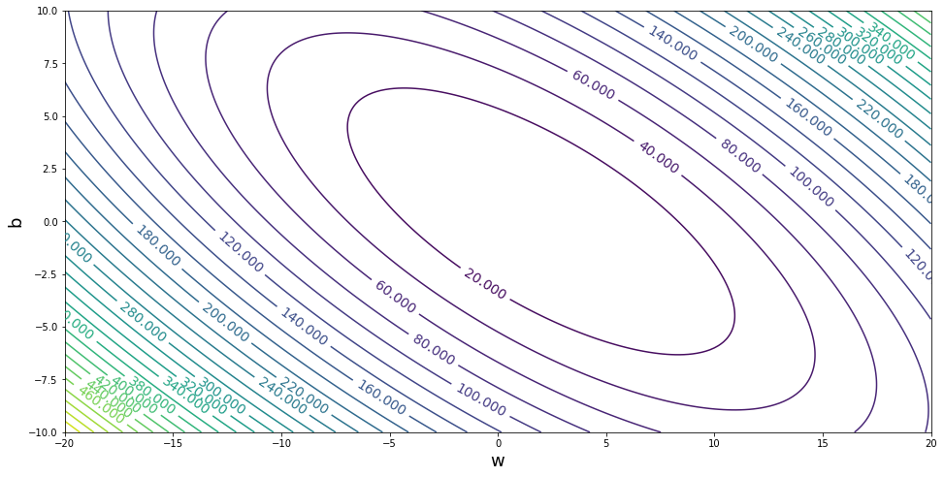




Training: Finding the Best Parameters
Optimizing the performance measure
Minimizing mean square error
$$b$$
$$m$$
$$b$$
$$m$$

Slide 10


Linear Regression
Methods for optimizing the objective
Grid search
Random search
(Solve for the minimum of this paraboloid)
Gradient descent
Performance measure:
Mean Squared Error
$$b$$
$$m$$

Slide 11
Gradient
Shared Drive Folder / Lec_9_10_Regression / Group N
regression_3_search_visualization.ipynb

Slide 12
Optimization
Gradients
$$b$$
$$m$$
$$b$$
$$m$$

Slide 13
Optimization
Gradients
$$b$$
$$m$$
$$b$$
$$m$$

Slide 14
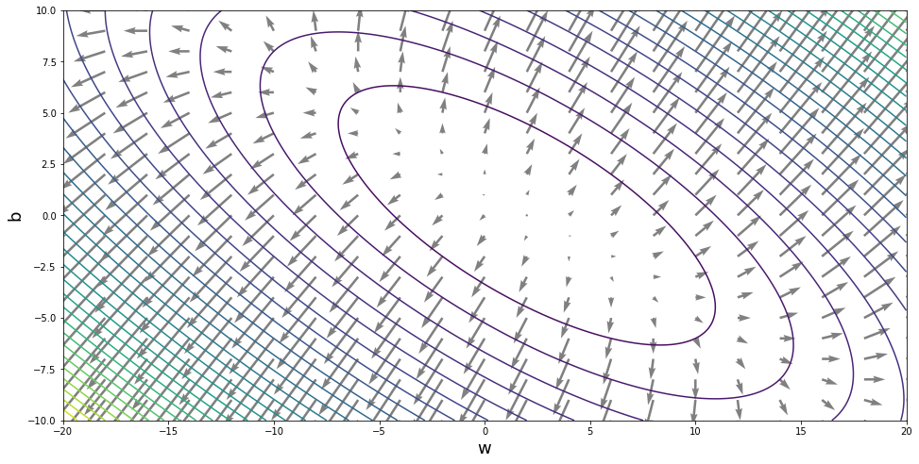
Optimization
Gradients
$$b$$
$$m$$
$$b$$
$$m$$

Slide 15
Adding More Input Features

Slide 16
Adding More Input Features
Coin values

Slide 17
Adding More Input Features
Alien coins

