Slide 1
Announcements
HW1
Gradescope, online
Due Wed 2/16

Slide 2

Demystifying AI Agent Design
Instructor: Pat Virtue

Slide 3
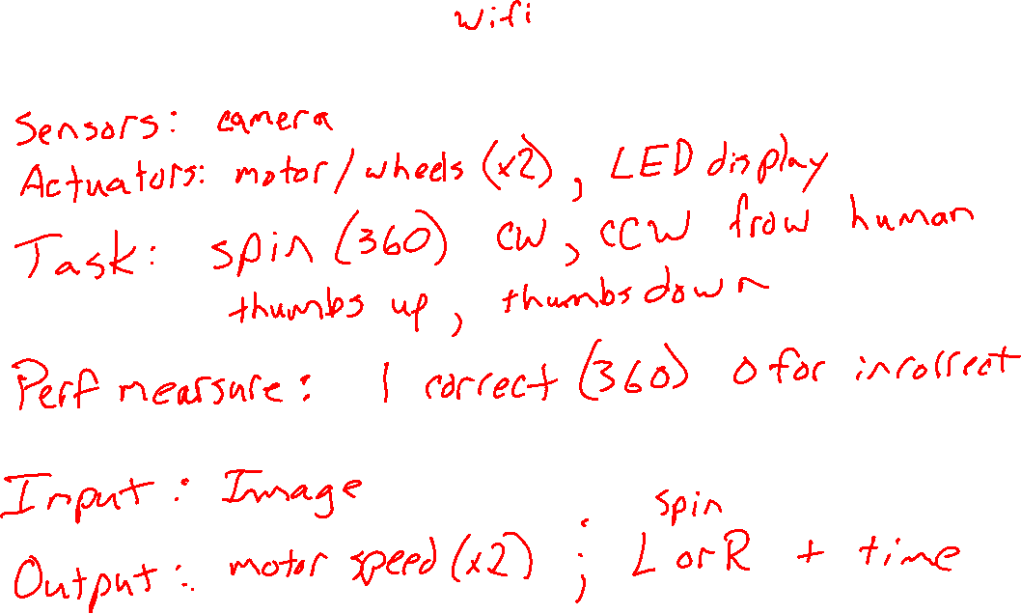
Jetbot Agent

Slide 4
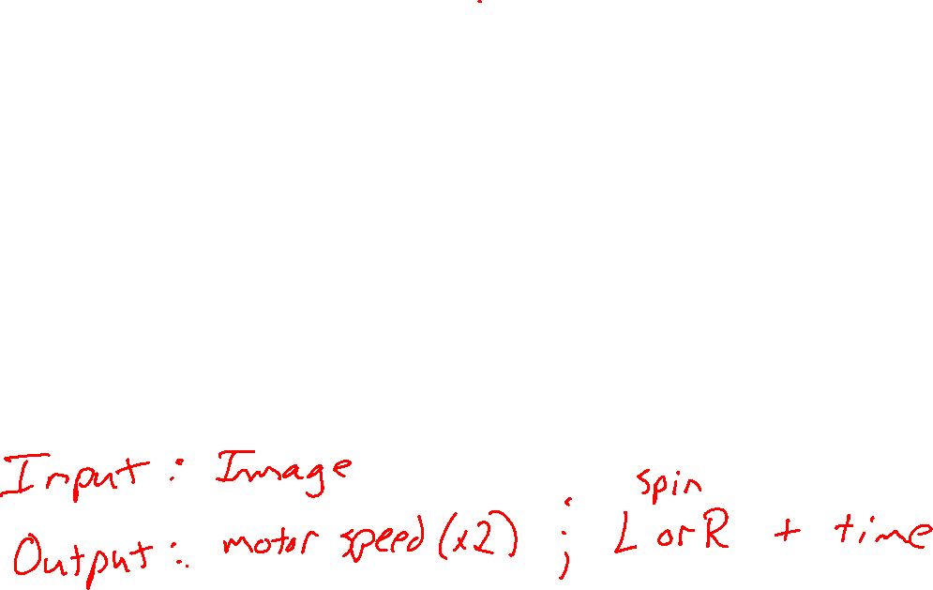
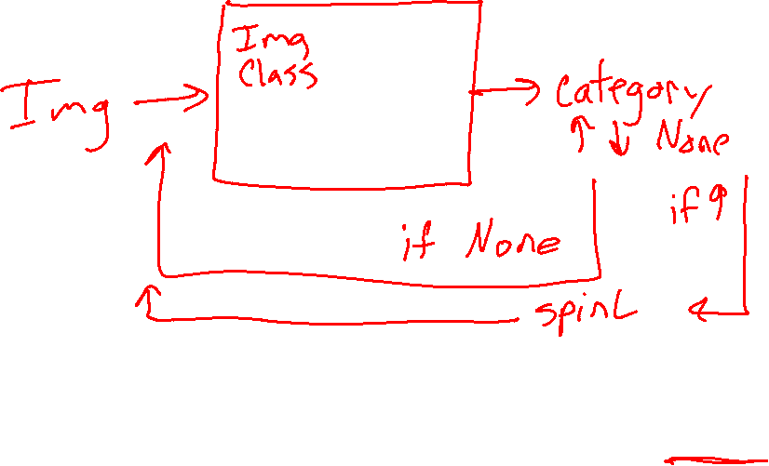
Jetbot Agent

Slide 5
Wordle Agent
https://www.powerlanguage.co.uk/wordle/

Slide 6

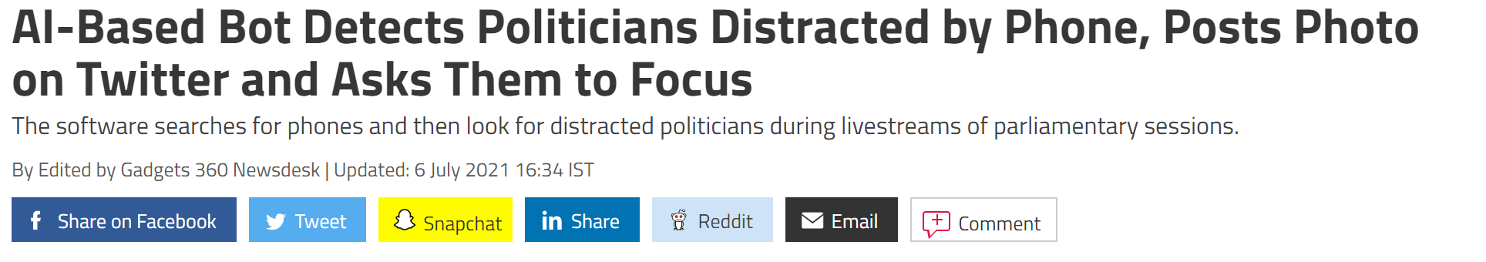
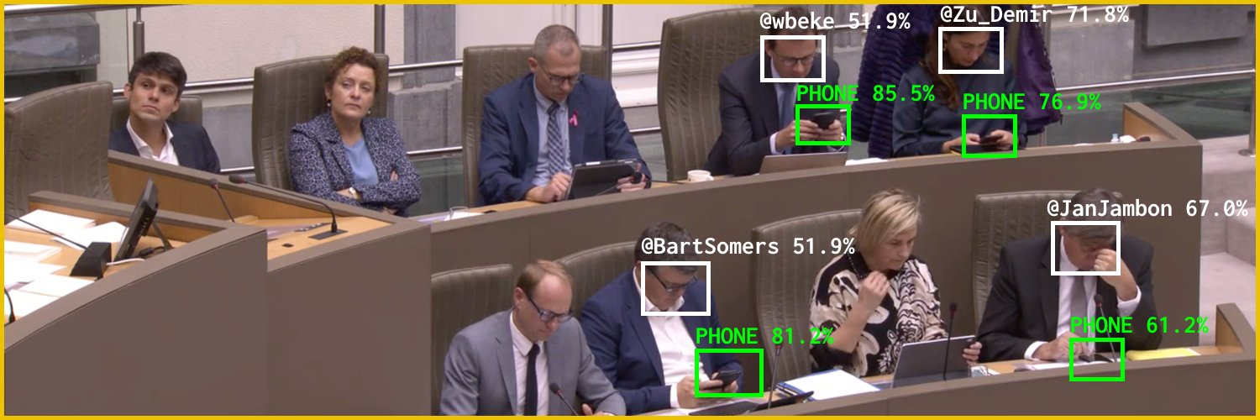
AI in the News
News:
https://gadgets.ndtv.com/social-networking/news/flemish-scrollers-ai-ml-bot-tool-software-belgium-politicians-distracted-phone-detect-troll-twitter-2480493
Source: Twitter @Flemish Scroller

Slide 7
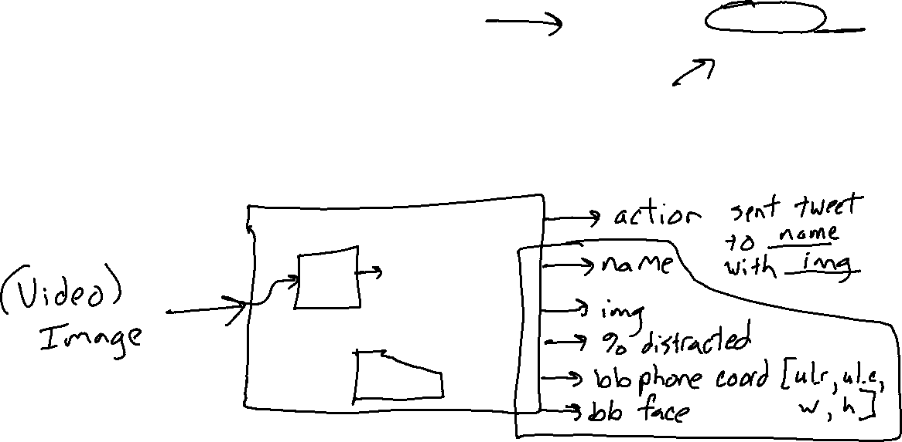
Input/Output
Distracted Politician Detection
What is the input and output for this task?
Image credit: Twitter @Flemish Scroller

Slide 8
Input/Output
Distracted Politician Detection
What is the performance measure?
Image credit: Twitter @Flemish Scroller

Slide 9
Input/Output
Distracted Politician Detection
What data do we need?
Image credit: Twitter @Flemish Scroller

Slide 10
Input/Output
Distracted Politician Detection
What can go wrong
Image credit: Twitter @Flemish Scroller

Slide 11

Reminder: Machine Learning
Using (training) data to learn a model that we’ll later use for prediction
Training Data
Model
Training
Prediction
Model
Input
Predicted
Output

Slide 12

Training Input
Training Output
Model
Training
Training
Training Error
Prediction
Training Input
Training Output Predicted
Training Output (Measured)
Model
Prediction
Testing Input
Testing Output Predicted
Testing Output (Measured)
Model
Testing
Testing Error

