Slide 1

Demystifying AI
Image Classification
Instructor: Pat Virtue

Slide 2

Image Classification
Input: Image
Output: Category that object in image belongs to (label)
Prediction
Input
?
Predicted
Output

Slide 3

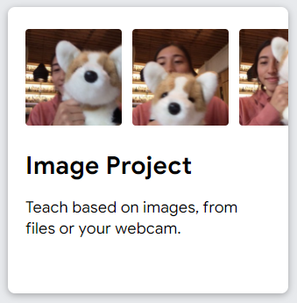
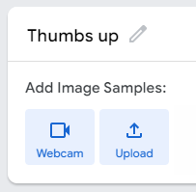
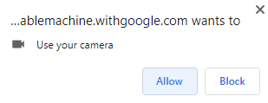
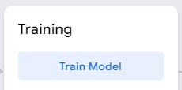

Teachable Machine
https://teachablemachine.withgoogle.com/
Click Get Started
Select Image Project
Select Standard Image Model
Rename Class 1 and 2: Thumbs up and thumbs down
Use webcam to collect images
Train your model

Slide 4

Reminder: Machine Learning
Using (training) data to learn a model that we’ll later use for prediction
Training Data
Input and Measured Output
Model
Structure and Parameters
Training
Prediction
Input
Model
Predicted
Output

Slide 5
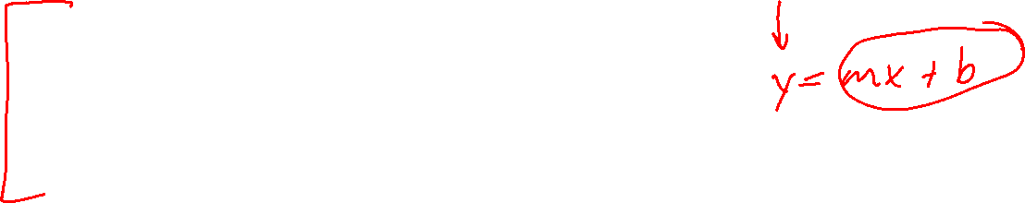
ML Image Classification Training
Training Data
Input and Measured Output
Model
Structure and Parameters
Training
Training Data:
Images and corresponding labels
Model:
Neural network
Humans design the neural network structure
Network parameters (think slope and intercept, but a whole lot of them) are determined during training to minimize training error

Slide 6
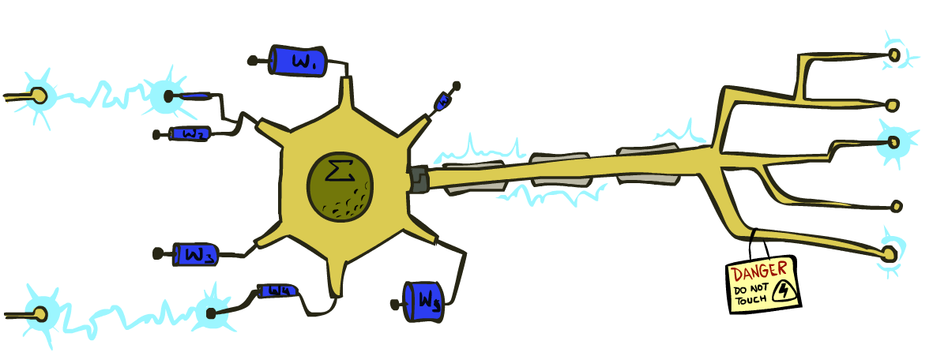
Very Loose Inspiration: Human Neurons
Slide from UC Berkeley AI

Slide 7
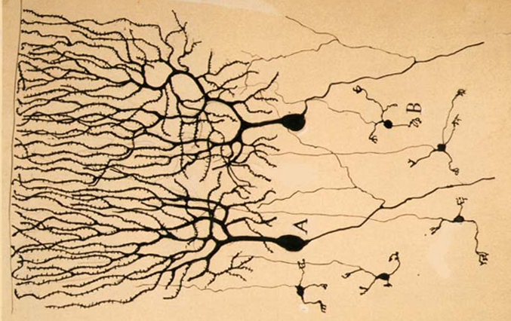
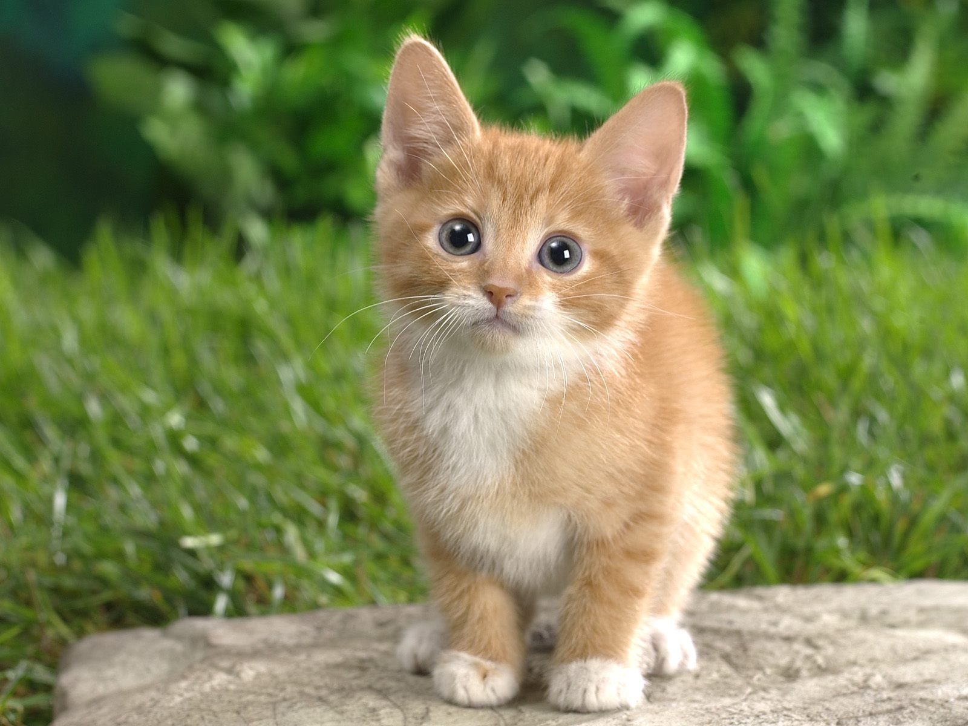

Neural Networks
Inspired by actual human brain
Output
Signal
Input Signal
DOG
CAT
TREE
CAR
SKY
Image: https://en.wikipedia.org/wiki/Neuron

Slide 8
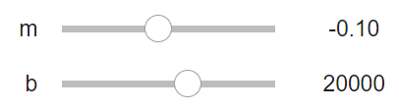
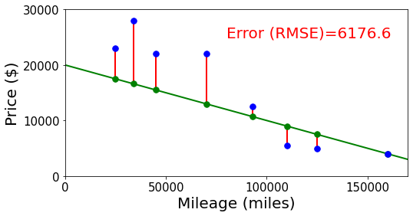


Neural Networks
Building on optimization for linear and logistic regression
Selling my car
$$y_{meas}$$
$$y_{pred}$$

Slide 9
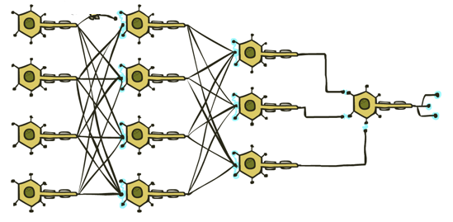
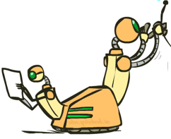


Neural Networks
Output
Signal
Many layers of neurons, millions of parameters
$$y_{pred}$$
Input Signal
DOG
CAT
TREE
CAR
SKY

Slide 10







Neural Networks
Output
Signal
Many layers of neurons, millions of parameters
$$y_{pred}$$
$$y_{meas}$$
Input Signal
DOG
CAT
TREE
CAR
SKY
$$0$$
$$1$$
$$0$$
$$0$$
$$0$$

Slide 11
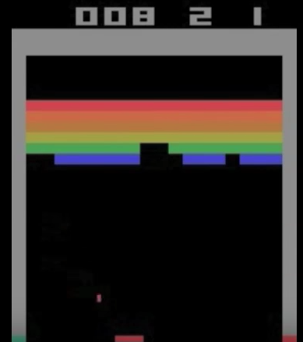
Neural Networks
Output
Signal
Many layers of neurons, millions of parameters
$$y_{pred}$$
Input Signal
LEFT
RIGHT
UP
DOWN
BUTTON

Slide 12
Teachable Machine
https://teachablemachine.withgoogle.com/
Task 1: Create a new image classification project with at least three classes
Task 2: Try training a project with very few images (one image per class maybe). Is this enough? Why or why not?
Task 3: Try training a project with training data that looks decent but is actually really biased.

Slide 13
Reminder: Machine Learning
Using (training) data to learn a model that we’ll later use for prediction
Training Data
Model
Training
Prediction
Model
Input
Predicted
Output

Slide 14
Training Input
Training Output
Model
Training
Training
Training Error
Prediction
Training Input
Training Output Predicted
Training Output (Measured)
Model
Prediction
Testing Input
Testing Output Predicted
Testing Output (Measured)
Model
Testing
Testing Error

Slide 15
Image Classification Data
Where is the data on the JetBot?

