Slide 1

Demystifying AI Data and ML Models
Instructor: Pat Virtue

Slide 2
Exercise 1: Input Output Prediction
Learn from training data input and output to predict test output
Fill in Predicted Output for each test data input

Slide 3
Exercise 2: Input Output Prediction
Learn from training data input and output to predict test output
Fill in Predicted Output for each test data input
Using the same method that you used to predict the test data output
Fill in Predicted Output for each train data input

Slide 4
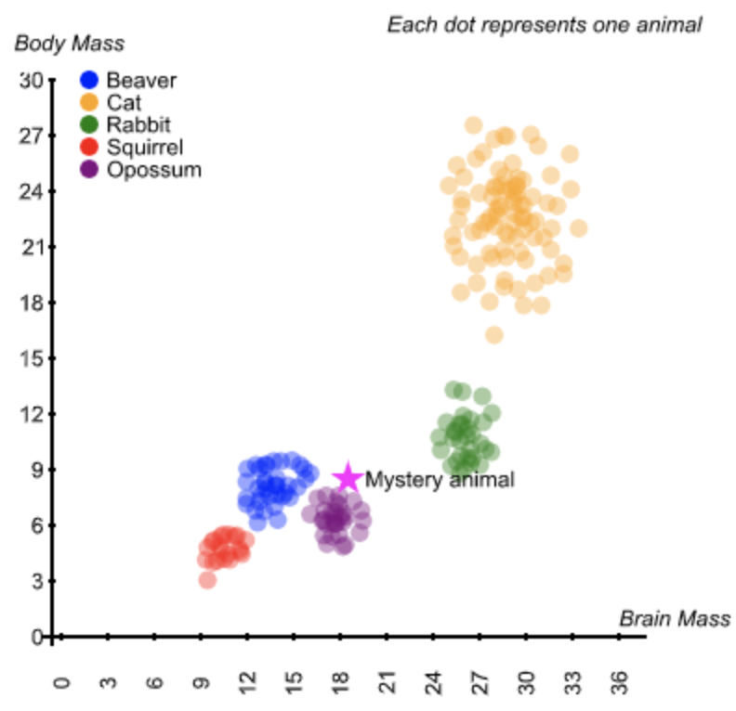

Agent Uses Data to Make Decisions
Agent
Input
?
Predicted
Output

Slide 5
Agent Uses Data to Make Decisions
Agent
Input
?
Predicted
Output

Slide 6
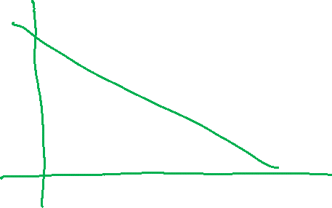
Agent Uses Data to Make Decisions
Agent
Input
?
Predicted
Output

Slide 7
Machine Learning
Using (training) data to learn a model that we’ll later use for prediction
Training Data
Input and Measured Output
Model
Structure and Parameters
Training
Prediction
Input
Model
Predicted
Output

Slide 8
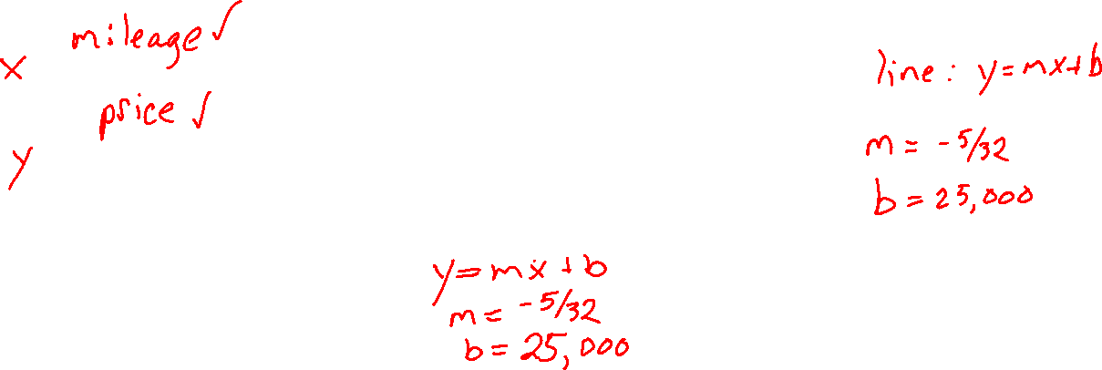
Machine Learning
Using (training) data to learn a model that we’ll later use for prediction
Training Data
Input:
Output:
Model
Structure:
Parameters:
Training
Prediction
Input
Predicted
Output

Slide 9
Vocab

Slide 10
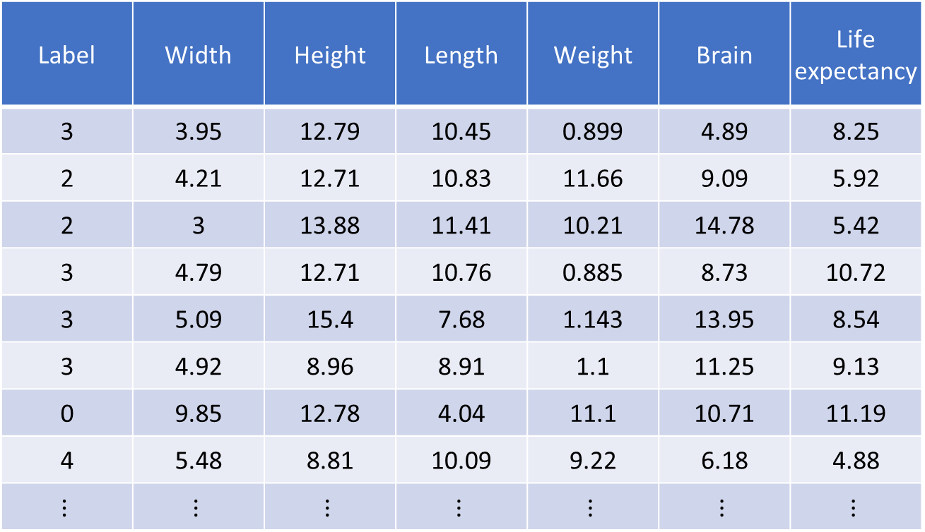
Data: Numerical Values
More input measurements
Label | Width | Height | Length | Weight | Brain | Life expectancy
3 | 3.95 | 12.79 | 10.45 | 0.899 | 4.89 | 8.25
2 | 4.21 | 12.71 | 10.83 | 11.66 | 9.09 | 5.92
2 | 3 | 13.88 | 11.41 | 10.21 | 14.78 | 5.42
3 | 4.79 | 12.71 | 10.76 | 0.885 | 8.73 | 10.72
3 | 5.09 | 15.4 | 7.68 | 1.143 | 13.95 | 8.54
3 | 4.92 | 8.96 | 8.91 | 1.1 | 11.25 | 9.13
0 | 9.85 | 12.78 | 4.04 | 11.1 | 10.71 | 11.19
4 | 5.48 | 8.81 | 10.09 | 9.22 | 6.18 | 4.88
$$⋮$$ | $$⋮$$ | $$⋮$$ | $$⋮$$ | $$⋮$$ | $$⋮$$ | $$⋮$$

Slide 11
Data: Numerical Values
Converting more complex data into a table of numerical values
Images (and video)
Language (words, sentences, books)
Audio signals (music, speech)

Slide 12
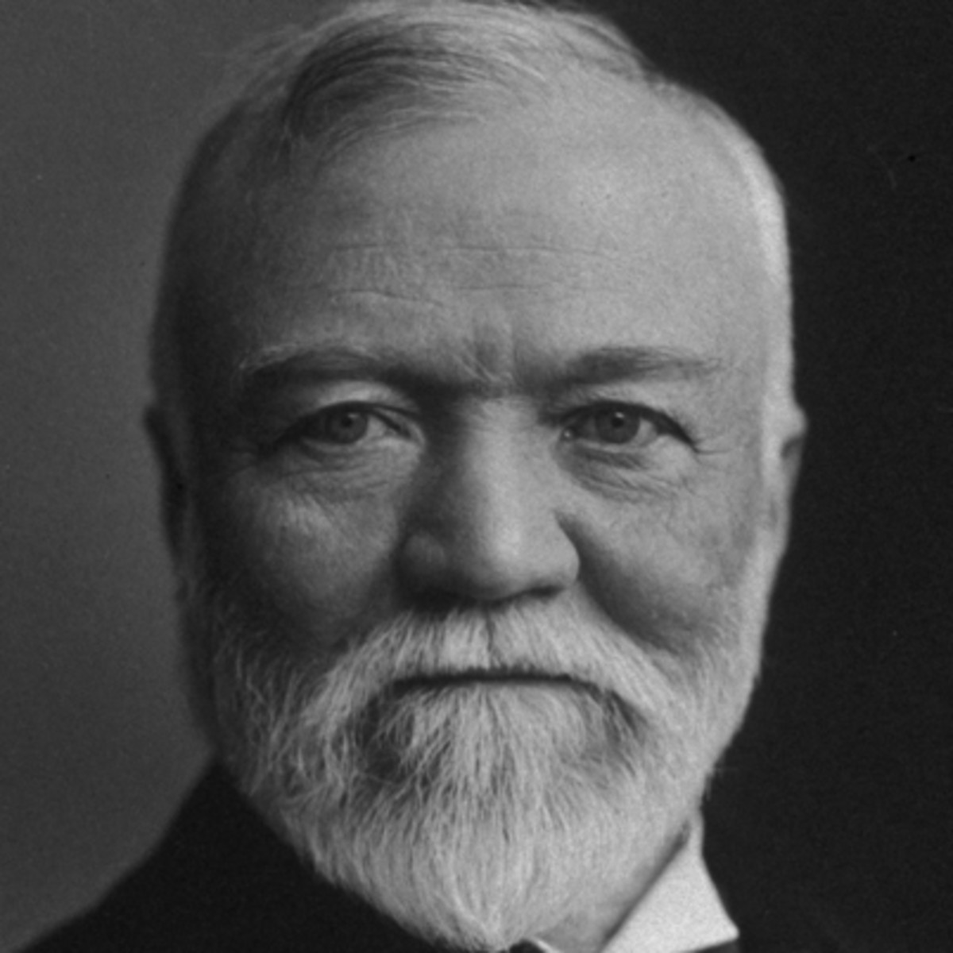
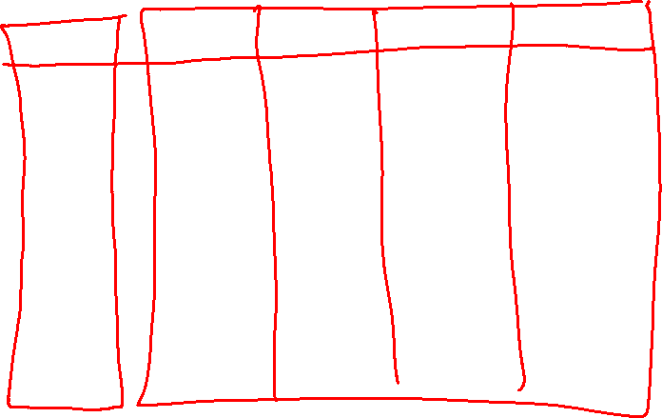
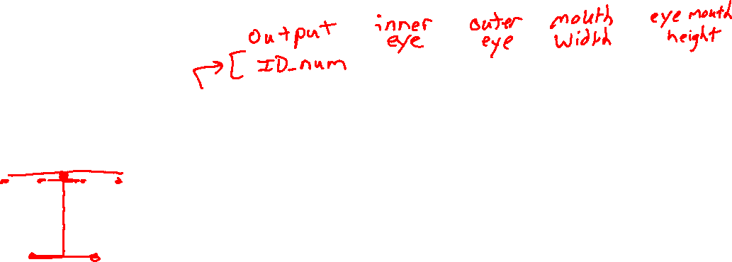
Data: Numerical Values
Converting more complex data into a table of numerical values
Task: Face recognition from image

Slide 13
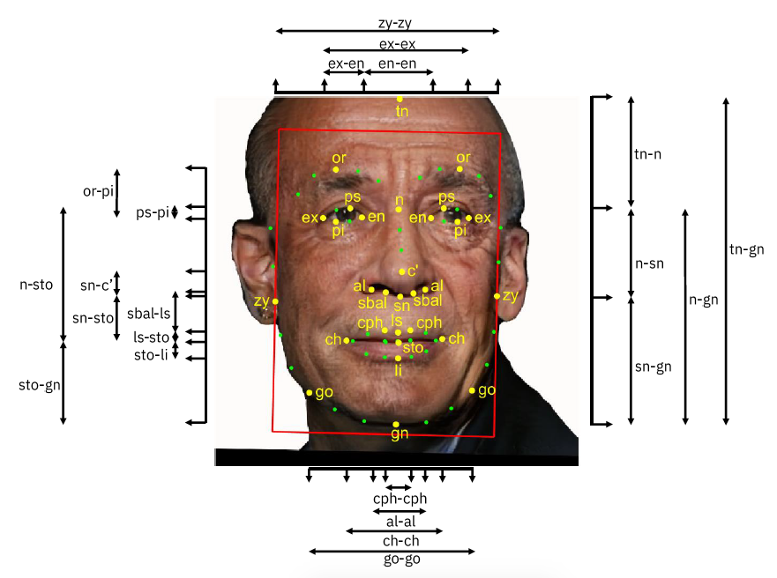
Face Recognition
Input Features?
Image credit: https://arxiv.org/abs/1901.10436

Slide 14
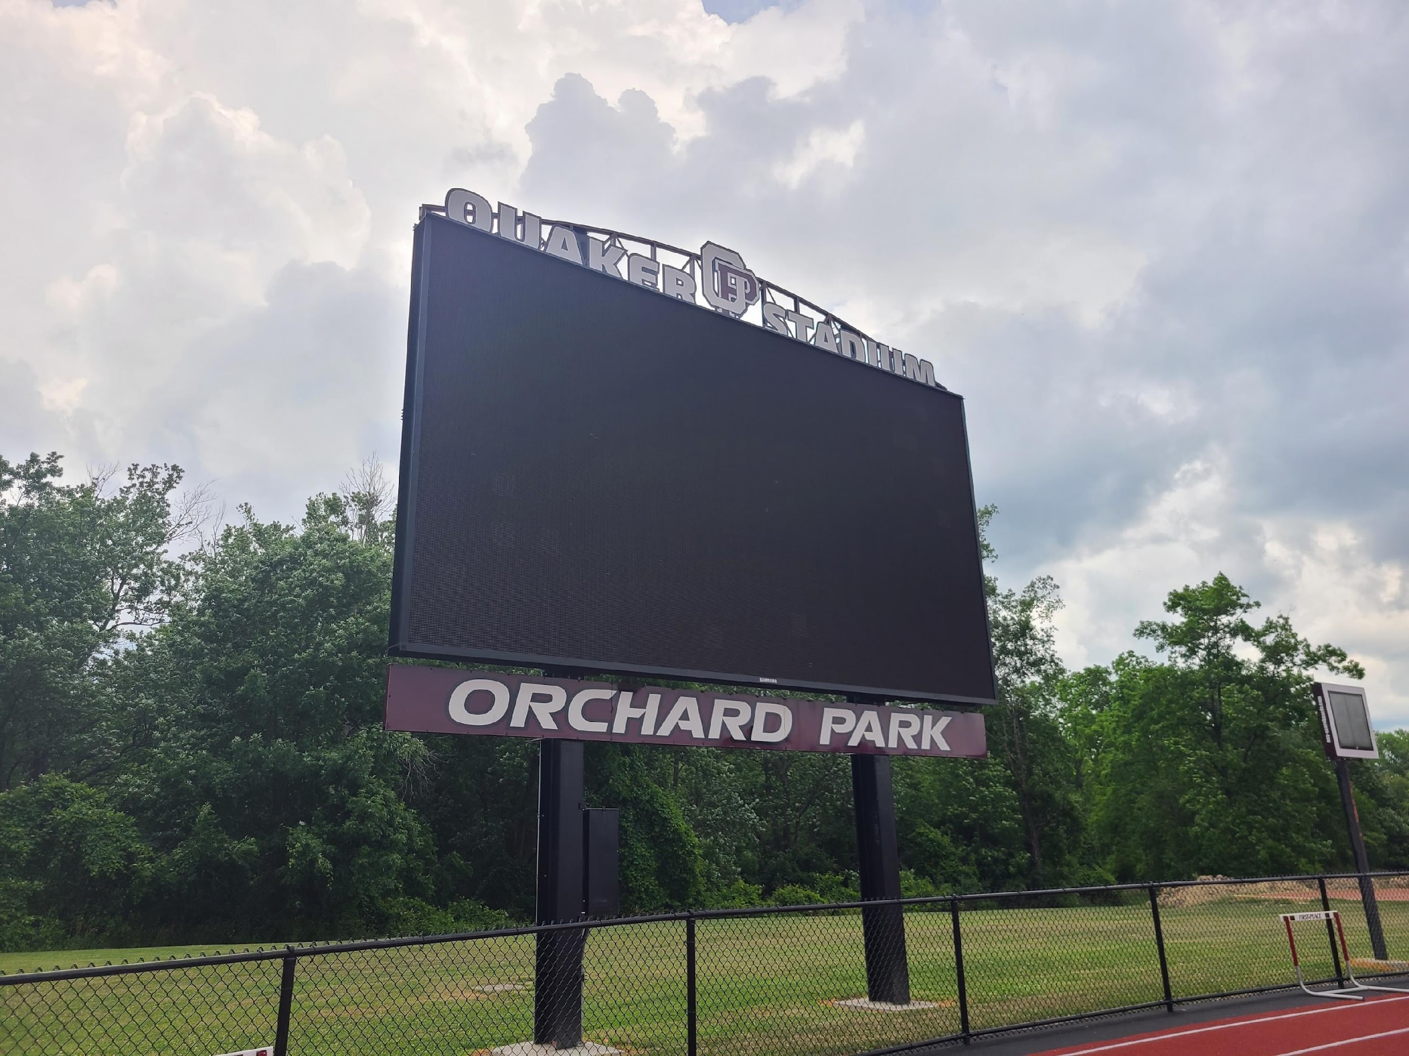
Face Recognition
Input Features?

Slide 15

Face Recognition
Input Features?

Slide 16


Face Recognition
Input Features?

Slide 17
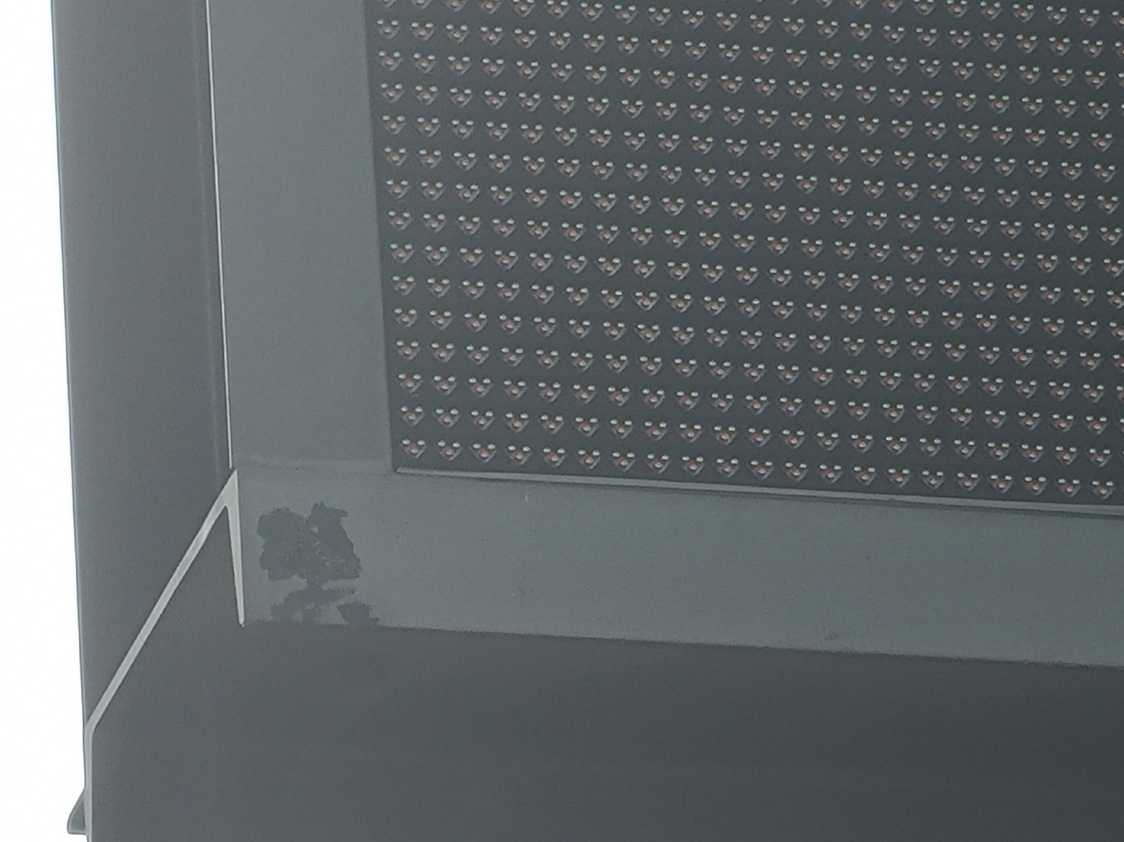
Face Recognition
Input Features?

Slide 18
Face Recognition
Input Features?

Slide 19
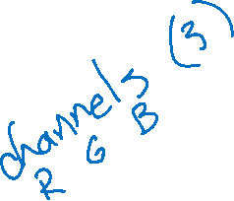
Face Recognition
Input Features?

Slide 20
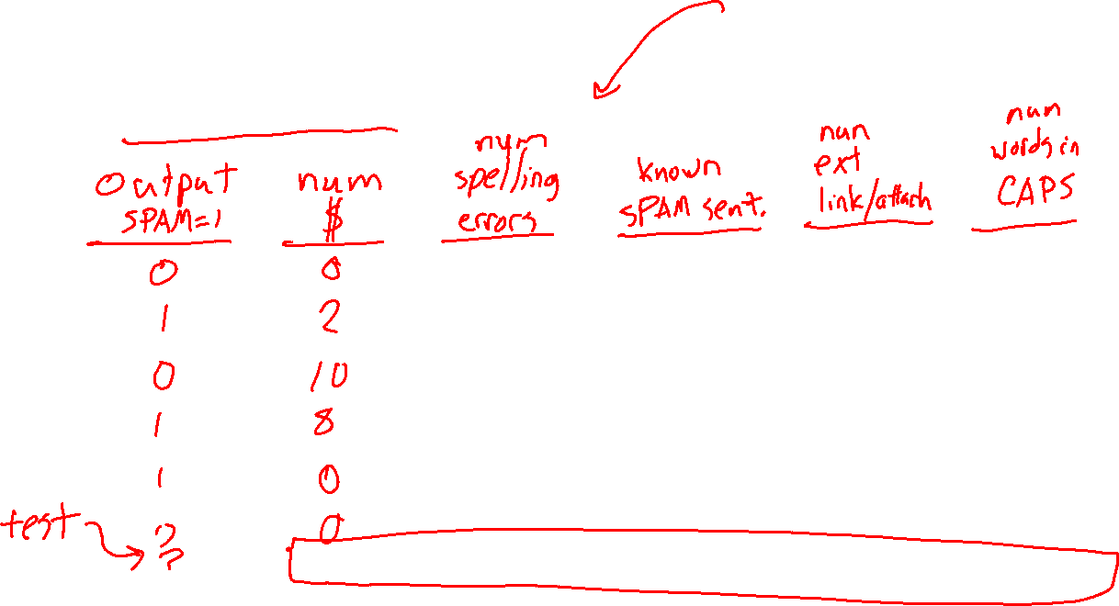
Data: Numerical Values
Converting more complex data into a table of numerical values
Task: SPAM classification from email (body) text

Slide 21
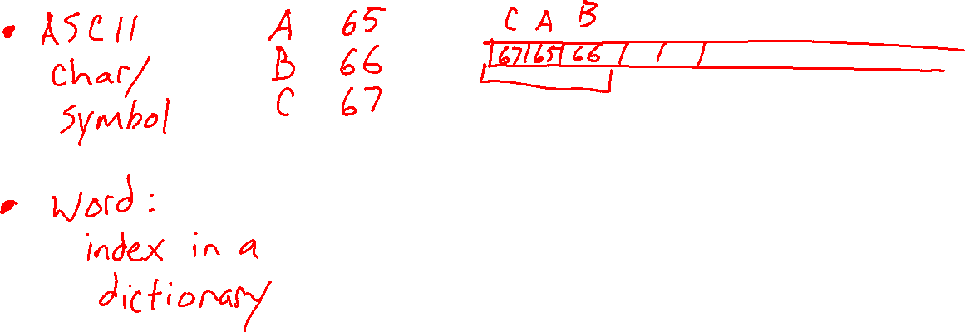
Data: Numerical Values
Converting more complex data into a table of numerical values
Task: SPAM classification from email (body) text

Slide 22
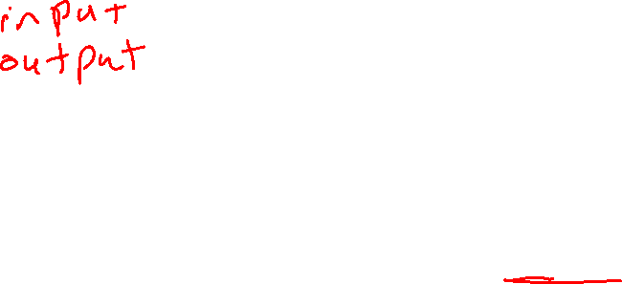
Reminder: Machine Learning
Using (training) data to learn a model that we’ll later use for prediction
Training Data
Model
Training
Prediction
Model
Input
Predicted
Output

Slide 23

Training Input
Training Output
Model
Training
Training
Training Error
Prediction
Training Input
Training Output Predicted
Training Output (Measured)
Model
Prediction
Testing Input
Testing Output Predicted
Testing Output (Measured)
Model
Testing
Testing Error

