Slide 1
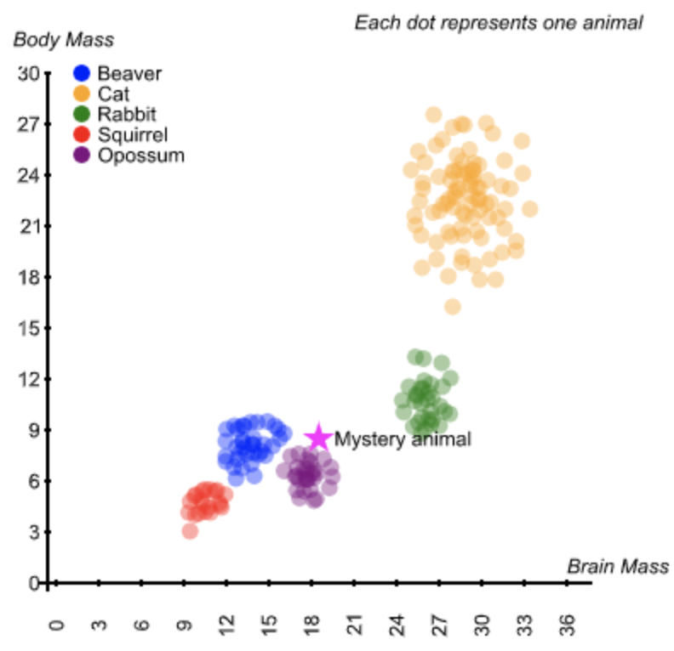
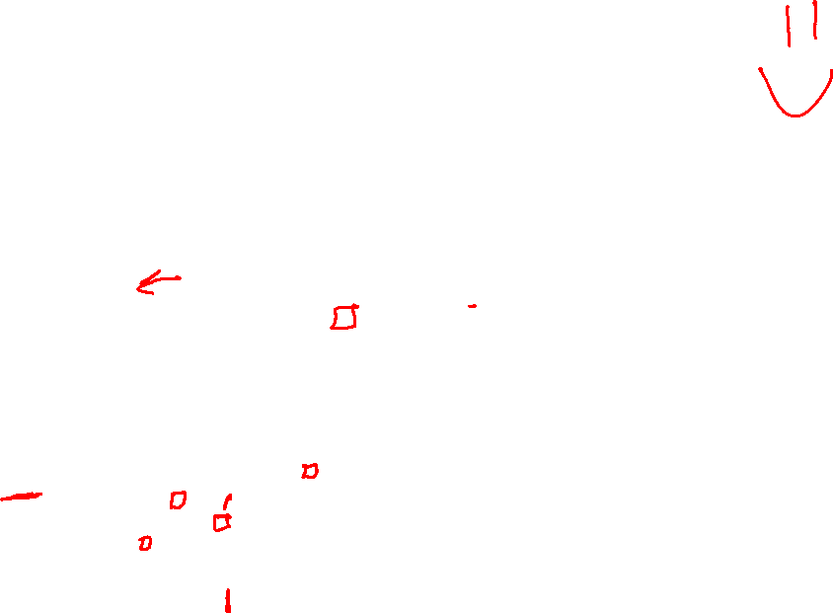
Visualizing Data to Make Predictions
What label should we assign the mystery point?

Slide 2

Demystifying AI Nearest Neighbor
Instructor: Pat Virtue

Slide 3
Visualizing Data to Make Predictions
What label should we assign the mystery point?

Slide 4
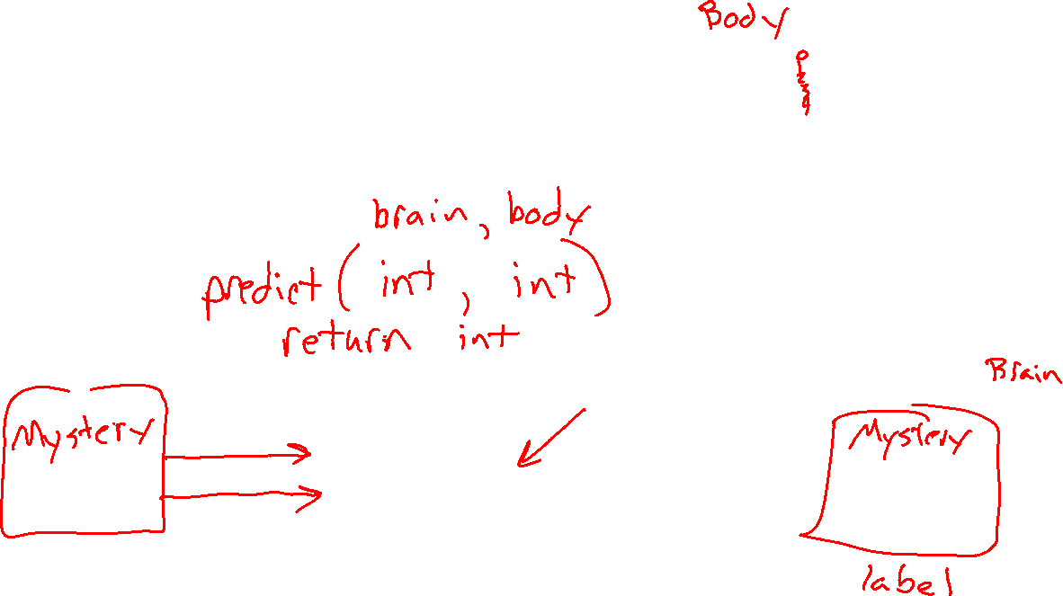
Input and Output?
What is the input and the output for this task?
Agent
Input
?
Predicted
Output

Slide 5
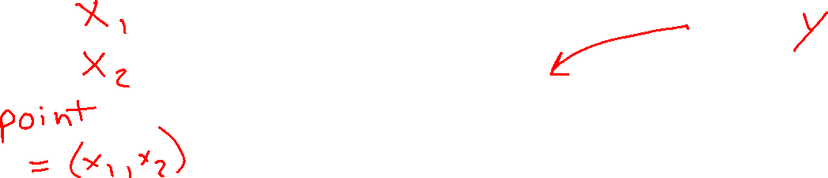

Agent Uses Data to Make Decisions
Agent
Input
?
Predicted
Output

Slide 6

Using Distance as a Measure of Similarity
Assumption: closer points are more likely to be in the same category

Slide 7
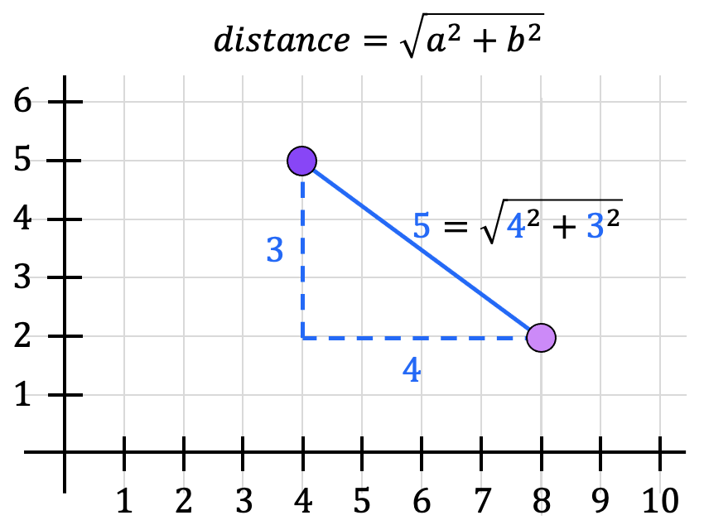
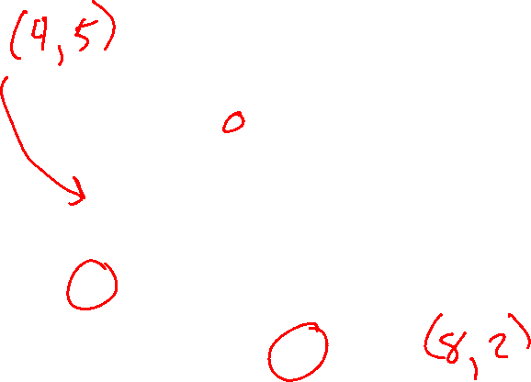
Distance

Slide 8
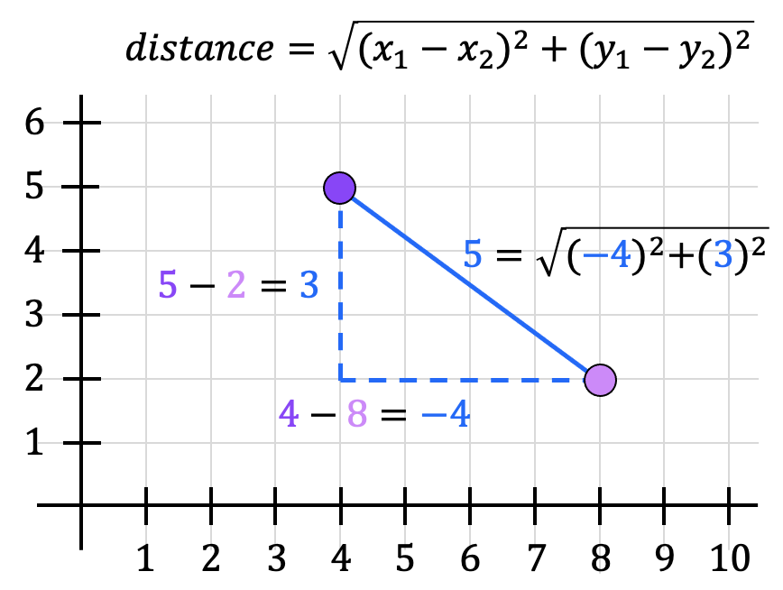
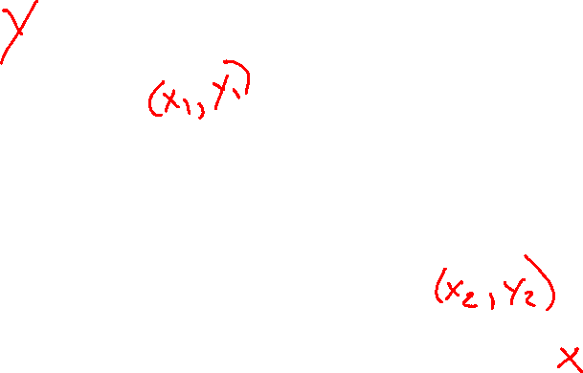
Distance

Slide 9
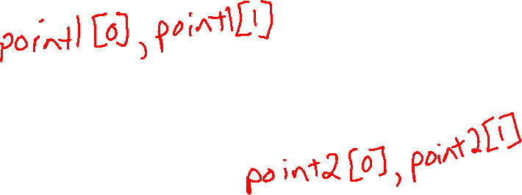
Distance

Slide 10
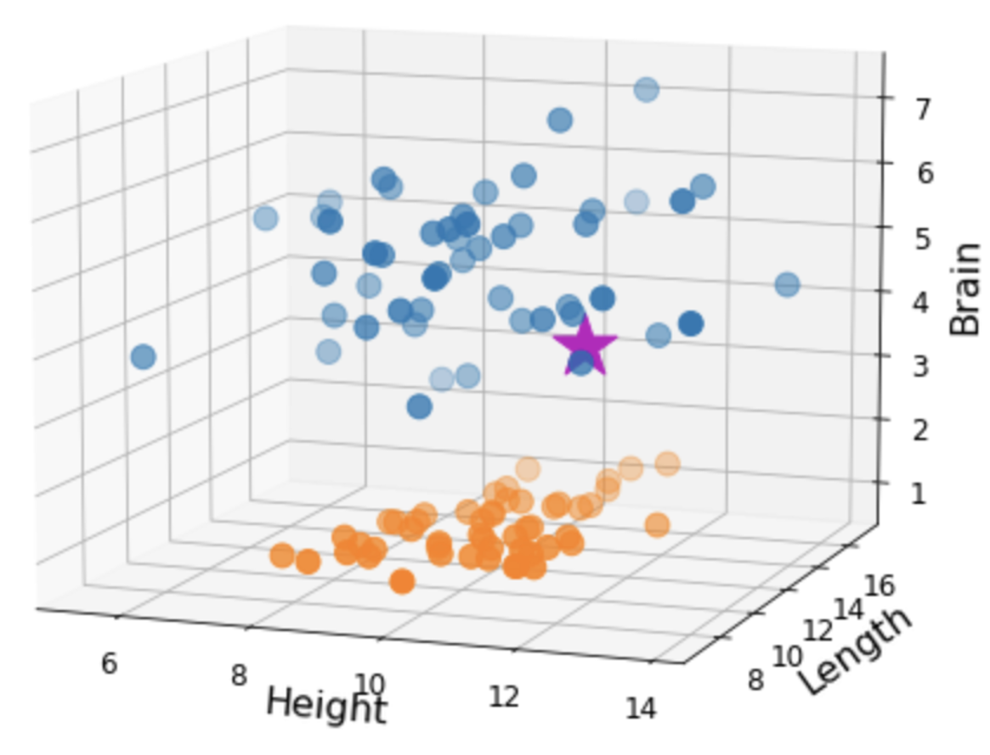
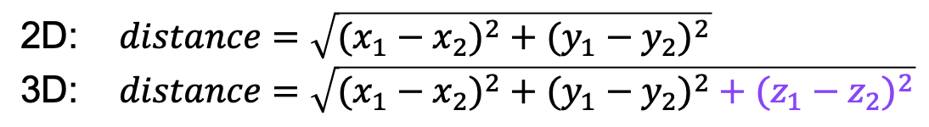

Distance

Slide 11
Distance

Slide 12
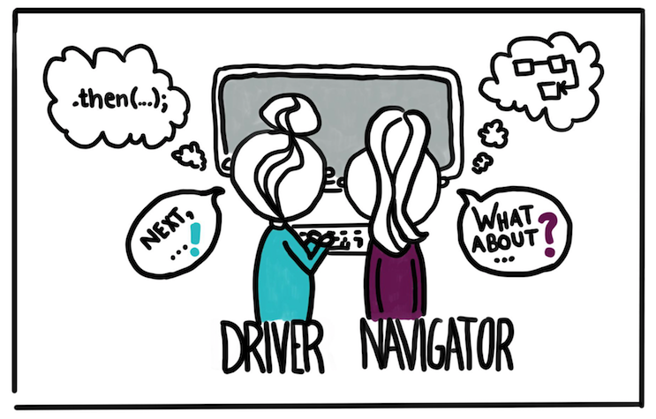
Pair Programming
https://devopedia.org/pair-programming

Slide 13
Exercise 1: Distance
Shared Drive Folder/Lec5_NearestNeighbor
https://drive.google.com/drive/folders/11aAngUK5sifAnK4izULqPC-Y0QnDfbqG

Slide 14
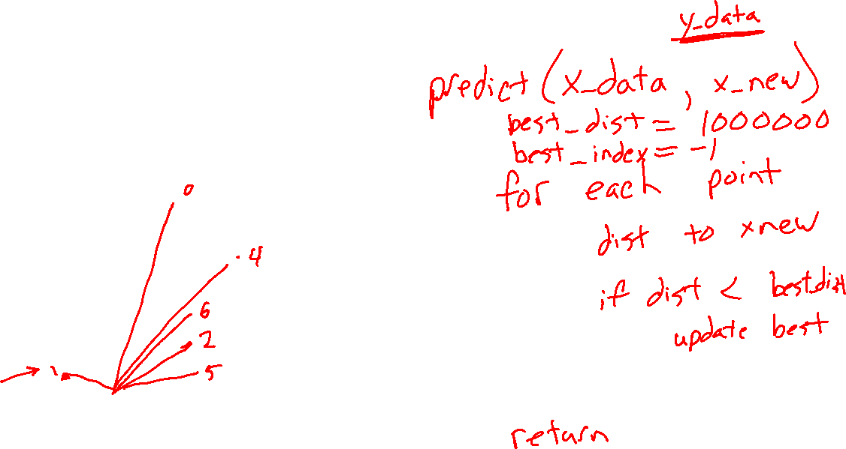
Nearest Neighbor Algorithm

Slide 15
Exercise 2: Nearest Neighbor
Shared Drive Folder/Lec5_NearestNeighbor
https://drive.google.com/drive/folders/11aAngUK5sifAnK4izULqPC-Y0QnDfbqG

Slide 16
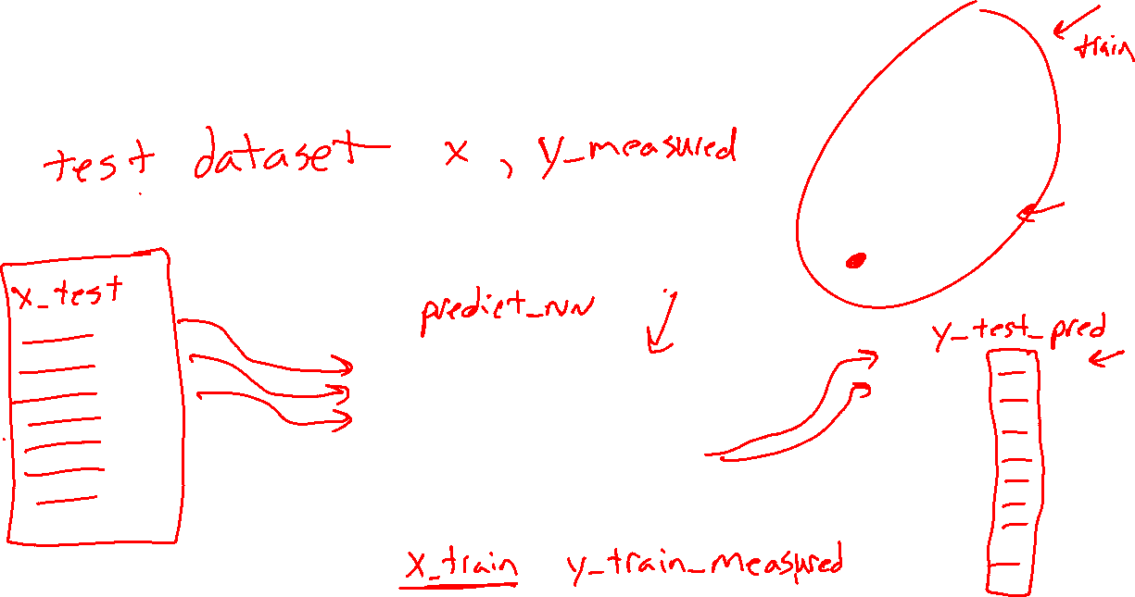
Performance Measure
How well did we do?
Agent
?

Slide 17
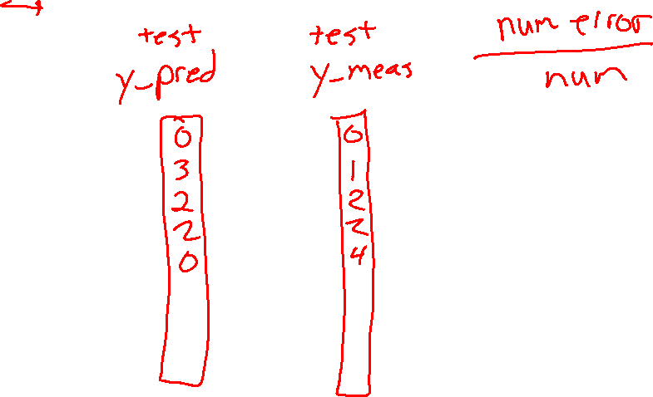
Performance Measure
Classification error rate

Slide 18
Exercise 3: Error rate
Shared Drive Folder/Lec5_NearestNeighbor
https://drive.google.com/drive/folders/11aAngUK5sifAnK4izULqPC-Y0QnDfbqG

